Slide 1
CS 60
Binary Search Trees (BSTs) & Use-it or Lose-it
2013-09-18
Wednesday – Week 2
Lecture 05

Slide 2
Survey
When did you finish the homework?
> 10pm Tuesday
> 7pm Tuesday
> 11pm Monday
> 11pm Sunday
< 11pm Sunday

Slide 3
Administrative Stuff
(Not in your notes)

Slide 4
BSTs
Practicing the Algorithms
In CS classes – sometimes you’re learning algorithms. You code them just to understand them better!
Colleen’s definition of algorithm:
a (sometimes beautiful) way to solve a problem

Slide 5
Tree Vocab Clarified
You can define this as Edges or Nodes. On the homework we use EDGES!
Lecture notes 4 said nodes.
Target Set = all the children of a node
Root
R
Height = number of EDGES on the longest path from root to a leaf
"child" node
"parent" node
E
A
U
Subtree
D
X
N
G
Leaf
Notes:
I don’t know if this really works...

Slide 6
Binary Search Tree FIND Algorithm
If you’re at a leaf – it isn’t in the tree!
If KEY is what we’re looking for – you found it!
If what we’re looking for is < KEY – recurse LEFT
If what we’re looking for is > KEY – recurse RIGHT
Binary Search Tree INSERT Algorithm
A little more complicated than it looks!
If you’re at a leaf – ADD IT!
If KEY is what we’re adding – return the tree
If what we’re adding is < KEY – recurse LEFT
If what we’re adding is > KEY – recurse RIGHT

Slide 7
Binary Search Tree Delete Algorithm
No children – just delete
One child – replace with child
Two children? (Booo!)
  Find the NEXT item (just bigger than node to delete)
    Smallest thing on right subtree
  Call delete the NEXT item
  Put the NEXT item to replace the original node
This is recursion!!!
Why won’t this be an infinite loop? (it won’t be)

Slide 8
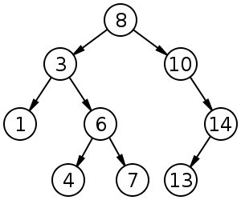
Insert 9, 2, 12
The old height was: _______ The new height is: _______
http://en.wikipedia.org/wiki/File:Binary_search_tree.svg

Slide 9
Delete 4, 1, 14
http://en.wikipedia.org/wiki/File:Binary_search_tree.svg

Slide 10
Delete 3
http://en.wikipedia.org/wiki/File:Binary_search_tree.svg

Slide 11
Delete 8
http://en.wikipedia.org/wiki/File:Binary_search_tree.svg

Slide 12
Determine an order that I could have added these numbers to the tree

Slide 13
How’s it going?
Got the first one
Got the first and second
Got the first, second, and third
Got the all of em
Stuck

Slide 14
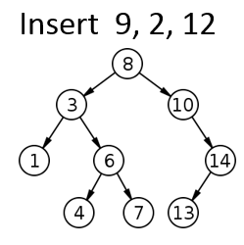
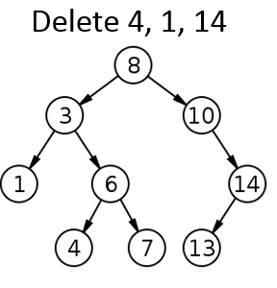
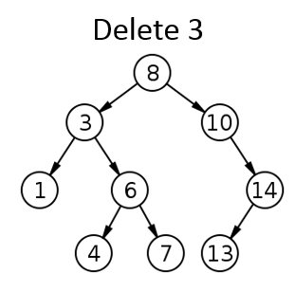
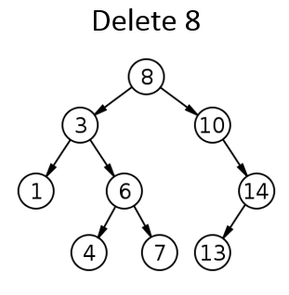
Solutions
We could add:
8, 3, 1, 6, 4, 7, 10, 14, 13

Slide 15
BSTs
Understanding the Implementation

Slide 16
What does this BST look like?
'(42 (20 (7 (1 () ()) (8 () ())) (31 () (41 () ()))) (100 (60 () ()) ()))
This is the implementation! BSTs are represented as lists.
We’ll use a different/better interface for working with BSTs.

Slide 17
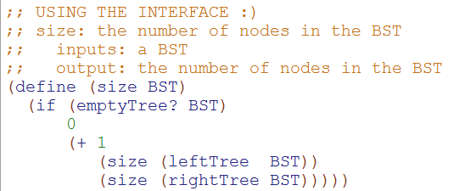
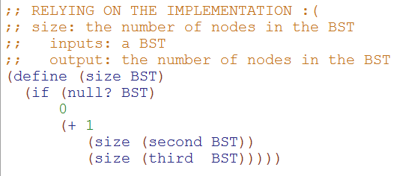
This is the BEAUTIFUL one!

Slide 18
REQUIRED Helper Functions
(define (make-BST key left right)
(list key left right))
(define (make-empty-BST)
'())
(define (make-BST-leaf key)
(make-BST key
(make-empty-BST)
(make-empty-BST)))
(define (emptyTree? tree)
(null? tree))
(define (leaf? tree)
(and (null? (leftTree tree))
(null? (rightTree tree))))
(define (key tree)
(first tree))
(define (leftTree tree)
(second tree))
(define (rightTree tree)
(third tree))

Slide 19
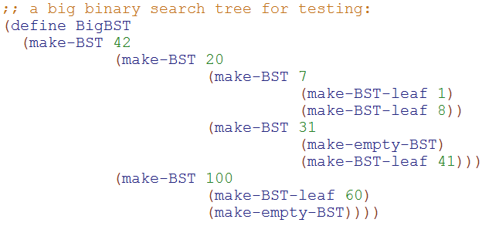
We write code based upon the interface
NOT the implementation

Slide 20
replace-root solution
(define (make-BST key left right)
(list key left right))
(define (make-empty-BST)
'())
(define (leaf? tree)
(and (null? (leftTree tree))
(null? (rightTree tree)))
(define (key tree)
(first tree))
(define (leftTree tree)
(second tree)
(define (rightTree tree)
(third tree))
(define (replace-root new-root BT)
(make-BST new-root
(leftTree BT)
(rightTree BT)))

Slide 21
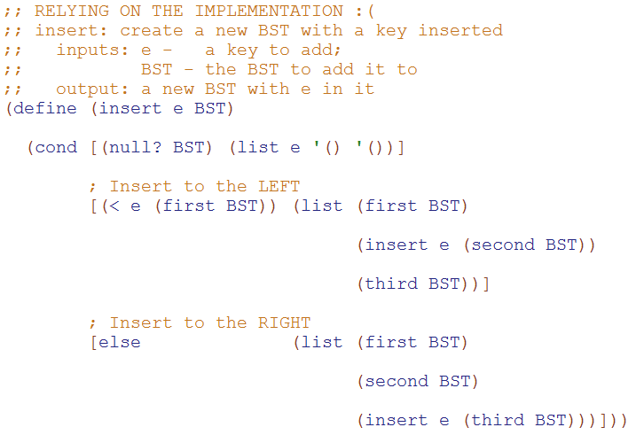
Modify this code to use the interface!

Slide 22
How’s insert going
I’ve made 0 replacements
I’ve made 3 replacements
I’ve made 6 replacements
I’ve made all replacements
Stuck

Slide 23
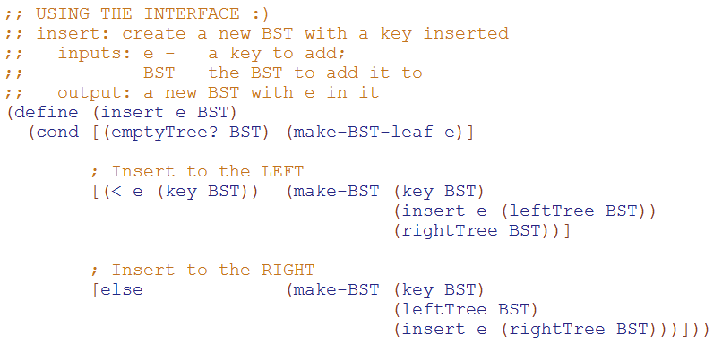
insert solution
NOTE: We make a new BST if we need to change anything!

Slide 24
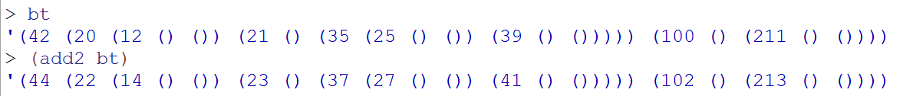
Write add2 for Binary Trees
Try this at home! (solution not provided)
Post to piazza if you get stuck!

Slide 25
Use It or Lose It

Slide 26
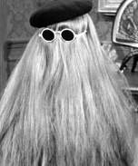
sublists
Use it or Lose it!
> (sublists '())
'(())
> (sublists '(b c))
'(() (c) (b) (b c))
> (sublists '(a b c))
'(() (c) (b) (b c) (a) (a c) (a b) (a b c))
You're it!
It
LOSE IT
USE IT

Slide 27
Use it or lose it ~ recursive strategizing
(1) single "it" out
(2) solve the problem without "it"
(3) solve the problem with "it"
if needed...
(4) Combine!
as appropriate...
Shouldn't this be called use it AND lose it?

Slide 28
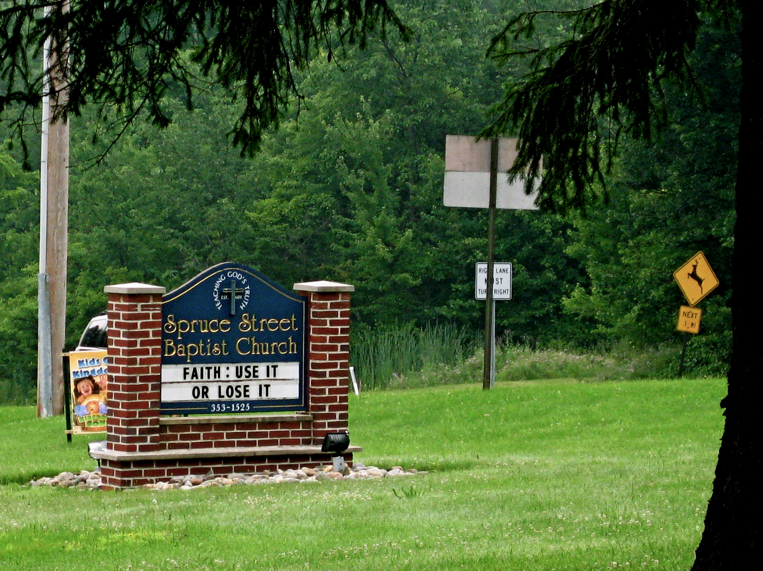
thanks to Allie Russell HMC '11
other church-front messages...?
Notes:
I don’t know if this really works...

Slide 29
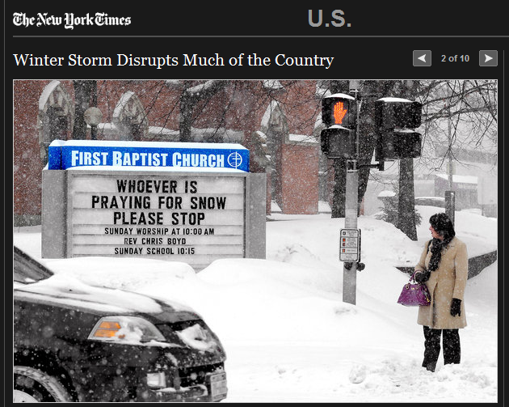
Notes:
I don’t know if this really works...

Slide 30
Use it or lose it
(sublists '( a b ))
'(( ) ( b ) ( a ) ( a b ))
returns ALL sublists of elements in L
the order of these sublists in these overall outputs does not matter...
(define (sublists L)
'(( ) ( c ) ( b ) ( b c )
(a) (a c) (a b) (a b c))
(sublists '( a b c ))
Base Case!
Use-it-or-lose-it
on the HW
(make-change Total CoinList)
This should return #t if it's possible to make change for Total using coins in CoinList; otherwise #f
(make-change 42 '(2 5 10 25 50))
#t ;; 42 == 2 + 5 + 10 + 25
(make-change 42 '(3 5 10 25 50))
#f ;; here, 42 can't be made
I think I lost it!

Slide 31
Use it or lose it
(sublists '( a b ))
'(( ) ( b ) ( a ) ( a b ))
returns ALL sublists of elements in L
the order of these sublists in these overall outputs does not matter...
(define (sublists L)
(if (null? L)
'(( ) ( c ) ( b ) ( b c )
(a) (a c) (a b) (a b c))
(sublists '( a b c ))
Base Case!
(let* ([it (first L))
[loseit (
[useit (
Use-it-or-lose-it
on the HW
(make-change Total CoinList)
This should return #t if it's possible to make change for Total using coins in CoinList; otherwise #f
(make-change 42 '(2 5 10 25 50))
#t ;; 42 == 2 + 5 + 10 + 25
(make-change 42 '(3 5 10 25 50))
#f ;; here, 42 can't be made
I think I lost it!

Slide 32
Where are you?
Base case written
loseit written
useit written
Combination done
STUCK on something!

Slide 33
Sublist Solution
(define (sublists L)
(if (null? L)
'(())
(let* ([it (first L)]
[loseit (sublists (rest L))]
[useit (map (lambda (one-sublist)
(cons it one-sublist))
loseit)])
(append loseit useit))))

Slide 34
Count-change
(use-it or lose-it example)

Slide 35
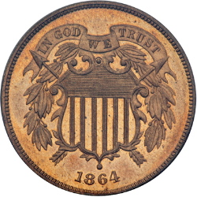
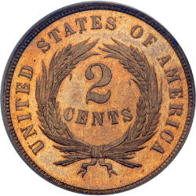
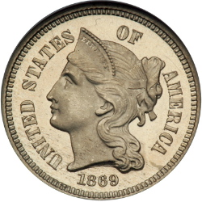
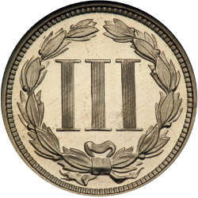
Hw #2
Change!
Can you make the total from the coins available? (odd denominations OK!)
(make-change total CoinList)
For example,
(make-change 42 '(2 5 2 10 25 2))
#t
(make-change 42 '(3 5 10 25 50))
#f

Slide 36
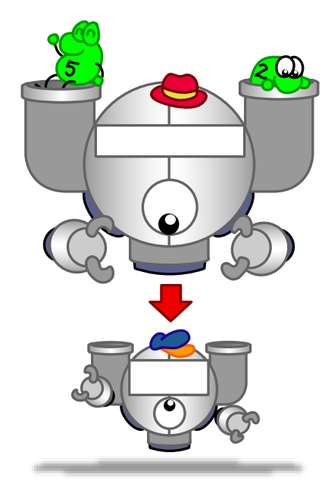

Function output is a function
(Woah!)

Slide 37
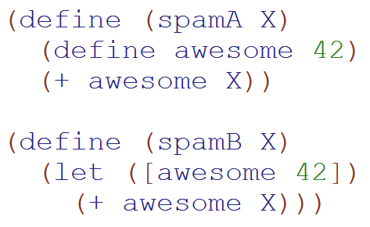
Language Detail:
You can use define inside a function
These return the same thing.
You can also define functions

Slide 38
Example: Function output is a function
(define (make-adder x)
(define (adder-function y) (+ x y))
>(make-adder 3)
#<procedure:adder-function>
>((make-adder 3) 4)
7
(+ 40 2) )
adder-function )
What is x? a) 3 b)4 c)??

Slide 39
Write make-adder with lambda
(define (make-adder x)

Slide 40
Syntactic Sugar (λ makes a function)
(define (square x) (* x x))
(define square (lambda (x) (* x x))
>(square 3)
9
>((lambda (x) (* x x)) 3)
Function name
Args
Body
The function to call
Input
Remember to keep track of your input/output type(s)!

Slide 41
Function output is a function
From earlier slide
(define (make-adder x)
(define (adder-function y) (+ x y))
adder-function)
(define (make-adder x)
(lambda (y) (+ x y)))
This is equivalent!
(Lambda makes things more concise.)
Beautiful!

Slide 42
(define (cat y)
(lambda (x) (+ x 1)))
(define dog
(lambda (x) (+ x 1)))
Which of these gives the answer 2?
I (cat 1)
II ((cat 1) 1)
III(dog 1)
IV ((dog 1) 1)
A) I&III
B) II&IV
C) I&IV
D) II&III
E) Not sure
Notes:
42

Slide 43
All you need is Love
Lambda
(you don’t need cons – you can write it with lambda)

Slide 44


We’re going to write our own cons
What type of thing is listB?
"string"
b) function
c) Number
d) ???

Slide 45
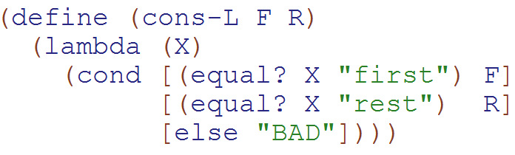
cons written with lambda & with define
What type of thing does cons-L return?
a) "string"
b) function
c) Number
d) ???

Slide 46
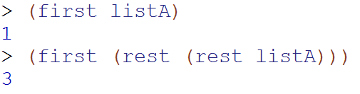
Normal (built-in) cons
Our
Cons-L
We can get the first and rest out – but it isn’t pretty

Slide 47
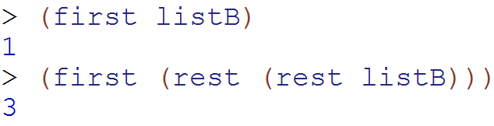
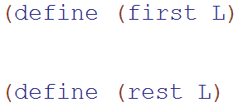
Write first and rest for cons-L
What type of thing is L?
a) "string" b) function
c) Number d) ???

Slide 48
uniq
(use-it or lose-it example)

Slide 49
Use it or lose it ~ recursive strategizing
(uniq '(D O D D S))→ ‘(O D S)

Slide 50
Use it or lose it ~ recursive strategizing
(uniq '(D O D D S))→ ‘(O D S)
(define (uniq L)
(if (null? L)
'()
(let* (( it )
( loseit )
(if
))))
let's give a name to the first element: we're going to use it and lose it and combine the results as necessary
solve the problem without "it"
do we need "it" ?
we don't need it
we do need it

Slide 51
Use it or lose it ~ recursive strategizing
(uniq '(D O D D S))→ ‘(O D S)
let's give a name to the first element: we're going to use it and lose it and combine the results as necessary
(define (uniq L)
(if (null? L)
'()
(let* (( it (first L) )
( loseit (uniq (rest L))))
(if (member it loseit)
loseit
(cons it loseit)
))))
solve the problem without "it"
do we need "it" ?
we don't need it
we do need it
SOLUTION

Slide 52
BONUS

Slide 53


Slide 54
Estimating Time
Most people grossly underestimate how long it takes to program (not thinking about time to debug and test)
You appear incompetent at programming (not true) if you can’t estimate how long something will take.
This is one of the hardest things to learn!!! Start to practice now! For each task estimate how long it will take and keep track of how wrong you were

Slide 55


Computer
Science
&
= AWESOME

Slide 56
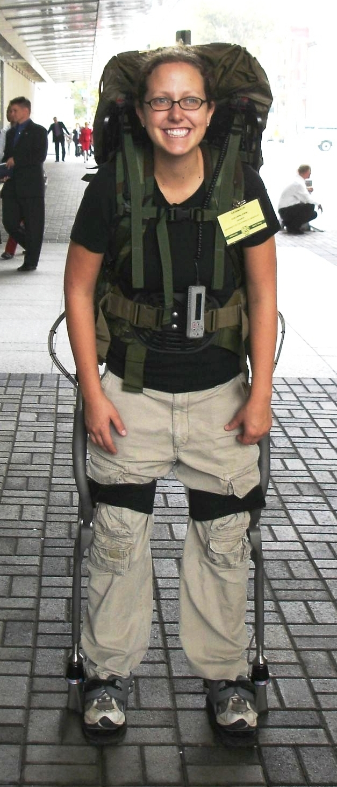
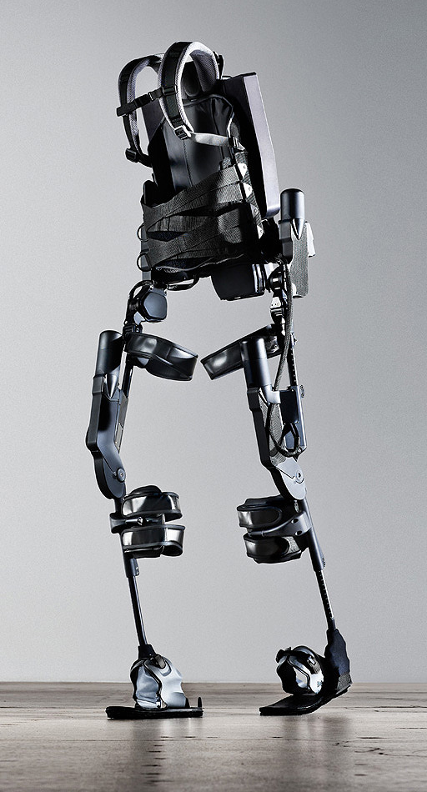
http://www.youtube.com/watch?v=pzRmNYA8LlY

Slide 57


ClickStart

Slide 58
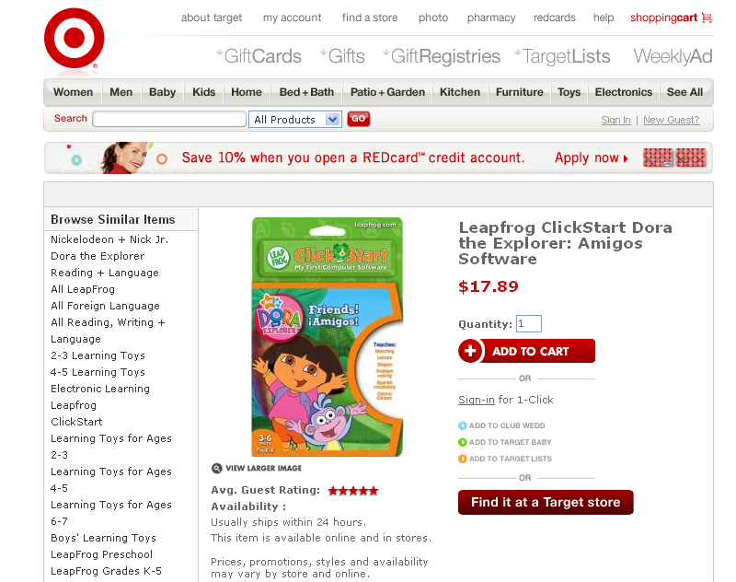

Slide 59
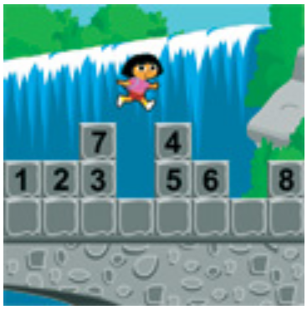
How should we represent the blocks in the computer?
Independent variables
2D Array
OpenList
I don’t know

Slide 60
The value in the array tells me what art asset to use
Each level is really a 3x10 vector!
0 | 0 | 7 | 0 | 4 | 0 | 0 | 0
1 | 2 | 3 | -4 | 5 | 6 | -7 | 8
B | B | B | B | B | B | B | B
Negative values tell me what block needs to go here to win!

Slide 61
0 | 0 | 7 | 0 | 4 | 0 | 0 | 0
1 | 2 | 3 | -4 | 5 | 6 | -7 | 8
0 | 0 | 0 | B | 0 | 0 | 0 | 0

Slide 62
BUGS!

Slide 63
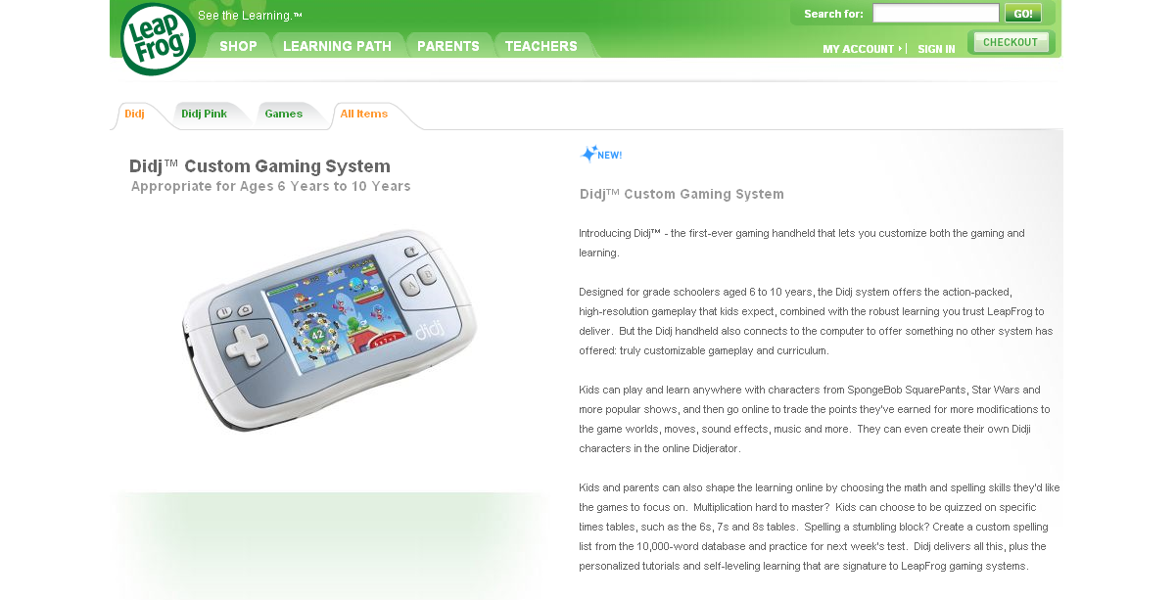

Slide 64
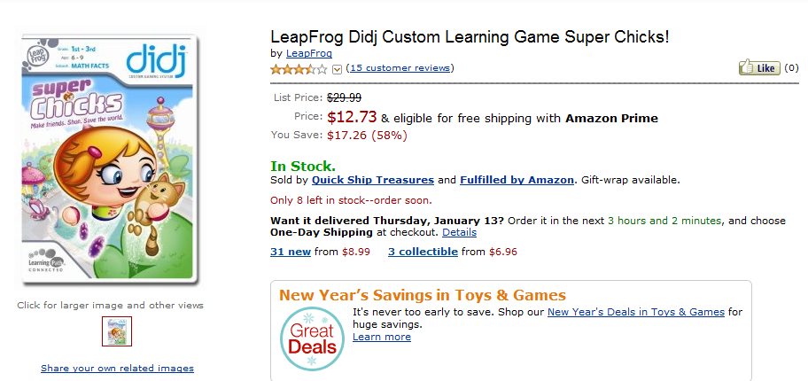
It is really sad when stuff you’ve made is on sale!

Slide 65
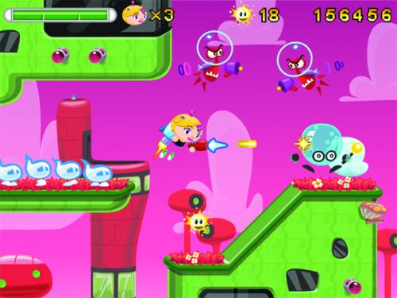
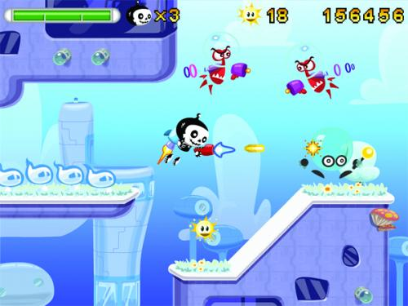

Which image is fake?
  A. Top Left
  B. Bottom Left
  C. Bottom Right

Slide 66
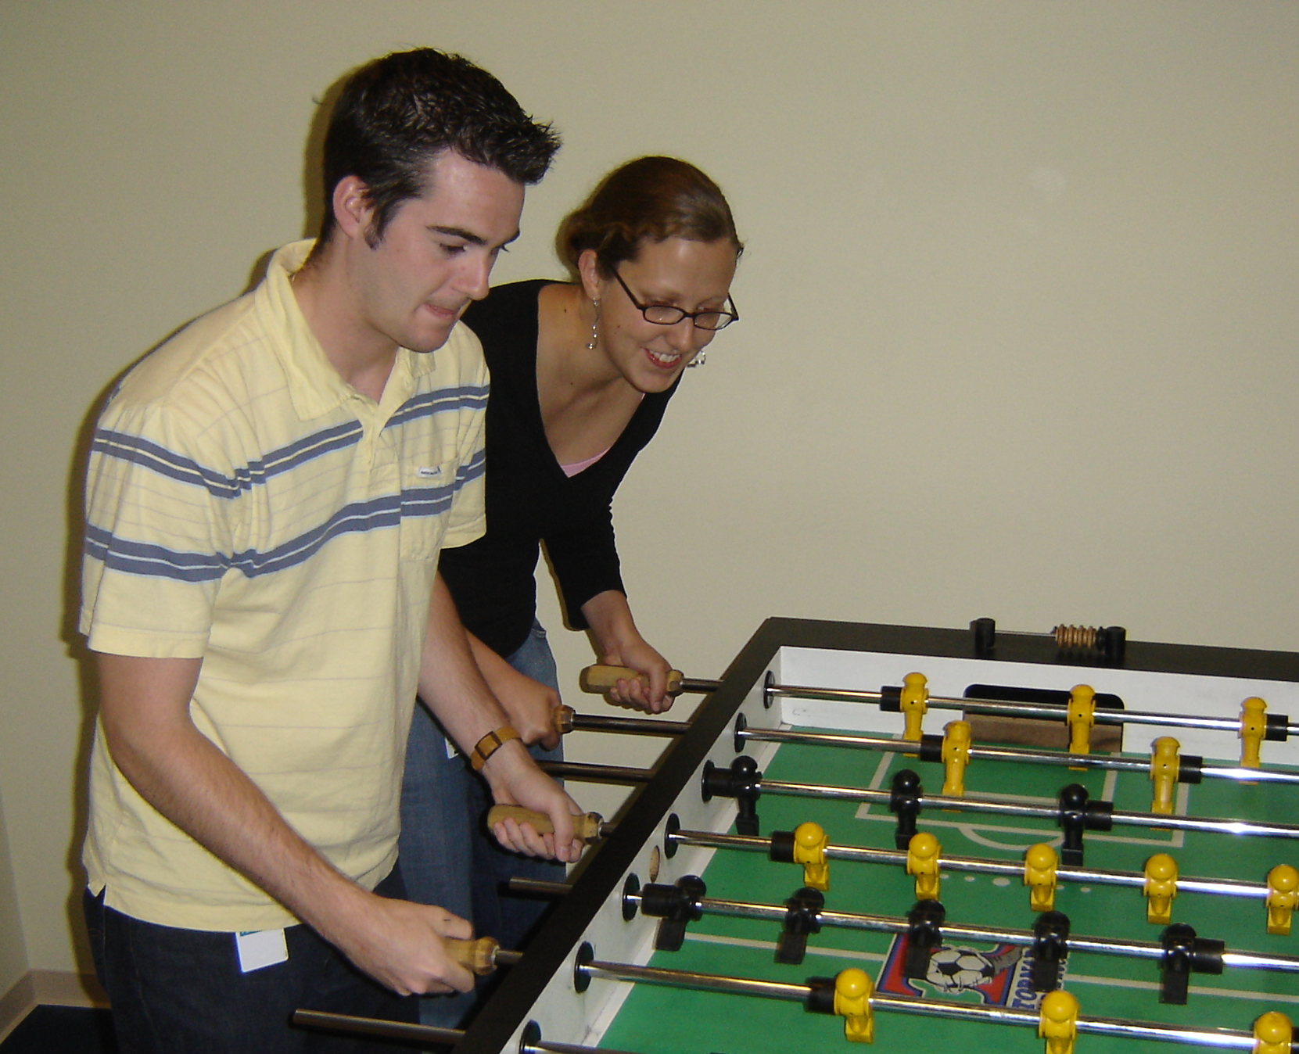

Slide 67
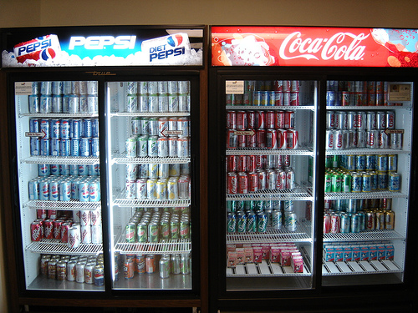

Slide 68
Big-O
2013-01-24
Thursday – Week 0
Lecture 02

Slide 69
What is the runtime of this?
(define (mystery a b)
(cond
((empty? b) (se a b))
((< a (first b)) (se a b))
(else (se (first b)
(mystery a (bf b))))))
A) Constant runtime
B) Linear runtime
C) Linear*Linear (quadratic)
D) Something else
E) No clue
Try to guess what type of thing the variables a & b will be
Try to come up with (small) input that triggers each case
Correct Answer

Slide 70
Bad variable names!
Make your code harder to read!
  Don’t do this!
Even though we do
  We will use bad variable names on exams so that you have to read/understand the code

Slide 71
Better variable names!
(define (insert num sent)
(cond
((empty? sent) (se num sent))
((< num (first sent)) (se num sent))
(else (se (first sent)
(insert num (bf sent))))))
STk>(insert 7 ’())
(7)
STk>(insert 1 ’(2 5 8))
(1 2 5 8)

Slide 72
Insert
STk>(insert 8 ’(2 5 6 9))
(2 5 6 8 9)
(insert 8 ’(2 5 6 9))
(insert 8 ’(5 6 9))
(se 2
(se 5
(insert 8 ’(6 9))
(se 6
(insert 8 ’(9))
(se 8 ’(9))
(se 2 (se 5 (se 6 (se 8 ’(9)))))
Notes:
72

Slide 73
Best vs. Worst Case
(define (insert num sent)
(cond
((empty? sent) (se num sent))
((< num (first sent)) (se num sent))
(else (se (first sent)
(insert num (bf sent))))))
STk>(insert 1 ’(2 3 4 5 6 7 8))
(1 2 3 4 5 6 7 8)
STk>(insert 9 ’(2 3 4 5 6 7 8))
(2 3 4 5 6 7 8 9)
BEST CASE
WORST CASE

Slide 74
Assumptions
We want something independent of the speed of the computer
We typically use N which is some reference to the “size” of the data.
  It might be the variable N (in factorial)
  It might be the size of your sentence
We don’t care about constant factors
  This is pretty silly in some cases but makes the math more beautiful
We typically think about the worst case!
It only matters for BIG input!

Slide 75
What is the runtime of this?
(define (sort sent)
(if (empty? sent)
sent
(insert (first sent)
(sort (bf sent)))))
Constant runtime
Linear runtime
Linear*Linear (quadratic)
Something else
No clue!
Correct Answer

Slide 76
Sort
STk>(sort ’(8 3 9))
(3 8 9)
(sort ’(8 3 9))
(sort ’(3 9))
(insert 8
(insert 3
(sort ’(9))
(insert 9
(sort ’())
’()
(insert 8 (insert 3 (insert 9 ’())))
Notes:
76

Slide 77
(insert 3
(insert 6
(insert 4
(insert 7
(insert 1
(insert 8
(insert 3
(insert 9
’()
))))))))
(sort sent) if sent length is N
1 + 2 + 3 + 4 + … + (N-1)+ N
Add to sent size 7
Add to sent size 6
Add to sent size 5
Add to sent size 4
Add to sent size 3
Add to sent size 2
Add to sent size 1
Add to sent size 0

Slide 78



Some Algebra to calculate:
1+2+…+n
// Written backwards

Slide 79

Some Algebra to calculate:
1+2+…+n

Slide 80


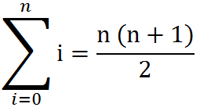
Some Algebra to calculate:
1+2+…+n
OR

