Slide 1


CS 60
Prolog is Hipster!
(Owl-based before owls were cool (at least were everywhere!))
Prolog & Graphs
2013-09-23
Monday – Week 3
Lecture 06

Slide 2
Survey
How bad was it getting eclipse up and running?
Not bad or already had it
Bad/Annoying
It still isn’t working for me

Slide 3
Thank you for the feedback!!!
Easy stuff – too slow
Hard parts – too fast
Don’t skip slides!
Java/Eclipse/Junit is a disaster!
What the heck is tail-recursion?!?
Difference between thumbs and clickers

Slide 4
Use It or Lose It

Slide 5
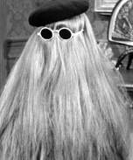
sublists Use it or Lose it!
> (sublists '())
'(())
> (sublists '(b c))
'(() (c) (b) (b c))
> (sublists '(a b c))
'(() (c) (b) (b c) (a) (a c) (a b) (a b c))
You're it!
It
WOAH!
USE IT is EXACTLY
the same as LOSE IT, just with “It” cons’d on!
LOSE IT
USE IT

Slide 6
Use it or lose it
(sublists '( a b ))
'(( ) ( b ) ( a ) ( a b ))
returns ALL sublists of elements in L
the order of these sublists in these overall outputs does not matter...
(define (sublists L)
'(( ) ( c ) ( b ) ( b c )
(a) (a c) (a b) (a b c))
(sublists '( a b c ))
Base Case!
Use-it-or-lose-it
on the HW
(make-change Total CoinList)
This should return #t if it's possible to make change for Total using coins in CoinList; otherwise #f
(make-change 42 '(2 5 10 25 50))
#t ;; 42 == 2 + 5 + 10 + 25
(make-change 42 '(3 5 10 25 50))
#f ;; here, 42 can't be made
I think I lost it!

Slide 7
Use it or lose it
(sublists '( a b ))
'(( ) ( b ) ( a ) ( a b ))
returns ALL sublists of elements in L
the order of these sublists in these overall outputs does not matter...
(define (sublists L)
(if (null? L)
'(( ) ( c ) ( b ) ( b c )
(a) (a c) (a b) (a b c))
(sublists '( a b c ))
Base Case!
(let* ([it (first L))
[loseit (
[useit (
Use-it-or-lose-it
Where are you?
Base case written
loseit written
useit written
Combination done
STUCK on something!

Slide 8
Sublist Solution
(define (sublists L)
(if (null? L)
'(())
(let* ([it (first L)]
[loseit (sublists (rest L))]
[useit (map (lambda (one-sublist)
(cons it one-sublist))
loseit)])
(append loseit useit))))

Slide 9
Graphs What – not how (how on Wed)

Slide 10
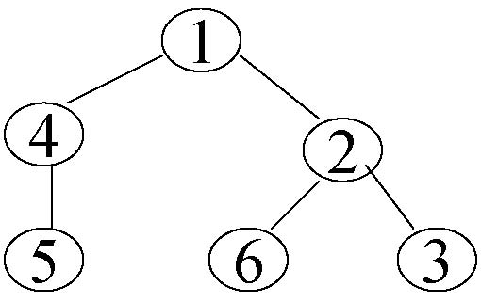
How Trees become Graphs (they can have cycles!)
Notes:
A graph G is a set V of vertices (sometimes called nodes), and a set E of edges (sometimes called arcs) that each connect two vertices together.
This is just like the trees – but with the trees we had the requirements and now any node can reference any other type of node.
Really we could think about any tree as a graph and really even any linked list as a tree and any linked list as a graph. It is just based upon the relationships of nodes.
Introduce E here and N!!
Point out potential infinite loop here!

Slide 11




Two Types of Graphs
Directed
Graph
Undirected
Graph
This vocab is important
Notes:
Two types of graphs. Directed – which is using directional arrows and undirected. Which is just as if there is an arrow in each direction for a given edge.
Define undirected and directed here.

Slide 12
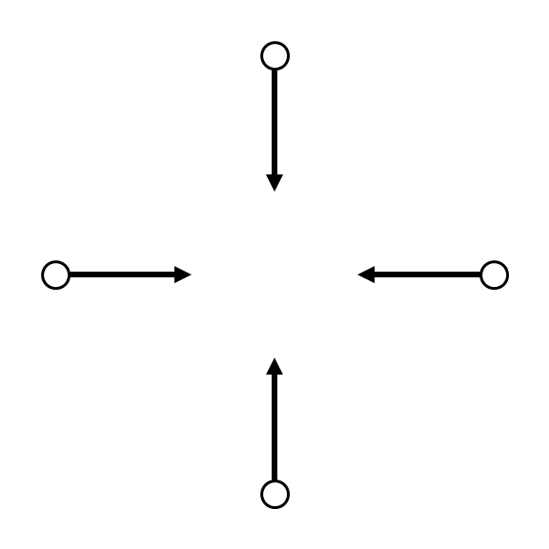
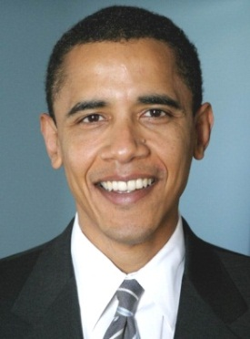
Nodes – Twitter users
Edges – Indicates following
Notes:
Obama is the third most followed person on twitter.
This shows the arrows – just because you follow obama doesn’t mean that he follows you – although Obama COULD follow you and another obama follower could follow other obama followers. (ANIMATION)
If every arrow went in both direction it would just be a undirected graph

Slide 13
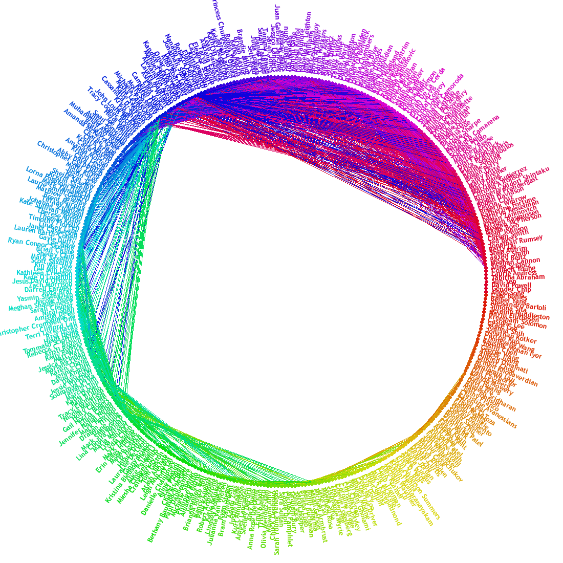
Nodes – FB Users
Edges – Friendships
Notes:
This is FB’s friend wheel. It shows which of my friends are friends with each other. And it is clustered.
This is undirected – if I’m friends with someone they are also friends with me.
We could think of facebook as a directed graph – where most edges are bi-directional. However, maybe when you create a friend request – that is like creating a directional arrow.

Slide 14
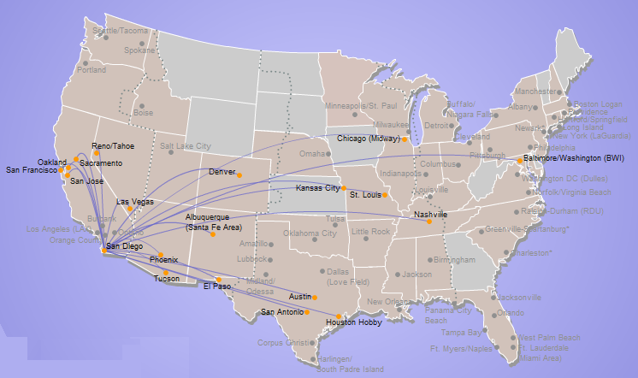
A map is a graph
Nodes – Airports
Edges – Flights
Edge weight
Distance
Flight cost
Travel Time
Notes:
A map is a graph. Here we have southwest’s direct flights from SD.

Slide 15
Graph Vocabulary & Examples
 | Weighted | Un-weighted
Directed | Flights | Twitter
Undirected | Interstates | Facebook

Slide 16
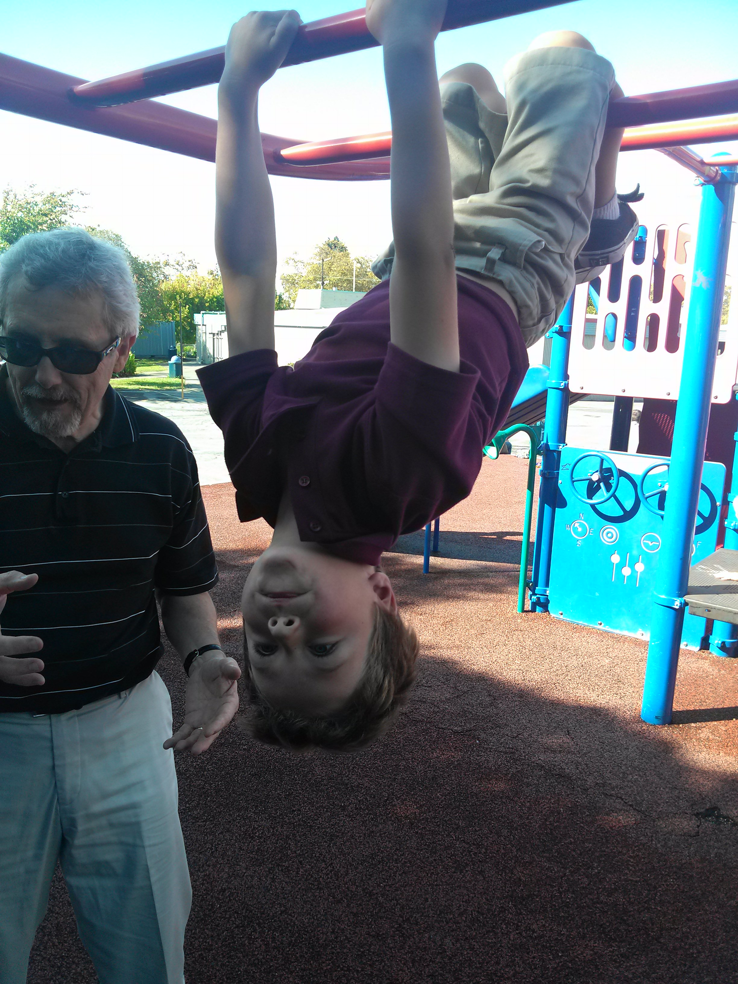
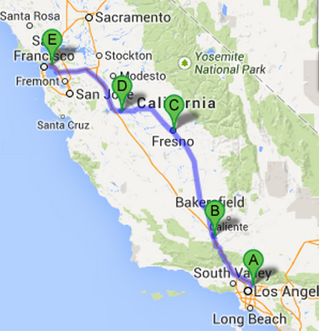
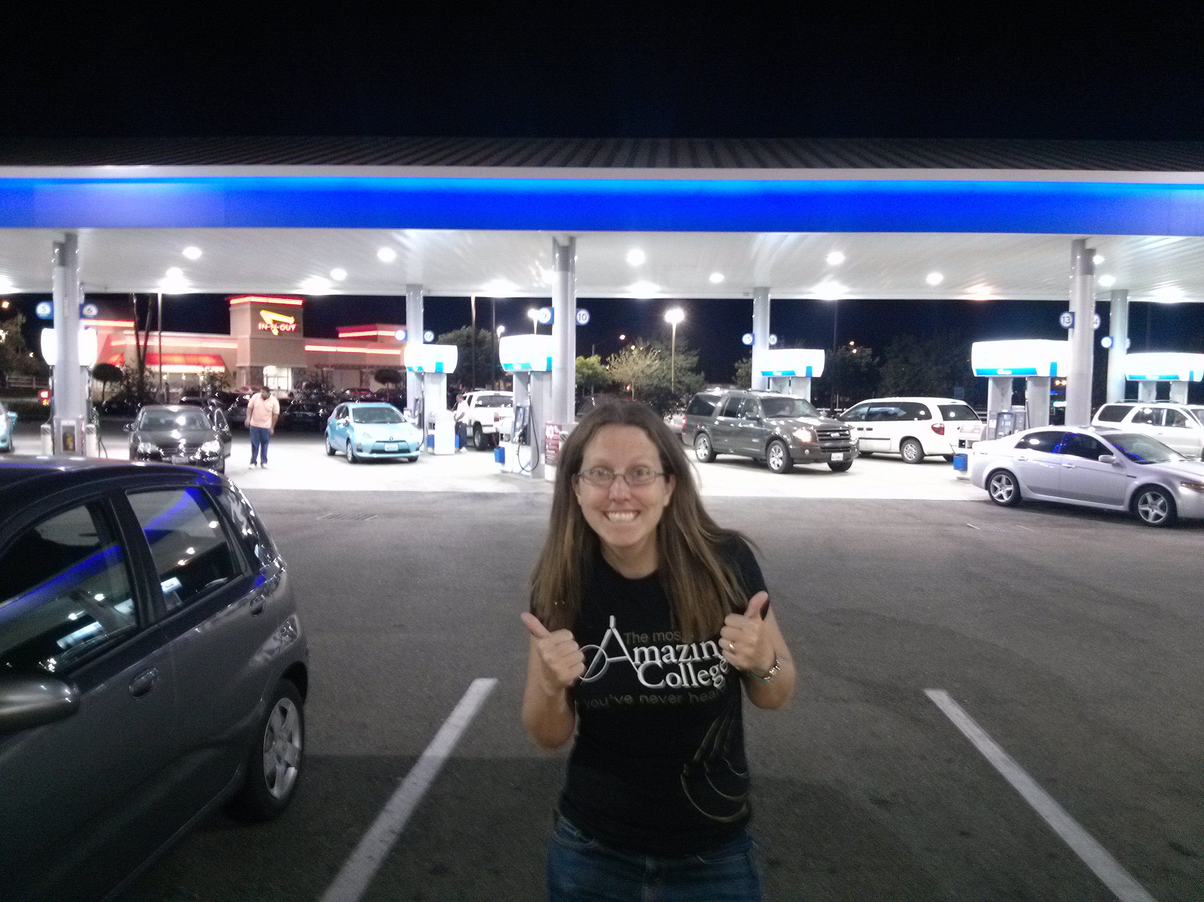
Colleen’s Weekend Graph

Slide 17
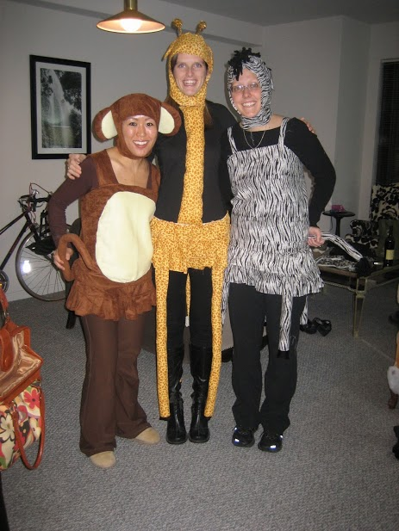
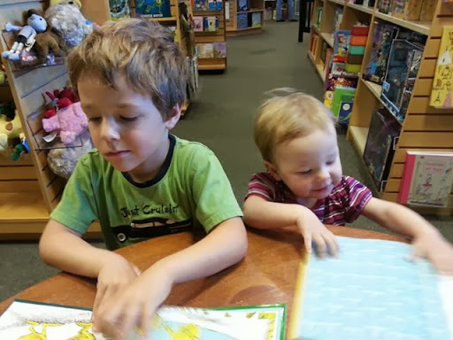

Slide 18
Weighted graphs
Weights
42
15
25
b
100
a
10
7
e
100
c
7
5
This graph looks heavy!
13
1
2
d

Slide 19
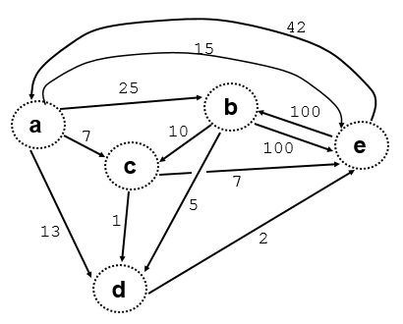
Edges in a Graph (What not How)
100
10
e
b
b
c
25
5
a
b
b
d
42
2
e
a
d
e
7
100
a
c
b
e
13
1
a
d
c
d
15
7
a
e
c
e

Slide 20
Graph-reachability: can you get from A to B?
?
Algorithm for determining: is there some path from A to B in the graph?
A
B
…
?
?
X
Y
I know I can get from X to Y (because I have an Edge from X to Y)
If I can get from A to X and from Y to B then I can get from A to B.
Edge X to Y might not be necessary – also try without it (lose it!)

Slide 21
Prolog Intro

Slide 22
The CS 60 language tree:
Programming
What mood am I in today?
Declarative
Programming
Imperative
Programming
Logic Programming
Functional Programming
Object-Oriented
Programming
Low-level Programming
Prolog
Racket
Java
JFlap
simply describe the problem - and I'll solve it!
algorithms via functions
data structures
machine models
more abstraction away from the machine
closer to the machine

Slide 23
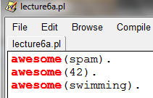
Prolog Demo 1: Facts and Queries (No variables)
Open Prolog
Edit new file
Type some facts:
awesome(spam).
awesome(42).
awesome(swimming).
Save the file
No space
.

Slide 24
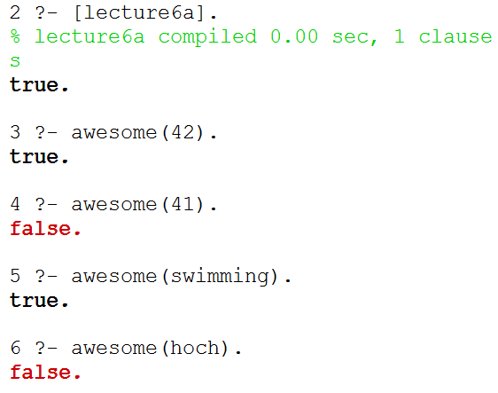
Prolog Demo 1: Facts and Queries (No variables)
Things typed into Prolog interpreter
[lecture6a].
awesome(42).
awesome(41).
awesome(swimming).
awesome(hoch).
Loads the file
Queries

Slide 25
Search to find facts (a.k.a. definitions) that match
The comparison process just goes character by character!
Query:
awesome(42).
Fact:
awesome(spam).
Fact:
awesome(42).
Fact:
awesome(swimming).
1
5
6
3
4
2

Slide 26
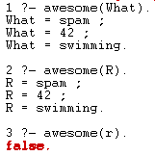
Prolog Demo 2: Variables in Queries
Things starting with Uppercase letters are variables
Things typed into Prolog interpreter
awesome(What).
awesome(R).
awesome(r).
; gets you the rest of the things that match
Lowercase r isn’t a variable. This is false.

Slide 27
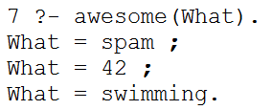
Search to find facts (a.k.a. definitions) that match
The goal is to find variable bindings!
Query:
awesome(What).
Fact:
awesome(spam).
Fact:
awesome(42).
Fact:
awesome(swimming).
1
5
6
3
4
2
What = spam
What = 42
What = swimming

Slide 28
Prolog Demos 1 & 2: Check-in
Write a definition to say that you are awesome.
Write a query to check if skittles are awesome.
Once you’re done, how do you feel about how Prolog executes queries?
A) Confident, B) Somewhat confident, C) Not confident D) I’m Stuck

Slide 29
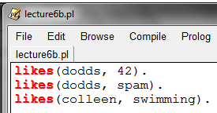
Prolog Demo 3: Multiple Items (no vars)
Facts added to lecture6b.py
likes(dodds, 42).
likes(dodds, spam).
likes(colleen, swimming).
Reads: “Dodds likes 42”
Facts can connect multiple things

Slide 30
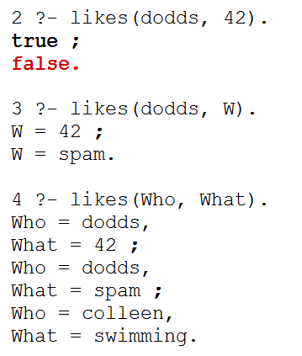
Search to find facts (a.k.a. definitions) that match
Query:
likes(dodds, 42).
Fact:
likes(dodds, 42).
Fact:
likes(dodds, spam).
Fact:
likes(colleen, swimming).
1
5
6
3
4
2

Slide 31
Prolog Demo 4: Multiple Variables in Queries
Queries typed into Prolog
likes(dodds, 42).
likes(dodds, W).
likes(Who, What).
There were two answers
Prolog tries to find bindings for all variables
Use helpful names!
2 bindings for each answer.

Slide 32
Search to find facts (a.k.a. definitions) that match
Query:
likes(dodds, W).
Fact:
likes(dodds, 42).
Fact:
likes(dodds, spam).
Fact:
likes(colleen, swimming).
1
5
6
3
4
2
W = 42
W = spam

Slide 33
Search to find facts (a.k.a. definitions) that match
Query:
likes(Who, What).
Fact:
likes(dodds, 42).
Fact:
likes(dodds, spam).
Fact:
likes(colleen, swimming).
1
5
6
3
4
2
Who = dodds What = 42
Who = dodds What = spam
Who = colleen What = swimming

Slide 34
Prolog Demos 3 & 4: Check-in
Write a definition to say that you like spam.
Write a query to see who likes spam.
Once you’re done - Do these diagrams make sense?
A) Yes, B) Somewhat, C) Not really, D) I’m Stuck

Slide 35
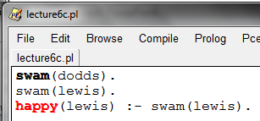
Prolog Demo 5: rules without variables
swam(dodds).
swam(lewis).
happy(lewis) :- swam(lewis).
“if”
facts
A rule
The head
The body

Slide 36
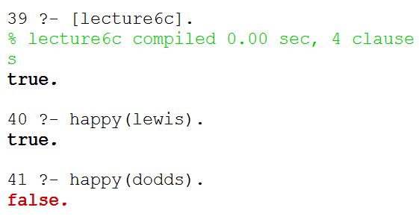
Prolog Demo 5: rules without variables
Queries typed into Prolog
happy(lewis).
happy(dodds).

Slide 37
Query:
happy(lewis).
Rule:
happy(lewis) :- swam(lewis).
Fact:
swam(dodds).
Fact:
swam(lewis).
6
1
2
4
5
3
swam(lewis). is like a new query
(aka subgoal)

Slide 38
Prolog Demo 5: Check-in
Write a definition to say that you swam.
Write a rule to say that if you swam you are happy.
Update the diagram on the next page to show how the query happy(lewis) would be executed.
Once you’re done – Prolog is going…
A) Too fast, B) About right, C) Too slow, D) I’m Stuck

Slide 39
UPDATE ME
Query:
happy(lewis).
Rule:
happy(lewis) :- swam(lewis).
Fact:
swam(dodds).
Fact:
swam(lewis).

Slide 40
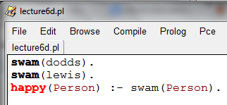
Prolog Demo 6: Rules with variables
Definitions/Rules
swam(dodds).
swam(lewis).
happy(Person) :- swam(Person).

Slide 41
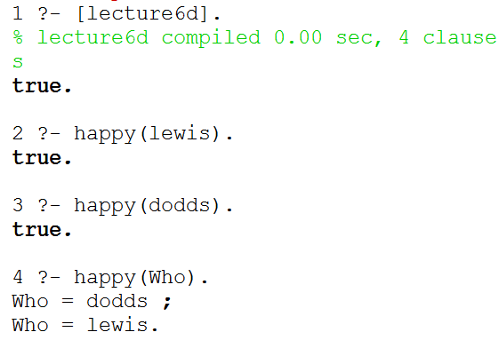
Prolog Demo 6: Rules with Variables
happy(lewis).
happy(dodds).
happy(Who).

Slide 42
Query:
happy(lewis).
Rule:
happy(Person) :- swam(Person).
Fact:
swam(dodds).
Fact:
swam(lewis).
6
1
Person = lewis
2
4
5
3

Slide 43
Query:
happy(Who).
Rule:
happy(Person) :- swam(Person).
Fact:
swam(dodds).
Fact:
swam(lewis).
6
1
Who = Person
2
4
5
3
Person = dodds
Person = lewis

Slide 44
Prolog Execution Summary (for your notes)
Depth-first search through possible bindings
Given a goal, Prolog tries the each rule of that name...
If a rule has subgoals/body (a right-hand side),
Subgoals are checked in order, binding variables as needed
Those bindings persist until backtracking backs over them
Watch out for unbound variables… !
If a goal or subgoal fails, Prolog backtracks and tries again with the next available option (another binding or rule).
Be careful with negation!
trace.

Slide 45
Prolog Demo 6: Check-in
Fill in the blank so that the query below returns false.
happy(_________).
Write a sentence (or more) that explains why this returns false.
Once you’re done – Prolog is going…
A) Too fast, B) About right, C) Too slow, D) I’m Stuck

Slide 46
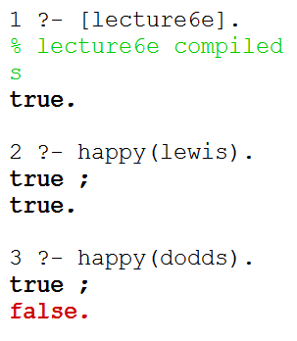
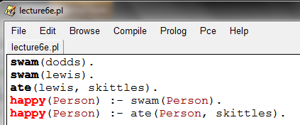
Prolog Demo 7: Multiple Rules
Both paths were true.
swam(dodds).
swam(lewis).
ate(lewis, skittles).
happy(Person) :- swam(Person).
happy(Person) :- ate(Person, skittles).
Two paths to happiness

Slide 47
Query:
happy(lewis).
Rule:
happy(Person) :- swam(Person).
Fact:
swam(dodds).
Fact:
swam(lewis).
Rule:
happy(Person) :- ate(Person, skittles).
Fact:
ate(lewis, skittles).
1
6
7
10
Person = lewis
Person = lewis
2
4
5
3
8
9

Slide 48
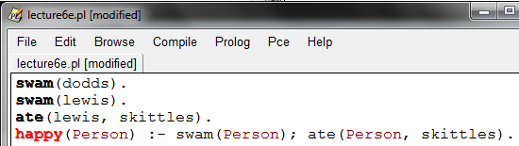
Prolog Demo 8: Using or (;) in rules
; means OR
We could re-write these two rules as 1.

Slide 49
Prolog Demo 8: Check-in
Write a new rule that a person is happy if they ate spam or skittles.
Come up with a way that you will remember that ; means “or.” Describe your method below:
Once you’re done – On in-class problems I like to
A) Finish the problem myself, B) Start the problem, C) I’m Stuck

Slide 50
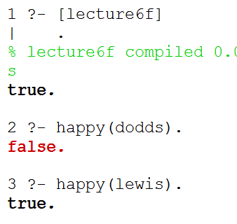
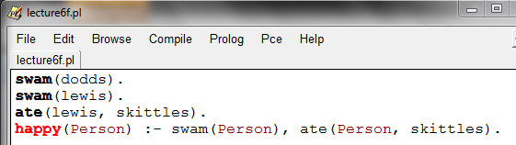
Prolog Demo 9: and
Rules/Definitions:
swam(dodds).
swam(lewis).
ate(lewis, skittles).
happy(Person) :- swam(Person), ate(Person, skittles).
Comma means AND

Slide 51
Query:
happy(lewis).
Rule:
happy(Person) :-
swam(Person), ate(Person, skittles)
Fact:
swam(dodds).
Fact:
swam(lewis).
Fact:
ate(lewis, skittles).
We have TWO subgoals
(work like subqueries)
8
1
Person = lewis
2
3
7
4
5
6
Here’s the second subquery/ subgoal

Slide 52
Prolog Demo 9: Check-in
Write a new rule that a person is happy if they ate spam and skittles.
Come up with a way that you will remember that , means “and.” Describe your method below:
Once you’re done – On in-class problems I like to
A) Work silently first, B) Talk to my partner first, C) I’m Stuck

Slide 53
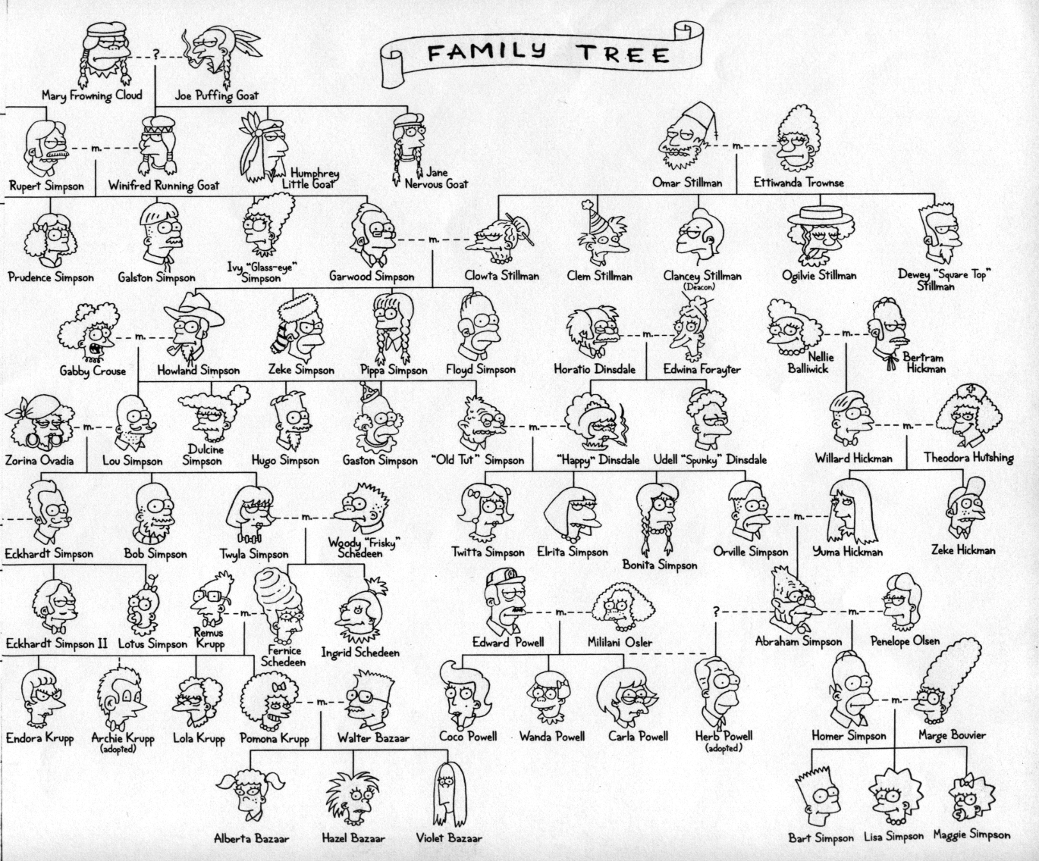

Slide 54
/*
* the parent predicate
*/
parent(olf, skug).
parent(helga, skug).
parent(skug, esmerelda).
parent(skugerina, esmerelda).
parent(esmerelda, klotho).
parent(gemini, klotho).
parent(esmerelda, atropos).
parent(gemini, atropos).
parent(esmerelda, lachesis).
parent(gemini, lachesis).
parent(olf, homericus).
parent(helga, homericus).
parent(ug, matilda).
parent(uggette, matilda).
parent(homericus, homer).
parent(matilda, homer).
parent(homericus, gomer).
parent(matilda, gomer).
parent(homer, bart).
parent(marge, bart).
parent(homer, lisa).
parent(marge, lisa).
parent(homer, maggie).
parent(marge, maggie).
parent(john, marge).
parent(jackie, marge).
parent(john, selma).
parent(jackie, selma).
parent(john, patty).
parent(jackie, patty).
parent(john, glum).
parent(jackie, glum).
parent(glum, millhouse).
parent(cher, millhouse).
parent(glum, terpsichore).
parent(cher, terpsichore).
/*
* the age predicate
*/
age(helga, 97).
age(olf, 99).
age(uggette, 93).
age(ug, 92).
age(matilda, 65).
age(homericus, 76).
age(skugerina, 101).
age(skug, 78).
age(esmerelda, 55).
age(gemini, 54).
age(klotho, 20).
age(atropos, 19).
age(lachesis, 18).
age(marge, 35).
age(homer, 38).
age(lisa, 8).
age(maggie, 1).
age(bart, 10).
age(gomer, 41).
age(john, 62).
age(jackie, 59).
age(patty, 38).
age(selma, 38).
age(glum, 27).
age(cher, 44).
age(millhouse, 8).
age(terpsichore, 8).
File simpsons.pl
/*
* the female predicate
*/
female(helga).
female(esmerelda).
female(skugerina).
female(uggette).
female(matilda).
female(marge).
female(jackie).
female(selma).
female(patty).
female(cher).
female(lisa).
female(maggie).
female(klotho).
female(atropos).
female(lachesis).
female(terpsichore).
/*
* the male predicate
*/
male(olf).
male(skug).
male(homericus).
male(ug).
male(homer).
male(gomer).
male(gemini).
male(john).
male(glum).
male(bart).
male(millhouse).

Slide 55
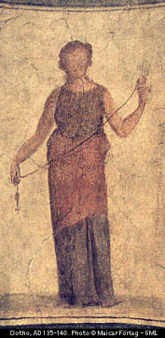
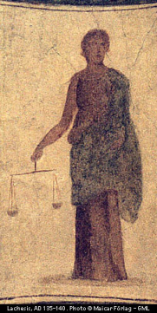
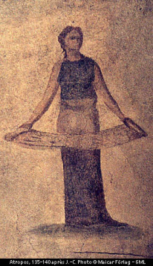


A more intuitive picture ...
age
age
female
male
99
97
92
93
olf
helga
ug
uggette
101
78
76
65
62
59
skugerina
skug
homericus
matilda
john
jackie
54
55
41
38
35
38
38
27
44
gemini
esmerelda
gomer
homer
marge
selma
patty
glum
cher
20
18
19
10
1
8
8
8
klotho
lachesis
atropos
bart
maggie
lisa
millhouse
terpsichore
Oh, brother!

Slide 56
Homework Prep
Write these four predicates in prolog:
True if MomOrDad is the parent of Kid
child(Kid, MomOrDad) :-
True if Mom is the parent of Kid and Mom is female
mother(Mom,Kid) :-
True if X is the parent of Y or if X is an ancestor of Y’s parent
anc(X,Y) :-
anc(X,Y) :-
true if N is the factorial of X (for X >= 0)
fac(X,N) :-
fac( , ) :-
Extra!
you need a base case, too – what should it be?

Slide 57
Solutions
/*
* Here are three rules about families
*/
child(X, Y) :- parent(Y, X).
mother(X, Y) :- female(X), parent(X, Y).
anc(X, Y) :- parent(X, Y).
anc(X, Y) :- parent(Z, Y), anc(X, Z).

Slide 58
Mutual Recursion

Slide 59
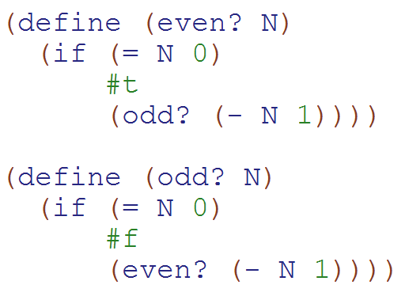
Mutual Recursion Example (Definition: Two functions that call each other)
How many times is odd? called in:
(even? 7)
a)0
b)1
c)2
d)3
e)> 3

Slide 60
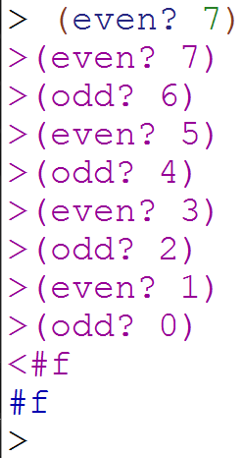
Mutual Recursion Solution

Slide 61
Syntactic Sugar (λ makes a function)
(define (square x) (* x x))
(define square (lambda (x) (* x x))
>(square 3)
9
>((lambda (x) (* x x)) 3)
Function name
Args
Body
The function to call
Input
Remember to keep track of your input/output type(s)!

Slide 62
Graph-reachability: can you get from s to d?
is there some path from s to d in G?
s == source
d == dest.
(define (reach? s d G)
?
s
d
…
?
?
X
Y
I know I can get from a to b. If I can get from S to A and from B to D…
(define unicycleGraph '(("A" "B") ("A" "D") ("B" "D") ("C" "B") ("C" "D") ("D" "E") ("E" "F") ("F" "G") ("G" "H") ("H" "E") ))

Slide 63
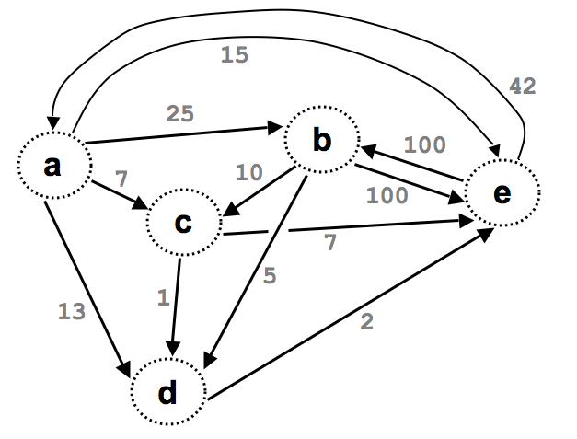

Slide 64
(define Gt '((e b 100) (a b 25) (e a 42)
(a c 7) (a d 13) (a e 15)
(b c 10) (b d 5) (d e 2)
(b e 100) (c d 1) (c e 7)) )
What might these weights represent?
42
15
25
b
100
a
10
7
e
100
c
7
5
This graph looks heavy!
13
1
2
No space
Weightedgraphs
d

Slide 65
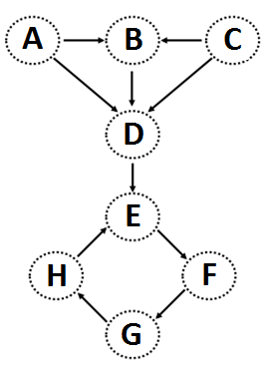
(nodes unicycleGraph)→'("A" "B" "D" "C" "E" "F" "G" "H")
(define (nodes graph)
Hint: how could we use remove-duplicates
(kids "A" unicycleGraph) → '("B" "D") (kids "B" unicycleGraph) → '("D")
(define unicycleGraph '(("A" "B") ("A" "D") ("B" "D") ("C" "B") ("C" "D") ("D" "E") ("E" "F") ("F" "G") ("G" "H") ("H" "E") ))
(define (kids n graph)
big-O( ) ~ edges or nodes?
parents?
Hint: could we use filter?
Notes:
big-O: could be edges or nodes!

Slide 66
Feel free to use available functions: remove-duplicates, nodes, kids, parents, and higher-order functions...
Write these functions for directed graphs.
(define (leaf? n G)
(leaf? n G) should return #t if n is a leaf in G and #f otherwise.
(
(leaf? "E" unicycleGraph)→ #f
Hint: call (kids n G)
(define (gkids n G)
(gkids n G) should compute the list of grandchildren of n in G: all nodes two edges away.
(
(gkids "E" unicycleGraph)→ '("G")
(gkids "A" unicycleGraph)→ '("D" "E")
Hint: use kids and map - It's a bit tricky...
(define (reach? a b G)
(reach? a b G) should return #t if there is some path from a to b in G and #f otherwise.
(
(reach? "B" "E" unicycleGraph)→ #t
there is definitely not enough room here – plus, we’ll talk about a solution in the next lecture...
(reach? "E" "B" unicycleGraph)→ #f
Notes:
I don’t know if this really works...

Slide 67
Graph-reachability: can you get from s to d?
is there some path from s to d in G?
s == source
d == dest.
(define (reach? s d G)
Consider the algorithm first, then the code...

Slide 68
Graph-reachability: can you get from s to d?
(define (reach? s d G)
(cond
(
(
( else (let* ([EDGE
[a
[b
[R
[loseit

Slide 69
How’s it going?
We wrote the base cases
We wrote Edge, A, B, & R.
We wrote loseit
We wrote the combination/answer

Slide 70
Graph-reachability: can you get from A to B?
What is N, the problem size?
(define (reach? s d G)
(cond
((equal? s d) #t)
((null? G) #f)
( else (let* ((EDGE (first G))
(R (rest G))
(loseit (reach? s d R))
(a (first EDGE))
(b (second EDGE))
(useit (and (reach? s a R)
(reach? b d R))...
(or useit loseit))))...
what are the base cases saying?
solve the problem without "it"
solve the problem with "it"
SOLUTION
big-O( )

Slide 71
Reach Solution
(define (reach? s d G)
(cond
((equal? s d) #t)
((null? G) #f)
( else (let* ([EDGE (first G)]
[a (first EDGE)]
[b (second EDGE)] [R (rest G)]
[loseit (reach? s d R)]
[useit (and (reach? s a R)
(reach? b d R))])
(or useit loseit)))))

Slide 72
Graph Representations

Slide 73
Graphs can be stored as Lists Edge List
This vocab is important
(define unicycleGraph '(
("A" "B") ("A" "D") ("B" "D") ("C" "B") ("C" "D") ("D" "E") ("E" "F") ("F" "G") ("G" "H") ("H" "E")
))
I can think of other ways to represent this graph!

Slide 74
(define Gt '((e b 100) (a b 25) (e a 42)
(a c 7) (a d 13) (a e 15)
(b c 10) (b d 5) (d e 2)
(b e 100) (c d 1) (c e 7)) )
What might these weights represent?
weights
15
42
25
b
100
This graph looks heavy!
a
10
7
e
100
c
7
5
13
1
2
Weightedgraphs
d

Slide 75
Graph Practice
2013-02-05
Tuesday – Week 2
Lecture 05

Slide 76
(nodes unicycleGraph)→'("A" "B" "D" "C" "E" "F" "G" "H")
(define (nodes graph)
Hint: how could we use remove-duplicates
(kids "A" unicycleGraph) → '("B" "D") (kids "B" unicycleGraph) → '("D")
(define unicycleGraph '(("A" "B") ("A" "D") ("B" "D") ("C" "B") ("C" "D") ("D" "E") ("E" "F") ("F" "G") ("G" "H") ("H" "E") ))
(define (kids n graph)
big-O( ) ~ edges or nodes?
parents?
Hint: could we use filter?
Notes:
big-O: could be edges or nodes!

Slide 77
Feel free to use available functions: remove-duplicates, nodes, kids, parents, and higher-order functions...
Write these functions for directed graphs.
(define (leaf? n G)
(leaf? n G) should return #t if n is a leaf in G and #f otherwise.
(
(leaf? "E" unicycleGraph)→ #f
Hint: call (kids n G)
(define (gkids n G)
(gkids n G) should compute the list of grandchildren of n in G: all nodes two edges away.
(
(gkids "E" unicycleGraph)→ '("G")
(gkids "A" unicycleGraph)→ '("D" "E")
Hint: use kids and map - It's a bit tricky...
(define (reach? a b G)
(reach? a b G) should return #t if there is some path from a to b in G and #f otherwise.
(
(reach? "B" "E" unicycleGraph)→ #t
there is definitely not enough room here – plus, we’ll talk about a solution later in lecture ...
(reach? "E" "B" unicycleGraph)→ #f
Notes:
I don’t know if this really works...

Slide 78
Where are you?
Working on leaf?
Working on gkids
Working on reach
STUCK on something!

Slide 79
Graph Reach
2013-02-05
Tuesday – Week 2
Lecture 05

Slide 80
Graph-reachability: can you get from s to d?
is there some path from s to d in G?
s == source
d == dest.
(define (reach? s d G)
Consider the algorithm first, then the code...

Slide 81
Graph-reachability: can you get from s to d?
is there some path from s to d in G?
s == source
d == dest.
(define (reach? s d G)
?
s
d
…
?
?
a
b
I know I can get from a to b. If I can get from S to A and from B to D…
(define unicycleGraph '(("A" "B") ("A" "D") ("B" "D") ("C" "B") ("C" "D") ("D" "E") ("E" "F") ("F" "G") ("G" "H") ("H" "E") ))

Slide 82
Graph-reachability: can you get from s to d?
(define (reach? s d G)
(cond
(
(
( else (let* ([EDGE
[a
[b
[R
[loseit

Slide 83
How’s it going?
We wrote the base cases
We wrote Edge, A, B, & R.
We wrote loseit
We wrote the combination/answer

Slide 84
Graph-reachability: can you get from A to B?
What is N, the problem size?
(define (reach? s d G)
(cond
((equal? s d) #t)
((null? G) #f)
( else (let* ((EDGE (first G))
(R (rest G))
(loseit (reach? s d R))
(a (first EDGE))
(b (second EDGE))
(useit (and (reach? s a R)
(reach? b d R))...
(or useit loseit))))...
what are the base cases saying?
solve the problem without "it"
solve the problem with "it"
SOLUTION
big-O( )

Slide 85
Reach Solution
(define (reach? s d G)
(cond
((equal? s d) #t)
((null? G) #f)
( else (let* ([EDGE (first G)]
[a (first EDGE)]
[b (second EDGE)] [R (rest G)]
[loseit (reach? s d R)]
[useit (and (reach? s a R)
(reach? b d R))])
(or useit loseit)))))

Slide 86
BONUS

Slide 87


Slide 88
Estimating Time
Most people grossly underestimate how long it takes to program (not thinking about time to debug and test)
You appear incompetent at programming (not true) if you can’t estimate how long something will take.
This is one of the hardest things to learn!!! Start to practice now! For each task estimate how long it will take and keep track of how wrong you were

Slide 89


Computer
Science
&
= AWESOME

Slide 90
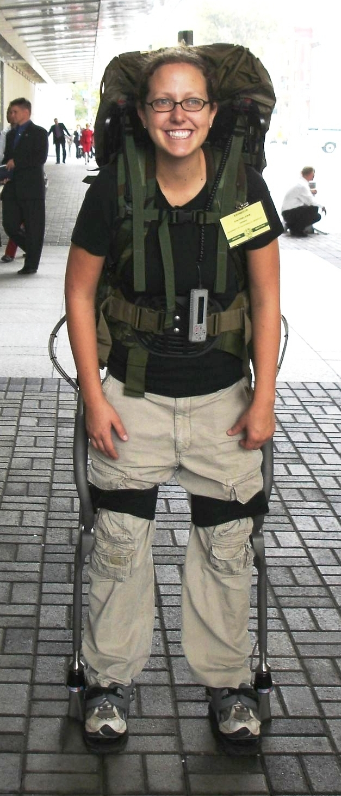
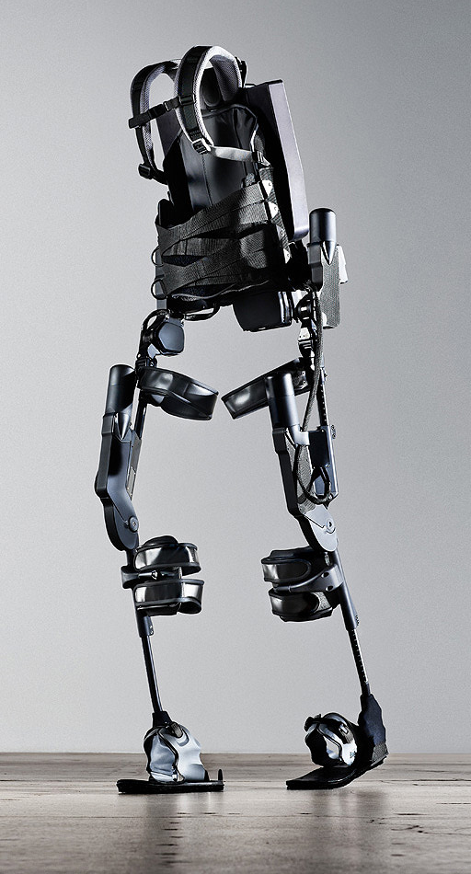
http://www.youtube.com/watch?v=pzRmNYA8LlY

Slide 91


ClickStart

Slide 92
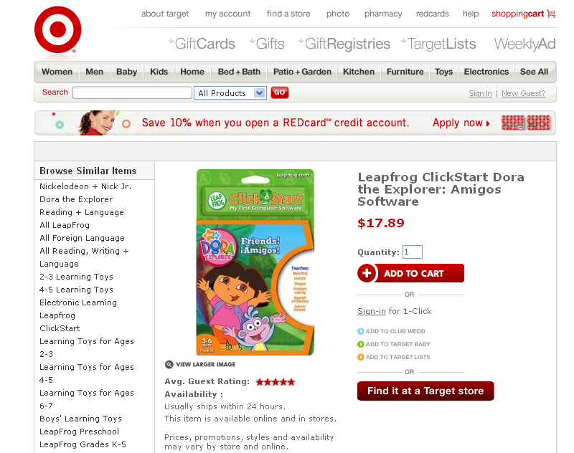

Slide 93
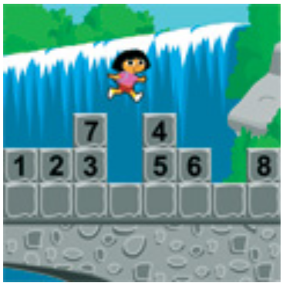
How should we represent the blocks in the computer?
Independent variables
2D Array
OpenList
I don’t know

Slide 94
The value in the array tells me what art asset to use
Each level is really a 3x10 vector!
0 | 0 | 7 | 0 | 4 | 0 | 0 | 0
1 | 2 | 3 | -4 | 5 | 6 | -7 | 8
B | B | B | B | B | B | B | B
Negative values tell me what block needs to go here to win!

Slide 95
0 | 0 | 7 | 0 | 4 | 0 | 0 | 0
1 | 2 | 3 | -4 | 5 | 6 | -7 | 8
0 | 0 | 0 | B | 0 | 0 | 0 | 0

Slide 96
BUGS!

Slide 97
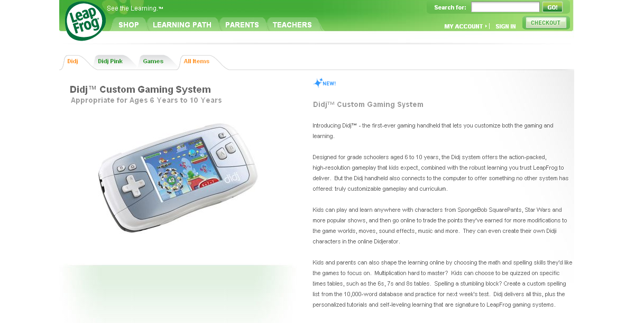

Slide 98

It is really sad when stuff you’ve made is on sale!

Slide 99



Which image is fake?
A. Top Left
B. Bottom Left
C. Bottom Right

Slide 100
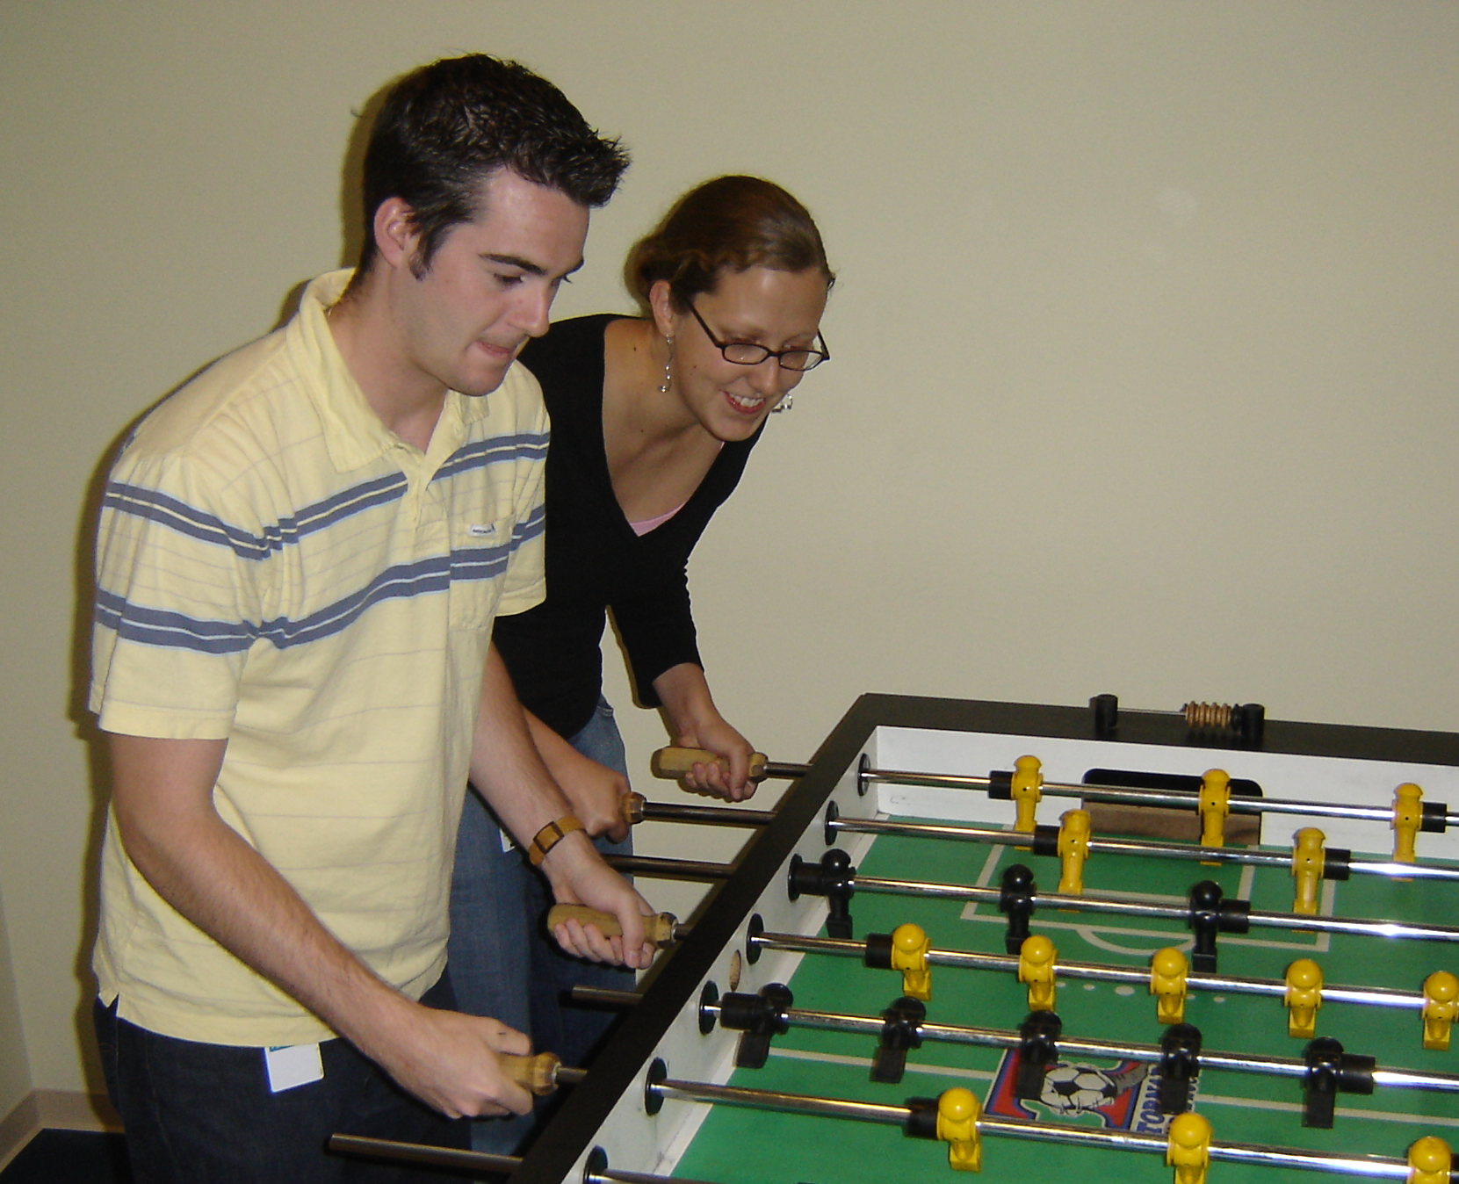

Slide 101
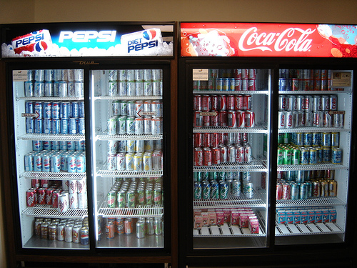

Slide 102
Big-O
2013-01-24
Thursday – Week 0
Lecture 02

Slide 103
What is the runtime of this?
(define (mystery a b)
(cond
((empty? b) (se a b))
((< a (first b)) (se a b))
(else (se (first b)
(mystery a (bf b))))))
A) Constant runtime
B) Linear runtime
C) Linear*Linear (quadratic)
D) Something else
E) No clue
Try to guess what type of thing the variables a & b will be
Try to come up with (small) input that triggers each case
Correct Answer

Slide 104
Bad variable names!
Make your code harder to read!
Don’t do this!
Even though we do
We will use bad variable names on exams so that you have to read/understand the code

Slide 105
Better variable names!
(define (insert num sent)
(cond
((empty? sent) (se num sent))
((< num (first sent)) (se num sent))
(else (se (first sent)
(insert num (bf sent))))))
STk>(insert 7 ’())
(7)
STk>(insert 1 ’(2 5 8))
(1 2 5 8)

Slide 106
Insert
STk>(insert 8 ’(2 5 6 9))
(2 5 6 8 9)
(insert 8 ’(2 5 6 9))
(insert 8 ’(5 6 9))
(se 2
(se 5
(insert 8 ’(6 9))
(se 6
(insert 8 ’(9))
(se 8 ’(9))
(se 2 (se 5 (se 6 (se 8 ’(9)))))
Notes:
106

Slide 107
Best vs. Worst Case
(define (insert num sent)
(cond
((empty? sent) (se num sent))
((< num (first sent)) (se num sent))
(else (se (first sent)
(insert num (bf sent))))))
STk>(insert 1 ’(2 3 4 5 6 7 8))
(1 2 3 4 5 6 7 8)
STk>(insert 9 ’(2 3 4 5 6 7 8))
(2 3 4 5 6 7 8 9)
BEST CASE
WORST CASE

Slide 108
Assumptions
We want something independent of the speed of the computer
We typically use N which is some reference to the “size” of the data.
It might be the variable N (in factorial)
It might be the size of your sentence
We don’t care about constant factors
This is pretty silly in some cases but makes the math more beautiful
We typically think about the worst case!
It only matters for BIG input!

Slide 109
What is the runtime of this?
(define (sort sent)
(if (empty? sent)
sent
(insert (first sent)
(sort (bf sent)))))
Constant runtime
Linear runtime
Linear*Linear (quadratic)
Something else
No clue!
Correct Answer

Slide 110
Sort
STk>(sort ’(8 3 9))
(3 8 9)
(sort ’(8 3 9))
(sort ’(3 9))
(insert 8
(insert 3
(sort ’(9))
(insert 9
(sort ’())
’()
(insert 8 (insert 3 (insert 9 ’())))
Notes:
110

Slide 111
(insert 3
(insert 6
(insert 4
(insert 7
(insert 1
(insert 8
(insert 3
(insert 9
’()
))))))))
(sort sent) if sent length is N
1 + 2 + 3 + 4 + … + (N-1)+ N
Add to sent size 7
Add to sent size 6
Add to sent size 5
Add to sent size 4
Add to sent size 3
Add to sent size 2
Add to sent size 1
Add to sent size 0

Slide 112



Some Algebra to calculate: 1+2+…+n
// Written backwards

Slide 113

Some Algebra to calculate: 1+2+…+n

Slide 114


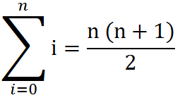
Some Algebra to calculate: 1+2+…+n
OR

Slide 115





// Take the log of both sides
// Remember:

