Slide 1
CS 60
Mutual Recursion, Prolog, & Unicalc
2013-09-25
Wednesday – Week 3
Lecture 07

Slide 2
Are you enjoying CS 60?
Yes, it is bigger than a bread box.
Yes, it is NOT bigger than a bread box
Somewhat
No
I’m stuck

Slide 3
Administrative Stuff
(Not in your notes)
If you lost points for enumerate (hw1), but shouldn’t have – email me! ☺
Quiz – due Tuesday at 5pm under Colleen’s office door (Olin 1280) The door is locked 5pm-8am
Colleen’s office hours 2-5pm on Tuesday in LAC

Slide 4
Mutual Recursion
(Hw3 Unicalc)

Slide 5
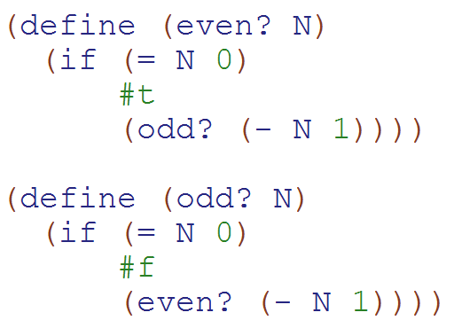
Mutual Recursion Example
(Two functions that call each other)
WARNING: This is ridiculous code that no one should ever write!!!!
But is a simple to understand example of mutual recursion!!!
How many times is odd? called in:
(even? 7)
a)0
b)1
c)2
d)3
e)> 3

Slide 6
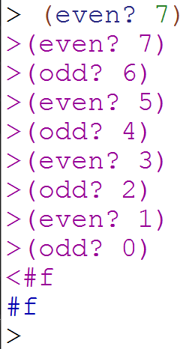
Mutual Recursion Solution
Here I used
(trace even?) and
(trace odd?)
So I could see what calls were made!
(Debugging tip!)

Slide 7
What you should understand right now:
Mutual recursion is when two functions call each other!

Slide 8
Unicalc
(Hw3 Unicalc)
You always read the book before writing the essay:
In CS you should:
Read the description of the problem
Read the provided code
The goals of this assignment:
Use mutual recursion
Make something that works
Figure out how pieces fit together
Practice reading!

Slide 9
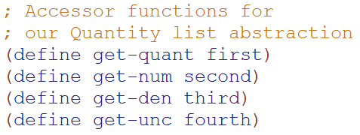
Quantity Lists
(Represented as Lists – HW3)
'(9.8 (meter) (second second) 0.01)
multiply, divide, add, power
Simplify units
Handle uncertainty
“Normalize” units
Quantity
Numerator (units)
Denominator (units)
Uncertainty

Slide 10
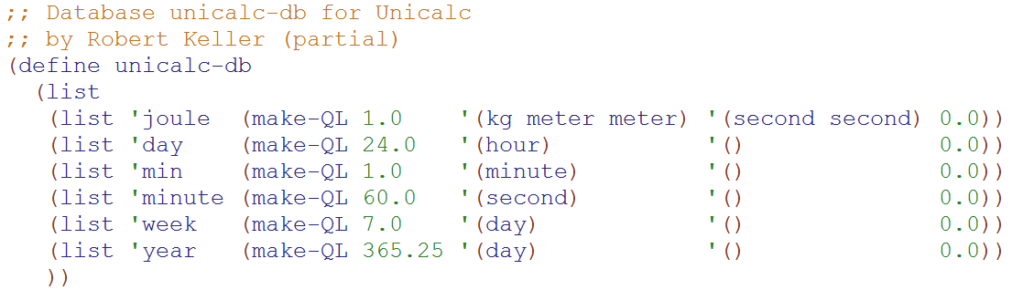
Database (assoc list) of conversions
Base units
(e.g. seconds, meters) don’t have an entry in the DB
All non-base units have a quantity-list conversion listed

Slide 11
Mutual Recursion
(norm-unit & norm-QL)
From DB
(list 'joule (make-QL 1.0 '(kg meter meter) '(second second) 0.0))
(norm-unit 'joule)
Calls:
(norm-QL '(1.0 (kg meter meter) (second second) 0.0))
Which calls:
> (norm-unit 'kg)
> (norm-unit 'meter)
> (norm-unit 'meter)
> (norm-unit 'second)
> (norm-unit 'second)
These are all base units so they don’t call norm-QL
norm-QL calls norm-unit once for EACH unit

Slide 12
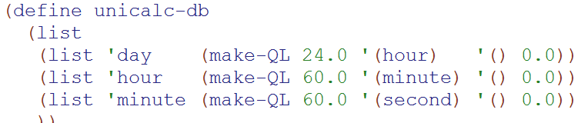
Mutual Recursion Example
(norm-unit 'day)
(norm-QL '(24.0 (hour) () 0.0))
(norm-unit 'hour)
(norm-QL '(60.0 (minute) () 0.0))
(norm-unit 'minute)
(norm-QL '(60.0 (second) () 0.0))
(norm-unit 'second)
Base units
(e.g. seconds, meters) don’t have an entry in the DB

Slide 13
Write notes to yourself about what you understand about unicalc at this point

Slide 14
Mutual Recursion
odd?
even?
norm-unit
norm-QL

Slide 15
What you should understand right now:
I will need to spend time reading the unicalc assignment
Unicalc uses mutual recursion
  norm-unit calls norm-QL
  norm-QL calls norm-unit
“Base units” don’t need to be normalized and therefore there is no entry for them in the unicalc database!

Slide 16
Prolog

Slide 17
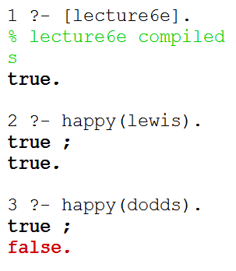
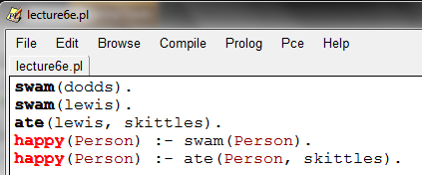
Prolog Demo 7:
Multiple Rules
Both paths were true.
swam(dodds).
swam(lewis).
ate(lewis, skittles).
happy(Person) :- swam(Person).
happy(Person) :- ate(Person, skittles).
Two paths to happiness

Slide 18
Query:
happy(lewis).
Rule:
happy(Person) :- swam(Person).
Fact:
swam(dodds).
Fact:
swam(lewis).
Rule:
happy(Person) :- ate(Person, skittles).
Fact:
ate(lewis, skittles).
1
6
7
10
Person = lewis
Person = lewis
2
4
5
3
8
9

Slide 19
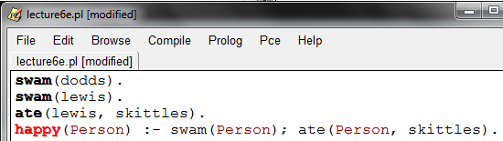
Prolog Demo 8: Using or (;) in rules
; means OR
We could re-write these two rules as 1.

Slide 20
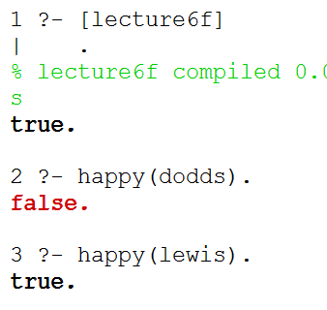
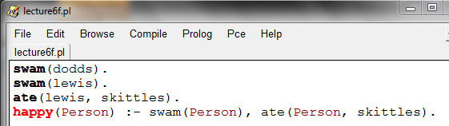
Prolog Demo 9: and
Rules/Definitions:
swam(dodds).
swam(lewis).
ate(lewis, skittles).
happy(Person) :- swam(Person), ate(Person, skittles).
Comma means AND

Slide 21
Query:
happy(lewis).
Rule:
happy(Person) :-
swam(Person), ate(Person, skittles)
Fact:
swam(dodds).
Fact:
swam(lewis).
Fact:
ate(lewis, skittles).
We have TWO subgoals
(work like subqueries)
8
1
Person = lewis
2
3
7
4
5
6
Here’s the second subquery/ subgoal

Slide 22
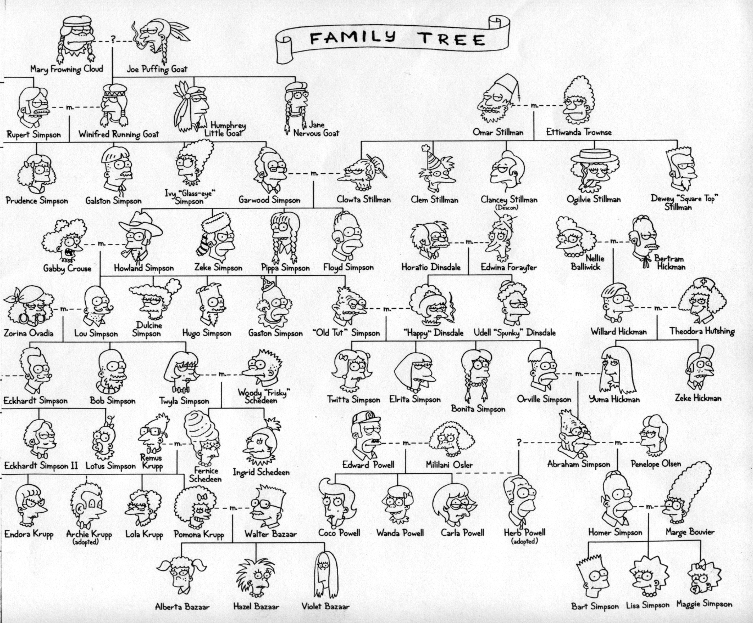

Slide 23
/*
* the parent predicate
*/
parent(olf, skug).
parent(helga, skug).
parent(skug, esmerelda).
parent(skugerina, esmerelda).
parent(esmerelda, klotho).
parent(gemini, klotho).
parent(esmerelda, atropos).
parent(gemini, atropos).
parent(esmerelda, lachesis).
parent(gemini, lachesis).
parent(olf, homericus).
parent(helga, homericus).
parent(ug, matilda).
parent(uggette, matilda).
parent(homericus, homer).
parent(matilda, homer).
parent(homericus, gomer).
parent(matilda, gomer).
parent(homer, bart).
parent(marge, bart).
parent(homer, lisa).
parent(marge, lisa).
parent(homer, maggie).
parent(marge, maggie).
parent(john, marge).
parent(jackie, marge).
parent(john, selma).
parent(jackie, selma).
parent(john, patty).
parent(jackie, patty).
parent(john, glum).
parent(jackie, glum).
parent(glum, millhouse).
parent(cher, millhouse).
parent(glum, terpsichore).
parent(cher, terpsichore).
/*
* the age predicate
*/
age(helga, 97).
age(olf, 99).
age(uggette, 93).
age(ug, 92).
age(matilda, 65).
age(homericus, 76).
age(skugerina, 101).
age(skug, 78).
age(esmerelda, 55).
age(gemini, 54).
age(klotho, 20).
age(atropos, 19).
age(lachesis, 18).
age(marge, 35).
age(homer, 38).
age(lisa, 8).
age(maggie, 1).
age(bart, 10).
age(gomer, 41).
age(john, 62).
age(jackie, 59).
age(patty, 38).
age(selma, 38).
age(glum, 27).
age(cher, 44).
age(millhouse, 8).
age(terpsichore, 8).
File simpsons.pl
/*
* the female predicate
*/
female(helga).
female(esmerelda).
female(skugerina).
female(uggette).
female(matilda).
female(marge).
female(jackie).
female(selma).
female(patty).
female(cher).
female(lisa).
female(maggie).
female(klotho).
female(atropos).
female(lachesis).
female(terpsichore).
/*
* the male predicate
*/
male(olf).
male(skug).
male(homericus).
male(ug).
male(homer).
male(gomer).
male(gemini).
male(john).
male(glum).
male(bart).
male(millhouse).

Slide 24
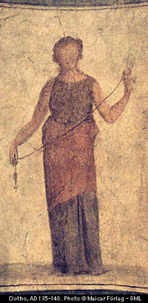
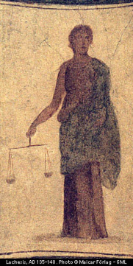
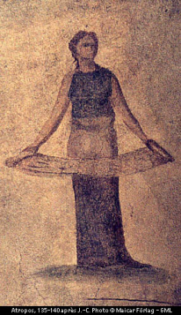
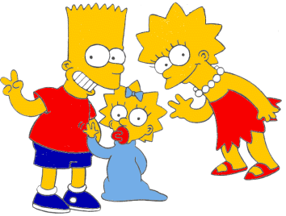

A more intuitive picture ...
age
age
female
male
99
97
92
93
olf
helga
ug
uggette
101
78
76
65
62
59
skugerina
skug
homericus
matilda
john
jackie
54
55
41
38
35
38
38
27
44
gemini
esmerelda
gomer
homer
marge
selma
patty
glum
cher
20
18
19
10
1
8
8
8
klotho
lachesis
atropos
bart
maggie
lisa
millhouse
terpsichore
Oh, brother!

Slide 25
Homework Prep
Write these three predicates in prolog:
True if MomOrDad is the parent of Kid
child(Kid, MomOrDad) :-
True if Mom is the parent of Kid and Mom is female
mother(Mom,Kid) :-
True if X is the parent of Y or if X is an ancestor of Y’s parent
anc(X,Y) :-
anc(X,Y) :-

Slide 26
Solutions
/*
* Here are three rules about families
*/
child(X, Y) :- parent(Y, X).
mother(X, Y) :- female(X), parent(X, Y).
anc(X, Y) :- parent(X, Y).
anc(X, Y) :- parent(Z, Y), anc(X, Z).
ORDER MATTERS!
We need to do parent(Z, Y) first because it creates a binding for Z.

Slide 27
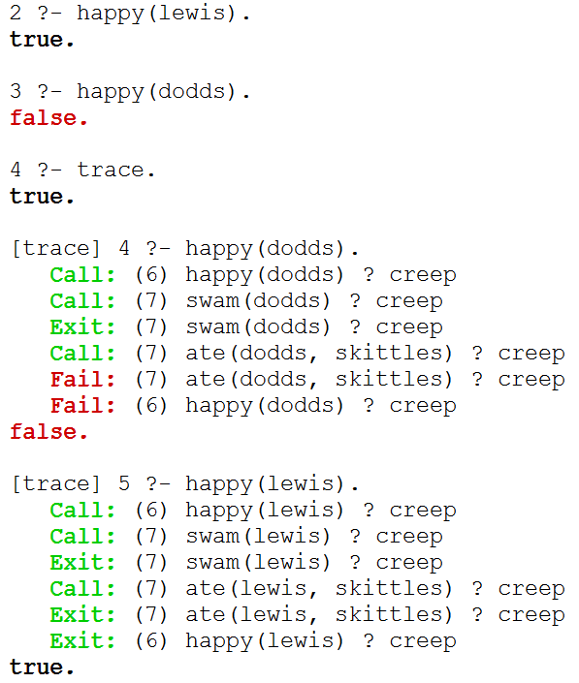

Slide 28
trace.
Starts tracing
Type C or
hit return
to go
step-by-step

Slide 29
trace.
Starts tracing
Type C or
hit return
to go
step-by-step
notrace.
Stops tracing

Slide 30
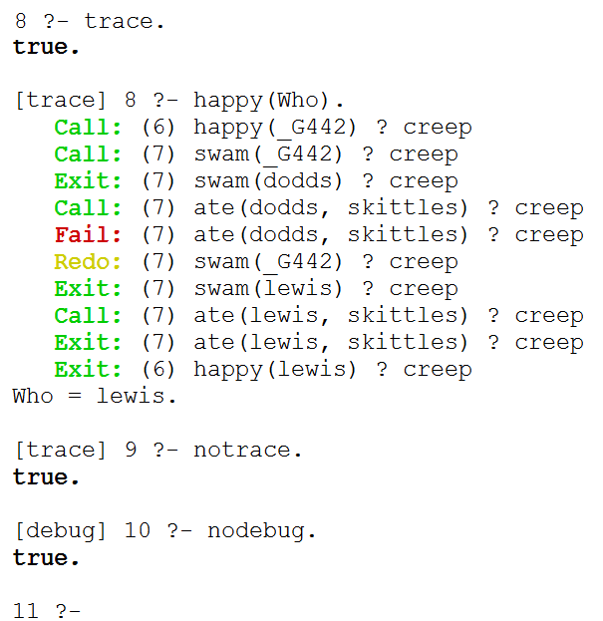
trace with Variables

Slide 31
trace with Variables
notrace.
Stops tracing
nodebug.
Stops debug

Slide 32

Equality
(why not justice?)
Professor
R. L’Heureux Lewis-McCoy

Slide 33
Negation (Summary)
“Unified” means a variable binding is created
X = Y
X = Y succeeds if X can be unified with Y.
X \= Y
X \= Y succeeds if X cannot be unified with Y.
X == Y
X == Y succeeds if X and Y are identical, i.e., they unify with no variable bindings occurring.
X \== Y
X \== Y succeeds if X and Y are not identical.
http://www.amzi.com/manuals/amzi/pro/ref_manipulating_terms.htm#EqualityofTerms

Slide 34
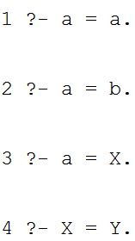
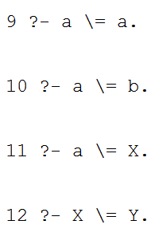
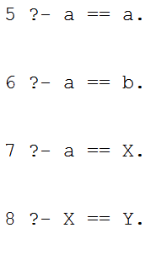
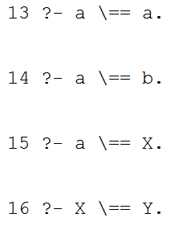
Equality and Negation (DEMO)
= succeeds if they CAN be unified
\=
succeeds if they CANNOT be unified
== succeeds if they are ALREADY the same
\== succeeds if they are NOT ALREADY the same

Slide 35
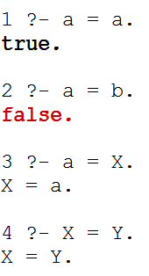
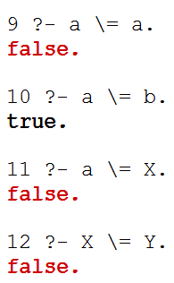
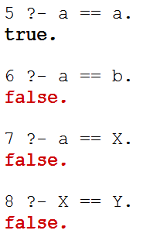
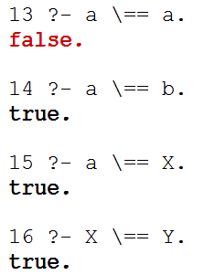
Equality and Negation (SOLUTION)
= succeeds if they CAN be unified
\=
succeeds if they CANNOT be unified
== succeeds if they are ALREADY the same
\== succeeds if they are NOT ALREADY the same

Slide 36
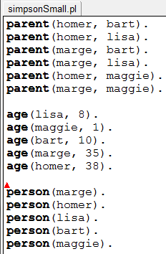
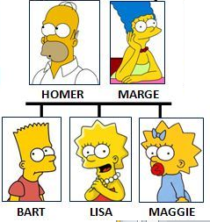
simpsonSmall.pl
parent(homer, bart).
parent(homer, lisa).
parent(marge, bart).
parent(marge, lisa).
parent(homer, maggie).
parent(marge, maggie).
age(lisa, 8).
age(maggie, 1).
age(bart, 10).
age(marge, 35).
age(homer, 38).
person(marge).
person(homer).
person(lisa).
person(bart).
person(maggie).

Slide 37
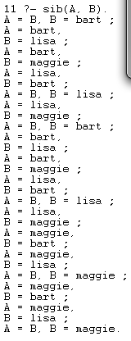
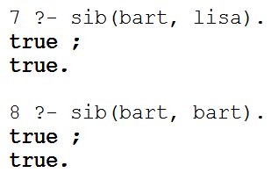
sib Demo
(Big idea: Negation)
This says that bart is his own sibling!

Slide 38
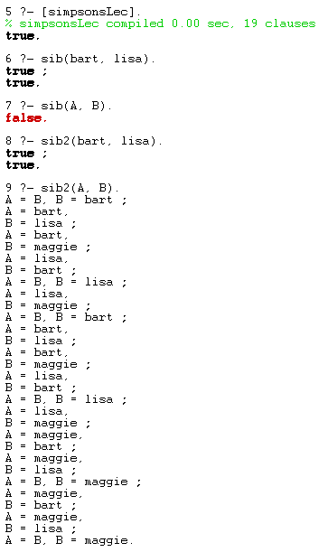

sib Demo
(Big idea: Negation)
If X and Y are unbound, X \= Y returns false
Works for specific cases.

Slide 39
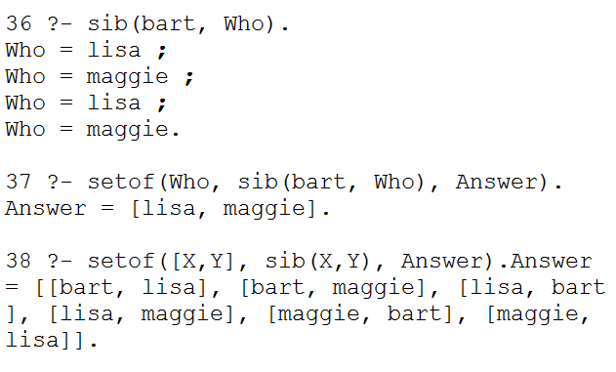
sib Demo (Big idea: Negation)
REMEMBER:
Put negation as late as possible
so that variables
already have known values!
Why are there all of these duplicates?

Slide 40
Meta-predicates
(HOFs in Prolog)

Slide 41
setof(format,query,Var).
setof allows you to see only non-duplicates
[X, Y] gives the format we want our answer in
(as a list)

Slide 42
Write query to return the setof marge’s children
setof is the only time I’ll nest anything in Prolog
I’ll do what I want! Humph!

Slide 43
Write query to return the setof marge’s children
setof is the only time I’ll nest anything in Prolog
I’ll do what I want! Humph!

Slide 44
Test Cases in Prolog

Slide 45
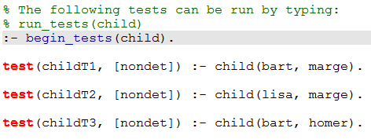
Don’t worry about this!
Focus on the right hand side of the test!!!

Slide 46
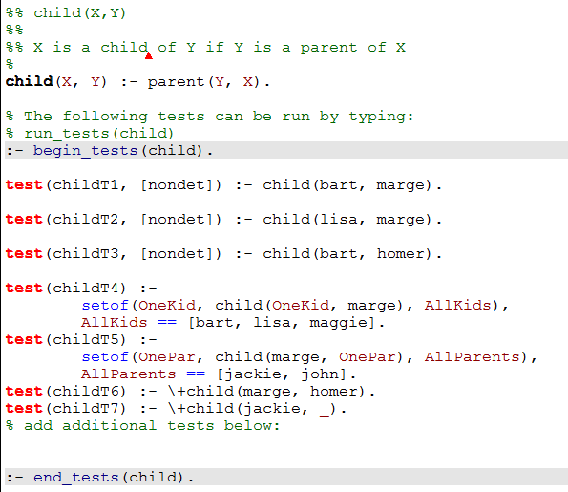
Order Matters

Slide 47
Negation
(and singleton variables)

Slide 48
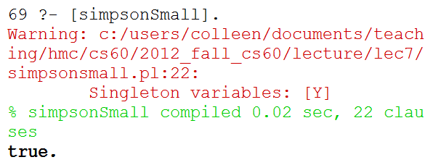
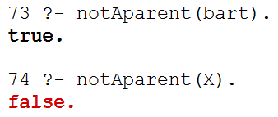
notAparent Demo (Intro: \+ )
\+ means not
Singleton variables: [Y].
_ is a variable that doesn’t need to match anything else.
I don’t care
As is:
Doesn’t work with variables!

Slide 49
How can I give Prolog enough information to make this inference?
Query:
notAparent(Who).
person(homer).
person(bart).
person(lisa).
person(maggie).
parent(homer, bart).
parent(homer, lisa).
parent(marge, bart).
parent(marge, lisa).
parent(homer, maggie).
parent(marge, maggie).
parent(homer, bart).
parent(homer, lisa).
parent(marge, bart).
parent(marge, lisa).
parent(homer, maggie).
parent(marge, maggie).
parent(homer, bart).
parent(homer, lisa).
parent(marge, bart).
parent(marge, lisa).
parent(homer, maggie).
parent(marge, maggie).
parent(homer, bart).
parent(homer, lisa).
parent(marge, bart).
parent(marge, lisa).
parent(homer, maggie).
parent(marge, maggie).
parent(homer, bart).
parent(homer, lisa).
parent(marge, bart).
parent(marge, lisa).
parent(homer, maggie).
parent(marge, maggie).
person(marge).
notAparent(X) :- person(X), \+ parent(X, _)

Slide 50
How can I give Prolog enough information to make this inference?
Query:
notAparent(Who).
person(homer).
person(bart).
person(lisa).
person(maggie).
parent(homer, bart).
parent(homer, lisa).
parent(marge, bart).
parent(marge, lisa).
parent(homer, maggie).
parent(marge, maggie).
parent(homer, bart).
parent(homer, lisa).
parent(marge, bart).
parent(marge, lisa).
parent(homer, maggie).
parent(marge, maggie).
parent(homer, bart).
parent(homer, lisa).
parent(marge, bart).
parent(marge, lisa).
parent(homer, maggie).
parent(marge, maggie).
parent(homer, bart).
parent(homer, lisa).
parent(marge, bart).
parent(marge, lisa).
parent(homer, maggie).
parent(marge, maggie).
parent(homer, bart).
parent(homer, lisa).
parent(marge, bart).
parent(marge, lisa).
parent(homer, maggie).
parent(marge, maggie).
person(marge).
notAparent(X) :- person(X), \+ parent(X, _)

Slide 51
BONUS

Slide 52


Slide 53
Estimating Time
Most people grossly underestimate how long it takes to program (not thinking about time to debug and test)
You appear incompetent at programming (not true) if you can’t estimate how long something will take.
This is one of the hardest things to learn!!! Start to practice now! For each task estimate how long it will take and keep track of how wrong you were

Slide 54


Computer
Science
&
= AWESOME

Slide 55

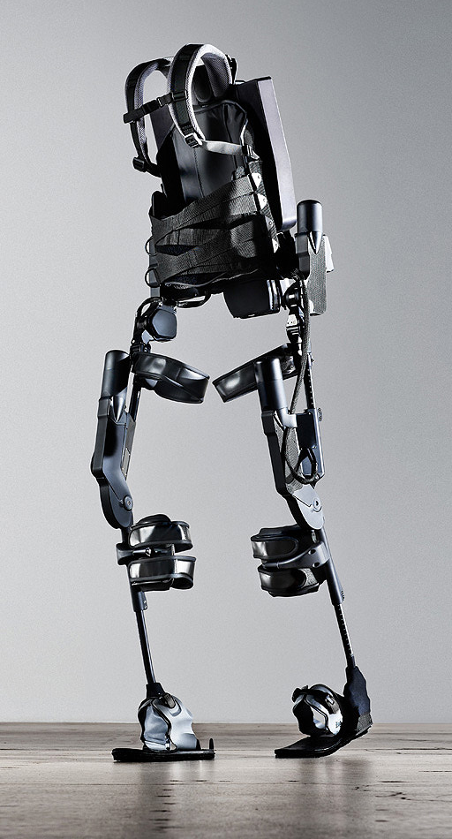
http://www.youtube.com/watch?v=pzRmNYA8LlY

Slide 56


ClickStart

Slide 57
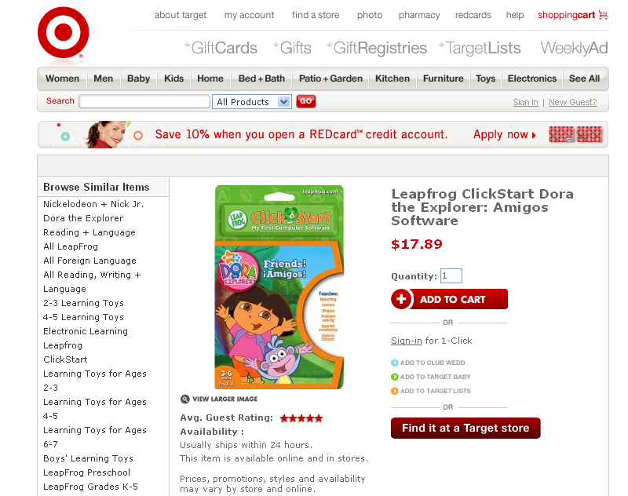

Slide 58
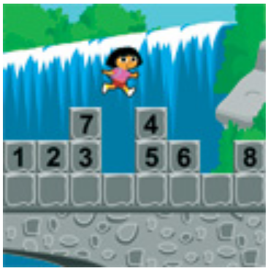
How should we represent the blocks in the computer?
Independent variables
2D Array
OpenList
I don’t know

Slide 59
The value in the array tells me what art asset to use
Each level is really a 3x10 vector!
0 | 0 | 7 | 0 | 4 | 0 | 0 | 0
1 | 2 | 3 | -4 | 5 | 6 | -7 | 8
B | B | B | B | B | B | B | B
Negative values tell me what block needs to go here to win!

Slide 60
0 | 0 | 7 | 0 | 4 | 0 | 0 | 0
1 | 2 | 3 | -4 | 5 | 6 | -7 | 8
0 | 0 | 0 | B | 0 | 0 | 0 | 0

Slide 61
BUGS!

Slide 62
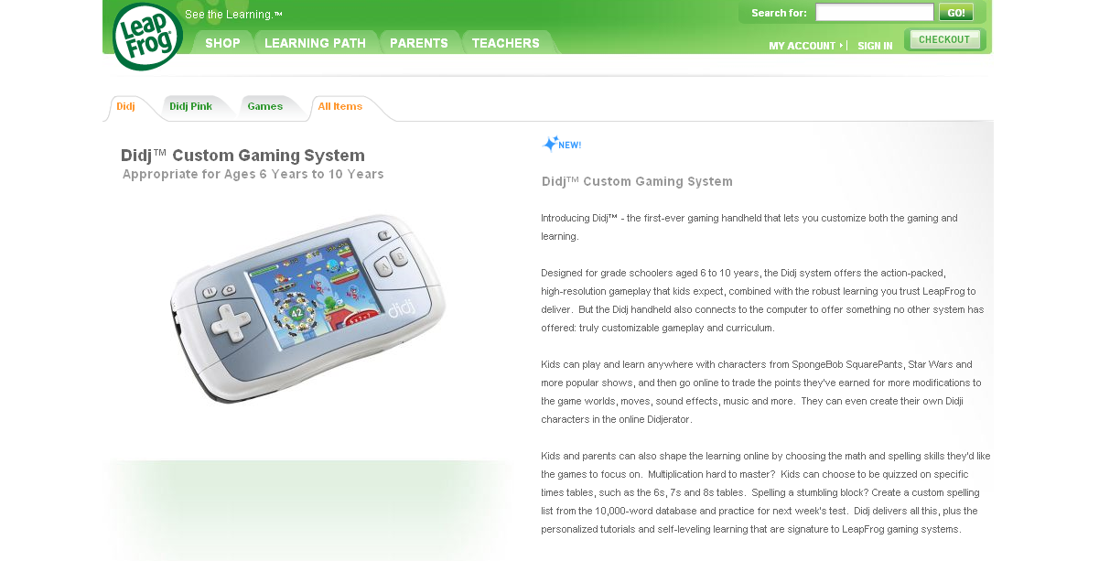

Slide 63
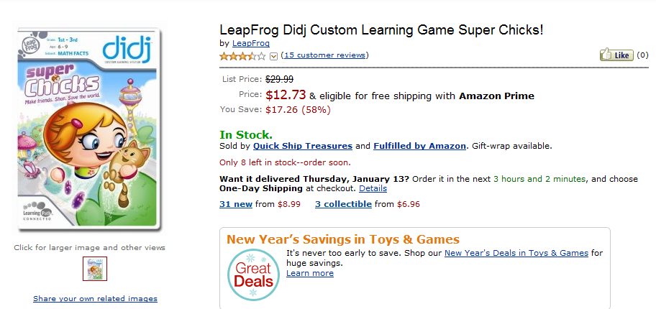
It is really sad when stuff you’ve made is on sale!

Slide 64



Which image is fake?
  A. Top Left
  B. Bottom Left
  C. Bottom Right

Slide 65
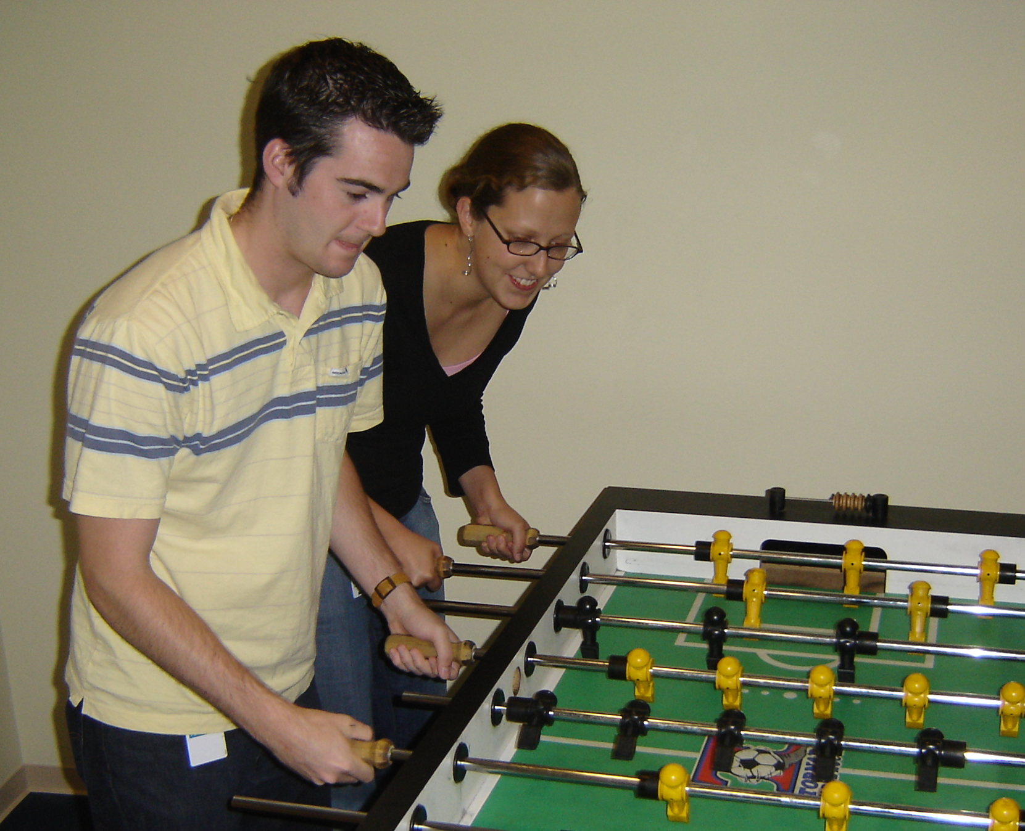

Slide 66
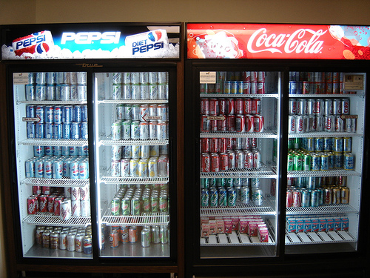

Slide 67
Big-O
2013-01-24
Thursday – Week 0
Lecture 02

Slide 68
What is the runtime of this?
(define (mystery a b)
(cond
((empty? b) (se a b))
((< a (first b)) (se a b))
(else (se (first b)
(mystery a (bf b))))))
A) Constant runtime
B) Linear runtime
C) Linear*Linear (quadratic)
D) Something else
E) No clue
Try to guess what type of thing the variables a & b will be
Try to come up with (small) input that triggers each case
Correct Answer

Slide 69
Bad variable names!
Make your code harder to read!
  Don’t do this!
Even though we do
  We will use bad variable names on exams so that you have to read/understand the code

Slide 70
Better variable names!
(define (insert num sent)
(cond
((empty? sent) (se num sent))
((< num (first sent)) (se num sent))
(else (se (first sent)
(insert num (bf sent))))))
STk>(insert 7 ’())
(7)
STk>(insert 1 ’(2 5 8))
(1 2 5 8)

Slide 71
Insert
STk>(insert 8 ’(2 5 6 9))
(2 5 6 8 9)
(insert 8 ’(2 5 6 9))
(insert 8 ’(5 6 9))
(se 2
(se 5
(insert 8 ’(6 9))
(se 6
(insert 8 ’(9))
(se 8 ’(9))
(se 2 (se 5 (se 6 (se 8 ’(9)))))
Notes:
71

Slide 72
Best vs. Worst Case
(define (insert num sent)
(cond
((empty? sent) (se num sent))
((< num (first sent)) (se num sent))
(else (se (first sent)
(insert num (bf sent))))))
STk>(insert 1 ’(2 3 4 5 6 7 8))
(1 2 3 4 5 6 7 8)
STk>(insert 9 ’(2 3 4 5 6 7 8))
(2 3 4 5 6 7 8 9)
BEST CASE
WORST CASE

Slide 73
Assumptions
We want something independent of the speed of the computer
We typically use N which is some reference to the “size” of the data.
  It might be the variable N (in factorial)
  It might be the size of your sentence
We don’t care about constant factors
  This is pretty silly in some cases but makes the math more beautiful
We typically think about the worst case!
It only matters for BIG input!

Slide 74
What is the runtime of this?
(define (sort sent)
(if (empty? sent)
sent
(insert (first sent)
(sort (bf sent)))))
Constant runtime
Linear runtime
Linear*Linear (quadratic)
Something else
No clue!
Correct Answer

Slide 75
Sort
STk>(sort ’(8 3 9))
(3 8 9)
(sort ’(8 3 9))
(sort ’(3 9))
(insert 8
(insert 3
(sort ’(9))
(insert 9
(sort ’())
’()
(insert 8 (insert 3 (insert 9 ’())))
Notes:
75

Slide 76
(insert 3
(insert 6
(insert 4
(insert 7
(insert 1
(insert 8
(insert 3
(insert 9
’()
))))))))
(sort sent) if sent length is N
1 + 2 + 3 + 4 + … + (N-1)+ N
Add to sent size 7
Add to sent size 6
Add to sent size 5
Add to sent size 4
Add to sent size 3
Add to sent size 2
Add to sent size 1
Add to sent size 0

Slide 77



Some Algebra to calculate:
1+2+…+n
// Written backwards

Slide 78

Some Algebra to calculate:
1+2+…+n

Slide 79


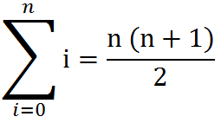
Some Algebra to calculate:
1+2+…+n
OR

Slide 80





// Take the log of both sides
// Remember:

