Slide 1
CS 60
Prolog Lists
When solving problems – the answer might be on that same page – Try to not peek!
2013-09-30
Monday – Week 4
Lecture 08

Slide 2
Do you plan to take CS70?
We’re trying to figure out how many sections we need ☺
Spring 2014 (next semester)
Fall 2014
Maybe sometime

Slide 3
Prolog’s Goal: Create consistent variable bindings (here’s how you can help)

Slide 4
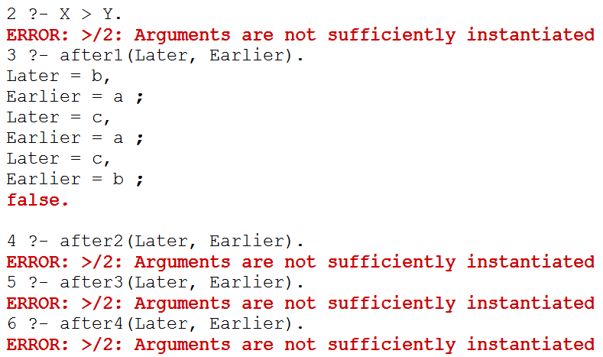
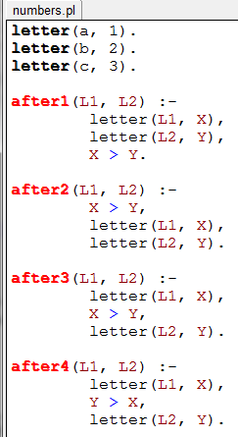
READ all of the examples: Which one of these works (doesn’t produce an error)?
after1
after2
after3
after4
Stuck!
We need to create variable bindings for things BEFORE we compare them!
I wonder what would happen if I typed:
?-
These predicates should be true if letter L1 is
AFTER letter L2 in the alphabet

Slide 5
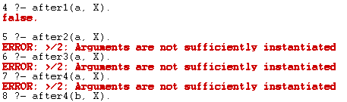
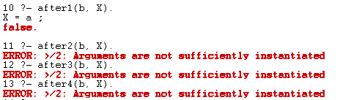
Solution
What’s the point?
Order matters!
Don’t just randomly reorder things! You can think about what order makes sense!

Slide 6
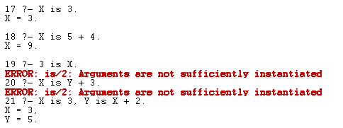
is allows you to do math. Only known values allowed on the right hand side!
My partner and I could figure ours out!
Yep!
Nope!
We have a guess!
Stuck!
I wonder what would happen if I typed:
?-

Slide 7
Recursion in Prolog

Slide 8
Write fac in Prolog
Incorrect solution! How many errors?
A) 1 B) 2 C) 3 D) 4
E) Stuck

Slide 9

Factorial SOLUTION
How would these work?
?- fac(0,N).
What’s the point?
Predicates don’t RETURN anything!
You can’t nest calculations like N-1
?- fac(1,N).
?- fac(2,N).
Try trace.
?- fac(3,N).

Slide 10
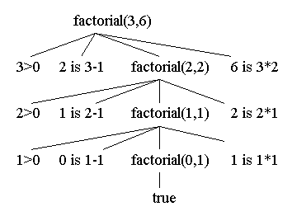
Visualizing Sub-Queries
http://www.csupomona.edu/~jrfisher/www/prolog_tutorial/2_2.html

Slide 11
List Unification

Slide 12
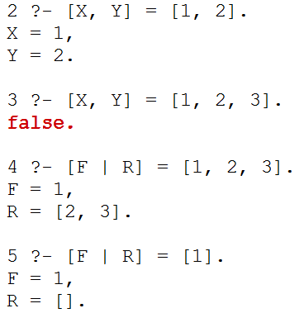
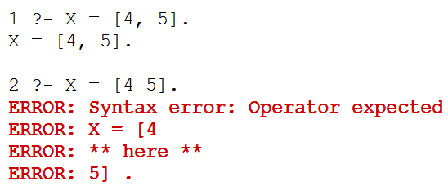
List Unification Demo
For lists to unify (=) they must have the exact same structure!
Each element in a list must be separated by a comma
| works like cons.
[First|Rest].

Slide 13
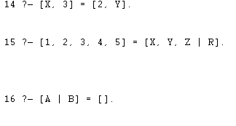
What Variable Bindings
Q: Why didn’t I ask “do any of these return false?”
Ans: because Prolog doesn’t return ANYTHING!!!
Are any of these predicates false?
1st one!
2nd one!
3rd one!
Multiple!
Stuck!
I wonder what would happen if I typed:
?-

Slide 14


List Unification Demo
Rules don’t “return” anything, so we put our “answer” as an argument!
For good style, remove singleton variables!
We can specify the list structure in the head of the rule
You won’t actually use these specific rules, this is just about understanding lists!

Slide 15
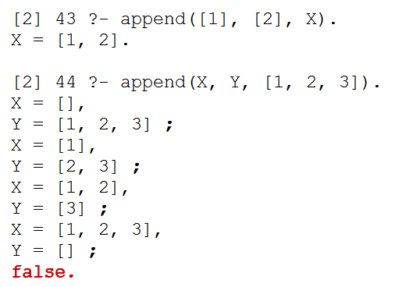
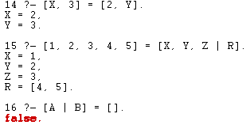
append (is built in)
Solution to previous problem

Slide 16

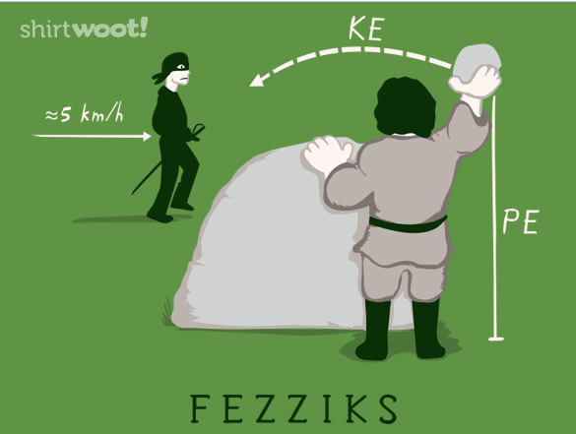

Slide 17

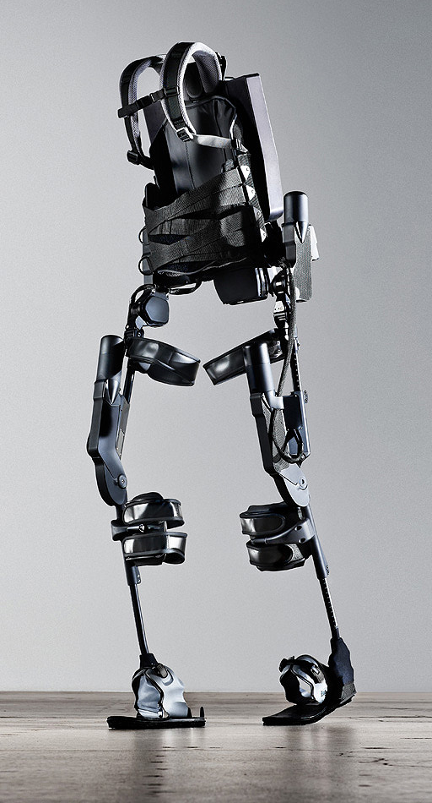
http://www.youtube.com/watch?v=pzRmNYA8LlY

Slide 18
List Examples (length) DEMO

Slide 19
Example: length (base case)
L unifies with []
N unifies with 0
"The length of L is N"
if
and
length(L,N) :- L = [], N = 0.
Even simpler version of this:
Prolog allows pattern-matching within the left-hand side of its rules!
length([],0).

Slide 20
Example: length (rule head)
length([],0).
This matches only the empty list.
This matches any NON-empty list – and names the first F and the rest R!
length([F|R],N) :-
This is read "F cons R" . It only binds to nonempty lists - and you can use F and R!

Slide 21
Example: length (rule body)
"F cons R"
L unifies with [F|R]
F = first of L
"The length of L is N"
R = rest of L
if
L is nonempty!
length(L,N) :- L = [F|R],
and
length(R,M),
and
N is M+1.
Even simpler version of this:
length([F|R],N) :- length(R,M),
N is M+1.
pattern matching is cool!

Slide 22
Length Solution
length([],0).
length([F|R],N) :- length(R,M),
N is M+1.

Slide 23
List Examples (member)

Slide 24
Example: member
Test
Generate
member(3, [1,2,3,4,5]).
true
member(E, [1,2,3,4,5]).
E = 1 ;
E = 2 ;
E = 3 ;
E = 4 ;
E = 5 ;
false
member(6, [1,2,3,4,5]).
false
both variable?

Slide 25
Write member
English: "E is a member of a list whose first element is E."
member( E, ).
English: "E is a member of a list whose first element might not be E, if …"
member( E, ) :-
Have you completed…
A) the base case B) the recursive case C) Stuck!

Slide 26
Member Solution
mem( E, [E|_] ).
mem( E, [_|R] ) :- mem(E, R).

Slide 27
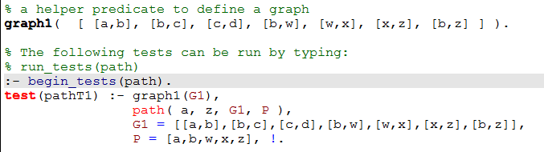
Prolog Test Cases
To test:
You should make SMALL graphs and SMALL trees!!!
We wrote this extra predicate JUST to be able to bind something to this graph!

Slide 28
Zebra Puzzle Hw 4

Slide 29
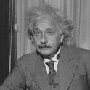
There are five houses:
The nationalities are norwegian, brit, swede, dane, german
The pets are dog, bird, zebra, cat, horse
The cigars are pallmall, winfield, dunhill, rothmans, marlboro
The beverages are tea, coffee, milk, water, beer
The house colors are red, green, yellow, blue, white
We know that
1) The Norwegian lives in the first house.
2) The person living in the center house drinks milk.
3) The Brit lives in a red house.
4) The Swede keeps dogs as pets.
5) The Dane drinks tea.
6) The Green house is next to, and on the left of the White house.
7) The owner of the Green house drinks coffee.
8) The person who smokes Pall Mall rears birds.
9) The owner of the Yellow house smokes Dunhill.
10) The man who smokes Marlboro lives next to the one who keeps cats.
11) The man who keeps horses lives next to the man who smokes Dunhill.
12) The man who smokes Winfields drinks beer.
13) The German smokes Rothmans.
14) The red house is to the right of the blue.
15) The Norwegian doesn't live by the red, white, or green houses
Who owns the zebra?
Einstein's Zebra puzzle: a logic challenge
The full puzzle

Slide 30
Zebra-puzzle representation
A list H reflecting the houses' spatial order
with the five items that each house has…
pet
cigar
beverage
nation
house color
H = [[norwegian, _, _, _, _], _, [_, _, _, milk, _], _, _]
House 1
House 3
House 2
Houses 4+5
Let's try this constraint:
7) The owner of the Green house drinks coffee.
Hint: use member and H

Slide 31
Got bindings?
houses( [H1, H2, H3, H4, H5 ] ) :-
H1 = [ N1, P1, S1, B1, C1 ],
H2 = [ N2, P2, S2, B2, C2 ],
H3 = [ N3, P3, S3, B3, C3 ],
H4 = [ N4, P4, S4, B4, C4 ],
H5 = [ N5, P5, S5, B5, C5 ],
perm( [N1,N2,N3,N4,N5], [norwegian, brit, swede, dane, german] ),
perm( [P1,P2,P3,P4,P5], [dog, bird, zebra, cat, horse] ),
perm( [S1,S2,S3,S4,S5], [pallmall, winfield, dunhill, rothmans, marlboro] ),
perm( [B1,B2,B3,B4,B5], [tea, coffee, milk, water, beer] ),
perm( [C1,C2,C3,C4,C5], [red, green, yellow, blue, white] ).
Question1: What does this houses predicate do?
Question2: How many binding-possibilities will Prolog try?
perm == permutation
predicate order can dramatically speed up/slow down Prolog's search!

Slide 32
Zebra-puzzle output
solve :-
einstein( [ H1, H2, H3, H4, H5 ] ),
write( ' first house: '), write(H1), nl,
write( 'second house: '), write(H2), nl,
write( ' third house: '), write(H3), nl,
write( 'fourth house: '), write(H4), nl,
write( ' fifth house: '), write(H5), nl.
A zero-argument predicate!
and its output:
?- solve.
first house: [norwegian, cat, dunhill, water, yellow]
second house: [dane, horse, marlboro, tea, blue]
third house: [brit, bird, pallmall, milk, red]
fourth house: [german, zebra, rothmans, coffee, green]
fifth house: [swede, dog, winfield, beer, white]
true

Slide 33
The Mystery of the Spamwarts Express
Five "people" are traveling home in adjacent train seats for break…
Seat 1
Seat 2
Seat 3
Seat 4
Seat 5
Names = [algird, bruno, collette, dino, edwina].
Each has a different name.
Schools = [pomona, pitzer, hmc, cmc, scripps].
Each is from a different Claremont College.
Snacks = [jots, chocolate, donuts, pez, spam].
Each has brought a different snack.
1) Dino and Bruno sat in the end seats.
2) Algird sat next to the student from HMC.
3) Collette sat next to friends with chocolate and donuts.
4) The HMC student brought spam as a snack and sat in the middle seat.
5) Chocolate was immediately to the left of pez.
6) Bruno, Dino, and Algird do not go to Scripps.
7) The Pomona student sat between the one with jots and the one with spam.
8) Dino did not sit next to the person with donuts.
9) The CMC student did not sit next to Edwina.
9 hints are available

Slide 34
Trees in Prolog

Slide 35
Finish the code for countnodes
42
tree1( [42,[5,[],[]],[60,[],[]]] ).
5
60
bst
# of nodes
countnodes([], 0).
countnodes([Root,L,R], N) :- countnodes(L,NoL),
countnodes(R,NoR),
N is _____________.
Could we have used = here?
A) Yes
B) No
C) No, but == works
D) We don’t know
E) We’re stuck
Notes:
secret strategy: randomly reorder things until it works!!

Slide 36
Write treemin
42
tree1( [42,[5,[],[]],[60,[],[]]] ).
5
60
How do we test treemin?
treemin(tree1, X).
treemin(Tree1,X).
tree1(T), treemin(T, X).
We’re stuck
Argument 1: BST
Argument 2: Min value
Notes:
secret strategy: randomly reorder things until it works!!

Slide 37

treemin Solution

Slide 38
Graphs in Prolog

Slide 39
Write kid
a
graph1( [[a,b],[b,c],[a,c]] ).
b
c
graph as a list of edges
# of edges
numedges([], 0).
numedges(G, N) :- length( G, N ).
Predicate is true if there is an edge from P to K.
kid(P,K,Graph) :-
parent
child (kid)
graph as list of edges
Notes:
secret strategy: randomly reorder things until it works!!

Slide 40

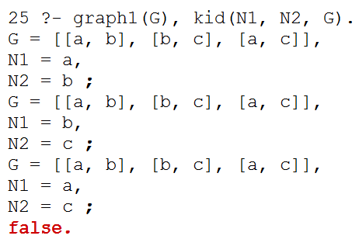
kid Solution
We don’t need a base case checking if Graph is the empty list because [] can’t unify with this!
Notice how we used the graph1 predicate!

Slide 41
Debugging & Combo of ,(and) and |(cons bar)

Slide 42

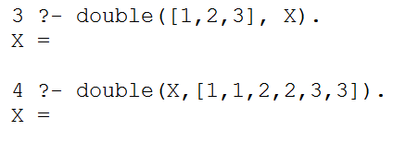
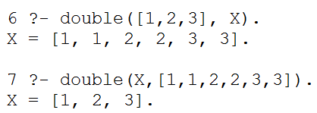
Debugging & Combo of , and |
Combo of , and |
[X, Y | R]
X = first
Y = second
R = rest
Behavior we get:
How many elements are in X for double([1,2,3], X).?
A) 3 B) 4 C) 6 D) ∞ E)?
Behavior we want

Slide 43
Double Solution

Slide 44
Extra Credit

Slide 45

24 (Problem #2)
4
7
4
7
Can you combine these numbers into 24 with the operations + - * ÷ ?
2
1
Each operation may be used any number of times.
2
1
A two-dot card from the "official" 24 game: 24game.com

Slide 46
24 (Problem #2)
4
7
4
7
Can you combine these numbers into 24 with the operations + - * ÷ ?
2
1
Each operation may be used any number of times.
2
1
solve( [‘+’,‘-’,‘*’,‘/’], [1,2,4,7], 24, Tree ).
operators available: (use any number of times)
values:
(use each exactly once)
arithmetic tree
final answer
Tree = [*, [+, 1, [-,7,2]], 4]

Slide 47
eval
Provided tree-evaluation code :
Note the base case!
eval(R, R) :- number(R).
eval(['+', A, B], R) :- eval(A, AR), eval(B, BR), R is AR + BR.
eval(['*', A, B], R) :- eval(A, AR), eval(B, BR), R is AR * BR.
eval(['-', A, B], R) :- eval(A, AR), eval(B, BR), R is AR - BR.
eval(['/', A, B], R) :- eval(A, AR), eval(B, BR), BR\==0, R is AR // BR.
the tree
also checks nonvar(A) and nonvar(B)
resulting value
Really?
This eval can both test and generate resulting values, R.

Slide 48
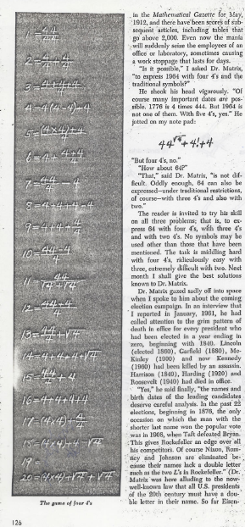
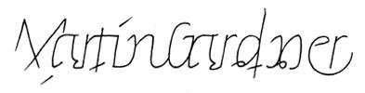
For four 4’s ...
0 = 4 + 4 - 4 - 4
1 = 44 / 44
2 = 4
...
8 = sqrt( .4 ) * ( 4 + 4 + 4 )
...
19 = ???
20 = 4! + 4 - 4 - 4
4/(4+4)
Ask around…

Slide 49
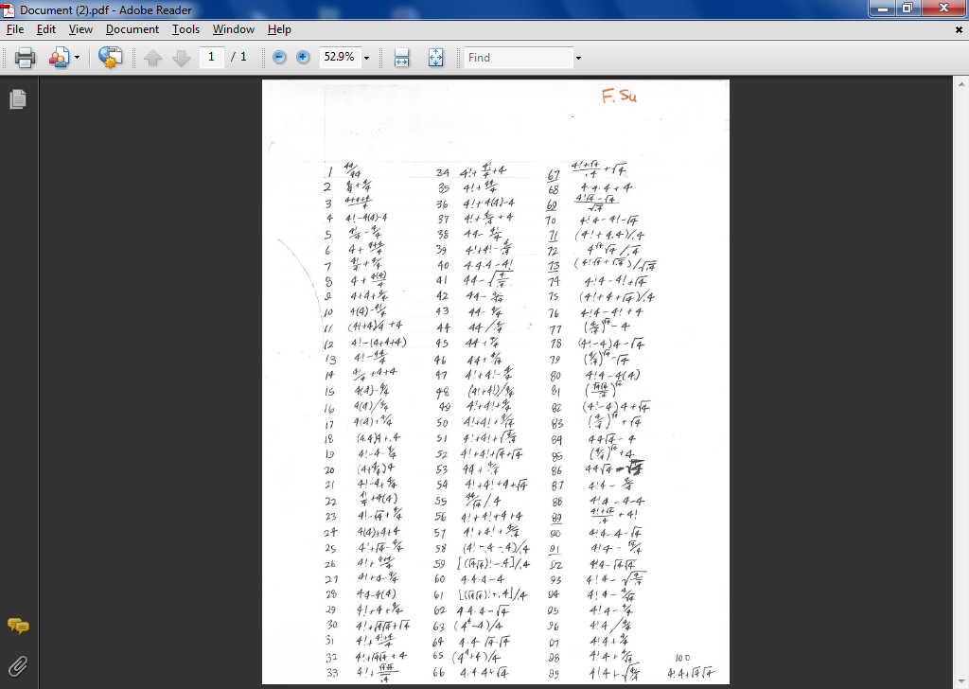

Slide 51
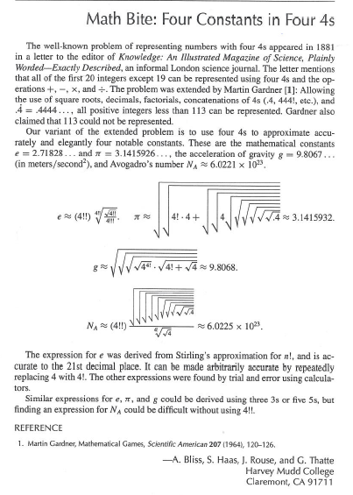
Using Prolog initially written in CS 60!

Slide 52
true or false ?
Name: ________________
For each line, determine if Prolog will find it true or false. What bindings will Prolog create?
[F|R] = [42]. <--
[F|R] = []. <--
[Root,L,R] = [42,[],[]] <--
[Root,L,R] = [42,[]] <--
X = 5+2. <--
X \= Y. <--
X=3, Y=2, X \= Y. <--
Binding
=
tries to assign any two structures to one another…
Structure
1+2 == 1+2. <--
1+2 == 2+1. <--
[1,X] == [1,X]. <--
[1,2] == [1,X]. <--
X \== Y. <--
X=3, Y=3, X \== Y. <--
==
compares any two structures to one another…
Math
X is 5+2. <--
X is Y+3. <--
Y = 6, X is Y*7. <--
1+2 is 2+1. <--
X = 3, Y < X <--
is
computes the right-hand side and binds to the left-hand side

Slide 53
Not all equals are created equal!
For each line, determine if Prolog will find it true or false. What bindings will Prolog create?
Binding
[F|R] = [42]. <-- true, binds F to 42 and R to []
[F|R] = []. <-- false, [] does not have a first!
[Root,L,R] = [42,[],[]] <-- true, binds Root=42, L=R=[]
[Root,L,R] = [42,[]] <-- false, different # of elems.
X = 5+2. <-- true, but X is 5+2, not 7
X \= Y. <-- false, X CAN unify with Y.
X=3, Y=2, X \= Y. <-- true, they can not be unified
=
tries to assign any two structures to one another…
Structure
1+2 == 1+2. <-- true, the same structure
1+2 == 2+1. <-- false, NOT the same structure!
[1,X] == [1,X]. <-- true
[1,2] == [1,X]. <-- false, no bindings are made
X \== Y. <-- true, they have different names!
X=3, Y=3, X \== Y. <-- false, it uses the values!
==
compares any two structures to one another…
Math
X is 5+2. <-- true, now X is 7
X is Y+3. <-- error: Y is unbound
Y = 6, X is Y*7. <-- true, X is bound to 42
1+2 is 2+1. <-- false: only evals the RHS
X = 3, Y < X <-- error: Y is unbound
is
computes the right-hand side and binds to the left-hand side

Slide 54
Homework Reference
age
age
female
male
99
97
92
93
olf
helga
ug
uggette
101
78
76
65
62
59
skugerina
skug
homericus
matilda
john
jackie
54
55
41
38
35
38
38
27
44
gemini
esmerelda
gomer
homer
marge
selma
patty
glum
cher
20
18
19
10
1
8
8
8
klotho
lachesis
atropos
bart
maggie
lisa
millhouse
terpsichore

Slide 55

Solutions

Slide 56
Bonus
2013-02-05
Tuesday – Week 2
Lecture 05

Slide 57
Not so fast… ?
Worst balanced case!?
Best-case?
Worst-case?
42
20
100
find
12
21
211
35
insert
25
39
delete
Notes:
I don’t know if this really works...

Slide 58
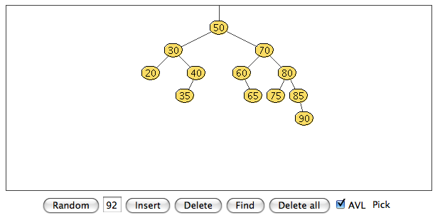
Trees are fast
find
For any constant left/right split-ratio of the data, all operations on trees are O(logN).
insert
delete
The solution: self-balancing trees.
AVL tree
Adelson-Velskii and Landis, An algorithm for the organization of information, 1960
http://www.csi.uottawa.ca/~stan/csi2514/applets/avl/BT.html
And if the data conspire against you to create an O(N) path...
... self-balance!
Notes:
I don’t know if this really works...

Slide 59
Big-O BONUS
2013-01-31
Thursday – Week 1
Lecture 04

Slide 60
Big - O
summarizes the asymptotic “Order” of the work done
ignore constant coefficients
ignore all but the biggest term
N - 1
O(N)
is
2N² + 5N
O(N²)
is
52N² + 4N³
O( )
is
the key to comparing programs and problems!

Slide 61
BONUS

Slide 62


Slide 63
Estimating Time
Most people grossly underestimate how long it takes to program (not thinking about time to debug and test)
You appear incompetent at programming (not true) if you can’t estimate how long something will take.
This is one of the hardest things to learn!!! Start to practice now! For each task estimate how long it will take and keep track of how wrong you were

Slide 64


Computer
Science
&
= AWESOME

Slide 65
http://www.youtube.com/watch?v=pzRmNYA8LlY

Slide 66


ClickStart

Slide 67
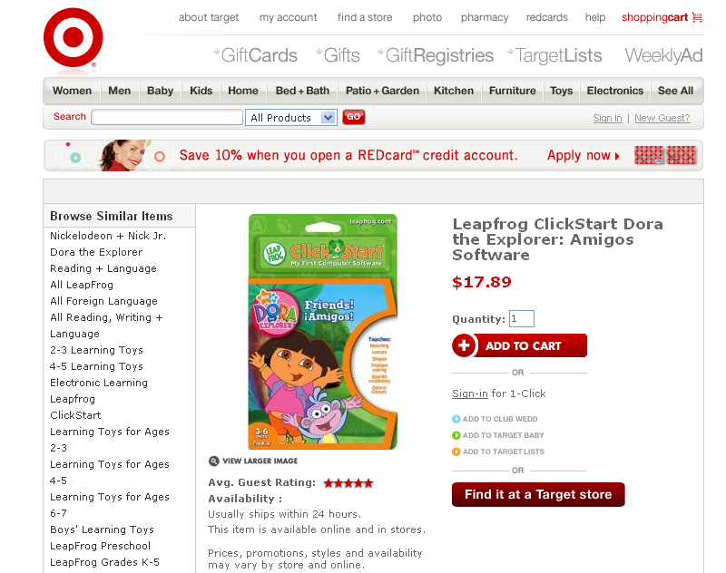

Slide 68
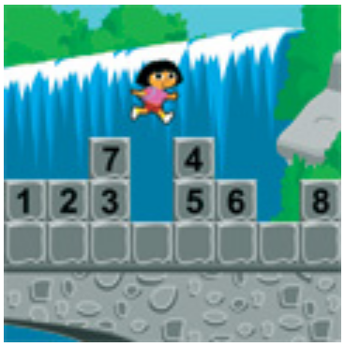
How should we represent the blocks in the computer?
Independent variables
2D Array
OpenList
I don’t know

Slide 69
The value in the array tells me what art asset to use
Each level is really a 3x10 vector!
0 | 0 | 7 | 0 | 4 | 0 | 0 | 0
1 | 2 | 3 | -4 | 5 | 6 | -7 | 8
B | B | B | B | B | B | B | B
Negative values tell me what block needs to go here to win!

Slide 70
0 | 0 | 7 | 0 | 4 | 0 | 0 | 0
1 | 2 | 3 | -4 | 5 | 6 | -7 | 8
0 | 0 | 0 | B | 0 | 0 | 0 | 0

Slide 71
BUGS!

Slide 72
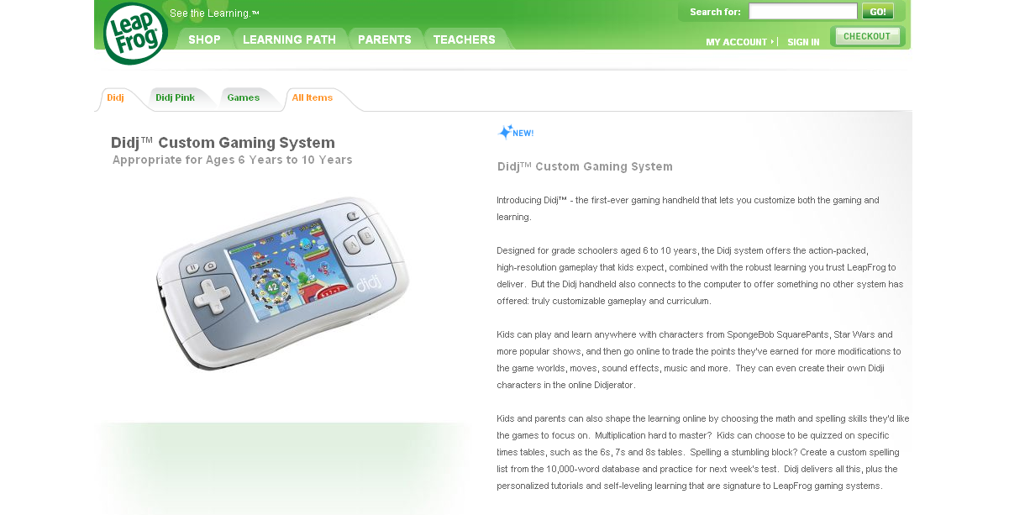

Slide 73
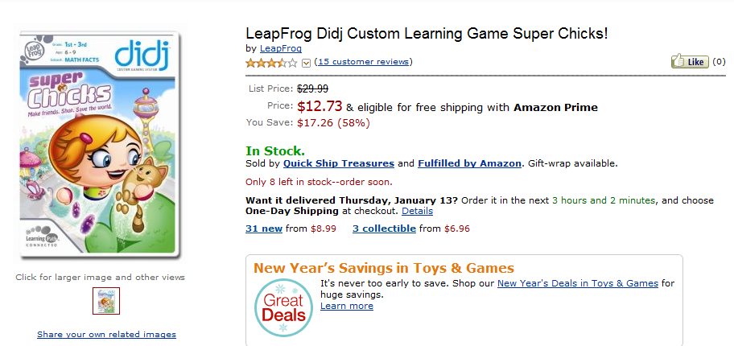
It is really sad when stuff you’ve made is on sale!

Slide 74



Which image is fake?
A. Top Left
B. Bottom Left
C. Bottom Right

Slide 75
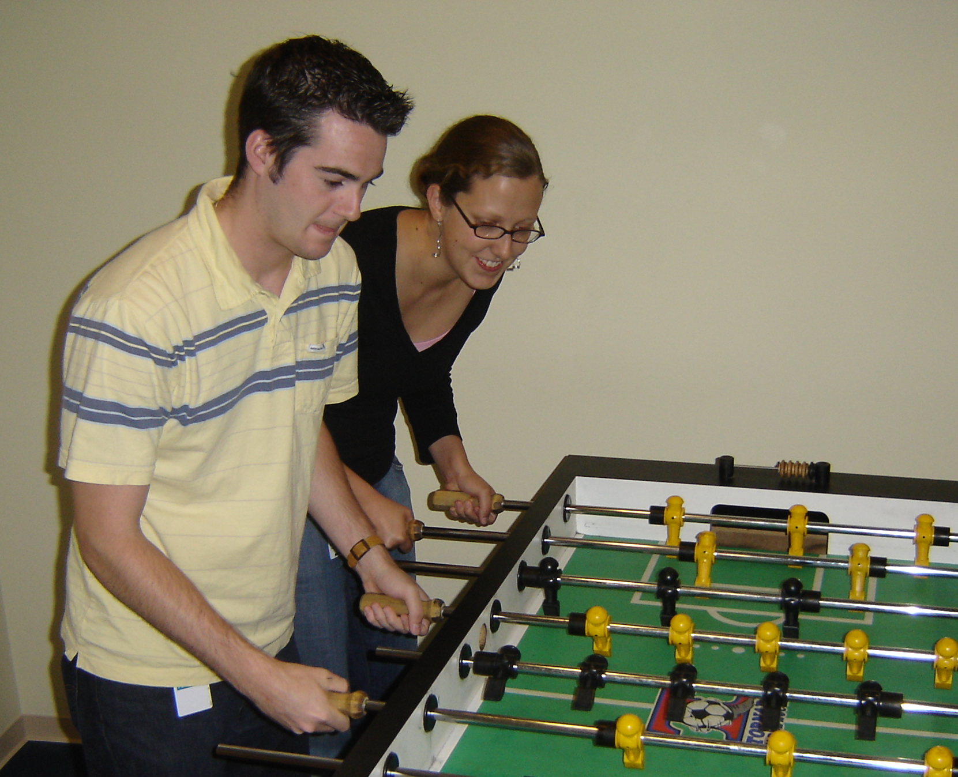

Slide 76
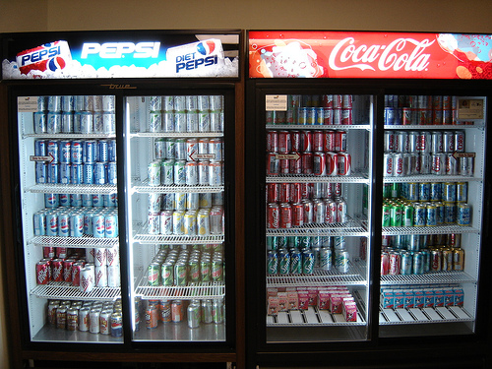

Slide 77
Sort
STk>(sort ’(8 3 9))
(3 8 9)
(sort ’(8 3 9))
(sort ’(3 9))
(insert 8
(insert 3
(sort ’(9))
(insert 9
(sort ’())
’()
(insert 8 (insert 3 (insert 9 ’())))
Notes:
77

Slide 78
(insert 3
(insert 6
(insert 4
(insert 7
(insert 1
(insert 8
(insert 3
(insert 9
’()
))))))))
(sort sent) if sent length is N
1 + 2 + 3 + 4 + … + (N-1)+ N
Add to sent size 7
Add to sent size 6
Add to sent size 5
Add to sent size 4
Add to sent size 3
Add to sent size 2
Add to sent size 1
Add to sent size 0

Slide 79



Some Algebra to calculate: 1+2+…+n
// Written backwards

Slide 80

Some Algebra to calculate: 1+2+…+n

Slide 81


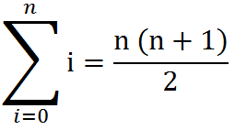
Some Algebra to calculate: 1+2+…+n
OR

Slide 82





// Take the log of both sides
// Remember:

