Slide 1
CS 60
Java Intro – Review
Java static
Big-O
2013-10-14
Monday – Week 6
Lecture 11

Slide 2
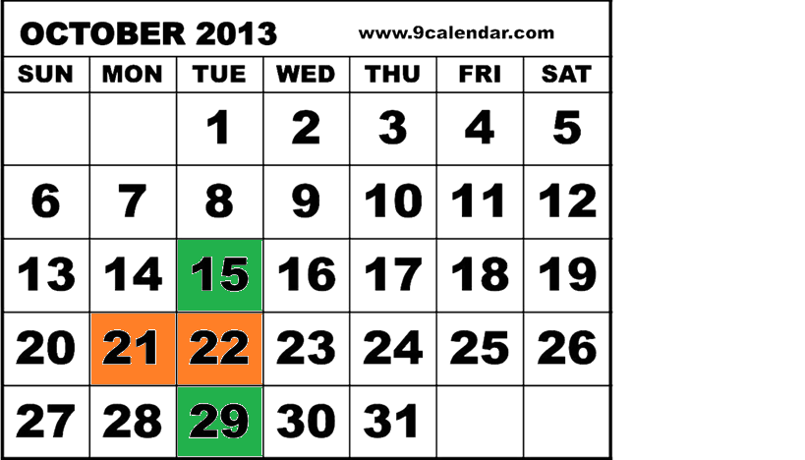
When should the next hw be due?
23rd B) 24th C) 18th D) 27th E)?
Hw 5 Oct 15th Hw 7 Oct 29th Fall Break Oct 21-22nd

Slide 3
Administrative Stuff (Not in your notes)
Quiz regrades:
Please staple an explanation to the front of your quiz
Give the quiz to Colleen (or slip under her door)
Colleen prefers to sit and think about regrades to avoid rash decisions
Office Hours 2-5 Tuesdays in the LAC

Slide 4
static
Never say: “Static” Always: “Static Method” “Static Variable”

Slide 5




C++
I think people will want to model REAL OBJECTS in their code.
We should let them do that!
Motivation for
static methods
OMG! I just want to call some simple functions like square-root or abs and I don’t want to have a stinkin’ Object!!!!
Static Methods
to the Rescue!!!
I think people will want to model REAL OBJECTS in their code.
EVERYTHING SHOULD BE AN OBJECT!!!!

Slide 6
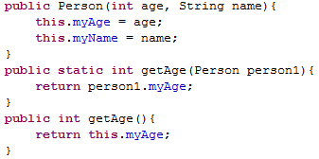
Constructor
Static Method
Have access to this!
All objects must be arguments or created in the method
Non-Static
Method

Slide 7
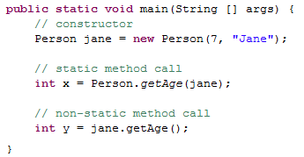

Slide 9
Motivation for
static variables
OMG! I don’t always want independent Objects (each with their own instance variables). Sometimes I want Objects of the same type to share some information!!!!
Static Variables
to the Rescue!!!

Slide 10
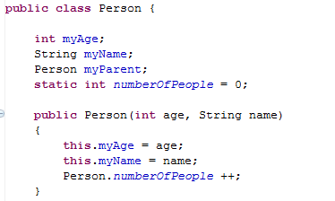
static variables (shared)
Global state shared by all instances of the class
Looks like an instance variable declaration + static
Access them as ClassName.fieldName

Slide 11
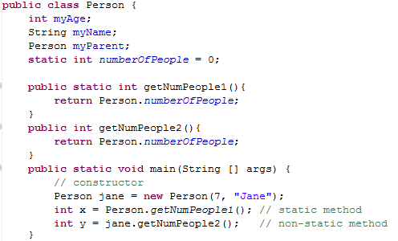
Write a sample call to each method:
Got the static one done
Got the non-static one done
Got both done
Stuck

Slide 13
Summations

Slide 14

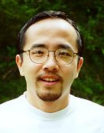
http://www.math.hmc.edu/funfacts/
REALLY COMMON SERIES (you should recognize these after today)
1 + 2 + 3 + … + (N-2) + (N-1) + N = N(N+1)/2 ∈ O(N²)
1 + 2 + 4 + … + N/4 + N/2 + N = 2N -1 ∈ O(N)
1 + 2 + 4 + … + 2^{N-2} + 2^{N-1} + 2^{N} = 2^{N+1} -1 ∈ O(2^{N})

Slide 15




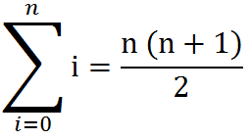
Some Algebra to calculate:
1 + 2 + 3 + … + (N-2) + (N-1) + N = N(N+1)/2 ∈ O(N²)
// Written backwards
OR

Slide 16
N + N/2 + N/4 + … + 4 + 2 + 1 = 2N -1 ∈ O(N)
N
2N
N | N/2
N | N/2 | N/4
N | N/2 | N/4 | N/8
N | N/2 | N/4 | N/8
N/16
The sum is less than 2N

Slide 17
2^{N} + 2^{N-1} + 2^{N-2} + … + 4 + 2 + 1 = 2^{N+1} -1 ∈ O(2^{N})
2^{N}
2 * 2^{N} = 2^{N+1}
2^{N} | 2^{N-1}
2^{N} | 2^{N-1} | 2^{N-2}
2^{N} | 2^{N-1} | 2^{N-2} | 2^{N-3}
2^{N} | 2^{N-1} | 2^{N-2} | 2^{N-3}
2^{N-4}
The sum is less than 2^{N+1}

Slide 18
http://www.math.hmc.edu/funfacts/
REALLY COMMON SERIES (you should recognize these after today)
1 + 2 + 3 + … + (N-2) + (N-1) + N = _________
1 + 2 + 4 + … + N/4 + N/2 + N = _________
1 + 2 + 4 + … + 2^{N-2} + 2^{N-1} + 2^{N} = _________

Slide 19
Big-O Formal Definition

Slide 20
Big-O Overview
We want to express the speed of an algorithm independently of a specific implementation on a specific machine.
We examine the cost of the algorithms for large input sets i.e. the asymptotic cost.
In later classes you’ll do this in more detail

Slide 21
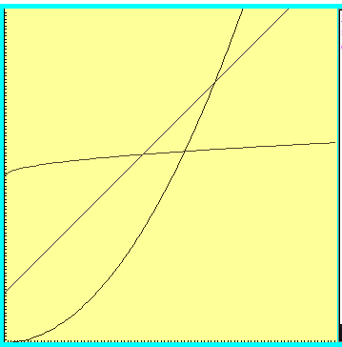



Which one is fastest?

Slide 22
“Woah! One of these is WAY better after this point. Let’s call that point N”

Slide 23



Which is fastest after some big value N?

Slide 24



Which is fastest after some value N?
WAIT – who cares? These are all proportional!
Sometimes we do care, but for simplicity we ignore constants

Slide 25
Formal definition
if and only if
for all n > N

Slide 26

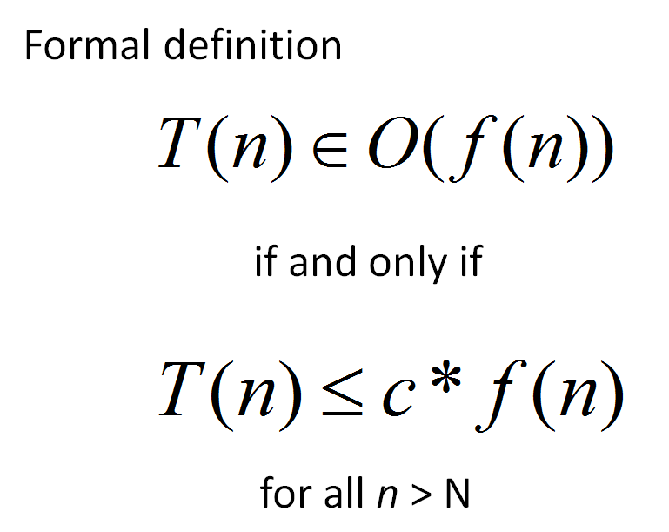
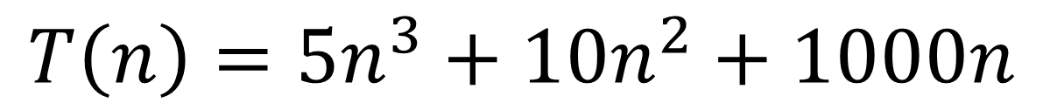
Applying the Formal Definition
$$T\left(n\right)=5n^{3}+10n^{2}+1000n$$
There is only one possible value for c and N
True
False
??
What values of c and N
make this true?

Slide 27

Big-O definition
(using different notation)
T(n) ∈ O(f(n)) means
(∃c) (∃N) (∀n > N) T(n) < c*f(n)
+ threshold N
there exists a constant c
for all input sizes bigger than that threshold, N
To claim that
42n² + 100n ∈ O(n²)
We need to find c and N such that for all n > N,
c =
N =
42n² + 100n < cn²
Notes:
n > 1001 = k, c = 1001
n > 1 = k, c = 42

Slide 28
Apply the formal definition
42n+999 ∈ O(n) ?
2
3
50n ∈ O(n ) ?
0.001*n! ∈ O(n ) ?
True or False?
True or False?
True or False?
c =
N =
c =
N =
c =
N =
Are these the “best” bounds?
Use simplest form with O notation

Slide 29
Runtimes (why we only care about the largest term)

Slide 30

How Fast Are Computers?
1 Hz = 1 operation /sec
2.9GHz = 2.9 x 10⁹ op / sec

Slide 31
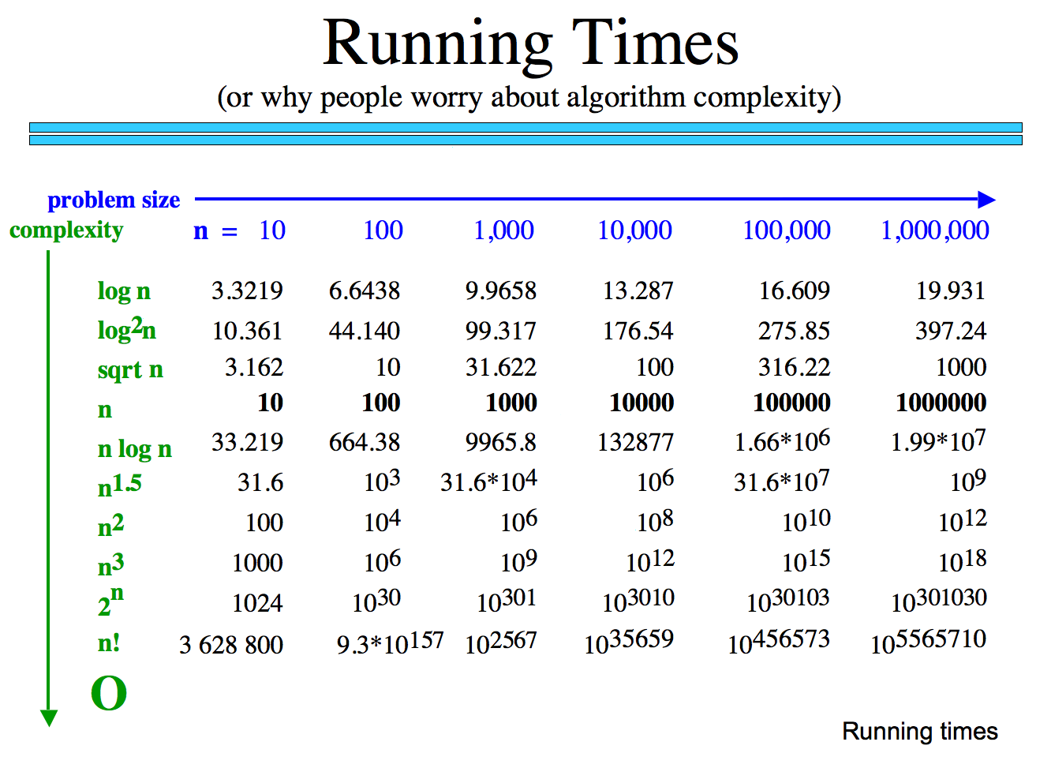
How many operations are required?
How long would these take if you have a 10 GHz Processor?

Slide 32
Why we only care about the largest term
How many operations are required?
Polynomial
Exp.
How big is n!
How long would these take if you have a 10 GHz Processor?

Slide 33
Classes of Problems
Big-O Order
n
n
n!
Intractable Problems (Exponential)
n
2
3
n
2
n
Tractable Problems (Polynomial)
n log(n)
Instead of using measured time – reason about the complexity of the problem
n
√n
log(n)
No Problem!
1

Slide 34
Big-O

Slide 35
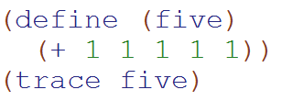
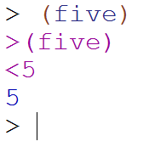
Big-O: Constant Time O(1)
O(1)
The runtime does not depend upon the magnitude of the input

Slide 36
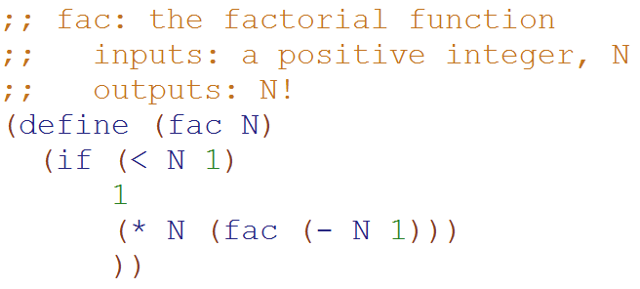
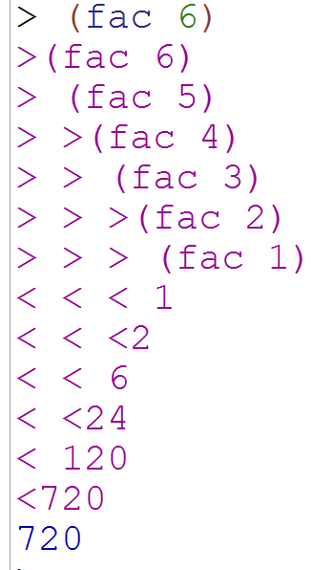
Big-O: Linear Time O(N)
O(N)
The runtime is proportional to the magnitude of the input

Slide 37
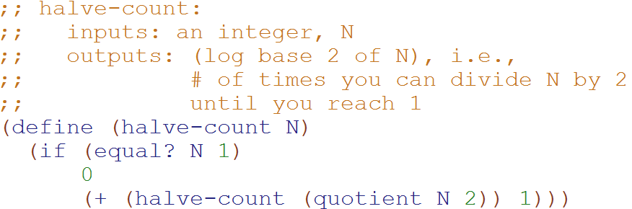
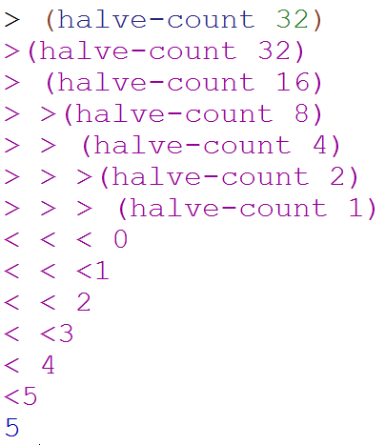
Big-O: Logarithmic Time O(log₂N)
O(log₂N)
The magnitude of the input is cut in half with each recursive call
Why does cutting the magnitude of the input in half each time produce O(log₂N) runtime?

Slide 38
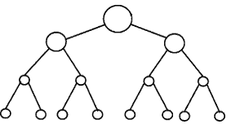
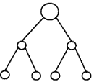


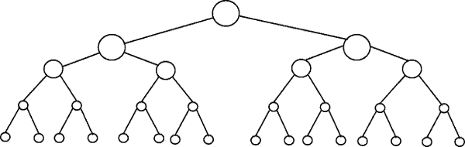
Perfectly Balanced Trees
h = 0
n = 1
h = 1
n = 3
h = 2
n = 7
h = 3
n = 15

Slide 39



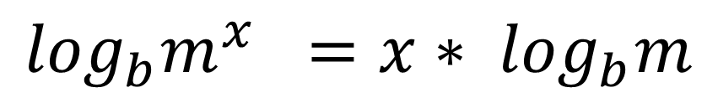
// Take the log of both sides
// Remember:
Ignore the minus 1
$$\log_{b}m^{x} ={x∗ log}_{b}m$$

Slide 40
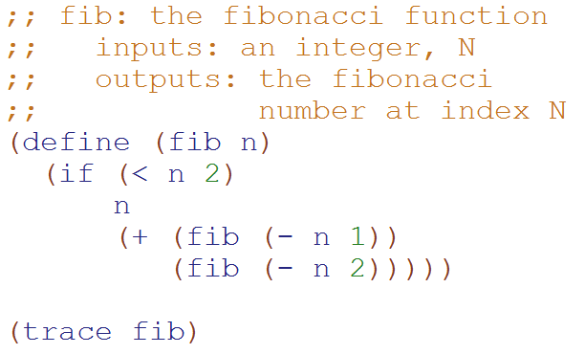
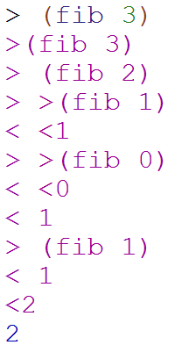
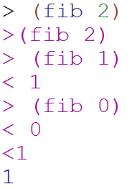
Big-O: Exponential Time O(2^{N})
O(2^{N})
You make two slightly smaller recursive calls each time

Slide 41
Loop Counting (calculate runtime by counting each step)

Slide 42
Example 1: Count the total # of constant-time operations?
for ( int i=0 ; i < N ; i++){
// constant-time operation
}
i=0
i=1
i=2
…
i=N-1
i=N
# ops per row
1
1
1
…
1
1
O(N)
Total
of N
Technically 3 operations!

Slide 43
Example 2: Count the total # of constant-time operations?
for ( int i=1 ; i < N ; i=i*2){
// constant-time operation
}
i=1
i=2
i=4
…
i=N/2
i=N
# ops per row
1
1
1
…
1
1
O(log₂(N))
Total
of log₂(N)

Slide 44
Example 3: Count the total # of constant-time operations?
for ( int i=N ; i > 0 ; i=i/2){
// constant-time operation
}
i=N
i=N/2
…
i=4
i=2
i=1
# ops per row
1
1
1
…
1
1
O(log₂(N))
Total
of log₂(N)

Slide 45
Example 4: Count the total # of constant-time operations?
for ( int i=0 ; i < N ; i++){
for ( int z=0 ; z < N ; z++){
// constant-time operation
}
}
i=0
i=1
i=2
…
i=N-1
i=N
# ops per row
N
N
N
…
N
N
O(N²)
Total
of N²

Slide 46
Example 5: Count the total # of constant-time operations?
for ( int i=0 ; i < N ; i++){
for ( int z=0 ; z < M ; z++){
// constant-time operation
}
}
i=0
i=1
i=2
…
i=N-1
i=N
# ops per row
M
M
M
…
M
M
O(N*M)
Total of N*M

Slide 47
Example 6: Count the total # of constant-time operations?
for ( int i=0 ; i < N ; i++){
for ( int z=0 ; z < i ; z++){
// constant-time operation
}
}
i=0
i=1
i=2
…
i=N-1
i=N
# ops per row
0
1
2
…
N-1
N
O(N²)
Total of N(N+1)/2

Slide 48
BONUS

Slide 49
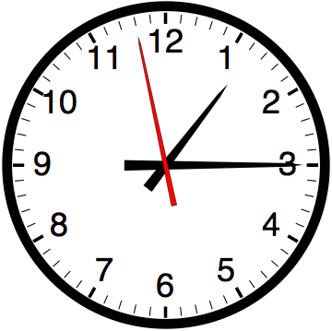

Slide 50


Computer
Science
&
= AWESOME

Slide 51

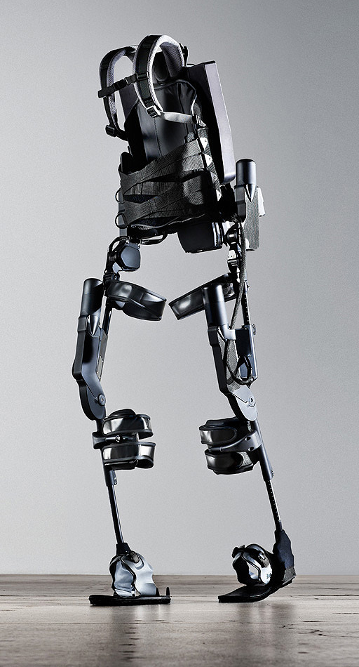
http://www.youtube.com/watch?v=pzRmNYA8LlY

Slide 52


ClickStart

Slide 53


Slide 54
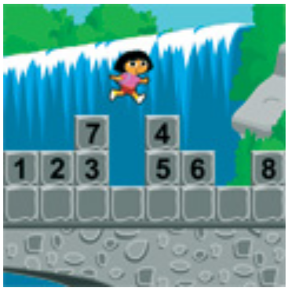
How should we represent the blocks in the computer?
Independent variables
2D Array
OpenList
I don’t know

Slide 55
The value in the array tells me what art asset to use
Each level is really a 3x10 vector!
0 | 0 | 7 | 0 | 4 | 0 | 0 | 0
1 | 2 | 3 | -4 | 5 | 6 | -7 | 8
B | B | B | B | B | B | B | B
Negative values tell me what block needs to go here to win!

Slide 56
0 | 0 | 7 | 0 | 4 | 0 | 0 | 0
1 | 2 | 3 | -4 | 5 | 6 | -7 | 8
0 | 0 | 0 | B | 0 | 0 | 0 | 0

Slide 57
BUGS!

Slide 58


Slide 59

It is really sad when stuff you’ve made is on sale!

Slide 60

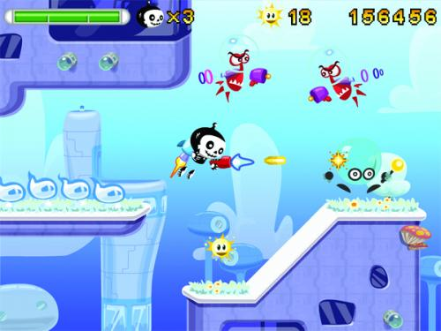

Which image is fake?
A. Top Left
B. Bottom Left
C. Bottom Right

Slide 61
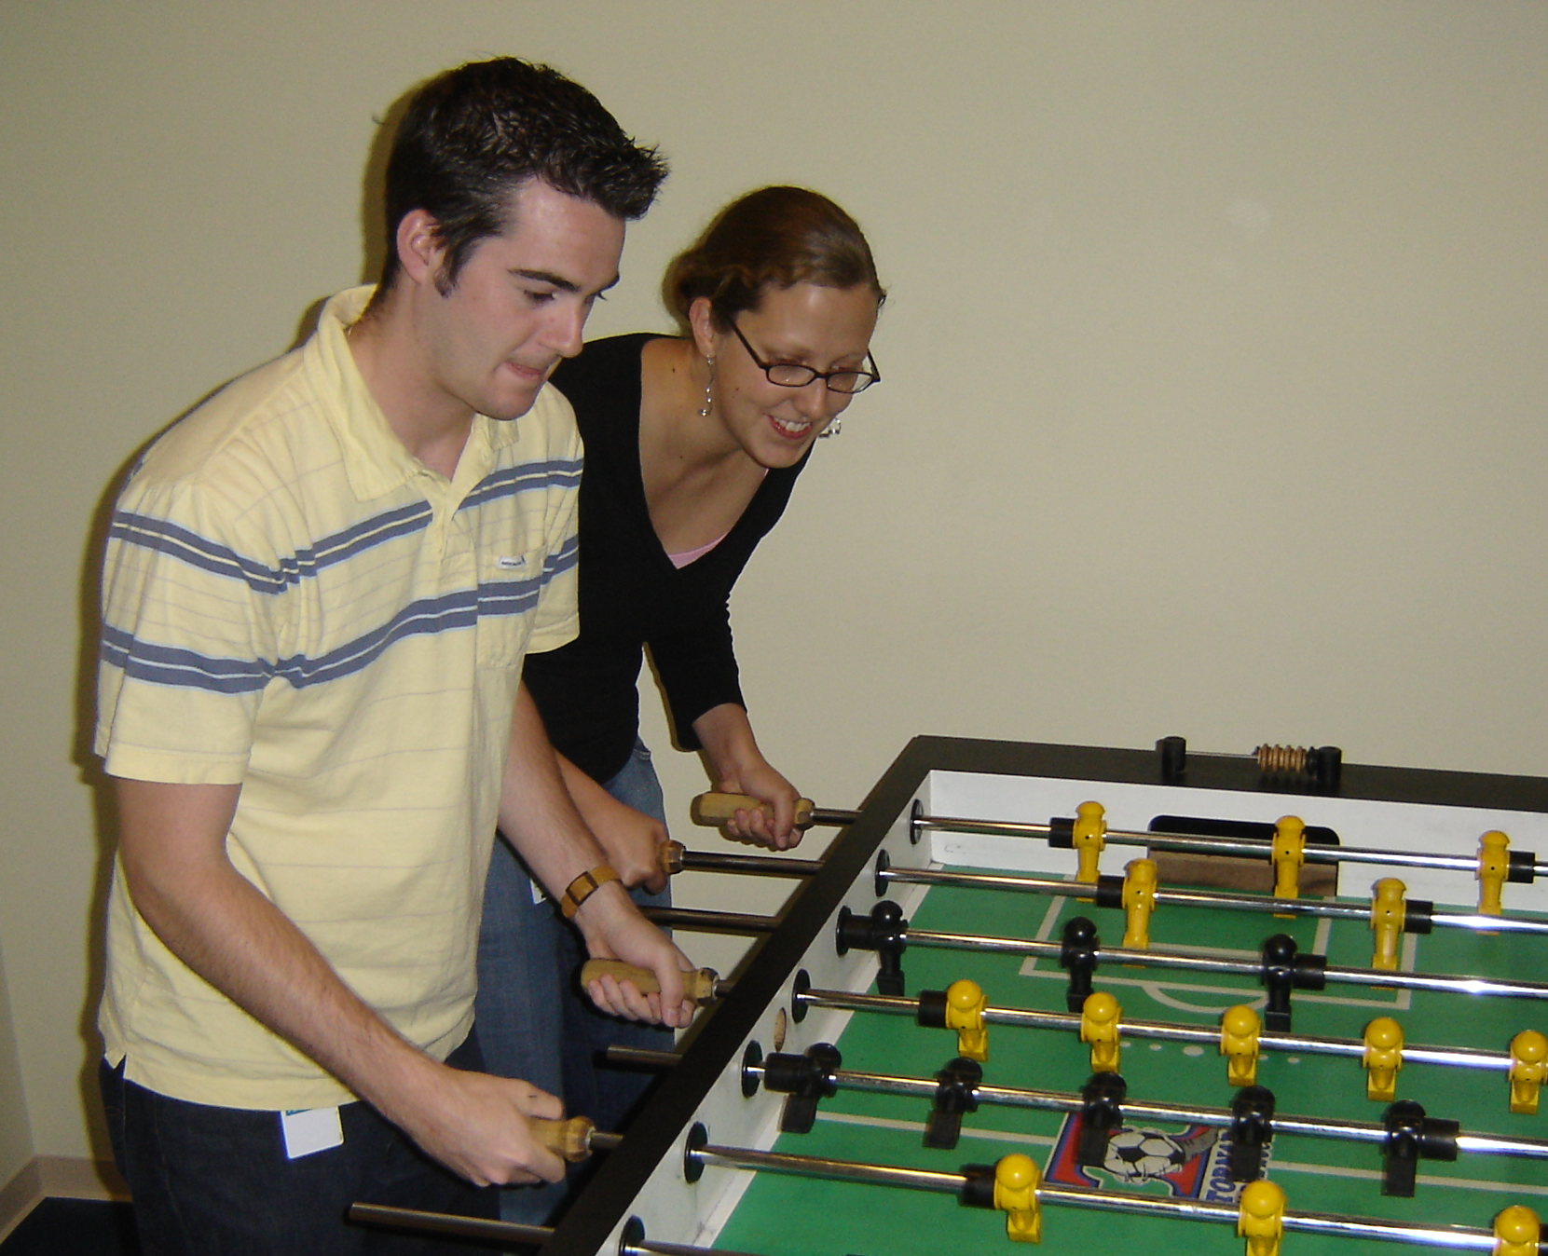

Slide 62
