Slide 1
CS 60
HW 6 Due Thursday 10/24 at 5:30pm
Hw 6, Big-O,
Merge Sort
2013-10-16
Wednesday – Week 6
Lecture 12

Slide 2
Survey
What do you think of Piazza?
I don’t need it
Getting a response is too slow
Responses aren’t as helpful
B & C
It rocks!

Slide 3
Eclipse/Java Tips!
Use ctrl + space to autofill
Type sysout and then ctrl + space to get System.out.println()
Click on the results from JUnit tests
Breakpoints
Automatically format a selection with Ctrl+Shift+F

Slide 4

Fill in the instance variables and constructor for Line 3
Set the values of the array elements to the numbers shown
Line3
coords
50
-8
32
12
Your constructor should be these values in the Line!!!!

Slide 5

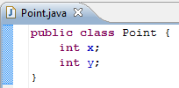
Fill in the instance variables and constructor for Line 4
Set the values of x and y as shown
Line4
points
Point
x
y
Point
x
y
50
32
-8
12

Slide 6
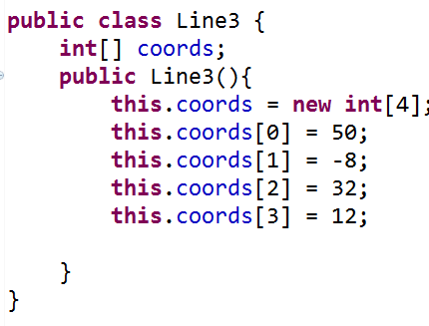
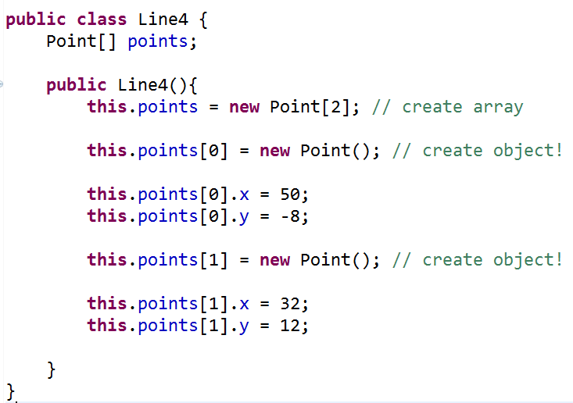

Slide 7
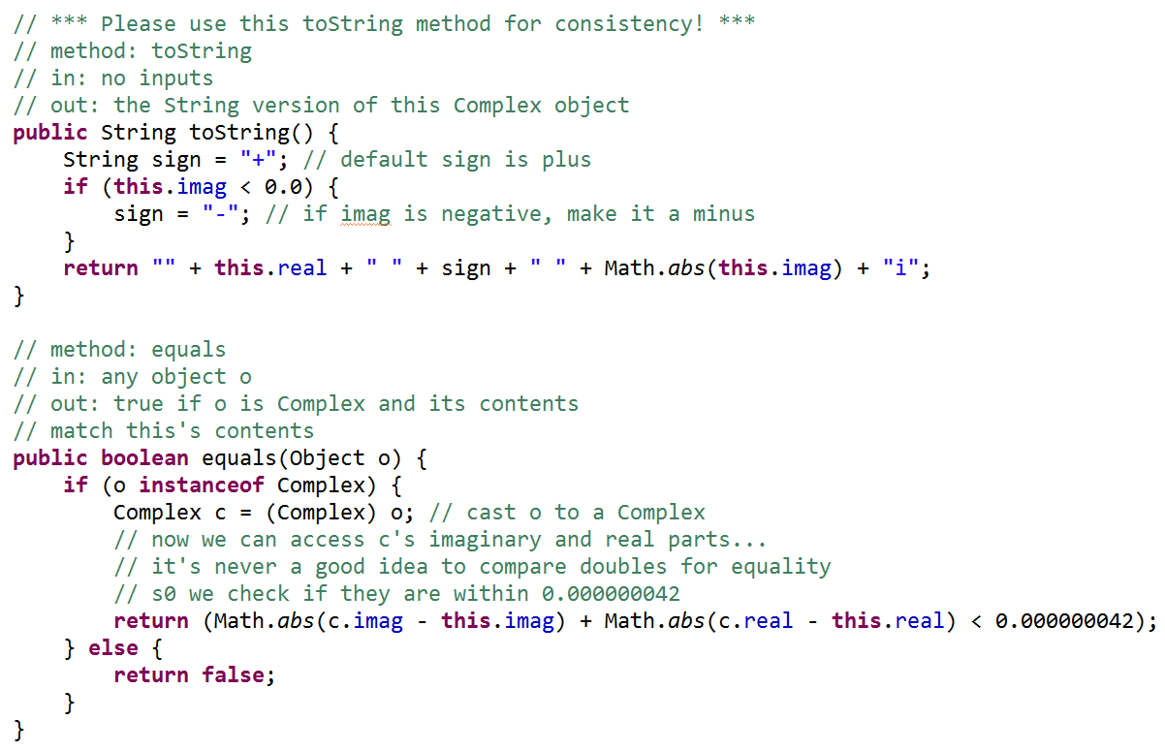
toString() is the method that gets called by System.out.println()
instanceof
Un-Java like syntax!!!
Checks the type of an object!

Slide 8
Big-O

Slide 9
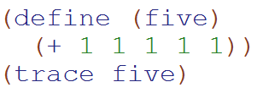
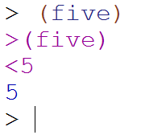
Big-O: Constant Time
O(1)
O(1)
The runtime does not depend upon the magnitude of the input

Slide 10
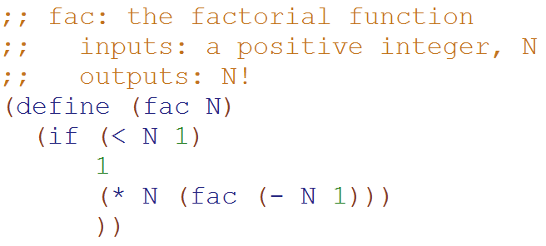
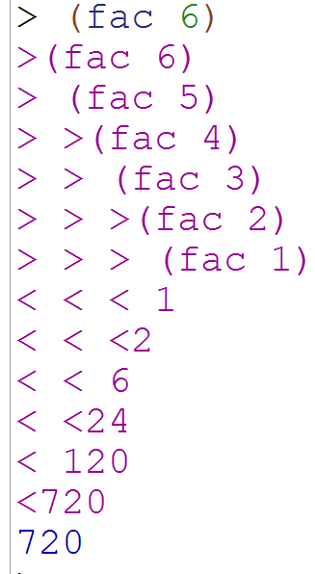
Big-O: Linear Time
O(N)
O(N)
The runtime is proportional to the magnitude of the input

Slide 11
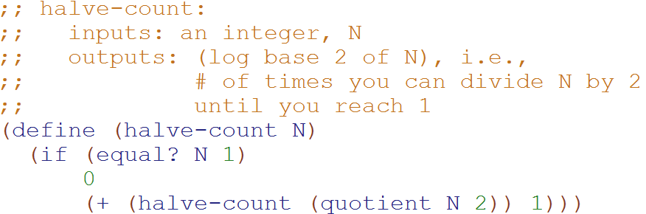
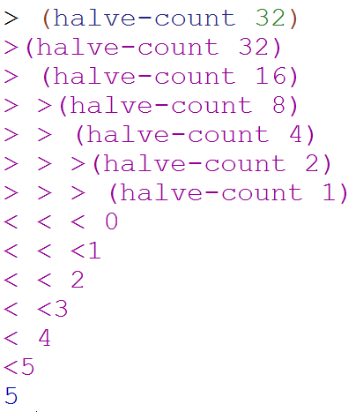
Big-O: Logarithmic Time
O(log₂N)
O(log₂N)
The magnitude of the input is cut in half with each recursive call
Why does cutting the magnitude of the input in half each time produce O(log₂N) runtime?

Slide 12
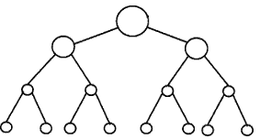
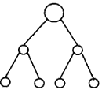


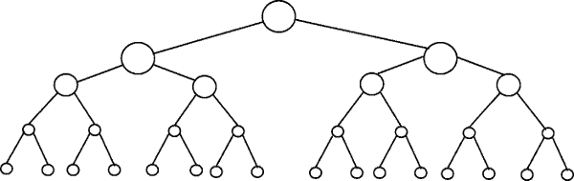
Perfectly Balanced Trees
h = 0
n = 1
h = 1
n = 3
h = 2
n = 7
h = 3
n = 15

Slide 13



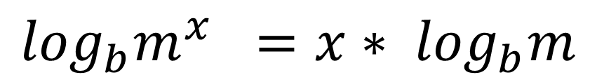
// Take the log of both sides
// Remember:
Ignore the minus 1
$$\log_{b}m^{x} ={x∗ log}_{b}m$$

Slide 14
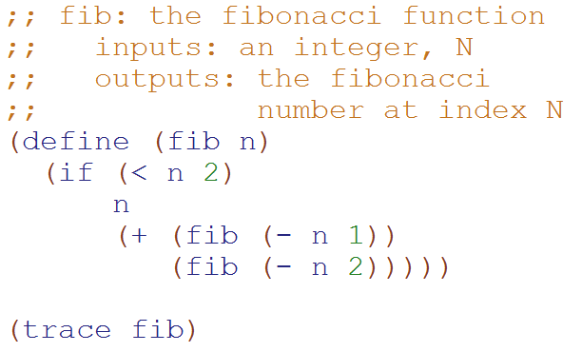
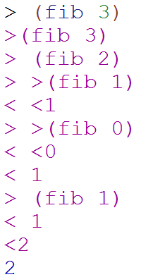
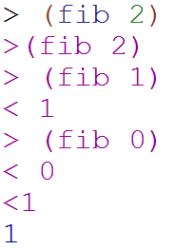
Big-O: Exponential Time
O(2^{N})
O(2^{N})
You make two slightly smaller recursive calls each time

Slide 15
Loop Counting
(calculate runtime by counting each step)

Slide 16
Example 1: Count the total # of constant-time operations?
for ( int i=0 ; i < N ; i++){
// constant-time operation
}
i=0
i=1
i=2
…
i=N-1
i=N
# ops per row
1
1
1
…
1
1
O(N)
Total
of N
Technically 3 operations!

Slide 17
Example 2: Count the total # of constant-time operations?
for ( int i=1 ; i < N ; i=i*2){
// constant-time operation
}
i=1
i=2
i=4
…
i=N/2
i=N
# ops per row
1
1
1
…
1
1
O(log₂(N))
Total
of log₂(N)

Slide 18
Example 3: Count the total # of constant-time operations?
for ( int i=N ; i > 0 ; i=i/2){
// constant-time operation
}
i=N
i=N/2
…
i=4
i=2
i=1
# ops per row
1
1
1
…
1
1
O(log₂(N))
Total
of log₂(N)

Slide 19
Example 4: Count the total # of constant-time operations?
for ( int i=0 ; i < N ; i++){
for ( int z=0 ; z < N ; z++){
// constant-time operation
}
}
i=0
i=1
i=2
…
i=N-1
i=N
# ops per row
N
N
N
…
N
N
O(N²)
Total
of N²

Slide 20
Example 5: Count the total # of constant-time operations?
for ( int i=0 ; i < N ; i++){
for ( int z=0 ; z < M ; z++){
// constant-time operation
}
}
i=0
i=1
i=2
…
i=N-1
i=N
# ops per row
M
M
M
…
M
M
O(N*M)
Total of N*M

Slide 21
Example 6: Count the total # of constant-time operations?
for ( int i=0 ; i < N ; i++){
for ( int z=0 ; z < i ; z++){
// constant-time operation
}
}
i=0
i=1
i=2
…
i=N-1
i=N
# ops per row
0
1
2
…
N-1
N
O(N²)
Total of N(N+1)/2

Slide 22

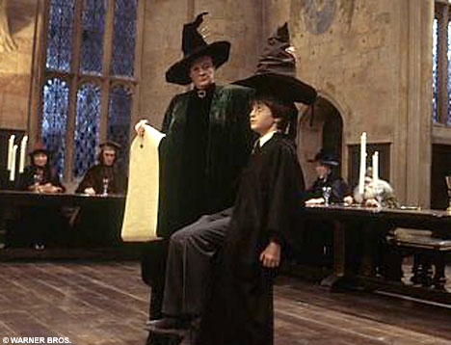
Merge Sort

Slide 23
Merge Demo
A | B | C | F | I | M | N | O
D | E | G | H | J | K | L | P
A | B | C | D | E | F | G | H | I | J | K | L | M | N | O | P

Slide 24
Mergesorting with any lists?!
Start with a list…
[ 7, 1, 9, 6, 5, 42, 3 ]
Split it into two halves (within 1) …
[ 7, 1, 9, 6 ]
[ 5, 42, 3 ]
Recurse !?!
[ 1, 6, 7, 9 ]
[ 3, 5, 42 ]
Merge.
[ 1, 3, 5, 6, 7, 9, 42 ]

Slide 25
Step 1: Recursively divide the problem in half

Slide 26
Step 2: Merge the two halves back together
A | B | C | D | E | F | G | H | I | J | K | L | M | N | O | P
A | B | C | I | J | K | D | L | M | N | E | F | G | H | O | P

Slide 27
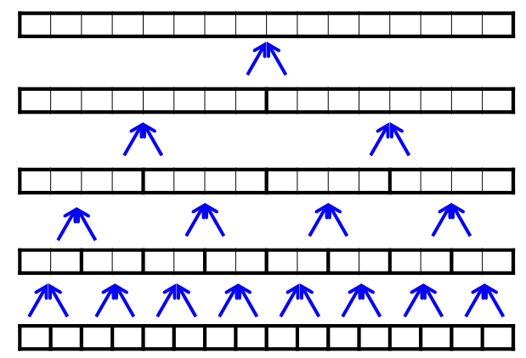
What is the runtime of MergeSort?
O(N)
O(N log N)
O(N²)
O(2^{N})
Stuck
Hints:
How many rows are there?
How much processing does each row require?

Slide 28
List and ListNode Classes
These are in one file!

Slide 29
List
myHead
mySize
ListNode
myFirst
myRest
spam
args
main
“a”
3
This is different than Racket b/c a List is different than an element of the List
(a ListNode)
If the name of this List is spam
How do you access the “a”?
Got it!
Not sure
Stuck
ListNode
myFirst
myRest
“b”
ListNode
myFirst
myRest
“c”

Slide 30
List
myHead
mySize
It is an empty List ☺
spam
args
main
0
Why do we have both List Objects and ListNode Objects?!?
spam
args
It is a null reference ☹
main
It isn’t empty. This points to a ListNode with null in it!
Because we needed a way to represent empty lists!
ListNode
myFirst
myRest
spam
args
main

Slide 31
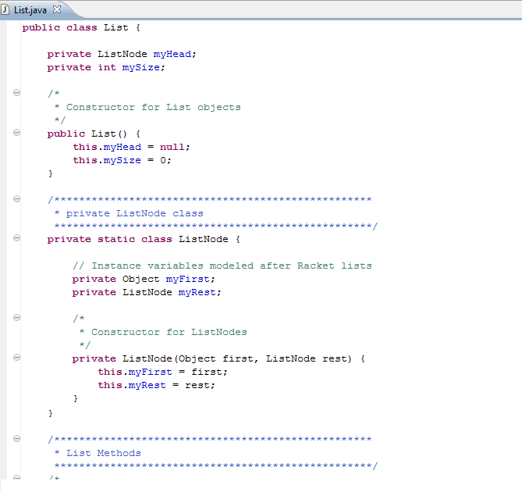
List
myHead
mySize
Private Inner Class:
Outside of the class people don’t know abut it
3
ListNode
myFirst
myRest
“L”

Slide 32
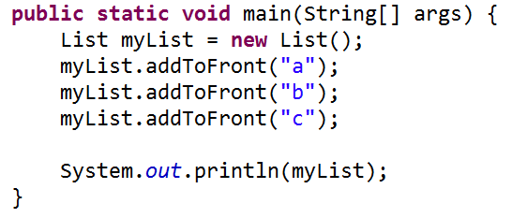
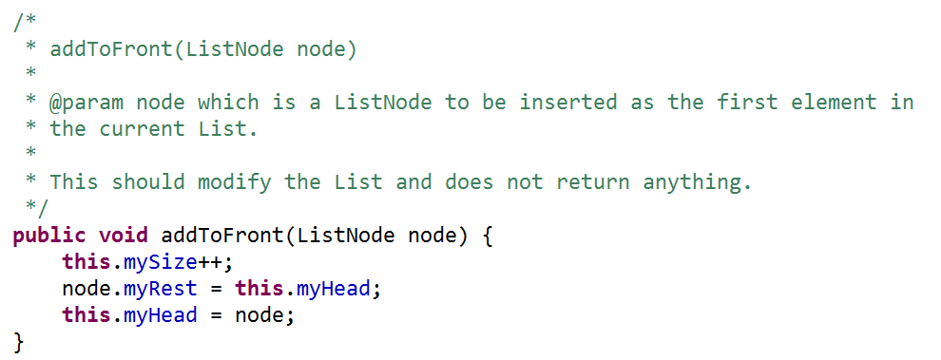
Draw what memory looks like after….
First call to addToFront
Second call to addToFront

Slide 34
List
myHead
mySize
ListNode
myFirst
myRest
myList
args
main
“c”
3
ListNode
myFirst
myRest
“b”
Solution!
ListNode
myFirst
myRest
“a”

Slide 35
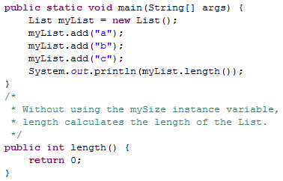
Write length

Slide 36
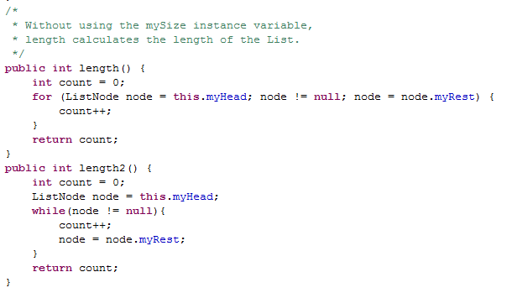
Length Solutions

Slide 37
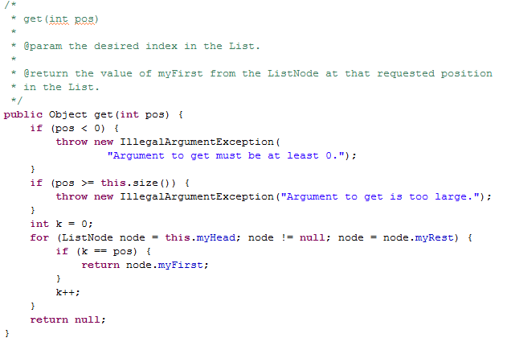
A Mysterious Method in List
We have to say what type of thing we return. But we can also FREAK OUT and throw an Exception

Slide 38
Bonus

Slide 39
Testing and
Test Driven Development
Remember to mention this at job interviews!

Slide 40


Slide 41
Test Driven Development
static void beAGoodProgrammer()
{
  while (true) // for each method
  {
  writeTest();
  writeCode();
  writeAFewMoreTests();
  writeCode();
  }
}

Slide 42
Why do Test Driven Development?
It is a way to brainstorm what your method is going to do.
It is hard to write test cases
Write your test cases before you’re biased by how your code is written

Slide 43
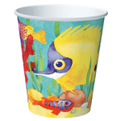
Never EVER start
writing a program until
you can solve the
problem by hand!

Slide 44
Inheritance

Slide 45
Inheritance Lingo
A Dog is an Animal
Dog extends Animal
Dog is the subclass of Animal
Animal is the superclass of
Animal
Animal
Dog
Dalmatian
Cat
A Dalmation is a Dog
A Dalmation is an Animal
Dalmation extends Dog
Dalmation is the subclass of Dog and Animal

Slide 46
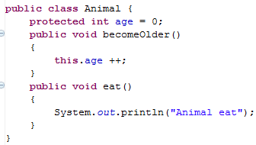
Animal
age
0

Slide 47
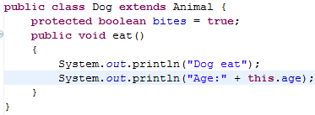
We can override the parent’s eat method
We can access the variable age, even though we didn’t include it in the Dog class directly
Dog
age
bites
Animal
age
0
true
0

Slide 48
Animal myAnimal= new Animal();
myAnimal.becomeOlder();
myAnimal.eat();

Slide 49
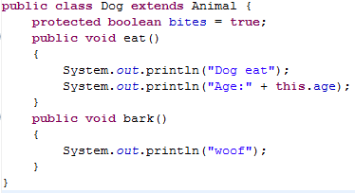
Dog myDog = new Dog();
myDog.eat();
myDog.bark(); // ↓ does this work? ___
myDog.becomeOlder();

Slide 50
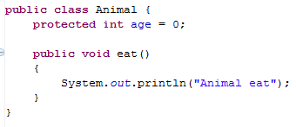
Animal myAnimal= new Animal();
myAnimal.bark();
↑Does this work???? _________

Slide 51
Subclasses (Children) Can
Declare new instance/class variables
Declare new methods
Override old implementations with new implementations
Access instance/class variables of the superclass (parent) *
Access methods of the superclass*
* only public, protected or default ones

Slide 52
Inheritance Puzzles
Dog d = new Animal();
Does this work? _______
No it doesn’t compile, If I want a Dog, an Animal will be NOT be acceptable because I might want to call a method that only a Dog can do!

Slide 53
Inheritance Puzzles
Animal a = new Dog();
Does this work? _______
YES it compiles and runs - If I want an Animal , a Dog will be acceptable because everything an Animal can do a Dog can do too!
Animal a = (Animal) new Dog();

Slide 54
Inheritance Puzzles
Animal a = new Dog();
Dog d = a;
Does this work? _______
No it doesn’t compile. The compiler doesn’t know it is really a Dog!
but we can PROMISE the compiler that it is with a cast
Dog d = (Dog) a;

Slide 55
Inheritance Puzzles
Animal a = new Animal();
Dog d = (Dog) a;
Does this work? _______
YES and NO - The compiler trusts your PROMISE (cast) but then if you run your program it has a RUN TIME ERROR because a is not a Dog

Slide 56
Inheritance Puzzles
Animal
Dog
Dalmatian
Poodle
Cat
Animal a = new Cat();
Dog d = (Dog) a;
d.bark();
Does this work? _______
YES and NO. It compiles, but then when we try to do the cast we get a RUN TIME ERROR, before we even try to call any dog methods on a.

Slide 57
Inheritance Puzzles
Animal a = new Dog();
a.bark();
Does this work? _______
NO it does not compile - The compiler thinks it is an Animal, and an Animal does not have a method bark
Dog d = (Dog) a; d.bark();
((Dog) a).bark();

Slide 58
Inheritance Puzzles
Animal a = new Dog();
a.eat();
Does this work? _______
YES- The compiler is happy - an Animal has an eat() method.
Which method is called the Animal eat()
or the Dog eat() ?

Slide 59
Inheritance Puzzles
Animal a = new Dog();
a.eat();
Which method is called the Animal eat()
or the Dog eat() ?
main
Animal a
Dog
age
bites
0
true

Slide 60
Ridable
Object
Animal
Machine
Car
Cat
Blender
Dog
Horse

Slide 61

Interfaces
I have a GREAT idea!
Everyone will want to make Ridable things that can
  turnLeft()
  turnRight()
  goForward()
How?!?!
  I don’t care!!!!

Slide 62
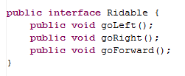
The Ridable interface

Slide 63
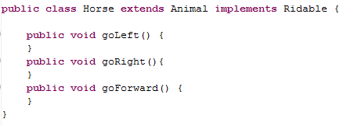
Horse can implement the Ridable interface

Slide 64
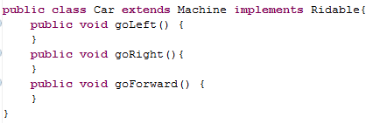
Car can implement the Ridable interface

Slide 65
We can have a Rideable remote control
(Rideable reference)
Rideable r1 = new Horse();
Rideable r2 = new Car();
r1.goForward();
r2.goForward();

Slide 66
Can we have a Ridable object?
Ridable r1 = new Ridable();
No! You can’t create an object of an interface!

Slide 67
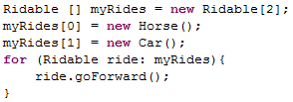
Interfaces can be cool!!!

Slide 68
Example
The sort method of the Array class promises to sort an array of objects, but under one condition: the objects in the array must implement the Comparable interface:
  public interface Comparable {
  int compareTo(Object other);
  }

Slide 69
Summary of Interfaces
Interfaces don’t implement ANY methods
  Just put a semicolon at the end of the method
Classes can implement multiple interfaces
To implement an interface you must write all of the methods that the interface defines

Slide 70
Cookies!
Cookie
Girl Scout Cookie
Thin mint
Shortbread
Chocolate Chip

Slide 71
Abstract Classes
(less lazy than Interfaces)
I have a GREAT idea!
Everyone will want to make Cookies that can have these methods:
  ingredients()
  isDelicious()
How?!?!
  isDelicious() is pretty simple, I’ll write that one
  ingredients() ?!? Sounds too hard! I’ll make that abstract

Slide 72
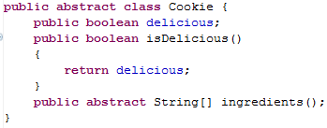
Abstract Class Cookie

Slide 73
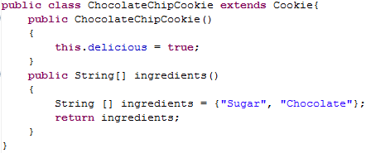
ChocolateChipCookie can extend the Abstract class Cookie

Slide 74
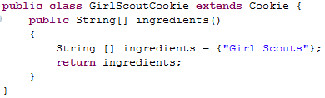
GirlScoutCookie can extend the Abstract class Cookie

Slide 75

We can have a Cookie remote control
(Cookie reference)

Slide 76
Can we have a Cookie object?
Cookie p1 = new Cookie();
No! You can’t create an object of an abstract class!

Slide 77
Abstract Class Summary
Label an Abstract class as abstract
Label any methods that you don’t want to implement as abstract
  Your children MUST write all of the abstract methods
Instance variables in the abstract class will be available in the child class
You can only extend one Class (abstract or otherwise)

Slide 78
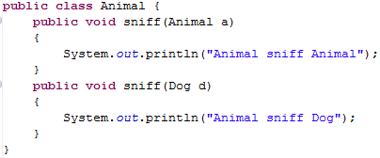
Inheritance and
Arguments
Animal
Dog
Cat

Slide 79
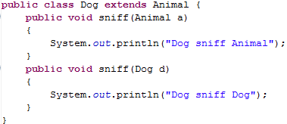
← Uses a1’s dynamic type
Animal a1 = new Dog();
Dog d1 = new Dog();
a1.sniff(d1);
d1.sniff(a1);
Animal a2 = new Dog();
a1.sniff(a2);
← Uses a1’s static type
← Uses a1’s dynamic type
Uses a2’s static type

Slide 80
Inheritance
Compilation:
  CALLER: It makes sure that the static type of the object has the appropriate method
  ARGS: It makes sure that the method takes in the static type of the arguments
Run-time:
  CALLER: When you call a method on an object it looks for the method starting at the object’s dynamic type
  ARGS: When you pass an object as an argument, it looks for a method with that static type

Slide 81
Animal a1 = new Dog();
Dog d1 = new Dog();
a1.sniff(d1);
d1.sniff(a1);
Animal a2 = new Dog();
a1.sniff(a2);
Dog
age
bites
0
true
Dog
age
bites
0
main
Animal a1
Animal a2
Dog d1
true
Dog
age
bites
0
true

Slide 82
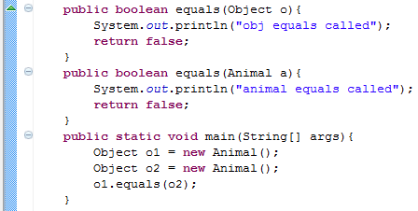
equals(Object o)
Which equals is called?
Object

Slide 83
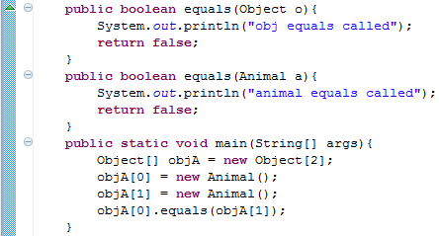
equals(Object o) and Arrays
Which equals is called?
Object

Slide 84
equals(Object o)
If others will call your methods with more generic references, you want to provide a method that takes in an Object

Slide 85
Big-O
BONUS

Slide 86



Some Algebra to calculate:
1+2+…+n
// Written backwards

Slide 87

Some Algebra to calculate:
1+2+…+n

Slide 88


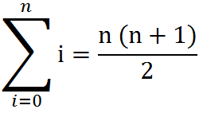
Some Algebra to calculate:
1+2+…+n
OR

Slide 89
Estimating Time
Most people grossly underestimate how long it takes to program (not thinking about time to debug and test)
You appear incompetent at programming (not true) if you can’t estimate how long something will take.
This is one of the hardest things to learn!!! Start to practice now! For each task estimate how long it will take and keep track of how wrong you were

Slide 90
BONUS

Slide 91
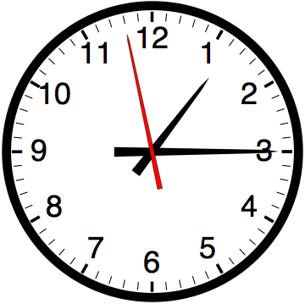

Slide 92


Computer
Science
&
= AWESOME

Slide 93

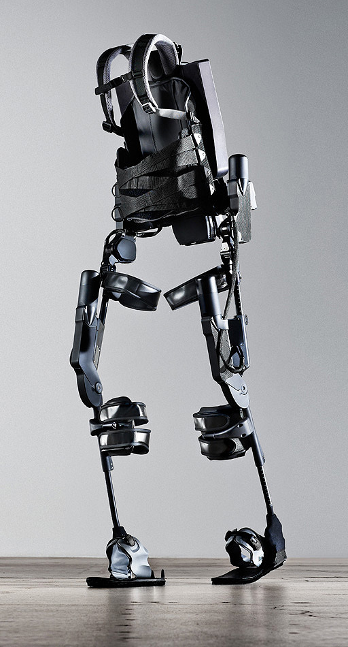
http://www.youtube.com/watch?v=pzRmNYA8LlY

Slide 94


ClickStart

Slide 95
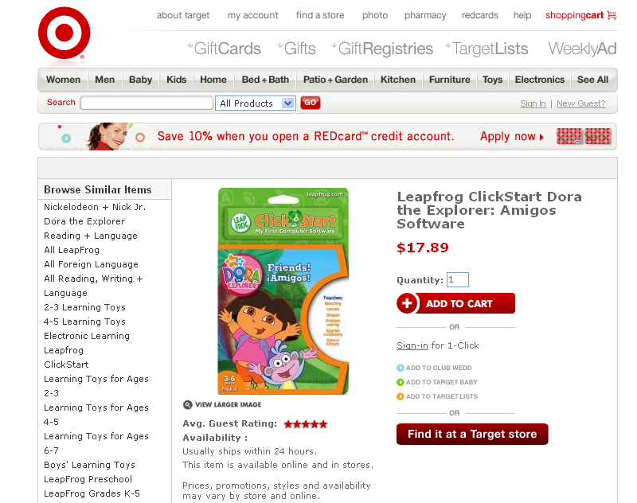

Slide 96
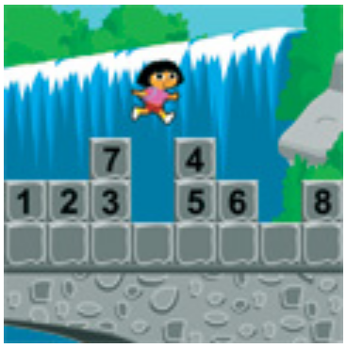
How should we represent the blocks in the computer?
Independent variables
2D Array
OpenList
I don’t know

Slide 97
The value in the array tells me what art asset to use
Each level is really a 3x10 vector!
0 | 0 | 7 | 0 | 4 | 0 | 0 | 0
1 | 2 | 3 | -4 | 5 | 6 | -7 | 8
B | B | B | B | B | B | B | B
Negative values tell me what block needs to go here to win!

Slide 98
0 | 0 | 7 | 0 | 4 | 0 | 0 | 0
1 | 2 | 3 | -4 | 5 | 6 | -7 | 8
0 | 0 | 0 | B | 0 | 0 | 0 | 0

Slide 99
BUGS!

Slide 100
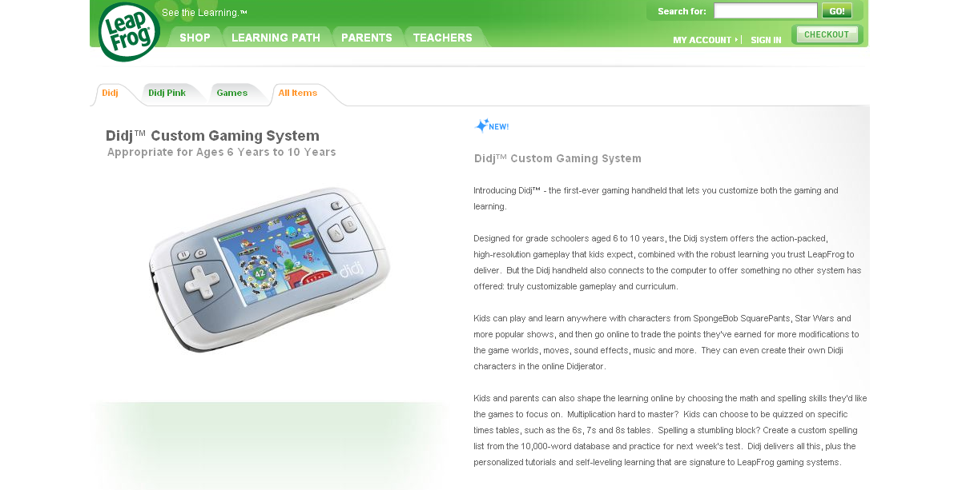

Slide 101
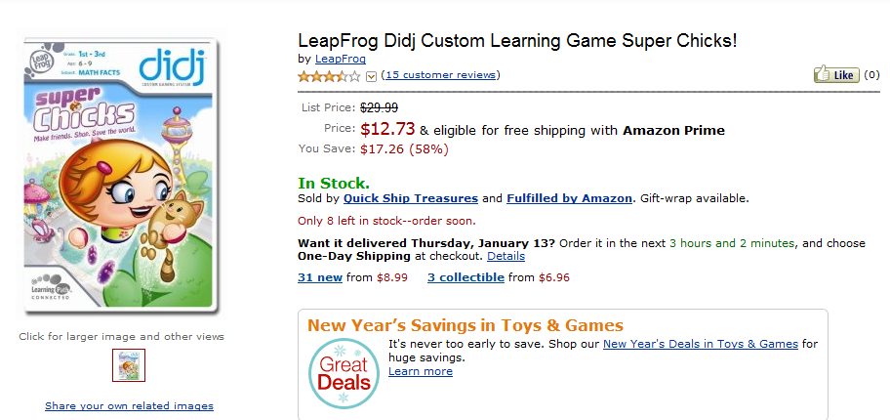
It is really sad when stuff you’ve made is on sale!

Slide 102
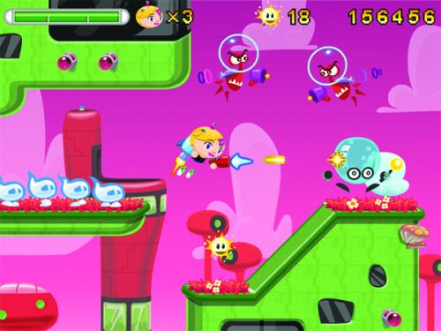
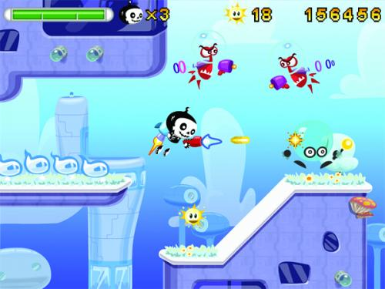

Which image is fake?
  A. Top Left
  B. Bottom Left
  C. Bottom Right

Slide 103


Slide 104


Slide 105
Sort
STk>(sort ’(8 3 9))
(3 8 9)
(sort ’(8 3 9))
(sort ’(3 9))
(insert 8
(insert 3
(sort ’(9))
(insert 9
(sort ’())
’()
(insert 8 (insert 3 (insert 9 ’())))
Notes:
105

Slide 106
(insert 3
(insert 6
(insert 4
(insert 7
(insert 1
(insert 8
(insert 3
(insert 9
’()
))))))))
(sort sent) if sent length is N
1 + 2 + 3 + 4 + … + (N-1)+ N
Add to sent size 7
Add to sent size 6
Add to sent size 5
Add to sent size 4
Add to sent size 3
Add to sent size 2
Add to sent size 1
Add to sent size 0

Slide 107

// Take the log of both sides
// Remember:

Slide 108



