Slide 1
CS 60
Dynamic Programming,
Floyd-Warshall
2013-10-29
Wednesday – Week 8
Lecture 15

Slide 2
After Homework 7
I am better at debugging
I like CS less
I like CS more
I B. II C. III D. I and II
E. I and III

Slide 3
BSTNode min()

Slide 4
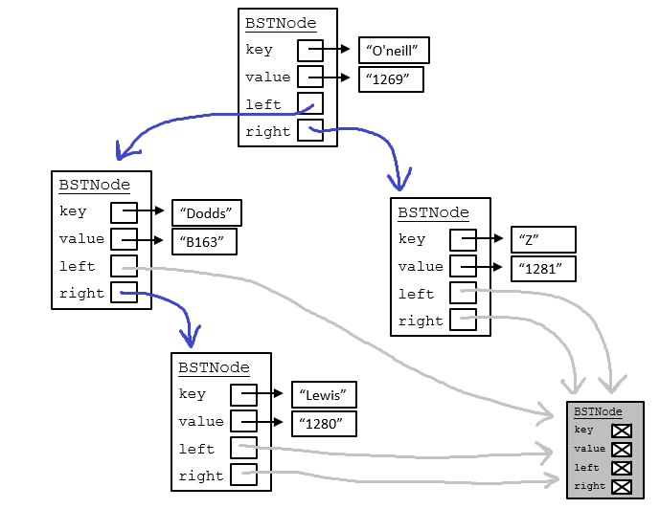
Remember! BSTNode should work like Racket and NEVER modify a BSTNode!

Slide 5
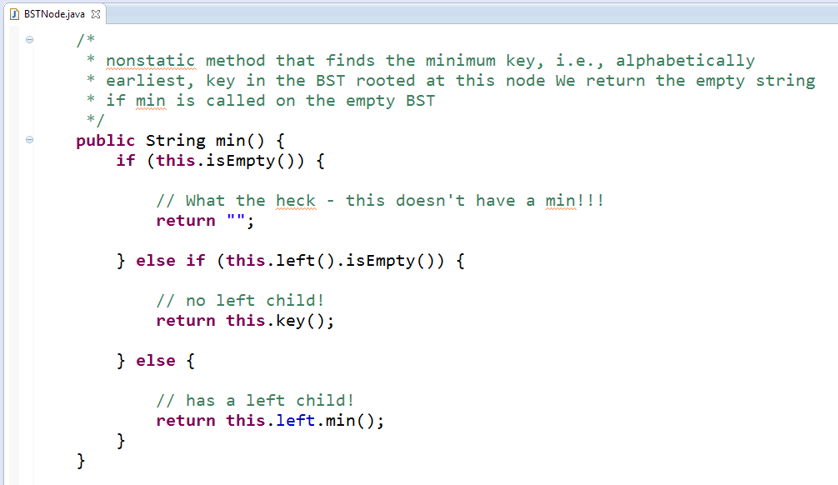
A
C
B
C
B
A

Slide 6
Dynamic Programming Review

Slide 7
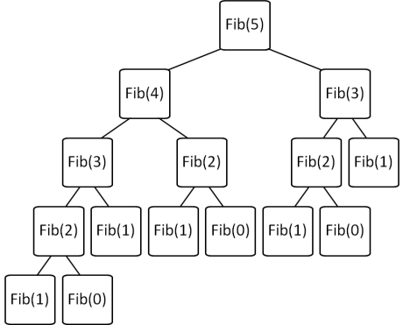
Differences between Memoization and Dynamic Programming
Brute Force Recursion
Top-Down
Memoization
Top-down
Keep track of recursive calls you’ve made and store the result.
Before you make a recursive call, check to see if you already know the answer.
Dynamic Programming
Bottom-up
Build up a table with answers to smaller problems
Make sure you always have already calculated the required components (e.g. fib(n-1) + fib(n-2))
Fibonacci Solution Methods

Slide 8
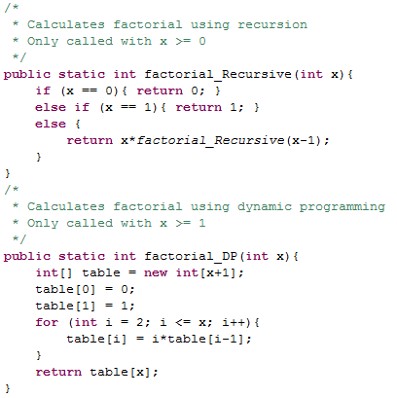
One cell in table for EACH possible recursive call.
Factorial using Dynamic Programming (DP)
(Note: it doesn’t provide any speed-up in this case)

Slide 9
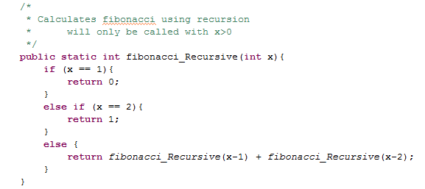
Fibonacci Using Recursion

Slide 10
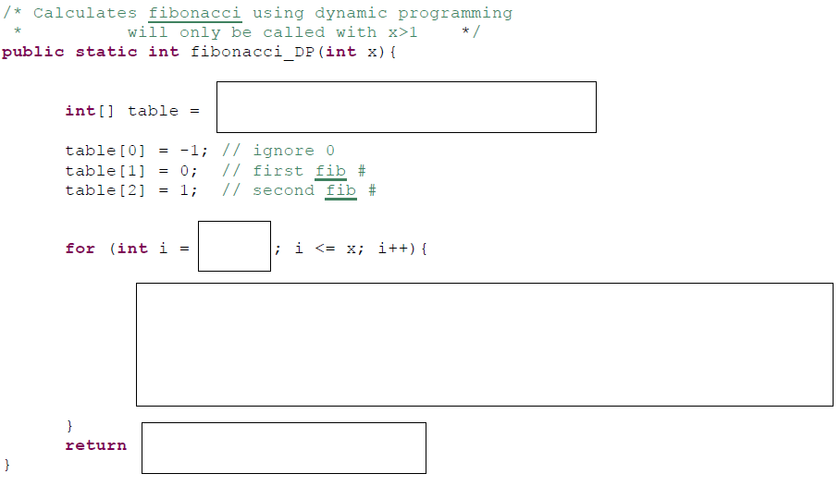
Fill In – Fibonacci DP
A) Stuck B) table[x] C)table[x-1] D)table[x+1]

Slide 11
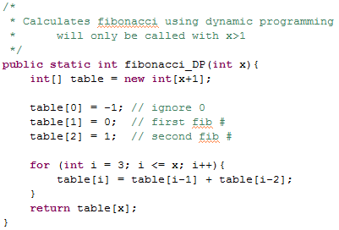
Fibonacci using Dynamic Programming (DP) SOLUTION

Slide 12

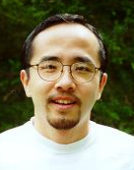
http://www.math.hmc.edu/funfacts/
REALLY COMMON SERIES (Test Yourself!!!)
1 + 2 + 3 + … + (N-2) + (N-1) + N =
1 + 2 + 4 + … + N/4 + N/2 + N =
1 + 2 + 4 + … + 2^{N-2} + 2^{N-1} + 2^{N} =
True or False?
T(N + M) ∈ O(N²)

Slide 13
http://www.math.hmc.edu/funfacts/
REALLY COMMON SERIES (you should recognize these after today)
1 + 2 + 3 + … + (N-2) + (N-1) + N = N(N+1)/2 ∈ O(N²)
1 + 2 + 4 + … + N/4 + N/2 + N = 2N -1 ∈ O(N)
1 + 2 + 4 + … + 2^{N-2} + 2^{N-1} + 2^{N} = 2^{N+1} -1 ∈ O(2^{N})
FALSE!
I need to pick a value of c and N BEFORE knowing what N and M are here.
T(N + M) ∈ O(N²)

Slide 14
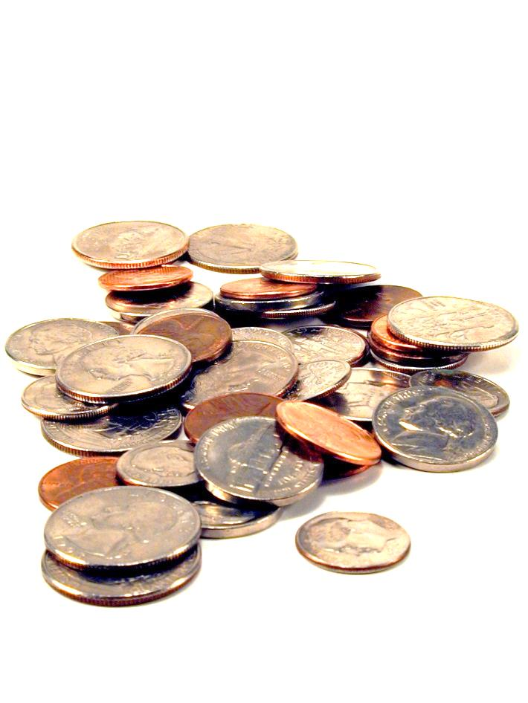
Making Change Hw9

Slide 15
we want the fewest coins that will produce this total
out of these denominations (we can use as many times as we want)
Does the algorithm of always using the largest coin possible get you the minimum number of coins?
A) Yes B) No C)??
change( 18, [1, 9, 10] )
Minimizing change...
in Racket + Prolog: recursive use-it-or…-or-lose-it

Slide 16
In CS (and life?) Greed usually doesn’t work

Slide 17
we want the fewest coins that will produce this total
out of these denominations (we can use as many times as we want)
Minimizing change...
change( 18, [1, 9, 10] )
What is the fewest coins I can use to make this total?
You need to invent this DP algorithm in Hw9
0 | 1 | 2 | 3 | 4 | 5 | 6 | 7 | 8 | 9 | 10 | 11 | 12 | 13 | 14 | 15 | 16 | 17 | 18
0 | 1 | 2 | 3 | 4 | 5 | 6 | 7 | 8 | 1 | 1 | 2 | 3 | 4
in Java: dynamic programming!

Slide 18
Floyd-Warshall (all-pairs shortest path)

Slide 19
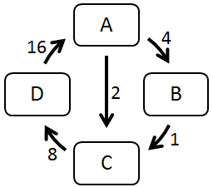
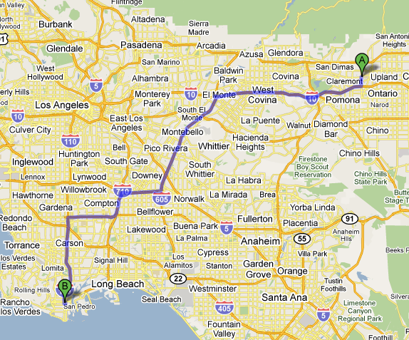

Finding all Paths
A directed graph:
Suppose we'd like the
shortest route from
any city to any other city.
How is this path different than the paths in the directed graph above?

Slide 20
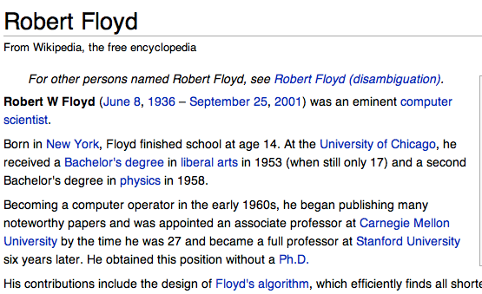
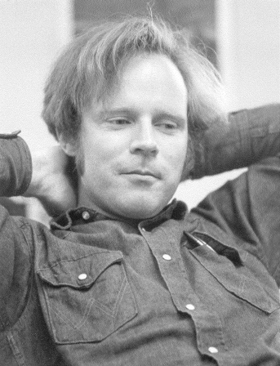
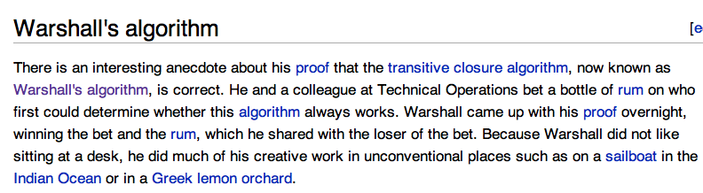
Floyd-Warshall algorithm
All-pairs shortest paths!
“Floyd may have been the first advocate of refactoring -- the rewriting of working programs from scratch, re-using only the essential ideas. Refactoring is now standard practice among computer programmers. By continuously looking for simpler ways to do the same thing, Floyd aimed to improve not only programs but also programmers' abilities and understanding...
He also was a passionate hiker and mountain climber who loved the wilderness country in the High Sierra…”
Stephen Warshall
What would a reasonable big-O running time be (N = # nodes)

Slide 21
Shortest Paths in CS60
O(N³)
O(2E)
min-dist
(Brute Force)
Floyd-Warshall
(Dynamic programming)
ALL PATHS
Hw2 part 1 Problem 9
ONE PATH

Slide 22
Graph Representations (adjacency matrix)

Slide 23
Cost:
0 if self-edge
Edge | Cost
A → A | 0
A → B | 4
A → C | 2
A → D | ∞
B → A | ∞
B → B | 0
B → C | 1
B → D | ∞
C → A | ∞
C → B | ∞
C → C | 0
C → D | 8
D → A
D → B
D → C
D → D
Graph Representations
(cont.)
Cost:
∞ if no edge
Cost:
Otherwise just the edge weight
A
4
16
Fill these out
D
2
B
1
8
C
A) 0 B) 1 C) 2 D) ∞ E) ??

Slide 24
Graph Representation:
Adjacency Matrix
Edge | Cost
A → A | 0
A → B | 4
A → C | 2
A → D | ∞
B → A | ∞
B → B | 0
B → C | 1
B → D | ∞
C → A | ∞
C → B | ∞
C → C | 0
C → D | 8
D → A | 16
D → B | ∞
D → C | ∞
D → D | 0
A
4
16
A → A | A → B | A → C | A → D
0 | 4 | 2 | ∞
B → A | B → B | B → C | B → D
∞ | 0 | 1 | ∞
C → A | C → B | C → C | C → D
∞ | ∞ | 0 | 8
D → A | D → B | D → C | D → D
16 | ∞ | ∞ | 0
D
2
B
1
8
C
This is the source (src)
 | A | B | C | D
A | 0 | 4 | 2 | ∞
B | ∞ | 0 | 1 | ∞
C | ∞ | ∞ | 0
D | 16 | ∞ |  | 0
This is the destination (dest)
A) 2 B) 4 C) 8 D) ∞

Slide 25
Adjacency Matrix
Cost:
0 if self-edge
Cost:
Edge weight
Cost:
∞ if no edge
A (1) → A (1) 0 | A (1) → B (2) 4 | A (1) → C (3) 2 | A (1) → D (4) ∞
B (2) → A (1) ∞ | B (2) → B (2) 0 | B (2) → C (3) 1 | B (2) → D (4) ∞
C (3) → A (1) ∞ | C (3) → B (2) ∞ | C (3) → C (3) 0 | C (3) → D (4) 8
D (4) → A (1) 16 | D (4) → B (2) ∞ | D (4) → C (3) ∞ | D (4) → D (4) 0

Slide 26
Adjacency Matrix (Floyd-Warshall implementation detail): Use a int[][] and number the nodes starting with 1
 | dest = 0 | dest = 1 | dest = 2 | dest = 3 | dest = 4
src = 0
src = 1 |  | A (1) → A (1) 0 | A (1) → B (2) 4 | A (1) → C (3) 2 | A (1) → D (4) ∞
src = 2 |  | B (2) → A (1) ∞ | B (2) → B (2) 0 | B (2) → C (3) 1 | B (2) → D (4) ∞
src = 3 |  | C (3) → A (1) ∞ | C (3) → B (2) ∞ | C (3) → C (3) 0 | C (3) → D (4) 8
src = 4 |  | D (4) → A (1) 16 | D (4) → B (2) ∞ | D (4) → C (3) ∞ | D (4) → D (4) 0
We’ll just ignore index 0 ☺

Slide 27
Tracing Floyd-Warshall

Slide 28
Floyd-Warshall algorithm
For each node K:
For each pair of nodes (X →Y):
See if using an intermediate node K can reduce the cost of that path:
min[cost(X →Y),
cost(X →K) + cost(K →Y)]
{A, B, C, D}
{A→A, A→B, A→C, A→D,
B→A, B→B, B→C, B→D,
C→A, C→B, C→C, C→D,
D→A, D→B, D→C, D→D}
Don’t use the intermediate node
Use the intermediate node

Slide 29
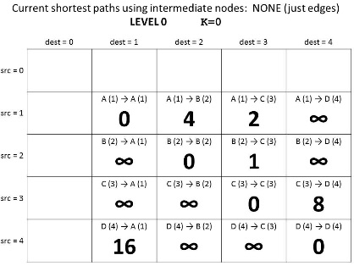
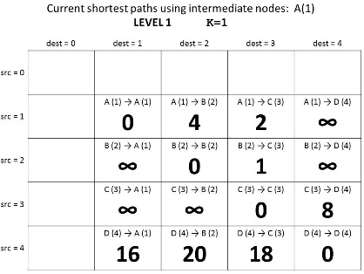
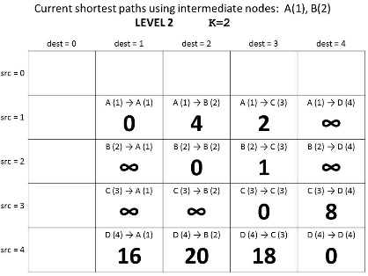
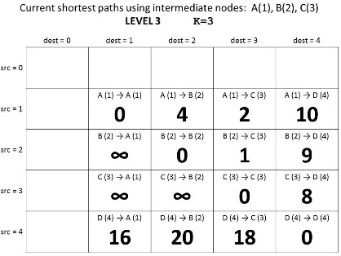
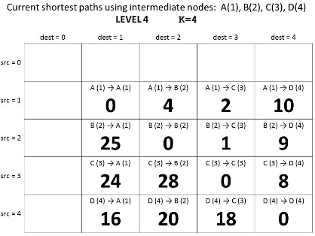
Guaranteed shortest path using NO intermediate nodes.
K = 0
Why does this give us the shortest path?
Guaranteed shortest path using only A as an intermediate node.
K = 1
Guaranteed shortest path using only A & B as intermediate nodes.
K = 2
Guaranteed shortest path using
only A, B, & C
as intermediate nodes.
K = 3
Guaranteed shortest path using
only A, B, C, & D
as intermediate nodes.
K = 4

Slide 30
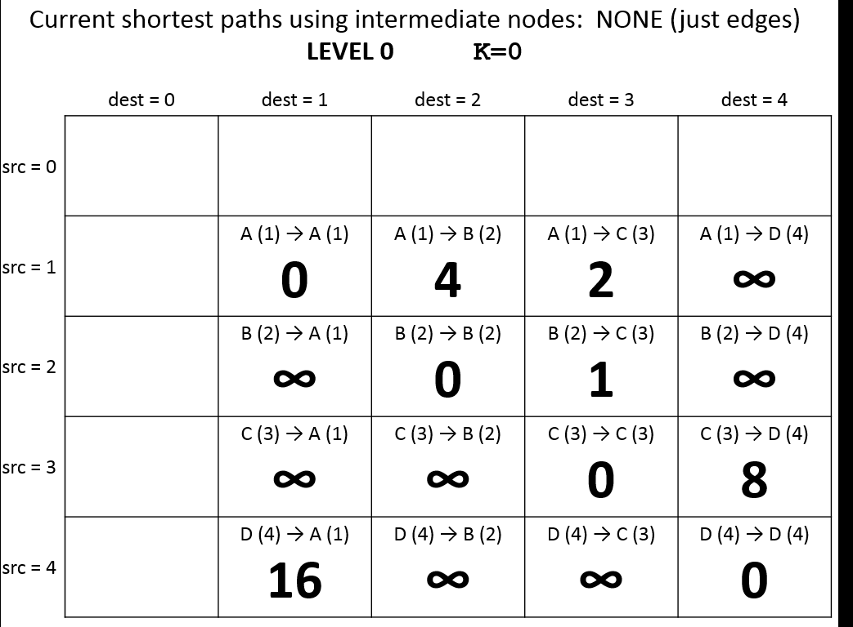
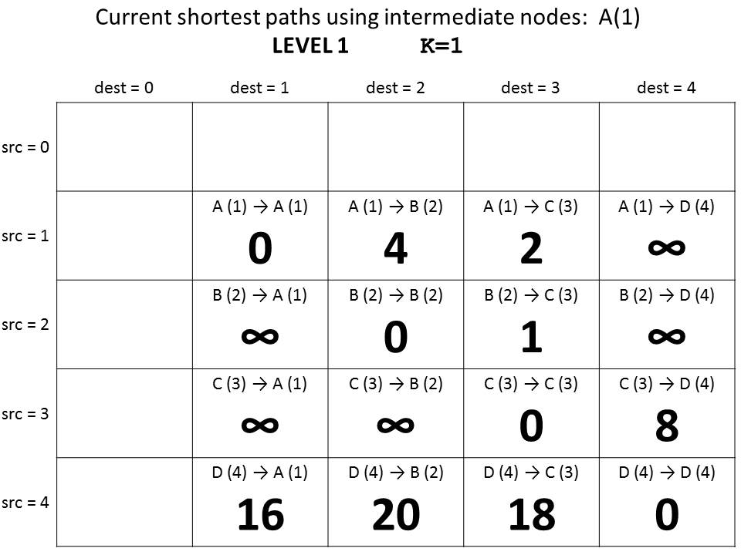
Costs if we get to use one intermediate Node: A (#1)
min[cost(X →Y),
cost(X →K) + cost(K →Y)]
min[cost(D →B),
cost(D →A) + cost(A→B)]

Slide 31
Guaranteed shortest path using NO intermediate nodes.
K = 0
Why does this give us the shortest path?
Guaranteed shortest path using only A as an intermediate node.
K = 1
Guaranteed shortest path using only A & B as intermediate nodes.
K = 2
Guaranteed shortest path using
only A, B, & C
as intermediate nodes.
K = 3
Guaranteed shortest path using
only A, B, C, & D
as intermediate nodes.
K = 4

Slide 32
Floyd-Warshall Pseudocode
We don’t use index 0, so we need N+1
int[][] cost = new int[N+1][N+1];
// set initial values = edge weights
for(int K=1; K<=N; K++){
for(int src=1; src<=N; src++){
for(int dest=1; dest<=N; dest++){
int prevCost = cost[src][dest];
int newCost = cost[src] [K] + cost [K] [dest];
cost[src][dest] = min(prevCost, newCost);
}
}
}
min[cost(X →Y),
cost(X →K) +
cost(K →Y)]

Slide 33
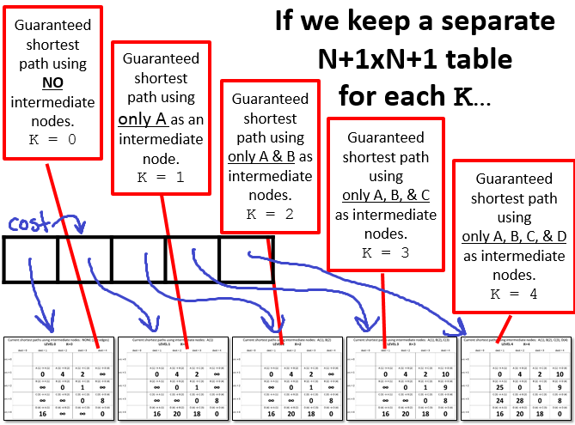

Slide 34
One N+1xN+1 array for each possible intermediate node
int[][][] cost = new int[N+1][N+1][N+1];
// set initial values = edge weights
for(int K=1; K<=N; K++){
for(int src=1; src<=N; src++){
for(int dest=1; dest<=N; dest++){
int prevCost = cost[K-1][src][dest];
int newCost = cost[K-1][src] [K] + cost[K-1] [K] [dest];
cost[k][src][dest]=min(prevCost, newCost);
}
}
}
Look at the “current” shortest path
Floyd-Warshall Pseudocode (Layers)

Slide 35
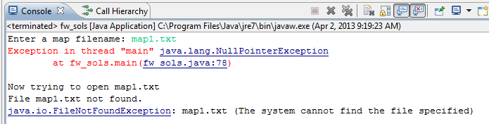
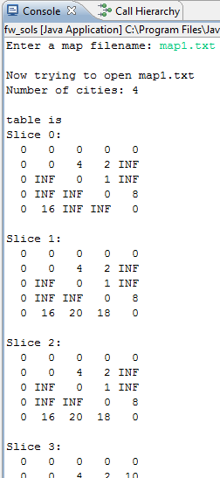
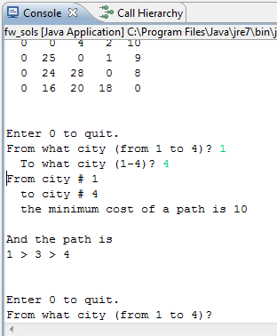
Shows each “layer” of the table cost
If you get this error (on this or Change) review the homework instructions
HOMEWORK 8
FILE INPUT!
You can query for ANY Path!

Slide 36
Discuss in your group
I’m thinking individually first
I’m talking to my neighbor
We think we’re set
We’re stuck
What is in cost?
int[][][] cost = new int[N+1][N+1][N+1];
What is in layer 0 (cost[0]) and layer N
int[][] start = cost[0];
int[][] done = cost[N];
Why will this give ALL shortest paths?

Slide 37
Current shortest paths using intermediate nodes: NONE (just edges) LEVEL 0 K=0
 | dest = 0 | dest = 1 | dest = 2 | dest = 3 | dest = 4
src = 0
src = 1 |  | A (1) → A (1) 0 | A (1) → B (2) 4 | A (1) → C (3) 2 | A (1) → D (4) ∞
src = 2 |  | B (2) → A (1) ∞ | B (2) → B (2) 0 | B (2) → C (3) 1 | B (2) → D (4) ∞
src = 3 |  | C (3) → A (1) ∞ | C (3) → B (2) ∞ | C (3) → C (3) 0 | C (3) → D (4) 8
src = 4 |  | D (4) → A (1) 16 | D (4) → B (2) ∞ | D (4) → C (3) ∞ | D (4) → D (4) 0

Slide 38
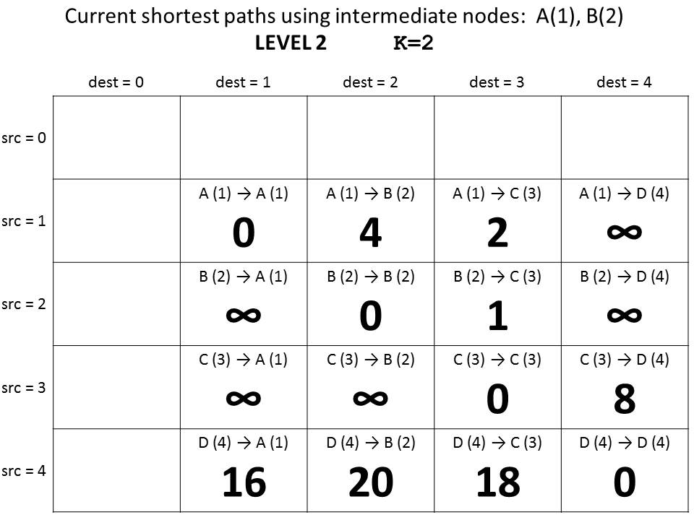
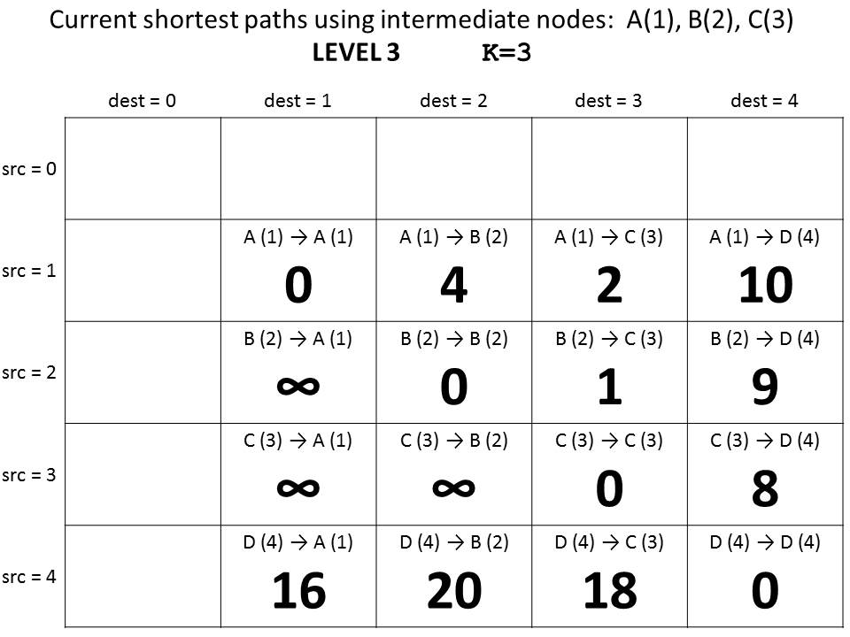
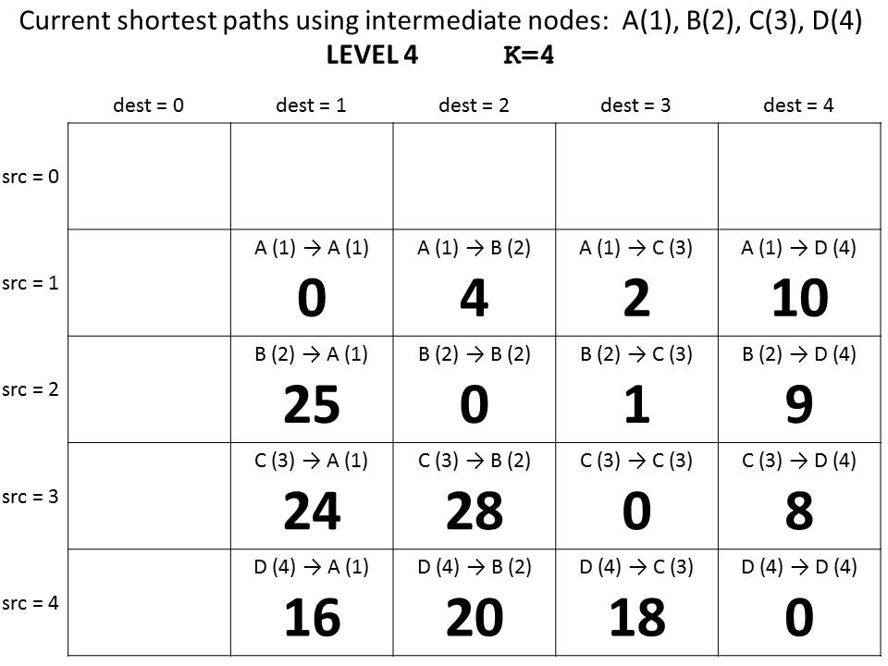

Slide 39
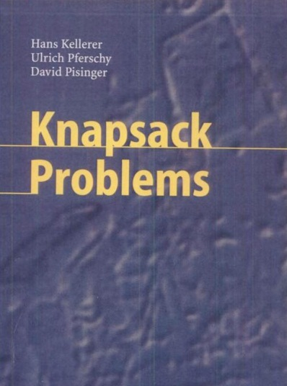
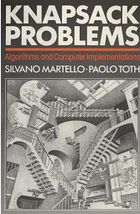
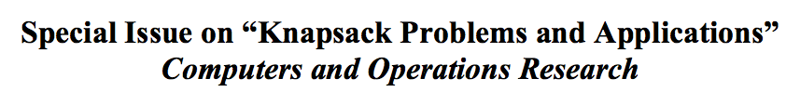
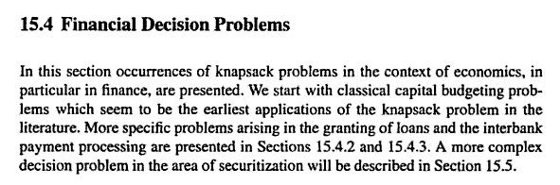
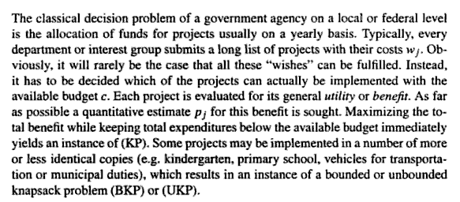
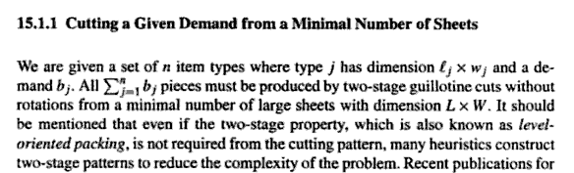
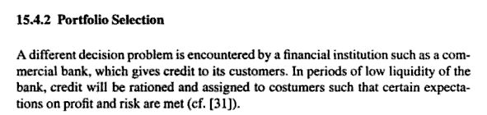
Knapsack!
2004 book
1990 book
Material use in manufacturing
Financial decision problems
Cryptosystems
Auction theory
~ Field of Operations Research

Slide 40

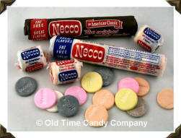

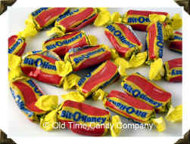
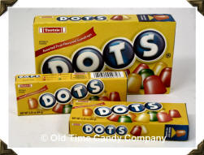
Recognize these?
1800's
1920's
1940's
1950's
1970's

Slide 41
Recognize these?
1800's
1920's
1940's
1950's
1970's
What should represent the 2000's?
Notes:
fun dip

Slide 42
Assume each of the candies has some value (v_{i})
v₁ = 100
w₁ = 2
v₁
w₁
i = 1
= 50
v₂ = 120
w₂ = 3
Assume each of the candies has some weight (w_{i})
v₂
w₂
= 40
i = 2
v₃ = 230
w₃ = 5
v₃
w₃
= 46
i = 3
We can calculate how good of a deal the candy is
v₄ = 560
w₄ = 7
v₄
w₄
i = 4
v_{i}
w_{i}
= 80
v₅ = 675
w₅ = 9
v₅
w₅
i = 5
= 75

Slide 43
Suppose "a friend" can consume a weight of 13. Assume that you won’t run out of candy
How can you maximize this candy-value experience?
v₁ = 100
w₁ = 2
v₁
w₁
i = 1
= 50
v₂ = 120
w₂ = 3
v₂
w₂
v₄ = 560
= 40
i = 2
1
w₄ = 7
v₄
w₄
v₃ = 230
= 80
w₃ = 5
v₃
w₃
i = 3
= 46
v₁ = 100
3
w₁ = 2
v₁
w₁
v₄ = 560
= 50
i = 1
w₄ = 7
v₄
w₄
i = 4
= 80
v_{Total} = 860
w_{Total} = 13
v₅ = 675
w₅ = 9
Does greed work?
v₅
w₅
i = 5
= 75

Slide 44
Suppose "a friend" can consume a weight of 13. Assume that you won’t run out of candy
How can you maximize this candy-value experience?
v₁ = 100
w₁ = 2
v₁
w₁
i = 1
= 50
v₂ = 120
w₂ = 3
v₂
w₂
v₅ = 675
= 40
i = 2
1
w₅ = 9
v₅
w₅
v₃ = 230
= 75
i = 5
w₃ = 5
v₃
w₃
i = 3
= 46
v₁ = 100
2
w₁ = 2
v₁
w₁
v₄ = 560
= 50
i = 1
w₄ = 7
v₄
w₄
i = 4
= 80
v_{Total} = 875
w_{Total} = 13
v₅ = 675
w₅ = 9
Does greed work?
v₅
w₅
i = 5
= 75

Slide 45
In CS (and life?) Greed usually doesn’t work

Slide 46
Knapsack problem
The Goal:
(most value I can carry)
Use-it-or-lose-it
Option 1 (lose it):
How much value can I carry if I just assumed I had a capacity one smaller?
bestValue( capacity ) =
bestValue( capacity-1 )
max
bestValue( capacity-w_{i} ) + v_{i}
over all possible i
Option 2 (use it):
How much value can I have if I use an item with
weight w_{i} and value v_{i}

Slide 47
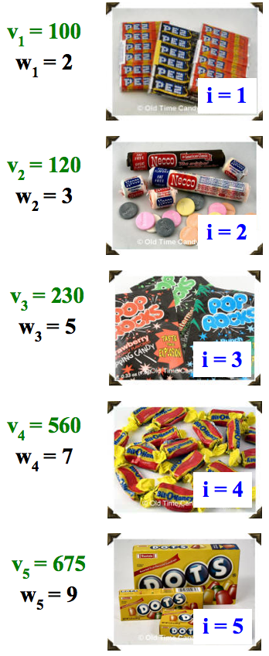
Dynamic programming
Create a table of possible recursive calls.
Compute the results of each one bottom-up.
T[ capacity ] = the maximum value obtainable for the given capacity
Which values are "easy" to fill in?
How do we fill in each cell?
CAPACITY
Fill in this table from 0 up to the actual capacity of interest…
0 | 1 | 2 | 3 | 4 | 5 | 6 | 7 | 8 | 9 | 10 | 11 | 12 | 13

Slide 48
(1) Finish filling in this table of best-results for the knapsack problem:
CAPACITY
0 | 1 | 2 | 3 | 4 | 5 | 6 | 7 | 8 | 9 | 10 | 11 | 12 | 13
0 | 0 | 100
Fill in this table from 0 up to the actual capacity of interest…
VALUE
Each cell is T[ capacity ] = the maximum value obtainable for the given capacity
(2) Estimate the big-O runtime of this table-filling algorithm, in terms of N, the number of items available and C, the capacity of the knapsack.
(3) How could you also keep track of the items to take using a 2nd table with one item per cell?
0 | 1 | 2 | 3 | 4 | 5 | 6 | 7 | 8 | 9 | 10 | 11 | 12 | 13

Slide 49
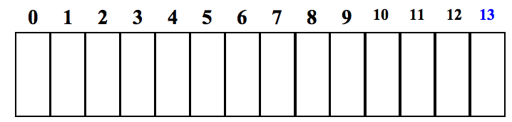
(1) Finish filling in this table of best-results for the knapsack problem:
CAPACITY
0
1
2
3
4
5
6
7
8
9
10
11
12
13
0
0
VALUE
100
120
200
230
300
560
560
675
680
775
795
875
Fill in this table from 0 up to the actual capacity of interest…
Each cell is T[ capacity ] = the maximum value obtainable for the given capacity
(2) Estimate the big-O runtime of this table-filling algorithm, in terms of C, the knapsack capacity.
What else does the big-O runtime depend on∞
O( N*C )
(3) How could you also keep track of the items to take using a 2nd table with one item per cell∞
CAPACITY
null
null
1
1
1
4
4
5
One Item
2
3
4
5
5
5

Slide 50
BSTNode
key
value
left
right
“O'neill”
“1269”
BSTNode
key
value
left
right
“Dodds”
BSTNode
key
value
left
right
“B163”
“Z”
“1281”
BSTNode
key
value
left
right
“Lewis”
“1280”
BSTNode
key
value
left
right

Slide 51
Guaranteed shortest path using NO intermediate nodes.
K = 0
If we keep a separate N+1xN+1 table
for each K…
Guaranteed shortest path using only A as an intermediate node.
K = 1
Guaranteed shortest path using only A & B as intermediate nodes.
K = 2
Guaranteed shortest path using
only A, B, & C
as intermediate nodes.
K = 3
Guaranteed shortest path using
only A, B, C, & D
as intermediate nodes.
K = 4

