Slide 1
CS 60
Hw 9
Parsing Intro
2013-11-04
Monday – Week 9
Lecture 16

Slide 2
Office Hours this week
Monday 7:00-8:00pm
  Colleen’s office 1280 Olin
Tuesday 2:00-3:50pm
  LAC lab

Slide 3
OpenList
Racket-style Lists in Java
(Provided)

Slide 4
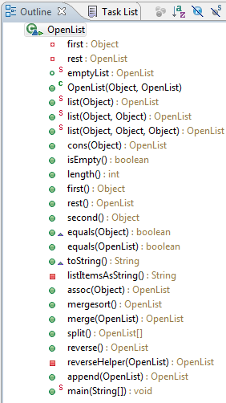
OpenList Overview
Instance variables
Representing an empty OpenList (static variable that ends EVERY list – just like emptyBSTNode)
Methods for constructing OpenLists (Constructors + static methods)
Methods to access stuff about OpenLists.
OpenLists can hold association lists!
OpenLists can do merge & merge sort!

Slide 5
Quantity
(Re-implement methods you wrote in Racket)

Slide 6
class Quantity
{
private double m; // the multiplier
private OpenList N; // the numerator
private OpenList D; // the denominator
private double u; // the uncertainty
public Quantity(double m, OpenList N, OpenList D, double u)
{
this.m = m; this.N = N; this.D = D; this.u = u;
}
public double getm() { return this.m; }
public OpenList getN() { return this.N; }
public OpenList getD() { return this.D; }
public double getu() { return this.u; }
public String toString()
{
return "{" + this.m + "," + this.N + "," + this.D + "," + this.u + "}";
}
Quantity
Unicalc, but in Java
"getters" - methods for obtaining data members without making the data itself public
{ 42.0, ["m"], ["s", "s"] }
Java's quantity object:
Scheme's quantity list:
( 42.0 ("m") ("s" "s") )
Notes:
I had told Jacob that the two matching curly bracers were never on the same line… (he had sent a question about his code,
and it was
if (L.isEmpty())
{ return this; }
else
{ return append… ; }
and I said -- oh; they're never on the same line…

Slide 7
class Quantity
{
// data members m, N, D, u
// constructor: Quantity( m, N, D, u )
// getters: getm(), getN(), getD(), getu()
public static Quantity simplify(Quantity Q) …
public static Quantity multiply(Quantity Q1, Quantity Q2) …
public static Quantity divide(Quantity Q1, Quantity Q2) …
public static Quantity norm_unit(String unit, OpenList DB) …
public static Quantity norm(Quantity Q, OpenList DB) …
public static Quantity add(Quantity Q1, Quantity Q2, OpenList DB) …
public static Quantity negate(Quantity Q) …
Quantity
Unicalc, but in Java
try this last one…

Slide 8
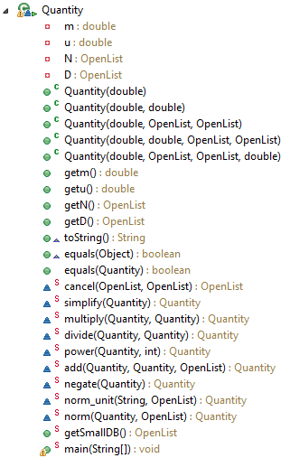
Quantity Overview
Instance variables
Constructors
To work more like Racket - Lots of static methods!
Accessors
Error propagation
Normalize Units using the association list of units
(and variables)

Slide 9
db.first().second() should be of type:
OpenList B) Object C) String D) Quantity E) ???
db is [
[foot, { 12.0, [inch], [], 0.0 }],
[cm, { 0.01, [meter], [], 0.0 }],
[mile, { 5280.0, [foot], [], 0.0 }],
[inch, { 0.0254, [meter], [], 0.0 }],
[hour, { 60.0, [minute], [], 0.0 }],
[minute, { 60.0, [second], [], 0.0 }],
[mph, { 1.0, [mile], [hour], 0.0 }],
[ohm, { 1.0, [volt], [ampere], 0.0 }],
[volt, { 1.0, [joule], [coulomb], 0.0 }],
[watt, { 1.0, [joule], [second], 0.0 }],
[coulomb, { 1.0, [ampere, second], [], 0.0 }],
[joule, { 1.0, [kg, meter, meter], [second, second], 0.0}]
]

Slide 10
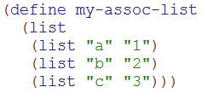



Review:
Racket assoc
Make an association list that stores keys and values.
Key
Value
Lookup information in the association list.
Sometimes the key won’t be there

Slide 11
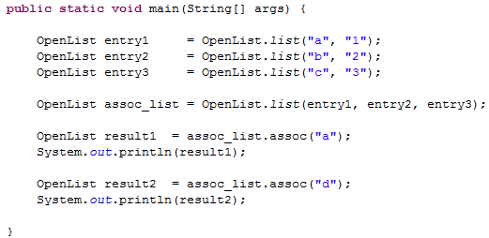
assoc in Java
What will print?
["a" "1"]
[]
"a"
"1"
???
This will print: [ ]

Slide 12
Big idea of Hw9
(Unicalc)
Parsing

Slide 13
A unicalc language
% java Evaluator
def yard 3 foot
{ 3.0, [foot], [] }
def furlong 0.125 mile
{ 0.125, [mile], [] }
def mile 5280 foot
{ 5280.0, [foot], [] }
1 foot + 2 yard
{ 7.0, [foot], [] }
def hour 3600 second
{ 3600.0, [second], [] }
def day 24 hour
{ 24.0, [hour], [] }
# 1 mile / day
???
An example
read-eval-print loop (REPL)
Woah! I can define things and then use them as units in calculations!
You will be adding things to the smallDB!
Notes:
REPL == read - eval - print - loop Prof. Keller had implemented in Scheme…
implementing in Java provides additional insight!

Slide 14
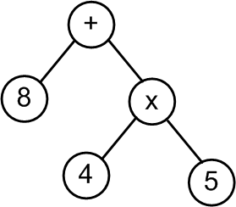
Big Picture for Unicalc in Java
String input
"8 + 4 * 5"
Tokenizer
String[] tokens
< “8” “+” “4” “*” “5” >
Parser
[+, [8], [*, [4], [5]]]
ParseTree tree
Evaluator
Quantity result
{28.0, [], [], 0.0}

Slide 15
ParseTree
Structure for the Tokens
(provided)
Returned by parse(String[] tokens)

Slide 16
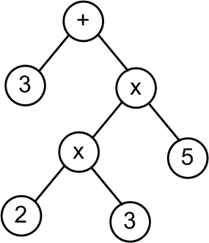
Evaluate these Parse Trees
Does this remind you of a previous homework assignment???
What is the value of this parse tree?
A) 33 B) 90 C)Other D)??

Slide 17
Design the ParseTree Class

Slide 18
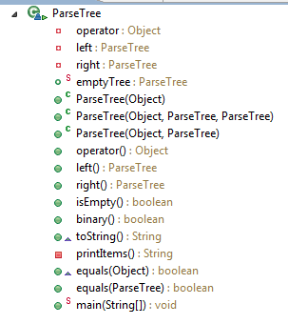
ParseTree
Overview
Instance variables
Constructors
Accessors

Slide 19
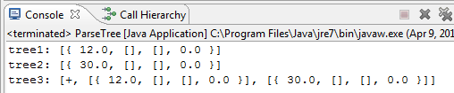
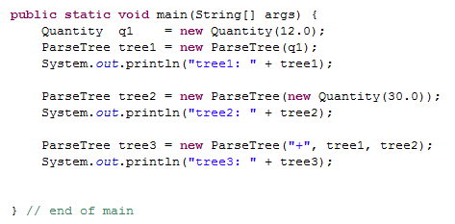
q1
tree1
args
main
Draw what memory looks like
A) Got it B) Stuck

Slide 20
q1
tree1
args
Quantity
m
u
N
D
main
ParseTree
operator
left
right
12.0
0.0
OpenList
first
rest
ParseTree
operator
left
right
Should there be two copies of this empty ParseTree here?
A) Yes B) No C)?

Slide 21
Creating ParseTrees

Slide 22
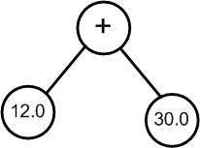
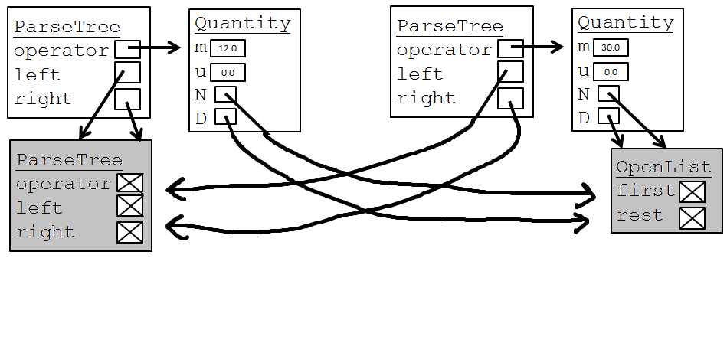
tree3
tree2
tree1
args
ParseTree
operator
left
right
Conceptual ParseTree
main
"+"

Slide 23
Big Picture for Unicalc in Java
String input
"8 + 4 * 5"
Tokenizer
String[] tokens
< “8” “+” “4” “*” “5” >
Parser
[+, [8], [*, [4], [5]]]
ParseTree tree
Evaluator
Quantity result
{28.0, [], [], 0.0}

Slide 24

Tokenizer
(Take in input and break it into pieces)
Java has a bunch of libraries, I bet I can use those to help me solve this problem!
It would save me time if Colleen just told me what libraries to use!

Slide 25

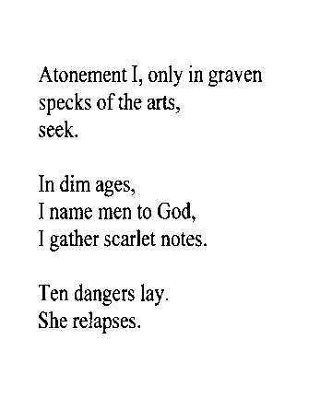
Tokenize – Figure out what are the tokens (words)
inumbrage
atonementionlyingravenspecksoftheartsseekindimagesinamementogodigatherscarletnotestendangerslaysherelapses
inumbrage
inumbrage
atonementionlyingravenspecksoftheartsseekindimagesinamementogodigatherscarletnotestendangerslaysherelapses
atonementionlyingravenspecksoftheartsseekindimagesinamementogodigatherscarletnotestendangerslaysherelapses
Re-parsable poetry?!
- Mike Maguire

Slide 26
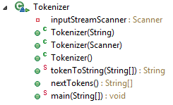
Tokenizer Overview
Instance variable: The input
Get the input from a file
Get the input from the command line
Default input: command line
Print
Most important method! Get the tokens!

Slide 27
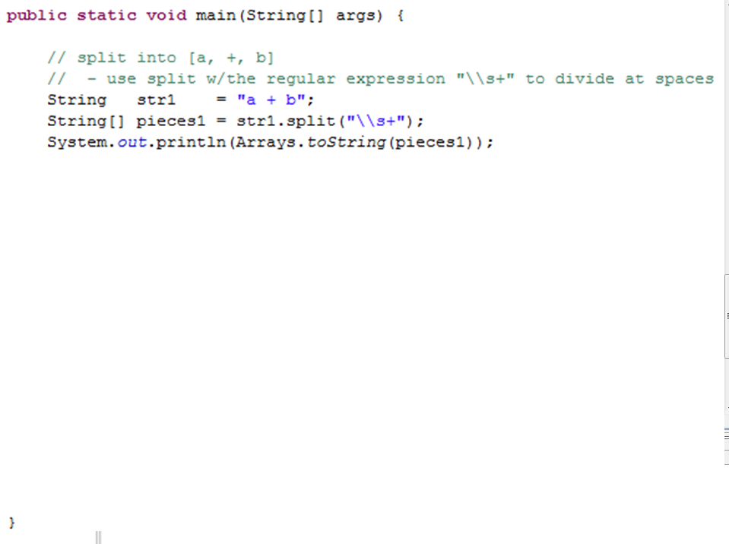
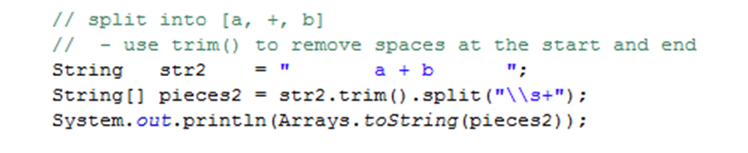
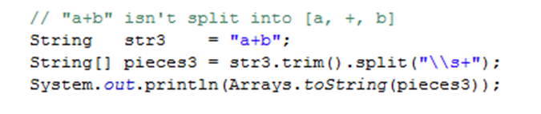
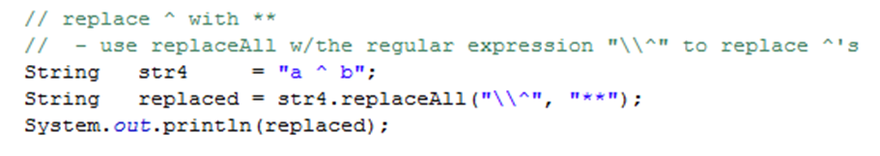
pieces1.length is 3
What is pieces3.length?
0
1
2
3
??
Can replaceAll help?

Slide 28
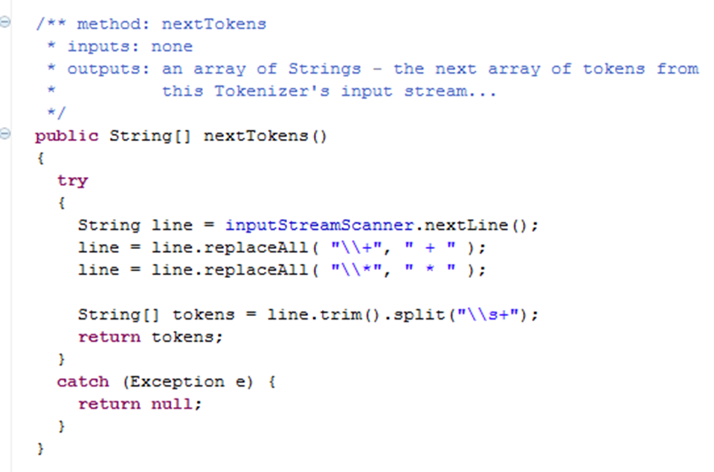
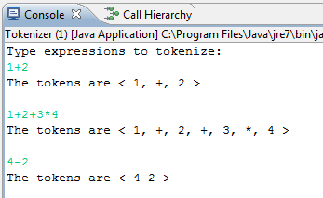
If I add more lines like this, does the order matter? A) Yes B) No
(Try to fix minus)
Tokenizer main method
Minus doesn’t get tokenized correctly!

Slide 29
Big Picture for Unicalc in Java
String input
"8 + 4 * 5"
Tokenizer
String[] tokens
< “8” “+” “4” “*” “5” >
Parser
[+, [8], [*, [4], [5]]]
ParseTree tree
Evaluator
Quantity result
{28.0, [], [], 0.0}

Slide 30
Evaluator
Evaluate the ParseTree

Slide 31
Examples: Numbers & Uncertainty & Units
The input line: 42
The tokens are < 42 >
The parseTree is [{ 42.0, [], [], 0.0 }]
The value is { 42.0, [], [], 0.0 }
The input line: 42~10
The tokens are < 42, ~, 10 >
The parseTree is [{ 42.0, [], [], 10.0 }]
The value is { 42.0, [], [], 10.0 }
The input line: 42 m
The tokens are < 42, m >
The parseTree is [{ 42.0, [m], [], 0.0 }]
The value is { 42.0, [m], [], 0.0 }
The input line: 42~10 v s m
The tokens are < 42, ~, 10, v, s, m >
The parseTree is [{ 42.0, [m, s, v], [], 10.0 }]
The value is { 42.0, [m, s, v], [], 10.0 }
Helpful for debugging to see the input, tokens, parseTree, and value.

Slide 32
Examples: Math without units
Notice the order of precedence
The input line: 5+6
The tokens are < 5, +, 6 >
The parseTree is [+, [{ 5.0, [], [], 0.0 }], [{ 6.0, [], [], 0.0 }]]
The value is { 11.0, [], [], 0.0 }
The input line: 5-6+7 // this grammar is _right_-associative
The tokens are < 5, -, 6, +, 7 >
The parseTree is [-, [{ 5.0, [], [], 0.0 }],
[+, [{ 6.0, [], [], 0.0 }], [{ 7.0, [], [], 0.0 }]]]
The value is { -8.0, [], [], 0.0 }
The input line: 5*6
The tokens are < 5, *, 6 >
The parseTree is [*, [{ 5.0, [], [], 0.0 }], [{ 6.0, [], [], 0.0 }]]
The value is { 30.0, [], [], 0.0 }
The input line: 5/6
The tokens are < 5, /, 6 >
The parseTree is [/, [{ 5.0, [], [], 0.0 }], [{ 6.0, [], [], 0.0 }]]
The value is { 0.833333, [], [], 0.0 }

Slide 33
Examples: Math with units
The input line: 3 m/s
The tokens are < 3, m, /, s >
The parseTree is [/, [{ 3.0, [m], [], 0.0 }],
[{ 1.0, [s], [], 0.0 }]]
The value is { 3.0, [m], [s], 0.0 }
The input line: 3 m * 2 m/s
The tokens are < 3, m, *, 2, m, /, s >
The parseTree is [*, [{ 3.0, [m], [], 0.0 }],
[/, [{ 2.0, [m], [], 0.0 }],
[{ 1.0, [s], [], 0.0 }]]]
The value is { 6.0, [m, m], [s], 0.0 }
The input line: 18 m/s + 42 m/s
The tokens are < 18, m, /, s, +, 42, m, /, s >
The parseTree is [+, [/, [{ 18.0, [m], [], 0.0 }],
[{ 1.0, [s], [], 0.0 }]],
[/, [{ 42.0, [m], [], 0.0 }],
[{ 1.0, [s], [], 0.0 }]]]
The value is { 60.0, [m], [s], 0.0 }
Input of "/ s" turned into the Quantity
[{ 1.0, [s], [], 0.0 }]]
Accumulation of Units!

Slide 34
Examples: Math Precedence
Notice the order of precedence
The input line: 5+6*7
The tokens are < 5, +, 6, *, 7 >
The parseTree is [+, [{ 5.0, [], [], 0.0 }],
[*, [{ 6.0, [], [], 0.0 }],
[{ 7.0, [], [], 0.0 }]]]
The value is { 47.0, [], [], 0.0 }
The input line: 5*6+7
The tokens are < 5, *, 6, +, 7 >
The parseTree is [+, [*, [{ 5.0, [], [], 0.0 }],
[{ 6.0, [], [], 0.0 }]],
[{ 7.0, [], [], 0.0 }]]
The value is { 37.0, [], [], 0.0 }
The input line: 3^2
The tokens are < 3, ^, 2 >
The parseTree is [^, [{ 3.0, [], [], 0.0 }],
2]
The value is { 9.0, [], [], 0.0 }

Slide 35
Examples: Parentheses
The input line: (42)
The tokens are < (, 42, ) >
The parseTree is [{ 42.0, [], [], 0.0 }]
The value is { 42.0, [], [], 0.0 }
The input line: (4+2)
The tokens are < (, 4, +, 2, ) >
The parseTree is [+, [{ 4.0, [], [], 0.0 }],
[{ 2.0, [], [], 0.0 }]]
The value is { 6.0, [], [], 0.0 }
The input line: (4+2)*7
The tokens are < (, 4, +, 2, ), *, 7 >
The parseTree is [*, [+, [{ 4.0, [], [], 0.0 }],
[{ 2.0, [], [], 0.0 }]],
[{ 7.0, [], [], 0.0 }]]
The value is { 42.0, [], [], 0.0 }
Parentheses determine the structure of the ParseTree, but aren’t represented in there.

Slide 36
Examples: Negation
The input line: (-42)
The tokens are < (, -, 42, ) >
The parseTree is [-, [{ 42.0, [], [], 0.0 }]]
The value is { -42.0, [], [], 0.0 }
The input line: 60 m +(-18 m)
The tokens are < 60, m, +, (, -, 18, m, ) >
The parseTree is [+, [{ 60.0, [m], [], 0.0 }],
[-, [{ 18.0, [m], [], 0.0 }]]]
The value is { -42.0, [m], [], 0.0 }
To negate a number, we MUST use parentheses (defined in the grammar)

Slide 37
Examples: def
The input line: def answer 42
The tokens are < def, answer, 42 >
The parseTree is [def, answer, [{ 42.0, [], [], 0.0 }]]
The value is { 42.0, [], [], 0.0 }
The current env is
[
[answer, { 42.0, [], [], 0.0 }]
]
The input line: 10 answer / s
The tokens are < 10, answer, /, s >
The parseTree is [/, [{ 10.0, [answer], [], 0.0 }],
[{ 1.0, [s], [], 0.0 }]]
The value is { 10.0, [answer], [s], 0.0 }
The current env is
[
[answer, { 42.0, [], [], 0.0 }]
]
def adds something to the environment
This wasn’t normalized!!! So it didn’t look up answer

Slide 38
Examples: def and # (which calls norm)
The input line: def answer 42
The tokens are < def, answer, 42 >
The parseTree is [def, answer, [{ 42.0, [], [], 0.0 }]]
The value is { 42.0, [], [], 0.0 }
The current env is
[
[answer, { 42.0, [], [], 0.0 }]
]
The input line: # 10 answer/s
The tokens are < #, 10, answer, /, s >
The parseTree is [#, [/, [{ 10.0, [answer], [], 0.0 }],
[{ 1.0, [s], [], 0.0 }]]]
The value is { 420.0, [], [s], 0.0 }
The current env is
[
[answer, { 42.0, [], [], 0.0 }]
]
# is the indication you want to normalize
(so it did look up answer)

Slide 39
Examples: def and minus (which calls norm)
The input line: def answer 42
The tokens are < def, answer, 42 >
The parseTree is [def, answer, [{ 42.0, [], [], 0.0 }]]
The value is { 42.0, [], [], 0.0 }
The current env is
[
[answer, { 42.0, [], [], 0.0 }]
]
The input line: 10 answer - 9 answer
The tokens are < 10, answer, -, 9, answer >
The parseTree is [-, [{ 10.0, [answer], [], 0.0 }],
[{ 9.0, [answer], [], 0.0 }]]
The value is { 42.0, [], [], 0.0 }
The current env is
[
[answer, { 42.0, [], [], 0.0 }]
]
We need to normalize when we do – and +
(so this looked up answer)

Slide 40
Examples: def (second call!)
The input line: def answer 42
The tokens are < def, answer, 42 >
The parseTree is [def, answer, [{ 42.0, [], [], 0.0 }]]
The value is { 42.0, [], [], 0.0 }
The current env is
[
[answer, { 42.0, [], [], 0.0 }]
]
The input line: def x 3 m/s
The tokens are < def, x, 3, m, /, s >
The parseTree is [def, x, [/, [{ 3.0, [m], [], 0.0 }],
[{ 1.0, [s], [], 0.0 }]]]
The value is { 3.0, [m], [s], 0.0 }
The current env is
[
[x, { 3.0, [m], [s], 0.0 }]
[answer, { 42.0, [], [], 0.0 }]
]
Our association list
(the environment)
can hold lots of things
(and they can have units)

Slide 41
Examples: def (3rd call)
The input line: def answer 7*(x+x)
The tokens are < def, answer, 7, *, (, x, +, x, ) >
The parseTree is [def, answer, [*, [{ 7.0, [], [], 0.0 }],
[+, [{ 1.0, [x], [], 0.0 }],
[{ 1.0, [x], [], 0.0 }]]]]
The value is { 42.0, [m], [s], 0.0 }
The current env is
[
[answer, { 42.0, [m], [s], 0.0 }]
[x, { 3.0, [m], [s], 0.0 }]
[answer, { 42.0, [], [], 0.0 }]
]
We can redefine answer, and it will always use the NEWEST version!

Slide 42
Examples: def (4th calls)
The input line: def hz 1/s
The tokens are < def, hz, 1, /, s >
The parseTree is [def, hz, [/, [{ 1.0, [], [], 0.0 }],
[{ 1.0, [s], [], 0.0 }]]]
The value is { 1.0, [], [s], 0.0 }
The current env is
[
[hz, { 1.0, [], [s], 0.0 }]
[answer, { 42.0, [m], [s], 0.0 }]
[x, { 3.0, [m], [s], 0.0 }]
[answer, { 42.0, [], [], 0.0 }]
]
This one is actually helpful to add to our environment
(the association list)

Slide 43
Examples: using multiple variables
The input line: answer + 18 m hz
The tokens are < answer, +, 18, m, hz >
The parseTree is [+, [{ 1.0, [answer], [], 0.0 }],
[{ 18.0, [hz, m], [], 0.0 }]]
The value is { 60.0, [m], [s], 0.0 }
The current env is
[
[hz, { 1.0, [], [s], 0.0 }]
[answer, { 42.0, [m], [s], 0.0 }]
[x, { 3.0, [m], [s], 0.0 }]
[answer, { 42.0, [], [], 0.0 }]
]
We normalize variables (answer) and units (hz) in the same way!

Slide 44
Grammars
Grammar: A set of rules that determines legal expressions in a language.
the starting rule or “production”
+
S V S
V
S = “I want to be a sum.”
V = “I want to be a value.”
"sum"
V
0
1
…
9
"value"
nonterminal or auxiliary symbol
This is how we write "or“ in grammars
each nonterminal symbol represents a “syntactic category”
terminal symbols -- things that appear in the expression to be parsed
alphabet = { +, 0, 1, …, 9 }

Slide 45
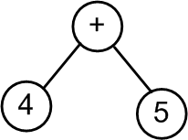
Grammars + Parsing
This shows how the production rules map to the tokens
A parser takes in tokens and outputs a parse tree,
according to some grammar!
Grammar:
S V S
V
+
S
"sum"
V
S
0
1
…
9
V
+
"value"
4
V
Parse tree: [+, [4], [5]]
5
Token list: <"4","+","5">
Input string: "4 + 5"

Slide 46
Grammars + Parsing
Show how the production rules map to the tokens
Grammar:
S
S V S
V
+
"sum"
V
0
1
…
9
"value"
Parse tree:
Token list: <"2","+","3","+","4" >
Draw the parse tree. How many nodes does it have? A) 3 B) 5 C) > 5 D) ??

Slide 47
DEMO – Parsing
Token list: <"4","+","5">
S
Calls V to handle V-stuff
When V returns
  If next token “+”
    Remove token
    Call S (recursion)
  If out of tokens
    Return
V
Removes token
Return
Grammar:
S V S
V
+
"sum"
V
0
1
…
9
"value"

Slide 48
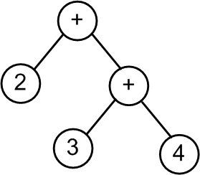
DEMO – Parsing
Token list: <"2","+","3","+","4" >
S
Calls V to handle V-stuff
When V returns
  If next token “+”
    Remove token
    Call S (recursion)
  If out of tokens
    Return
V
Removes token
Return
Grammar:
S V S
V
+
"sum"
V
0
1
…
9
"value"

Slide 49
A grammar defines all legal sentences
start here
S
V
+
S
V
-
S
V
S
V
0
1
…
9
Show how the production rules map to the tokens
A) Got it! B) Confused C) ??
8 - 4 + 5

Slide 50
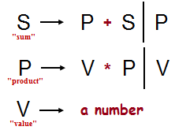
The Recursive Descent Parsing Algorithm
S
P
S
+
V
P
This shows how the production rules map to the tokens
V
*
P
8
V
4
5
Draw the resulting parse tree
< 8, +, 4, *, 5 >

Slide 51
Show how the production rules map to the tokens
S
Starting symbol
S
P
+
S
P
-
S
P
"sum"
P
V
*
P
V
/
P
V
"product"
V
0
1
…
9
"value"
1
Above, create the parse tree for the expression
What does parse tree evaluate to?
7 * 3 + 9 / 2
expression to be parsed
2
How could you change the grammar so that addition and subtraction had higher precedence than multiplication and division? And why might that be good?
What rule could you add that would enable the use of parentheses ( and ) for grouping terms?
3
Notes:
why it would be good -- because the expression comes out to 42!

Slide 52
Our grammar for the Unicalc language
Watch out…
* + vs. * +
the Start symbol
S
def
V
E
#
E
E
an Expression
E
P
+
E
P
-
E
P
you'll need to add code for these rules
a Product
P
K
*
P
K
/
P
K
a Ka-Power
K
U
^
I
U
a single Unit
U
(
E
)
(
-
E
)
Q
a Quantity list!
Q
D V
D~D V
V
*
*
+
zero or more Vs
with uncertainty!
one or more Vs
implemented in Parser.java for you already
D
a numeric value (Double)
42.0
V
a variable name (String)
"furlong"
I
a variable name (Integer)
5
tokens are in red

Slide 53
Our grammar with its parse trees…
the Start symbol
S
def
V
E
#
E
E
blue trees
[ "def", V, E ]
[ "#", E ]
E
an Expression
E
P
+
E
P
-
E
P
[ "+", P, E ]
[ "-", P, E ]
P
you'll need to add code for these rules
a Product
P
K
*
P
K
/
P
K
[ "∗", K, P ]
[ "/", K, P ]
K
a Ka-Power
K
U
^
I
U
[ "∗", U, I ]
U
a single Unit
U
(
E
)
(
-
E
)
Q
E
[ "-", E ]
Q
a Quantity list!
Q
D V
D~D V
V
*
+
[ { D [V∗] [ ] 0.0 } ]
[ { D [V∗] [ ] D } ]
[ { 1.0 [V+] [ ] 0.0 } ]
D
a numeric value (Double)
42.0
Quantity objects are in purple
V
a variable name (String)
"furlong"
I
a variable name (Integer)
5

Slide 54
BONUS

Slide 55
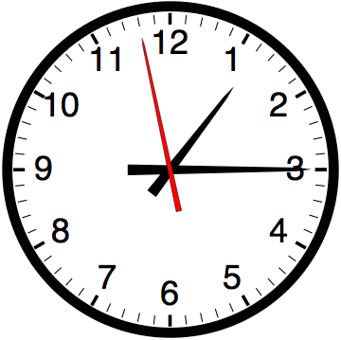

Slide 56


Computer
Science
&
= AWESOME

Slide 57

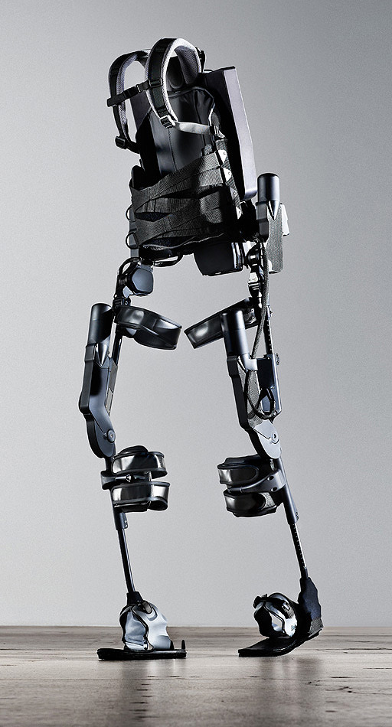
http://www.youtube.com/watch?v=pzRmNYA8LlY

Slide 58


ClickStart

Slide 59
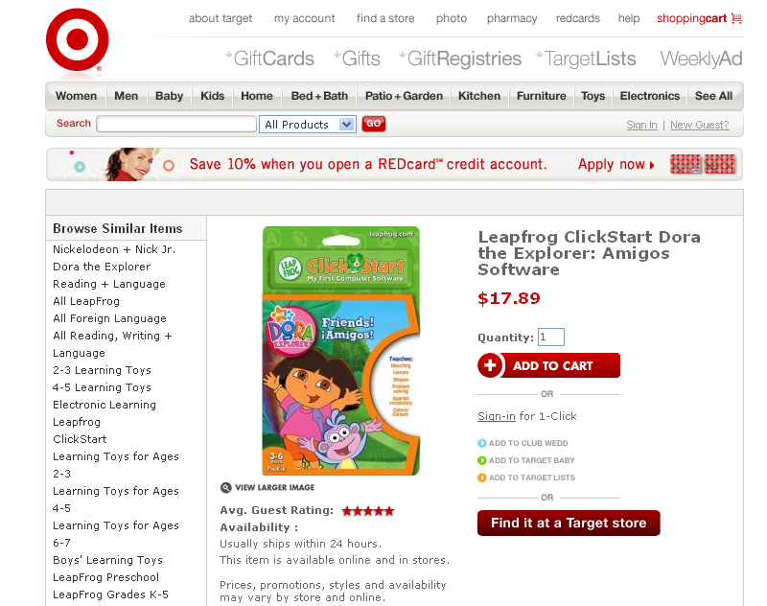

Slide 60

How should we represent the blocks in the computer?
Independent variables
2D Array
OpenList
I don’t know

Slide 61
The value in the array tells me what art asset to use
Each level is really a 3x10 vector!
0 | 0 | 7 | 0 | 4 | 0 | 0 | 0
1 | 2 | 3 | -4 | 5 | 6 | -7 | 8
B | B | B | B | B | B | B | B
Negative values tell me what block needs to go here to win!

Slide 62
0 | 0 | 7 | 0 | 4 | 0 | 0 | 0
1 | 2 | 3 | -4 | 5 | 6 | -7 | 8
0 | 0 | 0 | B | 0 | 0 | 0 | 0

Slide 63
BUGS!

Slide 64
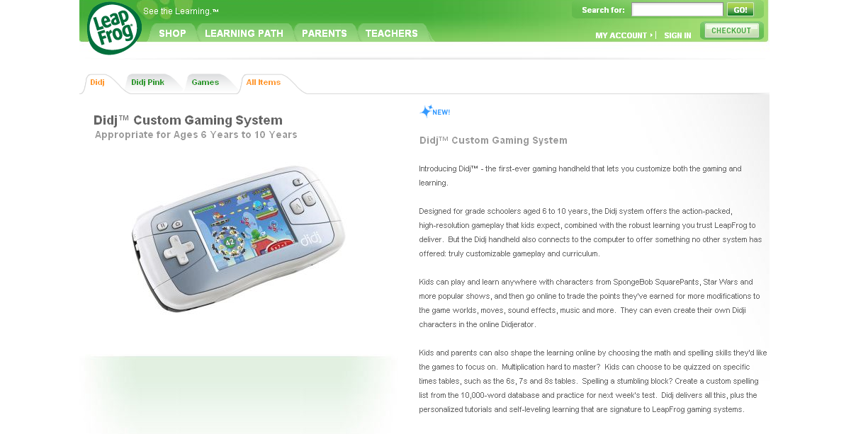

Slide 65

It is really sad when stuff you’ve made is on sale!

Slide 66



Which image is fake?
  A. Top Left
  B. Bottom Left
  C. Bottom Right

Slide 67
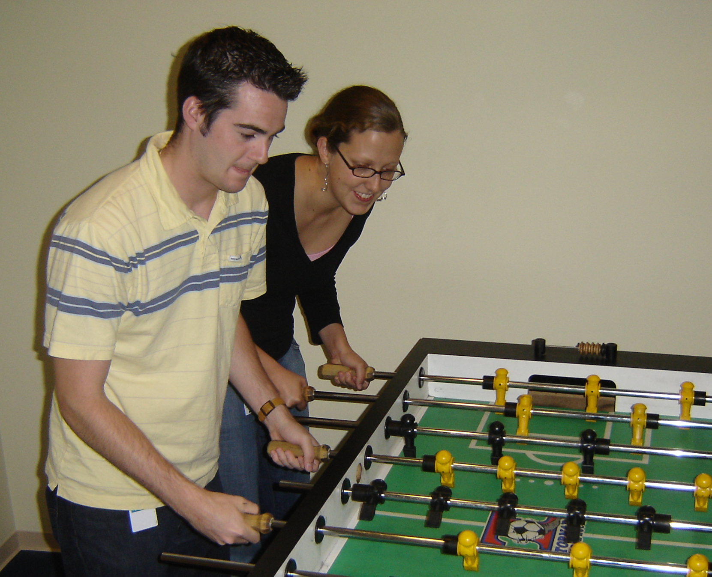

Slide 68
