Slide 1
CS 60
Parsing
2013-11-06
Wednesday – Week 9
Lecture 17

Slide 2
Announcements
Colleen is leaving town after class – back on Saturday.
  Checking email in the mornings and evenings

Slide 3
Review of Hw9
(Unicalc)
Parsing

Slide 4
What is the goal in hw9?
% java Evaluator
def yard 3 foot
{ 3.0, [foot], [] }
def furlong 0.125 mile
{ 0.125, [mile], [] }
def mile 5280 foot
{ 5280.0, [foot], [] }
1 foot + 2 yard
{ 7.0, [foot], [] }
def hour 3600 second
{ 3600.0, [second], [] }
def day 24 hour
{ 24.0, [hour], [] }
# 1 mile / day
???
An example
read-eval-print loop (REPL)
Woah! I can define things and then use them as units in calculations!
You will be adding things to the smallDB!
Notes:
REPL == read - eval - print - loop Prof. Keller had implemented in Scheme…
implementing in Java provides additional insight!

Slide 5
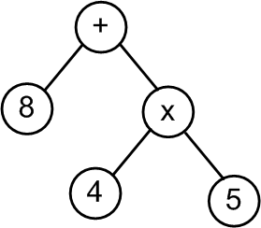
What were the steps in hw9?
String input
"8 + 4 * 5"
Tokenizer
String[] tokens
< “8” “+” “4” “*” “5” >
Parser
[+, [8], [*, [4], [5]]]
ParseTree tree
Evaluator
Quantity result
{28.0, [], [], 0.0}

Slide 6
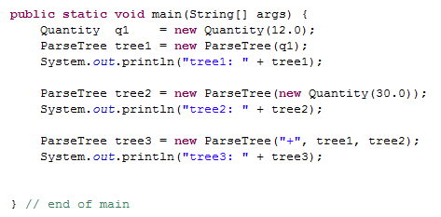
q1
tree1
args
Quantity
m
u
N
D
main
ParseTree
operator
left
right
12.0
0.0
OpenList
first
rest
ParseTree
operator
left
right
Should there be two copies of this empty ParseTree here?
A) Yes B) No C)?
What were the classes in hw9?

Slide 7
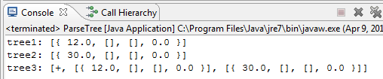
What were the classes/Objects in hw9?

Slide 8
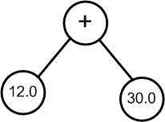
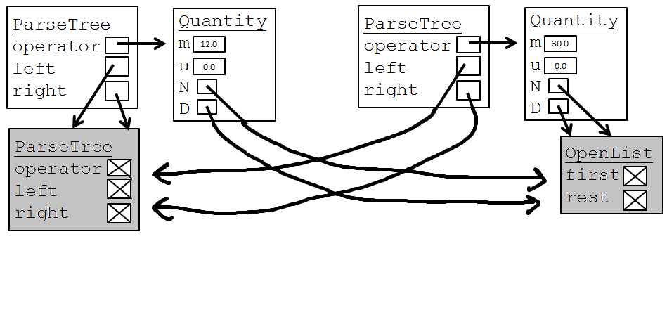
tree3
tree2
tree1
args
ParseTree
operator
left
right
Conceptual ParseTree
main
"+"

Slide 9
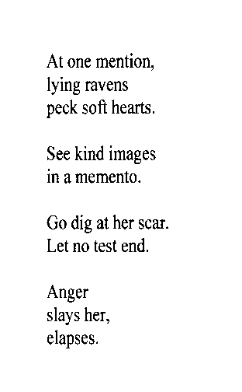
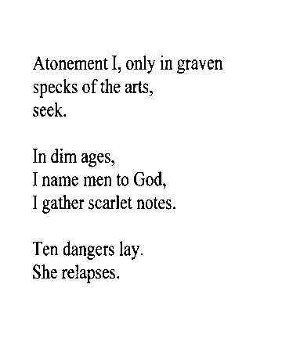
Just for fun/Example of tokenizing
inumbrage
atonementionlyingravenspecksoftheartsseekindimagesinamementogodigatherscarletnotestendangerslaysherelapses
inumbrage
inumbrage
atonementionlyingravenspecksoftheartsseekindimagesinamementogodigatherscarletnotestendangerslaysherelapses
atonementionlyingravenspecksoftheartsseekindimagesinamementogodigatherscarletnotestendangerslaysherelapses
Re-parsable poetry?!
- Mike Maguire

Slide 10
Our grammar for the Unicalc language
Watch out…
* + vs. * +
the Start symbol
S
def
V
E
#
E
E
an Expression
E
P
+
E
P
-
E
P
you'll need to add code for these rules
a Product
P
K
*
P
K
/
P
K
a Ka-Power
K
U
^
I
U
a single Unit
U
(
E
)
(
-
E
)
Q
a Quantity list!
Q
D V
D~D V
V
*
*
+
zero or more Vs
with uncertainty!
one or more Vs
implemented in Parser.java for you already
D
a numeric value (Double)
42.0
V
a variable name (String)
"furlong"
I
a variable name (Integer)
5
tokens are in red

Slide 11
Starting with a SMALL grammar
(2 rules)
A sum, S, is either a value, V, or a value, V, plus a sum, S.
S → V | V + S
A value, V, is a number.
V → 0|1|2|3|…

Slide 12
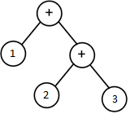





Parsing Sums
Find the V (I always start with a V)
If a + is next (I must be in the V+S case)
  skip the + and recurse (return ParseTree)
Else
  Return ParseTree with V in it
S → V | V + S V → 0|1|2|3|…
S
V
42 42 + 10 1 + 2 + 3

Slide 13
Grammar Vocab
Grammar: A set of rules that determines legal expressions in a language.
the starting rule or “production”
+
S V S
V
S = “I want to be a sum.”
V = “I want to be a value.”
"sum"
V
0
1
…
9
"value"
nonterminal or auxiliary symbol
This is how we write "or“ in grammars
each nonterminal symbol represents a “syntactic category”
terminal symbols -- things that appear in the expression to be parsed
alphabet = { +, 0, 1, …, 9 }

Slide 14
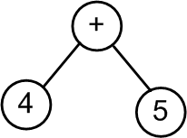
How grammars relate to ParseTrees
This shows how the production rules map to the tokens
A parser takes in tokens and outputs a parse tree,
according to some grammar!
Grammar:
S V S
V
+
"sum"
S
V
0
1
…
9
"value"
V
+
S
4
V
Parse tree: [+, [4], [5]]
5
Token list: <"4","+","5">
Input string: "4 + 5"

Slide 15
How grammars relate to ParseTrees
Show how the production rules map to the tokens
Grammar:
S
S V S
V
+
"sum"
V
0
1
…
9
"value"
Parse tree:
Token list: <"2","+","3","+","4" >
Draw the parse tree. How many nodes does it have? A) 3 B) 5 C) > 5 D) ??

Slide 16
We can handle + and – in the same rule
start here
S
V
+
S
V
-
S
V
S
V
0
1
…
9
Show how the production rules map to the tokens
A) Got it! B) Confused C) ??
8 - 4 + 5

Slide 17
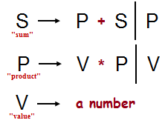
The Recursive Descent Parsing Algorithm
S
P
S
+
V
P
This shows how the production rules map to the tokens
V
*
P
8
V
4
5
Draw the resulting parse tree
< 8, +, 4, *, 5 >

Slide 18
Find the P (I always start with a P)
If a + or - is next (I must be in the P+S or P-S case)
  skip the + or - and recurse (return ParseTree)
Else
  Return ParseTree with P in it
Starting symbol
S
P
+
S
P
-
S
P
"sum"
P
V
*
P
V
/
P
V
"product"
Find the V (I always start with a V)
If a * or / is next (I must be in the V*P or V / P case)
  skip the * or / and recurse (return ParseTree)
Else
  Return ParseTree with V in it
V
0
1
…
9
"value"
Notes:
why it would be good -- because the expression comes out to 42!

Slide 19
Show how the production rules map to the tokens
S
Starting symbol
S
P
+
S
P
-
S
P
"sum"
P
V
*
P
V
/
P
V
"product"
V
0
1
…
9
"value"
7 * 3 + 9 / 2
expression to be parsed
Notes:
why it would be good -- because the expression comes out to 42!

Slide 20
Our grammar for the Unicalc language
Watch out…
* + vs. * +
the Start symbol
S
def
V
E
#
E
E
an Expression
E
P
+
E
P
-
E
P
you'll need to add code for these rules
a Product
P
K
*
P
K
/
P
K
a Ka-Power
K
U
^
I
U
a single Unit
U
(
E
)
(
-
E
)
Q
a Quantity list!
Q
D V
D~D V
V
*
*
+
zero or more Vs
with uncertainty!
one or more Vs
implemented in Parser.java for you already
D
a numeric value (Double)
42.0
V
a variable name (String)
"furlong"
I
a variable name (Integer)
5
tokens are in red

Slide 21
Our grammar with its parse trees…
the Start symbol
S
def
V
E
#
E
E
blue trees
[ "def", V, E ]
[ "#", E ]
E
an Expression
E
P
+
E
P
-
E
P
[ "+", P, E ]
[ "-", P, E ]
P
you'll need to add code for these rules
a Product
P
K
*
P
K
/
P
K
[ "∗", K, P ]
[ "/", K, P ]
K
a Ka-Power
K
U
^
I
U
[ "∗", U, I ]
U
a single Unit
U
(
E
)
(
-
E
)
Q
E
[ "-", E ]
Q
a Quantity list!
Q
D V
D~D V
V
*
+
[ { D [V∗] [ ] 0.0 } ]
[ { D [V∗] [ ] D } ]
[ { 1.0 [V+] [ ] 0.0 } ]
D
a numeric value (Double)
42.0
Quantity objects are in purple
V
a variable name (String)
"furlong"
I
a variable name (Integer)
5

Slide 22
Inheritance Review

Slide 23
Inheritance: extends
If we don’t explicitly say a class extends another class, it extends Object
public class Animal { }
public class Machine { }
public class Cat extends Animal { }
public class Dog extends Animal { }
Lots of Java Library classes extend Object
Child class
Parent class
We say “a Cat is an Animal” OR
“The child class object is a parent class object”
Object
Animal
Machine
Cat
Dog
String
When a class extends a parent class it can do all of the things that the parent class can do
1

Slide 24
public class Animal {
public int age = 3;
public void eat() {
// some code...
}
}
public class Dog extends Animal {
public void bark() {
System.out.println("yum");
}
public static void main(String[] args){
Dog d1 = new Dog();
Dog d2 = d1;
Animal a1 = d1;
}
}
Object
Animal
Machine
Cat
Dog
1
d1
d2
a1
args
Dog
age
main
3

Slide 25
T/F? Based upon the following object hierarchy:
Object
Animal
Machine
Car
Cat
Blender
Dog
Horse
Snoopy
Snoopy extends Dog ( T F )
A Snoopy object can do anything a Dog can do ( T F )
  Meaning: any public methods from the Dog class can be called on a Snoopy object
A Snoopy object can do anything an Animal can do ( T F )
  Meaning: any public methods from the Animal class can be called on a Snoopy object.
A Dog reference can refer to a Snoopy object ( T F )
An Object reference can refer to a Snoopy Object ( T F )
1
How many Trues? A) stuck B) 2 C) 3 D) 4 E) 5

Slide 26
Java Interfaces
Creating objects with common functionality
2

Slide 27
Ridable
Java Interfaces:
Ensuring common functionality
Object
Animal
Machine
Car
Cat
Blender
Dog
Horse
A Horse doesn’t extend a Car, but I want them to have some of the same methods to make them Ridable
2

Slide 28
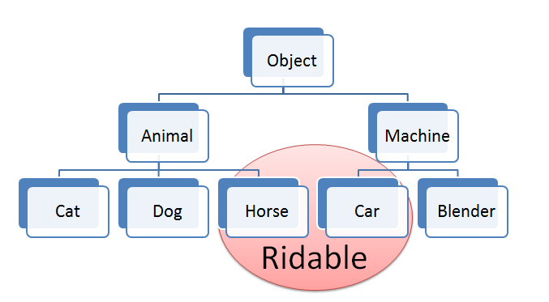
Goal: We want to have a Rideable remote control
(Rideable reference)
Rideable r1 = new Horse();
Rideable r2 = new Car();
r1.goForward();
r2.goForward();
2

Slide 29

Interfaces are Lazy!
I have a GREAT idea!
Everyone will want to make Ridable things that can
  turnLeft()
  turnRight()
  goForward()
How?!?!
  I don’t care!!!!
2

Slide 30
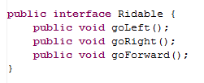
The Ridable interface
Interfaces don’t implement any methods!
They are just an idea!
2

Slide 31
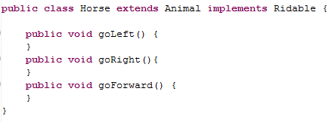
Horse can implement the Ridable interface
2
Horse is the child of Animal
Horse implements Ridable
Assume there is real code here

Slide 32
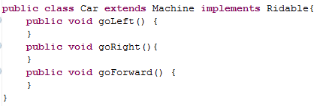
Car can implement the Ridable interface
2
Car is the child of Machine
Car implements Ridable

Slide 33
Can we have a Ridable object?
Ridable r1 = new Ridable();
Yes
No
I don’t know
2

Slide 34
Summary of Interfaces
2
( T F )
Interfaces don’t implement ANY methods
  Just put a semicolon at the end of the method
Classes can implement multiple interfaces
To implement an interface you must write all of the methods that the interface defines
When a class implements an interface you have a guarantee of what methods it will have
( T F )
( T F )
( T F )
How many Trues? A) stuck B) 1 C) 2 D) 3 E) 4

Slide 35
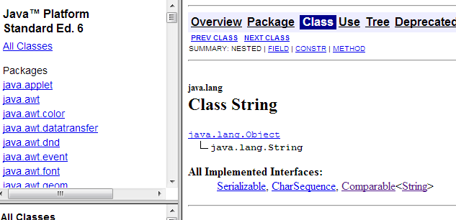
Interface Example: Comparable
  public interface Comparable {
  int compareTo(Object other);
  }
A more general type for the key of a BSTNode would have been Comparable
This is an example where an interface is actually useful!
2

Slide 36
Queues
First in – First Out
3

Slide 37

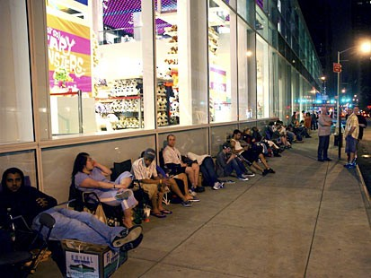

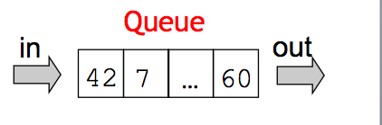
3
Queues
A first-in, first-out (FIFO) list
Or, first-come, first-served…
e.g., network requests -- or requests for network!
Queue
in
out
42
7
…
60
also, a hairstyle: the Imperial Queue
Greg Packer is at the front of this line somewhere…
Notes:
iPhone Line… Greag Packer got there 5am Monday morning for a 6pm Friday start of sales…
Can't buy a Wii!!

Slide 38
Typical Methods for Queues
enqueue: add something to the end of the queue
dequeue: remove something from the front of the queue
peek: look at the thing on the front of the queue
3

Slide 39

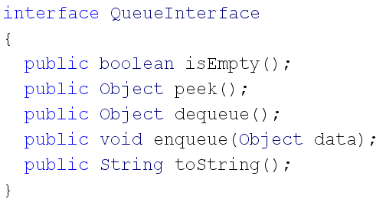
3
Interface Example: Queue
remove
add

Slide 40
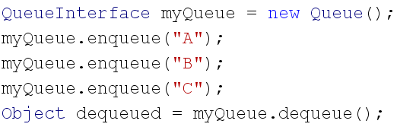

QUEUES: First in First Out
3
Create an object that implements QueueInterface
dequeued is "A"
A
B
C

Slide 41
What Java data structures could you use to implement a Queue?
List (from homework 6)
String[] (or some other Array)
An int
I and II
I only (II has some limitations)
II only (I has some limitations)
III
??

Slide 42

Try these
5
Read StackLL
Write isEmpty() for StackLL
Draw a picture of what this would produce.
Read StackArray code
Write isEmpty() for StackArray
Write peek() for StackArray and StackLL
Are you done with the pictures?
A) stuck B) Yes C) No

Slide 43
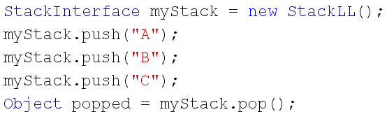
StackLL
front
StackCell
data
next
myStack
args
main
“B”
StackCell
data
next
“A”

Slide 44
Stacks
First in – Last out
4

Slide 45

Typical Methods for Stack
push : put something on top of the stack
pop: take something from the top of the stack
peek: look at the thing on the top of the stack
4

Slide 46
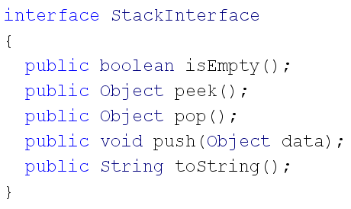
Interface Example: Stacks
4

Slide 47
STACKS: Last in First Out
Create an object that implements StackInterface
C
B
A
popped is "C"
4

Slide 48
BONUS

Slide 49
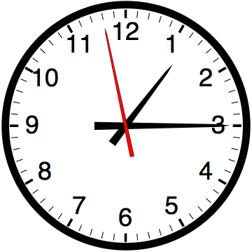

Slide 50


Computer
Science
&
= AWESOME

Slide 51
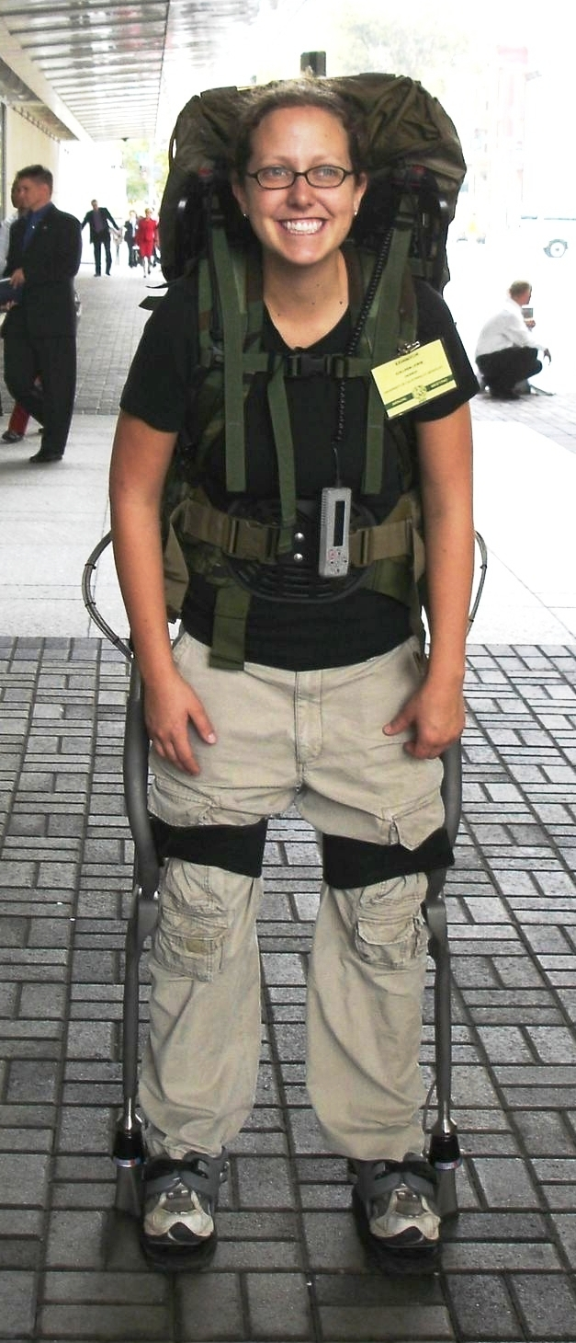
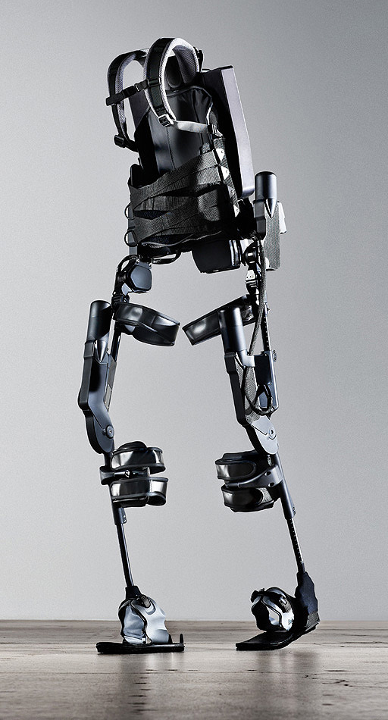
http://www.youtube.com/watch?v=pzRmNYA8LlY

Slide 52

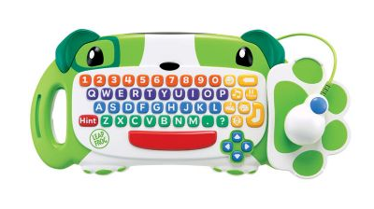
ClickStart

Slide 53
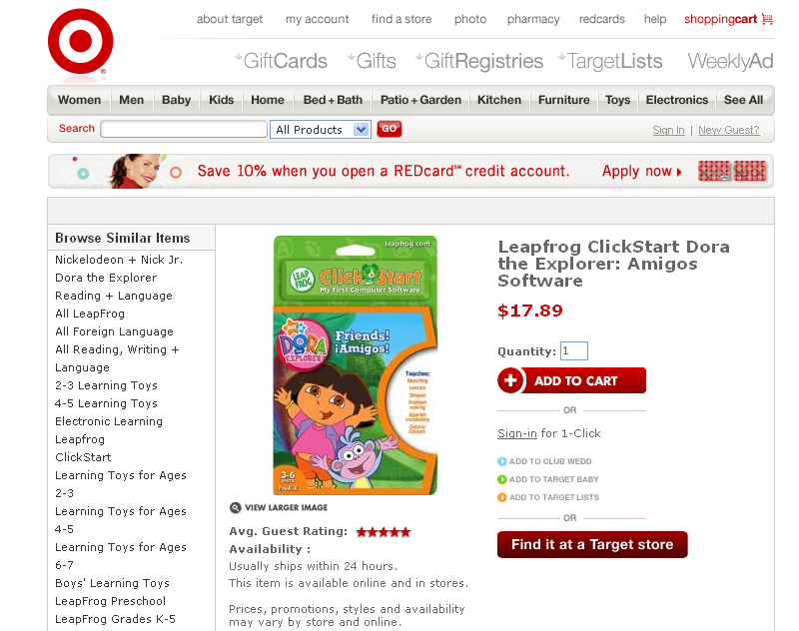

Slide 54
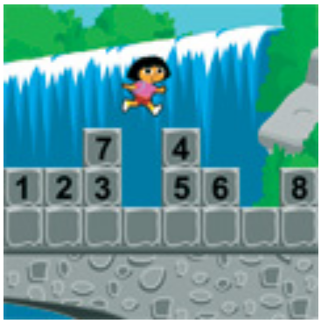
How should we represent the blocks in the computer?
Independent variables
2D Array
OpenList
I don’t know

Slide 55
The value in the array tells me what art asset to use
Each level is really a 3x10 vector!
0 | 0 | 7 | 0 | 4 | 0 | 0 | 0
1 | 2 | 3 | -4 | 5 | 6 | -7 | 8
B | B | B | B | B | B | B | B
Negative values tell me what block needs to go here to win!

Slide 56
0 | 0 | 7 | 0 | 4 | 0 | 0 | 0
1 | 2 | 3 | -4 | 5 | 6 | -7 | 8
0 | 0 | 0 | B | 0 | 0 | 0 | 0

Slide 57
BUGS!

Slide 58
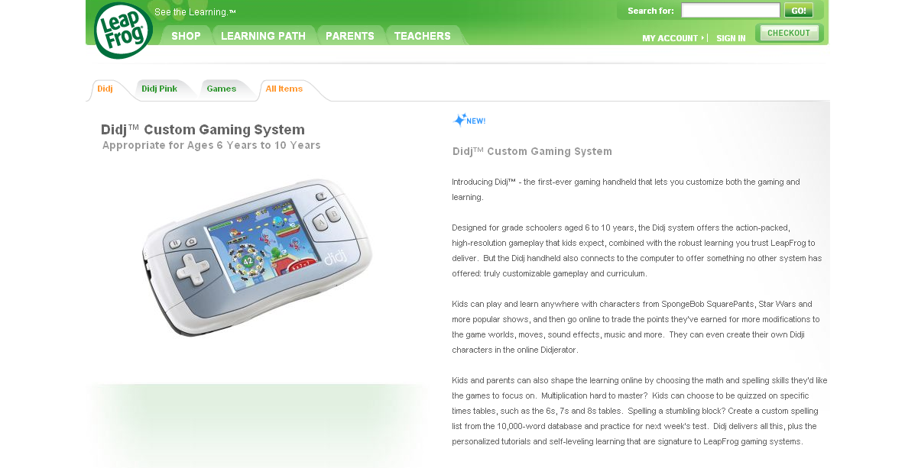

Slide 59
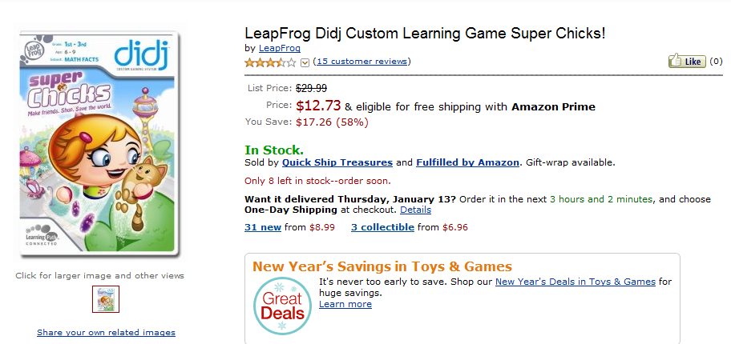
It is really sad when stuff you’ve made is on sale!

Slide 60
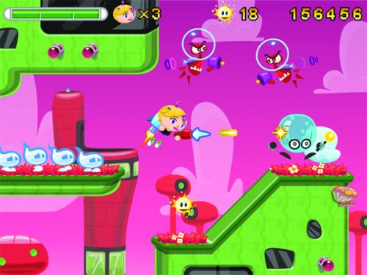
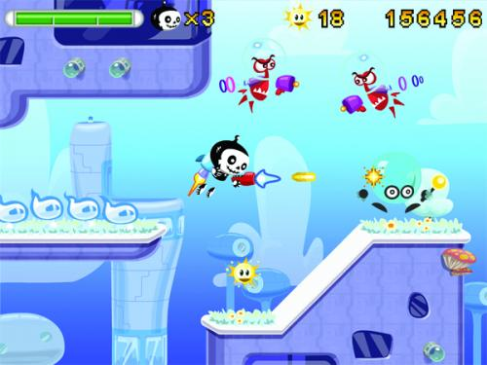

Which image is fake?
  A. Top Left
  B. Bottom Left
  C. Bottom Right

Slide 61
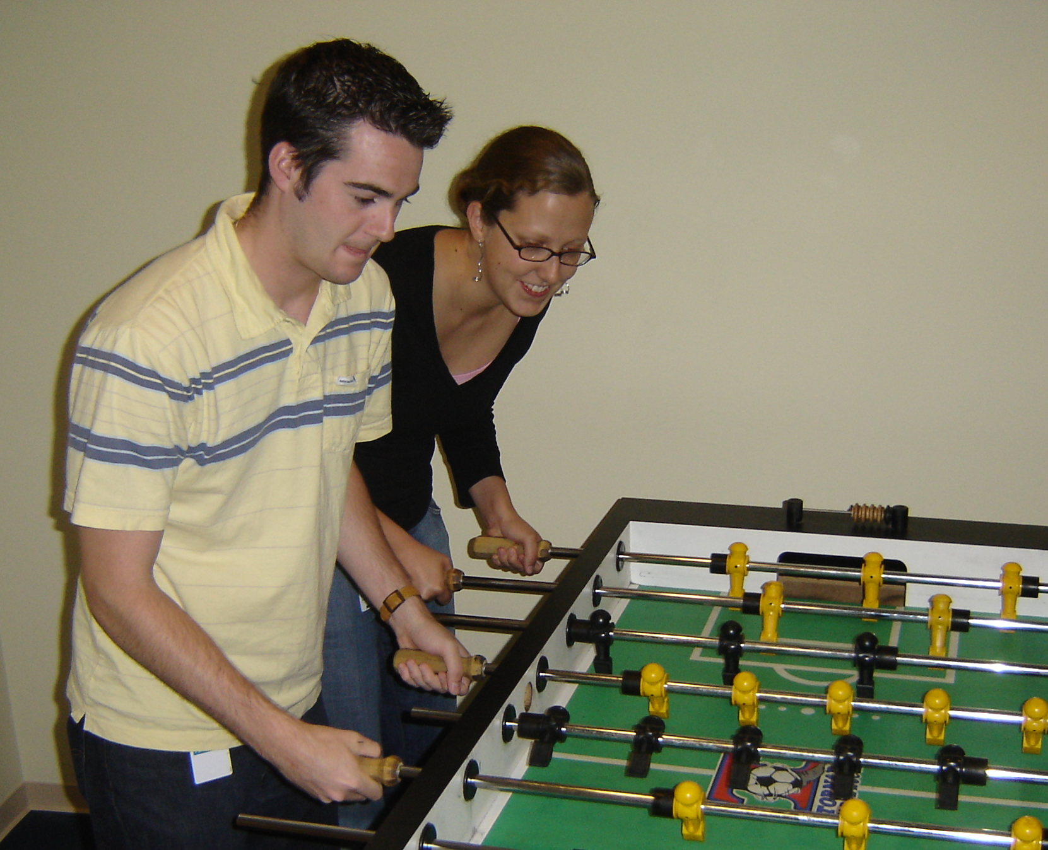

Slide 62
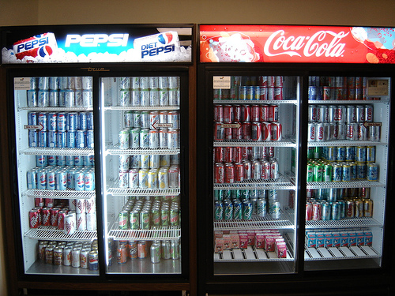

Slide 63
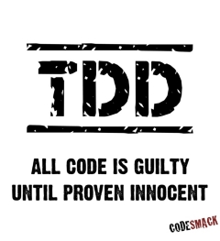
Test Driven Development

Slide 64
Test Driven Development
static void beAGoodProgrammer()
{
  while (true) // for each method
  {
  writeTest();
  writeCode();
  writeAFewMoreTests();
  writeCode();
  }
}
Remember to mention this at job interviews!

Slide 65
Why do Test Driven Development?
It is a way to brainstorm what your method is going to do.
It is hard to write test cases
Write your test cases before you’re biased by how your code is written

Slide 66
Modified TDD in CS60
When you read sample calls before your write your code
When we have provided test cases
When you write test cases
CS 60 Goal:
Before you write code (EVER) think…
How will I know if this works?
OR…Wow! Provided tests are helpful!

Slide 67
Test Driven Development Survey
Testing is terrible!
I like to USE tests that Colleen has written
I don’t mind writing tests
  b/c they are great to have when I write code
I like to write tests first
  b/c they help me think about the code

