Slide 1
CS 60
Sorting
& Big-O
2013-11-11
Monday – Week 10
Lecture 18

Slide 2
Survey – Help name Colleen’s research project
What’s the best title for a website with information about how students learn CS and how to teach CS:
CS Teaching Tips
CS Teaching Advice
Teaching CS
CS Pedagogy
CS Teaching Methods

Slide 3
Administrative Stuff (Not in your notes)
Regular office hours this week:
Tuesday 2-5pm in the LAC

Slide 4
Loop Counting

Slide 5
Example 7: Count the total # of constant-time operations?
for ( int i=0 ; i <= N ; i++){
// constant-time operation
}
for ( int z=0 ; z <= M ; z++){
// constant-time operation }
i=0
i=1
i=2
…
i=N-1
i=N
# ops per row
1
1
1
…
1
1
# ops per row
1
1
1
…
1
1
z=0
z=1
z=2
…
z=N-1
z=N
O(N+M)
Total of N
Total of M

Slide 6
Example 5: Count the total # of constant-time operations?
for ( int i=0 ; i <= N ; i++){
for ( int z=0 ; z <= M ; z++){
// constant-time operation
}
}
i=0
i=1
i=2
…
i=N-1
i=N
# ops per row
M
M
M
…
M
M
O(N*M)
Total of N*M

Slide 7
Example 3: Count the total # of constant-time operations?
for ( int i=N ; i > 0 ; i=i/2){
// constant-time operation
}
i=N
i=N/2
…
i=4
i=2
i=1
# ops per row
1
1
1
…
1
1
O(log₂(N))
Total
of log₂(N)

Slide 8
Recurrence Relationships (This will involve a lot of algebra – but no magic!)

Slide 9
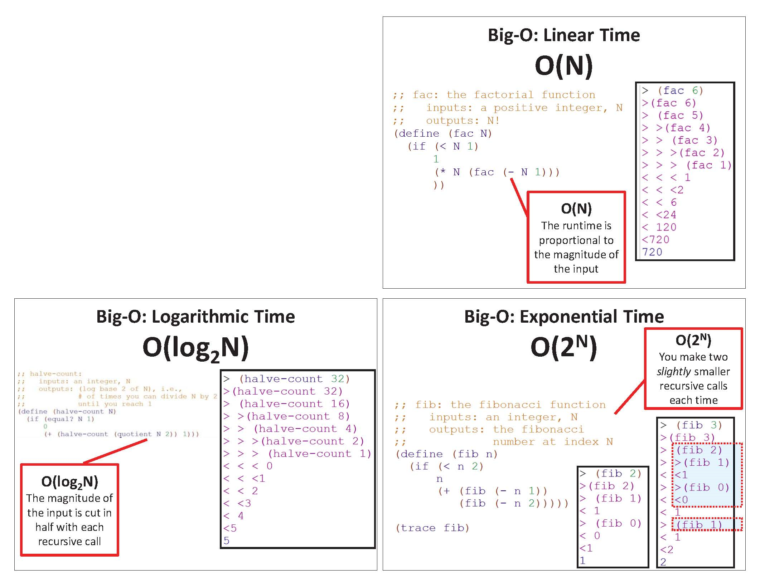
Imprecision ALERT!
Before, we looked at a specific example (e.g., N=6) and generalized!

Slide 10
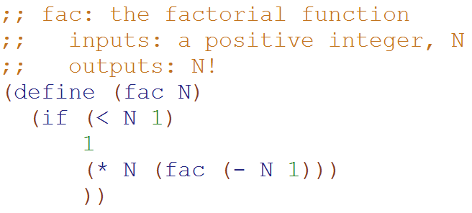
Big-O: Linear Time O(N)
How important was the assumption that this is exactly 1 constant-time operation?
Would using 6, 8, or 42 change the Big-O runtime?
A) Yes B) No C)??
How long does this take to run if N = 0?
Based upon this relationship
T(N) = 1 + T(N-1)
We can generalize that:
T(N-1) = 1 + T(N-2)
T(N-2) = 1 + T(N-3)
…
How long does this take to run for any N?
T(0) = 1
T(N) = 1 + T(N-1)
T(N) = 1 + 1 + T(N-2)
T(N) = 1 + 1 + 1 + T(N-3)
T(N) = 1 + 1 + 1 + … + 1 + 1 + 1
T(N) = N
Substitute this
Substitute this

Slide 11
Big-O: Linear Time O(N)
If N = 0,
only 3 constant-time operations
T(0) = 3
T(N) = 3 + T(N-1)
T(N) = 3 + 3 + T(N-2)
T(N) = 3 + 3 + 3 + T(N-3)
T(N) = 3 + 3 + 3 + … + 3 + 3 + 3
T(N) = 3N
BIG IDEA
The big-O answer is the same if we assume 3 constant-time operations or just 1
(on previous slide)
For N>0
3 constant-time operations
plus the recursive call

Slide 12
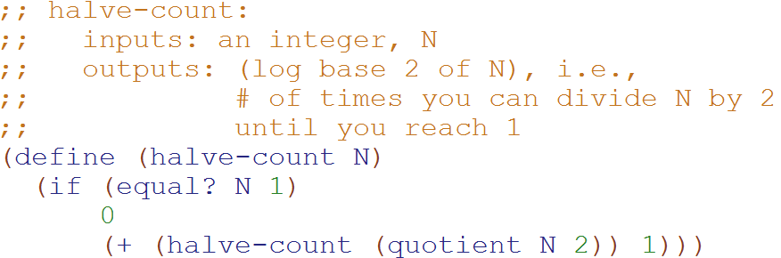
Big-O: Logarithmic Time O(log₂N)
Based upon this relationship
T(N) = 1 + T(N/2)
We can generalize that:
T(N/2) = 1 + T(N/4)
T(N/4) = 1 + T(N/8)
…
T(0) = 1
T(N) = 1 + T(N/2)
T(N) = 1 + 1 + T(N/4)
T(N) = 1 + 1 + 1 + T(N/8)
T(N) = 1 + 1 + 1 + … + 1 + 1 + 1
T(N) = logN
Substitute this
Substitute this

Slide 13

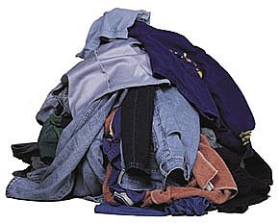




Bubble Sort
Selection Sort
Heap
Sort
Quick Sort
Merge
Sort

Slide 14

Bubble Sort

Slide 15
Bubble Sort Pseudocode http://www.youtube.com/watch?v=k4RRi_ntQc8
Step through the list to be sorted, compare adjacent elements, swap them if they are in the wrong order.
Repeat this process until no swaps are needed.
What is the Big-O runtime of Bubble Sort?
A) O(N) B) O(N log N) C) O(N²) D) O(2^{N}) E) ??
Is it sometimes faster than this? A) Yes B) No

Slide 16
Bubble Sort – Why it works!
Invariant: after the kth iteration, the k-largest elements are at the end of the list.

Slide 17
The Orange shows which elements are being compared.
15 | 3 | 1 | 9 | 4 | 7 | 5 | 4 | 0 | 12
3 | 15 | 1 | 9 | 4 | 7 | 5 | 4 | 0 | 12
3 | 1 | 15 | 9 | 4 | 7 | 5 | 4 | 0 | 12
3 | 1 | 9 | 15 | 4 | 7 | 5 | 4 | 0 | 12
3 | 1 | 9 | 4 | 15 | 7 | 5 | 4 | 0 | 12
3 | 1 | 9 | 4 | 7 | 15 | 5 | 4 | 0 | 12
3 | 1 | 9 | 4 | 7 | 5 | 15 | 4 | 0 | 12
3 | 1 | 9 | 4 | 7 | 5 | 4 | 15 | 0 | 12
3 | 1 | 9 | 4 | 7 | 5 | 4 | 0 | 15 | 12
3 | 1 | 9 | 4 | 7 | 5 | 4 | 0 | 12 | 15
The “biggest” element is in the right spot!

Slide 18
3 | 1 | 9 | 4 | 7 | 5 | 4 | 0 | 12 | 15
1 | 3 | 9 | 4 | 7 | 5 | 4 | 0 | 12 | 15
1 | 3 | 9 | 4 | 7 | 5 | 4 | 0 | 12 | 15
1 | 3 | 4 | 9 | 7 | 5 | 4 | 0 | 12 | 15
1 | 3 | 4 | 7 | 9 | 5 | 4 | 0 | 12 | 15
1 | 3 | 4 | 7 | 5 | 9 | 4 | 0 | 12 | 15
1 | 3 | 4 | 7 | 5 | 4 | 9 | 0 | 12 | 15
1 | 3 | 4 | 7 | 5 | 4 | 0 | 9 | 12 | 15
1 | 3 | 4 | 7 | 5 | 4 | 0 | 9 | 12 | 15
1 | 3 | 4 | 7 | 5 | 4 | 0 | 9 | 12 | 15
The two “biggest” elements are in the right spot!

Slide 19
1 | 3 | 4 | 7 | 5 | 4 | 0 | 9 | 12 | 15
1 | 3 | 4 | 7 | 5 | 4 | 0 | 9 | 12 | 15
1 | 3 | 4 | 7 | 5 | 4 | 0 | 9 | 12 | 15
1 | 3 | 4 | 7 | 5 | 4 | 0 | 9 | 12 | 15
1 | 3 | 4 | 5 | 7 | 4 | 0 | 9 | 12 | 15
1 | 3 | 4 | 5 | 4 | 7 | 0 | 9 | 12 | 15
1 | 3 | 4 | 5 | 4 | 0 | 7 | 9 | 12 | 15
1 | 3 | 4 | 5 | 4 | 0 | 7 | 9 | 12 | 15
1 | 3 | 4 | 5 | 4 | 0 | 7 | 9 | 12 | 15
1 | 3 | 4 | 5 | 4 | 0 | 7 | 9 | 12 | 15
The three “biggest” elements are in the right spot!

Slide 20
1 | 3 | 4 | 5 | 4 | 0 | 7 | 9 | 12 | 15
1 | 3 | 4 | 5 | 4 | 0 | 7 | 9 | 12 | 15
1 | 3 | 4 | 5 | 4 | 0 | 7 | 9 | 12 | 15
1 | 3 | 4 | 5 | 4 | 0 | 7 | 9 | 12 | 15
1 | 3 | 4 | 5 | 4 | 0 | 7 | 9 | 12 | 15
1 | 3 | 4 | 5 | 0 | 4 | 7 | 9 | 12 | 15
1 | 3 | 4 | 5 | 0 | 4 | 7 | 9 | 12 | 15
1 | 3 | 4 | 5 | 0 | 4 | 7 | 9 | 12 | 15
1 | 3 | 4 | 5 | 0 | 4 | 7 | 9 | 12 | 15
1 | 3 | 4 | 5 | 0 | 4 | 7 | 9 | 12 | 15
This entire set of n comparisons and we only swapped 2 elements!

Slide 21
; test cases for bubble
Started
Got base case
Got it
Stuck
(check-expect (bubble '(5))
'(5))
(check-expect (bubble '(5 1 2 3 4))
'(1 2 3 4 5))
(check-expect (bubble '(5 3 2 1 4))
'(3 2 1 4 5))
(check-expect (bubble '(3 5 2 1 4))
'(3 2 1 4 5))

Slide 22
; write bubble (in Racket)

Slide 23
; solution for bubble
(define (bubble L)
(if (or (null? L) (null? (rest L)))
L
(let ([element1 (first L)]
[element2 (second L)])
(if (> element1 element2)
(cons element2 (bubble (cons element1 (rest (rest L)))))
(cons element1 (bubble (cons element2 (rest (rest L))))) ))))

Slide 24

Sort

Slide 25
Insertion Sort Pseudocode
Starting with empty sequence of outputs S and the unsorted list of n input items I.
Add each item from input I, inserting into output sequence S at a position so the output is still in sorted order.
Invariant: at the kth iteration, the elements from 0 to k-1 in the output sequence S are sorted.
What is the Big-O runtime of Insertion Sort?
A) O(N) B) O(N log N) C) O(N²) D) O(2^{N}) E) ??
Is it sometimes faster than this? A) Yes B) No

Slide 26

Start with a “sorted” 1 element section
15 | 3 | 1 | 9 | 4 | 7 | 5 | 4 | 0 | 12
3 | 15 | 1 | 9 | 4 | 7 | 5 | 4 | 0 | 12
1 | 3 | 15 | 9 | 4 | 7 | 5 | 4 | 0 | 12
1 | 3 | 9 | 15 | 4 | 7 | 5 | 4 | 0 | 12
1 | 3 | 4 | 9 | 15 | 7 | 5 | 4 | 0 | 12
1 | 3 | 4 | 7 | 9 | 15 | 5 | 4 | 0 | 12
1 | 3 | 4 | 5 | 7 | 9 | 15 | 4 | 0 | 12
1 | 3 | 4 | 4 | 5 | 7 | 9 | 15 | 0 | 12
0 | 1 | 3 | 4 | 4 | 5 | 7 | 9 | 15 | 12
0 | 1 | 3 | 4 | 4 | 5 | 7 | 9 | 12 | 15

Slide 27
15 | 3 | 1 | 9 | 4 | 7 | 5 | 4 | 0 | 12
3 | 15 | 1 | 9 | 4 | 7 | 5 | 4 | 0 | 12
1 | 3 | 15 | 9 | 4 | 7 | 5 | 4 | 0 | 12
1 | 3 | 9 | 15 | 4 | 7 | 5 | 4 | 0 | 12
1 | 3 | 4 | 9 | 15 | 7 | 5 | 4 | 0 | 12
1 | 3 | 4 | 7 | 9 | 15 | 5 | 4 | 0 | 12
1 | 3 | 4 | 5 | 7 | 9 | 15 | 4 | 0 | 12
1 | 3 | 4 | 4 | 5 | 7 | 9 | 15 | 0 | 12
0 | 1 | 3 | 4 | 4 | 5 | 7 | 9 | 15 | 12
0 | 1 | 3 | 4 | 4 | 5 | 7 | 9 | 12 | 15
Let’s zoom into a single “insertion”

Slide 28
1 | 3 | 4 | 4 | 5 | 7 | 9 | 15 | 0 | 12
1 | 3 | 4 | 4 | 5 | 7 | 9 | 0 | 15
1 | 3 | 4 | 4 | 5 | 7 | 0 | 9 | 15
1 | 3 | 4 | 4 | 5 | 0 | 7 | 9 | 15
1 | 3 | 4 | 4 | 0 | 5 | 7 | 9 | 15
1 | 3 | 4 | 0 | 4 | 5 | 7 | 9 | 15
1 | 3 | 0 | 4 | 4 | 5 | 7 | 9 | 15
1 | 0 | 3 | 4 | 4 | 5 | 7 | 9 | 15
0 | 1 | 3 | 4 | 4 | 5 | 7 | 9 | 15 | 12
???
There are a lot of intermediate moves to get the 0 in the right spot.

Slide 29
% test cases for insert
:- begin_tests(insert).
test(insertT1) :- insert(1, [2, 3], [1, 2, 3]), !.
test(insertT2) :- insert(2, [1, 3], [1, 2, 3]), !.
test(insertT3) :- insert(3, [1, 2], [1, 2, 3]), !.
test(insertT4) :- insert(1, [1, 1], [1, 1, 1]), !.
test(insertT5) :- insert(1, [], [1]), !.
test(insertT6) :- \+insert(_, _, []).
:- end_tests(insert).
Started
Got base case
Got it
Stuck

Slide 30
% write insert in Prolog

Slide 31
% solution for insert
insert(X, [], [X]).
insert(X, [F|R], [X, F|R] ):- F >= X.
insert(X, [F|R], [F|R2]) :- X > F,
insert(X, R, R2).

Slide 32

Which is faster? A) Insertion Sort with an Array vs. B) Insertion Sort with a Linked List C) Tie! D) ??

Slide 33
Insertion Sort: O(n²)
Linked list
O(n) worst-case time to find the right position of S to insert each item (for n items).
O(1) time to insert the item (for n items).
Array
Find the right position in S in O(log n) time by binary search (for n items).
O(n) worst-case time to shift the larger items over to make room for the new item (for n items).

Slide 34

Selection Sort

Slide 35

Selection Sort Pseudocode
Starting an unsorted array (myArray) of n input items.
Walk through myArray and find the smallest item:
Swap the smallest item into the right place
(Also could: remove the item and put it at the end of an another array or linked list.)
Invariant: at the kth iteration, the k smallest elements of the input I are sorted.
What is the Big-O runtime of Selection Sort?
A) O(N) B) O(N log N) C) O(N²) D) O(2^{N}) E) ??

Slide 36
15 | 3 | 1 | 9 | 4 | 7 | 5 | 4 | 0 | 12
0 | 3 | 1 | 9 | 4 | 7 | 5 | 4 | 15 | 12
0 | 1 | 3 | 9 | 4 | 7 | 5 | 4 | 15 | 12
0 | 1 | 3 | 9 | 4 | 7 | 5 | 4 | 15 | 12
0 | 1 | 3 | 4 | 9 | 7 | 5 | 4 | 15 | 12
0 | 1 | 3 | 4 | 4 | 7 | 5 | 9 | 15 | 12
0 | 1 | 3 | 4 | 4 | 5 | 7 | 9 | 15 | 12
0 | 1 | 3 | 4 | 4 | 5 | 7 | 15 | 9 | 12
0 | 1 | 3 | 4 | 4 | 5 | 7 | 9 | 15 | 12
0 | 1 | 3 | 4 | 4 | 5 | 7 | 9 | 12 | 15
0 | 1 | 3 | 4 | 4 | 5 | 7 | 9 | 12 | 15
Swap the 15 with whatever is the smallest element
We swapped the 0 and the 15 (shown in gray)
Selection Sort
At this point the first 3 elements are sorted and in their final locations.

Slide 37
% test cases for min
:- begin_tests(min).
test(minT1) :- min([1, 2, 3], 1), !.
test(minT2) :- min([2, 1, 3], 1), !.
test(minT3) :- min([2, 3, 1], 1), !.
test(minT4) :- min([1, 1, 1], 1), !.
test(minT5) :- \+min([], _).
:- end_tests(min).
Started
Got base case
Got it
Stuck

Slide 38
% write min in Prolog

Slide 39
% solution for min
min([Min], Min).
min([F|R], Min):- min(R, Min), Min < F.
min([F|R], F) :- min(R, Min), Min > F.
min([F|R], F) :- min(R, Min), Min = F.

Slide 40
Runtime

Slide 41

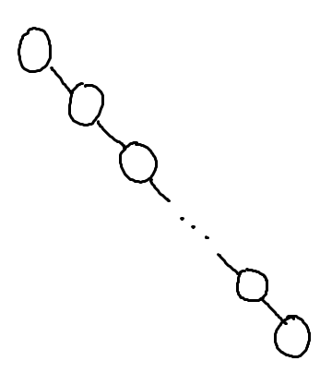
What is the worst case run-time for find in this Binary Search Tree?
O(1)
O(log n)
O(n log n)
O(n)
O(n²)

Slide 42
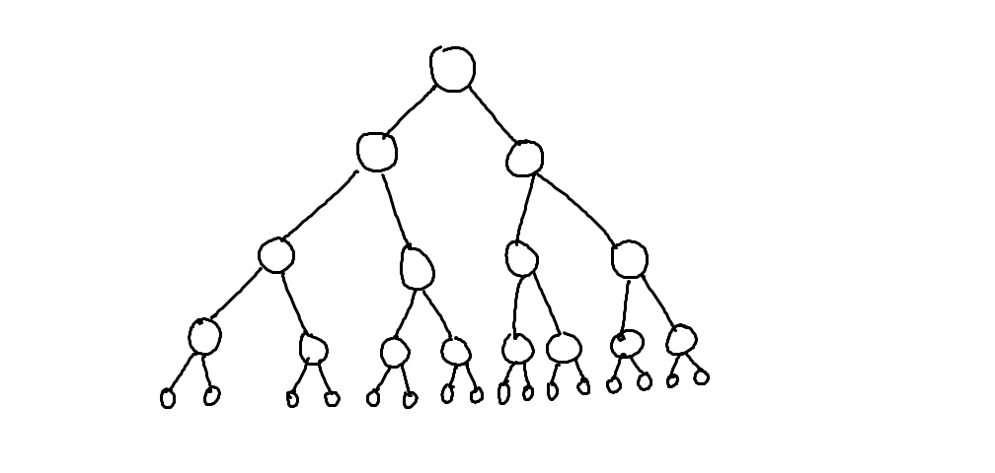
What is the worst case run-time for find in this Binary Search Tree?
O(1)
O(log n)
O(n log n)
O(n)
O(n²)
…

Slide 43
Assuming: all nodes have 0 or 1 children N nodes in the BST
BST Big-Oh (Completely Unbalanced Case)
Find |  | Insert |  | Delete
Best | Worst | Best | Worst | Best | Worst
O( ) | O( ) | O( ) | O( ) | O( ) | O( )

Slide 44
Assuming: all nodes have 0 or 2 children N nodes in the BST
BST Big-Oh (Balanced Case)
Find |  | Insert |  | Delete
Best | Worst | Best | Worst | Best | Worst
O( ) | O( ) | O( ) | O( ) | O( ) | O( )
O(1)
O(log n)
O(n log n)
O(n)
O(n²)

Slide 45
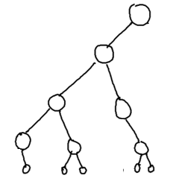
Assuming: most nodes have 0 or 2 children height is O(log n) N nodes in the BST
BST Big-Oh (Mostly Balanced Case)
Find |  | Insert |  | Delete
Best | Worst | Best | Worst | Best | Worst
O( ) | O( ) | O( ) | O( ) | O( ) | O( )

Slide 46
Big-Oh for Lists (a.k.a. linked lists)

Slide 47
Racket Lists Big-Oh
Insert (into front of list) | O( )
Insert (into end of list) | O( )
Find | O( )
Length | O( )
Delete (from the middle) | O( )
O(1)
O(log n)
O(n log n)
O(n)
O(n²)

Slide 48
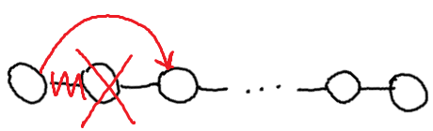
Assuming: the modifiable LinkedList using Hw5 List and ListNode
List/ListNode Big-Oh
Insert (into front of list) | O( )
Insert (into end of list) | O( )
Find (given a value) | O( )
Length | O( )
Delete (given a value) | O( )
Delete (given a ListNode ref) | O( )
O(1)
O(log n)
O(n log n)
O(n)
O(n²)

Slide 49
Big-Oh for Arrays

Slide 50
Unsorted Arrays Big-Oh
Insert (into first spot) | O( )
Insert (into last spot) | O( )
Find (given a value) | O( )
Delete (given a value) | O( )
5 | 3 | 8 | 2 | 1 | 7 | 0 | 0 | 0 | 0 | 0 | 0 | 0
Assuming:
unsorted array holding numbers within 1 to N
no duplicates
we keep track the last index we use (maxIndex)
all values at indices > maxIndex are 0 (unused).

Slide 51
Sorted Arrays Big-Oh
Insert (into first spot) | O( )
Insert (into last spot) | O( )
Find (given a value) | O( )
Delete (given a value) | O( )
Assuming:
sorted array holding numbers within 1 to N
no duplicates
we keep track the last index we use (maxIndex)
all values at indices > maxIndex are 0 (unused).
1 | 2 | 3 | 5 | 7 | 8 | 0 | 0 | 0 | 0 | 0 | 0 | 0

Slide 52
Boolean Arrays Big-Oh
Insert (into first spot) | O( )
Insert (into last spot) | O( )
Find (given a value) | O( )
Delete (given a value) | O( )
F₀ | T₁ | T₂ | T₃ | F₄ | T₅ | F₆ | T₇ | T₈
Assuming:
Boolean array representing numbers within 1 to X
X is a fixed number
no duplicates
Could I use this trick to store objects?

Slide 53
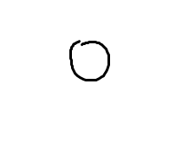
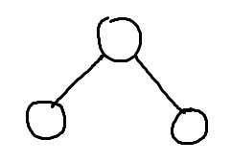
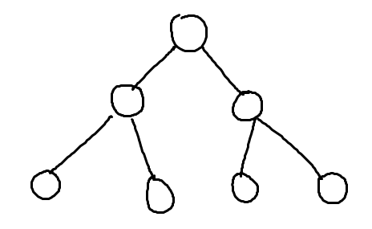
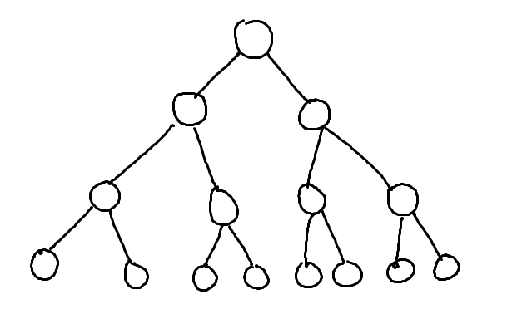
What’s the relationship between height and number of nodes?
3
7
1
15
31

Slide 54
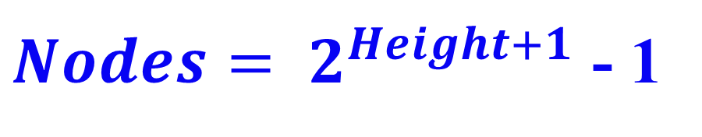
What’s the relationship between height and number of nodes?
1
3
7
Height | Nodes | 2^{Height+1}
0 | 1 | 2
1 | 3 | 4
2 | 7 | 8
3 | 15 | 16
4 | 31 | 32
5 | 63 | 64
15
31

Slide 55





// Take the log of both sides
Drop the 1
Who cares?
// Remember:

Slide 56
Runtimes (why we only care about the largest term)

Slide 57

How Fast Are Computers?
1 Hz = 1 operation /sec
2.9GHz = 2.9 x 10⁹ op / sec

Slide 58
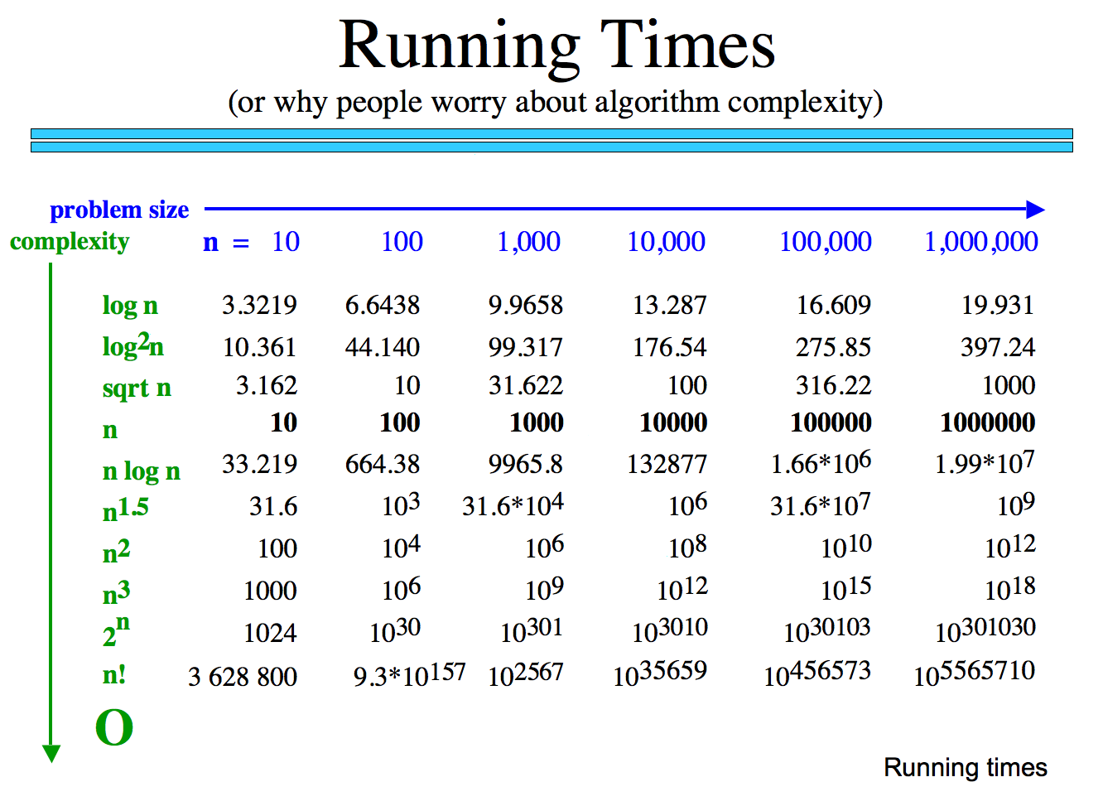
How many operations are required?
How long would these take if you have a 10 GHz Processor?

Slide 59
Why we only care about the largest term
How many operations are required?
Polynomial
Exp.
How big is n!
How long would these take if you have a 10 GHz Processor?

Slide 60
Classes of Problems
Big-O Order
n
n
n!
Intractable Problems (Exponential)
n
2
3
n
2
n
Tractable Problems (Polynomial)
n log(n)
Instead of using measured time – reason about the complexity of the problem
n
√n
log(n)
No Problem!
1

Slide 61
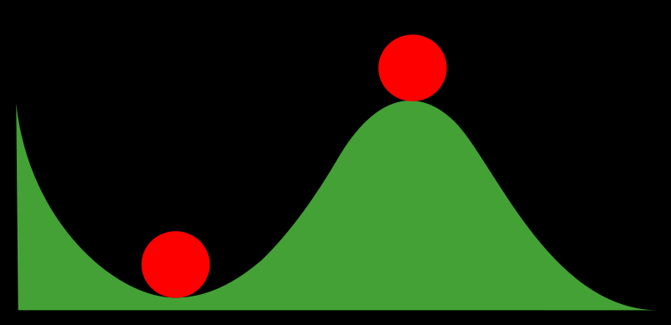
Stable and Non-Stable Sorting

Slide 62
Stable Sort
Sometimes there are equivalent keys in a data structure that is sorted.
Sometimes it matters if you change the order of those equivalent keys
E.g. Sorting music by song and then artist should keep each artists songs alphabetized
We call a sort “stable” if it doesn’t change the order of equivalent keys

Slide 63
Radix Sort (an example of a stable sort)

Slide 64
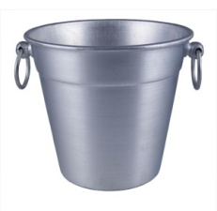
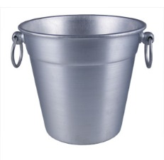
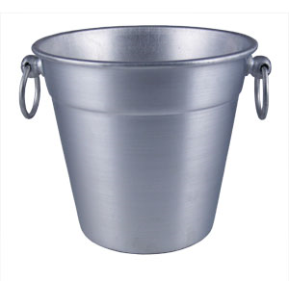

Easy Sorting Problems…
Sort N numbers in the range 0 to 9
0 | 1 | 2 | 3 | 4 | 5 | 6 | 7 | 8 | 9
How fast could you sort
N numbers
in the range 0 to B?
O(N)
O(B)
O(N+B)
O(N*B)
E) ??
In Big-O defining your variables is super important!

Slide 65
Harder Sorting Problems… Approach 1 – Two stages
Sort N numbers in the range 0 to 99
Make some buckets and calculate what bucket they need to go into.
Then sort each bucket
0 – 9 | 10-19 | 20-29 | 30-39 | 40-49 | 50-59 | 60-69 | 70-79 | 80-89 | 90-99

Slide 66
Harder Sorting Problems… Approach 2
Sort N numbers in the range 0 to 99
First sort by the one’s digit (this is counter intuitive)
95
25
98
29
20
32
93
85
97
38
39
0 | 1 | 2 | 3 | 4 | 5 | 6 | 7 | 8 | 9

Slide 67
Combine the buckets
Start from the first thing in the bucket
95
25
98
29
20
32
93
85
97
38
39
The 20’s are the correct relative order
0 | 1 | 2 | 3 | 4 | 5 | 6 | 7 | 8 | 9
20
20
32
93
85
25
25
95
97
38
98
39
29
29

Slide 68
Resort using the tens digit
20
32
93
85
25
95
97
38
98
39
29
Now Recombine!
98
29
39
97
25
38
95
20
32
85
93
0 | 1 | 2 | 3 | 4 | 5 | 6 | 7 | 8 | 9
20
25
29
32
38
39
85
93
95
97
98

Slide 69
Radix Sort the numbers 0-99
The running time for our example: (N + B)*2
We did two passes, each took N time.
We gathered up the buckets twice each took B time (where B is the number of buckets)

Slide 70








We can represent numbers with 1’s and 0’s
3 2 1 8
3*1000 + 2*100 + 1*10 + 8*1
1 0 0 1
1*8 + 0*4 + 0*2 + 1*1
We could use binary digits
0001 1
0010 2
0011 3
0100 4
0101 5
0110 6
0111 7
1000 8

Slide 71
Radix Sort with 32 bit numbers
We chose how many bits we want to sort at a time.
4 bits at a time (8 passes)
0000 0000 0000 0000 0000 0000 0000 0000
8 bits at a time (4 passes)
00000000 00000000 00000000 00000000
Running Time of Radix Sort in terms of
N: the number of items to sort
B: the number of buckets
P: the number of passes
Less than
Equal to
Greater than
??
O(N*B*P)

Slide 72
Quick Sort
This has to be the least helpful name ever…
But it is true. Quick Sort Rocks!

Slide 73
Quick Sort
Things we can do without too much trouble:
Divide up the list into two - based upon whether each element is bigger or smaller than a particular value (the “pivot”).
Delegating to another procedure to sort each of these halves
Sorting a 1 element list

Slide 74
QuickSort with Linked Lists
6 | 9 | 7 | 8 | 3 | 18 | 4 | 11 | 2 | 5 | 10
3 | 4 | 2 | 5
6
9 | 7 | 8 | 18 | 11 | 10
2
3
4 | 5
7 | 8
9
18 | 11 | 10
4
5
7
8
11 | 10
18
10
11
2 | 3 | 4 | 5 | 6 | 7 | 8 | 9 | 10 | 11 | 18

Slide 75
an array of zero or one elements is already sorted
function quicksort('array')
if length('array') = 1
return 'array'
select and remove a pivot value 'pivot' from 'array'
create empty lists 'less' and 'greater'
for each 'x' in 'array'
if 'x' <= 'pivot' then append 'x' to 'less'
else append 'x' to 'greater'
return concatenate(quicksort('less'), 'pivot', quicksort('greater'))
Divide
http://en.wikipedia.org/wiki/Quicksort

Slide 76
Quick Sort: The Algorithm (For your notes)
Given an unsorted list I of n items
Choose a pivot item v from I.
Partition I into two unsorted lists I1 and I2 I1 contains all items whose keys are smaller than v's key. I2 contains all items whose keys are larger than v's. Equal values can go either way.
After the partition v is in it’s final position.
Sort I1 recursively, yielding the sorted list S1.
Sort I2 recursively, yielding the sorted list S2.
Concatenate S1, v, and S2 together, yielding a sorted list S.

Slide 77
Can you make Quick Sort run in… (what is the worst you can do? Describe the input)
O(N)
O(N log N)
O(N²)
O(N³)
O(2^{N})

Slide 78
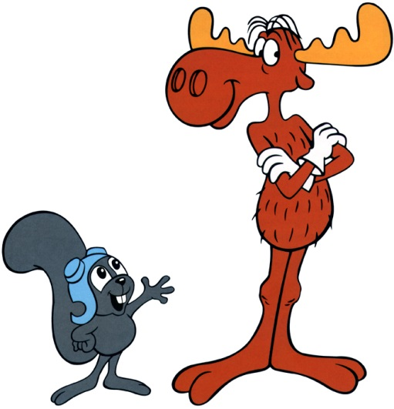
Can you make Quick Sort run in… (what is the best you can do? Describe the input)
O(N)
O(N log N)
O(N²)
O(N³)
O(2^{N})

Slide 79
Quick Sort – Choosing a Pivot
What if the pivot I chose was larger than all the other elements?
99 | 9 | 7 | 8 | 3 | 18 | 4 | 11 | 2 | 5 | 10
10 | 9 | 7 | 8 | 3 | 18 | 4 | 11 | 2 | 5 | 99
This gets sent to be recursively sorted
There is nothing to send in the other recursive call
Quick Sort is a “divide and conquer algorithm” but this didn’t divide!

Slide 80
Quick Sort
Worst case performance:
O(n²)
Best case performance:
O(n log n)
In practice the fastest known comparison-based sort for arrays
It matters how evenly the pivot divides the elements!!!

Slide 81
QuickSort with an Array
Pivot = first index you’re sorting
L = second index you’re sorting
G = last index you’re sorting
While L <= G
Increase L until it references something bigger than the pivot
Decrease G until it references something smaller than the pivot
Swap elements at L and G
Swap the pivot with the element at G

Slide 82
Quick Sort with an Array DEMO
L
L
L
L
G
L
G
G
G
G
G
G
6 | 5 | 2 | 8 | 3 | 18 | 4 | 11 | 7 | 9 | 10
6 | 5 | 2 | 4 | 3 | 18 | 8 | 11 | 7 | 9 | 10
3 | 5 | 2 | 4 | 6 | 18 | 8 | 11 | 7 | 9 | 10
6 | 9 | 7 | 8 | 3 | 18 | 4 | 11 | 2 | 5 | 10
6 | 9 | 7 | 8 | 3 | 18 | 4 | 11 | 2 | 5 | 10
6 | 9 | 7 | 8 | 3 | 18 | 4 | 11 | 2 | 5 | 10
6 | 9 | 7 | 8 | 3 | 18 | 4 | 11 | 2 | 5 | 10
6 | 9 | 7 | 8 | 3 | 18 | 4 | 11 | 2 | 5 | 10
6 | 5 | 7 | 8 | 3 | 18 | 4 | 11 | 2 | 9 | 10
6 | 5 | 7 | 8 | 3 | 18 | 4 | 11 | 2 | 9 | 10
6 | 5 | 7 | 8 | 3 | 18 | 4 | 11 | 2 | 9 | 10
6 | 5 | 2 | 8 | 3 | 18 | 4 | 11 | 7 | 9 | 10
6 | 5 | 2 | 8 | 3 | 18 | 4 | 11 | 7 | 9 | 10
6 | 5 | 2 | 8 | 3 | 18 | 4 | 11 | 7 | 9 | 10
6 | 5 | 2 | 4 | 3 | 18 | 8 | 11 | 7 | 9 | 10
6 | 5 | 2 | 4 | 3 | 18 | 8 | 11 | 7 | 9 | 10
6 | 5 | 2 | 4 | 3 | 18 | 8 | 11 | 7 | 9 | 10

Slide 83
Quick Sort Demo
6 | 9 | 7 | 8 | 3 | 18 | 4 | 11 | 2 | 5 | 10
6 | 9 | 7 | 8 | 3 | 18 | 4 | 11 | 2 | 5 | 10
6 | 9 | 7 | 8 | 3 | 18 | 4 | 11 | 2 | 5 | 10
6 | 9 | 7 | 8 | 3 | 18 | 4 | 11 | 2 | 5 | 10
6 | 9 | 7 | 8 | 3 | 18 | 4 | 11 | 2 | 5 | 10
6 | 5 | 7 | 8 | 3 | 18 | 4 | 11 | 2 | 9 | 10
6 | 5 | 7 | 8 | 3 | 18 | 4 | 11 | 2 | 9 | 10
6 | 5 | 7 | 8 | 3 | 18 | 4 | 11 | 2 | 9 | 10

Slide 84
Quick Sort Demo
6 | 5 | 7 | 8 | 3 | 18 | 4 | 11 | 2 | 9 | 10
6 | 5 | 2 | 8 | 3 | 18 | 4 | 11 | 7 | 9 | 10
6 | 5 | 2 | 8 | 3 | 18 | 4 | 11 | 7 | 9 | 10
6 | 5 | 2 | 8 | 3 | 18 | 4 | 11 | 7 | 9 | 10
6 | 5 | 2 | 8 | 3 | 18 | 4 | 11 | 7 | 9 | 10
6 | 5 | 2 | 4 | 3 | 18 | 8 | 11 | 7 | 9 | 10
6 | 5 | 2 | 4 | 3 | 18 | 8 | 11 | 7 | 9 | 10
6 | 5 | 2 | 4 | 3 | 18 | 8 | 11 | 7 | 9 | 10
6 | 5 | 2 | 4 | 3 | 18 | 8 | 11 | 7 | 9 | 10
3 | 5 | 2 | 4 | 6 | 18 | 8 | 11 | 7 | 9 | 10

Slide 85
Big-O Formal Definition

Slide 86
Big-O Overview
We want to express the speed of an algorithm independently of a specific implementation on a specific machine.
We examine the cost of the algorithms for large input sets i.e. the asymptotic cost.
In later classes you’ll do this in more detail

Slide 87
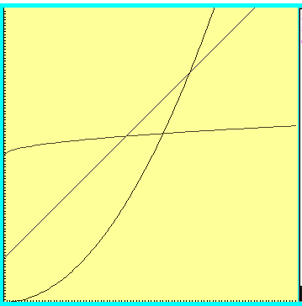



Which one is fastest?

Slide 88
“Woah! One of these is WAY better after this point. Let’s call that point N”

Slide 89



Which is fastest after some big value N?

Slide 90



Which is fastest after some value N?
WAIT – who cares? These are all proportional!
Sometimes we do care, but for simplicity we ignore constants

Slide 91
Formal definition
if and only if
for all n > N

Slide 92

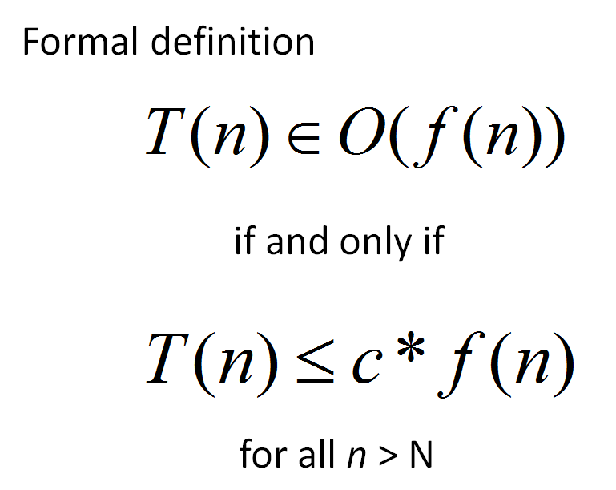
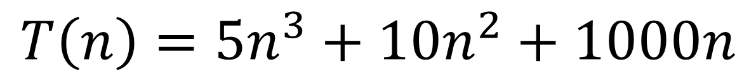
Applying the Formal Definition
$$T\left(n\right)=5n^{3}+10n^{2}+1000n$$
There is only one possible value for c and N
True
False
??
What values of c and N
make this true?

Slide 93

Big-O definition
(using different notation)
T(n) ∈ O(f(n)) means
(∃c) (∃N) (∀n > N) T(n) < c*f(n)
+ threshold N
there exists a constant c
for all input sizes bigger than that threshold, N
To claim that
42n² + 100n ∈ O(n²)
We need to find c and N such that for all n > N,
c =
N =
42n² + 100n < cn²
Notes:
n > 1001 = k, c = 1001
n > 1 = k, c = 42

Slide 94
Apply the formal definition
42n+999 ∈ O(n) ?
2
3
50n ∈ O(n ) ?
0.001*n! ∈ O(n ) ?
True or False?
True or False?
True or False?
c =
N =
c =
N =
c =
N =
Are these the “best” bounds?
Use simplest form with O notation

Slide 95
Recurrence Relationships (This will involve a lot of algebra – but no magic!)

Slide 96
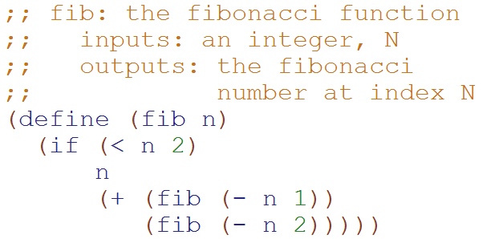
Big-O: Exponential Time O(2^{N})
T( __ ) = ______
T(N) = ___________________
How many terms?
1
2
3
4
??

Slide 97
Big-O: Exponential Time O(2^{N})
Define:
T₁(N) = 1 + 2*T₁(N-1)
T₂(N) = 1 + 2*T₂(N-2)
T₂(N) ≤ T(N) ≤ T₁(N)
T(1) = 1
T(N) = 1 + T(N-1) + T(N-2)
T₂(N) ≤ T(N)
1 + T₂(N-2) + T₂(N-2) ≤ 1 + T(N-1) + T(N-2)
1 + T₂(N-2) + T(N-2) ≤ 1 + T(N-1) + T(N-2)
?
?
This is complicated! Let’s look for an upper bound
T(N) ≤ T₁(N)
1 + T(N-1) + T(N-2) ≤ 1 + T₁(N-1) + T₁(N-1)
1 + T(N-1) + T(N-2) ≤ 1 + T₁(N-1) + T(N-2)

Slide 98
Big-O: Exponential Time O(2^{N})
Based upon this relationship
T₁(N) = 1 + 2*T₁(N-1)
We can generalize that:
T₁(N-1) = 1 + 2*T₁(N-2)
T₁(N-2) = 1 + 2*T₁(N-3)
…
T₁(1) = 1
T₁(N) = 1 + 2*T₁(N-1)
T₁(N) = 1 + 2*(1 + 2*T₁(N-2))
T₁(N) = 1 + 2 + 4*T₁(N-2)
T₁(N) = 1 + 2 + 4*(1 + 2T₁(N-3))
…
T₁(N) = 1 + 2 + 4 + … + 2^{N-1}
T₁(N) = 2^{N} -1
Substitute this
distribute
Substitute this

Slide 99
Big-O: Exponential Time O(2^{N})
Based upon this relationship
T₂(N) = 1 + 2*T₂(N-2)
We can generalize that:
T₂(N-2) = 1 + 2*T₂(N-4)
T₂(N-4) = 1 + 2*T₂(N-8)
…
T₂(0) = 1, T₂(1) = 1
T₂(N) = 1 + 2*T₂(N-2)
T₂(N) = 1 + 2*(1 + 2*T₂(N-4))
T₂(N) = 1 + 2 + 4*T₂(N-4)
T₂(N) = 1 + 2 + 4*(1 + 2T₂(N-8))
…
T₂(N) = 1 + 2 + 4 + … + 2^{N/2}
T₂(N) = 2*2^{N/2} -1 = 2^{N/2+1} -1
Substitute this
distribute
Substitute this
Simplification b/c we’re not worrying about odd values of N

Slide 100

Big-O: Exponential Time O(2^{N})
Define:
T₁(N) = 1 + 2*T₁(N-1)
T₂(N) = 1 + 2*T₂(N-2)
T₂(N) ≤ T(N) ≤ T₁(N)
T(1) = 1
T(N) = 1 + T(N-1) + T(N-2)
T₂(N) = 2^{N/2} -1 T₁(N) = 2^{N} -1
T₂(N) ≤ T(N) ≤ T₁(N)
2^{N/2} -1 ≤ T(N) ≤ 2^{N} -1(N-2)
We showed this
Calculated on previous slides.
Since Big-O is an upper bound,
T(N) O(2^{N})

Slide 101
Loop Counting (calculate runtime by counting each step)

Slide 102
Example 1: Count the total # of constant-time operations?
for ( int i=0 ; i < N ; i++){
// constant-time operation
}
i=0
i=1
i=2
…
i=N-1
i=N
# ops per row
1
1
1
…
1
1
O(N)
Total
of N
Technically 3 operations!

Slide 103
Example 2: Count the total # of constant-time operations?
for ( int i=1 ; i < N ; i=i*2){
// constant-time operation
}
i=1
i=2
i=4
…
i=N/2
i=N
# ops per row
1
1
1
…
1
1
O(log₂(N))
Total
of log₂(N)

Slide 104
Example 4: Count the total # of constant-time operations?
for ( int i=0 ; i < N ; i++){
for ( int z=0 ; z < N ; z++){
// constant-time operation
}
}
i=0
i=1
i=2
…
i=N-1
i=N
# ops per row
N
N
N
…
N
N
O(N²)
Total
of N²

Slide 105
Example 5: Count the total # of constant-time operations?
for ( int i=0 ; i < N ; i++){
for ( int z=0 ; z < M ; z++){
// constant-time operation
}
}
i=0
i=1
i=2
…
i=N-1
i=N
# ops per row
M
M
M
…
M
M
O(N*M)
Total of N*M

Slide 106
Example 6: Count the total # of constant-time operations?
for ( int i=0 ; i < N ; i++){
for ( int z=0 ; z < i ; z++){
// constant-time operation
}
}
i=0
i=1
i=2
…
i=N-1
i=N
# ops per row
0
1
2
…
N-1
N
O(N²)
Total of N(N+1)/2

Slide 107
Summations

Slide 108


http://www.math.hmc.edu/funfacts/
REALLY COMMON SERIES (you should recognize these after today)
1 + 2 + 3 + … + (N-2) + (N-1) + N = N(N+1)/2 ∈ O(N²)
1 + 2 + 4 + … + N/4 + N/2 + N = 2N -1 ∈ O(N)
1 + 2 + 4 + … + 2^{N-2} + 2^{N-1} + 2^{N} = 2^{N+1} -1 ∈ O(2^{N})

Slide 109




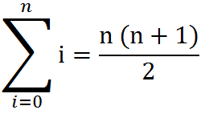
Some Algebra to calculate:
1 + 2 + 3 + … + (N-2) + (N-1) + N = N(N+1)/2 ∈ O(N²)
// Written backwards
OR

Slide 110
N + N/2 + N/4 + … + 4 + 2 + 1 = 2N -1 ∈ O(N)
N
2N
N | N/2
N | N/2 | N/4
N | N/2 | N/4 | N/8
N | N/2 | N/4 | N/8
N/16
The sum is less than 2N

Slide 111
2^{N} + 2^{N-1} + 2^{N-2} + … + 4 + 2 + 1 = 2^{N+1} -1 ∈ O(2^{N})
2^{N}
2 * 2^{N} = 2^{N+1}
2^{N} | 2^{N-1}
2^{N} | 2^{N-1} | 2^{N-2}
2^{N} | 2^{N-1} | 2^{N-2} | 2^{N-3}
2^{N} | 2^{N-1} | 2^{N-2} | 2^{N-3}
2^{N-4}
The sum is less than 2^{N+1}

Slide 112
BONUS

Slide 113
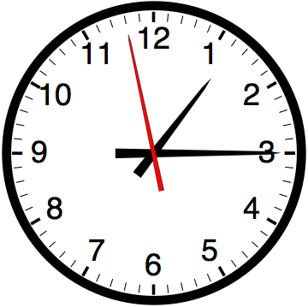

Slide 114


Computer
Science
&
= AWESOME

Slide 115

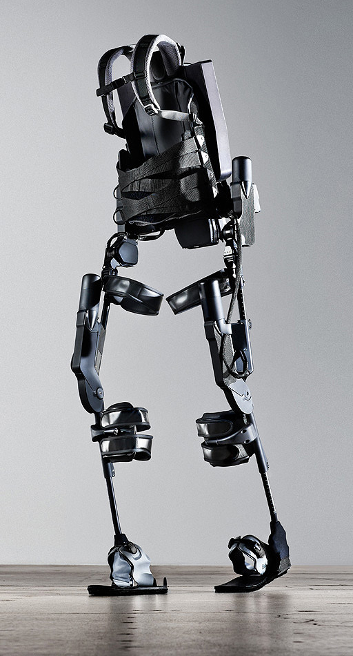
http://www.youtube.com/watch?v=pzRmNYA8LlY

Slide 116


ClickStart

Slide 117


Slide 118

How should we represent the blocks in the computer?
Independent variables
2D Array
OpenList
I don’t know

Slide 119
The value in the array tells me what art asset to use
Each level is really a 3x10 vector!
0 | 0 | 7 | 0 | 4 | 0 | 0 | 0
1 | 2 | 3 | -4 | 5 | 6 | -7 | 8
B | B | B | B | B | B | B | B
Negative values tell me what block needs to go here to win!

Slide 120
0 | 0 | 7 | 0 | 4 | 0 | 0 | 0
1 | 2 | 3 | -4 | 5 | 6 | -7 | 8
0 | 0 | 0 | B | 0 | 0 | 0 | 0

Slide 121
BUGS!

Slide 122


Slide 123

It is really sad when stuff you’ve made is on sale!

Slide 124



Which image is fake?
A. Top Left
B. Bottom Left
C. Bottom Right

Slide 125
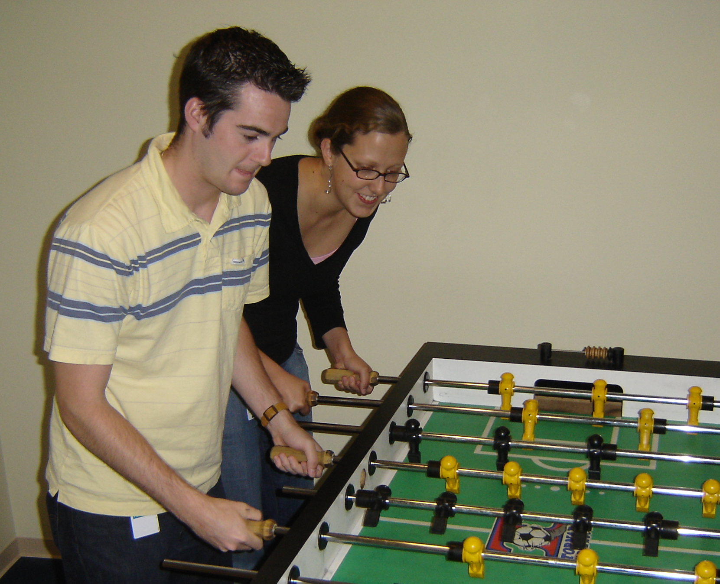

Slide 126
