Slide 1
CS 60
Sorting
& Big-O
(Continued)
2013-11-13
Wednesday – Week 10
Lecture 19

Slide 2
Survey – Settle a Carpool Debate
What do you think when someone encourages someone to be quiet by saying shhhhhh?
Rudest thing in the world
Rude
Sorta rude
Not rude

Slide 3
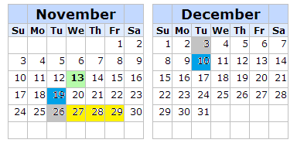
Homework Due Dates
We have a 1-week assignment left and a 2-week assignment. Thanksgiving: Nov 28
1-week due Nov 26th, 2-week due Dec 10
2-week due Dec 3rd, 1-week due Dec 10
I don’t care

Slide 4
Administrative Stuff (Not in your notes)
Homework will be posted this evening!

Slide 5
Recurrence Relationships (This will involve a lot of algebra – but no magic!)

Slide 6
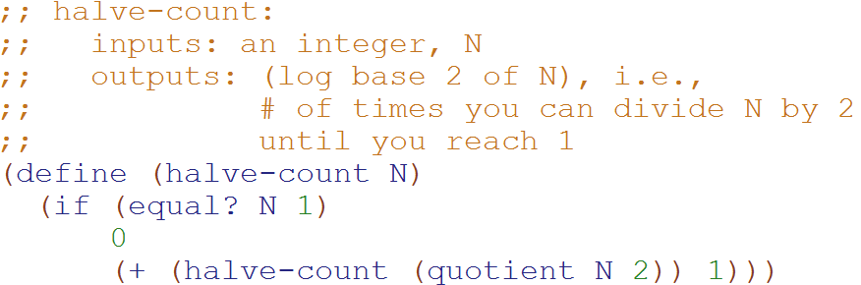
Big-O: Logarithmic Time O(log₂N)
Based upon this relationship
T(N) = 1 + T(N/2)
We can generalize that:
T(N/2) = 1 + T(N/4)
T(N/4) = 1 + T(N/8)
…
T(0) = 1
T(N) = 1 + T(N/2)
T(N) = 1 + 1 + T(N/4)
T(N) = 1 + 1 + 1 + T(N/8)
T(N) = 1 + 1 + 1 + … + 1 + 1 + 1
T(N) = logN
Substitute this
Substitute this

Slide 7
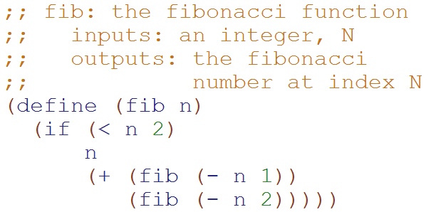
Big-O: Exponential Time O(2^{N})
T( __ ) = ______ T( __ ) = ______
T(N) = ___________________
How many terms?
1
2
3
4
??

Slide 8
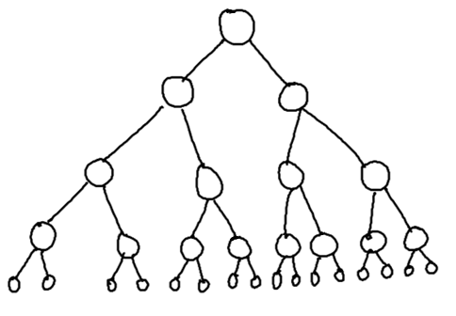
Fibonacci recurrence relationship
T(0) = 1
T(1) = 1
T(N) = 1 + T(N-1) + T(N-2)
)
Define:
T₁(N) = 1 + 2*T₁(N-1)
T₂(N) = 1 + 2*T₂(N-2)
T₂(N) ≤ T(N) ≤ T₁(N)
?
?

Slide 9
Big-O: Exponential Time O(2^{N})
Based upon this relationship
T₁(N) = 1 + 2*T₁(N-1)
We can generalize that:
T₁(N-1) = 1 + 2*T₁(N-2)
T₁(N-2) = 1 + 2*T₁(N-3)
…
T₁(1) = 1
T₁(N) = 1 + 2*T₁(N-1)
T₁(N) = 1 + 2*(1 + 2*T₁(N-2))
T₁(N) = 1 + 2 + 4*T₁(N-2)
T₁(N) = 1 + 2 + 4*(1 + 2T₁(N-3))
…
T₁(N) = 1 + 2 + 4 + … + 2^{N-1}
T₁(N) = 2^{N} -1
Substitute this
distribute
Substitute this

Slide 10
Big-O: Exponential Time O(2^{N})
Based upon this relationship
T₂(N) = 1 + 2*T₂(N-2)
We can generalize that:
T₂(N-2) = 1 + 2*T₂(N-4)
T₂(N-4) = 1 + 2*T₂(N-8)
…
T₂(0) = 1, T₂(1) = 1
T₂(N) = 1 + 2*T₂(N-2)
T₂(N) = 1 + 2*(1 + 2*T₂(N-4))
T₂(N) = 1 + 2 + 4*T₂(N-4)
T₂(N) = 1 + 2 + 4*(1 + 2T₂(N-8))
…
T₂(N) = 1 + 2 + 4 + … + 2^{N/2}
T₂(N) = 2*2^{N/2} -1 = 2^{N/2+1} -1
Substitute this
distribute
Substitute this
Simplification b/c we’re not worrying about odd values of N

Slide 11

Big-O: Exponential Time O(2^{N})
Define:
T₁(N) = 1 + 2*T₁(N-1)
T₂(N) = 1 + 2*T₂(N-2)
T₂(N) ≤ T(N) ≤ T₁(N)
T(1) = 1
T(N) = 1 + T(N-1) + T(N-2)
T₂(N) = 2^{N/2} -1 T₁(N) = 2^{N} -1
T₂(N) ≤ T(N) ≤ T₁(N)
2^{N/2} -1 ≤ T(N) ≤ 2^{N} -1(N-2)
Calculated on previous slides.
Since Big-O is an upper bound,
T(N) O(2^{N})

Slide 12
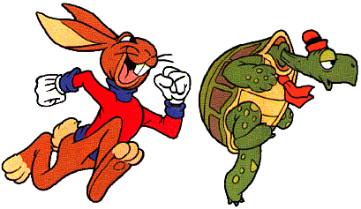
Quick Sort
This has to be the least helpful name ever…
But it is true. Quick Sort Rocks!

Slide 13
Quick Sort
Things we can do without too much trouble:
Divide up the list into two - based upon whether each element is bigger or smaller than a particular value (the “pivot”).
Delegating to another procedure to sort each of these halves
Sorting a 1 element list

Slide 14
QuickSort with Linked Lists
6 | 9 | 7 | 8 | 3 | 18 | 4 | 11 | 2 | 5 | 10
3 | 4 | 2 | 5
6
9 | 7 | 8 | 18 | 11 | 10
2
3
4 | 5
7 | 8
9
18 | 11 | 10
4
5
7
8
11 | 10
18
10
11
2 | 3 | 4 | 5 | 6 | 7 | 8 | 9 | 10 | 11 | 18

Slide 15
an array of zero or one elements is already sorted
function quicksort('array')
if length('array') = 1
return 'array'
select and remove a pivot value 'pivot' from 'array'
create empty lists 'less' and 'greater'
for each 'x' in 'array'
if 'x' <= 'pivot' then append 'x' to 'less'
else append 'x' to 'greater'
return concatenate(quicksort('less'), 'pivot', quicksort('greater'))
Divide
http://en.wikipedia.org/wiki/Quicksort

Slide 16
Quick Sort: The Algorithm (For your notes)
Given an unsorted list I of n items
Choose a pivot item v from I.
Partition I into two unsorted lists I1 and I2 I1 contains all items whose keys are smaller than v's key. I2 contains all items whose keys are larger than v's. Equal values can go either way.
After the partition v is in it’s final position.
Sort I1 recursively, yielding the sorted list S1.
Sort I2 recursively, yielding the sorted list S2.
Concatenate S1, v, and S2 together, yielding a sorted list S.

Slide 17

Can you make Quick Sort run in… (what is the worst you can do? Describe the input)
O(N)
O(N log N)
O(N²)
O(N³)
O(2^{N})

Slide 18
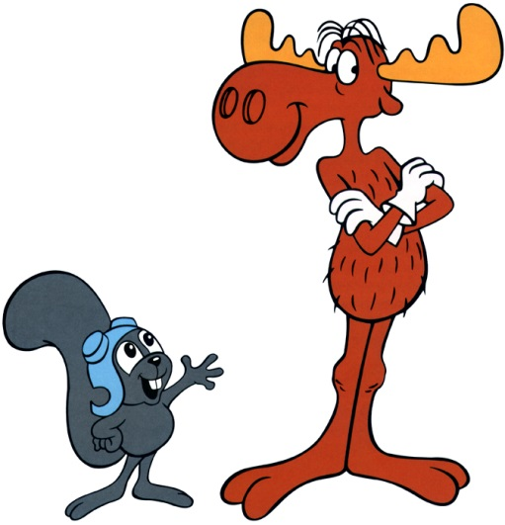
Can you make Quick Sort run in… (what is the best you can do? Describe the input)
O(N)
O(N log N)
O(N²)
O(N³)
O(2^{N})

Slide 19
Quick Sort – Choosing a Pivot
What if the pivot I chose was larger than all the other elements?
99 | 9 | 7 | 8 | 3 | 18 | 4 | 11 | 2 | 5 | 10
10 | 9 | 7 | 8 | 3 | 18 | 4 | 11 | 2 | 5 | 99
This gets sent to be recursively sorted
There is nothing to send in the other recursive call
Quick Sort is a “divide and conquer algorithm” but this didn’t divide!

Slide 20
Quick Sort
Worst case performance:
O(n²)
Best case performance:
O(n log n)
In practice the fastest known comparison-based sort for arrays
It matters how evenly the pivot divides the elements!!!

Slide 21
QuickSort with an Array
Pivot = first index you’re sorting
L = second index you’re sorting
G = last index you’re sorting
While L <= G
Increase L until it references something bigger than the pivot
Decrease G until it references something smaller than the pivot
Swap elements at L and G
Swap the pivot with the element at G

Slide 22
Quick Sort with an Array DEMO
L
L
L
L
G
L
G
G
G
G
G
G
6 | 5 | 2 | 8 | 3 | 18 | 4 | 11 | 7 | 9 | 10
6 | 5 | 2 | 4 | 3 | 18 | 8 | 11 | 7 | 9 | 10
3 | 5 | 2 | 4 | 6 | 18 | 8 | 11 | 7 | 9 | 10
6 | 9 | 7 | 8 | 3 | 18 | 4 | 11 | 2 | 5 | 10
6 | 9 | 7 | 8 | 3 | 18 | 4 | 11 | 2 | 5 | 10
6 | 9 | 7 | 8 | 3 | 18 | 4 | 11 | 2 | 5 | 10
6 | 9 | 7 | 8 | 3 | 18 | 4 | 11 | 2 | 5 | 10
6 | 9 | 7 | 8 | 3 | 18 | 4 | 11 | 2 | 5 | 10
6 | 5 | 7 | 8 | 3 | 18 | 4 | 11 | 2 | 9 | 10
6 | 5 | 7 | 8 | 3 | 18 | 4 | 11 | 2 | 9 | 10
6 | 5 | 7 | 8 | 3 | 18 | 4 | 11 | 2 | 9 | 10
6 | 5 | 2 | 8 | 3 | 18 | 4 | 11 | 7 | 9 | 10
6 | 5 | 2 | 8 | 3 | 18 | 4 | 11 | 7 | 9 | 10
6 | 5 | 2 | 8 | 3 | 18 | 4 | 11 | 7 | 9 | 10
6 | 5 | 2 | 4 | 3 | 18 | 8 | 11 | 7 | 9 | 10
6 | 5 | 2 | 4 | 3 | 18 | 8 | 11 | 7 | 9 | 10
6 | 5 | 2 | 4 | 3 | 18 | 8 | 11 | 7 | 9 | 10

Slide 23
Quick Sort Demo
6 | 9 | 7 | 8 | 3 | 18 | 4 | 11 | 2 | 5 | 10
6 | 9 | 7 | 8 | 3 | 18 | 4 | 11 | 2 | 5 | 10
6 | 9 | 7 | 8 | 3 | 18 | 4 | 11 | 2 | 5 | 10
6 | 9 | 7 | 8 | 3 | 18 | 4 | 11 | 2 | 5 | 10
6 | 9 | 7 | 8 | 3 | 18 | 4 | 11 | 2 | 5 | 10
6 | 5 | 7 | 8 | 3 | 18 | 4 | 11 | 2 | 9 | 10
6 | 5 | 7 | 8 | 3 | 18 | 4 | 11 | 2 | 9 | 10
6 | 5 | 7 | 8 | 3 | 18 | 4 | 11 | 2 | 9 | 10

Slide 24
Quick Sort Demo
6 | 5 | 7 | 8 | 3 | 18 | 4 | 11 | 2 | 9 | 10
6 | 5 | 2 | 8 | 3 | 18 | 4 | 11 | 7 | 9 | 10
6 | 5 | 2 | 8 | 3 | 18 | 4 | 11 | 7 | 9 | 10
6 | 5 | 2 | 8 | 3 | 18 | 4 | 11 | 7 | 9 | 10
6 | 5 | 2 | 8 | 3 | 18 | 4 | 11 | 7 | 9 | 10
6 | 5 | 2 | 4 | 3 | 18 | 8 | 11 | 7 | 9 | 10
6 | 5 | 2 | 4 | 3 | 18 | 8 | 11 | 7 | 9 | 10
6 | 5 | 2 | 4 | 3 | 18 | 8 | 11 | 7 | 9 | 10
6 | 5 | 2 | 4 | 3 | 18 | 8 | 11 | 7 | 9 | 10
3 | 5 | 2 | 4 | 6 | 18 | 8 | 11 | 7 | 9 | 10

Slide 25
Runtime

Slide 26
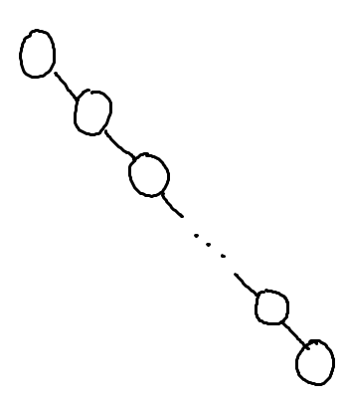
What is the worst case run-time for find in this Binary Search Tree?
O(1)
O(log n)
O(n log n)
O(n)
O(n²)

Slide 27
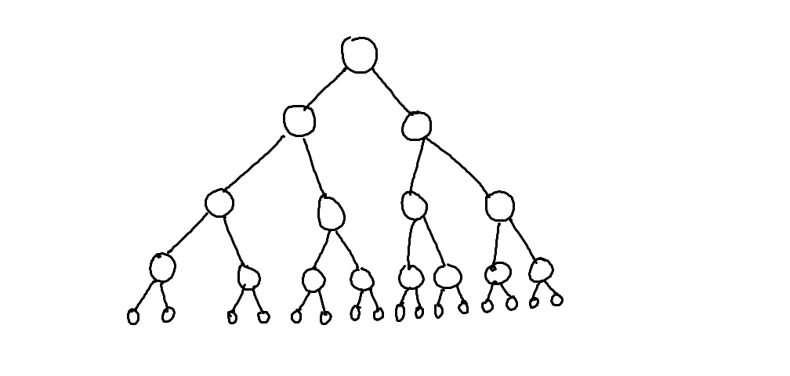
What is the worst case run-time for find in a “full” BST with n nodes?
O(1)
O(log n)
O(n log n)
O(n)
O(n²)
…

Slide 28
Assuming: all nodes have 0 or 1 children N nodes in the BST
BST Big-O (Completely Unbalanced Case)
Find |  | Insert |  | Delete
Best | Worst | Best | Worst | Best | Worst
O( ) | O( ) | O( ) | O( ) | O( ) | O( )

Slide 29
Assuming: all nodes have 0 or 2 children N nodes in the BST (and height = log(n))
BST Big-O (Balanced Case)
Find |  | Insert |  | Delete
Best | Worst | Best | Worst | Best | Worst
O( ) | O( ) | O( ) | O( ) | O( ) | O( )
O(1)
O(log n)
O(n log n)
O(n)
O(n²)

Slide 30
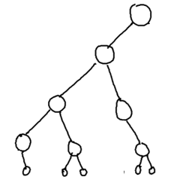
Assuming: most nodes have 0 or 2 children height is O(log n) N nodes in the BST
BST Big-O (Mostly Balanced Case)
Find |  | Insert |  | Delete
Best | Worst | Best | Worst | Best | Worst
O( ) | O( ) | O( ) | O( ) | O( ) | O( )

Slide 31
Big-O for Lists (a.k.a. linked lists)

Slide 32
Racket Lists Big-O
Insert (into front of list) | O( )
Insert (into end of list) | O( )
Find | O( )
Length | O( )
Delete (from the middle) | O( )
O(1)
O(log n)
O(n log n)
O(n)
O(n²)

Slide 33
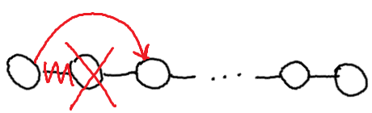
Assuming: the modifiable LinkedList using Hw5 List and ListNode
List/ListNode Big-O
Insert (into front of list) | O( )
Insert (into end of list) | O( )
Find (given a value) | O( )
Length | O( )
Delete (given a value) | O( )
Delete (given a ListNode ref) | O( )
O(1)
O(log n)
O(n log n)
O(n)
O(n²)

Slide 34
Big-O for Arrays

Slide 35
Unsorted Arrays Big-O
Insert (into first spot) | O( )
Insert (into last spot) | O( )
Find (given a value) | O( )
Delete (given a value) | O( )
5 | 3 | 8 | 2 | 1 | 7 | 0 | 0 | 0 | 0 | 0 | 0 | 0
Assuming:
unsorted array holding numbers within 1 to N
no duplicates
we keep track the last index we use (maxIndex)
all values at indices > maxIndex are 0 (unused).

Slide 36
Sorted Arrays Big-O
Insert (into first spot) | O( )
Insert (into last spot) | O( )
Find (given a value) | O( )
Delete (given a value) | O( )
Assuming:
sorted array holding numbers within 1 to N
no duplicates
we keep track the last index we use (maxIndex)
all values at indices > maxIndex are 0 (unused).
1 | 2 | 3 | 5 | 7 | 8 | 0 | 0 | 0 | 0 | 0 | 0 | 0

Slide 37
Boolean Arrays Big-O
Insert (into first spot) | O( )
Insert (into last spot) | O( )
Find (given a value) | O( )
Delete (given a value) | O( )
F₀ | T₁ | T₂ | T₃ | F₄ | T₅ | F₆ | T₇ | T₈
Assuming:
Boolean array representing numbers within 1 to X
X is a fixed number
no duplicates
Could I use this trick to store objects?

Slide 38
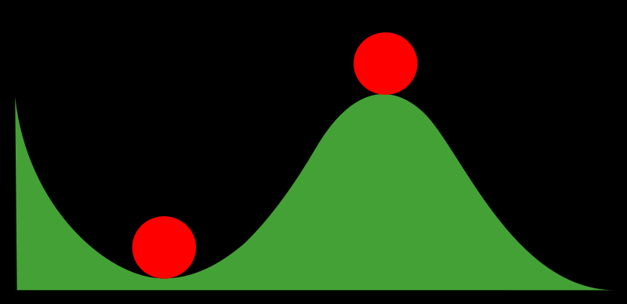
Stable and Non-Stable Sorting

Slide 39
Stable Sort
Sometimes there are equivalent keys in a data structure that is sorted.
Sometimes it matters if you change the order of those equivalent keys
E.g. Sorting music by song and then artist should keep each artists songs alphabetized
We call a sort “stable” if it doesn’t change the order of equivalent keys

Slide 40
Radix Sort (an example of a stable sort)

Slide 41
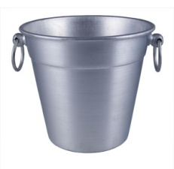
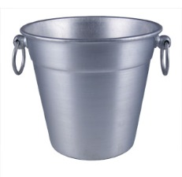
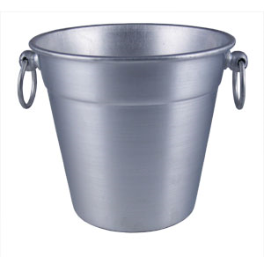

Easy Sorting Problems…
Sort N numbers in the range 0 to 9
0 | 1 | 2 | 3 | 4 | 5 | 6 | 7 | 8 | 9
How fast could you sort
N numbers
in the range 0 to B?
O(N)
O(B)
O(N+B)
O(N*B)
E) ??
In Big-O defining your variables is super important!

Slide 42
Harder Sorting Problems… Approach 1 – Two stages
Sort N numbers in the range 0 to 99
Make some buckets and calculate what bucket they need to go into.
Then sort each bucket
0 – 9 | 10-19 | 20-29 | 30-39 | 40-49 | 50-59 | 60-69 | 70-79 | 80-89 | 90-99

Slide 43
Harder Sorting Problems… Approach 2
Sort N numbers in the range 0 to 99
First sort by the one’s digit (this is counter intuitive)
95
25
98
29
20
32
93
85
97
38
39
0 | 1 | 2 | 3 | 4 | 5 | 6 | 7 | 8 | 9

Slide 44
Combine the buckets
Start from the first thing in the bucket
95
25
98
29
20
32
93
85
97
38
39
The 20’s are the correct relative order
0 | 1 | 2 | 3 | 4 | 5 | 6 | 7 | 8 | 9
20
20
32
93
85
25
25
95
97
38
98
39
29
29

Slide 45
Re-sort using the tens digit
20
32
93
85
25
95
97
38
98
39
29
Now Recombine!
98
29
39
97
25
38
95
20
32
85
93
0 | 1 | 2 | 3 | 4 | 5 | 6 | 7 | 8 | 9
20
25
29
32
38
39
85
93
95
97
98

Slide 46
Radix Sort the numbers 0-99
The running time for our example: (N + B)*2
We did two passes, each took N time.
We gathered up the buckets twice each took B time (where B is the number of buckets)

Slide 47








We can represent numbers with 1’s and 0’s
3 2 1 8
3*1000 + 2*100 + 1*10 + 8*1
1 0 0 1
1*8 + 0*4 + 0*2 + 1*1
We could use binary digits
0001 1
0010 2
0011 3
0100 4
0101 5
0110 6
0111 7
1000 8

Slide 48
Radix Sort with 32 bit numbers
We chose how many bits we want to sort at a time.
4 bits at a time (8 passes)
0000 0000 0000 0000 0000 0000 0000 0000
8 bits at a time (4 passes)
00000000 00000000 00000000 00000000
Running Time of Radix Sort in terms of
N: the number of items to sort
B: the number of buckets
P: the number of passes
Less than
Equal to
Greater than
??
O(N*B*P)

Slide 49
Runtime of Radix Sort
Running Time of Radix Sort in terms of
N: the number of items to sort
B: the number of buckets
P: the number of passes
O( P * (N+B))

Slide 50

Selection Sort

Slide 51

Selection Sort Pseudocode
Starting an unsorted array (myArray) of n input items.
Walk through myArray and find the smallest item:
Swap the smallest item into the right place
(Also could: remove the item and put it at the end of an another array or linked list.)
Invariant: at the kth iteration, the k smallest elements of the input I are sorted.
What is the Big-O runtime of Selection Sort?
A) O(N) B) O(N log N) C) O(N²) D) O(2^{N}) E) ??

Slide 52
% test cases for min
:- begin_tests(min).
test(minT1) :- min([1, 2, 3], 1), !.
test(minT2) :- min([2, 1, 3], 1), !.
test(minT3) :- min([2, 3, 1], 1), !.
test(minT4) :- min([1, 1, 1], 1), !.
test(minT5) :- \+min([], _).
:- end_tests(min).
Started
Got base case
Got it
Stuck

Slide 53
% write min in Prolog

Slide 54
% solution for min
min([Min], Min).
min([F|R], Min):- min(R, Min), Min < F.
min([F|R], F) :- min(R, Min), Min > F.
min([F|R], F) :- min(R, Min), Min = F.

Slide 55
Summations

Slide 56


http://www.math.hmc.edu/funfacts/
REALLY COMMON SERIES (you should recognize these after today)
1 + 2 + 3 + … + (N-2) + (N-1) + N = N(N+1)/2 ∈ O(N²)
1 + 2 + 4 + … + N/4 + N/2 + N = 2N -1 ∈ O(N)
1 + 2 + 4 + … + 2^{N-2} + 2^{N-1} + 2^{N} = 2^{N+1} -1 ∈ O(2^{N})

Slide 57




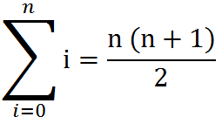
Some Algebra to calculate:
1 + 2 + 3 + … + (N-2) + (N-1) + N = N(N+1)/2 ∈ O(N²)
// Written backwards
OR

Slide 58
N + N/2 + N/4 + … + 4 + 2 + 1 = 2N -1 ∈ O(N)
N
2N
N | N/2
N | N/2 | N/4
N | N/2 | N/4 | N/8
N | N/2 | N/4 | N/8
N/16
The sum is less than 2N

Slide 59
2^{N} + 2^{N-1} + 2^{N-2} + … + 4 + 2 + 1 = 2^{N+1} -1 ∈ O(2^{N})
2^{N}
2 * 2^{N} = 2^{N+1}
2^{N} | 2^{N-1}
2^{N} | 2^{N-1} | 2^{N-2}
2^{N} | 2^{N-1} | 2^{N-2} | 2^{N-3}
2^{N} | 2^{N-1} | 2^{N-2} | 2^{N-3}
2^{N-4}
The sum is less than 2^{N+1}

Slide 60
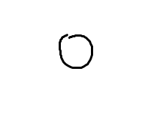
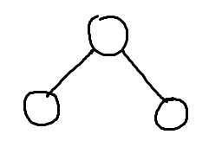
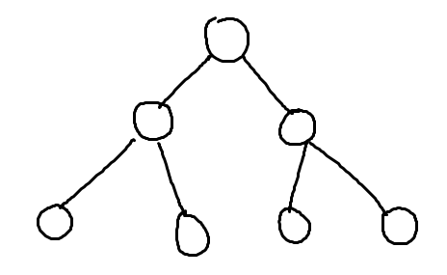
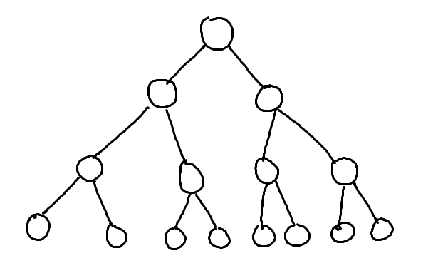
What’s the relationship between height and number of nodes?
3
7
1
15
31

Slide 61
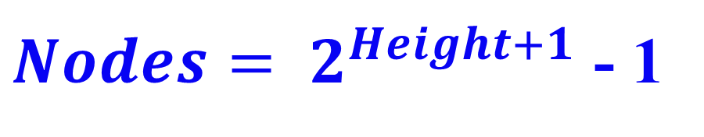
What’s the relationship between height and number of nodes?
1
3
7
Height | Nodes | 2^{Height+1}
0 | 1 | 2
1 | 3 | 4
2 | 7 | 8
3 | 15 | 16
4 | 31 | 32
5 | 63 | 64
15
31

Slide 62





// Take the log of both sides
Drop the 1
Who cares?
// Remember:

Slide 63
BONUS

Slide 64
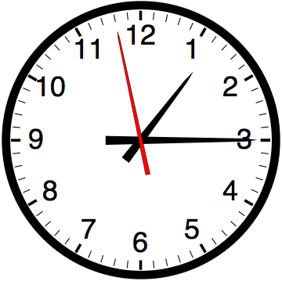

Slide 65


Computer
Science
&
= AWESOME

Slide 66

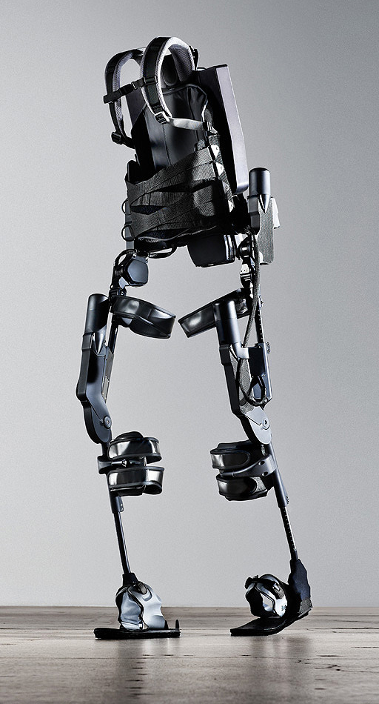
http://www.youtube.com/watch?v=pzRmNYA8LlY

Slide 67


ClickStart

Slide 68


Slide 69

How should we represent the blocks in the computer?
Independent variables
2D Array
OpenList
I don’t know

Slide 70
The value in the array tells me what art asset to use
Each level is really a 3x10 vector!
0 | 0 | 7 | 0 | 4 | 0 | 0 | 0
1 | 2 | 3 | -4 | 5 | 6 | -7 | 8
B | B | B | B | B | B | B | B
Negative values tell me what block needs to go here to win!

Slide 71
0 | 0 | 7 | 0 | 4 | 0 | 0 | 0
1 | 2 | 3 | -4 | 5 | 6 | -7 | 8
0 | 0 | 0 | B | 0 | 0 | 0 | 0

Slide 72
BUGS!

Slide 73


Slide 74

It is really sad when stuff you’ve made is on sale!

Slide 75



Which image is fake?
A. Top Left
B. Bottom Left
C. Bottom Right

Slide 76
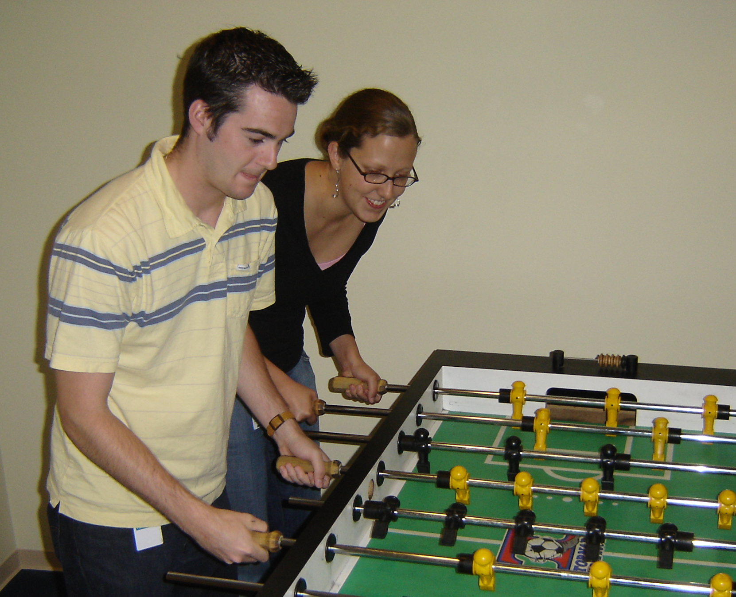

Slide 77
