Slide 1
CS 60
Finite Automata (hw11)
2013-11-18
Monday – Week 11
Lecture 20

Slide 2
Survey
Are you aware there are 3 sections of CS70?
Yes
No
I am now
Who cares! ☺

Slide 3
Finite Automata
(Models of Computation)

Slide 4
Hw 11
Nondeterministic Finite
Automata
Deterministic Finite Automata
DFA
1, 2, 6
NFA
5
4
10
Proof
3, 7, 8

Slide 5
DFA
1, 2, 6
NFA
5
4
10
Proof
3, 7, 8

Slide 6
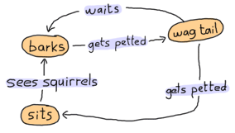
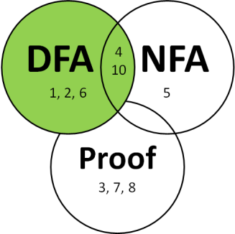
http://learnyousomeerlang.com/finite-state-machines
Assume the dog starts out in the sits state - then:
Sees squirrels, gets petted, waits, gets petted, gets petted, sees squirrels
Which state is the dog in A) sits B) barks C) wag tail D) ??

Slide 7
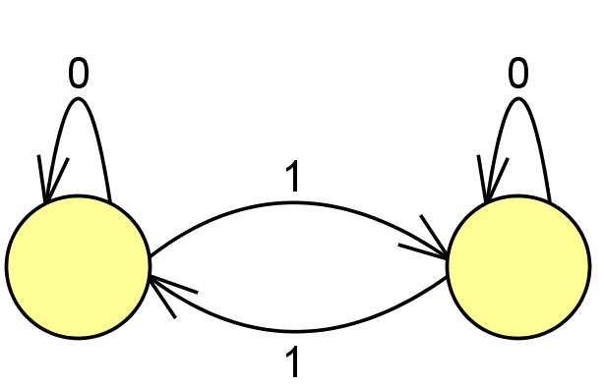
Deterministic Finite Automata (DFAs)
What symbol did we see?
1
Cool – follow this arrow (“Transition”)
to the other state.
What symbol did we see?
0
Cool – stay in this state.
These are states

Slide 8
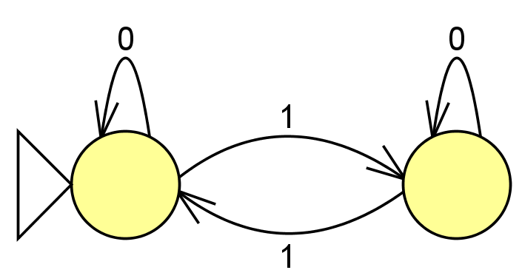
Identifying the Start State
(sometimes we just use an arrow)
This shows what state we start in
What state do we end up in if we see:
00000000001
Left state
Right state

Slide 9
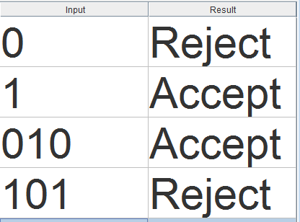
The Goal – To make decisions
We want to decide if the sequence of symbols we see matches the pattern we’re expecting.
What we’re expecting is referred to as the “Language”
∑ is the set of symbols we’re using
(which here has 0’s and 1’s).

Slide 10
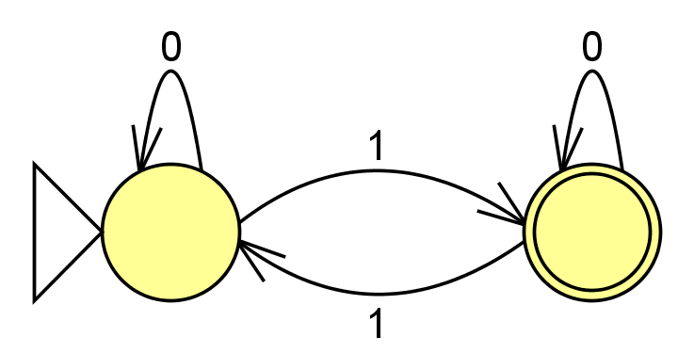
Identifying the accepting state(s)
This accepts strings that: ____________________
A) Got it!
This shows what state we want the sequence to end in
(if it ends here – accept)

Slide 11



JFLAP’s Creator – Dr. Susan Roger (Duke)
Colleen shares Susan’s interest in edible arts, but not motorcycles

Slide 12
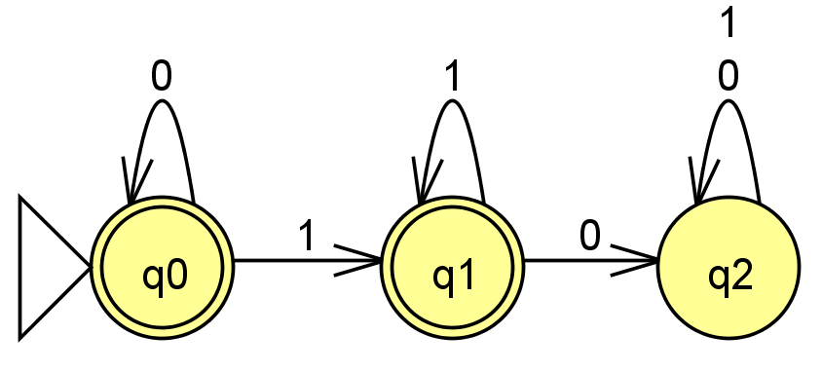
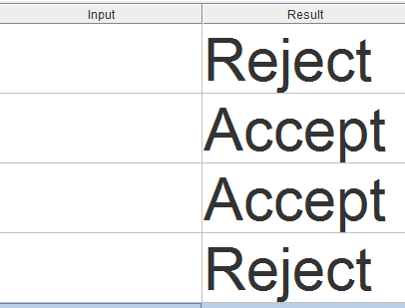
DFAs describe a Language
For both 1 and 0, stay in this state.
Fill in with sequences that would be accepted or rejected.
How would you describe what sequences this accepts?

Slide 13





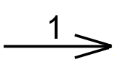

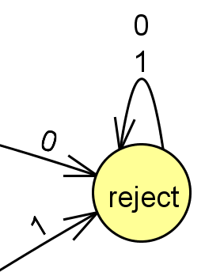
DFA Rules & Generation Tips
Rules about DFAs
Tips for writing DFAs
Indicate the starting state (aka initial state) with a triangle or arrow.
Indicate the accepting state(s) (aka final states) with concentric circles.
Every state must have a transition for every possible symbol.
Write out sequences (aka strings) that are accepted.
Write out sequences that are not accepted.
Identify what states might be important and what they will “mean”
Draw the DFA for a simple sequence that is accepted, then fill in other transitions.
Add a failing state

Slide 14
(1) Draw a DFA accepting
(2) Draw a DFA accepting the language
L = { w | w is the string 01 }
L = { w | w is a binary # that's a power of two }
initial 0s are OK
01
only 0s are not OK
the empty string λ is not OK
0010
100
10000
…
(3) Draw a DFA accepting
(4) Draw a DFA accepting
L = { w | w is a binary # that’s divisible by 4 }
L = { w | the first and last bit of w are the same }
initial 0s are OK
the empty string λ is OK
the empty string λ is OK
101
00
0010
0
1
λ
…
01000
0
λ
10100
…
Extra! use the minimum possible number of states in your four solutions…

Slide 15
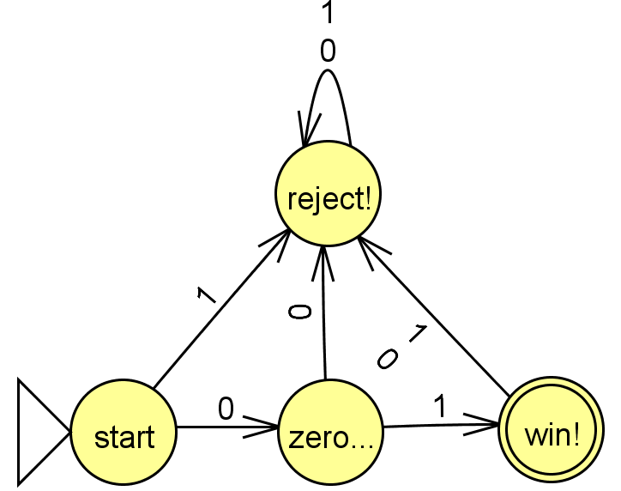
Solution
{w ∈ {0,1}* | w is the string 01}

Slide 16
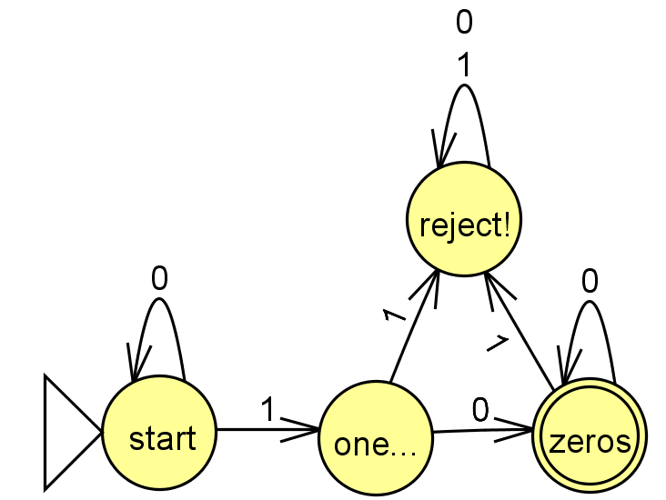
Solution
{w ∈ {0,1}* | w is a binary # that’s a power of 2}

Slide 17
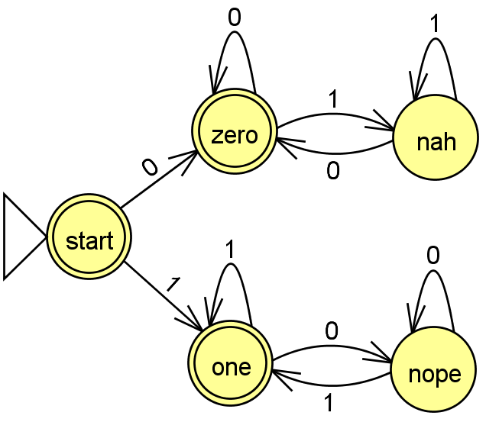
Solution
{w ∈ {0,1}* | first and last bit of w are the same}

Slide 18
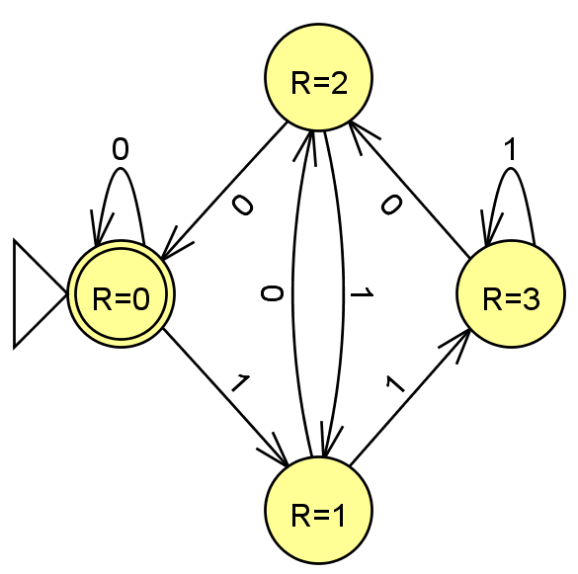
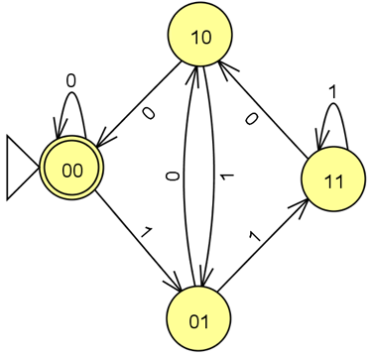
Solution
{w ∈ {0,1}* | w is a binary number that’s divisible by 4}
These are the last two digits we saw
R means Remainder
divided by 4

Slide 19
Extra DFA Practice
(Which one is this most similar to?)
L = {w ∈ {0,1}*| w’s third-to-last character is a 1}
A
{w ∈ {0,1}* | w is the string 01}
B
{w ∈ {0,1}* | w is a binary # that’s a power of 2}
C
{w ∈ {0,1}* | first and last bit of w are the same}
D
{w ∈ {0,1}* | w is a binary number that’s divisible by 4}

Slide 20
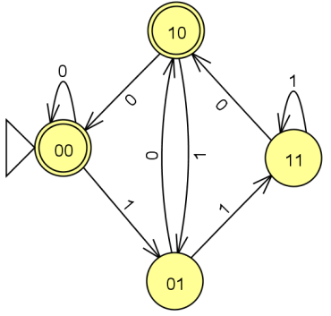
L = {w ∈ {0,1}*| w’s third-to-last character is a 1}
What states do we need?
Thinking about this problem might be helpful!
{w ∈ {0,1}* | w is a binary number that’s even}

Slide 21
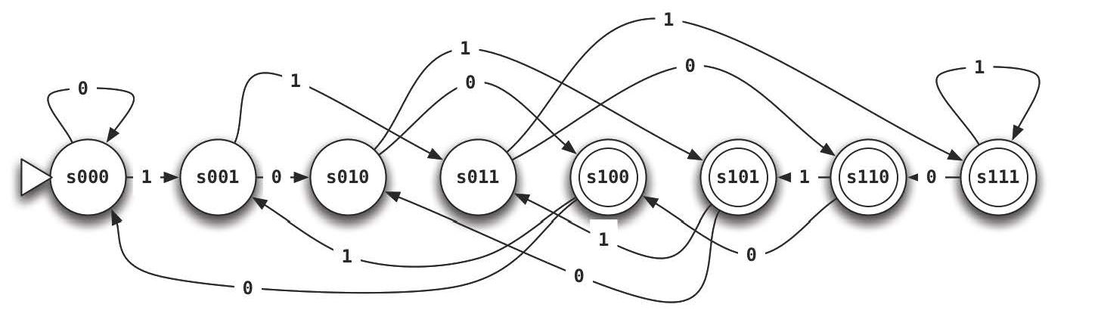
L = {w ∈ {0,1}*| w’s third-to-last character is a 1}
Solution
What states do we need?
Thinking about this problem might be helpful!
{w ∈ {0,1}* | w is a binary number that’s even}

Slide 22
Homework Due Tuesday Nov 26th
0. Do the JFLAP tutorial
DFA: at least two 0’s and at most one 1.
DFA: multiple of two or three 0’s
DFA/NFA: first two characters equal the last two
6. DFA: binary representation of multiples of 7
10.DFA/NFA equal occurrences of 01 and 10

Slide 23
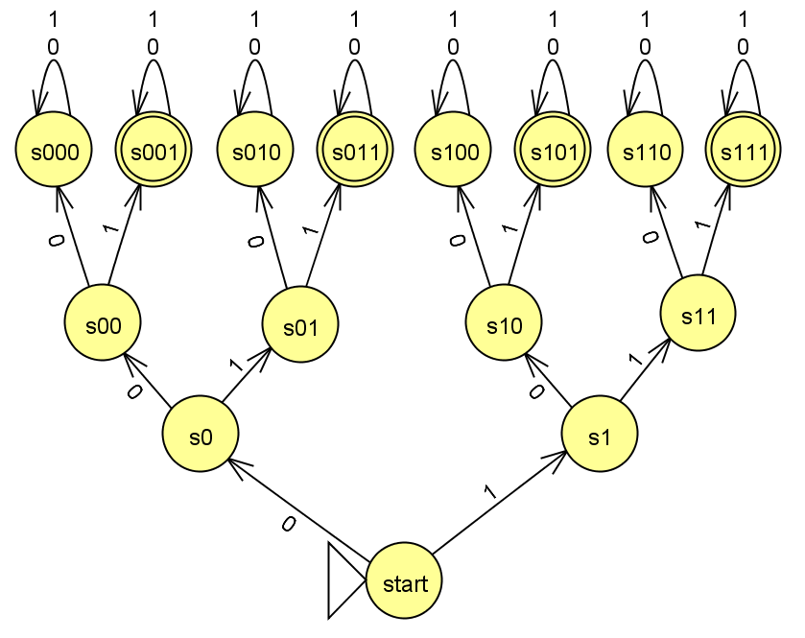
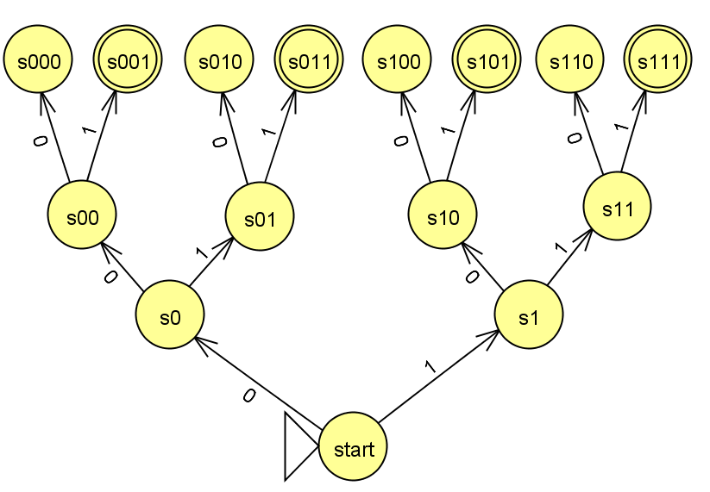
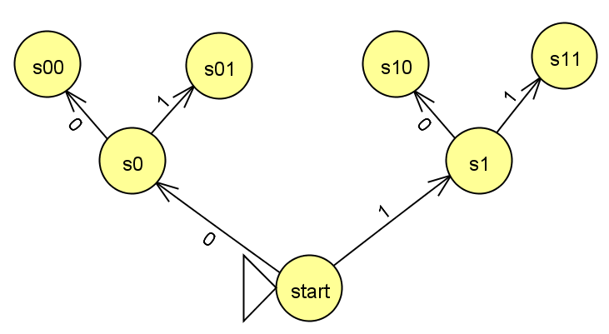
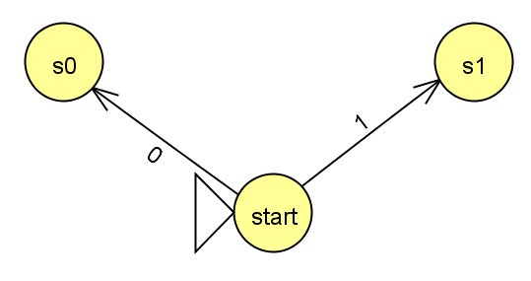
Could I do this with fewer states?
{w ∈ {0,1}*| w’s third character is a 1}

Slide 24
Indistinguishable States

Slide 25
DFA
1, 2, 6
NFA
5
4
10
Proof
3, 7, 8

Slide 26
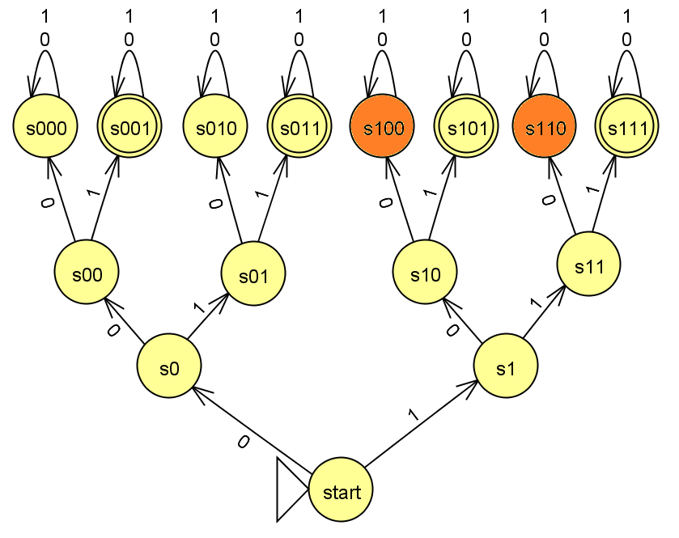
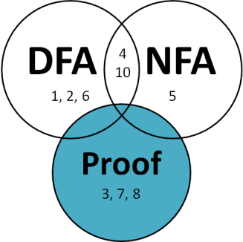
Indistinguishable States
States
s100 and s110
are indistinguishable!
The Strings
100 and 110
are indistinguishable!
Indistinguishable (Definition):
No matter what symbols come later, their fates are the same!

Slide 27
Distinguishable States/Minimal DFAs
Write the Minimal DFA, which has only distinguishable (necessary) states.
States necessary?
A) 4 B) 5 C) 6 D) >6 E)??
{w ∈ {0,1}*| w’s third character is a 1}

Slide 28
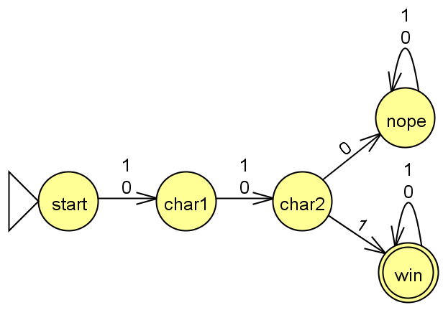
Distinguishable States/Minimal DFAs
Solution
Write the Minimal DFA, which has only distinguishable (necessary) states.
If I can create a DFA with X states, that proves you don’t need more than X states!
{w ∈ {0,1}*| w’s third character is a 1}

Slide 29
(Lower-bound on Necessary states!)
Next Topic: Distinguishability Theorem
If there is a pairwise distinguishable set of N strings for a language L, then a DFA accepting L must have ≥ N states.

Slide 30
Distinguishable States

Slide 31
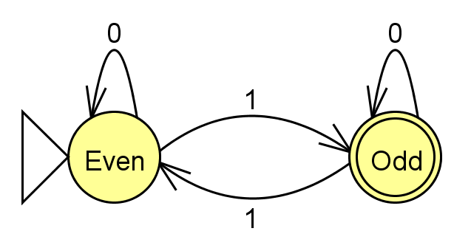
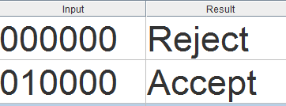
Indistinguishable (Definition):
No matter what symbols come later, their fates are the SAME!
Distinguishable (≈Definition):
For some following sequence,
their fates are DIFFERENT!
The Strings
100 and 110
are indistinguishable!
The Strings
00 and 01
are distinguishable!
What happens If 00 and 01 are followed by 0000? Both accepted?

Slide 32
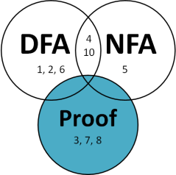

Formal Distinguishable Definition
e.g. w₁ = 01 and w₂ = 00
A language is what is specified by something like a DFA: what sequences of symbols are
in (accepted) and out (rejected)
Given a language L,
Strings w₁ and w₂ are distinguishable if
there exists z ∈ ∑*
such that w₁z ∈ L and w₂z∉ L (or vice versa)
e.g. z = 0000
∑ is the set of symbols
* means some # of them
e.g. 010000 is accepted
e.g. 000000 is rejected

Slide 33
Formal Pairwise Distinguishable Definition
Given a language L,
Strings w₁ and w₂ are distinguishable if
there exists z ∈ ∑*
such that w₁z ∈ L and w₂z∉ L (or vice versa)
These are strings
A set S = {w₁, w₂, ….}
is pairwise distinguishable
if w_{i} and w_{j} are distinguishable for i ≠ j.

Slide 34
***Distinguishability Theorem***
(Lower-bound on Necessary states!)
If there is a pairwise distinguishable set of N strings for a language L, then a DFA accepting L must have ≥ N states.
Given a language L,
Strings w₁ and w₂ are distinguishable if
there exists z ∈ ∑*
such that w₁z ∈ L and w₂z∉ L (or vice versa)
Definition of distinguishable
A set S = {w₁, w₂, ….}
is pairwise distinguishable
if w_{i} and w_{j} are distinguishable for i ≠ j.
Definition of pairwise distinguishable

Slide 35
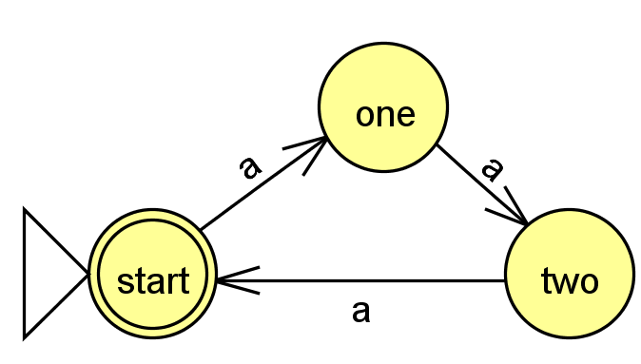
Prove that at least 3 states are required
Assume we have a state machine that accepts a multiple of three a’s
L = {a^{3n} | n ≥ 0 }.
What can you put at the end of both to make one of them accepted and one of them rejected
w_{i} | w_{j} | z | Is one accepted and on rejected?
a | aa
a | aaa
aa | aaa

Slide 36
Prove that at least 3 states are required
Solution
Assume we have a state machine that accepts a multiple of three a’s
L = {a^{3n} | n ≥ 0 }.
What can you put at the end of both to make one of them accepted and one of them rejected
w_{i} | w_{j} | z | Is one accepted and on rejected?
a | aa | a | aa reject aaa accept
a | aaa | aa | aaa accept aaaaa reject
aa | aaa | a | aaa accept aaaa reject

Slide 37
Prove that the start state is pairwise distinguishable from all other states
Assume we have a state machine that accepts when the first and last bit of w are the same.
w_{i} | w_{j} | z | Is one accepted and on rejected?
λ | 0 | 1 | 1 accept; 01 reject
λ | 1
λ
λ

Slide 38
Prove that the start state is pairwise distinguishable from all other states
Assume we have a state machine that accepts when the first and last bit of w are the same.
Solution
w_{i} | w_{j} | z | Is one accepted and on rejected?
λ | 0 | 1 | 1 accept; 01 reject
λ | 1 | 0 | 0 accept; 10 reject
λ | 01 | 1 | 1 accept; 011 reject
λ | 10 | 0 | 0 accept; 100 reject

Slide 39
How could you prove that at least 5 states are required????
Assume we have a state machine that accepts when the first and last bit of w are the same.
How many rows would be necessary?
A) 5! B) 5 C) 10 D) Other E)?
w_{i} | w_{j} | z | Is one accepted and on rejected?

Slide 40
***Distinguishability Theorem***
(Lower-bound on Necessary states!)
If there is a pairwise distinguishable set of N strings for a language L, then a DFA accepting L must have ≥ N states.
Given a language L,
Strings w₁ and w₂ are distinguishable if
there exists z ∈ ∑*
such that w₁z ∈ L and w₂z∉ L (or vice versa)
Definition of distinguishable
A set S = {w₁, w₂, ….}
is pairwise distinguishable
if w_{i} and w_{j} are distinguishable for i ≠ j.
Definition of pairwise distinguishable

Slide 41
Regular/
Non-Regular Languages

Slide 42
Regular Language
A language is regular if it can be recognized by a DFA.
The following are equivalent
There is a DFA accepting the set L
There is a NFA accepting L [Rabin and Scott]
  We’ll talk about this next!
L can be described by a regular expression [Kleene]
      You’ll see these in CS81.

Slide 43
***The Nonregular Language Theorem***
Myhill-Nerode theorem
If there is an infinite
pairwise distinguishable
set of strings (w.r.t. L),
it must be that L is not regular!
You can’t represent it with a DFA

Slide 44
Nonregular Language Proof
If there is an infinite
pairwise distinguishable
set of strings (w.r.t. L),
it must be that L is not regular!
Show that this is not regular
L = { 0^{n} 1^{n} | n ≥ 0 }

Slide 45
Nonregular Language Proof
Solution
If there is an infinite
pairwise distinguishable
set of strings (w.r.t. L),
it must be that L is not regular!
Show that this is not regular
L = { 0^{n} 1^{n} | n ≥ 0 }
Consider the infinite set:
{0^{n} | n is a pos. integer}
{0, 00, 000, 0000, … }
w_{i} = 0^{i} w_{j} = 0^{j} Note: i ≠ j
z = 1^{i} w_{i} z = 0^{i} 1^{i} w_{j} z = 0^{j} 1^{i}
Accepted
Rejected

Slide 46
Non-regular Language Proofs
How do you feel about them?
Not great
Okay
Great

Slide 47
Homework Due Friday
Prove that you need at least 6 states (for #2)
Prove that palindrome checking is not regular
Prove that power of two occurrences of 0’s is not regular

