Slide 1
CS 60
Proofs and Turing Machines (hw11)
& BFS/DFS (hw12)
2013-11-20
Wednesday – Week 11
Lecture 21

Slide 2
Survey
How many people do you think will take CS60?
<50
50-100
100-150
150-200
>200

Slide 3
Summary – DFA Proofs (Phrasing 1)
How many states do I need in my DFA?
Upper bound:
To prove that you don’t need more than X states:
Make a DFA with X states.
Lower bound:
To prove that you need at least Y states:
Find Y pairwise distinguishable strings.

Slide 4
Summary – DFA Proofs (Phrasing 2)
How many states do I need in my DFA?
Upper bound:
If you can make a DFA with X states,
that proves you don’t need more than X states.
Lower bound:
If you have Y pairwise distinguishable strings,
that proves you need at least Y states.

Slide 5
Survey?
Which is clearer?
Phrasing 1
Phrasing 2
They’re both clear
They’re both unclear

Slide 6
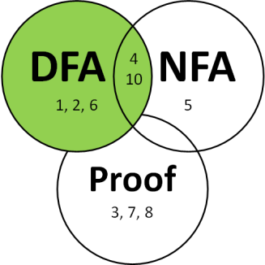





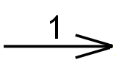

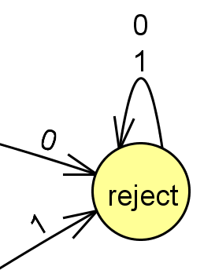
DFA Rules & Generation Tips
Rules about DFAs
Tips for writing DFAs
Indicate the starting state (aka initial state) with a triangle or arrow.
Indicate the accepting state(s) (aka final states) with concentric circles.
Every state must have a transition for every possible symbol.
Write out sequences (aka strings) that are accepted.
Write out sequences that are not accepted.
Identify what states might be important and what they will “mean”
Make sure each state has a transition for every possible symbol!
Add a failing state

Slide 7
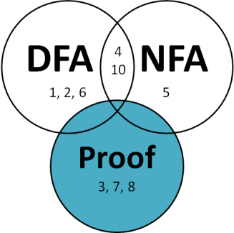
***Distinguishability Theorem*** (Lower-bound on Necessary states!)
If there is a pairwise distinguishable set of N strings for a language L, then a DFA accepting L must have ≥ N states.
Given a language L,
Strings w₁ and w₂ are distinguishable if
there exists z ∈ ∑*
such that w₁z ∈ L and w₂z∉ L (or vice versa)
Definition of distinguishable
A set S = {w₁, w₂, ….}
is pairwise distinguishable
if w_{i} and w_{j} are distinguishable for i ≠ j.
Definition of pairwise distinguishable

Slide 8
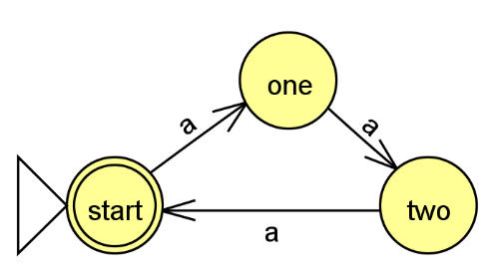
Example Proof for L = {a^{3n} | n ≥ 0 }
A multiple of 3 a’s.
Upper bound:
To prove that you don’t need more than X states:
Make a DFA with X states.
Lower bound:
To prove that you need at least Y states:
Find Y pairwise distinguishable strings.
Need no more than 3
Need at least 3
w_{i} | w_{j} | z | Is one accepted and on rejected?
a | aa | a | aa reject aaa accept
a | aaa | aa | aaa accept aaaaa reject
aa | aaa | a | aaa accept aaaa reject

Slide 9
Regular/ Non-Regular Languages

Slide 10
***The Non-Regular Language Theorem***
Myhill-Nerode theorem
If there is an infinite
pairwise distinguishable
set of strings (w.r.t. L),
it must be that L is not regular!
You can’t represent it with a DFA

Slide 11
Summary – Non-Regular Language Proofs
Identify an infinite set of strings
Show that any two strings in the set are distinguishable
Common mistakes:
Two string in the set are distinguishable, but not any two
Look for corner cases where two string would not be distinguishable! → Refine the set of infinite set of string
The description of the infinite set is ambiguous
If there is an infinite
pairwise distinguishable
set of strings (w.r.t. L),
it must be that L is not regular!

Slide 12
Non-Regular Language Proof
If there is an infinite
pairwise distinguishable
set of strings (w.r.t. L),
it must be that L is not regular!
Show that this is not regular
L = { 0^{n} 1^{n} | n ≥ 0 }

Slide 13
Non-Regular Language Proof
Solution
If there is an infinite
pairwise distinguishable
set of strings (w.r.t. L),
it must be that L is not regular!
Show that this is not regular
L = { 0^{n} 1^{n} | n ≥ 0 }
Consider the infinite set:
{0^{n} | n is a pos. integer}
{0, 00, 000, 0000, … }
w_{i} = 0^{i} w_{j} = 0^{j} Note: i ≠ j
z = 1^{i} w_{i} z = 0^{i} 1^{i} w_{j} z = 0^{j} 1^{i}
Accepted
Rejected

Slide 14
Non-regular Language Proofs
How do you feel about them?
Not great
Okay
Great

Slide 15
Homework 11
Prove that you need at least 6 states (for #2)
Prove that palindrome checking is not regular
Prove that power of two occurrences of 0’s is not regular

Slide 16
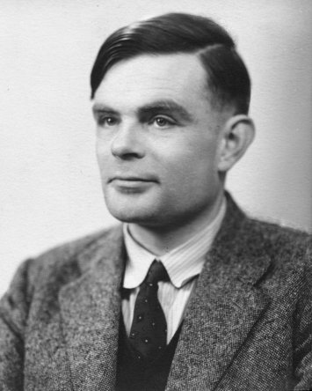
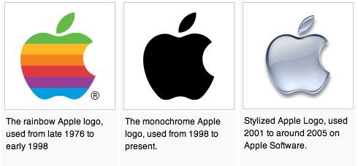
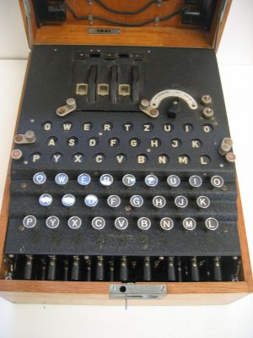
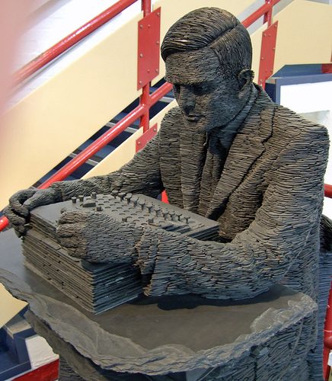
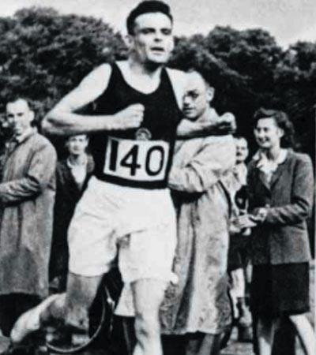
Alan Turing
AI !
1912-1954
WWII
Enigma machine ~ The axis's encryption engine
2007
Bletchley Park
1946

Slide 17
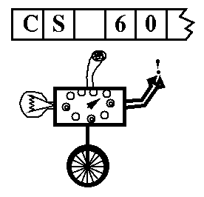
Turing Machines…
Alan Turing: “Logical Computing Machines”
A simple model of universal computation.
Starts on the leftmost character
The tape: an unbounded amount of memory. Consists of cells, each containing exactly one character characters (e.g. 0, 1, or □ (blank))
Read/write head for the tape
The control: a finite amount of memory, the control states -- some are accepting, some are not.
Ability to move left and right
The control state
The symbol now under the head
The symbols to the right of the head
The symbols to the left of the head
The complete state of a TM is determined by:

Slide 18
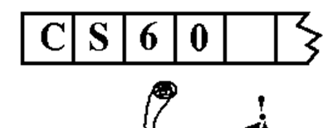
Turing Machine Demo
0
;
1
,
a Turing Machine rule:
R
READ SYMBOL
WRITE SYMBOL
MOTION

Slide 19
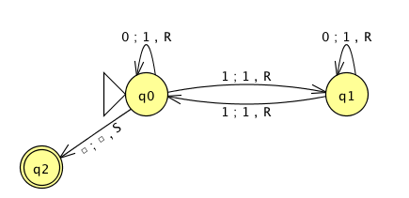
the input
0
1
0
1
1
the tape
"blanks" are everywhere else
R/W head
an accepting state always halts and then basks in its success!
if a transition is missing, the input FAILS!
0
;
1
,
a Turing Machine rule:
R
READ SYMBOL
WRITE SYMBOL
MOTION
Notes:
metric prefixes…

Slide 20
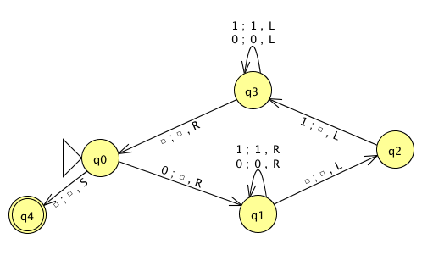
Name(s) __________________________________ Quiz
Run this TM on this input:
0
0
1
1
1
Is this input accepted or rejected?
What inputs are accepted in general? How does it work?
Extra: How could you change this to accept palindromes?
(just a thought experiment)
Notes:
metric prefixes…

Slide 21
Assignment #11
Problem: Create a JFLAP TM that accepts strings of 2^{N} zeros.
(You may assume the input is all zeros)
start
reject
0
accept
0
0
accept
0
0
0
reject
0
0
0
0
accept
Extra Credit:
in as few states as possible (3)
… but you ARE allowed to make the alphabet bigger!

Slide 22
Tips: Create a JFLAP TM that accepts strings of 2^{N} zeros.
Can you solve a related, simpler problem?
Can you make the problem smaller?

Slide 23
DFA
1, 2, 6
NFA
5
4 10
Proof
3, 7, 8

Slide 24
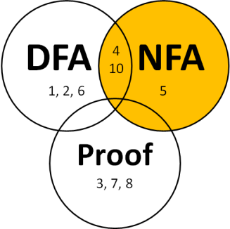
Nondeterministic Finite Automata (NFAs)
Rules:
States can have any number of transitions for a single character. (zero, one, more...)
Can transition without reading input (λ)
Accepts iff there is at least one accepting path
Have the power to guess the right way to go

Slide 25
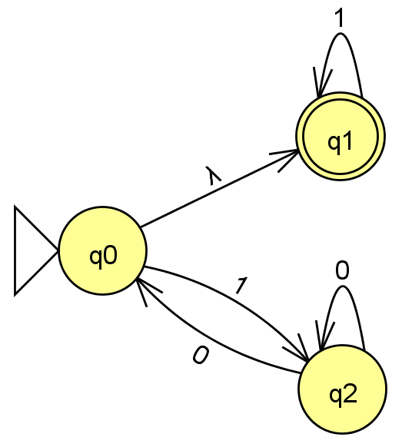
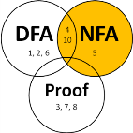
NFAs: Adding nondeterminism to DFAs
NFA Rules:
States can have any number of transitions for a single character. (zero, one, more...)
Can transition without reading input (λ)
Accepts iff there is at least one accepting path
Have the power to guess the right way to go.
NFAs
(Nondeterministic Finite Automata)
What happens with …
- an input of 1 ?
- an input of 0 ?
- an input of 11 ?
How many fail?
A) 0 B) 1-2 C) 3 D) 4 E) ?
- an input of 101 ?
- an input of λ?
Is L = { all strings beginning with 1 } ?
Notes:
equivalent NFAs?
is this possible?

Slide 26
If you were going to implement an NFA in code, what language would you want to use?
Python
Racket
Prolog
Java
Other

Slide 27
DFAs
≡
NFAs
≡
RegEx's
To show:
How many states?
A) 4 B) 5 C) 6 D) >6 E) ?
DFAs can represent NFAs
λ, 0, or multiple transitions
What DFA states might we need?
Notes:
Key property of NFA – multiple states at once….
Key insight was that you could represent this deterministically by considering all different SUBSETS of states that you might be in!

Slide 28
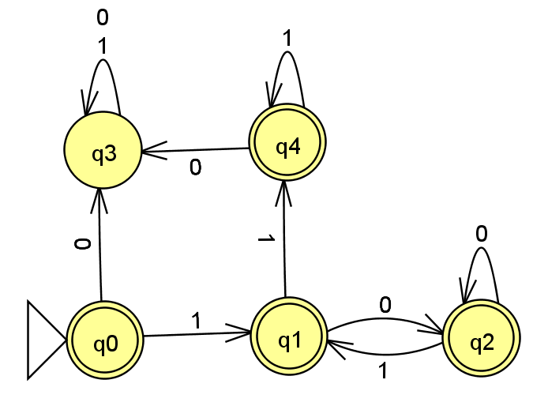
Solution
DFAs
≡
NFAs
≡
RegEx's
To show:
DFAs can represent NFAs
λ, 0, or multiple transitions
Notes:
Key property of NFA – multiple states at once….
Key insight was that you could represent this deterministically by considering all different SUBSETS of states that you might be in!

Slide 29
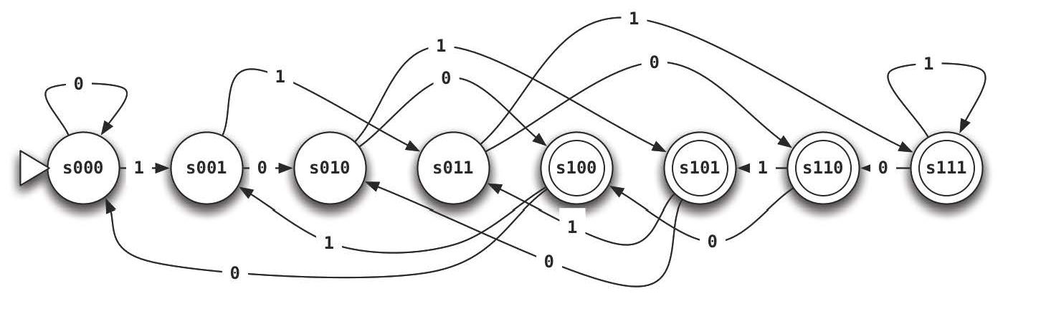
Write the NFA for this Language
L = {w ∈ {0,1}*| w’s third-to-last character is a 1}
strings not in L
λ
11
01
01011001
1111111011
strings in L
110
100
0000100
111111111
a DFA would require 8 states
Notes:
good to have a lambda here at the start

Slide 30
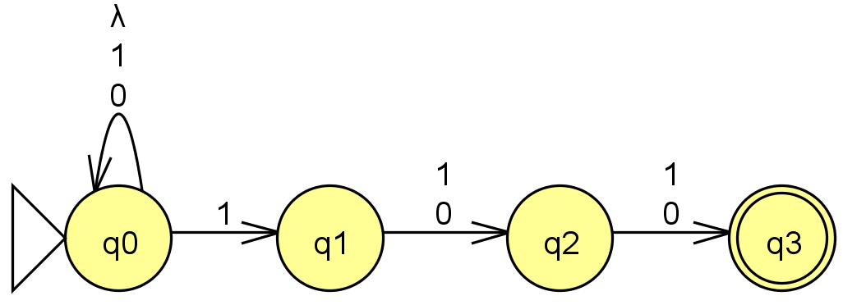
Solution
Write the NFA for this Language
L = {w ∈ {0,1}*| w’s third-to-last character is a 1}
strings not in L
λ
11
01
01011001
1111111011
strings in L
110
100
0000100
111111111
a DFA would require 8 states
Notes:
good to have a lambda here at the start

Slide 31


Depth First Search (DFS) & Breadth First Search (BFS)

Slide 32
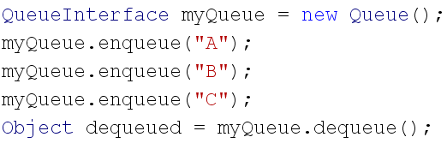

QUEUES: First in First Out
REVIEW
Create an object that implements QueueInterface
dequeued is "A"
A
B
C

Slide 33
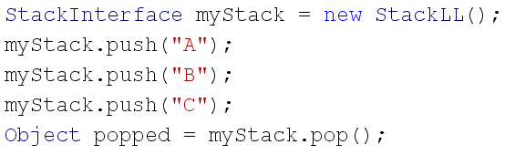
STACKS: Last in First Out
REVIEW
Create an object that implements StackInterface
C
B
A
popped is "C"
4

Slide 34
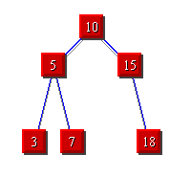
Breadth First Search (BFS)
Depth
First Search (DFS)
STACKS
QUEUES

Slide 35
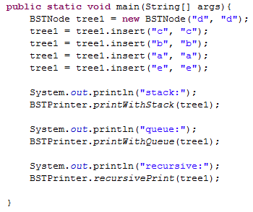
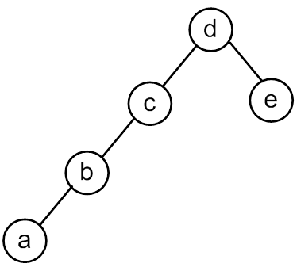

Slide 36
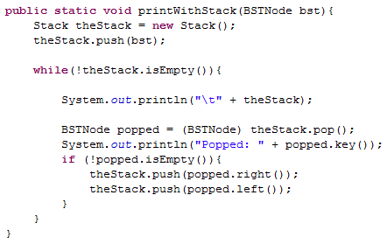
Print With a Stack

Slide 37
<TOP> d <BOTTOM>
Popped: d
<TOP> c e <BOTTOM>
Popped: c
<TOP> b empty e <BOTTOM>
Popped: b
<TOP> a empty empty e <BOTTOM>
Popped: a
<TOP> empty empty empty empty e <BOTTOM>
Popped: empty
<TOP> empty empty empty e <BOTTOM>
Popped: empty
<TOP> empty empty e <BOTTOM>
Popped: empty
<TOP> empty e <BOTTOM>
Popped: empty
<TOP> e <BOTTOM>
Popped: e
<TOP> empty empty <BOTTOM>
Popped: empty
<TOP> empty <BOTTOM>
Popped: empty

Slide 38
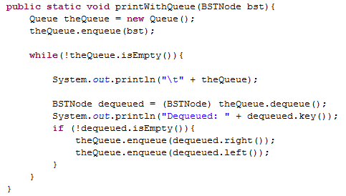
Print With a Queue

Slide 39
<FRONT> d <BACK>
Dequeued: d
<FRONT> e c <BACK>
Dequeued: e
<FRONT> c empty empty <BACK>
Dequeued: c
<FRONT> empty empty empty b <BACK>
Dequeued: empty
<FRONT> empty empty b <BACK>
Dequeued: empty
<FRONT> empty b <BACK>
Dequeued: empty
<FRONT> b <BACK>
Dequeued: b
<FRONT> empty a <BACK>
Dequeued: empty
<FRONT> a <BACK>
Dequeued: a
<FRONT> empty empty <BACK>
Dequeued: empty
<FRONT> empty <BACK>

Slide 40
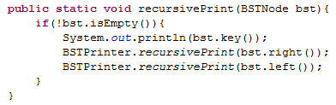

Slide 41
BONUS

Slide 42


Computer
Science
&
= AWESOME

Slide 43
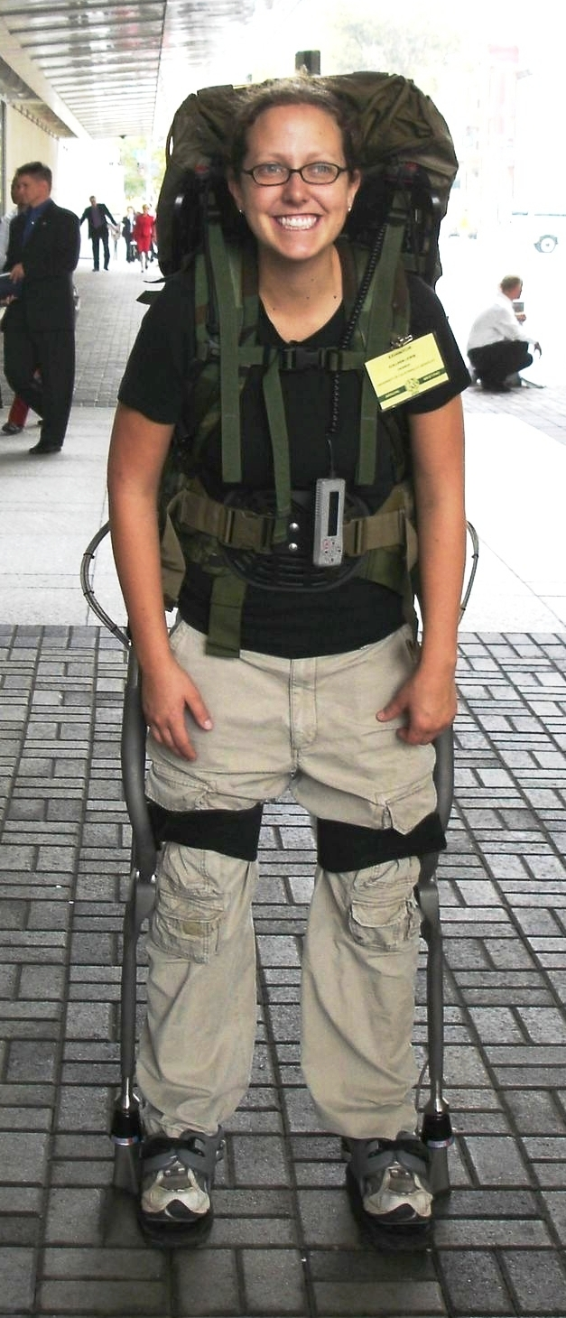
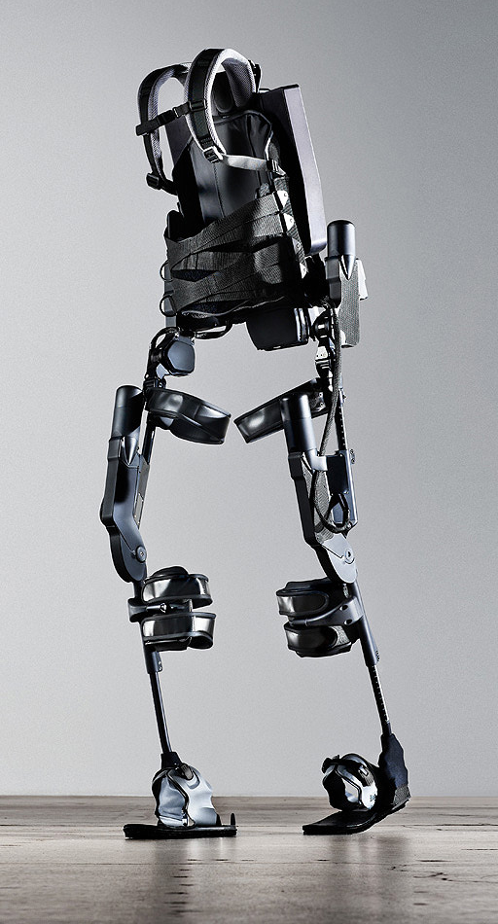
http://www.youtube.com/watch?v=pzRmNYA8LlY

Slide 44


ClickStart

Slide 45
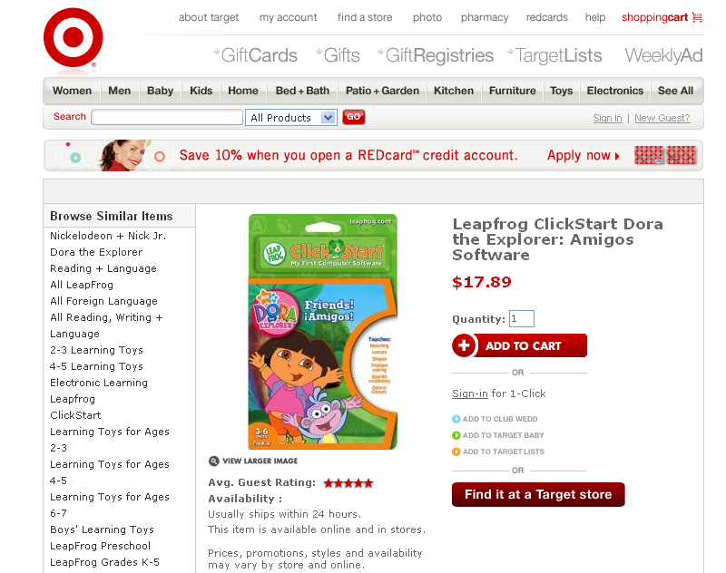

Slide 46


Slide 47
The value in the array tells me what art asset to use
Each level is really a 3x10 array!
0 | 0 | 7 | 0 | 4 | 0 | 0 | 0
1 | 2 | 3 | -4 | 5 | 6 | -7 | 8
B | B | B | B | B | B | B | B
Negative values tell me what block needs to go here to win!

Slide 48
0 | 0 | 7 | 0 | 4 | 0 | 0 | 0
1 | 2 | 3 | -4 | 5 | 6 | -7 | 8
0 | 0 | 0 | B | 0 | 0 | 0 | 0

Slide 49
BUGS!

Slide 50
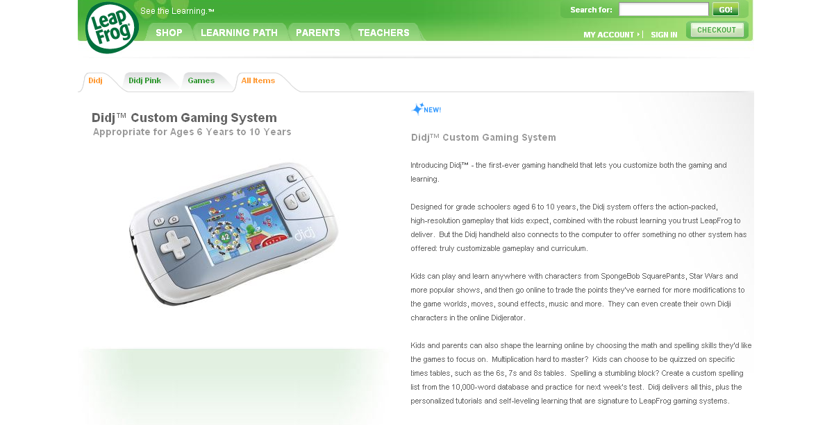

Slide 51

It is really sad when stuff you’ve made is on sale!

Slide 52



Which image is fake?
A. Top Left
B. Bottom Left
C. Bottom Right

Slide 53
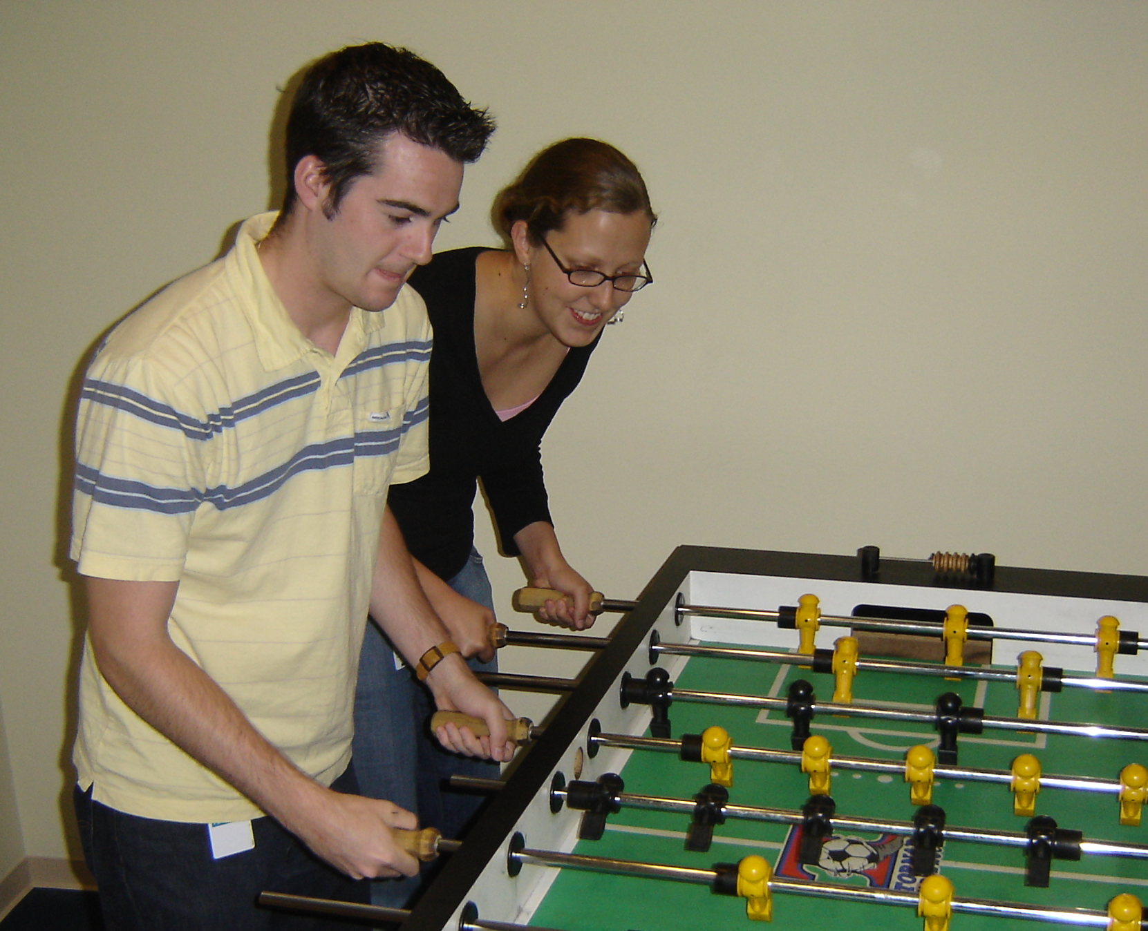

Slide 54
