Slide 1
CS 60
Spampede (Snake game) Abstract classes, & Sorting
2013-11-25
Monday – Week 11
Lecture 22

Slide 2
Survey
How’s your week???
Extra awesome!!!
Awesome
Sorta-awesome
Not-so-awesome
Ahhh!!!!

Slide 3
Abstract Classes

Slide 4
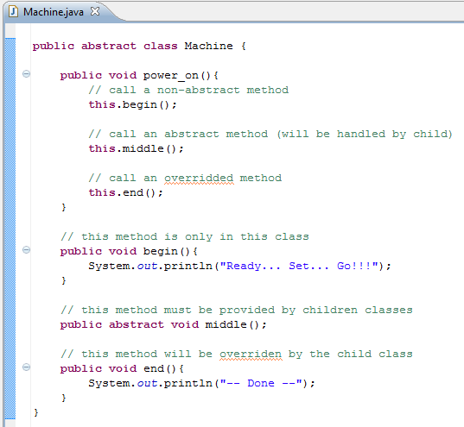
We can call unimplemented methods
We don’t have to implement all methods

Slide 5
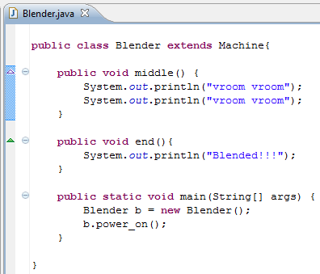
Does "Blended!!!"
get printed?
A) Yes B) No C)?

Slide 6
ArrayList & Generics
Actually stored as an array, so access time is O(1).
Like a list because it can grow and shrink – costs O(N)
What I want you to remember:
Arrays do not change size

Slide 7
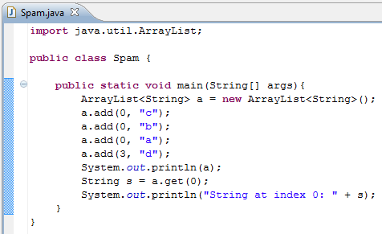

Use the <> to indicate what type of reference to use!
Add “b” at index 0
System.out.println calls toString() on input

Slide 8
Spampede Demo

Slide 9
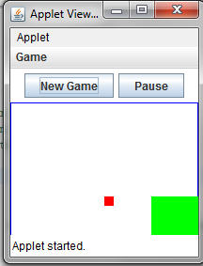
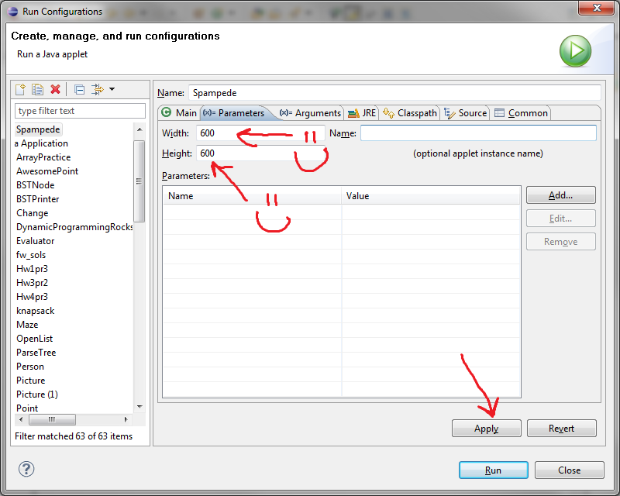
Run Spampede.java
If your window is funny shaped…

Slide 10

Keep track of spam and your pede

Slide 11
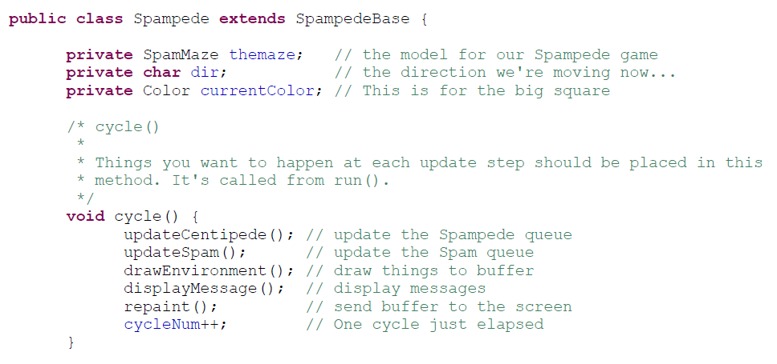
cycle()

Slide 12
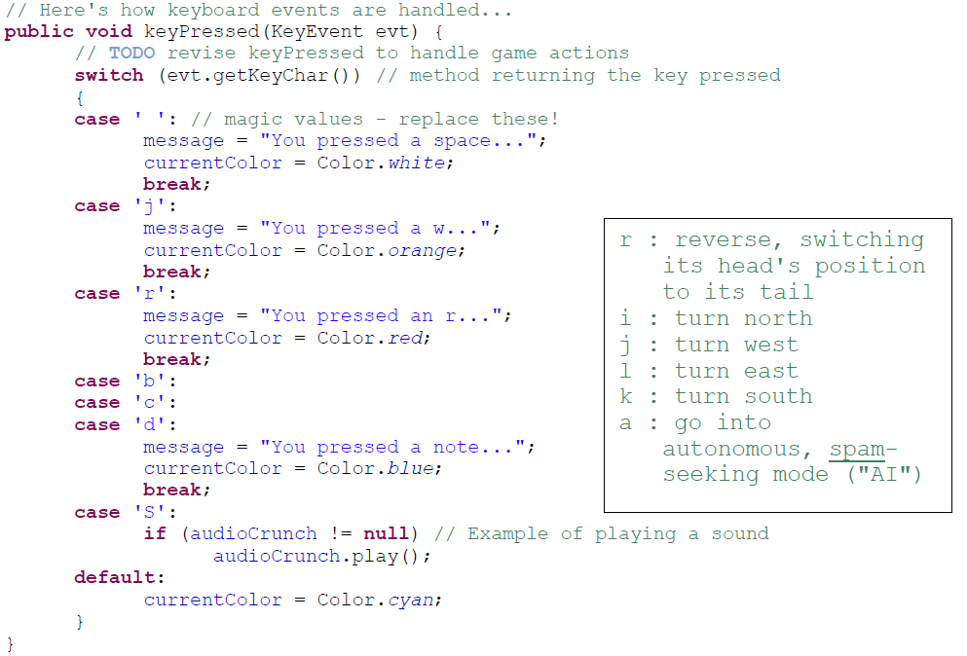
A separate thread will handle key presses

Slide 13
DFS/BFS Review

Slide 14
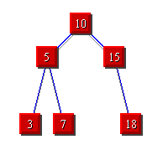
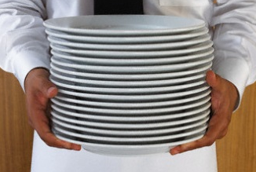

Breadth First Search (BFS)
3
Depth
First Search (DFS)
STACKS
QUEUES

Slide 15
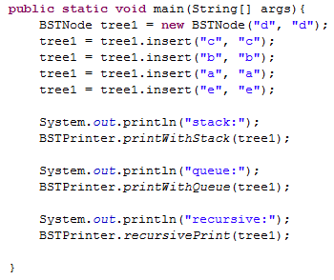
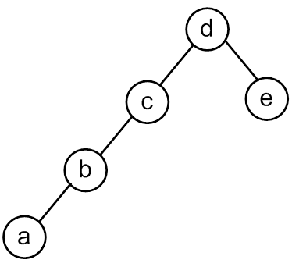
Remember the emptyBSTNode?

Slide 16
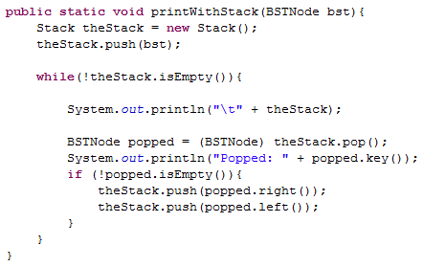
Print With a Stack

Slide 17
<TOP> d <BOTTOM>
Popped: d
<TOP> c e <BOTTOM>
Popped: c
<TOP> b empty e <BOTTOM>
Popped: b
<TOP> a empty empty e <BOTTOM>
Popped: a
<TOP> empty empty empty empty e <BOTTOM>
Popped: empty
<TOP> empty empty empty e <BOTTOM>
Popped: empty
<TOP> empty empty e <BOTTOM>
Popped: empty
<TOP> empty e <BOTTOM>
Popped: empty
<TOP> e <BOTTOM>
Popped: e
<TOP> empty empty <BOTTOM>
Popped: empty
<TOP> empty <BOTTOM>
Popped: empty
We put a bunch of empty stuff on the stack!
(a bunch of references to emptyBSTNode)

Slide 18
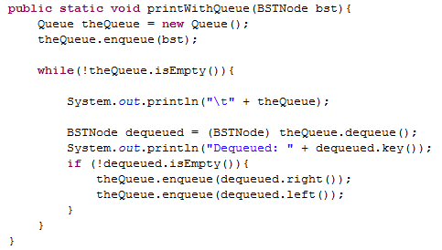
Print With a Queue

Slide 19
<FRONT> d <BACK>
Dequeued: d
<FRONT> e c <BACK>
Dequeued: e
<FRONT> c empty empty <BACK>
Dequeued: c
<FRONT> empty empty empty b <BACK>
Dequeued: empty
<FRONT> empty empty b <BACK>
Dequeued: empty
<FRONT> empty b <BACK>
Dequeued: empty
<FRONT> b <BACK>
Dequeued: b
<FRONT> empty a <BACK>
Dequeued: empty
<FRONT> a <BACK>
Dequeued: a
<FRONT> empty empty <BACK>
Dequeued: empty
<FRONT> empty <BACK>

Slide 20
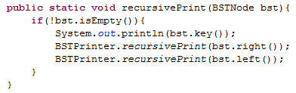
Will this print in the same order as:
Stack
Queue
?

Slide 21
Searching

Slide 22
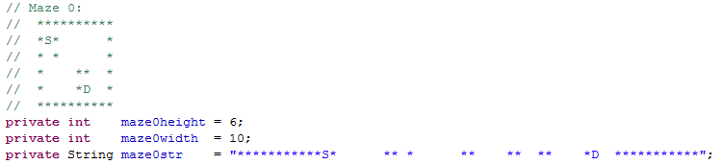
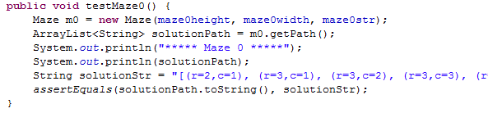
*: wall
S: Start
D: Destination
Input to make a Maze
getPath() returns an ArrayList<String>

Slide 23
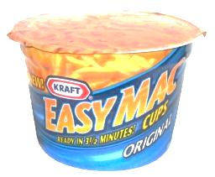


BFS Traversal Pseudocode (WRONG)
A
B
create an empty Queue
enequeue the starting node
while (the queue is not empty)
{
dequeue a node: “it”
for each neighbor of “it”
{
enqueue the neighbor
}
}
C
D
A. Looks good to me!
B. I see a problem! C. I see a solution!
it
it
it
it
it
A
B
D
D
C
C
A

Slide 24
BFS Traversal Pseudocode (Fixed)
Don’t look at your handout
create an empty Queue
enqueue the starting node
mark starting node as inTheQueue
while (the queue is not empty)
{
dequeue a node: “it”
for each neighbor of “it”
{
if (neighbor is not inTheQueue)
{
enqueue the neighbor
mark neighbor as inTheQueue
}
}
}
Mark node as “inTheQueue” or “visited” when we put it into the Queue
Would we have the same problem with a Stack?

Slide 25

Search for Spam!
Sample Input
class Maze
6 10
**********
*S* *
* * *
* ** *
* *D *
**********
class MazeCell
**********
*S* *
*o* oooo *
*oooo**o *
* *Do *
**********
class Maze
{
private MazeCell[][] maze;
Sample solution
Notes:
I don’t know if this really works...

Slide 26
Maze and MazeCell
col
col
col
col
col
col
0
1
2
3
4
5
class MazeCell
{
private int row;
private int col;
private char contents;
private boolean visited;
private MazeCell parent;
MazeCell(int row, int col, char c)
{
this.row = row;
this.col = col;
this.contents = c;
this.visited = false;
this.parent = null;
}
}
row
0
row
1
row
2
row
'D'
'S'
3
row
' '
4
row
'*'
'*'
5
Here are the available characters:
'S' = Start Spam Seeking
'*' = Wall!
'D' = Delectible Dinner Destination
' ' = Open Space
Notes:
I don’t know if this really works...

Slide 27
Demo Naming Conventions
 | D |  | S
 | K | A | B | C
 | D | I | S | E
 | J | H | G | F
 |  |  | L
Name all cells so we can refer to them in the demos!
'S' = Start Spam Seeking
'D' = Delectible Dinner Destination

Slide 28
 | K | A | B | C
 | D | I | S | E
 | J | H | G | F
 |  |  | L
create an empty Stack
push the starting node
mark starting node as visited
while (the stack is not empty)
{
pop a node: “it”
for each neighbor of “it”
{
if (neighbor is not visited)
{
push the neighbor
mark neighbor as visited
set parent of neighbor
if (neighbor is D){
DONE!!! } }
}
}
5
DEMO
&& not wall
A. Looks good to me!
B. I see a problem! C. I see a solution!
2nd
1st
3rd
4th
A | B | C | D | E | F | G | H | I | J | K | L | S

Slide 29
 | K | A | B | C
 | D | I | S | E
 | J | H | G | F
 |  |  | L

Slide 30
DFS Traversal (Stack) Solutions:
 | K | A | B | C
 | D | I | S | E
 | J | H | G | F
 |  |  | L
2nd
1st
3rd
4th
 |  |  |  |  |  |  |  |  |  | L
 |  |  |  |  |  |  |  |  | F | F | F
 |  |  |  |  |  | G |  | H | H | H | H | H |  | J
 |  |  |  |  | E | E | E | E | E | E | E | E | E | E | E
 |  |  |  | B | B | B | B | B | B | B | B | B | B | B | B
 | S |  | I | I | I | I | I | I | I | I | I | I | I | I | I
Stack begins here!
 | A | B | C | D | E | F | G | H | I | J | K | L | S
Visited? |  | T |  |  | T | T | T | T | T | T |  | T | T
Order visited |  |  |  |  |  | 3rd | 1st | 4th |  | 5th |  | 2nd | 0th
Parent |  |  |  | J |  | G | S | G |  | H |  | G

Slide 31
Stack Based (DFS) vs. Queue Based (BFS)
create an empty Stack
push the starting node
mark starting node as visited
while (the stack is not empty)
{
pop a node: “it”
for each neighbor of “it”
{
if (neighbor is not visited)
{
push the neighbor
mark neighbor as visited
set parent of neighbor
if (neighbor is D){
DONE!!! } }
}
}
create an empty Queue
enqueue the starting node
mark starting node as visited
while (the queue is not empty)
{
dequeue a node: “it”
for each neighbor of “it”
{
if (neighbor is not visited)
{
enqueue the neighbor
mark neighbor as visited
set parent of neighbor
if (neighbor is D){
DONE!!! } }
}
}

Slide 32
 | K | A | B | C
 | D | I | S | E
 | J | H | G | F
 |  |  | L
create an empty Queue
enqueue the starting node
mark starting node as visited
while (the queue is not empty)
{
dequeue a node: “it”
for each neighbor of “it”
{
if (neighbor is not visited)
{
enqueue the neighbor
mark neighbor as visited
set parent of neighbor
if (neighbor is D){
DONE!!! }}}}
DEMO
2nd
1st
3rd
4th
&& not wall
A | B | C | D | E | F | G | H | I | J | K | L | S

Slide 33
 | K | A | B | C
 | D | I | S | E
 | J | H | G | F
 |  |  | L

Slide 34
BFS Traversal (Queue) Solutions:
 | K | A | B | C
 | D | I | S | E
 | J | H | G | F
 |  |  | L
5
Queue begins here!
S
I
I | B
I | B | E
I | B | E | G
B | E | G
2nd
1st
3rd
4th
 | A | B | C | D | E | F | G | H | I | J | K | L | S
Visited? |  | T |  |  | T |  | T |  | T |  |  |  | T
Parent |  | S |  | I | S |  | S |  | S

Slide 35
BFS Traversal (Queue) Solutions (different order)
 | K | A | B | C
 | D | I | S | E
 | J | H | G | F
 |  |  | L
Queue begins here!
5
S
B
B | E
B | E | G
B | E | G | I
E | G | I
E | G | I | C
E | G | I | C | A
G | I | C | A
G | I | C | A | F
I | C | A | F
I | C | A | F | L
I | C | A | F | L | H
C | A | F | L | H
1st
4th
2nd
3rd
 | A | B | C | D | E | F | G | H | I | J | K | L | S
Visited | T | T | T |  | T | T | T | T | T |  |  | T | T
Parent | B | S | B | I | S | E | S | G | S |  |  | G

Slide 36
Stack Based (DFS) vs. Queue Based (BFS)
5
Which is better smaller (better)?
Speed of search?
1) DFS 2) BFS 3) Depends
Memory use?
1) DFS 2) BFS 3) Depends
Length of final path?
1) DFS 2) BFS 3) Depends

Slide 37
Big-O for Arrays

Slide 38
Unsorted Arrays Big-O
Insert (into first spot) | O( )
Insert (into last spot) | O( )
Find (given a value) | O( )
Delete (given a value) | O( )
5 | 3 | 8 | 2 | 1 | 7 | 0 | 0 | 0 | 0 | 0 | 0 | 0
Assuming:
unsorted array holding numbers within 1 to N
no duplicates
we keep track the last index we use (maxIndex)
all values at indices > maxIndex are 0 (unused).

Slide 39
Sorted Arrays Big-O
Insert (into first spot) | O( )
Insert (into last spot) | O( )
Find (given a value) | O( )
Delete (given a value) | O( )
Assuming:
sorted array holding numbers within 1 to N
no duplicates
we keep track the last index we use (maxIndex)
all values at indices > maxIndex are 0 (unused).
1 | 2 | 3 | 5 | 7 | 8 | 0 | 0 | 0 | 0 | 0 | 0 | 0

Slide 40
Boolean Arrays Big-O
Insert (into first spot) | O( )
Insert (into last spot) | O( )
Find (given a value) | O( )
Delete (given a value) | O( )
F₀ | T₁ | T₂ | T₃ | F₄ | T₅ | F₆ | T₇ | T₈
Assuming:
Boolean array representing numbers within 1 to X
X is a fixed number
no duplicates
Could I use this trick to store objects?

Slide 41
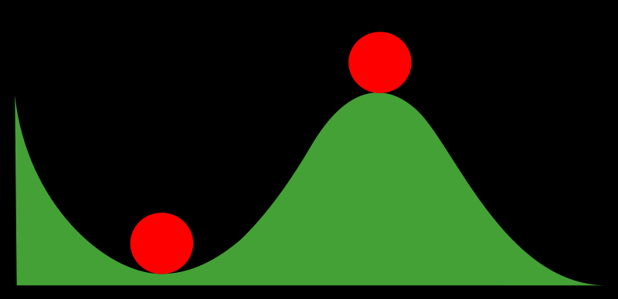
Stable and Non-Stable Sorting

Slide 42
Stable Sort
Sometimes there are equivalent keys in a data structure that is sorted.
Sometimes it matters if you change the order of those equivalent keys
E.g. Sorting music by song and then artist should keep each artists songs alphabetized
We call a sort “stable” if it doesn’t change the order of equivalent keys

Slide 43
Radix Sort (an example of a stable sort)

Slide 44
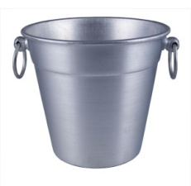
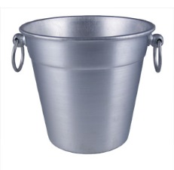
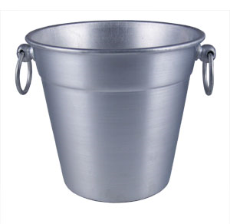

Easy Sorting Problems…
Sort N numbers in the range 0 to 9
0 | 1 | 2 | 3 | 4 | 5 | 6 | 7 | 8 | 9
How fast could you sort
N numbers
in the range 0 to B?
O(N)
O(B)
O(N+B)
O(N*B)
E) ??
In Big-O defining your variables is super important!

Slide 45
Harder Sorting Problems… Approach 1 – Two stages
Sort N numbers in the range 0 to 99
Make some buckets and calculate what bucket they need to go into.
Then sort each bucket
0 – 9 | 10-19 | 20-29 | 30-39 | 40-49 | 50-59 | 60-69 | 70-79 | 80-89 | 90-99

Slide 46
Harder Sorting Problems… Approach 2
Sort N numbers in the range 0 to 99
First sort by the one’s digit (this is counter intuitive)
95
25
98
29
20
32
93
85
97
38
39
0 | 1 | 2 | 3 | 4 | 5 | 6 | 7 | 8 | 9

Slide 47
Combine the buckets
Start from the first thing in the bucket
95
25
98
29
20
32
93
85
97
38
39
The 20’s are the correct relative order
0 | 1 | 2 | 3 | 4 | 5 | 6 | 7 | 8 | 9
20
20
32
93
85
25
25
95
97
38
98
39
29
29

Slide 48
Re-sort using the tens digit
20
32
93
85
25
95
97
38
98
39
29
Now Recombine!
98
29
39
97
25
38
95
20
32
85
93
0 | 1 | 2 | 3 | 4 | 5 | 6 | 7 | 8 | 9
20
25
29
32
38
39
85
93
95
97
98

Slide 49
Radix Sort the numbers 0-99
The running time for our example: (N + B)*2
We did two passes, each took N time.
We gathered up the buckets twice each took B time (where B is the number of buckets)

Slide 50








We can represent numbers with 1’s and 0’s
3 2 1 8
3*1000 + 2*100 + 1*10 + 8*1
1 0 0 1
1*8 + 0*4 + 0*2 + 1*1
We could use binary digits
0001 1
0010 2
0011 3
0100 4
0101 5
0110 6
0111 7
1000 8

Slide 51
Radix Sort with 32 bit numbers
We chose how many bits we want to sort at a time.
4 bits at a time (8 passes)
0000 0000 0000 0000 0000 0000 0000 0000
8 bits at a time (4 passes)
00000000 00000000 00000000 00000000
Running Time of Radix Sort in terms of
N: the number of items to sort
B: the number of buckets
P: the number of passes
Less than
Equal to
Greater than
??
O(N*B*P)

Slide 52
Runtime of Radix Sort
Running Time of Radix Sort in terms of
N: the number of items to sort
B: the number of buckets
P: the number of passes
O( P * (N+B))

Slide 53
SpampedeBase
On what page do I change something to make the snake go faster?
A) 1 B) 2 C) 3 D) 4 E) more than one possible

Slide 54
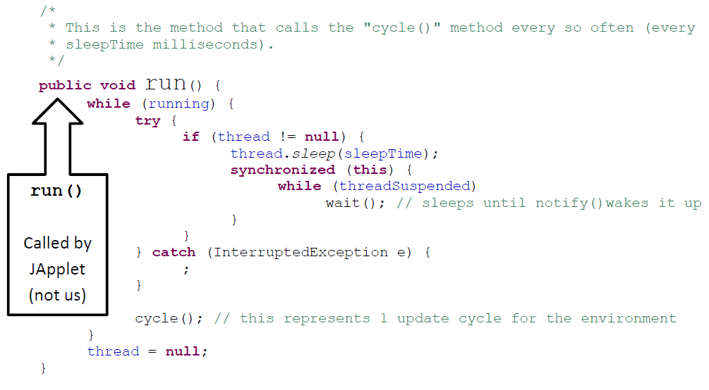
run() calls cycle()
If I removed this block, what wouldn’t work?
Anything!!! Eek!
Stopping
Pausing
Starting
??

Slide 55
Spampede.java
Thread thread; // the thread controlling the updates
boolean threadSuspended; // paused?
boolean running; // null?
public void run()
{
while (running)
{
try
{
if (thread != null)
{
thread.sleep(sleepTime);
synchronized(this)
{
while (threadSuspended)
wait();
}
}
}
catch (InterruptedException e) { ; }
cycle();
}
thread = null;
}
button- and key- handling
spam-handling
// called by the “Start” button
public synchronized void go()
{
if (thread == null)
{
thread = new Thread(this);
running = true;
thread.start();
threadSuspended = false;
}
else
threadSuspended = false;
notify();
}
// called by the “Pause” button
void pause()
{
if (thread != null)
threadSuspended = true;
}
this is the connection with the outside world…

Slide 56
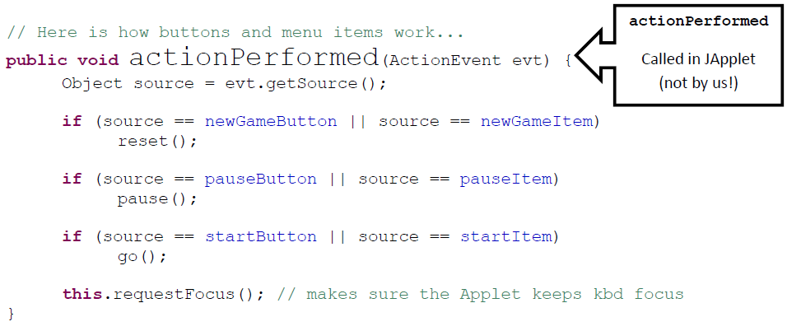
actionPerformed
Would the start button still work if you removed:
source == startItem
Yes – something else would break
Yes – nothing would break!
No – the button wouldn’t work
??

Slide 57
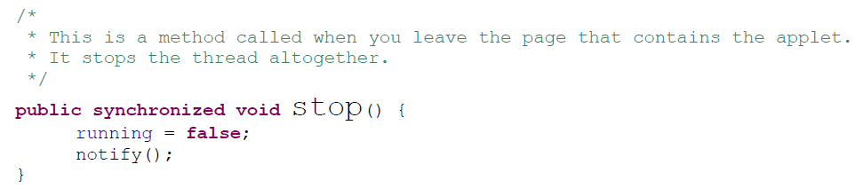
How does stop() work?
stop() only sets the instance variable running to false. In what method does this actually cause it to stop?
pause()
go()
run()
reset()
??

Slide 58
Object
wait()
notify()
Reuse via inheritance
get reused, too!
Component
public void requestFocus()
reusing base-classes' methods
public void addKeyListener()
public void repaint()
Container
public void paint()
public void add(Component c)
Panel
public void addNotify()
JApplet
public void init()
SpampedeBase
overriding of base-classes' methods
public void init()
public void paint()
Spampede

Slide 59

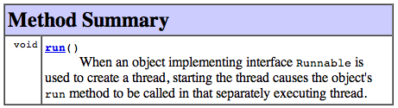
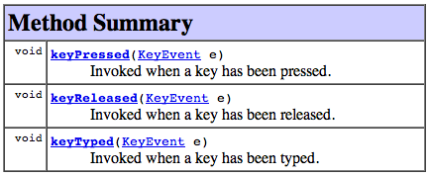
Interfaces enable event handling...
public class SpampedeBase extends JApplet implements ActionListener, KeyListener, Runnable
"this object can handle button presses..."
"this object can run in a separate thread"
handles button presses...
"this object can handle key presses..."
The object that waits for key presses, button presses, etc. is called a Listener …

Slide 60
Spampede
Look at the code for Spampede.
Do you think the code for BFS will go in here?
A) Yes B) No

Slide 61
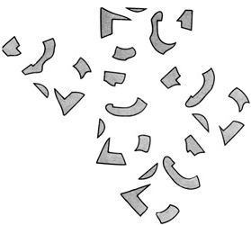
Event-driven execution
Events are things that happen to a graphical application
Button Presses • Text Entries
Key Presses, Key Releases, Key Events
Each object receiving an event notifies its “Listener”
The Listener then handles the event appropriately
// Here's how keyboard events are handled...
public void keyPressed(KeyEvent evt)
{
switch (evt.getKeyChar())
{
case 'k':
message = "Unicycles only!";
this.dir = 'k';
break;
What's 'k'?
context?

Slide 62
BONUS

Slide 63
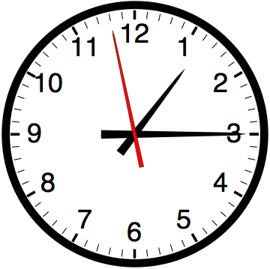

Slide 64


Computer
Science
&
= AWESOME

Slide 65
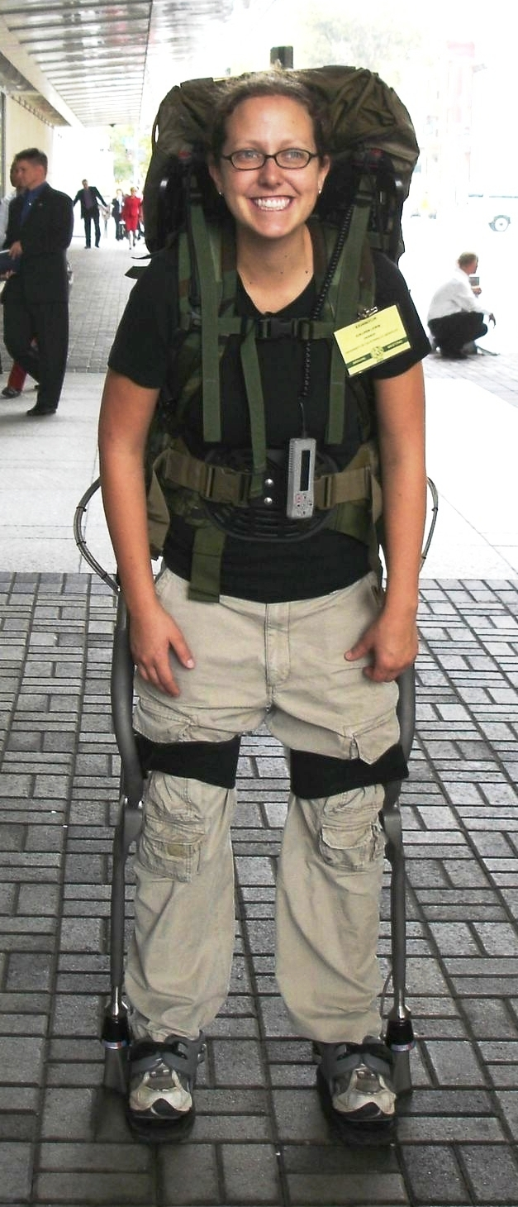
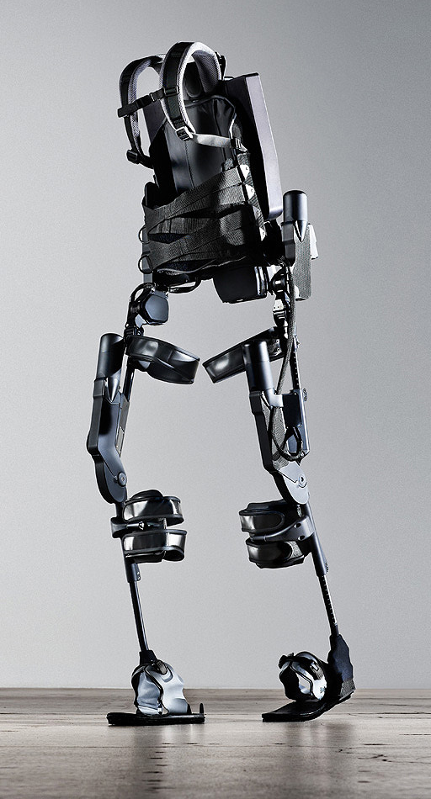
http://www.youtube.com/watch?v=pzRmNYA8LlY

Slide 66

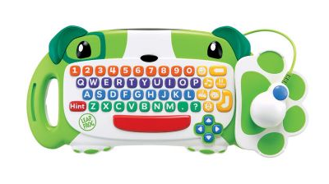
ClickStart

Slide 67
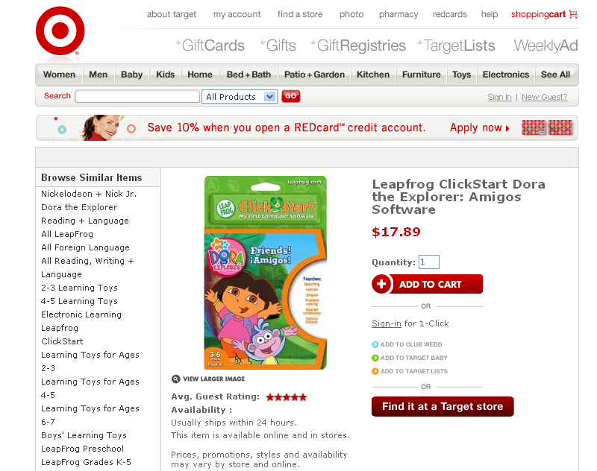

Slide 68
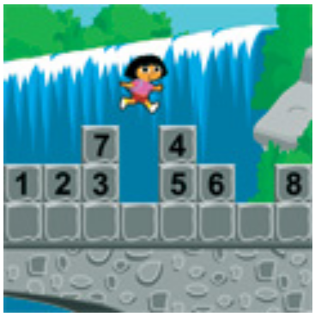
How should we represent the blocks in the computer?
Independent variables
2D Array
OpenList
I don’t know

Slide 69
The value in the array tells me what art asset to use
Each level is really a 3x10 vector!
0 | 0 | 7 | 0 | 4 | 0 | 0 | 0
1 | 2 | 3 | -4 | 5 | 6 | -7 | 8
B | B | B | B | B | B | B | B
Negative values tell me what block needs to go here to win!

Slide 70
0 | 0 | 7 | 0 | 4 | 0 | 0 | 0
1 | 2 | 3 | -4 | 5 | 6 | -7 | 8
0 | 0 | 0 | B | 0 | 0 | 0 | 0

Slide 71
BUGS!

Slide 72
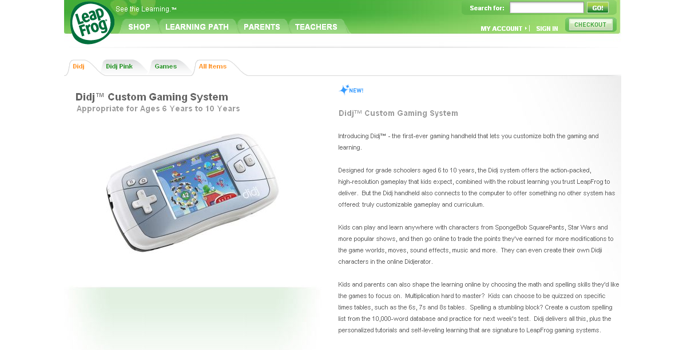

Slide 73
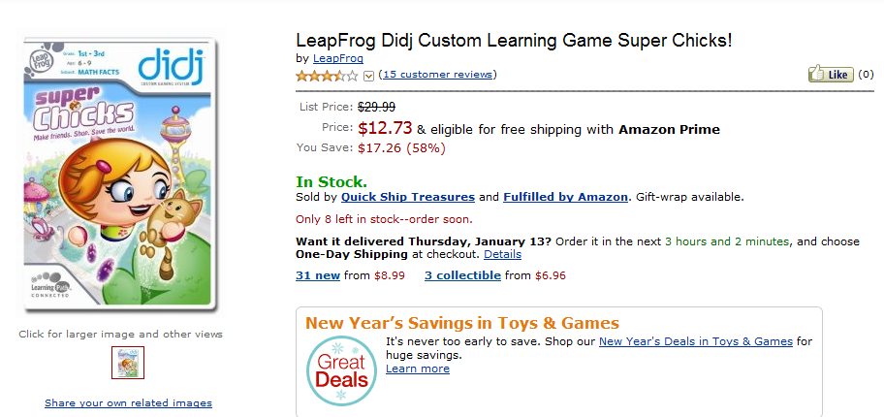
It is really sad when stuff you’ve made is on sale!

Slide 74
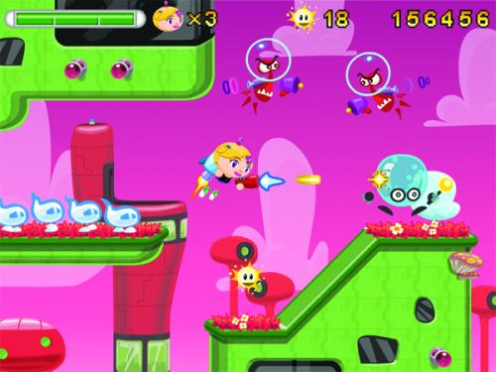
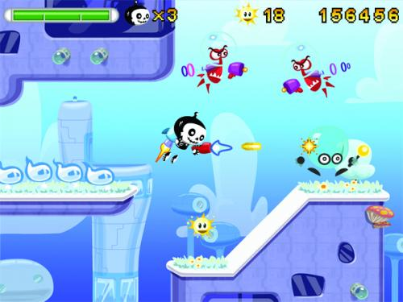

Which image is fake?
A. Top Left
B. Bottom Left
C. Bottom Right

Slide 75
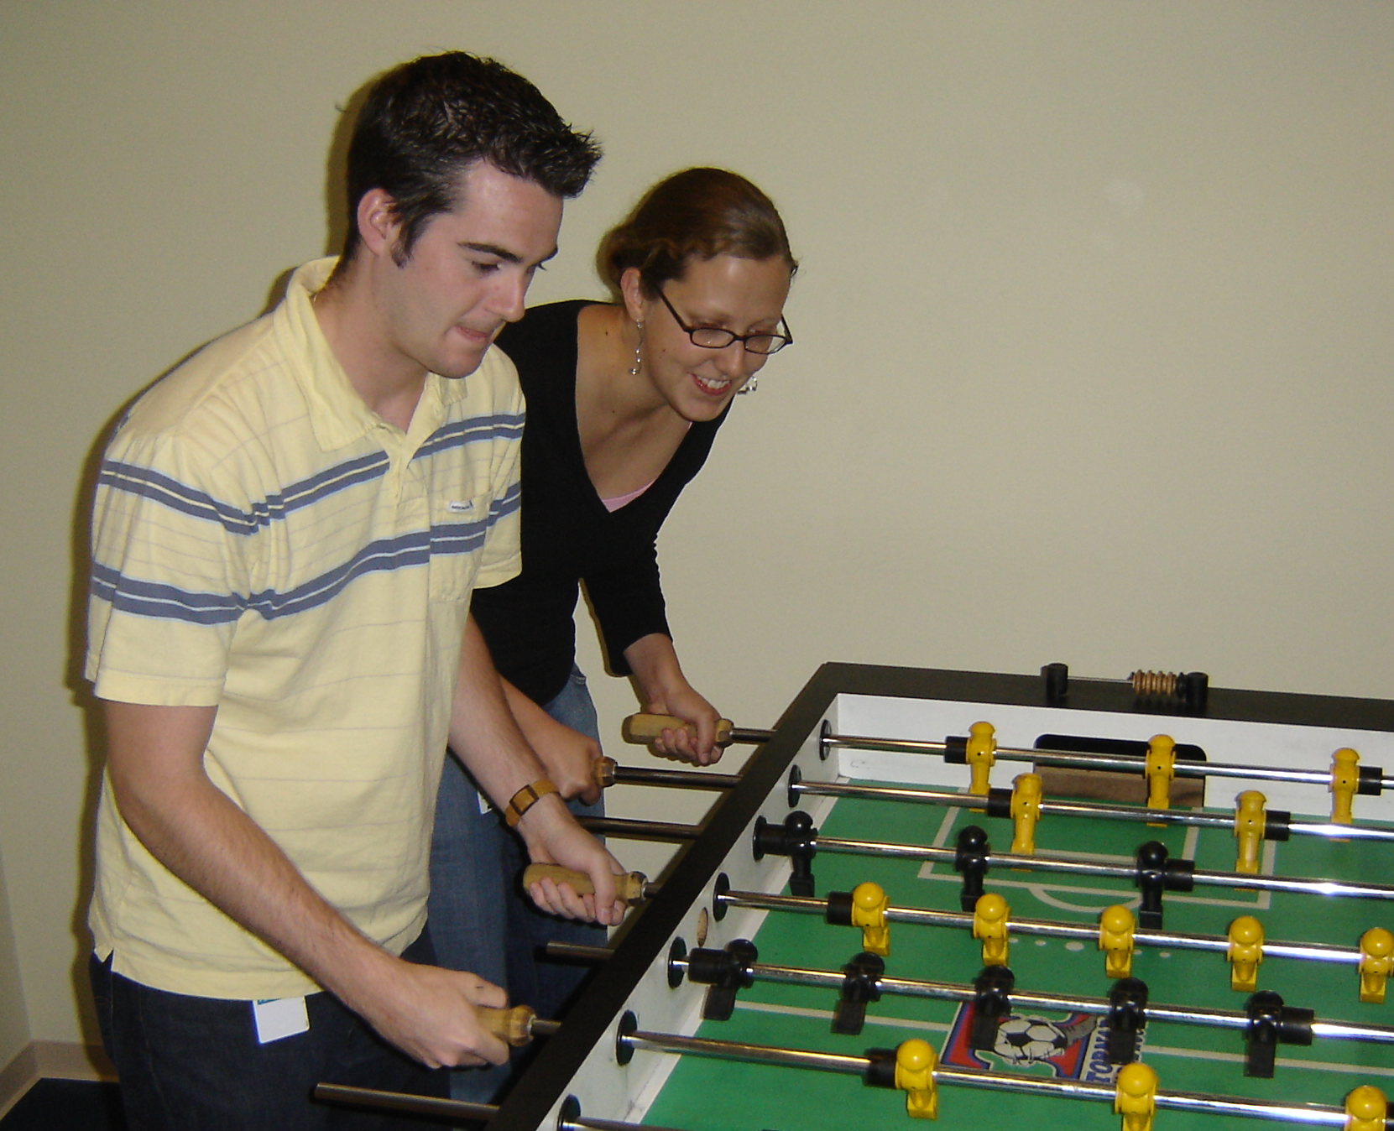

Slide 76
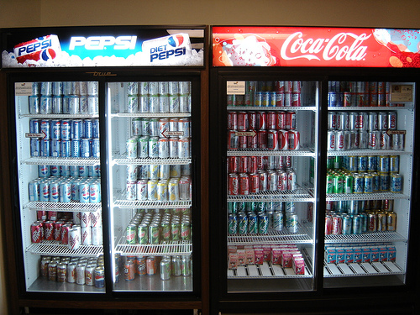

Slide 77
create an empty Queue
enqueue the starting node
mark starting node as visited
while (the queue is not empty)
{
dequeue a node: “it”
for each neighbor of “it”
{
if (neighbor is not visited)
{
enqueue the neighbor
mark neighbor as visited
set parent of neighbor
if (neighbor is D){
DONE!!! } }
}
}

Slide 78
create an empty Stack
push the starting node
mark starting node as visited
while (the stack is not empty)
{
pop a node: “it”
for each neighbor of “it”
{
if (neighbor is not visited)
{
push the neighbor
mark neighbor as visited
set parent of neighbor
if (neighbor is D){
DONE!!! } }
}
}

Slide 79
A | B | C | D | E | F | G | H | I | J | K | L | S

