Slide 1
CS 60
Spampede
(Snake game)
2013-12-02
Monday – Week 12
Lecture 23

Slide 2
Survey
Did you get into the classes you need?
Yes
Some
No
Ahhhh!!!

Slide 3
Review from Lecture 22
Abstract classes
You don’t implement all of the methods
Children classes implement all remaining methods
Generics
Some libraries have us specify what type of Objects they hold. e.g.
LinkedList<MazeCell> pedeCells = new LinkedList<MazeCell>();
BFS/DFS
Breadth first search (Queue) – for shortest path!
Depth first search (Stack)

Slide 4
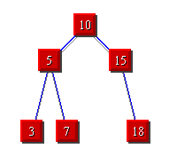
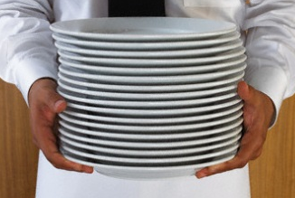

Breadth First Search (BFS)
Depth
First Search (DFS)
STACKS
QUEUES

Slide 5
Identify in what order the cells would be visited!
1st
4th
2nd
Breadth First Search (BFS)
Depth First Search (DFS)
3rd
 |  |  |  | 1
 |  |  |  | X | 2
 |  |  |  | 2
 |  |  |  | 1
 |  |  |  | X

Slide 6
Identify in what order the cells would be visited! (Solution)
1st
4th
2nd
Breadth First Search (BFS)
Depth First Search (DFS)
3rd
78 | 70 | 58 | 42 | 25 | 41 | 57 | 69 | 77
72 | 60 | 44 | 27 | 13 | 26 | 43 | 59 | 71
62 | 46 | 29 | 15 | 5 | 14 | 28 | 45 | 61
48 | 31 | 17 | 7 | 1 | 6 | 16 | 30 | 47
40 | 24 | 12 | 4 | X | 2 | 8 | 18 | 32
56 | 39 | 23 | 11 | 3 | 9 | 19 | 33 | 49
68 | 55 | 38 | 22 | 10 | 20 | 34 | 50 | 63
76 | 67 | 54 | 37 | 21 | 35 | 51 | 64 | 73
80 | 75 | 66 | 53 | 36 | 52 | 65 | 74 | 79
32 | 33 | 34 | 35 | 4 | 5 | 6 | 7 | 8
31 | 66 | 67 | 36 | 3 | 46 | 47 | 48 | 9
30 | 65 | 68 | 37 | 2 | 45 | 80 | 49 | 10
29 | 64 | 69 | 38 | 1 | 44 | 79 | 50 | 11
28 | 63 | 70 | 39 | X | 43 | 78 | 51 | 12
27 | 62 | 71 | 40 | 41 | 42 | 77 | 52 | 13
26 | 61 | 72 | 73 | 74 | 75 | 76 | 53 | 14
25 | 60 | 59 | 58 | 57 | 56 | 55 | 54 | 15
24 | 23 | 22 | 21 | 20 | 19 | 18 | 17 | 16

Slide 7
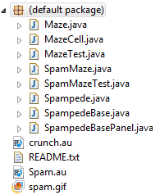
Spampede Files

Slide 8
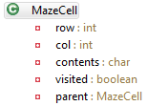
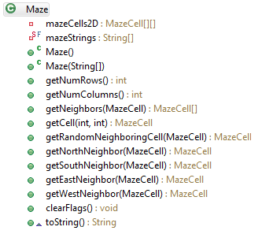
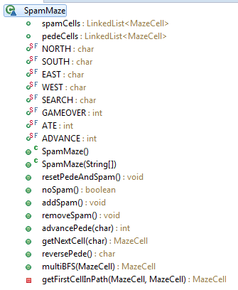
Class Structure (Preview)
has many
is a

Slide 9
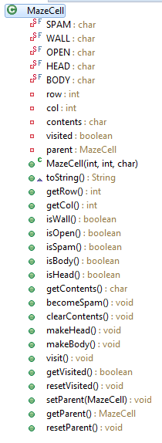
MazeCell (Provided)
Types of contents
Instance variables
Constructor, toString, access row and column info
Methods to inspect contents
Methods for doing BFS:
visited:
avoid infinite loops parent:
retrace path
Methods to modify contents

Slide 10
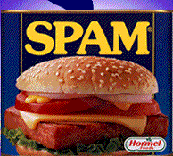
Maze
Sample Input
class Maze
**********
*S* *
* * *
* ** *
* *D *
**********
class MazeCell
class Maze
{
private MazeCell[][] mazeCells2D;
Notes:
I don’t know if this really works...

Slide 11
Maze has a MazeCell[][]
Nothing
crazy
clearFlags(): Clear
visited and parent for all MazeCells after running BFS.

Slide 12
class SpamMaze extends Maze {
Instance variables
Modes for pede movement
Possible results of movement
Constructors & Initialization
Spam updating
Pede movement

Slide 13
Class Structure
has many
is a

Slide 14


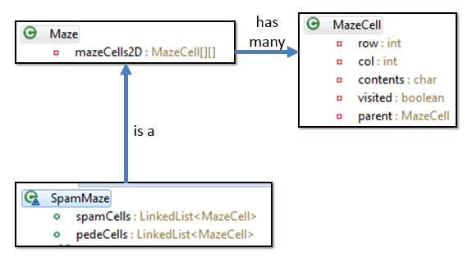
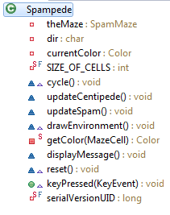
Full Class Structure
You can ignore!
You can ignore!
has one
is a
has one

Slide 15
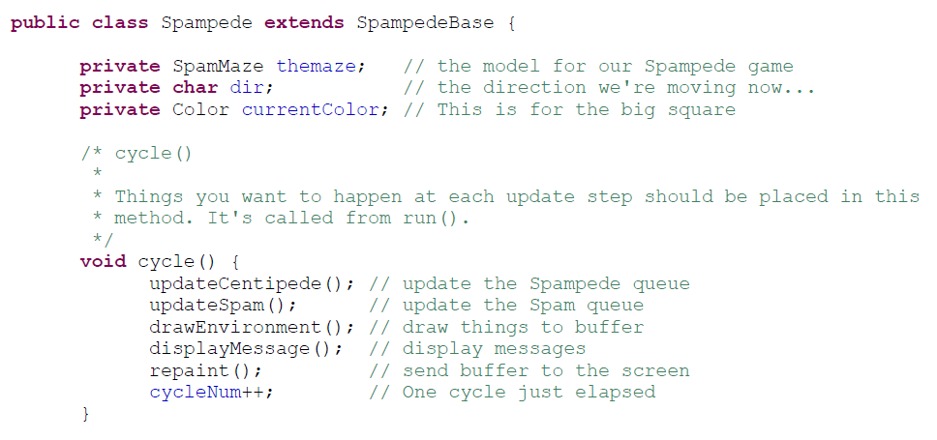
Spampede
Called every frame!
You write this stuff
Called when a key is pressed (update dir)

Slide 16
Development Priorities 1 of 3
Get ready to go!
Download all files (hw12)
add them to a new Eclipse Java project
Run Spampede.java (see note below about modifying the window size!)
MazeCell.java
Read it!
SpampedeBase.java
Don't read it! - you can, but don't need to know how it works!
SpampedeBasePanel.java
Don't read it! - you can, but don't need to know how it works!
Maze.java
Read it!
write Maze(String[] mazeStrings) - use toString() to test
write getNorthNeighbor(MazeCell cell) - add tests to MazeTest.java to test
write getSouthNeighbor(MazeCell cell) - add tests to MazeTest.java to test
write getEastNeighbor(MazeCell cell) - add tests to MazeTest.java to test
write getWestNeighbor(MazeCell cell) - add tests to MazeTest.java to test
write getNeighbors(MazeCell center) - add tests to MazeTest.java to test
write getRandomNeighboringCell(MazeCell start) - add tests to MazeTest.java to test
write clearFlags() // won't need this until later! but it isn't too bad to write in advance

Slide 17
Development Priorities 2 of 3
Spampede.java - Display the board/key presses!
Read it!
write drawEnvironment() - run Spampede.java to test!
read keyPressed(KeyEvent evt) and run Spampede.java to experiment
write keyPressed(KeyEvent evt) - add print statements in the method and run Spampede.java to test
SpamMaze.java - Get the spam and pede ready!
Read it!
write resetPedeAndSpam()
write noSpam()
write addSpam()
write removeSpam()
write getNextCell(char direction) // don't implement AI mode yet!
write advancePede(char direction) // don't implement AI mode yet!
Spampede.java - Make the game (other than AI/reverse) work!
write updateSpam() - run Spampede.java or write test cases to test!
write updateCentipede() - run Spampede.java or write test cases to test!

Slide 18
Development Priorities 3 of 3
SpamMaze.java - Implement AI mode and reverse!
write multiBFS(MazeCell start) - you'll need clearFlags() here!
write getNextCell(char direction) // implement AI mode!
write advancePede(char direction) // implement AI mode!
write reversePede()
Note!
multiBFS and reversePede are the most challenging parts!

Slide 19
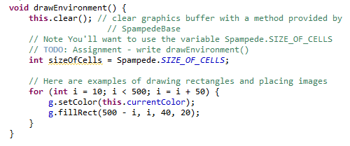
Draw what you think drawEnvironment does!

Slide 20
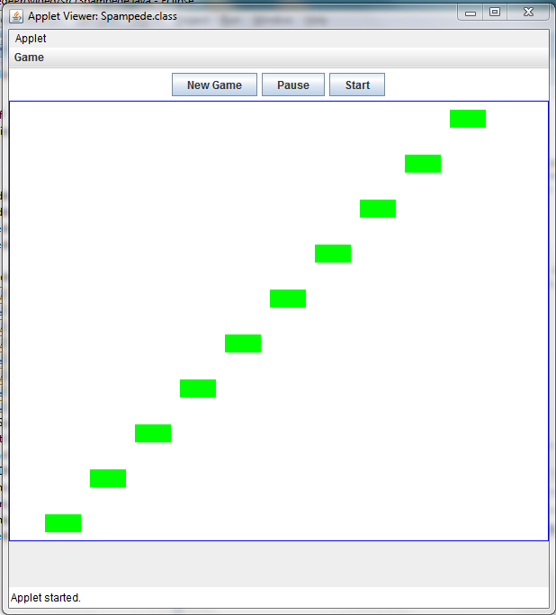

Slide 21
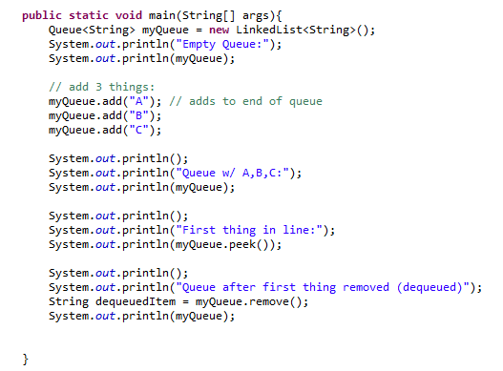
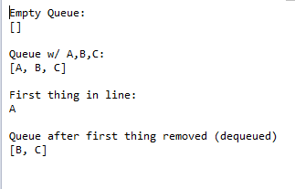
Treat a LinkedList like a Queue

Slide 22

Treat a LinkedList like a Queue

Slide 23
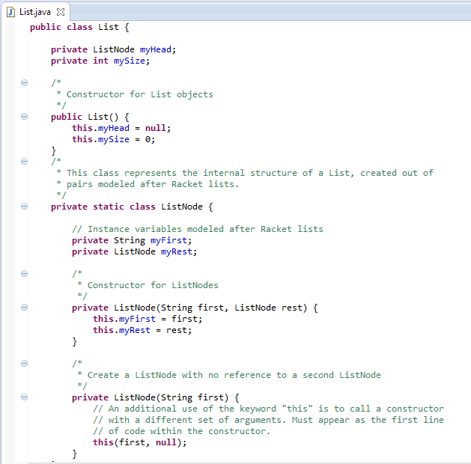

Slide 24
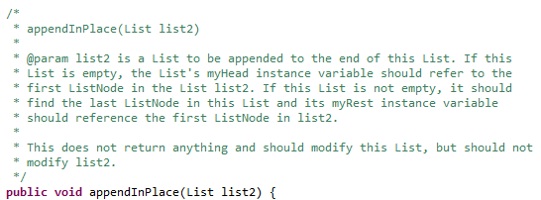

Slide 25
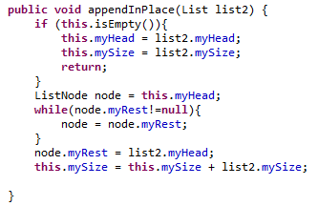
appendInPlace Solution

Slide 26
Stack Based (DFS) vs. Queue Based (BFS)
Which is better smaller (better)?
Speed of search?
1) DFS 2) BFS 3) Depends
Memory use?
1) DFS 2) BFS 3) Depends
Length of final path?
1) DFS 2) BFS 3) Depends

Slide 27
Big-O for Arrays

Slide 28
Unsorted Arrays Big-O
Insert (into first spot) | O( )
Insert (into last spot) | O( )
Find (given a value) | O( )
Delete (given a value) | O( )
5 | 3 | 8 | 2 | 1 | 7 | 0 | 0 | 0 | 0 | 0 | 0 | 0
Assuming:
unsorted array holding numbers within 1 to N
no duplicates
we keep track the last index we use (maxIndex)
all values at indices > maxIndex are 0 (unused).

Slide 29
Sorted Arrays Big-O
Insert (into first spot) | O( )
Insert (into last spot) | O( )
Find (given a value) | O( )
Delete (given a value) | O( )
Assuming:
sorted array holding numbers within 1 to N
no duplicates
we keep track the last index we use (maxIndex)
all values at indices > maxIndex are 0 (unused).
1 | 2 | 3 | 5 | 7 | 8 | 0 | 0 | 0 | 0 | 0 | 0 | 0

Slide 30
Boolean Arrays Big-O
Insert (into first spot) | O( )
Insert (into last spot) | O( )
Find (given a value) | O( )
Delete (given a value) | O( )
F₀ | T₁ | T₂ | T₃ | F₄ | T₅ | F₆ | T₇ | T₈
Assuming:
Boolean array representing numbers within 1 to X
X is a fixed number
no duplicates
Could I use this trick to store objects?

Slide 31

Stable and Non-Stable Sorting

Slide 32
Stable Sort
Sometimes there are equivalent keys in a data structure that is sorted.
Sometimes it matters if you change the order of those equivalent keys
E.g. Sorting music by song and then artist should keep each artists songs alphabetized
We call a sort “stable” if it doesn’t change the order of equivalent keys

Slide 33
Radix Sort (an example of a stable sort)

Slide 34
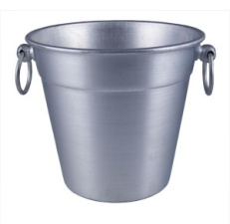
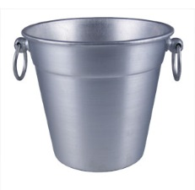
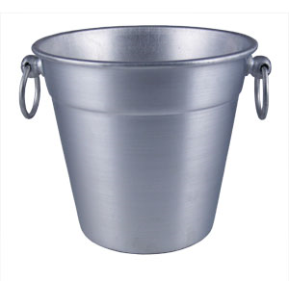

Easy Sorting Problems…
Sort N numbers in the range 0 to 9
0 | 1 | 2 | 3 | 4 | 5 | 6 | 7 | 8 | 9
How fast could you sort
N numbers
in the range 0 to B?
O(N)
O(B)
O(N+B)
O(N*B)
E) ??
In Big-O defining your variables is super important!

Slide 35
Harder Sorting Problems… Approach 1 – Two stages
Sort N numbers in the range 0 to 99
Make some buckets and calculate what bucket they need to go into.
Then sort each bucket
0 – 9 | 10-19 | 20-29 | 30-39 | 40-49 | 50-59 | 60-69 | 70-79 | 80-89 | 90-99

Slide 36
Harder Sorting Problems… Approach 2
Sort N numbers in the range 0 to 99
First sort by the one’s digit (this is counter intuitive)
95
25
98
29
20
32
93
85
97
38
39
0 | 1 | 2 | 3 | 4 | 5 | 6 | 7 | 8 | 9

Slide 37
Combine the buckets
Start from the first thing in the bucket
95
25
98
29
20
32
93
85
97
38
39
The 20’s are the correct relative order
0 | 1 | 2 | 3 | 4 | 5 | 6 | 7 | 8 | 9
20
20
32
93
85
25
25
95
97
38
98
39
29
29

Slide 38
Re-sort using the tens digit
20
32
93
85
25
95
97
38
98
39
29
Now Recombine!
98
29
39
97
25
38
95
20
32
85
93
0 | 1 | 2 | 3 | 4 | 5 | 6 | 7 | 8 | 9
20
25
29
32
38
39
85
93
95
97
98

Slide 39
Radix Sort the numbers 0-99
The running time for our example: (N + B)*2
We did two passes, each took N time.
We gathered up the buckets twice each took B time (where B is the number of buckets)

Slide 40








We can represent numbers with 1’s and 0’s
3 2 1 8
3*1000 + 2*100 + 1*10 + 8*1
1 0 0 1
1*8 + 0*4 + 0*2 + 1*1
We could use binary digits
0001 1
0010 2
0011 3
0100 4
0101 5
0110 6
0111 7
1000 8

Slide 41
Radix Sort with 32 bit numbers
We chose how many bits we want to sort at a time.
4 bits at a time (8 passes)
0000 0000 0000 0000 0000 0000 0000 0000
8 bits at a time (4 passes)
00000000 00000000 00000000 00000000
Running Time of Radix Sort in terms of
N: the number of items to sort
B: the number of buckets
P: the number of passes
Less than
Equal to
Greater than
??
O(N*B*P)

Slide 42
Runtime of Radix Sort
Running Time of Radix Sort in terms of
N: the number of items to sort
B: the number of buckets
P: the number of passes
O( P * (N+B))

Slide 43
SpampedeBase
On what page do I change something to make the snake go faster?
A) 1 B) 2 C) 3 D) 4 E) more than one possible

Slide 44
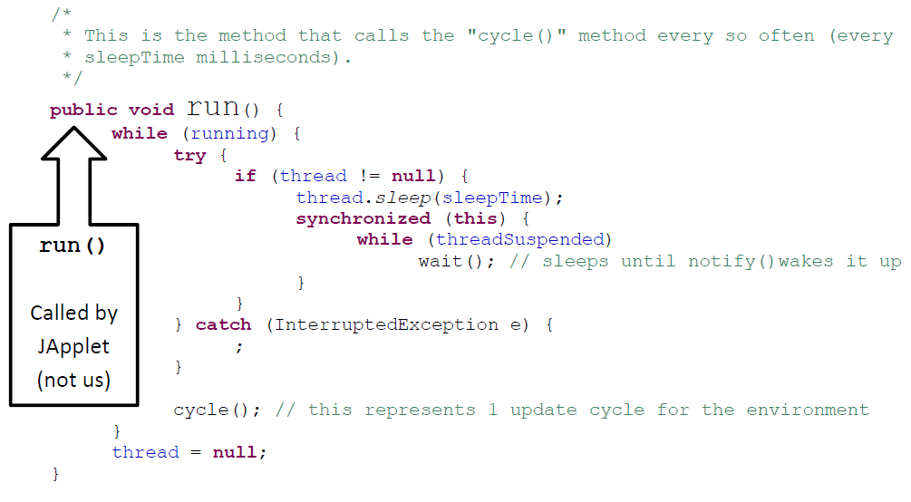
run() calls cycle()
If I removed this block, what wouldn’t work?
Anything!!! Eek!
Stopping
Pausing
Starting
??

Slide 45
Spampede.java
Thread thread; // the thread controlling the updates
boolean threadSuspended; // paused?
boolean running; // null?
public void run()
{
while (running)
{
try
{
if (thread != null)
{
thread.sleep(sleepTime);
synchronized(this)
{
while (threadSuspended)
wait();
}
}
}
catch (InterruptedException e) { ; }
cycle();
}
thread = null;
}
button- and key- handling
spam-handling
// called by the “Start” button
public synchronized void go()
{
if (thread == null)
{
thread = new Thread(this);
running = true;
thread.start();
threadSuspended = false;
}
else
threadSuspended = false;
notify();
}
// called by the “Pause” button
void pause()
{
if (thread != null)
threadSuspended = true;
}
this is the connection with the outside world…

Slide 46
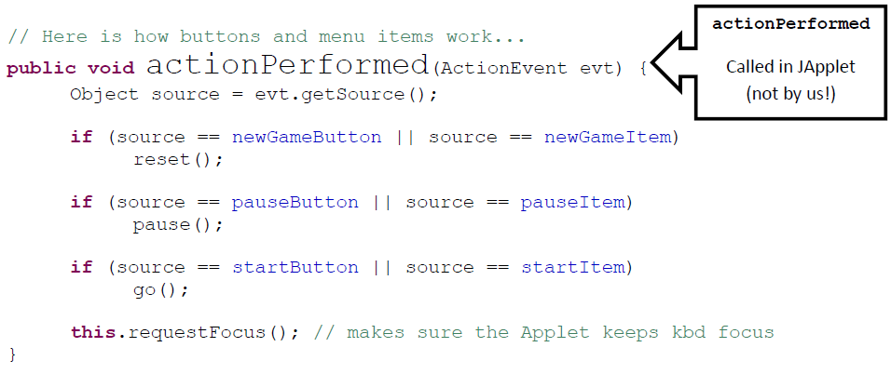
actionPerformed
Would the start button still work if you removed:
source == startItem
Yes – something else would break
Yes – nothing would break!
No – the button wouldn’t work
??

Slide 47
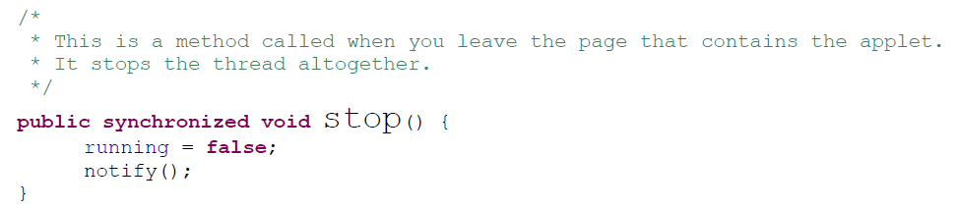
How does stop() work?
stop() only sets the instance variable running to false. In what method does this actually cause it to stop?
pause()
go()
run()
reset()
??

Slide 48
Object
wait()
notify()
Reuse via inheritance
get reused, too!
Component
public void requestFocus()
reusing base-classes' methods
public void addKeyListener()
public void repaint()
Container
public void paint()
public void add(Component c)
Panel
public void addNotify()
JApplet
public void init()
SpampedeBase
overriding of base-classes' methods
public void init()
public void paint()
Spampede

Slide 49

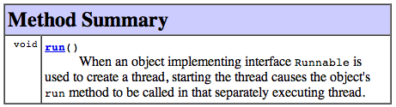
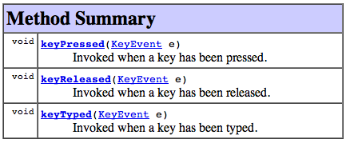
Interfaces enable event handling...
public class SpampedeBase extends JApplet implements ActionListener, KeyListener, Runnable
"this object can handle button presses..."
"this object can run in a separate thread"
handles button presses...
"this object can handle key presses..."
The object that waits for key presses, button presses, etc. is called a Listener …

Slide 50
Spampede
Look at the code for Spampede.
Do you think the code for BFS will go in here?
A) Yes B) No

Slide 51
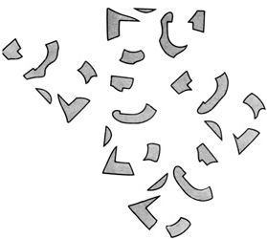
Event-driven execution
Events are things that happen to a graphical application
Button Presses • Text Entries
Key Presses, Key Releases, Key Events
Each object receiving an event notifies its “Listener”
The Listener then handles the event appropriately
// Here's how keyboard events are handled...
public void keyPressed(KeyEvent evt)
{
switch (evt.getKeyChar())
{
case 'k':
message = "Unicycles only!";
this.dir = 'k';
break;
What's 'k'?
context?

Slide 52
BONUS

Slide 53
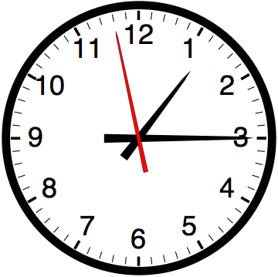

Slide 54


Computer
Science
&
= AWESOME

Slide 55
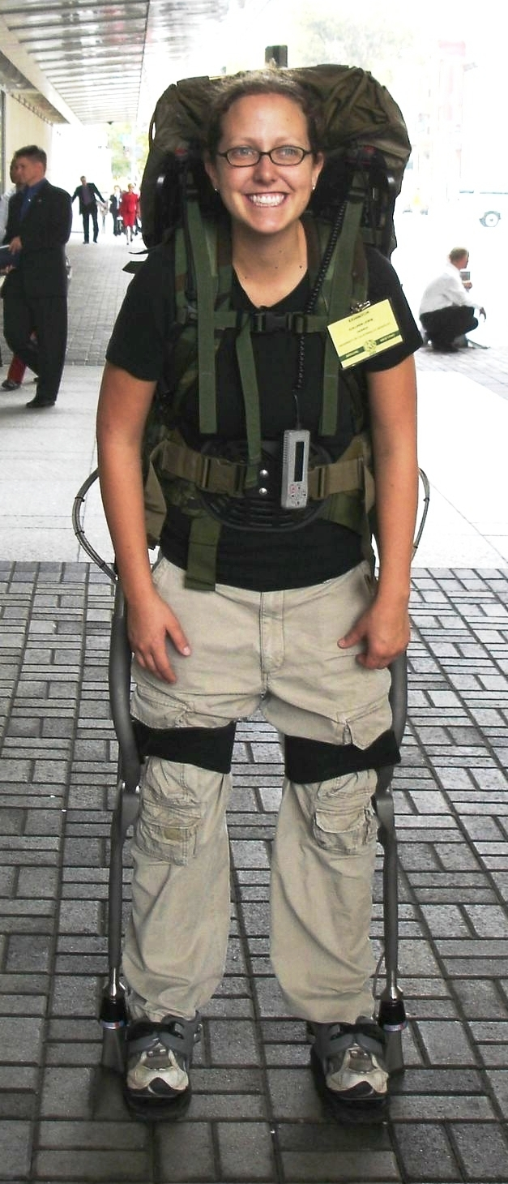
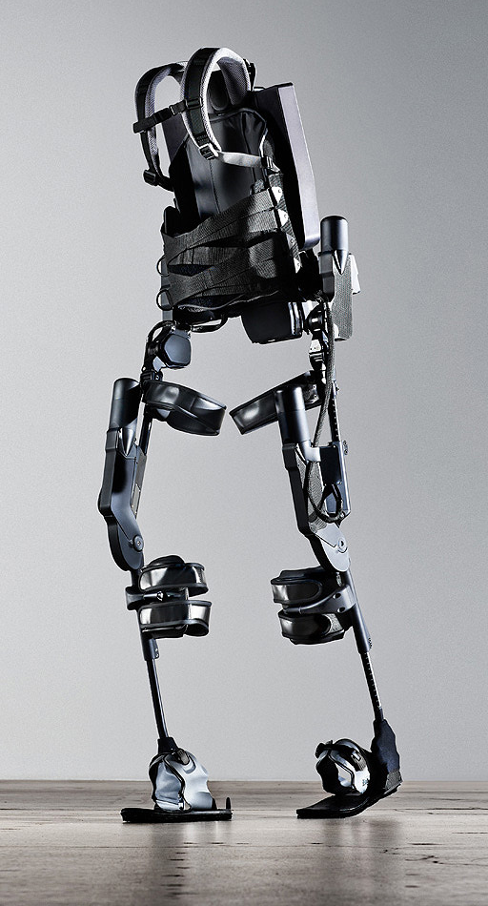
http://www.youtube.com/watch?v=pzRmNYA8LlY

Slide 56

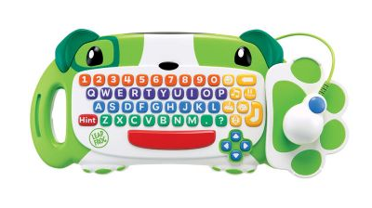
ClickStart

Slide 57
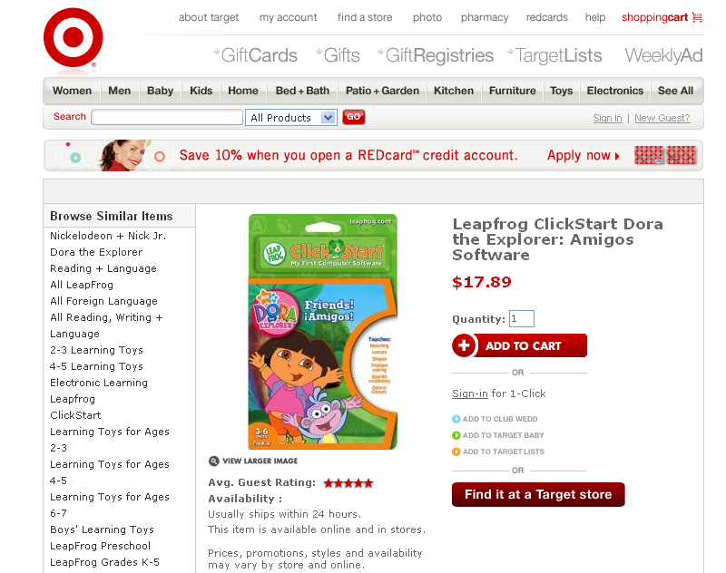

Slide 58
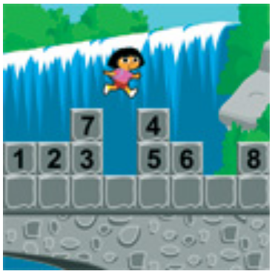
How should we represent the blocks in the computer?
Independent variables
2D Array
OpenList
I don’t know

Slide 59
The value in the array tells me what art asset to use
Each level is really a 3x10 vector!
0 | 0 | 7 | 0 | 4 | 0 | 0 | 0
1 | 2 | 3 | -4 | 5 | 6 | -7 | 8
B | B | B | B | B | B | B | B
Negative values tell me what block needs to go here to win!

Slide 60
0 | 0 | 7 | 0 | 4 | 0 | 0 | 0
1 | 2 | 3 | -4 | 5 | 6 | -7 | 8
0 | 0 | 0 | B | 0 | 0 | 0 | 0

Slide 61
BUGS!

Slide 62
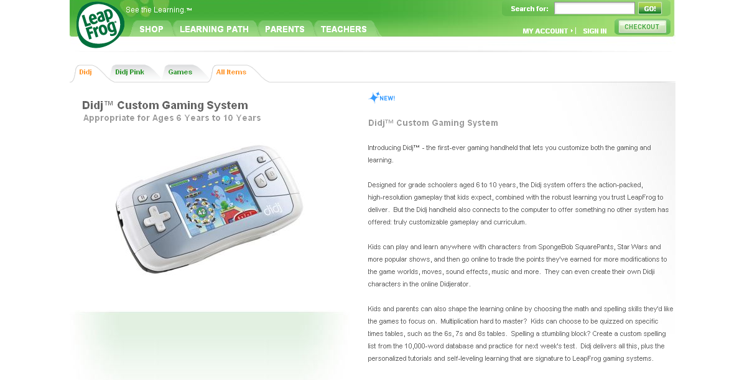

Slide 63
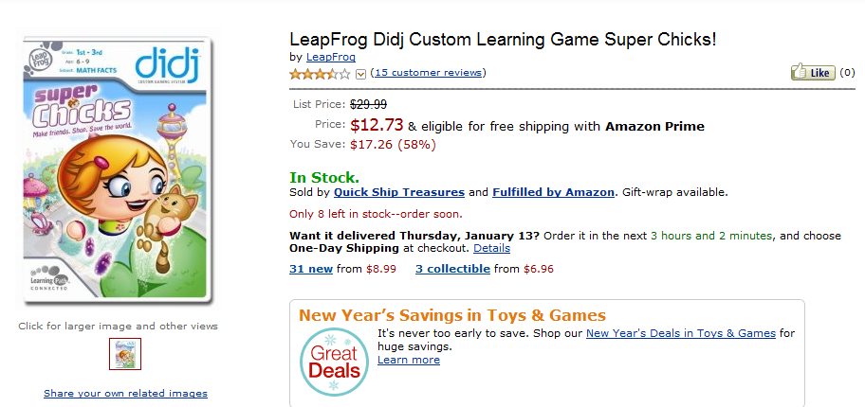
It is really sad when stuff you’ve made is on sale!

Slide 64
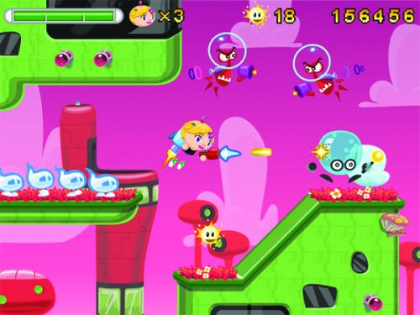
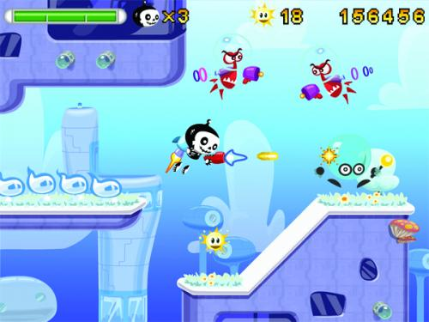
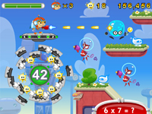
Which image is fake?
A. Top Left
B. Bottom Left
C. Bottom Right

Slide 65
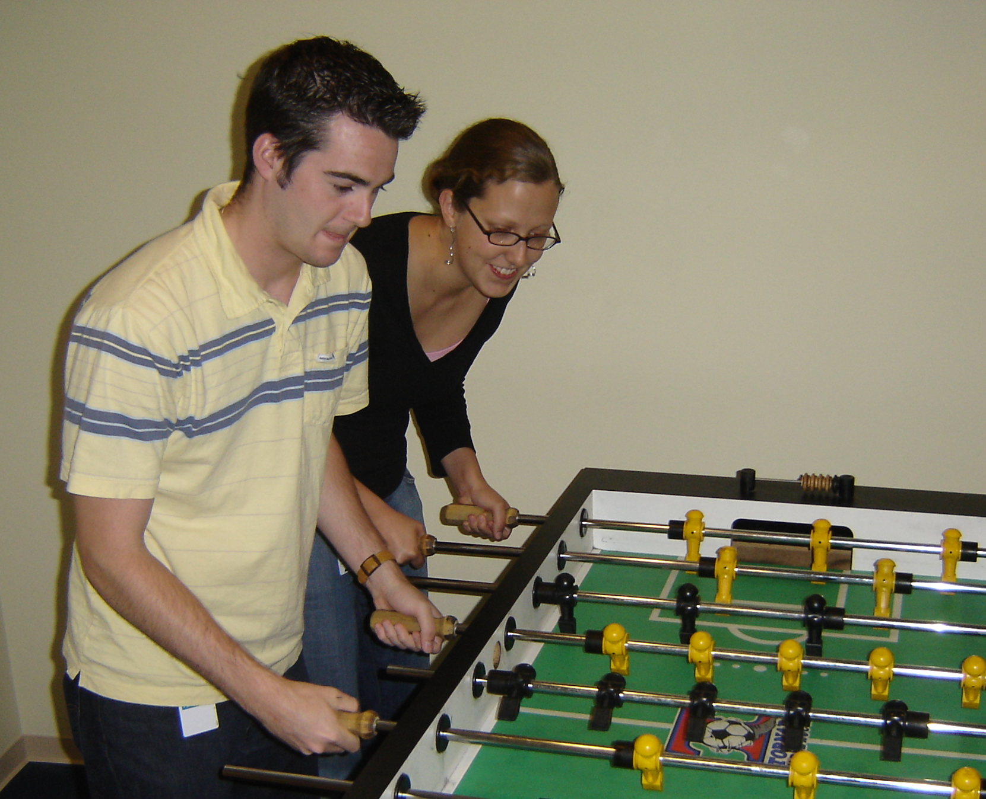

Slide 66
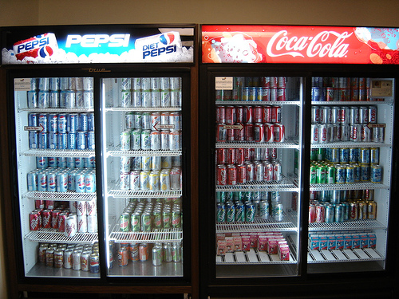

Slide 67
create an empty Queue
enqueue the starting node
mark starting node as visited
while (the queue is not empty)
{
dequeue a node: “it”
for each neighbor of “it”
{
if (neighbor is not visited)
{
enqueue the neighbor
mark neighbor as visited
set parent of neighbor
if (neighbor is D){
DONE!!! } }
}
}

Slide 68
create an empty Stack
push the starting node
mark starting node as visited
while (the stack is not empty)
{
pop a node: “it”
for each neighbor of “it”
{
if (neighbor is not visited)
{
push the neighbor
mark neighbor as visited
set parent of neighbor
if (neighbor is D){
DONE!!! } }
}
}

Slide 69
A | B | C | D | E | F | G | H | I | J | K | L | S

