Slide 1
CS 60
Java Intro
2013-02-28
Thursday – Week 5
Lecture 12

Slide 2
Survey
Should we shuffle seats?
No
Sure – if we can pick our partners
  (and be assigned if we don’t pick)
Java
Not sure

Slide 3
Administrative Stuff
(Not in your notes)
Lost iclicker
No Class Next Thursday (March 7th)

Slide 4
Classes in Java
In CS60 we haven’t used the functionality of classes yet!
How To
2013-02-28
Thursday – Week 5
Lecture 12
Big Idea!

Slide 5
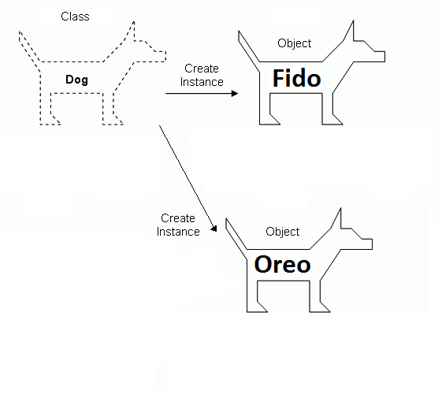
Classes (So we can make objects)
Big Idea!
Image modified from:
http://www.4guysfromrolla.com/webtech/chapters/BuildASPNETWebSite/ch02.2.shtml

Slide 6
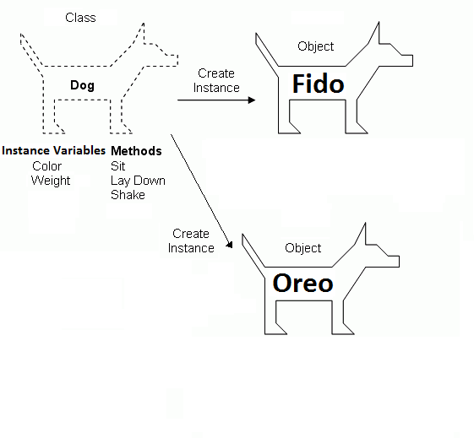
Classes Specify Properties
(Instance Variables & Methods)
Big Idea!
Image modified from:
http://www.4guysfromrolla.com/webtech/chapters/BuildASPNETWebSite/ch02.2.shtml

Slide 7
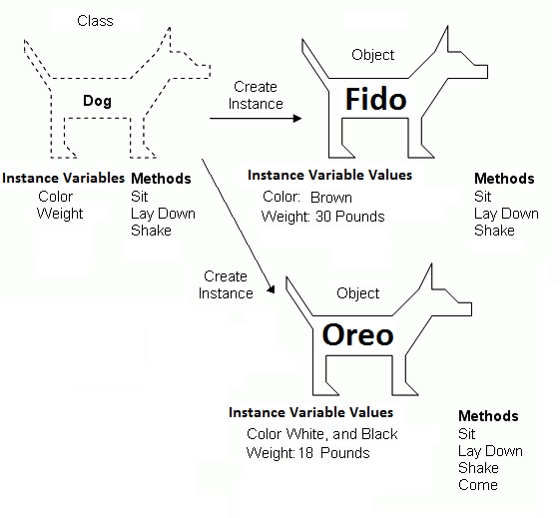
Classes Specify Properties
(Instance Variables & Methods)
Classes
(So we can make objects)
Big Idea!
Image modified from:
http://www.4guysfromrolla.com/webtech/chapters/BuildASPNETWebSite/ch02.2.shtml

Slide 8
Vocab Review
Which one could be compared to a factory?
Class
Object
Instance Variable

Slide 9
Vocab Review (Solution)
Which one could be compared to a factory?
Class – A blueprint for Objects
Object – An instance of a class
Instance Variable – The stuff each object has

Slide 10
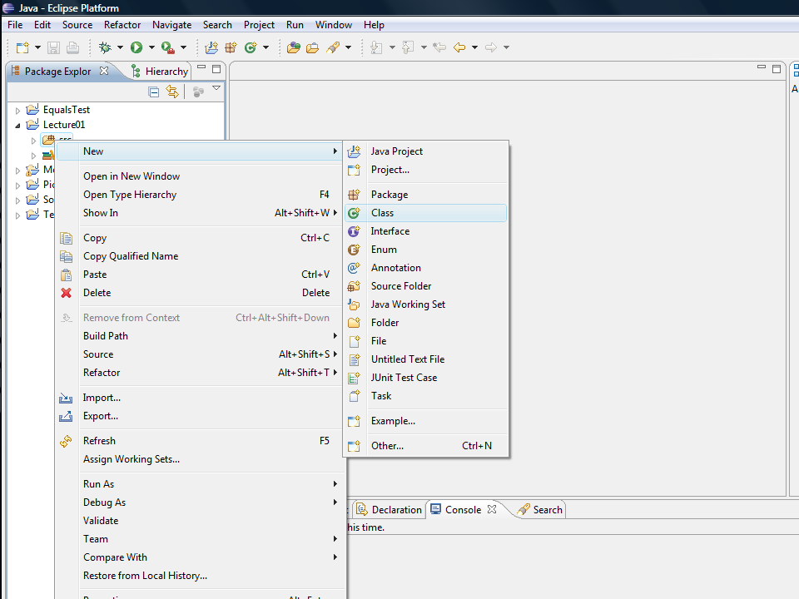
How To

Slide 11
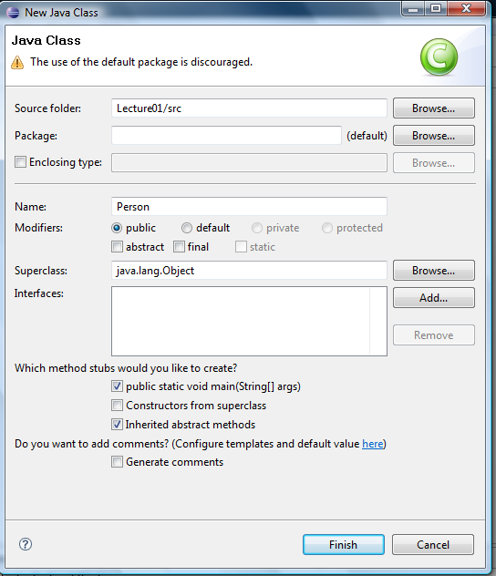
Big Idea!
I want to make some Person objects
main runs when you press
Give me a main method!
How To

Slide 12
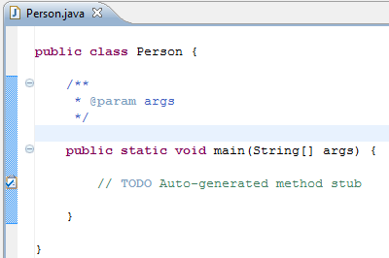
Creates the file Person.java
Class names should start with a Capital Letter
& must match the file name!
How To

Slide 13
I want to make some Person objects
Everyone can make these Person objects
To make objects I need a class
Big Idea!

Slide 14
Start and end the class
How To

Slide 15
Method named main
Everyone can call this method
How To
And they don’t need a Person first
And returns nothing
Input: an array of Strings

Slide 16
// Good looking
// comment!
// TODOs are your friend
Window -> Show View -> Tasks
How To

Slide 17
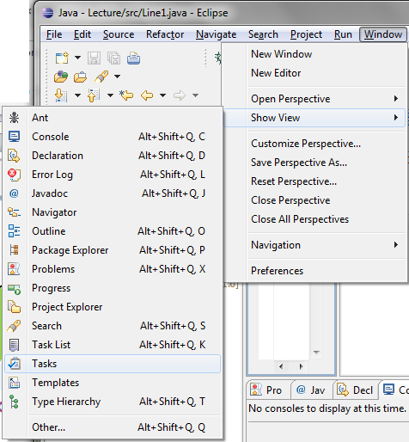

Slide 18
Instance Variables
Specified by the class.
Each object has its own set.
2013-02-28
Thursday – Week 5
Lecture 12
Big Idea!

Slide 19
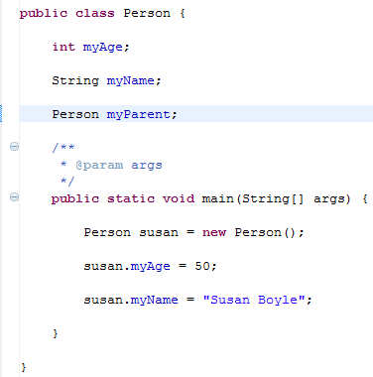
Big Idea!
Instance variables.
One per object!
You can even have a reference to a Person
Person
myAge
myName
myParent
Every Person Object has its own value for these instance variables

Slide 20
Big Idea!
new
Create a reference to a Person
Create a Person
Set your reference to point to your object

Slide 21
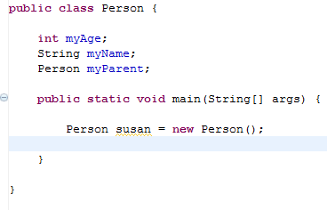
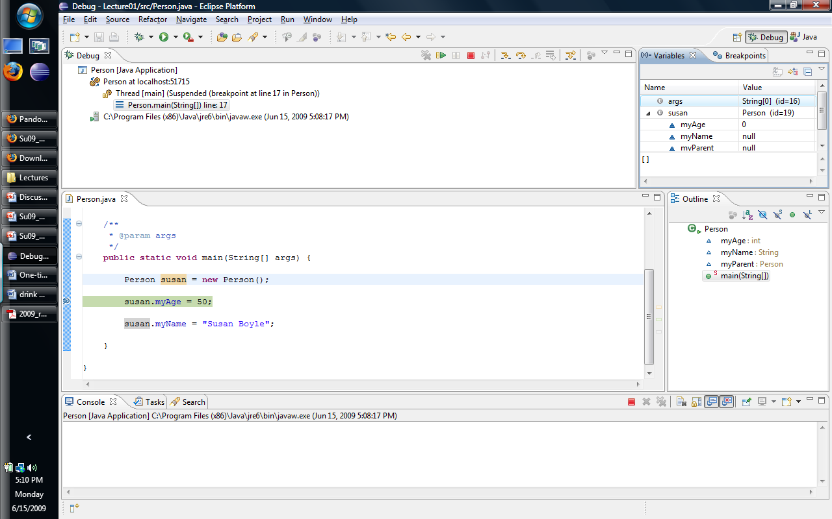
Person
myAge
myName
myParent
How we draw objects
0
How Eclipse draws objects

Slide 22
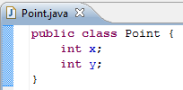


What instance variables do I need for these Objects?
Line1
x1
y1
x2
y2
50
Line2
p1
p2
Point
x
y
-8
50
32
-8
12
Point
x
y
32
12

Slide 23
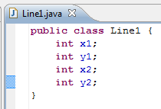
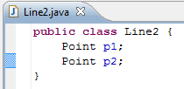
What instance variables do I need for these Objects? SOLUTION
Line1
x1
y1
x2
y2
50
Line2
p1
p2
Point
x
y
-8
50
32
-8
12
Point
x
y
32
12

Slide 24
Constructors &
Modifying Objects
2013-02-28
Thursday – Week 5
Lecture 12
Big Idea!

Slide 25
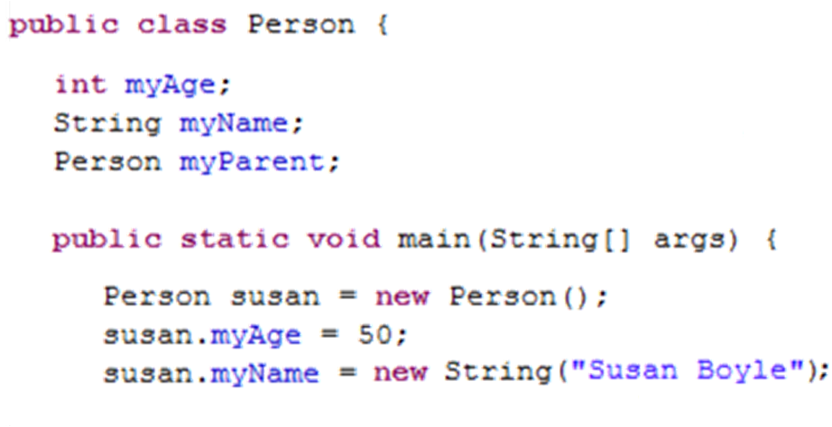
The dot accesses stuff in the object
(here instance variables)
susan
args
Person
myAge
myName
myParent
0
main
50
Susan Boyle

Slide 26
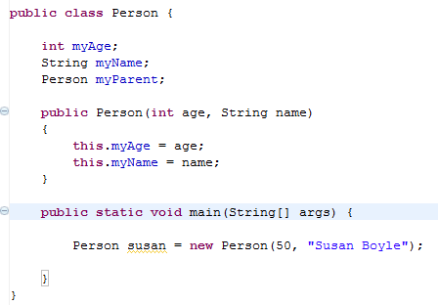
Constructor for a Person
Set this’s instance variables
new calls the constructor

Slide 27
What does memory look like at this point?
(at the arrow)
age
name
this
50
Person constructor
Susan Boyle
Person
myAge
myName
myParent
susan
args
0
main
50

Slide 28
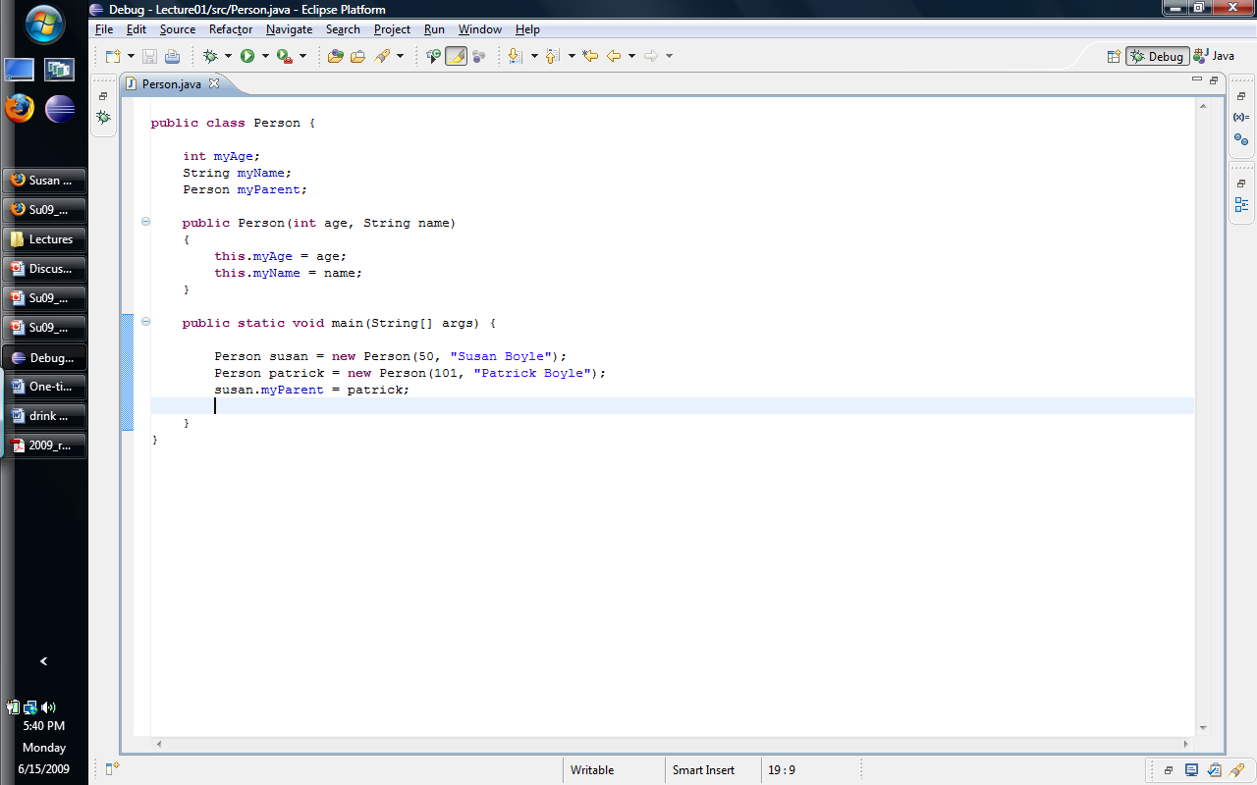
Draw what memory looks like at this point!
You don’t need to draw the Person Constructor Frame

Slide 30
Answer
Person
myAge
myName
myParent
50
Susan Boyle
susan
patrick
args
main
Person
myAge
myName
myParent
101
Patrick Boyle

Slide 31
Writing Methods
2013-02-28
Thursday – Week 5
Lecture 12
Big Idea!

Slide 32
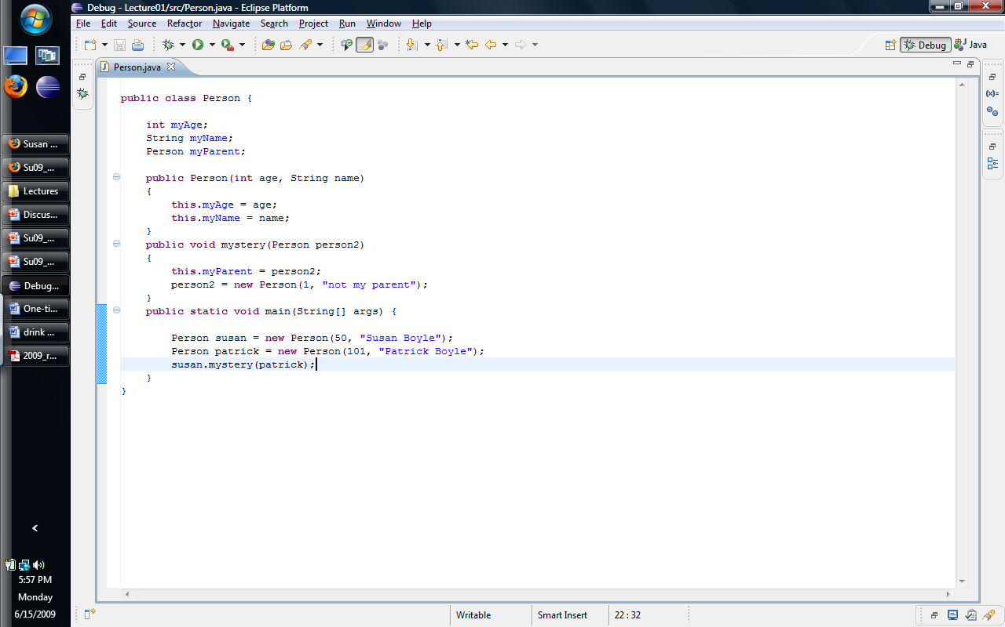
Not static
Can access this
Doesn’t return anything
Method named mystery
Input is a Person object
Call mystery with a Person object “dot” method name

Slide 33
Draw what memory looks like at this point!

Slide 34
this
person2
mystery
Person
myAge
myName
myParent
50
Susan Boyle
susan
patrick
main
Person
myAge
myName
myParent
101
Patrick Boyle

Slide 35
Person
myAge
myName
myParent
1
This is not my parent
this
person2
mystery
Person
myAge
myName
myParent
50
Susan Boyle
susan
patrick
main
Person
myAge
myName
myParent
101
Patrick Boyle

Slide 36
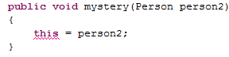
You can’t change this!!!
mystery
this
person2
Person
myAge
myName
myParent
mystery
50
Susan Boyle
susan
patrick
main
Person
myAge
myName
myParent
101
Patrick Boyle

Slide 37
Arrays
2013-02-28
Thursday – Week 5
Lecture 12
Big Idea!

Slide 38
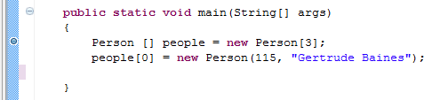
Debugging an Array
main
people
Person
myAge
myName
myParent
115
Gertrude Baines

Slide 39
Array Basics
Create a reference to a Person Array
Create a new Person Array
Access an element from an Array

Slide 40
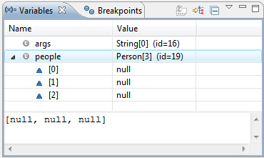
Debugging an Array
After the first line:

Slide 41
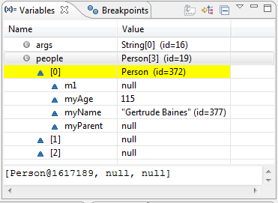
Debugging an Array
After the second line:

Slide 42
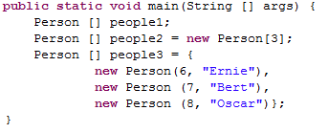
Person
myAge
myName
myParent
8
Oscar
Person
myAge
myName
myParent
main
people1
people2
people3
7
Bert
Person
myAge
myName
myParent
6
Ernie

Slide 43
Arrays Summary
Set to the default value for primitive types
  Primitive types are
    non-objects
    lower-case things (e.g. int, bool, float)
Set to null for objects (elements 0 to size-1)
Type [] arrayName = new Type[size];
Arrays don’t change size
Arrays hold one type of thing
Access items in the array using the [] notation
arrayName[pos] = newValue;

Slide 44


Fill in the instance variables for Line3 and Line 4
Line3
coords
50
-8
32
12
Line4
points
Point
x
y
Point
x
y
50
32
-8
12

Slide 45

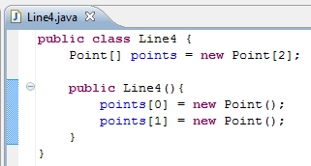
Fill in the instance variables for Line3 and Line 4
Line3
coords
50
-8
32
12
Line4
points
Point
x
y
Point
x
y
50
32
-8
12

Slide 46
Bonus

Slide 47
Never say: “Static”
Always:
“Static Method”
“Static Variable”

Slide 48
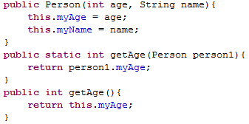
Constructor
Static Method
Have access to this!
All objects must be arguments or created in the method
Non-Static
Method

Slide 49
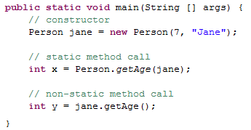

Slide 50
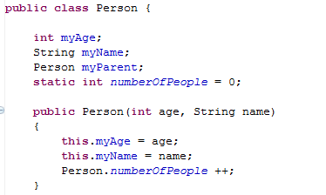
static variables (shared)
Global state shared by all instances of the class
Looks like an instance variable declaration + static
Access them as ClassName.fieldName

Slide 51
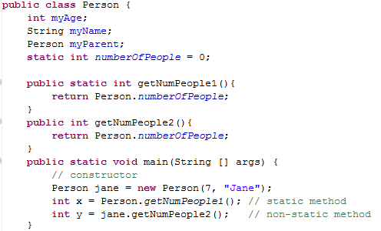

Slide 52
Flow of Control

Slide 53
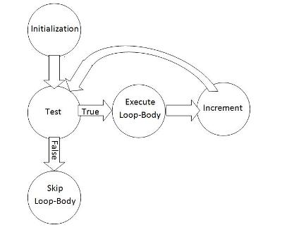
for Loops
for (initialize; test; increment)
{
  // loop-body
}

Slide 54
for Loops
Use representations to keep track of the state of variables
for (int i = 0; i<4; i++)
{
  System.out.print(i + “ “);
}
i
0
1
2
3
4
5

Slide 55
return
break
continue
Code after Loop
Code after

Slide 56
Flow of control
break – breaks from the inner most loop enclosing the break and continues executing at the code after the loop.
return – causes the method to end immediately and return to the calling method
continue – transfers control to the header of the inner most enclosing loop.

Slide 57
Testing and
Test Driven Development
Remember to mention this at job interviews!

Slide 58


Slide 59
Test Driven Development
static void beAGoodProgrammer()
{
  while (true) // for each method
  {
  writeTest();
  writeCode();
  writeAFewMoreTests();
  writeCode();
  }
}

Slide 60
Why do Test Driven Development?
It is a way to brainstorm what your method is going to do.
It is hard to write test cases
Write your test cases before you’re biased by how your code is written

Slide 61

Goal: Merge two int[]s that are already sorted
If we want to write this program, what should we do first?
Write TESTS!

Slide 62
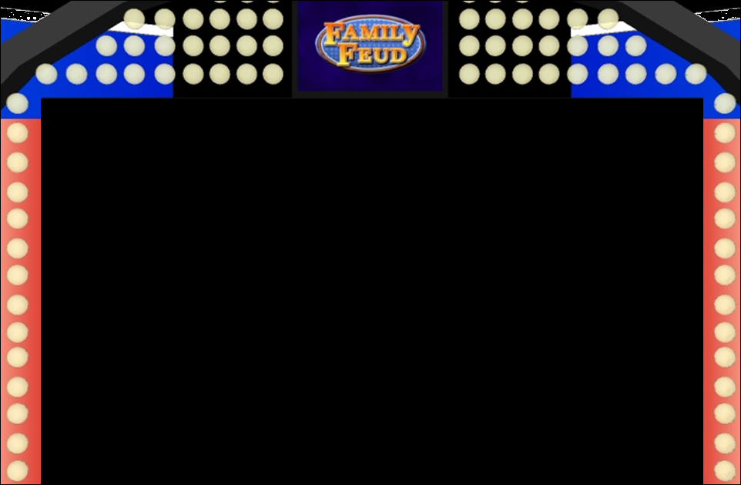
Array1 is empty |  | Array2 is empty
Array1 only has 1 element |  | Array2 only has 1 element
All Array1 > All Array2 |  | All Array2 > All Array1
First element from Array1 |  | First element from Array2
Sequential Array1 elements |  | Sequential Array2 elements
Correct final length |  | All values copied

Slide 63
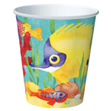
Never EVER start
writing a program until
you can solve the
problem by hand!

Slide 64
Plan using Pseudocode for Merge
Before the loop:
Make a new array
For each element in the new array:
Compare:
  the next element from Array1
  the next element from Array2
Put the correct element into the new array
After the loop:
Return the new array

Slide 65
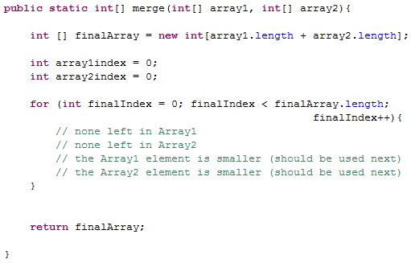
Make a new array
Create index variables for Array1 and Array2
Test
Initialization
Increment
Body: Compare and Set
Return the new array

Slide 66
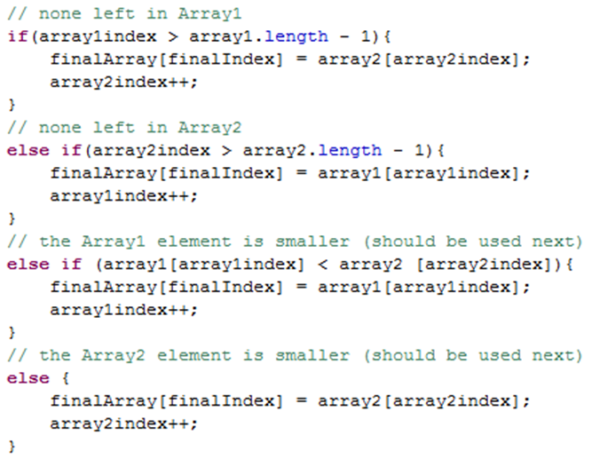
Copy from Array 2
Copy from Array 1
Copy from Array 1
Copy from Array 2

Slide 67
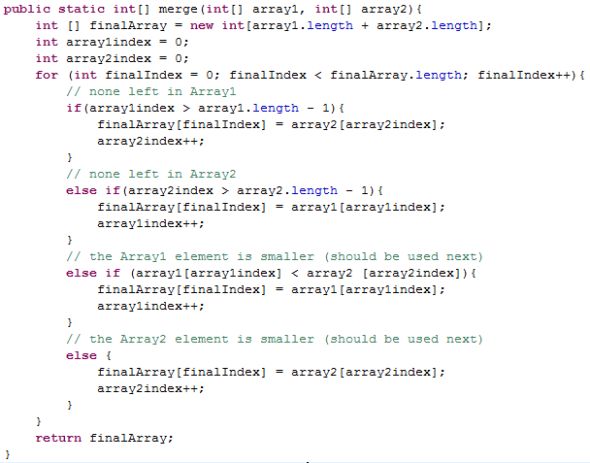

Slide 68
Inheritance

Slide 69
Inheritance Lingo
A Dog is an Animal
Dog extends Animal
Dog is the subclass of Animal
Animal is the superclass of
Animal
Animal
Dog
Dalmatian
Cat
A Dalmation is a Dog
A Dalmation is an Animal
Dalmation extends Dog
Dalmation is the subclass of Dog and Animal

Slide 70
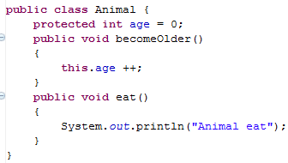
Animal
age
0

Slide 71
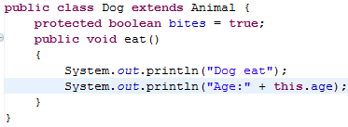
We can override the parent’s eat method
We can access the variable age, even though we didn’t include it in the Dog class directly
Dog
age
bites
Animal
age
0
true
0

Slide 72
Animal myAnimal= new Animal();
myAnimal.becomeOlder();
myAnimal.eat();

Slide 73
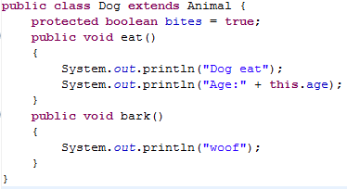
Dog myDog = new Dog();
myDog.eat();
myDog.bark(); // ↓ does this work? ___
myDog.becomeOlder();

Slide 74
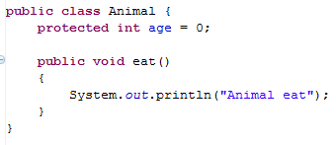
Animal myAnimal= new Animal();
myAnimal.bark();
↑Does this work???? _________

Slide 75
Subclasses (Children) Can
Declare new instance/class variables
Declare new methods
Override old implementations with new implementations
Access instance/class variables of the superclass (parent) *
Access methods of the superclass*
* only public, protected or default ones

Slide 76
Inheritance Puzzles
Dog d = new Animal();
Does this work? _______
No it doesn’t compile, If I want a Dog, an Animal will be NOT be acceptable because I might want to call a method that only a Dog can do!

Slide 77
Inheritance Puzzles
Animal a = new Dog();
Does this work? _______
YES it compiles and runs - If I want an Animal , a Dog will be acceptable because everything an Animal can do a Dog can do too!
Animal a = (Animal) new Dog();

Slide 78
Inheritance Puzzles
Animal a = new Dog();
Dog d = a;
Does this work? _______
No it doesn’t compile. The compiler doesn’t know it is really a Dog!
but we can PROMISE the compiler that it is with a cast
Dog d = (Dog) a;

Slide 79
Inheritance Puzzles
Animal a = new Animal();
Dog d = (Dog) a;
Does this work? _______
YES and NO - The compiler trusts your PROMISE (cast) but then if you run your program it has a RUN TIME ERROR because a is not a Dog

Slide 80
Inheritance Puzzles
Animal
Dog
Dalmatian
Poodle
Cat
Animal a = new Cat();
Dog d = (Dog) a;
d.bark();
Does this work? _______
YES and NO. It compiles, but then when we try to do the cast we get a RUN TIME ERROR, before we even try to call any dog methods on a.

Slide 81
Inheritance Puzzles
Animal a = new Dog();
a.bark();
Does this work? _______
NO it does not compile - The compiler thinks it is an Animal, and an Animal does not have a method bark
Dog d = (Dog) a; d.bark();
((Dog) a).bark();

Slide 82
Inheritance Puzzles
Animal a = new Dog();
a.eat();
Does this work? _______
YES- The compiler is happy - an Animal has an eat() method.
Which method is called the Animal eat()
or the Dog eat() ?

Slide 83
Inheritance Puzzles
Animal a = new Dog();
a.eat();
Which method is called the Animal eat()
or the Dog eat() ?
main
Animal a
Dog
age
bites
0
true

Slide 84
Ridable
Object
Animal
Machine
Car
Cat
Blender
Dog
Horse

Slide 85

Interfaces
I have a GREAT idea!
Everyone will want to make Ridable things that can
  turnLeft()
  turnRight()
  goForward()
How?!?!
  I don’t care!!!!

Slide 86
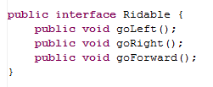
The Ridable interface

Slide 87
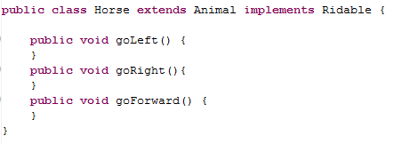
Horse can implement the Ridable interface

Slide 88
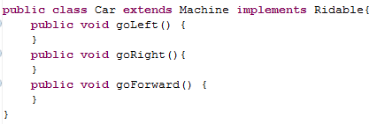
Car can implement the Ridable interface

Slide 89
We can have a Rideable remote control
(Rideable reference)
Rideable r1 = new Horse();
Rideable r2 = new Car();
r1.goForward();
r2.goForward();

Slide 90
Can we have a Ridable object?
Ridable r1 = new Ridable();
No! You can’t create an object of an interface!

Slide 91
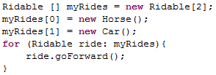
Interfaces can be cool!!!

Slide 92
Example
The sort method of the Array class promises to sort an array of objects, but under one condition: the objects in the array must implement the Comparable interface:
  public interface Comparable {
  int compareTo(Object other);
  }

Slide 93
Summary of Interfaces
Interfaces don’t implement ANY methods
  Just put a semicolon at the end of the method
Classes can implement multiple interfaces
To implement an interface you must write all of the methods that the interface defines

Slide 94
Cookies!
Cookie
Girl Scout Cookie
Thin mint
Shortbread
Chocolate Chip

Slide 95
Abstract Classes
(less lazy than Interfaces)
I have a GREAT idea!
Everyone will want to make Cookies that can have these methods:
  ingredients()
  isDelicious()
How?!?!
  isDelicious() is pretty simple, I’ll write that one
  ingredients() ?!? Sounds too hard! I’ll make that abstract

Slide 96
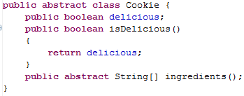
Abstract Class Cookie

Slide 97
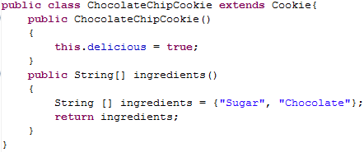
ChocolateChipCookie can extend the Abstract class Cookie

Slide 98
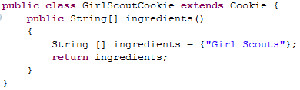
GirlScoutCookie can extend the Abstract class Cookie

Slide 99

We can have a Cookie remote control
(Cookie reference)

Slide 100
Can we have a Cookie object?
Cookie p1 = new Cookie();
No! You can’t create an object of an abstract class!

Slide 101
Abstract Class Summary
Label an Abstract class as abstract
Label any methods that you don’t want to implement as abstract
  Your children MUST write all of the abstract methods
Instance variables in the abstract class will be available in the child class
You can only extend one Class (abstract or otherwise)

Slide 102
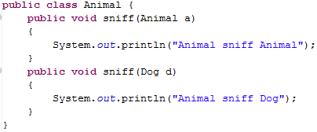
Inheritance and
Arguments
Animal
Dog
Cat

Slide 103
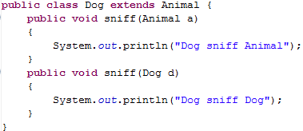
← Uses a1’s dynamic type
Animal a1 = new Dog();
Dog d1 = new Dog();
a1.sniff(d1);
d1.sniff(a1);
Animal a2 = new Dog();
a1.sniff(a2);
← Uses a1’s static type
← Uses a1’s dynamic type
Uses a2’s static type

Slide 104
Inheritance
Compilation:
  CALLER: It makes sure that the static type of the object has the appropriate method
  ARGS: It makes sure that the method takes in the static type of the arguments
Run-time:
  CALLER: When you call a method on an object it looks for the method starting at the object’s dynamic type
  ARGS: When you pass an object as an argument, it looks for a method with that static type

Slide 105
Animal a1 = new Dog();
Dog d1 = new Dog();
a1.sniff(d1);
d1.sniff(a1);
Animal a2 = new Dog();
a1.sniff(a2);
Dog
age
bites
0
true
Dog
age
bites
0
main
Animal a1
Animal a2
Dog d1
true
Dog
age
bites
0
true

Slide 106
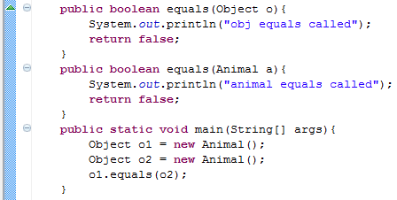
equals(Object o)
Which equals is called?
Object

Slide 107
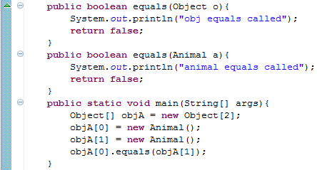
equals(Object o) and Arrays
Which equals is called?
Object

Slide 108
equals(Object o)
If others will call your methods with more generic references, you want to provide a method that takes in an Object

Slide 109
Big-O
BONUS

Slide 110



Some Algebra to calculate:
1+2+…+n
// Written backwards

Slide 111

Some Algebra to calculate:
1+2+…+n

Slide 112


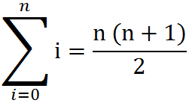
Some Algebra to calculate:
1+2+…+n
OR

Slide 113
Estimating Time
Most people grossly underestimate how long it takes to program (not thinking about time to debug and test)
You appear incompetent at programming (not true) if you can’t estimate how long something will take.
This is one of the hardest things to learn!!! Start to practice now! For each task estimate how long it will take and keep track of how wrong you were

Slide 114
BONUS

Slide 115
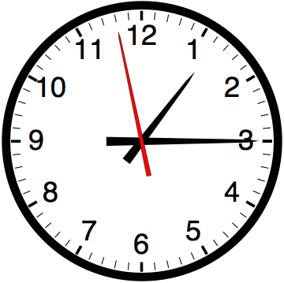

Slide 116


Computer
Science
&
= AWESOME

Slide 117


http://www.youtube.com/watch?v=pzRmNYA8LlY

Slide 118


ClickStart

Slide 119


Slide 120

How should we represent the blocks in the computer?
Independent variables
2D Array
OpenList
I don’t know

Slide 121
The value in the array tells me what art asset to use
Each level is really a 3x10 vector!
0 | 0 | 7 | 0 | 4 | 0 | 0 | 0
1 | 2 | 3 | -4 | 5 | 6 | -7 | 8
B | B | B | B | B | B | B | B
Negative values tell me what block needs to go here to win!

Slide 122
0 | 0 | 7 | 0 | 4 | 0 | 0 | 0
1 | 2 | 3 | -4 | 5 | 6 | -7 | 8
0 | 0 | 0 | B | 0 | 0 | 0 | 0

Slide 123
BUGS!

Slide 124


Slide 125

It is really sad when stuff you’ve made is on sale!

Slide 126



Which image is fake?
  A. Top Left
  B. Bottom Left
  C. Bottom Right

Slide 127


Slide 128


Slide 129
Sort
STk>(sort ’(8 3 9))
(3 8 9)
(sort ’(8 3 9))
(sort ’(3 9))
(insert 8
(insert 3
(sort ’(9))
(insert 9
(sort ’())
’()
(insert 8 (insert 3 (insert 9 ’())))
Notes:
129

Slide 130
(insert 3
(insert 6
(insert 4
(insert 7
(insert 1
(insert 8
(insert 3
(insert 9
’()
))))))))
(sort sent) if sent length is N
1 + 2 + 3 + 4 + … + (N-1)+ N
Add to sent size 7
Add to sent size 6
Add to sent size 5
Add to sent size 4
Add to sent size 3
Add to sent size 2
Add to sent size 1
Add to sent size 0

Slide 131





// Take the log of both sides
// Remember:

Slide 132



