Slide 1
CS 60
Java Arrays, Lists, and Trees
2013-03-05
Thursday – Week 6
Lecture 13

Slide 2
Survey
Should we shuffle seats?
No
Sure – if we can pick our partners
(and be assigned if we don’t pick)
Not sure

Slide 3
Administrative Stuff (Not in your notes)
Get your (graded) Racket Quiz
Pick up a copy of the Prolog Quiz
Due Wednesday March 13th at 5pm
Under Colleen’s door
No Class Thursday (March 7th)
Lost iclicker

Slide 4
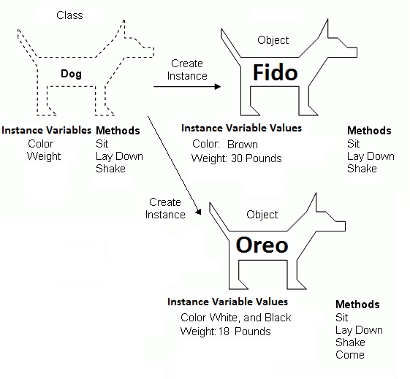
Classes Specify Properties (Instance Variables & Methods)
Classes
(So we can make objects)
Big Idea!
Image modified from: http://www.4guysfromrolla.com/webtech/chapters/BuildASPNETWebSite/ch02.2.shtml

Slide 5
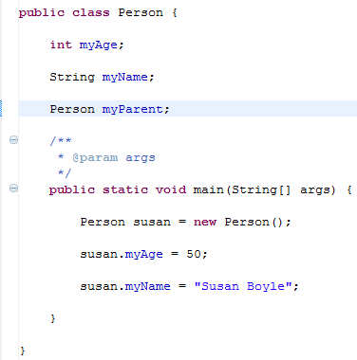
Big Idea!
Instance variables.
One per object!
You can even have a reference to a Person
Person
myAge
myName
myParent
Every Person Object has its own value for these instance variables

Slide 6
Arrays
2013-03-05
Thursday – Week 6
Lecture 13
Big Idea!

Slide 7
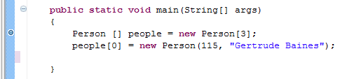
Debugging an Array
people
args
main
Person
myAge
myName
myParent
115
Gertrude Baines

Slide 8
Array Basics
Create a reference to a Person Array
Create a new Person Array
Access an element from an Array

Slide 9
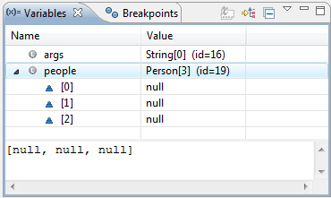
Debugging an Array in Eclipse
After the first line:

Slide 10
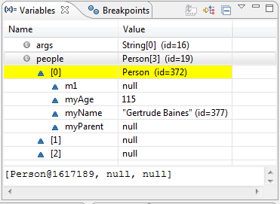
Debugging an Array in Eclipse
After the second line:

Slide 11
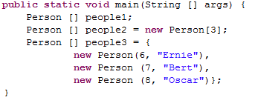
Person
myAge
myName
myParent
6
Ernie
Person
myAge
myName
myParent
7
people1
people2
people3
Bert
main
Person
myAge
myName
myParent
8
Oscar

Slide 12
Arrays Summary
Set to the default value for primitive types
Primitive types are
non-objects
lower-case things (e.g. int, bool, float)
Set to null for objects (elements 0 to size-1)
Type [] arrayName = new Type[size];
Arrays don’t change size
Arrays hold one type of thing
Access items in the array using the [] notation
arrayName[pos] = newValue;

Slide 13
Constructors & Arrays
2013-03-05
Thursday – Week 6
Lecture 13

Slide 14

Write: (A) instance variables, (B) constructor, (C) body of main to create the Line3 Object shown (D) Stuck!
myLine
args
Line3
coords
main
50
-8
32
12

Slide 15
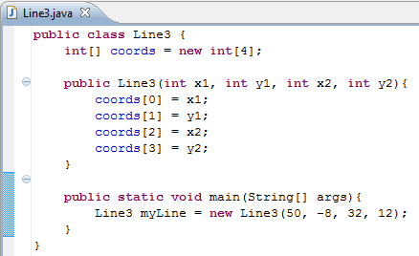
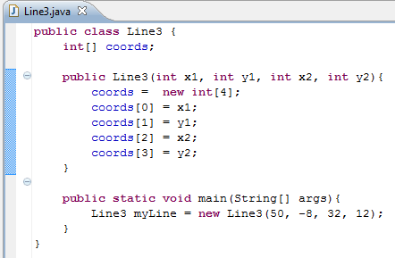
Line3 Solution
Another Correct Version

Slide 16
static
2013-03-05
Thursday – Week 6
Lecture 13
Never say: “Static” Always: “Static Method” “Static Variable”

Slide 17
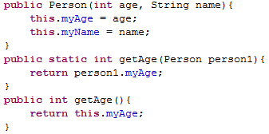
Constructor
Static Method
Have access to this!
All objects must be arguments or created in the method
Non-Static
Method

Slide 18
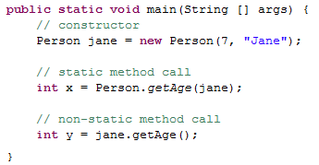

Slide 19
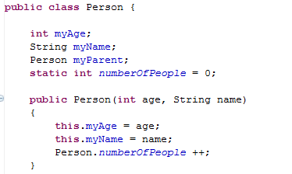
static variables (shared)
Global state shared by all instances of the class
Looks like an instance variable declaration + static
Access them as ClassName.fieldName

Slide 20
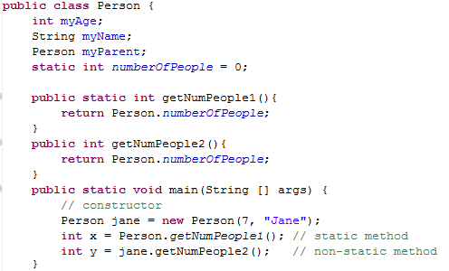
Write a sample call to each method:
Got the static one done
Got the non-static one done
Got both done
Stuck

Slide 21

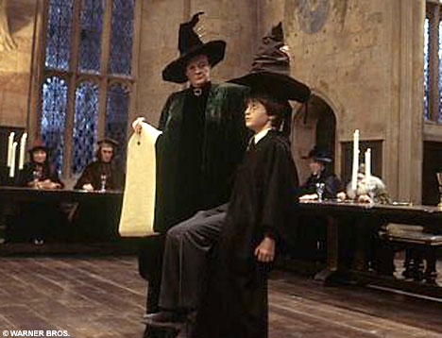
Merge Sort

Slide 22
Merge Demo
A | B | C | F | I | M | N | O
D | E | G | H | J | K | L | P
A | B | C | D | E | F | G | H | I | J | K | L | M | N | O | P

Slide 23
Mergesorting with any lists?!
Start with a list…
[ 7, 1, 9, 6, 5, 42, 3 ]
Split it into two halves (within 1) …
[ 7, 1, 9, 6 ]
[ 5, 42, 3 ]
Recurse !?!
[ 1, 6, 7, 9 ]
[ 3, 5, 42 ]
Merge.
[ 1, 3, 5, 6, 7, 9, 42 ]

Slide 24
Step 1: Recursively divide the problem in half

Slide 25
Step 2: Merge the two halves back together
A | B | C | D | E | F | G | H | I | J | K | L | M | N | O | P
A | B | C | I | J | K | D | L | M | N | E | F | G | H | O | P

Slide 26
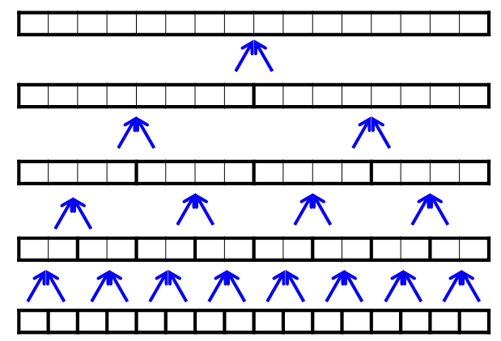
What is the runtime of MergeSort?
O(N)
O(N log N)
O(N²)
O(2^{N})
Stuck
Hints:
How many rows are there?
How much processing does each row require?

Slide 27
List and ListNode Classes
These are in one file!

Slide 28
List
myHead
mySize
ListNode
myFirst
myRest
spam
args
main
“a”
3
This is different than Racket b/c a List is different than an element of the List
(a ListNode)
If the name of this List is spam
How do you access the “a”?
Got it!
Not sure
Stuck
ListNode
myFirst
myRest
“b”
ListNode
myFirst
myRest
“c”

Slide 29
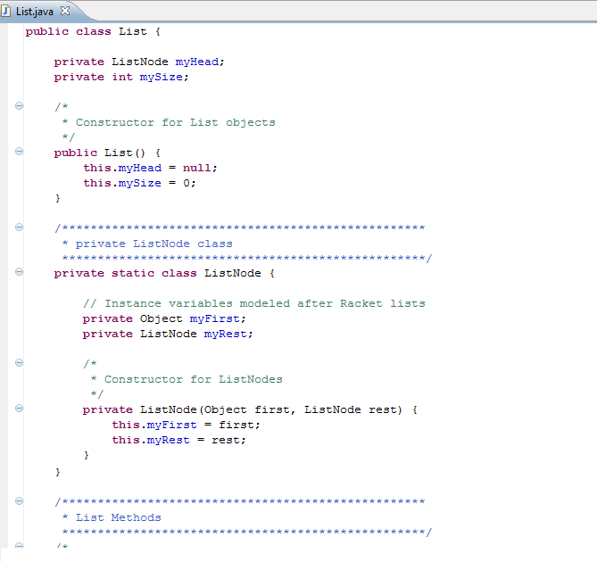
List
myHead
mySize
3
ListNode
myFirst
myRest
“L”

Slide 30
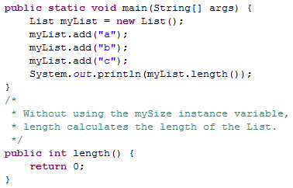
Write length

Slide 31
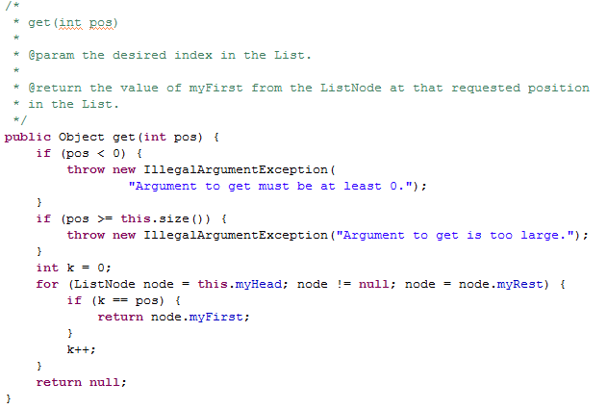
A Mysterious Method in List
We have to say what type of thing we return. But we can also FREAK OUT and throw and Exception

Slide 32
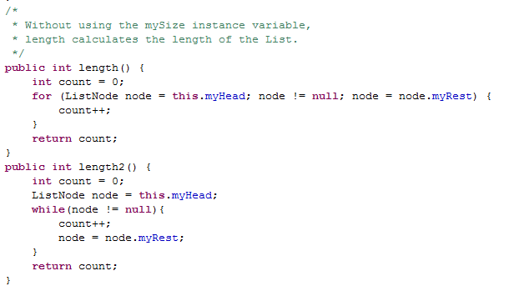
Length Solutions

Slide 33
BSTNode Class
It is a strange class for Java because we will not modify our BSTNode Objects
(to be like Racket)

Slide 34
BSTNode Class
BSTNode
key
value
left
right
“Lewis”
“1241”
emptyNode
class BSTNode {
private String key;
private Object value;
private BSTNode left;
private BSTNode right;
public static BSTNode emptyNode = new BSTNode(null,null,null,null);
BSTNode
key
value
left
right

Slide 35
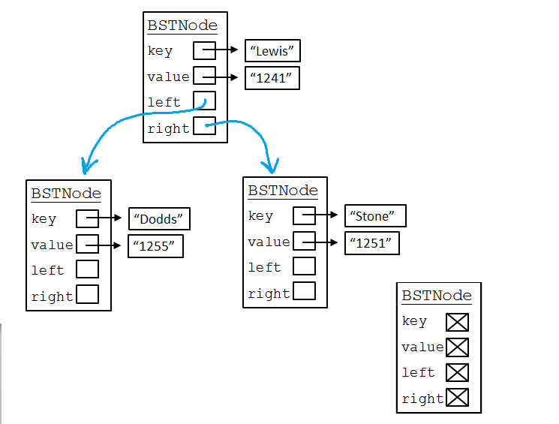
Racket: '(Lewis (Dodds () ()) (Stone () ()))
Prolog:
[lewis, [dodds,[],[]]
[stone,[],[]]]
Although now we have a key (what you search with) PLUS some other information (the value)

Slide 36
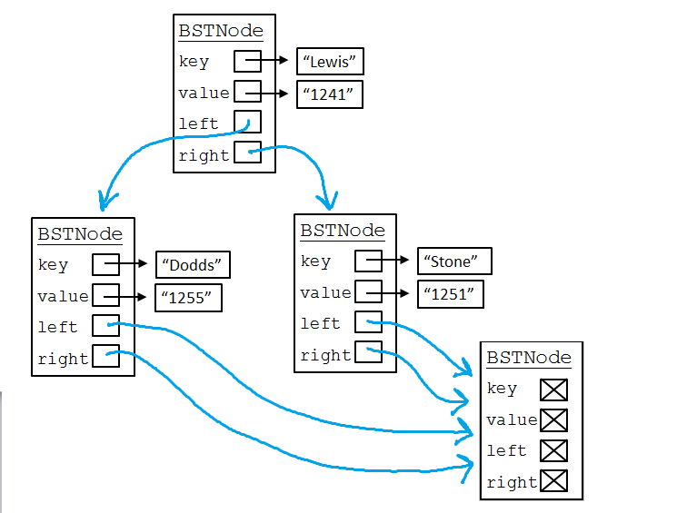
Instead of using '() or [], we’ll make an Object to represent the empty list. To save space, we’ll use just one of them!

Slide 37
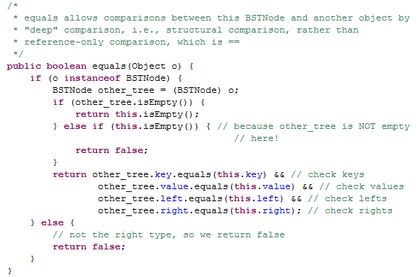
A Mysterious Method in BSTNode
Every Object can be referenced as type Object, instanceof tells us the REAL type

Slide 38
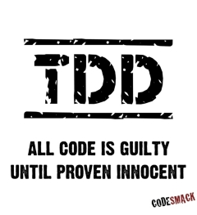
Test Driven Development

Slide 39
Test Driven Development
static void beAGoodProgrammer()
{
while (true) // for each method
{
writeTest();
writeCode();
writeAFewMoreTests();
writeCode();
}
}
Remember to mention this at job interviews!

Slide 40
Why do Test Driven Development?
It is a way to brainstorm what your method is going to do.
It is hard to write test cases
Write your test cases before you’re biased by how your code is written

Slide 41
Modified TDD in CS60
When you read sample calls before your write your code
When you have provided test cases
When we have you write test cases
CS 60 Goal:
Before you write code (EVER) think…
How will I know if this works?
OR…Wow! Provided tests are helpful!

Slide 42

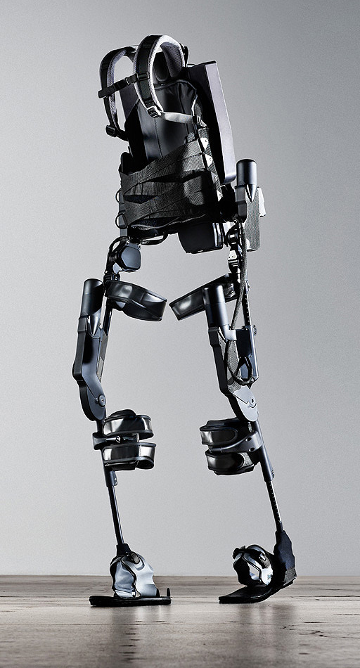
http://www.youtube.com/watch?v=pzRmNYA8LlY

Slide 43
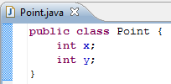

Line4
points
Point
x
y
Point
x
y
50
32
-8
12

Slide 44

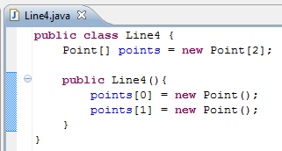
Write the instance variables and constructors
Line3
coords
50
-8
32
12
Line4
points
Point
x
y
Point
x
y
50
32
-8
12

Slide 45
Inheritance

Slide 46
Inheritance Lingo
A Dog is an Animal
Dog extends Animal
Dog is the subclass of Animal
Animal is the superclass of
Animal
Animal
Dog
Dalmatian
Cat
A Dalmation is a Dog
A Dalmation is an Animal
Dalmation extends Dog
Dalmation is the subclass of Dog and Animal

Slide 47
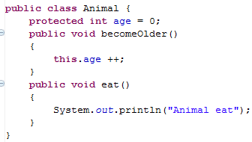
Animal
age
0

Slide 48
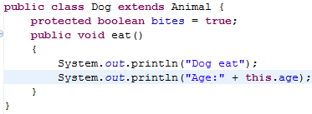
We can override the parent’s eat method
We can access the variable age, even though we didn’t include it in the Dog class directly
Dog
age
bites
Animal
age
0
true
0

Slide 49
Animal myAnimal= new Animal();
myAnimal.becomeOlder();
myAnimal.eat();

Slide 50
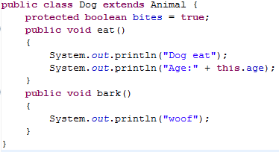
Dog myDog = new Dog();
myDog.eat();
myDog.bark(); // ↓ does this work? ___
myDog.becomeOlder();

Slide 51
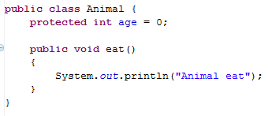
Animal myAnimal= new Animal();
myAnimal.bark();
↑Does this work???? _________

Slide 52
Subclasses (Children) Can
Declare new instance/class variables
Declare new methods
Override old implementations with new implementations
Access instance/class variables of the superclass (parent) *
Access methods of the superclass*
* only public, protected or default ones

Slide 53
Inheritance Puzzles
Dog d = new Animal();
Does this work? _______
No it doesn’t compile, If I want a Dog, an Animal will be NOT be acceptable because I might want to call a method that only a Dog can do!

Slide 54
Inheritance Puzzles
Animal a = new Dog();
Does this work? _______
YES it compiles and runs - If I want an Animal , a Dog will be acceptable because everything an Animal can do a Dog can do too!
Animal a = (Animal) new Dog();

Slide 55
Inheritance Puzzles
Animal a = new Dog();
Dog d = a;
Does this work? _______
No it doesn’t compile. The compiler doesn’t know it is really a Dog!
but we can PROMISE the compiler that it is with a cast
Dog d = (Dog) a;

Slide 56
Inheritance Puzzles
Animal a = new Animal();
Dog d = (Dog) a;
Does this work? _______
YES and NO - The compiler trusts your PROMISE (cast) but then if you run your program it has a RUN TIME ERROR because a is not a Dog

Slide 57
Inheritance Puzzles
Animal
Dog
Dalmatian
Poodle
Cat
Animal a = new Cat();
Dog d = (Dog) a;
d.bark();
Does this work? _______
YES and NO. It compiles, but then when we try to do the cast we get a RUN TIME ERROR, before we even try to call any dog methods on a.

Slide 58
Inheritance Puzzles
Animal a = new Dog();
a.bark();
Does this work? _______
NO it does not compile - The compiler thinks it is an Animal, and an Animal does not have a method bark
Dog d = (Dog) a; d.bark();
((Dog) a).bark();

Slide 59
Inheritance Puzzles
Animal a = new Dog();
a.eat();
Does this work? _______
YES- The compiler is happy - an Animal has an eat() method.
Which method is called the Animal eat() or the Dog eat() ?

Slide 60
Inheritance Puzzles
Animal a = new Dog();
a.eat();
Which method is called the Animal eat() or the Dog eat() ?
main
Animal a
Dog
age
bites
0
true

Slide 61
Ridable
Object
Animal
Machine
Car
Cat
Blender
Dog
Horse

Slide 62

Interfaces
I have a GREAT idea!
Everyone will want to make Ridable things that can
turnLeft()
turnRight()
goForward()
How?!?!
I don’t care!!!!

Slide 63
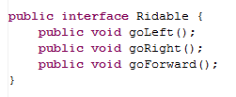
The Ridable interface

Slide 64
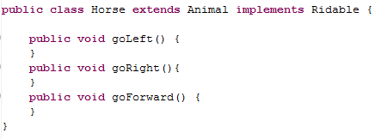
Horse can implement the Ridable interface

Slide 65
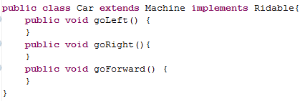
Car can implement the Ridable interface

Slide 66
We can have a Rideable remote control (Rideable reference)
Rideable r1 = new Horse();
Rideable r2 = new Car();
r1.goForward();
r2.goForward();

Slide 67
Can we have a Ridable object?
Ridable r1 = new Ridable();
No! You can’t create an object of an interface!

Slide 68
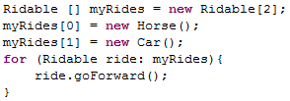
Interfaces can be cool!!!

Slide 69
Example
The sort method of the Array class promises to sort an array of objects, but under one condition: the objects in the array must implement the Comparable interface:
public interface Comparable {
int compareTo(Object other);
}

Slide 70
Summary of Interfaces
Interfaces don’t implement ANY methods
Just put a semicolon at the end of the method
Classes can implement multiple interfaces
To implement an interface you must write all of the methods that the interface defines

Slide 71
Cookies!
Cookie
Girl Scout Cookie
Thin mint
Shortbread
Chocolate Chip

Slide 72
Abstract Classes (less lazy than Interfaces)
I have a GREAT idea!
Everyone will want to make Cookies that can have these methods:
ingredients()
isDelicious()
How?!?!
isDelicious() is pretty simple, I’ll write that one
ingredients() ?!? Sounds too hard! I’ll make that abstract

Slide 73
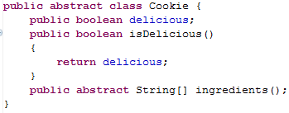
Abstract Class Cookie

Slide 74
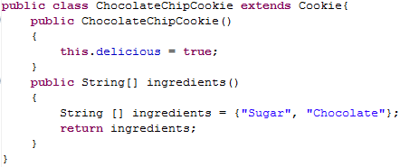
ChocolateChipCookie can extend the Abstract class Cookie

Slide 75
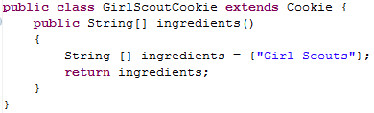
GirlScoutCookie can extend the Abstract class Cookie

Slide 76

We can have a Cookie remote control (Cookie reference)

Slide 77
Can we have a Cookie object?
Cookie p1 = new Cookie();
No! You can’t create an object of an abstract class!

Slide 78
Abstract Class Summary
Label an Abstract class as abstract
Label any methods that you don’t want to implement as abstract
Your children MUST write all of the abstract methods
Instance variables in the abstract class will be available in the child class
You can only extend one Class (abstract or otherwise)

Slide 79
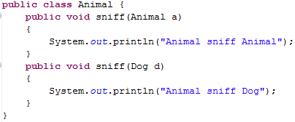
Inheritance and Arguments
Animal
Dog
Cat

Slide 80
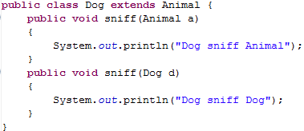
← Uses a1’s dynamic type
Animal a1 = new Dog();
Dog d1 = new Dog();
a1.sniff(d1);
d1.sniff(a1);
Animal a2 = new Dog();
a1.sniff(a2);
← Uses a1’s static type
← Uses a1’s dynamic type
Uses a2’s static type

Slide 81
Inheritance
Compilation:
CALLER: It makes sure that the static type of the object has the appropriate method
ARGS: It makes sure that the method takes in the static type of the arguments
Run-time:
CALLER: When you call a method on an object it looks for the method starting at the object’s dynamic type
ARGS: When you pass an object as an argument, it looks for a method with that static type

Slide 82
Animal a1 = new Dog();
Dog d1 = new Dog();
a1.sniff(d1);
d1.sniff(a1);
Animal a2 = new Dog();
a1.sniff(a2);
Dog
age
bites
0
true
Dog
age
bites
0
main
Animal a1
Animal a2
Dog d1
true
Dog
age
bites
0
true

Slide 83
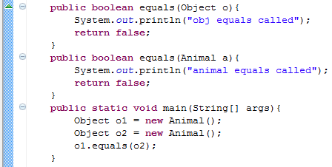
equals(Object o)
Which equals is called?
Object

Slide 84
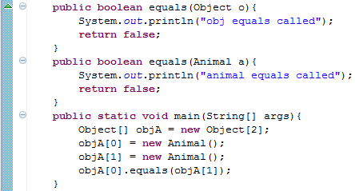
equals(Object o) and Arrays
Which equals is called?
Object

Slide 85
equals(Object o)
If others will call your methods with more generic references, you want to provide a method that takes in an Object

Slide 86
Big-O BONUS

Slide 87



Some Algebra to calculate: 1+2+…+n
// Written backwards

Slide 88

Some Algebra to calculate: 1+2+…+n

Slide 89


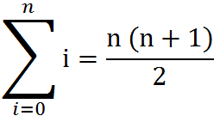
Some Algebra to calculate: 1+2+…+n
OR

Slide 90
Estimating Time
Most people grossly underestimate how long it takes to program (not thinking about time to debug and test)
You appear incompetent at programming (not true) if you can’t estimate how long something will take.
This is one of the hardest things to learn!!! Start to practice now! For each task estimate how long it will take and keep track of how wrong you were

Slide 91
BONUS

Slide 92


Slide 93


Computer
Science
&
= AWESOME

Slide 94

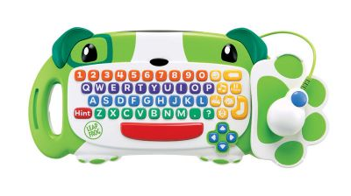
ClickStart

Slide 95
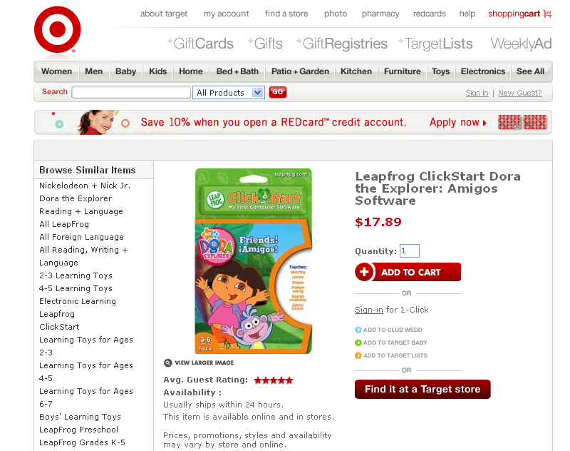

Slide 96
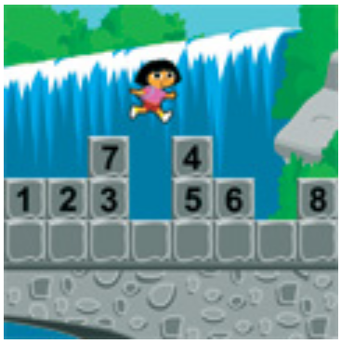
How should we represent the blocks in the computer?
Independent variables
2D Array
OpenList
I don’t know

Slide 97
The value in the array tells me what art asset to use
Each level is really a 3x10 vector!
0 | 0 | 7 | 0 | 4 | 0 | 0 | 0
1 | 2 | 3 | -4 | 5 | 6 | -7 | 8
B | B | B | B | B | B | B | B
Negative values tell me what block needs to go here to win!

Slide 98
0 | 0 | 7 | 0 | 4 | 0 | 0 | 0
1 | 2 | 3 | -4 | 5 | 6 | -7 | 8
0 | 0 | 0 | B | 0 | 0 | 0 | 0

Slide 99
BUGS!

Slide 100
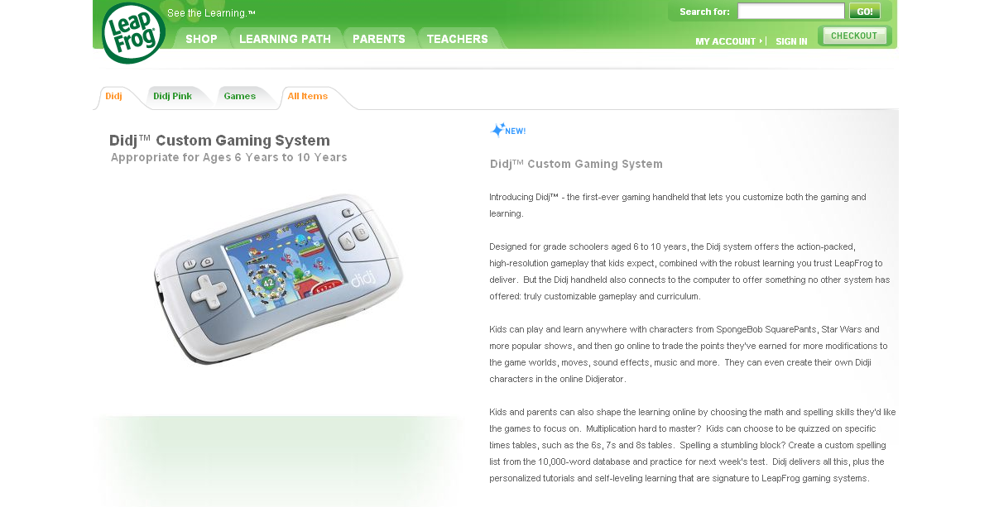

Slide 101
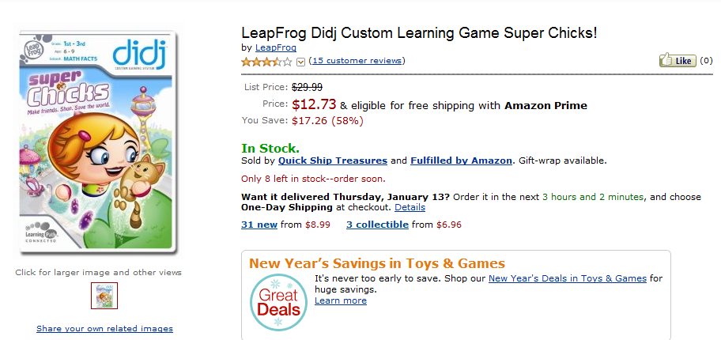
It is really sad when stuff you’ve made is on sale!

Slide 102
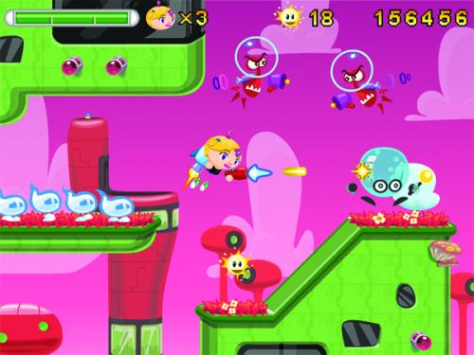
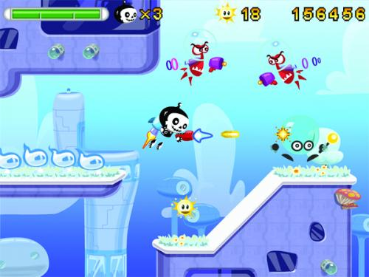

Which image is fake?
A. Top Left
B. Bottom Left
C. Bottom Right

Slide 103
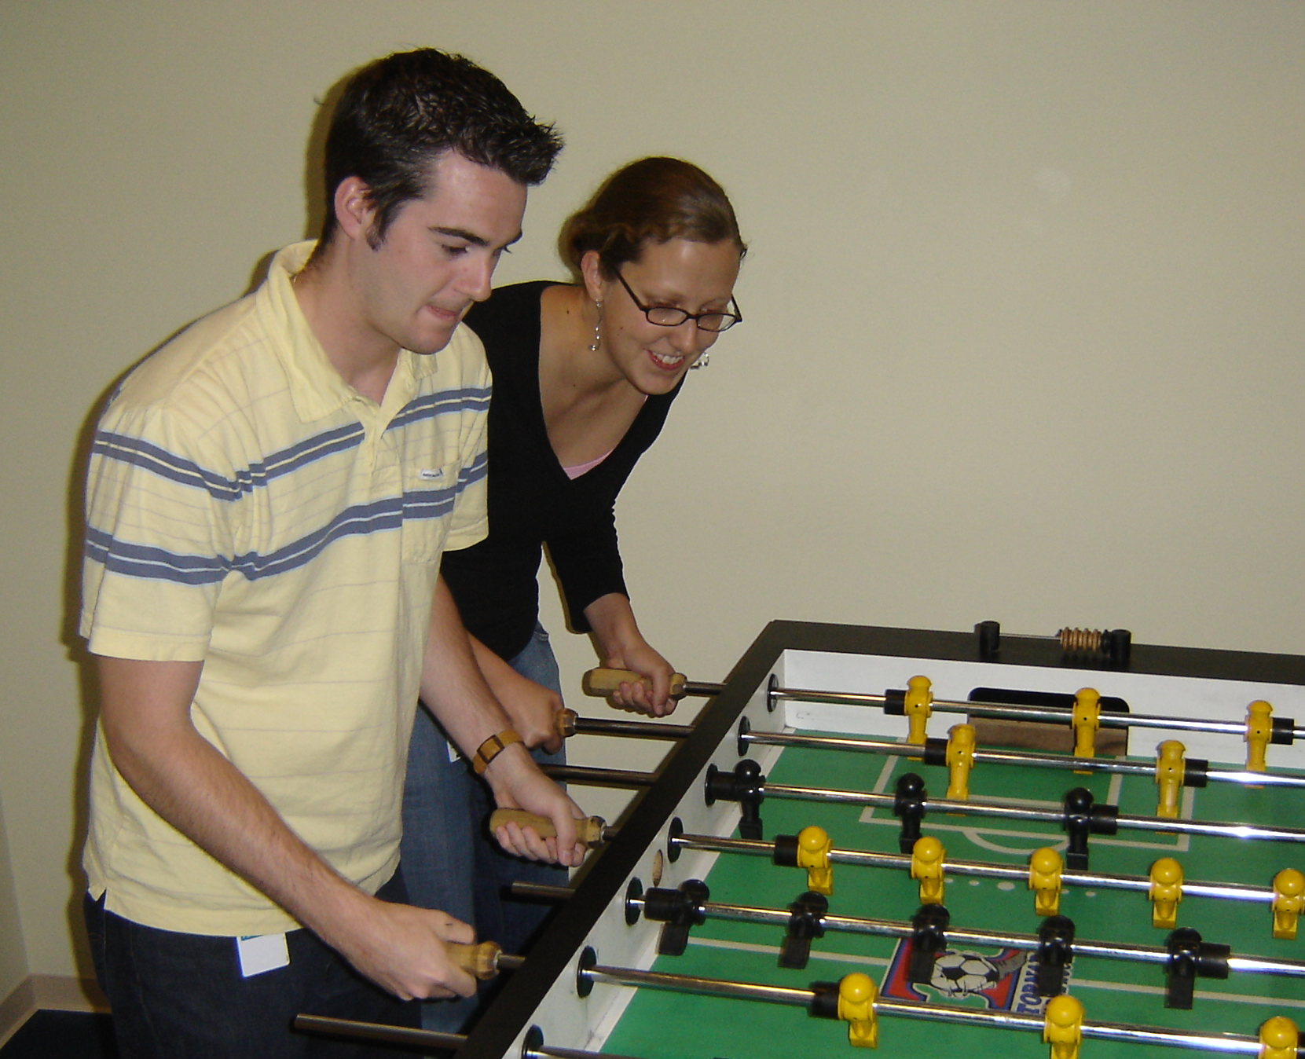

Slide 104
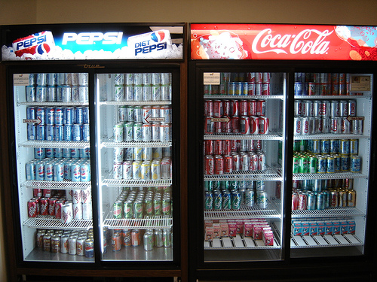

Slide 105
Sort
STk>(sort ’(8 3 9))
(3 8 9)
(sort ’(8 3 9))
(sort ’(3 9))
(insert 8
(insert 3
(sort ’(9))
(insert 9
(sort ’())
’()
(insert 8 (insert 3 (insert 9 ’())))
Notes:
105

Slide 106
(insert 3
(insert 6
(insert 4
(insert 7
(insert 1
(insert 8
(insert 3
(insert 9
’()
))))))))
(sort sent) if sent length is N
1 + 2 + 3 + 4 + … + (N-1)+ N
Add to sent size 7
Add to sent size 6
Add to sent size 5
Add to sent size 4
Add to sent size 3
Add to sent size 2
Add to sent size 1
Add to sent size 0

Slide 107





// Take the log of both sides
// Remember:

Slide 108



Slide 109
BSTNode
key
value
left
right
“Lewis”
BSTNode
key
value
left
right
“1241”
BSTNode
key
value
left
right
BSTNode
key
value
left
right
“Dodds”
“Stone”
“1255”
“1251”

Slide 110
BSTNode
key
value
left
right
“Lewis”
BSTNode
key
value
left
right
“1241”
BSTNode
key
value
left
right
BSTNode
key
value
left
right
“Dodds”
“Stone”
“1255”
“1251”

Slide 111
main
people
BSTNode
key
value
left
right
“Lewis”
“1241”
BSTNode
key
value
left
right

