Slide 1
CS 60
Inheritance, Interfaces, Queues, Stacks
2013-03-12
Tuesday – Week 7
Lecture 14

Slide 2
Survey
Spring Break
I’m staying in my HMC home for Spring Break
I’m going home for Spring Break
I’m going somewhere else

Slide 3
Administrative Stuff
(Not in your notes)
Prolog Quiz
  Due Wednesday March 13th at 5pm
  Under Colleen’s door
  Has 4 pages (not 4 questions)
Homework 6 length!
Homework 7 due Wednesday after spring break
  March 27th at 11:59 pm

Slide 4
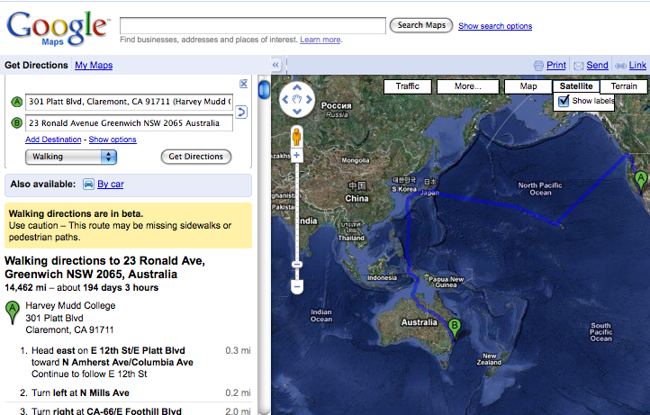
Direction Finding!
no problem!

Slide 5
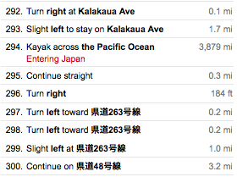
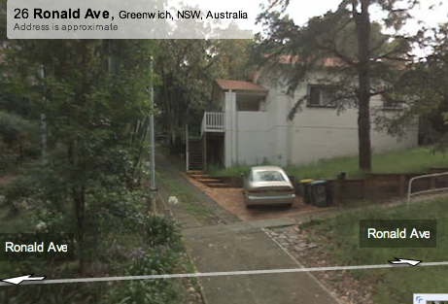

Slide 6
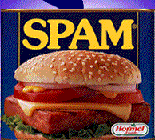
Search for Spam!
class Maze
This maze looks kinda easy to me…
class MazeCell
How is this is the same problem?
Notes:
I don’t know if this really works...

Slide 7
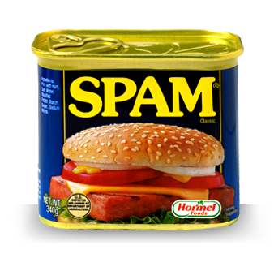
Toolkit for your search for Spam
2
Interfaces
  Builds upon inheritance
Stacks
  Builds upon interfaces
  Builds upon understanding Java data structures
Queues
Breadth first search
  Builds upon queues
Depth first search
  Builds upon stacks
1
4
5
3
6

Slide 8
Inheritance: extends
If we don’t explicitly say a class extends another class, it extends Object
public class Animal { }
public class Machine { }
public class Cat extends Animal { }
public class Dog extends Animal { }
Lots of Java Library classes extend Object
Child class
Parent class
We say “a Cat is an Animal” OR
“The child class object is a parent class object”
Object
Animal
Machine
Cat
Dog
String
When a class extends a parent class it can do all of the things that the parent class can do
1

Slide 9
public class Animal {
public int age = 3;
public void eat() {
// some code...
}
}
public class Dog extends Animal {
public void bark() {
System.out.println("yum");
}
public static void main(String[] args){
Dog d1 = new Dog();
Dog d2 = d1;
Animal a1 = d1;
}
}
Object
Animal
Machine
Cat
Dog
1
d1
d2
a1
args
Dog
age
main
3

Slide 10
T/F? Based upon the following object hierarchy:
Object
Animal
Machine
Car
Cat
Blender
Dog
Horse
Snoopy
Snoopy extends Dog ( T F )
A Snoopy object can do anything a Dog can do ( T F )
  Meaning: any public methods from the Dog class can be called on a Snoopy object
A Snoopy object can do anything an Animal can do ( T F )
  Meaning: any public methods from the Animal class can be called on a Snoopy object.
A Dog reference can refer to a Snoopy object ( T F )
An Object reference can refer to a Snoopy Object ( T F )
1
How many Trues? A) stuck B) 2 C) 3 D) 4 E) 5

Slide 11
Java Interfaces
Creating objects with common functionality
2

Slide 12
Ridable
Java Interfaces:
Ensuring common functionality
Object
Animal
Machine
Car
Cat
Blender
Dog
Horse
A Horse doesn’t extend a Car, but I want them to have some of the same methods to make them Ridable
2

Slide 13
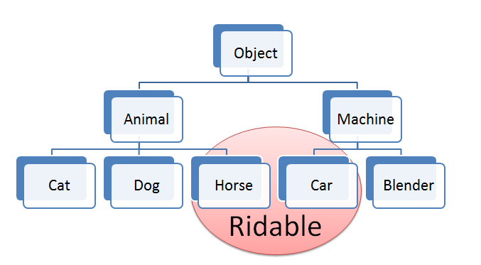
Goal: We want to have a Rideable remote control
(Rideable reference)
Rideable r1 = new Horse();
Rideable r2 = new Car();
r1.goForward();
r2.goForward();
2

Slide 14

Interfaces are Lazy!
I have a GREAT idea!
Everyone will want to make Ridable things that can
  turnLeft()
  turnRight()
  goForward()
How?!?!
  I don’t care!!!!
2

Slide 15
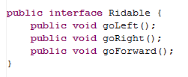
The Ridable interface
Interfaces don’t implement any methods!
They are just an idea!
2

Slide 16
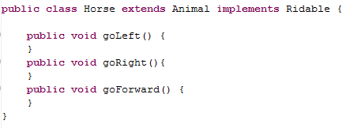
Horse can implement the Ridable interface
2
Horse is the child of Animal
Horse implements Ridable
Assume there is real code here

Slide 17
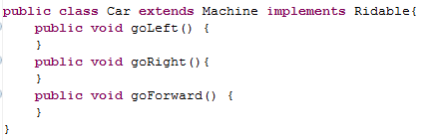
Car can implement the Ridable interface
2
Car is the child of Machine
Car implements Ridable

Slide 18
Can we have a Ridable object?
Ridable r1 = new Ridable();
Yes
No
I don’t know
2

Slide 19
Summary of Interfaces
2
( T F )
Interfaces don’t implement ANY methods
  Just put a semicolon at the end of the method
Classes can implement multiple interfaces
To implement an interface you must write all of the methods that the interface defines
When a class implements an interface you have a guarantee of what methods it will have
( T F )
( T F )
( T F )
How many Trues? A) stuck B) 1 C) 2 D) 3 E) 4

Slide 20
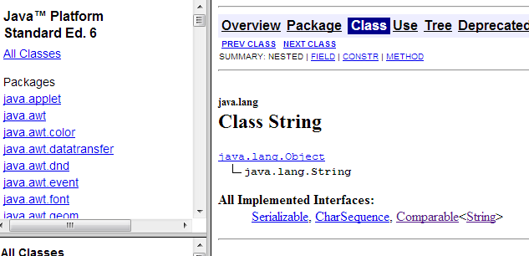
Interface Example: Comparable
  public interface Comparable {
  int compareTo(Object other);
  }
A more general type for the key of a BSTNode would have been Comparable
This is an example where an interface is actually useful!
2

Slide 21
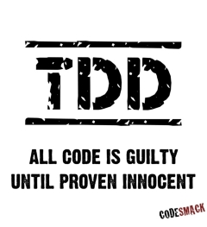
Test Driven Development
Slides from LAST set of lecture notes!

Slide 22
Test Driven Development
static void beAGoodProgrammer()
{
  while (true) // for each method
  {
  writeTest();
  writeCode();
  writeAFewMoreTests();
  writeCode();
  }
}
Remember to mention this at job interviews!

Slide 23
Why do Test Driven Development?
It is a way to brainstorm what your method is going to do.
It is hard to write test cases
Write your test cases before you’re biased by how your code is written

Slide 24
Modified TDD in CS60
When you read sample calls before your write your code
When we have provided test cases
When you write test cases
CS 60 Goal:
Before you write code (EVER) think…
How will I know if this works?
OR…Wow! Provided tests are helpful!

Slide 25
Test Driven Development Survey
Testing is terrible!
I like to USE tests that Colleen has written
I don’t mind writing tests
  b/c they are great to have when I write code
I like to write tests first
  b/c they help me think about the code

Slide 26

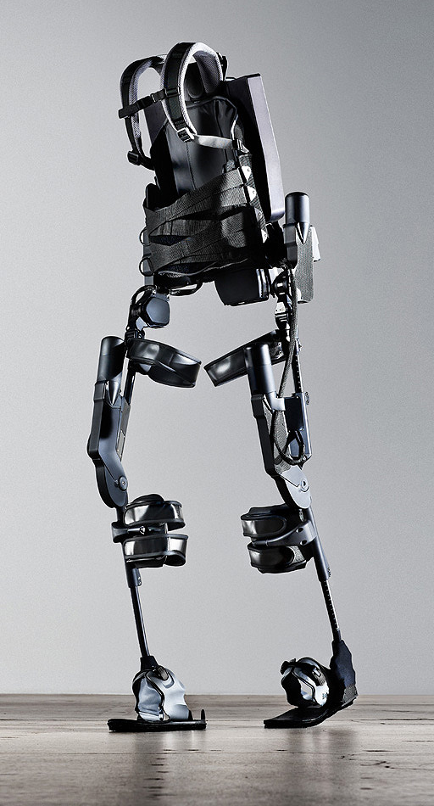
http://www.youtube.com/watch?v=pzRmNYA8LlY

Slide 27
Queues
First in – First Out
3

Slide 28

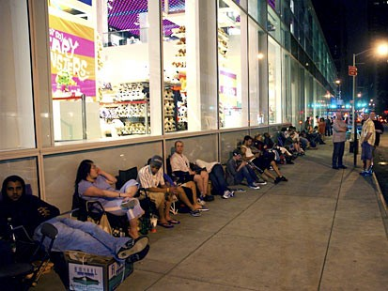
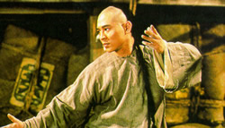
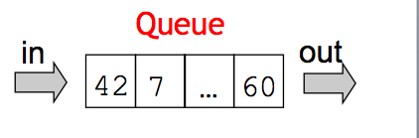
3
Queues
A first-in, first-out (FIFO) list
Or, first-come, first-served…
e.g., network requests -- or requests for network!
Queue
in
out
42
7
…
60
also, a hairstyle: the Imperial Queue
Greg Packer is at the front of this line somewhere…
Notes:
iPhone Line… Greag Packer got there 5am Monday morning for a 6pm Friday start of sales…
Can't buy a Wii!!

Slide 29
Typical Methods for Queues
enqueue: add something to the end of the queue
dequeue: remove something from the front of the queue
peek: look at the thing on the front of the queue
3

Slide 30

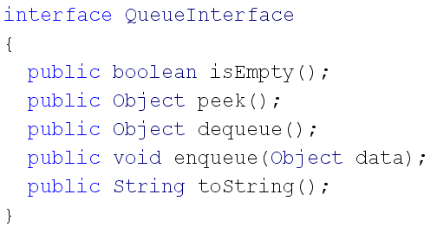
3
Interface Example: Queue
remove
add

Slide 31
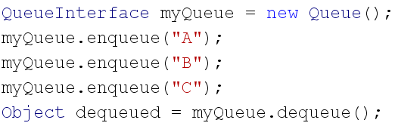

QUEUES: First in First Out
3
Create an object that implements QueueInterface
dequeued is "A"
A
B
C

Slide 32
What Java data structures could you use to implement a Queue?
List (from homework 6)
String[] (or some other Array)
An int
I and II
I only (II has some limitations)
II only (I has some limitations)
III
??

Slide 33
Stacks
First in – Last out
4

Slide 34
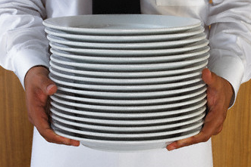
Typical Methods for Stack
push : put something on top of the stack
pop: take something from the top of the stack
peek: look at the thing on the top of the stack
4

Slide 35
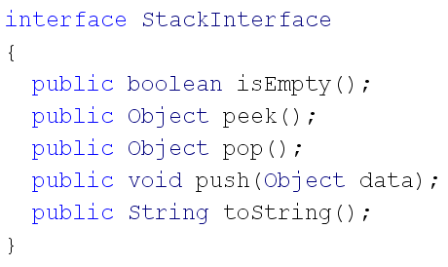
Interface Example: Stacks
4

Slide 36
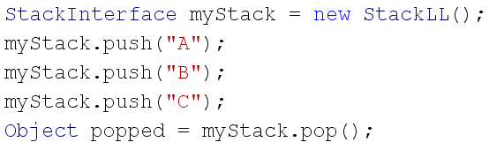
STACKS: Last in First Out
Create an object that implements StackInterface
C
B
A
popped is "C"
4

Slide 37

Try these
5
Read StackLL
Write isEmpty() for StackLL
Draw a picture of what this would produce.
Read StackArray code
Write isEmpty() for StackArray
Write peek() for StackArray and StackLL
Are you done with the pictures?
A) stuck B) Yes C) No

Slide 38
StackCell
data
next
main
StackLL
front
StackCell
data
next

Slide 39
StackCell
data
next
main
StackLL
front
StackCell
data
next

Slide 40
StackLL
front
StackCell
data
next
myStack
args
main
“B”
StackCell
data
next
“A”

Slide 41
Debugging in Eclipse
Demo

Slide 42
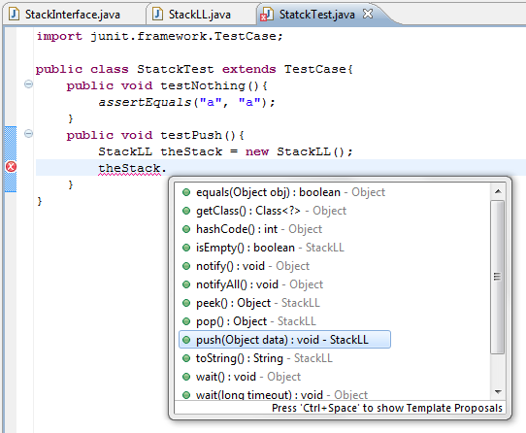
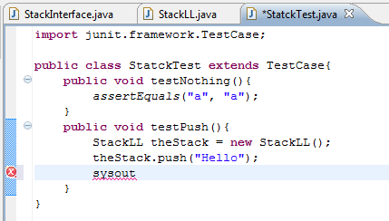
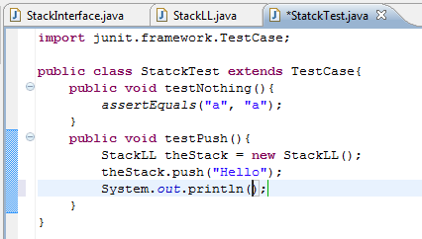
Eclipse
Ctrl + Space Tricks
Ctrl+Space
Ctrl+Space

Slide 43
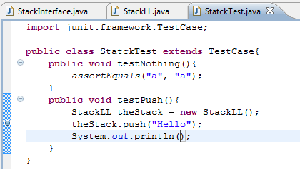

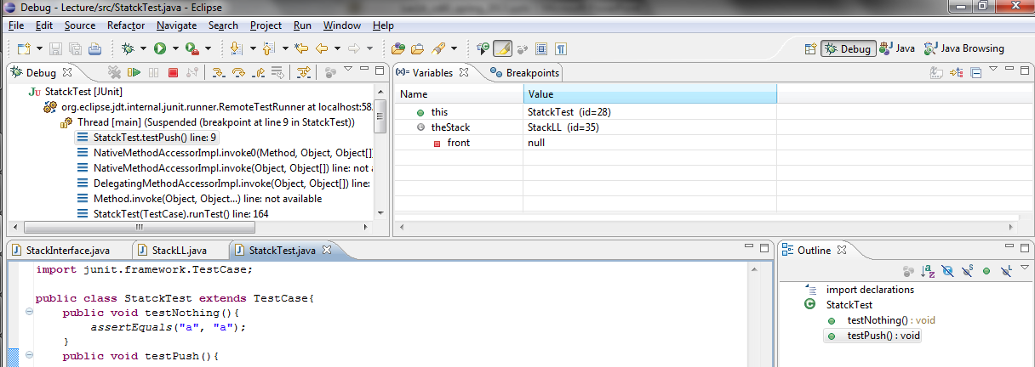
Debugging
STEP 1: Double click to add a break point
Eclipse will stop BEFORE we execute this line.
STEP 2: Click on the BUG to run
STEP 3: Click on Debug View
(or set as default)

Slide 44
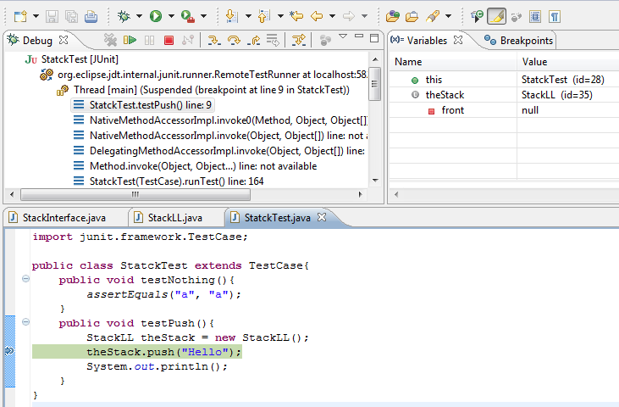

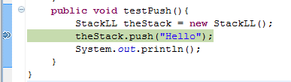
Go line by line IN this method
Next line to execute

Slide 45
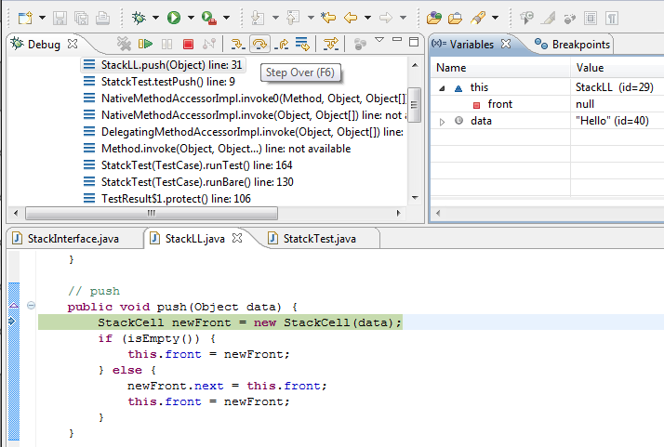


Variables!
AFTER stepping into
Execute this line
Return from this function (go back to where it was called)

Slide 46
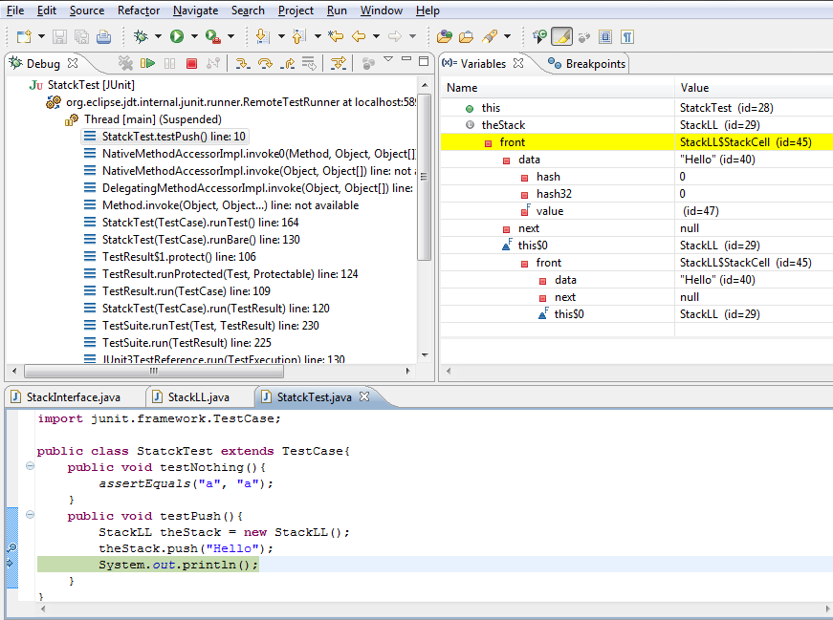
In test cases “this” isn’t important
Here is our variable
theStack
Instance variable
data
Other variables we didn’t create (built in)
Other variables we didn’t create (built in)
Instance variable
next
AFTER returning from the method

