Slide 1
CS 60
Inheritance & Casting
Breadth First Search (BFS),
Depth First Search (DFS),
ArrayList
2013-03-14
Thursday – Week 7
Lecture 15

Slide 2
Survey
How was the test
Too hard
Too long
Too hard and too long
Okay

Slide 3
Administrative Stuff
(Not in your notes)
Homework 7 zip file updated!

Slide 4
Inheritance & Casting

Slide 5
Inheritance Lingo Review
A Dog is an Animal
Dog extends Animal
Dog is the subclass of Animal
Animal is the superclass of
Animal
Animal
Dog
Dalmatian
Cat
A Dalmation is a Dog
A Dalmation is an Animal
Dalmation extends Dog
Dalmation is the subclass of Dog and Animal

Slide 6
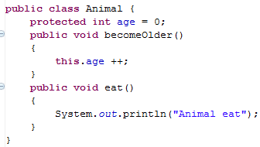
Animal
age
0
Animal myAnimal= new Animal();
myAnimal.becomeOlder();
myAnimal.eat();

Slide 7
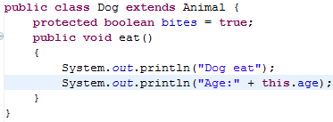
We can override the parent’s eat method
We can access the variable age, even though we didn’t include it in the Dog class directly
Dog
age
bites
Animal
age
0
true
0

Slide 8
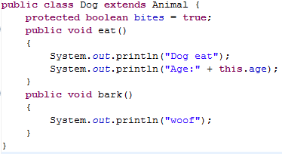
Dog myDog = new Dog();
myDog.eat();
myDog.bark(); // ↓ does this work? ___
myDog.becomeOlder();

Slide 9
Subclasses (Children) Can
Declare new instance/class variables
Declare new methods
Override old implementations with new implementations
Access instance/class variables of the superclass (parent) *
Access methods of the superclass*
* only public, protected or default ones

Slide 10
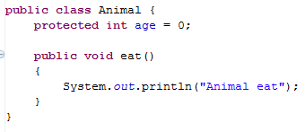
Inheritance Puzzle 0: child method on parent
Animal myAnimal= new Animal();
myAnimal.bark();
Does this compile without errors? ( Y N )
If Yes: Does it run without errors? ( Y N )
No it doesn’t compile b/c Animals don’t have a bark() method

Slide 11
Inheritance Puzzle 1: Parent Reference
Animal a = new Dog();
Does this compile without errors? ( Y N )
If Yes: Does it run without errors? ( Y N )
YES it compiles and runs - If I want an Animal , a Dog will be acceptable because everything an Animal can do a Dog can do too!
Animal a = (Animal) new Dog();

Slide 12
Inheritance Puzzle 2: Child reference
Dog d = new Animal();
Does this compile without errors? ( Y N )
If Yes: Does it run without errors? ( Y N )
No it doesn’t compile, If I want a Dog, an Animal will be NOT be acceptable because I might want to call a method that only a Dog can do!

Slide 13
Inheritance Puzzle 3: CASTING
Animal a = new Dog();
Dog d = a;
Does this compile without errors? ( Y N )
If Yes: Does it run without errors? ( Y N )
No it doesn’t compile. The compiler doesn’t know it is really a Dog!
but we can PROMISE the compiler that it is with a cast
Dog d = (Dog) a;

Slide 14
Inheritance Puzzle 4: Untrue Cast
Animal a = new Animal();
Dog d = (Dog) a;
Does this compile without errors? ( Y N )
If Yes: Does it run without errors? ( Y N )
YES and NO - The compiler trusts your PROMISE (cast) but then if you run your program it has a RUN TIME ERROR because a is not a Dog

Slide 15
Inheritance Puzzle 5: Untrue Cast
Animal
Dog
Cat
Animal a = new Cat();
Dog d = (Dog) a; // line 2
d.bark();
Does this compile without errors? ( Y N )
If Yes: Does it run without errors? ( Y N )
It compiles, but then when we try to do the cast we get a RUN TIME ERROR on line 2.

Slide 16
Inheritance Puzzle 6: Child method call on Parent Reference
Animal a = new Dog();
a.bark();
Does this compile without errors? ( Y N )
If Yes: Does it run without errors? ( Y N )
NO it does not compile - The compiler thinks it is an Animal, and an Animal does not have a method bark
Dog d = (Dog) a; d.bark();
((Dog) a).bark();

Slide 17
Inheritance Puzzle 7: Method call
Animal a = new Dog();
a.eat();
Which method is called the Animal eat()
or the Dog eat() ?
The compiler is happy b/c an Animal has an eat() method.
The Dog eat() will be called, b/c a is really a Dog!
main
Animal a
Dog
age
bites
0
true

Slide 18
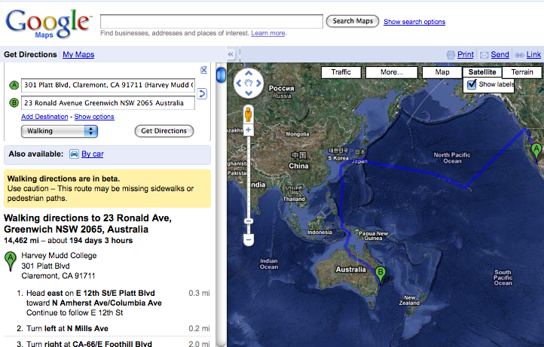
Direction Finding!
no problem!

Slide 19

Search for Spam!
class Maze
This maze looks kinda easy to me…
class MazeCell
How is this is the same problem?
Notes:
I don’t know if this really works...

Slide 20
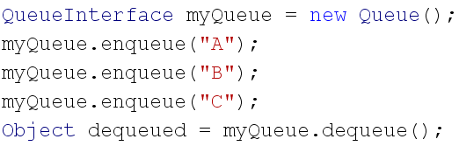

QUEUES: First in First Out
REVIEW
Create an object that implements QueueInterface
dequeued is "A"
A
B
C

Slide 21
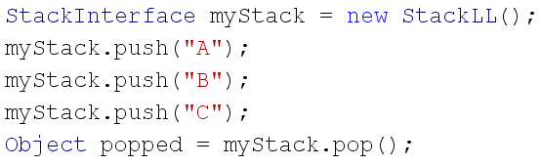
STACKS: Last in First Out
REVIEW
Create an object that implements StackInterface
C
B
A
popped is "C"
4

Slide 22
3
Stack vs. Queue information structures
/*
* StackInterface
*/
interface StackInterface
{
public int pop();
public void push(Object data);
public Object peek();
public boolean isEmpty();
public String toString();
}
/*
* QueueInterface
*/
interface QueueInterface
{
public int dequeue();
public void enqueue(Object data);
public Object peek();
public boolean isEmpty();
public String toString();
}
in
out
in
42
7
…
60
42
7
…
60
out
Stack
Queue
How will switching to a Queue change our search procedure?

Slide 23
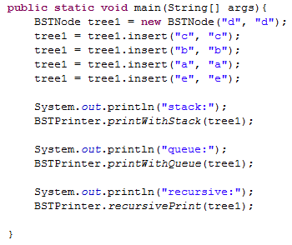
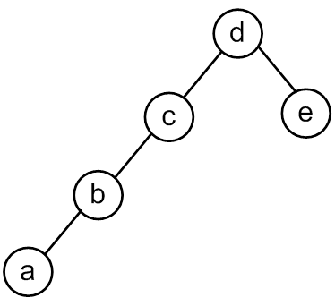

Slide 24
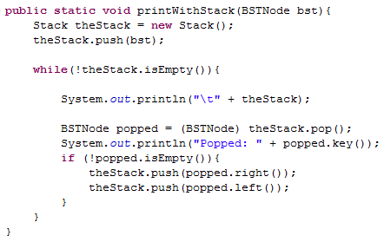
Print With a Stack

Slide 25
<TOP> d <BOTTOM>
Popped: d
<TOP> c e <BOTTOM>
Popped: c
<TOP> b empty e <BOTTOM>
Popped: b
<TOP> a empty empty e <BOTTOM>
Popped: a
<TOP> empty empty empty empty e <BOTTOM>
Popped: empty
<TOP> empty empty empty e <BOTTOM>
Popped: empty
<TOP> empty empty e <BOTTOM>
Popped: empty
<TOP> empty e <BOTTOM>
Popped: empty
<TOP> e <BOTTOM>
Popped: e
<TOP> empty empty <BOTTOM>
Popped: empty
<TOP> empty <BOTTOM>
Popped: empty

Slide 26
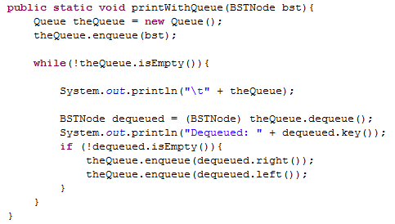
Print With a Queue

Slide 27
<FRONT> d <BACK>
Dequeued: d
<FRONT> e c <BACK>
Dequeued: e
<FRONT> c empty empty <BACK>
Dequeued: c
<FRONT> empty empty empty b <BACK>
Dequeued: empty
<FRONT> empty empty b <BACK>
Dequeued: empty
<FRONT> empty b <BACK>
Dequeued: empty
<FRONT> b <BACK>
Dequeued: b
<FRONT> empty a <BACK>
Dequeued: empty
<FRONT> a <BACK>
Dequeued: a
<FRONT> empty empty <BACK>
Dequeued: empty
<FRONT> empty <BACK>

Slide 28
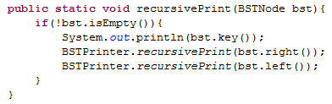

Slide 29
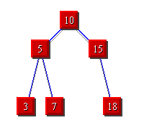


Breadth First Search
(BFS)
3
Depth
First Search
(DFS)
STACKS
QUEUES

Slide 30
ArrayList & Generics

Slide 31
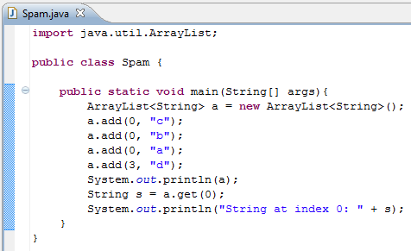

Use the <> to indicate what type of reference to use!
Add “b” at index 0
Good looking print statements

Slide 32
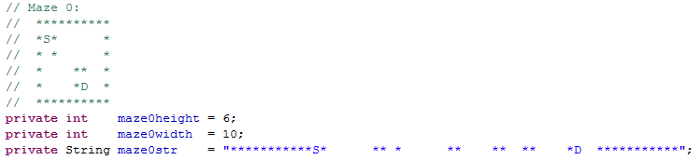
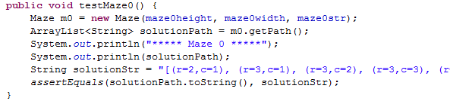
*: wall
S: Start
D: Destination
Input to make a Maze
getPath() returns an ArrayList<String>

Slide 33
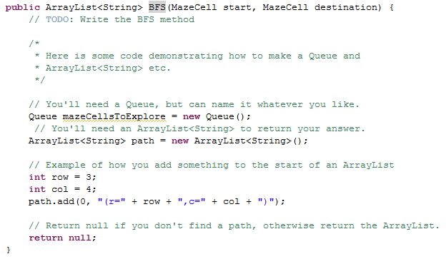

Slide 34
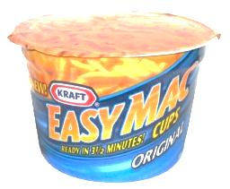

BFS Traversal Pseudocode (WRONG)
A
B
create an empty Queue
enequeue the starting node
while (the queue is not empty)
{
  dequeue a node: “it”
  for each neighbor of “it”
  {
    enqueue the neighbor
  }
}
C
D
A. Looks good to me!
B. I see a problem!
C. I see a solution!
it
it
it
it
it
A
B
D
D
C
C
A

Slide 35
BFS Traversal Pseudocode (Fixed)
Don’t look at your handout
create an empty Queue
enqueue the starting node
mark starting node as inTheQueue
while (the queue is not empty)
{
  dequeue a node: “it”
  for each neighbor of “it”
  {
  if (neighbor is not inTheQueue)
  {
  enqueue the neighbor
  mark neighbor as inTheQueue
    }
  }
}
Mark node as “inTheQueue” or “visited” when we put it into the Queue
Would we have the same problem with a Stack?

Slide 36
Search for Spam!
Sample Input
class Maze
6 10
**********
*S* *
* * *
* ** *
* *D *
**********
class MazeCell
**********
*S* *
*o* oooo *
*oooo**o *
* *Do *
**********
class Maze
{
private MazeCell[][] maze;
Sample solution
Notes:
I don’t know if this really works...

Slide 37
Maze and MazeCell
col
col
col
col
col
col
0
1
2
3
4
5
class MazeCell
{
private int row;
private int col;
private char contents;
private boolean visited;
private MazeCell parent;
MazeCell(int row, int col, char c)
{
this.row = row;
this.col = col;
this.contents = c;
this.visited = false;
this.parent = null;
}
}
row
0
row
1
row
2
row
'D'
'S'
3
row
' '
4
row
'*'
'*'
5
Here are the available characters:
'S' = Start Spam Seeking
'*' = Wall!
'D' = Delectible Dinner Destination
' ' = Open Space
Notes:
I don’t know if this really works...

Slide 38
Demo Naming Conventions
 | D |  | S
 | K | A | B | C
 | D | I | S | E
 | J | H | G | F
 |  |  | L
Name all cells so we can refer to them in the demos!
'S' = Start Spam Seeking
'D' = Delectible Dinner Destination

Slide 39
 | K | A | B | C
 | D | I | S | E
 | J | H | G | F
 |  |  | L
create an empty Stack
push the starting node
mark starting node as visited
while (the stack is not empty)
{
  pop a node: “it”
  for each neighbor of “it”
  {
  if (neighbor is not visited)
  {
  push the neighbor
  mark neighbor as visited
  set parent of neighbor
    if (neighbor is D){
    DONE!!! }
    }
  }
}
5
DEMO
&& not wall
A. Looks good to me!
B. I see a problem!
C. I see a solution!
2nd
1st
3rd
4th
A | B | C | D | E | F | G | H | I | J | K | L | S

Slide 40
 | K | A | B | C
 | D | I | S | E
 | J | H | G | F
 |  |  | L

Slide 41
DFS Traversal (Stack)
Solutions:
 | K | A | B | C
 | D | I | S | E
 | J | H | G | F
 |  |  | L
2nd
1st
3rd
4th
 |  |  |  |  |  |  |  |  |  | L
 |  |  |  |  |  |  |  |  | F | F | F
 |  |  |  |  |  | G |  | H | H | H | H | H |  | J
 |  |  |  |  | E | E | E | E | E | E | E | E | E | E | E
 |  |  |  | B | B | B | B | B | B | B | B | B | B | B | B
 | S |  | I | I | I | I | I | I | I | I | I | I | I | I | I
Stack begins here!
 | A | B | C | D | E | F | G | H | I | J | K | L | S
Visited? |  | T |  |  | T | T | T | T | T | T |  | T | T
Order visited |  |  |  |  |  | 3rd | 1st | 4th |  | 5th |  | 2nd | 0th
Parent |  |  |  | J |  | G | S | G |  | H |  | G

Slide 42
Stack Based (DFS) vs. Queue Based (BFS)
create an empty Stack
push the starting node
mark starting node as visited
while (the stack is not empty)
{
  pop a node: “it”
  for each neighbor of “it”
  {
  if (neighbor is not visited)
  {
  push the neighbor
  mark neighbor as visited
  set parent of neighbor
    if (neighbor is D){
    DONE!!! }
    }
  }
}
create an empty Queue
enqueue the starting node
mark starting node as visited
while (the queue is not empty)
{
  dequeue a node: “it”
  for each neighbor of “it”
  {
  if (neighbor is not visited)
  {
  enqueue the neighbor
  mark neighbor as visited
  set parent of neighbor
    if (neighbor is D){
    DONE!!! }
    }
  }
}

Slide 43
 | K | A | B | C
 | D | I | S | E
 | J | H | G | F
 |  |  | L
create an empty Queue
enqueue the starting node
mark starting node as visited
while (the queue is not empty)
{
  dequeue a node: “it”
  for each neighbor of “it”
  {
  if (neighbor is not visited)
  {
  enqueue the neighbor
  mark neighbor as visited
  set parent of neighbor
    if (neighbor is D){
    DONE!!! }}}}
DEMO
2nd
1st
3rd
4th
&& not wall
A | B | C | D | E | F | G | H | I | J | K | L | S

Slide 44
 | K | A | B | C
 | D | I | S | E
 | J | H | G | F
 |  |  | L

Slide 45
BFS Traversal (Queue)
Solutions:
 | K | A | B | C
 | D | I | S | E
 | J | H | G | F
 |  |  | L
5
Queue begins here!
S
I
I | B
I | B | E
I | B | E | G
B | E | G
2nd
1st
3rd
4th
 | A | B | C | D | E | F | G | H | I | J | K | L | S
Visited? |  | T |  |  | T |  | T |  | T |  |  |  | T
Parent |  | S |  | I | S |  | S |  | S

Slide 46
BFS Traversal (Queue)
Solutions (different order)
 | K | A | B | C
 | D | I | S | E
 | J | H | G | F
 |  |  | L
Queue begins here!
5
S
B
B | E
B | E | G
B | E | G | I
E | G | I
E | G | I | C
E | G | I | C | A
G | I | C | A
G | I | C | A | F
I | C | A | F
I | C | A | F | L
I | C | A | F | L | H
C | A | F | L | H
1st
4th
2nd
3rd
 | A | B | C | D | E | F | G | H | I | J | K | L | S
Visited | T | T | T |  | T | T | T | T | T |  |  | T | T
Parent | B | S | B | I | S | E | S | G | S |  |  | G

Slide 47
Stack Based (DFS) vs. Queue Based (BFS)
5
Which is better smaller (better)?
  Speed of search?
    1) DFS 2) BFS 3) Depends
  Memory use?
    1) DFS 2) BFS 3) Depends
  Length of final path?
    1) DFS 2) BFS 3) Depends

