Slide 1
CS 60
Prolog Quiz,
BFS/DFS Review, PhotoEditor (Hw8)
2013-03-26
Tuesday – Week 8
Lecture 16

Slide 2
Pick up Your Quiz
Organized by Login
AA BA CA DA EA
AZ BZ CZ DZ EZ

Slide 3
Survey
If you did poorly on the Prolog quiz, you shouldn't do computer science
  (FALSE)
If you did poorly on the Prolog quiz, you will never learn Prolog
  (FALSE)
If you did poorly on the Prolog quiz, you will probably fail the class
  (FALSE - it is only 3% of your grade!)
If you did poorly on the Prolog quiz, you should study more (or do something different) for the final
  (TRUE)

Slide 4
Administrative Stuff
(Not in your notes)
There are extra lecture notes in front of Colleen’s office! Organized by date (new on the top)
Email Colleen if you have questions about your quiz!
If you would like a problem on your quiz re-graded, staple your explanation to the front of the quiz and put it under Colleen’s door
HW Regrade request to be processed Thursday

Slide 5
Prolog Quiz
Review

Slide 6
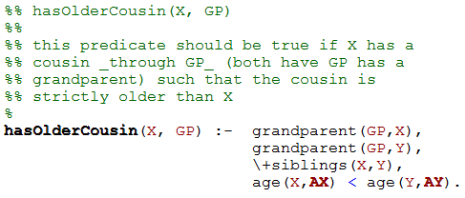
This isn’t legal Prolog – Why?
Prolog Practice hasOlderCousin
from Simpson’s HW3

Slide 7
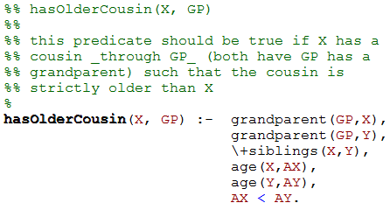
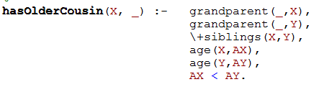
Prolog Practice hasOlderCousin from Simpson’s HW3
Can we replace GP with _?
A) Yes
B) No
C) Stuck

Slide 8
Prolog Practice hasOlderCousin from Simpson’s HW3
If we change this X to be Y, does this find the Oldest Cousin?
A) Yes B) No C) Stuck

Slide 9
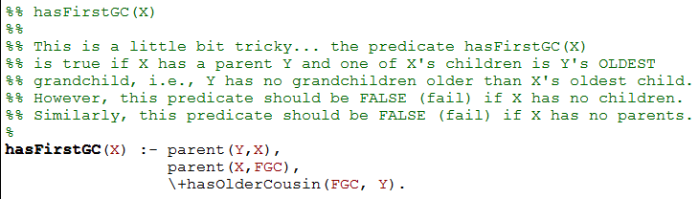
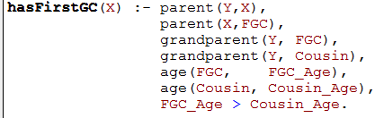
Prolog Practice
hasFirstGC
from Simpson’s HW3
Are these equivalent?
A) Yes B) No C) Stuck

Slide 10
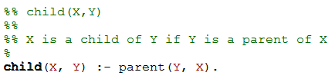
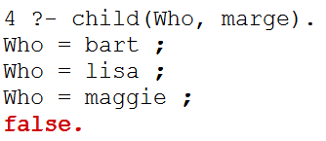
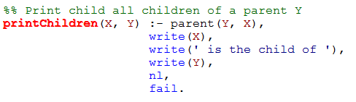
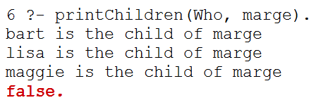
fail vs. variable bindings from Spamventure HW 5
We had to type ; to get each new variable binding

Slide 11
Common Mistakes on the Prolog Quiz
Mistake: Assuming Prolog queries “return” something like Racket functions
  Note: Any Prolog “output” has to be an argument to the query
Mistake: Using _ when you need a consistent variable binding
Mistake: Assuming longer than something is equivalent to longest
Mistake: Confusing variable bindings and fail/write.

Slide 12
BFS/DFS
Review

Slide 13
create an empty Queue
enqueue the starting node
mark starting node as visited
while (the queue is not empty)
{
  dequeue a node: “it”
  for each neighbor of “it”
  {
  if (neighbor is not visited)
  {
  enqueue the neighbor
  mark neighbor as visited
  set parent of neighbor
    if (neighbor is D){
    DONE!!! Return path
    }
    }
  }}
Pseudocode for Hw 7
2nd
1st
3rd
4th
&& not wall
 | K | A | B | C
 | D | I | S | E
 | J | H | G | F
 |  |  | L
Use the order from the HW

Slide 14
BFS Traversal (Queue)
What is the path?
 | K | A | B | C
 | D | I | S | E
 | J | H | G | F
 |  |  | L
Queue begins here!
S
I
I | B
I | B | E
I | B | E | G
B | E | G
2nd
1st
3rd
4th
 | A | B | C | D | E | F | G | H | I | J | K | L | S
Visited? |  | T |  |  | T |  | T |  | T |  |  |  | T
Parent |  | S |  | I | S |  | S |  | S

Slide 15
BFS Traversal (Queue)
Solutions (different order)
 | K | A | B | C
 | D | I | S | E
 | J | H | G | F
 |  |  | L
Queue begins here!
S
B
B | E
B | E | G
B | E | G | I
E | G | I
E | G | I | C
E | G | I | C | A
G | I | C | A
G | I | C | A | F
I | C | A | F
I | C | A | F | L
I | C | A | F | L | H
C | A | F | L | H
1st
Calculate the Path
Is this the SHORTEST Path?
A) Yes B) No C) Stuck
4th
2nd
3rd
 | A | B | C | D | E | F | G | H | I | J | K | L | S
Visited | T | T | T |  | T | T | T | T | T |  |  | T | T
Parent | B | S | B | I | S | E | S | G | S |  |  | G

Slide 16
Stack Based (DFS) vs. Queue Based (BFS)
Which is smaller (better)?
  Speed of search?
    A) DFS B) BFS C) Depends D) ??
  Memory use?
    A) DFS B) BFS C) Depends D) ??
  Length of final path?
    A) DFS B) BFS C) Depends D) ??

Slide 17
Homework 8 grayscale
(use it as an example)

Slide 18
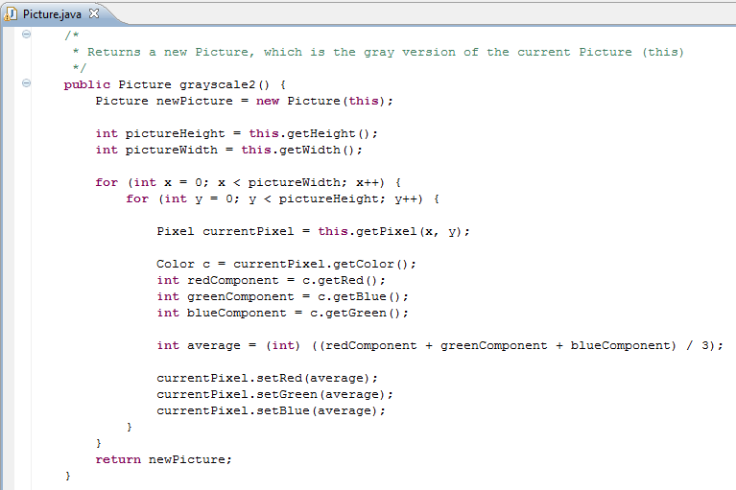
Based upon this code,
what types of Objects are there?
And what methods do they have?
Does this method modify this?
A)Yes
B)No
C)Stuck

Slide 19
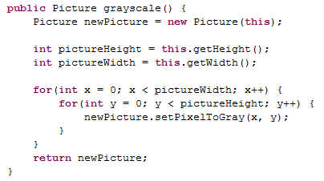
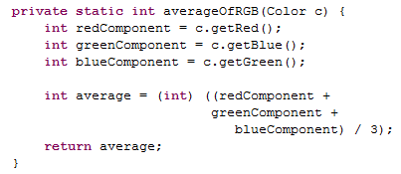
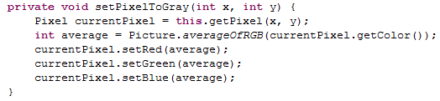
Avoid redundancy with helpers (not shown here)
Helper methods should be private
Make methods short/understandable with helpers

Slide 20
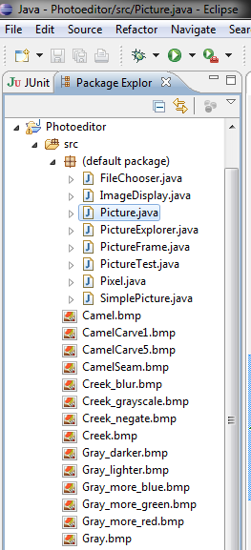
There are
a LOT of files in hw8.zip
Follow the download Instructions CLOSELY!

Slide 21
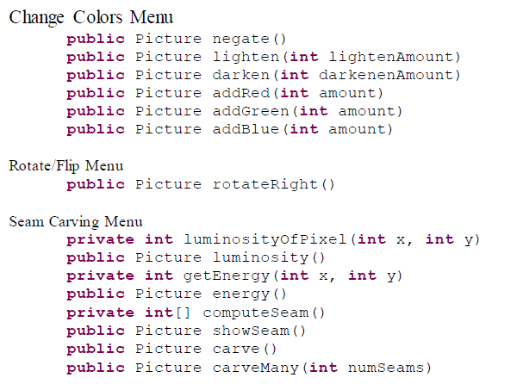
Methods to Write
Avoid redundancy with helpers

Slide 22
Seam Carving

Slide 23
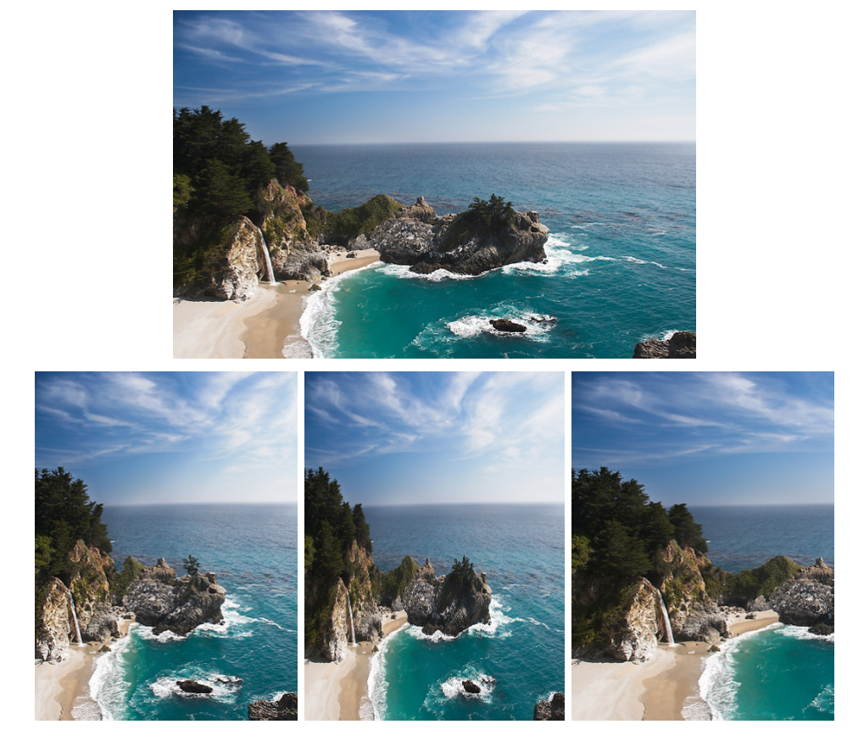
The problem
original image
?
device size

Slide 24
Three possible solutions
original image
Seam Carving
1
2
3
What happened in each case?

Slide 25

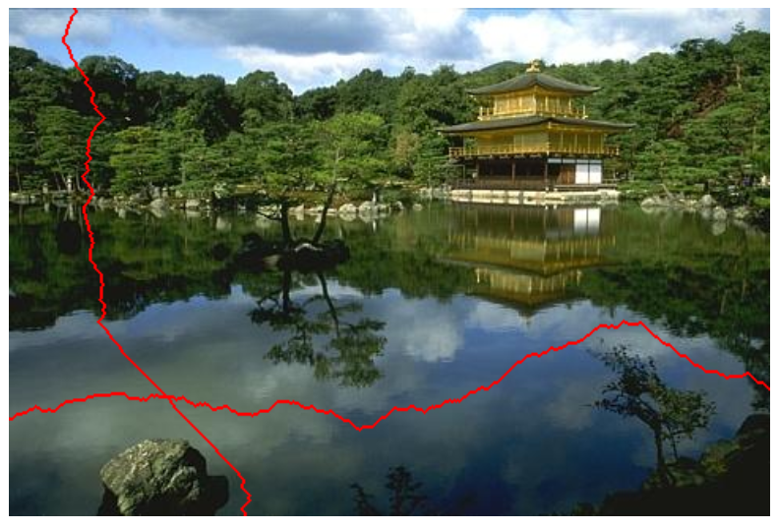
Remove less important seams
to make the picture smaller!
seams
original image
2007 !
you're encouraged to use the original paper as a guide...

Slide 26
Definition of Seams (+ Demo)
Seams
Go from the top row to the bottom row
Connect by an edge or a corner
Seams are the lowest “energy” path

Slide 27





Seam Carving:
The Big Picture
Original
Luminosity
Energy
Seam
Seam Removed

Slide 28
Background:
How
pictures are represented
 | x = 0 | x = 1 | x = 2 | x = 3 | x = 4 | x = 5 | x = 6 | x = 7
y = 0 | R:144 G:189 B:254 | R:143 G:185 B:245 | R:147 G:184 B:236 | R:168 G:197 B:231 | R:110 G:128 B:140 | R:121 G:130 B:127 | R:82 G:81 B:78 | R:76 G:70 B:64
y = 1 | R:142 G:187 B:252 | R:148 G:190 B:250 | R:157 G:194 B:246 | R:158 G:186 B:223 | R:126 G:144 B:158 | R:112 G:121 B:120 | R:14 G:15 B:10 | R:73 G:70 B:64
y = 2 | R:146 G:192 B:254 | R:143 G:185 B:243 | R:152 G:189 B:242 | R:153 G:181 B:220 | R:54 G:71 B:87 | R:112 G:122 B:124 | R:75 G:77 B:71 | R:34 G:34 B:25
y = 3 | R:147 G:193 B:252 | R:152 G:194 B:252 | R:159 G:196 B:249 | R:138 G:167 B:209 | R:23 G:41 B:63 | R:156 G:165 B:170 | R:51 G:53 B:48 | R:89 G:91 B:79
y = 4 | R:149 G:194 B:251 | R:156 G:199 B:254 | R:153 G:190 B:245 | R:166 G:194 B:241 | R:40 G:57 B:82 | R:79 G:89 B:98 | R:73 G:79 B:71 | R:68 G:72 B:58
y = 5 | R:148 G:194 B:246 | R:154 G:197 B:250 | R:159 G:196 B:251 | R:162 G:193 B:240 | R:95 G:114 B:146 | R:47 G:59 B:70 | R:64 G:71 B:64 | R:99 G:106 B:88
y = 6 | R:155 G:199 B:246 | R:157 G:199 B:249 | R:159 G:196 B:251 | R:164 G:194 B:244 | R:176 G:196 B:231 | R:94 G:107 B:123 | R:70 G:80 B:71 | R:54 G:64 B:43
y = 7 | R:156 G:200 B:245 | R:158 G:200 B:248 | R:165 G:202 B:255 | R:165 G:195 B:245 | R:182 G:202 B:239 | R:157 G:170 B:186 | R:62 G:72 B:64 | R:61 G:69 B:48
Original

Slide 29
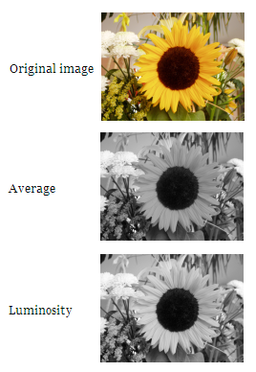
Step 1: Convert to Luminosity
Original
Luminosity
Red, Green, and Blue are all this:
 | x = 0 | x = 1 | x = 2 | x = 3 | x = 4 | x = 5 | x = 6 | x = 7
y = 0 | R:144 G:189 B:254 | R:143 G:185 B:245 | R:147 G:184 B:236 | R:168 G:197 B:231 | R:110 G:128 B:140 | R:121 G:130 B:127 | R:82 G:81 B:78 | R:76 G:70 B:64
y = 1 | R:142 G:187 B:252 | R:148 G:190 B:250 | R:157 G:194 B:246 | R:158 G:186 B:223 | R:126 G:144 B:158 | R:112 G:121 B:120 | R:14 G:15 B:10 | R:73 G:70 B:64
y = 2 | R:146 G:192 B:254 | R:143 G:185 B:243 | R:152 G:189 B:242 | R:153 G:181 B:220 | R:54 G:71 B:87 | R:112 G:122 B:124 | R:75 G:77 B:71 | R:34 G:34 B:25
y = 3 | R:147 G:193 B:252 | R:152 G:194 B:252 | R:159 G:196 B:249 | R:138 G:167 B:209 | R:23 G:41 B:63 | R:156 G:165 B:170 | R:51 G:53 B:48 | R:89 G:91 B:79
y = 4 | R:149 G:194 B:251 | R:156 G:199 B:254 | R:153 G:190 B:245 | R:166 G:194 B:241 | R:40 G:57 B:82 | R:79 G:89 B:98 | R:73 G:79 B:71 | R:68 G:72 B:58
y = 5 | R:148 G:194 B:246 | R:154 G:197 B:250 | R:159 G:196 B:251 | R:162 G:193 B:240 | R:95 G:114 B:146 | R:47 G:59 B:70 | R:64 G:71 B:64 | R:99 G:106 B:88
y = 6 | R:155 G:199 B:246 | R:157 G:199 B:249 | R:159 G:196 B:251 | R:164 G:194 B:244 | R:176 G:196 B:231 | R:94 G:107 B:123 | R:70 G:80 B:71 | R:54 G:64 B:43
y = 7 | R:156 G:200 B:245 | R:158 G:200 B:248 | R:165 G:202 B:255 | R:165 G:195 B:245 | R:182 G:202 B:239 | R:157 G:170 B:186 | R:62 G:72 B:64 | R:61 G:69 B:48
 | x = 0 | x = 1 | x = 2 | x = 3 | x = 4 | x = 5 | x = 6 | x = 7
y = 0 | 184 | 180 | 179 | 193 | 125 | 127 | 81 | 70
y = 1 | 182 | 185 | 189 | 182 | 141 | 119 | 14 | 70
y = 2 | 186 | 180 | 184 | 177 | 68 | 120 | 76 | 33
y = 3 | 187 | 189 | 191 | 163 | 38 | 163 | 52 | 89
y = 4 | 188 | 193 | 186 | 191 | 55 | 87 | 77 | 70
y = 5 | 187 | 191 | 192 | 189 | 112 | 57 | 69 | 103
y = 6 | 193 | 193 | 192 | 191 | 194 | 105 | 77 | 60
y = 7 | 193 | 194 | 197 | 192 | 200 | 168 | 69 | 65

Slide 30

Step 2: Calculate Energy
Luminosity
Energy
 | x = 0 | x = 1 | x = 2 | x = 3 | x = 4 | x = 5 | x = 6 | x = 7
y = 0 | 184 | 180 | 179 | 193 | 125 | 127 | 81 | 70
y = 1 | 182 | 185 | 189 | 182 | 141 | 119 | 14 | 70
y = 2 | 186 | 180 | 184 | 177 | 68 | 120 | 76 | 33
y = 3 | 187 | 189 | 191 | 163 | 38 | 163 | 52 | 89
y = 4 | 188 | 193 | 186 | 191 | 55 | 87 | 77 | 70
y = 5 | 187 | 191 | 192 | 189 | 112 | 57 | 69 | 103
y = 6 | 193 | 193 | 192 | 191 | 194 | 105 | 77 | 60
y = 7 | 193 | 194 | 197 | 192 | 200 | 168 | 69 | 65
 | x = 0 | x = 1 | x = 2 | x = 3 | x = 4 | x = 5 | x = 6 | x = 7
y = 0 | 6 | 6 | 24 | 79 | 18 | 54 | 78 | 11
y = 1 | 7 | 9 | 12 | 46 | 95 | 106 | 118 | 93
y = 2 | 7 | 13 | 14 | 123 | 82 | 87 | 67 | 99
y = 3 | 3 | 6 | 33 | 153 | 142 | 187 | 62 | 56
y = 4 | 6 | 9 | 11 | 138 | 89 | 40 | 15 | 40
y = 5 | 10 | 3 | 3 | 79 | 137 | 60 | 42 | 77
y = 6 | 0 | 2 | 6 | 4 | 95 | 91 | 25 | 22
y = 7 | 1 | 4 | 10 | 9 | 38 | 162 | 12 | 9

Slide 31

Step 2: Calculate Energy
Luminosity
Energy
Check that these are right.
 | x = 0 | x = 1 | x = 2
y = 0 | 184 | 180 | 179
y = 1 | 182 | 185 | 189
y = 2 | 186 | 180 | 184
 | x = 0 | x = 1
y = 0 | 6 | 6
y = 1 | 7 | 9

Slide 32
Step 2: Calculate Energy
These are just numbers, but we CAN visualize them as grayscale values.
Luminosity
Energy
 | x = 0 | x = 1 | x = 2 | x = 3 | x = 4 | x = 5 | x = 6 | x = 7
y = 0 | 184 | 180 | 179 | 193 | 125 | 127 | 81 | 70
y = 1 | 182 | 185 | 189 | 182 | 141 | 119 | 14 | 70
y = 2 | 186 | 180 | 184 | 177 | 68 | 120 | 76 | 33
y = 3 | 187 | 189 | 191 | 163 | 38 | 163 | 52 | 89
y = 4 | 188 | 193 | 186 | 191 | 55 | 87 | 77 | 70
y = 5 | 187 | 191 | 192 | 189 | 112 | 57 | 69 | 103
y = 6 | 193 | 193 | 192 | 191 | 194 | 105 | 77 | 60
y = 7 | 193 | 194 | 197 | 192 | 200 | 168 | 69 | 65
 | x = 0 | x = 1 | x = 2 | x = 3 | x = 4 | x = 5 | x = 6 | x = 7
y = 0 | 6 | 6 | 24 | 79 | 18 | 54 | 78 | 11
y = 1 | 7 | 9 | 12 | 46 | 95 | 106 | 118 | 93
y = 2 | 7 | 13 | 14 | 123 | 82 | 87 | 67 | 99
y = 3 | 3 | 6 | 33 | 153 | 142 | 187 | 62 | 56
y = 4 | 6 | 9 | 11 | 138 | 89 | 40 | 15 | 40
y = 5 | 10 | 3 | 3 | 79 | 137 | 60 | 42 | 77
y = 6 | 0 | 2 | 6 | 4 | 95 | 91 | 25 | 22
y = 7 | 1 | 4 | 10 | 9 | 38 | 162 | 12 | 9

Slide 33

Step 3: Find the minimum path
(from top to bottom)
This is the interesting step. We’ll come back to this!
Energy
Seam
 | x = 0 | x = 1 | x = 2 | x = 3 | x = 4 | x = 5 | x = 6 | x = 7
y = 0 | 6 | 6 | 24 | 79 | 18 | 54 | 78 | 11
y = 1 | 7 | 9 | 12 | 46 | 95 | 106 | 118 | 93
y = 2 | 7 | 13 | 14 | 123 | 82 | 87 | 67 | 99
y = 3 | 3 | 6 | 33 | 153 | 142 | 187 | 62 | 56
y = 4 | 6 | 9 | 11 | 138 | 89 | 40 | 15 | 40
y = 5 | 10 | 3 | 3 | 79 | 137 | 60 | 42 | 77
y = 6 | 0 | 2 | 6 | 4 | 95 | 91 | 25 | 22
y = 7 | 1 | 4 | 10 | 9 | 38 | 162 | 12 | 9
 | x = 0 | x = 1 | x = 2 | x = 3 | x = 4 | x = 5 | x = 6 | x = 7
y = 0 | 6 | 6 | 24 | 79 | 18 | 54 | 78 | 11
y = 1 | 7 | 9 | 12 | 46 | 95 | 106 | 118 | 93
y = 2 | 7 | 13 | 14 | 123 | 82 | 87 | 67 | 99
y = 3 | 3 | 6 | 33 | 153 | 142 | 187 | 62 | 56
y = 4 | 6 | 9 | 11 | 138 | 89 | 40 | 15 | 40
y = 5 | 10 | 3 | 3 | 79 | 137 | 60 | 42 | 77
y = 6 | 0 | 2 | 6 | 4 | 95 | 91 | 25 | 22
y = 7 | 1 | 4 | 10 | 9 | 38 | 162 | 12 | 9

Slide 34




Step 4: Remove the pixels from the minimum path

Slide 35
Seam Carving:
The Big Picture
(End)
?
Original
Luminosity
Energy
Seam
Seam Removed

Slide 36
Debugging Tip
To debug your code,
sometimes
you have to write additional code!
(True/False)

Slide 37
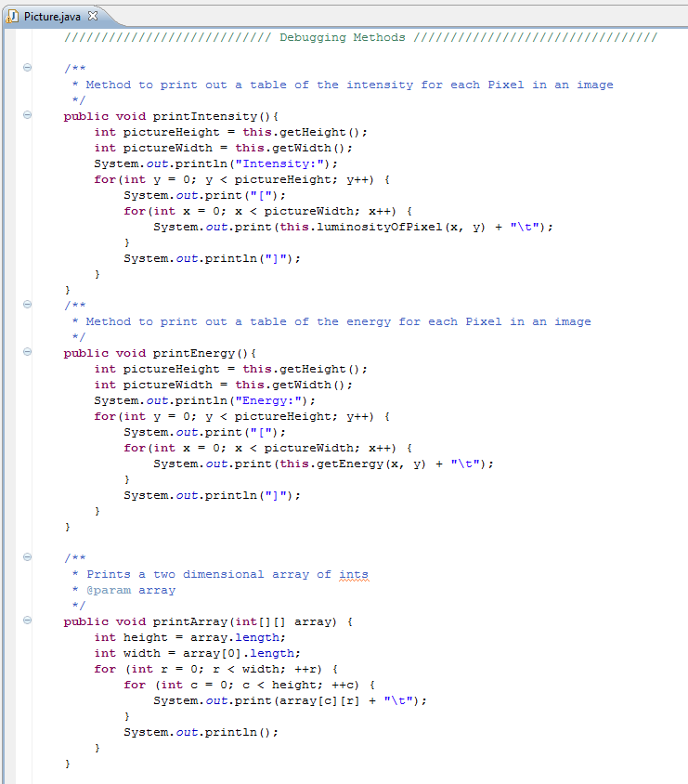
Colleen wrote you some debugging code

Slide 38
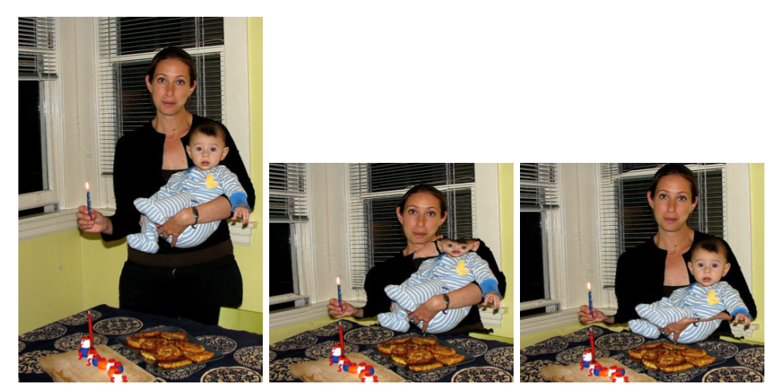
Not perfect…
Straightforward seam carving does not always work!
Target size
What's conspiring against the algorithm here?

Slide 39
Problems?
Straightforward seam carving does not always work!
What's conspiring against the algorithm here?

Slide 40
Not the face!
Protecting the results from a face-detector makes a huge difference…
What's been lost instead?

Slide 41
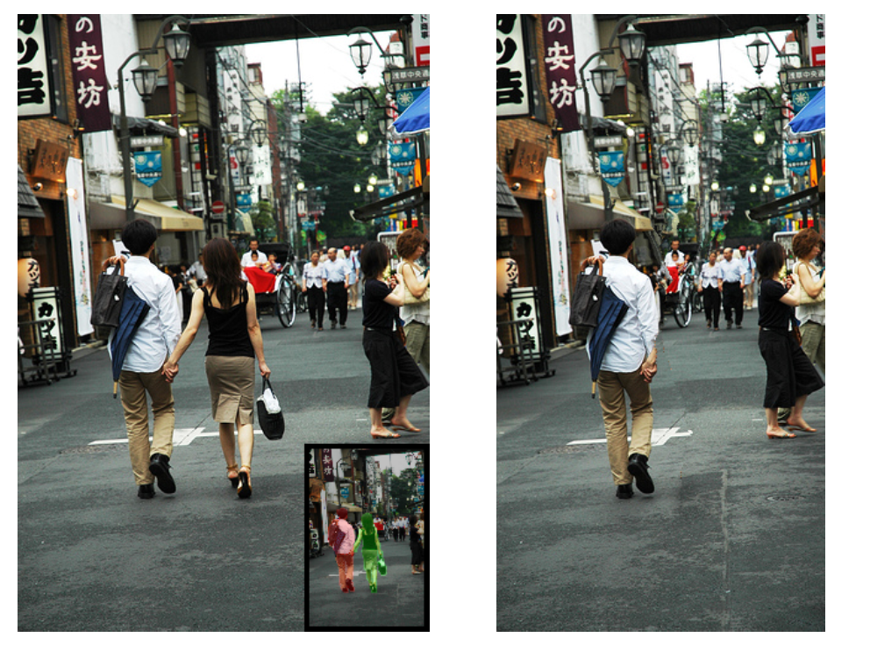

Applications: Seams can remove people!

Slide 42
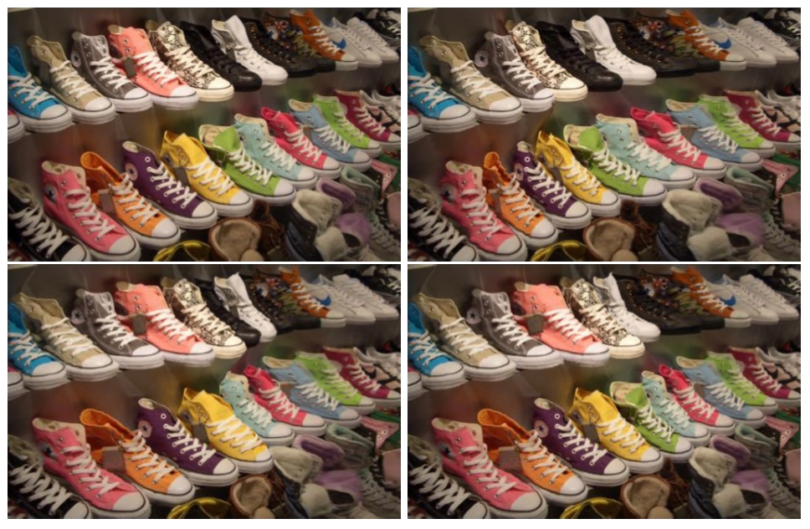
All others had 1 shoe removed! Which shoe?
Applications: Lost a shoe?
Original

Slide 43
Dynamic Programming Intro

Slide 44
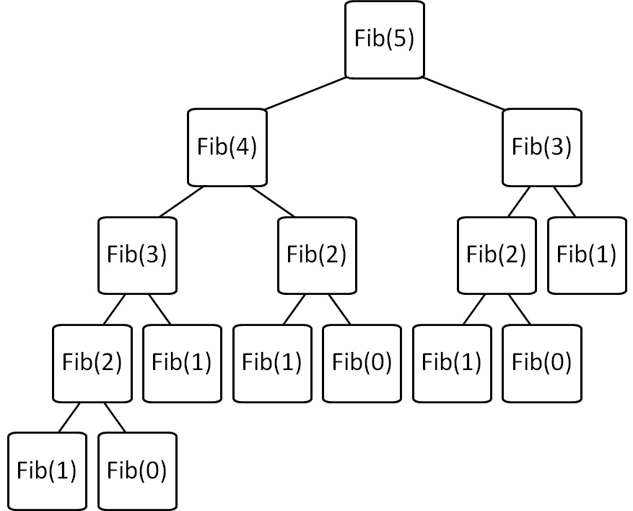
Consider: Fibonacci
Brute force Fib(N)
is O(2^{N}) ☹
Can we improve this?

Slide 45
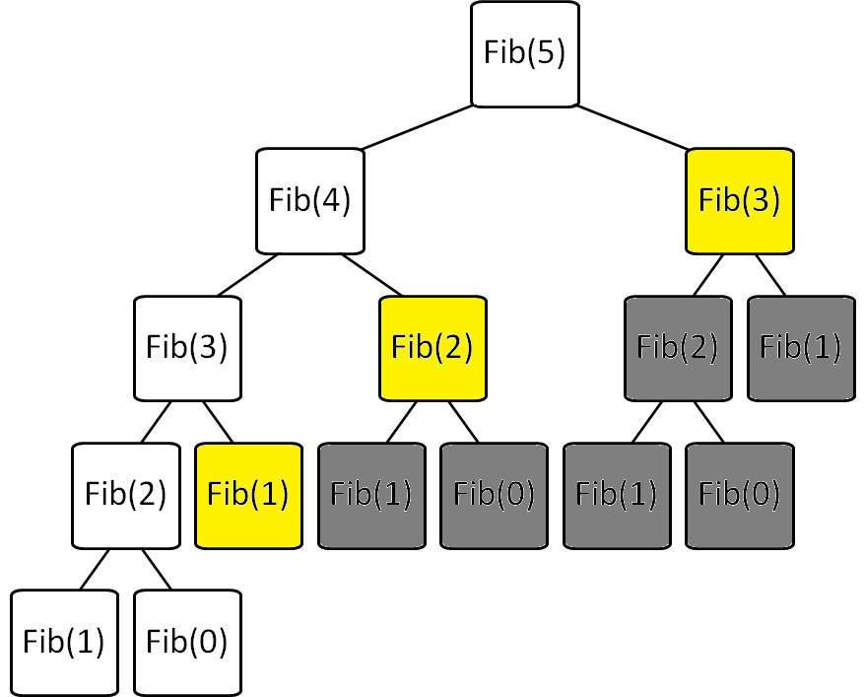
Fibonacci with Memoization
Keep track of recursive calls you’ve made and store the result!
Before you make a recursive call, check to see if you already know the answer.
Top-down (just like the regular recursive version)
Before I make the calls shown in yellow, I find that I already know the answer!

Slide 46
Fibonacci with Dynamic Programming
Work from the bottom-up!
Instead of doing the recursion, work from the bottom-up to create a table of answers of all recursive calls that might be made
We will NEVER make a recursive call, because we will always have already calculated the required components (e.g. fib(n-1) + fib(n-2))
Fib(0) | Fib(1) | Fib(2) | Fib(3) | Fib(4) | Fib(5)
0 | 1 | 1 | 2 | 3 | 5

Slide 47
Consider: Fibonacci
Brute force of Fib(N)
  is O(2^{N}) ☹
Memoization of Fib(N)
  is O(N) + overhead for keeping track of what recursive calls have been made
Dynamic Programming of Fib(N)
  is O(N) + overhead for making a table of size (O(N))

Slide 48
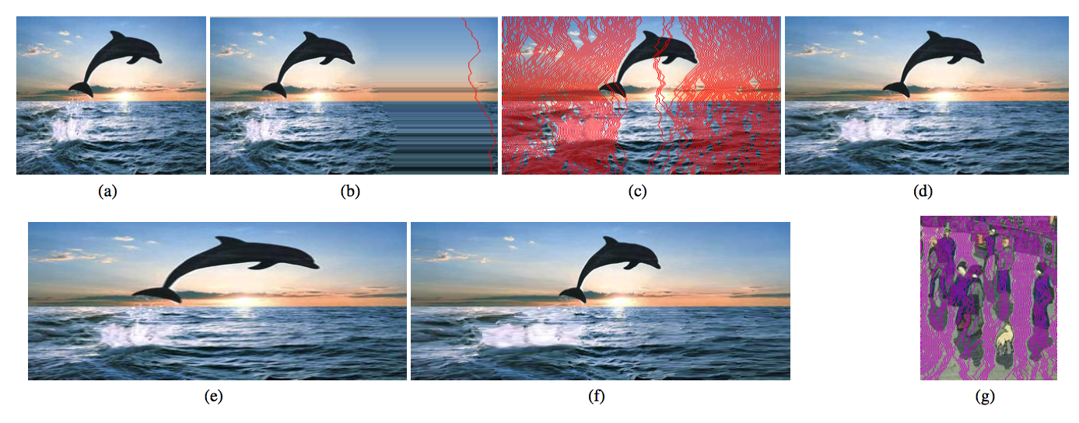
Expanding the image?
original image
Will this work?
I want to add 42 pixels in width
for (int i=0; i<42; i++){
(1) find a seam
(2) duplicate the seam
}

Slide 49
Expanding the image?
original image
best-seam (least-energy) expansion
The best 50% of seams used for more uniform expansion

Slide 50
Expanding the image?
200% of original (scaling)
200% of original (seam-insertion)

Slide 51
Write Recursive Pseudocode to find a path based upon getEnergy
 | x = 0 | x = 1 | x = 2 | x = 3 | x = 4 | x = 5 | x = 6 | x = 7
y = 0 | 6 | 6 | 24 | 79 | 18 | 54 | 78 | 11
y = 1 | 7 | 9 | 12 | 46 | 95 | 106 | 118 | 93
y = 2 | 7 | 13 | 14 | 123 | 82 | 87 | 67 | 99
y = 3 | 3 | 6 | 33 | 153 | 142 | 187 | 62 | 56
y = 4 | 6 | 9 | 11 | 138 | 89 | 40 | 15 | 40
y = 5 | 10 | 3 | 3 | 79 | 137 | 60 | 42 | 77
y = 6 | 0 | 2 | 6 | 4 | 95 | 91 | 25 | 22
y = 7 | 1 | 4 | 10 | 9 | 38 | 162 | 12 | 9

Slide 52
How do we pick a seam?
?
Original
Grayscale
Energy
Seam
Seam Removed
We’ll discuss one possible method using dynamic programming, and later look at benefits of this over a recursive use-it-or-lose-it
Seams
Go from the top row to the bottom row
Connect by an edge or a corner
Seams are the lowest “energy” path

Slide 53
How do we pick a seam?
?
Original
Luminosity
Energy
Seam
Seam Removed
We’ll discuss one possible method using dynamic programming, and later look at benefits of this over a recursive use-it-or-lose-it
Seams
Go from the top row to the bottom row
Connect by an edge or a corner
Seams are the lowest “energy” path

Slide 54
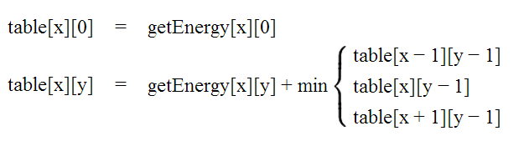
Identify Minimal Paths
Store Information in int[][] table
getEnergy
table
 | x = 0 | x = 1 | x = 2 | x = 3 | x = 4 | x = 5 | x = 6 | x = 7
y = 0 | 6 | 6 | 24 | 79 | 18 | 54 | 78 | 11
y = 1 | 7 | 9 | 12 | 46 | 95 | 106 | 118 | 93
y = 2 | 7 | 13 | 14 | 123 | 82 | 87 | 67 | 99
y = 3 | 3 | 6 | 33 | 153 | 142 | 187 | 62 | 56
y = 4 | 6 | 9 | 11 | 138 | 89 | 40 | 15 | 40
y = 5 | 10 | 3 | 3 | 79 | 137 | 60 | 42 | 77
y = 6 | 0 | 2 | 6 | 4 | 95 | 91 | 25 | 22
y = 7 | 1 | 4 | 10 | 9 | 38 | 162 | 12 | 9
 | x = 0 | x = 1 | x = 2 | x = 3 | x = 4 | x = 5 | x = 6 | x = 7
y = 0
y = 1
y = 2
y = 3
y = 4
y = 5
y = 6
y = 7

Slide 55
Fill out the y=0 row of table based upon the base case
getEnergy
table
 | x = 0 | x = 1 | x = 2 | x = 3 | x = 4 | x = 5 | x = 6 | x = 7
y = 0 | 6 | 6 | 24 | 79 | 18 | 54 | 78 | 11
y = 1 | 7 | 9 | 12 | 46 | 95 | 106 | 118 | 93
y = 2 | 7 | 13 | 14 | 123 | 82 | 87 | 67 | 99
y = 3 | 3 | 6 | 33 | 153 | 142 | 187 | 62 | 56
y = 4 | 6 | 9 | 11 | 138 | 89 | 40 | 15 | 40
y = 5 | 10 | 3 | 3 | 79 | 137 | 60 | 42 | 77
y = 6 | 0 | 2 | 6 | 4 | 95 | 91 | 25 | 22
y = 7 | 1 | 4 | 10 | 9 | 38 | 162 | 12 | 9
 | x = 0 | x = 1 | x = 2 | x = 3 | x = 4 | x = 5 | x = 6 | x = 7
y = 0 | 6 | 6 | 24 | 79 | 18 | 54 | 78 | 11
y = 1
y = 2
y = 3
y = 4
y = 5
y = 6
y = 7

Slide 56
Fill out each row of table based upon the 2nd rule
getEnergy
table
 | x = 0 | x = 1 | x = 2 | x = 3 | x = 4 | x = 5 | x = 6 | x = 7
y = 0 | 6 | 6 | 24 | 79 | 18 | 54 | 78 | 11
y = 1 | 7 | 9 | 12 | 46 | 95 | 106 | 118 | 93
y = 2 | 7 | 13 | 14 | 123 | 82 | 87 | 67 | 99
y = 3 | 3 | 6 | 33 | 153 | 142 | 187 | 62 | 56
y = 4 | 6 | 9 | 11 | 138 | 89 | 40 | 15 | 40
y = 5 | 10 | 3 | 3 | 79 | 137 | 60 | 42 | 77
y = 6 | 0 | 2 | 6 | 4 | 95 | 91 | 25 | 22
y = 7 | 1 | 4 | 10 | 9 | 38 | 162 | 12 | 9
 | x = 0 | x = 1 | x = 2 | x = 3 | x = 4 | x = 5 | x = 6 | x = 7
y = 0 | 6 | 6 | 24 | 79 | 18 | 54 | 78 | 11
y = 1
y = 2
y = 3
y = 4
y = 5
y = 6
y = 7

Slide 57
Fill out each row of table based upon the 2nd rule (cont.)
getEnergy
table
 | x = 0 | x = 1 | x = 2 | x = 3 | x = 4 | x = 5 | x = 6 | x = 7
y = 0 | 6 | 6 | 24 | 79 | 18 | 54 | 78 | 11
y = 1 | 7 | 9 | 12 | 46 | 95 | 106 | 118 | 93
y = 2 | 7 | 13 | 14 | 123 | 82 | 87 | 67 | 99
y = 3 | 3 | 6 | 33 | 153 | 142 | 187 | 62 | 56
y = 4 | 6 | 9 | 11 | 138 | 89 | 40 | 15 | 40
y = 5 | 10 | 3 | 3 | 79 | 137 | 60 | 42 | 77
y = 6 | 0 | 2 | 6 | 4 | 95 | 91 | 25 | 22
y = 7 | 1 | 4 | 10 | 9 | 38 | 162 | 12 | 9
 | x = 0 | x = 1 | x = 2 | x = 3 | x = 4 | x = 5 | x = 6 | x = 7
y = 0 | 6 | 6 | 24 | 79 | 18 | 54 | 78 | 11
y = 1 | 13
y = 2
y = 3
y = 4
y = 5
y = 6
y = 7

Slide 58
What do the cells in getEnergy and table mean?
This is the cost of including this pixel in the path
getEnergy
table
 | x = 0 | x = 1 | x = 2 | x = 3 | x = 4 | x = 5 | x = 6 | x = 7
y = 0 | 6 | 6 | 24 | 79 | 18 | 54 | 78 | 11
y = 1 | 7 | 9 | 12 | 46 | 95 | 106 | 118 | 93
y = 2 | 7 | 13 | 14 | 123 | 82 | 87 | 67 | 99
y = 3 | 3 | 6 | 33 | 153 | 142 | 187 | 62 | 56
y = 4 | 6 | 9 | 11 | 138 | 89 | 40 | 15 | 40
y = 5 | 10 | 3 | 3 | 79 | 137 | 60 | 42 | 77
y = 6 | 0 | 2 | 6 | 4 | 95 | 91 | 25 | 22
y = 7 | 1 | 4 | 10 | 9 | 38 | 162 | 12 | 9
 | x = 0 | x = 1 | x = 2 | x = 3 | x = 4 | x = 5 | x = 6 | x = 7
y = 0 | 6 | 6 | 24 | 79 | 18 | 54 | 78 | 11
y = 1 | 13 | 15 | 18 | 64 | 113 | 124 | 129 | 104
y = 2
y = 3
y = 4
y = 5
y = 6
y = 7
This is the cost of the shortest path that includes this pixel

Slide 59
Final version of table
How do we find the shortest path from this?
getEnergy
table
 | x = 0 | x = 1 | x = 2 | x = 3 | x = 4 | x = 5 | x = 6 | x = 7
y = 0 | 6 | 6 | 24 | 79 | 18 | 54 | 78 | 11
y = 1 | 7 | 9 | 12 | 46 | 95 | 106 | 118 | 93
y = 2 | 7 | 13 | 14 | 123 | 82 | 87 | 67 | 99
y = 3 | 3 | 6 | 33 | 153 | 142 | 187 | 62 | 56
y = 4 | 6 | 9 | 11 | 138 | 89 | 40 | 15 | 40
y = 5 | 10 | 3 | 3 | 79 | 137 | 60 | 42 | 77
y = 6 | 0 | 2 | 6 | 4 | 95 | 91 | 25 | 22
y = 7 | 1 | 4 | 10 | 9 | 38 | 162 | 12 | 9
 | x = 0 | x = 1 | x = 2 | x = 3 | x = 4 | x = 5 | x = 6 | x = 7
y = 0 | 6 | 6 | 24 | 79 | 18 | 54 | 78 | 11
y = 1 | 13 | 15 | 18 | 64 | 113 | 124 | 129 | 104
y = 2 | 20 | 26 | 29 | 141 | 146 | 200 | 171 | 203
y = 3 | 23 | 26 | 59 | 182 | 283 | 333 | 233 | 227
y = 4 | 29 | 32 | 37 | 197 | 271 | 273 | 242 | 267
y = 5 | 39 | 32 | 35 | 116 | 334 | 302 | 284 | 319
y = 6 | 32 | 34 | 38 | 39 | 211 | 375 | 309 | 306
y = 7 | 33 | 36 | 44 | 47 | 77 | 373 | 318 | 315
This is the cost of the shortest path that includes this pixel

Slide 60
Keep track of the parent
 | x = 0 | x = 1 | x = 2 | x = 3 | x = 4 | x = 5 | x = 6 | x = 7
y = 0 | N/A | N/A | N/A | N/A | N/A | N/A | N/A | N/A
y = 1
y = 2
y = 3
y = 4
y = 5
y = 6
y = 7
parent
table
 | x = 0 | x = 1 | x = 2 | x = 3 | x = 4 | x = 5 | x = 6 | x = 7
y = 0 | 6 | 6 | 24 | 79 | 18 | 54 | 78 | 11
y = 1 | 13 | 15 | 18 | 64 | 113 | 124 | 129 | 104
y = 2 | 20 | 26 | 29 | 141 | 146 | 200 | 171 | 203
y = 3 | 23 | 26 | 59 | 182 | 283 | 333 | 233 | 227
y = 4 | 29 | 32 | 37 | 197 | 271 | 273 | 242 | 267
y = 5 | 39 | 32 | 35 | 116 | 334 | 302 | 284 | 319
y = 6 | 32 | 34 | 38 | 39 | 211 | 375 | 309 | 306
y = 7 | 33 | 36 | 44 | 47 | 77 | 373 | 318 | 315

Slide 61

Keep track of the parent
 | x = 0 | x = 1 | x = 2 | x = 3 | x = 4 | x = 5 | x = 6 | x = 7
y = 0 | N/A | N/A | N/A | N/A | N/A | N/A | N/A | N/A
y = 1 | x=0 | x=1 | x=1 | x=4 | x=4 | x=4 | x=7 | x=7
y = 2 | x=0 | x=0 | x=1 | x=2 | x=3 | x=4 | x=7 | x=7
y = 3 | x=0 | x=0 | x=1 | x=2 | x=3 | x=4 | x=6 | x=6
y = 4 | x=0 | x=0 | x=1 | x=2 | x=3 | x=6 | x=7 | x=7
y = 5 | x=0 | x=0 | x=1 | x=2 | x=3 | x=6 | x=6 | x=6
y = 6 | x=1 | x=1 | x=1 | x=2 | x=3 | x=6 | x=6 | x=6
y = 7 | x=0 | x=0 | x=1 | x=2 | x=3 | x=4 | x=7 | x=7
parent
table
 | x = 0 | x = 1 | x = 2 | x = 3 | x = 4 | x = 5 | x = 6 | x = 7
y = 0 | 6 | 6 | 24 | 79 | 18 | 54 | 78 | 11
y = 1 | 13 | 15 | 18 | 64 | 113 | 124 | 129 | 104
y = 2 | 20 | 26 | 29 | 141 | 146 | 200 | 171 | 203
y = 3 | 23 | 26 | 59 | 182 | 283 | 333 | 233 | 227
y = 4 | 29 | 32 | 37 | 197 | 271 | 273 | 242 | 267
y = 5 | 39 | 32 | 35 | 116 | 334 | 302 | 284 | 319
y = 6 | 32 | 34 | 38 | 39 | 211 | 375 | 309 | 306
y = 7 | 33 | 36 | 44 | 47 | 77 | 373 | 318 | 315
You can backtrack to find the path from the smallest total path
(in the last row)

Slide 62
How do we pick a seam?
(SUMMARY)
Fill out a 2D array “table” based upon the rules below
Fill out a 2D array “parent” based upon which x value has the minimum path in the row above.
Pick the path with the minimum weight (in the last row) and backtrack through parent to find the path.

Slide 63
What do the cells in getEnergy and table mean?
SOLUTION
This is the cost of including this pixel in the path
getEnergy
table
 | x = 0 | x = 1 | x = 2 | x = 3 | x = 4 | x = 5 | x = 6 | x = 7
y = 0 | 6 | 6 | 24 | 79 | 18 | 54 | 78 | 11
y = 1 | 7 | 9 | 12 | 46 | 95 | 106 | 118 | 93
y = 2 | 7 | 13 | 14 | 123 | 82 | 87 | 67 | 99
y = 3 | 3 | 6 | 33 | 153 | 142 | 187 | 62 | 56
y = 4 | 6 | 9 | 11 | 138 | 89 | 40 | 15 | 40
y = 5 | 10 | 3 | 3 | 79 | 137 | 60 | 42 | 77
y = 6 | 0 | 2 | 6 | 4 | 95 | 91 | 25 | 22
y = 7 | 1 | 4 | 10 | 9 | 38 | 162 | 12 | 9
 | x = 0 | x = 1 | x = 2 | x = 3 | x = 4 | x = 5 | x = 6 | x = 7
y = 0 | 6 | 6 | 24 | 79 | 18 | 54 | 78 | 11
y = 1 | 13 | 15 | 18 | 64 | 113 | 124 | 129 | 104
y = 2
y = 3
y = 4
y = 5
y = 6
y = 7
This is the cost of the shortest path that includes this pixel

Slide 64
Fib(1)
Fib(3)
Fib(0)
Fib(2)
Fib(1)
Fib(5)
Fib(0)
Fib(2)
Fib(1)
Fib(4)
Fib(1)
Fib(3)
Fib(0)
Fib(2)
Fib(1)

Slide 65
Fib(5)
Fib(3)
Fib(1)
Fib(2)
Fib(4)
Fib(2)
Fib(3)
Fib(0)
Fib(1)
Fib(0)
Fib(1)
Fib(1)
Fib(2)
Fib(0)
Fib(1)

