Slide 1
CS 60
Seam Carving,
Dynamic Programming
2013-03-28
Thursday – Week 8
Lecture 17

Slide 2
Administrative Stuff
(Not in your notes)
It isn’t too late to talk to Colleen about your quiz!!!!
hw8.zip updated

Slide 3
Prolog Quiz Bonus
Submit a copy of CORRECT solutions to each question on the quiz + explanation of something you now understand better
  Just use regular paper (you can keep your quiz)
  You can hand write it or type it
  You can collaborate but need to write your own solution (no pair programming)
5 points extra credit
Due Thursday April 4th in class

Slide 4
Dynamic Programming Intro

Slide 5
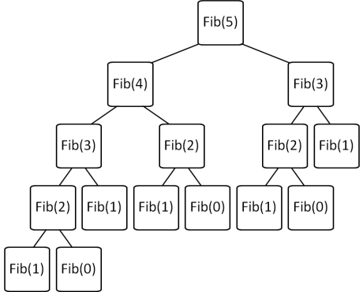
Differences between Memoization and Dynamic Programming
Brute Force Recursion
  Top-Down
Memoization
  Top-down
  Keep track of recursive calls you’ve made and store the result.
  Before you make a recursive call, check to see if you already know the answer.
Dynamic Programming
  Bottom-up
  Build up a table with answers to smaller problems
  Make sure you always have already calculated the required components (e.g. fib(n-1) + fib(n-2))
Fibonacci Solution Methods

Slide 6
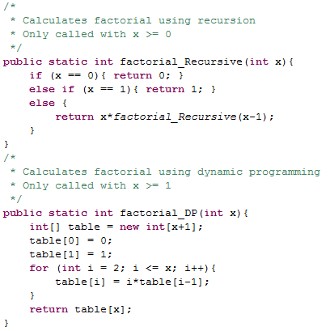
One cell in table for EACH possible recursive call.
Factorial using Dynamic Programming (DP)
(Note: it doesn’t provide any speed-up in this case)

Slide 7
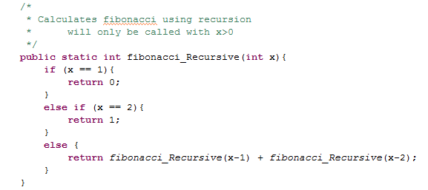
Fibonacci Using Recursion

Slide 8
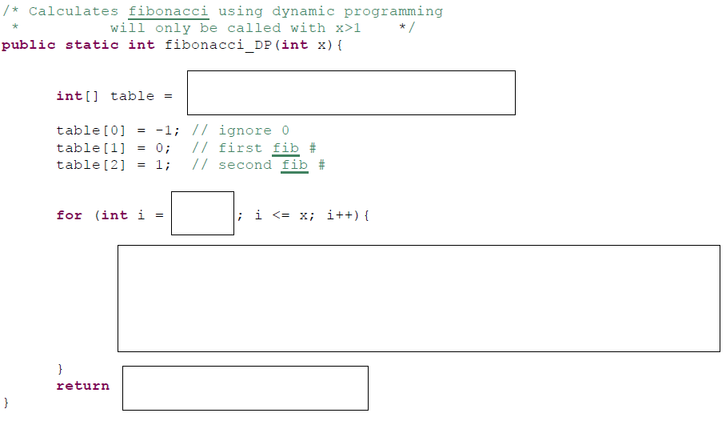
Fill In – Fibonacci DP
A) Stuck B) table[x] C)table[x-1] D)table[x+1]

Slide 9
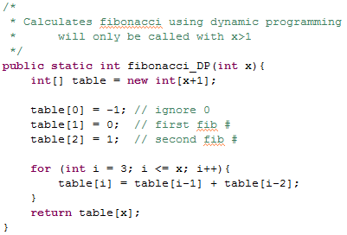
Fibonacci using Dynamic Programming (DP) SOLUTION

Slide 10
Seam Carving

Slide 11
Definition of Seams (+ Demo)
Seams
Go from the top row to the bottom row
Connect by an edge or a corner
Seams are the lowest “energy” path

Slide 12





Seam Carving:
The Big Picture
Original
Luminosity
Energy
Seam
Seam Removed

Slide 13
Background:
How
pictures are represented
 | x = 0 | x = 1 | x = 2 | x = 3 | x = 4 | x = 5 | x = 6 | x = 7
y = 0 | R:144 G:189 B:254 | R:143 G:185 B:245 | R:147 G:184 B:236 | R:168 G:197 B:231 | R:110 G:128 B:140 | R:121 G:130 B:127 | R:82 G:81 B:78 | R:76 G:70 B:64
y = 1 | R:142 G:187 B:252 | R:148 G:190 B:250 | R:157 G:194 B:246 | R:158 G:186 B:223 | R:126 G:144 B:158 | R:112 G:121 B:120 | R:14 G:15 B:10 | R:73 G:70 B:64
y = 2 | R:146 G:192 B:254 | R:143 G:185 B:243 | R:152 G:189 B:242 | R:153 G:181 B:220 | R:54 G:71 B:87 | R:112 G:122 B:124 | R:75 G:77 B:71 | R:34 G:34 B:25
y = 3 | R:147 G:193 B:252 | R:152 G:194 B:252 | R:159 G:196 B:249 | R:138 G:167 B:209 | R:23 G:41 B:63 | R:156 G:165 B:170 | R:51 G:53 B:48 | R:89 G:91 B:79
y = 4 | R:149 G:194 B:251 | R:156 G:199 B:254 | R:153 G:190 B:245 | R:166 G:194 B:241 | R:40 G:57 B:82 | R:79 G:89 B:98 | R:73 G:79 B:71 | R:68 G:72 B:58
y = 5 | R:148 G:194 B:246 | R:154 G:197 B:250 | R:159 G:196 B:251 | R:162 G:193 B:240 | R:95 G:114 B:146 | R:47 G:59 B:70 | R:64 G:71 B:64 | R:99 G:106 B:88
y = 6 | R:155 G:199 B:246 | R:157 G:199 B:249 | R:159 G:196 B:251 | R:164 G:194 B:244 | R:176 G:196 B:231 | R:94 G:107 B:123 | R:70 G:80 B:71 | R:54 G:64 B:43
y = 7 | R:156 G:200 B:245 | R:158 G:200 B:248 | R:165 G:202 B:255 | R:165 G:195 B:245 | R:182 G:202 B:239 | R:157 G:170 B:186 | R:62 G:72 B:64 | R:61 G:69 B:48
Original

Slide 14
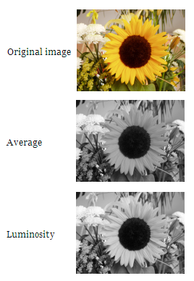
Step 1: Convert to Luminosity
Original
Luminosity
Red, Green, and Blue are all this:
 | x = 0 | x = 1 | x = 2 | x = 3 | x = 4 | x = 5 | x = 6 | x = 7
y = 0 | R:144 G:189 B:254 | R:143 G:185 B:245 | R:147 G:184 B:236 | R:168 G:197 B:231 | R:110 G:128 B:140 | R:121 G:130 B:127 | R:82 G:81 B:78 | R:76 G:70 B:64
y = 1 | R:142 G:187 B:252 | R:148 G:190 B:250 | R:157 G:194 B:246 | R:158 G:186 B:223 | R:126 G:144 B:158 | R:112 G:121 B:120 | R:14 G:15 B:10 | R:73 G:70 B:64
y = 2 | R:146 G:192 B:254 | R:143 G:185 B:243 | R:152 G:189 B:242 | R:153 G:181 B:220 | R:54 G:71 B:87 | R:112 G:122 B:124 | R:75 G:77 B:71 | R:34 G:34 B:25
y = 3 | R:147 G:193 B:252 | R:152 G:194 B:252 | R:159 G:196 B:249 | R:138 G:167 B:209 | R:23 G:41 B:63 | R:156 G:165 B:170 | R:51 G:53 B:48 | R:89 G:91 B:79
y = 4 | R:149 G:194 B:251 | R:156 G:199 B:254 | R:153 G:190 B:245 | R:166 G:194 B:241 | R:40 G:57 B:82 | R:79 G:89 B:98 | R:73 G:79 B:71 | R:68 G:72 B:58
y = 5 | R:148 G:194 B:246 | R:154 G:197 B:250 | R:159 G:196 B:251 | R:162 G:193 B:240 | R:95 G:114 B:146 | R:47 G:59 B:70 | R:64 G:71 B:64 | R:99 G:106 B:88
y = 6 | R:155 G:199 B:246 | R:157 G:199 B:249 | R:159 G:196 B:251 | R:164 G:194 B:244 | R:176 G:196 B:231 | R:94 G:107 B:123 | R:70 G:80 B:71 | R:54 G:64 B:43
y = 7 | R:156 G:200 B:245 | R:158 G:200 B:248 | R:165 G:202 B:255 | R:165 G:195 B:245 | R:182 G:202 B:239 | R:157 G:170 B:186 | R:62 G:72 B:64 | R:61 G:69 B:48
 | x = 0 | x = 1 | x = 2 | x = 3 | x = 4 | x = 5 | x = 6 | x = 7
y = 0 | 184 | 180 | 179 | 193 | 125 | 127 | 81 | 70
y = 1 | 182 | 185 | 189 | 182 | 141 | 119 | 14 | 70
y = 2 | 186 | 180 | 184 | 177 | 68 | 120 | 76 | 33
y = 3 | 187 | 189 | 191 | 163 | 38 | 163 | 52 | 89
y = 4 | 188 | 193 | 186 | 191 | 55 | 87 | 77 | 70
y = 5 | 187 | 191 | 192 | 189 | 112 | 57 | 69 | 103
y = 6 | 193 | 193 | 192 | 191 | 194 | 105 | 77 | 60
y = 7 | 193 | 194 | 197 | 192 | 200 | 168 | 69 | 65

Slide 15

Step 2: Calculate Energy
Luminosity
Energy
 | x = 0 | x = 1 | x = 2 | x = 3 | x = 4 | x = 5 | x = 6 | x = 7
y = 0 | 184 | 180 | 179 | 193 | 125 | 127 | 81 | 70
y = 1 | 182 | 185 | 189 | 182 | 141 | 119 | 14 | 70
y = 2 | 186 | 180 | 184 | 177 | 68 | 120 | 76 | 33
y = 3 | 187 | 189 | 191 | 163 | 38 | 163 | 52 | 89
y = 4 | 188 | 193 | 186 | 191 | 55 | 87 | 77 | 70
y = 5 | 187 | 191 | 192 | 189 | 112 | 57 | 69 | 103
y = 6 | 193 | 193 | 192 | 191 | 194 | 105 | 77 | 60
y = 7 | 193 | 194 | 197 | 192 | 200 | 168 | 69 | 65
 | x = 0 | x = 1 | x = 2 | x = 3 | x = 4 | x = 5 | x = 6 | x = 7
y = 0 | 6 | 6 | 24 | 79 | 18 | 54 | 78 | 11
y = 1 | 7 | 9 | 12 | 46 | 95 | 106 | 118 | 93
y = 2 | 7 | 13 | 14 | 123 | 82 | 87 | 67 | 99
y = 3 | 3 | 6 | 33 | 153 | 142 | 187 | 62 | 56
y = 4 | 6 | 9 | 11 | 138 | 89 | 40 | 15 | 40
y = 5 | 10 | 3 | 3 | 79 | 137 | 60 | 42 | 77
y = 6 | 0 | 2 | 6 | 4 | 95 | 91 | 25 | 22
y = 7 | 1 | 4 | 10 | 9 | 38 | 162 | 12 | 9

Slide 16

Step 2: Calculate Energy
Luminosity
Energy
 | x = 0 | x = 1 | x = 2
y = 0 | 184 | 180 | 179
y = 1 | 182 | 185 | 189
y = 2 | 186 | 180 | 184
 | x = 0 | x = 1
y = 0 | 6 | 6
y = 1 | 7 | 9

Slide 17
Step 2: Calculate Energy
These are just numbers, but we CAN visualize them as grayscale values.
Luminosity
Energy
 | x = 0 | x = 1 | x = 2 | x = 3 | x = 4 | x = 5 | x = 6 | x = 7
y = 0 | 184 | 180 | 179 | 193 | 125 | 127 | 81 | 70
y = 1 | 182 | 185 | 189 | 182 | 141 | 119 | 14 | 70
y = 2 | 186 | 180 | 184 | 177 | 68 | 120 | 76 | 33
y = 3 | 187 | 189 | 191 | 163 | 38 | 163 | 52 | 89
y = 4 | 188 | 193 | 186 | 191 | 55 | 87 | 77 | 70
y = 5 | 187 | 191 | 192 | 189 | 112 | 57 | 69 | 103
y = 6 | 193 | 193 | 192 | 191 | 194 | 105 | 77 | 60
y = 7 | 193 | 194 | 197 | 192 | 200 | 168 | 69 | 65
 | x = 0 | x = 1 | x = 2 | x = 3 | x = 4 | x = 5 | x = 6 | x = 7
y = 0 | 6 | 6 | 24 | 79 | 18 | 54 | 78 | 11
y = 1 | 7 | 9 | 12 | 46 | 95 | 106 | 118 | 93
y = 2 | 7 | 13 | 14 | 123 | 82 | 87 | 67 | 99
y = 3 | 3 | 6 | 33 | 153 | 142 | 187 | 62 | 56
y = 4 | 6 | 9 | 11 | 138 | 89 | 40 | 15 | 40
y = 5 | 10 | 3 | 3 | 79 | 137 | 60 | 42 | 77
y = 6 | 0 | 2 | 6 | 4 | 95 | 91 | 25 | 22
y = 7 | 1 | 4 | 10 | 9 | 38 | 162 | 12 | 9

Slide 18

Step 3: Find the minimum path
(from top to bottom)
This is the interesting step. We’ll discuss this today!
Energy
Seam
 | x = 0 | x = 1 | x = 2 | x = 3 | x = 4 | x = 5 | x = 6 | x = 7
y = 0 | 6 | 6 | 24 | 79 | 18 | 54 | 78 | 11
y = 1 | 7 | 9 | 12 | 46 | 95 | 106 | 118 | 93
y = 2 | 7 | 13 | 14 | 123 | 82 | 87 | 67 | 99
y = 3 | 3 | 6 | 33 | 153 | 142 | 187 | 62 | 56
y = 4 | 6 | 9 | 11 | 138 | 89 | 40 | 15 | 40
y = 5 | 10 | 3 | 3 | 79 | 137 | 60 | 42 | 77
y = 6 | 0 | 2 | 6 | 4 | 95 | 91 | 25 | 22
y = 7 | 1 | 4 | 10 | 9 | 38 | 162 | 12 | 9
 | x = 0 | x = 1 | x = 2 | x = 3 | x = 4 | x = 5 | x = 6 | x = 7
y = 0 | 6 | 6 | 24 | 79 | 18 | 54 | 78 | 11
y = 1 | 7 | 9 | 12 | 46 | 95 | 106 | 118 | 93
y = 2 | 7 | 13 | 14 | 123 | 82 | 87 | 67 | 99
y = 3 | 3 | 6 | 33 | 153 | 142 | 187 | 62 | 56
y = 4 | 6 | 9 | 11 | 138 | 89 | 40 | 15 | 40
y = 5 | 10 | 3 | 3 | 79 | 137 | 60 | 42 | 77
y = 6 | 0 | 2 | 6 | 4 | 95 | 91 | 25 | 22
y = 7 | 1 | 4 | 10 | 9 | 38 | 162 | 12 | 9

Slide 19




Step 4: Remove the pixels from the minimum path

Slide 20
Seam Carving:
The Big Picture
(End)
?
Original
Luminosity
Energy
Seam
Seam Removed

Slide 21
How do we use recursion to calculate the lowest
cost path?
Energy
 | x = 0 | x = 1 | x = 2 | x = 3 | x = 4 | x = 5 | x = 6 | x = 7
y = 0 | 6 | 6 | 24 | 79 | 18 | 54 | 78 | 11
y = 1 | 7 | 9 | 12 | 46 | 95 | 106 | 118 | 93
y = 2 | 7 | 13 | 14 | 123 | 82 | 87 | 67 | 99
y = 3 | 3 | 6 | 33 | 153 | 142 | 187 | 62 | 56
y = 4 | 6 | 9 | 11 | 138 | 89 | 40 | 15 | 40
y = 5 | 10 | 3 | 3 | 79 | 137 | 60 | 42 | 77
y = 6 | 0 | 2 | 6 | 4 | 95 | 91 | 25 | 22
y = 7 | 1 | 4 | 10 | 9 | 38 | 162 | 12 | 9

Slide 22
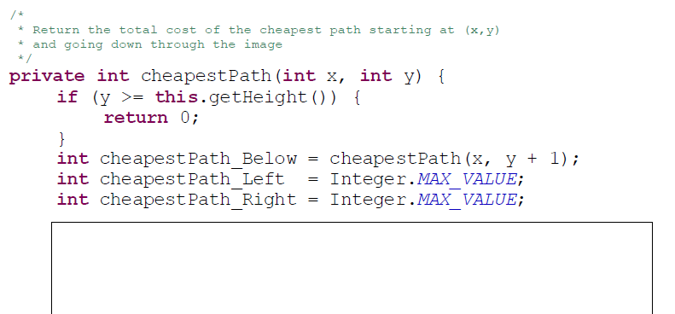
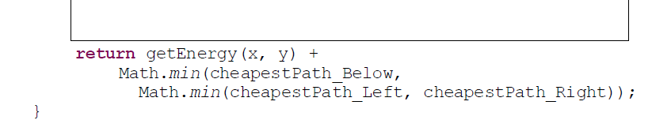
Fill in the Blanks for cheapestPath
(Using RECURSION)
Did you use an if? A) Yes B) No C)Stuck
Try cheapestPath_Recursive too

Slide 23
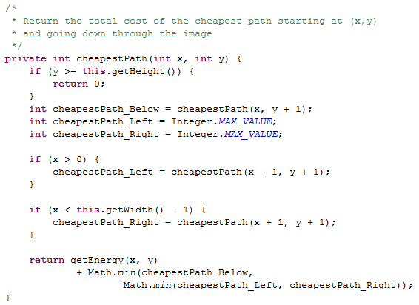
SOLUTION

Slide 24
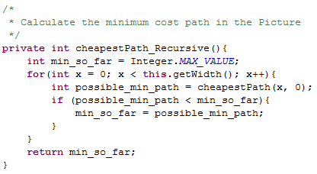
SOLUTION

Slide 25
For DP: We want one cell in table for EACH possible recursive call.
If Height = 5 and Width = 6
How many cells should table have?
A)11 B) 6 C) 30 D) ?

Slide 26
How do we use Dynamic Programming to calculate
the lowest
cost path?
Energy
 | x = 0 | x = 1 | x = 2 | x = 3 | x = 4 | x = 5 | x = 6 | x = 7
y = 0 | 6 | 6 | 24 | 79 | 18 | 54 | 78 | 11
y = 1 | 7 | 9 | 12 | 46 | 95 | 106 | 118 | 93
y = 2 | 7 | 13 | 14 | 123 | 82 | 87 | 67 | 99
y = 3 | 3 | 6 | 33 | 153 | 142 | 187 | 62 | 56
y = 4 | 6 | 9 | 11 | 138 | 89 | 40 | 15 | 40
y = 5 | 10 | 3 | 3 | 79 | 137 | 60 | 42 | 77
y = 6 | 0 | 2 | 6 | 4 | 95 | 91 | 25 | 22
y = 7 | 1 | 4 | 10 | 9 | 38 | 162 | 12 | 9

Slide 27
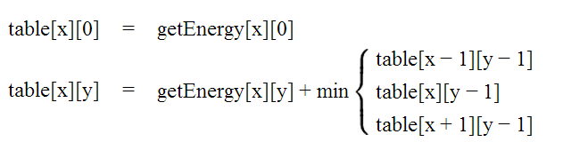
Identify Minimal Paths
Store Information in int[][] table
getEnergy
table
 | x = 0 | x = 1 | x = 2 | x = 3 | x = 4 | x = 5 | x = 6 | x = 7
y = 0 | 6 | 6 | 24 | 79 | 18 | 54 | 78 | 11
y = 1 | 7 | 9 | 12 | 46 | 95 | 106 | 118 | 93
y = 2 | 7 | 13 | 14 | 123 | 82 | 87 | 67 | 99
y = 3 | 3 | 6 | 33 | 153 | 142 | 187 | 62 | 56
y = 4 | 6 | 9 | 11 | 138 | 89 | 40 | 15 | 40
y = 5 | 10 | 3 | 3 | 79 | 137 | 60 | 42 | 77
y = 6 | 0 | 2 | 6 | 4 | 95 | 91 | 25 | 22
y = 7 | 1 | 4 | 10 | 9 | 38 | 162 | 12 | 9
 | x = 0 | x = 1 | x = 2 | x = 3 | x = 4 | x = 5 | x = 6 | x = 7
y = 0
y = 1
y = 2
y = 3
y = 4
y = 5
y = 6
y = 7

Slide 28
Fill out the y=0 row of table based upon the base case
getEnergy
table
 | x = 0 | x = 1 | x = 2 | x = 3 | x = 4 | x = 5 | x = 6 | x = 7
y = 0 | 6 | 6 | 24 | 79 | 18 | 54 | 78 | 11
y = 1 | 7 | 9 | 12 | 46 | 95 | 106 | 118 | 93
y = 2 | 7 | 13 | 14 | 123 | 82 | 87 | 67 | 99
y = 3 | 3 | 6 | 33 | 153 | 142 | 187 | 62 | 56
y = 4 | 6 | 9 | 11 | 138 | 89 | 40 | 15 | 40
y = 5 | 10 | 3 | 3 | 79 | 137 | 60 | 42 | 77
y = 6 | 0 | 2 | 6 | 4 | 95 | 91 | 25 | 22
y = 7 | 1 | 4 | 10 | 9 | 38 | 162 | 12 | 9
 | x = 0 | x = 1 | x = 2 | x = 3 | x = 4 | x = 5 | x = 6 | x = 7
y = 0 | 6 | 6 | 24 | 79 | 18 | 54 | 78 | 11
y = 1
y = 2
y = 3
y = 4
y = 5
y = 6
y = 7

Slide 29
Fill out each row of table based upon the 2nd rule
getEnergy
table
 | x = 0 | x = 1 | x = 2 | x = 3 | x = 4 | x = 5 | x = 6 | x = 7
y = 0 | 6 | 6 | 24 | 79 | 18 | 54 | 78 | 11
y = 1 | 7 | 9 | 12 | 46 | 95 | 106 | 118 | 93
y = 2 | 7 | 13 | 14 | 123 | 82 | 87 | 67 | 99
y = 3 | 3 | 6 | 33 | 153 | 142 | 187 | 62 | 56
y = 4 | 6 | 9 | 11 | 138 | 89 | 40 | 15 | 40
y = 5 | 10 | 3 | 3 | 79 | 137 | 60 | 42 | 77
y = 6 | 0 | 2 | 6 | 4 | 95 | 91 | 25 | 22
y = 7 | 1 | 4 | 10 | 9 | 38 | 162 | 12 | 9
 | x = 0 | x = 1 | x = 2 | x = 3 | x = 4 | x = 5 | x = 6 | x = 7
y = 0 | 6 | 6 | 24 | 79 | 18 | 54 | 78 | 11
y = 1
y = 2
y = 3
y = 4
y = 5
y = 6
y = 7

Slide 30
Fill out each row of table based upon the 2nd rule (cont.)
getEnergy
table
 | x = 0 | x = 1 | x = 2 | x = 3 | x = 4 | x = 5 | x = 6 | x = 7
y = 0 | 6 | 6 | 24 | 79 | 18 | 54 | 78 | 11
y = 1 | 7 | 9 | 12 | 46 | 95 | 106 | 118 | 93
y = 2 | 7 | 13 | 14 | 123 | 82 | 87 | 67 | 99
y = 3 | 3 | 6 | 33 | 153 | 142 | 187 | 62 | 56
y = 4 | 6 | 9 | 11 | 138 | 89 | 40 | 15 | 40
y = 5 | 10 | 3 | 3 | 79 | 137 | 60 | 42 | 77
y = 6 | 0 | 2 | 6 | 4 | 95 | 91 | 25 | 22
y = 7 | 1 | 4 | 10 | 9 | 38 | 162 | 12 | 9
 | x = 0 | x = 1 | x = 2 | x = 3 | x = 4 | x = 5 | x = 6 | x = 7
y = 0 | 6 | 6 | 24 | 79 | 18 | 54 | 78 | 11
y = 1 | 13
y = 2
y = 3
y = 4
y = 5
y = 6
y = 7

Slide 31
What do the cells in getEnergy and table mean?
This is the cost of including this pixel in the path
getEnergy
table
 | x = 0 | x = 1 | x = 2 | x = 3 | x = 4 | x = 5 | x = 6 | x = 7
y = 0 | 6 | 6 | 24 | 79 | 18 | 54 | 78 | 11
y = 1 | 7 | 9 | 12 | 46 | 95 | 106 | 118 | 93
y = 2 | 7 | 13 | 14 | 123 | 82 | 87 | 67 | 99
y = 3 | 3 | 6 | 33 | 153 | 142 | 187 | 62 | 56
y = 4 | 6 | 9 | 11 | 138 | 89 | 40 | 15 | 40
y = 5 | 10 | 3 | 3 | 79 | 137 | 60 | 42 | 77
y = 6 | 0 | 2 | 6 | 4 | 95 | 91 | 25 | 22
y = 7 | 1 | 4 | 10 | 9 | 38 | 162 | 12 | 9
 | x = 0 | x = 1 | x = 2 | x = 3 | x = 4 | x = 5 | x = 6 | x = 7
y = 0 | 6 | 6 | 24 | 79 | 18 | 54 | 78 | 11
y = 1 | 13 | 15 | 18 | 64 | 113 | 124 | 129 | 104
y = 2
y = 3
y = 4
y = 5
y = 6
y = 7
This is the cost of the shortest path that includes this pixel

Slide 32
Final version of table
How do we find the shortest path from this?
getEnergy
table
 | x = 0 | x = 1 | x = 2 | x = 3 | x = 4 | x = 5 | x = 6 | x = 7
y = 0 | 6 | 6 | 24 | 79 | 18 | 54 | 78 | 11
y = 1 | 7 | 9 | 12 | 46 | 95 | 106 | 118 | 93
y = 2 | 7 | 13 | 14 | 123 | 82 | 87 | 67 | 99
y = 3 | 3 | 6 | 33 | 153 | 142 | 187 | 62 | 56
y = 4 | 6 | 9 | 11 | 138 | 89 | 40 | 15 | 40
y = 5 | 10 | 3 | 3 | 79 | 137 | 60 | 42 | 77
y = 6 | 0 | 2 | 6 | 4 | 95 | 91 | 25 | 22
y = 7 | 1 | 4 | 10 | 9 | 38 | 162 | 12 | 9
 | x = 0 | x = 1 | x = 2 | x = 3 | x = 4 | x = 5 | x = 6 | x = 7
y = 0 | 6 | 6 | 24 | 79 | 18 | 54 | 78 | 11
y = 1 | 13 | 15 | 18 | 64 | 113 | 124 | 129 | 104
y = 2 | 20 | 26 | 29 | 141 | 146 | 200 | 171 | 203
y = 3 | 23 | 26 | 59 | 182 | 283 | 333 | 233 | 227
y = 4 | 29 | 32 | 37 | 197 | 271 | 273 | 242 | 267
y = 5 | 39 | 32 | 35 | 116 | 334 | 302 | 284 | 319
y = 6 | 32 | 34 | 38 | 39 | 211 | 375 | 309 | 306
y = 7 | 33 | 36 | 44 | 47 | 77 | 373 | 318 | 315
This is the cost of the shortest path that includes this pixel

Slide 33
Keep track of the parent
 | x = 0 | x = 1 | x = 2 | x = 3 | x = 4 | x = 5 | x = 6 | x = 7
y = 0 | N/A | N/A | N/A | N/A | N/A | N/A | N/A | N/A
y = 1
y = 2
y = 3
y = 4
y = 5
y = 6
y = 7
parent
table
 | x = 0 | x = 1 | x = 2 | x = 3 | x = 4 | x = 5 | x = 6 | x = 7
y = 0 | 6 | 6 | 24 | 79 | 18 | 54 | 78 | 11
y = 1 | 13 | 15 | 18 | 64 | 113 | 124 | 129 | 104
y = 2 | 20 | 26 | 29 | 141 | 146 | 200 | 171 | 203
y = 3 | 23 | 26 | 59 | 182 | 283 | 333 | 233 | 227
y = 4 | 29 | 32 | 37 | 197 | 271 | 273 | 242 | 267
y = 5 | 39 | 32 | 35 | 116 | 334 | 302 | 284 | 319
y = 6 | 32 | 34 | 38 | 39 | 211 | 375 | 309 | 306
y = 7 | 33 | 36 | 44 | 47 | 77 | 373 | 318 | 315

Slide 34

Keep track of the parent
 | x = 0 | x = 1 | x = 2 | x = 3 | x = 4 | x = 5 | x = 6 | x = 7
y = 0 | N/A | N/A | N/A | N/A | N/A | N/A | N/A | N/A
y = 1 | x=0 | x=1 | x=1 | x=4 | x=4 | x=4 | x=7 | x=7
y = 2 | x=0 | x=0 | x=1 | x=2 | x=3 | x=4 | x=7 | x=7
y = 3 | x=0 | x=0 | x=1 | x=2 | x=3 | x=4 | x=6 | x=6
y = 4 | x=0 | x=0 | x=1 | x=2 | x=3 | x=6 | x=7 | x=7
y = 5 | x=0 | x=0 | x=1 | x=2 | x=3 | x=6 | x=6 | x=6
y = 6 | x=1 | x=1 | x=1 | x=2 | x=3 | x=6 | x=6 | x=6
y = 7 | x=0 | x=0 | x=1 | x=2 | x=3 | x=4 | x=7 | x=7
parent
table
 | x = 0 | x = 1 | x = 2 | x = 3 | x = 4 | x = 5 | x = 6 | x = 7
y = 0 | 6 | 6 | 24 | 79 | 18 | 54 | 78 | 11
y = 1 | 13 | 15 | 18 | 64 | 113 | 124 | 129 | 104
y = 2 | 20 | 26 | 29 | 141 | 146 | 200 | 171 | 203
y = 3 | 23 | 26 | 59 | 182 | 283 | 333 | 233 | 227
y = 4 | 29 | 32 | 37 | 197 | 271 | 273 | 242 | 267
y = 5 | 39 | 32 | 35 | 116 | 334 | 302 | 284 | 319
y = 6 | 32 | 34 | 38 | 39 | 211 | 375 | 309 | 306
y = 7 | 33 | 36 | 44 | 47 | 77 | 373 | 318 | 315
You can backtrack to find the path from the smallest total path
(in the last row)

Slide 35
How do we pick a seam?
(SUMMARY)
Fill out a 2D array “table” based upon the rules below
Fill out a 2D array “parent” based upon which x value has the minimum path in the row above.
Pick the path with the minimum weight (in the last row) and backtrack through parent to find the path.

Slide 36
What do the cells in getEnergy and table mean?
SOLUTION
This is the cost of including this pixel in the path
getEnergy
table
 | x = 0 | x = 1 | x = 2 | x = 3 | x = 4 | x = 5 | x = 6 | x = 7
y = 0 | 6 | 6 | 24 | 79 | 18 | 54 | 78 | 11
y = 1 | 7 | 9 | 12 | 46 | 95 | 106 | 118 | 93
y = 2 | 7 | 13 | 14 | 123 | 82 | 87 | 67 | 99
y = 3 | 3 | 6 | 33 | 153 | 142 | 187 | 62 | 56
y = 4 | 6 | 9 | 11 | 138 | 89 | 40 | 15 | 40
y = 5 | 10 | 3 | 3 | 79 | 137 | 60 | 42 | 77
y = 6 | 0 | 2 | 6 | 4 | 95 | 91 | 25 | 22
y = 7 | 1 | 4 | 10 | 9 | 38 | 162 | 12 | 9
 | x = 0 | x = 1 | x = 2 | x = 3 | x = 4 | x = 5 | x = 6 | x = 7
y = 0 | 6 | 6 | 24 | 79 | 18 | 54 | 78 | 11
y = 1 | 13 | 15 | 18 | 64 | 113 | 124 | 129 | 104
y = 2
y = 3
y = 4
y = 5
y = 6
y = 7
This is the cost of the shortest path that includes this pixel

Slide 37
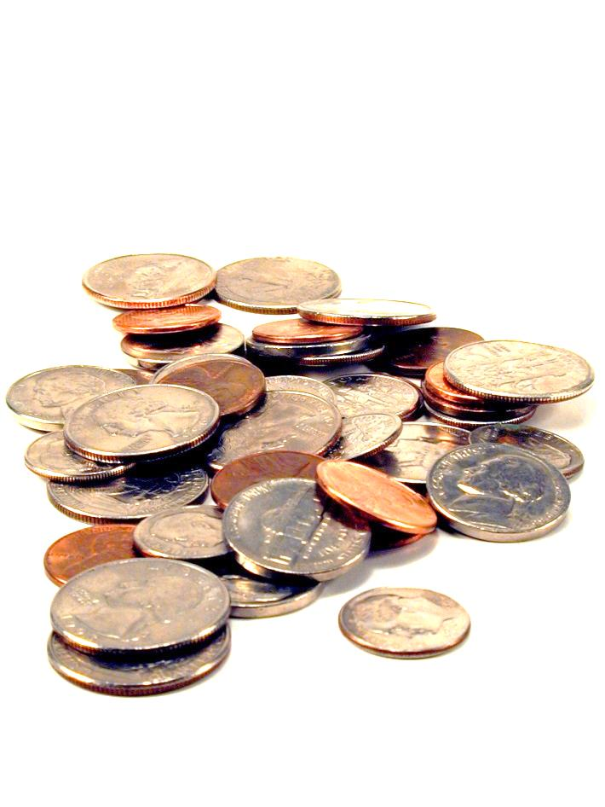
Making Change
Hw9

Slide 38
we want the fewest coins that will produce this total
out of these denominations (we can use as many times as we want)
Does the algorithm of always using the largest coin possible get you the minimum number of coins?
A) Yes B) No C)??
change( 18, [1, 9, 10] )
Minimizing change...
in Racket + Prolog: recursive use-it-or…-or-lose-it

Slide 39
In CS (and life?)
Greed usually doesn’t work

Slide 40
we want the fewest coins that will produce this total
out of these denominations (we can use as many times as we want)
Minimizing change...
change( 18, [1, 9, 10] )
What is the fewest coins I can use to make this total?
You need to invent this DP algorithm in Hw9
0 | 1 | 2 | 3 | 4 | 5 | 6 | 7 | 8 | 9 | 10 | 11 | 12 | 13 | 14 | 15 | 16 | 17 | 18
0 | 1 | 2 | 3 | 4 | 5 | 6 | 7 | 8 | 1 | 1 | 2 | 3 | 4
in Java: dynamic programming!

Slide 41

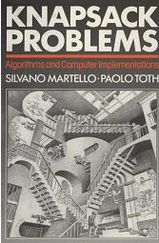
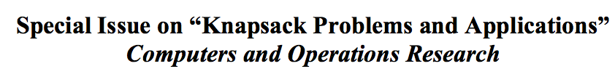
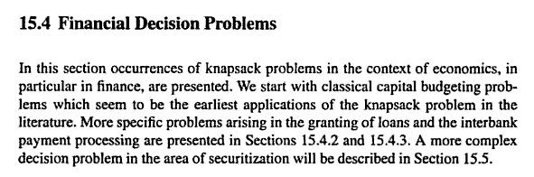
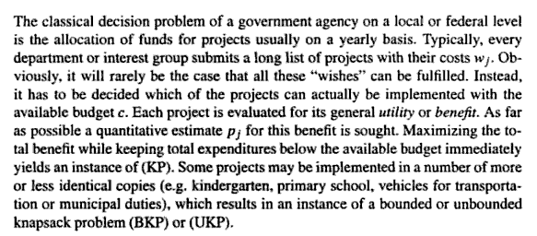
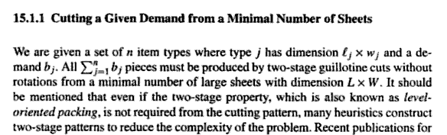
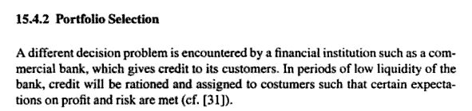
Knapsack!
2004 book
1990 book
Material use in manufacturing
Financial decision problems
Cryptosystems
Auction theory
~ Field of Operations Research

Slide 42
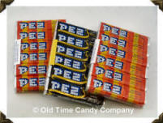
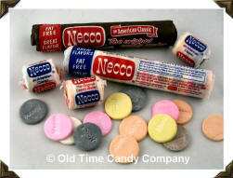

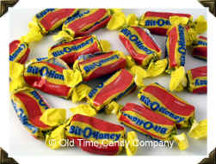
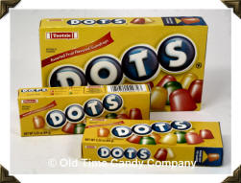
Recognize these?
1800's
1920's
1940's
1950's
1970's

Slide 43
Recognize these?
1800's
1920's
1940's
1950's
1970's
What should represent the 2000's?
Notes:
fun dip

Slide 44
Assume each of the candies has some value (v)
v₁ = 100
w₁ = 2
v₁
w₁
i = 1
= 50
v₂ = 120
w₂ = 3
Assume each of the candies has some weight (w)
v₂
w₂
= 40
i = 2
v₃ = 230
w₃ = 5
v₃
w₃
i = 3
= 46
We can calculate how good of a deal the candy is
v₄ = 560
w₄ = 7
v₄
w₄
i = 4
v_{i}
w_{i}
= 80
v₅ = 675
w₅ = 9
v₅
w₅
i = 5
= 75

Slide 45
Suppose "a friend" can consume a weight of 13. Assume that you won’t run out of candy
How can you maximize this
candy-value experience?
v₁ = 100
w₁ = 2
uc₁ = 50
i = 1
v₂ = 120
w₂ = 3
uc₂ = 40
i = 2
v₄ = 560
w₄ = 7
v₃ = 230
uc₄ = 80
i = 4
w₃ = 5
uc₃ = 46
i = 3
v₁ = 100
3
w₁ = 2
v₄ = 560
uc₁ = 50
i = 1
w₄ = 7
uc₄ = 80
i = 4
v_{Total} = 860
w_{Total} = 13
v₅ = 675
w₅ = 9
Does greed work?
uc₅ = 75
i = 5

Slide 46
Suppose "a friend" can consume a weight of 13. Assume that you won’t run out of candy
How can you maximize this
candy-value experience?
v₁ = 100
w₁ = 2
uc₁ = 50
i = 1
v₂ = 120
w₂ = 3
uc₂ = 40
i = 2
v₅ = 675
w₅ = 9
v₃ = 230
uc₅ = 75
i = 5
w₃ = 5
uc₃ = 46
i = 3
v₁ = 100
2
w₁ = 2
v₄ = 560
uc₁ = 50
i = 1
w₄ = 7
uc₄ = 80
i = 4
v_{Total} = 875
w_{Total} = 13
v₅ = 675
w₅ = 9
Does greed work?
uc₅ = 75
i = 5

Slide 47
In CS (and life?)
Greed usually doesn’t work

Slide 48
Knapsack problem
v₁ = 100
w₁ = 2
i = 1
v₂ = 120
Use-it-or-lose-it
w₂ = 3
i = 2
bestValue( capacity ) =
v₃ = 230
w₃ = 5
bestValue( capacity-1 )
i = 3
max
bestValue( capacity-w_{i} ) + v_{i}
v₄ = 560
over all possible i
w₄ = 7
i = 4
v₅ = 675
w₅ = 9
i = 5

Slide 49
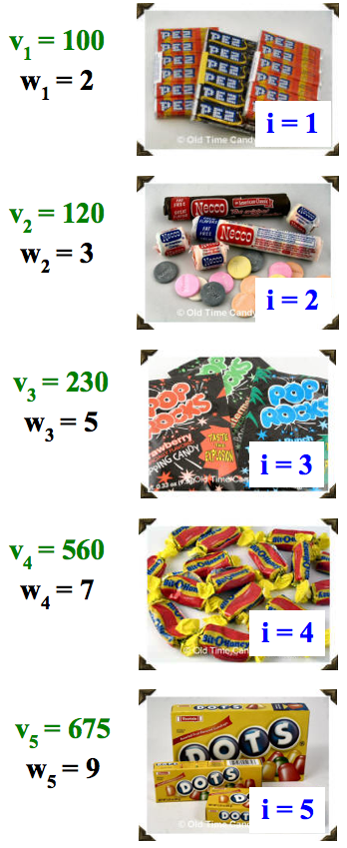
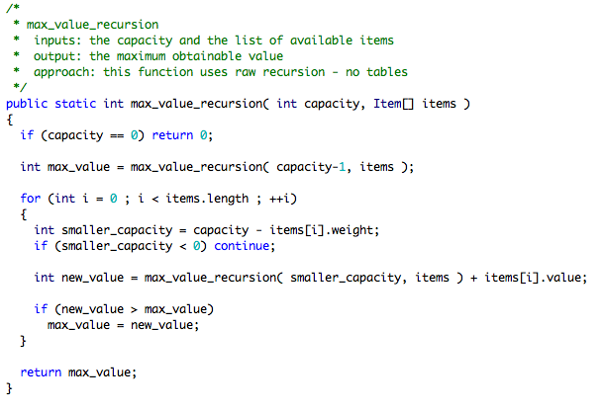
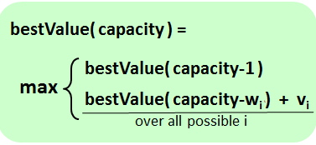
Knapsack problem ~ recursive code
Do you see how these rules relate to the recursive code?
Yes B) No

Slide 50
Dynamic programming
Create a table of possible recursive calls.
Compute the results of each one bottom-up.
T[ capacity ] = the maximum value obtainable for the given capacity
Which values are "easy" to fill in?
How do we fill in each cell?
CAPACITY
Fill in this table from 0 up to the actual capacity of interest…
0 | 1 | 2 | 3 | 4 | 5 | 6 | 7 | 8 | 9 | 10 | 11 | 12 | 13

Slide 51
(1) Finish filling in this table of best-results for the knapsack problem:
CAPACITY
0 | 1 | 2 | 3 | 4 | 5 | 6 | 7 | 8 | 9 | 10 | 11 | 12 | 13
0 | 0 | 100
Fill in this table from 0 up to the actual capacity of interest…
VALUE
Each cell is T[ capacity ] = the maximum value obtainable for the given capacity
(2) Estimate the big-O runtime of this table-filling algorithm, in terms of N, the number of items available.
What else does the big-O runtime depend on?
(3) How could you also keep track of the items to take using a 2nd table with one item per cell?
0 | 1 | 2 | 3 | 4 | 5 | 6 | 7 | 8 | 9 | 10 | 11 | 12 | 13

Slide 52
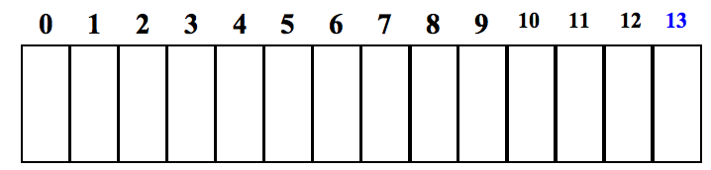
(1) Finish filling in this table of best-results for the knapsack problem:
CAPACITY
0
1
2
3
4
5
6
7
8
9
10
11
12
13
0
0
VALUE
100
120
200
230
300
560
560
675
680
775
795
875
Fill in this table from 0 up to the actual capacity of interest…
Each cell is T[ capacity ] = the maximum value obtainable for the given capacity
(2) Estimate the big-O runtime of this table-filling algorithm, in terms of C, the knapsack capacity.
What else does the big-O runtime depend on∞
O( N*C )
Quiz
(3) How could you also keep track of the items to take using a 2nd table with one item per cell∞
CAPACITY
null
null
1
1
1
4
4
5
One Item
2
3
4
5
5
5

