Slide 1
CS 60
Floyd Warshall’s Algorithm
& Big-O
2013-04-02
Tuesday – Week 9
Lecture 18

Slide 2
Survey
What did you think of Hw8?
Awesome!
Really hard to debug!
All of the above (a & b)
Too difficult, frustrating, or annoying

Slide 3
Survey
I would like to move the Java quiz 1 week later
Sounds fine
Sounds terrible
Wednesday April 17th at 5pm

Slide 4
Administrative Stuff
(Not in your notes)
It isn’t too late to talk to Colleen about your quiz!!!!
No office hours for Colleen Friday

Slide 5
Prolog Quiz Bonus
Submit a copy of CORRECT solutions to each question on the quiz + explanation of something you now understand better
  Just use regular paper (you can keep your quiz)
  You can hand write it or type it
  You can collaborate but need to write your own solution (no pair programming)
5 points extra credit
Due Thursday April 4th in class

Slide 6
Floyd-Warshall
(all-pairs shortest path)

Slide 7
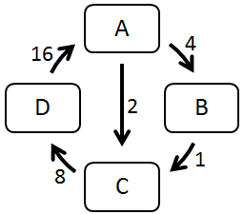
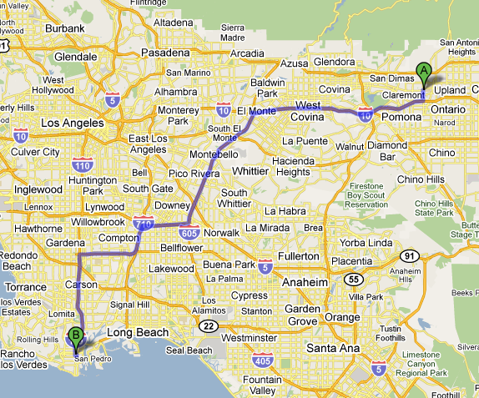

Finding all Paths
A directed graph:
Suppose we'd like the
shortest route from
any city to any other city.
How is this path different than the paths in the directed graph above?

Slide 8
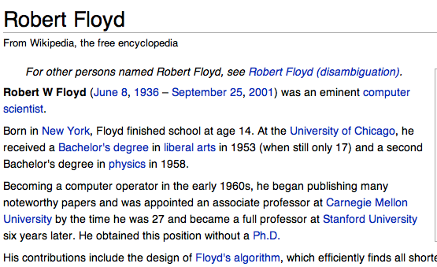
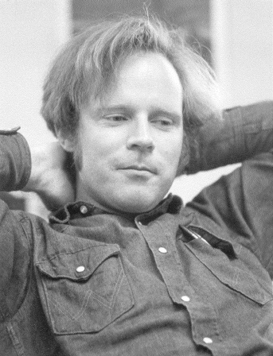
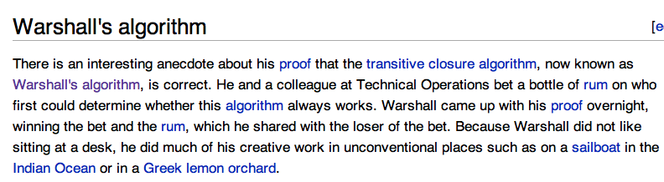
Floyd-Warshall algorithm
All-pairs shortest paths!
“Floyd may have been the first advocate of refactoring -- the rewriting of working programs from scratch, re-using only the essential ideas. Refactoring is now standard practice among computer programmers. By continuously looking for simpler ways to do the same thing, Floyd aimed to improve not only programs but also programmers' abilities and understanding...
He also was a passionate hiker and mountain climber who loved the wilderness country in the High Sierra…”
Stephen Warshall
What would a reasonable big-O running time be (N = # nodes)

Slide 9
Shortest Paths in CS60
O(N³)
O(2^{N})
min-dist
(Brute Force)
Floyd-Warshall
(Dynamic programming)
ALL PATHS
Hw2 part 1 Problem 9
ONE PATH

Slide 10
Graph Representations
(adjacency matrix)

Slide 11
Cost:
0 if self-edge
Edge | Cost
A → A | 0
A → B | 4
A → C | 2
A → D | ∞
B → A | ∞
B → B | 0
B → C | 1
B → D | ∞
C → A | ∞
C → B | ∞
C → C | 0
C → D | 8
D → A
D → B
D → C
D → D
Graph Representations
(cont.)
This is a non-standard representation that we’ll use today.
Cost:
∞ if no edge
Cost:
Otherwise just the edge weight
A
4
16
Fill these out
D
2
B
1
8
C
A) 0 B) 1 C) 2 D) ∞ E) ??

Slide 12
Graph Representation:
Adjacency Matrix
Edge | Cost
A → A | 0
A → B | 4
A → C | 2
A → D | ∞
B → A | ∞
B → B | 0
B → C | 1
B → D | ∞
C → A | ∞
C → B | ∞
C → C | 0
C → D | 8
D → A | 16
D → B | ∞
D → C | ∞
D → D | 0
A
4
16
A → A | A → B | A → C | A → D
0 | 4 | 2 | ∞
B → A | B → B | B → C | B → D
∞ | 0 | 1 | ∞
C → A | C → B | C → C | C → D
∞ | ∞ | 0 | 8
D → A | D → B | D → C | D → D
16 | ∞ | ∞ | 0
D
2
B
1
8
C
This is the source (src)
 | A | B | C | D
A | 0 | 4 | 2 | ∞
B | ∞ | 0 | 1 | ∞
C | ∞ | ∞ | 0
D | 16 | ∞ |  | 0
This is the destination (dest)
A) 2 B) 4 C) 8 D) ∞

Slide 13
Adjacency Matrix
Cost:
0 if self-edge
Cost:
Edge weight
Cost:
∞ if no edge
A (1) → A (1) 0 | A (1) → B (2) 4 | A (1) → C (3) 2 | A (1) → D (4) ∞
B (2) → A (1) ∞ | B (2) → B (2) 0 | B (2) → C (3) 1 | B (2) → D (4) ∞
C (3) → A (1) ∞ | C (3) → B (2) ∞ | C (3) → C (3) 0 | C (3) → D (4) 8
D (4) → A (1) 16 | D (4) → B (2) ∞ | D (4) → C (3) ∞ | D (4) → D (4) 0

Slide 14
Adjacency Matrix (Floyd-Warshall implementation detail):
Use a int[][] and number the nodes starting with 1
 | dest = 0 | dest = 1 | dest = 2 | dest = 3 | dest = 4
src = 0
src = 1 |  | A (1) → A (1) 0 | A (1) → B (2) 4 | A (1) → C (3) 2 | A (1) → D (4) ∞
src = 2 |  | B (2) → A (1) ∞ | B (2) → B (2) 0 | B (2) → C (3) 1 | B (2) → D (4) ∞
src = 3 |  | C (3) → A (1) ∞ | C (3) → B (2) ∞ | C (3) → C (3) 0 | C (3) → D (4) 8
src = 4 |  | D (4) → A (1) 16 | D (4) → B (2) ∞ | D (4) → C (3) ∞ | D (4) → D (4) 0

Slide 15
Tracing
Floyd-Warshall

Slide 16
Floyd-Warshall algorithm
For each node K:
For each pair of nodes (X →Y):
See if using an intermediate node K can reduce the cost of that path:
min[cost(X →Y),
cost(X →K) + cost(K →Y)]
{A, B, C, D}
{A→A, A→B, A→C, A→D,
B→A, B→B, B→C, B→D,
C→A, C→B, C→C, C→D,
D→A, D→B, D→C, D→D}

Slide 17
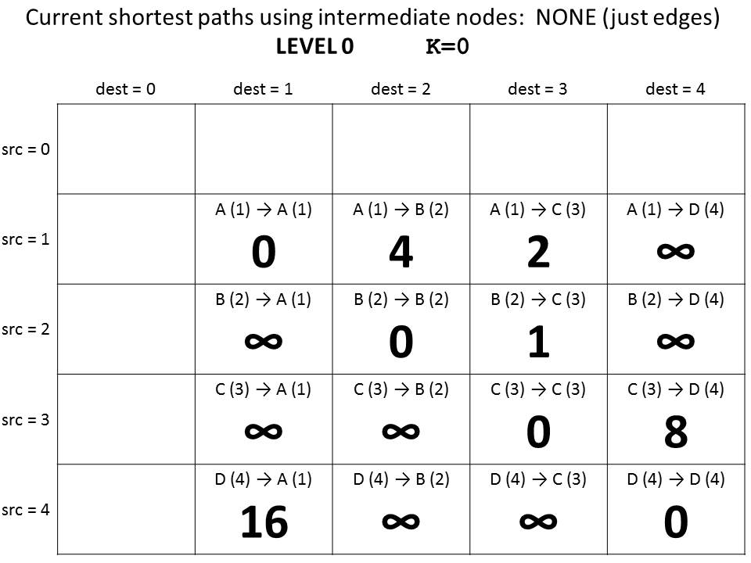
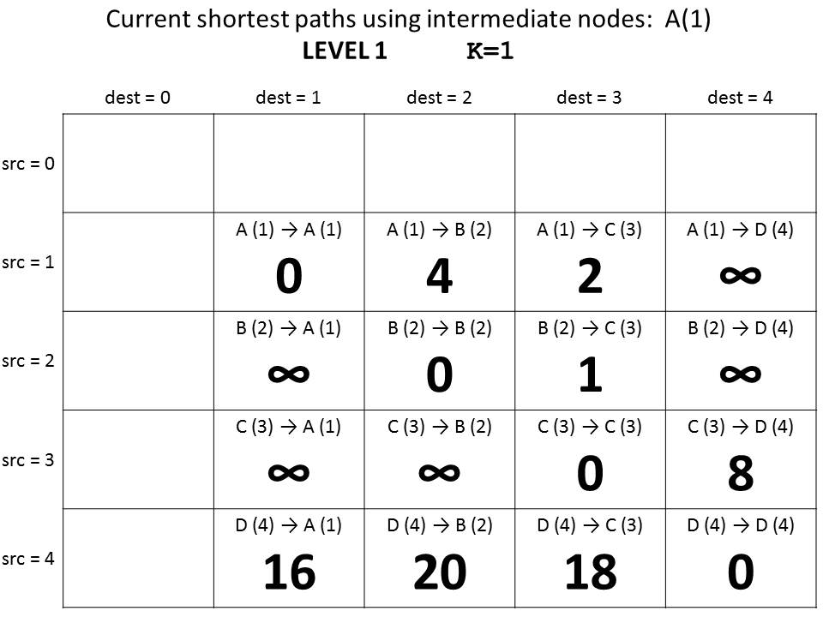
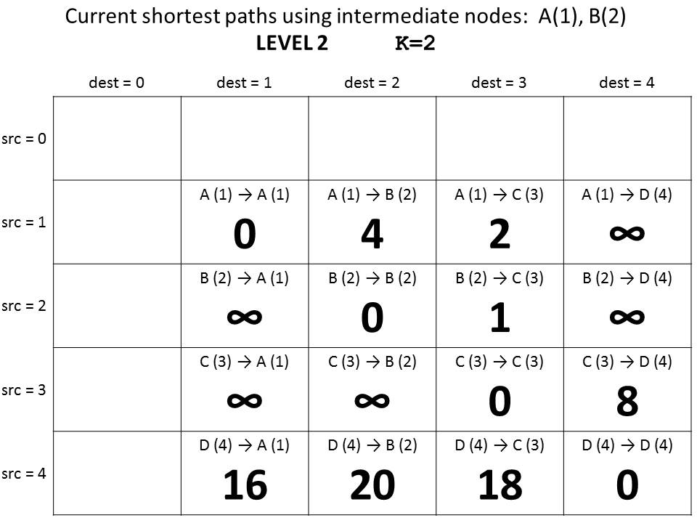
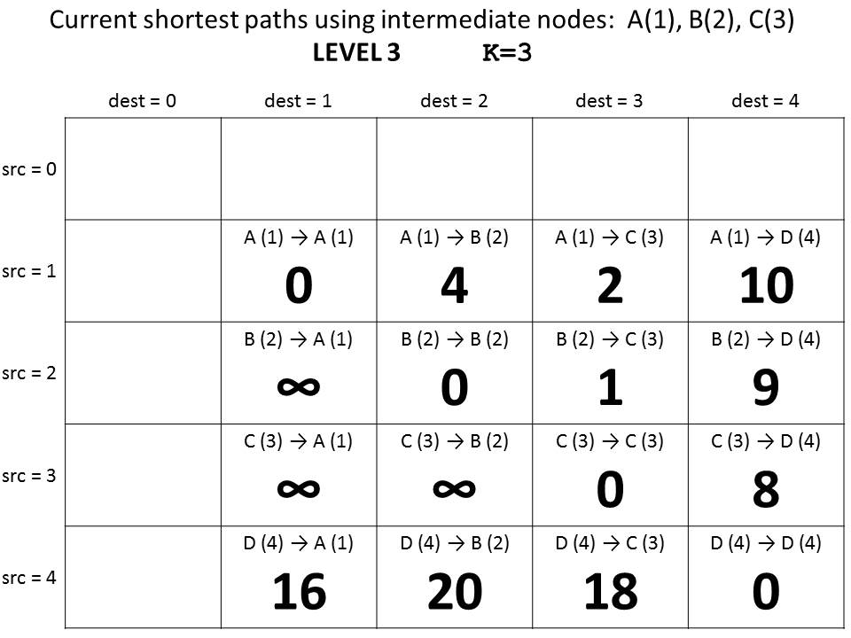
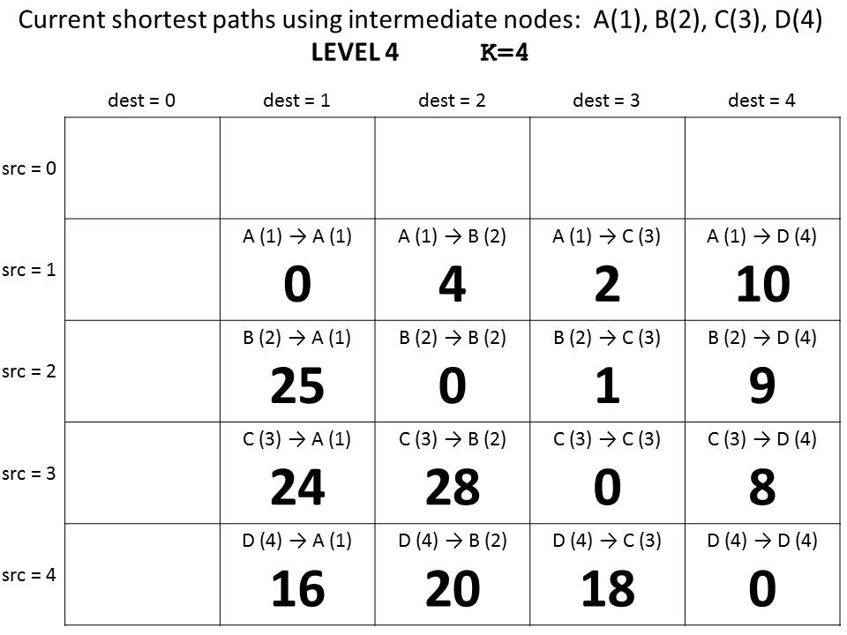
Guaranteed shortest path using NO intermediate nodes.
K = 0
Why does this give us the shortest path?
Guaranteed shortest path using only A as an intermediate node.
K = 1
Guaranteed shortest path using only A & B as intermediate nodes.
K = 2
Guaranteed shortest path using
only A, B, & C
as intermediate nodes.
K = 3
Guaranteed shortest path using
only A, B, C, & D
as intermediate nodes.
K = 4

Slide 18
Floyd-Warshall Pseudocode
We don’t use index 0, so we need N+1
int[][] cost = new int[N+1][N+1];
// set initial values = edge weights
for(int K=0; K<N; K++){
for(int src=0; src<N; src++){
for(int dest=0; dest<N; dest++){
int prevCost = cost[src][dest];
int newCost = cost[src] [K] +
cost [K] [dest];
cost[src][dest] = min(prevCost, newCost);
}
}
}
min[cost(X →Y),
cost(X →K) +
cost(K →Y)]

Slide 19
Guaranteed shortest path using NO intermediate nodes.
K = 0
If we keep a separate N+1xN+1 table
for each K…
Guaranteed shortest path using only A as an intermediate node.
K = 1
Guaranteed shortest path using only A & B as intermediate nodes.
K = 2
Guaranteed shortest path using
only A, B, & C
as intermediate nodes.
K = 3
Guaranteed shortest path using
only A, B, C, & D
as intermediate nodes.
K = 4

Slide 20
One N+1xN+1 array for each possible intermediate node
int[][][] cost = new int[N+1][N+1][N+1];
// set initial values = edge weights
for(int K=1; K<=N; K++){
for(int src=1; src<=N; src++){
for(int dest=1; dest<=N; dest++){
int prevCost = cost[K-1][src][dest];
int newCost = cost[K-1][src] [K] +
cost[K-1] [K] [dest];
cost[k][src][dest]=min(prevCost, newCost);
}
}
}
Look at the “current” shortest path
Floyd-Warshall Pseudocode (Layers)

Slide 21
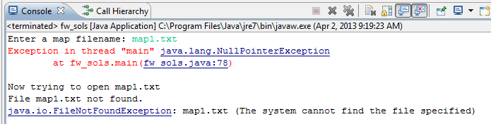
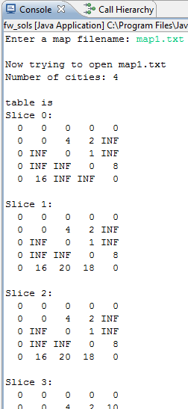
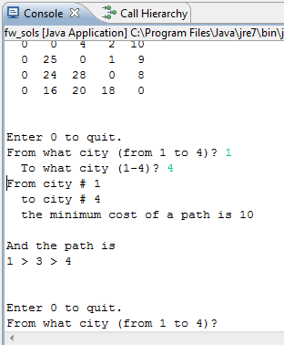
Shows each “layer” of the table cost
If you get this error (on this or Change) review the homework instructions
HOMEWORK 9
FILE INPUT!
You can query for ANY Path!

Slide 22
Discuss in your group
(then fill out K=1 table)
What is in cost?
  int[][][] cost = new int[N+1][N+1][N+1];
  What is in layer 0 (cost[0]) and layer N
    int[][] start = cost[0];
    int[][] done = cost[N+1];
Why will this give ALL shortest paths?

Slide 23
Current shortest paths using intermediate nodes: NONE (just edges)
LEVEL 0 K=0
 | dest = 0 | dest = 1 | dest = 2 | dest = 3 | dest = 4
src = 0
src = 1 |  | A (1) → A (1) 0 | A (1) → B (2) 4 | A (1) → C (3) 2 | A (1) → D (4) ∞
src = 2 |  | B (2) → A (1) ∞ | B (2) → B (2) 0 | B (2) → C (3) 1 | B (2) → D (4) ∞
src = 3 |  | C (3) → A (1) ∞ | C (3) → B (2) ∞ | C (3) → C (3) 0 | C (3) → D (4) 8
src = 4 |  | D (4) → A (1) 16 | D (4) → B (2) ∞ | D (4) → C (3) ∞ | D (4) → D (4) 0

Slide 24
Current shortest paths using intermediate nodes: A(1)
LEVEL 1 K=1
 | dest = 0 | dest = 1 | dest = 2 | dest = 3 | dest = 4
src = 0
src = 1 |  | A (1) → A (1) | A (1) → B (2) | A (1) → C (3) | A (1) → D (4)
src = 2 |  | B (2) → A (1) | B (2) → B (2) | B (2) → C (3) | B (2) → D (4)
src = 3 |  | C (3) → A (1) | C (3) → B (2) | C (3) → C (3) | C (3) → D (4)
src = 4 |  | D (4) → A (1) | D (4) → B (2) | D (4) → C (3) | D (4) → D (4)

Slide 25
Current shortest paths using intermediate nodes: A(1), B(2)
LEVEL 2 K=2
 | dest = 0 | dest = 1 | dest = 2 | dest = 3 | dest = 4
src = 0
src = 1 |  | A (1) → A (1) | A (1) → B (2) | A (1) → C (3) | A (1) → D (4)
src = 2 |  | B (2) → A (1) | B (2) → B (2) | B (2) → C (3) | B (2) → D (4)
src = 3 |  | C (3) → A (1) | C (3) → B (2) | C (3) → C (3) | C (3) → D (4)
src = 4 |  | D (4) → A (1) | D (4) → B (2) | D (4) → C (3) | D (4) → D (4)

Slide 26
Current shortest paths using intermediate nodes: A(1), B(2), C(3)
LEVEL 3 K=3
 | dest = 0 | dest = 1 | dest = 2 | dest = 3 | dest = 4
src = 0
src = 1 |  | A (1) → A (1) | A (1) → B (2) | A (1) → C (3) | A (1) → D (4)
src = 2 |  | B (2) → A (1) | B (2) → B (2) | B (2) → C (3) | B (2) → D (4)
src = 3 |  | C (3) → A (1) | C (3) → B (2) | C (3) → C (3) | C (3) → D (4)
src = 4 |  | D (4) → A (1) | D (4) → B (2) | D (4) → C (3) | D (4) → D (4)

Slide 27
Current shortest paths using intermediate nodes: A(1), B(2), C(3), D(4)
LEVEL 4 K=4
 | dest = 0 | dest = 1 | dest = 2 | dest = 3 | dest = 4
src = 0
src = 1 |  | A (1) → A (1) | A (1) → B (2) | A (1) → C (3) | A (1) → D (4)
src = 2 |  | B (2) → A (1) | B (2) → B (2) | B (2) → C (3) | B (2) → D (4)
src = 3 |  | C (3) → A (1) | C (3) → B (2) | C (3) → C (3) | C (3) → D (4)
src = 4 |  | D (4) → A (1) | D (4) → B (2) | D (4) → C (3) | D (4) → D (4)

Slide 29
Big-O
From:
2013-01-22
Tuesday – Week 0
Lecture 01

Slide 30
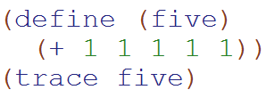
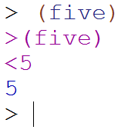
Big-O: Constant Time
O(1)
O(1)
The runtime does not depend upon the magnitude of the input
O(1)
O(log N)
O(N)
O(2^{N})
??

Slide 31
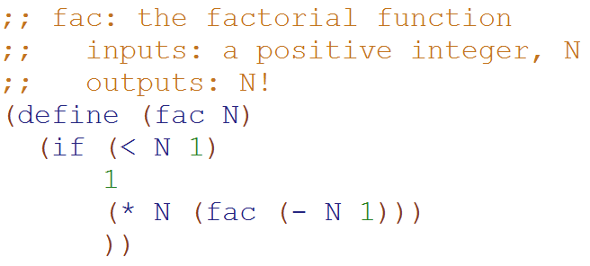
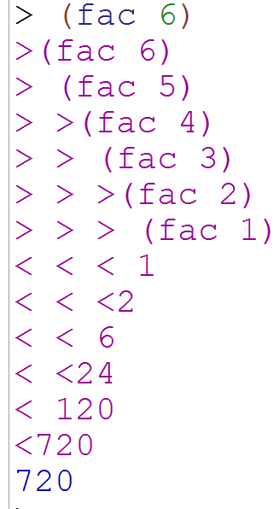
Big-O: Linear Time
O(N)
O(N)
The runtime is proportional to the magnitude of the input
O(1)
O(log N)
O(N)
O(2^{N})
??

Slide 32
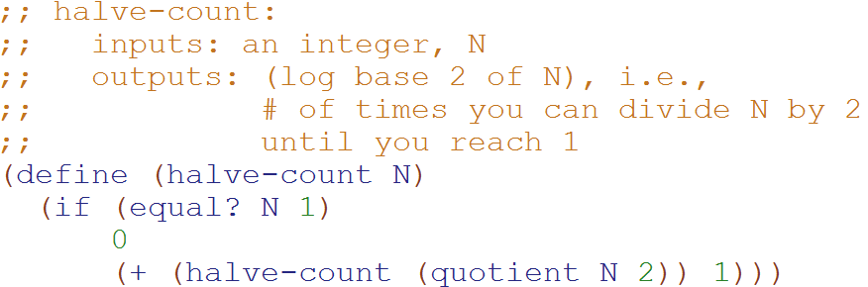
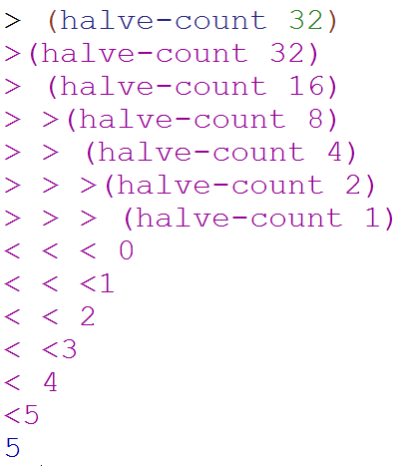
Big-O: Logarithmic Time
O(log₂N)
O(log₂N)
The magnitude of the input is cut in half with each recursive call
O(1)
O(log N)
O(N)
O(2^{N})
??
Why does cutting the magnitude of the input in half each time produce O(log₂N) runtime?

Slide 33
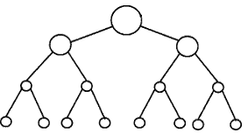
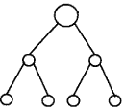


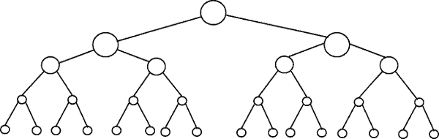
Perfectly Balanced Trees
h = 0
n = 1
h = 1
n = 3
h = 2
n = 7
h = 3
n = 15

Slide 34



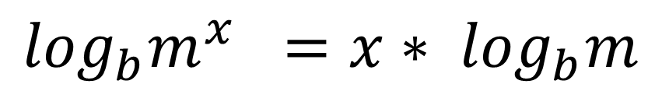
// Take the log of both sides
Ignore the minus 1
// Remember:
$$\log_{b}m^{x} ={x∗ log}_{b}m$$

Slide 35
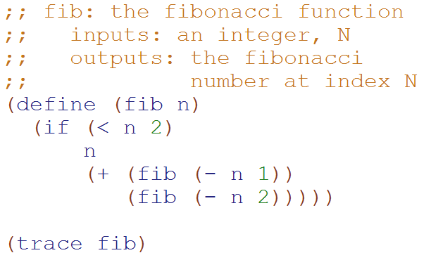
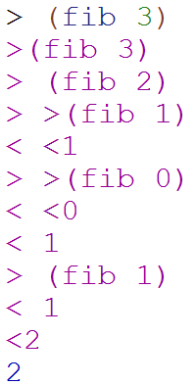
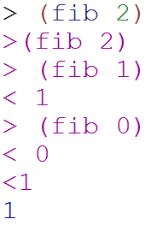
Big-O: Exponential Time
O(2^{N})
O(1)
O(log N)
O(N)
O(2^{N})
??
O(2^{N})
You make two slightly smaller recursive calls each time

Slide 36
Runtimes
(why we only care about the largest term)

Slide 37

How Fast Are Computers?
1 Hz = 1 operation /sec
2.9GHz = 2.9 x 10⁹ op / sec

Slide 38
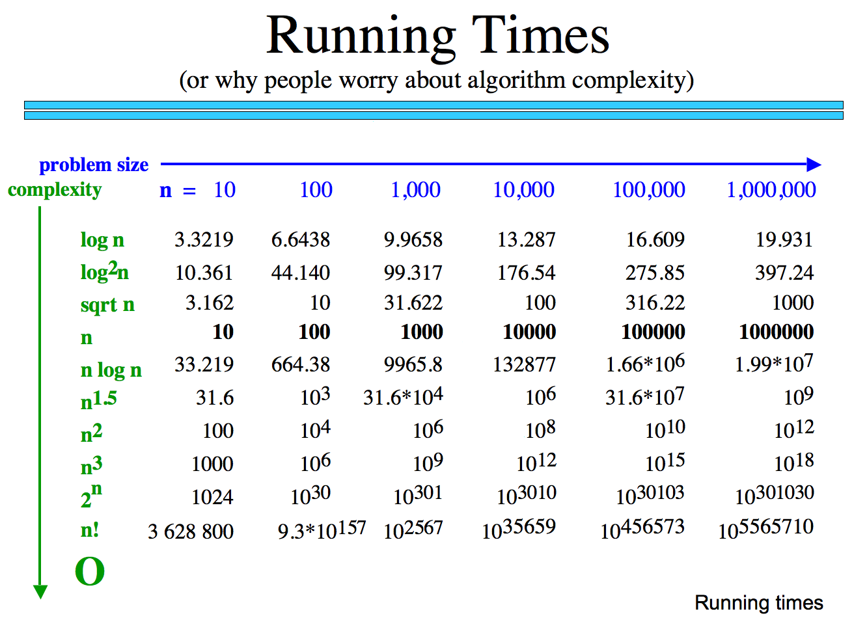
How many operations are required?
How long would these take if you have a 10 GHz Processor?

Slide 39
Why we only care about the largest term
How many operations are required?
Polynomial
Exp.
How big is n!
How long would these take if you have a 10 GHz Processor?

Slide 40
Classes of Problems
Big-O Order
n
n
n!
Intractable Problems (Exponential)
n
2
3
n
2
n
Tractable Problems (Polynomial)
n log(n)
Instead of using measured time – reason about the complexity of the problem
n
√n
log(n)
No Problem!
1

Slide 41
Big-O Formal Definition

Slide 42
Big-O Overview
We want to express the speed of an algorithm independently of a specific implementation on a specific machine.
We examine the cost of the algorithms for large input sets i.e. the asymptotic cost.
In later classes you’ll do this in more detail

Slide 43
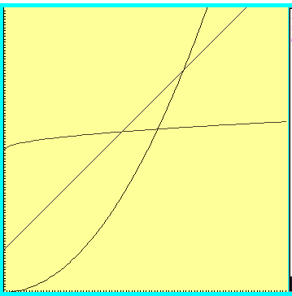



Which one is fastest?

Slide 44
“Woah! One of these is WAY better after this point. Let’s call that point N”

Slide 45



Which is fastest after some big value N?

Slide 46



Which is fastest after some value N?
WAIT – who cares? These are all proportional!
Sometimes we do care, but for simplicity we ignore constants

Slide 47
Formal definition
if and only if
for all n > N

Slide 48

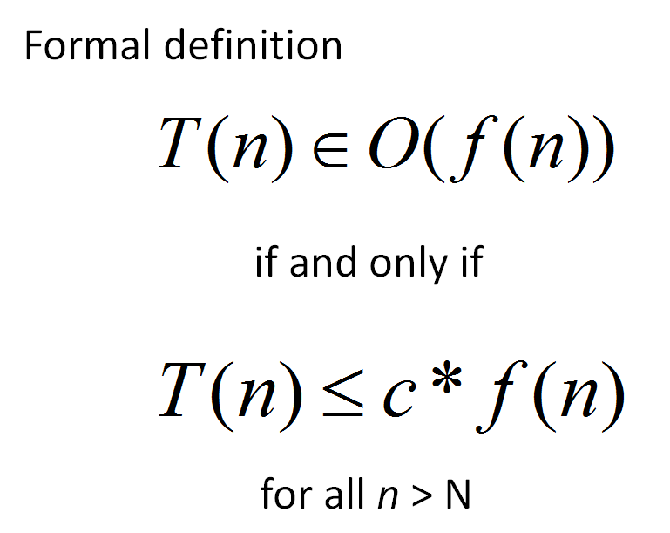
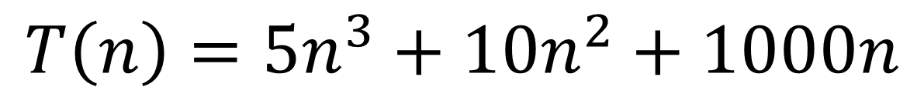
Applying the Formal Definition
$$T\left(n\right)=5n^{3}+10n^{2}+1000n$$
There is only one possible value for c and N
True
False
??
What values of c and N
make this true?

Slide 49

Big-O definition
(using different notation)
T(n) ∈ O(f(n)) means
(∃c) (∃N) (∀n > N) T(n) < c*f(n)
+ threshold N
there exists a constant c
for all input sizes bigger than that threshold, N
To claim that
42n² + 100n ∈ O(n²)
We need to find c and N such that for all n > N,
c =
N =
42n² + 100n < cn²
Notes:
n > 1001 = k, c = 1001
n > 1 = k, c = 42

Slide 50
Apply the formal definition
42n+999 ∈ O(n) ?
2
3
50n ∈ O(n ) ?
0.001*n! ∈ O(n ) ?
True or False?
True or False?
True or False?
c =
N =
c =
N =
c =
N =
Are these the “best” bounds?
Use simplest form with O notation

Slide 51
Loop Counting
(calculate runtime by counting each step)

Slide 52
Example 1: Count the total # of constant-time operations?
for ( int i=0 ; i < N ; i++){
// constant-time operation
}
i=0
i=1
i=2
…
i=N-1
i=N
# ops per row
1
1
1
…
1
1
O(N)
Total
of N
Technically 3 operations!

Slide 53
Example 2: Count the total # of constant-time operations?
for ( int i=1 ; i < N ; i=i*2){
// constant-time operation
}
i=1
i=2
i=4
…
i=N/2
i=N
# ops per row
1
1
1
…
1
1
O(log₂(N))
Total
of log₂(N)

Slide 54
Example 3: Count the total # of constant-time operations?
for ( int i=N ; i > 0 ; i=i/2){
// constant-time operation
}
i=N
i=N/2
…
i=4
i=2
i=1
# ops per row
1
1
1
…
1
1
O(log₂(N))
Total
of log₂(N)

Slide 55
Example 4: Count the total # of constant-time operations?
for ( int i=0 ; i < N ; i++){
for ( int z=0 ; z < N ; z++){
// constant-time operation
}
}
i=0
i=1
i=2
…
i=N-1
i=N
# ops per row
N
N
N
…
N
N
O(N²)
Total
of N²

Slide 56
Example 5: Count the total # of constant-time operations?
for ( int i=0 ; i < N ; i++){
for ( int z=0 ; z < M ; z++){
// constant-time operation
}
}
i=0
i=1
i=2
…
i=N-1
i=N
# ops per row
M
M
M
…
M
M
O(N*M)
Total of N*M

Slide 57
Example 6: Count the total # of constant-time operations?
for ( int i=0 ; i < N ; i++){
for ( int z=0 ; z < i ; z++){
// constant-time operation
}
}
i=0
i=1
i=2
…
i=N-1
i=N
# ops per row
0
1
2
…
N-1
N
O(N²)
Total of N(N+1)/2

Slide 58
Summations

Slide 59


http://www.math.hmc.edu/funfacts/
REALLY COMMON SERIES (you should recognize these after today)
1 + 2 + 3 + … + (N-2) + (N-1) + N = N(N+1)/2 ∈ O(N²)
1 + 2 + 4 + … + N/4 + N/2 + N = 2N -1 ∈ O(N)
1 + 2 + 4 + … + 2^{N-2} + 2^{N-1} + 2^{N} = 2^{N+1} -1 ∈ O(2^{N})

Slide 60




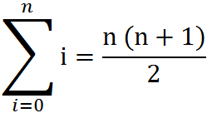
Some Algebra to calculate:
1 + 2 + 3 + … + (N-2) + (N-1) + N = N(N+1)/2 ∈ O(N²)
// Written backwards
OR

Slide 61
N + N/2 + N/4 + … + 4 + 2 + 1 = 2N -1 ∈ O(N)
N
2N
N | N/2
N | N/2 | N/4
N | N/2 | N/4 | N/8
N | N/2 | N/4 | N/8
N/16
The sum is less than 2N

Slide 62
2^{N} + 2^{N-1} + 2^{N-2} + … + 4 + 2 + 1 = 2^{N+1} -1 ∈ O(2^{N})
2^{N}
2 * 2^{N} = 2^{N+1}
2^{N} | 2^{N-1}
2^{N} | 2^{N-1} | 2^{N-2}
2^{N} | 2^{N-1} | 2^{N-2} | 2^{N-3}
2^{N} | 2^{N-1} | 2^{N-2} | 2^{N-3}
2^{N-4}
The sum is less than 2^{N+1}

Slide 63
BONUS

Slide 64
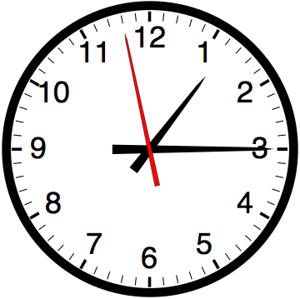

Slide 65


Computer
Science
&
= AWESOME

Slide 66

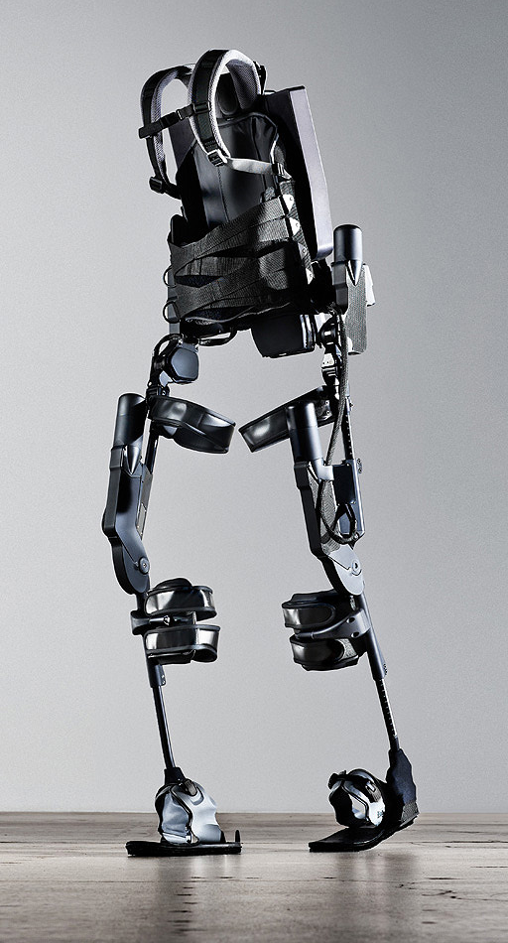
http://www.youtube.com/watch?v=pzRmNYA8LlY

Slide 67


ClickStart

Slide 68


Slide 69
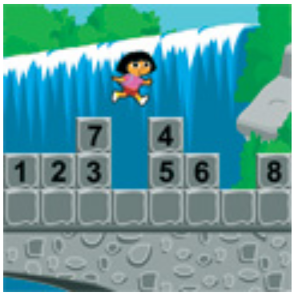
How should we represent the blocks in the computer?
Independent variables
2D Array
OpenList
I don’t know

Slide 70
The value in the array tells me what art asset to use
Each level is really a 3x10 vector!
0 | 0 | 7 | 0 | 4 | 0 | 0 | 0
1 | 2 | 3 | -4 | 5 | 6 | -7 | 8
B | B | B | B | B | B | B | B
Negative values tell me what block needs to go here to win!

Slide 71
0 | 0 | 7 | 0 | 4 | 0 | 0 | 0
1 | 2 | 3 | -4 | 5 | 6 | -7 | 8
0 | 0 | 0 | B | 0 | 0 | 0 | 0

Slide 72
BUGS!

Slide 73


Slide 74

It is really sad when stuff you’ve made is on sale!

Slide 75



Which image is fake?
  A. Top Left
  B. Bottom Left
  C. Bottom Right

Slide 76
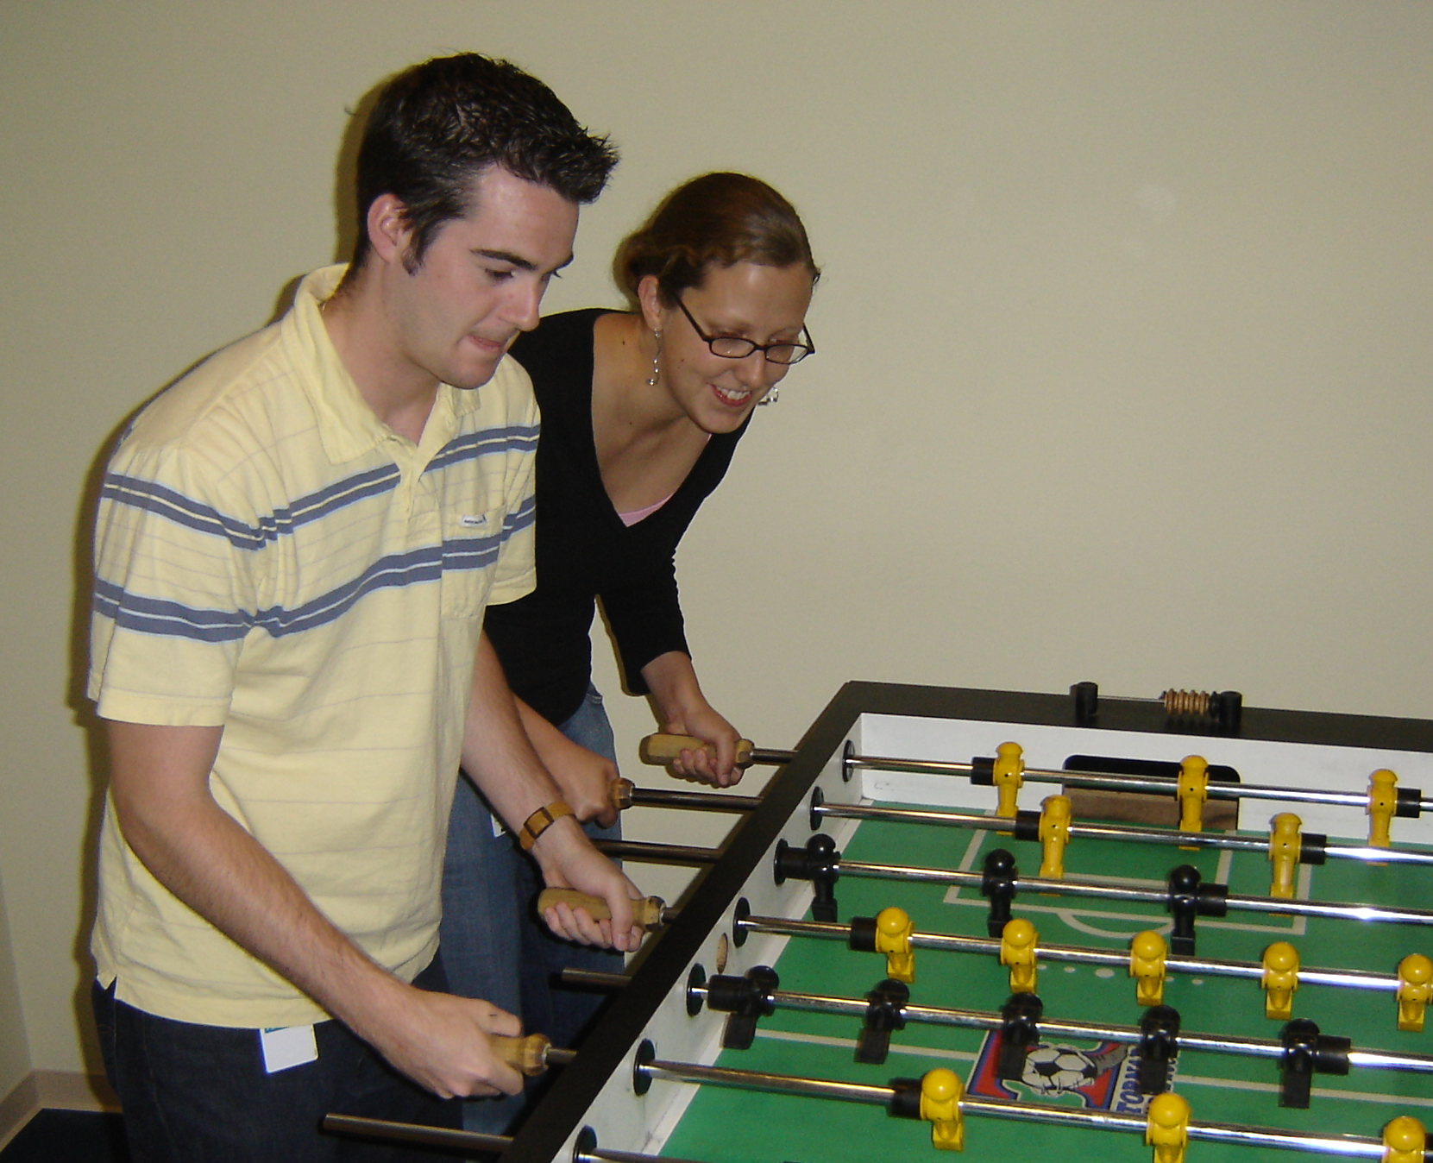

Slide 77
