Slide 1
CS 60
Big-O (cont.)
Parsing Intro
2013-04-04
Thursday – Week 9
Lecture 19

Slide 2
Survey
What did you think of Hw8?
Awesome!
Really hard to debug!
All of the above (a & b)
Too difficult, frustrating, or annoying

Slide 3
Administrative Stuff
(Not in your notes)
Prolog Quiz Bonus due today!
It isn’t too late to talk to Colleen about your quiz!!!!
  Or other stuff
  There is a reason I have 5 hours of office hours a week!
No office hours Friday!

Slide 4
Floyd-Warshall Pseudocode (updated!)

Slide 5
int[][][] cost = new int[N+1][N+1][N+1];
// set initial values = edge weights
for(int K=1; K<=N; K++){
for(int src=1; src<=N; src++){
for(int dest=1; dest<=N; dest++){
int prevCost = cost[K-1][src][dest];
int newCost = cost[K-1][src] [K] +
cost[K-1] [K] [dest];
cost[k][src][dest]=min(prevCost, newCost);
}
}
}
Floyd-Warshall Pseudocode (updated!)

Slide 6
Loop Counting

Slide 7
Example 7: Count the total # of constant-time operations?
for ( int i=0 ; i < N ; i++){
// constant-time operation
}
for ( int z=0 ; z < M ; z++){
// constant-time operation
}
i=0
i=1
i=2
…
i=N-1
i=N
# ops per row
1
1
1
…
1
1
# ops per row
1
1
1
…
1
1
z=0
z=1
z=2
…
z=N-1
z=N
O(N+M)
Total of N
Total of M

Slide 8
Example 5: Count the total # of constant-time operations?
for ( int i=0 ; i < N ; i++){
for ( int z=0 ; z < M ; z++){
// constant-time operation
}
}
i=0
i=1
i=2
…
i=N-1
i=N
# ops per row
M
M
M
…
M
M
O(N*M)
Total of N*M

Slide 9
Summations

Slide 10

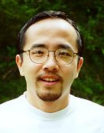
http://www.math.hmc.edu/funfacts/
REALLY COMMON SERIES (you should recognize these after today)
1 + 2 + 3 + … + (N-2) + (N-1) + N = N(N+1)/2 ∈ O(N²)
1 + 2 + 4 + … + N/4 + N/2 + N = 2N -1 ∈ O(N)
1 + 2 + 4 + … + 2^{N-2} + 2^{N-1} + 2^{N} = 2^{N+1} -1 ∈ O(2^{N})

Slide 11




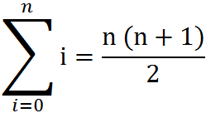
Some Algebra to calculate:
1 + 2 + 3 + … + (N-2) + (N-1) + N = N(N+1)/2 ∈ O(N²)
// Written backwards
OR

Slide 12
N + N/2 + N/4 + … + 4 + 2 + 1 = 2N -1 ∈ O(N)
N
2N
N | N/2
N | N/2 | N/4
N | N/2 | N/4 | N/8
N | N/2 | N/4 | N/8
N/16
The sum is less than 2N

Slide 13
2^{N} + 2^{N-1} + 2^{N-2} + … + 4 + 2 + 1 = 2^{N+1} -1 ∈ O(2^{N})
2^{N}
2 * 2^{N} = 2^{N+1}
2^{N} | 2^{N-1}
2^{N} | 2^{N-1} | 2^{N-2}
2^{N} | 2^{N-1} | 2^{N-2} | 2^{N-3}
2^{N} | 2^{N-1} | 2^{N-2} | 2^{N-3}
2^{N-4}
The sum is less than 2^{N+1}

Slide 14
Recurrence Relationships
(This will involve a lot of algebra – but no magic!)

Slide 15
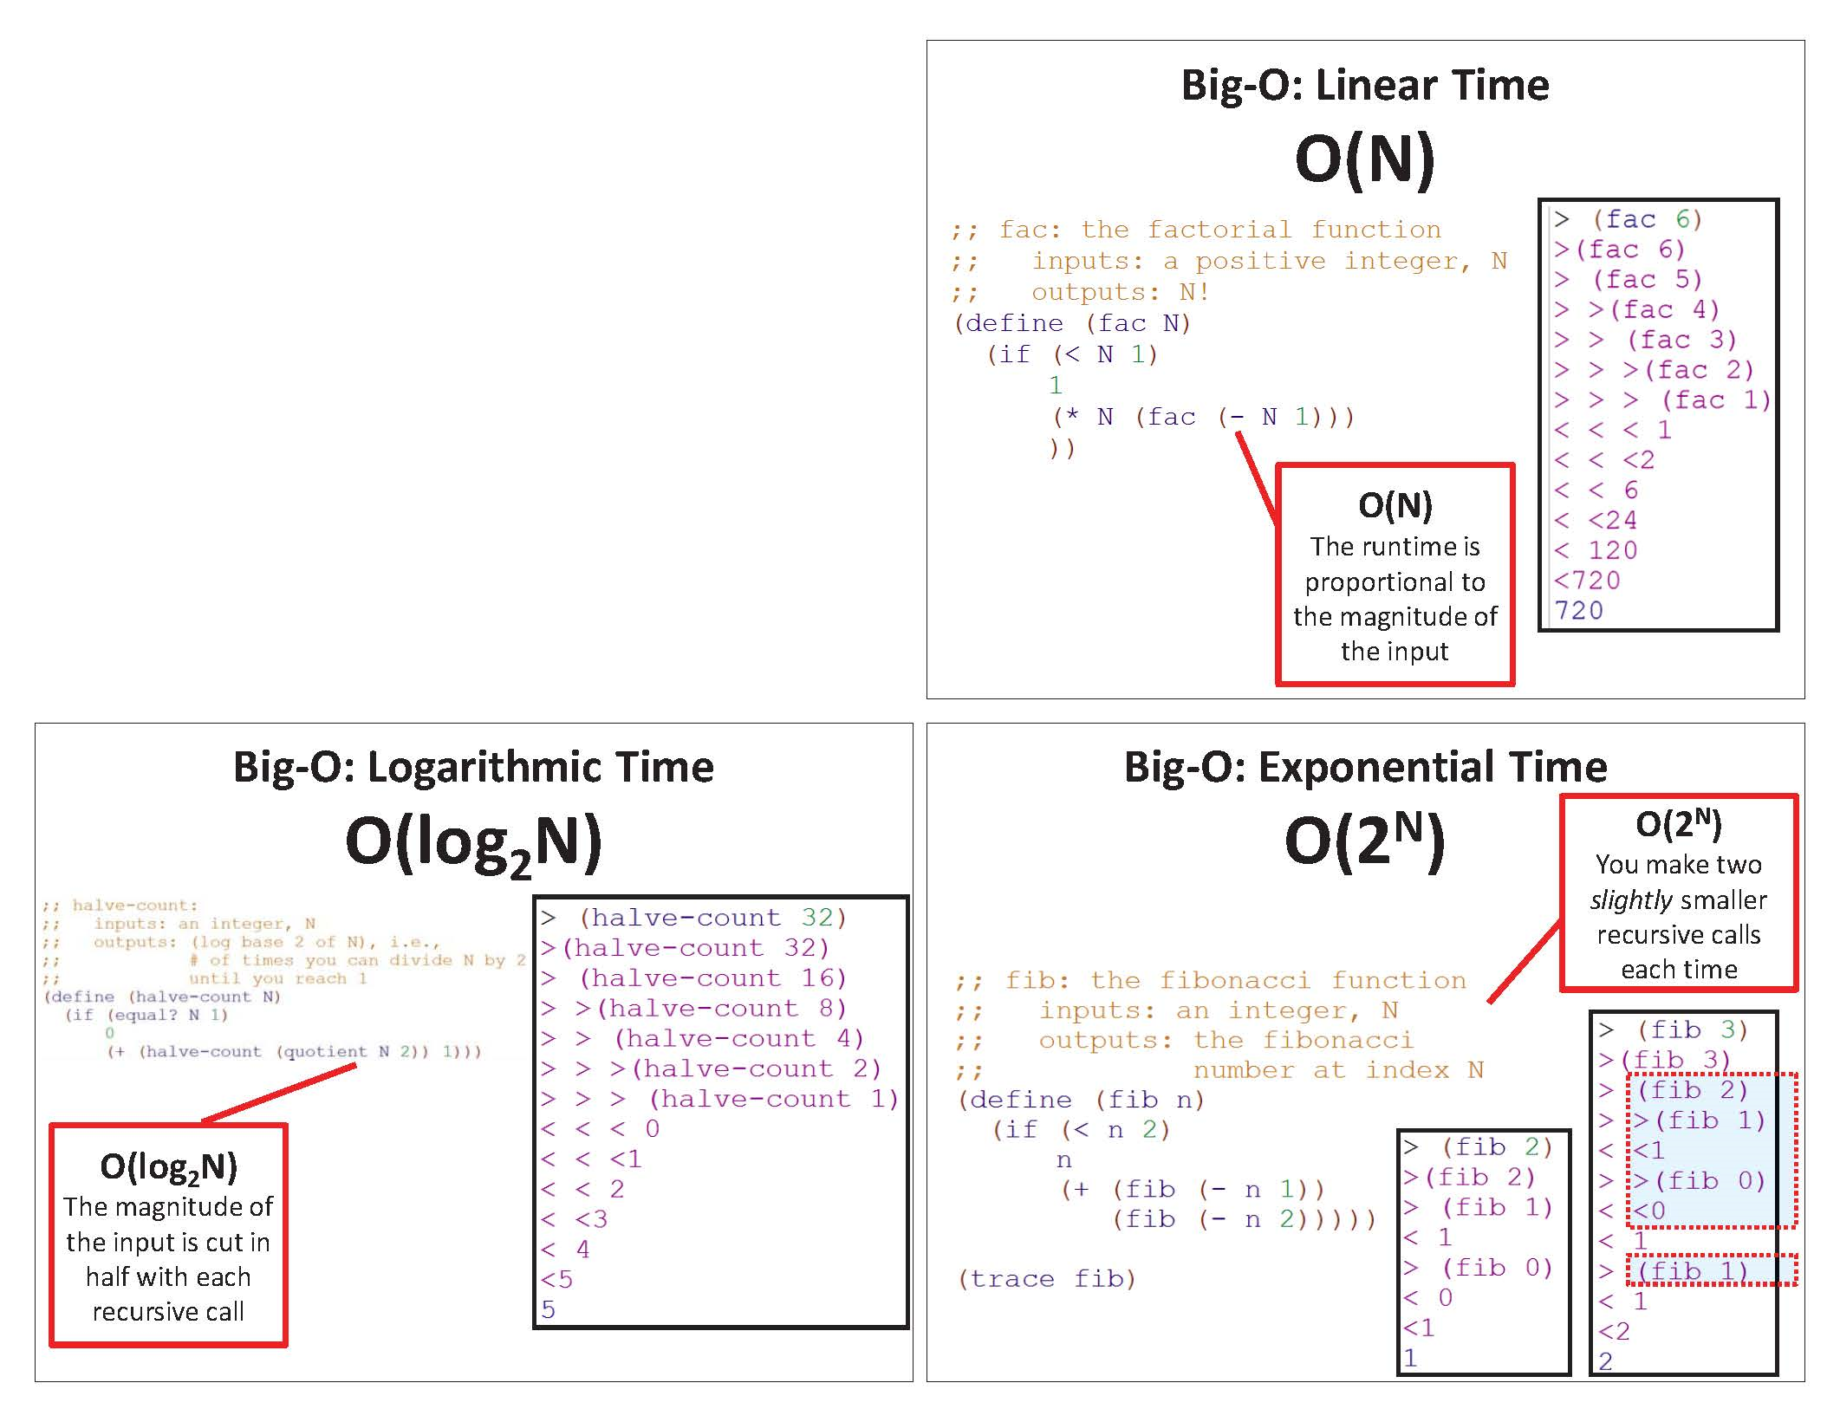
Imprecision ALERT!
Before, we looked at a specific example (e.g., N=6) and generalized!

Slide 16
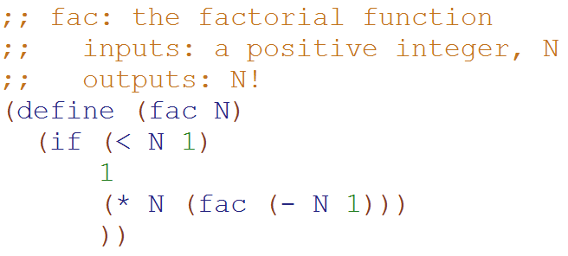
Big-O: Linear Time
O(N)
How important was the assumption that this is exactly 1 constant-time operation?
Would using 6, 8, or 42 change the Big-O runtime?
A) Yes B) No C)??
Based upon this relationship
T(N) = 1 + T(N-1)
We can generalize that:
T(N-1) = 1 + T(N-2)
T(N-2) = 1 + T(N-3)
…
T(0) = 1
T(N) = 1 + T(N-1)
T(N) = 1 + 1 + T(N-2)
T(N) = 1 + 1 + 1 + T(N-3)
T(N) = 1 + 1 + 1 + … + 1 + 1 + 1
T(N) = N
Substitute this
Substitute this

Slide 17
Big-O: Linear Time
O(N)
If N = 0,
only 3 constant-time operations
T(0) = 3
T(N) = 3 + T(N-1)
T(N) = 3 + 3 + T(N-2)
T(N) = 3 + 3 + 3 + T(N-3)
T(N) = 3 + 3 + 3 + … + 3 + 3 + 3
T(N) = 3N
BIG IDEA
The big-O answer is the same if we assume 3 constant-time operations or just 1
(on previous slide)
For N>0
3 constant-time operations
plus the recursive call

Slide 18
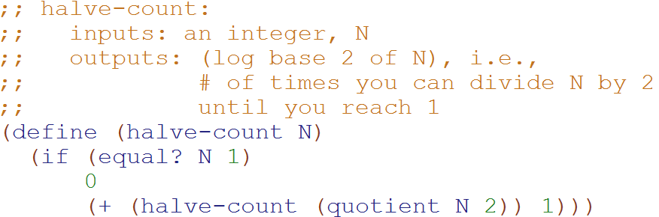
Big-O: Logarithmic Time
O(log₂N)
Based upon this relationship
T(N) = 1 + T(N/2)
We can generalize that:
T(N/2) = 1 + T(N/4)
T(N/4) = 1 + T(N/8)
…
T(0) = 1
T(N) = 1 + T(N/2)
T(N) = 1 + 1 + T(N/4)
T(N) = 1 + 1 + 1 + T(N/8)
T(N) = 1 + 1 + 1 + … + 1 + 1 + 1
T(N) = logN
Substitute this
Substitute this

Slide 19
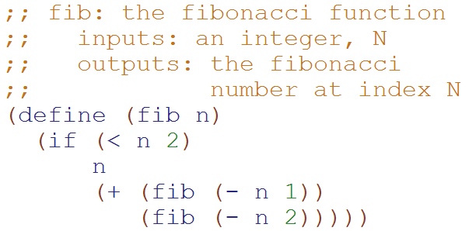
Big-O:
Exponential Time
O(2^{N})
T( __ ) = ______
T(N) = ___________________
How many terms?
1
2
3
4
??

Slide 20
Big-O:
Exponential Time
O(2^{N})
Define:
T₁(N) = 1 + 2*T₁(N-1)
T₂(N) = 1 + 2*T₂(N-2)
T₂(N) ≤ T(N) ≤ T₁(N)
T(1) = 1
T(N) = 1 + T(N-1) + T(N-2)
T₂(N) ≤ T(N)
1 + T₂(N-2) + T₂(N-2) ≤ 1 + T(N-1) + T(N-2)
1 + T₂(N-2) + T(N-2) ≤ 1 + T(N-1) + T(N-2)
?
?
This is complicated! Let’s look for an upper bound
T(N) ≤ T₁(N)
1 + T(N-1) + T(N-2) ≤ 1 + T₁(N-1) + T₁(N-1)
1 + T(N-1) + T(N-2) ≤ 1 + T₁(N-1) + T(N-2)

Slide 21
Big-O:
Exponential Time
O(2^{N})
Based upon this relationship
T₁(N) = 1 + 2*T₁(N-1)
We can generalize that:
T₁(N-1) = 1 + 2*T₁(N-2)
T₁(N-2) = 1 + 2*T₁(N-3)
…
T₁(1) = 1
T₁(N) = 1 + 2*T₁(N-1)
T₁(N) = 1 + 2*(1 + 2*T₁(N-2))
T₁(N) = 1 + 2 + 4*T₁(N-2)
T₁(N) = 1 + 2 + 4*(1 + 2T₁(N-3))
…
T₁(N) = 1 + 2 + 4 + … + 2^{N-1}
T₁(N) = 2^{N} -1
Substitute this
distribute
Substitute this

Slide 22
Big-O:
Exponential Time
O(2^{N})
Based upon this relationship
T₂(N) = 1 + 2*T₂(N-2)
We can generalize that:
T₂(N-2) = 1 + 2*T₂(N-4)
T₂(N-4) = 1 + 2*T₂(N-8)
…
T₂(0) = 1, T₂(1) = 1
T₂(N) = 1 + 2*T₂(N-2)
T₂(N) = 1 + 2*(1 + 2*T₂(N-4))
T₂(N) = 1 + 2 + 4*T₂(N-4)
T₂(N) = 1 + 2 + 4*(1 + 2T₂(N-8))
…
T₂(N) = 1 + 2 + 4 + … + 2^{N/2}
T₂(N) = 2*2^{N/2} -1 = 2^{N/2+1} -1
Substitute this
distribute
Substitute this
Simplification b/c we’re not worrying about odd values of N

Slide 23

Big-O:
Exponential Time
O(2^{N})
Define:
T₁(N) = 1 + 2*T₁(N-1)
T₂(N) = 1 + 2*T₂(N-2)
T₂(N) ≤ T(N) ≤ T₁(N)
T(1) = 1
T(N) = 1 + T(N-1) + T(N-2)
T₂(N) = 2^{N/2} -1 T₁(N) = 2^{N} -1
T₂(N) ≤ T(N) ≤ T₁(N)
2^{N/2} -1 ≤ T(N) ≤ 2^{N} -1(N-2)
We showed this
Calculated on previous slides.
Since Big-O is an upper bound,
T(N) O(2^{N})

Slide 24
Unicalc in Java

Slide 25
class Quantity
{
private double m; // the multiplier
private OpenList N; // the numerator
private OpenList D; // the denominator
private double u; // the uncertainty
public Quantity(double m, OpenList N, OpenList D, double u)
{
this.m = m; this.N = N; this.D = D; this.u = u;
}
public double getm() { return this.m; }
public OpenList getN() { return this.N; }
public OpenList getD() { return this.D; }
public double getu() { return this.u; }
public String toString()
{
return "{" + this.m + "," + this.N + "," + this.D + "," + this.u + "}";
}
Quantity
Unicalc, but in Java
"getters" - methods for obtaining data members without making the data itself public
{ 42.0, ["m"], ["s", "s"] }
Java's quantity object:
Scheme's quantity list:
( 42.0 ("m") ("s" "s") )
Notes:
I had told Jacob that the two matching curly bracers were never on the same line… (he had sent a question about his code,
and it was
if (L.isEmpty())
{ return this; }
else
{ return append… ; }
and I said -- oh; they're never on the same line…

Slide 26
class Quantity
{
// data members m, N, D, u
// constructor: Quantity( m, N, D, u )
// getters: getm(), getN(), getD(), getu()
public static Quantity simplify(Quantity Q) …
public static Quantity multiply(Quantity Q1, Quantity Q2) …
public static Quantity divide(Quantity Q1, Quantity Q2) …
public static Quantity norm_unit(String unit, OpenList DB) …
public static Quantity norm(Quantity Q, OpenList DB) …
public static Quantity add(Quantity Q1, Quantity Q2, OpenList DB) …
public static Quantity negate(Quantity Q) …
Quantity
Unicalc, but in Java
try this last one…

Slide 27
A unicalc language
% java Evaluator
def yard 3 foot
{ 3.0, [foot], [] }
def furlong 0.125 mile
{ 0.125, [mile], [] }
def mile 5280 foot
{ 5280.0, [foot], [] }
1 foot + 2 yard
{ 7.0, [foot], [] }
def hour 3600 second
{ 3600.0, [second], [] }
def day 24 hour
{ 24.0, [hour], [] }
# 1 mile / day
???
An example
read-eval-print loop (REPL)
Notes:
REPL == read - eval - print - loop Prof. Keller had implemented in Scheme…
implementing in Java provides additional insight!

Slide 28
Big idea of Hw9
(Unicalc)
Parsing

Slide 29
Big Picture for Unicalc in Java
String input
Tokenizer
String[] tokens
Parser
ParseTree tree
Evaluator
Quantity result

Slide 30
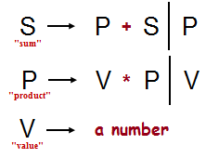
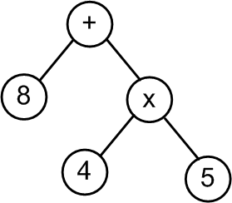
Big Picture for Unicalc in Java
String
"8 + 4 * 5"
Token List
< “8” “+” “4” “*” “5” >
Parse Tree
[+, [8], [*, [4], [5]]]
Evaluation
28.0
How is this going to work?

Slide 31

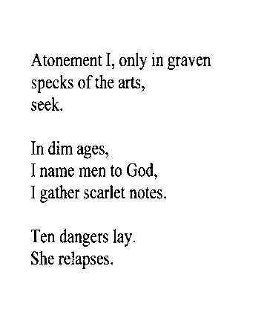
Tokenize – Figure out what are the tokens (words)
inumbrage
atonementionlyingravenspecksoftheartsseekindimagesinamementogodigatherscarletnotestendangerslaysherelapses
inumbrage
inumbrage
atonementionlyingravenspecksoftheartsseekindimagesinamementogodigatherscarletnotestendangerslaysherelapses
atonementionlyingravenspecksoftheartsseekindimagesinamementogodigatherscarletnotestendangerslaysherelapses
Re-parsable poetry?!
- Mike Maguire

Slide 32
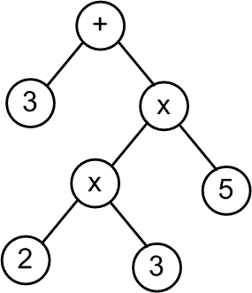
Evaluate these Parse Trees
Does this remind you of a previous homework assignment???
What is the value of this parse tree?
A) 33 B) 90 C)Other D)??

Slide 33
Big Picture for Unicalc in Java
String input
Tokenizer
String[] tokens
Parser
ParseTree tree
Evaluator
Quantity result

Slide 34
Grammars
Grammar: A set of rules that determines legal expressions in a language.
the starting rule or “production”
+
S V S
V
S = “I want to be a sum.”
V = “I want to be a value.”
"sum"
V
0
1
…
9
"value"
nonterminal or auxiliary symbol
This is how we write "or“ in grammars
each nonterminal symbol represents a “syntactic category”
terminal symbols -- things that appear in the expression to be parsed
alphabet = { +, 0, 1, …, 9 }

Slide 35
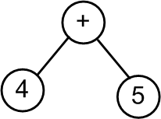
Grammars + Parsing
This shows how the production rules map to the tokens
A parser takes in tokens and outputs a parse tree,
according to some grammar!
Grammar:
S V S
V
+
S
"sum"
V
S
0
1
…
9
V
+
"value"
4
V
Parse tree: [+, [4], [5]]
5
Token list: <"4","+","5">
Input string: "4 + 5"

Slide 36
Grammars + Parsing
Show how the production rules map to the tokens
Grammar:
S
S V S
V
+
"sum"
V
0
1
…
9
"value"
Parse tree:
Token list: <"2","+","3","+","4" >
Draw the parse tree. How many nodes does it have? A) 3 B) 5 C) > 5 D) ??

Slide 37
DEMO – Parsing
Token list: <"4","+","5">
S
Calls V to handle V-stuff
When V returns
  If next token “+”
    Remove token
    Call S (recursion)
  If out of tokens
    Return
V
Removes token
Return
Grammar:
S V S
V
+
"sum"
V
0
1
…
9
"value"

Slide 38
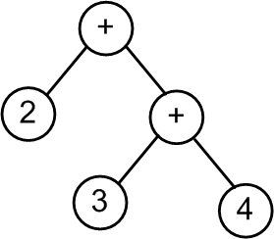
DEMO – Parsing
Token list: <"2","+","3","+","4" >
S
Calls V to handle V-stuff
When V returns
  If next token “+”
    Remove token
    Call S (recursion)
  If out of tokens
    Return
V
Removes token
Return
Grammar:
S V S
V
+
"sum"
V
0
1
…
9
"value"

Slide 39
A grammar defines all legal sentences
start here
S
V
+
S
V
-
S
V
S
V
0
1
…
9
Show how the production rules map to the tokens
A) Got it! B) Confused C) ??
8 - 4 + 5

Slide 40
The Recursive Descent Parsing Algorithm
S
P
S
+
V
P
This shows how the production rules map to the tokens
V
*
P
8
V
4
5
Draw the resulting parse tree
< 8, +, 4, *, 5 >

Slide 41
Show how the production rules map to the tokens
S
Starting symbol
S
P
+
S
P
-
S
P
"sum"
P
V
*
P
V
/
P
V
"product"
V
0
1
…
9
"value"
1
Above, create the parse tree for the expression
What does parse tree evaluate to?
7 * 3 + 9 / 2
expression to be parsed
2
How could you change the grammar so that addition and subtraction had higher precedence than multiplication and division? And why might that be good?
What rule could you add that would enable the use of parentheses ( and ) for grouping terms?
3
Notes:
why it would be good -- because the expression comes out to 42!

Slide 42
Our grammar for the Unicalc language
Watch out…
* + vs. * +
the Start symbol
S
def
V
E
#
E
E
an Expression
E
P
+
E
P
-
E
P
you'll need to add code for these rules
a Product
P
K
*
P
K
/
P
K
a Ka-Power
K
U
^
I
U
a single Unit
U
(
E
)
(
-
E
)
Q
a Quantity list!
Q
D V
D~D V
V
*
*
+
zero or more Vs
with uncertainty!
one or more Vs
implemented in Parser.java for you already
D
a numeric value (Double)
42.0
V
a variable name (String)
"furlong"
I
a variable name (Integer)
5
tokens are in red

Slide 43
Our grammar with its parse trees…
the Start symbol
S
def
V
E
#
E
E
blue trees
[ "def", V, E ]
[ "#", E ]
E
an Expression
E
P
+
E
P
-
E
P
[ "+", P, E ]
[ "-", P, E ]
P
you'll need to add code for these rules
a Product
P
K
*
P
K
/
P
K
[ "∗", K, P ]
[ "/", K, P ]
K
a Ka-Power
K
U
^
I
U
[ "∗", U, I ]
U
a single Unit
U
(
E
)
(
-
E
)
Q
E
[ "-", E ]
Q
a Quantity list!
Q
D V
D~D V
V
*
+
[ { D [V∗] [ ] 0.0 } ]
[ { D [V∗] [ ] D } ]
[ { 1.0 [V+] [ ] 0.0 } ]
D
a numeric value (Double)
42.0
Quantity objects are in purple
V
a variable name (String)
"furlong"
I
a variable name (Integer)
5

Slide 44
BONUS

Slide 45


Slide 46


Computer
Science
&
= AWESOME

Slide 47

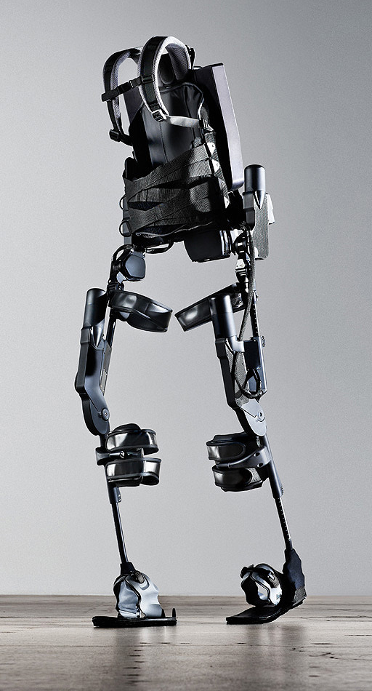
http://www.youtube.com/watch?v=pzRmNYA8LlY

Slide 48


ClickStart

Slide 49


Slide 50

How should we represent the blocks in the computer?
Independent variables
2D Array
OpenList
I don’t know

Slide 51
The value in the array tells me what art asset to use
Each level is really a 3x10 vector!
0 | 0 | 7 | 0 | 4 | 0 | 0 | 0
1 | 2 | 3 | -4 | 5 | 6 | -7 | 8
B | B | B | B | B | B | B | B
Negative values tell me what block needs to go here to win!

Slide 52
0 | 0 | 7 | 0 | 4 | 0 | 0 | 0
1 | 2 | 3 | -4 | 5 | 6 | -7 | 8
0 | 0 | 0 | B | 0 | 0 | 0 | 0

Slide 53
BUGS!

Slide 54


Slide 55

It is really sad when stuff you’ve made is on sale!

Slide 56



Which image is fake?
  A. Top Left
  B. Bottom Left
  C. Bottom Right

Slide 57
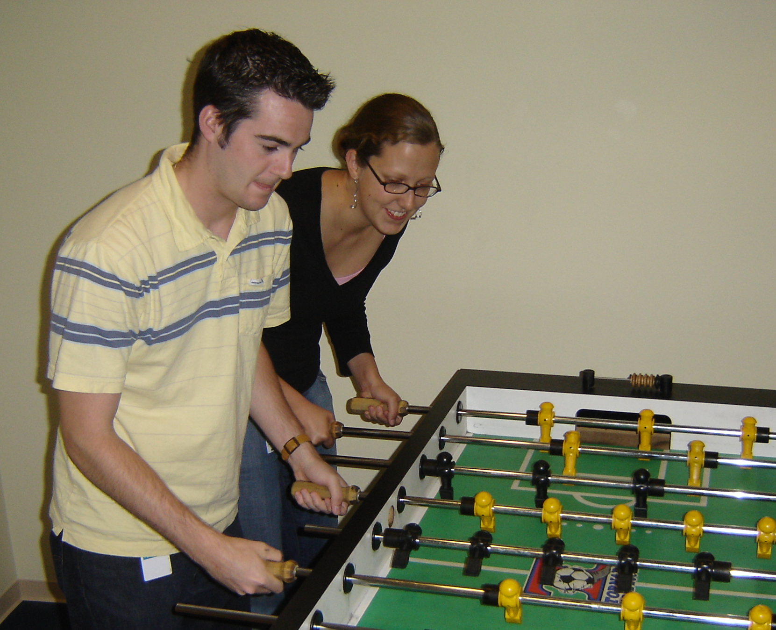

Slide 58
