Slide 1
CS 60
Parsing Framework
Homework 10
2013-04-09
Tuesday – Week 10
Lecture 20

Slide 2
Survey
Do you think it would be fun to be a CS60 grutor?
Yes – I like helping people!!!
Yes – CS60 should have lots of grutors!!!
Yes – I’d like to review CS60 material after the class!!!
All of the above
Nice try Colleen – No.

Slide 3
Administrative Stuff
(Not in your notes)
Java Quiz due April 17th
init(together) – Conference designed for women in CS – Sunday April 14th - At UC Irvine
  Let me know if you want to attend
You should come and talk to me!!! ☺

Slide 4
Big idea of Hw10
(Unicalc)
Parsing
Thursday’s lecture notes said “Hw9” which is wrong.

Slide 5
Big Picture for Unicalc in Java
String input
Tokenizer
String[] tokens
Parser
ParseTree tree
Evaluator
Quantity result

Slide 6
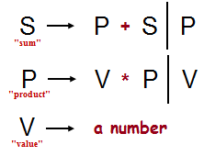
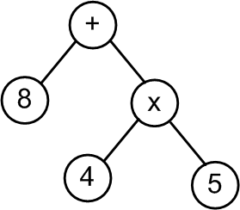
Big Picture for Unicalc in Java
String
"8 + 4 * 5"
Token List
< “8” “+” “4” “*” “5” >
Parse Tree
[+, [8], [*, [4], [5]]]
Evaluation
28.0
How is this going to work?

Slide 7
Examples: Numbers & Uncertainty & Units
The input line: 42
The tokens are < 42 >
The parseTree is [{ 42.0, [], [], 0.0 }]
The value is { 42.0, [], [], 0.0 }
The input line: 42~10
The tokens are < 42, ~, 10 >
The parseTree is [{ 42.0, [], [], 10.0 }]
The value is { 42.0, [], [], 10.0 }
The input line: 42 m
The tokens are < 42, m >
The parseTree is [{ 42.0, [m], [], 0.0 }]
The value is { 42.0, [m], [], 0.0 }
The input line: 42~10 v s m
The tokens are < 42, ~, 10, v, s, m >
The parseTree is [{ 42.0, [m, s, v], [], 10.0 }]
The value is { 42.0, [m, s, v], [], 10.0 }
Helpful for debugging to see the input, tokens, parseTree, and value.

Slide 8
Examples: Math without units
Notice the order of precedence
The input line: 5+6
The tokens are < 5, +, 6 >
The parseTree is [+, [{ 5.0, [], [], 0.0 }], [{ 6.0, [], [], 0.0 }]]
The value is { 11.0, [], [], 0.0 }
The input line: 5-6+7 // this grammar is _right_-associative
The tokens are < 5, -, 6, +, 7 >
The parseTree is [-, [{ 5.0, [], [], 0.0 }],
[+, [{ 6.0, [], [], 0.0 }], [{ 7.0, [], [], 0.0 }]]]
The value is { -8.0, [], [], 0.0 }
The input line: 5*6
The tokens are < 5, *, 6 >
The parseTree is [*, [{ 5.0, [], [], 0.0 }], [{ 6.0, [], [], 0.0 }]]
The value is { 30.0, [], [], 0.0 }
The input line: 5/6
The tokens are < 5, /, 6 >
The parseTree is [/, [{ 5.0, [], [], 0.0 }], [{ 6.0, [], [], 0.0 }]]
The value is { 0.833333, [], [], 0.0 }

Slide 9
Examples: Math with units
The input line: 3 m/s
The tokens are < 3, m, /, s >
The parseTree is [/, [{ 3.0, [m], [], 0.0 }],
[{ 1.0, [s], [], 0.0 }]]
The value is { 3.0, [m], [s], 0.0 }
The input line: 3 m * 2 m/s
The tokens are < 3, m, *, 2, m, /, s >
The parseTree is [*, [{ 3.0, [m], [], 0.0 }],
[/, [{ 2.0, [m], [], 0.0 }],
[{ 1.0, [s], [], 0.0 }]]]
The value is { 6.0, [m, m], [s], 0.0 }
The input line: 18 m/s + 42 m/s
The tokens are < 18, m, /, s, +, 42, m, /, s >
The parseTree is [+, [/, [{ 18.0, [m], [], 0.0 }],
[{ 1.0, [s], [], 0.0 }]],
[/, [{ 42.0, [m], [], 0.0 }],
[{ 1.0, [s], [], 0.0 }]]]
The value is { 60.0, [m], [s], 0.0 }
Input of "/ s" turned into the Quantity
[{ 1.0, [s], [], 0.0 }]]
Accumulation of Units!

Slide 10
Examples: Math Precedence
Notice the order of precedence
The input line: 5+6*7
The tokens are < 5, +, 6, *, 7 >
The parseTree is [+, [{ 5.0, [], [], 0.0 }],
[*, [{ 6.0, [], [], 0.0 }],
[{ 7.0, [], [], 0.0 }]]]
The value is { 47.0, [], [], 0.0 }
The input line: 5*6+7
The tokens are < 5, *, 6, +, 7 >
The parseTree is [+, [*, [{ 5.0, [], [], 0.0 }],
[{ 6.0, [], [], 0.0 }]],
[{ 7.0, [], [], 0.0 }]]
The value is { 37.0, [], [], 0.0 }
The input line: 3^2
The tokens are < 3, ^, 2 >
The parseTree is [^, [{ 3.0, [], [], 0.0 }],
2]
The value is { 9.0, [], [], 0.0 }

Slide 11
Examples: Parentheses
The input line: (42)
The tokens are < (, 42, ) >
The parseTree is [{ 42.0, [], [], 0.0 }]
The value is { 42.0, [], [], 0.0 }
The input line: (4+2)
The tokens are < (, 4, +, 2, ) >
The parseTree is [+, [{ 4.0, [], [], 0.0 }],
[{ 2.0, [], [], 0.0 }]]
The value is { 6.0, [], [], 0.0 }
The input line: (4+2)*7
The tokens are < (, 4, +, 2, ), *, 7 >
The parseTree is [*, [+, [{ 4.0, [], [], 0.0 }],
[{ 2.0, [], [], 0.0 }]],
[{ 7.0, [], [], 0.0 }]]
The value is { 42.0, [], [], 0.0 }
Parentheses determine the structure of the ParseTree, but aren’t represented in there.

Slide 12
Examples: Negation
The input line: (-42)
The tokens are < (, -, 42, ) >
The parseTree is [-, [{ 42.0, [], [], 0.0 }]]
The value is { -42.0, [], [], 0.0 }
The input line: 60 m +(-18 m)
The tokens are < 60, m, +, (, -, 18, m, ) >
The parseTree is [+, [{ 60.0, [m], [], 0.0 }],
[-, [{ 18.0, [m], [], 0.0 }]]]
To negate a number, we MUST use parentheses (defined in the grammar)

Slide 13
Examples: def
The input line: def answer 42
The tokens are < def, answer, 42 >
The parseTree is [def, answer, [{ 42.0, [], [], 0.0 }]]
The value is { 42.0, [], [], 0.0 }
The current env is
[
[answer, { 42.0, [], [], 0.0 }]
]
The input line: 10 answer / s
The tokens are < 10, answer, /, s >
The parseTree is [/, [{ 10.0, [answer], [], 0.0 }],
[{ 1.0, [s], [], 0.0 }]]
The value is { 10.0, [answer], [s], 0.0 }
The current env is
[
[answer, { 42.0, [], [], 0.0 }]
]
def adds something to the environment
This wasn’t normalized!!! So it didn’t look up answer

Slide 14
Examples: def and # (which calls norm)
The input line: def answer 42
The tokens are < def, answer, 42 >
The parseTree is [def, answer, [{ 42.0, [], [], 0.0 }]]
The value is { 42.0, [], [], 0.0 }
The current env is
[
[answer, { 42.0, [], [], 0.0 }]
]
The input line: # 10 answer/s
The tokens are < #, 10, answer, /, s >
The parseTree is [#, [/, [{ 10.0, [answer], [], 0.0 }],
[{ 1.0, [s], [], 0.0 }]]]
The value is { 420.0, [], [s], 0.0 }
The current env is
[
[answer, { 42.0, [], [], 0.0 }]
]
# is the indication you want to normalize
(so it did look up answer)

Slide 15
Examples: def and minus (which calls norm)
The input line: def answer 42
The tokens are < def, answer, 42 >
The parseTree is [def, answer, [{ 42.0, [], [], 0.0 }]]
The value is { 42.0, [], [], 0.0 }
The current env is
[
[answer, { 42.0, [], [], 0.0 }]
]
The input line: 10 answer - 9 answer
The tokens are < 10, answer, -, 9, answer >
The parseTree is [-, [{ 10.0, [answer], [], 0.0 }],
[{ 9.0, [answer], [], 0.0 }]]
The value is { 42.0, [], [], 0.0 }
The current env is
[
[answer, { 42.0, [], [], 0.0 }]
]
We need to normalize when we do – and +
(so this looked up answer)

Slide 16
Examples: def (second call!)
The input line: def answer 42
The tokens are < def, answer, 42 >
The parseTree is [def, answer, [{ 42.0, [], [], 0.0 }]]
The value is { 42.0, [], [], 0.0 }
The current env is
[
[answer, { 42.0, [], [], 0.0 }]
]
The input line: def x 3 m/s
The tokens are < def, x, 3, m, /, s >
The parseTree is [def, x, [/, [{ 3.0, [m], [], 0.0 }],
[{ 1.0, [s], [], 0.0 }]]]
The value is { 3.0, [m], [s], 0.0 }
The current env is
[
[x, { 3.0, [m], [s], 0.0 }]
[answer, { 42.0, [], [], 0.0 }]
]
Our association list
(the environment)
can hold lots of things
(and they can have units)

Slide 17
Examples: def (3rd call)
The input line: def answer 7*(x+x)
The tokens are < def, answer, 7, *, (, x, +, x, ) >
The parseTree is [def, answer, [*, [{ 7.0, [], [], 0.0 }],
[+, [{ 1.0, [x], [], 0.0 }],
[{ 1.0, [x], [], 0.0 }]]]]
The value is { 42.0, [m], [s], 0.0 }
The current env is
[
[answer, { 42.0, [m], [s], 0.0 }]
[x, { 3.0, [m], [s], 0.0 }]
[answer, { 42.0, [], [], 0.0 }]
]
We can redefine answer, and it will always use the NEWEST version!

Slide 18
Examples: def (4th calls)
The input line: def hz 1/s
The tokens are < def, hz, 1, /, s >
The parseTree is [def, hz, [/, [{ 1.0, [], [], 0.0 }],
[{ 1.0, [s], [], 0.0 }]]]
The value is { 1.0, [], [s], 0.0 }
The current env is
[
[hz, { 1.0, [], [s], 0.0 }]
[answer, { 42.0, [m], [s], 0.0 }]
[x, { 3.0, [m], [s], 0.0 }]
[answer, { 42.0, [], [], 0.0 }]
]
This one is actually helpful to add to our environment
(the association list)

Slide 19
Examples: using multiple variables
The input line: answer + 18 m hz
The tokens are < answer, +, 18, m, hz >
The parseTree is [+, [{ 1.0, [answer], [], 0.0 }],
[{ 18.0, [hz, m], [], 0.0 }]]
The value is { 60.0, [m], [s], 0.0 }
The current env is
[
[hz, { 1.0, [], [s], 0.0 }]
[answer, { 42.0, [m], [s], 0.0 }]
[x, { 3.0, [m], [s], 0.0 }]
[answer, { 42.0, [], [], 0.0 }]
]
We normalize variables (answer) and units (hz) in the same way!

Slide 20
OpenList
Racket Lists in Java
(Provided)

Slide 21
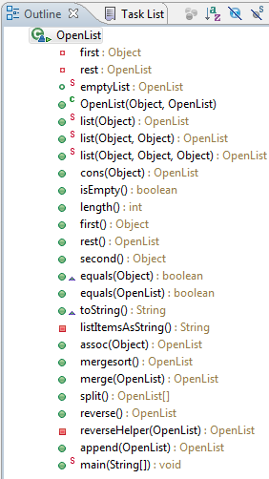
OpenList Overview
Instance variables
Representing an empty OpenList (static variable that ends EVERY list – just like emptyBSTNode)
Methods for constructing OpenLists (Constructors + static methods)
Methods to access stuff about OpenLists.
OpenLists can hold association lists!
OpenLists can do merge & merge sort!

Slide 22
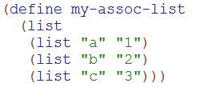



Review:
Racket assoc
Make an association list that stores keys and values.
Key
Value
Lookup information in the association list.
Sometimes the key won’t be there

Slide 23
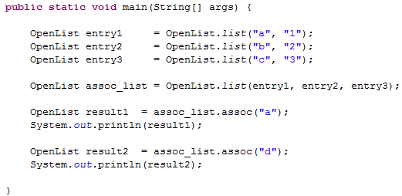
assoc in Java
What will print?
["a" "1"]
[]
"a"
"1"
???
This will print: _____

Slide 24
Quantity
(Re-implement methods you wrote in Racket)

Slide 25
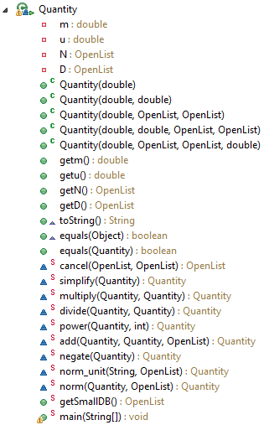
Quantity Overview
Instance variables
Constructors
Accessors
Error propagation
Normalize Units using the association list of units
(and variables)

Slide 26
DB.first().second() should be of type:
OpenList B) Object C) String D) Quantity E) ???
DB is [
[foot, { 12.0, [inch], [], 0.0 }],
[cm, { 0.01, [meter], [], 0.0 }],
[mile, { 5280.0, [foot], [], 0.0 }],
[inch, { 0.0254, [meter], [], 0.0 }],
[hour, { 60.0, [minute], [], 0.0 }],
[minute, { 60.0, [second], [], 0.0 }],
[mph, { 1.0, [mile], [hour], 0.0 }],
[ohm, { 1.0, [volt], [ampere], 0.0 }],
[volt, { 1.0, [joule], [coulomb], 0.0 }],
[watt, { 1.0, [joule], [second], 0.0 }],
[coulomb, { 1.0, [ampere, second], [], 0.0 }],
[joule, { 1.0, [kg, meter, meter], [second, second], 0.0}]
]

Slide 27
Tokenizer
(Take in input and break it into pieces)

Slide 28
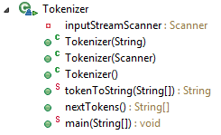
Tokenizer Overview
Instance variable: The input
Get the input from a file
Get the input from the command line
Default input: command line
Print
Most important method! Get the tokens!

Slide 29
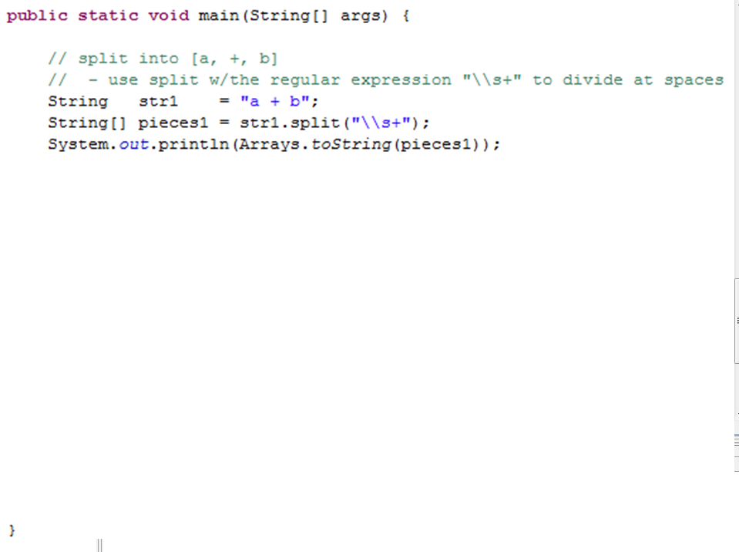
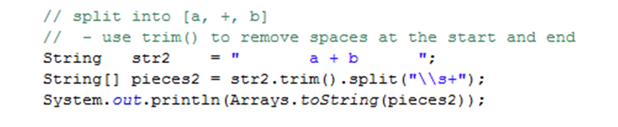
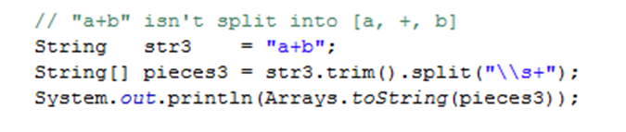
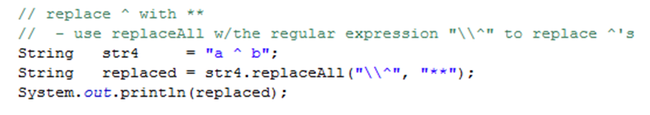
pieces1.length is 3
What is pieces3.length?
0
1
2
3
??
Can replaceAll help?

Slide 30
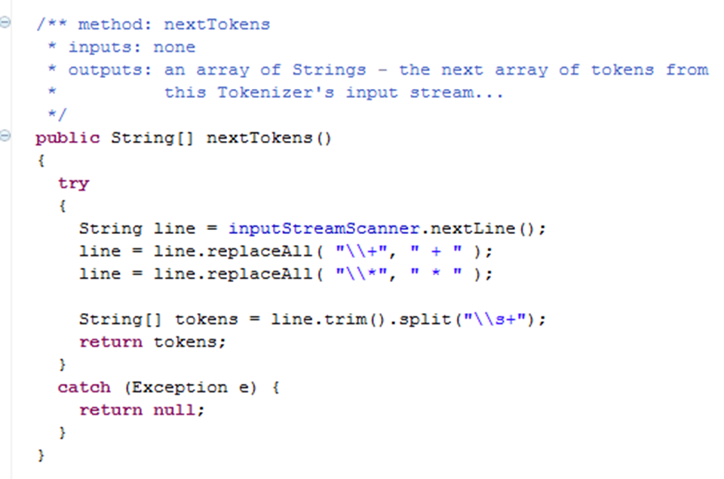
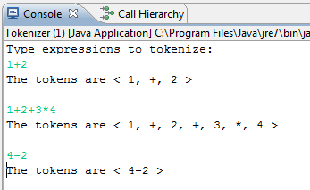
If I add more lines like this, does the order matter? A) Yes B) No
(Try to fix minus)
Tokenizer main method
Minus doesn’t get tokenized correctly!

Slide 31
Big Picture for Unicalc in Java
String input
Tokenizer
String[] tokens
Parser
ParseTree tree
Evaluator
Quantity result

Slide 32
ParseTree
Structure for the Tokens
(provided)
Returned by parse(String[] tokens)

Slide 33
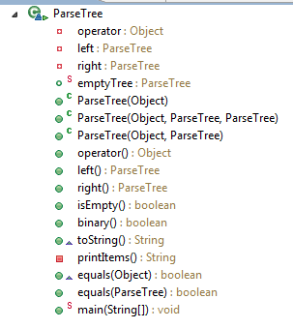
ParseTree
Overview
Instance variables
Constructors
Accessors

Slide 34
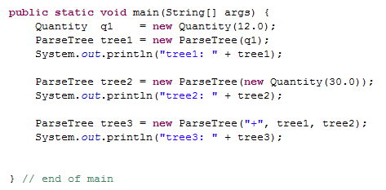
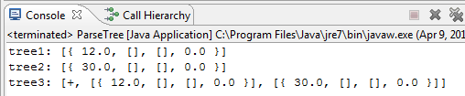
Creating ParseTrees
Are lines with either tree1 or tree2 an error?
A) Yes B) No

Slide 35
q1
tree1
args
Quantity
m
u
N
D
main
ParseTree
operator
left
right
12.0
0.0
OpenList
first
rest
ParseTree
operator
left
right
Should there be two copies of this empty ParseTree here?
A) Yes B) No C)?

Slide 36
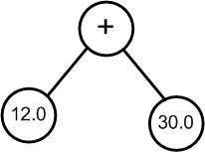
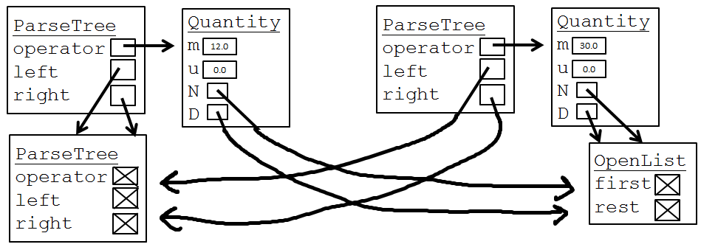
tree3
tree2
tree1
args
ParseTree
operator
left
right
Conceptual ParseTree
main
"+"

Slide 37
Big Picture for Unicalc in Java
String input
Tokenizer
String[] tokens
Parser
ParseTree tree
Evaluator
Quantity result

Slide 38
Evaluator
Evaluate the ParseTree

Slide 39
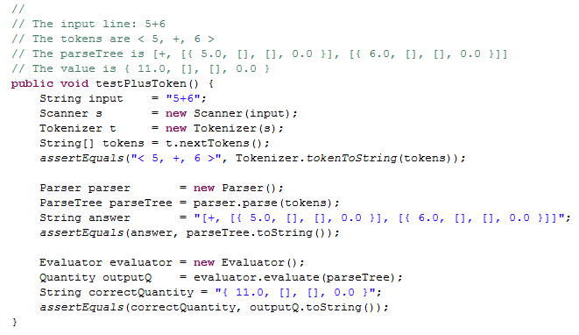
EvaluatorTest.java
Do I create any unnecessary variables here?
(That NEVER get used?)
A) Yes B) No C)?

Slide 40
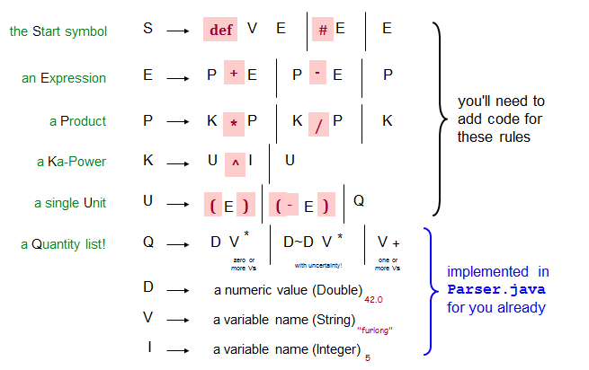
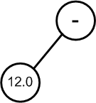
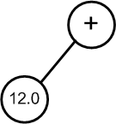
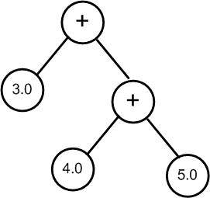
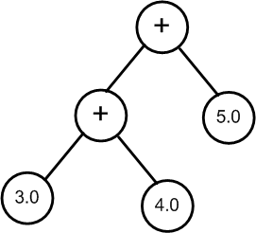
Are any of these invalid ParseTrees?
A) Yes B) No C) ?

Slide 41
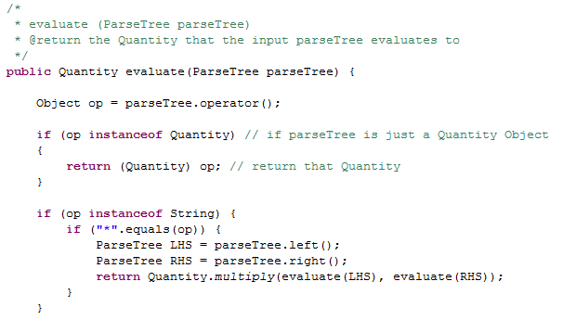
evaluate(ParseTree parseTree)
Should parseTree.left() return a Quantity instead?
A) Yes B) No C) ?

Slide 42
Parser
Create the ParseTree from the tokens

Slide 43
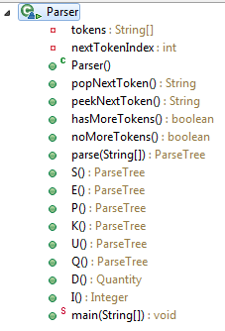

Slide 44
Big Picture for Unicalc in Java
String input
Tokenizer
String[] tokens
Parser
ParseTree tree
Evaluator
Quantity result

Slide 45
Our grammar with its parse trees…
the Start symbol
S
def
V
E
#
E
E
blue trees
[ "def", V, E ]
[ "#", E ]
E
an Expression
E
P
+
E
P
-
E
P
[ "+", P, E ]
[ "-", P, E ]
P
you'll need to add code for these rules
a Product
P
K
*
P
K
/
P
K
[ "∗", K, P ]
[ "/", K, P ]
K
a Ka-Power
K
U
^
I
U
[ "∗", U, I ]
U
a single Unit
U
(
E
)
(
-
E
)
Q
E
[ "-", E ]
Q
a Quantity list!
Q
D V
D~D V
V
*
+
[ { D [V∗] [ ] 0.0 } ]
[ { D [V∗] [ ] D } ]
[ { 1.0 [V+] [ ] 0.0 } ]
D
a numeric value (Double)
42.0
Quantity objects are in purple
V
a variable name (String)
"furlong"
I
a variable name (Integer)
5

Slide 46
BONUS

Slide 47
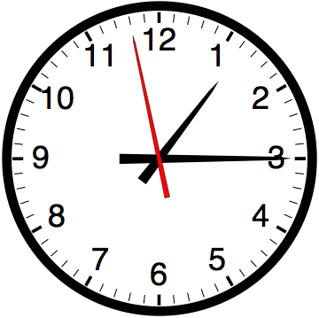

Slide 48


Computer
Science
&
= AWESOME

Slide 49

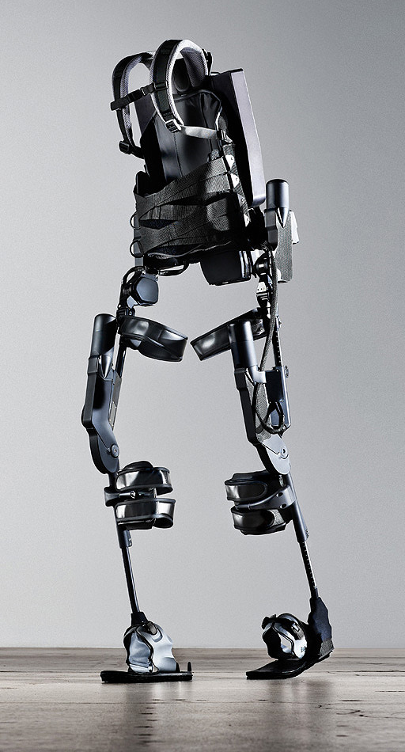
http://www.youtube.com/watch?v=pzRmNYA8LlY

Slide 50

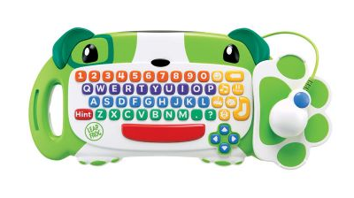
ClickStart

Slide 51
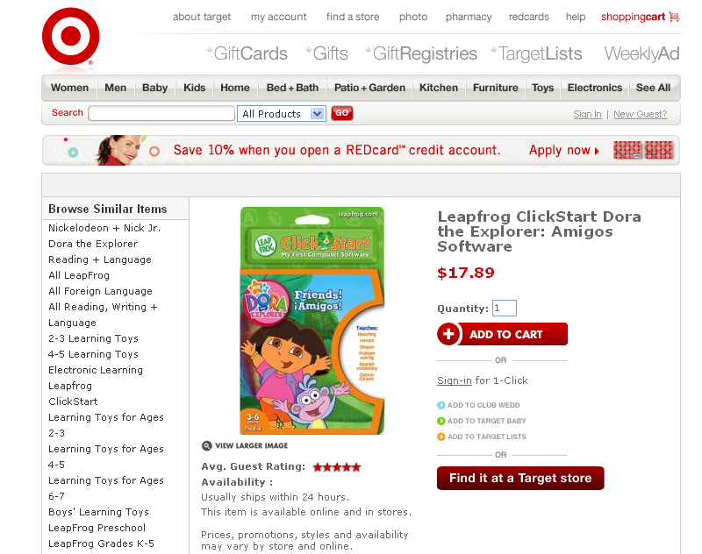

Slide 52

How should we represent the blocks in the computer?
Independent variables
2D Array
OpenList
I don’t know

Slide 53
The value in the array tells me what art asset to use
Each level is really a 3x10 vector!
0 | 0 | 7 | 0 | 4 | 0 | 0 | 0
1 | 2 | 3 | -4 | 5 | 6 | -7 | 8
B | B | B | B | B | B | B | B
Negative values tell me what block needs to go here to win!

Slide 54
0 | 0 | 7 | 0 | 4 | 0 | 0 | 0
1 | 2 | 3 | -4 | 5 | 6 | -7 | 8
0 | 0 | 0 | B | 0 | 0 | 0 | 0

Slide 55
BUGS!

Slide 56
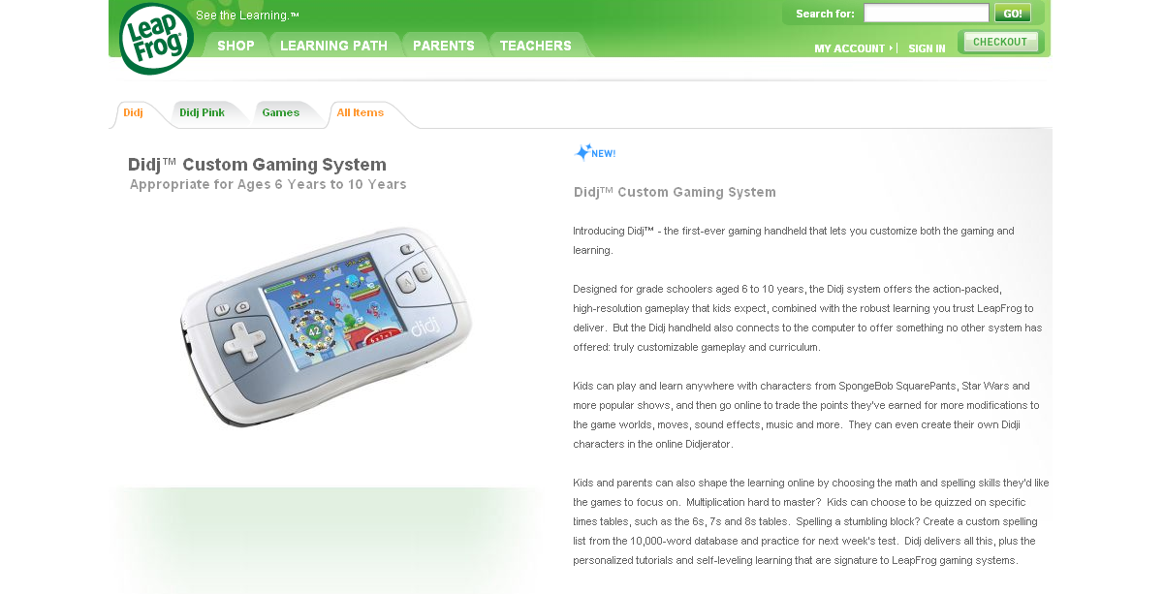

Slide 57

It is really sad when stuff you’ve made is on sale!

Slide 58

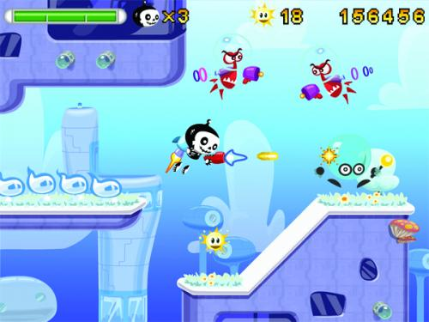

Which image is fake?
  A. Top Left
  B. Bottom Left
  C. Bottom Right

Slide 59
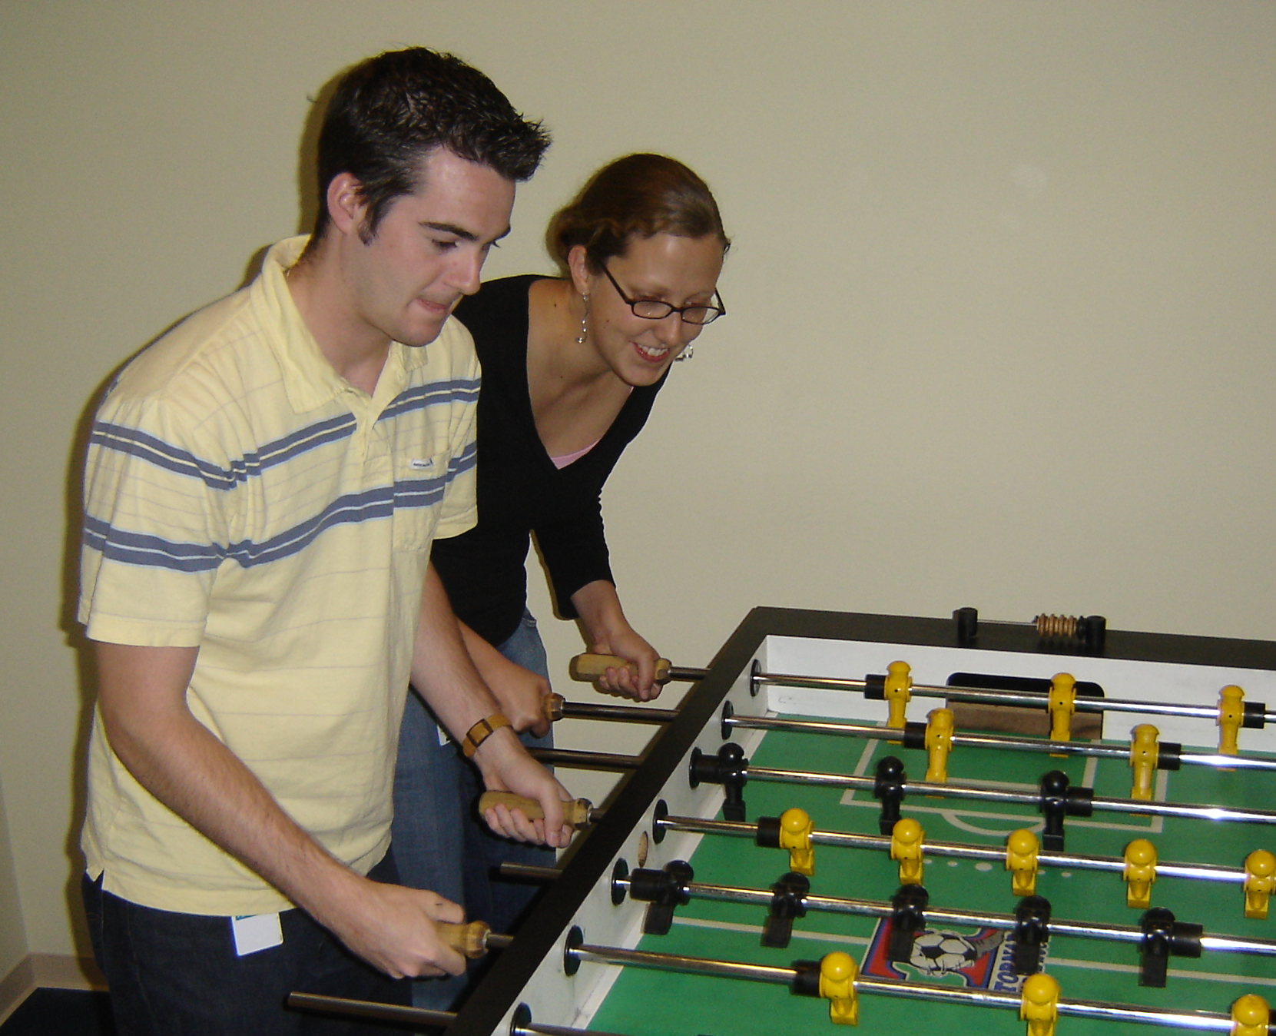

Slide 60
