Slide 1
CS 60
Inheritance, Exceptions, & Sorting
2013-04-11
Thursday – Week 10
Lecture 21

Slide 2
Survey
When Colleen has “lunch hours” during reading week and exam week – do you think people will come and share their experiences from CS60?
Yes – Probably
Maybe not – Everyone will be super busy!
No
I don’t know

Slide 3
Administrative Stuff (Not in your notes)
Java Quiz due April 17th
I have extra lecture notes from previous classes!
init(together) – Conference designed for women in CS – Sunday April 14th - At UC Irvine
Let me know if you want to attend
You should come and talk to me!!! ☺

Slide 4
Inheritance (last time we focused on how we can reference various objects, now we’re focused on constructing objects and calling methods)

Slide 5
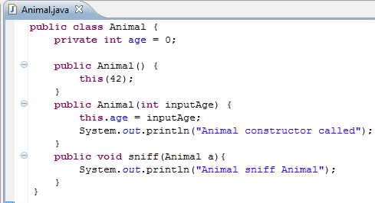
Calling another constructor in the class
Call the OTHER constructor
(Weird use of this)

Slide 6
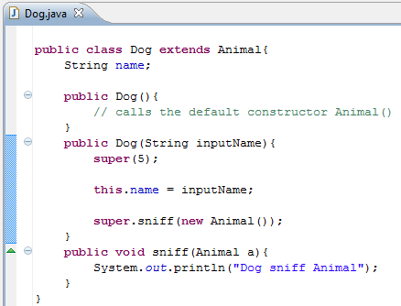
Things a child class can do…
Dog extends Animal
By default the Animal() constructor is called. It would be equivalent to write: super()
Explicitly call the Animal(int) constructor
Override the parent method
Call the parent method

Slide 7
Inheritance: this and super
Calling constructors
this( )
calls a different constructor in the same class
super( )
calls a constructor in the parent class
Calling methods
this.methodName( )
calls a method in the same class
super.methodName( )
calls a method in the parent class
The inside of these parentheses are blank but there could be different numbers and types of arguments

Slide 8
Inheritance (How to decide what method gets called)

Slide 9
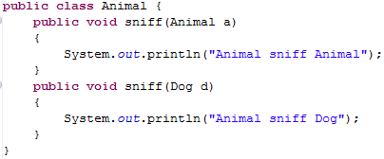
Inheritance and Arguments
Animal
Dog
Cat

Slide 10
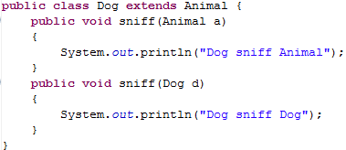
Animal a1 = new Dog();
Dog d1 = new Dog();
a1.sniff(d1);
A
What gets called?
B
C
D

Slide 11
Animal a1 = new Dog();
Dog d1 = new Dog();
d1.sniff(a1);
A
What gets called?
B
C
D

Slide 12
Animal a1 = new Dog();
Animal a2 = new Dog();
a1.sniff(a2);
A
What gets called?
B
C
D

Slide 13
← Uses a1’s dynamic type
ANSWERS
Animal a1 = new Dog();
Dog d1 = new Dog();
a1.sniff(d1);
d1.sniff(a1);
Animal a2 = new Dog();
a1.sniff(a2);
D
← Uses a1’s static type
C
C
← Uses a1’s dynamic type
Uses a2’s static type

Slide 14
Figuring out what compiles and what method to call!
Compilation:
CALLER: It makes sure that the static type of the object has the appropriate method
ARGS: It makes sure that the method takes in the static type of the arguments
Run-time:
CALLER: When you call a method on an object it looks for the method in the class of the object’s dynamic type
ARGS: When you pass an object as an argument, it looks for a method with that static type

Slide 15
Animal a1 = new Dog();
Dog d1 = new Dog();
a1.sniff(d1);
d1.sniff(a1);
Animal a2 = new Dog();
a1.sniff(a2);
Dog
age
bites
0
true
Dog
age
bites
0
main
Animal a1
Animal a2
Dog d1
true
Dog
age
bites
0
true

Slide 16
equals (why) we always use Object as the argument: public boolean equals(Object o)

Slide 17
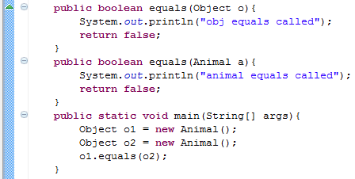
equals(Object o)
A
B
Which equals is called?
Object

Slide 18
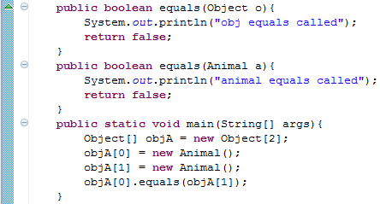
equals(Object o) and Arrays
A
B
Which equals is called?
Object

Slide 19
equals(Object o) The take away
If others will call your methods with more generic references, you want to provide a method that takes in an Object

Slide 20
Exceptions Option 1: Catch Checked Exceptions Option 2: Declare that you might throw the exception

Slide 21
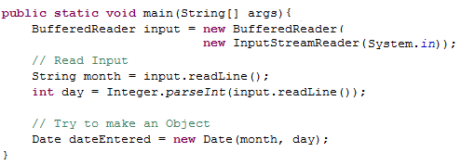
Opportunities for things to go wrong
User doesn’t type a number
User input isn’t a valid date

Slide 22
Exception Hierarchy (Just Objects)
Throwable
Exception
Runtime Exception
Error
Illegal Argument Exception
Number Format Exception
Buffer Overflow Exception
Null Pointer Exception
IO Exception
File Not Found Exception
A user defined Exception
Object

Slide 23
Exception Hierarchy (the big idea: Exceptions are Objects)
Throwable
Exception
Runtime Exception
Error
Illegal Argument Exception
Number Format Exception
Buffer Overflow Exception
Null Pointer Exception
IO Exception
File Not Found Exception
A user defined Exception
Object
Unchecked
Exceptions
Checked Exceptions

Slide 24
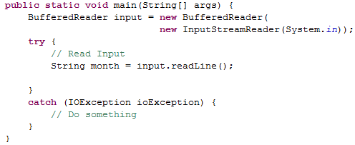
Option 1: Catch Checked Exceptions
Getting user input could cause an error
Exception Type
Variable name for the Exception Object

Slide 25
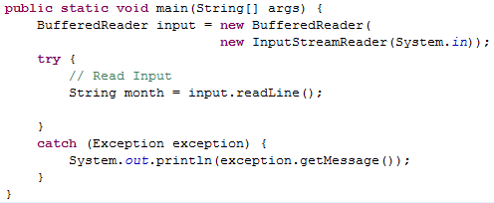
Using the Exception Hierarchy
Might “throw” an IOException
We can catch the superclass and catch all subclasses
All Exception Objects have a getMessage() method

Slide 26
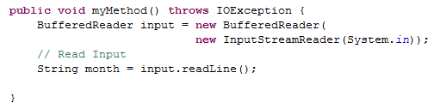
Option 2: Declare that you might throw the exception
Someone calling myMethod() needs to either declare that they may throw an IOException
or catch the exception with try/catch.
Getting user input could throw an IOException
(which is a Checked Exception)

Slide 27
Exception Hierarchy
Throwable
Exception
Runtime Exception
Error
Illegal Argument Exception
Number Format Exception
Buffer Overflow Exception
Null Pointer Exception
IO Exception
File Not Found Exception
A user defined Exception
Object
Unchecked Exceptions:
Can be declared and
caught but it is not
required
Checked Exceptions:
Declare you might throw or use try/catch

Slide 28
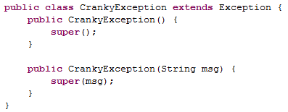
Make your own Exception Subclass

Slide 29
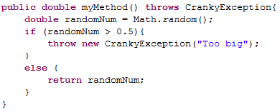
Throwing Exceptions
throw
(sort of like return)
A method can only throw one exception at a time!
Create a new CrankyException Object

Slide 30

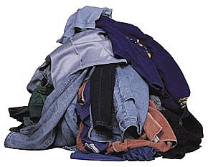
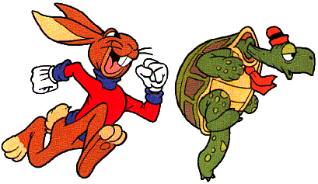


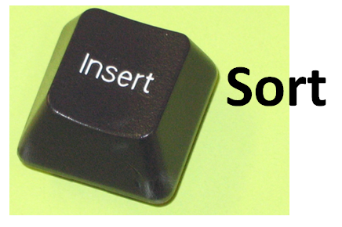
Bubble Sort
Selection Sort
Heap
Sort
Quick Sort
Merge
Sort

Slide 31

Bubble Sort

Slide 32
Bubble Sort Pseudocode http://www.youtube.com/watch?v=k4RRi_ntQc8
Step through the list to be sorted, compare adjacent elements, swap them if they are in the wrong order.
Repeat this process until no swaps are needed.
What is the Big-O runtime of Bubble Sort?
A) O(N) B) O(N log N) C) O(N²) D) O(2^{N}) E) ??
Is it sometimes faster than this? A) Yes B) No

Slide 33
Bubble Sort – Why it works!
Invariant: after the kth iteration, the k-largest elements are at the end of the list.

Slide 34
The Orange shows which elements are being compared.
15 | 3 | 1 | 9 | 4 | 7 | 5 | 4 | 0 | 12
3 | 15 | 1 | 9 | 4 | 7 | 5 | 4 | 0 | 12
3 | 1 | 15 | 9 | 4 | 7 | 5 | 4 | 0 | 12
3 | 1 | 9 | 15 | 4 | 7 | 5 | 4 | 0 | 12
3 | 1 | 9 | 4 | 15 | 7 | 5 | 4 | 0 | 12
3 | 1 | 9 | 4 | 7 | 15 | 5 | 4 | 0 | 12
3 | 1 | 9 | 4 | 7 | 5 | 15 | 4 | 0 | 12
3 | 1 | 9 | 4 | 7 | 5 | 4 | 15 | 0 | 12
3 | 1 | 9 | 4 | 7 | 5 | 4 | 0 | 15 | 12
3 | 1 | 9 | 4 | 7 | 5 | 4 | 0 | 12 | 15
The “biggest” element is in the right spot!

Slide 35
3 | 1 | 9 | 4 | 7 | 5 | 4 | 0 | 12 | 15
1 | 3 | 9 | 4 | 7 | 5 | 4 | 0 | 12 | 15
1 | 3 | 9 | 4 | 7 | 5 | 4 | 0 | 12 | 15
1 | 3 | 4 | 9 | 7 | 5 | 4 | 0 | 12 | 15
1 | 3 | 4 | 7 | 9 | 5 | 4 | 0 | 12 | 15
1 | 3 | 4 | 7 | 5 | 9 | 4 | 0 | 12 | 15
1 | 3 | 4 | 7 | 5 | 4 | 9 | 0 | 12 | 15
1 | 3 | 4 | 7 | 5 | 4 | 0 | 9 | 12 | 15
1 | 3 | 4 | 7 | 5 | 4 | 0 | 9 | 12 | 15
1 | 3 | 4 | 7 | 5 | 4 | 0 | 9 | 12 | 15
The two “biggest” elements are in the right spot!

Slide 36
1 | 3 | 4 | 7 | 5 | 4 | 0 | 9 | 12 | 15
1 | 3 | 4 | 7 | 5 | 4 | 0 | 9 | 12 | 15
1 | 3 | 4 | 7 | 5 | 4 | 0 | 9 | 12 | 15
1 | 3 | 4 | 7 | 5 | 4 | 0 | 9 | 12 | 15
1 | 3 | 4 | 5 | 7 | 4 | 0 | 9 | 12 | 15
1 | 3 | 4 | 5 | 4 | 7 | 0 | 9 | 12 | 15
1 | 3 | 4 | 5 | 4 | 0 | 7 | 9 | 12 | 15
1 | 3 | 4 | 5 | 4 | 0 | 7 | 9 | 12 | 15
1 | 3 | 4 | 5 | 4 | 0 | 7 | 9 | 12 | 15
1 | 3 | 4 | 5 | 4 | 0 | 7 | 9 | 12 | 15
The three “biggest” elements are in the right spot!

Slide 37
1 | 3 | 4 | 5 | 4 | 0 | 7 | 9 | 12 | 15
1 | 3 | 4 | 5 | 4 | 0 | 7 | 9 | 12 | 15
1 | 3 | 4 | 5 | 4 | 0 | 7 | 9 | 12 | 15
1 | 3 | 4 | 5 | 4 | 0 | 7 | 9 | 12 | 15
1 | 3 | 4 | 5 | 4 | 0 | 7 | 9 | 12 | 15
1 | 3 | 4 | 5 | 0 | 4 | 7 | 9 | 12 | 15
1 | 3 | 4 | 5 | 0 | 4 | 7 | 9 | 12 | 15
1 | 3 | 4 | 5 | 0 | 4 | 7 | 9 | 12 | 15
1 | 3 | 4 | 5 | 0 | 4 | 7 | 9 | 12 | 15
1 | 3 | 4 | 5 | 0 | 4 | 7 | 9 | 12 | 15
This entire set of n comparisons and we only swapped 2 elements!

Slide 38

Sort

Slide 39
Insertion Sort Pseudocode
Starting with empty sequence of outputs S and the unsorted list of n input items I.
Add each item from input I, inserting into output sequence S at a position so the output is still in sorted order.
Invariant: at the kth iteration, the elements from 0 to k-1 in the output sequence S are sorted.
What is the Big-O runtime of Insertion Sort?
A) O(N) B) O(N log N) C) O(N²) D) O(2^{N}) E) ??
Is it sometimes faster than this? A) Yes B) No

Slide 40

Start with a “sorted” 1 element section
15 | 3 | 1 | 9 | 4 | 7 | 5 | 4 | 0 | 12
3 | 15 | 1 | 9 | 4 | 7 | 5 | 4 | 0 | 12
1 | 3 | 15 | 9 | 4 | 7 | 5 | 4 | 0 | 12
1 | 3 | 9 | 15 | 4 | 7 | 5 | 4 | 0 | 12
1 | 3 | 4 | 9 | 15 | 7 | 5 | 4 | 0 | 12
1 | 3 | 4 | 7 | 9 | 15 | 5 | 4 | 0 | 12
1 | 3 | 4 | 5 | 7 | 9 | 15 | 4 | 0 | 12
1 | 3 | 4 | 4 | 5 | 7 | 9 | 15 | 0 | 12
0 | 1 | 3 | 4 | 4 | 5 | 7 | 9 | 15 | 12
0 | 1 | 3 | 4 | 4 | 5 | 7 | 9 | 12 | 15

Slide 41
15 | 3 | 1 | 9 | 4 | 7 | 5 | 4 | 0 | 12
3 | 15 | 1 | 9 | 4 | 7 | 5 | 4 | 0 | 12
1 | 3 | 15 | 9 | 4 | 7 | 5 | 4 | 0 | 12
1 | 3 | 9 | 15 | 4 | 7 | 5 | 4 | 0 | 12
1 | 3 | 4 | 9 | 15 | 7 | 5 | 4 | 0 | 12
1 | 3 | 4 | 7 | 9 | 15 | 5 | 4 | 0 | 12
1 | 3 | 4 | 5 | 7 | 9 | 15 | 4 | 0 | 12
1 | 3 | 4 | 4 | 5 | 7 | 9 | 15 | 0 | 12
0 | 1 | 3 | 4 | 4 | 5 | 7 | 9 | 15 | 12
0 | 1 | 3 | 4 | 4 | 5 | 7 | 9 | 12 | 15
Let’s zoom into a single “insertion”

Slide 42
1 | 3 | 4 | 4 | 5 | 7 | 9 | 15 | 0 | 12
1 | 3 | 4 | 4 | 5 | 7 | 9 | 0 | 15
1 | 3 | 4 | 4 | 5 | 7 | 0 | 9 | 15
1 | 3 | 4 | 4 | 5 | 0 | 7 | 9 | 15
1 | 3 | 4 | 4 | 0 | 5 | 7 | 9 | 15
1 | 3 | 4 | 0 | 4 | 5 | 7 | 9 | 15
1 | 3 | 0 | 4 | 4 | 5 | 7 | 9 | 15
1 | 0 | 3 | 4 | 4 | 5 | 7 | 9 | 15
0 | 1 | 3 | 4 | 4 | 5 | 7 | 9 | 15 | 12
???
There are a lot of intermediate moves to get the 0 in the right spot.

Slide 43

Which is faster? A) Insertion Sort with an Array vs. B) Insertion Sort with a Linked List C) Tie! D) ??

Slide 44
Insertion Sort: O(n²)
Linked list
O(n) worst-case time to find the right position of S to insert each item (for n items).
O(1) time to insert the item (for n items).
Array
Find the right position in S in O(log n) time by binary search (for n items).
O(n) worst-case time to shift the larger items over to make room for the new item (for n items).

Slide 45

Selection Sort

Slide 46

Selection Sort Pseudocode
Starting an unsorted array (myArray) of n input items.
Walk through myArray and find the smallest item:
Swap the smallest item into the right place
(Also could: remove the item and put it at the end of an another array or linked list.)
Invariant: at the kth iteration, the k smallest elements of the input I are sorted.
What is the Big-O runtime of Selection Sort?
A) O(N) B) O(N log N) C) O(N²) D) O(2^{N}) E) ??

Slide 47
15 | 3 | 1 | 9 | 4 | 7 | 5 | 4 | 0 | 12
0 | 3 | 1 | 9 | 4 | 7 | 5 | 4 | 15 | 12
0 | 1 | 3 | 9 | 4 | 7 | 5 | 4 | 15 | 12
0 | 1 | 3 | 9 | 4 | 7 | 5 | 4 | 15 | 12
0 | 1 | 3 | 4 | 9 | 7 | 5 | 4 | 15 | 12
0 | 1 | 3 | 4 | 4 | 7 | 5 | 9 | 15 | 12
0 | 1 | 3 | 4 | 4 | 5 | 7 | 9 | 15 | 12
0 | 1 | 3 | 4 | 4 | 5 | 7 | 15 | 9 | 12
0 | 1 | 3 | 4 | 4 | 5 | 7 | 9 | 15 | 12
0 | 1 | 3 | 4 | 4 | 5 | 7 | 9 | 12 | 15
0 | 1 | 3 | 4 | 4 | 5 | 7 | 9 | 12 | 15
Swap the 15 with whatever is the smallest element
We swapped the 0 and the 15 (shown in gray)
Selection Sort
At this point the first 3 elements are sorted and in their final locations.

Slide 48

Stable and Non-Stable Sorting

Slide 49
Stable Sort
Sometimes there are equivalent keys in a data structure that is sorted.
Sometimes it matters if you change the order of those equivalent keys
E.g. Sorting music by song and then artist should keep each artists songs alphabetized
We call a sort “stable” if it doesn’t change the order of equivalent keys

Slide 50
Radix Sort (an example of a stable sort)

Slide 51
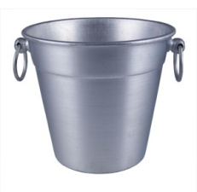
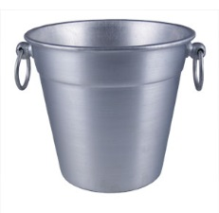
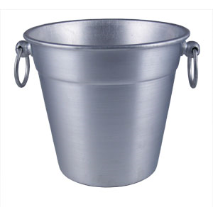

Easy Sorting Problems…
Sort N numbers in the range 0 to 9
0 | 1 | 2 | 3 | 4 | 5 | 6 | 7 | 8 | 9
How fast could you sort
N numbers
in the range 0 to B?
O(N)
O(B)
O(N+B)
O(N*B)
E) ??
In Big-O defining your variables is super important!

Slide 52
Harder Sorting Problems… Approach 1 – Two stages
Sort N numbers in the range 0 to 99
Make some buckets and calculate what bucket they need to go into.
Then sort each bucket
0 – 9 | 10-19 | 20-29 | 30-39 | 40-49 | 50-59 | 60-69 | 70-79 | 80-89 | 90-99

Slide 53
Harder Sorting Problems… Approach 2
Sort N numbers in the range 0 to 99
First sort by the one’s digit (this is counter intuitive)
95
25
98
29
20
32
93
85
97
38
39
0 | 1 | 2 | 3 | 4 | 5 | 6 | 7 | 8 | 9

Slide 54
Combine the buckets
Start from the first thing in the bucket
95
25
98
29
20
32
93
85
97
38
39
The 20’s are the correct relative order
0 | 1 | 2 | 3 | 4 | 5 | 6 | 7 | 8 | 9
20
20
32
93
85
25
25
95
97
38
98
39
29
29

Slide 55
Resort using the tens digit
20
32
93
85
25
95
97
38
98
39
29
Now Recombine!
98
29
39
97
25
38
95
20
32
85
93
0 | 1 | 2 | 3 | 4 | 5 | 6 | 7 | 8 | 9
20
25
29
32
38
39
85
93
95
97
98

Slide 56
Radix Sort the numbers 0-99
The running time for our example: (N + B)*2
We did two passes, each took N time.
We gathered up the buckets twice each took B time (where B is the number of buckets)

Slide 57








We can represent numbers with 1’s and 0’s
3 2 1 8
3*1000 + 2*100 + 1*10 + 8*1
1 0 0 1
1*8 + 0*4 + 0*2 + 1*1
We could use binary digits
0001 1
0010 2
0011 3
0100 4
0101 5
0110 6
0111 7
1000 8

Slide 58
Radix Sort with 32 bit numbers
We chose how many bits we want to sort at a time.
4 bits at a time (8 passes)
0000 0000 0000 0000 0000 0000 0000 0000
8 bits at a time (4 passes)
00000000 00000000 00000000 00000000
Running Time of Radix Sort in terms of
N: the number of items to sort
B: the number of buckets
P: the number of passes
Less than
Equal to
Greater than
??
O(N*B*P)

Slide 59
Quick Sort
This has to be the least helpful name ever…
But it is true. Quick Sort Rocks!

Slide 60
Quick Sort
Things we can do without too much trouble:
Divide up the list into two based upon whether each element is bigger or smaller than a particular value (the “pivot”).
Delegating to another procedure to sort each of these halves
Sorting a 1 element list

Slide 61
Quick Sort DEMO
I
I
I
I
J
I
J
J
J
J
J
J
6 | 5 | 2 | 8 | 3 | 18 | 4 | 11 | 7 | 9 | 10
6 | 5 | 2 | 4 | 3 | 18 | 8 | 11 | 7 | 9 | 10
3 | 5 | 2 | 4 | 6 | 18 | 8 | 11 | 7 | 9 | 10
6 | 9 | 7 | 8 | 3 | 18 | 4 | 11 | 2 | 5 | 10
6 | 9 | 7 | 8 | 3 | 18 | 4 | 11 | 2 | 5 | 10
6 | 9 | 7 | 8 | 3 | 18 | 4 | 11 | 2 | 5 | 10
6 | 9 | 7 | 8 | 3 | 18 | 4 | 11 | 2 | 5 | 10
6 | 9 | 7 | 8 | 3 | 18 | 4 | 11 | 2 | 5 | 10
6 | 5 | 7 | 8 | 3 | 18 | 4 | 11 | 2 | 9 | 10
6 | 5 | 7 | 8 | 3 | 18 | 4 | 11 | 2 | 9 | 10
6 | 5 | 7 | 8 | 3 | 18 | 4 | 11 | 2 | 9 | 10
6 | 5 | 2 | 8 | 3 | 18 | 4 | 11 | 7 | 9 | 10
6 | 5 | 2 | 8 | 3 | 18 | 4 | 11 | 7 | 9 | 10
6 | 5 | 2 | 8 | 3 | 18 | 4 | 11 | 7 | 9 | 10
6 | 5 | 2 | 4 | 3 | 18 | 8 | 11 | 7 | 9 | 10
6 | 5 | 2 | 4 | 3 | 18 | 8 | 11 | 7 | 9 | 10
6 | 5 | 2 | 4 | 3 | 18 | 8 | 11 | 7 | 9 | 10

Slide 62
Quick Sort Demo
6 | 9 | 7 | 8 | 3 | 18 | 4 | 11 | 2 | 5 | 10
6 | 9 | 7 | 8 | 3 | 18 | 4 | 11 | 2 | 5 | 10
6 | 9 | 7 | 8 | 3 | 18 | 4 | 11 | 2 | 5 | 10
6 | 9 | 7 | 8 | 3 | 18 | 4 | 11 | 2 | 5 | 10
6 | 9 | 7 | 8 | 3 | 18 | 4 | 11 | 2 | 5 | 10
6 | 5 | 7 | 8 | 3 | 18 | 4 | 11 | 2 | 9 | 10
6 | 5 | 7 | 8 | 3 | 18 | 4 | 11 | 2 | 9 | 10
6 | 5 | 7 | 8 | 3 | 18 | 4 | 11 | 2 | 9 | 10

Slide 63
Quick Sort Demo
6 | 5 | 7 | 8 | 3 | 18 | 4 | 11 | 2 | 9 | 10
6 | 5 | 2 | 8 | 3 | 18 | 4 | 11 | 7 | 9 | 10
6 | 5 | 2 | 8 | 3 | 18 | 4 | 11 | 7 | 9 | 10
6 | 5 | 2 | 8 | 3 | 18 | 4 | 11 | 7 | 9 | 10
6 | 5 | 2 | 8 | 3 | 18 | 4 | 11 | 7 | 9 | 10
6 | 5 | 2 | 4 | 3 | 18 | 8 | 11 | 7 | 9 | 10
6 | 5 | 2 | 4 | 3 | 18 | 8 | 11 | 7 | 9 | 10
6 | 5 | 2 | 4 | 3 | 18 | 8 | 11 | 7 | 9 | 10
6 | 5 | 2 | 4 | 3 | 18 | 8 | 11 | 7 | 9 | 10
3 | 5 | 2 | 4 | 6 | 18 | 8 | 11 | 7 | 9 | 10

Slide 64
Quick Sort – Choosing a Pivot
What if the pivot I chose was larger than all the other elements?
99 | 9 | 7 | 8 | 3 | 18 | 4 | 11 | 2 | 5 | 10
10 | 9 | 7 | 8 | 3 | 18 | 4 | 11 | 2 | 5 | 99
This gets sent to be recursively sorted
There is nothing to send in the other recursive call
Quick Sort is a “divide and conquer algorithm” but this didn’t divide!

Slide 65
Quick Sort
Worst case performance:
O(n²)
Best case performance:
O(n log n)
In practice the fastest known comparison-based sort for arrays
It matters how evenly the pivot divides the elements!!!

Slide 66
Quick Sort: The Algorithm (For your notes)
Given an unsorted list I of n items
Choose a pivot item v from I.
Partition I into two unsorted lists I1 and I2 I1 contains all items whose keys are smaller than v's key. I2 contains all items whose keys are larger than v's. Equal values can go either way.
After the partition v is in it’s final position.
Sort I1 recursively, yielding the sorted list S1.
Sort I2 recursively, yielding the sorted list S2.
Concatenate S1, v, and S2 together, yielding a sorted list S.

Slide 67
BONUS

Slide 68


Slide 69


Computer
Science
&
= AWESOME

Slide 70

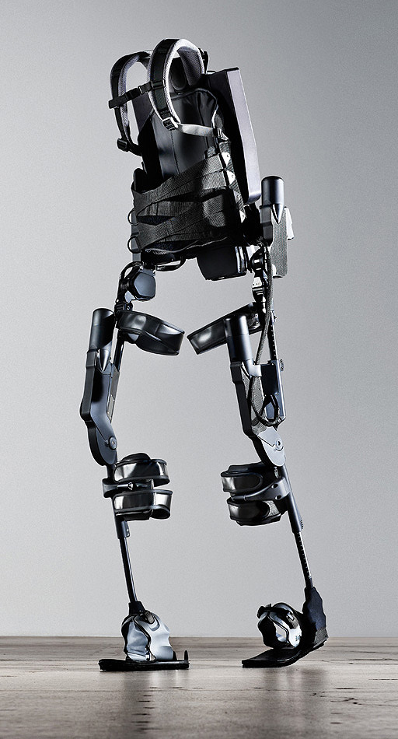
http://www.youtube.com/watch?v=pzRmNYA8LlY

Slide 71


ClickStart

Slide 72


Slide 73
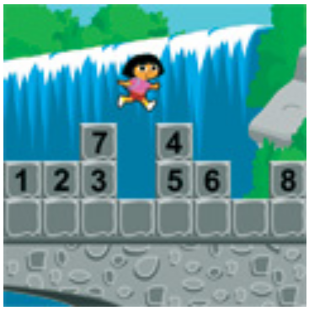
How should we represent the blocks in the computer?
Independent variables
2D Array
OpenList
I don’t know

Slide 74
The value in the array tells me what art asset to use
Each level is really a 3x10 vector!
0 | 0 | 7 | 0 | 4 | 0 | 0 | 0
1 | 2 | 3 | -4 | 5 | 6 | -7 | 8
B | B | B | B | B | B | B | B
Negative values tell me what block needs to go here to win!

Slide 75
0 | 0 | 7 | 0 | 4 | 0 | 0 | 0
1 | 2 | 3 | -4 | 5 | 6 | -7 | 8
0 | 0 | 0 | B | 0 | 0 | 0 | 0

Slide 76
BUGS!

Slide 77


Slide 78
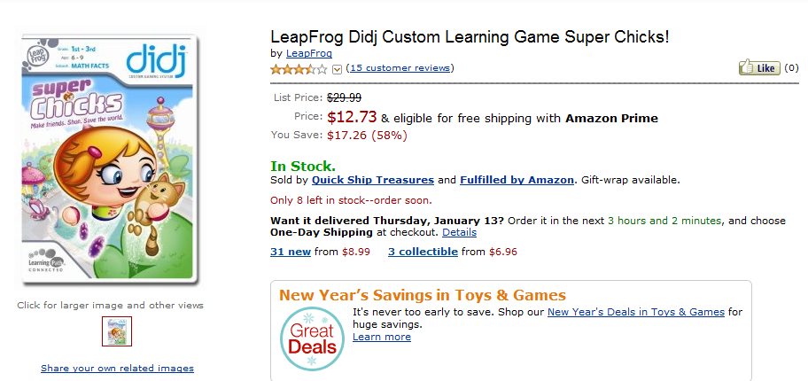
It is really sad when stuff you’ve made is on sale!

Slide 79



Which image is fake?
A. Top Left
B. Bottom Left
C. Bottom Right

Slide 80
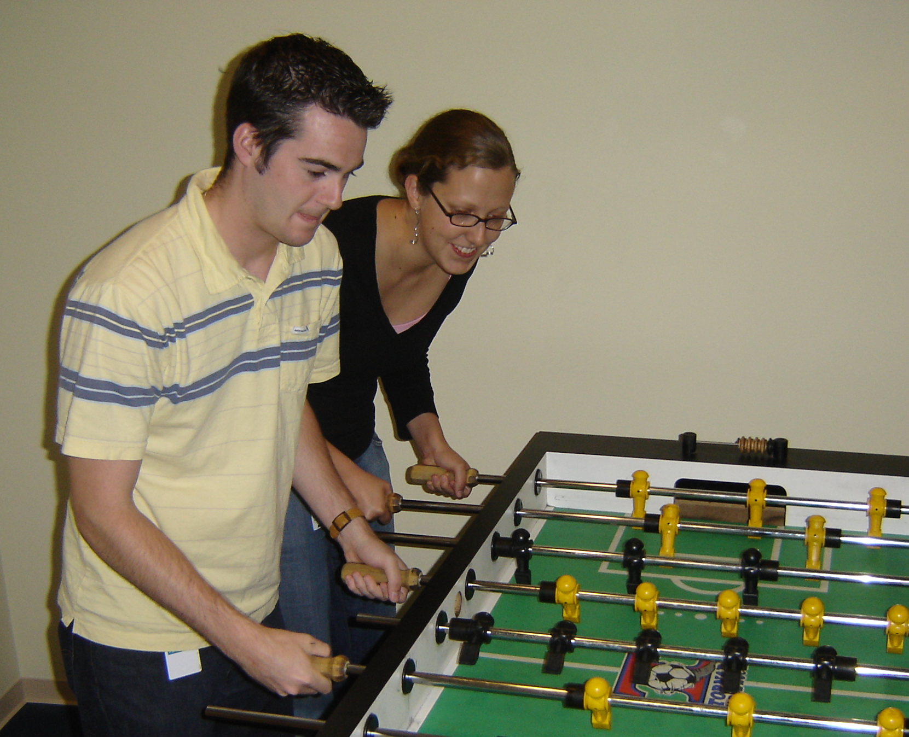

Slide 81
