Slide 1
CS 60
Spampede (Snake game) Abstract classes, Threads, & Sorting
2013-04-16
Tuesday – Week 11
Lecture 22

Slide 2
Survey
When Colleen has “lunch hours” during reading week and exam week – do you think people will come and share their experiences from CS60?
Yes – Probably
Maybe not – Everyone will be super busy!
No
I don’t know

Slide 3
Administrative Stuff (Not in your notes)
Java Quiz due April 17th
I have extra lecture notes from previous classes!
Email me to schedule an appointment!

Slide 4
Spampede Demo

Slide 5
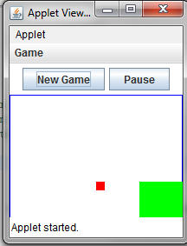
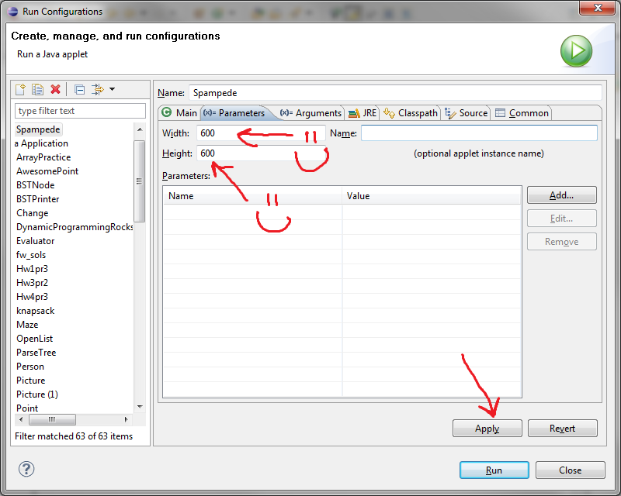
Run Spampede.java
If your window is funny shaped…

Slide 6

(Other than the graphics) How is this different than the BFS you wrote?

Slide 7
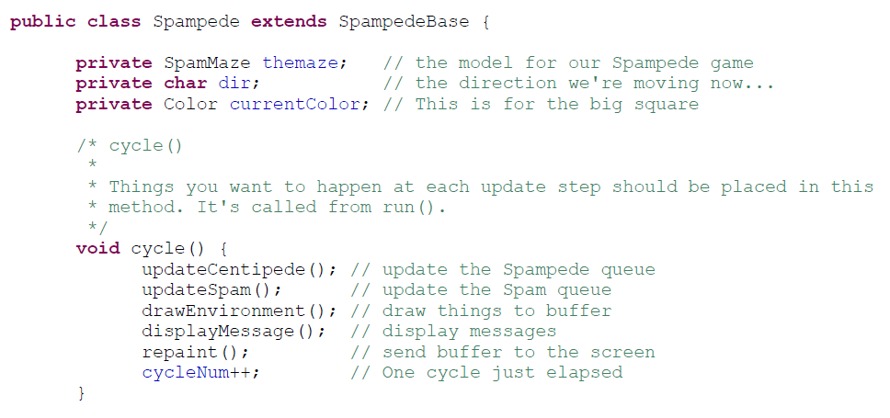
cycle()

Slide 8
Spampede
Look at the code for Spampede.
Do you think the code for BFS will go in here?
A) Yes B) No

Slide 9
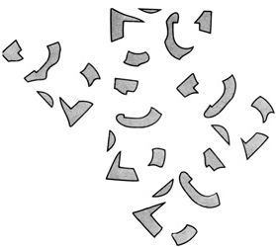
Event-driven execution
Events are things that happen to a graphical application
Button Presses • Text Entries
Key Presses, Key Releases, Key Events
Each object receiving an event notifies its “Listener”
The Listener then handles the event appropriately
// Here's how keyboard events are handled...
public void keyPressed(KeyEvent evt)
{
switch (evt.getKeyChar())
{
case 'k':
message = "Unicycles only!";
this.dir = 'k';
break;
What's 'k'?
context?

Slide 10
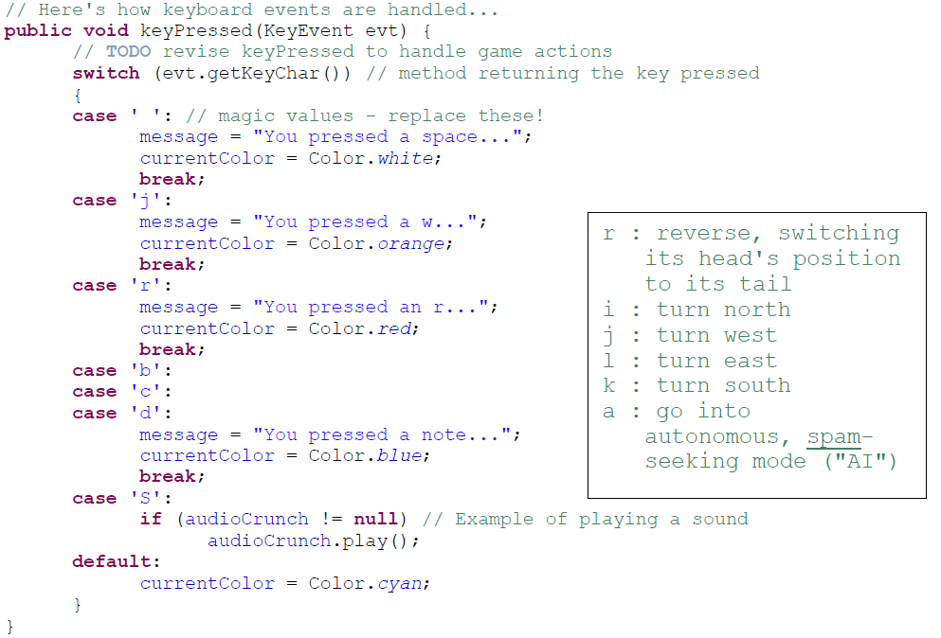
A separate thread will handle key presses

Slide 11
Abstract Classes

Slide 12
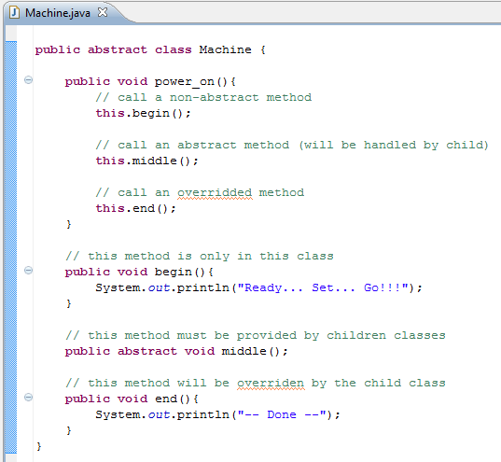
We can call unimplemented methods
We don’t have to implement all methods

Slide 13
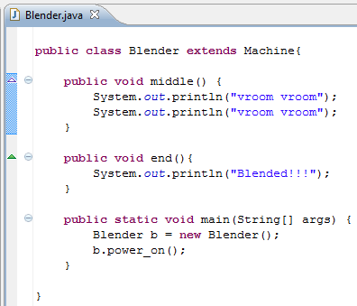
Does "Blended!!!"
get printed?
A) Yes B) No C)?

Slide 14
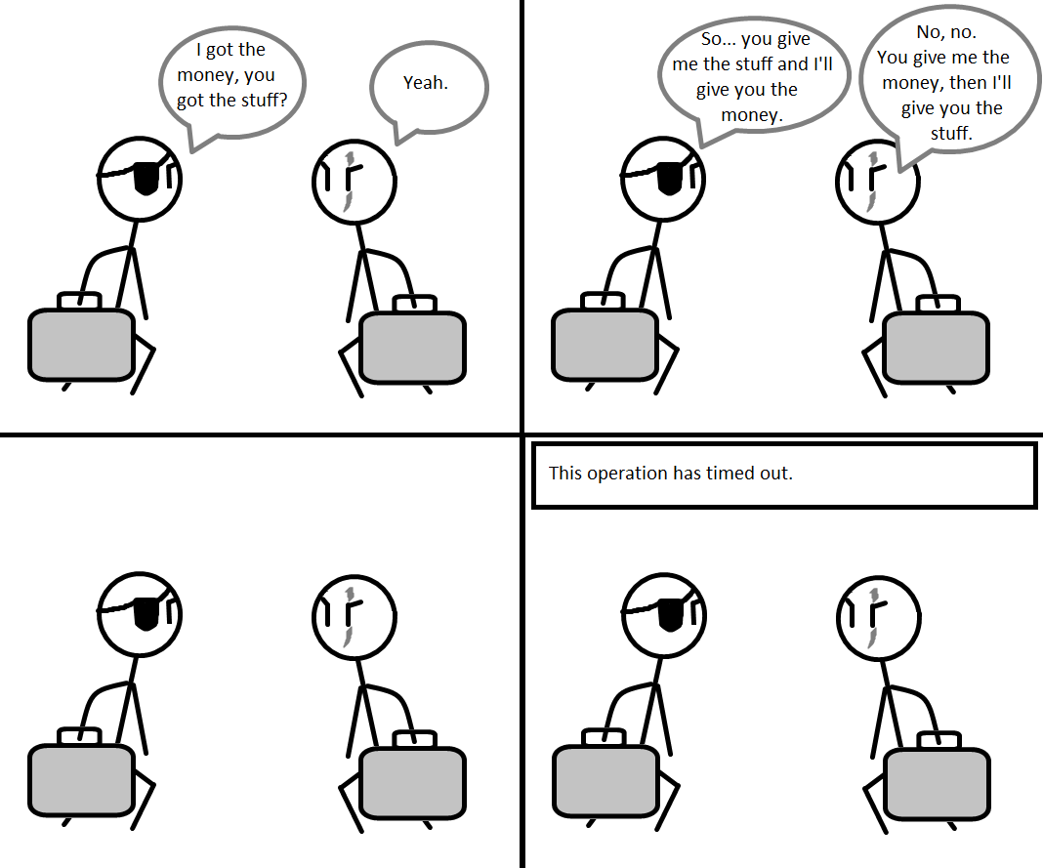
http://codingcomics.blogspot.com/2009/08/concurrency-issues.html

Slide 15
Problems With Concurrency
Incorrectness
Inefficiency
Deadlock
Unfairness

Slide 16
Thread threats?
Suppose there are two threads that can update the game's score, which is now 40...
Thread 1
Thread 2
read current score
read current score
score += 1
score += 1
write new score
write new score
Any problems lurking?

Slide 17
Thread threats?
Suppose there are two threads that can update the game's score, which is now 40...
Thread 1
Thread 2
read current score
score += 1
write new score
read current score
score += 1
write new score
OK! score is updated twice and is now 42

Slide 18
Thread threats?
Suppose there are two threads that can update the game's score, which is now 40...
Thread 1
Thread 2
read current score
score += 1
write new score
read current score
score += 1
write new score
OK! score is updated twice and is now 42

Slide 19
Thread threats?
Suppose there are two threads that can update the game's score, which is now 40...
Thread 1
Thread 2
read current score
read current score
score += 1
write new score
score += 1
write new score
Problem!!

Slide 20
SpampedeBase
On what page do I change something to make the snake go faster?
A) 1 B) 2 C) 3 D) 4 E) more than one possible

Slide 21
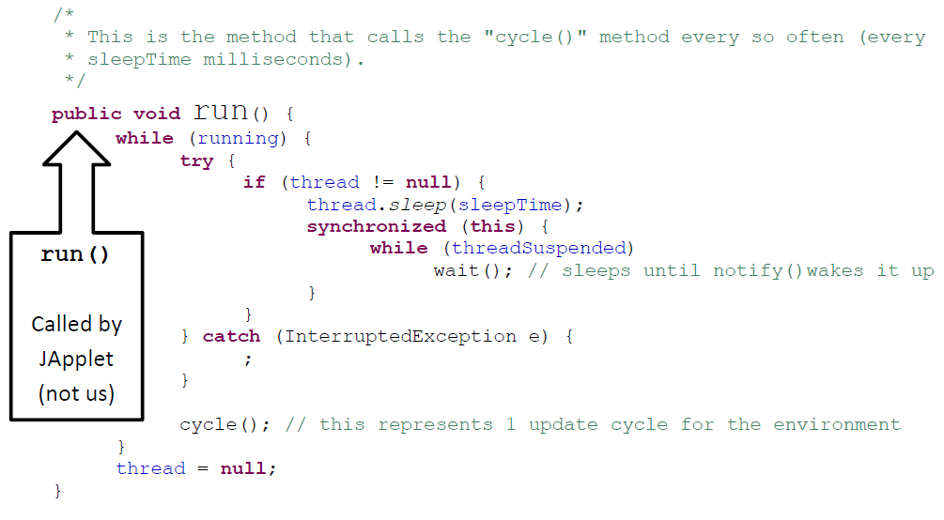
run() calls cycle()
If I removed this block, what wouldn’t work?
Anything!!! Eek!
Stopping
Pausing
Starting
??

Slide 22
Spampede.java
Thread thread; // the thread controlling the updates
boolean threadSuspended; // paused?
boolean running; // null?
public void run()
{
while (running)
{
try
{
if (thread != null)
{
thread.sleep(sleepTime);
synchronized(this)
{
while (threadSuspended)
wait();
}
}
}
catch (InterruptedException e) { ; }
cycle();
}
thread = null;
}
button- and key- handling
spam-handling
// called by the “Start” button
public synchronized void go()
{
if (thread == null)
{
thread = new Thread(this);
running = true;
thread.start();
threadSuspended = false;
}
else
threadSuspended = false;
notify();
}
// called by the “Pause” button
void pause()
{
if (thread != null)
threadSuspended = true;
}
this is the connection with the outside world…

Slide 23
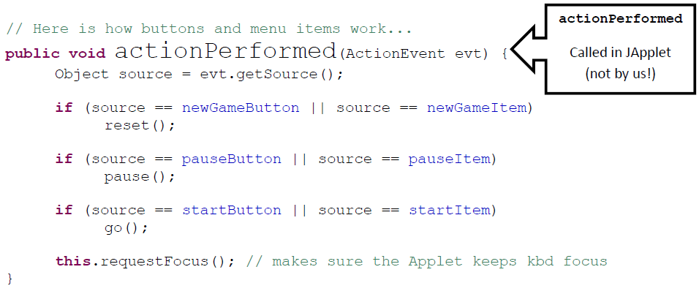
actionPerformed
Would the start button still work if you removed:
source == startItem
Yes – something else would break
Yes – nothing would break!
No – the button wouldn’t work
??

Slide 24
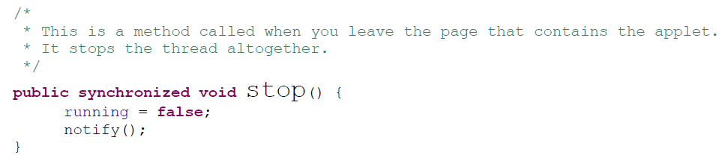
How does stop() work?
stop() only sets the instance variable running to false. In what method does this actually cause it to stop?
pause()
go()
run()
reset()
??

Slide 25
Object
wait()
notify()
Reuse via inheritance
get reused, too!
Component
public void requestFocus()
reusing base-classes' methods
public void addKeyListener()
public void repaint()
Container
public void paint()
public void add(Component c)
Panel
public void addNotify()
JApplet
public void init()
SpampedeBase
overriding of base-classes' methods
public void init()
public void paint()
Spampede

Slide 26

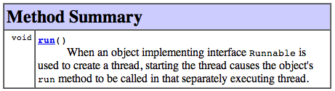
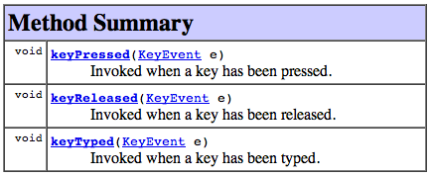
Interfaces enable event handling...
public class SpampedeBase extends JApplet implements ActionListener, KeyListener, Runnable
"this object can handle button presses..."
"this object can run in a separate thread"
handles button presses...
"this object can handle key presses..."
The object that waits for key presses, button presses, etc. is called a Listener …

Slide 27
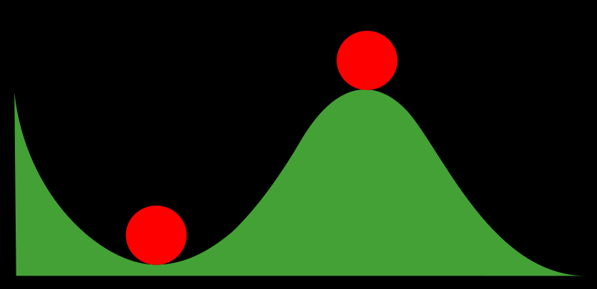
Stable and Non-Stable Sorting

Slide 28
Stable Sort
Sometimes there are equivalent keys in a data structure that is sorted.
Sometimes it matters if you change the order of those equivalent keys
E.g. Sorting music by song and then artist should keep each artists songs alphabetized
We call a sort “stable” if it doesn’t change the order of equivalent keys

Slide 29
Radix Sort (an example of a stable sort)

Slide 30
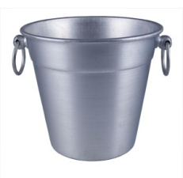
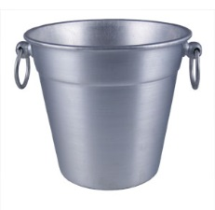
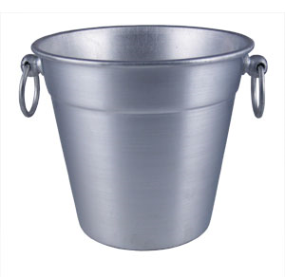

Easy Sorting Problems…
Sort N numbers in the range 0 to 9
0 | 1 | 2 | 3 | 4 | 5 | 6 | 7 | 8 | 9
How fast could you sort
N numbers
in the range 0 to B?
O(N)
O(B)
O(N+B)
O(N*B)
E) ??
In Big-O defining your variables is super important!

Slide 31
Harder Sorting Problems… Approach 1 – Two stages
Sort N numbers in the range 0 to 99
Make some buckets and calculate what bucket they need to go into.
Then sort each bucket
0 – 9 | 10-19 | 20-29 | 30-39 | 40-49 | 50-59 | 60-69 | 70-79 | 80-89 | 90-99

Slide 32
Harder Sorting Problems… Approach 2
Sort N numbers in the range 0 to 99
First sort by the one’s digit (this is counter intuitive)
95
25
98
29
20
32
93
85
97
38
39
0 | 1 | 2 | 3 | 4 | 5 | 6 | 7 | 8 | 9

Slide 33
Combine the buckets
Start from the first thing in the bucket
95
25
98
29
20
32
93
85
97
38
39
The 20’s are the correct relative order
0 | 1 | 2 | 3 | 4 | 5 | 6 | 7 | 8 | 9
20
20
32
93
85
25
25
95
97
38
98
39
29
29

Slide 34
Resort using the tens digit
20
32
93
85
25
95
97
38
98
39
29
Now Recombine!
98
29
39
97
25
38
95
20
32
85
93
0 | 1 | 2 | 3 | 4 | 5 | 6 | 7 | 8 | 9
20
25
29
32
38
39
85
93
95
97
98

Slide 35
Radix Sort the numbers 0-99
The running time for our example: (N + B)*2
We did two passes, each took N time.
We gathered up the buckets twice each took B time (where B is the number of buckets)

Slide 36








We can represent numbers with 1’s and 0’s
3 2 1 8
3*1000 + 2*100 + 1*10 + 8*1
1 0 0 1
1*8 + 0*4 + 0*2 + 1*1
We could use binary digits
0001 1
0010 2
0011 3
0100 4
0101 5
0110 6
0111 7
1000 8

Slide 37
Radix Sort with 32 bit numbers
We chose how many bits we want to sort at a time.
4 bits at a time (8 passes)
0000 0000 0000 0000 0000 0000 0000 0000
8 bits at a time (4 passes)
00000000 00000000 00000000 00000000
Running Time of Radix Sort in terms of
N: the number of items to sort
B: the number of buckets
P: the number of passes
Less than
Equal to
Greater than
??
O(N*B*P)

Slide 38
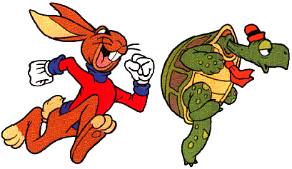
Quick Sort
This has to be the least helpful name ever…
But it is true. Quick Sort Rocks!

Slide 39
Quick Sort
Things we can do without too much trouble:
Divide up the list into two based upon whether each element is bigger or smaller than a particular value (the “pivot”).
Delegating to another procedure to sort each of these halves
Sorting a 1 element list

Slide 40
Quick Sort DEMO
I
I
I
I
J
I
J
J
J
J
J
J
6 | 5 | 2 | 8 | 3 | 18 | 4 | 11 | 7 | 9 | 10
6 | 5 | 2 | 4 | 3 | 18 | 8 | 11 | 7 | 9 | 10
3 | 5 | 2 | 4 | 6 | 18 | 8 | 11 | 7 | 9 | 10
6 | 9 | 7 | 8 | 3 | 18 | 4 | 11 | 2 | 5 | 10
6 | 9 | 7 | 8 | 3 | 18 | 4 | 11 | 2 | 5 | 10
6 | 9 | 7 | 8 | 3 | 18 | 4 | 11 | 2 | 5 | 10
6 | 9 | 7 | 8 | 3 | 18 | 4 | 11 | 2 | 5 | 10
6 | 9 | 7 | 8 | 3 | 18 | 4 | 11 | 2 | 5 | 10
6 | 5 | 7 | 8 | 3 | 18 | 4 | 11 | 2 | 9 | 10
6 | 5 | 7 | 8 | 3 | 18 | 4 | 11 | 2 | 9 | 10
6 | 5 | 7 | 8 | 3 | 18 | 4 | 11 | 2 | 9 | 10
6 | 5 | 2 | 8 | 3 | 18 | 4 | 11 | 7 | 9 | 10
6 | 5 | 2 | 8 | 3 | 18 | 4 | 11 | 7 | 9 | 10
6 | 5 | 2 | 8 | 3 | 18 | 4 | 11 | 7 | 9 | 10
6 | 5 | 2 | 4 | 3 | 18 | 8 | 11 | 7 | 9 | 10
6 | 5 | 2 | 4 | 3 | 18 | 8 | 11 | 7 | 9 | 10
6 | 5 | 2 | 4 | 3 | 18 | 8 | 11 | 7 | 9 | 10

Slide 41
Quick Sort Demo
6 | 9 | 7 | 8 | 3 | 18 | 4 | 11 | 2 | 5 | 10
6 | 9 | 7 | 8 | 3 | 18 | 4 | 11 | 2 | 5 | 10
6 | 9 | 7 | 8 | 3 | 18 | 4 | 11 | 2 | 5 | 10
6 | 9 | 7 | 8 | 3 | 18 | 4 | 11 | 2 | 5 | 10
6 | 9 | 7 | 8 | 3 | 18 | 4 | 11 | 2 | 5 | 10
6 | 5 | 7 | 8 | 3 | 18 | 4 | 11 | 2 | 9 | 10
6 | 5 | 7 | 8 | 3 | 18 | 4 | 11 | 2 | 9 | 10
6 | 5 | 7 | 8 | 3 | 18 | 4 | 11 | 2 | 9 | 10

Slide 42
Quick Sort Demo
6 | 5 | 7 | 8 | 3 | 18 | 4 | 11 | 2 | 9 | 10
6 | 5 | 2 | 8 | 3 | 18 | 4 | 11 | 7 | 9 | 10
6 | 5 | 2 | 8 | 3 | 18 | 4 | 11 | 7 | 9 | 10
6 | 5 | 2 | 8 | 3 | 18 | 4 | 11 | 7 | 9 | 10
6 | 5 | 2 | 8 | 3 | 18 | 4 | 11 | 7 | 9 | 10
6 | 5 | 2 | 4 | 3 | 18 | 8 | 11 | 7 | 9 | 10
6 | 5 | 2 | 4 | 3 | 18 | 8 | 11 | 7 | 9 | 10
6 | 5 | 2 | 4 | 3 | 18 | 8 | 11 | 7 | 9 | 10
6 | 5 | 2 | 4 | 3 | 18 | 8 | 11 | 7 | 9 | 10
3 | 5 | 2 | 4 | 6 | 18 | 8 | 11 | 7 | 9 | 10

Slide 43
Quick Sort – Choosing a Pivot
What if the pivot I chose was larger than all the other elements?
99 | 9 | 7 | 8 | 3 | 18 | 4 | 11 | 2 | 5 | 10
10 | 9 | 7 | 8 | 3 | 18 | 4 | 11 | 2 | 5 | 99
This gets sent to be recursively sorted
There is nothing to send in the other recursive call
Quick Sort is a “divide and conquer algorithm” but this didn’t divide!

Slide 44
Quick Sort
Worst case performance:
O(n²)
Best case performance:
O(n log n)
In practice the fastest known comparison-based sort for arrays
It matters how evenly the pivot divides the elements!!!

Slide 45
Quick Sort: The Algorithm (For your notes)
Given an unsorted list I of n items
Choose a pivot item v from I.
Partition I into two unsorted lists I1 and I2 I1 contains all items whose keys are smaller than v's key. I2 contains all items whose keys are larger than v's. Equal values can go either way.
After the partition v is in it’s final position.
Sort I1 recursively, yielding the sorted list S1.
Sort I2 recursively, yielding the sorted list S2.
Concatenate S1, v, and S2 together, yielding a sorted list S.

Slide 46
BONUS

Slide 47
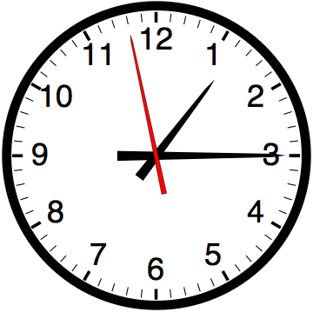

Slide 48


Computer
Science
&
= AWESOME

Slide 49
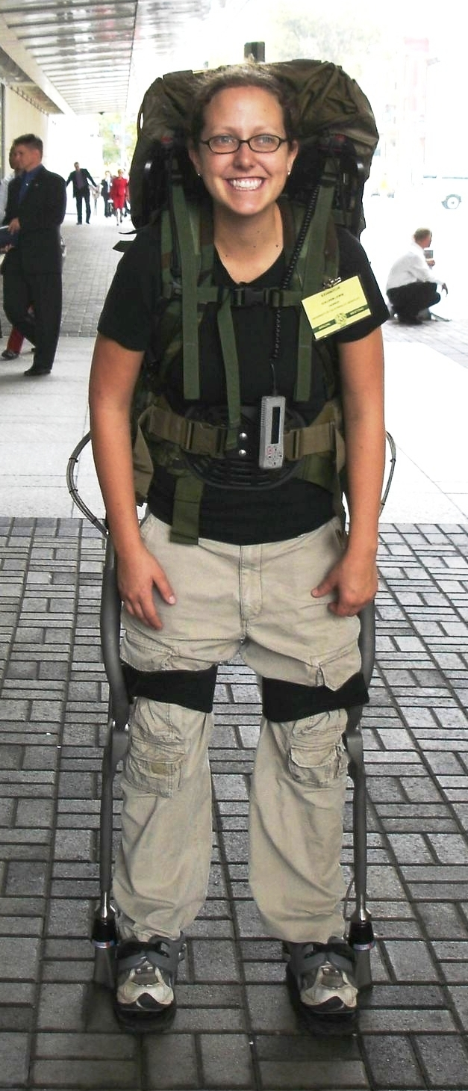
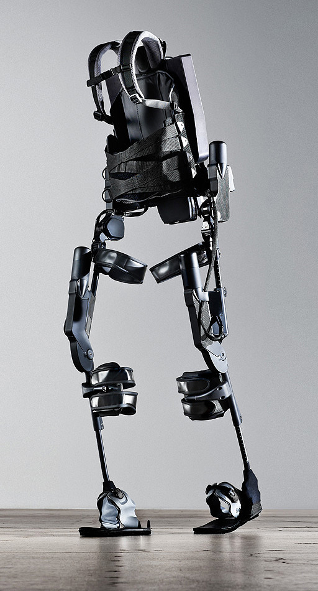
http://www.youtube.com/watch?v=pzRmNYA8LlY

Slide 50

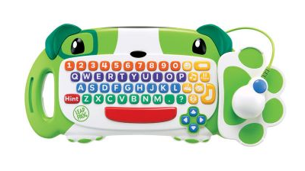
ClickStart

Slide 51
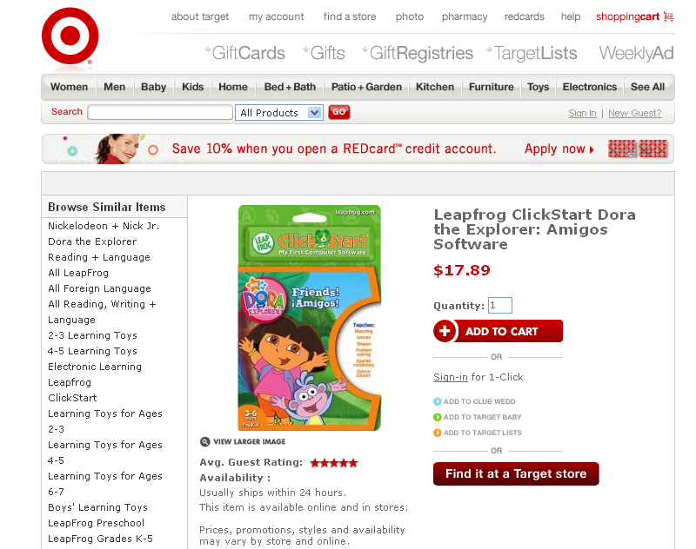

Slide 52
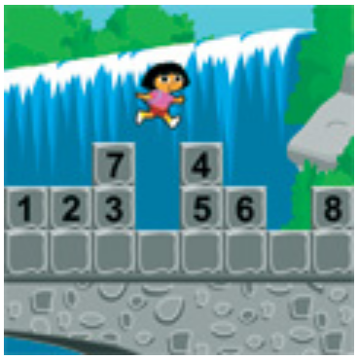
How should we represent the blocks in the computer?
Independent variables
2D Array
OpenList
I don’t know

Slide 53
The value in the array tells me what art asset to use
Each level is really a 3x10 vector!
0 | 0 | 7 | 0 | 4 | 0 | 0 | 0
1 | 2 | 3 | -4 | 5 | 6 | -7 | 8
B | B | B | B | B | B | B | B
Negative values tell me what block needs to go here to win!

Slide 54
0 | 0 | 7 | 0 | 4 | 0 | 0 | 0
1 | 2 | 3 | -4 | 5 | 6 | -7 | 8
0 | 0 | 0 | B | 0 | 0 | 0 | 0

Slide 55
BUGS!

Slide 56
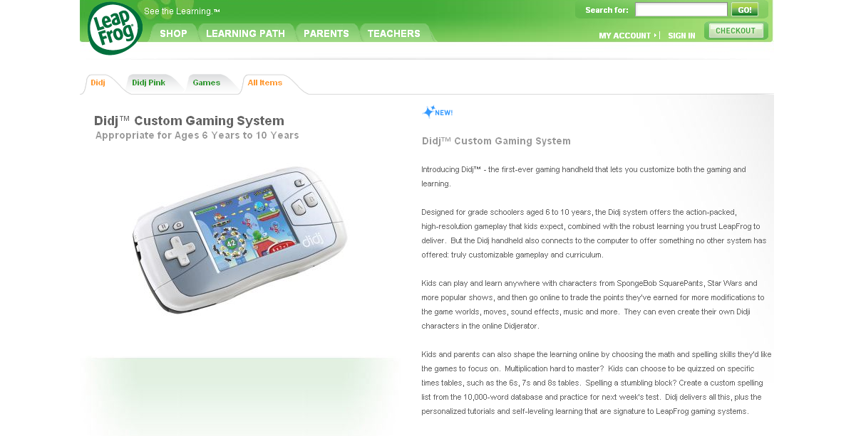

Slide 57
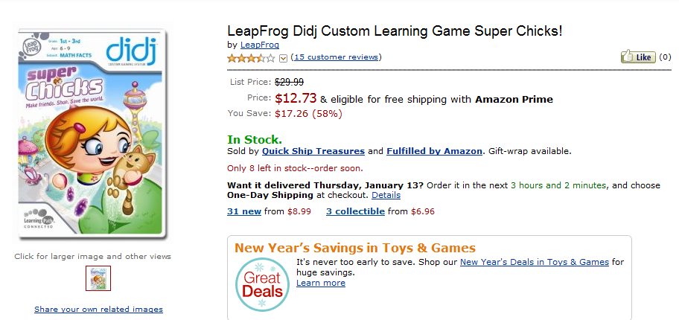
It is really sad when stuff you’ve made is on sale!

Slide 58
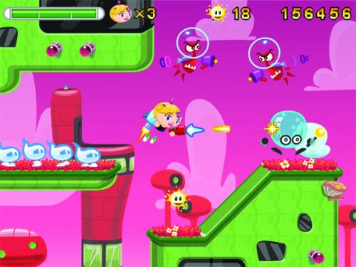
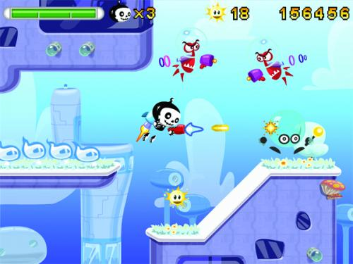

Which image is fake?
A. Top Left
B. Bottom Left
C. Bottom Right

Slide 59
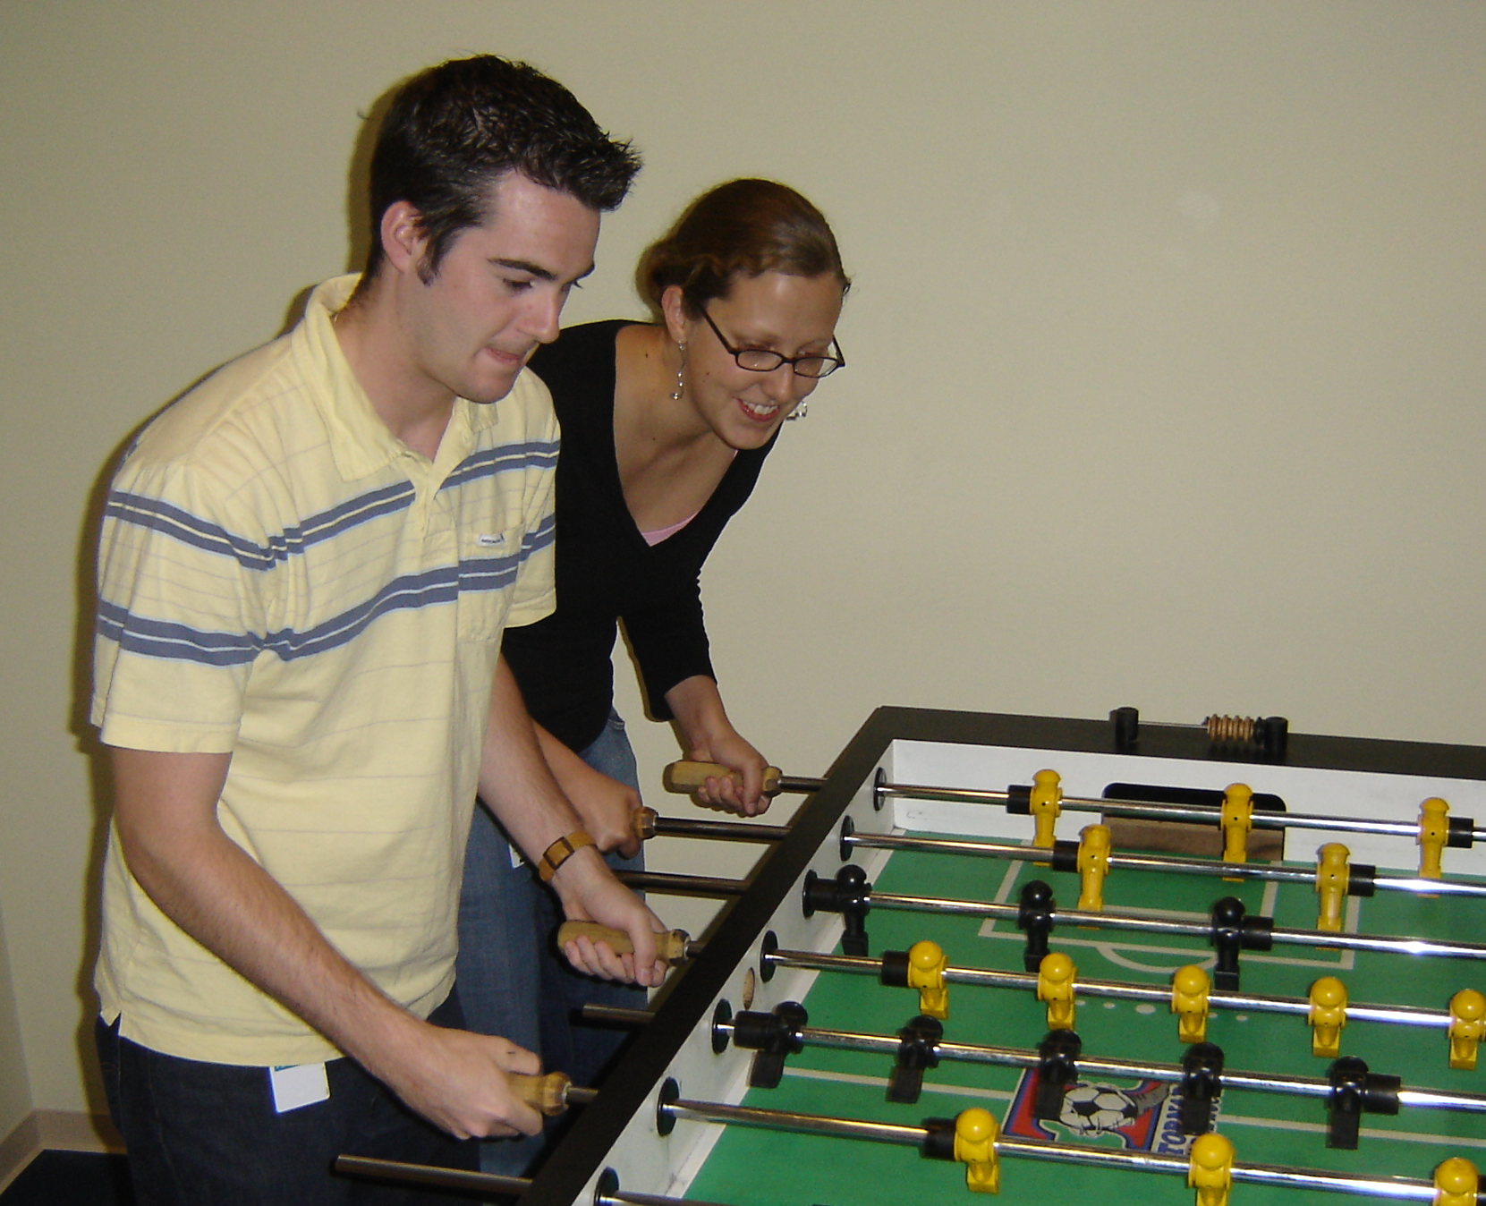

Slide 60
