Slide 1
CS 60
Radix Sort (Runtime), Quick Sort,
Spampede, Runtimes
2013-04-16
Thursday – Week 11
Lecture 23

Slide 2
Survey
How did the Java quiz compare to the Prolog one?
Way worse!
Worse!
About the same
Better!
Way better!

Slide 3
Administrative Stuff
(Not in your notes)
Email me to schedule an appointment!

Slide 4
Radix Sort
(Revisit the Big-O Runtime)

Slide 5
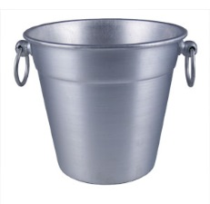

Harder Sorting Problems… Approach 2
Sort N numbers in the range 0 to 99
First sort by the one’s digit (this is counter intuitive)
95
25
98
29
20
32
93
85
97
38
39
0 | 1 | 2 | 3 | 4 | 5 | 6 | 7 | 8 | 9

Slide 6
Combine the buckets
Start from the first thing in the bucket
95
25
98
29
20
32
93
85
97
38
39
The 20’s are the correct relative order
0 | 1 | 2 | 3 | 4 | 5 | 6 | 7 | 8 | 9
20
20
32
93
85
25
25
95
97
38
98
39
29
29

Slide 7
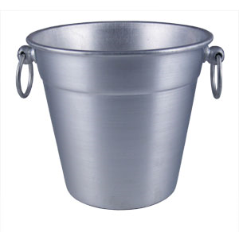
Resort using the tens digit
20
32
93
85
25
95
97
38
98
39
29
Now Recombine!
98
29
39
97
25
38
95
20
32
85
93
0 | 1 | 2 | 3 | 4 | 5 | 6 | 7 | 8 | 9
20
25
29
32
38
39
85
93
95
97
98

Slide 8
Radix Sort with 32 bit numbers
We chose how many bits we want to sort at a time.
4 bits at a time (8 passes)
  0000 0000 0000 0000 0000 0000 0000 0000
8 bits at a time (4 passes)
  00000000 00000000 00000000 00000000
Running Time of Radix Sort in terms of
  N: the number of items to sort
  B: the number of buckets
  P: the number of passes
Less than
Equal to
Greater than
??
O(N*B*P)

Slide 9
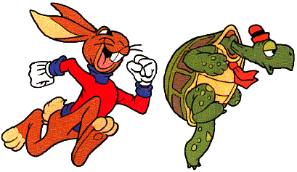
Quick Sort
This has to be the least helpful name ever…
But it is true. Quick Sort Rocks!

Slide 10
Quick Sort
Things we can do without too much trouble:
  Divide up the list into two based upon whether each element is bigger or smaller than a particular value (the “pivot”).
  Delegating to another procedure to sort each of these halves
  Sorting a 1 element list

Slide 11
an array of zero or one elements is already sorted
function quicksort('array')
if length('array') = 1
return 'array'
select and remove a pivot value 'pivot' from 'array'
create empty lists 'less' and 'greater'
for each 'x' in 'array'
if 'x' = 'pivot' then append 'x' to 'less'
else append 'x' to 'greater'
return concatenate(quicksort('less'),
'pivot',
quicksort('greater'))
Divide
http://en.wikipedia.org/wiki/Quicksort

Slide 12
Quick Sort: The Algorithm
(For your notes)
Given an unsorted list I of n items
Choose a pivot item v from I.
Partition I into two unsorted lists I1 and I2 I1 contains all items whose keys are smaller than v's key. I2 contains all items whose keys are larger than v's. Equal values can go either way.
After the partition v is in it’s final position.
Sort I1 recursively, yielding the sorted list S1.
Sort I2 recursively, yielding the sorted list S2.
Concatenate S1, v, and S2 together, yielding a sorted list S.

Slide 13
QuickSort with Linked Lists
6 | 9 | 7 | 8 | 3 | 18 | 4 | 11 | 2 | 5 | 10
3 | 4 | 2 | 5
6
9 | 7 | 8 | 18 | 11 | 10
2
3
4 | 5
7 | 8
9
18 | 11 | 10
4
5
7
8
11 | 10
18
10
11
2 | 3 | 4 | 5 | 6 | 7 | 8 | 9 | 10 | 11 | 18

Slide 14

Can you make Quick Sort run in…
(what is the worst you can do? Describe the input)
O(N)
O(N log N)
O(N²)
O(N³)
O(2^{N})

Slide 15
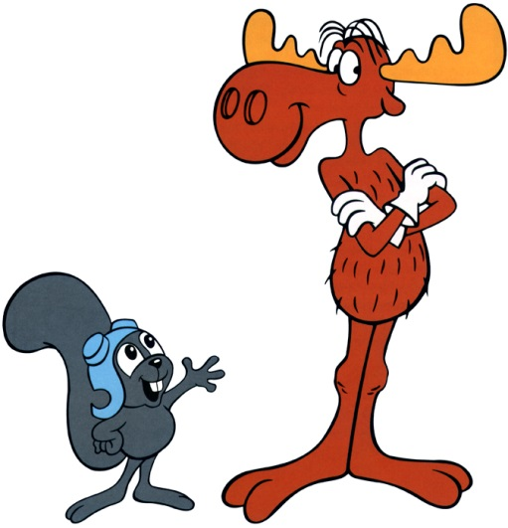
Can you make Quick Sort run in…
(what is the best you can do? Describe the input)
O(N)
O(N log N)
O(N²)
O(N³)
O(2^{N})

Slide 16
QuickSort with an Array
Pivot = first index you’re sorting
L = second index you’re sorting
G = last index you’re sorting
While L <= G
  Increase L until it references something bigger than the pivot
  Decrease G until it references something smaller than the pivot
  Swap elements at L and G
Swap the pivot with the element at G

Slide 17
Quick Sort with an Array
DEMO
L
L
L
L
G
L
G
G
G
G
G
G
6 | 5 | 2 | 8 | 3 | 18 | 4 | 11 | 7 | 9 | 10
6 | 5 | 2 | 4 | 3 | 18 | 8 | 11 | 7 | 9 | 10
3 | 5 | 2 | 4 | 6 | 18 | 8 | 11 | 7 | 9 | 10
6 | 9 | 7 | 8 | 3 | 18 | 4 | 11 | 2 | 5 | 10
6 | 9 | 7 | 8 | 3 | 18 | 4 | 11 | 2 | 5 | 10
6 | 9 | 7 | 8 | 3 | 18 | 4 | 11 | 2 | 5 | 10
6 | 9 | 7 | 8 | 3 | 18 | 4 | 11 | 2 | 5 | 10
6 | 9 | 7 | 8 | 3 | 18 | 4 | 11 | 2 | 5 | 10
6 | 5 | 7 | 8 | 3 | 18 | 4 | 11 | 2 | 9 | 10
6 | 5 | 7 | 8 | 3 | 18 | 4 | 11 | 2 | 9 | 10
6 | 5 | 7 | 8 | 3 | 18 | 4 | 11 | 2 | 9 | 10
6 | 5 | 2 | 8 | 3 | 18 | 4 | 11 | 7 | 9 | 10
6 | 5 | 2 | 8 | 3 | 18 | 4 | 11 | 7 | 9 | 10
6 | 5 | 2 | 8 | 3 | 18 | 4 | 11 | 7 | 9 | 10
6 | 5 | 2 | 4 | 3 | 18 | 8 | 11 | 7 | 9 | 10
6 | 5 | 2 | 4 | 3 | 18 | 8 | 11 | 7 | 9 | 10
6 | 5 | 2 | 4 | 3 | 18 | 8 | 11 | 7 | 9 | 10

Slide 18
Quick Sort – Choosing a Pivot
What if the pivot I chose was larger than all the other elements?
99 | 9 | 7 | 8 | 3 | 18 | 4 | 11 | 2 | 5 | 10
10 | 9 | 7 | 8 | 3 | 18 | 4 | 11 | 2 | 5 | 99
This gets sent to be recursively sorted
There is nothing to send in the other recursive call
Quick Sort is a “divide and conquer algorithm” but this didn’t divide!

Slide 19
Quick Sort
Worst case performance:
  O(n²)
Best case performance:
  O(n log n)
In practice the fastest known comparison-based sort for arrays
It matters how evenly the pivot divides the elements!!!

Slide 20
Spampede is about Software Engineering
Hw11:
  Refactor Maze code for use by Spampede
  Goal: Code that is beautiful
    Well commented
    Modular (small methods)
      Easy to test
      Easy to understand

Slide 21
Homework 11 (Spampede refactor)
Homework 7
public ArrayList<String> BFS(MazeCell start, MazeCell destination) {
Class Today
public void BFS(MazeCell start, MazeCell destination) {
Homework 11
public MazeCell multiBFS(MazeCell start, char destination) {
Start: MazeCell
BFS
Path: ArrayList
End: MazeCell
Start: MazeCell
BFS
Next Step: MazeCell
goal: char

Slide 22
/*
* method: multiBFS
* input: a starting cell and a char to seek output: the maze cell that is
* BESIDE START and NEXT ALONG the path to the nearest destination!
*
* optional: printing the path to the goal if you do, BE SURE TO CLEAR
* _EVERYTHING_ OUT! before returning...
*
* if there is no path, this method should return an open MazeCell that is
* NEXT TO START
*
* if there is no open MazeCell that is NEXT TO START, this method
* should return any MazeCell that is next to start (and it will crash)
*/
protected MazeCell multiBFS(MazeCell start, char destination) {
}
Add this to the Maze Class
(or use our starter file)
The snake crashes (not Java)

Slide 23
Look at the provided BFS code
Write a list of good style things and things you could refactor (improve)
How many things are on your list?
  0-2
  3-6
  7-10
  > 10
  Stuck

Slide 24
Drawing in Spampede

Slide 25
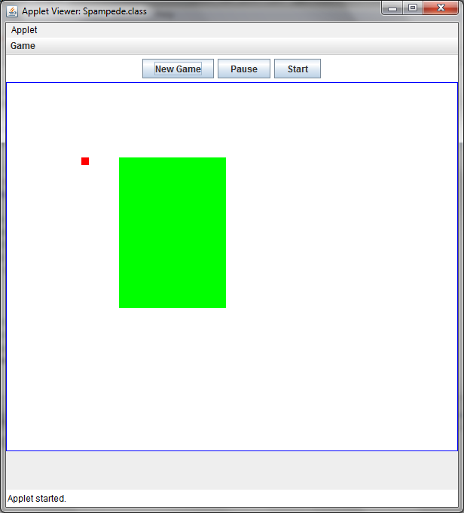
public class Spampede extends JApplet
implements ActionListener, KeyListener, Runnable
{
Image image; // off-screen buffer
Graphics g; // that buffer's graphical tools
// in init: image = createImage(getSize().width, GAMEB_DHEIGHT);
// in init: g = image.getGraphics();
void drawEnvironment()
{
clear(); // Clear the buffer
g.setColor(Color.red);
g.fillRect(100,100,10,10);
g.setColor(currentColor);
g.fillRect(150,100,142,200);
}

Slide 26
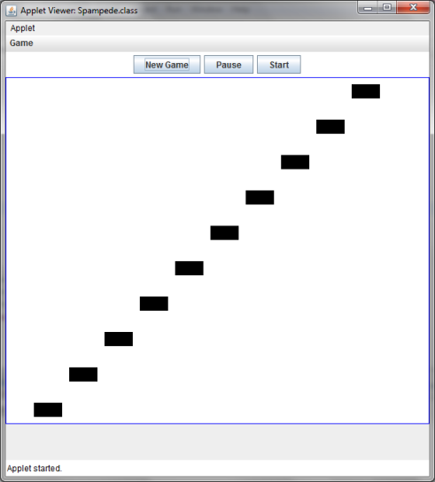
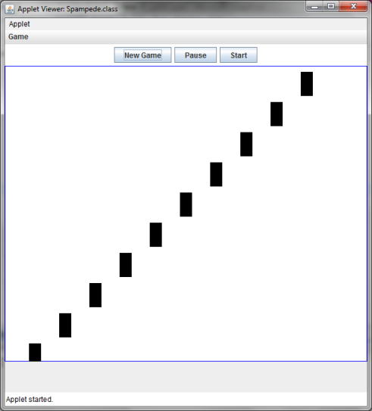
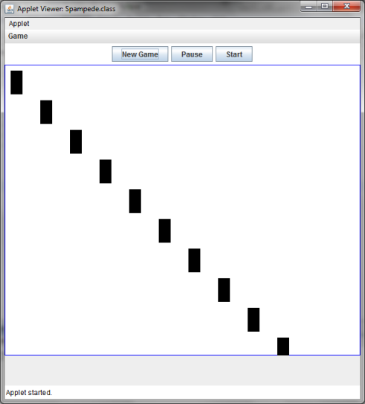
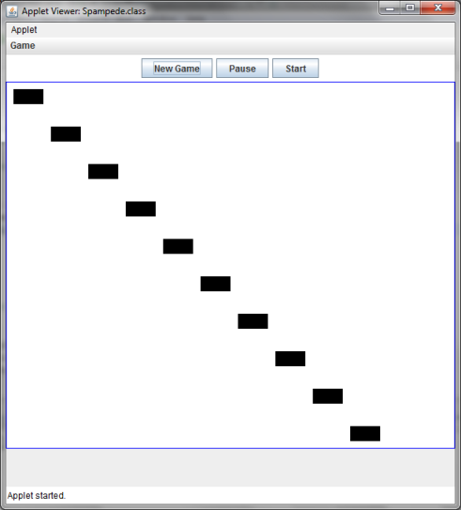
What does this draw?
for(int i = 10; i < 500; i=i+50){
g.setColor(Color.BLACK);
g.fillRect(i, i, 40, 20);
}
A B C D

Slide 27
Runtime

Slide 28
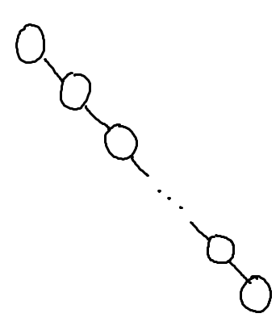
What is the worst case run-time for find in this Binary Search Tree?
O(1)
O(log n)
O(n log n)
O(n)
O(n²)

Slide 29
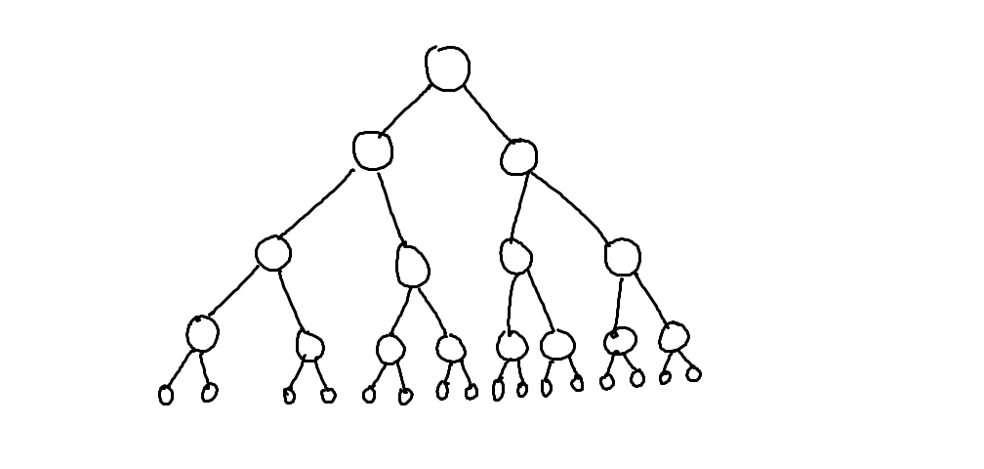
What is the worst case run-time for find in this Binary Search Tree?
O(1)
O(log n)
O(n log n)
O(n)
O(n²)

Slide 30
Assuming: all nodes have 0 or 1 children
N nodes in the BST
BST Big-Oh (Completely Unbalanced Case)
Find |  | Insert |  | Delete
Best | Worst | Best | Worst | Best | Worst
O( ) | O( ) | O( ) | O( ) | O( ) | O( )

Slide 31
Assuming: all nodes have 0 or 2 children
N nodes in the BST
BST Big-Oh (Balanced Case)
Find |  | Insert |  | Delete
Best | Worst | Best | Worst | Best | Worst
O( ) | O( ) | O( ) | O( ) | O( ) | O( )
O(1)
O(log n)
O(n log n)
O(n)
O(n²)

Slide 32
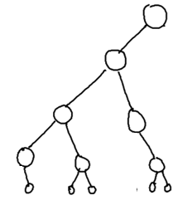
Assuming: most nodes have 0 or 2 children height is O(log n)
N nodes in the BST
BST Big-Oh (Mostly Balanced Case)
Find |  | Insert |  | Delete
Best | Worst | Best | Worst | Best | Worst
O( ) | O( ) | O( ) | O( ) | O( ) | O( )

Slide 33
Big-Oh for
Lists
(a.k.a. linked lists)

Slide 34
Racket Lists Big-Oh
Insert (into front of list) | O( )
Insert (into end of list) | O( )
Find | O( )
Length | O( )
Delete (from the middle) | O( )
O(1)
O(log n)
O(n log n)
O(n)
O(n²)

Slide 35
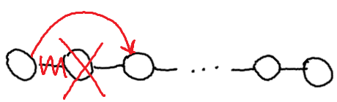
Assuming: the modifiable LinkedList using Hw5 List and ListNode
List/ListNode Big-Oh
Insert (into front of list) | O( )
Insert (into end of list) | O( )
Find (given a value) | O( )
Length | O( )
Delete (given a value) | O( )
Delete (given a ListNode ref) | O( )
O(1)
O(log n)
O(n log n)
O(n)
O(n²)

Slide 36
Big-Oh for Arrays

Slide 37
Unsorted Arrays Big-Oh
Insert (into first spot) | O( )
Insert (into last spot) | O( )
Find (given a value) | O( )
Delete (given a value) | O( )
5 | 3 | 8 | 2 | 1 | 7 | 0 | 0 | 0 | 0 | 0 | 0 | 0
Assuming:
unsorted array holding numbers within 1 to N
no duplicates
we keep track the last index we use (maxIndex)
all values at indices > maxIndex are 0 (unused).

Slide 38
Sorted Arrays Big-Oh
Insert (into first spot) | O( )
Insert (into last spot) | O( )
Find (given a value) | O( )
Delete (given a value) | O( )
Assuming:
sorted array holding numbers within 1 to N
no duplicates
we keep track the last index we use (maxIndex)
all values at indices > maxIndex are 0 (unused).
1 | 2 | 3 | 5 | 7 | 8 | 0 | 0 | 0 | 0 | 0 | 0 | 0

Slide 39
Boolean Arrays Big-Oh
Insert (into first spot) | O( )
Insert (into last spot) | O( )
Find (given a value) | O( )
Delete (given a value) | O( )
F₀ | T₁ | T₂ | T₃ | F₄ | T₅ | F₆ | T₇ | T₈
Assuming:
Boolean array representing numbers within 1 to X
X is a fixed number
no duplicates
Could I use
this trick to
store objects?

Slide 40

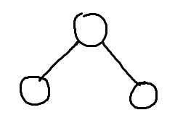
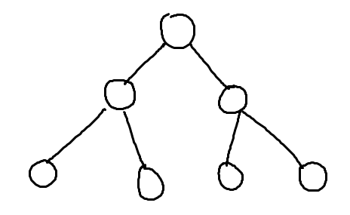
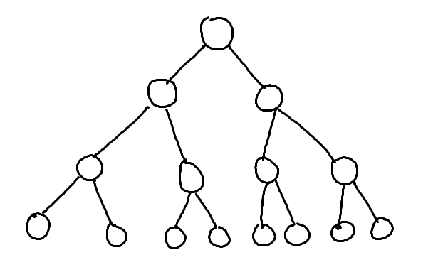
What’s the relationship between height and number of nodes?
3
7
1
15
31

Slide 41
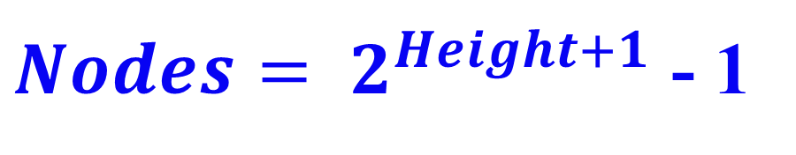
What’s the relationship between height and number of nodes?
1
3
7
Height | Nodes | 2^{Height+1}
0 | 1 | 2
1 | 3 | 4
2 | 7 | 8
3 | 15 | 16
4 | 31 | 32
5 | 63 | 64
15
31

Slide 42





// Take the log of both sides
Drop the 1
Who cares?
// Remember:

Slide 43
BONUS

Slide 44


Slide 45


Computer
Science
&
= AWESOME

Slide 46

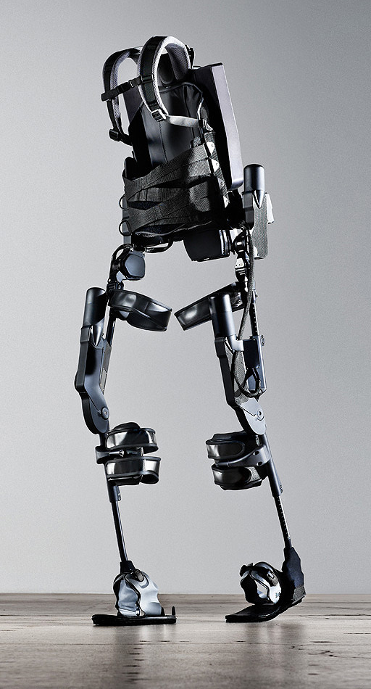
http://www.youtube.com/watch?v=pzRmNYA8LlY

Slide 47


ClickStart

Slide 48
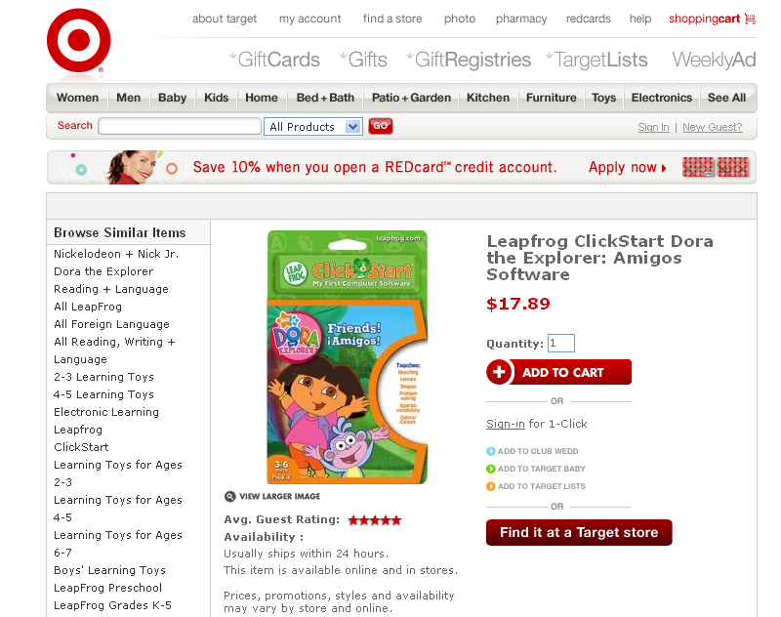

Slide 49

How should we represent the blocks in the computer?
Independent variables
2D Array
OpenList
I don’t know

Slide 50
The value in the array tells me what art asset to use
Each level is really a 3x10 vector!
0 | 0 | 7 | 0 | 4 | 0 | 0 | 0
1 | 2 | 3 | -4 | 5 | 6 | -7 | 8
B | B | B | B | B | B | B | B
Negative values tell me what block needs to go here to win!

Slide 51
0 | 0 | 7 | 0 | 4 | 0 | 0 | 0
1 | 2 | 3 | -4 | 5 | 6 | -7 | 8
0 | 0 | 0 | B | 0 | 0 | 0 | 0

Slide 52
BUGS!

Slide 53
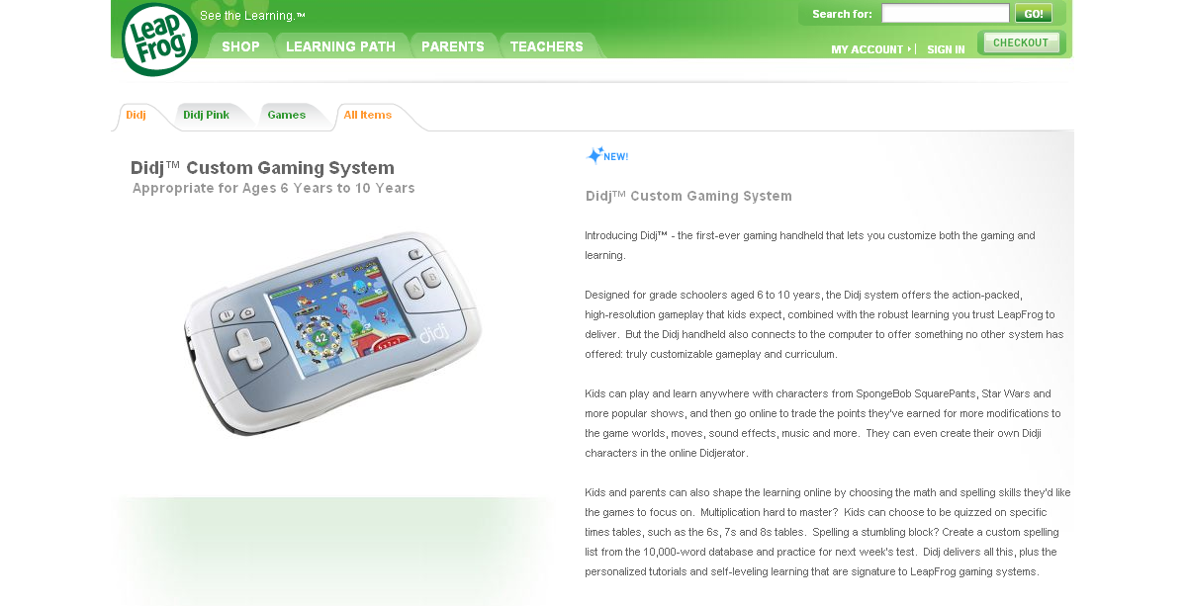

Slide 54

It is really sad when stuff you’ve made is on sale!

Slide 55



Which image is fake?
  A. Top Left
  B. Bottom Left
  C. Bottom Right

Slide 56
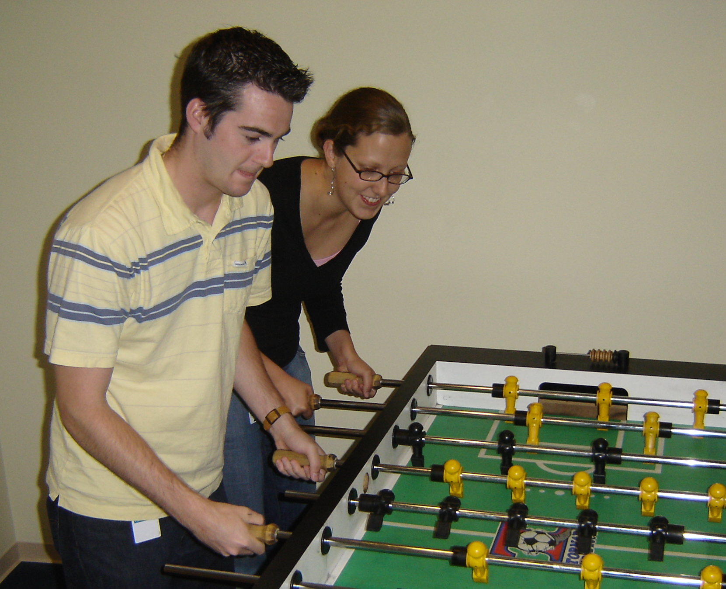

Slide 57
