Slide 1
CS 60
Java Quiz Review, Runtime Review,
Finite Automata (hw13)
2013-04-23
Tuesday – Week 12
Lecture 24

Slide 2
Survey
Hw 10 Sorting
Was cool – you should use it again
Was educational – you should use it again
Both a and b
Was terrible (or not worth reusing)

Slide 3
Administrative Stuff
(Not in your notes)
Email me to schedule an appointment!
Hw 13 – 50 points
Hw 12 – Extra credit
  Finish the assignment by Sunday at 3pm
  Help your classmates for 2 hours in the LAC
  Get 10 points!
  (See assignment for full details)

Slide 4
Runtime

Slide 5
Big-O for
Lists
(a.k.a. linked lists)

Slide 6
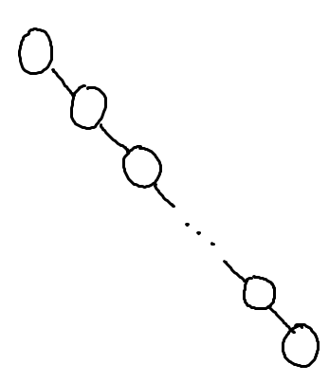
Racket Lists Big-Oh
Insert (into front of list) | O( )
Insert (into end of list) | O( )
Find | O( )
Length | O( )
Delete (from the middle) | O( )
O(1)
O(log n)
O(n log n)
O(n)
O(n²)

Slide 7
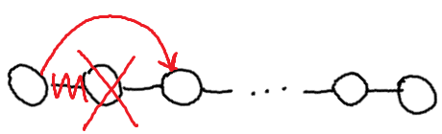
Assuming: the modifiable LinkedList using Hw5 List and ListNode
List/ListNode Big-Oh
Insert (into front of list) | O( )
Insert (into end of list) | O( )
Find (given a value) | O( )
Length | O( )
Delete (given a value) | O( )
Delete (given a ListNode ref) | O( )
O(1)
O(log n)
O(n log n)
O(n)
O(n²)

Slide 8
Big-Oh for Arrays

Slide 9
Unsorted Arrays Big-Oh
Insert (into first spot) | O( )
Insert (into last spot) | O( )
Find (given a value) | O( )
Delete (given a value) | O( )
O(1)
O(log X)
O(X)
O(log maxIndex)
O(maxIndex)
5 | 3 | 8 | 2 | 1 | 7 | 0 | 0 | 0 | 0 | 0 | 0 | 0
Assuming:
unsorted array holding numbers within 1 to X
no duplicates
we keep track the last index we use (maxIndex)
all values at indices > maxIndex are 0 (unused).

Slide 10
Sorted Arrays Big-Oh
Insert (into first spot) | O( )
Insert (into last spot) | O( )
Find (given a value) | O( )
Delete (given a value) | O( )
O(1)
O(log X)
O(X)
O(log maxIndex)
O(maxIndex)
Assuming:
sorted array holding numbers within 1 to X
no duplicates
we keep track the last index we use (maxIndex)
all values at indices > maxIndex are 0 (unused).
1 | 2 | 3 | 5 | 7 | 8 | 0 | 0 | 0 | 0 | 0 | 0 | 0

Slide 11
Boolean Arrays Big-Oh
Insert (into first spot) | O( )
Insert (into last spot) | O( )
Find (given a value) | O( )
Delete (given a value) | O( )
O(1)
O(log X)
O(X)
O(log maxIndex)
O(maxIndex)
F₀ | T₁ | T₂ | T₃ | F₄ | T₅ | F₆ | T₇ | T₈
Assuming:
Boolean array representing numbers within 1 to X
X is a fixed number
no duplicates
Could I use
this trick to
store objects?

Slide 12
HashTables!
Convert an Object into a number so you can store the Object in an array!

Slide 13
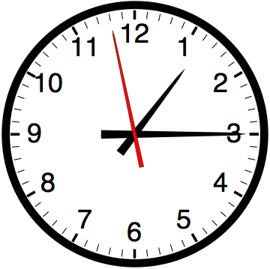

Slide 14
Estimating Time
Most people grossly underestimate how long it takes to program (not thinking about time to debug and test)
You appear incompetent at programming (not true) if you can’t estimate how long something will take.
This is one of the hardest things to learn!!! Start to practice now! For each task estimate how long it will take and keep track of how wrong you were

Slide 15
Finite Automata
(Models of Computation)

Slide 16
Homework 13 Due Friday May 3rd at 11:59pm
Nondeterministic Finite
Automata
Deterministic Finite Automata
DFA
1, 2, 6
NFA
5
4
10
Proof
3, 7, 8

Slide 17
DFA
1, 2, 6
NFA
5
4
10
Proof
3, 7, 8

Slide 18
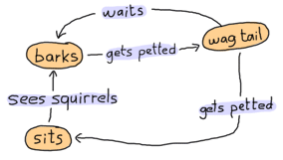
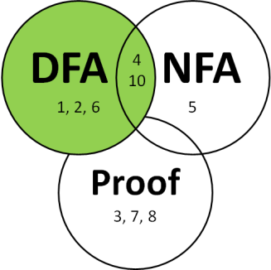
http://learnyousomeerlang.com/finite-state-machines
Assume the dog starts out in the sits state - then:
Sees squirrels, gets petted, waits, gets petted, gets petted, sees squirrels
Which state is the dog in A) sits B) barks C) wag tail D) ??

Slide 19
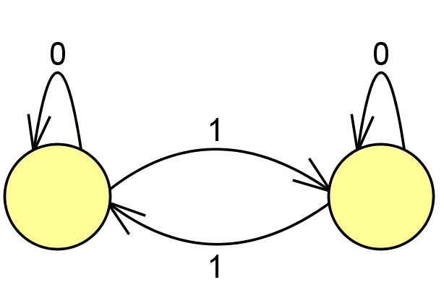
Deterministic Finite Automata (DFAs)
What symbol did we see?
1
Cool – follow this arrow (“Transition”)
to the other state.
What symbol did we see?
0
Cool – stay in this state.
These are states

Slide 20
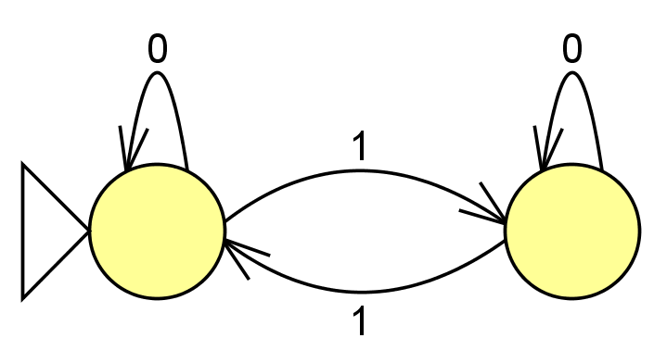
Identifying the Start State
(sometimes we just use an arrow)
This shows what state we start in
What state do we end up in if we see:
00000000001
Left state
Right state

Slide 21
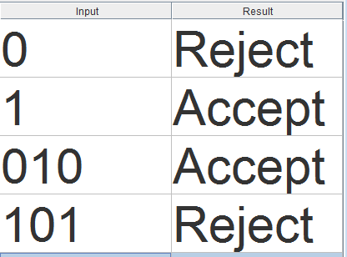
The Goal – To make decisions
We want to decide if the sequence of symbols we see matches the pattern we’re expecting.
What we’re expecting is referred to as the “Language”
∑ is the set of symbols we’re using
(which here has 0’s and 1’s).

Slide 22
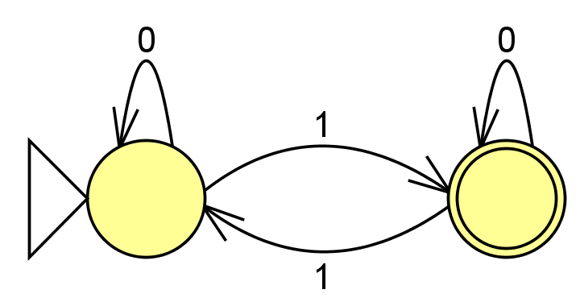
Identifying the accepting state(s)
This accepts strings that: ____________________
A) Got it!
This shows what state we want the sequence to end in
(if it ends here – accept)

Slide 23


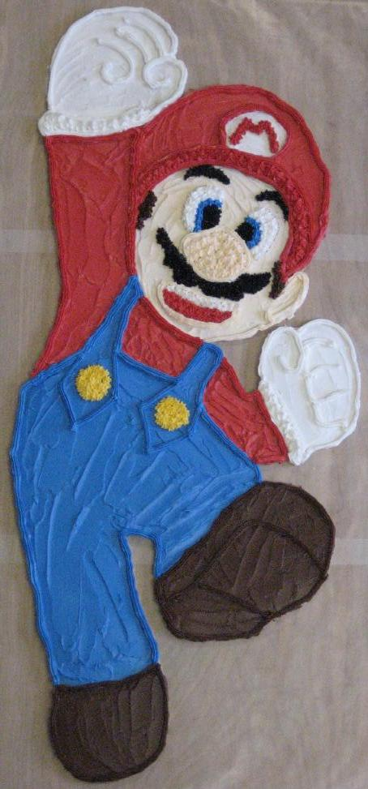
JFLAP’s Creator – Dr. Susan Roger (Duke)
Colleen shares Susan’s interest in edible arts, but not motorcycles

Slide 24
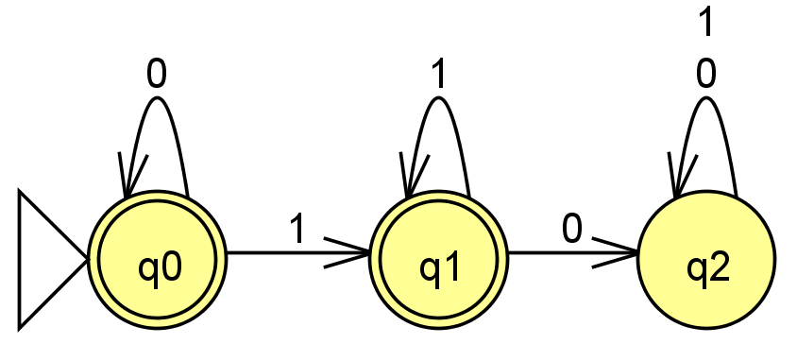
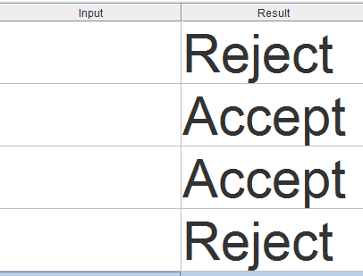
DFAs describe a Language
For both 1 and 0, stay in this state.
Fill in with sequences that would be accepted or rejected.
How would you describe what sequences this accepts?

Slide 25





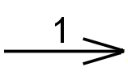

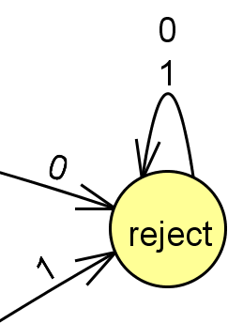
DFA Rules & Generation Tips
Rules about DFAs
Tips for writing DFAs
Indicate the starting state (aka initial state) with a triangle or arrow.
Indicate the accepting state(s) (aka final states) with concentric circles.
Every state must have a transition for every possible symbol.
Write out sequences (aka strings) that are accepted.
Write out sequences that are not accepted.
Identify what states might be important and what they will “mean”
Draw the DFA for a simple sequence that is accepted, then fill in other transitions.
Add a failing state

Slide 26
(1) Draw a DFA accepting
(2) Draw a DFA accepting the language
L = { w | w is the string 01 }
L = { w | w is a binary # that's a power of two }
initial 0s are OK
01
only 0s are not OK
the empty string λ is not OK
0010
100
10000
…
(3) Draw a DFA accepting
(4) Draw a DFA accepting
L = { w | w is a binary # that’s divisible by 4 }
L = { w | the first and last bit of w are the same }
initial 0s are OK
the empty string λ is OK
the empty string λ is OK
101
00
0010
0
1
λ
…
01000
0
λ
10100
…
Extra! use the minimum possible number of states in your four solutions…

Slide 27
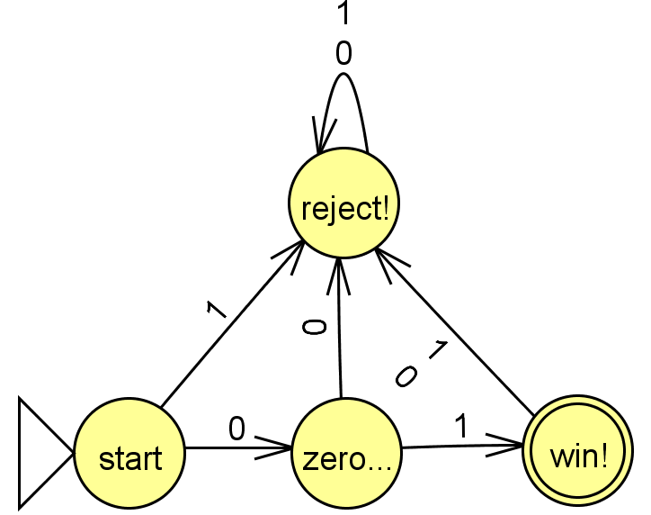
Solution
{w ∈ {0,1}* | w is the string 01}

Slide 28
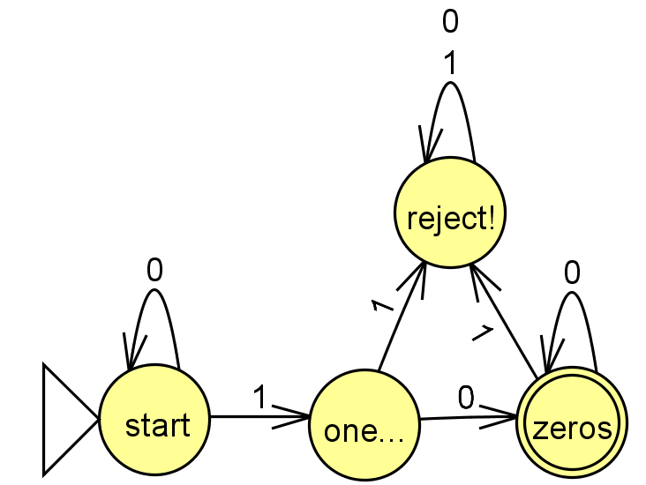
Solution
{w ∈ {0,1}* | w is a binary # that’s a power of 2}

Slide 29
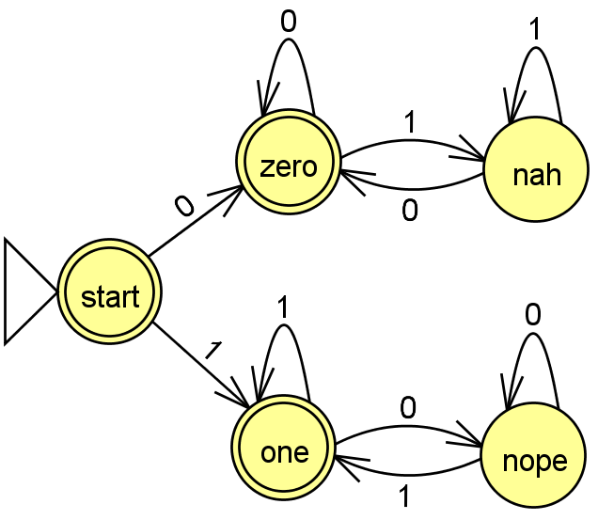
Solution
{w ∈ {0,1}* | first and last bit of w are the same}

Slide 30
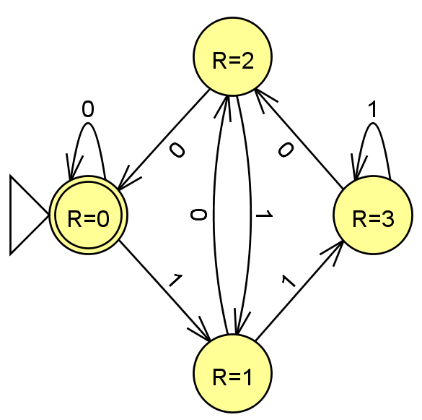
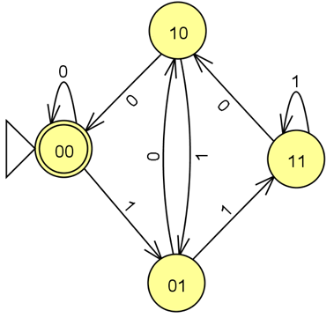
Solution
{w ∈ {0,1}* | w is a binary number that’s divisible by 4}
These are the last two digits we saw
R means Remainder
divided by 4

Slide 31
Extra DFA Practice
(Which one is this most similar to?)
L = {w ∈ {0,1}*| w’s third-to-last character is a 1}
A
{w ∈ {0,1}* | w is the string 01}
B
{w ∈ {0,1}* | w is a binary # that’s a power of 2}
C
{w ∈ {0,1}* | first and last bit of w are the same}
D
{w ∈ {0,1}* | w is a binary number that’s divisible by 4}

Slide 32
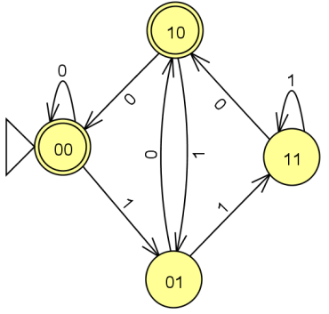
L = {w ∈ {0,1}*| w’s third-to-last character is a 1}
What states do we need?
Thinking about this problem might be helpful!
{w ∈ {0,1}* | w is a binary number that’s even}

Slide 33
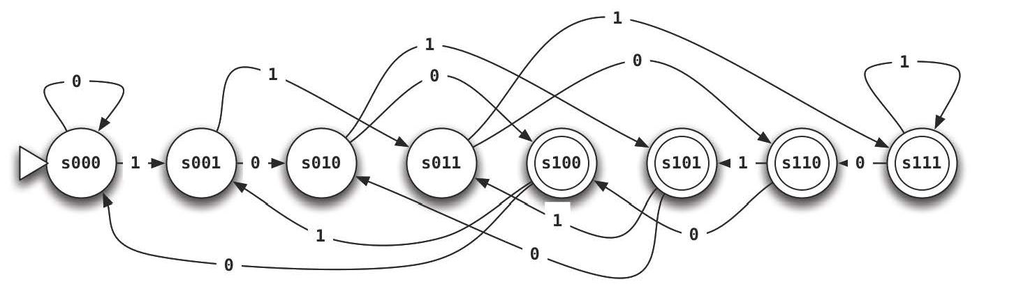
L = {w ∈ {0,1}*| w’s third-to-last character is a 1}
Solution
What states do we need?
Thinking about this problem might be helpful!
{w ∈ {0,1}* | w is a binary number that’s even}

Slide 34
Homework Due Friday May 3rd
0. Do the JFLAP tutorial
DFA: at least two 0’s and at most one 1.
DFA: multiple of two or three 0’s
DFA/NFA: first two characters equal the last two
6. DFA: binary representation of multiples of 7
10.DFA/NFA equal occurrences of 01 and 10

Slide 35
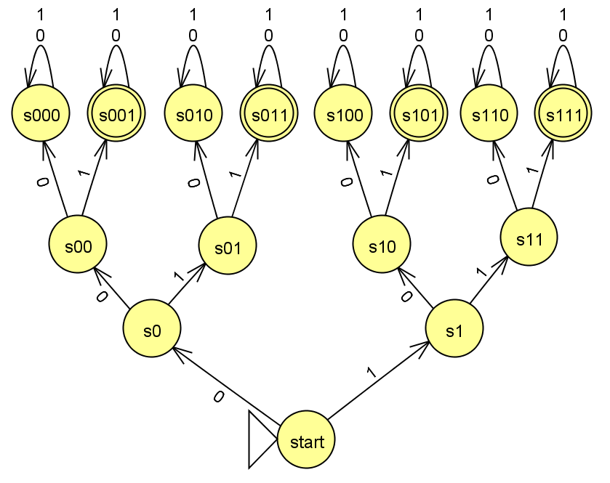
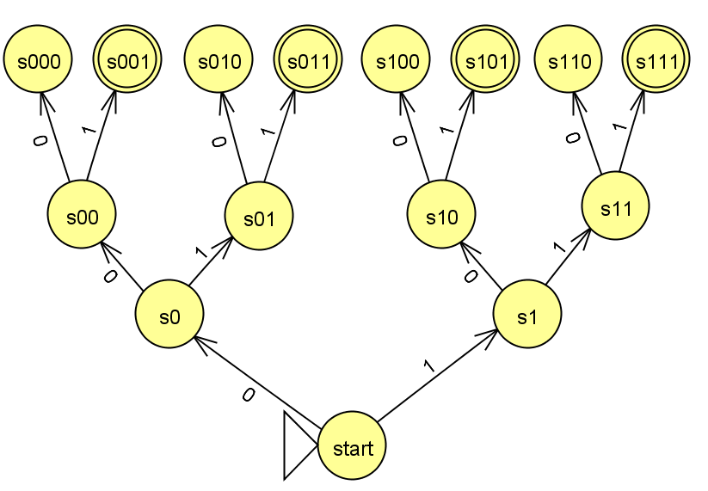
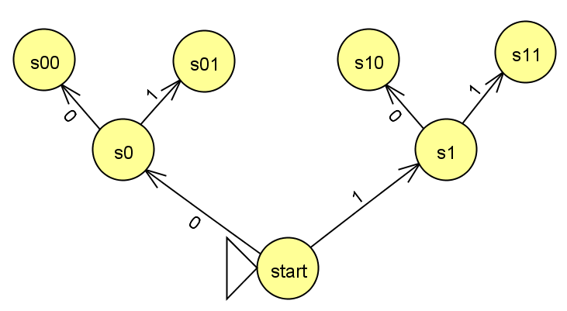
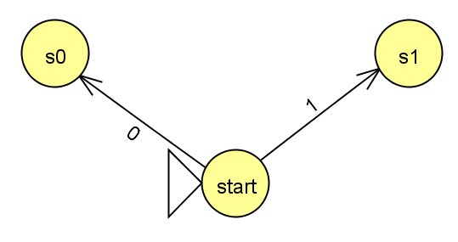
Could I do this with fewer states?
{w ∈ {0,1}*| w’s third character is a 1}

