Slide 1
CS 60
Finite Automata (hw13)
2013-04-25
Thursday – Week 12
Lecture 25

Slide 2
Survey
Were you annoyed that I didn’t explain hash tables Tuesday?
Nah
What?
I would have preferred you did
A little annoyed
Annoyed

Slide 3
Survey
What if participation was measured by iclickers?
To get full credit – you should have to click:
95% of days
80% of days
70% of days
50% of days
iClickers shouldn’t be used for participation

Slide 4
Administrative Stuff (Not in your notes)
Email me to schedule an appointment!
Hw 13 – 50 points
Hw 12 – Extra credit
Finish the assignment by Sunday at 3pm
Help your classmates for 2 hours in the LAC
Get 10 points!
(See assignment for full details)

Slide 5
DFA Review

Slide 6
Homework 13 Due Friday May 3rd at 11:59pm
Nondeterministic Finite
Automata
Deterministic Finite Automata
DFA
1, 2, 6
NFA
5
4 10
Proof
3, 7, 8

Slide 7
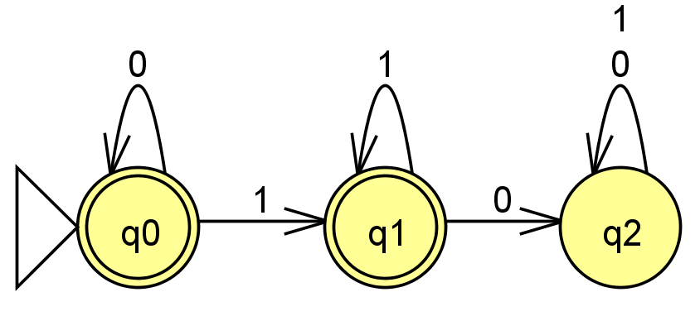
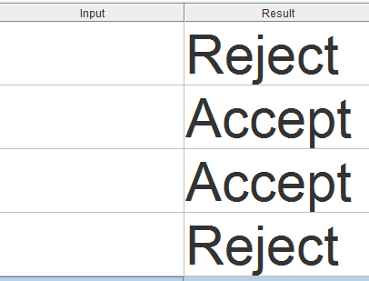
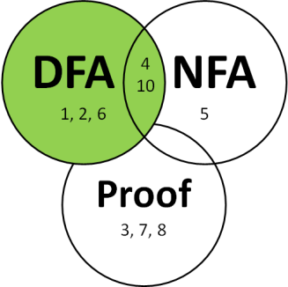
DFAs describe a Language
Fill in with sequences that would be accepted or rejected.
How would you describe what sequences this accepts?

Slide 8





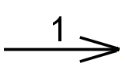
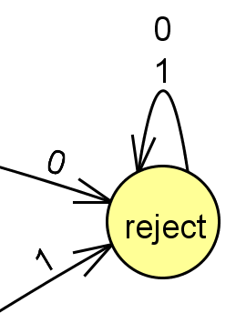

DFA Rules & Generation Tips
Tips for writing DFAs
Rules about DFAs
Write out sequences (aka strings) that are accepted.
Write out sequences that are not accepted.
Identify what states might be important and what they will “mean”
Draw the DFA for a simple sequence that is accepted, then fill in other transitions.
Add a failing state
Compare to other problems you’ve solved
Indicate the starting state (aka initial state) with a triangle or arrow.
Indicate the accepting state(s) (aka final states) with concentric circles.
Every state must have a transition for every possible symbol.

Slide 9
(1) Draw a DFA accepting
(2) Draw a DFA accepting the language
L = { w | w is the string 01 }
L = { w | w is a binary # that's a power of two }
initial 0s are OK
01
only 0s are not OK
the empty string λ is not OK
0010
100
10000
…
(3) Draw a DFA accepting
(4) Draw a DFA accepting
L = { w | w is a binary # that’s divisible by 4 }
L = { w | the first and last bit of w are the same }
initial 0s are OK
the empty string λ is OK
the empty string λ is OK
101
00
0010
0
1
λ
…
01000
0
λ
10100
…
Done with:
A) 1 B) 2 C) 3 D) 4 E) ???
Extra! use the minimum possible number of states in your four solutions…

Slide 10
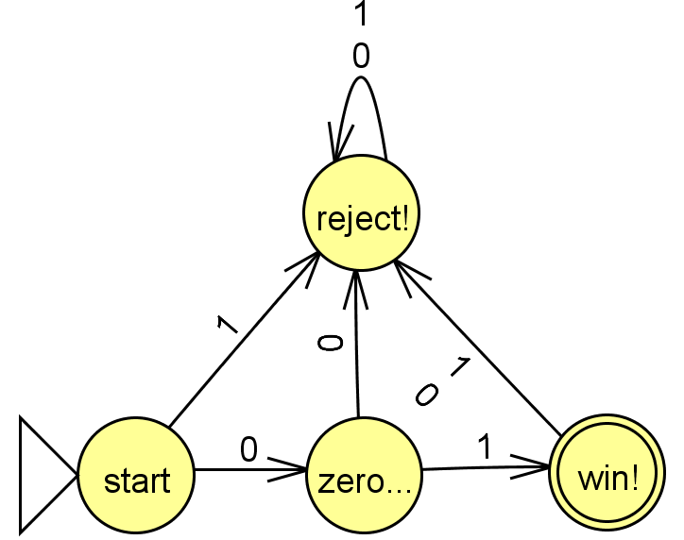
Solution
{w ∈ {0,1}* | w is the string 01}

Slide 11
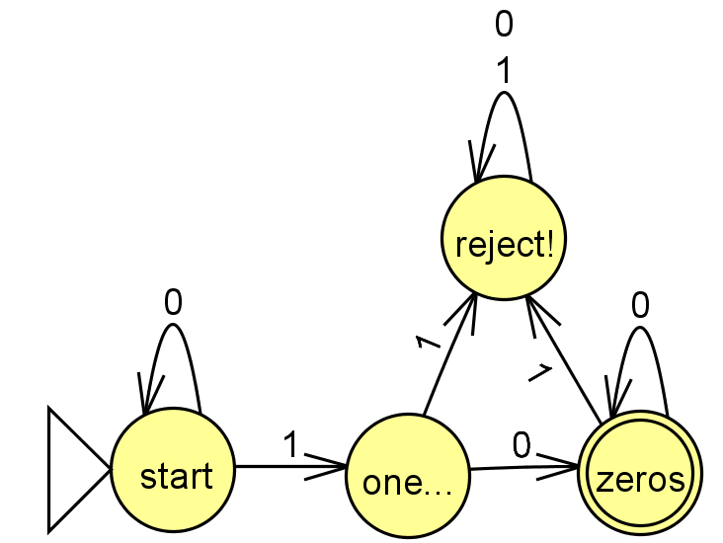
Solution
{w ∈ {0,1}* | w is a binary # that’s a power of 2}

Slide 12
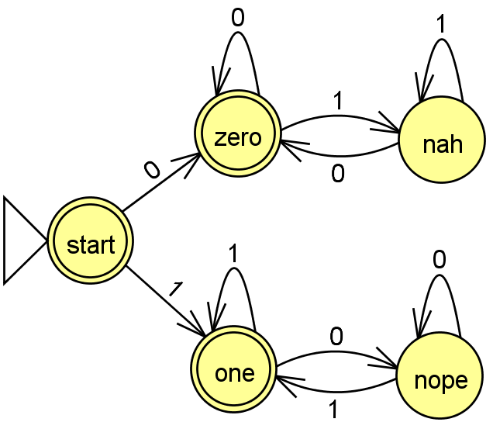
Solution
{w ∈ {0,1}* | first and last bit of w are the same}

Slide 13
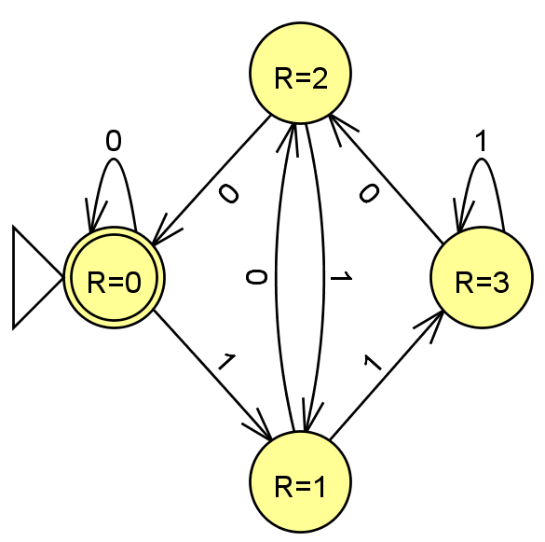
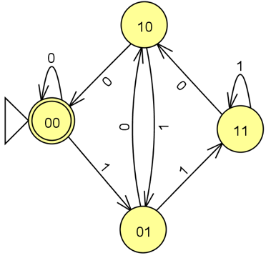
Solution
{w ∈ {0,1}* | w is a binary number that’s divisible by 4}
These are the last two digits we saw
R means Remainder
divided by 4

Slide 14
Extra DFA Practice (Which one is this most similar to?)
L = {w ∈ {0,1}*| w’s third-to-last character is a 1}
A
{w ∈ {0,1}* | w is the string 01}
B
{w ∈ {0,1}* | w is a binary # that’s a power of 2}
C
{w ∈ {0,1}* | first and last bit of w are the same}
D
{w ∈ {0,1}* | w is a binary number that’s divisible by 4}

Slide 15
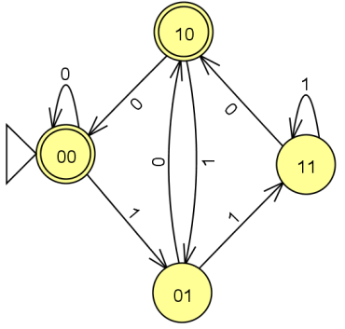
L = {w ∈ {0,1}*| w’s third-to-last character is a 1}
What states do we need?
Thinking about this problem might be helpful!
{w ∈ {0,1}* | w is a binary number that’s even}

Slide 16
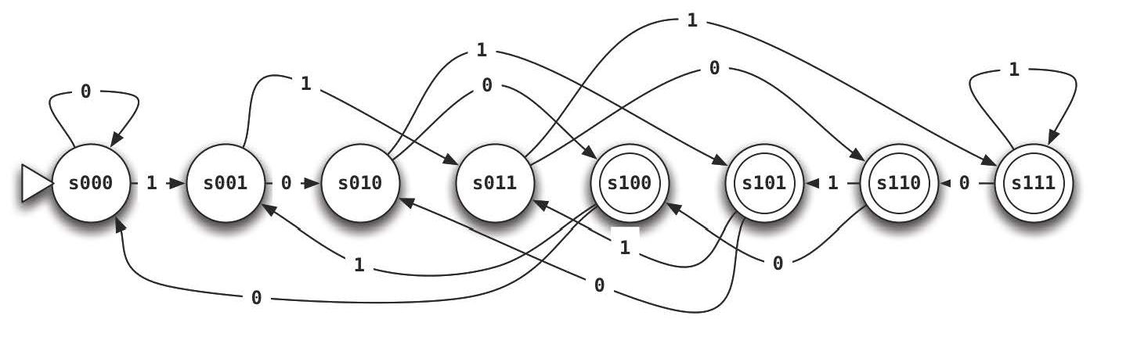
L = {w ∈ {0,1}*| w’s third-to-last character is a 1}
Solution
What states do we need?
Thinking about this problem might be helpful!
{w ∈ {0,1}* | w is a binary number that’s even}

Slide 17
Homework Due Friday May 3rd
0. Do the JFLAP tutorial
DFA: at least two 0’s and at most one 1.
DFA: multiple of two or three 0’s
DFA/NFA: first two characters equal the last two
6. DFA: binary representation of multiples of 7
10.DFA/NFA equal occurrences of 01 and 10

Slide 18
Indistinguishable States

Slide 19
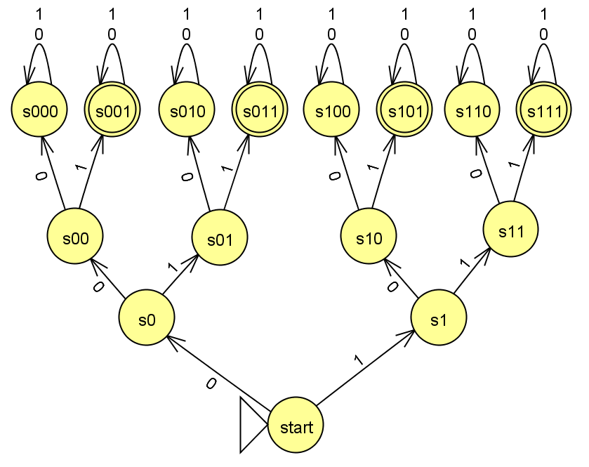
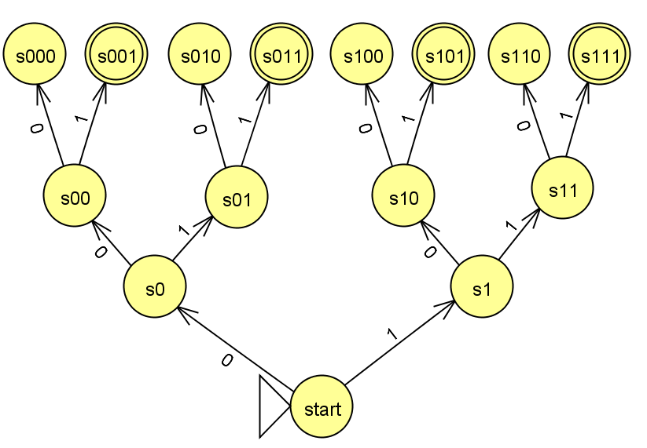
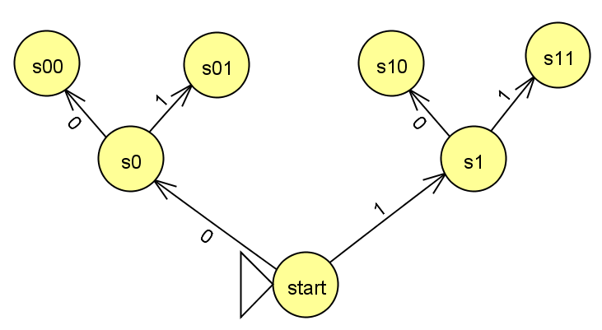
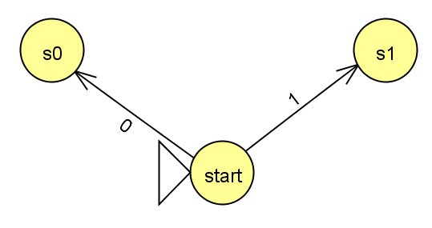
Could I do this with fewer states?
{w ∈ {0,1}*| w’s third character is a 1}

Slide 20
DFA
1, 2, 6
NFA
5
4 10
Proof
3, 7, 8

Slide 21
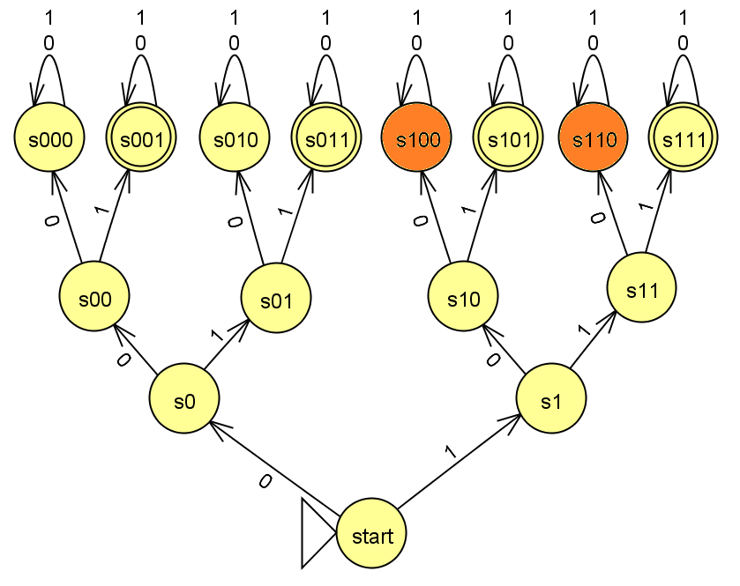
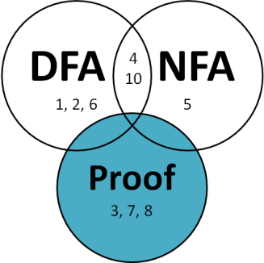
Indistinguishable States
States
s100 and s110
are indistinguishable!
The Strings
100 and 110
are indistinguishable!
Indistinguishable (Definition):
No matter what symbols come later, their fates are the same!

Slide 22
Distinguishable States/Minimal DFAs
Write the Minimal DFA, which has only distinguishable (necessary) states.
States necessary?
A) 4 B) 5 C) 6 D) >6 E)??
{w ∈ {0,1}*| w’s third character is a 1}

Slide 23
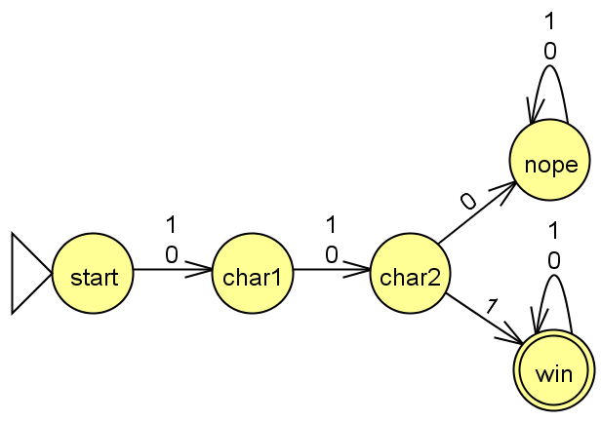
Distinguishable States/Minimal DFAs
Solution
Write the Minimal DFA, which has only distinguishable (necessary) states.
If I can create a DFA with X states, that proves you don’t need more than X states!
{w ∈ {0,1}*| w’s third character is a 1}

Slide 24
Distinguishable States

Slide 25
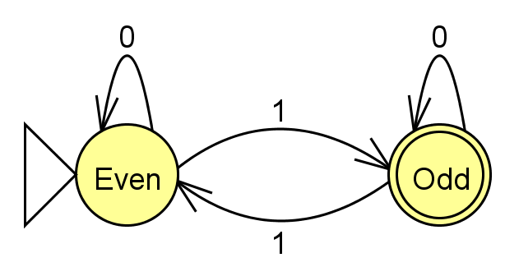
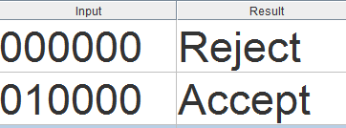
Indistinguishable (Definition):
No matter what symbols come later, their fates are the SAME!
Distinguishable (≈Definition):
For some following sequence,
their fates are DIFFERENT!
The Strings
100 and 110
are indistinguishable!
The Strings
00 and 01
are distinguishable!
What happens If 00 and 01 are followed by 0000? Both accepted?

Slide 26
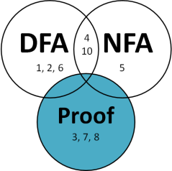

Formal Distinguishable Definition
e.g. w₁ = 01 and w₂ = 00
A language is what is specified by something like a DFA: what sequences of symbols are in (accepted) and out (rejected)
Given a language L,
Strings w₁ and w₂ are distinguishable if
there exists z ∈ ∑*
such that w₁z ∈ L and w₂z∉ L (or vice versa)
e.g. z = 0000
∑ is the set of symbols
* means some # of them
e.g. 010000 is accepted
e.g. 000000 is rejected

Slide 27
Formal Pairwise Distinguishable Definition
Given a language L,
Strings w₁ and w₂ are distinguishable if
there exists z ∈ ∑*
such that w₁z ∈ L and w₂z∉ L (or vice versa)
These are strings
A set S = {w₁, w₂, ….}
is pairwise distinguishable
if w_{i} and w_{j} are distinguishable for i ≠ j.

Slide 28
***Distinguishability Theorem*** (Lower-bound on Necessary states!)
If there is a pairwise distinguishable set of N strings for a language L, then a DFA accepting L must have ≥ N states.
Given a language L,
Strings w₁ and w₂ are distinguishable if
there exists z ∈ ∑*
such that w₁z ∈ L and w₂z∉ L (or vice versa)
Definition of distinguishable
A set S = {w₁, w₂, ….}
is pairwise distinguishable
if w_{i} and w_{j} are distinguishable for i ≠ j.
Definition of pairwise distinguishable

Slide 29
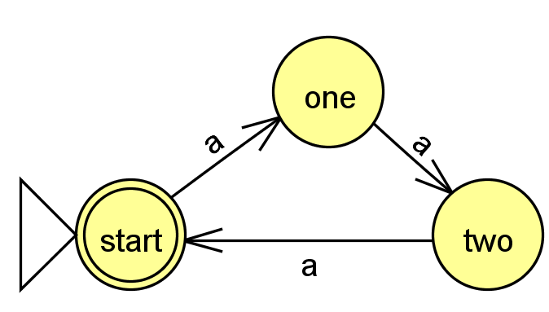
Prove that at least 3 states are required
Assume we have a state machine that accepts a multiple of three a’s
L = {a^{3n} | n ≥ 0 }.
What can you put at the end of both to make one of them accepted and one of them rejected
w_{i} | w_{j} | z | Is one accepted and on rejected?
a | aa
a | aaa
aa | aaa

Slide 30
Prove that at least 3 states are required
Solution
Assume we have a state machine that accepts a multiple of three a’s
L = {a^{3n} | n ≥ 0 }.
What can you put at the end of both to make one of them accepted and one of them rejected
w_{i} | w_{j} | z | Is one accepted and on rejected?
a | aa | a | aa reject aaa accept
a | aaa | aa | aaa accept aaaaa reject
aa | aaa | a | aaa accept aaaa reject

Slide 31
Prove that the start state is pairwise distinguishable from all other states
Assume we have a state machine that accepts when the first and last bit of w are the same.
w_{i} | w_{j} | z | Is one accepted and on rejected?
λ | 0 | 1 | 1 accept; 01 reject
λ | 1
λ
λ

Slide 32
Prove that the start state is pairwise distinguishable from all other states
Assume we have a state machine that accepts when the first and last bit of w are the same.
Solution
w_{i} | w_{j} | z | Is one accepted and on rejected?
λ | 0 | 1 | 1 accept; 01 reject
λ | 1 | 0 | 0 accept; 10 reject
λ | 01 | 1 | 1 accept; 011 reject
λ | 10 | 0 | 0 accept; 100 reject

Slide 33
How could you prove that at least 5 states are required????
Assume we have a state machine that accepts when the first and last bit of w are the same.
How many rows would be necessary?
A) 5! B) 5 C) 10 D) Other E)?
w_{i} | w_{j} | z | Is one accepted and on rejected?

Slide 34
***Distinguishability Theorem*** (Lower-bound on Necessary states!)
If there is a pairwise distinguishable set of N strings for a language L, then a DFA accepting L must have ≥ N states.
Given a language L,
Strings w₁ and w₂ are distinguishable if
there exists z ∈ ∑*
such that w₁z ∈ L and w₂z∉ L (or vice versa)
Definition of distinguishable
A set S = {w₁, w₂, ….}
is pairwise distinguishable
if w_{i} and w_{j} are distinguishable for i ≠ j.
Definition of pairwise distinguishable

Slide 35
Regular/ Non-Regular Languages

Slide 36
Regular Language
A language is regular if it can be recognized by a DFA.
The following are equivalent
There is a DFA accepting the set L
There is a NFA accepting L [Rabin and Scott]
We’ll talk about this next!
L can be described by a regular expression [Kleene]
You’ll see these in CS81.

Slide 37
***The Nonregular Language Theorem***
Myhill-Nerode theorem
If there is an infinite
pairwise distinguishable
set of strings (w.r.t. L),
it must be that L is not regular!
You can’t represent it with a DFA

Slide 38
Nonregular Language Proof
If there is an infinite
pairwise distinguishable
set of strings (w.r.t. L),
it must be that L is not regular!
Show that this is not regular
L = { 0^{n} 1^{n} | n ≥ 0 }

Slide 39
Nonregular Language Proof
Solution
If there is an infinite
pairwise distinguishable
set of strings (w.r.t. L),
it must be that L is not regular!
Show that this is not regular
L = { 0^{n} 1^{n} | n ≥ 0 }
Consider the infinite set:
{0^{n} | n is a pos. integer}
{0, 00, 000, 0000, … }
w_{i} = 0^{i} w_{j} = 0^{j} Note: i ≠ j
z = 1^{i} w_{i} z = 0^{i} 1^{i} w_{j} z = 0^{j} 1^{i}
Accepted
Rejected

Slide 40
Non-regular Language Proofs
How do you feel about them?
Not great
Okay
Great

Slide 41
Homework Due Friday
Prove that you need at least 6 states (for #2)
Prove that palindrome checking is not regular
Prove that power of two occurrences of 0’s is not regular

Slide 42
DFA
1, 2, 6
NFA
5
4 10
Proof
3, 7, 8

Slide 43
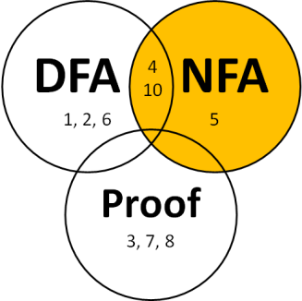
Nondeterministic Finite Automata (NFAs)
Rules:
States can have any number of transitions for a single character. (zero, one, more...)
Can transition without reading input (λ)
Accepts iff there is at least one accepting path
Have the power to guess the right way to go

Slide 44
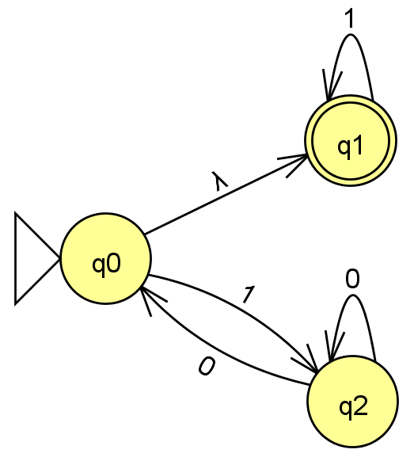
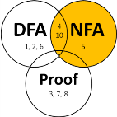
NFAs: Adding nondeterminism to DFAs
NFA Rules:
States can have any number of transitions for a single character. (zero, one, more...)
Can transition without reading input (λ)
Accepts iff there is at least one accepting path
Have the power to guess the right way to go.
NFAs
(Nondeterministic Finite Automata)
What happens with …
- an input of 1 ?
- an input of 0 ?
- an input of 11 ?
How many fail?
A) 0 B) 1-2 C) 3 D) 4 E) ?
- an input of 101 ?
- an input of λ?
Is L = { all strings beginning with 1 } ?
Notes:
equivalent NFAs?
is this possible?

Slide 45
If you were going to implement an NFA in code, what language would you want to use?
Python
Racket
Prolog
Java
Other

Slide 46
Write the NFA for this Language
L = {w ∈ {0,1}*| w’s third-to-last character is a 1}
strings not in L
λ
11
01
01011001
1111111011
strings in L
110
100
0000100
111111111
a DFA would require 8 states
Notes:
good to have a lambda here at the start

Slide 47
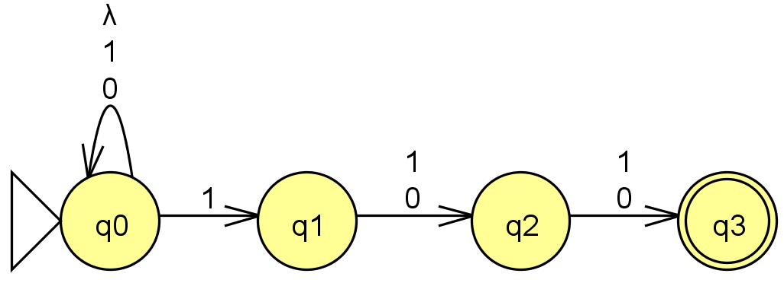
Solution
Write the NFA for this Language
L = {w ∈ {0,1}*| w’s third-to-last character is a 1}
strings not in L
λ
11
01
01011001
1111111011
strings in L
110
100
0000100
111111111
a DFA would require 8 states
Notes:
good to have a lambda here at the start

Slide 48
DFAs
≡
NFAs
≡
RegEx's
To show:
How many states?
A) 4 B) 5 C) 6 D) >6 E) ?
DFAs can represent NFAs
λ, 0, or multiple transitions
q1
1
λ
q0
1
0
q2
0
What DFA states might we need?
Notes:
Key property of NFA – multiple states at once….
Key insight was that you could represent this deterministically by considering all different SUBSETS of states that you might be in!

Slide 49
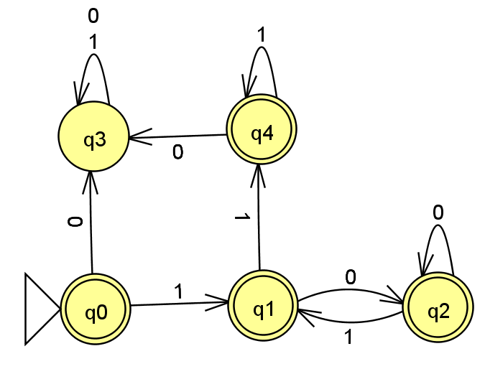
Solution
DFAs
≡
NFAs
≡
RegEx's
To show:
DFAs can represent NFAs
λ, 0, or multiple transitions
q1
1
λ
q0
1
0
q2
0
What DFA states might we need?
Notes:
Key property of NFA – multiple states at once….
Key insight was that you could represent this deterministically by considering all different SUBSETS of states that you might be in!

Slide 50
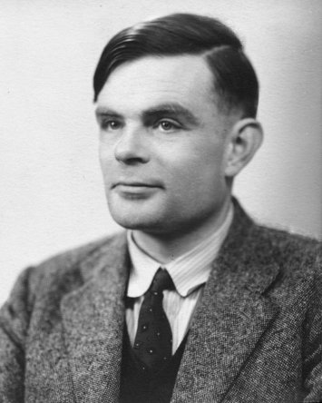
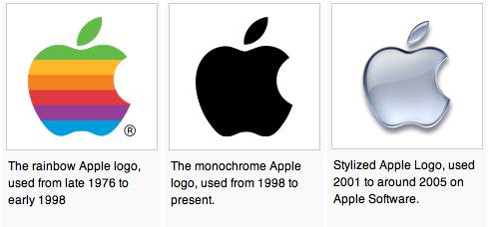
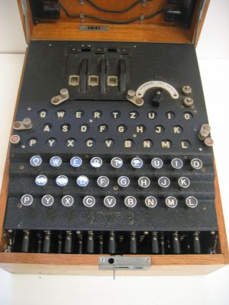
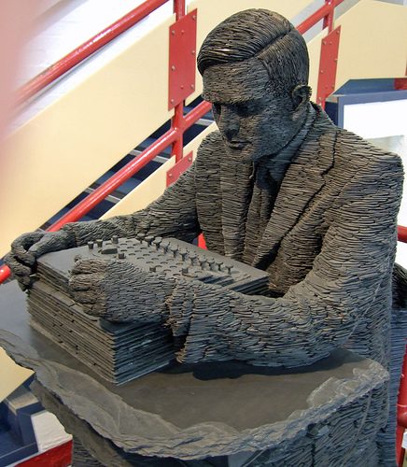
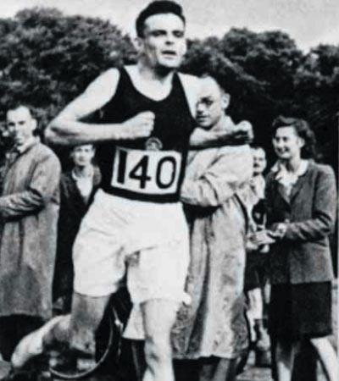
Alan Turing
AI !
1912-1954
WWII
Enigma machine ~ The axis's encryption engine
2007
Bletchley Park
1946

Slide 51

Turing Machines…
Alan Turing: “Logical Computing Machines”
A simple model of universal computation.
Starts on the leftmost character
The tape: an unbounded amount of memory. Consists of cells, each containing exactly one character characters (e.g. 0, 1, or □ (blank))
Read/write head for the tape
The control: a finite amount of memory, the control states -- some are accepting, some are not.
Ability to move left and right
The control state
The symbol now under the head
The symbols to the right of the head
The symbols to the left of the head
The complete state of a TM is determined by:

Slide 52

Turing Machine Practice
0
;
1
,
a Turing Machine rule:
R
READ SYMBOL
WRITE SYMBOL
MOTION

Slide 53
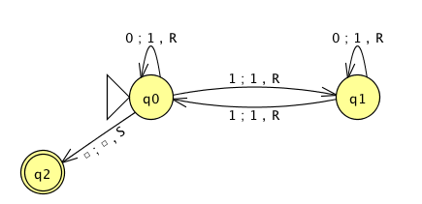
the input
0
1
0
1
1
the tape
"blanks" are everywhere else
R/W head
an accepting state always halts and then basks in its success!
if a transition is missing, the input FAILS!
0
;
1
,
a Turing Machine rule:
R
READ SYMBOL
WRITE SYMBOL
MOTION
Notes:
metric prefixes…

Slide 54
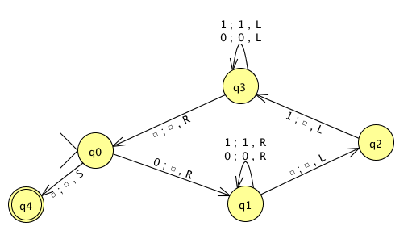
Name(s) __________________________________ Quiz
Run this TM on this input:
0
0
1
1
1
Is this input accepted or rejected?
What inputs are accepted in general? How does it work?
Extra: How could you change this to accept palindromes?
(just a thought experiment)
Notes:
metric prefixes…

Slide 55
Assignment #12
Problem: Create a JFLAP TM that accepts strings of 2^{N} zeros.
(You may assume the input is all zeros)
start
reject
0
accept
0
0
accept
0
0
0
reject
0
0
0
0
accept
Extra Credit:
in as few states as possible (3)
… but you ARE allowed to make the alphabet bigger!

Slide 56
Tips: Create a JFLAP TM that accepts strings of 2^{N} zeros.
Can you solve a related, simpler problem?
Can you make the problem smaller?

Slide 57
BONUS

Slide 58


Computer
Science
&
= AWESOME

Slide 59

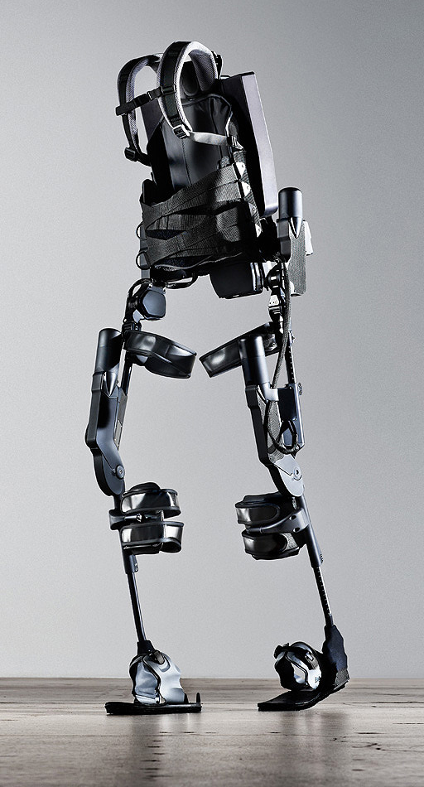
http://www.youtube.com/watch?v=pzRmNYA8LlY

Slide 60


ClickStart

Slide 61
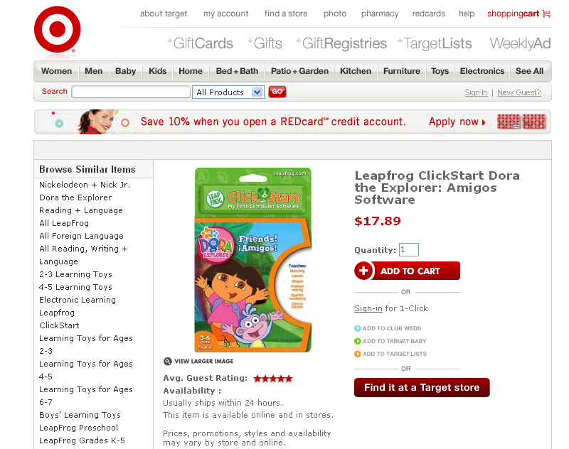

Slide 62


Slide 63
The value in the array tells me what art asset to use
Each level is really a 3x10 array!
0 | 0 | 7 | 0 | 4 | 0 | 0 | 0
1 | 2 | 3 | -4 | 5 | 6 | -7 | 8
B | B | B | B | B | B | B | B
Negative values tell me what block needs to go here to win!

Slide 64
0 | 0 | 7 | 0 | 4 | 0 | 0 | 0
1 | 2 | 3 | -4 | 5 | 6 | -7 | 8
0 | 0 | 0 | B | 0 | 0 | 0 | 0

Slide 65
BUGS!

Slide 66
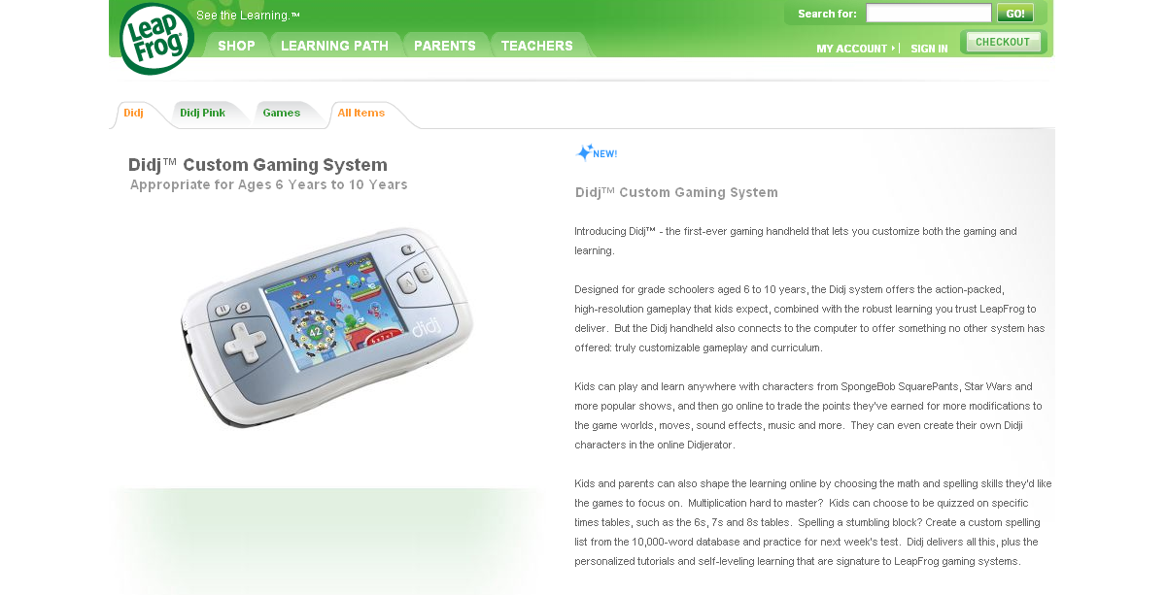

Slide 67

It is really sad when stuff you’ve made is on sale!

Slide 68



Which image is fake?
A. Top Left
B. Bottom Left
C. Bottom Right

Slide 69
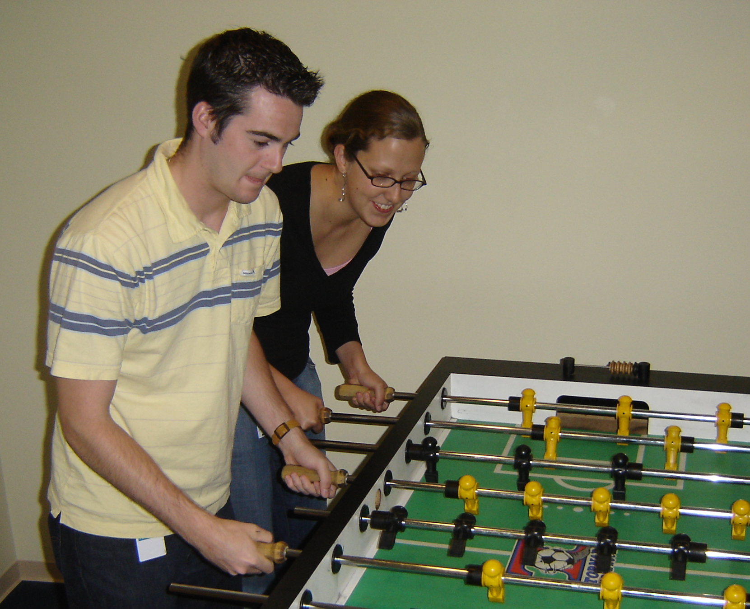

Slide 70
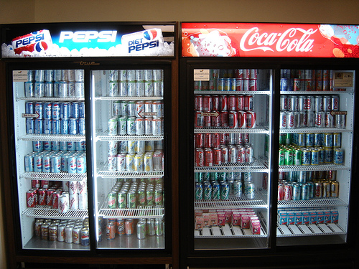

Slide 71
Use the Career Center!
They have this thing where you can apply online to get interviews. Then the interviews are on campus.
Are there unprofessional photos of you on facebook?
A. Yes and they are public
B. Yes but they are private
C. No (This is the best answer!)
It is all about who you know!

Slide 72
Concurrency

Slide 73
Clicker poll ☺
Are you allowed to talk about the midterm on piazza or in public yet?
Yes
No

Slide 74
Dining Philosophers
Philosophers are sitting around a large round table, each with a bowl of Chinese food in front of him/her. Between periods of deep thought they may start eating whenever they want to, with their bowls being filled frequently. But there are only 5 chopsticks available, one to the left of each bowl. When a philosopher wants to start eating, he/she must pick up the chopstick to the left of his bowl and the chopstick to the right of his bowl.

Slide 75
Dining Philosophers
A) Heard of it before (and know the point)
B) Never heard of it before (but get it)
C) Never heard of it before (but going to get it)

Slide 76
Problems with Concurrency
Incorrectness
Inefficiency
Deadlock
Unfairness

Slide 77
BELOW the line…
(set! x (+ 1 x))
Lookup x
Add 1 to x
Set x
Actually one set! is composed of 3 steps

Slide 78
What if these “happened” one after the other
(set! x (+ 1 x))
(set! x (+ 1 x))
P1: Lookup x
P1: Add 1 to x
P1: Set x
P2: Lookup x
P2: Add 1 to x
P2: Set x
X: 100
X: 100 101
X: 100 101 102

Slide 79
If these execute in parallel: Possibility for Incorrect Results!
(set! x (+ 1 x)) (set! x (+ 1 x))
P1: Lookup x
P1: Add 1 to x
P1: Set x
P2: Lookup x
P2: Add 1 to x
P2: Set x
Within a process they are
NEVER re-ordered!
Only interleaved with another process
X: 100 101
X: 100 101 101
X: 100

Slide 80
How many possible outcomes?
(define x 100)
(parallel-execute
(lambda() (set! x (+ x 6)))
(lambda() (set! x (+ x 5))))
1 possible outcome
2 possible outcomes
3 possible outcomes
4 possible outcomes
5 possible outcomes
Thunk:
Lambda of with no arguments

Slide 81
EVERY ordering!
1 1 2 2
1 2 1 2
2 1 1 2
1 2 2 1
2 1 2 1
2 2 1 1
P1 then P2
P2 clobbers P1
P1 clobbers P2
P2 then P1
(set! x (+ 6 x)) (set! x (+ 5 x))
P1: Lookup x
P1: Add 6 to x
P1: Set x
P2: Lookup x
P2: Add 5 to x
P2: Set x

Slide 82
If these execute in parallel… Write out the sequence of events
(define x 10)
(set! x (+ x x)) (set! x (+ 1 x))
P1: Lookup x
P1: Lookup x
P1: Add x to x
P1: Set x
P2: Lookup x
P2: Add 1 to x
P2: Set x
Critical section
2 possible outcomes for x
3 possible outcomes for x
4 possible outcomes for x
5 possible outcomes for x
More than 5

Slide 83
EVERY ordering!
1 1 1 2 2
1 1 2 1 2
1 2 1 1 2
2 1 1 1 2
1 1 2 2 1
1 2 1 2 1
2 1 1 2 1
1 2 2 1 1
2 1 2 1 1
2 2 1 1 1
P1 then P2
P2 clobbers P1
P1 clobbers P2
P2 between P1’s lookups
P2 then P1

Slide 84
Possible outcomes
(set! x (+ x x)) (set! x (+ 1 x))
P1 then P2
P1: Lookup x
P1: Lookup x
P1: Set x
P2: Lookup x
P2: Set x
P2 then P1
P2: Lookup x
P2: Set x
P1: Lookup x
P1: Lookup x
P1: Set x
P2 between P1’s lookups
P1: Lookup x
P2: Lookup x
P2: Set x
P1: Lookup x
P1: Set x
P2 clobbers P1
P1: Lookup x
P1: Lookup x
P2: Lookup x
P1: Set x
P2: Set x
P1 clobbers P2
P1: Lookup x
P1: Lookup x
P2: Lookup x
P2: Set x
P1: Set x

Slide 85
Our definition of a “correct answer”?
(define x 10)
(parallel-execute
(lambda() (set! x (+ x x)))
(lambda() (set! x (+ 1 x))))
Correct answers:
21 (line 1 first)
22 (line 2 first)
“Ensure that a concurrent system produces the same result as if the processes had run sequentially in some order.”

Slide 86
Protecting from incorrectness

Slide 87

Serializers protect things And make things they protect serial (def: taking place in a series)
(define stephanie (make-serializer))
(define phill (make-serializer))
(define hamilton (make-serializer))
Occupied. You’ve got to wait!

Slide 88
Serializers protect things And make things they protect serial (def: taking place in a series)
(define stephanie-x (make-serializer))
(parallel-execute
(stephanie-x (lambda()(set! x (+ x 1)))
(stephanie-x (lambda()(set! x (+ x x)))
(stephanie-x (lambda()(set! x (+ x 9))))
Serializer stephanie-x
will make sure nothing she
protects happen concurrently.
“Ensure that a concurrent system produces the same result as if the processes had run sequentially in some order.”

Slide 89
Serializers protect things And make things they protect serial (def: taking place in a series)
(define hamilton-x (make-serializer))
(define phill-y (make-serializer))
(parallel-execute
(hamilton-x (lambda()(set! x (+ x 1)))
(hamilton-x (lambda()(set! x (+ x x)))
(phill-y (lambda()(set! y (+ y 1)))
(phill-y (lambda()(set! y (+ y y)))
(hamilton-x (lambda()(set! x (+ x 9))))

Slide 90
Serializers protect things And make things they protect serial (def: taking place in a series)
(define x 10)
(define stephanie-x (make-serializer))
(define hamilton-x (make-serializer))
(parallel-execute
(stephanie-x (lambda()(set! x (+ x 1)))
(hamilton-x (lambda()(set! x (+ x x)))))
Will this ensure the answer will be 21 or 22?
A. Yes B. No C. Not sure

Slide 91
We’ve seen INCORRECT… now INEFFICIENCY
(define phill-xy (make-serializer))
(parallel-execute
(phill-xy (lambda()(set! x (+ x 1)))
(phill-xy (lambda()(set! x (+ x x)))
(phill-xy (lambda()(set! y (+ y 1)))
(phill-xy (lambda()(set! y (+ y y)))
(phill-xy (lambda()(set! x (+ x 9))))
It would be correct to interleave x’s and y’s

Slide 92
You’ve seen INCORRECT and INEFFICIENT… now DEADLOCK
(define serial-x (make-serializer))
(define serial-y (make-serializer))
(parallel-execute
(serial-x (lambda()(set! x (+ x 1)))
(serial-y (lambda()
(set! y (+ y y)
(set! y (+ y 1)))
(serial-y (serial-x (lambda ()
(set! y (+ y 1))
(set! x (+ x 1))))))
Critical section

Slide 93
You’ve seen INCORRECT and INEFFICIENT… now DEADLOCK
(define serial-x (make-serializer))
(define serial-y (make-serializer))
(parallel-execute
(serial-y (serial-x (lambda ()
(set! y (+ y 1))
(set! x (+ x 1)))))
(serial-x (serial-y (lambda ()
(set! y (+ y 1))
(set! x (+ x 1))))))

Slide 94
Problems with Concurrency
Incorrectness
Inefficiency
Deadlock
Unfairness

Slide 95
Implementing Serializers
With a mutex

Slide 96

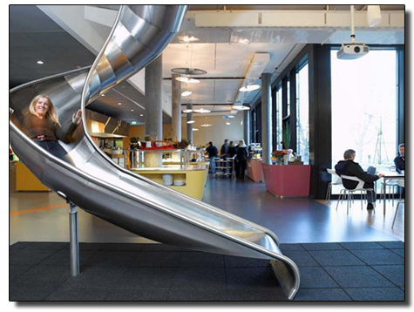
Wrinkles and I want to share
Is-someone-using-the-slide?
NO

Slide 97
Write make-mutex
STk> (define mutex1 (make-mutex))
STk> (mutex1 'aquire)
aquired
STk> (set! x (+ x 3))
okay
STk> (mutex1 'release)
released
How hard is this question?
A. Hard B. Medium C. Not hard

Slide 98
(make-mutex)Solution
(define (make-mutex)
(define the-mutex
(lambda (m)
(cond
((equal? m 'aquire) 'aquire)
((equal? m 'release) 'release)
(else 'blah))))
the-mutex)

Slide 99
(define (make-mutex)
(let ((in-use? #f))
(define the-mutex (lambda (m)
(cond
((eq? m 'aquire)
(if in-use?
(the-mutex 'aquire)
(set! in-use? #t)))
((eq? m 'release)
(set! in-use? #f))))
the-mutex))

Slide 100
(define (make-mutex)
(let ((in-use? (list #f)))
(define the-mutex(lambda (m)
(cond
((eq? m 'aquire)
(if(test-and-set! in-use?)
(the-mutex 'aquire)
(set! in-use? #t)))
((eq? m 'release)
(clear in-use?))))
the-mutex))

Slide 101
clear!
(define (clear! in-use?)
(set-car! in-use? false))
in-use?
car
cdr
#F

Slide 102
Write test-and-set!
STk> (define in-use? (list #f))
in-use?
STk> (test-and-set! in-use?)
#f
STk> in-use?
(#t)
STk> (define in-use? (list #t))
in-use?
STk> (test-and-set! in-use?)
#t
STk> in-use?
(#t)
A) Student
chalk
B) Student
emacs
C) Colleen
chalk
D) Colleen
emacs

Slide 103
test-and-set! SOLUTION
(define (test-and-set! in-use?)
(if (car in-use?)
#t
(begin
(set-car! in-use? true)
#f)))
Normally built into hardware! And this can have concurrency problems too!
in-use?
car
cdr
#F

Slide 104
(define (make-mutex)
(let ((in-use? (list #f)))
(define the-mutex (lambda (m)
(cond
((eq? m 'aquire)
(if(test-and-set! in-use?)
(the-mutex 'aquire)
(set! in-use? #t)))
((eq? m 'release)
(clear in-use?))))
the-mutex))
Does our test-and-set! Code work
with this make-mutex code? A) Yes B) No

Slide 105
“Correct answers”
(define y 4)
(parallel-execute
(lambda ()
(set! y (* y y)))
(lambda ()
(set! y (+ y 2)))
(lambda ()
(set! y (/ y 2))))
How many correct answers?
1
3
4
5
6

Slide 106

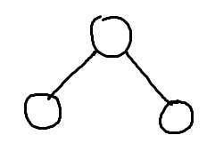
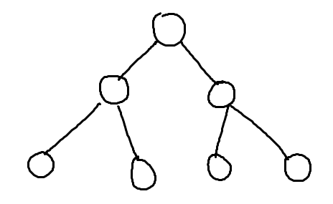
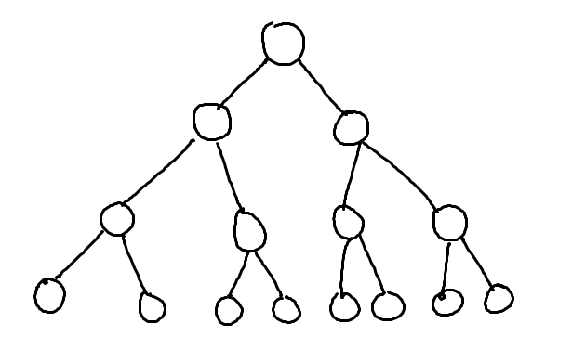
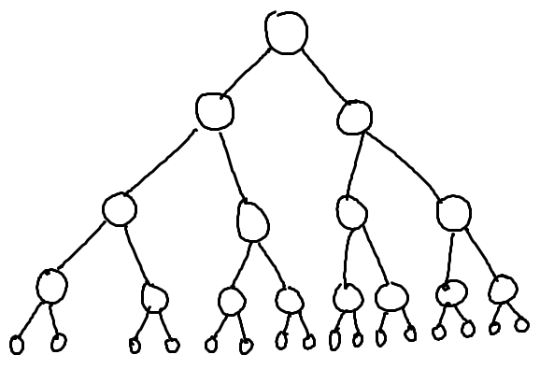
What’s the relationship between height and number of nodes?
3
7
1
15
31

Slide 107
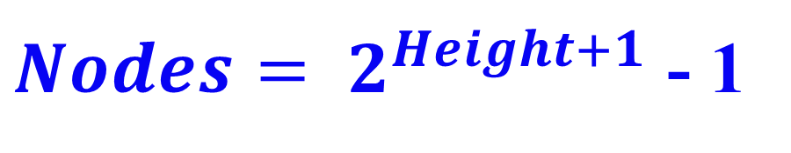
What’s the relationship between height and number of nodes?
1
3
7
Height | Nodes | 2^{Height+1}
0 | 1 | 2
1 | 3 | 4
2 | 7 | 8
3 | 15 | 16
4 | 31 | 32
5 | 63 | 64
15
31

Slide 108





// Take the log of both sides
Drop the 1
Who cares?
// Remember:

Slide 109
