Slide 1
CS 60
NFAs, Turing Machines
2013-04-30
Tuesday – Week 13
Lecture 26

Slide 2
Survey
Were you annoyed that I didn’t explain hash tables Tuesday?
Nah
What?
I would have preferred you did
A little annoyed
Annoyed

Slide 3
Administrative Stuff (Not in your notes)
Email me to schedule an appointment!
Hw 13 – 50 points
Grutor info session/Study break
Friday, May 10th of reading days from 1-4pm
Feedback from CS 70
Feedback/chatting lunches
Office hours next week

Slide 4
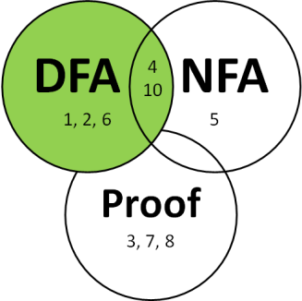





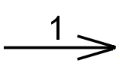
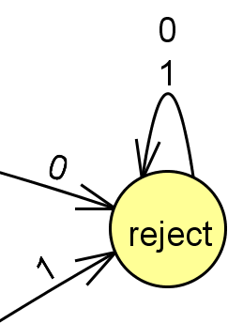

DFA Rules & Generation Tips
Tips for writing DFAs
Rules about DFAs
Write out sequences (aka strings) that are accepted.
Write out sequences that are not accepted.
Identify what states might be important and what they will “mean”
Draw the DFA for a simple sequence that is accepted, then fill in other transitions.
Add a failing state
Compare to other problems you’ve solved
Indicate the starting state (aka initial state) with a triangle or arrow.
Indicate the accepting state(s) (aka final states) with concentric circles.
Every state must have a transition for every possible symbol.

Slide 5
Writing DFAs
Do you feel ready to do this on the homework?
It will be good
It will be okay
It won’t be great

Slide 6
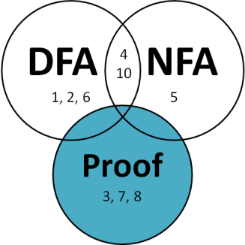
***Distinguishability Theorem*** (Lower-bound on Necessary states!)
If there is a pairwise distinguishable set of N strings for a language L, then a DFA accepting L must have ≥ N states.
Given a language L,
Strings w₁ and w₂ are distinguishable if
there exists z ∈ ∑*
such that w₁z ∈ L and w₂z∉ L (or vice versa)
Definition of distinguishable
A set S = {w₁, w₂, ….}
is pairwise distinguishable
if w_{i} and w_{j} are distinguishable for i ≠ j.
Definition of pairwise distinguishable

Slide 7
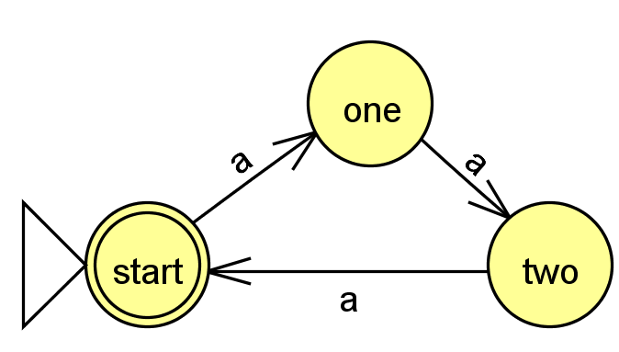
Prove that at least 3 states are required
Solution
Assume we have a state machine that accepts a multiple of three a’s
L = {a^{3n} | n ≥ 0 }.
What can you put at the end of both to make one of them accepted and one of them rejected
w_{i} | w_{j} | z | Is one accepted and on rejected?
a | aa | a | aa reject aaa accept
a | aaa | aa | aaa accept aaaaa reject
aa | aaa | a | aaa accept aaaa reject

Slide 8
Distinguishability Theorem Proof
Do you feel ready to use this technique on the homework?
It will be good
It will be okay
It won’t be great

Slide 9
***The Nonregular Language Theorem***
Myhill-Nerode theorem
If there is an infinite
pairwise distinguishable
set of strings (w.r.t. L),
it must be that L is not regular!
You can’t represent it with a DFA

Slide 10
Nonregular Language Proof
Solution
If there is an infinite
pairwise distinguishable
set of strings (w.r.t. L),
it must be that L is not regular!
Show that this is not regular
L = { 0^{n} 1^{n} | n ≥ 0 }
Consider the infinite set:
{0^{n} | n is a pos. integer}
{0, 00, 000, 0000, … }
w_{i} = 0^{i} w_{j} = 0^{j} Note: i ≠ j
z = 1^{i} w_{i} z = 0^{i} 1^{i} w_{j} z = 0^{j} 1^{i}
Accepted
Rejected

Slide 11
Non-regular Language Proof
Do you feel ready to use this technique on the homework?
It will be good
It will be okay
It won’t be great

Slide 12
Homework Due Friday
Prove that you need at least 6 states (for #2)
Prove that palindrome checking is not regular
Prove that power of two occurrences of 0’s is not regular

Slide 13
DFA
1, 2, 6
NFA
5
4 10
Proof
3, 7, 8

Slide 14
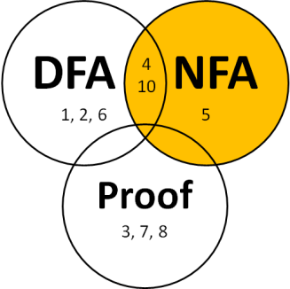
Nondeterministic Finite Automata (NFAs)
Rules:
States can have any number of transitions for a single character. (zero, one, more...)
Can transition without reading input (λ)
Accepts iff there is at least one accepting path
Tries all possible paths!

Slide 15
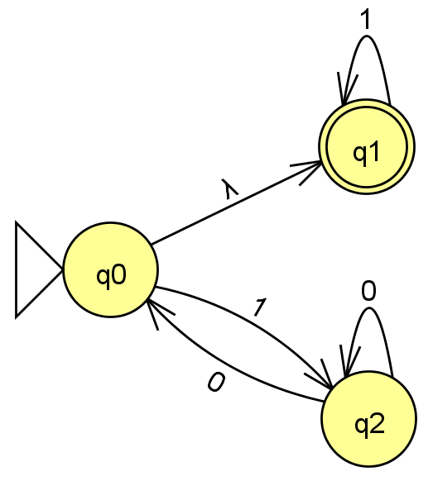
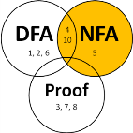
NFAs: Adding nondeterminism to DFAs
NFAs
NFA Rules:
States can have any number of transitions for a single character. (zero, one, more...)
Can transition without reading input (λ)
Accepts iff there is at least one accepting path
Tries all possible paths!
(Nondeterministic Finite Automata)
What happens with …
- an input of 1 ?
- an input of 0 ?
- an input of 11 ?
How many fail?
A) 0 B) 1-2 C) 3 D) 4 E) ?
- an input of 101 ?
- an input of λ?
Is L = { all strings beginning with 1 } ?
Notes:
equivalent NFAs?
is this possible?

Slide 16
If you were going to implement an NFA in code, what language would you want to use?
Python
Racket
Prolog
Java
Other

Slide 17
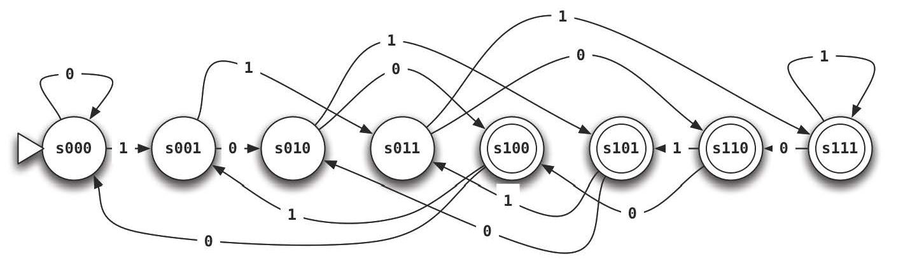
Write the NFA for this Language
L = {w ∈ {0,1}*| w’s third-to-last character is a 1}
strings not in L
λ
11
01
01011001
1111111011
strings in L
110
100
0000100
111111111
a DFA would require 8 states
Notes:
good to have a lambda here at the start

Slide 18
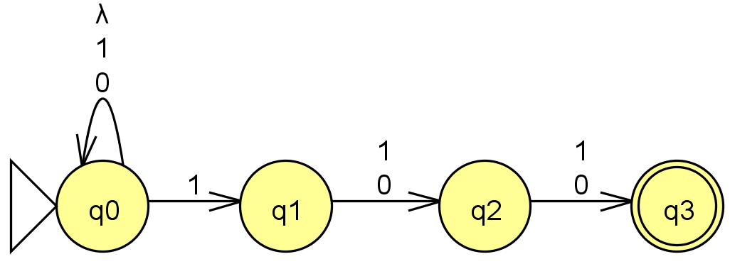
Solution
Write the NFA for this Language
L = {w ∈ {0,1}*| w’s third-to-last character is a 1}
strings not in L
λ
11
01
01011001
1111111011
strings in L
110
100
0000100
111111111
a DFA would require 8 states
Notes:
good to have a lambda here at the start

Slide 19
DFAs
≡
NFAs
≡
RegEx's
To show:
How many states?
A) 4 B) 5 C) 6 D) >6 E) ?
DFAs can represent NFAs
λ, 0, or multiple transitions
q1
1
λ
q0
1
0
q2
0
What DFA states might we need?
Notes:
Key property of NFA – multiple states at once….
Key insight was that you could represent this deterministically by considering all different SUBSETS of states that you might be in!

Slide 20
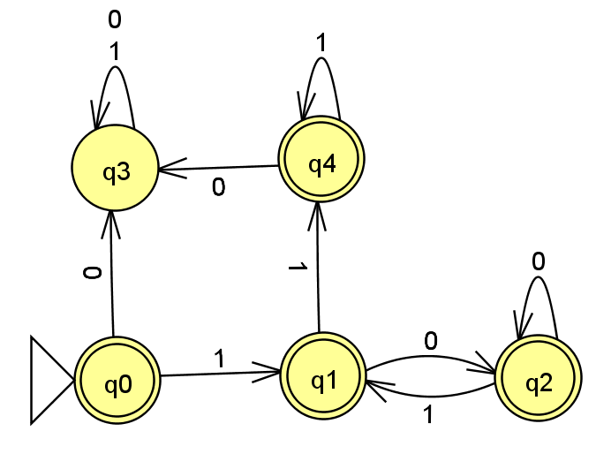
Solution
DFAs
≡
NFAs
≡
RegEx's
To show:
DFAs can represent NFAs
λ, 0, or multiple transitions
q1
1
λ
q0
1
0
q2
0
What DFA states might we need?
Notes:
Key property of NFA – multiple states at once….
Key insight was that you could represent this deterministically by considering all different SUBSETS of states that you might be in!

Slide 21
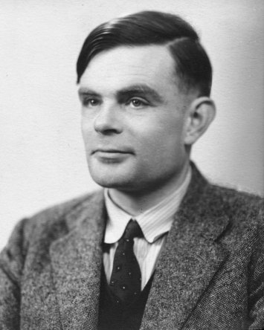
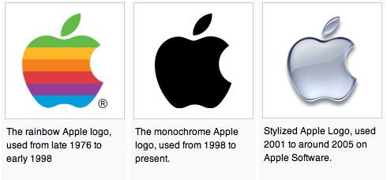
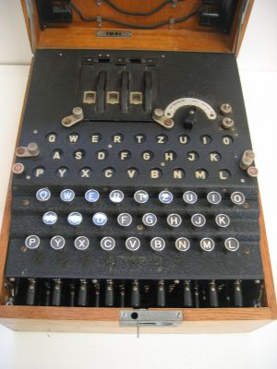
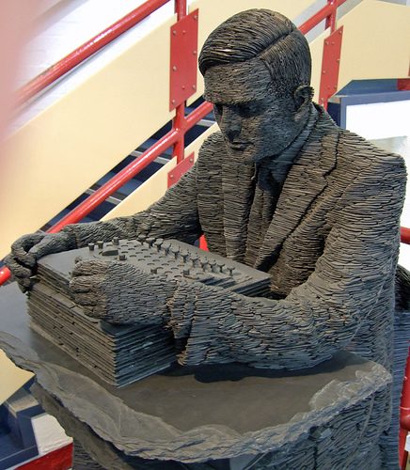
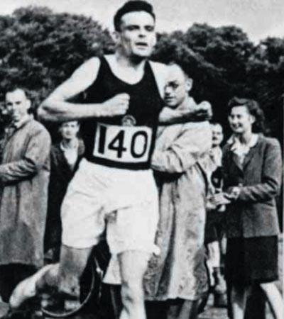
Alan Turing
AI !
1912-1954
WWII
Enigma machine ~ The axis's encryption engine
2007
Bletchley Park
1946

Slide 22
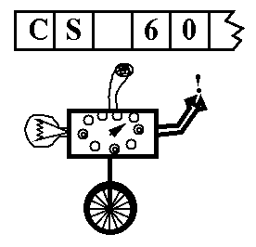
Turing Machines…
Alan Turing: “Logical Computing Machines”
A simple model of universal computation.
Starts on the leftmost character
The tape: an unbounded amount of memory. Consists of cells, each containing exactly one character characters (e.g. 0, 1, or □ (blank))
Read/write head for the tape
The control: a finite amount of memory, the control states -- some are accepting, some are not.
Ability to move left and right
The control state
The symbol now under the head
The symbols to the right of the head
The symbols to the left of the head
The complete state of a TM is determined by:

Slide 23

Turing Machine Practice
0
;
1
,
a Turing Machine rule:
R
READ SYMBOL
WRITE SYMBOL
MOTION

Slide 24
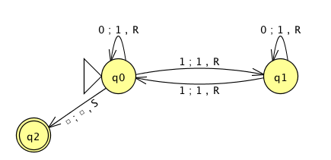
the input
0
1
0
1
1
the tape
"blanks" are everywhere else
R/W head
an accepting state always halts and then basks in its success!
if a transition is missing, the input FAILS!
0
;
1
,
a Turing Machine rule:
R
READ SYMBOL
WRITE SYMBOL
MOTION
Notes:
metric prefixes…

Slide 25
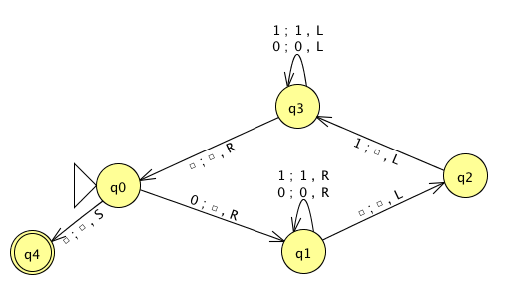
Run this TM on this input:
0
0
1
1
1
Is this input accepted or rejected?
What inputs are accepted in general? How does it work?
Extra: How could you change this to accept palindromes?
(just a thought experiment)
Notes:
metric prefixes…

Slide 26
Assignment #13
Problem: Create a JFLAP TM that accepts strings of 2^{N} zeros.
(You may assume the input is all zeros)
start
reject
0
accept
0
0
accept
0
0
0
reject
0
0
0
0
accept
Extra Credit:
in as few states as possible (3)
… but you ARE allowed to make the alphabet bigger!

Slide 27
Tips: Create a JFLAP TM that accepts strings of 2^{N} zeros.
Can you solve a related, simpler problem?
Can you make the problem smaller?

Slide 28
BONUS

Slide 29


Computer
Science
&
= AWESOME

Slide 30
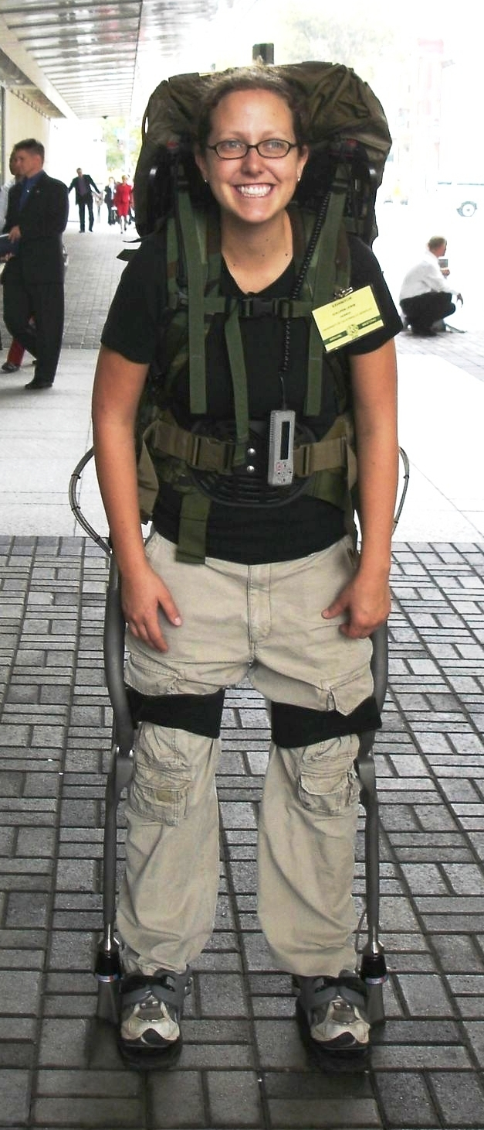
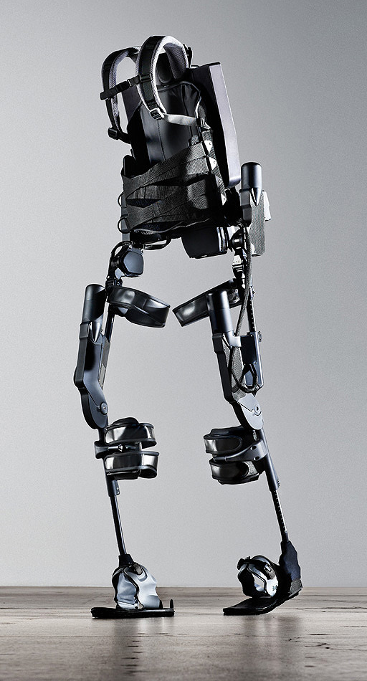
http://www.youtube.com/watch?v=pzRmNYA8LlY

Slide 31


ClickStart

Slide 32
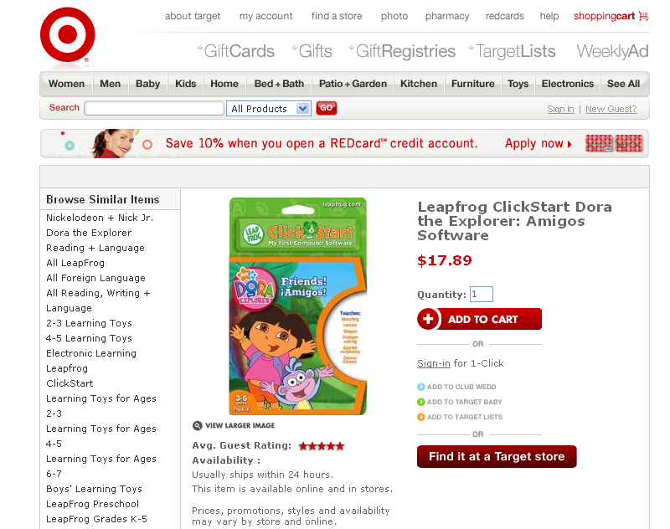

Slide 33


Slide 34
The value in the array tells me what art asset to use
Each level is really a 3x10 array!
0 | 0 | 7 | 0 | 4 | 0 | 0 | 0
1 | 2 | 3 | -4 | 5 | 6 | -7 | 8
B | B | B | B | B | B | B | B
Negative values tell me what block needs to go here to win!

Slide 35
0 | 0 | 7 | 0 | 4 | 0 | 0 | 0
1 | 2 | 3 | -4 | 5 | 6 | -7 | 8
0 | 0 | 0 | B | 0 | 0 | 0 | 0

Slide 36
BUGS!

Slide 37
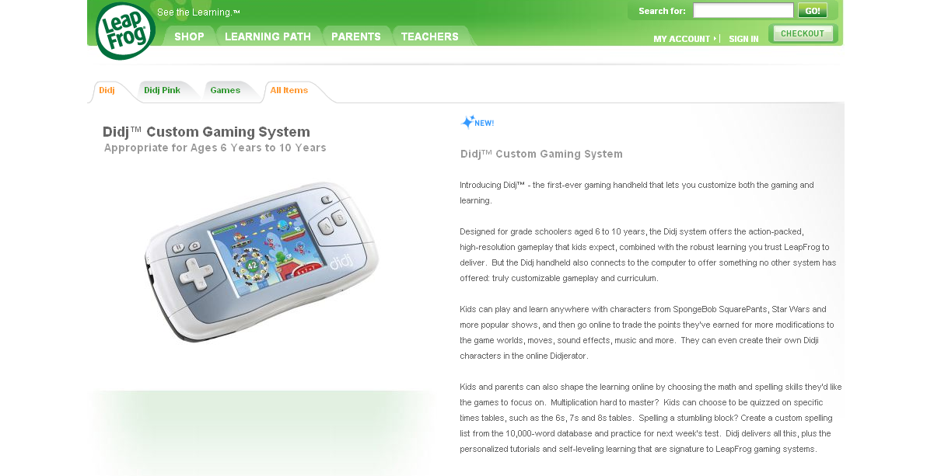

Slide 38

It is really sad when stuff you’ve made is on sale!

Slide 39



Which image is fake?
A. Top Left
B. Bottom Left
C. Bottom Right

Slide 40
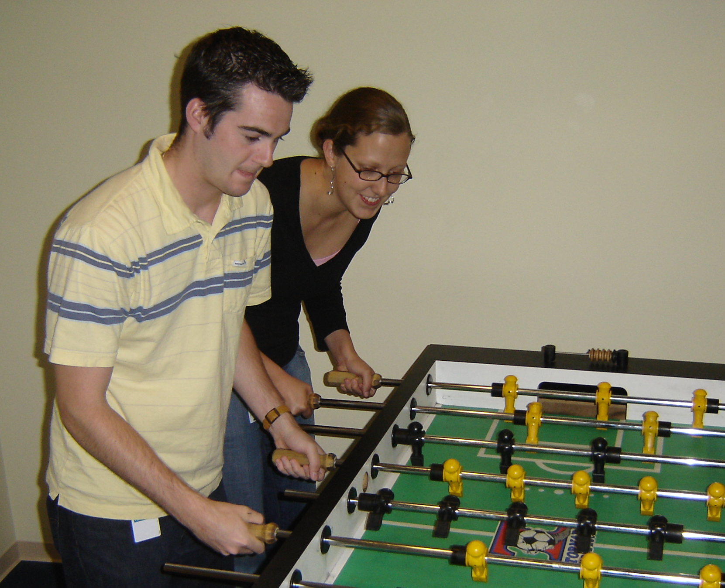

Slide 41
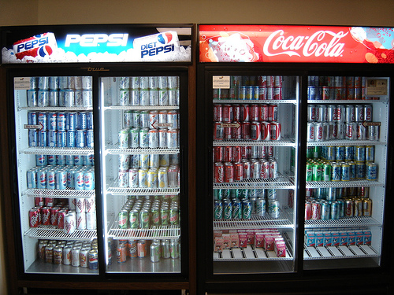

Slide 42
Use the Career Center!
They have this thing where you can apply online to get interviews. Then the interviews are on campus.
Are there unprofessional photos of you on facebook?
A. Yes and they are public
B. Yes but they are private
C. No (This is the best answer!)
It is all about who you know!

