Slide 1
CS 60
Jflap, Hash Tables, Logs
Practice Test
Done!
2013-05-02
Thursday – Week 13
Lecture 27

Slide 2
Administrative Stuff
(Not in your notes)
Email me to schedule an appointment!
Hw 13 – 50 points – NOW DUE MONDAY!
Grutor info session/Study break
  Friday, May 10th of reading days from 1-4pm
  Big Beckman: B100
Feedback from CS 70
Feedback/chatting lunches
Office hours next week

Slide 3
Using Jflap (Demo)

Slide 4
Hash Tables

Slide 5
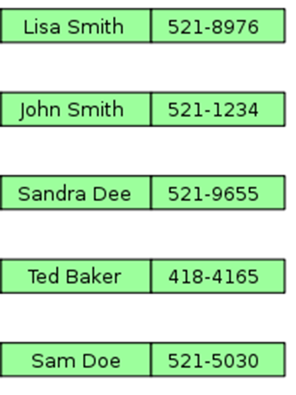
Hash Table: Problem Statement
I have some data (e.g., phone numbers) that I want to look-up (e.g., using names) as fast as possible.
Find should be O(1)
Insert should be O(1)
Remove should be O(1)
* Actually all of these will be
O(N), but O(1) on average.
* Images from Wikipedia

Slide 6
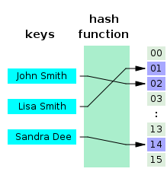
Hash Table: Raw Materials
I can use arrays, which are O(1) for access
I have a “hash function” that converts data into number.

Slide 7
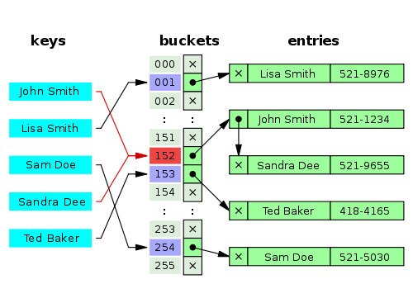
Step 1: Compute Hash Code using Hash Function
Step 2: Assign each Hash Code to an array index
(might use mod)
Step 3: Put stuff at that index
(possibly chain)
(there are various strategies for collisions)

Slide 8
Log Review

Slide 9

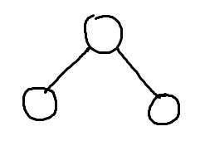
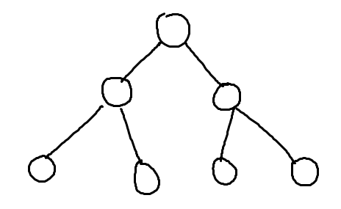
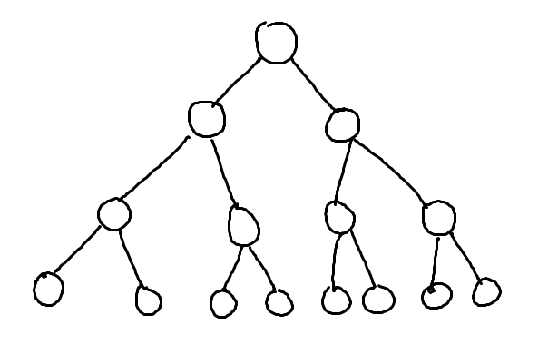
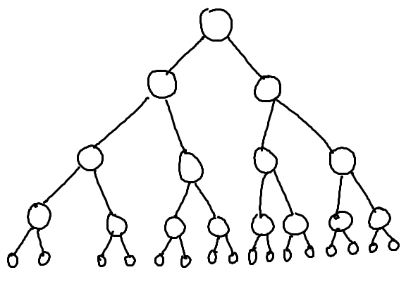
What’s the relationship between height and number of nodes?
3
7
1
15
31

Slide 10
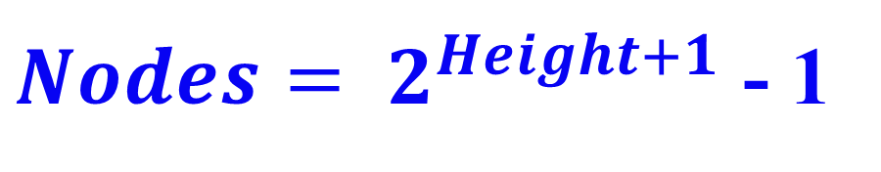
What’s the relationship between height and number of nodes?
1
3
7
Height | Nodes | 2^{Height+1}
0 | 1 | 2
1 | 3 | 4
2 | 7 | 8
3 | 15 | 16
4 | 31 | 32
5 | 63 | 64
15
31

Slide 11





// Take the log of both sides
Drop the 1
Who cares?
// Remember:

Slide 12
Thanks for an AWESOME semester!

