Slide 1
CS 60
Recursion and Racket Functions
2014-09-08
Monday – Week 1
Lecture 02

Slide 2
Lecture 02 - Learning Goals
Can predict the output of function compositions including null?, first, rest, append, cons,and list
Can write (and trace) recursive code that:
  Takes a number as input
  Takes a list as input
  Returns a list

Slide 3
Warm-up – Write Factorial
(You can start before class)

Slide 4
How’s HW 0 going?
Done!
Good way through it!
I’ve started
I haven’t started
What homework?

Slide 5
Racket Lists (Accessors)
DEMO

Slide 6
first and rest
always start evaluating at the inside parentheses
> (first '("spam" "is" "awesome"))
"spam"
> (rest '("spam" "is" "awesome"))
'("is" "awesome")
> (first '("spam"))
"spam"
> (rest '("spam"))
'()
first returns
the first thing in the list
rest returns
everything but
the first thing in the list

Slide 7
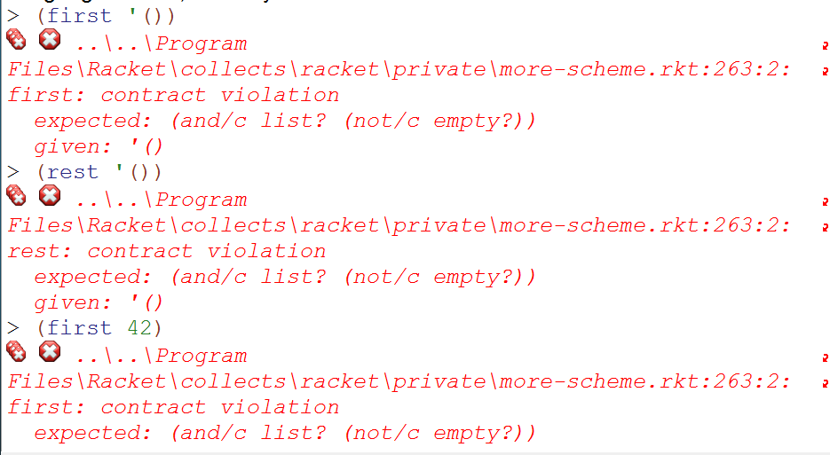
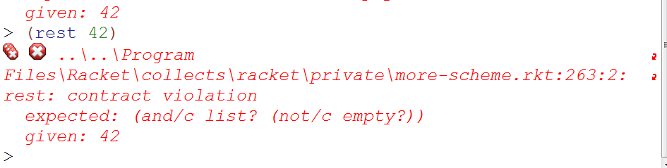
first and rest MUST be called on a list with at least one element

Slide 8
null?
> (null? '())
#t
> (null? '("spam"))
#f
> (null? 42)
#f
null?
returns #t if the argument is a list with zero elements
This helps us avoid the errors from the previous slide!

Slide 9
first and rest
Which one of these will return 42
A.
> (rest (first '("spam" 42 "CS60")))
B.
> (first (rest (rest '("spam" 42 "CS60"))))
C.
> (first (rest '("spam" 42 "CS60")))
D. I’m not sure

Slide 10
Recursion with Racket Lists
(as input)

Slide 11
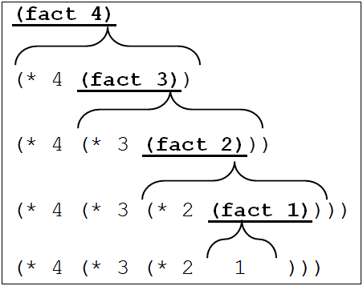
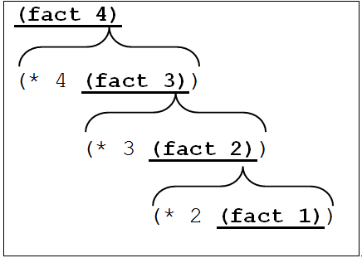

Forward
(define (fact x)
(if (<= x 1)
1
(* x (fact (- x 1)))))

Slide 12
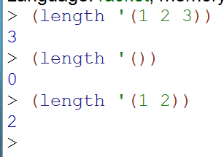
Write Length
(modify fact)
(define (fact x)
(if (<= x 1)
1
(* x (fact (- x 1)))))
What do you think?
Got it! Feels natural to use a template!
Got it! Feels unnatural to use a template!
I got the base case rewritten
I got the recursive case rewritten
I’m stuck!

Slide 13
Write the Forward trace of length

Slide 14
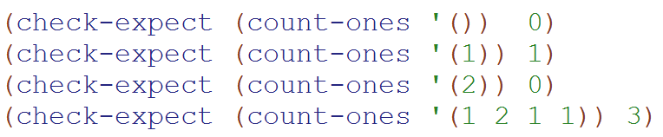
Extra Practice – Count-Ones
Based upon len, write count-ones
(define (cool temp)
(cond
[(> temp 75) "hot"]
[(< temp 65) "cold"]
[ else "ok"]))

Slide 15
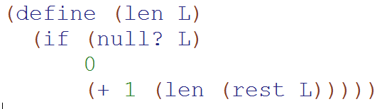
We can use strategies:
Forward – Do I have code I want to check by tracing?
Backward – Do I know what it does at the base case?
One step – Do I know what it should do?

Slide 16
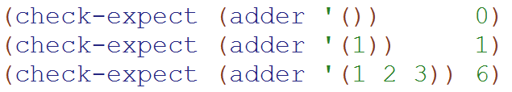
Extra Practice – adder
Based upon len, write adder

Slide 18
Racket Lists (Creators)
DEMO

Slide 19
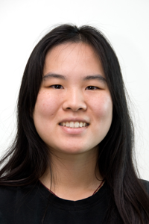
Image Credits
Simply Scheme (black and white diagrams)
http://www.eecs.berkeley.edu/~bh/ss-toc2.html
By Brian Harvey and Matthew Wright
CS Illustrated (color images)
http://csillustrated.berkeley.edu/
By http://csillustrated.berkeley.edu/artists.php
  Images used are all by Ketrina Yim

Slide 20
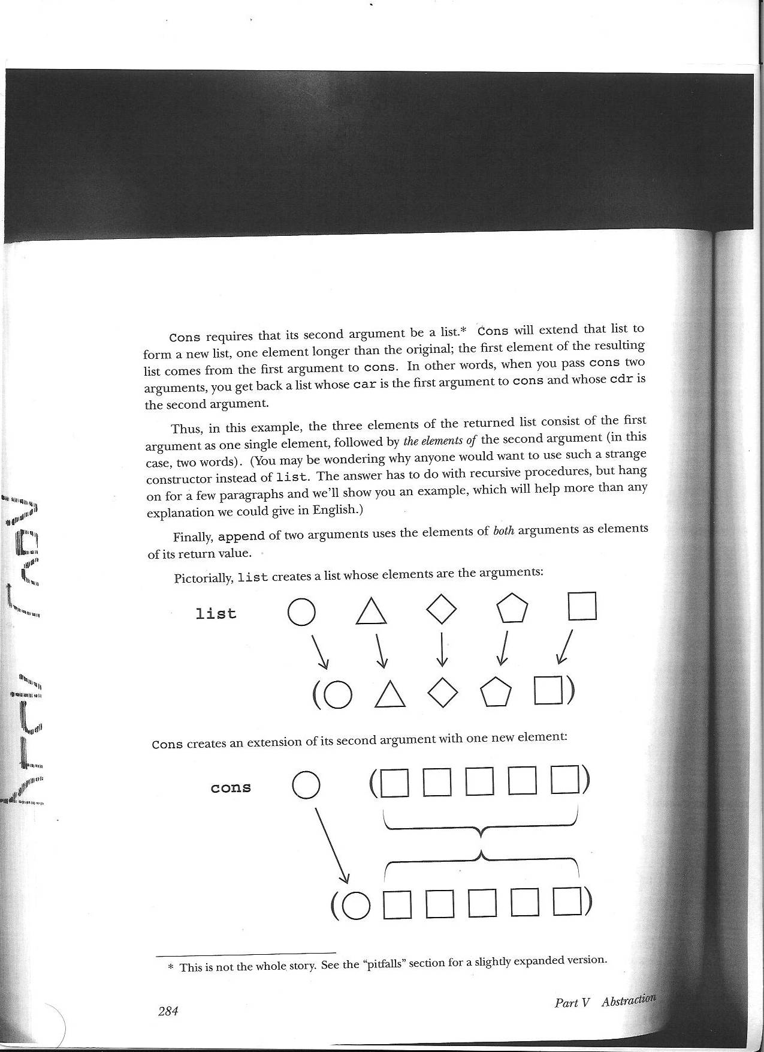
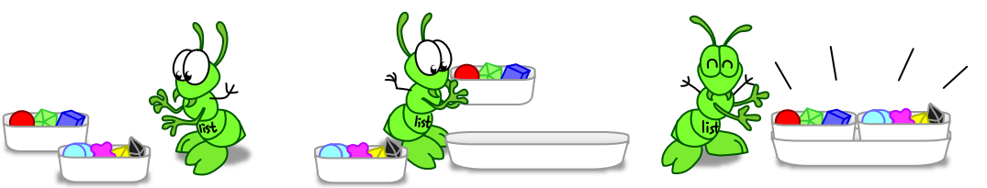
list
Takes any number of arguments and puts them in a list
(list '(1 2 3) '(4 5 6)) ➔ '((1 2 3) (4 5 6))
(list 1 2 3 #t +) ➔ '(1 2 3 #t #<procedure:+>))

Slide 21
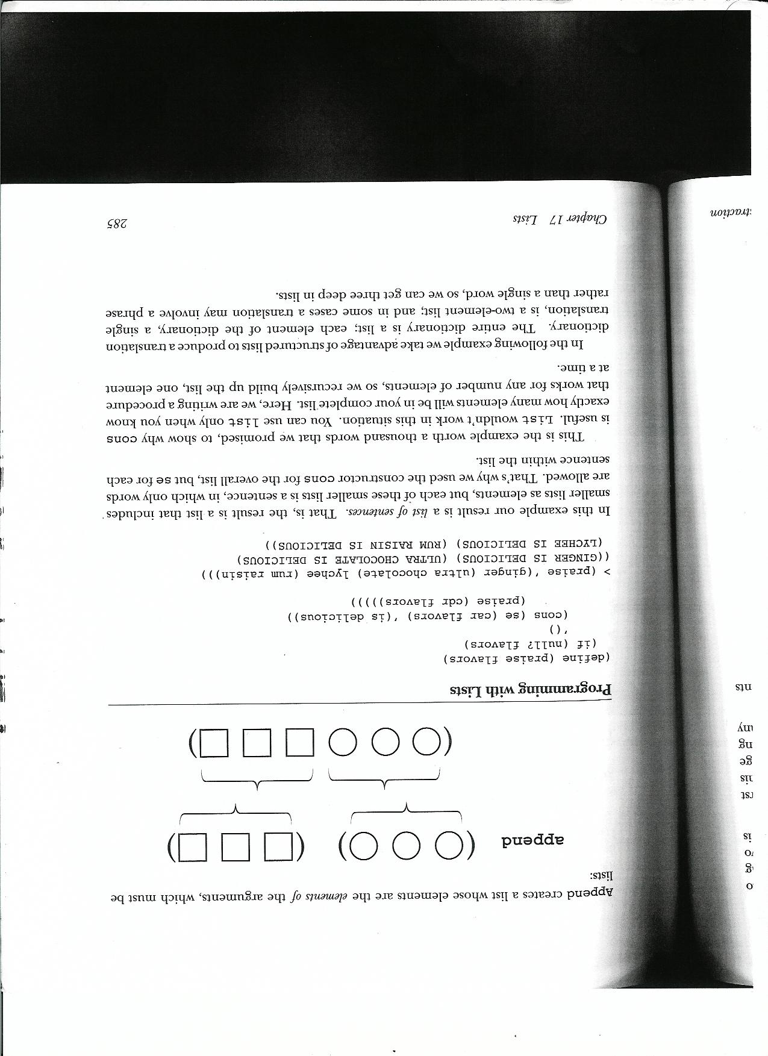
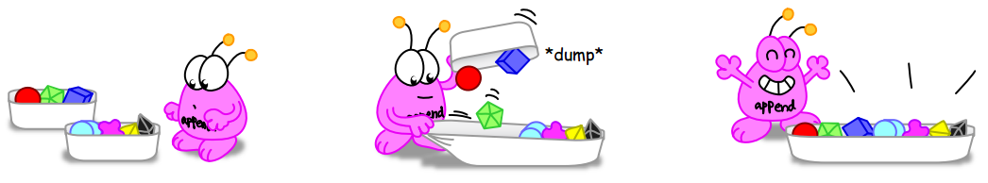
append
Takes two lists and turns them into one
Both arguments MUST be lists
(append '(1 2 3) '(4 5 6)) ➔ '(1 2 3 4 5 6)
(append '((1 2 3)) '(4 5 6)) ➔ '((1 2 3) 4 5 6)

Slide 22
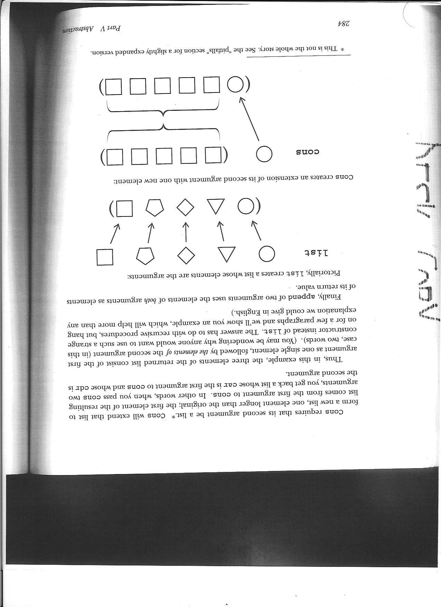
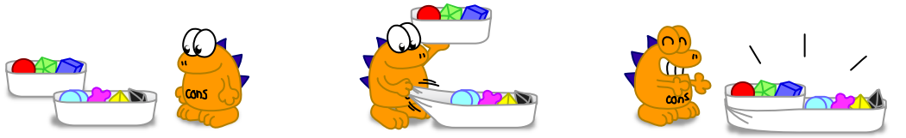
cons
Takes two arguments
If the second arg is a list
  Makes the first arg the first of the new list
  Makes the second arg the rest of the new list
(cons 1 '(2 3)) ➔ '(1 2 3)
(cons '(1) '(2 3)) ➔ '((1) 2 3)

Slide 23
cons
> (cons "spam" '( "rad“ ))
___________________________
> (cons '("spam") '( "rad“ ))
__________________
> (cons "spam" '())
__________________
> (cons '() '( () "rad"))
__________________
> (cons '("spam") '(("rad")))
_____________________

Slide 24
append
(append '("spam") '(42)) ➔ _____________
(append '("spam") '()) ➔ _______________
(append '() '("spam")) ➔ ____________
(append '("spam") '(())) ➔ ____________
(append '(()())'("spam")) ➔ ____________

Slide 25
list
(list 1 2 3 4) ➔ _____________
(list 1 2 '() 3) ➔ _______________
(list '()) ➔ ____________
(list '("spam") '(())) ➔ ____________
(list '(()())'("spam")) ➔ ____________

Slide 26
cons
Try to produce the list '(1 2 3 4) using only cons and '() and 1 2 3 and 4?
Done with cons
Done with append
Done with list
Done with this page
Stuck!

Slide 27
append
(append '("spam") '(42)) ➔ ‘("spam" 42)
(append '("spam") '()) ➔ ‘("spam")
(append '() '("spam")) ➔ ‘("spam")
(append '("spam") '(())) ➔ ‘("spam" ())
(append '(()())'("spam")) ➔ ‘(() () "spam")

Slide 28
cons
> (cons "spam" '( "rad“ ))
'("spam" "rad")
> (cons '("spam") '( "rad“ ))
'(("spam") "rad")
> (cons "spam" '())
'("spam")
> (cons '() '( () "rad"))
'(() () "rad")
> (cons '("spam") '(("rad")))
'(("spam") ("rad"))
Solution

Slide 29
list
(list 1 2 3 4) ➔ '(1 2 3 4)
(list 1 2 '() 3) ➔ '(1 2 () 3)
(list '()) ➔ '(())
(list '("spam") '(())) ➔ '(("spam") (()))
(list '(()())'("spam")) ➔ '((()())("spam"))
The number of arguments given to list is equal to the length of the resulting list!

Slide 30
Lists Are Pairs

Slide 31
“cons makes a pair”
Pairs
first
rest
first
rest
We can get back the first argument to cons by calling first.
We can get back the second argument to cons by calling rest.
Selectors
Constructors
cons

Slide 32
Make the Empty List the rest
The second argument to cons should always be a list!
STk> (cons 2 '())
'(2)
first
rest
2

Slide 33
Make the Empty List the first
We can get back the first argument to cons by calling first.
STk> (cons '() '())
'(())
first
rest
We can get back the second argument to cons by calling rest.
()

Slide 34
Lists are made with pairs!
STk> (define a (cons 1 (cons 2 '()))
a
first
rest
first
rest
1
2
STk> (define b (list 1 2))
b
first
rest
first
rest
1
2

Slide 35
Bonus
Dots
The second argument to cons should always be a list!
But Racket doesn’t vomit. It uses this dot to represent how it is storing the information.
first
rest
STk> (cons 1 2)
'(1 . 2)
STk> (cons 1 '())
'(1)
STk> (cons 1 '())
'(1 .( ))
1
2
first
rest
1
You can think of Racket as ALWAYS using the dots, but simplifying it for you!
A dot and an open paren cancel!

Slide 36
How do you get the 3?
STk> (define a (list 1 2 (list 3 4) 5))
a
first
rest
first
rest
first
rest
first
rest
1
2
5
(first (first (rest (rest a))))
(rest (rest (first (first a))))
(rest (first (rest (first a))))
(first (rest (first (rest a))))
The picture doesn’t match the code!
first
rest
first
rest
3
4

Slide 37
How do you get the 2?
STk> (define a (list 1 2 3 4))
a
first
rest
first
rest
first
rest
first
rest
1
2
3
4
(first (rest a))
(rest (first a))
(rest (rest (first a)))
(first (rest (rest a)))
(rest (first (first a)))

Slide 38
Recursion with Racket Lists
(as output)

Slide 39
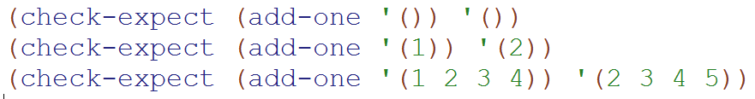

Bonus: Rewrite len to add 1 to each item

Slide 40
Using the “One Step” Method

Slide 41
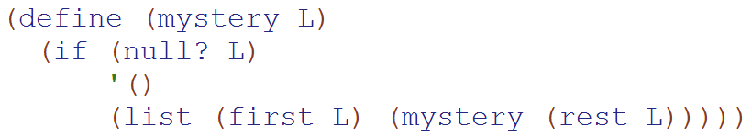
Experiment: Using list instead of cons
Calculate:
(mystery '(1 2 3))
Did you use
Forward?
Backwards?
One-step?
I’m stuck!

Slide 42
Association Lists
(assoc)

Slide 43
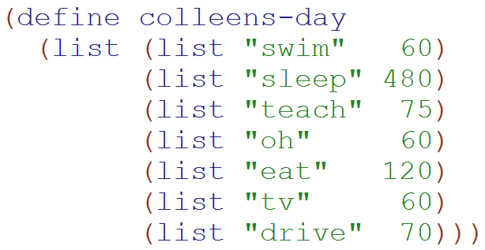
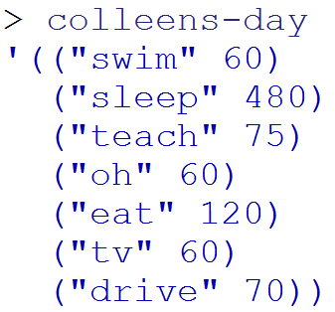
Example of an Association List
An “Association List”
is always a list of lists
(or empty)
A list with 7 elements
(each of which is a list of 2 elements)

Slide 44
assoc
> (assoc "swim" colleens-day)
'("swim" 60)
> (assoc "tv" colleens-day)
'("tv" 60)
> (assoc "eat spam" colleens-day)
#f
assoc
Returns the first list
that starts with the first argument.

Slide 45
Equal?
=
Eq?

Slide 46
Review: Lists are made with pairs!
> (define a (list 1 2 3 4))
a
first
rest
first
rest
first
rest
first
rest
1
2
3
4
> (define a (list 1 2 3 4))really does this:
> (define a (cons 1 (cons 2 (cons 3 (cons 4 '())))))
> (define b (cons 4 '()))
first
rest
b
4

Slide 47
In Racket we NEVER modify pairs
(you can but that’s Un-Rackety)
Append makes a copy of the 1st argument and points the last pair to the 2nd argument
> (define a (list 1 2))
> (define b (list 3 4 5))
> (define c (append a b))
a
first
rest
first
rest
c
b
2
1
first
rest
first
rest
first
rest
first
rest
first
rest
2
3
4
5
1

Slide 48
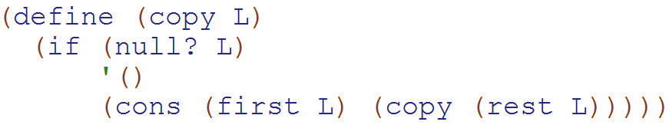

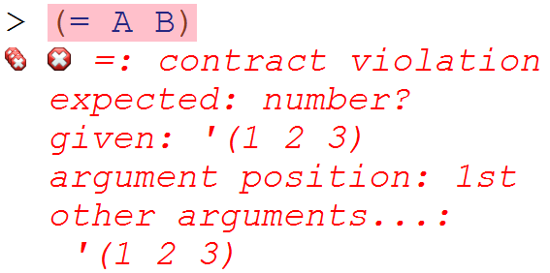

equal? vs. eq? vs. =
=
only works with numbers
equal?
if they are logically equal
eq?
if they are actually the same pairs

Slide 50
Lists are made with pairs!
STk> (define a (list 1 2 3 4))
a
first
rest
first
rest
first
rest
first
rest
1
2
3
4
STk> (define b (list 1 2))
b
first
rest
first
rest
1
2

Slide 51
Accessing Elements
Using first and rest

Slide 52
The Empty List w/ first & rest
STk> (define x (cons 2 ‘())
x
STk> x
(2)
STk> (first x)
2
STk> (rest x)
()
first
rest
x
2

Slide 53
The truth about append
STk> (define a (list 1 2))
STk> (define b (list 3 4 5))
STk> (define c (append a b))
a
first
rest
first
rest
c
b
2
1
first
rest
first
rest
first
rest
first
rest
first
rest
2
3
4
5
1

Slide 54
Practice Removing Dots
BONUS

Slide 55
Dots
first
rest
STk> (cons 1 '())
'(1 . ())
'(1)
STk> (cons 1 (cons 2 '()))
'(1 . (2 .( )))
'(1 2)
1
first
rest
first
rest
1
2

Slide 56
Practice Removing Dots
Draw the boxes
What scheme would print
Write it with dots
Invent a new puzzle
Stuck!!!
(cons
(cons 1 '())
(cons
2
(cons
(cons 3 4)
(cons 5 '()))))

Slide 57
Practice Removing Dots
(cons
(cons 1 '())
(cons
2
(cons
(cons 3 4)
(cons 5 '()))))
first
rest
1
first
rest
5

Slide 58
Practice Removing Dots
(cons
(cons 1 '())
(cons
2
(cons
(cons 3 4)
(cons 5 '()))))
first
rest
1
first
rest
3
4
first
rest
5

Slide 59
Practice Removing Dots
first
rest
(cons
(cons 1 '())
(cons
2
(cons
(cons 3 4)
(cons 5 '()))))
first
rest
1
first
rest
3
4
first
rest
5

Slide 60
Practice Removing Dots
first
rest
(cons
(cons 1 '())
(cons
2
(cons
(cons 3 4)
(cons 5 '()))))
first
rest
1
first
rest
3
4
first
rest
5

Slide 61
Practice Removing Dots
(cons
(cons 1 '())
(cons
2
(cons
(cons 3 4)
(cons 5 '()))))
first
rest
1
first
rest
first
rest
5
first
rest
3
4

Slide 62
Practice Removing Dots
(cons
(cons 1 '())
(cons
2
(cons
(cons 3 4)
(cons 5 '()))))
first
rest
1
first
rest
first
rest
5
first
rest
first
rest
2
3
4

Slide 63
Practice Removing Dots
(cons
(cons 1 '())
(cons
2
(cons
(cons 3 4)
(cons 5 '()))))
first
rest
1
first
rest
first
rest
first
rest
5
first
rest
2
3
4

Slide 64
Practice Removing Dots
first
rest
(cons
(cons 1 '())
(cons
2
(cons
(cons 3 4)
(cons 5 '()))))
first
rest
1
first
rest
first
rest
first
rest
5
first
rest
2
3
4

Slide 65
Solution
first
rest
first
rest
first
rest
first
rest
2
5
first
rest
first
rest
1
3
4
((1) 2 (3 . 4) 5)
((1.()).(2.((3.4).(5.()))))

Slide 66
BONUS

Slide 67
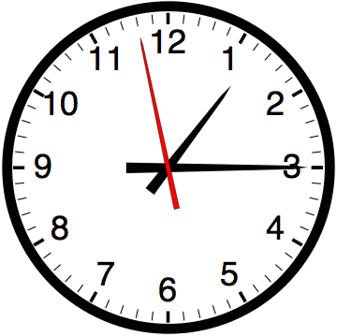

Slide 68
Estimating Time
Most people grossly underestimate how long it takes to program (not thinking about time to debug and test)
You appear incompetent at programming (not true) if you can’t estimate how long something will take.
This is one of the hardest things to learn!!! Start to practice now! For each task estimate how long it will take and keep track of how wrong you were

Slide 69


Computer
Science
&
= AWESOME

Slide 70
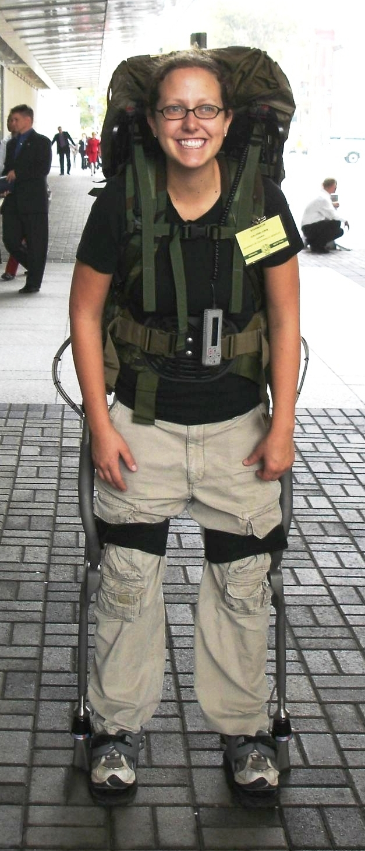
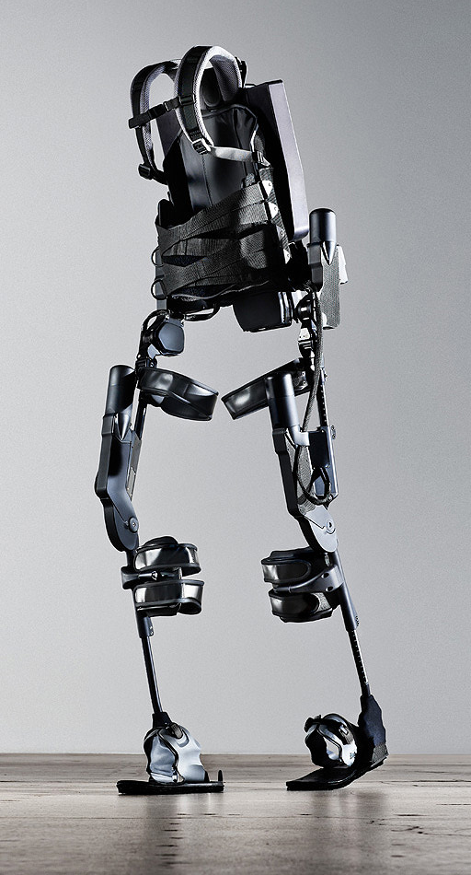
http://www.youtube.com/watch?v=pzRmNYA8LlY

Slide 71

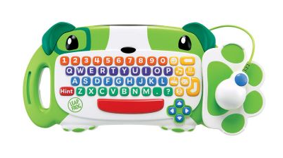
ClickStart

Slide 72
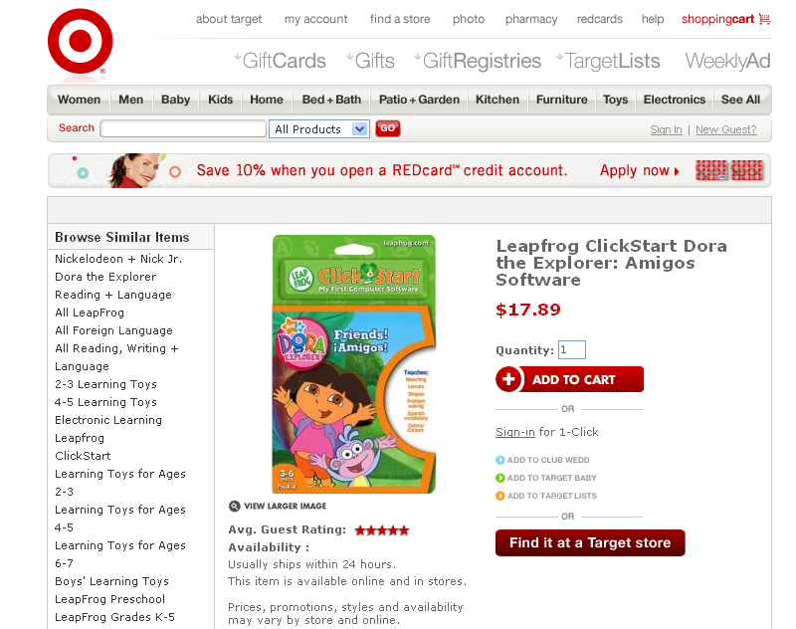

Slide 73
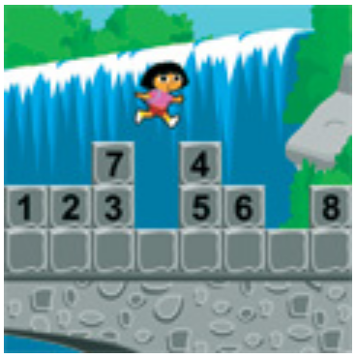
How should we represent the blocks in the computer?
Independent variables
2D Array
OpenList
I don’t know

Slide 74
The value in the array tells me what art asset to use
Each level is really a 3x10 vector!
0 | 0 | 7 | 0 | 4 | 0 | 0 | 0
1 | 2 | 3 | -4 | 5 | 6 | -7 | 8
B | B | B | B | B | B | B | B
Negative values tell me what block needs to go here to win!

Slide 75
0 | 0 | 7 | 0 | 4 | 0 | 0 | 0
1 | 2 | 3 | -4 | 5 | 6 | -7 | 8
0 | 0 | 0 | B | 0 | 0 | 0 | 0

Slide 76
BUGS!

Slide 77
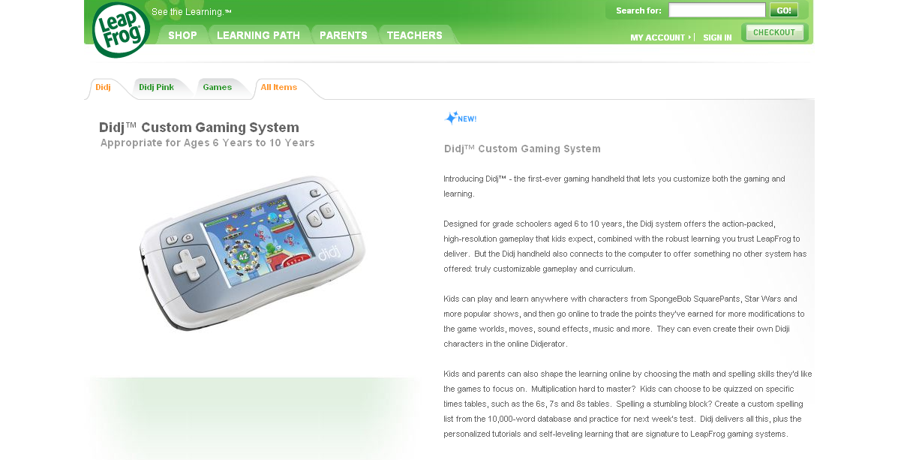

Slide 78
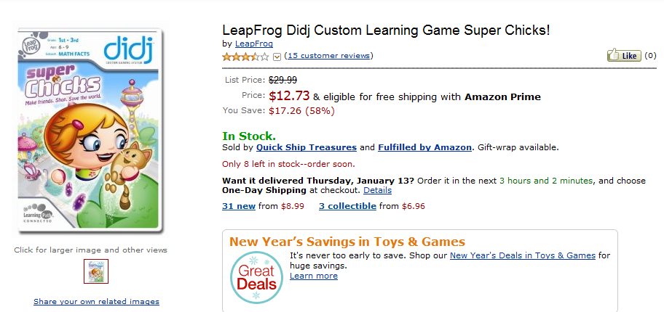
It is really sad when stuff you’ve made is on sale!

Slide 79
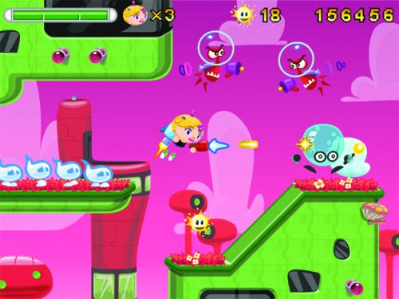
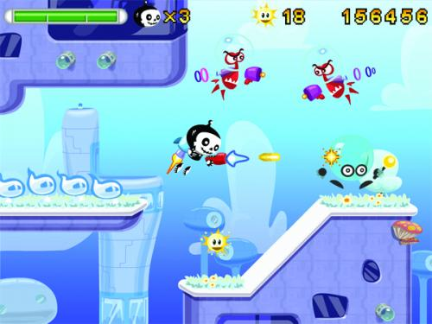

Which image is fake?
  A. Top Left
  B. Bottom Left
  C. Bottom Right

Slide 80
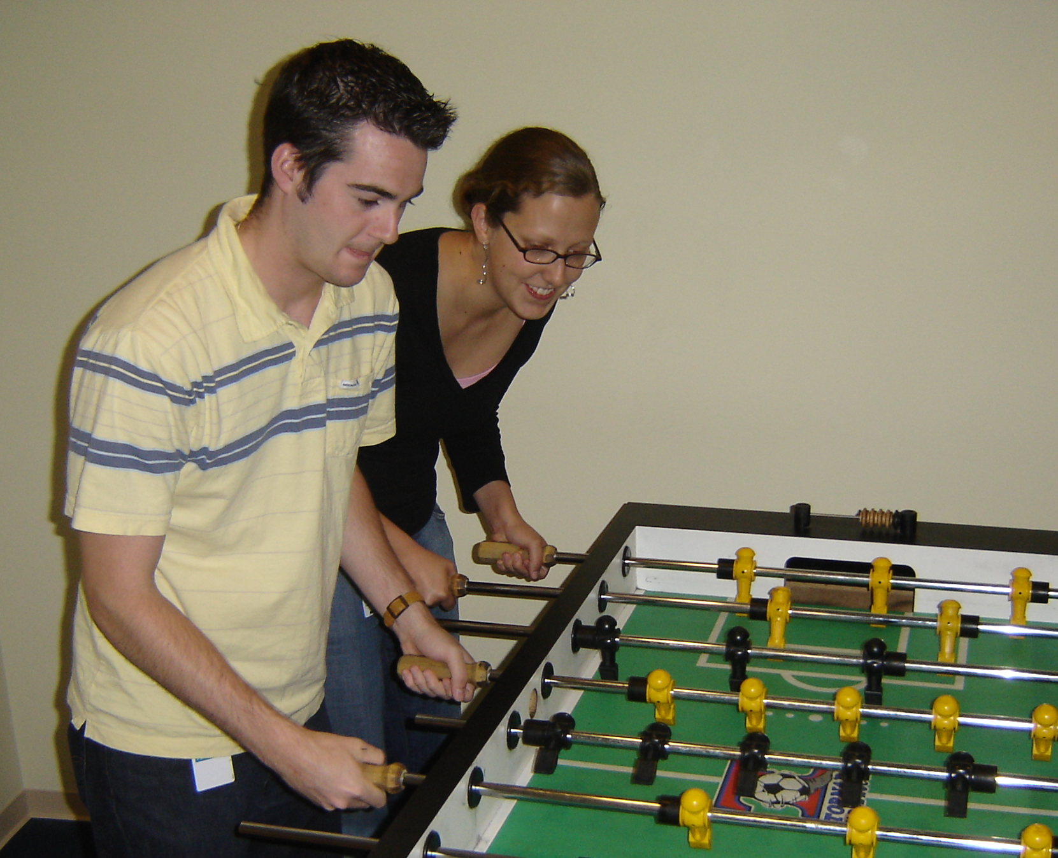

Slide 81
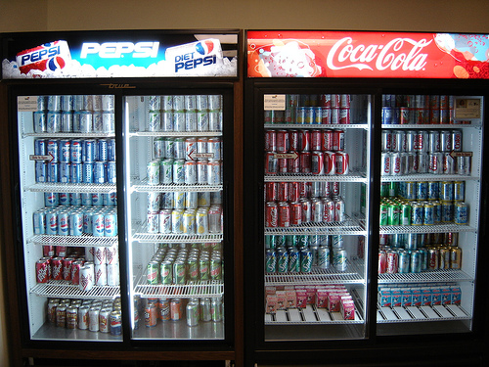

Slide 82
Scheme is BEAUTIFUL!

Slide 83
We don’t need no stinkin’ pairs
(define (cons x y)
(lambda (which)
(cond
((equal? which 'first) x)
((equal? which 'rest) y)
(else (error "Bad message"
which)))))
(define (first pair)
(pair 'first))
(define (rest pair)
(pair 'rest))

Slide 84
Try It!
Try to use this new cons!
Does it work the same way as before?
Yes
No
I don’t know

Slide 85
Big-O
2013-01-24
Thursday – Week 0
Lecture 02

Slide 86
What is the runtime of this?
(define (mystery a b)
(cond
((empty? b) (se a b))
((< a (first b)) (se a b))
(else (se (first b)
(mystery a (bf b))))))
A) Constant runtime
B) Linear runtime
C) Linear*Linear (quadratic)
D) Something else
E) No clue
Try to guess what type of thing the variables a & b will be
Try to come up with (small) input that triggers each case
Correct Answer

Slide 87
Bad variable names!
Make your code harder to read!
  Don’t do this!
Even though we do
  We will use bad variable names on exams so that you have to read/understand the code

Slide 88
Better variable names!
(define (insert num sent)
(cond
((empty? sent) (se num sent))
((< num (first sent)) (se num sent))
(else (se (first sent)
(insert num (bf sent))))))
STk>(insert 7 ’())
(7)
STk>(insert 1 ’(2 5 8))
(1 2 5 8)

Slide 89
Insert
STk>(insert 8 ’(2 5 6 9))
(2 5 6 8 9)
(insert 8 ’(2 5 6 9))
(insert 8 ’(5 6 9))
(se 2
(se 5
(insert 8 ’(6 9))
(se 6
(insert 8 ’(9))
(se 8 ’(9))
(se 2 (se 5 (se 6 (se 8 ’(9)))))
Notes:
89

Slide 90
Best vs. Worst Case
(define (insert num sent)
(cond
((empty? sent) (se num sent))
((< num (first sent)) (se num sent))
(else (se (first sent)
(insert num (bf sent))))))
STk>(insert 1 ’(2 3 4 5 6 7 8))
(1 2 3 4 5 6 7 8)
STk>(insert 9 ’(2 3 4 5 6 7 8))
(2 3 4 5 6 7 8 9)
BEST CASE
WORST CASE

Slide 91
Assumptions
We want something independent of the speed of the computer
We typically use N which is some reference to the “size” of the data.
  It might be the variable N (in factorial)
  It might be the size of your sentence
We don’t care about constant factors
  This is pretty silly in some cases but makes the math more beautiful
We typically think about the worst case!
It only matters for BIG input!

Slide 92
What is the runtime of this?
(define (sort sent)
(if (empty? sent)
sent
(insert (first sent)
(sort (bf sent)))))
Constant runtime
Linear runtime
Linear*Linear (quadratic)
Something else
No clue!
Correct Answer

Slide 93
Sort
STk>(sort ’(8 3 9))
(3 8 9)
(sort ’(8 3 9))
(sort ’(3 9))
(insert 8
(insert 3
(sort ’(9))
(insert 9
(sort ’())
’()
(insert 8 (insert 3 (insert 9 ’())))
Notes:
93

Slide 94
(insert 3
(insert 6
(insert 4
(insert 7
(insert 1
(insert 8
(insert 3
(insert 9
’()
))))))))
(sort sent) if sent length is N
1 + 2 + 3 + 4 + … + (N-1)+ N
Add to sent size 7
Add to sent size 6
Add to sent size 5
Add to sent size 4
Add to sent size 3
Add to sent size 2
Add to sent size 1
Add to sent size 0

Slide 95



Some Algebra to calculate:
1+2+…+n
// Written backwards

Slide 96

Some Algebra to calculate:
1+2+…+n

Slide 97


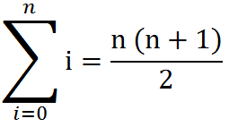
Some Algebra to calculate:
1+2+…+n
OR

Slide 98
How to use Let
(create new variables in definitions)
(let
  ( [<variable1> <value1>]
  [<variable2> <value2>]
  )
  <body>
  )
(define (spam)
(let ([a 3]
[b 4])
(+ a b)
))

Slide 99
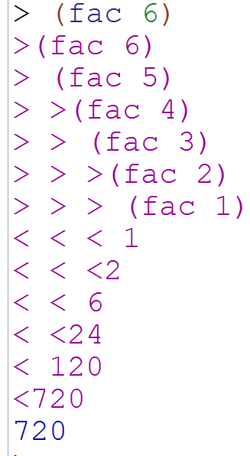
Debugging in Racket
Import the library
(require racket/trace)
(trace fac)
Use this to see what recursive calls get made

