Slide 1
CS 60
Tail Recursion &
Lists of Lists
2014-09-10
Wednesday – Week 1
Lecture 03

Slide 2
Anonymous
Grading

Slide 3
How do you feel about parentheses?
Love ‘em
Hate ‘em
Getting used to them
This isn’t that interesting of a question
I wish the submission system worked

Slide 4
Lecture 03 - Learning Goals
Can explain that using computers (e.g. installing Eclipse) is unrelated to learning computer science
Can write describe the benefits of tail-recursion
Can translate code between embedded and tail-recursion
Can write (and trace) recursive code that:
  Returns a list
Can write code that works with Lists of Lists

Slide 5
Warm-up – Write len
(You can start before class)

Slide 6
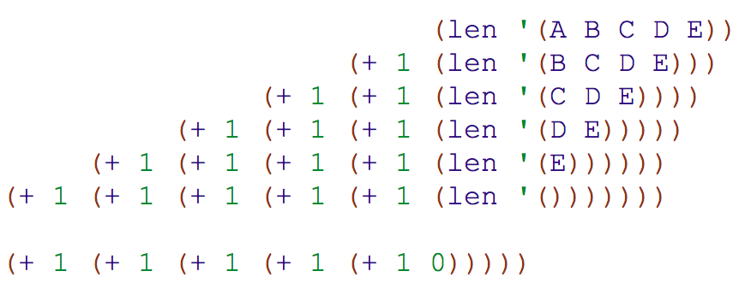
Example Calls to len

Slide 7
Tail Recursion

Slide 8

Hw1pr3.java Download Eclipse
You’ll learn Java this semester
Starting this week, each week you’ll do a little Java
You’ll be encouraged to use Eclipse
  A programming environment
  A.K.A. an IDE (Integrated Development Environment)
  You’ll download Eclipse and a JDK
Demo: Starting
Homework 1 part 3

Slide 9
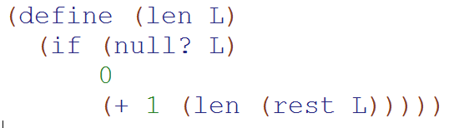
len (solution)

Slide 10
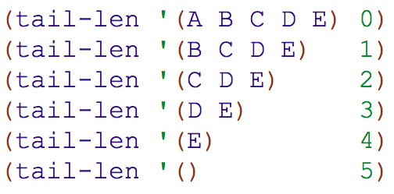
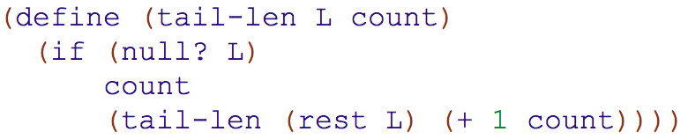
tail-len
What if we added an extra argument to len so that we didn’t need to keep track of all those + 1s

Slide 11
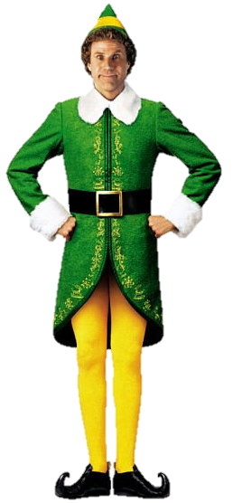
If you were designing a computer (i.e. an elf-powered computer) How could you allocate elves differently if we used this trick?
Write code for tail-len & then explain your answer here.

Slide 12
Check-in
I have my iClicker with me
I get the code, but not why it is more awesome
I get why it is more awesome, but not the code
I get the code AND why it is more awesome
I’m stuck

Slide 13
tail-len solution
The base case return value is different!
We add an extra argument
Both use the same Base-Case
Both pass the next elf the
(rest L)

Slide 14
Check-in
Tail recursion makes sense
Tail recursion is starting to make sense
Tail recursion doesn’t make much sense YET

Slide 15
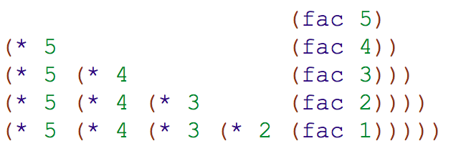
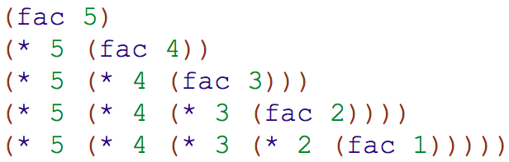
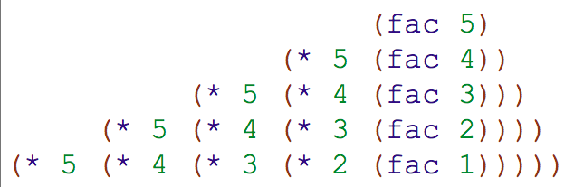
Which of these is most intuitive?
A
D. Doesn’t matter
B
C

Slide 16
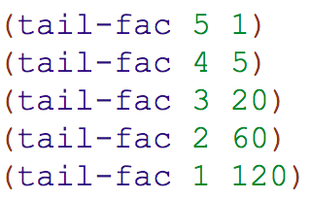
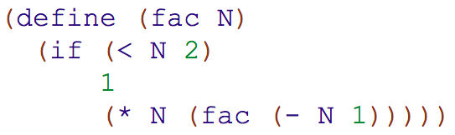
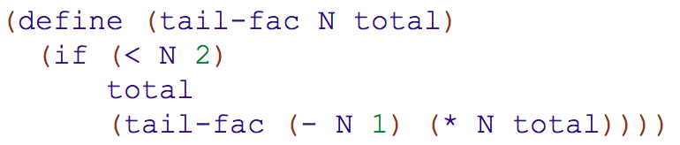
Write tail-fac

Slide 17
tail-fac solution
Vocab:
This is your “accumulator”

Slide 18
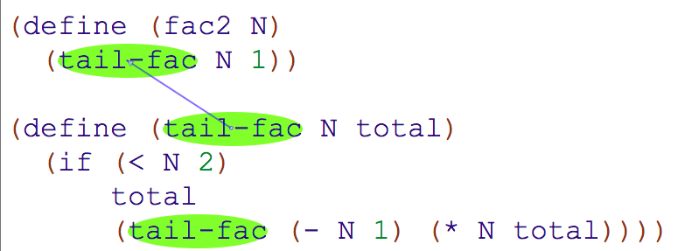
You can add a “wrapper” around your tail recursion
(so that people calling your function don’t have to remember the default value for your accumulator)

Slide 19
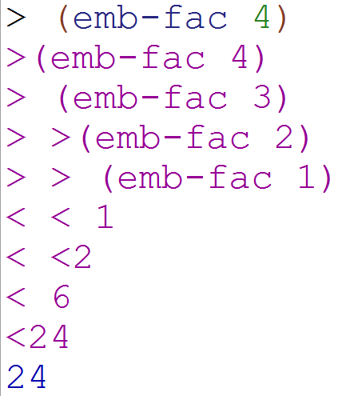
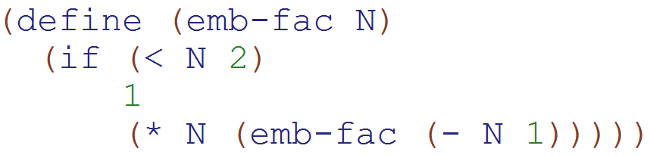
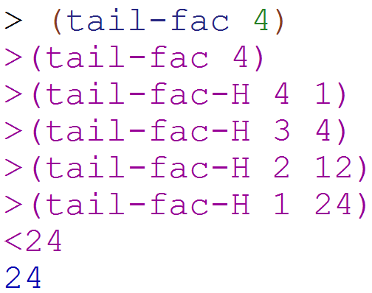
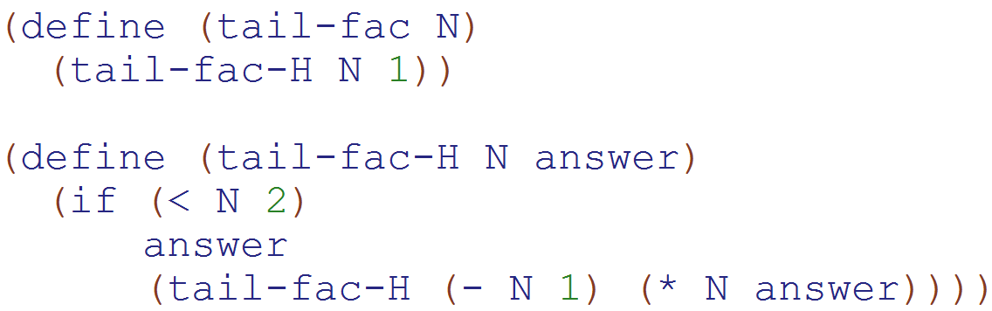
Embedded Recursion
We combine something with the recursive call to calculate the final answer
Tail Recursion
We return the result of the recursive call directly

Slide 20
Tail Recursion Summary
The return value only depends upon the recursive call.
You (usually) need an extra argument to keep track of your answer
Because of this extra argument, you want a helper function so that your user doesn’t need to know about your extra argument
Your base case (usually) returns your answer

Slide 21
Check-in
Tail recursion makes sense
Tail recursion is starting to make sense
Tail recursion doesn’t make much sense YET

Slide 22
REVIEW from Lecture 02
Open parenthesis means “Call this function”
Racket always returns something
cons puts makes
  the first argument - the first of the output from cons
  the second argument – the rest of the output from cons
append takes two things that are lists

Slide 23
Recursion with Racket Lists
(as output)

Slide 24
Review: Lists are made with pairs!
> (define a (list 1 2 3 4))
a
first
rest
first
rest
first
rest
first
rest
1
2
3
4
> (define a (list 1 2 3 4))really does this:
> (define a (cons 1 (cons 2 (cons 3 (cons 4 '())))))

Slide 25
Where are you?
No code written
Code done
Tracing done
I’m stuck on the code
I’m stuck on the tracing

Slide 26
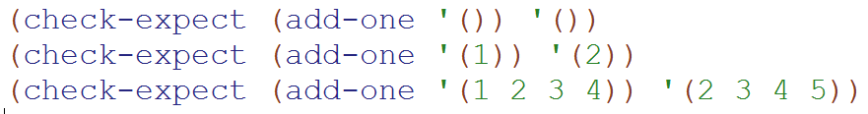

Rewrite len to add 1 to each item

Slide 27
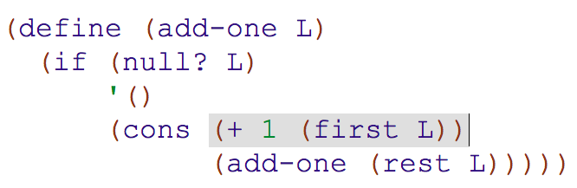
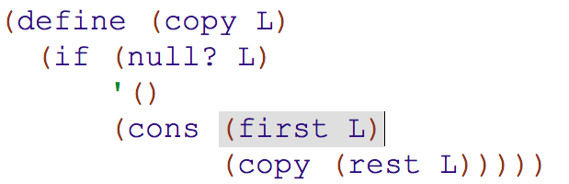
add-one solution
This is a common pattern!
(Do you remember map?)

Slide 28
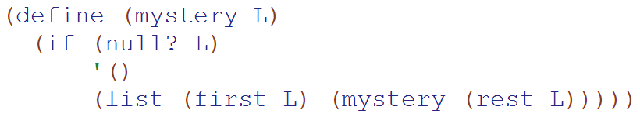
Experiment: Using list instead of cons
Calculate:
(mystery '(1 2 3))

Slide 29
Equal?
=
Eq?
member

Slide 30
In Racket we NEVER modify pairs
(you can but that’s Un-Rackety)
Append makes a copy of the 1st argument and points the last pair to the 2nd argument
> (define a (list 1 2))
> (define b (list 3 4 5))
> (define c (append a b))
a
first
rest
first
rest
c
b
2
1
first
rest
first
rest
first
rest
first
rest
first
rest
2
3
4
5
1

Slide 31
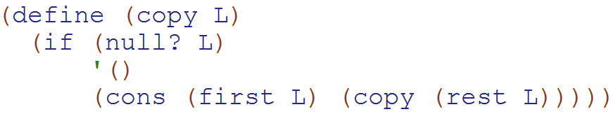

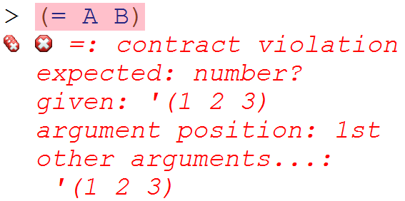

equal? vs. eq? vs. =
=
only works with numbers
equal?
if they are logically equal
eq?
if they are actually the same pairs

Slide 32
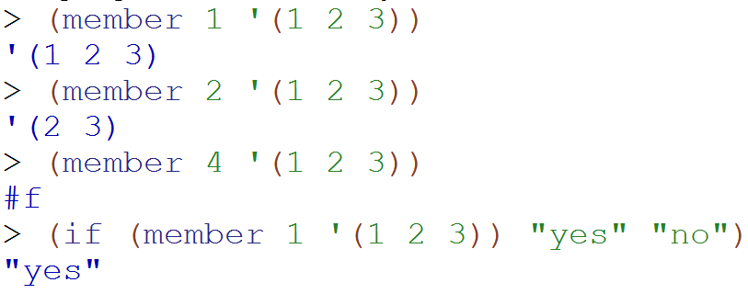
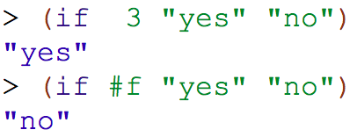
Trivia: member/everything that isn’t #f is true!

Slide 33
Remove

Slide 34
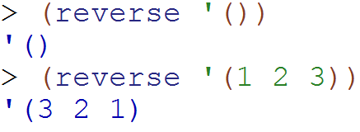
Write reverse by modifying copy
NOTE: reverse is provided in Racket!
Hint – Use 1-step recursive reasoning!

Slide 35
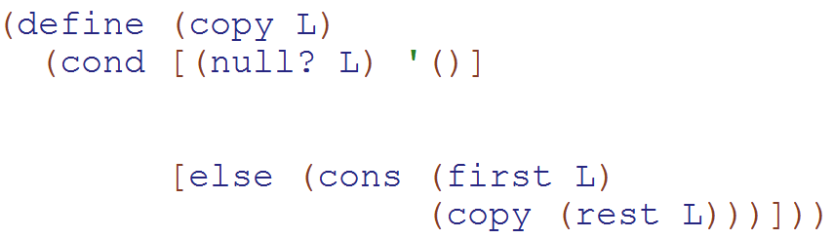
Write reverse by modifying copy
NOTE: reverse is provided in Racket!
copy using if
copy using cond

Slide 36
Write reverse by modifying copy
NOTE: reverse is provided in Racket!
Do you think it is helpful to modify existing functions?
Sometimes – I used this technique on the homework
Sometimes – but I haven’t tried it outside of class
No – because I feel pretty comfortable with recursion
No – I think it makes it harder
Other

Slide 37
Intentionally Blank

Slide 38
LOLs
(Lists Of Lists or deep-lists)

Slide 39
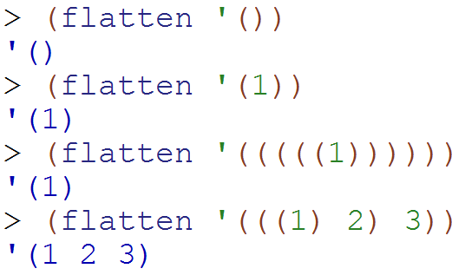
Flat List: (def.) List with no sublists
These are a hint!!!!
Fill in the blanks.
What does this return?
'(2 3)
'(3)
'((3))
'()
??

Slide 40
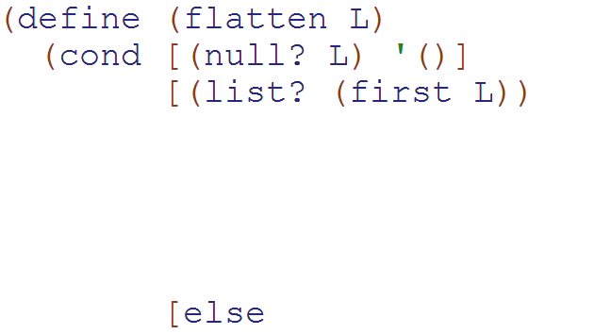
Write flatten
These should be helpful!

Slide 41
flatten Solution
(define (flatten L)
(cond [(null? L) L]
[(list? (first L))
(append (flatten (first L))
(flatten (rest L)))]
[else
(cons (first L)
(flatten (rest L)))]))

Slide 42
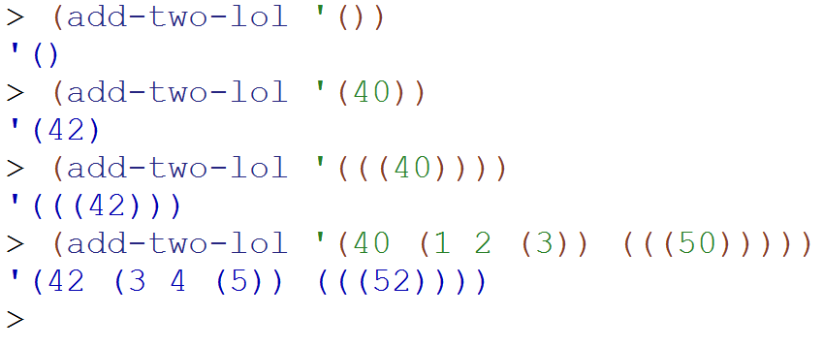
Write add-two-lol

Slide 43
add-two-lol SOLUTION
(define (add-two-lol L)
(cond [(null? L) L]
[(list? (first L))
(cons (add-two-lol (first L))
(add-two-lol (rest L)))]
[else
(cons (+ 2 (first L))
(add-two-lol (rest L)))]))

Slide 44
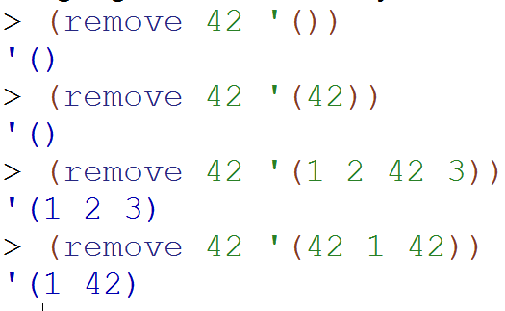
Modify copy to write remove

Slide 45
Write remove by modifying copy
NOTE: remove is provided in Racket!
copy using if
copy using cond

Slide 46
Remove Solution
(define (remove e L)
(cond [(null? L) L]
[(equal? (first L) e) (rest L)]
[else (cons (first L) (remove e (rest L))
)]))

Slide 47
BONUS

Slide 48
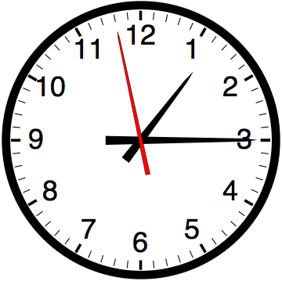

Slide 49
Estimating Time
Most people grossly underestimate how long it takes to program (not thinking about time to debug and test)
You appear incompetent at programming (not true) if you can’t estimate how long something will take.
This is one of the hardest things to learn!!! Start to practice now! For each task estimate how long it will take and keep track of how wrong you were

Slide 50


Computer
Science
&
= AWESOME

Slide 51
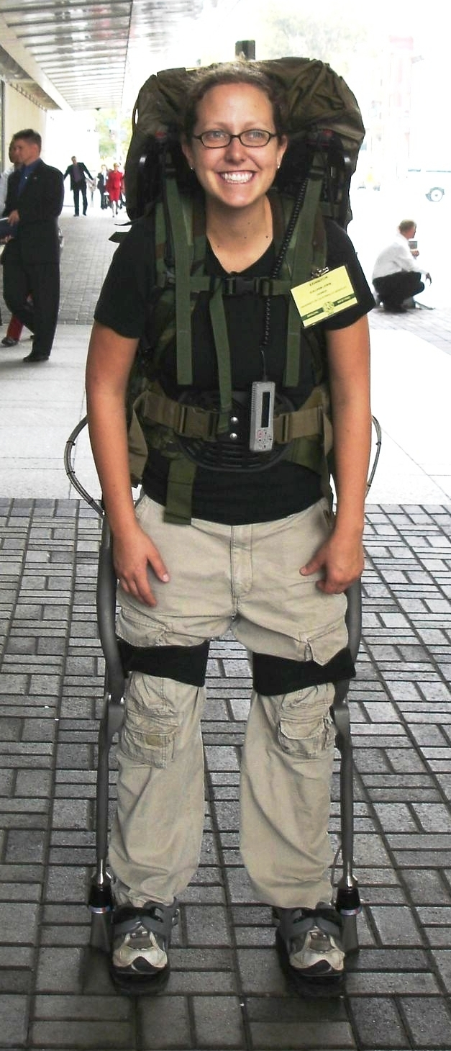
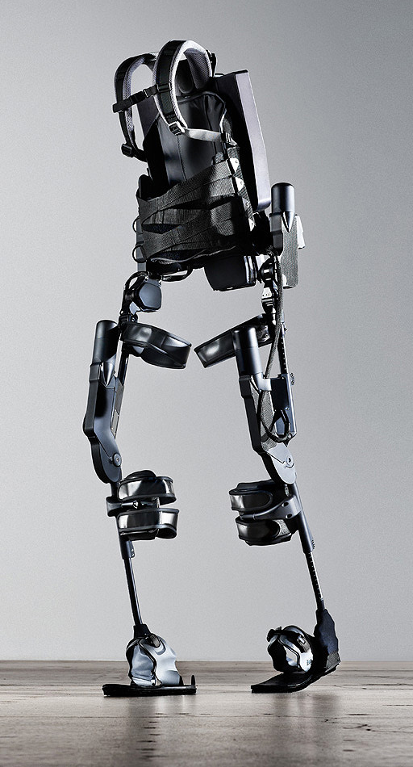
http://www.youtube.com/watch?v=pzRmNYA8LlY

Slide 52

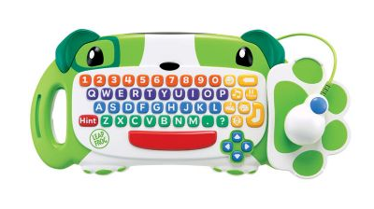
ClickStart

Slide 53
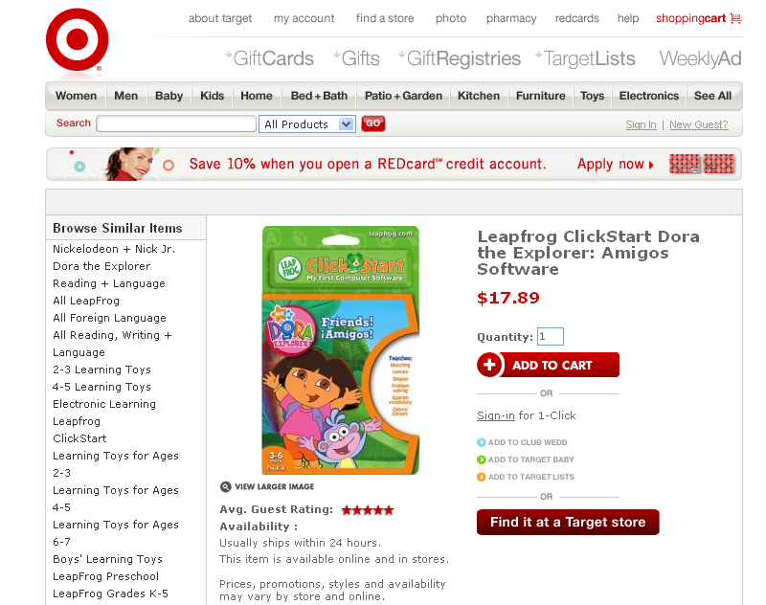

Slide 54
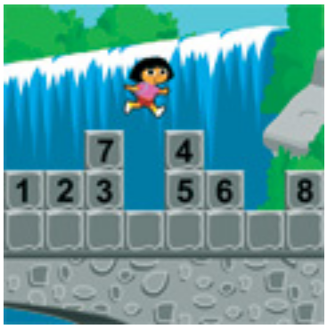
How should we represent the blocks in the computer?
Independent variables
2D Array
OpenList
I don’t know

Slide 55
The value in the array tells me what art asset to use
Each level is really a 3x10 vector!
0 | 0 | 7 | 0 | 4 | 0 | 0 | 0
1 | 2 | 3 | -4 | 5 | 6 | -7 | 8
B | B | B | B | B | B | B | B
Negative values tell me what block needs to go here to win!

Slide 56
0 | 0 | 7 | 0 | 4 | 0 | 0 | 0
1 | 2 | 3 | -4 | 5 | 6 | -7 | 8
0 | 0 | 0 | B | 0 | 0 | 0 | 0

Slide 57
BUGS!

Slide 58
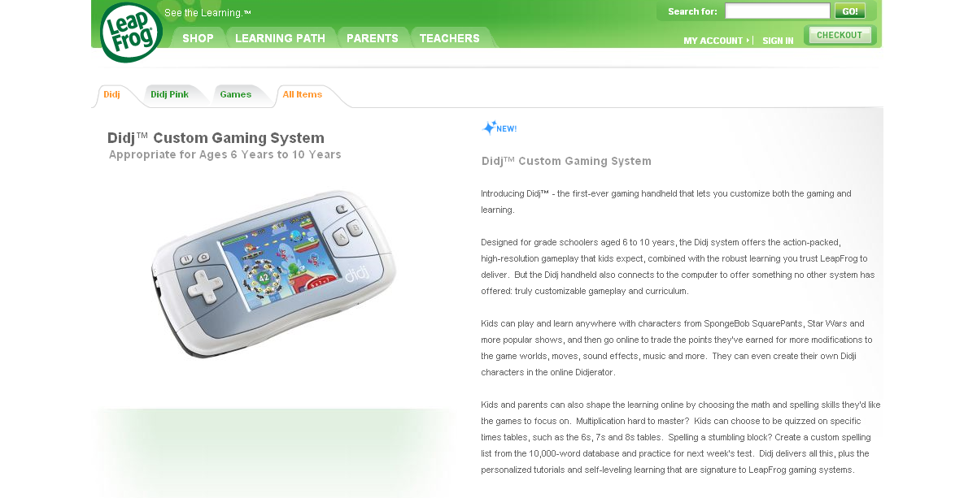

Slide 59
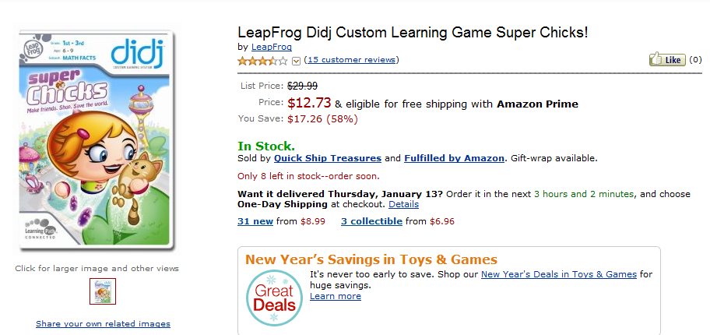
It is really sad when stuff you’ve made is on sale!

Slide 60
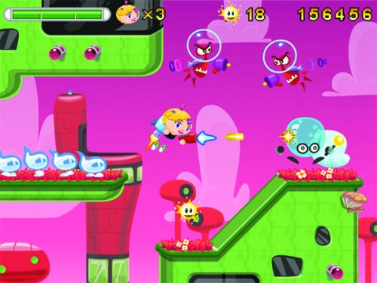
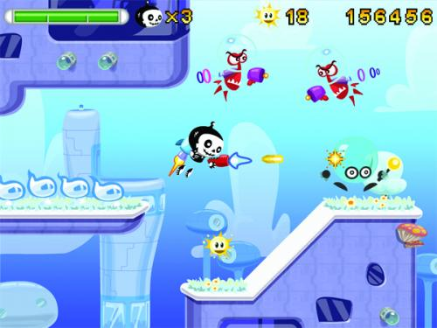

Which image is fake?
  A. Top Left
  B. Bottom Left
  C. Bottom Right

Slide 61
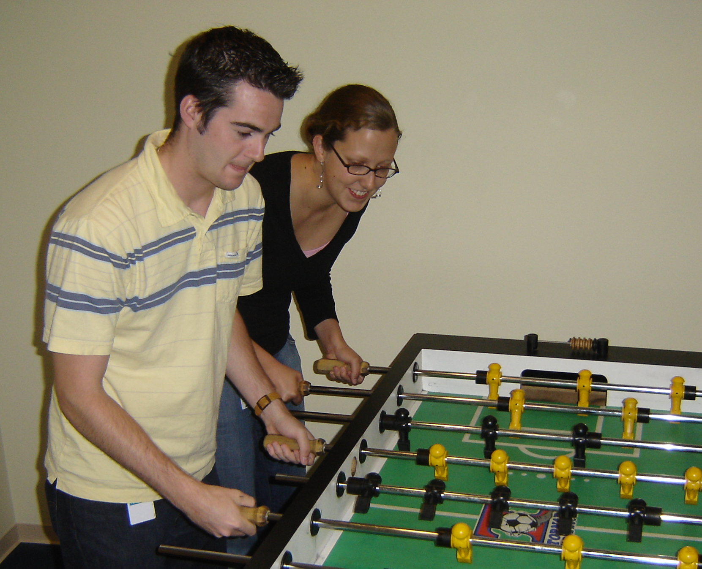

Slide 62
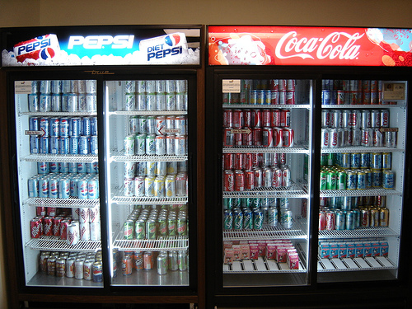

Slide 63
Scheme is BEAUTIFUL!

Slide 64
We don’t need no stinkin’ pairs
(define (cons x y)
(lambda (which)
(cond
((equal? which 'first) x)
((equal? which 'rest) y)
(else (error "Bad message"
which)))))
(define (first pair)
(pair 'first))
(define (rest pair)
(pair 'rest))

Slide 65
Try It!
Try to use this new cons!
Does it work the same way as before?
Yes
No
I don’t know

Slide 66
Big-O
2013-01-24
Thursday – Week 0
Lecture 02

Slide 67
What is the runtime of this?
(define (mystery a b)
(cond
((empty? b) (se a b))
((< a (first b)) (se a b))
(else (se (first b)
(mystery a (bf b))))))
A) Constant runtime
B) Linear runtime
C) Linear*Linear (quadratic)
D) Something else
E) No clue
Try to guess what type of thing the variables a & b will be
Try to come up with (small) input that triggers each case
Correct Answer

Slide 68
Bad variable names!
Make your code harder to read!
  Don’t do this!
Even though we do
  We will use bad variable names on exams so that you have to read/understand the code

Slide 69
Better variable names!
(define (insert num sent)
(cond
((empty? sent) (se num sent))
((< num (first sent)) (se num sent))
(else (se (first sent)
(insert num (bf sent))))))
STk>(insert 7 ’())
(7)
STk>(insert 1 ’(2 5 8))
(1 2 5 8)

Slide 70
Insert
STk>(insert 8 ’(2 5 6 9))
(2 5 6 8 9)
(insert 8 ’(2 5 6 9))
(insert 8 ’(5 6 9))
(se 2
(se 5
(insert 8 ’(6 9))
(se 6
(insert 8 ’(9))
(se 8 ’(9))
(se 2 (se 5 (se 6 (se 8 ’(9)))))
Notes:
70

Slide 71
Best vs. Worst Case
(define (insert num sent)
(cond
((empty? sent) (se num sent))
((< num (first sent)) (se num sent))
(else (se (first sent)
(insert num (bf sent))))))
STk>(insert 1 ’(2 3 4 5 6 7 8))
(1 2 3 4 5 6 7 8)
STk>(insert 9 ’(2 3 4 5 6 7 8))
(2 3 4 5 6 7 8 9)
BEST CASE
WORST CASE

Slide 72
Assumptions
We want something independent of the speed of the computer
We typically use N which is some reference to the “size” of the data.
  It might be the variable N (in factorial)
  It might be the size of your sentence
We don’t care about constant factors
  This is pretty silly in some cases but makes the math more beautiful
We typically think about the worst case!
It only matters for BIG input!

Slide 73
What is the runtime of this?
(define (sort sent)
(if (empty? sent)
sent
(insert (first sent)
(sort (bf sent)))))
Constant runtime
Linear runtime
Linear*Linear (quadratic)
Something else
No clue!
Correct Answer

Slide 74
Sort
STk>(sort ’(8 3 9))
(3 8 9)
(sort ’(8 3 9))
(sort ’(3 9))
(insert 8
(insert 3
(sort ’(9))
(insert 9
(sort ’())
’()
(insert 8 (insert 3 (insert 9 ’())))
Notes:
74

Slide 75
(insert 3
(insert 6
(insert 4
(insert 7
(insert 1
(insert 8
(insert 3
(insert 9
’()
))))))))
(sort sent) if sent length is N
1 + 2 + 3 + 4 + … + (N-1)+ N
Add to sent size 7
Add to sent size 6
Add to sent size 5
Add to sent size 4
Add to sent size 3
Add to sent size 2
Add to sent size 1
Add to sent size 0

Slide 76



Some Algebra to calculate:
1+2+…+n
// Written backwards

Slide 77

Some Algebra to calculate:
1+2+…+n

Slide 78


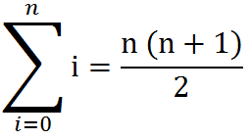
Some Algebra to calculate:
1+2+…+n
OR

Slide 79
How to use Let
(create new variables in definitions)
(let
  ( [<variable1> <value1>]
  [<variable2> <value2>]
  )
  <body>
  )
(define (spam)
(let ([a 3]
[b 4])
(+ a b)
))

Slide 80
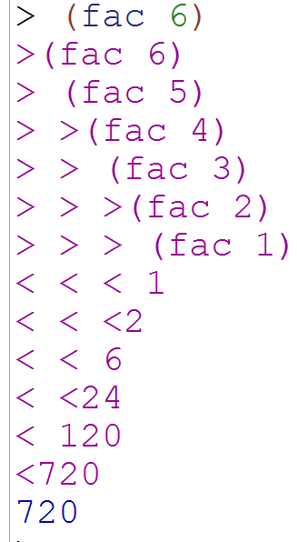
Debugging in Racket
Import the library
(require racket/trace)
(trace fac)
Use this to see what recursive calls get made

