Slide 1
CS 60
HOF, lambda
Binary search trees
2013-09-16
Monday – Week 2
Lecture 04

Slide 2
Did you successfully install Java?
What? Why?
Yes
I tried – but was unsuccessful
I haven’t tried yet
Other

Slide 3
Lecture 04 – Learning Goals
Write and call functions that take a function as input
Predict the behavior of binary search tree (BST) algorithms find, insert, & delete.
Write functions that takes a BST as input or return a BST.

Slide 4
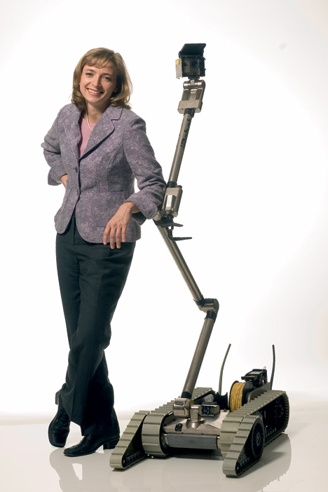
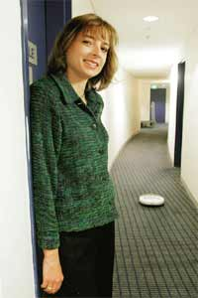
running Scheme!
Helen Greiner, co-founder and CEO of iRobot (at left in each image!)
Notes:
I don’t know if this really works...

Slide 5
In your favorite media player you can…
Get the artist or length of any song in a list (map)
Get a list of only the songs that match your criteria (filter)
Organize the list of songs (sort)
Combine multiple songs into a playlist (foldr)

Slide 6
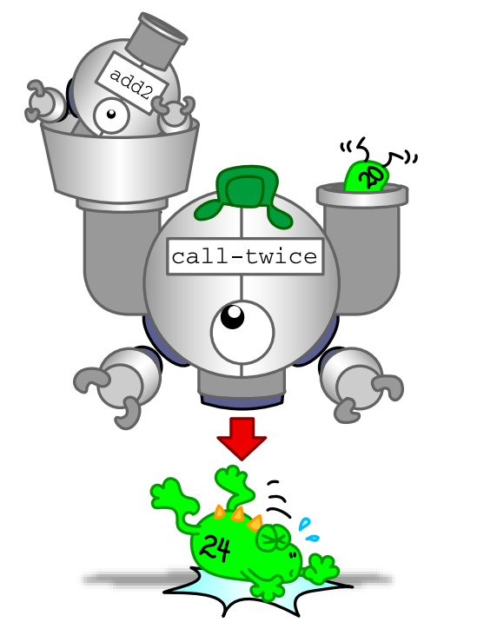
Higher Order Functions
Functions that take another function as input.
(or output a function)
map
foldr
filter
sort

Slide 7

Image Credits
Simply Scheme (black and white diagrams)
http://www.eecs.berkeley.edu/~bh/ss-toc2.html
By Brian Harvey and Matthew Wright
CS Illustrated (color images)
http://csillustrated.berkeley.edu/
By http://csillustrated.berkeley.edu/artists.php
Images used are all by Ketrina Yim

Slide 8
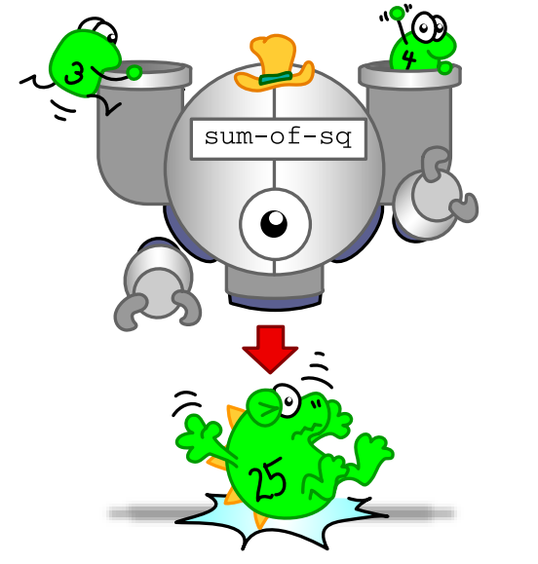
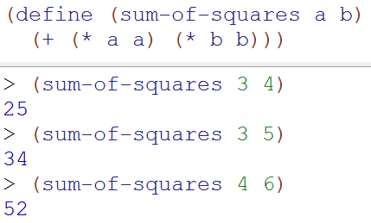

Old News (Takes numbers as input and returns a number)

Slide 9
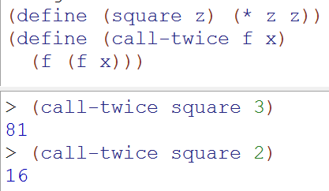
Breaking News: The input to the function is function!

Slide 10
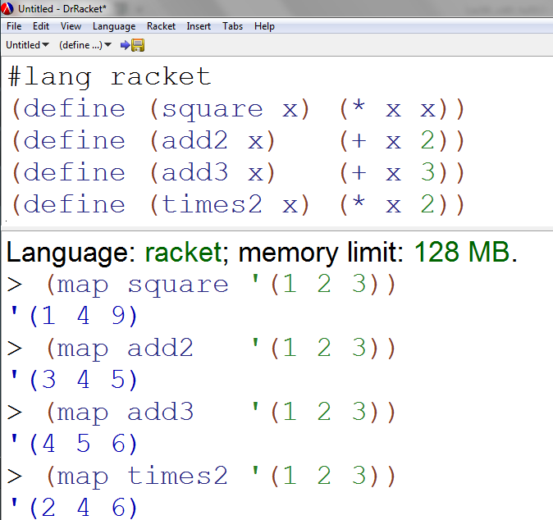
Map Demo

Slide 11
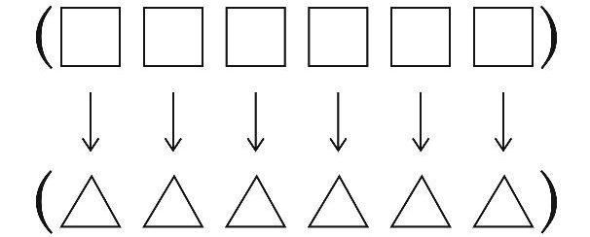
(map proc L) Applies a function to every element in a list
First argument proc is a function
Second argument L is a list
Returns a list in which the function proc has been applied to each element of the input list L

Slide 12
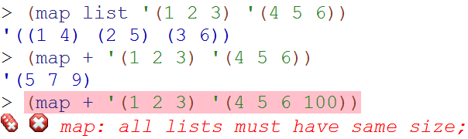
map with multiple lists
map can take in multiple lists – the function takes one element from each list
(not as important)

Slide 13
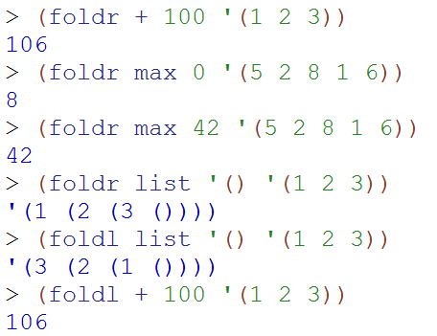
foldr foldl (fold Right and fold Left)

Slide 14
(foldl proc init L) Combines elements in a list
First argument proc is a function
Second argument init is an initial value (like a base case return value)
Third argument L is a list
Returns a list in which the function proc has been called with input:
init and the first element of L
and then that result and the next element of L are provided as input until there are no more elements in L

Slide 15
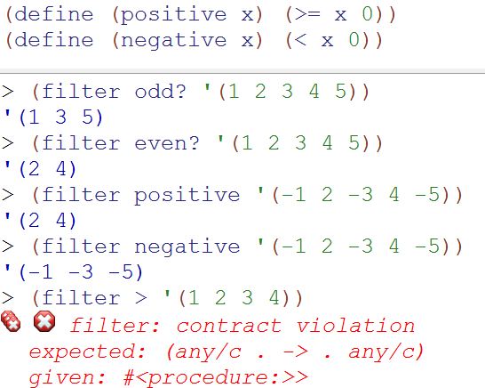
filter keeps elements that return true
Needs a function that takes 1 argument

Slide 16
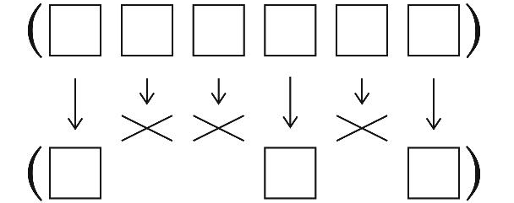
(filter predicate L) keeps elements that return true
First argument predicate is a function
Second argument L is a list
Returns a list that only contains the elements in L that return #t (or a true value) if passed as the input to predicate

Slide 17
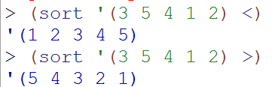

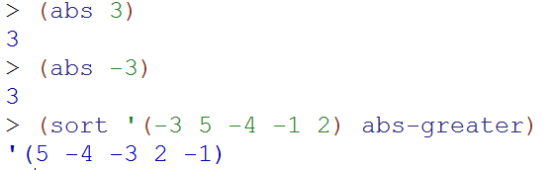
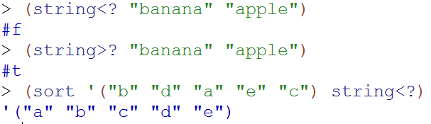
(sort L predicate)

Slide 18
(sort L predicate) sorts the elements in L
First argument L is a list
Second argument predicate is a function that takes two arguments and returns true or false if the two elements are “in order”
Returns a list in sorted order, based upon the results of passing pairs of values to predicate

Slide 19

Write map

Slide 20
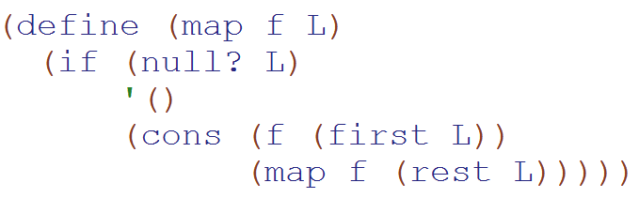
(map func L) SOLUTION
map
(built into Racket)

Slide 21
Binary Search Trees BSTs Practicing the Algorithms
In CS classes – sometimes you’re learning algorithms. You code them just to understand them better!
Colleen’s definition of algorithm:
a (sometimes beautiful) way to solve a problem

Slide 22
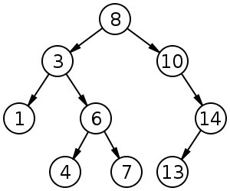
Binary Search Tree (BST) Example

Slide 23
Binary Search Tree (BST) Example
Each node has:
0, 1 or 2 children
All children in the left subtree are smaller
All children in the right subtree are larger
No duplicates are allowed

Slide 24
Binary Search Tree (BST) Vocab
Root – Node at the top of the tree
Subtree – a subset of the tree rooted at one node
Leaf – Node with no children
Height - number of EDGES on the longest path from root to a leaf
Note: what is the height of a tree with 1 node?

Slide 25
Binary Search Tree Insert & Delete (homework 2)

Slide 26
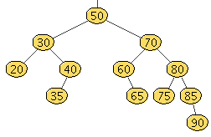

Slide 28
Binary Search Tree FIND Algorithm
If you’re at a leaf – it isn’t in the tree!
If KEY is what we’re looking for – you found it!
If what we’re looking for is < KEY – recurse LEFT
If what we’re looking for is > KEY – recurse RIGHT
Binary Search Tree INSERT Algorithm
A little more complicated than it looks!
If you’re at a leaf – ADD IT!
If KEY is what we’re adding – return the tree
If what we’re adding is < KEY – recurse LEFT
If what we’re adding is > KEY – recurse RIGHT

Slide 31
Binary Search Tree Delete Algorithm
No children – just delete
One child – replace with child
Two children? (Booo!)
Find the NEXT item (just bigger than node to delete)
Smallest thing on right subtree
Call delete the NEXT item
Put the NEXT item to replace the original node
This is recursion!!!
Why won’t this be an infinite loop? (it won’t be)

Slide 32
Insert 9, 2, 12
The old height was: _______ The new height is: _______
http://en.wikipedia.org/wiki/File:Binary_search_tree.svg

Slide 33
Delete 4, 1, 14
http://en.wikipedia.org/wiki/File:Binary_search_tree.svg

Slide 34
Delete 3
http://en.wikipedia.org/wiki/File:Binary_search_tree.svg

Slide 35
Delete 8
http://en.wikipedia.org/wiki/File:Binary_search_tree.svg

Slide 36
Determine an order that I could have added these numbers to the tree

Slide 37
How’s it going?
Got the first one
Got the first and second
Got the first, second, and third
Got the all of em
Stuck

Slide 38
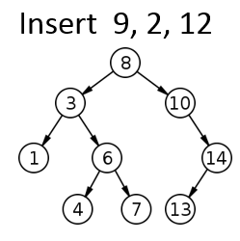
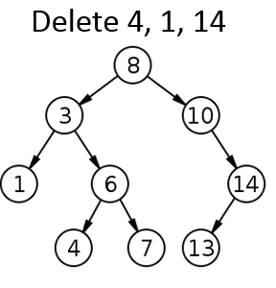
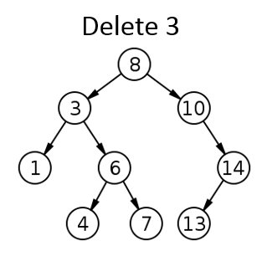
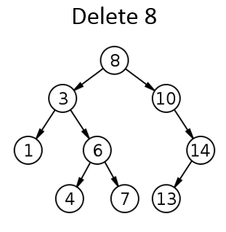
Solutions
We could add:
8, 3, 1, 6, 4, 7, 10, 14, 13

Slide 39
Keys & Values In association lists & BSTs
Something we want to use to look something else up
Something we want to look up

Slide 40
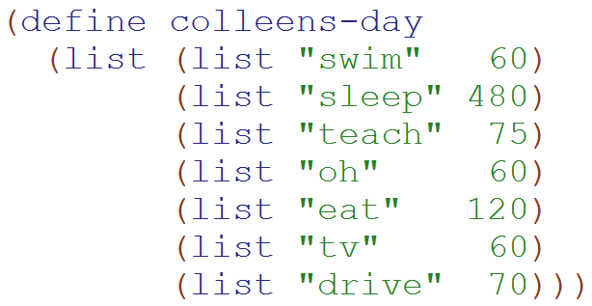
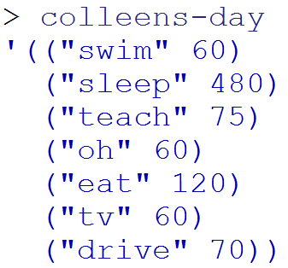
Example of an Association List
An “Association List”
is always a list of lists
(or empty)
A list with 7 elements
(each of which is a list of 2 elements)

Slide 41
assoc
> (assoc "swim" colleens-day)
'("swim" 60)
> (assoc "tv" colleens-day)
'("tv" 60)
> (assoc "eat spam" colleens-day)
#f
assoc
Returns the first list
that starts with the first argument.

Slide 42
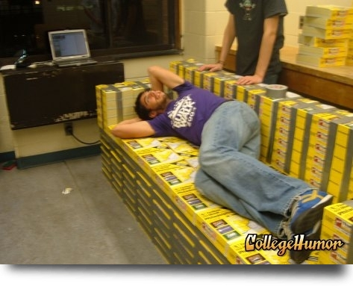
Lists' disadvantages
AAA Aardvark Training
909-555-NICE
key
value
Fran’s Foto
909-555-FOTO
phone books hold the key
Mo’s Mermaids
909-555-SWIM
If we use assoc, we have to look at EACH entry until we get to that entry!
Pam’s Pretzels
909-555-PRZL
Zyzzyva Exterminators
909-555-GONE
Notes:
I don’t know if this really works...

Slide 43
Trees are fast!
What do you use to look things up?
Key
Value
??
Idea: use our phone-book search to structure our data!
Mo’s Mermaids
909-555-SWIM
“key”
“value”
Fran’s Foto
909-555-FOTO
Pam’s Pretzels
909-555-PRZL
AAA Aardvark Training
909-555-NICE
???
???
Zyzzyva Exterminators
909-555-GONE
How deep will this tree be?
Notes:
I don’t know if this really works...

Slide 44

REQUIRED Helper Functions
(define (make-BST key left right)...
(define (make-empty-BST) ...
(define (make-BST-leaf key) ...
(define (emptyTree? tree) ...
(define (leaf? tree) ...
(define (key tree) ...
(define (leftTree tree) ...
(define (rightTree tree) ...

Slide 45
Write find Should return #t or #f depending upon if the key is in the tree
(define (find key tree)

Slide 46
Write insert Should return a new tree with the new key added
(define (insert key-to-add tree)

Slide 47
Write add2 Should return a new tree where every key has been increased by 2
(define (add2 tree)

Slide 48
Write find-max Should return the maximum key in the tree
(define (find-max tree)

Slide 49
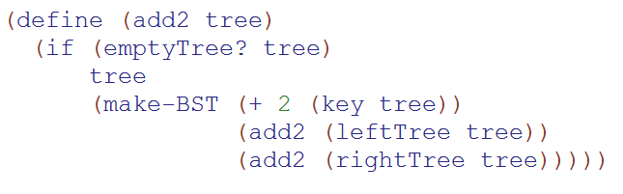
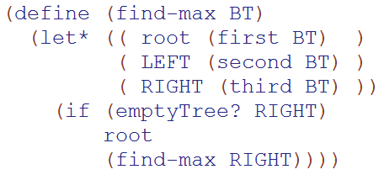
Solutions

Slide 50
Solutions

Slide 51
getting the most from BSTs
(in) a list representing a non-empty BST
N = # of nodes
(find-max BT) = (out) the largest of BST's elements
42
(define (find-max BT)
(let* (( root (first BT) )
( LEFT (second BT) )
( RIGHT (third BT) ))
(
20
100
12
21
211
35
25
Notes:
I don’t know if this really works...

Slide 52
Graphs
2013-01-31
Thursday – Week 1
Lecture 04

Slide 53
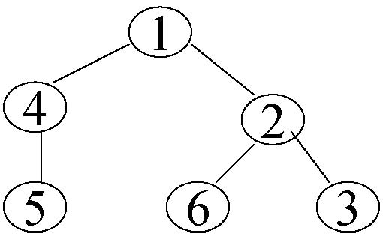
How Trees become Graphs
Notes:
A graph G is a set V of vertices (sometimes called nodes), and a set E of edges (sometimes called arcs) that each connect two vertices together.
This is just like the trees – but with the trees we had the requirements and now any node can reference any other type of node.
Really we could think about any tree as a graph and really even any linked list as a tree and any linked list as a graph. It is just based upon the relationships of nodes.
Introduce E here and N!!
Point out potential infinite loop here!

Slide 54




Two Types of Graphs
Directed
Graph
Undirected
Graph
This vocab is important
Notes:
Two types of graphs. Directed – which is using directional arrows and undirected. Which is just as if there is an arrow in each direction for a given edge.
Define undirected and directed here.

Slide 55
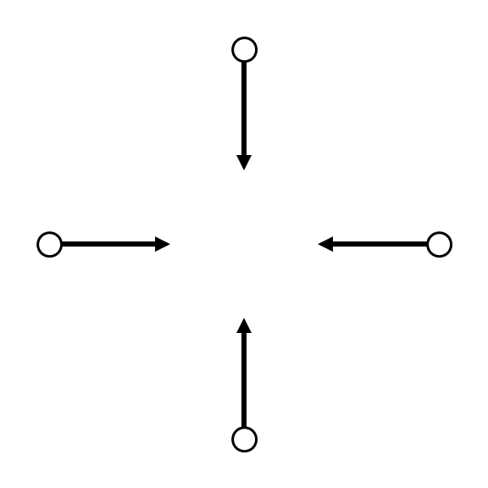

Nodes – Twitter users
Edges – Indicates following
Notes:
Obama is the third most followed person on twitter.
This shows the arrows – just because you follow obama doesn’t mean that he follows you – although Obama COULD follow you and another obama follower could follow other obama followers. (ANIMATION)
If every arrow went in both direction it would just be a undirected graph

Slide 56
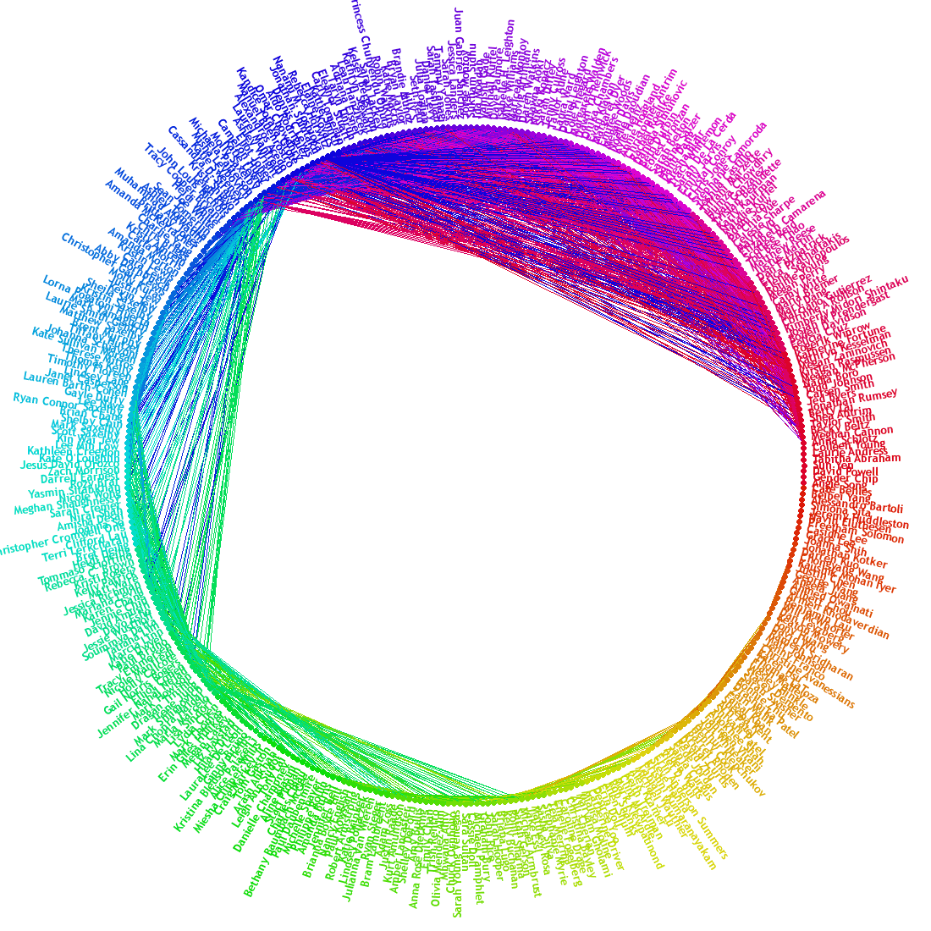
Nodes – FB Users
Edges – Friendships
Notes:
This is FB’s friend wheel. It shows which of my friends are friends with each other. And it is clustered.
This is undirected – if I’m friends with someone they are also friends with me.
We could think of facebook as a directed graph – where most edges are bi-directional. However, maybe when you create a friend request – that is like creating a directional arrow.

Slide 57
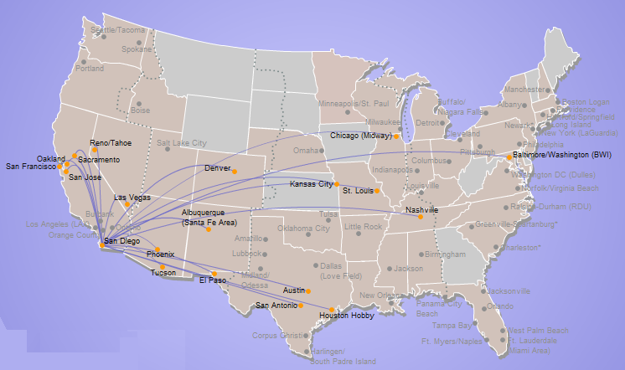
A map is a graph
Nodes – Airports
Edges – Flights
Edge weight
Distance
Flight cost
Travel Time
Notes:
A map is a graph. Here we have southwest’s direct flights from SD.

Slide 58
Graph Vocabulary
 | Weighted | Un-weighted
Directed | Flights | Twitter
Undirected | Interstates | Facebook

Slide 59
Graph Representations
2013-01-31
Thursday – Week 1
Lecture 04

Slide 60
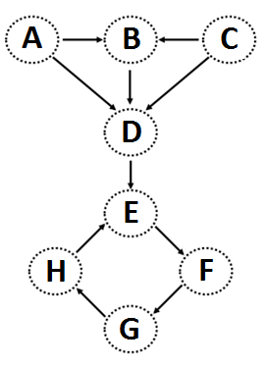
Graphs can be stored as Lists Edge List
This vocab is important
(define unicycleGraph '(
("A" "B") ("A" "D") ("B" "D") ("C" "B") ("C" "D") ("D" "E") ("E" "F") ("F" "G") ("G" "H") ("H" "E")
))
I can think of other ways to represent this graph!

Slide 61
(define Gt '((e b 100) (a b 25) (e a 42)
(a c 7) (a d 13) (a e 15)
(b c 10) (b d 5) (d e 2)
(b e 100) (c d 1) (c e 7)) )
What might these weights represent?
weights
15
42
25
b
100
This graph looks heavy!
a
10
7
e
100
c
7
5
13
1
2
Weightedgraphs
d

Slide 62
Graph Practice
2013-01-31
Thursday – Week 1
Lecture 04

Slide 63
(nodes unicycleGraph)→'("A" "B" "D" "C" "E" "F" "G" "H")
(define (nodes graph)
Hint: how could we use remove-duplicates
(kids "A" unicycleGraph) → '("B" "D") (kids "B" unicycleGraph) → '("D")
(define unicycleGraph '(("A" "B") ("A" "D") ("B" "D") ("C" "B") ("C" "D") ("D" "E") ("E" "F") ("F" "G") ("G" "H") ("H" "E") ))
(define (kids n graph)
big-O( ) ~ edges or nodes?
parents?
Hint: could we use filter?
Notes:
big-O: could be edges or nodes!

Slide 64
Feel free to use available functions: remove-duplicates, nodes, kids, parents, and higher-order functions...
Write these functions for directed graphs.
(define (leaf? n G)
(leaf? n G) should return #t if n is a leaf in G and #f otherwise.
(
(leaf? "E" unicycleGraph)→ #f
Hint: call (kids n G)
(define (gkids n G)
(gkids n G) should compute the list of grandchildren of n in G: all nodes two edges away.
(
(gkids "E" unicycleGraph)→ '("G")
(gkids "A" unicycleGraph)→ '("D" "E")
Hint: use kids and map - It's a bit tricky...
(define (reach? a b G)
(reach? a b G) should return #t if there is some path from a to b in G and #f otherwise.
(
(reach? "B" "E" unicycleGraph)→ #t
there is definitely not enough room here – plus, we’ll talk about a solution in the next lecture...
(reach? "E" "B" unicycleGraph)→ #f
Notes:
I don’t know if this really works...

Slide 65
All you need is Love Lambda (you don’t need cons – you can write it with lambda)
2013-01-31
Thursday – Week 1
Lecture 04

Slide 66
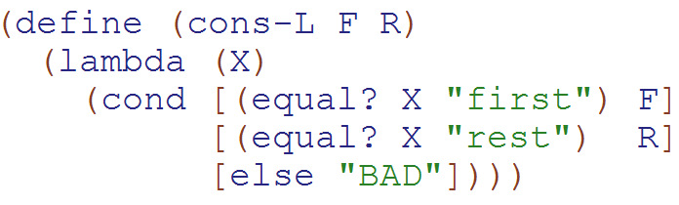
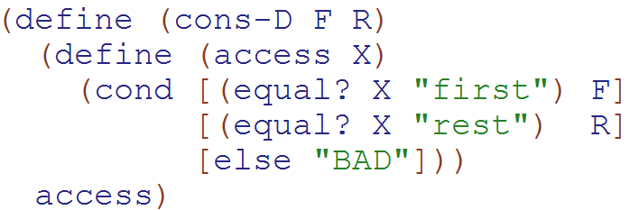
cons written with lambda & with define
Showing both in case people aren’t down with Lambda yet.
Both cons-L and cons-D return a function!!!

Slide 67
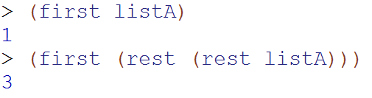


Normal (built-in) cons
Our
Cons-L
We can get the first and rest out – but it isn’t pretty

Slide 68
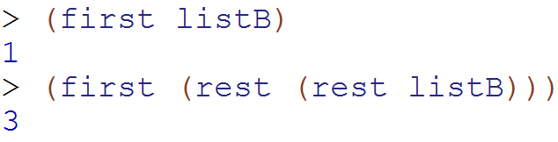
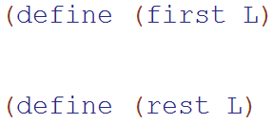
Write first and rest for cons-L
What type of thing is L?
a) "string" b) function
c) Number d) ???

Slide 69
BONUS

Slide 70


Slide 71
Estimating Time
Most people grossly underestimate how long it takes to program (not thinking about time to debug and test)
You appear incompetent at programming (not true) if you can’t estimate how long something will take.
This is one of the hardest things to learn!!! Start to practice now! For each task estimate how long it will take and keep track of how wrong you were

Slide 72


Computer
Science
&
= AWESOME

Slide 73
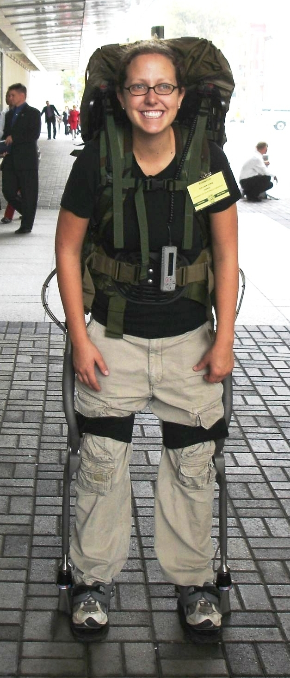
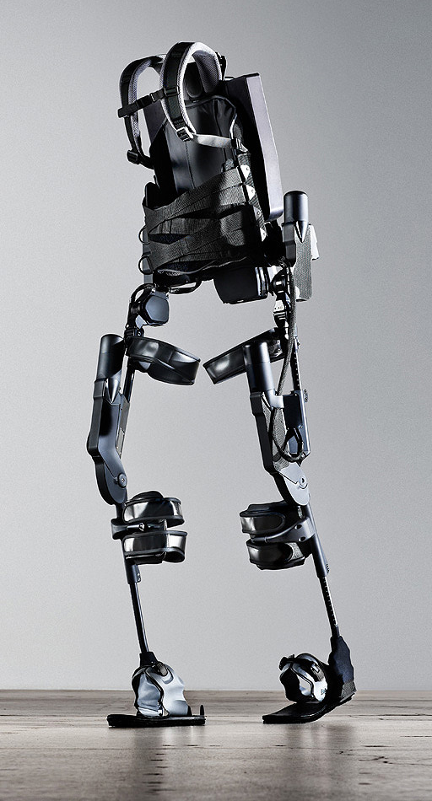
http://www.youtube.com/watch?v=pzRmNYA8LlY

Slide 74


ClickStart

Slide 75
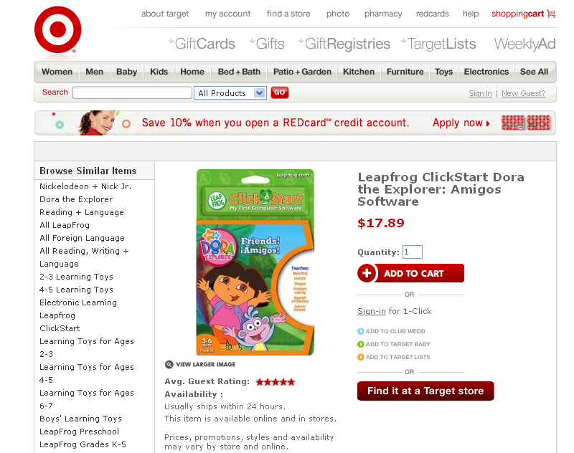

Slide 76
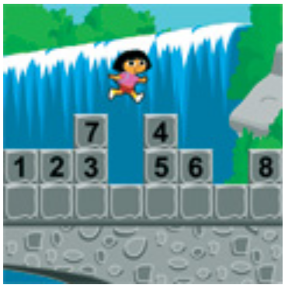
How should we represent the blocks in the computer?
Independent variables
2D Array
OpenList
I don’t know

Slide 77
The value in the array tells me what art asset to use
Each level is really a 3x10 vector!
0 | 0 | 7 | 0 | 4 | 0 | 0 | 0
1 | 2 | 3 | -4 | 5 | 6 | -7 | 8
B | B | B | B | B | B | B | B
Negative values tell me what block needs to go here to win!

Slide 78
0 | 0 | 7 | 0 | 4 | 0 | 0 | 0
1 | 2 | 3 | -4 | 5 | 6 | -7 | 8
0 | 0 | 0 | B | 0 | 0 | 0 | 0

Slide 79
BUGS!

Slide 80
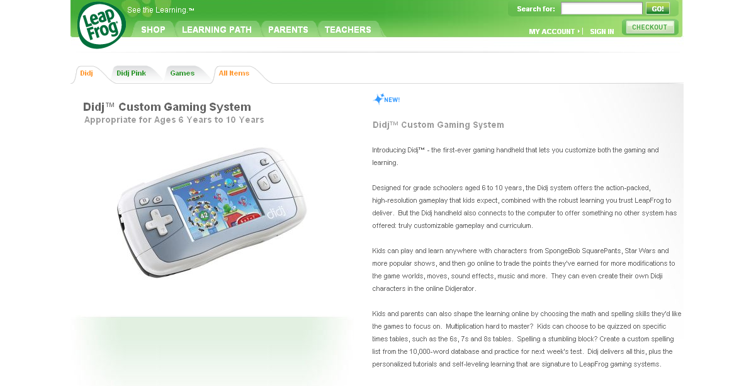

Slide 81
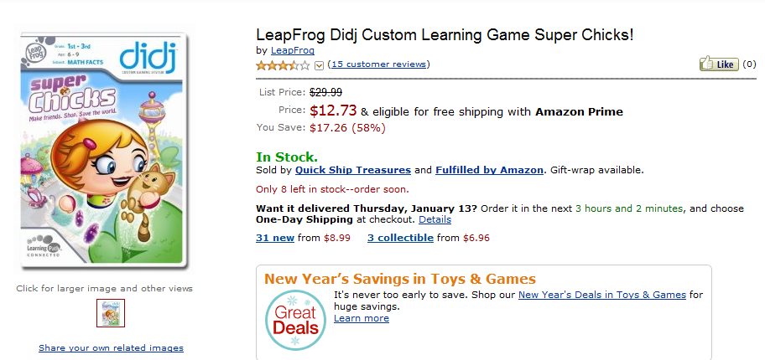
It is really sad when stuff you’ve made is on sale!

Slide 82



Which image is fake?
A. Top Left
B. Bottom Left
C. Bottom Right

Slide 83
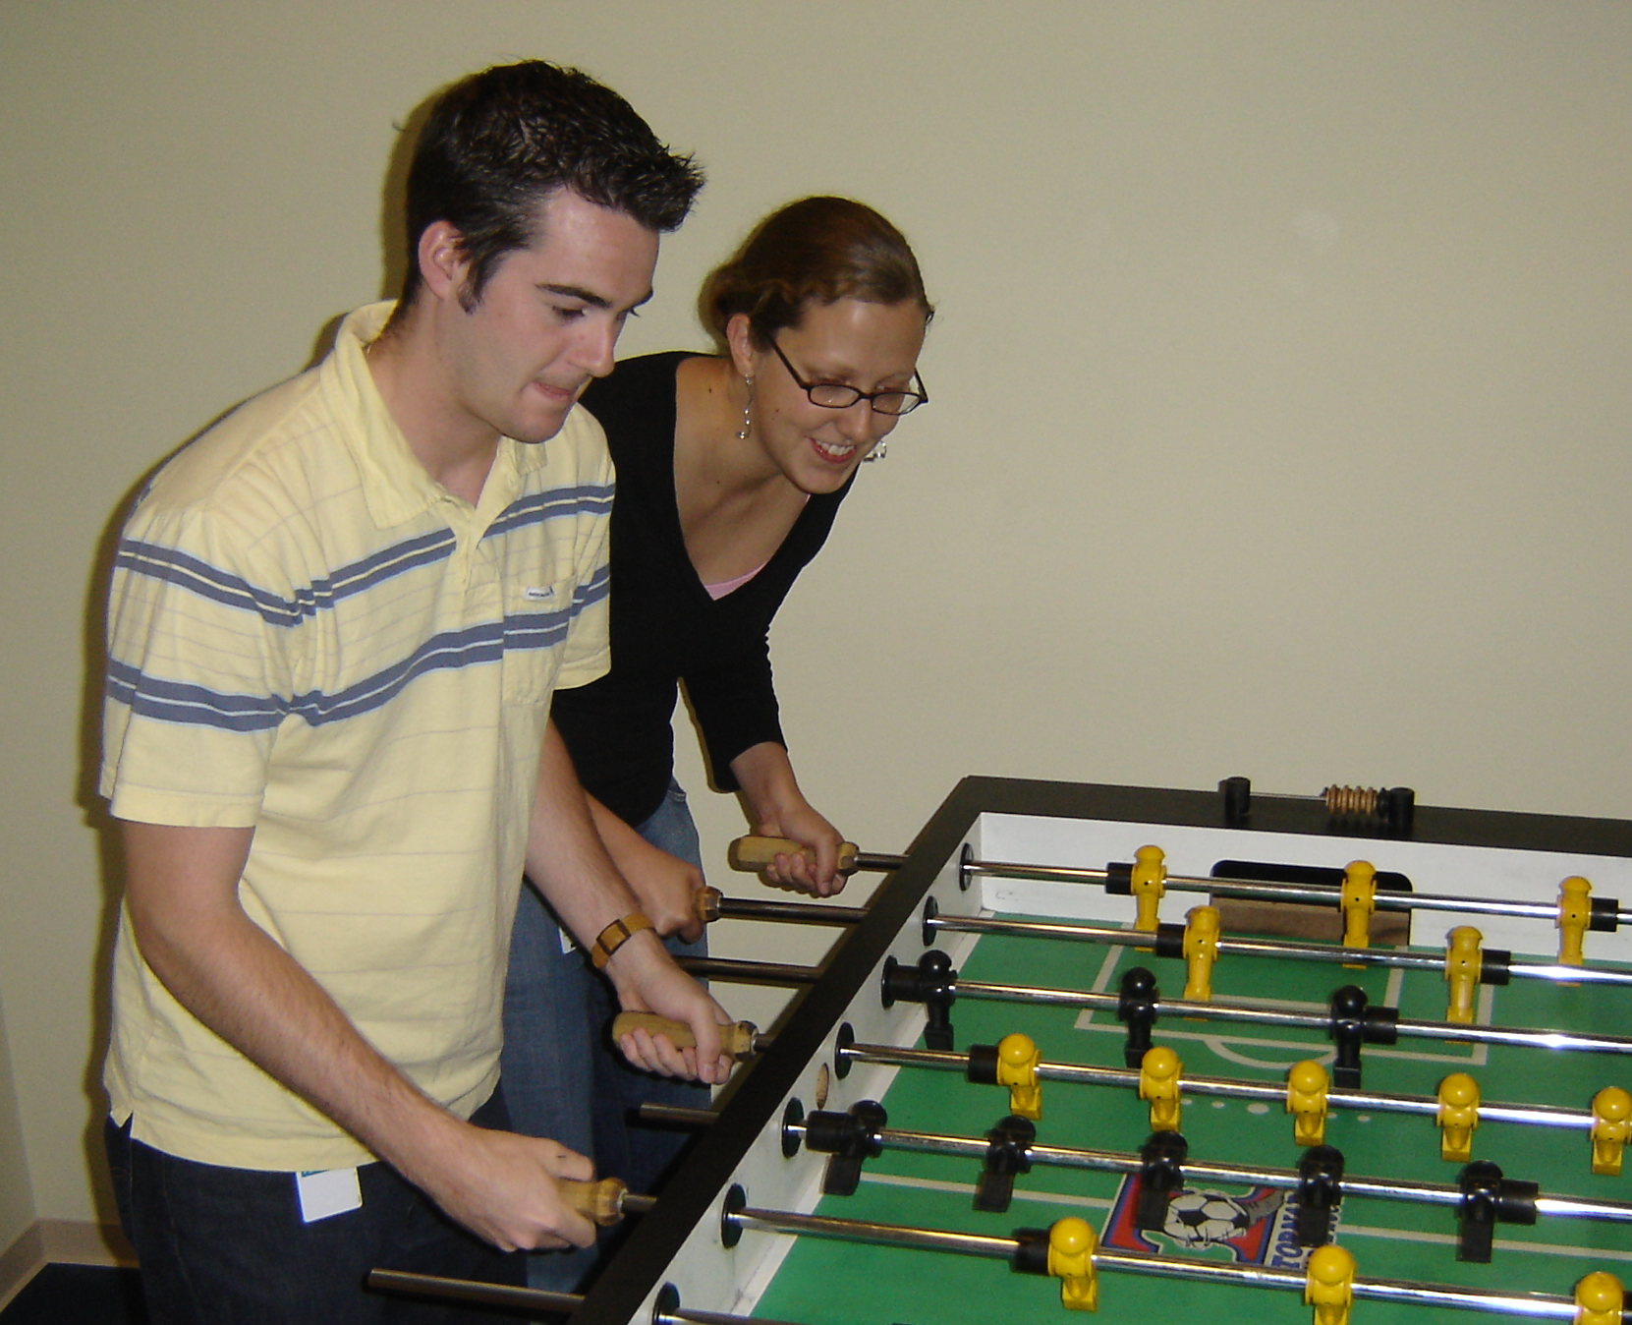

Slide 84
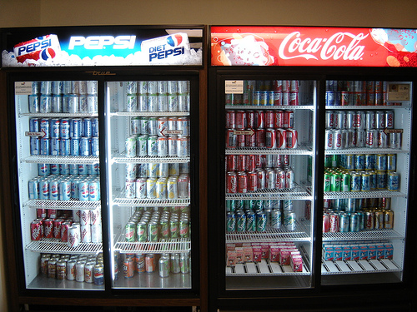

Slide 85
Scheme is BEAUTIFUL!

Slide 86
We don’t need no stinkin’ pairs
(define (cons x y)
(lambda (which)
(cond
((equal? which 'first) x)
((equal? which 'rest) y)
(else (error "Bad message"
which)))))
(define (first pair)
(pair 'first))
(define (rest pair)
(pair 'rest))

