Slide 1
CS 60
Binary Search Trees (BSTs) & Use-it or Lose-it
2014-09-17
Wednesday – Week 2
Lecture 05

Slide 2
Warm-up (You can start before class)
What are the properties of BSTs that are always true?
What are the three cases for BST delete?

Slide 3
Submission System

Slide 4
Lecture 05 – Learning Goals
Translate between function definitions and lambda calls
Write code that returns a new BST
Describe why abstraction is awesome (particularly in the case of BST helper functions)
Create & identify cases where lambda is useful

Slide 5
Lambda λ Makes a procedure!
Well… it actually makes a function (i.e. has no side effects) because we never change things in Racket!
But in the slides I’ll use function and procedure interchangeably.

Slide 6
lambda What before why

Slide 7
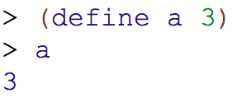
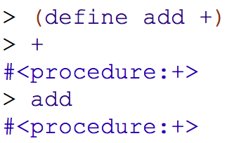
Old News We can store procedures in variables

Slide 8

Introducing: lambda lambda makes a procedure (and it has crazy syntax)
lambda
lambda makes a procedure
inputs
Go in parens after the word lambda
body
Is JUST like the body from a regular function definition

Slide 9
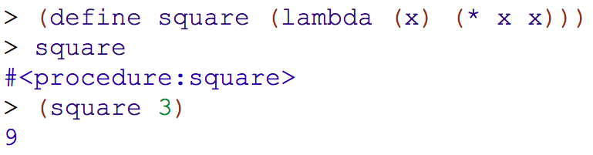

We can use lambda to make all of our procedures! (And that’s what Racket does!!!)
We don’t even have to name the function with a variable to call it!
This is the procedure
This is the input
Two parens – parens mean “call this function!”

Slide 10
Syntactic Sugar (λ makes a procedure)
(define (square x) (* x x))
(define square (lambda (x) (* x x))
>(square 3)
9
>((lambda (x) (* x x)) 3)
Function name
Args
Body
The function to call
Input
Remember to keep track of your input/output type(s)!

Slide 11
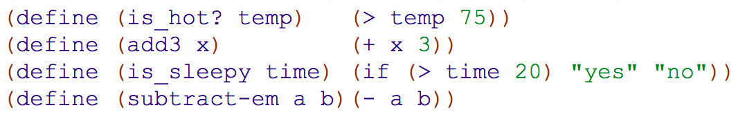
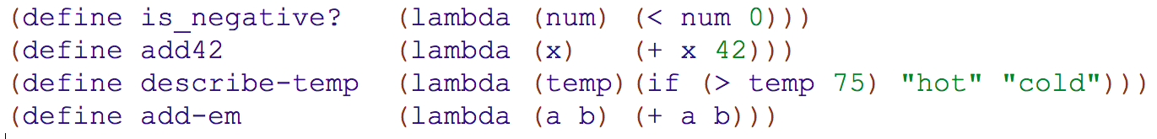
Lecture 05: Practice with lambda Name: _______________ Translate between function definitions and lambda calls

Slide 12
Lecture 05: Practice with lambda Name: _______________ Translate between function definitions and lambda calls

Slide 13
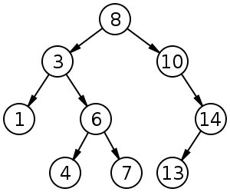
Binary Search Trees BSTs

Slide 14
BST insert
Four cases for inserting the element e into a BST
Empty BST
The root’s key is EQUAL TO e
The root’s key is LESS THAN e
The root’s key is GREATER THAN e

Slide 15



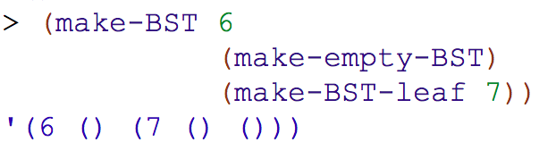
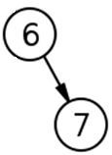
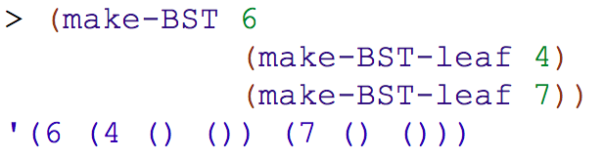
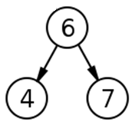
How are BSTs represented?

Slide 16
Write the BST Helper Functions (Based upon the previous slide)
(define (make-BST key left right)
(define (make-empty-BST)
(define (make-BST-leaf key)
(define (emptyTree? tree)
(define (leaf? tree)
(define (key tree)
(define (leftTree tree)
(define (rightTree tree)

Slide 17
Rewrite insert without the BST Helper Functions (Just to see how ugly it is!)

Slide 18
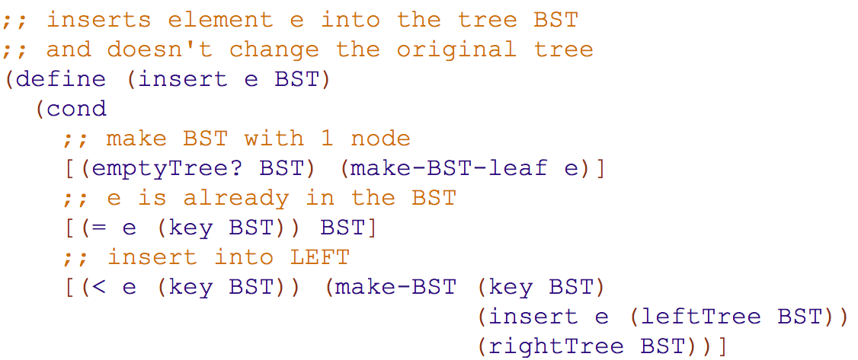
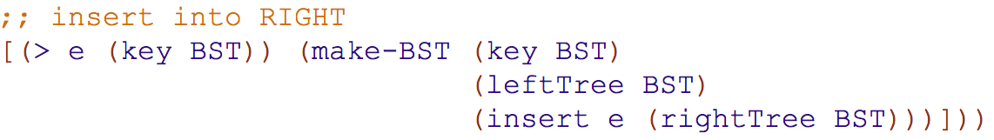
insert solution

Slide 19
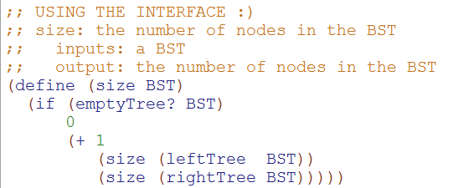
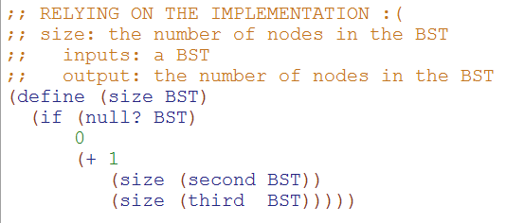
This is the BEAUTIFUL one!

Slide 20
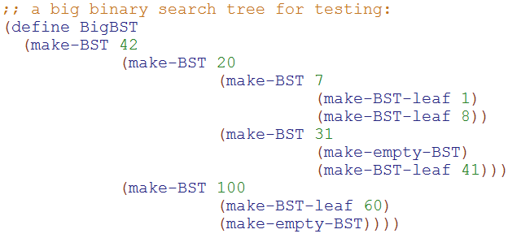
We write code based upon the interface NOT the implementation

Slide 21
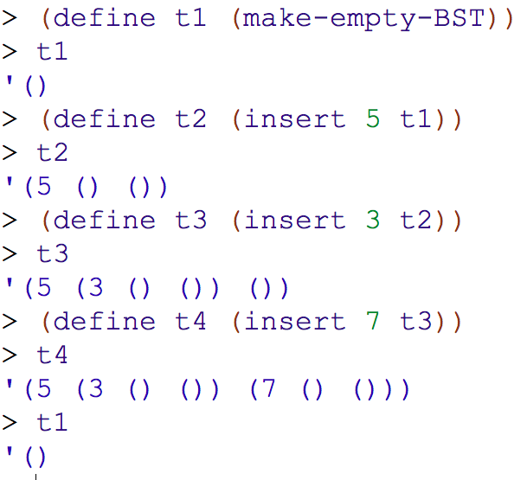
Sample calls to insert (Note we don’t change the trees!)

Slide 22
REQUIRED Helper Functions - Solutions
(define (make-BST key left right)
(list key left right))
(define (make-empty-BST)
'())
(define (make-BST-leaf key)
(make-BST key
(make-empty-BST)
(make-empty-BST)))
(define (emptyTree? tree)
(null? tree))
(define (leaf? tree)
(and (null? (leftTree tree))
(null? (rightTree tree))))
(define (key tree)
(first tree))
(define (leftTree tree)
(second tree))
(define (rightTree tree)
(third tree))

Slide 23
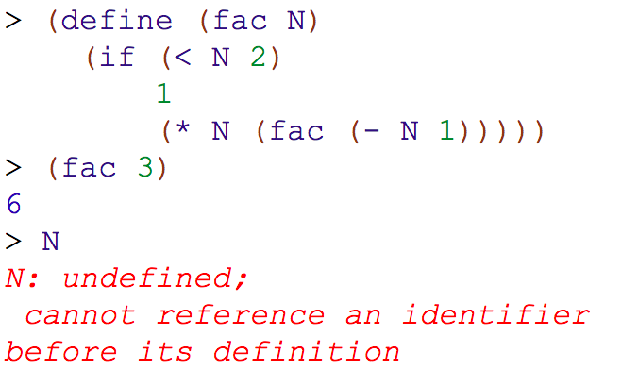
Scope Why can’t I access the N?

Slide 24
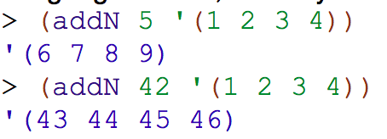

Write addN by filling in the blank (This should be a pain!)

Slide 25

addN Solution
I can’t define my adding function outside of addN, because I don’t know what n should be until addN is called!

Slide 26
Use only higher-order functions, not raw recursion, to write these :
Name: ____________________ Login: ___________________
1
smush should concatenate all of the elements of L, which you should assume are lists
2
addk should add k to each element of L (all will be numeric)
( smush '((t h i) (s i s) (s o c o) (o l) )
'( t h i s i s s o c o o l )
( addk 60 '( -18 101 7940 ) )
'( 42 161 8000 )
(define (addk k L)
(map L))
What should this be?
3
Lotto-winner takes a list of tickets: '( (name n1 n2 n3 n4 n5) (name n1 n2 n3 n4 n5) ... ) and a list of winning numbers W as input. Then, lotto should return a list of the name of the winner (most matches with W) and the number of matches made.
( lotto-winner '( (Amy 2 3 41 42 50) (Bea 3 40 50 51 52) ) '( 1 3 41 51 52 ) )
'( Bea 3 )
Here, write a helper function: (matches T W) returns the number of elements T and W have in common.
( matches ' (Bea 3 40 50 51 52) '( 1 3 41 51 52 ) )
3
(define (matches T W)
(
Hint: use filter + member...

Slide 27
1
smush should concatenate all of the elements of L, which you should assume are lists
( smush '((t h i) (s i s) (s o c o) (o l) ) → '( t h i s i s s o c o o l )
(define (smush L)
(foldr _______ ______ L))
(foldr proc init L)

Slide 28
2
addk should add k to each element of L (all will be numeric)
( addk 60 '( -18 101 7940 ) ) → '( 42 161 8000 )
(define (addk k L)
(map L))
(map proc L)

Slide 29
3
(matches T W) returns the number of elements T and W have in common.
(matches '(Bea 3 40 50 51 52) '(1 3 41 51 52))→ 3
(filter predicate L)

Slide 30
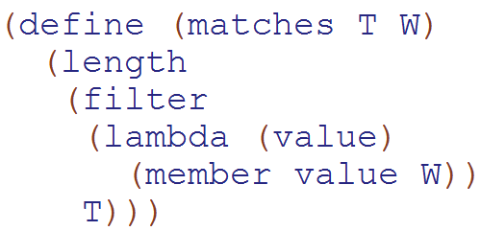
3
(matches T W) returns the number of elements T and W have in common.
(matches '(Bea 3 40 50 51 52) '(1 3 41 51 52))→ 3
(filter predicate L)

Slide 31
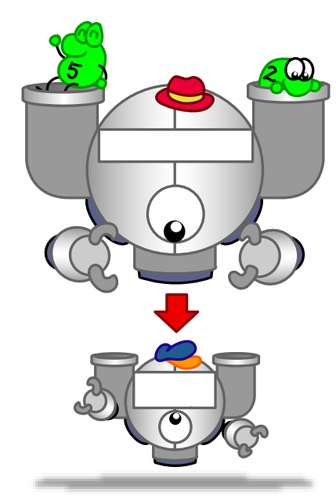

Function output is a function
(Woah!)

Slide 32
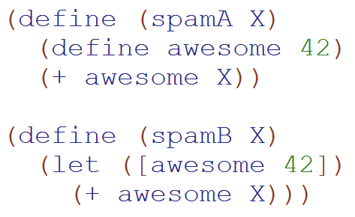
Language Detail: You can use define inside a function
These return the same thing.
You can also define functions

Slide 33
Example: Function output is a function
(define (make-adder x)
(define (adder-function y) (+ x y))
>(make-adder 3)
#<procedure:adder-function>
>((make-adder 3) 4)
7
(+ 40 2) )
adder-function )
What is x? a) 3 b)4 c)??

Slide 34
Write make-adder with lambda
(define (make-adder x)

Slide 35
Function output is a function
From earlier slide
(define (make-adder x)
(define (adder-function y) (+ x y))
adder-function)
(define (make-adder x)
(lambda (y) (+ x y)))
This is equivalent!
(Lambda makes things more concise.)
Beautiful!

Slide 36
(define (cat y)
(lambda (x) (+ x 1)))
(define dog
(lambda (x) (+ x 1)))
Which of these gives the answer 2?
I (cat 1)
II ((cat 1) 1)
III(dog 1)
IV ((dog 1) 1)
A) I&III
B) II&IV
C) I&IV
D) II&III
E) Not sure
Notes:
36

Slide 37
Graphs What – not how

Slide 38
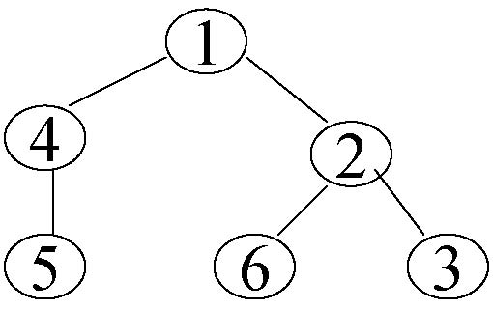
How Trees become Graphs (they can have cycles!)
Notes:
A graph G is a set V of vertices (sometimes called nodes), and a set E of edges (sometimes called arcs) that each connect two vertices together.
This is just like the trees – but with the trees we had the requirements and now any node can reference any other type of node.
Really we could think about any tree as a graph and really even any linked list as a tree and any linked list as a graph. It is just based upon the relationships of nodes.
Introduce E here and N!!
Point out potential infinite loop here!

Slide 39




Two Types of Graphs
Directed
Graph
Undirected
Graph
This vocab is important
Notes:
Two types of graphs. Directed – which is using directional arrows and undirected. Which is just as if there is an arrow in each direction for a given edge.
Define undirected and directed here.

Slide 40
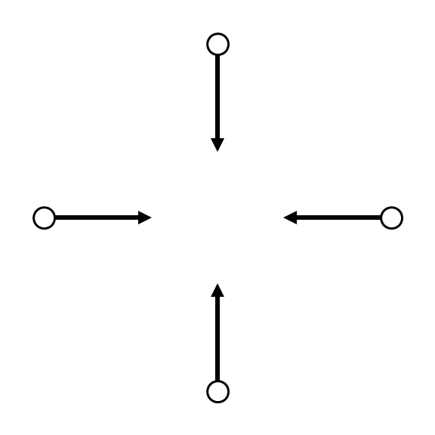

Nodes – Twitter users
Edges – Indicates following
Notes:
Obama is the third most followed person on twitter.
This shows the arrows – just because you follow obama doesn’t mean that he follows you – although Obama COULD follow you and another obama follower could follow other obama followers. (ANIMATION)
If every arrow went in both direction it would just be a undirected graph

Slide 41
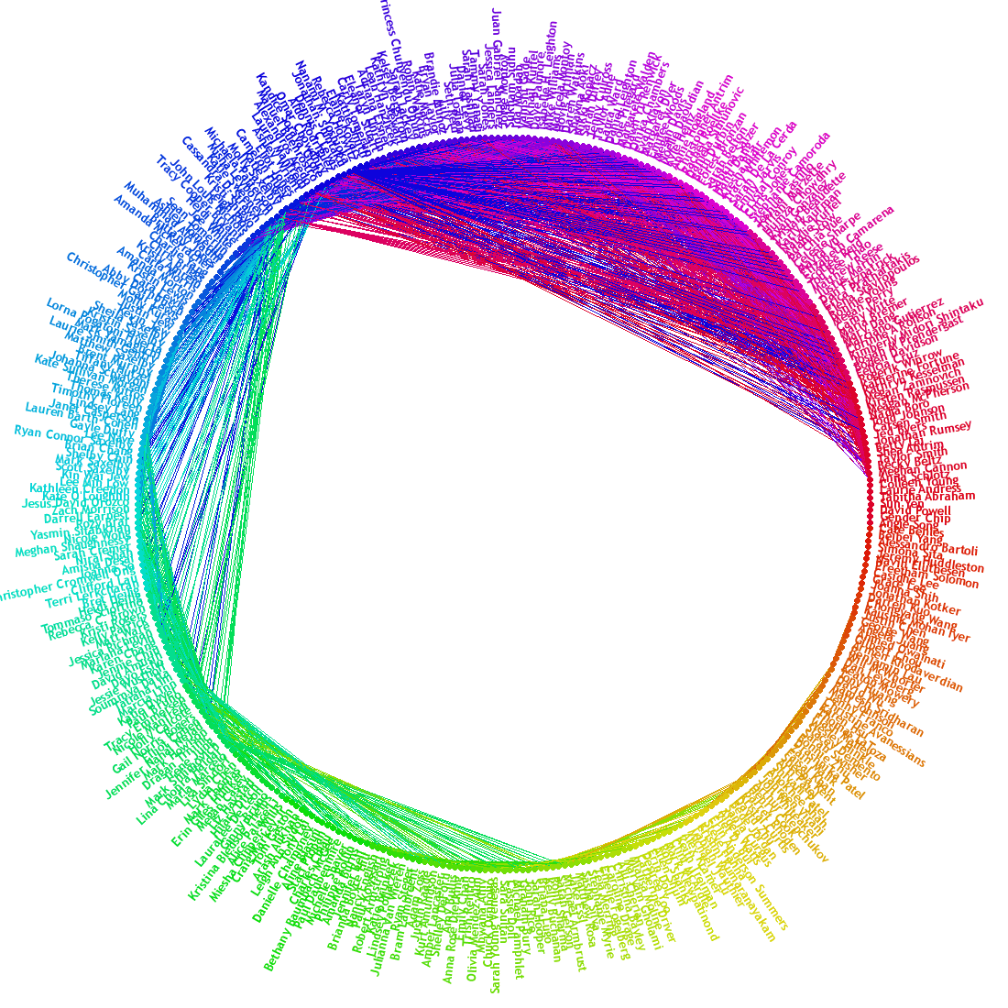
Nodes – FB Users
Edges – Friendships
Notes:
This is FB’s friend wheel. It shows which of my friends are friends with each other. And it is clustered.
This is undirected – if I’m friends with someone they are also friends with me.
We could think of facebook as a directed graph – where most edges are bi-directional. However, maybe when you create a friend request – that is like creating a directional arrow.

Slide 42
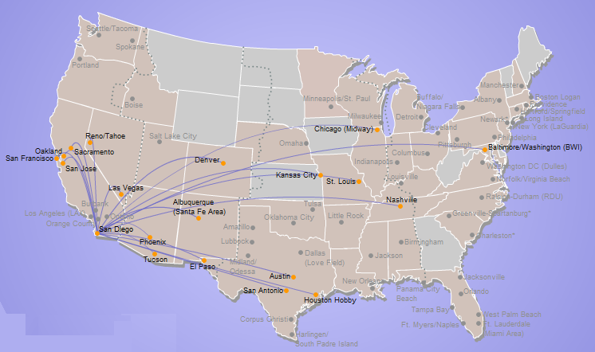
A map is a graph
Nodes – Airports
Edges – Flights
Edge weight
Distance
Flight cost
Travel Time
Notes:
A map is a graph. Here we have southwest’s direct flights from SD.

Slide 43
Graph Vocabulary & Examples
 | Weighted | Un-weighted
Directed | Flights | Twitter
Undirected | Interstates | Facebook

Slide 44
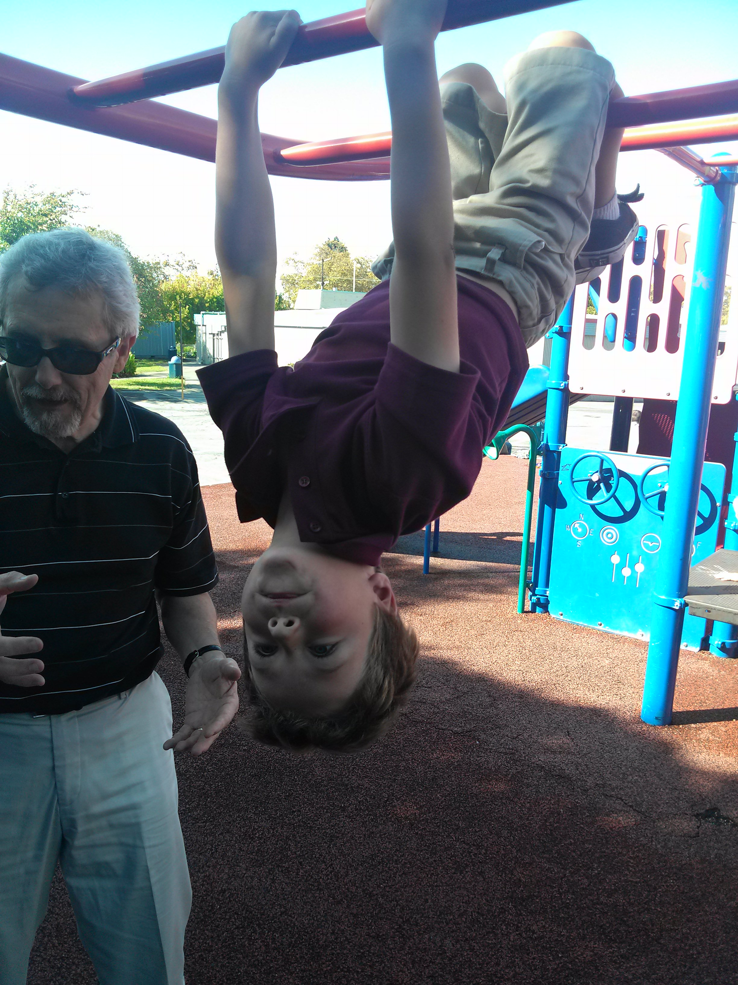
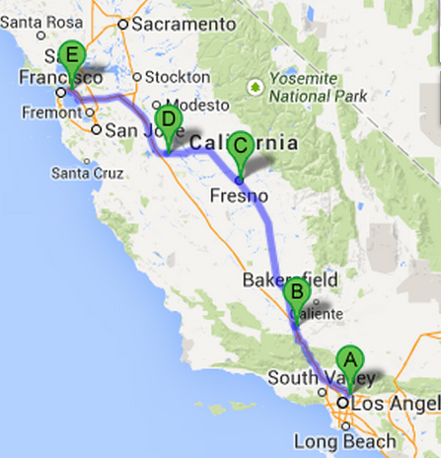
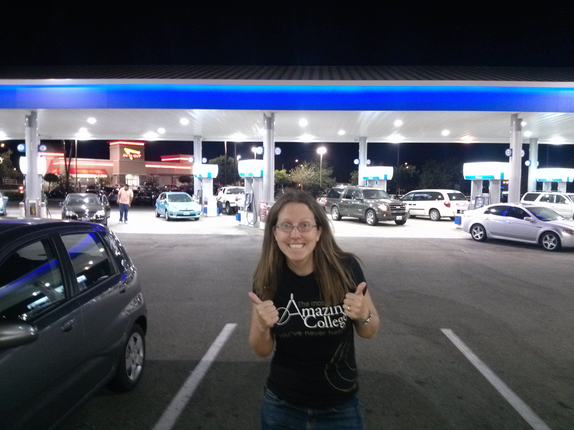
Colleen’s Weekend Graph

Slide 45
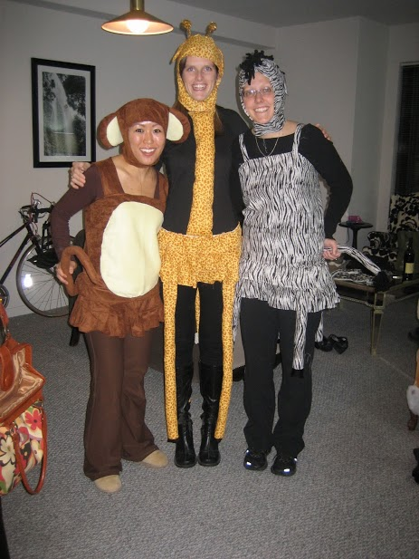
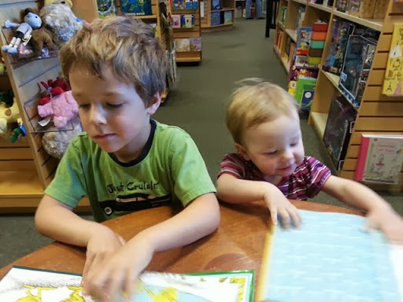

Slide 46
Weighted graphs
Weights
42
15
25
b
100
a
10
7
e
100
c
7
5
This graph looks heavy!
13
1
2
d

Slide 47
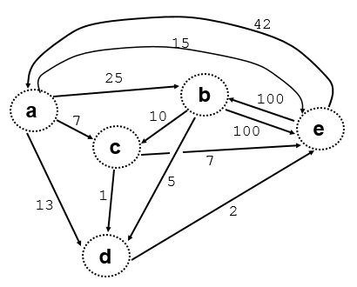
Edges in a Graph (What not How)
100
10
e
b
b
c
25
5
a
b
b
d
42
2
e
a
d
e
7
100
a
c
b
e
13
1
a
d
c
d
15
7
a
e
c
e

Slide 48
Graph-reachability: can you get from A to B?
?
Algorithm for determining: is there some path from A to B in the graph?
A
B
…
?
?
X
Y
I know I can get from X to Y (because I have an Edge from X to Y)
If I can get from A to X and from Y to B then I can get from A to B.
Edge X to Y might not be necessary – also try without it (lose it!)

Slide 49
Use It or Lose It

Slide 50
Use it or lose it ~ recursive strategizing
(1) single "it" out
(2) solve the problem without "it"
(3) solve the problem with "it"
if needed...
(4) Combine!
as appropriate...
Shouldn't this be called use it AND lose it?

Slide 51
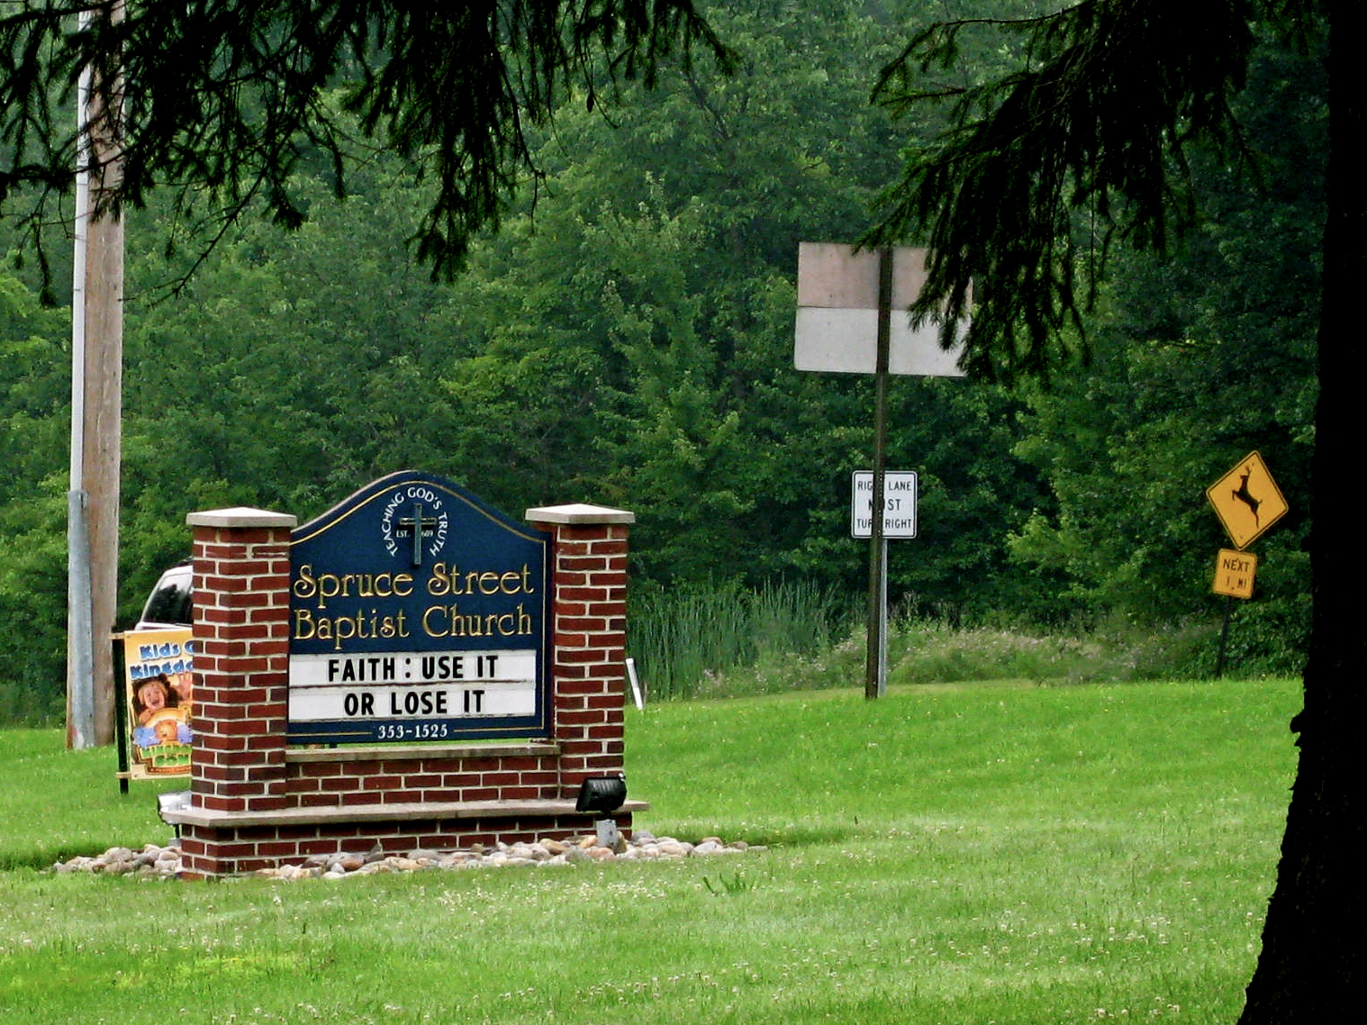
thanks to Allie Russell HMC '11
other church-front messages...?
Notes:
I don’t know if this really works...

Slide 52
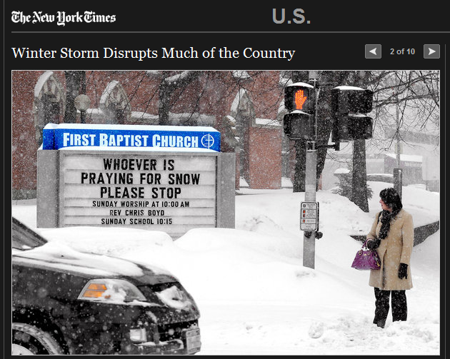
Notes:
I don’t know if this really works...

Slide 53
uniq (use-it or lose-it example)

Slide 54
Use it or lose it ~ recursive strategizing
(uniq '(D O D D S))→ ‘(O D S)

Slide 55
Use it or lose it ~ recursive strategizing
(uniq '(D O D D S))→ ‘(O D S)
(define (uniq L)
(if (null? L)
'()
(let* (( it )
( loseit )
(if
))))
let's give a name to the first element: we're going to use it and lose it and combine the results as necessary
solve the problem without "it"
do we need "it" ?
we don't need it
we do need it

Slide 56
Use it or lose it ~ recursive strategizing
(uniq '(D O D D S))→ ‘(O D S)
let's give a name to the first element: we're going to use it and lose it and combine the results as necessary
(define (uniq L)
(if (null? L)
'()
(let* (( it (first L) )
( loseit (uniq (rest L))))
(if (member it loseit)
loseit
(cons it loseit)
))))
solve the problem without "it"
do we need "it" ?
we don't need it
we do need it
SOLUTION

Slide 57
Count-change (use-it or lose-it example)

Slide 58
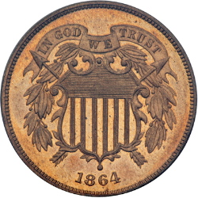
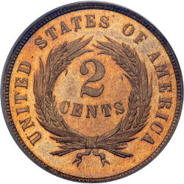
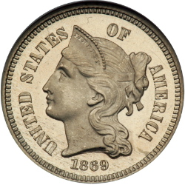
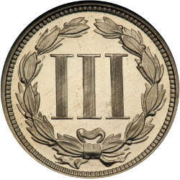
Hw #2
Change!
Can you make the total from the coins available? (odd denominations OK!)
(make-change total CoinList)
For example,
(make-change 42 '(2 5 2 10 25 2))
#t
(make-change 42 '(3 5 10 25 50))
#f

Slide 59
Function output is a function
(Woah!)

Slide 60
Language Detail: You can use define inside a function
These return the same thing.
You can also define functions

Slide 61
Example: Function output is a function
(define (make-adder x)
(define (adder-function y) (+ x y))
>(make-adder 3)
#<procedure:adder-function>
>((make-adder 3) 4)
7
(+ 40 2) )
adder-function )
What is x? a) 3 b)4 c)??

Slide 62
Write make-adder with lambda
(define (make-adder x)

Slide 63
Function output is a function
From earlier slide
(define (make-adder x)
(define (adder-function y) (+ x y))
adder-function)
(define (make-adder x)
(lambda (y) (+ x y)))
This is equivalent!
(Lambda makes things more concise.)
Beautiful!

Slide 64
(define (cat y)
(lambda (x) (+ x 1)))
(define dog
(lambda (x) (+ x 1)))
Which of these gives the answer 2?
I (cat 1)
II ((cat 1) 1)
III(dog 1)
IV ((dog 1) 1)
A) I&III
B) II&IV
C) I&IV
D) II&III
E) Not sure
Notes:
64

Slide 65
All you need is Love Lambda (you don’t need cons – you can write it with lambda)

Slide 66


We’re going to write our own cons
What type of thing is listB?
"string"
b) function
c) Number
d) ???

Slide 67
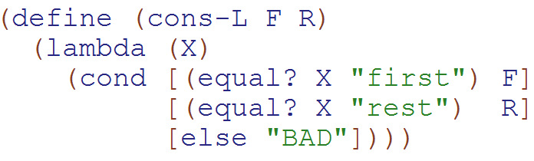
cons written with lambda & with define
What type of thing does cons-L return?
a) "string"
b) function
c) Number
d) ???

Slide 68
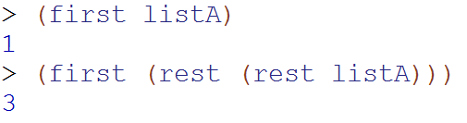
Normal (built-in) cons
Our
Cons-L
We can get the first and rest out – but it isn’t pretty

Slide 69
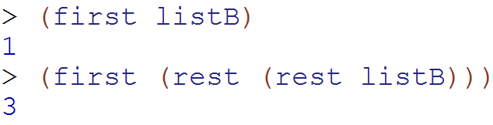
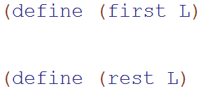
Write first and rest for cons-L
What type of thing is L?
a) "string" b) function
c) Number d) ???

Slide 70


Map Demo (lambda intro)
Instead of defining the function before calling map,
I can make an anonymous function using lambda
Do I want to define a function? Nah – I’ll just use lambda

Slide 71
replace-root solution
(define (make-BST key left right)
(list key left right))
(define (make-empty-BST)
'())
(define (leaf? tree)
(and (null? (leftTree tree))
(null? (rightTree tree)))
(define (key tree)
(first tree))
(define (leftTree tree)
(second tree)
(define (rightTree tree)
(third tree))
(define (replace-root new-root BT)
(make-BST new-root
(leftTree BT)
(rightTree BT)))

Slide 72
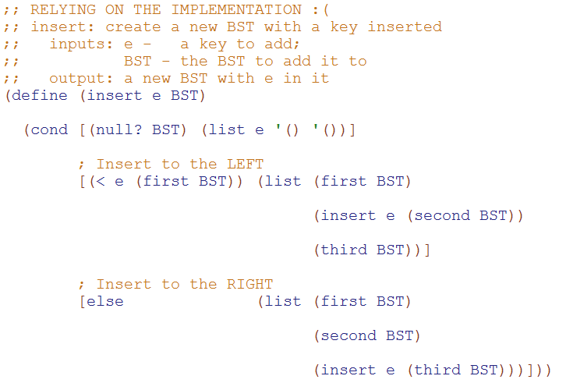
Modify this code to use the interface!

Slide 73
BONUS

Slide 74
Use it or lose it
(sublists '( a b ))
'(( ) ( b ) ( a ) ( a b ))
returns ALL sublists of elements in L
the order of these sublists in these overall outputs does not matter...
(define (sublists L)
'(( ) ( c ) ( b ) ( b c )
(a) (a c) (a b) (a b c))
(sublists '( a b c ))
Base Case!
Use-it-or-lose-it
on the HW
(make-change Total CoinList)
This should return #t if it's possible to make change for Total using coins in CoinList; otherwise #f
(make-change 42 '(2 5 10 25 50))
#t ;; 42 == 2 + 5 + 10 + 25
(make-change 42 '(3 5 10 25 50))
#f ;; here, 42 can't be made
I think I lost it!

Slide 75
Use it or lose it
(sublists '( a b ))
'(( ) ( b ) ( a ) ( a b ))
returns ALL sublists of elements in L
the order of these sublists in these overall outputs does not matter...
(define (sublists L)
(if (null? L)
'(( ) ( c ) ( b ) ( b c )
(a) (a c) (a b) (a b c))
(sublists '( a b c ))
Base Case!
(let* ([it (first L))
[loseit (
[useit (
Use-it-or-lose-it
on the HW
(make-change Total CoinList)
This should return #t if it's possible to make change for Total using coins in CoinList; otherwise #f
(make-change 42 '(2 5 10 25 50))
#t ;; 42 == 2 + 5 + 10 + 25
(make-change 42 '(3 5 10 25 50))
#f ;; here, 42 can't be made
I think I lost it!

Slide 76
Where are you?
Base case written
loseit written
useit written
Combination done
STUCK on something!

Slide 77
Sublist Solution
(define (sublists L)
(if (null? L)
'(())
(let* ([it (first L)]
[loseit (sublists (rest L))]
[useit (map (lambda (one-sublist)
(cons it one-sublist))
loseit)])
(append loseit useit))))

Slide 78


Slide 79
Estimating Time
Most people grossly underestimate how long it takes to program (not thinking about time to debug and test)
You appear incompetent at programming (not true) if you can’t estimate how long something will take.
This is one of the hardest things to learn!!! Start to practice now! For each task estimate how long it will take and keep track of how wrong you were

Slide 80


Computer
Science
&
= AWESOME

Slide 81
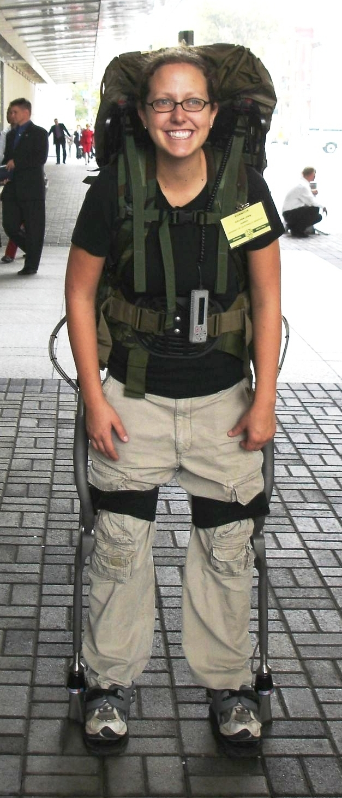
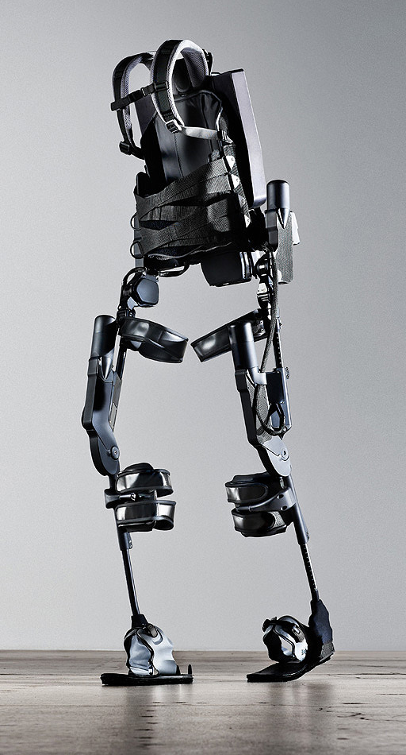
http://www.youtube.com/watch?v=pzRmNYA8LlY

Slide 82

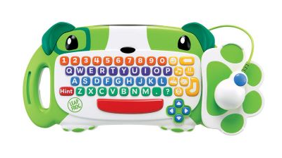
ClickStart

Slide 83
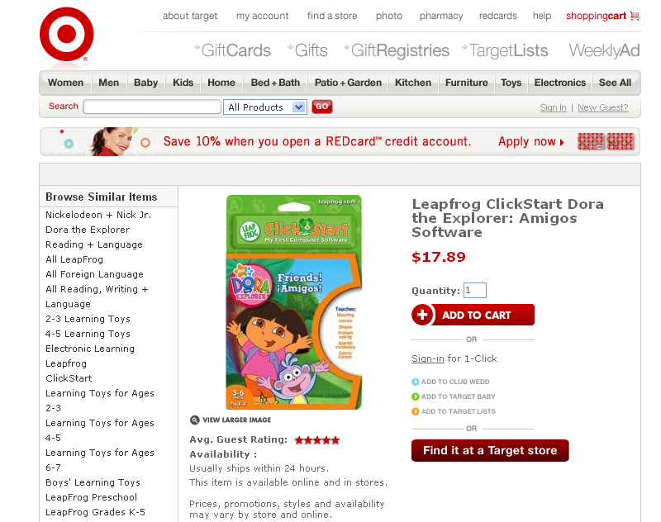

Slide 84
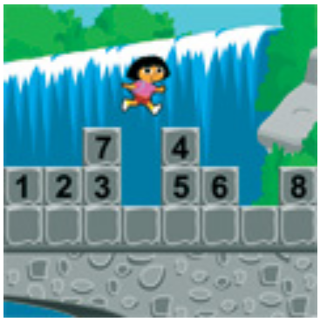
How should we represent the blocks in the computer?
Independent variables
2D Array
OpenList
I don’t know

Slide 85
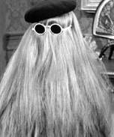
sublists Use it or Lose it!
> (sublists '())
'(())
> (sublists '(b c))
'(() (c) (b) (b c))
> (sublists '(a b c))
'(() (c) (b) (b c) (a) (a c) (a b) (a b c))
You're it!
It
LOSE IT
USE IT

Slide 86
The value in the array tells me what art asset to use
Each level is really a 3x10 vector!
0 | 0 | 7 | 0 | 4 | 0 | 0 | 0
1 | 2 | 3 | -4 | 5 | 6 | -7 | 8
B | B | B | B | B | B | B | B
Negative values tell me what block needs to go here to win!

Slide 87
0 | 0 | 7 | 0 | 4 | 0 | 0 | 0
1 | 2 | 3 | -4 | 5 | 6 | -7 | 8
0 | 0 | 0 | B | 0 | 0 | 0 | 0

Slide 88
BUGS!

Slide 89
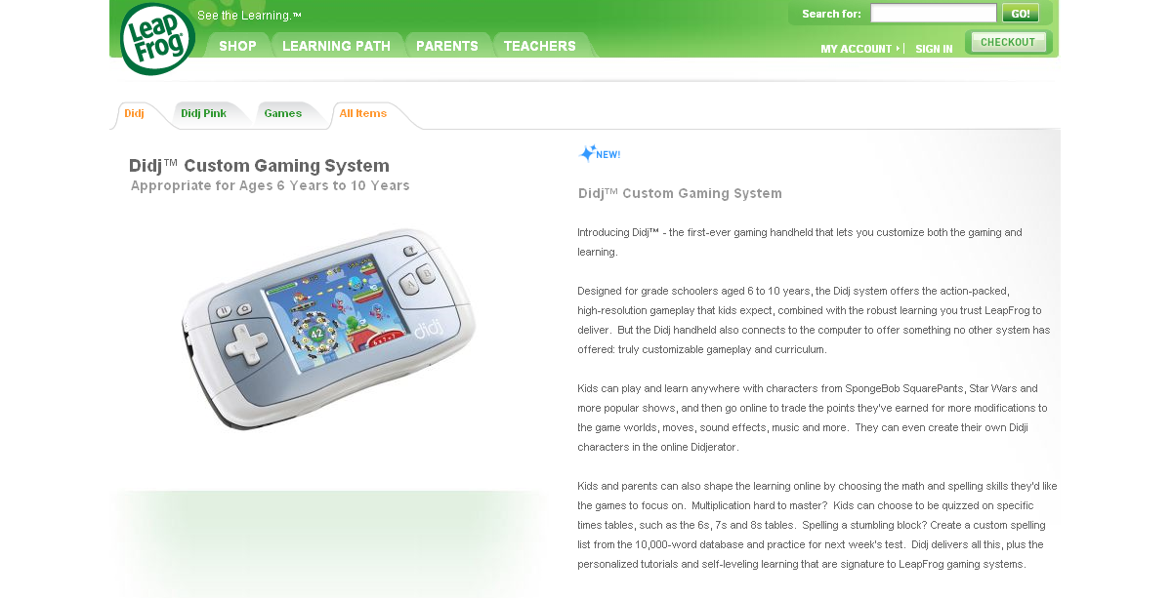

Slide 90
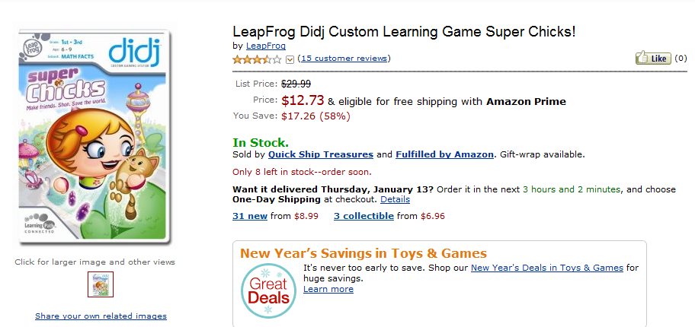
It is really sad when stuff you’ve made is on sale!

Slide 91



Which image is fake?
A. Top Left
B. Bottom Left
C. Bottom Right

Slide 92


Slide 93


Slide 94
Big-O
2013-01-24
Thursday – Week 0
Lecture 02

Slide 95
What is the runtime of this?
(define (mystery a b)
(cond
((empty? b) (se a b))
((< a (first b)) (se a b))
(else (se (first b)
(mystery a (bf b))))))
A) Constant runtime
B) Linear runtime
C) Linear*Linear (quadratic)
D) Something else
E) No clue
Try to guess what type of thing the variables a & b will be
Try to come up with (small) input that triggers each case
Correct Answer

Slide 96
Bad variable names!
Make your code harder to read!
Don’t do this!
Even though we do
We will use bad variable names on exams so that you have to read/understand the code

Slide 97
Better variable names!
(define (insert num sent)
(cond
((empty? sent) (se num sent))
((< num (first sent)) (se num sent))
(else (se (first sent)
(insert num (bf sent))))))
STk>(insert 7 ’())
(7)
STk>(insert 1 ’(2 5 8))
(1 2 5 8)

Slide 98
Insert
STk>(insert 8 ’(2 5 6 9))
(2 5 6 8 9)
(insert 8 ’(2 5 6 9))
(insert 8 ’(5 6 9))
(se 2
(se 5
(insert 8 ’(6 9))
(se 6
(insert 8 ’(9))
(se 8 ’(9))
(se 2 (se 5 (se 6 (se 8 ’(9)))))
Notes:
98

Slide 99
Best vs. Worst Case
(define (insert num sent)
(cond
((empty? sent) (se num sent))
((< num (first sent)) (se num sent))
(else (se (first sent)
(insert num (bf sent))))))
STk>(insert 1 ’(2 3 4 5 6 7 8))
(1 2 3 4 5 6 7 8)
STk>(insert 9 ’(2 3 4 5 6 7 8))
(2 3 4 5 6 7 8 9)
BEST CASE
WORST CASE

Slide 100
Assumptions
We want something independent of the speed of the computer
We typically use N which is some reference to the “size” of the data.
It might be the variable N (in factorial)
It might be the size of your sentence
We don’t care about constant factors
This is pretty silly in some cases but makes the math more beautiful
We typically think about the worst case!
It only matters for BIG input!

Slide 101
What is the runtime of this?
(define (sort sent)
(if (empty? sent)
sent
(insert (first sent)
(sort (bf sent)))))
Constant runtime
Linear runtime
Linear*Linear (quadratic)
Something else
No clue!
Correct Answer

Slide 102
Sort
STk>(sort ’(8 3 9))
(3 8 9)
(sort ’(8 3 9))
(sort ’(3 9))
(insert 8
(insert 3
(sort ’(9))
(insert 9
(sort ’())
’()
(insert 8 (insert 3 (insert 9 ’())))
Notes:
102

Slide 103
(insert 3
(insert 6
(insert 4
(insert 7
(insert 1
(insert 8
(insert 3
(insert 9
’()
))))))))
(sort sent) if sent length is N
1 + 2 + 3 + 4 + … + (N-1)+ N
Add to sent size 7
Add to sent size 6
Add to sent size 5
Add to sent size 4
Add to sent size 3
Add to sent size 2
Add to sent size 1
Add to sent size 0

Slide 104



Some Algebra to calculate: 1+2+…+n
// Written backwards

Slide 105

Some Algebra to calculate: 1+2+…+n

Slide 106



Some Algebra to calculate: 1+2+…+n
OR

