Slide 1


CS 42
Prolog is Hipster!
(Owl-based before owls were cool
(at least were everywhere!))
Prolog ROCKS!
2014-09-23
Prof. Colleen Lewis

Slide 2
Lecture 06 – Learning Goals
In Prolog, write and predict the behavior of
facts and queries with no variables – Demo 1.
queries with variables – Demo 2
facts and queries with multiple variables – Demos 3 & 4
rules that use and/or
Draw diagrams of how Prolog executes queries and binds variables – Demo 4
Explain how prolog works – and that it isn’t complicated!
(But we can write complicated programs ☺)

Slide 3
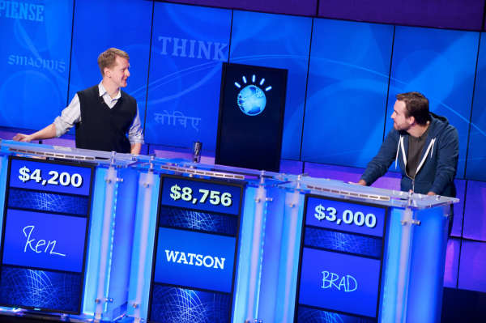
Prolog Intro

Slide 4
The CS 60 language tree:
Programming
What mood am I in today?
Declarative
Programming
Imperative
Programming
Logic Programming
Functional Programming
Object-Oriented
Programming
Low-level Programming
Prolog
Racket
Java
JFlap
simply describe the problem - and I'll solve it!
algorithms via functions
data structures
machine models
more abstraction away from the machine
closer to the machine

Slide 5
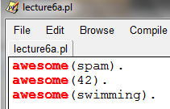
Prolog Demo 1: Facts and Queries (No variables)
Open Prolog
Edit new file
Type some facts:
awesome(spam).
awesome(42).
awesome(swimming).
Save the file
No space
.

Slide 6
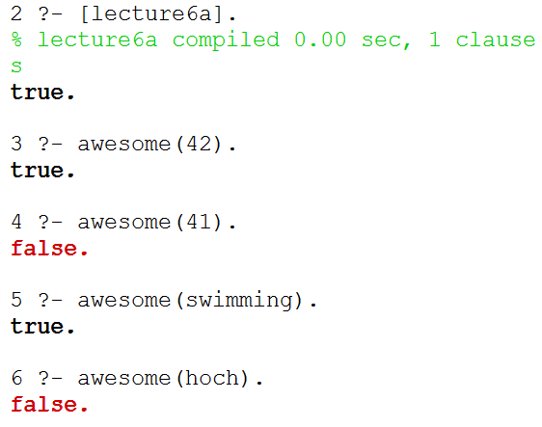
Prolog Demo 1: Facts and Queries (No variables)
Current facts:
Loads the file
Queries

Slide 7
How prolog searches to find facts that match
☹

Slide 8
How prolog searches to find facts that match
☺

Slide 9
How prolog searches to find facts that match
☹

Slide 10
How prolog searches to find facts that match
Current facts:
Example Query:
The comparison process just goes character by character!
Query:
awesome(42).
Fact:
awesome(spam).
Fact:
awesome(42).
Fact:
awesome(swimming).
1
5
6
3
4
2

Slide 11
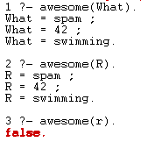
Prolog Demo 2: Variables in Queries
Things starting with Uppercase letters are variables
Facts:
; gets you the rest of the things that match
Lowercase r isn’t a variable. This is false.

Slide 12
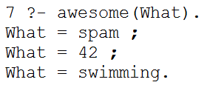
Search to find facts (a.k.a. definitions) that match
The goal is to find variable bindings!
Query:
awesome(What).
Fact:
awesome(spam).
Fact:
awesome(42).
Fact:
awesome(swimming).
1
5
6
3
4
2
What = spam
What = 42
What = swimming

Slide 13
Prolog Demos 1 & 2: Check-in
Write a definition to say that you are awesome.
Write a query to check if skittles are awesome.
Once you’re done, how do you feel about how Prolog executes queries?
A) Confident, B) Somewhat confident, C) Not confident D) I’m Stuck

Slide 14
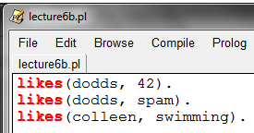
Prolog Demo 3: Multiple Items (no vars)
Facts added to lecture6b.py
likes(dodds, 42).
likes(dodds, spam).
likes(colleen, swimming).
Reads: “Dodds likes 42”
Facts can connect multiple things

Slide 15
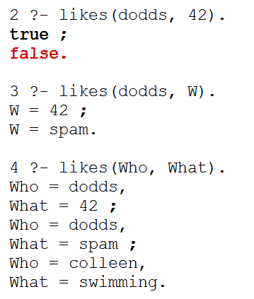
Search to find facts (a.k.a. definitions) that match
Query:
likes(dodds, 42).
Fact:
likes(dodds, 42).
Fact:
likes(dodds, spam).
Fact:
likes(colleen, swimming).
1
5
6
3
4
2

Slide 16
Sometimes Prolog Optimizes BUT PROLOG MAKES SENSE
If we only got true here, that would have been just as correct. If Prolog had looked ahead, it would have figured out there were no more trues and could have just responded true.
Sometimes Prolog is unpredictable about stuff like this where it might look ahead, but it doesn’t matter to correctness.

Slide 17
Prolog Demo 4: Multiple Variables in Queries
There were two answers
Use descriptive names!
Prolog tries to find bindings for all variables
2 bindings for each answer.

Slide 18
Search to find facts (a.k.a. definitions) that match
Query:
likes(dodds, W).
Fact:
likes(dodds, 42).
Fact:
likes(dodds, spam).
Fact:
likes(colleen, swimming).
1
5
6
3
4
2
W = 42
W = spam

Slide 19
Prolog Demos 3 & 4: Check-in
Write a definition to say that you like spam.
Write a query to see who likes spam.
Once you’re done - Do these diagrams make sense?
A) Yes, B) Somewhat, C) Not really, D) I’m Stuck

Slide 20
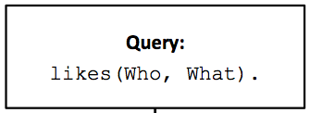
Draw how this query would execute

Slide 21
SOLUTION
Query:
likes(Who, What).
Fact:
likes(dodds, 42).
Fact:
likes(dodds, spam).
Fact:
likes(colleen, swimming).
1
5
6
3
4
2
Who = dodds What = 42
Who = dodds What = spam
Who = colleen What = swimming

Slide 22
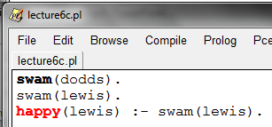
Prolog Demo 5: rules without variables
“if”
facts
A rule
The head
The body

Slide 23
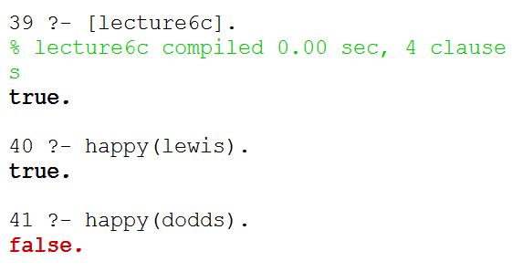
Prolog Demo 5: rules without variables

Slide 24
Query:
happy(lewis).
Rule:
happy(lewis) :- swam(lewis).
Fact:
swam(dodds).
Fact:
swam(lewis).
6
1
2
4
5
3
swam(lewis). is like a new query
(aka subgoal)

Slide 25
Prolog Demo 5: Check-in
Write a definition to say that you swam.
Write a rule to say that if you swam you are happy.
Update the diagram on the next page to show how the query happy(lewis) would be executed.
Once you’re done – Prolog is going…
A) Too fast, B) About right, C) Too slow, D) I’m Stuck

Slide 26
UPDATE ME
Query:
happy(lewis).
Rule:
happy(lewis) :- swam(lewis).
Fact:
swam(dodds).
Fact:
swam(lewis).

Slide 27
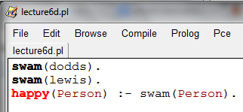
Prolog Demo 6: Rules with variables

Slide 28
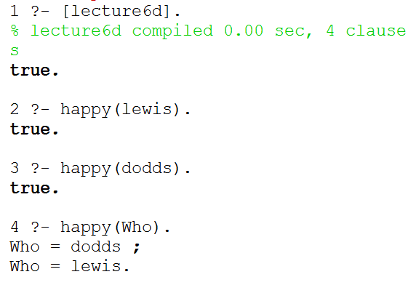
Prolog Demo 6: Rules with Variables

Slide 29
Query:
happy(lewis).
Rule:
happy(Person) :- swam(Person).
Fact:
swam(dodds).
Fact:
swam(lewis).
6
1
Person = lewis
2
4
5
3

Slide 30
Query:
happy(Who).
Rule:
happy(Person) :- swam(Person).
Fact:
swam(dodds).
Fact:
swam(lewis).
6
1
Who = Person
2
4
5
3
Person = dodds
Person = lewis

Slide 31
Prolog Execution Summary (for your notes)
Depth-first search through possible bindings
Given a goal, Prolog tries the each rule of that name...
If a rule has subgoals/body (a right-hand side),
Subgoals are checked in order, binding variables as needed
Those bindings persist until backtracking backs over them
Watch out for unbound variables… !
If a goal or subgoal fails, Prolog backtracks and tries again with the next available option (another binding or rule).
Be careful with negation!
trace.

Slide 32
Prolog Demo 6: Check-in
Fill in the blank so that the query below returns false.
happy(_________).
Write a sentence (or more) that explains why this returns false.
Once you’re done – Prolog is going…
A) Too fast, B) About right, C) Too slow, D) I’m Stuck

Slide 33
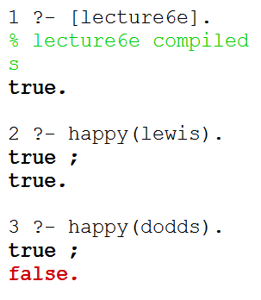
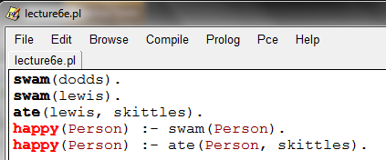
Prolog Demo 7: Multiple Rules
Both paths were true.
Two paths to happiness

Slide 34
Query:
happy(lewis).
Rule:
happy(Person) :- swam(Person).
Fact:
swam(dodds).
Fact:
swam(lewis).
Rule:
happy(Person) :- ate(Person, skittles).
Fact:
ate(lewis, skittles).
1
6
7
10
Person = lewis
Person = lewis
2
4
5
3
8
9

Slide 35
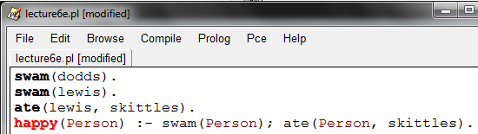
Prolog Demo 8: Using or (;) in rules
; means OR
We could re-write these two rules as 1.

Slide 36
Prolog Demo 8: Check-in
Write a new rule that a person is happy if they ate spam or skittles.
Come up with a way that you will remember that ; means “or.” Describe your method below:
Once you’re done – On in-class problems I like to
A) Finish the problem myself, B) Start the problem, C) I’m Stuck

Slide 37
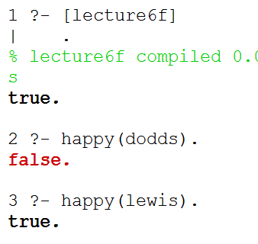
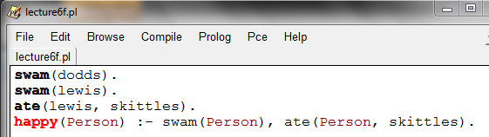
Prolog Demo 9: and
Comma means AND

Slide 38
Query:
happy(lewis).
Rule:
happy(Person) :-
swam(Person), ate(Person, skittles)
Fact:
swam(dodds).
Fact:
swam(lewis).
Fact:
ate(lewis, skittles).
We have TWO subgoals
(work like subqueries)
8
1
Person = lewis
2
3
7
4
5
6
Here’s the second subquery/ subgoal

Slide 39
Prolog Demo 9: Check-in
Write a new rule that a person is happy if they ate spam and skittles.
Come up with a way that you will remember that , means “and.” Describe your method below:
Once you’re done – On in-class problems I like to
A) Work silently first, B) Talk to my partner first, C) I’m Stuck

Slide 40
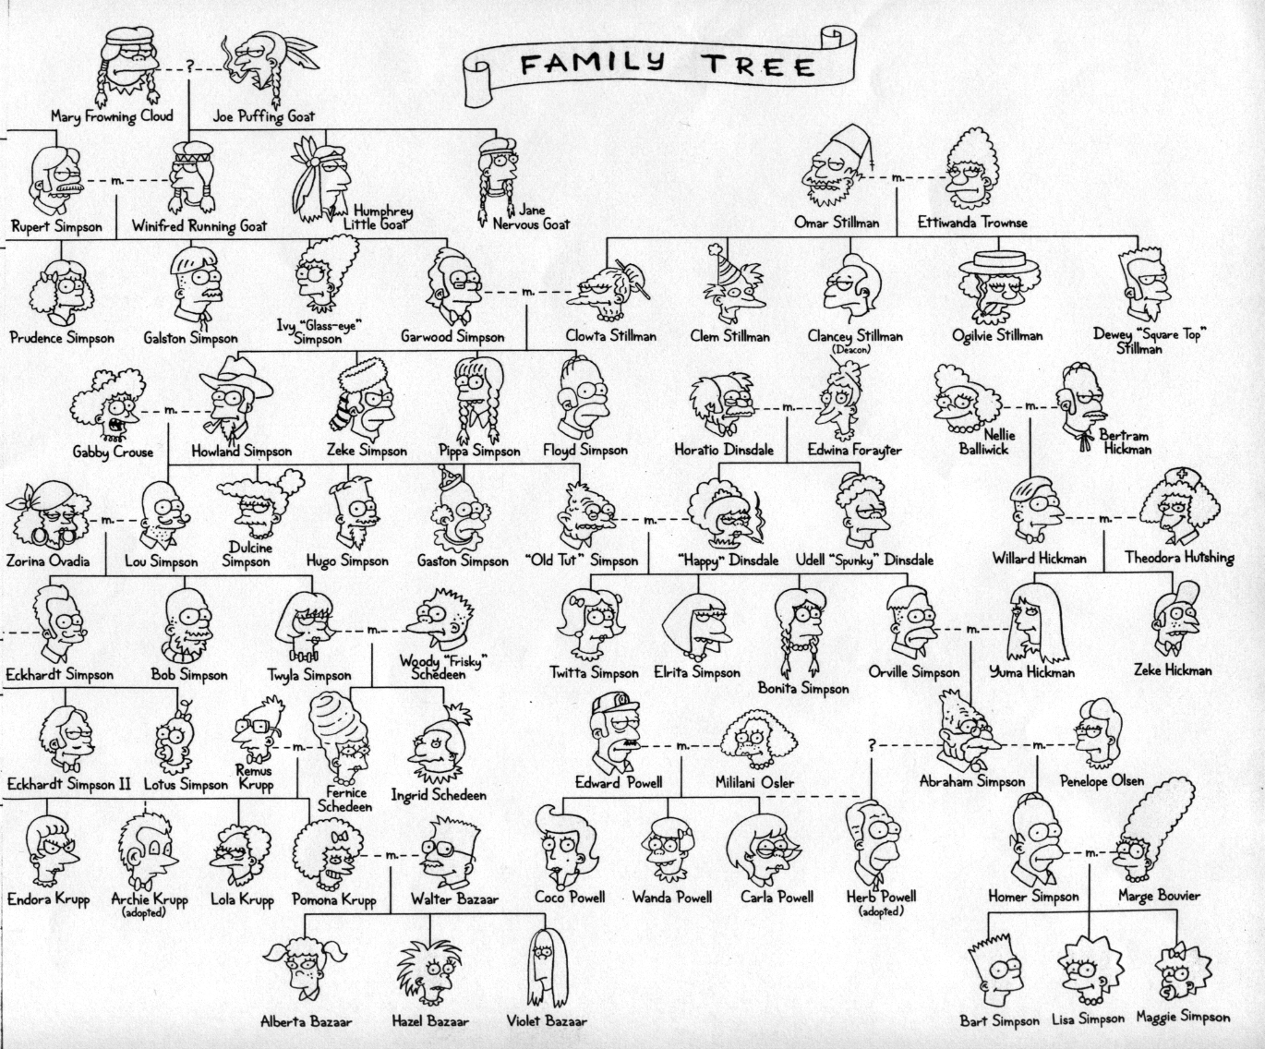

Slide 41
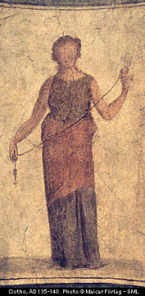
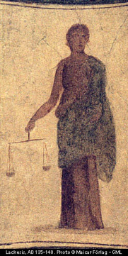
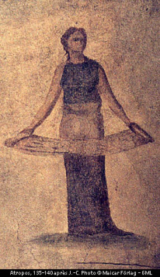
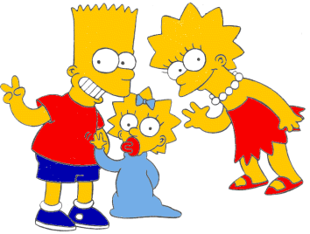

Our Invented Simpsons Tree
age
age
female
male
99
97
92
93
olf
helga
ug
uggette
101
78
76
65
62
59
skugerina
skug
homericus
matilda
john
jackie
54
55
41
38
35
38
38
27
44
gemini
esmerelda
gomer
homer
marge
selma
patty
glum
cher
20
18
19
10
1
8
8
8
klotho
lachesis
atropos
bart
maggie
lisa
millhouse
terpsichore
Oh, brother!

Slide 42
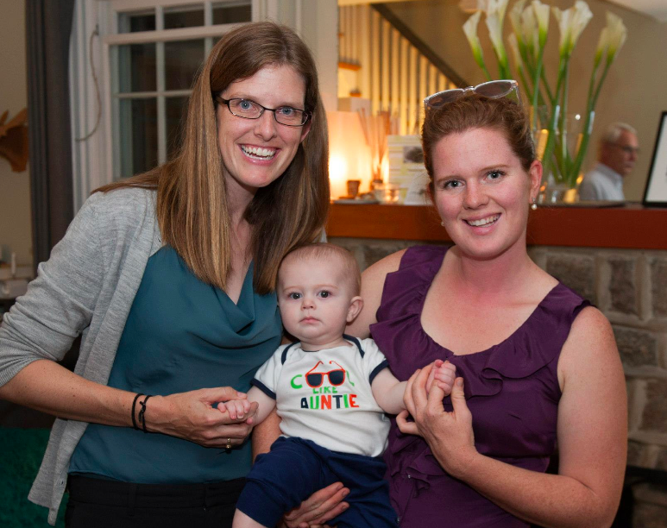
/*
* the parent predicate
*/
parent(olf, skug).
parent(helga, skug).
parent(skug, esmerelda).
parent(skugerina, esmerelda).
parent(esmerelda, klotho).
parent(gemini, klotho).
parent(esmerelda, atropos).
parent(gemini, atropos).
parent(esmerelda, lachesis).
parent(gemini, lachesis).
parent(olf, homericus).
parent(helga, homericus).
parent(ug, matilda).
parent(uggette, matilda).
parent(homericus, homer).
parent(matilda, homer).
parent(homericus, gomer).
parent(matilda, gomer).
parent(homer, bart).
parent(marge, bart).
parent(homer, lisa).
parent(marge, lisa).
parent(homer, maggie).
parent(marge, maggie).
parent(john, marge).
parent(jackie, marge).
parent(john, selma).
parent(jackie, selma).
parent(john, patty).
parent(jackie, patty).
parent(john, glum).
parent(jackie, glum).
parent(glum, millhouse).
parent(cher, millhouse).
parent(glum, terpsichore).
parent(cher, terpsichore).
/*
* the age predicate
*/
age(helga, 97).
age(olf, 99).
age(uggette, 93).
age(ug, 92).
age(matilda, 65).
age(homericus, 76).
age(skugerina, 101).
age(skug, 78).
age(esmerelda, 55).
age(gemini, 54).
age(klotho, 20).
age(atropos, 19).
age(lachesis, 18).
age(marge, 35).
age(homer, 38).
age(lisa, 8).
age(maggie, 1).
age(bart, 10).
age(gomer, 41).
age(john, 62).
age(jackie, 59).
age(patty, 38).
age(selma, 38).
age(glum, 27).
age(cher, 44).
age(millhouse, 8).
age(terpsichore, 8).
File simpsons.pl
/*
* the female predicate
*/
female(helga).
female(esmerelda).
female(skugerina).
female(uggette).
female(matilda).
female(marge).
female(jackie).
female(selma).
female(patty).
female(cher).
female(lisa).
female(maggie).
female(klotho).
female(atropos).
female(lachesis).
female(terpsichore).
/*
* the male predicate
*/
male(olf).
male(skug).
male(homericus).
male(ug).
male(homer).
male(gomer).
male(gemini).
male(john).
male(glum).
male(bart).
male(millhouse).

Slide 43
Homework Prep
Write these three predicates in prolog:
True if MomOrDad is the parent of Kid
child(Kid, MomOrDad) :-
True if Mom is the parent of Kid and Mom is female
mother(Mom,Kid) :-
True if X is the parent of Y or if X is an ancestor of Y’s parent
anc(X,Y) :-
anc(X,Y) :-

Slide 44
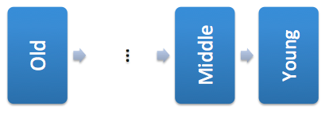
Solutions
/*
* Here are three rules about families
*/
Child(Kid, Adult) :- parent(Adult, Kid).
mother(Mom, Kid) :- female(Mom),
parent(Mom, Kid).
anc(Old, Young) :- parent(Old, Young).
Anc(Old, Young) :- parent(Middle, Young),
anc(Old, Middle).

Slide 45
trace without Variables
What sub-queries get executed if I write:
?- happy(lewis)

Slide 46
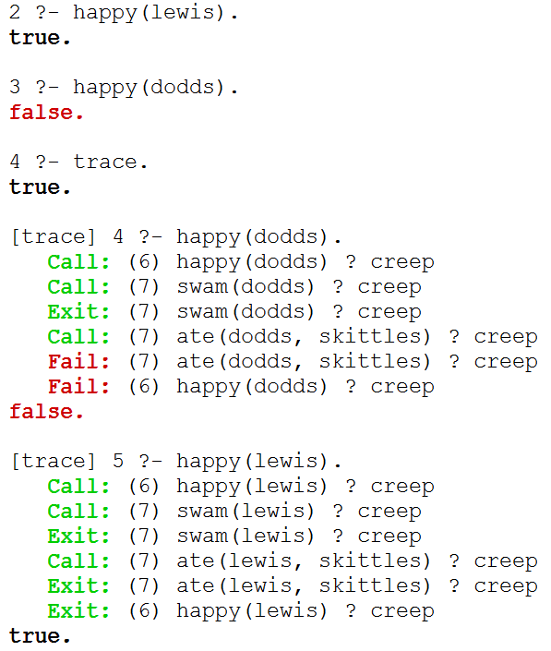
trace without Variables

Slide 47
trace.
Starts tracing
Type C or
hit return
to go
step-by-step

Slide 48
trace.
Starts tracing
Type C or
hit return
to go
step-by-step
notrace.
Stops tracing

Slide 49
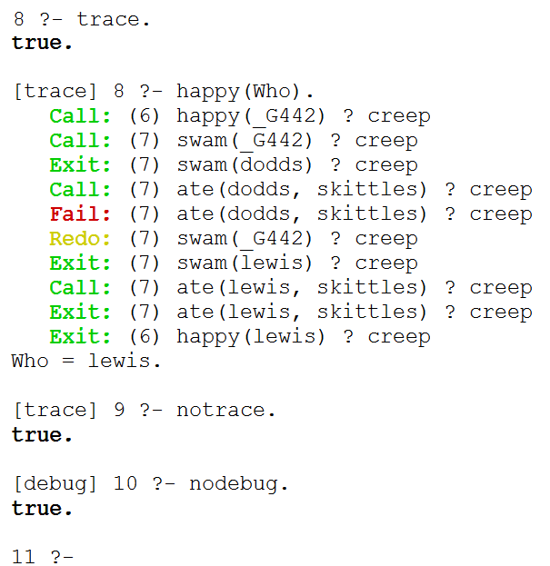
trace with Variables

Slide 50
trace with Variables
notrace.
Stops tracing
nodebug.
Stops debug

Slide 51
Mutual Recursion

Slide 52
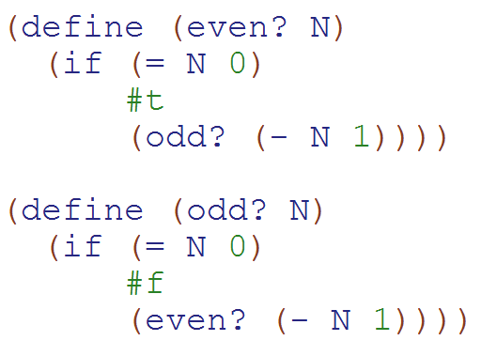
Mutual Recursion Example (Definition: Two functions that call each other)
How many times is odd? called in:
(even? 7)
a)0
b)1
c)2
d)3
e)> 3

Slide 53
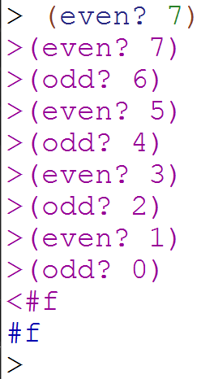
Mutual Recursion Solution

Slide 54
Graph-reachability: can you get from s to d?
is there some path from s to d in G?
s == source
d == dest.
(define (reach? s d G)
?
s
d
…
?
?
X
Y
I know I can get from a to b. If I can get from S to A and from B to D…
(define unicycleGraph '(("A" "B") ("A" "D") ("B" "D") ("C" "B") ("C" "D") ("D" "E") ("E" "F") ("F" "G") ("G" "H") ("H" "E") ))

Slide 55
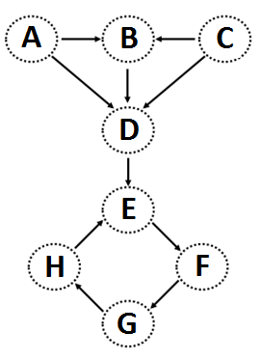
(nodes unicycleGraph)→'("A" "B" "D" "C" "E" "F" "G" "H")
(define (nodes graph)
Hint: how could we use remove-duplicates
(kids "A" unicycleGraph) → '("B" "D") (kids "B" unicycleGraph) → '("D")
(define unicycleGraph '(("A" "B") ("A" "D") ("B" "D") ("C" "B") ("C" "D") ("D" "E") ("E" "F") ("F" "G") ("G" "H") ("H" "E") ))
(define (kids n graph)
big-O( ) ~ edges or nodes?
parents?
Hint: could we use filter?
Notes:
big-O: could be edges or nodes!

Slide 56
Feel free to use available functions: remove-duplicates, nodes, kids, parents, and higher-order functions...
Write these functions for directed graphs.
(define (leaf? n G)
(leaf? n G) should return #t if n is a leaf in G and #f otherwise.
(
(leaf? "E" unicycleGraph)→ #f
Hint: call (kids n G)
(define (gkids n G)
(gkids n G) should compute the list of grandchildren of n in G: all nodes two edges away.
(
(gkids "E" unicycleGraph)→ '("G")
(gkids "A" unicycleGraph)→ '("D" "E")
Hint: use kids and map - It's a bit tricky...
(define (reach? a b G)
(reach? a b G) should return #t if there is some path from a to b in G and #f otherwise.
(
(reach? "B" "E" unicycleGraph)→ #t
there is definitely not enough room here – plus, we’ll talk about a solution in the next lecture...
(reach? "E" "B" unicycleGraph)→ #f
Notes:
I don’t know if this really works...

Slide 57
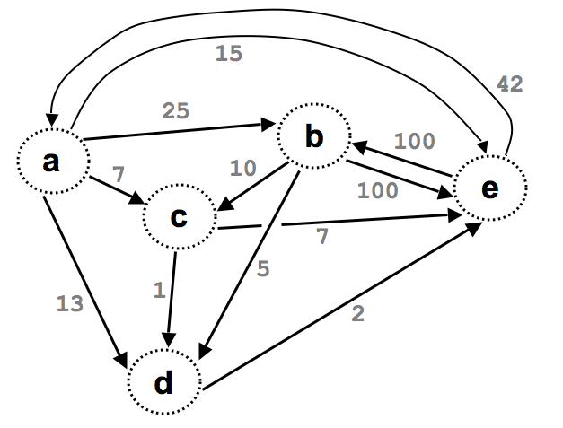

Slide 58
(define Gt '((e b 100) (a b 25) (e a 42)
(a c 7) (a d 13) (a e 15)
(b c 10) (b d 5) (d e 2)
(b e 100) (c d 1) (c e 7)) )
What might these weights represent?
42
15
25
b
100
a
10
7
e
100
c
7
5
This graph looks heavy!
13
1
2
No space
Weightedgraphs
d

Slide 59
Graph-reachability: can you get from s to d?
is there some path from s to d in G?
s == source
d == dest.
(define (reach? s d G)
Consider the algorithm first, then the code...

Slide 60
Graph-reachability: can you get from s to d?
(define (reach? s d G)
(cond
(
(
( else (let* ([EDGE
[a
[b
[R
[loseit

Slide 61
How’s it going?
We wrote the base cases
We wrote Edge, A, B, & R.
We wrote loseit
We wrote the combination/answer

Slide 62
Graph-reachability: can you get from A to B?
What is N, the problem size?
(define (reach? s d G)
(cond
((equal? s d) #t)
((null? G) #f)
( else (let* ((EDGE (first G))
(R (rest G))
(loseit (reach? s d R))
(a (first EDGE))
(b (second EDGE))
(useit (and (reach? s a R)
(reach? b d R))...
(or useit loseit))))...
what are the base cases saying?
solve the problem without "it"
solve the problem with "it"
SOLUTION
big-O( )

Slide 63
Reach Solution
(define (reach? s d G)
(cond
((equal? s d) #t)
((null? G) #f)
( else (let* ([EDGE (first G)]
[a (first EDGE)]
[b (second EDGE)] [R (rest G)]
[loseit (reach? s d R)]
[useit (and (reach? s a R)
(reach? b d R))])
(or useit loseit)))))

Slide 64
Graph Representations

Slide 65
Graphs can be stored as Lists Edge List
This vocab is important
(define unicycleGraph '(
("A" "B") ("A" "D") ("B" "D") ("C" "B") ("C" "D") ("D" "E") ("E" "F") ("F" "G") ("G" "H") ("H" "E")
))
I can think of other ways to represent this graph!

Slide 66
(define Gt '((e b 100) (a b 25) (e a 42)
(a c 7) (a d 13) (a e 15)
(b c 10) (b d 5) (d e 2)
(b e 100) (c d 1) (c e 7)) )
What might these weights represent?
weights
15
42
25
b
100
This graph looks heavy!
a
10
7
e
100
c
7
5
13
1
2
Weightedgraphs
d

Slide 67
Graph Practice
2013-02-05
Tuesday – Week 2
Lecture 05

Slide 68
(nodes unicycleGraph)→'("A" "B" "D" "C" "E" "F" "G" "H")
(define (nodes graph)
Hint: how could we use remove-duplicates
(kids "A" unicycleGraph) → '("B" "D") (kids "B" unicycleGraph) → '("D")
(define unicycleGraph '(("A" "B") ("A" "D") ("B" "D") ("C" "B") ("C" "D") ("D" "E") ("E" "F") ("F" "G") ("G" "H") ("H" "E") ))
(define (kids n graph)
big-O( ) ~ edges or nodes?
parents?
Hint: could we use filter?
Notes:
big-O: could be edges or nodes!

Slide 69
Feel free to use available functions: remove-duplicates, nodes, kids, parents, and higher-order functions...
Write these functions for directed graphs.
(define (leaf? n G)
(leaf? n G) should return #t if n is a leaf in G and #f otherwise.
(
(leaf? "E" unicycleGraph)→ #f
Hint: call (kids n G)
(define (gkids n G)
(gkids n G) should compute the list of grandchildren of n in G: all nodes two edges away.
(
(gkids "E" unicycleGraph)→ '("G")
(gkids "A" unicycleGraph)→ '("D" "E")
Hint: use kids and map - It's a bit tricky...
(define (reach? a b G)
(reach? a b G) should return #t if there is some path from a to b in G and #f otherwise.
(
(reach? "B" "E" unicycleGraph)→ #t
there is definitely not enough room here – plus, we’ll talk about a solution later in lecture ...
(reach? "E" "B" unicycleGraph)→ #f
Notes:
I don’t know if this really works...

Slide 70
Where are you?
Working on leaf?
Working on gkids
Working on reach
STUCK on something!

Slide 71
Graph Reach
2013-02-05
Tuesday – Week 2
Lecture 05

Slide 72
Graph-reachability: can you get from s to d?
is there some path from s to d in G?
s == source
d == dest.
(define (reach? s d G)
Consider the algorithm first, then the code...

Slide 73
Graph-reachability: can you get from s to d?
is there some path from s to d in G?
s == source
d == dest.
(define (reach? s d G)
?
s
d
…
?
?
a
b
I know I can get from a to b. If I can get from S to A and from B to D…
(define unicycleGraph '(("A" "B") ("A" "D") ("B" "D") ("C" "B") ("C" "D") ("D" "E") ("E" "F") ("F" "G") ("G" "H") ("H" "E") ))

Slide 74
Graph-reachability: can you get from s to d?
(define (reach? s d G)
(cond
(
(
( else (let* ([EDGE
[a
[b
[R
[loseit

Slide 75
How’s it going?
We wrote the base cases
We wrote Edge, A, B, & R.
We wrote loseit
We wrote the combination/answer

Slide 76
Graph-reachability: can you get from A to B?
What is N, the problem size?
(define (reach? s d G)
(cond
((equal? s d) #t)
((null? G) #f)
( else (let* ((EDGE (first G))
(R (rest G))
(loseit (reach? s d R))
(a (first EDGE))
(b (second EDGE))
(useit (and (reach? s a R)
(reach? b d R))...
(or useit loseit))))...
what are the base cases saying?
solve the problem without "it"
solve the problem with "it"
SOLUTION
big-O( )

Slide 77
Reach Solution
(define (reach? s d G)
(cond
((equal? s d) #t)
((null? G) #f)
( else (let* ([EDGE (first G)]
[a (first EDGE)]
[b (second EDGE)] [R (rest G)]
[loseit (reach? s d R)]
[useit (and (reach? s a R)
(reach? b d R))])
(or useit loseit)))))

Slide 78
Use It or Lose It

Slide 79
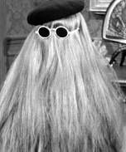
sublists Use it or Lose it!
> (sublists '())
'(())
> (sublists '(b c))
'(() (c) (b) (b c))
> (sublists '(a b c))
'(() (c) (b) (b c) (a) (a c) (a b) (a b c))
You're it!
It
WOAH!
USE IT is EXACTLY
the same as LOSE IT, just with “It” cons’d on!
LOSE IT
USE IT

Slide 80
Use it or lose it
(sublists '( a b ))
'(( ) ( b ) ( a ) ( a b ))
returns ALL sublists of elements in L
the order of these sublists in these overall outputs does not matter...
(define (sublists L)
'(( ) ( c ) ( b ) ( b c )
(a) (a c) (a b) (a b c))
(sublists '( a b c ))
Base Case!
Use-it-or-lose-it
on the HW
(make-change Total CoinList)
This should return #t if it's possible to make change for Total using coins in CoinList; otherwise #f
(make-change 42 '(2 5 10 25 50))
#t ;; 42 == 2 + 5 + 10 + 25
(make-change 42 '(3 5 10 25 50))
#f ;; here, 42 can't be made
I think I lost it!

Slide 81
Use it or lose it
(sublists '( a b ))
'(( ) ( b ) ( a ) ( a b ))
returns ALL sublists of elements in L
the order of these sublists in these overall outputs does not matter...
(define (sublists L)
(if (null? L)
'(( ) ( c ) ( b ) ( b c )
(a) (a c) (a b) (a b c))
(sublists '( a b c ))
Base Case!
(let* ([it (first L))
[loseit (
[useit (
Use-it-or-lose-it
Where are you?
Base case written
loseit written
useit written
Combination done
STUCK on something!

Slide 82
Sublist Solution
(define (sublists L)
(if (null? L)
'(())
(let* ([it (first L)]
[loseit (sublists (rest L))]
[useit (map (lambda (one-sublist)
(cons it one-sublist))
loseit)])
(append loseit useit))))

Slide 83
BONUS

Slide 84


Slide 85
Estimating Time
Most people grossly underestimate how long it takes to program (not thinking about time to debug and test)
You appear incompetent at programming (not true) if you can’t estimate how long something will take.
This is one of the hardest things to learn!!! Start to practice now! For each task estimate how long it will take and keep track of how wrong you were

Slide 86


Computer
Science
&
= AWESOME

Slide 87
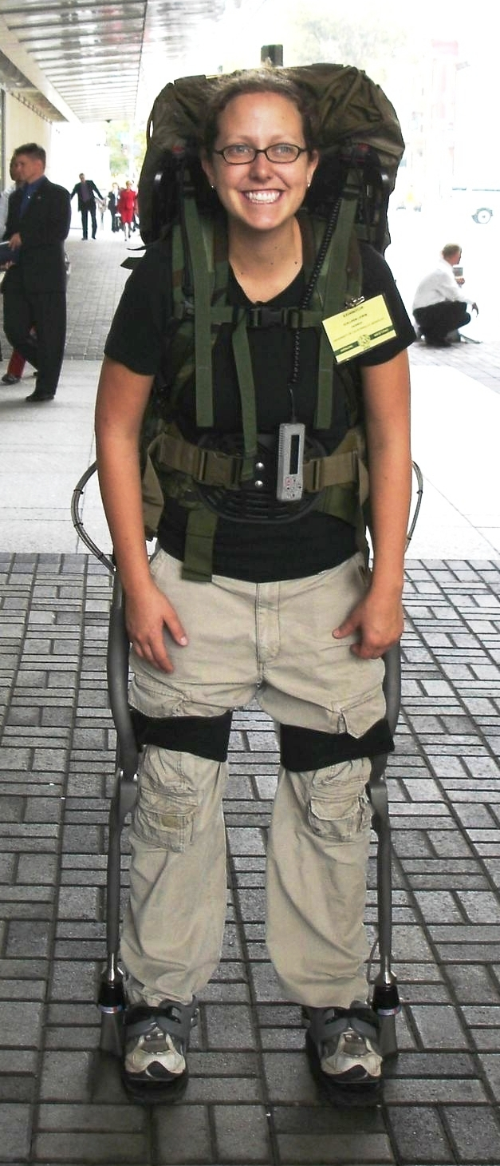
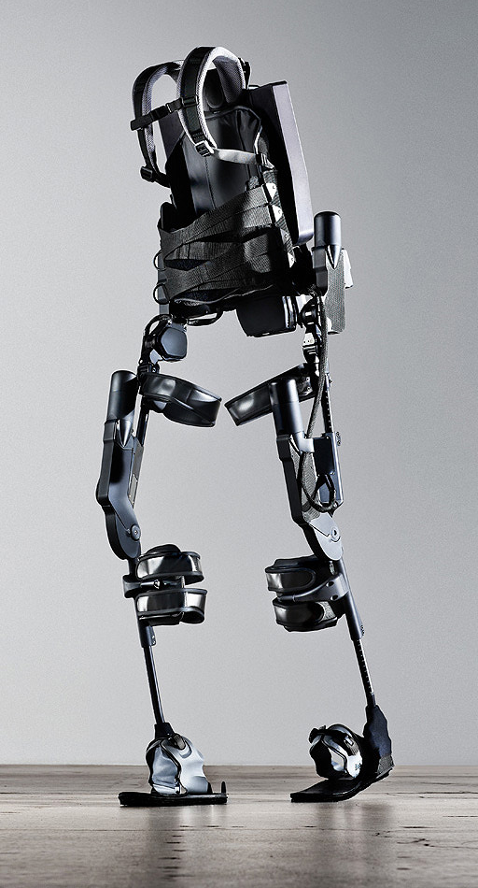
http://www.youtube.com/watch?v=pzRmNYA8LlY

Slide 88

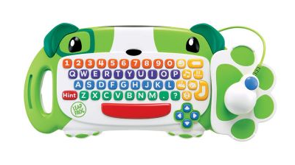
ClickStart

Slide 89
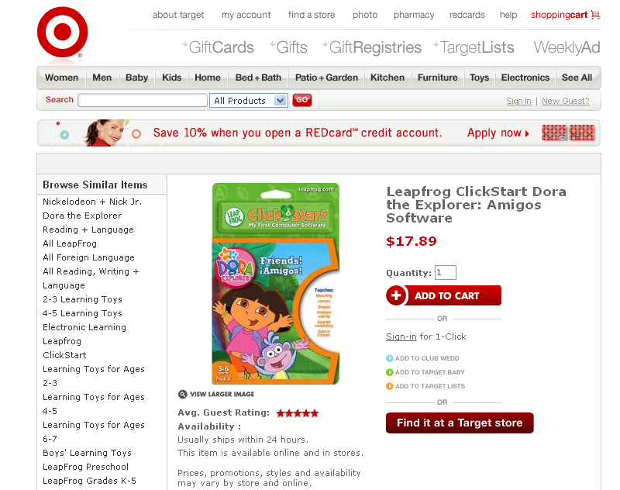

Slide 90
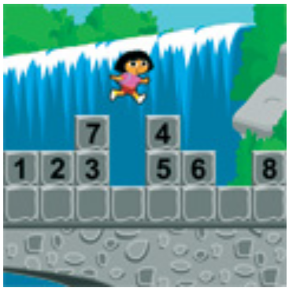
How should we represent the blocks in the computer?
Independent variables
2D Array
OpenList
I don’t know

Slide 91
The value in the array tells me what art asset to use
Each level is really a 3x10 vector!
0 | 0 | 7 | 0 | 4 | 0 | 0 | 0
1 | 2 | 3 | -4 | 5 | 6 | -7 | 8
B | B | B | B | B | B | B | B
Negative values tell me what block needs to go here to win!

Slide 92
0 | 0 | 7 | 0 | 4 | 0 | 0 | 0
1 | 2 | 3 | -4 | 5 | 6 | -7 | 8
0 | 0 | 0 | B | 0 | 0 | 0 | 0

Slide 93
BUGS!

Slide 94
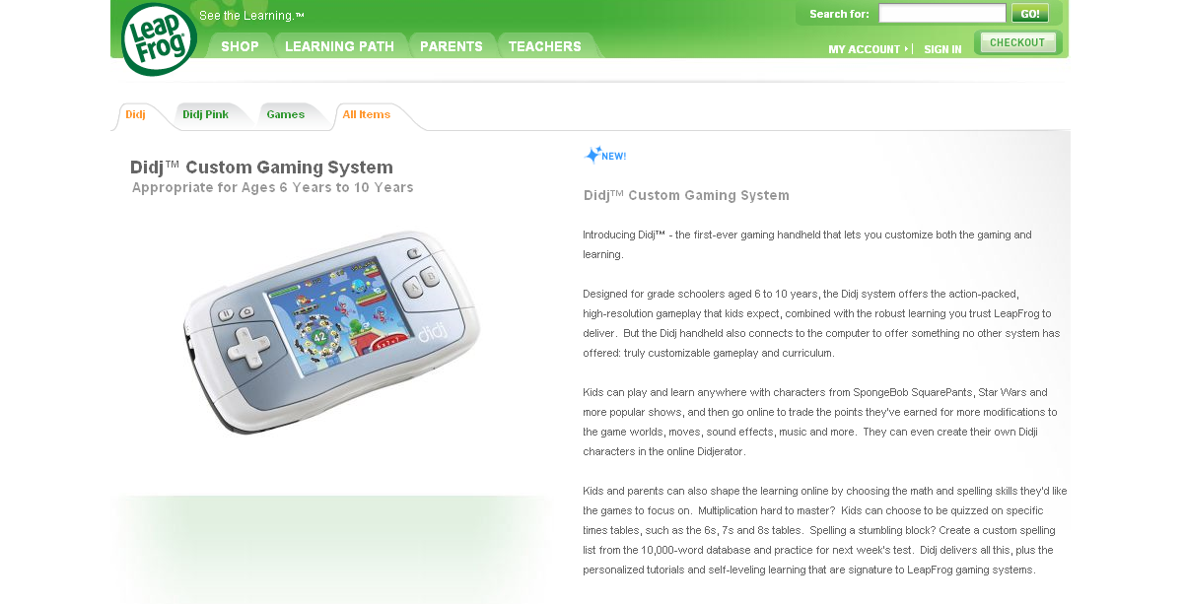

Slide 95
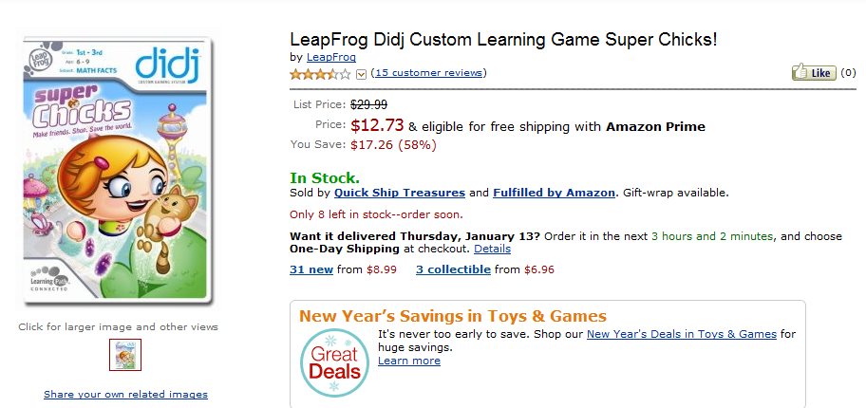
It is really sad when stuff you’ve made is on sale!

Slide 96

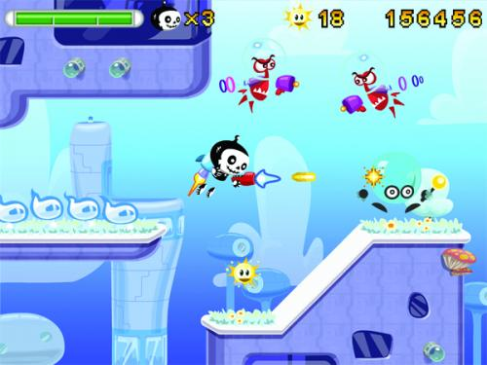

Which image is fake?
A. Top Left
B. Bottom Left
C. Bottom Right

Slide 97
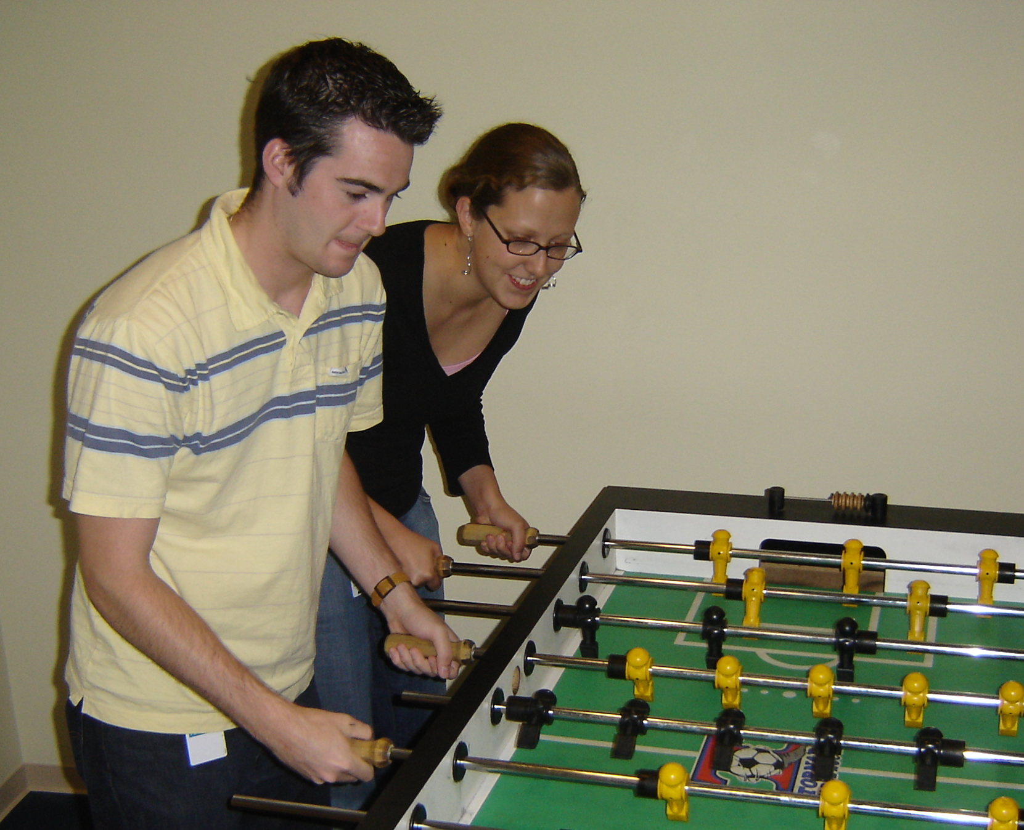

Slide 98
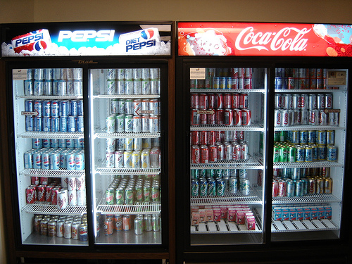

Slide 99
Big-O
2013-01-24
Thursday – Week 0
Lecture 02

Slide 100
What is the runtime of this?
(define (mystery a b)
(cond
((empty? b) (se a b))
((< a (first b)) (se a b))
(else (se (first b)
(mystery a (bf b))))))
A) Constant runtime
B) Linear runtime
C) Linear*Linear (quadratic)
D) Something else
E) No clue
Try to guess what type of thing the variables a & b will be
Try to come up with (small) input that triggers each case
Correct Answer

Slide 101
Bad variable names!
Make your code harder to read!
Don’t do this!
Even though we do
We will use bad variable names on exams so that you have to read/understand the code

Slide 102
Better variable names!
(define (insert num sent)
(cond
((empty? sent) (se num sent))
((< num (first sent)) (se num sent))
(else (se (first sent)
(insert num (bf sent))))))
STk>(insert 7 ’())
(7)
STk>(insert 1 ’(2 5 8))
(1 2 5 8)

Slide 103
Insert
STk>(insert 8 ’(2 5 6 9))
(2 5 6 8 9)
(insert 8 ’(2 5 6 9))
(insert 8 ’(5 6 9))
(se 2
(se 5
(insert 8 ’(6 9))
(se 6
(insert 8 ’(9))
(se 8 ’(9))
(se 2 (se 5 (se 6 (se 8 ’(9)))))
Notes:
103

Slide 104
Best vs. Worst Case
(define (insert num sent)
(cond
((empty? sent) (se num sent))
((< num (first sent)) (se num sent))
(else (se (first sent)
(insert num (bf sent))))))
STk>(insert 1 ’(2 3 4 5 6 7 8))
(1 2 3 4 5 6 7 8)
STk>(insert 9 ’(2 3 4 5 6 7 8))
(2 3 4 5 6 7 8 9)
BEST CASE
WORST CASE

Slide 105
Assumptions
We want something independent of the speed of the computer
We typically use N which is some reference to the “size” of the data.
It might be the variable N (in factorial)
It might be the size of your sentence
We don’t care about constant factors
This is pretty silly in some cases but makes the math more beautiful
We typically think about the worst case!
It only matters for BIG input!

Slide 106
What is the runtime of this?
(define (sort sent)
(if (empty? sent)
sent
(insert (first sent)
(sort (bf sent)))))
Constant runtime
Linear runtime
Linear*Linear (quadratic)
Something else
No clue!
Correct Answer

Slide 107
Sort
STk>(sort ’(8 3 9))
(3 8 9)
(sort ’(8 3 9))
(sort ’(3 9))
(insert 8
(insert 3
(sort ’(9))
(insert 9
(sort ’())
’()
(insert 8 (insert 3 (insert 9 ’())))
Notes:
107

Slide 108
(insert 3
(insert 6
(insert 4
(insert 7
(insert 1
(insert 8
(insert 3
(insert 9
’()
))))))))
(sort sent) if sent length is N
1 + 2 + 3 + 4 + … + (N-1)+ N
Add to sent size 7
Add to sent size 6
Add to sent size 5
Add to sent size 4
Add to sent size 3
Add to sent size 2
Add to sent size 1
Add to sent size 0

Slide 109



Some Algebra to calculate: 1+2+…+n
// Written backwards

Slide 110

Some Algebra to calculate: 1+2+…+n

Slide 111


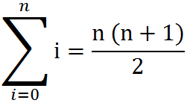
Some Algebra to calculate: 1+2+…+n
OR

Slide 112





// Take the log of both sides
// Remember:

