Slide 1
CS 60
Mutual Recursion, Prolog, & Unicalc
2014-09-24
Wednesday – Week 3
Lecture 07

Slide 2
Lecture 07 – Learning Goals
Understand the output provided by prolog’s trace.
Write recursive prolog queries.
Reason about how prolog executes negation.
Describe mutual recursion.
Remember that you should read (multiple times) and take notes on provided code and assignment descriptions.

Slide 3
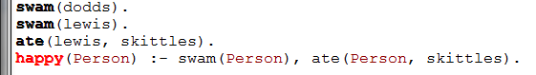
What sub-queries get executed if I write:
?- happy(lewis)

Slide 4
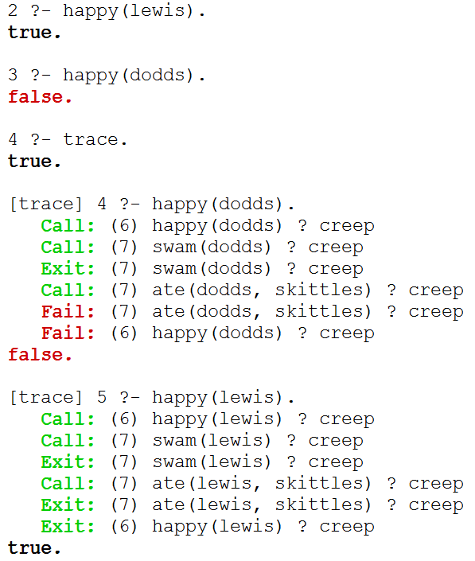

Slide 5
trace.
Starts tracing
Type C or
hit return
to go
step-by-step

Slide 6
trace.
Starts tracing
Type C or
hit return
to go
step-by-step
notrace.
Stops tracing

Slide 7
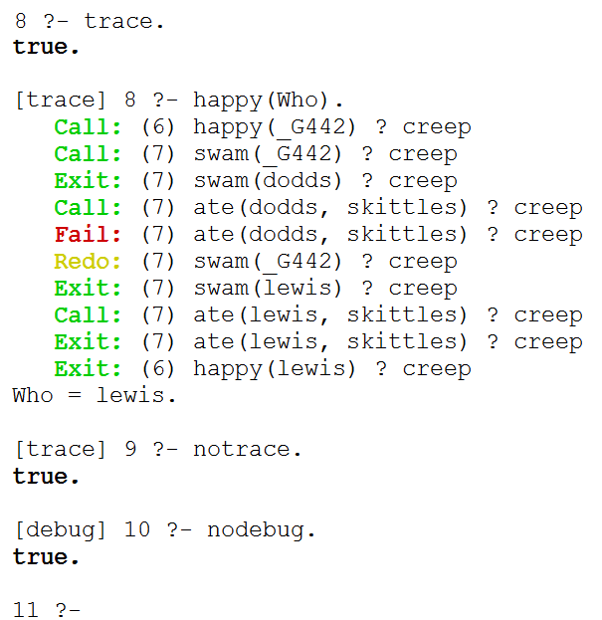
trace with Variables

Slide 8
trace with Variables
notrace.
Stops tracing
nodebug.
Stops debug

Slide 9
Prolog

Slide 10
/*
* the parent predicate
*/
parent(olf, skug).
parent(helga, skug).
parent(skug, esmerelda).
parent(skugerina, esmerelda).
parent(esmerelda, klotho).
parent(gemini, klotho).
parent(esmerelda, atropos).
parent(gemini, atropos).
parent(esmerelda, lachesis).
parent(gemini, lachesis).
parent(olf, homericus).
parent(helga, homericus).
parent(ug, matilda).
parent(uggette, matilda).
parent(homericus, homer).
parent(matilda, homer).
parent(homericus, gomer).
parent(matilda, gomer).
parent(homer, bart).
parent(marge, bart).
parent(homer, lisa).
parent(marge, lisa).
parent(homer, maggie).
parent(marge, maggie).
parent(john, marge).
parent(jackie, marge).
parent(john, selma).
parent(jackie, selma).
parent(john, patty).
parent(jackie, patty).
parent(john, glum).
parent(jackie, glum).
parent(glum, millhouse).
parent(cher, millhouse).
parent(glum, terpsichore).
parent(cher, terpsichore).
/*
* the age predicate
*/
age(helga, 97).
age(olf, 99).
age(uggette, 93).
age(ug, 92).
age(matilda, 65).
age(homericus, 76).
age(skugerina, 101).
age(skug, 78).
age(esmerelda, 55).
age(gemini, 54).
age(klotho, 20).
age(atropos, 19).
age(lachesis, 18).
age(marge, 35).
age(homer, 38).
age(lisa, 8).
age(maggie, 1).
age(bart, 10).
age(gomer, 41).
age(john, 62).
age(jackie, 59).
age(patty, 38).
age(selma, 38).
age(glum, 27).
age(cher, 44).
age(millhouse, 8).
age(terpsichore, 8).
File simpsons.pl
/*
* the female predicate
*/
female(helga).
female(esmerelda).
female(skugerina).
female(uggette).
female(matilda).
female(marge).
female(jackie).
female(selma).
female(patty).
female(cher).
female(lisa).
female(maggie).
female(klotho).
female(atropos).
female(lachesis).
female(terpsichore).
/*
* the male predicate
*/
male(olf).
male(skug).
male(homericus).
male(ug).
male(homer).
male(gomer).
male(gemini).
male(john).
male(glum).
male(bart).
male(millhouse).

Slide 11
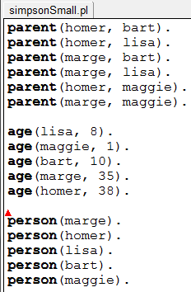
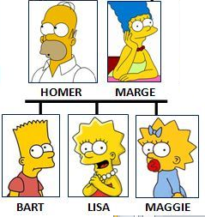
simpsonSmall.pl
parent(homer, bart).
parent(homer, lisa).
parent(marge, bart).
parent(marge, lisa).
parent(homer, maggie).
parent(marge, maggie).
age(lisa, 8).
age(maggie, 1).
age(bart, 10).
age(marge, 35).
age(homer, 38).
person(marge).
person(homer).
person(lisa).
person(bart).
person(maggie).

Slide 12
Homework Prep
Write these three predicates in prolog:
True if MomOrDad is the parent of Kid
child(Kid, MomOrDad) :-
True if Mom is the parent of Kid and Mom is female
mother(Mom,Kid) :-
True if X is the parent of Y or if X is an ancestor of Y’s parent
anc(X,Y) :-
anc(X,Y) :-
X is the sibling of Y if they have the same parent (The point of this one -- We need NOT!!!)
sibling(X,Y) :-

Slide 13
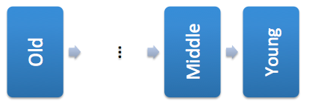
Solutions
/*
* Here are three rules about families
*/
Child(Kid, Adult) :- parent(Adult, Kid).
mother(Mom, Kid) :- female(Mom),
parent(Mom, Kid).
anc(Old, Young) :- parent(Old, Young).
Anc(Old, Young) :- parent(Middle, Young),
anc(Old, Middle).

Slide 14
Equality and
Negation

Slide 15
Negation (Summary)
“Unified” means a variable binding is created
X = Y
X = Y succeeds if X can be unified with Y.
X \= Y
X \= Y succeeds if X cannot be unified with Y.
X == Y
X == Y succeeds if X and Y are identical, i.e., they unify with no variable bindings occurring.
X \== Y
X \== Y succeeds if X and Y are not identical.
http://www.amzi.com/manuals/amzi/pro/ref_manipulating_terms.htm#EqualityofTerms

Slide 16
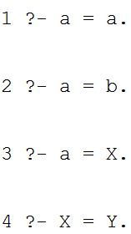
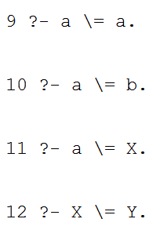
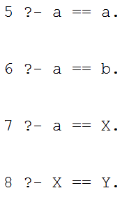
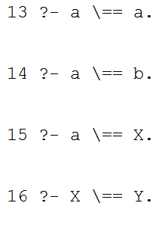
Equality and Negation (DEMO)
= succeeds if they CAN be unified
\=
succeeds if they CANNOT be unified
== succeeds if they are ALREADY the same
\== succeeds if they are NOT ALREADY the same

Slide 17
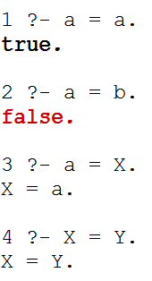
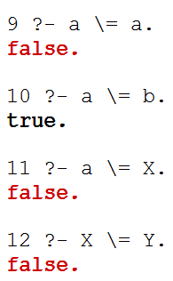
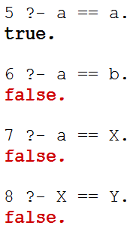
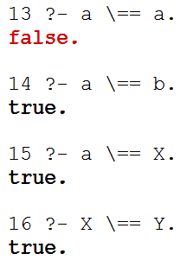
Equality and Negation (SOLUTION)
= succeeds if they CAN be unified
\=
succeeds if they CANNOT be unified
== succeeds if they are ALREADY the same
\== succeeds if they are NOT ALREADY the same

Slide 18
simpsonSmall.pl
parent(homer, bart).
parent(homer, lisa).
parent(marge, bart).
parent(marge, lisa).
parent(homer, maggie).
parent(marge, maggie).
age(lisa, 8).
age(maggie, 1).
age(bart, 10).
age(marge, 35).
age(homer, 38).
person(marge).
person(homer).
person(lisa).
person(bart).
person(maggie).

Slide 19
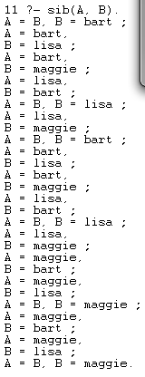
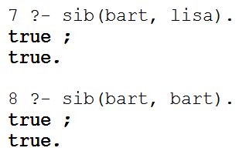
sib Demo
(Big idea: Negation)
This says that bart is his own sibling!

Slide 20
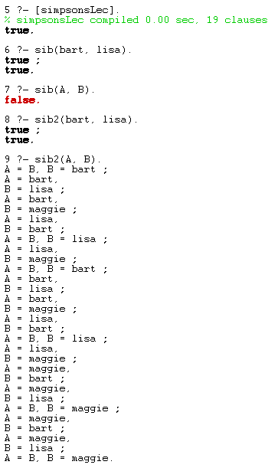

sib Demo
(Big idea: Negation)
If X and Y are unbound, X \= Y is false
Works for specific cases.

Slide 21
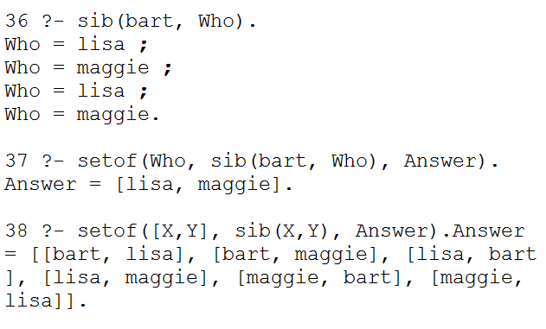
sib Demo (Big idea: Negation)
REMEMBER:
Put negation as late as possible
so that variables
already have known values!
Why are there all of these duplicates?

Slide 22
Meta-predicates
(HOFs in Prolog)

Slide 23
setof(format,query,Var).
setof allows you to see only non-duplicates
[X, Y] gives the format we want our answer in
(as a list)

Slide 24
Write query to return the setof marge’s children
setof is the only time I’ll nest anything in Prolog
I’ll do what I want! Humph!

Slide 25
Test Cases in Prolog

Slide 26
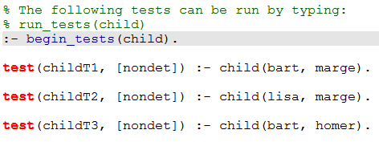
Don’t worry about this!
Focus on the right hand side of the test!!!

Slide 27
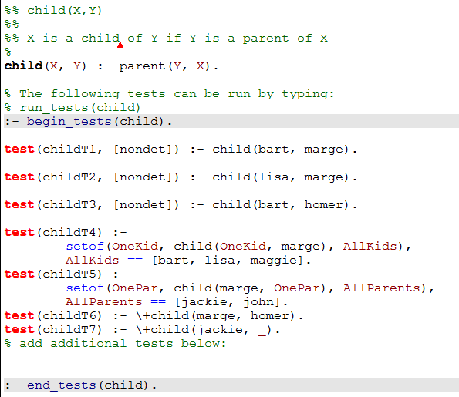
Order Matters

Slide 28
Negation
(and singleton variables)

Slide 29
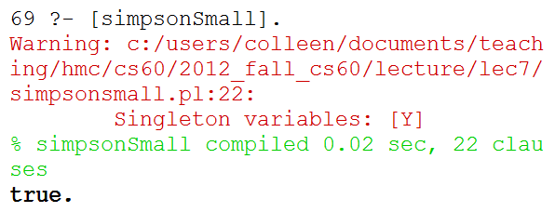
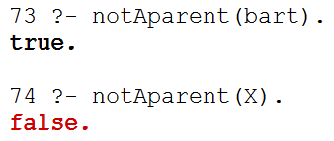
notAparent Demo (Intro: \+ )
\+ means not
Singleton variables: [Y].
_ is a variable that doesn’t need to match anything else.
I don’t care
As is:
Doesn’t work with variables!

Slide 30
How can I give Prolog enough information to make this inference?
Query:
notAparent(Who).
person(homer).
person(bart).
person(lisa).
person(maggie).
parent(homer, bart).
parent(homer, lisa).
parent(marge, bart).
parent(marge, lisa).
parent(homer, maggie).
parent(marge, maggie).
parent(homer, bart).
parent(homer, lisa).
parent(marge, bart).
parent(marge, lisa).
parent(homer, maggie).
parent(marge, maggie).
parent(homer, bart).
parent(homer, lisa).
parent(marge, bart).
parent(marge, lisa).
parent(homer, maggie).
parent(marge, maggie).
parent(homer, bart).
parent(homer, lisa).
parent(marge, bart).
parent(marge, lisa).
parent(homer, maggie).
parent(marge, maggie).
parent(homer, bart).
parent(homer, lisa).
parent(marge, bart).
parent(marge, lisa).
parent(homer, maggie).
parent(marge, maggie).
person(marge).
notAparent(X) :- person(X), \+ parent(X, _)

Slide 31
How can I give Prolog enough information to make this inference?
Query:
notAparent(Who).
person(homer).
person(bart).
person(lisa).
person(maggie).
parent(homer, bart).
parent(homer, lisa).
parent(marge, bart).
parent(marge, lisa).
parent(homer, maggie).
parent(marge, maggie).
parent(homer, bart).
parent(homer, lisa).
parent(marge, bart).
parent(marge, lisa).
parent(homer, maggie).
parent(marge, maggie).
parent(homer, bart).
parent(homer, lisa).
parent(marge, bart).
parent(marge, lisa).
parent(homer, maggie).
parent(marge, maggie).
parent(homer, bart).
parent(homer, lisa).
parent(marge, bart).
parent(marge, lisa).
parent(homer, maggie).
parent(marge, maggie).
parent(homer, bart).
parent(homer, lisa).
parent(marge, bart).
parent(marge, lisa).
parent(homer, maggie).
parent(marge, maggie).
person(marge).
notAparent(X) :- person(X), \+ parent(X, _)

Slide 32
Mutual Recursion
(Hw3 Unicalc)

Slide 33
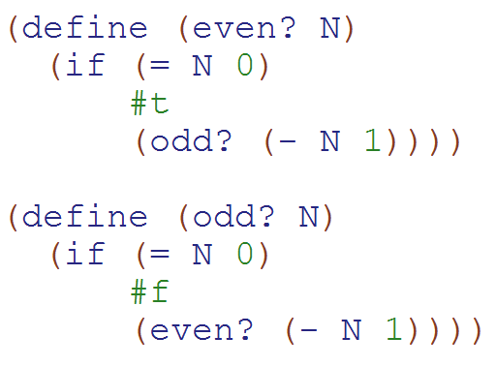
Mutual Recursion Example
(Two functions that call each other)
WARNING: This is ridiculous code that no one should ever write!!!!
But is a simple to understand example of mutual recursion!!!
How many times is odd? called in:
(even? 7)
a)0
b)1
c)2
d)3
e)> 3

Slide 34
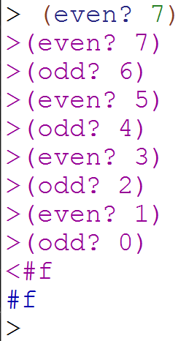
Mutual Recursion Solution
Here I used
(trace even?) and
(trace odd?)
So I could see what calls were made!
(Debugging tip!)

Slide 35
What you should understand right now:
Mutual recursion is when two functions call each other!

Slide 36
Unicalc
(Hw3 Unicalc)
You always read the book before writing the essay:
In CS you should:
Read the description of the problem
Read the provided code
The goals of this assignment:
Use mutual recursion
Make something that works
Figure out how pieces fit together
Practice reading!

Slide 37
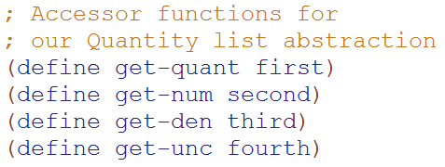
Quantity Lists
(Represented as Lists – HW3)
'(9.8 (meter) (second second) 0.01)
multiply, divide, add, power
Simplify units
Handle uncertainty
“Normalize” units
Quantity
Numerator (units)
Denominator (units)
Uncertainty

Slide 38
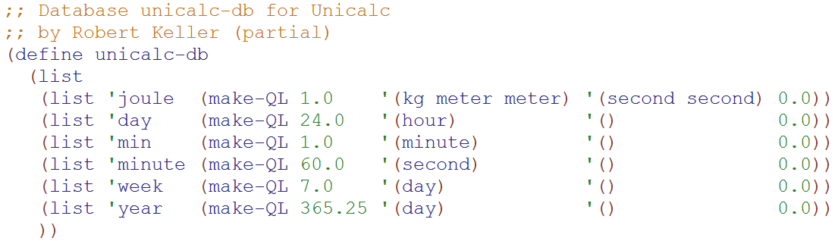
Database (assoc list) of conversions
Base units
(e.g. seconds, meters) don’t have an entry in the DB
All non-base units have a quantity-list conversion listed

Slide 39
Mutual Recursion Example 1
(norm-unit & norm-QL)
(list 'joule (make-QL 1.0 '(kg meter meter) '(second second) 0.0))
(norm-unit 'joule)
Calls:
(norm-QL '(1.0 (kg meter meter) (second second) 0.0))
Which calls:
> (norm-unit 'kg)
> (norm-unit 'meter)
> (norm-unit 'meter)
> (norm-unit 'second)
> (norm-unit 'second)
From DB
If there is assoc-list entry
(i.e. not a base unit)
norm-unit calls norm-QL once
These are all base units so they don’t call norm-QL
norm-QL calls norm-unit once for EACH unit

Slide 40
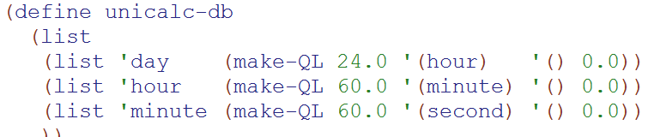
Mutual Recursion Example
(norm-unit 'day)
(norm-QL '(24.0 (hour) () 0.0))
(norm-unit 'hour)
(norm-QL '(60.0 (minute) () 0.0))
(norm-unit 'minute)
(norm-QL '(60.0 (second) () 0.0))
(norm-unit 'second)
Base units
(e.g. seconds, meters) don’t have an entry in the DB

Slide 41
Write notes to yourself about what you understand about unicalc at this point

Slide 42
Mutual Recursion
odd?
even?
norm-unit
norm-QL

Slide 43
What you should understand right now:
I will need to spend time reading the unicalc assignment
Unicalc uses mutual recursion
  norm-unit calls norm-QL
  norm-QL calls norm-unit
“Base units” don’t need to be normalized and therefore there is no entry for them in the unicalc database!

Slide 44
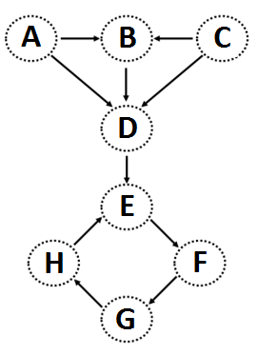
Graphs can be stored as Lists
Edge List
This vocab is important
(define unicycleGraph
'(
("A" "B") ("A" "D") ("B" "D") ("C" "B") ("C" "D") ("D" "E") ("E" "F") ("F" "G") ("G" "H") ("H" "E")
))
I can think of other ways to represent this graph!

Slide 45
Graph-reachability: can you get from s to d?
is there some path from s to d in G?
s == source
d == dest.
(define (reach? s d G)
?
s
d
…
?
?
a
b
I know I can get from a to b. If I can get from S to A and from B to D…
(define unicycleGraph '(("A" "B") ("A" "D") ("B" "D") ("C" "B") ("C" "D") ("D" "E") ("E" "F") ("F" "G") ("G" "H") ("H" "E") ))

Slide 46
Graph-reachability: can you get from s to d?
is there some path from s to d in G?
s == source
d == dest.
(define (reach? s d G)
Consider the algorithm first, then the code...

Slide 47
Graph-reachability: can you get from s to d?
(define (reach? s d G)
(cond
(
(
( else (let* ([EDGE
[a
[b
[R
[loseit

Slide 48
(nodes unicycleGraph)→'("A" "B" "D" "C" "E" "F" "G" "H")
(define (nodes graph)
Hint: how could we use remove-duplicates
(kids "A" unicycleGraph) → '("B" "D")
(kids "B" unicycleGraph) → '("D")
(define unicycleGraph '(("A" "B") ("A" "D") ("B" "D") ("C" "B") ("C" "D") ("D" "E") ("E" "F") ("F" "G") ("G" "H") ("H" "E") ))
(define (kids n graph)
big-O( ) ~ edges or nodes?
parents?
Hint: could we use filter?
Notes:
big-O: could be edges or nodes!

Slide 49
Feel free to use available functions: remove-duplicates, nodes, kids, parents, and higher-order functions...
Write these functions for directed graphs.
(define (leaf? n G)
(leaf? n G) should return #t if n is a leaf in G and #f otherwise.
(
(leaf? "E" unicycleGraph)→ #f
Hint: call (kids n G)
(define (gkids n G)
(gkids n G) should compute the list of grandchildren of n in G: all nodes two edges away.
(
(gkids "E" unicycleGraph)→ '("G")
(gkids "A" unicycleGraph)→ '("D" "E")
Hint: use kids and map - It's a bit tricky...
(define (reach? a b G)
(reach? a b G) should return #t if there is some path from a to b in G and #f otherwise.
(
(reach? "B" "E" unicycleGraph)→ #t
there is definitely not enough room here – plus, we’ll talk about a solution in the next lecture...
(reach? "E" "B" unicycleGraph)→ #f
Notes:
I don’t know if this really works...

Slide 50
Graph-reachability: can you get from s to d?
is there some path from s to d in G?
s == source
d == dest.
(define (reach? s d G)
Consider the algorithm first, then the code...

Slide 51
Graph-reachability: can you get from s to d?
is there some path from s to d in G?
s == source
d == dest.
(define (reach? s d G)
Consider the algorithm first, then the code...

Slide 52
Graph-reachability: can you get from s to d?
is there some path from s to d in G?
s == source
d == dest.
(define (reach? s d G)
?
s
d
…
?
?
X
Y
I know I can get from a to b. If I can get from S to A and from B to D…
(define unicycleGraph '(("A" "B") ("A" "D") ("B" "D") ("C" "B") ("C" "D") ("D" "E") ("E" "F") ("F" "G") ("G" "H") ("H" "E") ))

Slide 53
(nodes unicycleGraph)→'("A" "B" "D" "C" "E" "F" "G" "H")
(define (nodes graph)
Hint: how could we use remove-duplicates
(kids "A" unicycleGraph) → '("B" "D")
(kids "B" unicycleGraph) → '("D")
(define unicycleGraph '(("A" "B") ("A" "D") ("B" "D") ("C" "B") ("C" "D") ("D" "E") ("E" "F") ("F" "G") ("G" "H") ("H" "E") ))
(define (kids n graph)
big-O( ) ~ edges or nodes?
parents?
Hint: could we use filter?
Notes:
big-O: could be edges or nodes!

Slide 54
Feel free to use available functions: remove-duplicates, nodes, kids, parents, and higher-order functions...
Write these functions for directed graphs.
(define (leaf? n G)
(leaf? n G) should return #t if n is a leaf in G and #f otherwise.
(
(leaf? "E" unicycleGraph)→ #f
Hint: call (kids n G)
(define (gkids n G)
(gkids n G) should compute the list of grandchildren of n in G: all nodes two edges away.
(
(gkids "E" unicycleGraph)→ '("G")
(gkids "A" unicycleGraph)→ '("D" "E")
Hint: use kids and map - It's a bit tricky...
(define (reach? a b G)
(reach? a b G) should return #t if there is some path from a to b in G and #f otherwise.
(
(reach? "B" "E" unicycleGraph)→ #t
there is definitely not enough room here – plus, we’ll talk about a solution in the next lecture...
(reach? "E" "B" unicycleGraph)→ #f
Notes:
I don’t know if this really works...

Slide 55
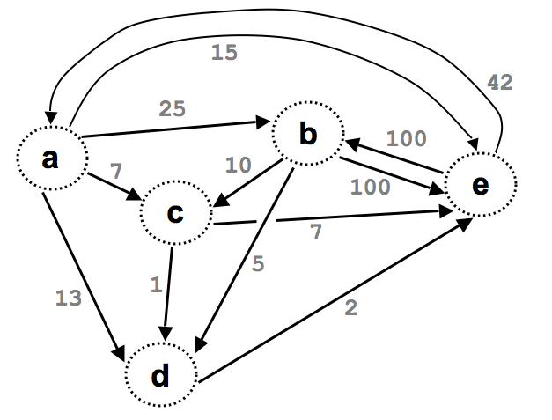

Slide 56
(define Gt '((e b 100) (a b 25) (e a 42)
(a c 7) (a d 13) (a e 15)
(b c 10) (b d 5) (d e 2)
(b e 100) (c d 1) (c e 7)) )
What might these weights represent?
42
15
25
b
100
a
10
7
e
100
c
7
5
This graph looks heavy!
13
1
2
No space
Weightedgraphs
d

Slide 57
Graph-reachability: can you get from s to d?
is there some path from s to d in G?
s == source
d == dest.
(define (reach? s d G)
Consider the algorithm first, then the code...

Slide 58
Graph-reachability: can you get from s to d?
(define (reach? s d G)
(cond
(
(
( else (let* ([EDGE
[a
[b
[R
[loseit

Slide 59
How’s it going?
We wrote the base cases
We wrote Edge, A, B, & R.
We wrote loseit
We wrote the combination/answer

Slide 60
Graph-reachability: can you get from A to B?
What is N, the problem size?
(define (reach? s d G)
(cond
((equal? s d) #t)
((null? G) #f)
( else (let* ((EDGE (first G))
(R (rest G))
(loseit (reach? s d R))
(a (first EDGE))
(b (second EDGE))
(useit (and (reach? s a R)
(reach? b d R))...
(or useit loseit))))...
what are the base cases saying?
solve the problem without "it"
solve the problem with "it"
SOLUTION
big-O( )

Slide 61
Reach Solution
(define (reach? s d G)
(cond
((equal? s d) #t)
((null? G) #f)
( else (let* ([EDGE (first G)]
[a (first EDGE)]
[b (second EDGE)] [R (rest G)]
[loseit (reach? s d R)]
[useit (and (reach? s a R)
(reach? b d R))])
(or useit loseit)))))

Slide 62
Graph Representations

Slide 63
Graphs can be stored as Lists
Edge List
This vocab is important
(define unicycleGraph
'(
("A" "B") ("A" "D") ("B" "D") ("C" "B") ("C" "D") ("D" "E") ("E" "F") ("F" "G") ("G" "H") ("H" "E")
))
I can think of other ways to represent this graph!

Slide 64
(define Gt '((e b 100) (a b 25) (e a 42)
(a c 7) (a d 13) (a e 15)
(b c 10) (b d 5) (d e 2)
(b e 100) (c d 1) (c e 7)) )
What might these weights represent?
weights
15
42
25
b
100
This graph looks heavy!
a
10
7
e
100
c
7
5
13
1
2
Weightedgraphs
d

Slide 65
Graph Practice
2013-02-05
Tuesday – Week 2
Lecture 05

Slide 66
(nodes unicycleGraph)→'("A" "B" "D" "C" "E" "F" "G" "H")
(define (nodes graph)
Hint: how could we use remove-duplicates
(kids "A" unicycleGraph) → '("B" "D")
(kids "B" unicycleGraph) → '("D")
(define unicycleGraph '(("A" "B") ("A" "D") ("B" "D") ("C" "B") ("C" "D") ("D" "E") ("E" "F") ("F" "G") ("G" "H") ("H" "E") ))
(define (kids n graph)
big-O( ) ~ edges or nodes?
parents?
Hint: could we use filter?
Notes:
big-O: could be edges or nodes!

Slide 67
Feel free to use available functions: remove-duplicates, nodes, kids, parents, and higher-order functions...
Write these functions for directed graphs.
(define (leaf? n G)
(leaf? n G) should return #t if n is a leaf in G and #f otherwise.
(
(leaf? "E" unicycleGraph)→ #f
Hint: call (kids n G)
(define (gkids n G)
(gkids n G) should compute the list of grandchildren of n in G: all nodes two edges away.
(
(gkids "E" unicycleGraph)→ '("G")
(gkids "A" unicycleGraph)→ '("D" "E")
Hint: use kids and map - It's a bit tricky...
(define (reach? a b G)
(reach? a b G) should return #t if there is some path from a to b in G and #f otherwise.
(
(reach? "B" "E" unicycleGraph)→ #t
there is definitely not enough room here – plus, we’ll talk about a solution later in lecture ...
(reach? "E" "B" unicycleGraph)→ #f
Notes:
I don’t know if this really works...

Slide 68
Where are you?
Working on leaf?
Working on gkids
Working on reach
STUCK on something!

Slide 69
Graph Reach
2013-02-05
Tuesday – Week 2
Lecture 05

Slide 70
Graph-reachability: can you get from s to d?
is there some path from s to d in G?
s == source
d == dest.
(define (reach? s d G)
Consider the algorithm first, then the code...

Slide 71
Graph-reachability: can you get from s to d?
is there some path from s to d in G?
s == source
d == dest.
(define (reach? s d G)
?
s
d
…
?
?
a
b
I know I can get from a to b. If I can get from S to A and from B to D…
(define unicycleGraph '(("A" "B") ("A" "D") ("B" "D") ("C" "B") ("C" "D") ("D" "E") ("E" "F") ("F" "G") ("G" "H") ("H" "E") ))

Slide 72
Graph-reachability: can you get from s to d?
(define (reach? s d G)
(cond
(
(
( else (let* ([EDGE
[a
[b
[R
[loseit

Slide 73
How’s it going?
We wrote the base cases
We wrote Edge, A, B, & R.
We wrote loseit
We wrote the combination/answer

Slide 74
Graph-reachability: can you get from A to B?
What is N, the problem size?
(define (reach? s d G)
(cond
((equal? s d) #t)
((null? G) #f)
( else (let* ((EDGE (first G))
(R (rest G))
(loseit (reach? s d R))
(a (first EDGE))
(b (second EDGE))
(useit (and (reach? s a R)
(reach? b d R))...
(or useit loseit))))...
what are the base cases saying?
solve the problem without "it"
solve the problem with "it"
SOLUTION
big-O( )

Slide 75
Reach Solution
(define (reach? s d G)
(cond
((equal? s d) #t)
((null? G) #f)
( else (let* ([EDGE (first G)]
[a (first EDGE)]
[b (second EDGE)] [R (rest G)]
[loseit (reach? s d R)]
[useit (and (reach? s a R)
(reach? b d R))])
(or useit loseit)))))

Slide 76
BONUS

Slide 77


Slide 78
Estimating Time
Most people grossly underestimate how long it takes to program (not thinking about time to debug and test)
You appear incompetent at programming (not true) if you can’t estimate how long something will take.
This is one of the hardest things to learn!!! Start to practice now! For each task estimate how long it will take and keep track of how wrong you were

Slide 79


Computer
Science
&
= AWESOME

Slide 80

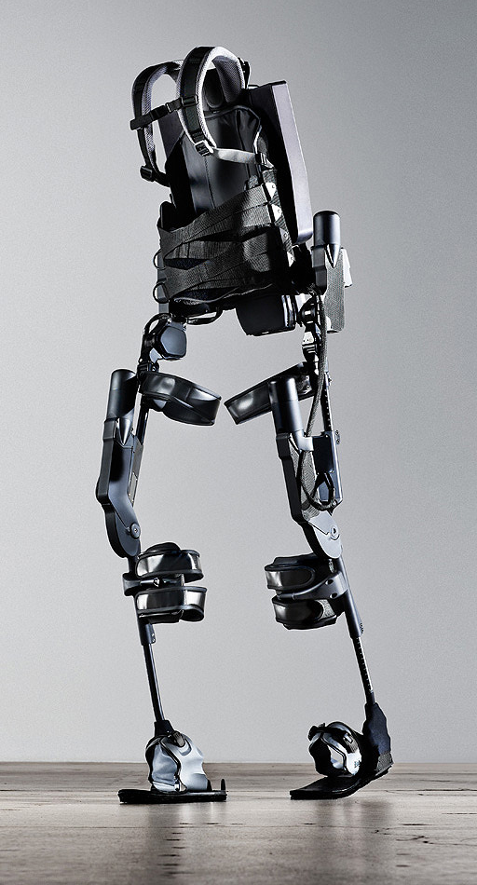
http://www.youtube.com/watch?v=pzRmNYA8LlY

Slide 81


ClickStart

Slide 82


Slide 83
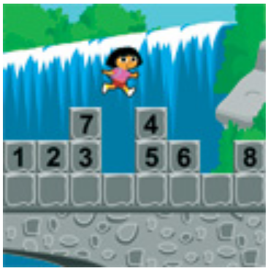
How should we represent the blocks in the computer?
Independent variables
2D Array
OpenList
I don’t know

Slide 84
The value in the array tells me what art asset to use
Each level is really a 3x10 vector!
0 | 0 | 7 | 0 | 4 | 0 | 0 | 0
1 | 2 | 3 | -4 | 5 | 6 | -7 | 8
B | B | B | B | B | B | B | B
Negative values tell me what block needs to go here to win!

Slide 85
0 | 0 | 7 | 0 | 4 | 0 | 0 | 0
1 | 2 | 3 | -4 | 5 | 6 | -7 | 8
0 | 0 | 0 | B | 0 | 0 | 0 | 0

Slide 86
BUGS!

Slide 87


Slide 88

It is really sad when stuff you’ve made is on sale!

Slide 89



Which image is fake?
  A. Top Left
  B. Bottom Left
  C. Bottom Right

Slide 90
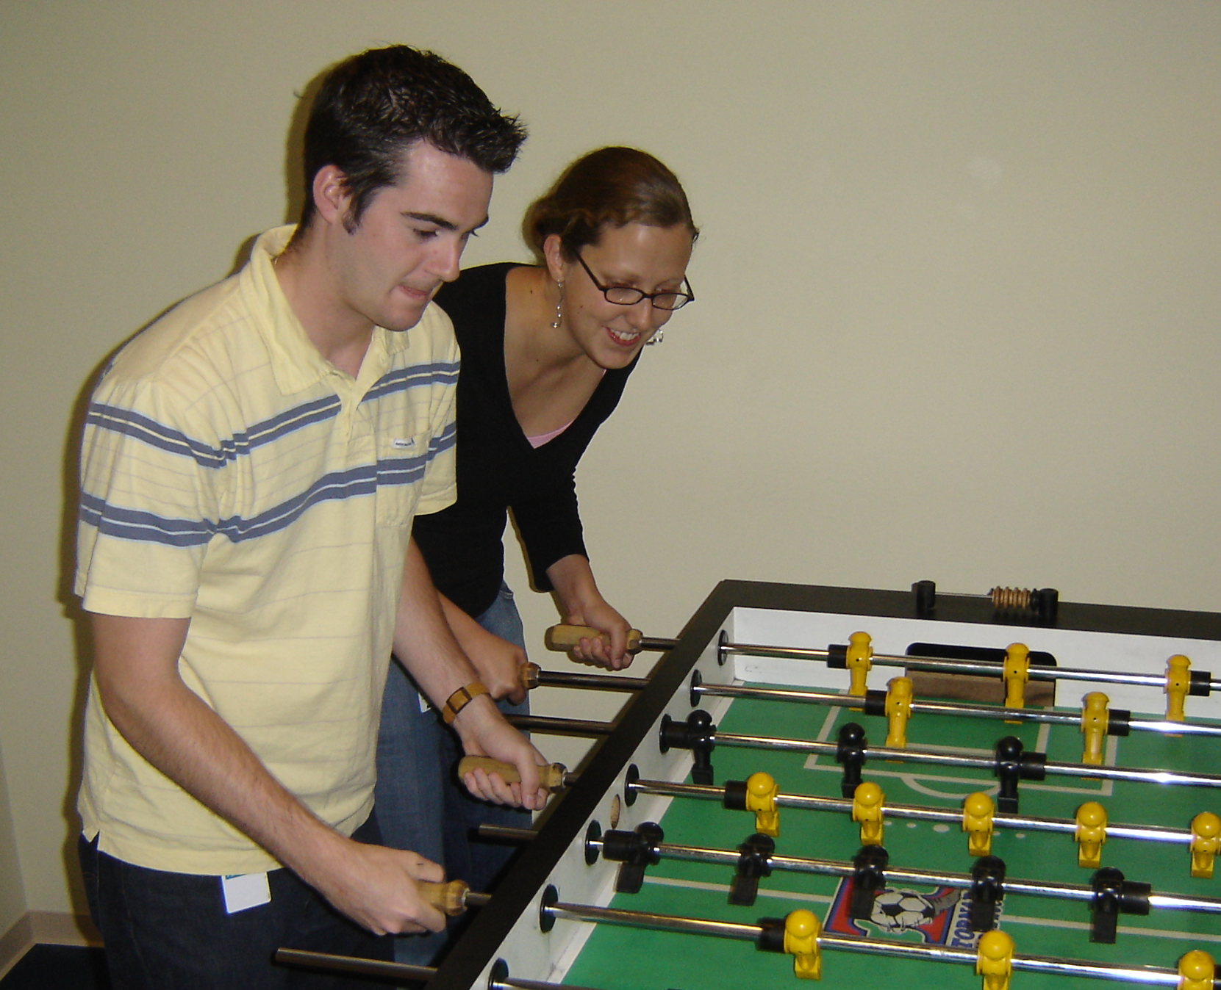

Slide 91
