Slide 1
CS 60
Java Intro – Review
Java static
Big-O
2014-10-13
Monday – Week 6
Lecture 12

Slide 2
Lecture 12 – Learning Goals
Explain the mathematical function log₂(x)
Write code and explain the value of:
  Static methods
  Static variables
Read the formal Big-O definition in English
Know the summations of:
    1 + 2 + 3 + … + N
    1 + 2 + 4 + … + N
    1 + 2 + 4 + … + 2^{N}
Calculate the Big-O of code using loop counting

Slide 3
Administrative Stuff
(Not in your notes)
Quiz regrades:
  Please staple an explanation to the front of your quiz
  Give the quiz to Colleen (or slip under her door)
  Colleen prefers to sit and think about regrades to avoid rash decisions

Slide 4
log₂(x) is not scary
log₂(1) = 0
log₂(2) = 1
log₂(3) = 1.584962500721156
log₂(4) = 2
log₂(5) = 2.321928094887362
log₂(6) = 2.584962500721156
log₂(7) = 2.807354922057604
log₂(8) = 3
log₂(9) = 3.169925001442312
log₂(10) = 3.321928094887362
2⁰ = 1
log₂(x) means
the power you have to raise 2 by
in order to get x.
2¹ = 2
2² = 4
2³ = 8
2 ^{3.169925001442312} = 9
http://logbase2.blogspot.com/2007/12/log-base-2.html

Slide 5
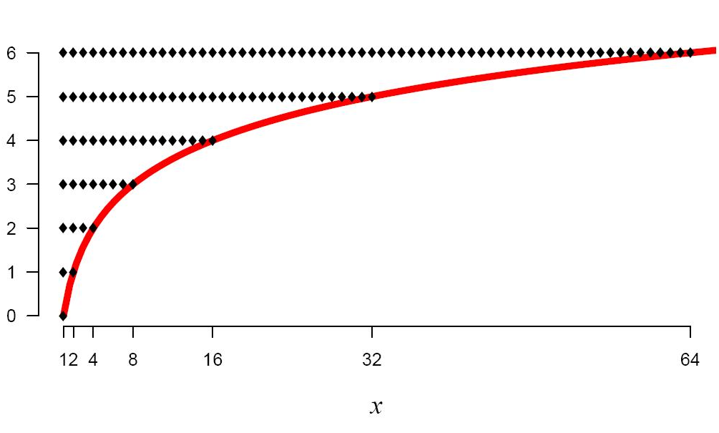
log₂(x)
log₂(x) means
the power you have to raise 2 by
in order to get x.
http://logbase2.blogspot.com/2007/12/log-base-2.html

Slide 6
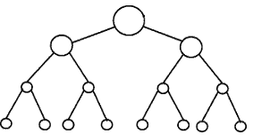
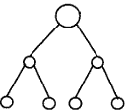


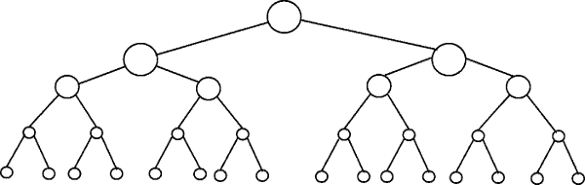
Perfectly Balanced Trees
h = 0
n = 1
h = 1
n = 3
h = 2
n = 7
h = 3
n = 15

Slide 7
Number of Items (n) | Number of Rows | log₂(x) means the power you have to raise 2 by in order to get x.
2-3 | 2 | 1 = log₂(2) < log₂ (3) < 2
4-7 | 3 | 2 = log₂(4) < log₂ (7) < 3
8-15 | 4 | 3 = log₂(8) < log₂ (15) < 4
16-31 | 5 | 4 = log₂(16) < log₂ (31) < 5
32-63 | 6 | 5 = log₂(32) < log₂ (63) < 6
64-127 | 7 | 6 = log₂(64) < log₂ (127) < 7
128-255 | 8 | 7 = log₂(128) < log₂ (255) < 8
256-511 | 9 | 8 = log₂(256) < log₂ (511) < 9
512-1023 | 10 | 9 = log₂(512) < log₂ (1023) < 10

Slide 8
Number of Items (n) | Number of Rows | log₂(x) means the power you have to raise 2 by in order to get x.
2-3 | 2 | 1 = log₂(2) < log₂ (3) < 2
4-7 | 3 | 2 = log₂(4) < log₂ (7) < 3
8-15 | 4 | 3 = log₂(8) < log₂ (15) < 4
16-31 | 5 | 4 = log₂(16) < log₂ (31) < 5
32-63 | 6 | 5 = log₂(32) < log₂ (63) < 6
64-127 | 7 | 6 = log₂(64) < log₂ (127) < 7
128-255 | 8 | 7 = log₂(128) < log₂ (255) < 8
256-511 | 9 | 8 = log₂(256) < log₂ (511) < 9
512-1023 | 10 | 9 = log₂(512) < log₂ (1023) < 10

Slide 9
Number of Items (n) | Number of Rows | log₂(x) means the power you have to raise 2 by in order to get x.
2-3 | 2 | 1 = log₂(2) < log₂ (3) < 2
4-7 | 3 | 2 = log₂(4) < log₂ (7) < 3
8-15 | 4 | 3 = log₂(8) < log₂ (15) < 4
16-31 | 5 | 4 = log₂(16) < log₂ (31) < 5
32-63 | 6 | 5 = log₂(32) < log₂ (63) < 6
64-127 | 7 | 6 = log₂(64) < log₂ (127) < 7
128-255 | 8 | 7 = log₂(128) < log₂ (255) < 8
256-511 | 9 | 8 = log₂(256) < log₂ (511) < 9
512-1023 | 10 | 9 = log₂(512) < log₂ (1023) < 10

Slide 10
Number of Items (n) | Number of Rows | log₂(x) means the power you have to raise 2 by in order to get x.
2-3 | 2 | 1 = log₂(2) < log₂ (3) < 2
4-7 | 3 | 2 = log₂(4) < log₂ (7) < 3
8-15 | 4 | 3 = log₂(8) < log₂ (15) < 4
16-31 | 5 | 4 = log₂(16) < log₂ (31) < 5
32-63 | 6 | 5 = log₂(32) < log₂ (63) < 6
64-127 | 7 | 6 = log₂(64) < log₂ (127) < 7
128-255 | 8 | 7 = log₂(128) < log₂ (255) < 8
256-511 | 9 | 8 = log₂(256) < log₂ (511) < 9
512-1023 | 10 | 9 = log₂(512) < log₂ (1023) < 10

Slide 11
Number of Items (n) | Number of Rows | log₂(x) means the power you have to raise 2 by in order to get x.
2-3 | 2 | 1 = log₂(2) < log₂ (3) < 2
4-7 | 3 | 2 = log₂(4) < log₂ (7) < 3
8-15 | 4 | 3 = log₂(8) < log₂ (15) < 4
16-31 | 5 | 4 = log₂(16) < log₂ (31) < 5
32-63 | 6 | 5 = log₂(32) < log₂ (63) < 6
64-127 | 7 | 6 = log₂(64) < log₂ (127) < 7
128-255 | 8 | 7 = log₂(128) < log₂ (255) < 8
256-511 | 9 | 8 = log₂(256) < log₂ (511) < 9
512-1023 | 10 | 9 = log₂(512) < log₂ (1023) < 10

Slide 12
Number of Items (n) | Number of Rows | log₂(x) means the power you have to raise 2 by in order to get x.
2-3 | 2 | 1 = log₂(2) < log₂ (3) < 2
4-7 | 3 | 2 = log₂(4) < log₂ (7) < 3
8-15 | 4 | 3 = log₂(8) < log₂ (15) < 4
16-31 | 5 | 4 = log₂(16) < log₂ (31) < 5
32-63 | 6 | 5 = log₂(32) < log₂ (63) < 6
64-127 | 7 | 6 = log₂(64) < log₂ (127) < 7
128-255 | 8 | 7 = log₂(128) < log₂ (255) < 8
256-511 | 9 | 8 = log₂(256) < log₂ (511) < 9
512-1023 | 10 | 9 = log₂(512) < log₂ (1023) < 10
If you have a balanced binary tree with n nodes,
the height is log₂(n) ± 1
(i.e. approximately log₂(n))

Slide 13
static
Never say: “Static”
Always:
“Static Method”
“Static Variable”

Slide 14




C++
I think people will want to model REAL OBJECTS in their code.
We should let them do that!
Motivation for
static methods #1
OMG! I just want to call some simple functions like square-root or abs and I don’t want to have a stinkin’ Object!!!!
Static Methods
to the Rescue!!!
I think people will want to model REAL OBJECTS in their code.
EVERYTHING SHOULD BE AN OBJECT!!!!

Slide 15
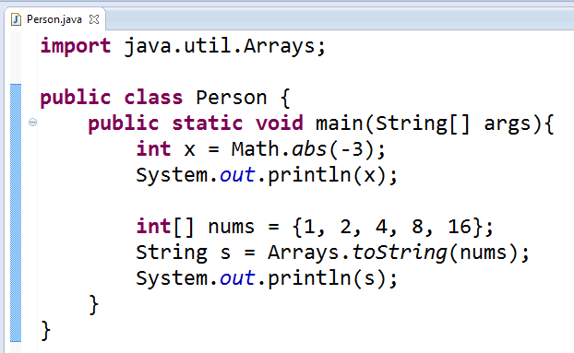
Some handy static functions
(i.e. they are called on the class, not on an object)
It would be annoying to make a
new Math object to be able to call abs.

Slide 16
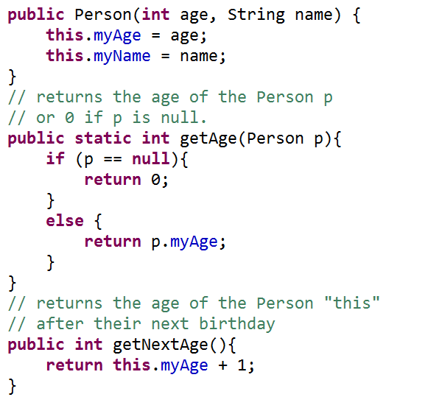
Big Idea!
Constructor
Has access to this!
Static Method
All objects must be arguments or created in the method
Non-Static
Method
Has access to this!

Slide 17
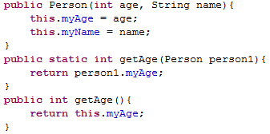
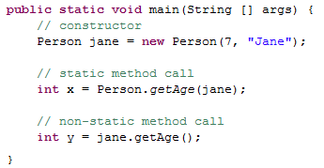
How To

Slide 18
C++
I think people will want to model REAL OBJECTS in their code.
We should let them do that!
Motivation for
static methods #2
OMG! I might have a null Object and want to avoid accidental
“Null Pointer Exceptions”
(aka Null Pointer Errors)
Static Methods
to the Rescue!!!
I think people will want to model REAL OBJECTS in their code.
EVERYTHING SHOULD BE AN OBJECT!!!!

Slide 19
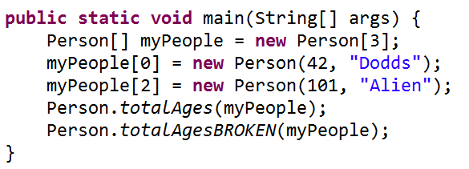
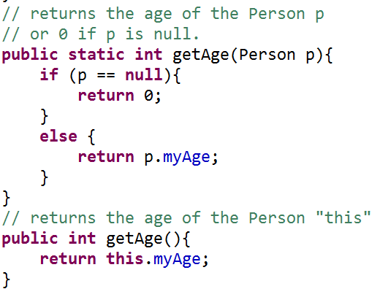
Woah!
myPeople[1] is null
Woah!
The static getAge
Will just return 0 if p is null
Woah!
The non-static getAge
Will freak out if called on a null object

Slide 20
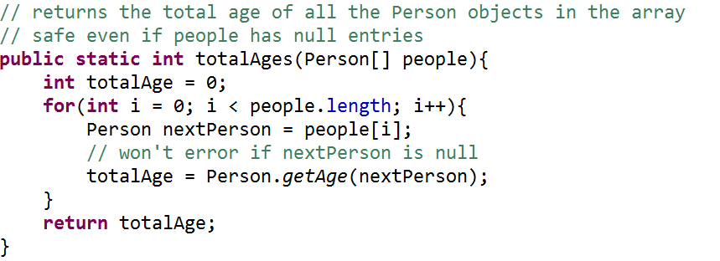
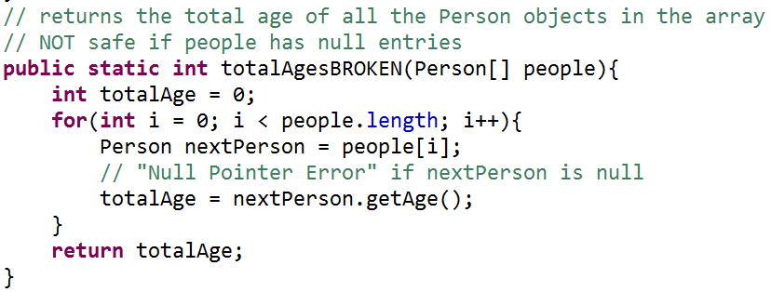
Explain to yourself why this works!

Slide 21
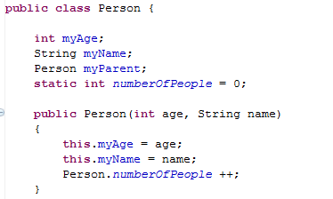
static variables (shared)
Global state shared by all instances of the class
Looks like an instance variable declaration + static
Access them as ClassName.fieldName

Slide 22
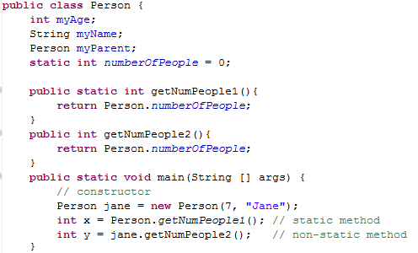
Write a sample call to each method:
Got the static one done
Got the non-static one done
Got both done
Stuck

Slide 23
Solution

Slide 24
Summations

Slide 25

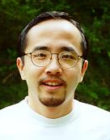
http://www.math.hmc.edu/funfacts/
REALLY COMMON SERIES (you should recognize these after today)
1 + 2 + 3 + … + (N-2) + (N-1) + N = _________
1 + 2 + 4 + … + N/4 + N/2 + N = _________
1 + 2 + 4 + … + 2^{N-2} + 2^{N-1} + 2^{N} = _________

Slide 26




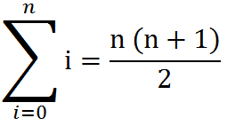
Some Algebra to calculate:
1 + 2 + 3 + … + (N-2) + (N-1) + N = N(N+1)/2 ∈ O(N²)
// Written backwards
OR

Slide 27
N + N/2 + N/4 + … + 4 + 2 + 1 = 2N -1 ∈ O(N)
N
2N
N | N/2
N | N/2 | N/4
N | N/2 | N/4 | N/8
N | N/2 | N/4 | N/8
N/16
The sum is less than 2N

Slide 28
2^{N} + 2^{N-1} + 2^{N-2} + … + 4 + 2 + 1 = 2^{N+1} -1 ∈ O(2^{N})
2^{N}
2 * 2^{N} = 2^{N+1}
2^{N} | 2^{N-1}
2^{N} | 2^{N-1} | 2^{N-2}
2^{N} | 2^{N-1} | 2^{N-2} | 2^{N-3}
2^{N} | 2^{N-1} | 2^{N-2} | 2^{N-3}
2^{N-4}
The sum is less than 2^{N+1}

Slide 29
http://www.math.hmc.edu/funfacts/
REALLY COMMON SERIES (you should recognize these after today)
1 + 2 + 3 + … + (N-2) + (N-1) + N = N(N+1)/2 ∈ O(N²)
1 + 2 + 4 + … + N/4 + N/2 + N = 2N -1 ∈ O(N)
1 + 2 + 4 + … + 2^{N-2} + 2^{N-1} + 2^{N} = 2^{N+1} -1 ∈ O(2^{N})

Slide 30
Big-O Formal Definition

Slide 31
Big-O Overview
We want to express the speed of an algorithm independently of a specific implementation on a specific machine.
We examine the cost of the algorithms for large input sets i.e. the asymptotic cost.
In later classes you’ll do this in more detail

Slide 32
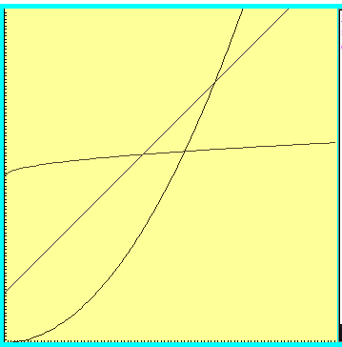



Which one is fastest?

Slide 33
“Woah! One of these is WAY better after this point. Let’s call that point N”

Slide 34



Which is fastest after some big value N?

Slide 35



Which is fastest after some value N?
WAIT – who cares? These are all proportional!
Sometimes we do care, but for simplicity we ignore constants

Slide 36
Formal definition
if and only if
for all n > N

Slide 37

Big-O definition
(using different notation)
T(n) ∈ O(f(n)) means
(∃c) (∃N) (∀n > N) T(n) < c*f(n)
+ threshold N
there exists a constant c
for all input sizes bigger than that threshold, N
To claim that
42n² + 100n ∈ O(n²)
We need to find c and N such that for all n > N,
c =
N =
42n² + 100n < cn²
Notes:
n > 1001 = k, c = 1001
n > 1 = k, c = 42

Slide 38
Apply the formal definition
42n+999 ∈ O(n) ?
2
3
50n ∈ O(n ) ?
0.001*n! ∈ O(n ) ?
True or False?
True or False?
True or False?
c =
N =
c =
N =
c =
N =
Are these the “best” bounds?
Use simplest form with O notation

Slide 39
Runtimes
(why we only care about the largest term)

Slide 40

How Fast Are Computers?
1 Hz = 1 operation /sec
2.9GHz = 2.9 x 10⁹ op / sec

Slide 41
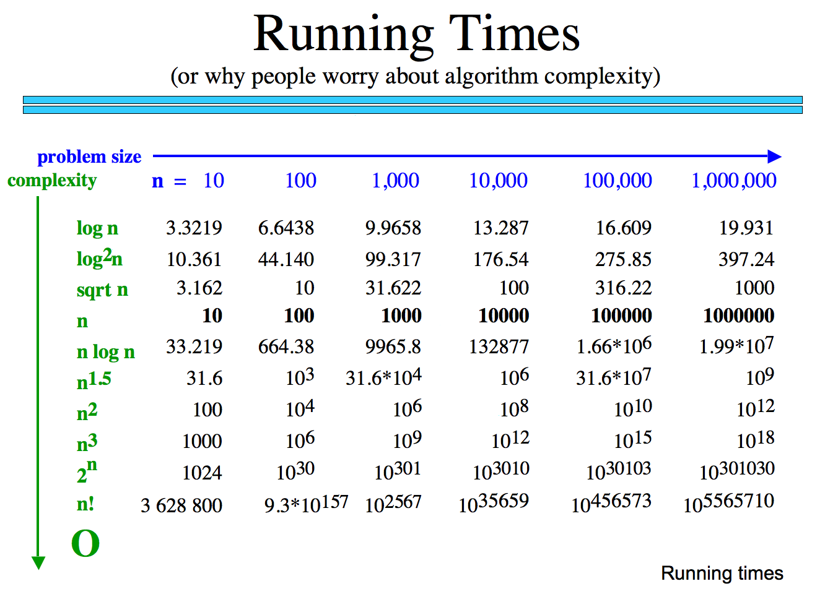
How many operations are required?
How long would these take if you have a 10 GHz Processor?

Slide 42
Why we only care about the largest term
How many operations are required?
Polynomial
Exp.
How big is n!
How long would these take if you have a 10 GHz Processor?

Slide 43
Classes of Problems
Big-O Order
n
n
n!
Intractable Problems (Exponential)
n
2
3
n
2
n
Tractable Problems (Polynomial)
n log(n)
Instead of using measured time – reason about the complexity of the problem
n
√n
log(n)
No Problem!
1

Slide 44
Big-O

Slide 45
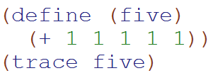
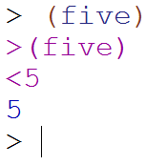
Big-O: Constant Time
O(1)
O(1)
The runtime does not depend upon the magnitude of the input

Slide 46
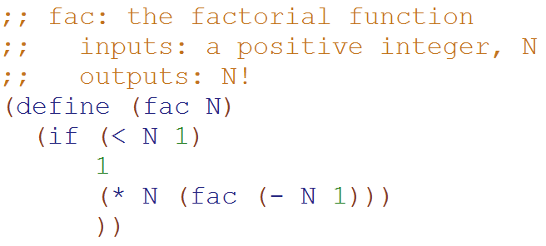
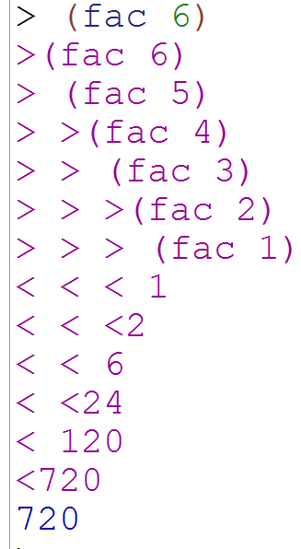
Big-O: Linear Time
O(N)
O(N)
The runtime is proportional to the magnitude of the input

Slide 47
Loop Counting
(calculate runtime by counting each step)

Slide 48
Example 1: Count the total # of constant-time operations?
for ( int i=0 ; i < N ; i++){
// constant-time operation
}
i=0
i=1
i=2
…
i=N-1
i=N
# ops per row
1
1
1
…
1
1
O(N)
Total
of N
Technically 3 operations!

Slide 49
Example 4: Count the total # of constant-time operations?
for ( int i=0 ; i < N ; i++){
for ( int z=0 ; z < N ; z++){
// constant-time operation
}
}
i=0
i=1
i=2
…
i=N-1
i=N
# ops per row
N
N
N
…
N
N
O(N²)
Total
of N²

Slide 50
Example 5: Count the total # of constant-time operations?
for ( int i=0 ; i < N ; i++){
for ( int z=0 ; z < M ; z++){
// constant-time operation
}
}
i=0
i=1
i=2
…
i=N-1
i=N
# ops per row
M
M
M
…
M
M
O(N*M)
Total of N*M

Slide 51
Example 6: Count the total # of constant-time operations?
for ( int i=0 ; i < N ; i++){
for ( int z=0 ; z < i ; z++){
// constant-time operation
}
}
i=0
i=1
i=2
…
i=N-1
i=N
# ops per row
0
1
2
…
N-1
N
O(N²)
Total of N(N+1)/2

Slide 52
Example 2: Count the total # of constant-time operations?
for ( int i=1 ; i < N ; i=i*2){
// constant-time operation
}
i=1
i=2
i=4
…
i=N/2
i=N
# ops per row
1
1
1
…
1
1
O(log₂(N))
Total
of log₂(N)

Slide 53
Example 3: Count the total # of constant-time operations?
for ( int i=N ; i > 0 ; i=i/2){
// constant-time operation
}
i=N
i=N/2
…
i=4
i=2
i=1
# ops per row
1
1
1
…
1
1
O(log₂(N))
Total
of log₂(N)

Slide 54
BONUS

Slide 55
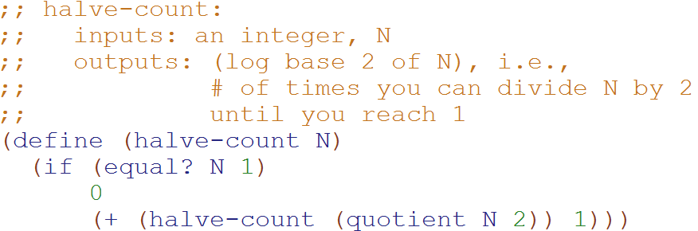
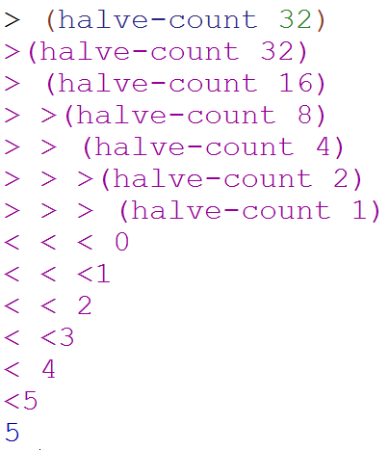
Big-O: Logarithmic Time
O(log₂N)
O(log₂N)
The magnitude of the input is cut in half with each recursive call
Why does cutting the magnitude of the input in half each time produce O(log₂N) runtime?

Slide 56
Perfectly Balanced Trees
h = 0
n = 1
h = 1
n = 3
h = 2
n = 7
h = 3
n = 15

Slide 57



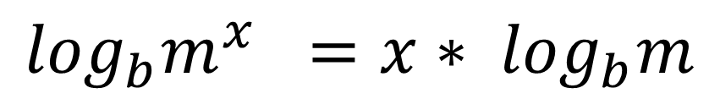
// Take the log of both sides
// Remember:
Ignore the minus 1
$$\log_{b}m^{x} ={x∗ log}_{b}m$$

Slide 58
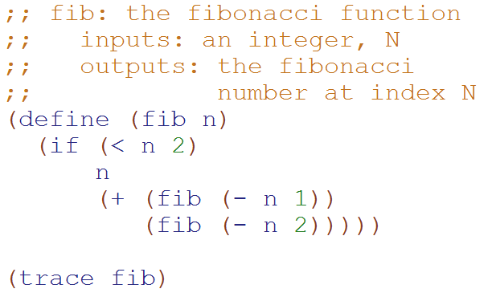
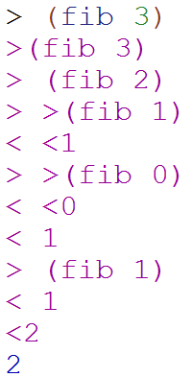
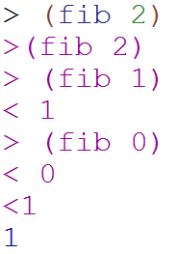
Big-O: Exponential Time
O(2^{N})
O(2^{N})
You make two slightly smaller recursive calls each time

Slide 59
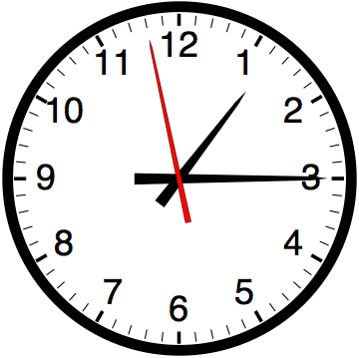

Slide 60


Computer
Science
&
= AWESOME

Slide 61

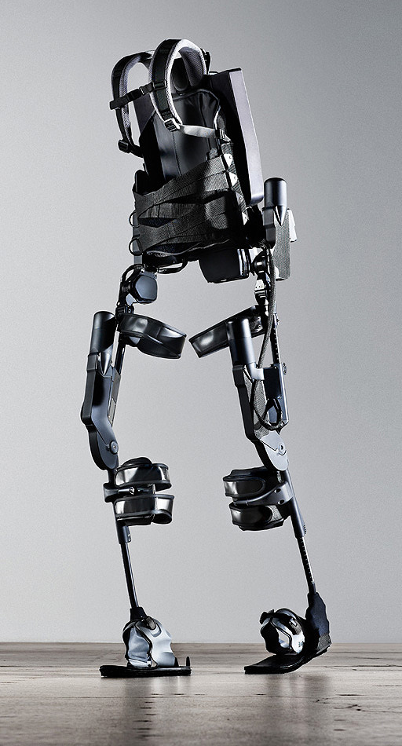
http://www.youtube.com/watch?v=pzRmNYA8LlY

Slide 62


ClickStart

Slide 63


Slide 64
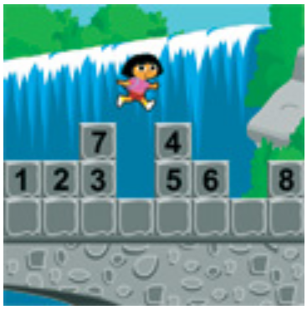
How should we represent the blocks in the computer?
Independent variables
2D Array
OpenList
I don’t know

Slide 65
The value in the array tells me what art asset to use
Each level is really a 3x10 vector!
0 | 0 | 7 | 0 | 4 | 0 | 0 | 0
1 | 2 | 3 | -4 | 5 | 6 | -7 | 8
B | B | B | B | B | B | B | B
Negative values tell me what block needs to go here to win!

Slide 66
0 | 0 | 7 | 0 | 4 | 0 | 0 | 0
1 | 2 | 3 | -4 | 5 | 6 | -7 | 8
0 | 0 | 0 | B | 0 | 0 | 0 | 0

Slide 67
BUGS!

Slide 68


Slide 69

It is really sad when stuff you’ve made is on sale!

Slide 70



Which image is fake?
  A. Top Left
  B. Bottom Left
  C. Bottom Right

Slide 71
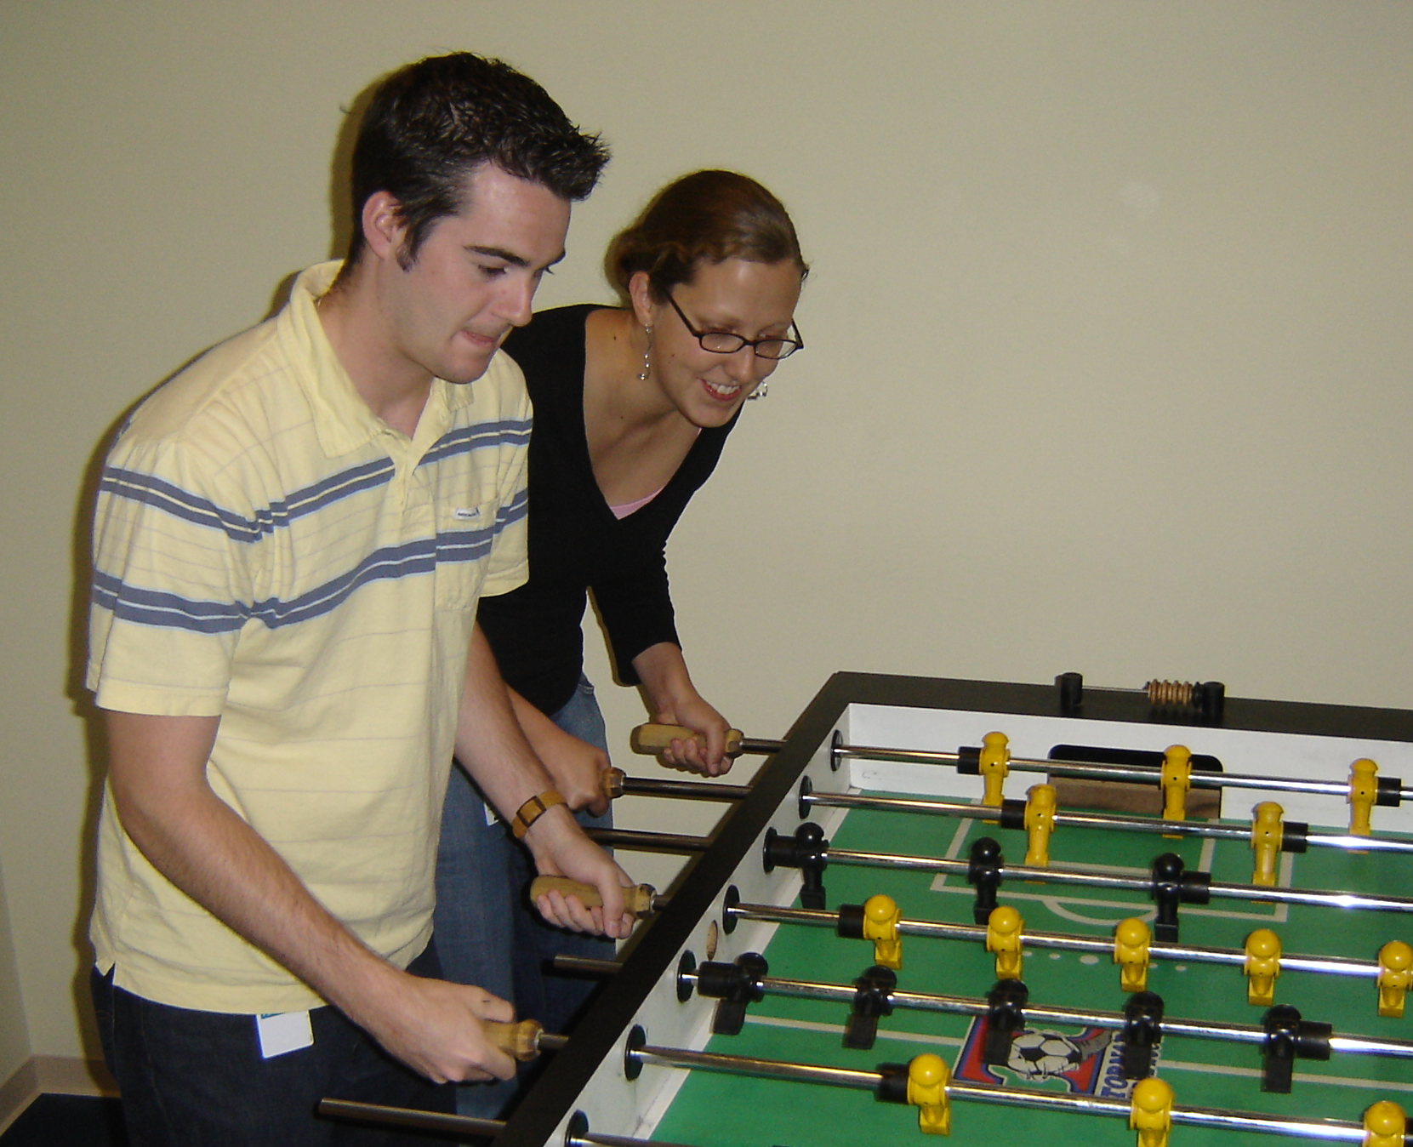

Slide 72
