Slide 1
CS 60
Big-O, List/ListNode
2014-10-15
Wednesday – Week 6
Lecture 13

Slide 2
Lecture 12 – Learning Goals
Calculate the Big-O of code using loop counting
Describe the benefit of Big-O and apply the formal definition
Write code for arbitrary structures of Objects in Java
Be familiar with List and ListNode objects (homework 6 – October 28th)

Slide 3


http://www.math.hmc.edu/funfacts/
Warm-up – You should recognize these!
1 + 2 + 3 + … + (N-2) + (N-1) + N = _________
1 + 2 + 4 + … + N/4 + N/2 + N = _________
1 + 2 + 4 + … + 2^{N-2} + 2^{N-1} + 2^{N} = _________

Slide 4




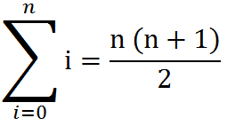
Some Algebra to calculate:
1 + 2 + 3 + … + (N-2) + (N-1) + N = N(N+1)/2 ∈ O(N²)
// Written backwards
OR

Slide 5
N + N/2 + N/4 + … + 4 + 2 + 1 = 2N -1 ∈ O(N)
N
2N
N | N/2
N | N/2 | N/4
N | N/2 | N/4 | N/8
N | N/2 | N/4 | N/8
N/16
The sum is less than 2N

Slide 6
2^{N} + 2^{N-1} + 2^{N-2} + … + 4 + 2 + 1 = 2^{N+1} -1 ∈ O(2^{N})
2^{N}
2 * 2^{N} = 2^{N+1}
2^{N} | 2^{N-1}
2^{N} | 2^{N-1} | 2^{N-2}
2^{N} | 2^{N-1} | 2^{N-2} | 2^{N-3}
2^{N} | 2^{N-1} | 2^{N-2} | 2^{N-3}
2^{N-4}
The sum is less than 2^{N+1}

Slide 7
http://www.math.hmc.edu/funfacts/
REALLY COMMON SERIES (you should recognize these after today)
1 + 2 + 3 + … + (N-2) + (N-1) + N = N(N+1)/2 ∈ O(N²)
1 + 2 + 4 + … + N/4 + N/2 + N = 2N -1 ∈ O(N)
1 + 2 + 4 + … + 2^{N-2} + 2^{N-1} + 2^{N} = 2^{N+1} -1 ∈ O(2^{N})

Slide 8
How many selfies?
Assumptions:
We have n students in class
    Selfie an accepted verb replacement of “take a selfie with”
Questions:
How many selfies/pictures if:
  Colleen selfies with each person ______
  10 professors selfie with each person _____
  P professors selfie with each person _____
  Each person selfies with every other person ____

Slide 9
Runtimes

Slide 10

How Fast Are Computers?
1 Hz = 1 operation /sec
2.9GHz = 2.9 x 10⁹ op / sec

Slide 11
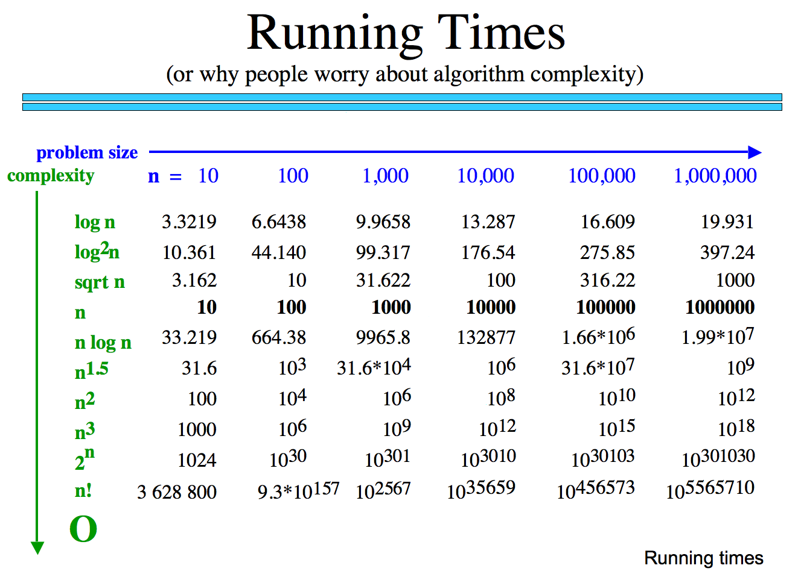
How many operations are required?
How long would these take if you have a 10 GHz Processor?

Slide 12
Why we only care about the largest term
How many operations are required?
Polynomial
Exp.
How big is n!
How long would these take if you have a 10 GHz Processor?

Slide 13
Classes of Problems
Big-O Order
n
n
n!
Intractable Problems (Exponential)
n
2
3
n
2
n
Tractable Problems (Polynomial)
n log(n)
Instead of using measured time – reason about the complexity of the problem
n
√n
log(n)
No Problem!
1

Slide 14
Big-O Formal Definition

Slide 15
Big-O Overview
We want to express the speed of an algorithm independently of a specific implementation on a specific machine.
We examine the cost of the algorithms for large input sets i.e. the asymptotic cost.
In later classes you’ll do this in more detail

Slide 16
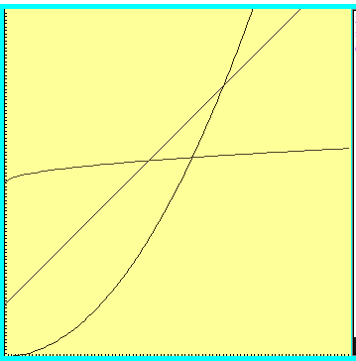



Which one is fastest?

Slide 17
“Woah! One of these is WAY better after this point. Let’s call that point N”

Slide 18



Which is fastest after some big value N?

Slide 19



Which is fastest after some value N?
WAIT – who cares? These are all proportional!
Sometimes we do care, but for simplicity we ignore constants

Slide 20
Formal definition
if and only if
for all n > N

Slide 21

Big-O definition
(using different notation)
T(n) ∈ O(f(n)) means
(∃c) (∃N) (∀n > N) T(n) < c*f(n)
+ threshold N
there exists a constant c
for all input sizes bigger than that threshold, N
To claim that
42n² + 100n ∈ O(n²)
We need to find c and N such that for all n > N,
c =
N =
42n² + 100n < cn²
Notes:
n > 1001 = k, c = 1001
n > 1 = k, c = 42

Slide 22
Apply the formal definition
42n+999 ∈ O(n) ?
2
3
50n ∈ O(n ) ?
0.001*n! ∈ O(n ) ?
True or False?
True or False?
True or False?
c =
N =
c =
N =
c =
N =
Are these the “best” bounds?
Use simplest form with O notation

Slide 23
Big-O

Slide 24
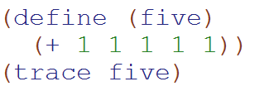
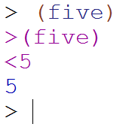
Big-O: Constant Time
O(1)
O(1)
The runtime does not depend upon the magnitude of the input

Slide 25
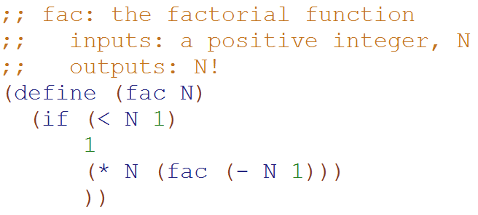
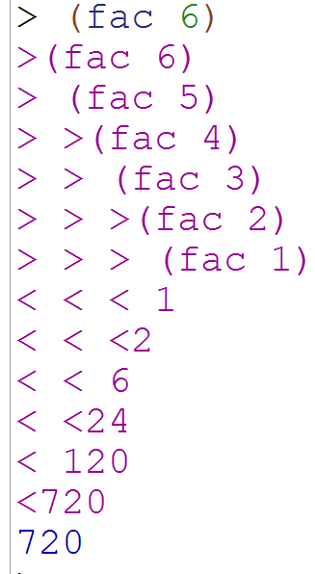
Big-O: Linear Time
O(N)
O(N)
The runtime is proportional to the magnitude of the input

Slide 26
Loop Counting
(calculate runtime by counting each step)

Slide 27
Example 1: Count the total # of constant-time operations?
for ( int i=0 ; i < N ; i++){
// constant-time operation
}
i=0
i=1
i=2
…
i=N-1
i=N
# ops per row
1
1
1
…
1
1
O(N)
Total
of N
Technically 3 operations!

Slide 28
Example 2: Count the total # of constant-time operations?
for ( int i=0 ; i < N ; i++){
for ( int z=0 ; z < N ; z++){
// constant-time operation
}
}
i=0
i=1
i=2
…
i=N-1
i=N
# ops per row
N
N
N
…
N
N
O(N²)
Total
of N²

Slide 29
Example 3: Count the total # of constant-time operations?
for ( int i=0 ; i < N ; i++){
for ( int z=0 ; z < M ; z++){
// constant-time operation
}
}
i=0
i=1
i=2
…
i=N-1
i=N
# ops per row
M
M
M
…
M
M
O(N*M)
Total of N*M

Slide 30
Example 4: Count the total # of constant-time operations?
for ( int i=0 ; i < N ; i++){
for ( int z=0 ; z < i ; z++){
// constant-time operation
}
}
i=0
i=1
i=2
…
i=N-1
i=N
# ops per row
0
1
2
…
N-1
N
O(N²)
Total of N(N+1)/2

Slide 31
Eclipse/Java Tips!
Use ctrl + space to autofill
Type sysout and then ctrl + space to get System.out.println()
Click on the results from JUnit tests
Breakpoints
Automatically format a selection with Ctrl+Shift+F

Slide 32

Fill in the instance variables and constructor for Line3
Set the values of the array elements to the numbers shown
Also add a line in the main method to call the constructor
Line3
coords
50
-8
32
12

Slide 33

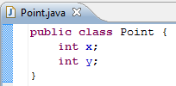
Fill in the instance variables and constructor for Line4
Set the values of x and y as shown
Line4
points
Point
x
y
Point
x
y
50
32
-8
12

Slide 34
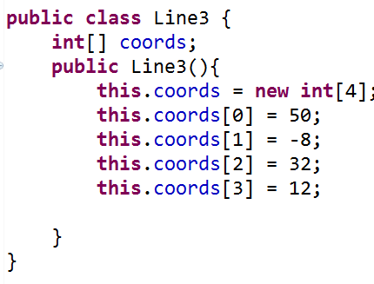
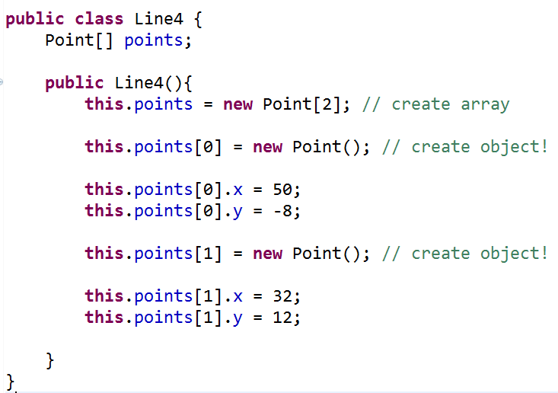

Slide 35
List and ListNode Classes
These are in one file!

Slide 36
List
myHead
mySize
ListNode
myFirst
myRest
spam
args
main
“a”
3
This is different than Racket b/c a List is different than an element of the List
(a ListNode)
If the name of this List is spam
How do you access the “a”?
Got it!
Not sure
Stuck
ListNode
myFirst
myRest
“b”
ListNode
myFirst
myRest
“c”

Slide 37
List
myHead
mySize
It is an empty List ☺
spam
args
main
0
Why do we have both List Objects and ListNode Objects?!?
spam
args
It is a null reference ☹
main
It isn’t empty. This points to a ListNode with null in it!
Because we needed a way to represent empty lists!
ListNode
myFirst
myRest
spam
args
main

Slide 38
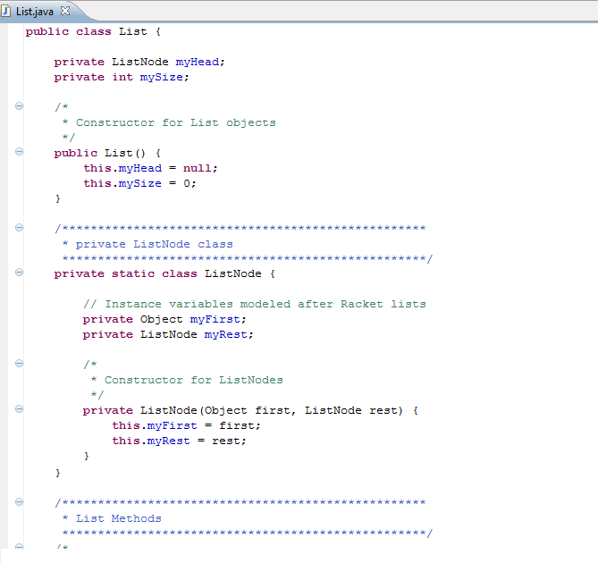
List
myHead
mySize
Private Inner Class:
Outside of the class people don’t know abut it
3
ListNode
myFirst
myRest
“L”

Slide 39
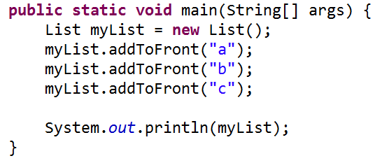
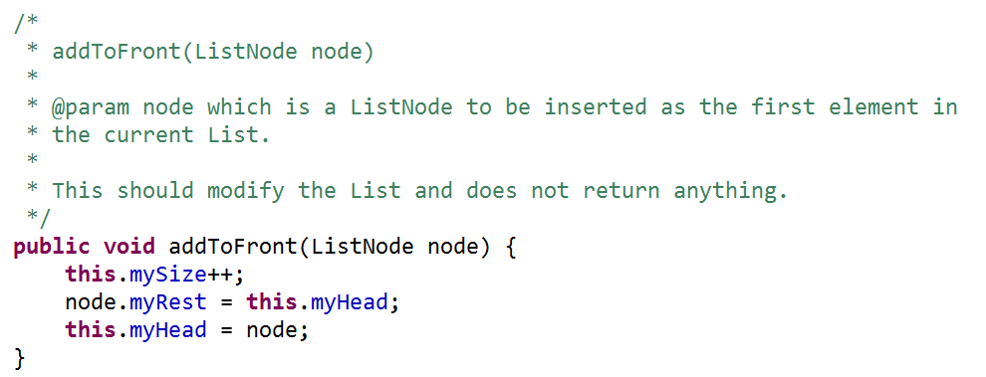
Draw what memory looks like after….
First call to addToFront
Second call to addToFront

Slide 40
List
myHead
mySize
ListNode
myFirst
myRest
myList
args
main
“c”
3
ListNode
myFirst
myRest
“b”
Solution!
ListNode
myFirst
myRest
“a”

Slide 41
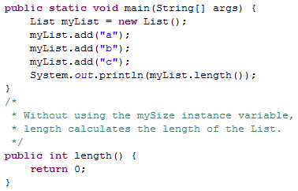
Write length

Slide 42
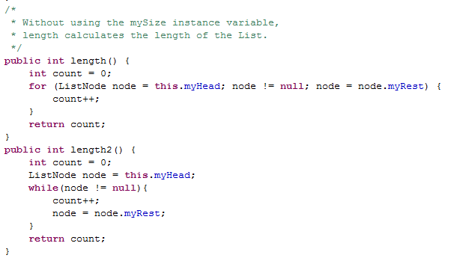
Length Solutions

Slide 43
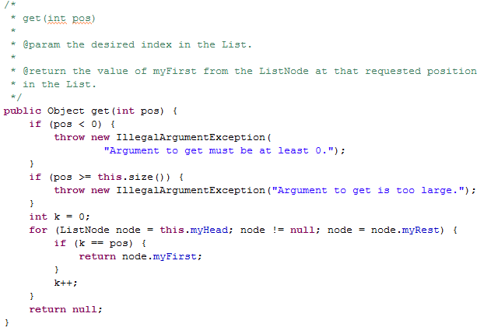
A Mysterious Method in List
We have to say what type of thing we return. But we can also FREAK OUT and throw an Exception

Slide 44
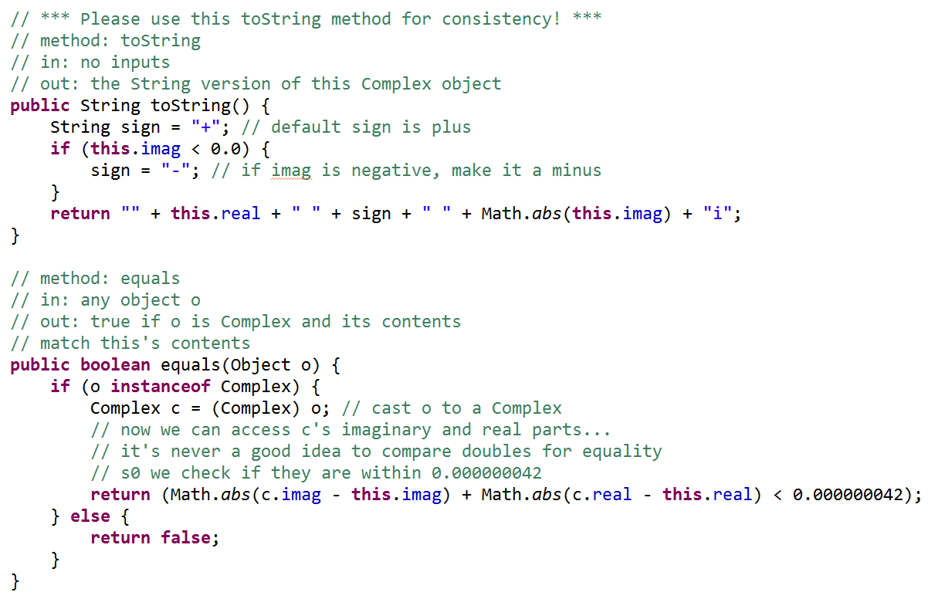
toString() is the method that gets called by System.out.println()
instanceof
Un-Java like syntax!!!
Checks the type of an object!

Slide 45
BONUS

Slide 46
log₂(x) is not scary
log₂(1) = 0
log₂(2) = 1
log₂(3) = 1.584962500721156
log₂(4) = 2
log₂(5) = 2.321928094887362
log₂(6) = 2.584962500721156
log₂(7) = 2.807354922057604
log₂(8) = 3
log₂(9) = 3.169925001442312
log₂(10) = 3.321928094887362
2⁰ = 1
log₂(x) means
the power you have to raise 2 by
in order to get x.
2¹ = 2
2² = 4
2³ = 8
2 ^{3.169925001442312} = 9
http://logbase2.blogspot.com/2007/12/log-base-2.html

Slide 47
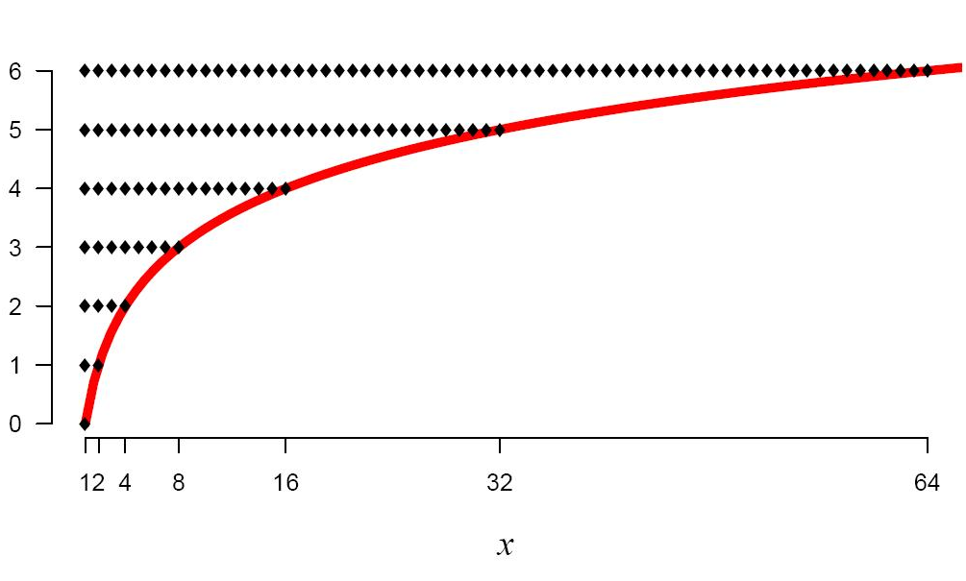
log₂(x)
log₂(x) means
the power you have to raise 2 by
in order to get x.
http://logbase2.blogspot.com/2007/12/log-base-2.html

Slide 48
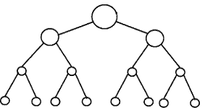
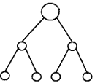


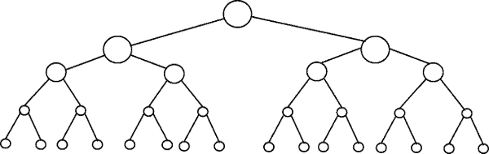
Perfectly Balanced Trees
h = 0
n = 1
h = 1
n = 3
h = 2
n = 7
h = 3
n = 15

Slide 49
Number of Items (n) | Number of Rows | log₂(x) means the power you have to raise 2 by in order to get x.
2-3 | 2 | 1 = log₂(2) < log₂ (3) < 2
4-7 | 3 | 2 = log₂(4) < log₂ (7) < 3
8-15 | 4 | 3 = log₂(8) < log₂ (15) < 4
16-31 | 5 | 4 = log₂(16) < log₂ (31) < 5
32-63 | 6 | 5 = log₂(32) < log₂ (63) < 6
64-127 | 7 | 6 = log₂(64) < log₂ (127) < 7
128-255 | 8 | 7 = log₂(128) < log₂ (255) < 8
256-511 | 9 | 8 = log₂(256) < log₂ (511) < 9
512-1023 | 10 | 9 = log₂(512) < log₂ (1023) < 10
If you have a balanced binary tree with n nodes,
the height is log₂(n) ± 1
(i.e. approximately log₂(n))

Slide 50
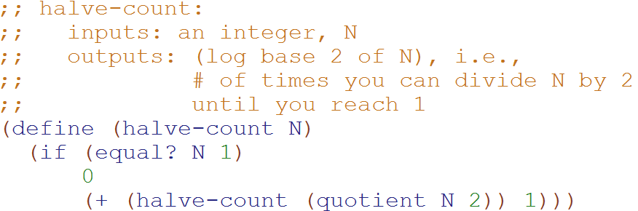
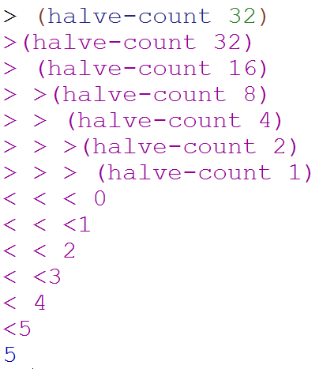
Big-O: Logarithmic Time
O(log₂N)
O(log₂N)
The magnitude of the input is cut in half with each recursive call
Why does cutting the magnitude of the input in half each time produce O(log₂N) runtime?

Slide 51
Example 2: Count the total # of constant-time operations?
for ( int i=1 ; i < N ; i=i*2){
// constant-time operation
}
i=1
i=2
i=4
…
i=N/2
i=N
# ops per row
1
1
1
…
1
1
O(log₂(N))
Total
of log₂(N)

Slide 52
Example 3: Count the total # of constant-time operations?
for ( int i=N ; i > 0 ; i=i/2){
// constant-time operation
}
i=N
i=N/2
…
i=4
i=2
i=1
# ops per row
1
1
1
…
1
1
O(log₂(N))
Total
of log₂(N)

Slide 53
Perfectly Balanced Trees
h = 0
n = 1
h = 1
n = 3
h = 2
n = 7
h = 3
n = 15

Slide 54



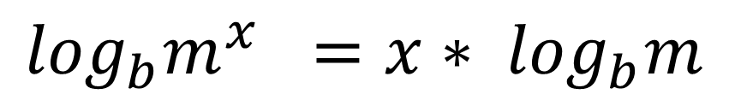
// Take the log of both sides
// Remember:
Ignore the minus 1
$$\log_{b}m^{x} ={x∗ log}_{b}m$$

Slide 55
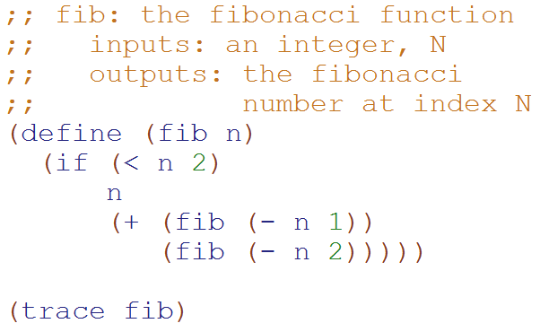
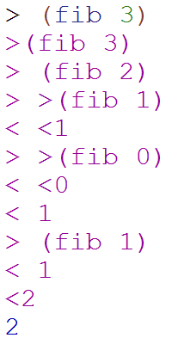
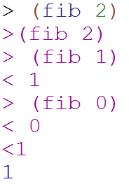
Big-O: Exponential Time
O(2^{N})
O(2^{N})
You make two slightly smaller recursive calls each time

Slide 56
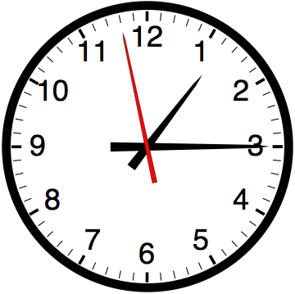

Slide 57


Computer
Science
&
= AWESOME

Slide 58

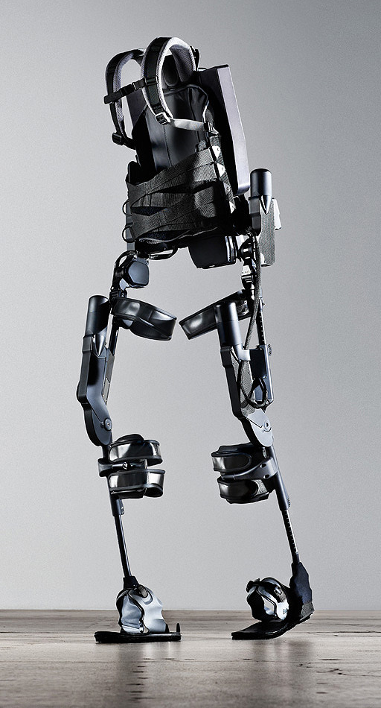
http://www.youtube.com/watch?v=pzRmNYA8LlY

Slide 59


ClickStart

Slide 60


Slide 61

How should we represent the blocks in the computer?
Independent variables
2D Array
OpenList
I don’t know

Slide 62
The value in the array tells me what art asset to use
Each level is really a 3x10 vector!
0 | 0 | 7 | 0 | 4 | 0 | 0 | 0
1 | 2 | 3 | -4 | 5 | 6 | -7 | 8
B | B | B | B | B | B | B | B
Negative values tell me what block needs to go here to win!

Slide 63
0 | 0 | 7 | 0 | 4 | 0 | 0 | 0
1 | 2 | 3 | -4 | 5 | 6 | -7 | 8
0 | 0 | 0 | B | 0 | 0 | 0 | 0

Slide 64
BUGS!

Slide 65


Slide 66

It is really sad when stuff you’ve made is on sale!

Slide 67



Which image is fake?
  A. Top Left
  B. Bottom Left
  C. Bottom Right

Slide 68
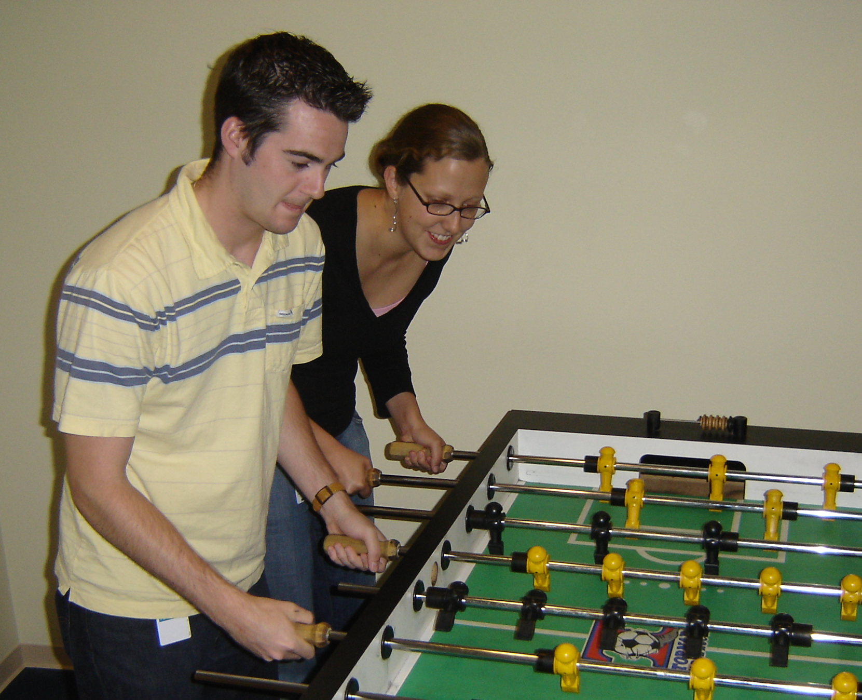

Slide 69
