Slide 1
CS 60
List/ListNode
Merge Sort
Inheritance
2014-10-22
Wednesday – Week 7
Lecture 14

Slide 2
Lecture 14 – Learning Goals
Write code with List and ListNode objects.
Describe Merge Sort (be ready to code it).
Define static type and dynamic type.
Explain the value of inheritance.
Predict the behavior of code using inheritance and different static and dynamic types.
Explain why you always write a method: equals(Object ob) in class Tee instead of equals(Tee ob)

Slide 3


http://www.math.hmc.edu/funfacts/
Warm-up – You should recognize these!
1 + 2 + 3 + … + (N-2) + (N-1) + N = _________
1 + 2 + 4 + … + N/4 + N/2 + N = _________
1 + 2 + 4 + … + 2^{N-2} + 2^{N-1} + 2^{N} = _________

Slide 4
List and ListNode Classes
These are in one file!

Slide 5
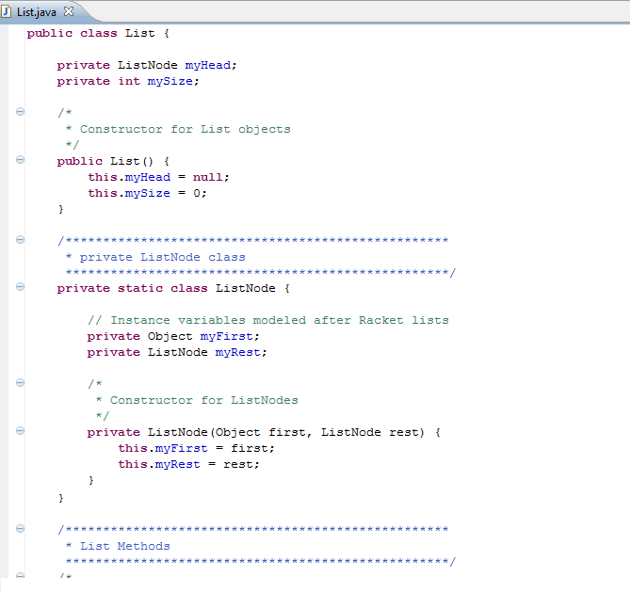
List
myHead
mySize
Private Inner Class:
Outside of the class people don’t know abut it
3
ListNode
myFirst
myRest
“L”

Slide 6
List
myHead
mySize
ListNode
myFirst
myRest
myList
args
main
“c”
3
ListNode
myFirst
myRest
“b”
Solution!
ListNode
myFirst
myRest
“a”

Slide 7
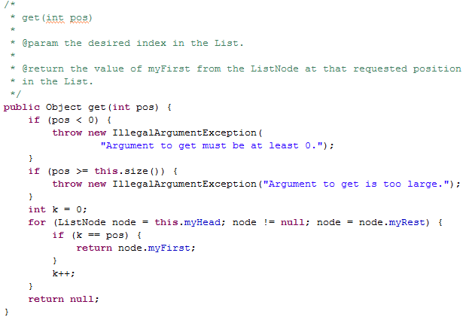
A Mysterious Method in List
We have to say what type of thing we return. But we can also FREAK OUT and throw an Exception

Slide 8
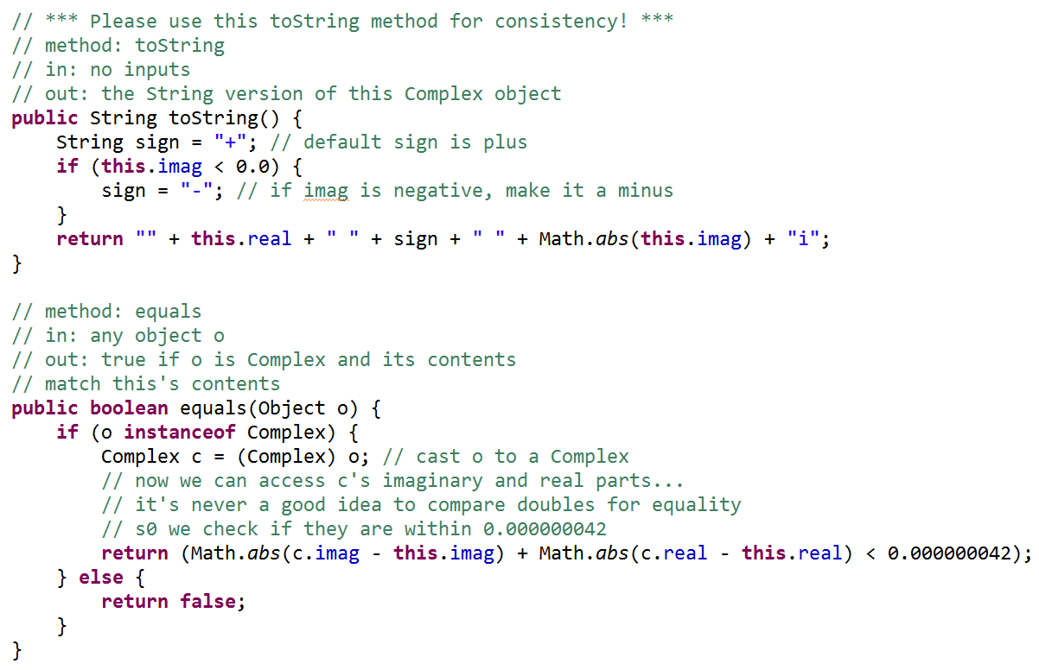
toString() is the method that gets called by System.out.println()
instanceof
Un-Java like syntax!!!
Checks the type of an object!

Slide 9
List
myHead
mySize
It is an empty List ☺
spam
args
main
0
Why do we have both List Objects and ListNode Objects?!?
spam
args
It is a null reference ☹
main
It isn’t empty. This points to a ListNode with null in it!
Because we needed a way to represent empty lists!
ListNode
myFirst
myRest
spam
args
main

Slide 10

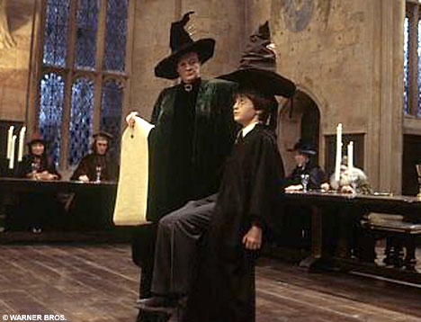
Merge Sort

Slide 11
What is the runtime of Merge?
(if the final length of the list is N)
Merge Demo
A | B | C | F | I | M | N | O
D | E | G | H | J | K | L | P
A | B | C | D | E | F | G | H | I | J | K | L | M | N | O | P
O(1)
O(log₂N)
O(N)
O(N²)
Stuck

Slide 12
Mergesorting with any lists?!
Start with a list…
[ 7, 1, 9, 6, 5, 42, 3 ]
Split it into two halves (within 1) …
[ 7, 1, 9, 6 ]
[ 5, 42, 3 ]
Recurse !?!
[ 1, 6, 7, 9 ]
[ 3, 5, 42 ]
Merge.
[ 1, 3, 5, 6, 7, 9, 42 ]

Slide 13
Step 1: Recursively divide the problem in half

Slide 14
Step 2: Merge the two halves back together
A | B | C | D | E | F | G | H | I | J | K | L | M | N | O | P
A | B | C | I | J | K | D | L | M | N | E | F | G | H | O | P

Slide 15
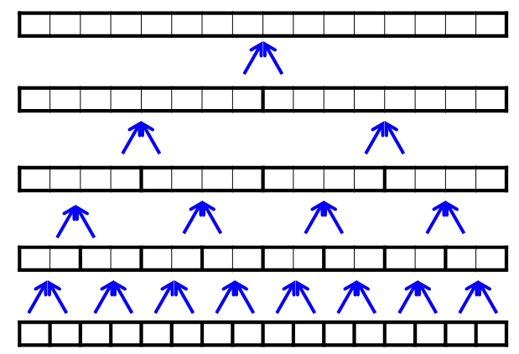
What is the runtime of MergeSort?
O(N)
O(N log₂N)
O(N²)
O(2^{N})
Stuck
Hints:
How many rows are there?
How much processing does each row require?

Slide 16
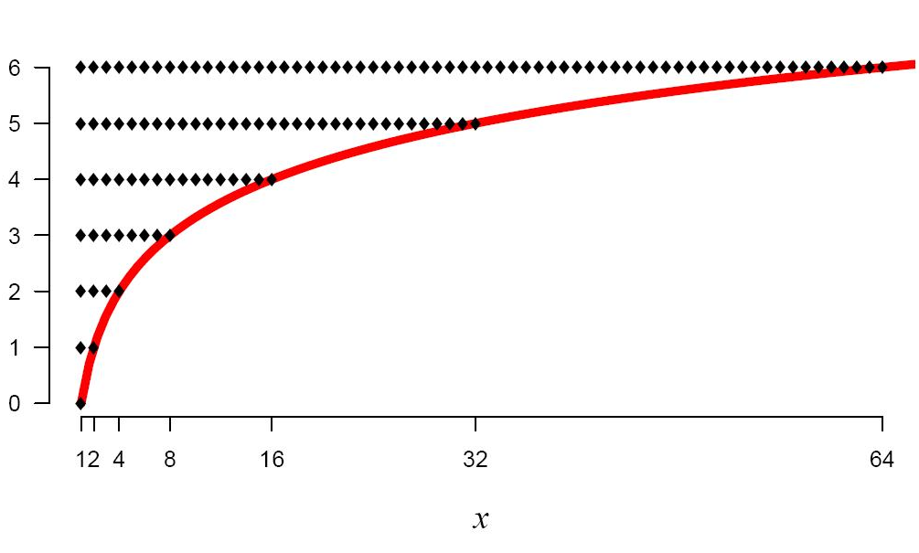
log₂(x)
log₂(x) means
the power you have to raise 2 by
in order to get x.
http://logbase2.blogspot.com/2007/12/log-base-2.html

Slide 17
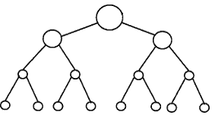
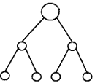


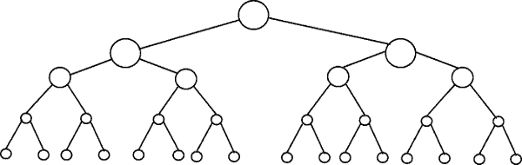
Perfectly Balanced Trees
h = 0
n = 1
h = 1
n = 3
h = 2
n = 7
h = 3
n = 15

Slide 18
Number of Items (n) | Number of Rows | log₂(x) means the power you have to raise 2 by in order to get x.
2-3 | 2 | 1 = log₂(2) < log₂ (3) < 2
4-7 | 3 | 2 = log₂(4) < log₂ (7) < 3
8-15 | 4 | 3 = log₂(8) < log₂ (15) < 4
16-31 | 5 | 4 = log₂(16) < log₂ (31) < 5
32-63 | 6 | 5 = log₂(32) < log₂ (63) < 6
64-127 | 7 | 6 = log₂(64) < log₂ (127) < 7
128-255 | 8 | 7 = log₂(128) < log₂ (255) < 8
256-511 | 9 | 8 = log₂(256) < log₂ (511) < 9
512-1023 | 10 | 9 = log₂(512) < log₂ (1023) < 10
If you have a balanced binary tree with n nodes,
the height is log₂(n) ± 1
(i.e. approximately log₂(n))

Slide 19
Inheritance & Casting

Slide 20
Inheritance Lingo
A Dog is an Animal
Dog extends Animal
Dog is the subclass of Animal
Animal is the superclass of
Dog
Animal
Dog
Dalmatian
Cat
A Dalmation is a Dog
A Dalmation is an Animal
Dalmation extends Dog
Dalmation is the subclass of Dog and Animal

Slide 21
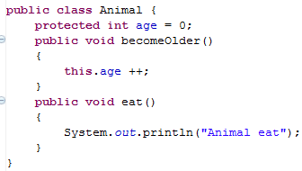
Animal
age
0
Animal myAnimal= new Animal();
myAnimal.becomeOlder();
myAnimal.eat();

Slide 22
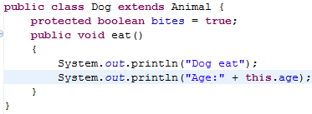
We can override the parent’s eat method
We can access the variable age, even though we didn’t include it in the Dog class directly
Dog
age
bites
Animal
age
0
true
0

Slide 23
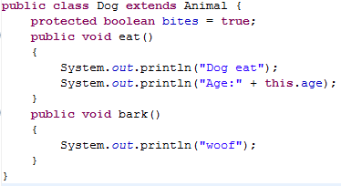
Dog myDog = new Dog();
myDog.eat();
myDog.bark(); // ↓ does this work? ___
myDog.becomeOlder();

Slide 25
Subclasses (Children) Can
Declare new instance/class variables
Declare new methods
Override old implementations with new implementations
Access instance/class variables of the superclass (parent) *
Access methods of the superclass*
* only public, protected or default ones

Slide 26
An object has two types:
Static type – The type of the reference
Dynamic type – The type of the object
This is totally different than
static methods
  i.e. don’t need an object to call it
static variables
  i.e. class variables shared by all instances of an object

Slide 27
Inheritance Puzzles
Dog d = new Animal();
Does this work? _______
No it doesn’t compile, If I want a Dog, an Animal will be NOT be acceptable because I might want to call a method that only a Dog can do!
Yes
No
I don’t know

Slide 28
Inheritance Puzzles
Animal a = new Dog();
Does this work? _______
YES it compiles and runs - If I want an Animal , a Dog will be acceptable because everything an Animal can do a Dog can do too!
Animal a = (Animal) new Dog();
Yes
No
I don’t know

Slide 29
Inheritance Puzzles
Animal a = new Dog();
Dog d = a;
Does this work? _______
No it doesn’t compile. The compiler doesn’t know it is really a Dog!
but we can PROMISE the compiler that it is with a cast
Dog d = (Dog) a;
Yes
No
I don’t know

Slide 30
Inheritance Puzzles
Animal a = new Animal();
Dog d = (Dog) a;
Does this work? _______
YES and NO - The compiler trusts your PROMISE (cast) but then if you run your program it has a RUN TIME ERROR because a is not a Dog
Yes
No
I don’t know

Slide 31
Inheritance Puzzles
Yes
No
I don’t know
Animal
Dog
Dalmatian
Poodle
Cat
Animal a = new Cat();
Dog d = (Dog) a;
d.bark();
Does this work? _______
YES and NO. It compiles, but then when we try to do the cast we get a RUN TIME ERROR, before we even try to call any dog methods on a.

Slide 32
Inheritance Puzzles
Animal a = new Dog();
a.bark();
Does this work? _______
NO it does not compile - The compiler thinks it is an Animal, and an Animal does not have a method bark
Dog d = (Dog) a; d.bark();
((Dog) a).bark();
Yes
No
I don’t know

Slide 33
Inheritance Puzzles
Animal a = new Dog();
a.eat();
Does this work? _______
YES- The compiler is happy - an Animal has an eat() method.
Which method is called the Animal eat()
or the Dog eat() ?
Yes
No
I don’t know

Slide 34
Inheritance Puzzles
Animal eat()
Dog eat()
I don’t know
Animal a = new Dog();
a.eat();
Which method is called the Animal eat()
or the Dog eat() ?
main
Animal a
Dog
age
bites
0
true

Slide 35
An object has two types:
Static type – The type of the reference
Dynamic type – The type of the object
This is totally different than
static methods
  i.e. don’t need an object to call it
static variables
  i.e. class variables shared by all instances of an object

Slide 36
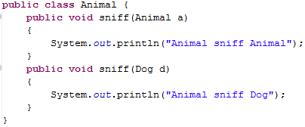
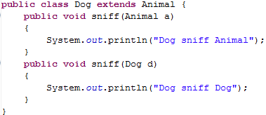

Slide 37
Inheritance and
Arguments
Animal
Dog
Cat

Slide 38
← Uses a1’s dynamic type
Animal a1 = new Dog();
Dog d1 = new Dog();
a1.sniff(d1);
d1.sniff(a1);
Animal a2 = new Dog();
a1.sniff(a2);
← Uses a1’s static type
← Uses a1’s dynamic type
Uses a2’s static type

Slide 39
Inheritance
Compilation:
  CALLER: It makes sure that the static type of the object has the appropriate method
  ARGS: It makes sure that the method takes in the static type of the arguments
Run-time:
  CALLER: When you call a method on an object it looks for the method starting at the object’s dynamic type
  ARGS: When you pass an object as an argument, it looks for a method with that static type

Slide 40
Animal a1 = new Dog();
Dog d1 = new Dog();
a1.sniff(d1);
d1.sniff(a1);
Animal a2 = new Dog();
a1.sniff(a2);
Dog
age
bites
0
true
Dog
age
bites
0
main
Animal a1
Animal a2
Dog d1
true
Dog
age
bites
0
true

Slide 41
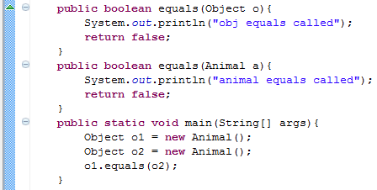
equals(Object o)
Which equals is called?
Object

Slide 42
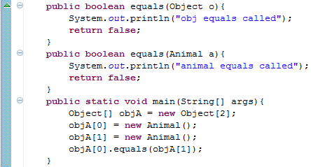
equals(Object o) and Arrays
Which equals is called?
Object

Slide 43
equals(Object o)
If others will call your methods with more generic references, you want to provide a method that takes in an Object

Slide 44
Ridable
Object
Animal
Machine
Car
Cat
Blender
Dog
Horse

Slide 45

Interfaces
I have a GREAT idea!
Everyone will want to make Ridable things that can
  turnLeft()
  turnRight()
  goForward()
How?!?!
  I don’t care!!!!

Slide 46
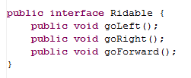
The Ridable interface

Slide 47
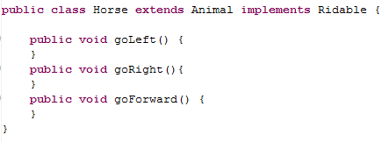
Horse can implement the Ridable interface

Slide 48
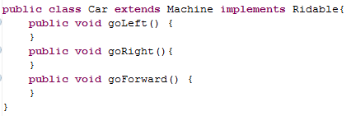
Car can implement the Ridable interface

Slide 49
We can have a Rideable remote control
(Rideable reference)
Rideable r1 = new Horse();
Rideable r2 = new Car();
r1.goForward();
r2.goForward();

Slide 50
Can we have a Ridable object?
Ridable r1 = new Ridable();
No! You can’t create an object of an interface!

Slide 51
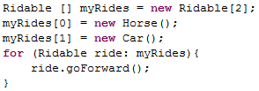
Interfaces can be cool!!!

Slide 52
Example
The sort method of the Array class promises to sort an array of objects, but under one condition: the objects in the array must implement the Comparable interface:
  public interface Comparable {
  int compareTo(Object other);
  }

Slide 53
Summary of Interfaces
Interfaces don’t implement ANY methods
  Just put a semicolon at the end of the method
Classes can implement multiple interfaces
To implement an interface you must write all of the methods that the interface defines

Slide 54
Cookies!
Cookie
Girl Scout Cookie
Thin mint
Shortbread
Chocolate Chip

Slide 55
Abstract Classes
(less lazy than Interfaces)
I have a GREAT idea!
Everyone will want to make Cookies that can have these methods:
  ingredients()
  isDelicious()
How?!?!
  isDelicious() is pretty simple, I’ll write that one
  ingredients() ?!? Sounds too hard! I’ll make that abstract

Slide 56
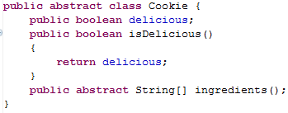
Abstract Class Cookie

Slide 57
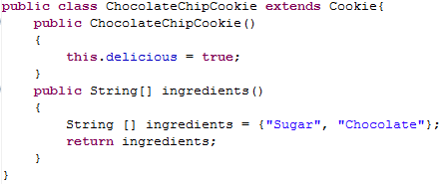
ChocolateChipCookie can extend the Abstract class Cookie

Slide 58
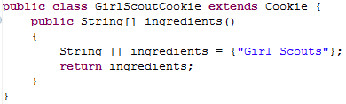
GirlScoutCookie can extend the Abstract class Cookie

Slide 59

We can have a Cookie remote control
(Cookie reference)

Slide 60
Can we have a Cookie object?
Cookie p1 = new Cookie();
No! You can’t create an object of an abstract class!

Slide 61
Abstract Class Summary
Label an Abstract class as abstract
Label any methods that you don’t want to implement as abstract
  Your children MUST write all of the abstract methods
Instance variables in the abstract class will be available in the child class
You can only extend one Class (abstract or otherwise)

Slide 62
BONUS

Slide 63
log₂(x) is not scary
log₂(1) = 0
log₂(2) = 1
log₂(3) = 1.584962500721156
log₂(4) = 2
log₂(5) = 2.321928094887362
log₂(6) = 2.584962500721156
log₂(7) = 2.807354922057604
log₂(8) = 3
log₂(9) = 3.169925001442312
log₂(10) = 3.321928094887362
2⁰ = 1
log₂(x) means
the power you have to raise 2 by
in order to get x.
2¹ = 2
2² = 4
2³ = 8
2 ^{3.169925001442312} = 9
http://logbase2.blogspot.com/2007/12/log-base-2.html

Slide 64
log₂(x)
log₂(x) means
the power you have to raise 2 by
in order to get x.
http://logbase2.blogspot.com/2007/12/log-base-2.html

Slide 65
Perfectly Balanced Trees
h = 0
n = 1
h = 1
n = 3
h = 2
n = 7
h = 3
n = 15

Slide 66
Number of Items (n) | Number of Rows | log₂(x) means the power you have to raise 2 by in order to get x.
2-3 | 2 | 1 = log₂(2) < log₂ (3) < 2
4-7 | 3 | 2 = log₂(4) < log₂ (7) < 3
8-15 | 4 | 3 = log₂(8) < log₂ (15) < 4
16-31 | 5 | 4 = log₂(16) < log₂ (31) < 5
32-63 | 6 | 5 = log₂(32) < log₂ (63) < 6
64-127 | 7 | 6 = log₂(64) < log₂ (127) < 7
128-255 | 8 | 7 = log₂(128) < log₂ (255) < 8
256-511 | 9 | 8 = log₂(256) < log₂ (511) < 9
512-1023 | 10 | 9 = log₂(512) < log₂ (1023) < 10
If you have a balanced binary tree with n nodes,
the height is log₂(n) ± 1
(i.e. approximately log₂(n))

Slide 67
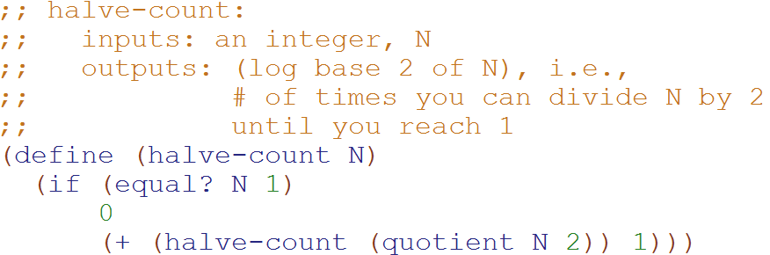
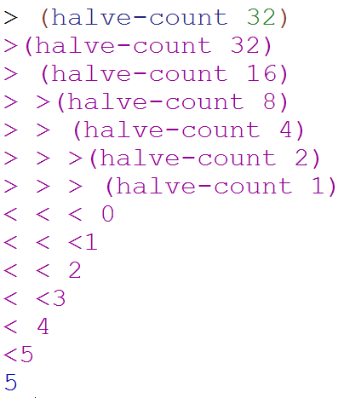
Big-O: Logarithmic Time
O(log₂N)
O(log₂N)
The magnitude of the input is cut in half with each recursive call
Why does cutting the magnitude of the input in half each time produce O(log₂N) runtime?

Slide 68
Example 2: Count the total # of constant-time operations?
for ( int i=1 ; i < N ; i=i*2){
// constant-time operation
}
i=1
i=2
i=4
…
i=N/2
i=N
# ops per row
1
1
1
…
1
1
O(log₂(N))
Total
of log₂(N)

Slide 69
Example 3: Count the total # of constant-time operations?
for ( int i=N ; i > 0 ; i=i/2){
// constant-time operation
}
i=N
i=N/2
…
i=4
i=2
i=1
# ops per row
1
1
1
…
1
1
O(log₂(N))
Total
of log₂(N)

Slide 70
Perfectly Balanced Trees
h = 0
n = 1
h = 1
n = 3
h = 2
n = 7
h = 3
n = 15

Slide 71



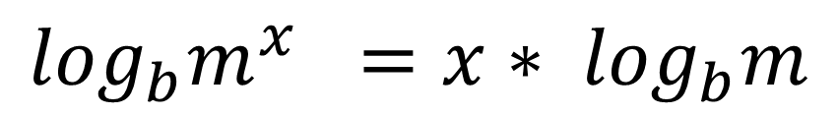
// Take the log of both sides
// Remember:
Ignore the minus 1
$$\log_{b}m^{x} ={x∗ log}_{b}m$$

Slide 72
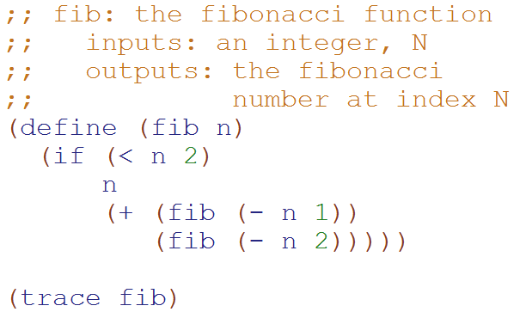
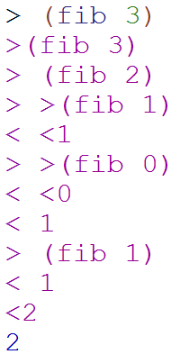
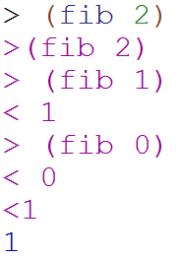
Big-O: Exponential Time
O(2^{N})
O(2^{N})
You make two slightly smaller recursive calls each time

Slide 73
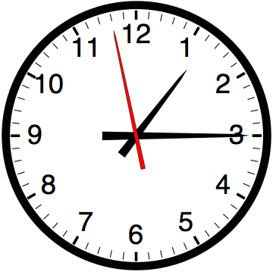

Slide 74


Computer
Science
&
= AWESOME

Slide 75

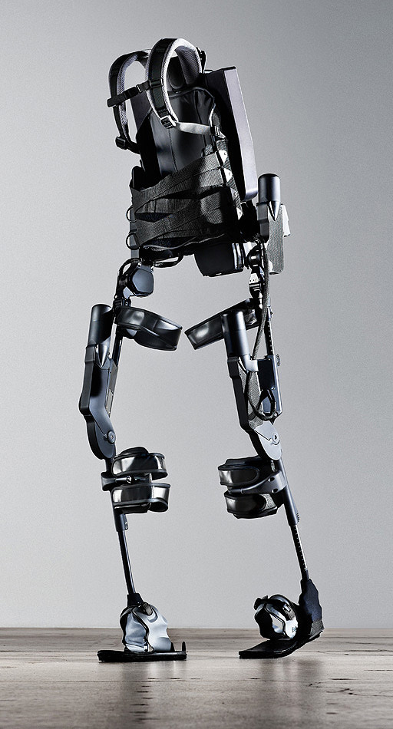
http://www.youtube.com/watch?v=pzRmNYA8LlY

Slide 76


ClickStart

Slide 77
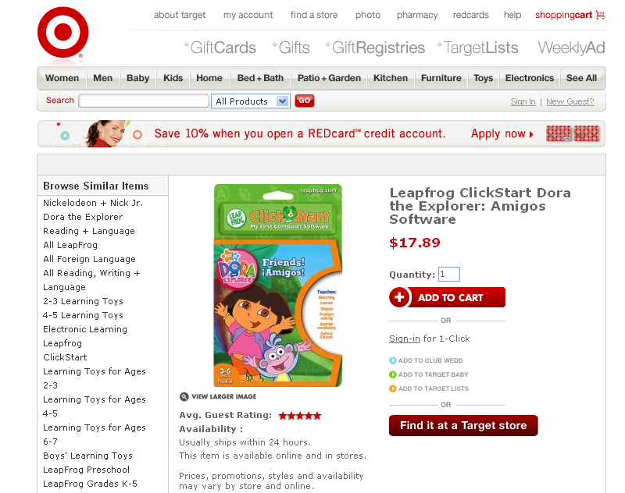

Slide 78
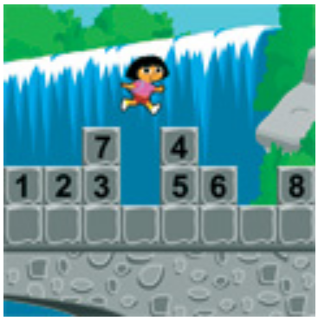
How should we represent the blocks in the computer?
Independent variables
2D Array
OpenList
I don’t know

Slide 79
The value in the array tells me what art asset to use
Each level is really a 3x10 vector!
0 | 0 | 7 | 0 | 4 | 0 | 0 | 0
1 | 2 | 3 | -4 | 5 | 6 | -7 | 8
B | B | B | B | B | B | B | B
Negative values tell me what block needs to go here to win!

Slide 80
0 | 0 | 7 | 0 | 4 | 0 | 0 | 0
1 | 2 | 3 | -4 | 5 | 6 | -7 | 8
0 | 0 | 0 | B | 0 | 0 | 0 | 0

Slide 81
BUGS!

Slide 82
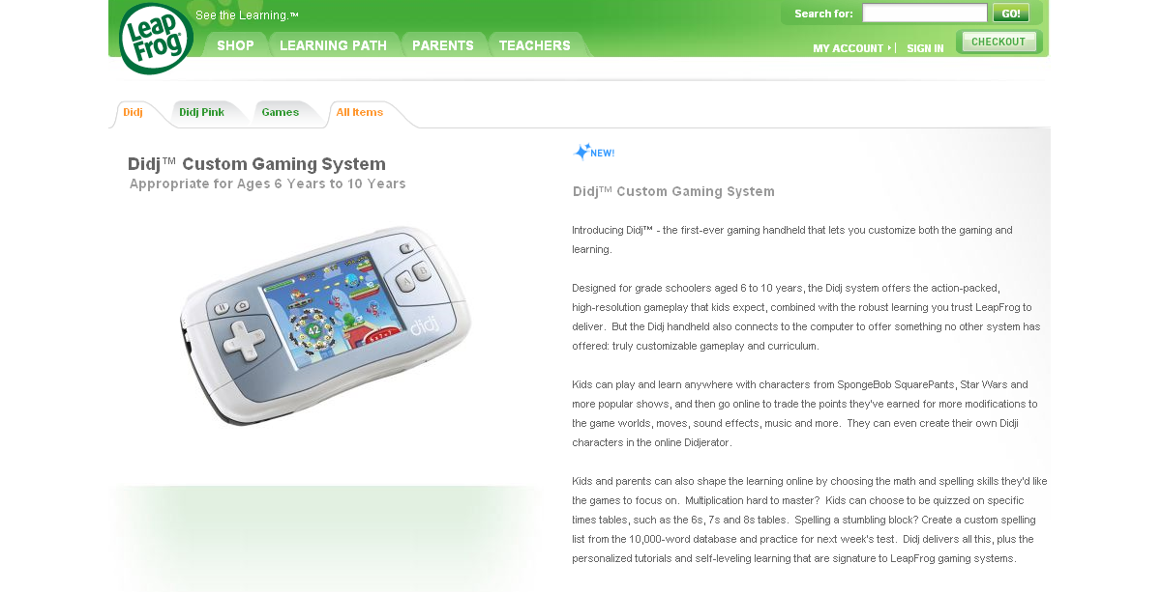

Slide 83
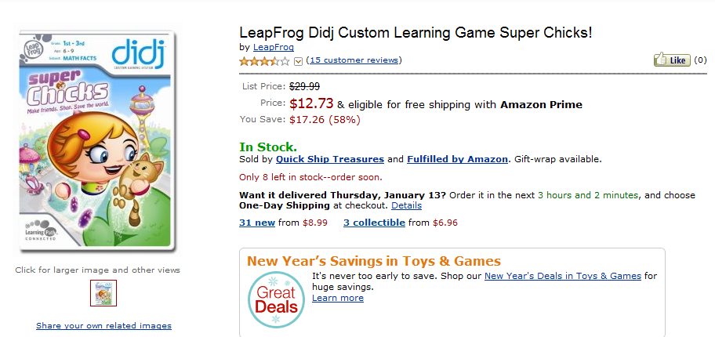
It is really sad when stuff you’ve made is on sale!

Slide 84
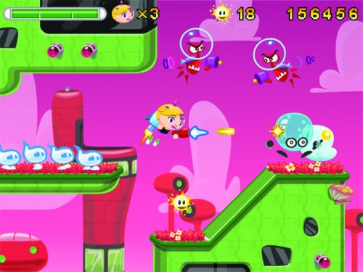
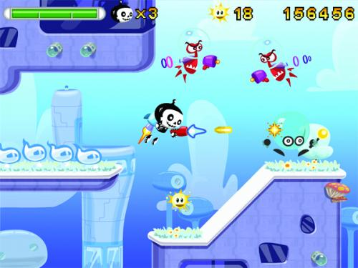

Which image is fake?
  A. Top Left
  B. Bottom Left
  C. Bottom Right

Slide 85
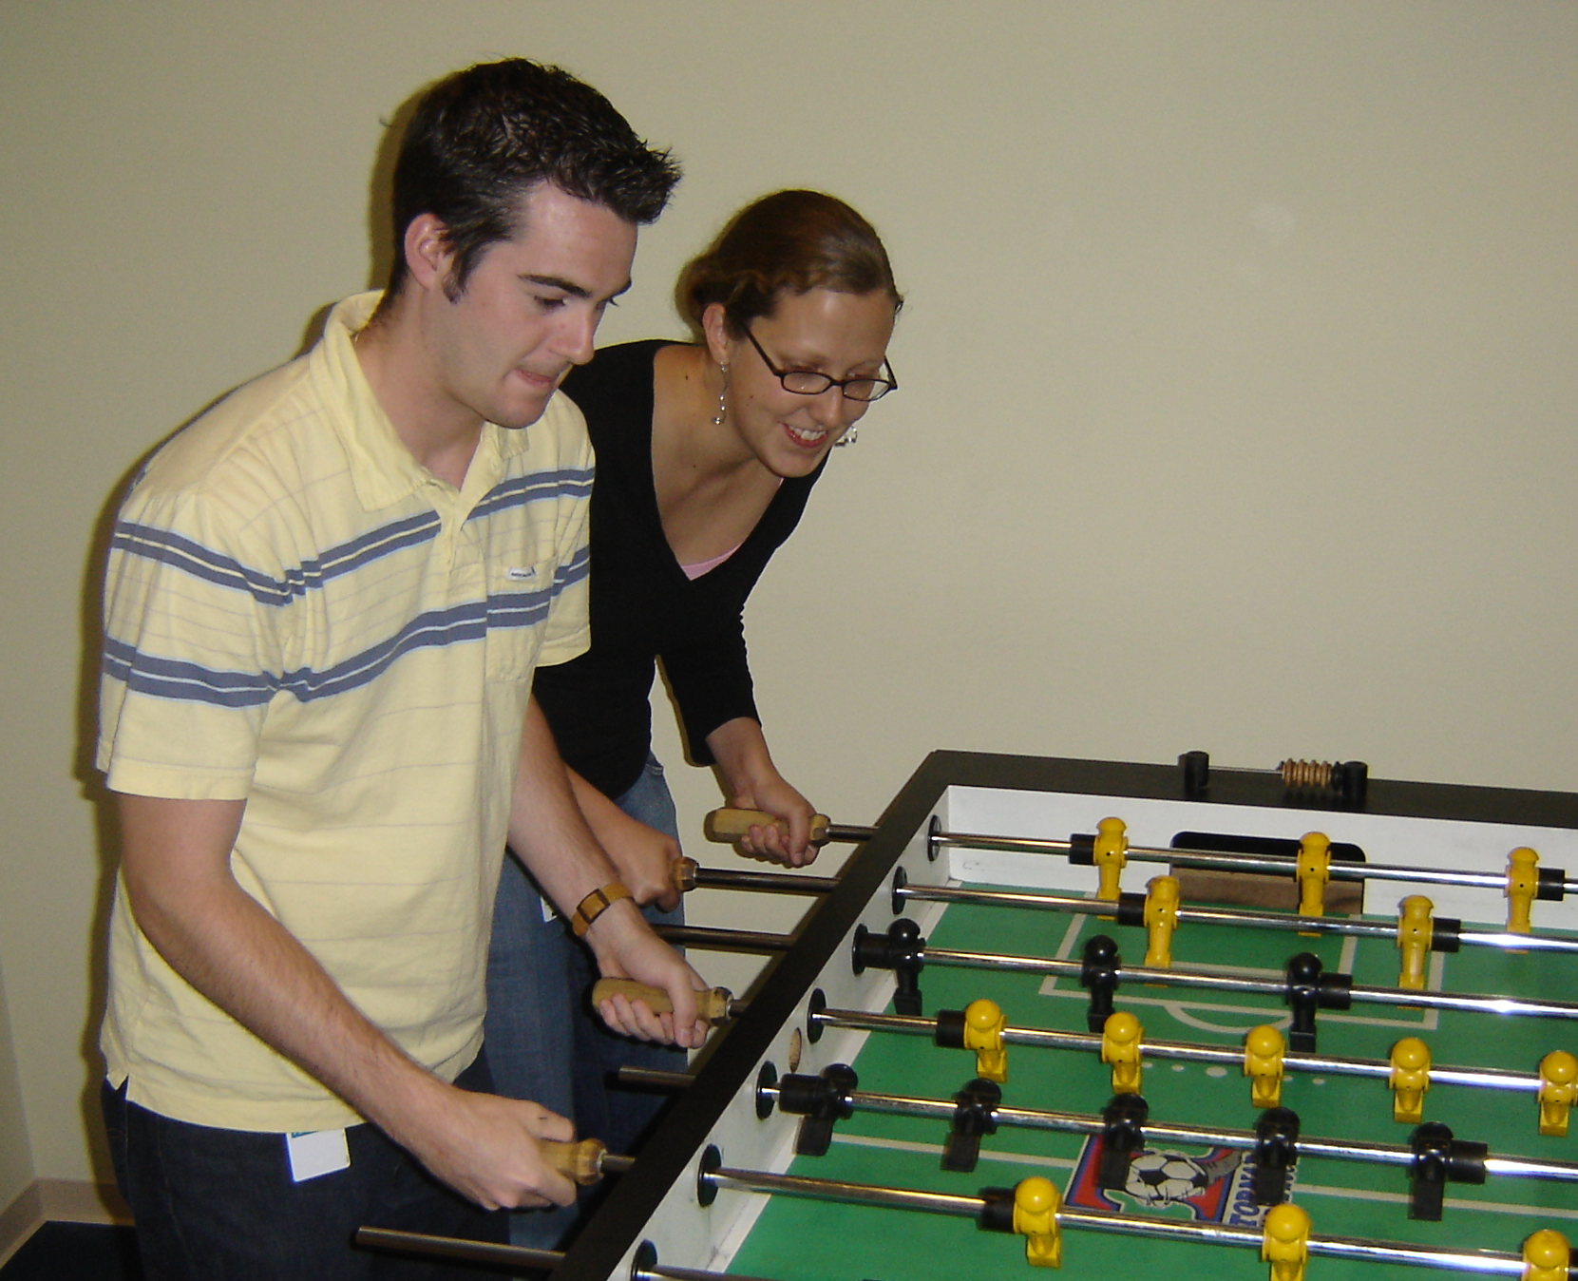

Slide 86
