Slide 1
CS 60
Inheritance
2014-10-27
Monday – Week 8
Lecture 15

Slide 2
Lecture 15 – Learning Goals
Define static type and dynamic type.
Explain the value of inheritance.
Predict the behavior of code using inheritance and different static and dynamic types.
Explain why you always write a method: equals(Object ob) in class Tee instead of equals(Tee ob)
Describe the differences between Interfaces and Abstract Classes and be able to use either

Slide 3
Inheritance & Casting

Slide 4
Inheritance Lingo
A Dog is an Animal
Dog extends Animal
Dog is the subclass of Animal
Animal is the superclass of
Dog
Animal
Dog
Dalmatian
Cat
A Dalmation is a Dog
A Dalmation is an Animal
Dalmation extends Dog
Dalmation is the subclass of Dog and Animal

Slide 5
Subclasses (Children) Can
Declare new instance/class variables
Declare new methods
Override old implementations with new implementations
Access instance/class variables of the superclass (parent) *
Access methods of the superclass*
* only public, protected or default ones

Slide 6
An object has two types:
Static type – The type of the reference
Dynamic type – The type of the object
This is totally different than
static methods
i.e. don’t need an object to call it
static variables
i.e. class variables shared by all instances of an object

Slide 7
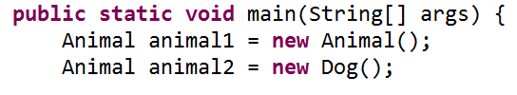
Static vs. Dynamic Type
Static type – The type of the reference
The static type of animal1 is ___________
The static type of animal2 is ___________
Dynamic type – The type of the object
The dynamic type of animal1 is ___________
The dynamic type of animal2 is ___________

Slide 8
Static vs. Dynamic Type
Static type – The type of the reference
The static type of animal1 is Animal
The static type of animal2 is Animal
Dynamic type – The type of the object
The dynamic type of animal1 is Animal
The dynamic type of animal2 is Dog

Slide 9
Inheritance Puzzles
Dog d = new Animal();
Does this work? _______
No it doesn’t compile, If I want a Dog, an Animal will be NOT be acceptable because I might want to call a method that only a Dog can do!
Yes
No
I don’t know

Slide 10
Inheritance Puzzles
Animal a = new Dog();
Does this work? _______
YES it compiles and runs - If I want an Animal , a Dog will be acceptable because everything an Animal can do a Dog can do too!
Animal a = (Animal) new Dog();
Yes
No
I don’t know

Slide 11
Inheritance Puzzles
Animal a = new Dog();
Dog d = a;
Does this work? _______
No it doesn’t compile. The compiler doesn’t know it is really a Dog!
but we can PROMISE the compiler that it is with a cast
Dog d = (Dog) a;
Yes
No
I don’t know

Slide 12
Inheritance Puzzles
Animal a = new Animal();
Dog d = (Dog) a;
Does this work? _______
YES and NO - The compiler trusts your PROMISE (cast) but then if you run your program it has a RUN TIME ERROR because a is not a Dog
Yes
No
I don’t know

Slide 13
Inheritance Puzzles
Yes
No
I don’t know
Animal
Dog
Dalmatian
Poodle
Cat
Animal a = new Cat();
Dog d = (Dog) a;
d.bark();
Does this work? _______
YES and NO. It compiles, but then when we try to do the cast we get a RUN TIME ERROR, before we even try to call any dog methods on a.

Slide 14
Inheritance Puzzles
Animal a = new Dog();
a.bark();
Does this work? _______
NO it does not compile - The compiler thinks it is an Animal, and an Animal does not have a method bark
Dog d = (Dog) a; d.bark();
((Dog) a).bark();
Yes
No
I don’t know

Slide 15
Inheritance Puzzles
Animal a = new Dog();
a.eat();
Does this work? _______
YES- The compiler is happy - an Animal has an eat() method.
Which method is called the Animal eat() or the Dog eat() ?
Yes
No
I don’t know

Slide 16
Inheritance Puzzles
Animal eat()
Dog eat()
I don’t know
Animal a = new Dog();
a.eat();
Which method is called the Animal eat() or the Dog eat() ?
main
Animal a
Dog
age
bites
0
true

Slide 17
An object has two types:
Static type – The type of the reference
Dynamic type – The type of the object
This is totally different than
static methods
i.e. don’t need an object to call it
static variables
i.e. class variables shared by all instances of an object

Slide 18
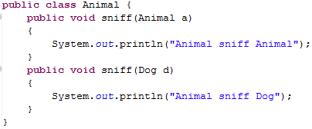
Inheritance and Arguments
Animal
Dog
Cat

Slide 19
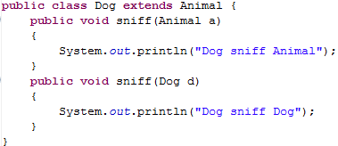
Animal
Dog
Cat

Slide 21

What method should we call?
Use the dynamic type of the caller
Use the static type of the argument
Caller
Argument

Slide 22
How does Java check if this should compile?
Use the static type of the caller
Use the static type of the argument
Caller
Argument

Slide 23
← Uses a1’s dynamic type
What method should we call?
Animal a1 = new Dog();
Dog d1 = new Dog();
a1.sniff(d1);
d1.sniff(a1);
Animal a2 = new Dog();
a1.sniff(a2);
← Uses a1’s static type
← Uses a1’s dynamic type
Uses a2’s static type

Slide 24
Inheritance
Compilation:
CALLER: It makes sure that the static type of the object has the appropriate method
ARGS: It makes sure that the method takes in the static type of the arguments
Run-time:
CALLER: When you call a method on an object it looks for the method starting at the object’s dynamic type
ARGS: When you pass an object as an argument, it looks for a method with that static type

Slide 25
Animal a1 = new Dog();
Dog d1 = new Dog();
a1.sniff(d1);
d1.sniff(a1);
Animal a2 = new Dog();
a1.sniff(a2);
Dog
age
bites
0
true
Dog
age
bites
0
main
Animal a1
Animal a2
Dog d1
true
Dog
age
bites
0
true

Slide 26
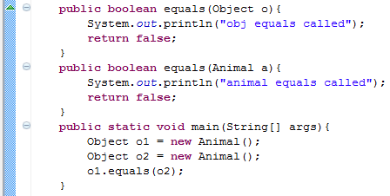
equals(Object o)
Which equals is called?
Object

Slide 27
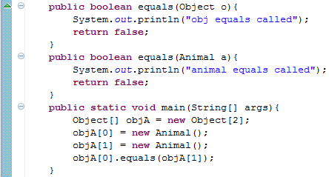
equals(Object o) and Arrays
Which equals is called?
Object

Slide 28
equals(Object o)
If others will call your methods with more generic references, you want to provide a method that takes in an Object

Slide 29
Ridable
Object
Animal
Machine
Car
Cat
Blender
Dog
Horse

Slide 30

Interfaces
I have a GREAT idea!
Everyone will want to make Ridable things that can
turnLeft()
turnRight()
goForward()
How?!?!
I don’t care!!!!

Slide 31
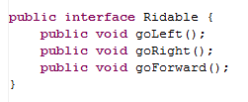
The Ridable interface

Slide 32
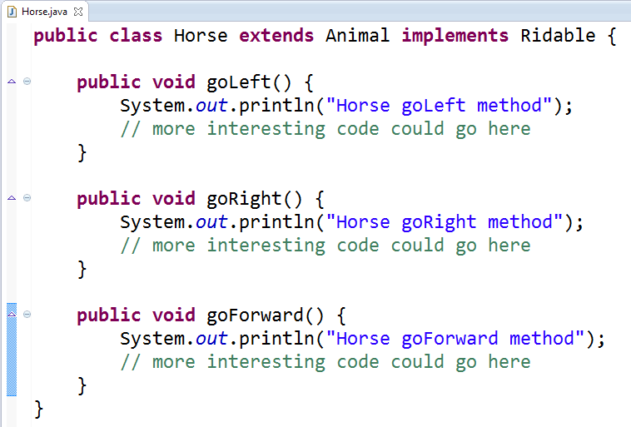
Horse can implement the Ridable interface

Slide 33
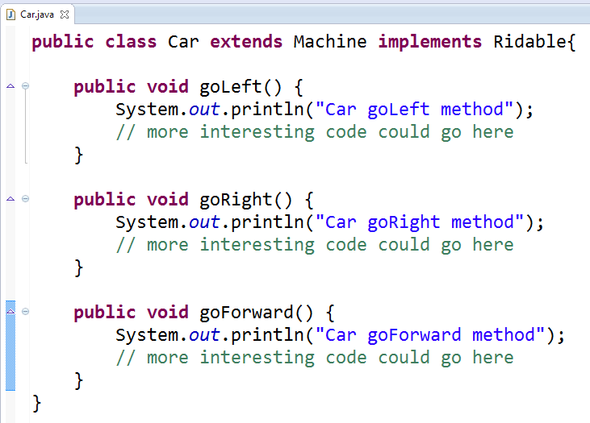
Car can implement the Ridable interface

Slide 34
We can have a Rideable remote control (Rideable reference)
Rideable r1 = new Horse();
Rideable r2 = new Car();
r1.goForward();
r2.goForward();

Slide 35
Can we have a Ridable object?
Ridable r1 = new Ridable();
No! You can’t create an object of an interface!

Slide 36
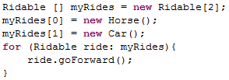
Interfaces can be cool!!!

Slide 37
Example
The sort method of the Array class promises to sort an array of objects, but under one condition: the objects in the array must implement the Comparable interface:
public interface Comparable {
int compareTo(Object other);
}

Slide 38
Summary of Interfaces
Interfaces don’t implement ANY methods
Just put a semicolon at the end of the method
Classes can implement multiple interfaces
To implement an interface you must write all of the methods that the interface defines

Slide 39
Cookies!
Cookie
Girl Scout Cookie
Thin mint
Shortbread
Chocolate Chip

Slide 40
Abstract Classes (less lazy than Interfaces)
I have a GREAT idea!
Everyone will want to make Cookies that can have these methods:
ingredients()
isDelicious()
How?!?!
isDelicious() is pretty simple, I’ll write that one
ingredients() ?!? Sounds too hard! I’ll make that abstract

Slide 41
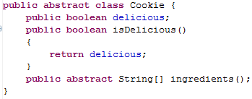
Abstract Class Cookie

Slide 42
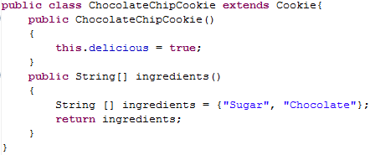
ChocolateChipCookie can extend the Abstract class Cookie

Slide 43
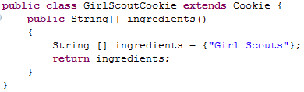
GirlScoutCookie can extend the Abstract class Cookie

Slide 44

We can have a Cookie remote control (Cookie reference)

Slide 45
Can we have a Cookie object?
Cookie p1 = new Cookie();
No! You can’t create an object of an abstract class!

Slide 46
Abstract Class Summary
Label an Abstract class as abstract
Label any methods that you don’t want to implement as abstract
Your children MUST write all of the abstract methods
Instance variables in the abstract class will be available in the child class
You can only extend one Class (abstract or otherwise)

Slide 47
List and ListNode Classes
These are in one file!

Slide 48
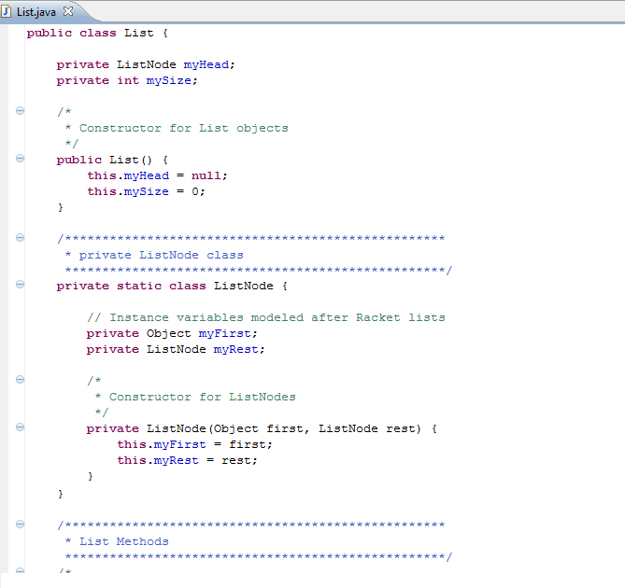
List
myHead
mySize
Private Inner Class:
Outside of the class people don’t know abut it
3
ListNode
myFirst
myRest
“L”

Slide 49
List
myHead
mySize
ListNode
myFirst
myRest
myList
args
main
“c”
3
ListNode
myFirst
myRest
“b”
Solution!
ListNode
myFirst
myRest
“a”

Slide 50
BONUS

Slide 51
log₂(x) is not scary
log₂(1) = 0 log₂(2) = 1 log₂(3) = 1.584962500721156 log₂(4) = 2 log₂(5) = 2.321928094887362 log₂(6) = 2.584962500721156 log₂(7) = 2.807354922057604 log₂(8) = 3 log₂(9) = 3.169925001442312 log₂(10) = 3.321928094887362
2⁰ = 1
log₂(x) means
the power you have to raise 2 by
in order to get x.
2¹ = 2
2² = 4
2³ = 8
2 ^{3.169925001442312} = 9
http://logbase2.blogspot.com/2007/12/log-base-2.html

Slide 52
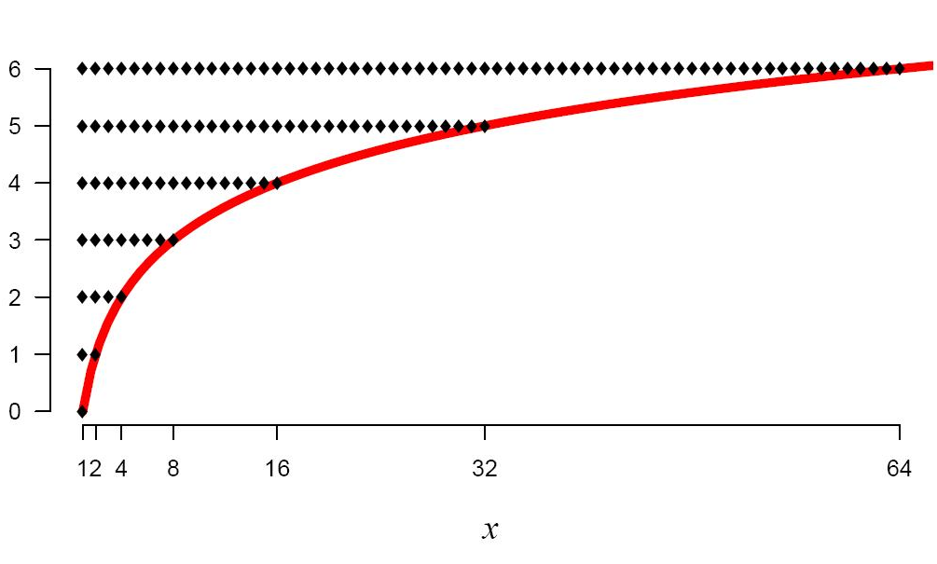
log₂(x)
log₂(x) means
the power you have to raise 2 by
in order to get x.
http://logbase2.blogspot.com/2007/12/log-base-2.html

Slide 53
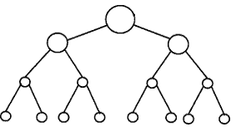
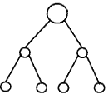


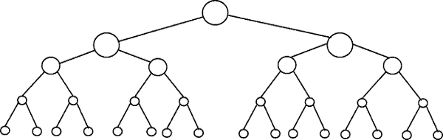
Perfectly Balanced Trees
h = 0
n = 1
h = 1
n = 3
h = 2
n = 7
h = 3
n = 15

Slide 54
Number of Items (n) | Number of Rows | log₂(x) means the power you have to raise 2 by in order to get x.
2-3 | 2 | 1 = log₂(2) < log₂ (3) < 2
4-7 | 3 | 2 = log₂(4) < log₂ (7) < 3
8-15 | 4 | 3 = log₂(8) < log₂ (15) < 4
16-31 | 5 | 4 = log₂(16) < log₂ (31) < 5
32-63 | 6 | 5 = log₂(32) < log₂ (63) < 6
64-127 | 7 | 6 = log₂(64) < log₂ (127) < 7
128-255 | 8 | 7 = log₂(128) < log₂ (255) < 8
256-511 | 9 | 8 = log₂(256) < log₂ (511) < 9
512-1023 | 10 | 9 = log₂(512) < log₂ (1023) < 10
If you have a balanced binary tree with n nodes,
the height is log₂(n) ± 1
(i.e. approximately log₂(n))

Slide 55
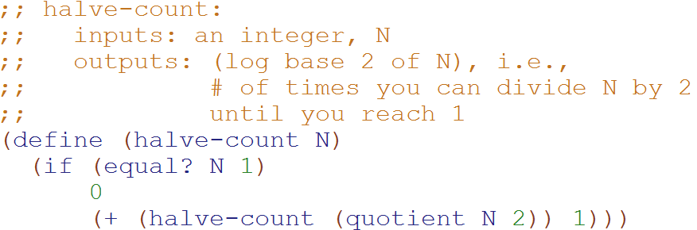
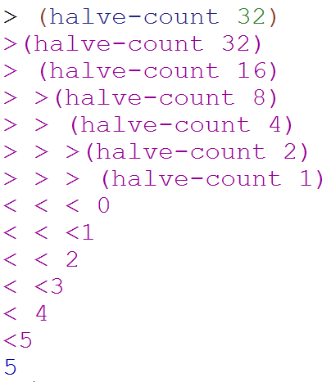
Big-O: Logarithmic Time O(log₂N)
O(log₂N)
The magnitude of the input is cut in half with each recursive call
Why does cutting the magnitude of the input in half each time produce O(log₂N) runtime?

Slide 56
Example 2: Count the total # of constant-time operations?
for ( int i=1 ; i < N ; i=i*2){
// constant-time operation
}
i=1
i=2
i=4
…
i=N/2
i=N
# ops per row
1
1
1
…
1
1
O(log₂(N))
Total
of log₂(N)

Slide 57
Example 3: Count the total # of constant-time operations?
for ( int i=N ; i > 0 ; i=i/2){
// constant-time operation
}
i=N
i=N/2
…
i=4
i=2
i=1
# ops per row
1
1
1
…
1
1
O(log₂(N))
Total
of log₂(N)

Slide 58
Perfectly Balanced Trees
h = 0
n = 1
h = 1
n = 3
h = 2
n = 7
h = 3
n = 15

Slide 59



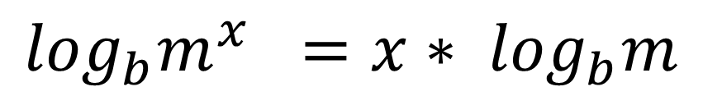
// Take the log of both sides
// Remember:
Ignore the minus 1
$$\log_{b}m^{x} ={x∗ log}_{b}m$$

Slide 60
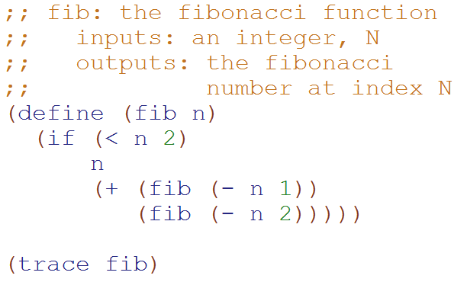
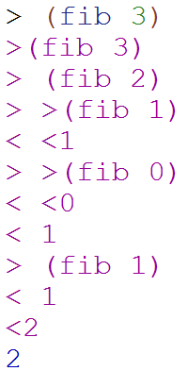
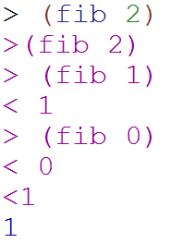
Big-O: Exponential Time O(2^{N})
O(2^{N})
You make two slightly smaller recursive calls each time

Slide 61
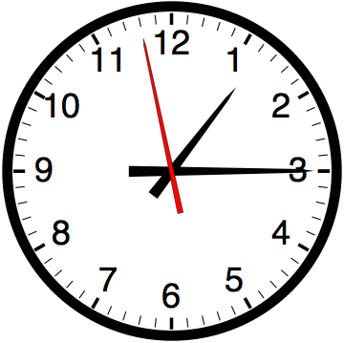

Slide 62


Computer
Science
&
= AWESOME

Slide 63

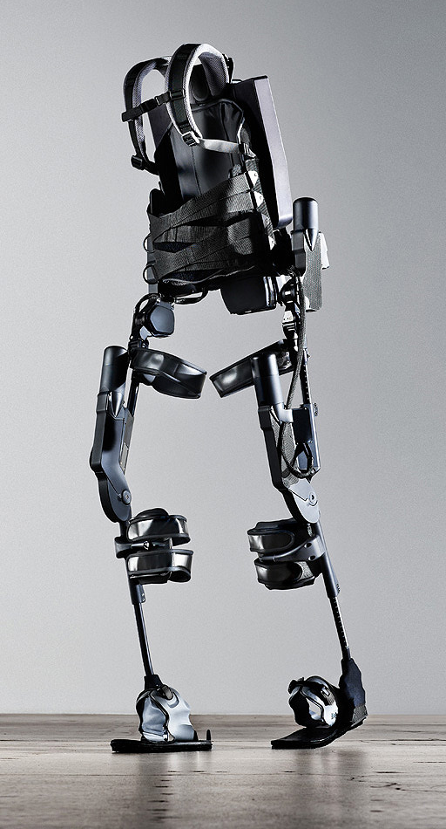
http://www.youtube.com/watch?v=pzRmNYA8LlY

Slide 64


ClickStart

Slide 65
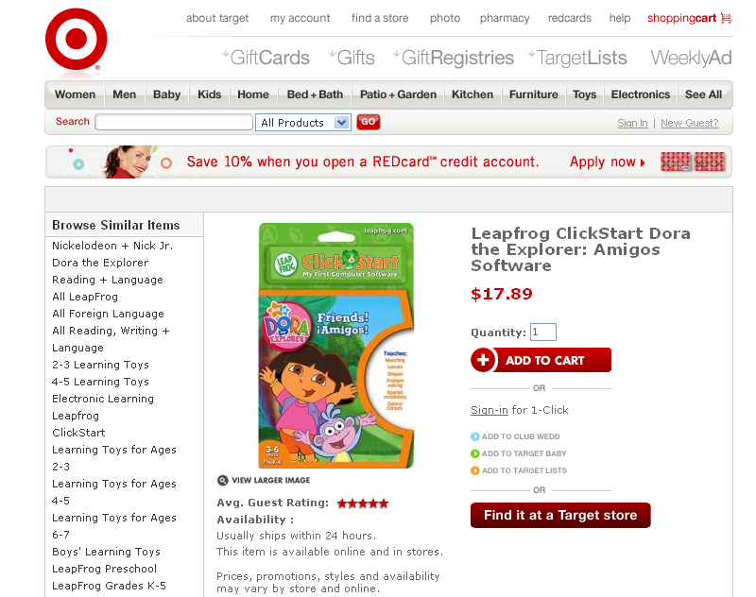

Slide 66
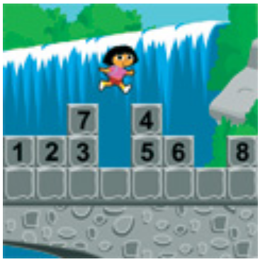
How should we represent the blocks in the computer?
Independent variables
2D Array
OpenList
I don’t know

Slide 67
The value in the array tells me what art asset to use
Each level is really a 3x10 vector!
0 | 0 | 7 | 0 | 4 | 0 | 0 | 0
1 | 2 | 3 | -4 | 5 | 6 | -7 | 8
B | B | B | B | B | B | B | B
Negative values tell me what block needs to go here to win!

Slide 68
0 | 0 | 7 | 0 | 4 | 0 | 0 | 0
1 | 2 | 3 | -4 | 5 | 6 | -7 | 8
0 | 0 | 0 | B | 0 | 0 | 0 | 0

Slide 69
BUGS!

Slide 70
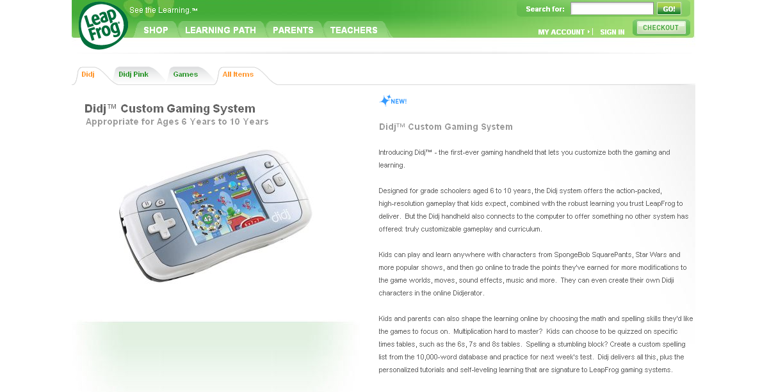

Slide 71
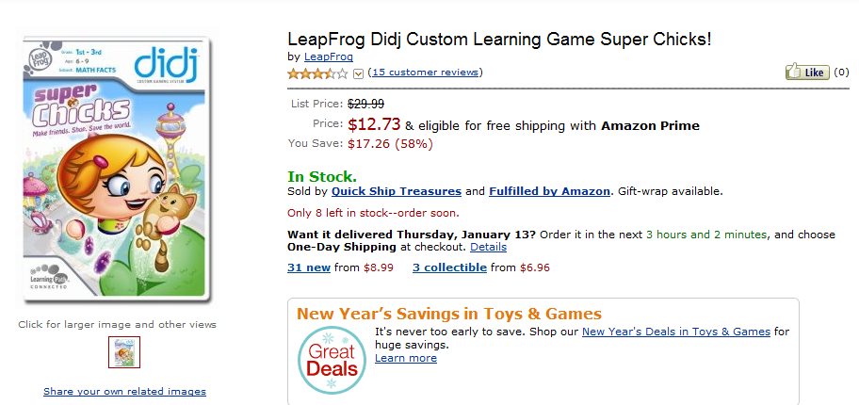
It is really sad when stuff you’ve made is on sale!

Slide 72
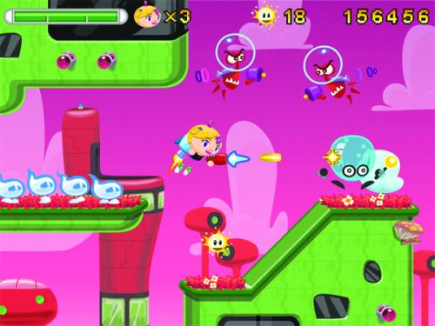
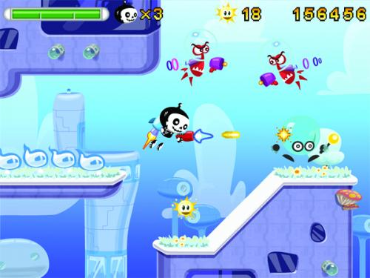

Which image is fake?
A. Top Left
B. Bottom Left
C. Bottom Right

Slide 73
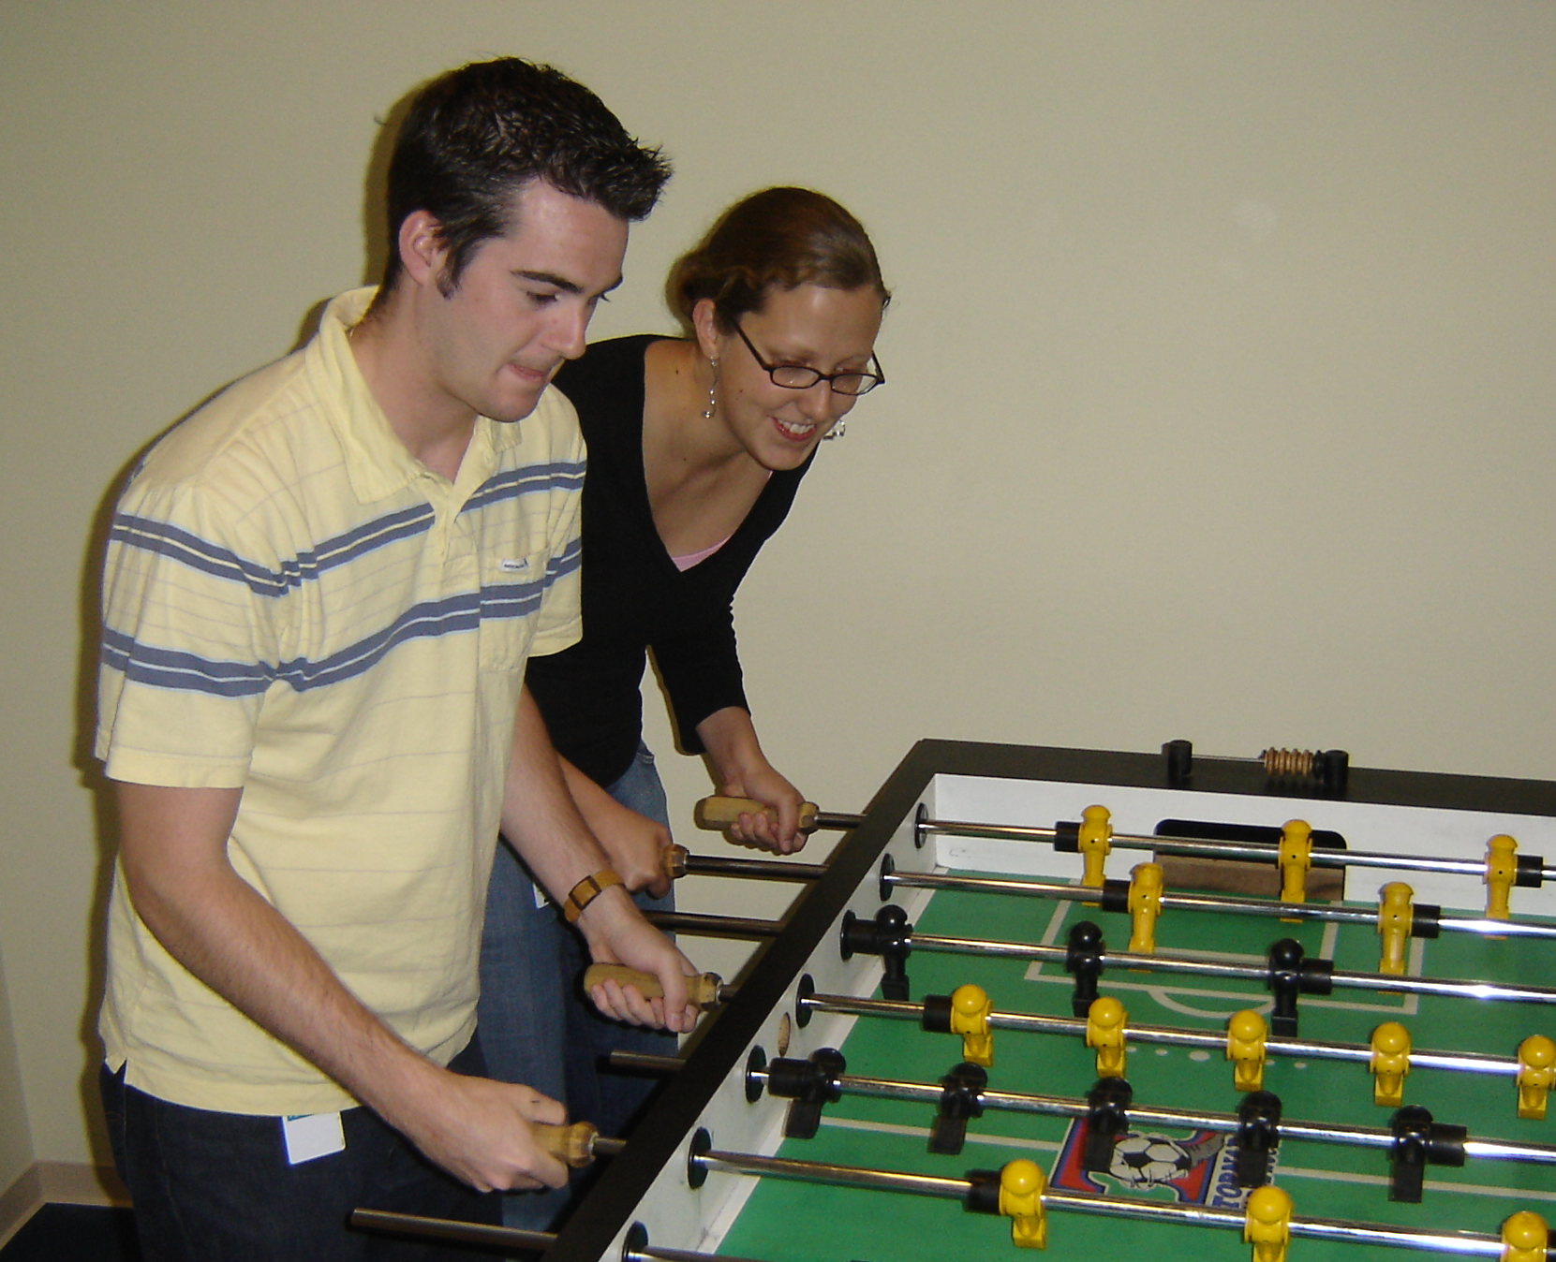

Slide 74
