Slide 1
CS 60
PhotoEditor (Hw7)
2014-10-29
Wednesday – Week 8
Lecture 16

Slide 2
Lecture 16 – Learning Goals
Use and describe super() and super
Trace through Picture.java code (ready for hw7)
Describe 2D Arrays
Look at Java code and be able to infer what methods, classes, and instance variables exist

Slide 3
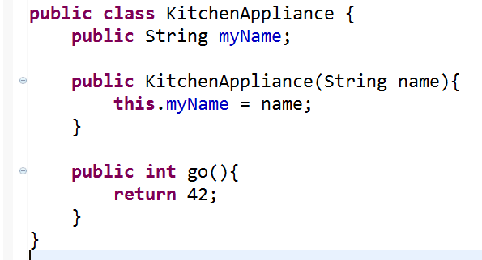
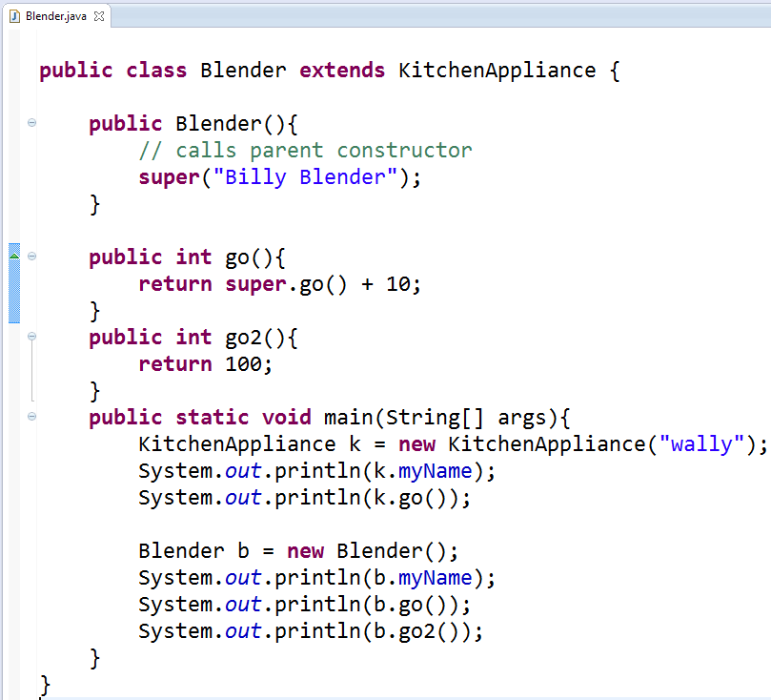

Slide 4
Homework 7 grayscale (use it as an example)

Slide 5
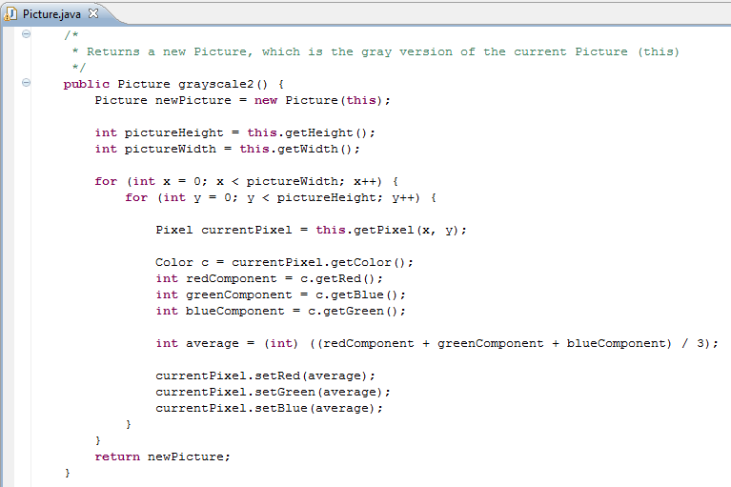
Based upon this code,
what types of Objects are there?
And what methods do they have?
Does this method modify this?
A)Yes
B)No
C)Stuck

Slide 7
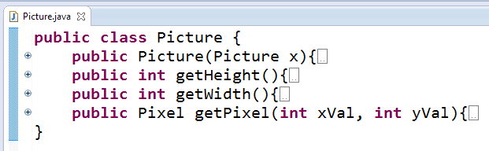
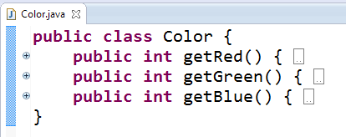
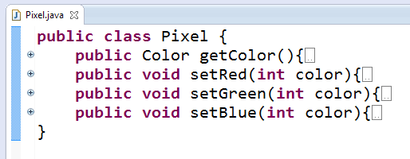
These are reasonable hypotheses about what Classes and methods must exist based upon the grayscale2 method.

Slide 8
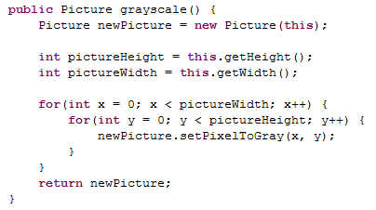
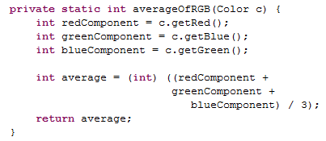
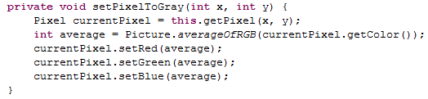
Avoid redundancy with helpers (not shown here)
Helper methods should be private
Make methods short/understandable with helpers

Slide 9
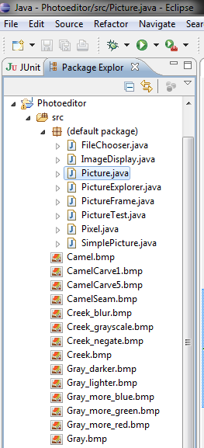
There are
a LOT of files in hw7.zip
What is this assignment about?
Making something cool
Practice:
Conditionals/Loops
Working with Objects
Working with a large code base
Challenges:
Debugging!!!
Using Eclipse

Slide 10
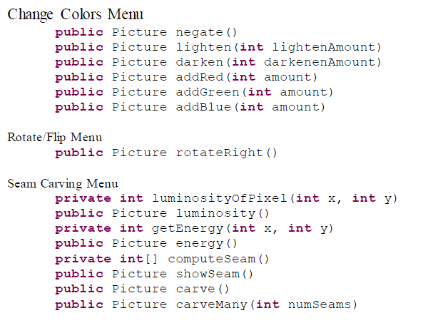
Methods to Write
Style requirement:
Avoid redundancy with helpers

Slide 11
2D Arrays

Slide 12
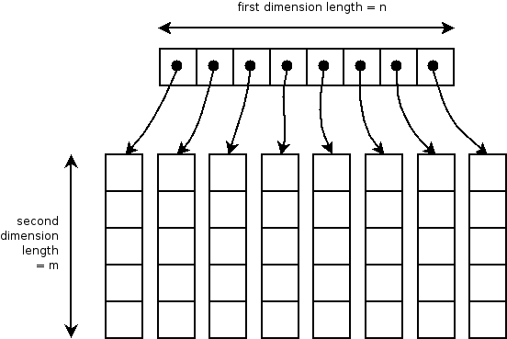
int [][] table = new int[8][5];
We can visualize them in different ways
Two dimensional arrays – Array of arrays

Slide 13
Seam Carving

Slide 14
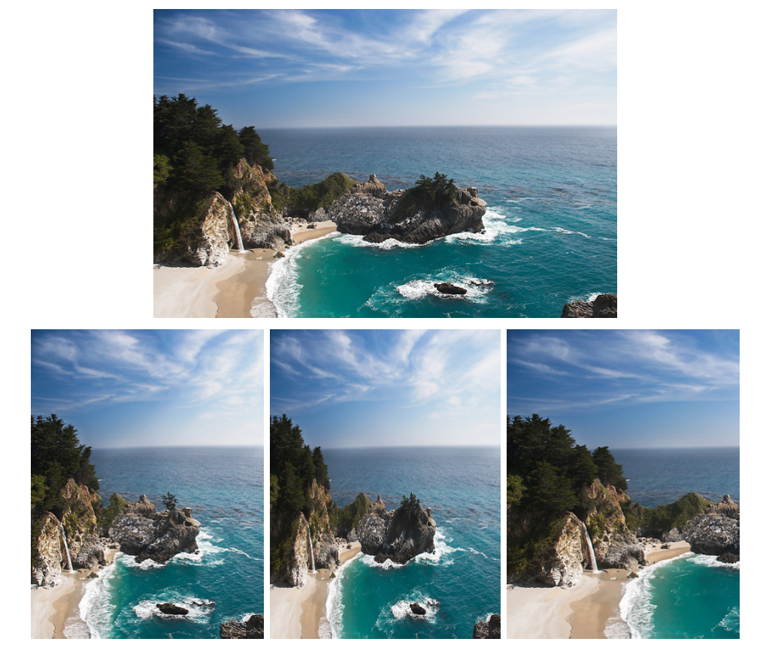
The problem
original image
?
device size

Slide 15
Three possible solutions
original image
Seam Carving
1
2
3
What happened in each case?

Slide 16

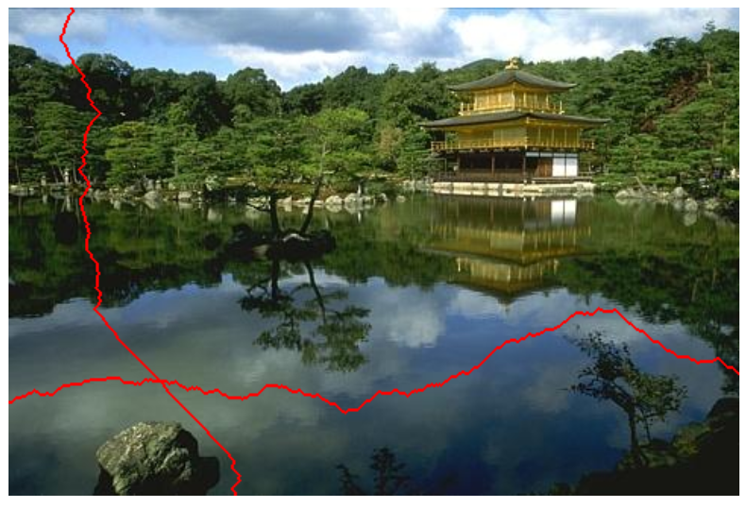
Remove less important seams
to make the picture smaller!
seams
original image
2007 !
you're encouraged to use the original paper as a guide...

Slide 17
Definition of Seams (+ Demo)
Seams
Go from the top row to the bottom row
Connect by an edge or a corner
Seams are the lowest “energy” path

Slide 18





Seam Carving: The Big Picture
Original
Luminosity
Energy
Seam
Seam Removed

Slide 19





Seam Carving: The Big Picture (we’ll use two example pictures today)
Original
Luminosity
Energy
Seam
Seam Removed

Slide 20
Background:
How
pictures are represented
 | x = 0 | x = 1 | x = 2 | x = 3 | x = 4 | x = 5 | x = 6 | x = 7
y = 0 | R:144 G:189 B:254 | R:143 G:185 B:245 | R:147 G:184 B:236 | R:168 G:197 B:231 | R:110 G:128 B:140 | R:121 G:130 B:127 | R:82 G:81 B:78 | R:76 G:70 B:64
y = 1 | R:142 G:187 B:252 | R:148 G:190 B:250 | R:157 G:194 B:246 | R:158 G:186 B:223 | R:126 G:144 B:158 | R:112 G:121 B:120 | R:14 G:15 B:10 | R:73 G:70 B:64
y = 2 | R:146 G:192 B:254 | R:143 G:185 B:243 | R:152 G:189 B:242 | R:153 G:181 B:220 | R:54 G:71 B:87 | R:112 G:122 B:124 | R:75 G:77 B:71 | R:34 G:34 B:25
y = 3 | R:147 G:193 B:252 | R:152 G:194 B:252 | R:159 G:196 B:249 | R:138 G:167 B:209 | R:23 G:41 B:63 | R:156 G:165 B:170 | R:51 G:53 B:48 | R:89 G:91 B:79
y = 4 | R:149 G:194 B:251 | R:156 G:199 B:254 | R:153 G:190 B:245 | R:166 G:194 B:241 | R:40 G:57 B:82 | R:79 G:89 B:98 | R:73 G:79 B:71 | R:68 G:72 B:58
y = 5 | R:148 G:194 B:246 | R:154 G:197 B:250 | R:159 G:196 B:251 | R:162 G:193 B:240 | R:95 G:114 B:146 | R:47 G:59 B:70 | R:64 G:71 B:64 | R:99 G:106 B:88
y = 6 | R:155 G:199 B:246 | R:157 G:199 B:249 | R:159 G:196 B:251 | R:164 G:194 B:244 | R:176 G:196 B:231 | R:94 G:107 B:123 | R:70 G:80 B:71 | R:54 G:64 B:43
y = 7 | R:156 G:200 B:245 | R:158 G:200 B:248 | R:165 G:202 B:255 | R:165 G:195 B:245 | R:182 G:202 B:239 | R:157 G:170 B:186 | R:62 G:72 B:64 | R:61 G:69 B:48
Original

Slide 21
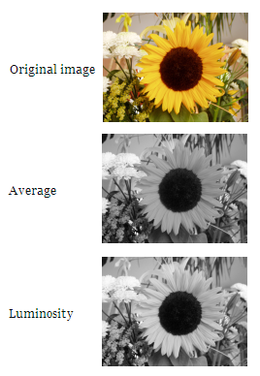
Step 1: Convert to Luminosity
Original
Luminosity
Red, Green, and Blue are all this:
 | x = 0 | x = 1 | x = 2 | x = 3 | x = 4 | x = 5 | x = 6 | x = 7
y = 0 | R:144 G:189 B:254 | R:143 G:185 B:245 | R:147 G:184 B:236 | R:168 G:197 B:231 | R:110 G:128 B:140 | R:121 G:130 B:127 | R:82 G:81 B:78 | R:76 G:70 B:64
y = 1 | R:142 G:187 B:252 | R:148 G:190 B:250 | R:157 G:194 B:246 | R:158 G:186 B:223 | R:126 G:144 B:158 | R:112 G:121 B:120 | R:14 G:15 B:10 | R:73 G:70 B:64
y = 2 | R:146 G:192 B:254 | R:143 G:185 B:243 | R:152 G:189 B:242 | R:153 G:181 B:220 | R:54 G:71 B:87 | R:112 G:122 B:124 | R:75 G:77 B:71 | R:34 G:34 B:25
y = 3 | R:147 G:193 B:252 | R:152 G:194 B:252 | R:159 G:196 B:249 | R:138 G:167 B:209 | R:23 G:41 B:63 | R:156 G:165 B:170 | R:51 G:53 B:48 | R:89 G:91 B:79
y = 4 | R:149 G:194 B:251 | R:156 G:199 B:254 | R:153 G:190 B:245 | R:166 G:194 B:241 | R:40 G:57 B:82 | R:79 G:89 B:98 | R:73 G:79 B:71 | R:68 G:72 B:58
y = 5 | R:148 G:194 B:246 | R:154 G:197 B:250 | R:159 G:196 B:251 | R:162 G:193 B:240 | R:95 G:114 B:146 | R:47 G:59 B:70 | R:64 G:71 B:64 | R:99 G:106 B:88
y = 6 | R:155 G:199 B:246 | R:157 G:199 B:249 | R:159 G:196 B:251 | R:164 G:194 B:244 | R:176 G:196 B:231 | R:94 G:107 B:123 | R:70 G:80 B:71 | R:54 G:64 B:43
y = 7 | R:156 G:200 B:245 | R:158 G:200 B:248 | R:165 G:202 B:255 | R:165 G:195 B:245 | R:182 G:202 B:239 | R:157 G:170 B:186 | R:62 G:72 B:64 | R:61 G:69 B:48
 | x = 0 | x = 1 | x = 2 | x = 3 | x = 4 | x = 5 | x = 6 | x = 7
y = 0 | 184 | 180 | 179 | 193 | 125 | 127 | 81 | 70
y = 1 | 182 | 185 | 189 | 182 | 141 | 119 | 14 | 70
y = 2 | 186 | 180 | 184 | 177 | 68 | 120 | 76 | 33
y = 3 | 187 | 189 | 191 | 163 | 38 | 163 | 52 | 89
y = 4 | 188 | 193 | 186 | 191 | 55 | 87 | 77 | 70
y = 5 | 187 | 191 | 192 | 189 | 112 | 57 | 69 | 103
y = 6 | 193 | 193 | 192 | 191 | 194 | 105 | 77 | 60
y = 7 | 193 | 194 | 197 | 192 | 200 | 168 | 69 | 65

Slide 22

Step 2: Calculate Energy
Luminosity
Energy
 | x = 0 | x = 1 | x = 2 | x = 3 | x = 4 | x = 5 | x = 6 | x = 7
y = 0 | 184 | 180 | 179 | 193 | 125 | 127 | 81 | 70
y = 1 | 182 | 185 | 189 | 182 | 141 | 119 | 14 | 70
y = 2 | 186 | 180 | 184 | 177 | 68 | 120 | 76 | 33
y = 3 | 187 | 189 | 191 | 163 | 38 | 163 | 52 | 89
y = 4 | 188 | 193 | 186 | 191 | 55 | 87 | 77 | 70
y = 5 | 187 | 191 | 192 | 189 | 112 | 57 | 69 | 103
y = 6 | 193 | 193 | 192 | 191 | 194 | 105 | 77 | 60
y = 7 | 193 | 194 | 197 | 192 | 200 | 168 | 69 | 65
 | x = 0 | x = 1 | x = 2 | x = 3 | x = 4 | x = 5 | x = 6 | x = 7
y = 0 | 6 | 6 | 24 | 79 | 18 | 54 | 78 | 11
y = 1 | 7 | 9 | 12 | 46 | 95 | 106 | 118 | 93
y = 2 | 7 | 13 | 14 | 123 | 82 | 87 | 67 | 99
y = 3 | 3 | 6 | 33 | 153 | 142 | 187 | 62 | 56
y = 4 | 6 | 9 | 11 | 138 | 89 | 40 | 15 | 40
y = 5 | 10 | 3 | 3 | 79 | 137 | 60 | 42 | 77
y = 6 | 0 | 2 | 6 | 4 | 95 | 91 | 25 | 22
y = 7 | 1 | 4 | 10 | 9 | 38 | 162 | 12 | 9

Slide 23

Step 2: Calculate Energy
Luminosity
Energy
Check that these are right.
 | x = 0 | x = 1 | x = 2
y = 0 | 184 | 180 | 179
y = 1 | 182 | 185 | 189
y = 2 | 186 | 180 | 184
 | x = 0 | x = 1
y = 0 | 6 | 6
y = 1 | 7 | 9

Slide 24
Step 2: Calculate Energy
These are just numbers, but we CAN visualize them as grayscale values.
Luminosity
Energy
 | x = 0 | x = 1 | x = 2 | x = 3 | x = 4 | x = 5 | x = 6 | x = 7
y = 0 | 184 | 180 | 179 | 193 | 125 | 127 | 81 | 70
y = 1 | 182 | 185 | 189 | 182 | 141 | 119 | 14 | 70
y = 2 | 186 | 180 | 184 | 177 | 68 | 120 | 76 | 33
y = 3 | 187 | 189 | 191 | 163 | 38 | 163 | 52 | 89
y = 4 | 188 | 193 | 186 | 191 | 55 | 87 | 77 | 70
y = 5 | 187 | 191 | 192 | 189 | 112 | 57 | 69 | 103
y = 6 | 193 | 193 | 192 | 191 | 194 | 105 | 77 | 60
y = 7 | 193 | 194 | 197 | 192 | 200 | 168 | 69 | 65
 | x = 0 | x = 1 | x = 2 | x = 3 | x = 4 | x = 5 | x = 6 | x = 7
y = 0 | 6 | 6 | 24 | 79 | 18 | 54 | 78 | 11
y = 1 | 7 | 9 | 12 | 46 | 95 | 106 | 118 | 93
y = 2 | 7 | 13 | 14 | 123 | 82 | 87 | 67 | 99
y = 3 | 3 | 6 | 33 | 153 | 142 | 187 | 62 | 56
y = 4 | 6 | 9 | 11 | 138 | 89 | 40 | 15 | 40
y = 5 | 10 | 3 | 3 | 79 | 137 | 60 | 42 | 77
y = 6 | 0 | 2 | 6 | 4 | 95 | 91 | 25 | 22
y = 7 | 1 | 4 | 10 | 9 | 38 | 162 | 12 | 9

Slide 25
Calculate Energy
Original
Luminosity
Energy
Seam
Seam Removed
 | x = 0 | x = 1 | x = 2
y = 0 | R:110G:120 B:151 | R:120 G:130 B:160 | R:120 G:120 B:120
y = 1 | R:90 G:110 B:170 | R:120 G:130 B:160 | R:130 G:130 B:130
y = 2 | R:130 G:140 B:170 | R:150 G:150 B:150 | R:200 G:190 B:165
y = 3 | R:150 G:150 B:150 | R:150 G:140 B:110 | R:150 G:140 B:110
y = 4 | R:140 G:110 B:175 | R:100 G:100 B:100 | R:140 G:120 B:65
 | x = 0 | x = 1 | x = 2
y = 0 | 120 | 130 | 120
y = 1 | 110 | 130 | 130
y = 2 | 140 | 150 | 190
y = 3 | 150 | 140 | 140
y = 4 | 120 | 100 | 120
 | x = 0 | x = 1 | x = 2
y = 0
y = 1
y = 2
y = 3
y = 4

Slide 26
Solution – Calculate Energy
Original
Luminosity
Energy
Seam
Seam Removed
 | x = 0 | x = 1 | x = 2
y = 0 | R:110G:120 B:151 | R:120 G:130 B:160 | R:120 G:120 B:120
y = 1 | R:90 G:110 B:170 | R:120 G:130 B:160 | R:130 G:130 B:130
y = 2 | R:130 G:140 B:170 | R:150 G:150 B:150 | R:200 G:190 B:165
y = 3 | R:150 G:150 B:150 | R:150 G:140 B:110 | R:150 G:140 B:110
y = 4 | R:140 G:110 B:175 | R:100 G:100 B:100 | R:140 G:120 B:65
 | x = 0 | x = 1 | x = 2
y = 0 | 120 | 130 | 120
y = 1 | 110 | 130 | 130
y = 2 | 140 | 150 | 190
y = 3 | 150 | 140 | 140
y = 4 | 120 | 100 | 120
 | x = 0 | x = 1 | x = 2
y = 0 | 20 | 10 | 20
y = 1 | 50 | 20 | 60
y = 2 | 20 | 50 | 90
y = 3 | 40 | 40 | 20
y = 4 | 50 | 60 | 40

Slide 27

Step 3: Find the minimum path (from top to bottom)
This is the interesting step. We’ll come back to this!
Energy
Seam
 | x = 0 | x = 1 | x = 2 | x = 3 | x = 4 | x = 5 | x = 6 | x = 7
y = 0 | 6 | 6 | 24 | 79 | 18 | 54 | 78 | 11
y = 1 | 7 | 9 | 12 | 46 | 95 | 106 | 118 | 93
y = 2 | 7 | 13 | 14 | 123 | 82 | 87 | 67 | 99
y = 3 | 3 | 6 | 33 | 153 | 142 | 187 | 62 | 56
y = 4 | 6 | 9 | 11 | 138 | 89 | 40 | 15 | 40
y = 5 | 10 | 3 | 3 | 79 | 137 | 60 | 42 | 77
y = 6 | 0 | 2 | 6 | 4 | 95 | 91 | 25 | 22
y = 7 | 1 | 4 | 10 | 9 | 38 | 162 | 12 | 9
 | x = 0 | x = 1 | x = 2 | x = 3 | x = 4 | x = 5 | x = 6 | x = 7
y = 0 | 6 | 6 | 24 | 79 | 18 | 54 | 78 | 11
y = 1 | 7 | 9 | 12 | 46 | 95 | 106 | 118 | 93
y = 2 | 7 | 13 | 14 | 123 | 82 | 87 | 67 | 99
y = 3 | 3 | 6 | 33 | 153 | 142 | 187 | 62 | 56
y = 4 | 6 | 9 | 11 | 138 | 89 | 40 | 15 | 40
y = 5 | 10 | 3 | 3 | 79 | 137 | 60 | 42 | 77
y = 6 | 0 | 2 | 6 | 4 | 95 | 91 | 25 | 22
y = 7 | 1 | 4 | 10 | 9 | 38 | 162 | 12 | 9

Slide 28




Step 4: Remove the pixels from the minimum path (2 carvings shown)

Slide 29
Seam Carving: The Big Picture (End)
?
Original
Luminosity
Energy
Seam
Seam Removed

Slide 30
Debugging Tip
To debug your code,
sometimes
you have to write additional code!
(True/False)

Slide 31
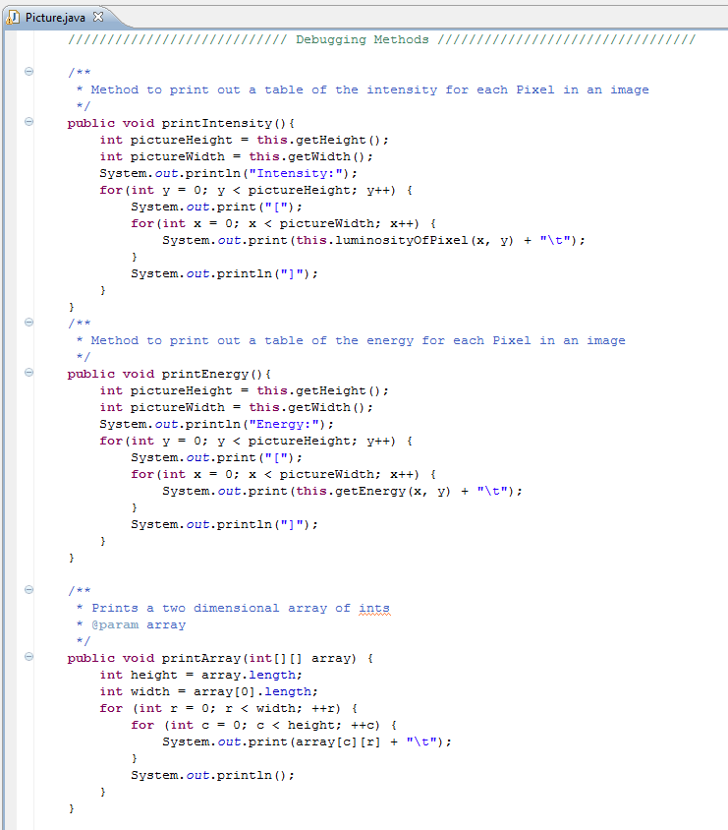
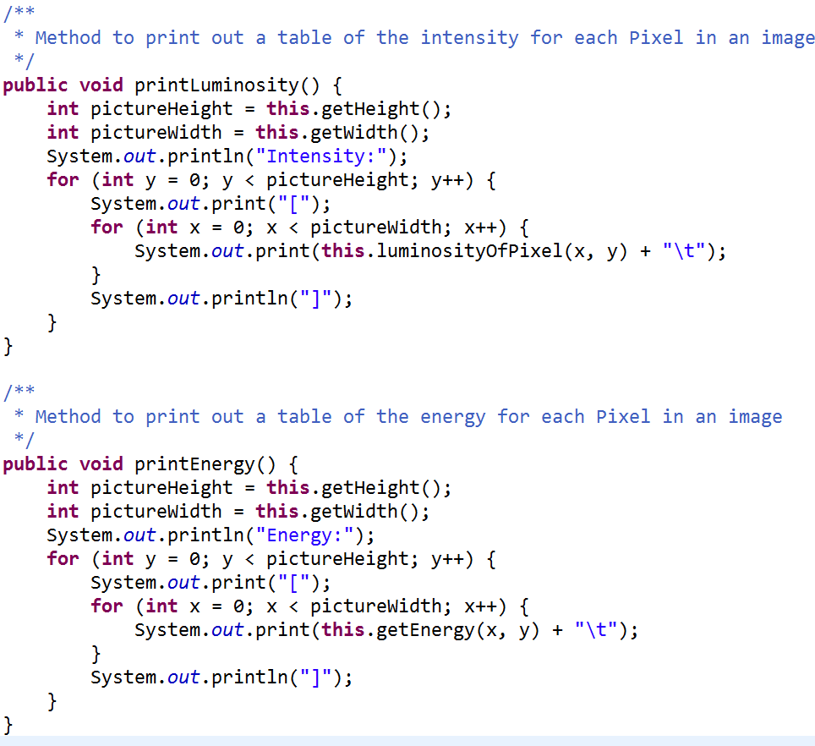
Colleen wrote you some debugging code

Slide 32
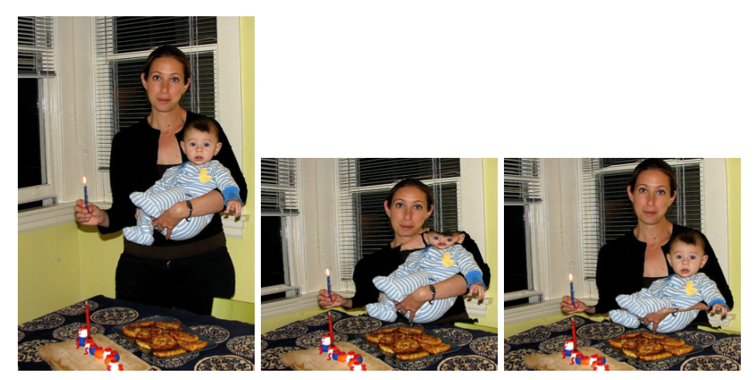
Not perfect…
Straightforward seam carving does not always work!
Target size
What's conspiring against the algorithm here?

Slide 33
Problems?
Straightforward seam carving does not always work!
What's conspiring against the algorithm here?

Slide 34
Not the face!
Protecting the results from a face-detector makes a huge difference…
What's been lost instead?

Slide 35
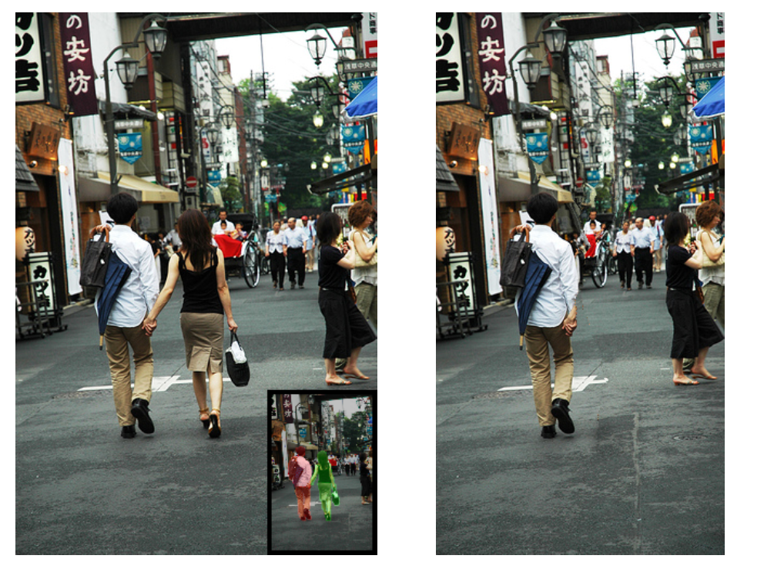
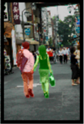
Applications: Seams can remove people!

Slide 36
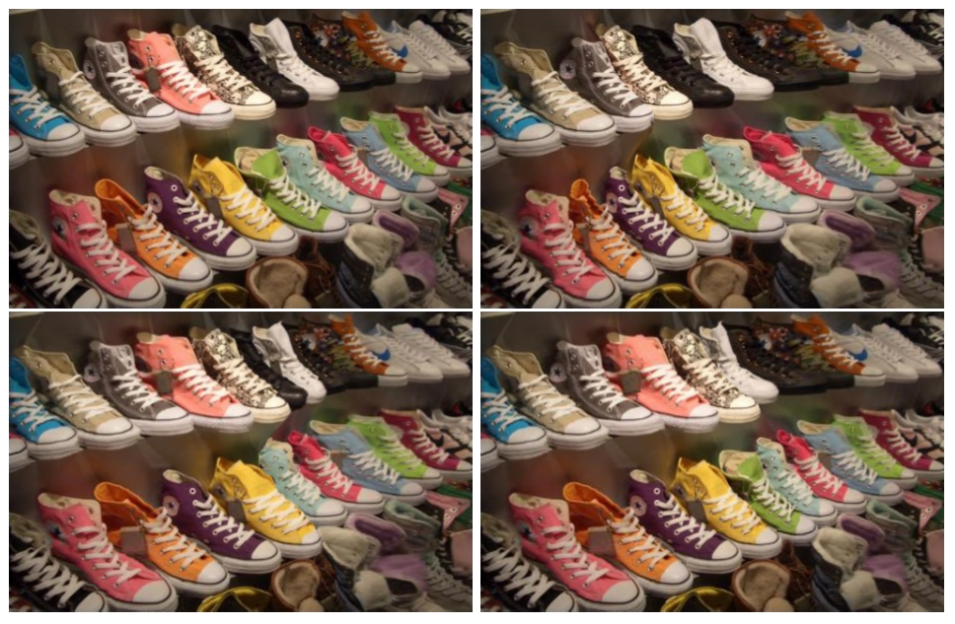
All others had 1 shoe removed! Which shoe?
Applications: Lost a shoe?
Original

Slide 37
Dynamic Programming Intro

Slide 38
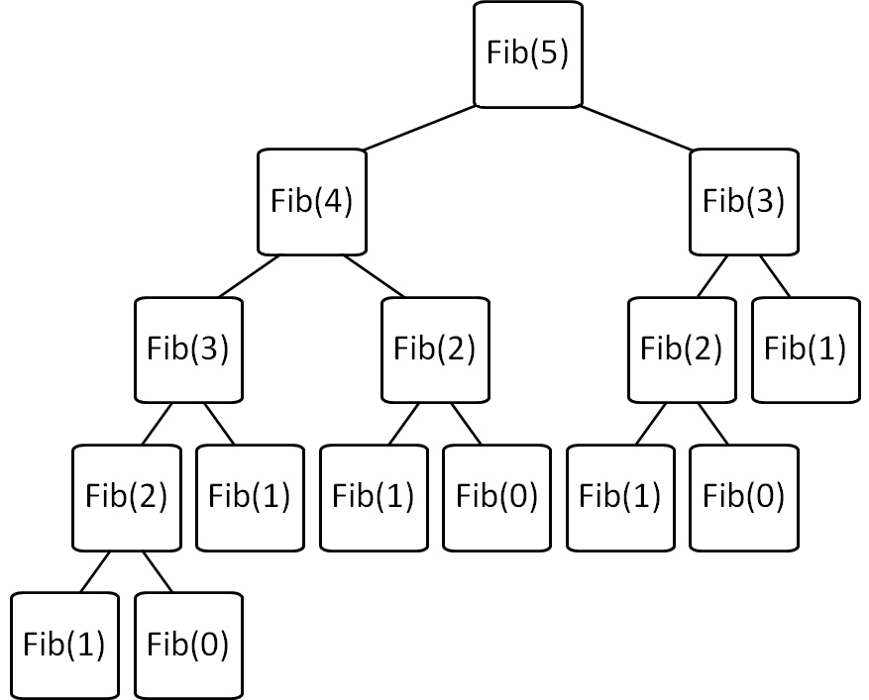
Consider: Fibonacci fib(X) = fib(X-1) + fib(X-2)
Brute force Fib(N)
is O(2^{N}) ☹
Can we improve this?

Slide 39
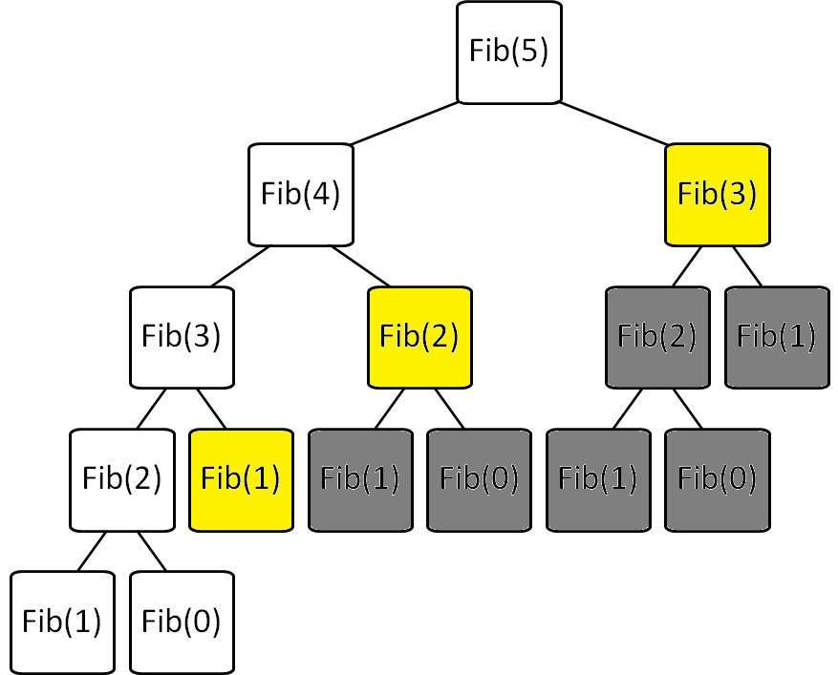
Fibonacci with Memoization Keep track of recursive calls you’ve made and store the result!
Before you make a recursive call, check to see if you already know the answer.
Top-down (just like the regular recursive version)
Before I make the calls shown in yellow, I find that I already know the answer!

Slide 40
Fibonacci with Dynamic Programming Work from the bottom-up!
Instead of doing the recursion, work from the bottom-up to create a table of answers of all recursive calls that might be made
We will NEVER make a recursive call, because we will always have already calculated the required components (e.g. fib(n-1) + fib(n-2))
Fib(0) | Fib(1) | Fib(2) | Fib(3) | Fib(4) | Fib(5)
0 | 1 | 1 | 2 | 3 | 5

Slide 41
Consider: Fibonacci
Brute force of Fib(N)
is O(2^{N}) ☹
Memoization of Fib(N)
is O(N) + overhead for keeping track of what recursive calls have been made
Dynamic Programming of Fib(N)
is O(N) + overhead for making a table of size N

Slide 42
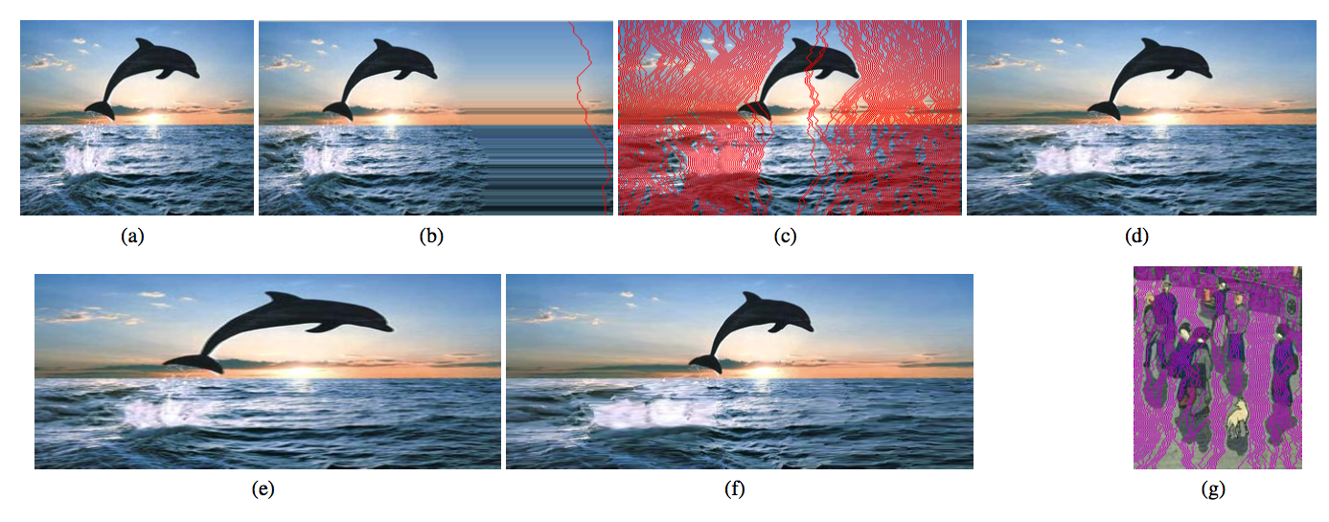
Expanding the image?
original image
Will this work?
I want to add 42 pixels in width
for (int i=0; i<42; i++){
(1) find a seam
(2) duplicate the seam
}

Slide 43
Expanding the image?
original image
best-seam (least-energy) expansion
The best 50% of seams used for more uniform expansion

Slide 44
Expanding the image?
200% of original (scaling)
200% of original (seam-insertion)

Slide 45
How do we pick a seam?
?
Original
Luminosity
Energy
Seam
Seam Removed
We’ll discuss one possible method using dynamic programming, and later look at benefits of this over a recursive use-it-or-lose-it
Seams
Go from the top row to the bottom row
Connect by an edge or a corner
Seams are the lowest “energy” path

Slide 46
Seam Carving: The Big Picture
Original
Luminosity
Energy
Seam
Seam Removed
 | x = 0 | x = 1 | x = 2
y = 0 | R:110G:120 B:151 | R:120 G:130 B:160 | R:120 G:120 B:120
y = 1 | R:90 G:110 B:170 | R:120 G:130 B:160 | R:130 G:130 B:130
y = 2 | R:130 G:140 B:170 | R:150 G:150 B:150 | R:200 G:190 B:165
y = 3 | R:150 G:150 B:150 | R:150 G:140 B:110 | R:150 G:140 B:110
y = 4 | R:140 G:110 B:175 | R:100 G:100 B:100 | R:140 G:120 B:65
 | x = 0 | x = 1 | x = 2
y = 0 | 120 | 130 | 120
y = 1 | 110 | 130 | 130
y = 2 | 140 | 150 | 190
y = 3 | 150 | 140 | 140
y = 4 | 120 | 100 | 120
 | x = 0 | x = 1 | x = 2
y = 0 | 20 | 10 | 20
y = 1 | 50 | 20 | 60
y = 2 | 20 | 50 | 90
y = 3 | 40 | 40 | 20
y = 4 | 50 | 60 | 40

Slide 47
Write Recursive Pseudocode to find the min path cost based upon getEnergy
 | x = 0 | x = 1 | x = 2 | x = 3 | x = 4 | x = 5 | x = 6 | x = 7
y = 0 | 6 | 6 | 24 | 79 | 18 | 54 | 78 | 11
y = 1 | 7 | 9 | 12 | 46 | 95 | 106 | 118 | 93
y = 2 | 7 | 13 | 14 | 123 | 82 | 87 | 67 | 99
y = 3 | 3 | 6 | 33 | 153 | 142 | 187 | 62 | 56
y = 4 | 6 | 9 | 11 | 138 | 89 | 40 | 15 | 40
y = 5 | 10 | 3 | 3 | 79 | 137 | 60 | 42 | 77
y = 6 | 0 | 2 | 6 | 4 | 95 | 91 | 25 | 22
y = 7 | 1 | 4 | 10 | 9 | 38 | 162 | 12 | 9
public int minPathCost(int x, int y) {

Slide 48
Write Recursive Pseudocode to find the min path cost based upon getEnergy
 | x = 0 | x = 1 | x = 2 | x = 3 | x = 4 | x = 5 | x = 6 | x = 7
y = 0 | 6 | 6 | 24 | 79 | 18 | 54 | 78 | 11
y = 1 | 7 | 9 | 12 | 46 | 95 | 106 | 118 | 93
y = 2 | 7 | 13 | 14 | 123 | 82 | 87 | 67 | 99
y = 3 | 3 | 6 | 33 | 153 | 142 | 187 | 62 | 56
y = 4 | 6 | 9 | 11 | 138 | 89 | 40 | 15 | 40
y = 5 | 10 | 3 | 3 | 79 | 137 | 60 | 42 | 77
y = 6 | 0 | 2 | 6 | 4 | 95 | 91 | 25 | 22
y = 7 | 1 | 4 | 10 | 9 | 38 | 162 | 12 | 9
That’s THREE recursive calls!
For each cell in the top row
Return:
energy at that cell +
minimum path cost of 3 cells below
YUCK! There aren’t always 3 cells below!

Slide 49
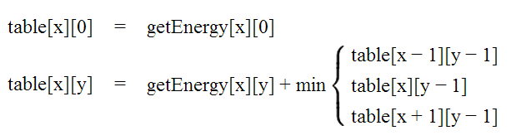
Identify Minimal Paths Store Information in int[][] table
getEnergy
table
 | x = 0 | x = 1 | x = 2 | x = 3 | x = 4 | x = 5 | x = 6 | x = 7
y = 0 | 6 | 6 | 24 | 79 | 18 | 54 | 78 | 11
y = 1 | 7 | 9 | 12 | 46 | 95 | 106 | 118 | 93
y = 2 | 7 | 13 | 14 | 123 | 82 | 87 | 67 | 99
y = 3 | 3 | 6 | 33 | 153 | 142 | 187 | 62 | 56
y = 4 | 6 | 9 | 11 | 138 | 89 | 40 | 15 | 40
y = 5 | 10 | 3 | 3 | 79 | 137 | 60 | 42 | 77
y = 6 | 0 | 2 | 6 | 4 | 95 | 91 | 25 | 22
y = 7 | 1 | 4 | 10 | 9 | 38 | 162 | 12 | 9
 | x = 0 | x = 1 | x = 2 | x = 3 | x = 4 | x = 5 | x = 6 | x = 7
y = 0
y = 1
y = 2
y = 3
y = 4
y = 5
y = 6
y = 7

Slide 50
Fill out the y=0 row of table based upon the base case
getEnergy
table
 | x = 0 | x = 1 | x = 2 | x = 3 | x = 4 | x = 5 | x = 6 | x = 7
y = 0 | 6 | 6 | 24 | 79 | 18 | 54 | 78 | 11
y = 1 | 7 | 9 | 12 | 46 | 95 | 106 | 118 | 93
y = 2 | 7 | 13 | 14 | 123 | 82 | 87 | 67 | 99
y = 3 | 3 | 6 | 33 | 153 | 142 | 187 | 62 | 56
y = 4 | 6 | 9 | 11 | 138 | 89 | 40 | 15 | 40
y = 5 | 10 | 3 | 3 | 79 | 137 | 60 | 42 | 77
y = 6 | 0 | 2 | 6 | 4 | 95 | 91 | 25 | 22
y = 7 | 1 | 4 | 10 | 9 | 38 | 162 | 12 | 9
 | x = 0 | x = 1 | x = 2 | x = 3 | x = 4 | x = 5 | x = 6 | x = 7
y = 0 | 6 | 6 | 24 | 79 | 18 | 54 | 78 | 11
y = 1
y = 2
y = 3
y = 4
y = 5
y = 6
y = 7

Slide 51
Fill out each row of table based upon the 2nd rule
getEnergy
table
 | x = 0 | x = 1 | x = 2 | x = 3 | x = 4 | x = 5 | x = 6 | x = 7
y = 0 | 6 | 6 | 24 | 79 | 18 | 54 | 78 | 11
y = 1 | 7 | 9 | 12 | 46 | 95 | 106 | 118 | 93
y = 2 | 7 | 13 | 14 | 123 | 82 | 87 | 67 | 99
y = 3 | 3 | 6 | 33 | 153 | 142 | 187 | 62 | 56
y = 4 | 6 | 9 | 11 | 138 | 89 | 40 | 15 | 40
y = 5 | 10 | 3 | 3 | 79 | 137 | 60 | 42 | 77
y = 6 | 0 | 2 | 6 | 4 | 95 | 91 | 25 | 22
y = 7 | 1 | 4 | 10 | 9 | 38 | 162 | 12 | 9
 | x = 0 | x = 1 | x = 2 | x = 3 | x = 4 | x = 5 | x = 6 | x = 7
y = 0 | 6 | 6 | 24 | 79 | 18 | 54 | 78 | 11
y = 1
y = 2
y = 3
y = 4
y = 5
y = 6
y = 7

Slide 52
Fill out each row of table based upon the 2nd rule (cont.)
getEnergy
table
 | x = 0 | x = 1 | x = 2 | x = 3 | x = 4 | x = 5 | x = 6 | x = 7
y = 0 | 6 | 6 | 24 | 79 | 18 | 54 | 78 | 11
y = 1 | 7 | 9 | 12 | 46 | 95 | 106 | 118 | 93
y = 2 | 7 | 13 | 14 | 123 | 82 | 87 | 67 | 99
y = 3 | 3 | 6 | 33 | 153 | 142 | 187 | 62 | 56
y = 4 | 6 | 9 | 11 | 138 | 89 | 40 | 15 | 40
y = 5 | 10 | 3 | 3 | 79 | 137 | 60 | 42 | 77
y = 6 | 0 | 2 | 6 | 4 | 95 | 91 | 25 | 22
y = 7 | 1 | 4 | 10 | 9 | 38 | 162 | 12 | 9
 | x = 0 | x = 1 | x = 2 | x = 3 | x = 4 | x = 5 | x = 6 | x = 7
y = 0 | 6 | 6 | 24 | 79 | 18 | 54 | 78 | 11
y = 1 | 13
y = 2
y = 3
y = 4
y = 5
y = 6
y = 7

Slide 53
What do the cells in getEnergy and table mean?
This is the cost of including this pixel in the path
getEnergy
table
 | x = 0 | x = 1 | x = 2 | x = 3 | x = 4 | x = 5 | x = 6 | x = 7
y = 0 | 6 | 6 | 24 | 79 | 18 | 54 | 78 | 11
y = 1 | 7 | 9 | 12 | 46 | 95 | 106 | 118 | 93
y = 2 | 7 | 13 | 14 | 123 | 82 | 87 | 67 | 99
y = 3 | 3 | 6 | 33 | 153 | 142 | 187 | 62 | 56
y = 4 | 6 | 9 | 11 | 138 | 89 | 40 | 15 | 40
y = 5 | 10 | 3 | 3 | 79 | 137 | 60 | 42 | 77
y = 6 | 0 | 2 | 6 | 4 | 95 | 91 | 25 | 22
y = 7 | 1 | 4 | 10 | 9 | 38 | 162 | 12 | 9
 | x = 0 | x = 1 | x = 2 | x = 3 | x = 4 | x = 5 | x = 6 | x = 7
y = 0 | 6 | 6 | 24 | 79 | 18 | 54 | 78 | 11
y = 1 | 13 | 15 | 18 | 64 | 113 | 124 | 129 | 104
y = 2
y = 3
y = 4
y = 5
y = 6
y = 7
This is the cost of the shortest path that includes this pixel

Slide 54
Final version of table How do we find the shortest path from this?
getEnergy
table
 | x = 0 | x = 1 | x = 2 | x = 3 | x = 4 | x = 5 | x = 6 | x = 7
y = 0 | 6 | 6 | 24 | 79 | 18 | 54 | 78 | 11
y = 1 | 7 | 9 | 12 | 46 | 95 | 106 | 118 | 93
y = 2 | 7 | 13 | 14 | 123 | 82 | 87 | 67 | 99
y = 3 | 3 | 6 | 33 | 153 | 142 | 187 | 62 | 56
y = 4 | 6 | 9 | 11 | 138 | 89 | 40 | 15 | 40
y = 5 | 10 | 3 | 3 | 79 | 137 | 60 | 42 | 77
y = 6 | 0 | 2 | 6 | 4 | 95 | 91 | 25 | 22
y = 7 | 1 | 4 | 10 | 9 | 38 | 162 | 12 | 9
 | x = 0 | x = 1 | x = 2 | x = 3 | x = 4 | x = 5 | x = 6 | x = 7
y = 0 | 6 | 6 | 24 | 79 | 18 | 54 | 78 | 11
y = 1 | 13 | 15 | 18 | 64 | 113 | 124 | 129 | 104
y = 2 | 20 | 26 | 29 | 141 | 146 | 200 | 171 | 203
y = 3 | 23 | 26 | 59 | 182 | 283 | 333 | 233 | 227
y = 4 | 29 | 32 | 37 | 197 | 271 | 273 | 242 | 267
y = 5 | 39 | 32 | 35 | 116 | 334 | 302 | 284 | 319
y = 6 | 32 | 34 | 38 | 39 | 211 | 375 | 309 | 306
y = 7 | 33 | 36 | 44 | 47 | 77 | 373 | 318 | 315
This is the cost of the shortest path that includes this pixel

Slide 55
Practice How do we find the shortest path from this?
Energy
table
 | x = 0 | x = 1 | x = 2
y = 0 | 20 | 10 | 20
y = 1 | 50 | 20 | 60
y = 2 | 20 | 50 | 90
y = 3 | 40 | 40 | 20
y = 4 | 50 | 60 | 40
 | x = 0 | x = 1 | x = 2
y = 0
y = 1
y = 2
y = 3
y = 4
This is the cost of the shortest path that includes this pixel

Slide 56
SOLUTION table How do we find the shortest path from this?
Energy
table
 | x = 0 | x = 1 | x = 2
y = 0 | 20 | 10 | 20
y = 1 | 50 | 20 | 60
y = 2 | 20 | 50 | 90
y = 3 | 40 | 40 | 20
y = 4 | 50 | 60 | 40
 | x = 0 | x = 1 | x = 2
y = 0 | 20 | 10 | 20
y = 1 | 60 | 30 | 70
y = 2 | 50 | 80 | 120
y = 3 | 90 | 90 | 100
y = 4 | 140 | 150 | 130

Slide 57
Keep track of the parent
 | x = 0 | x = 1 | x = 2 | x = 3 | x = 4 | x = 5 | x = 6 | x = 7
y = 0 | N/A | N/A | N/A | N/A | N/A | N/A | N/A | N/A
y = 1
y = 2
y = 3
y = 4
y = 5
y = 6
y = 7
parent
table
 | x = 0 | x = 1 | x = 2 | x = 3 | x = 4 | x = 5 | x = 6 | x = 7
y = 0 | 6 | 6 | 24 | 79 | 18 | 54 | 78 | 11
y = 1 | 13 | 15 | 18 | 64 | 113 | 124 | 129 | 104
y = 2 | 20 | 26 | 29 | 141 | 146 | 200 | 171 | 203
y = 3 | 23 | 26 | 59 | 182 | 283 | 333 | 233 | 227
y = 4 | 29 | 32 | 37 | 197 | 271 | 273 | 242 | 267
y = 5 | 39 | 32 | 35 | 116 | 334 | 302 | 284 | 319
y = 6 | 32 | 34 | 38 | 39 | 211 | 375 | 309 | 306
y = 7 | 33 | 36 | 44 | 47 | 77 | 373 | 318 | 315

Slide 58

Keep track of the parent
 | x = 0 | x = 1 | x = 2 | x = 3 | x = 4 | x = 5 | x = 6 | x = 7
y = 0 | N/A | N/A | N/A | N/A | N/A | N/A | N/A | N/A
y = 1 | x=0 | x=1 | x=1 | x=4 | x=4 | x=4 | x=7 | x=7
y = 2 | x=0 | x=0 | x=1 | x=2 | x=3 | x=4 | x=7 | x=7
y = 3 | x=0 | x=0 | x=1 | x=2 | x=3 | x=4 | x=6 | x=6
y = 4 | x=0 | x=0 | x=1 | x=2 | x=3 | x=6 | x=7 | x=7
y = 5 | x=0 | x=0 | x=1 | x=2 | x=3 | x=6 | x=6 | x=6
y = 6 | x=1 | x=1 | x=1 | x=2 | x=3 | x=6 | x=6 | x=6
y = 7 | x=0 | x=0 | x=1 | x=2 | x=3 | x=4 | x=7 | x=7
parent
table
 | x = 0 | x = 1 | x = 2 | x = 3 | x = 4 | x = 5 | x = 6 | x = 7
y = 0 | 6 | 6 | 24 | 79 | 18 | 54 | 78 | 11
y = 1 | 13 | 15 | 18 | 64 | 113 | 124 | 129 | 104
y = 2 | 20 | 26 | 29 | 141 | 146 | 200 | 171 | 203
y = 3 | 23 | 26 | 59 | 182 | 283 | 333 | 233 | 227
y = 4 | 29 | 32 | 37 | 197 | 271 | 273 | 242 | 267
y = 5 | 39 | 32 | 35 | 116 | 334 | 302 | 284 | 319
y = 6 | 32 | 34 | 38 | 39 | 211 | 375 | 309 | 306
y = 7 | 33 | 36 | 44 | 47 | 77 | 373 | 318 | 315
You can backtrack to find the path from the smallest total path (in the last row)

Slide 59
Practice How do we find the shortest path from this?
Energy
table
parent
 | x = 0 | x = 1 | x = 2
y = 0 | 20 | 10 | 20
y = 1 | 50 | 20 | 60
y = 2 | 20 | 50 | 90
y = 3 | 40 | 40 | 20
y = 4 | 50 | 60 | 40
 | x = 0 | x = 1 | x = 2
y = 0 | 20 | 10 | 20
y = 1 | 60 | 30 | 70
y = 2 | 50 | 80 | 120
y = 3 | 90 | 90 | 100
y = 4 | 140 | 150 | 130
 | x = 0 | x = 1 | x = 2
y = 0
y = 1
y = 2
y = 3
y = 4

Slide 60
SOLUTION parent How do we find the shortest path from this?
Energy
table
parent
 | x = 0 | x = 1 | x = 2
y = 0 | 20 | 10 | 20
y = 1 | 50 | 20 | 60
y = 2 | 20 | 50 | 90
y = 3 | 40 | 40 | 20
y = 4 | 50 | 60 | 40
 | x = 0 | x = 1 | x = 2
y = 0 | 20 | 10 | 20
y = 1 | 60 | 30 | 70
y = 2 | 50 | 80 | 120
y = 3 | 90 | 90 | 100
y = 4 | 140 | 150 | 130
 | x = 0 | x = 1 | x = 2
y = 0 | N/A | N/A | N/A
y = 1 | x=1 | x=1 | x=1
y = 2 | x=1 | x=1 | x=1
y = 3 | x=0 | x=0 | x=1
y = 4 | x=0 | x=1 | x=1
When in doubt – go with ABOVE

Slide 61
How do we pick a seam? (SUMMARY)
Fill out a 2D array “table” based upon the rules below
Fill out a 2D array “parent” based upon which x value has the minimum path in the row above.
Pick the path with the minimum weight (in the last row) and backtrack through parent to find the path.

