Slide 1
CS 60
BSTNode &
Dynamic Programming
2014-11-03
Monday – Week 9
Lecture 17

Slide 2
Lecture 17 – Learning Goals
Reason about trade-offs in BST design
Describe eccentricities with BSTNode design:
  We never modify BSTNodes (like Racket)
  We write every method static and non-statically (to reinforce the difference)
Describe the process of developing a DP solution
Understand a knapsack problem
Be prepared to solve the countChange problem

Slide 3
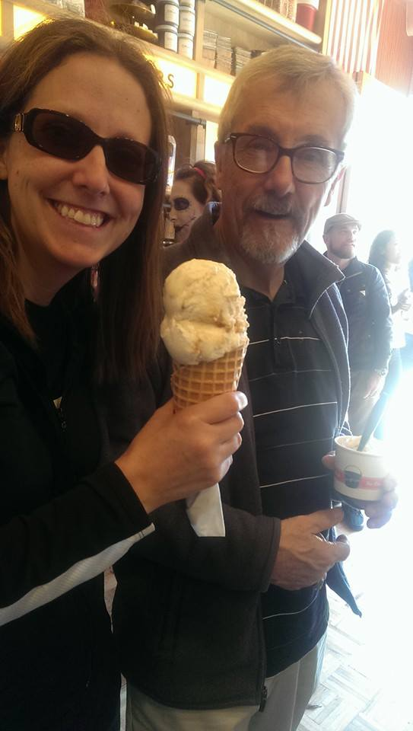
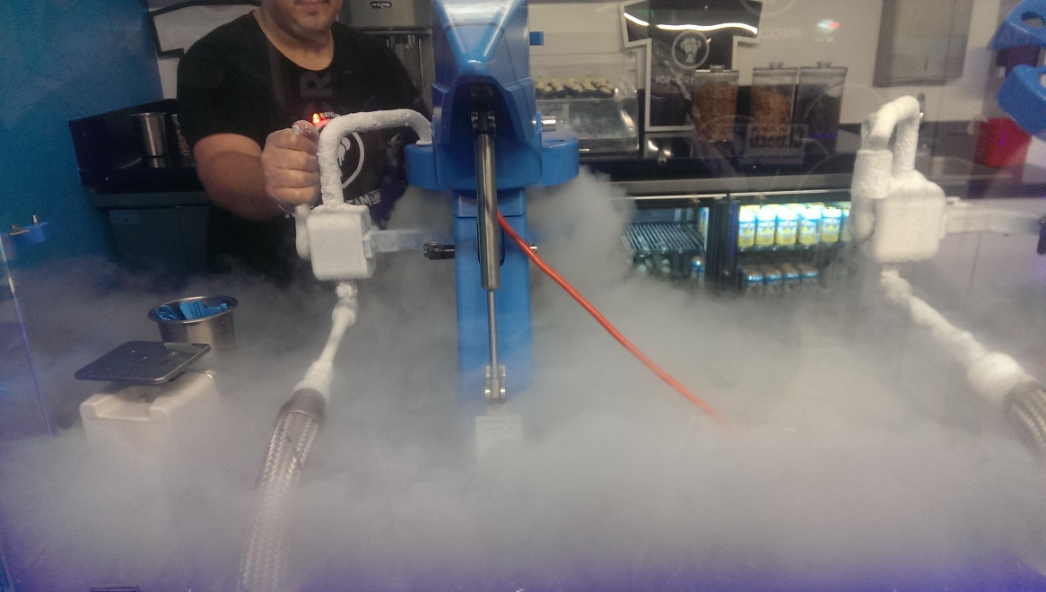
Weekend of
Ice Cream

Slide 4
Design a Java BST data structure
Design a class that can store Binary Search Trees.
  Specify all instance variables
  Draw a picture of what a BST looks like with the following information:
    Key: “Dodds” Value: “Alien” (root)
    Key: “Ben” Value: “Cow” (left tree)
    Key: “Kuenning” Value: “Penguin” (right tree)
  Draw a picture of an empty BST

Slide 5
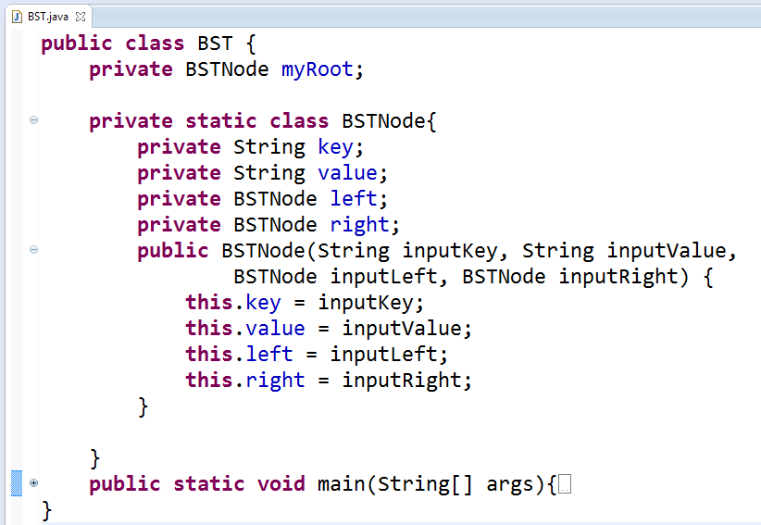
First possible BST structure
(Consistent with List/ListNode example from Hw6)

Slide 6
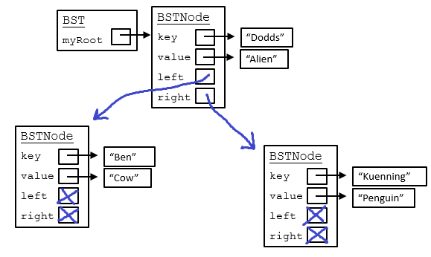
First possible BST structure
(Consistent with List/ListNode example from Hw6)

Slide 7
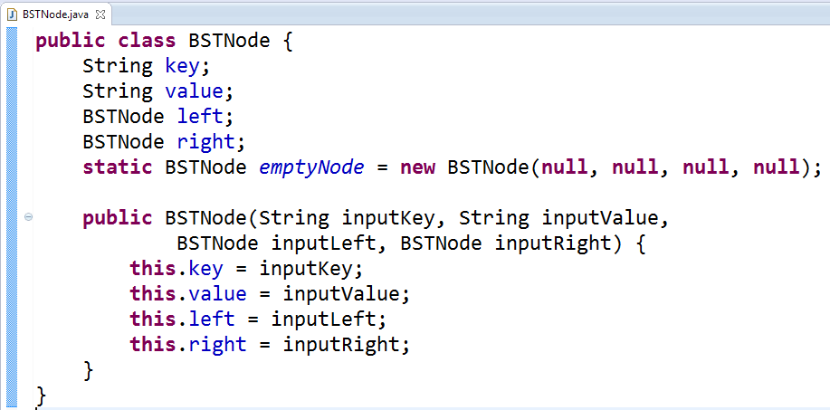
Second possible BST structure
(NOT Consistent with List/ListNode example from Hw6)

Slide 8
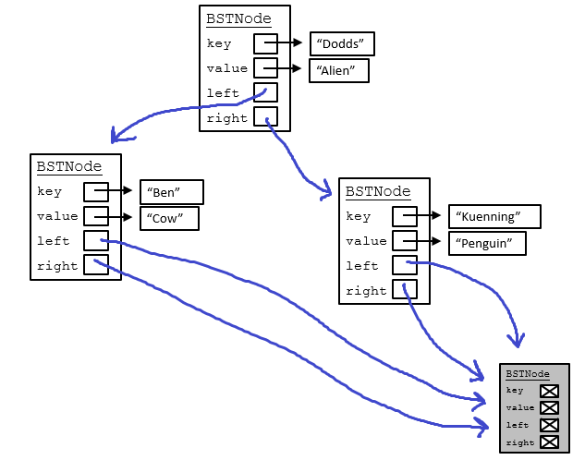
Second possible BST structure
(NOT Consistent with List/ListNode example from Hw6)

Slide 9
BSTNode Class
Short Version: Do NOT Modify BSTNodes!
Long Version: This is a strange class for Java because we will not modify our BSTNode Objects (This is to be like Racket and to help you to better understand how Racket behaved)

Slide 10
BSTNode Class
BSTNode
key
value
left
right
“Lewis”
“1280”
emptyNode
class BSTNode {
private String key;
private Object value;
private BSTNode left;
private BSTNode right;
public static BSTNode emptyNode =
new BSTNode(null,null,null,null);
BSTNode
key
value
left
right

Slide 11
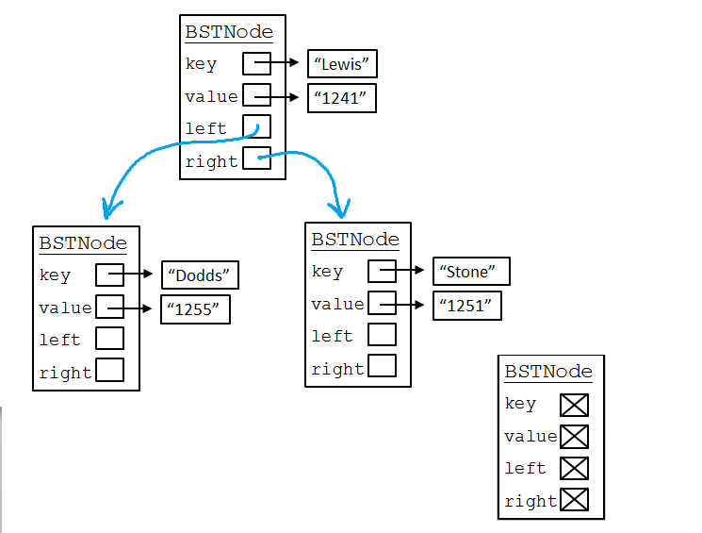
Racket:
'(Lewis (Dodds () ())
(Stone () ()))
Prolog:
[lewis, [dodds,[],[]]
[stone,[],[]]]
Although now we have a key (what you search with) PLUS some other information (the value)
Big Idea: Key & Value

Slide 12
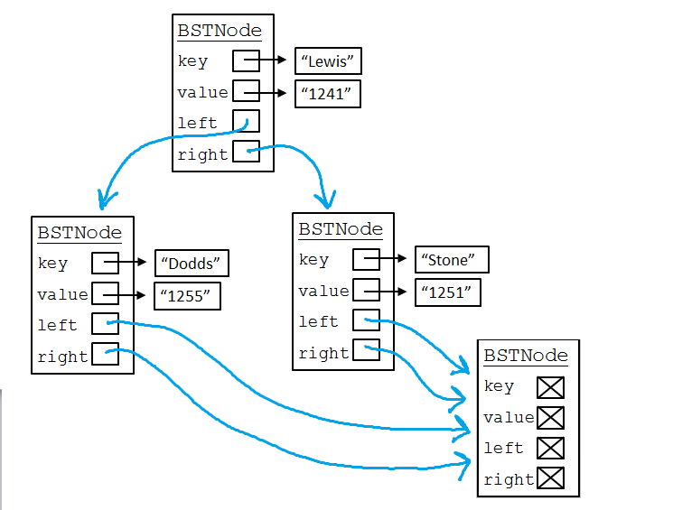
Instead of using '() or [], we’ll make an Object to represent the empty list. To save space, we’ll use just one of them!
Big Idea: empty BST

Slide 13
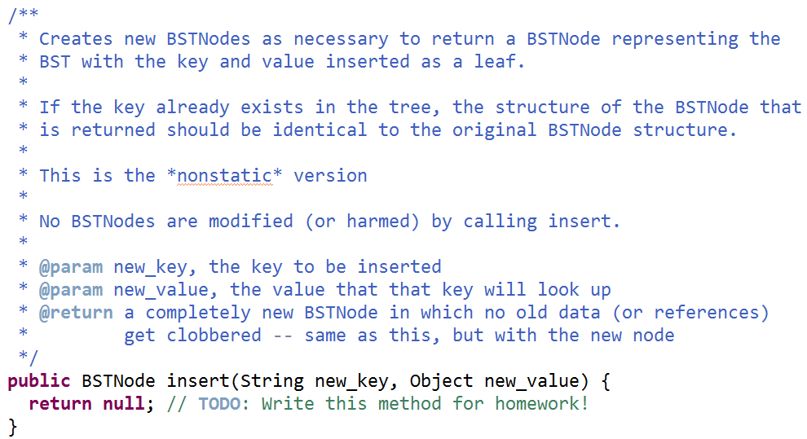
BSTNode insert

Slide 14
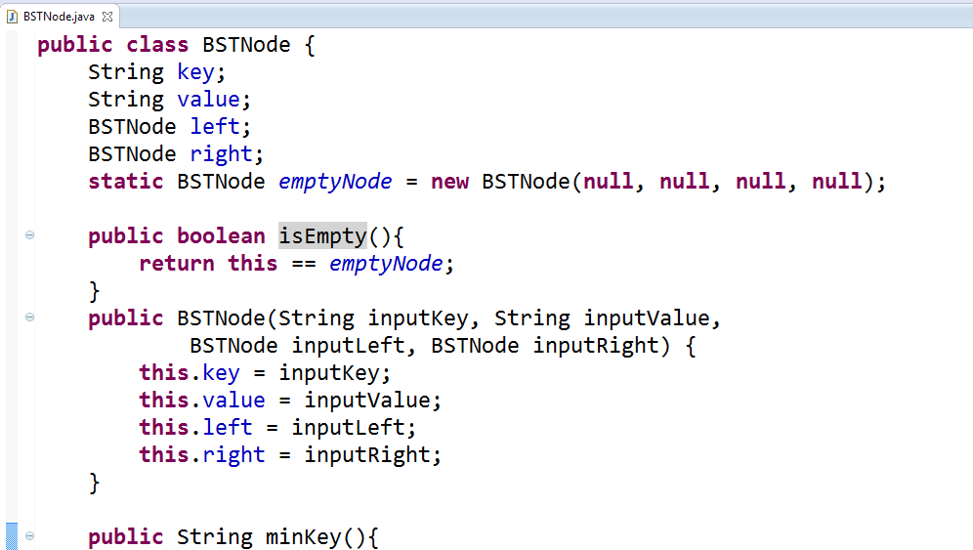
Write minKey()
If called on an empty BST, return null
Otherwise, return the key that is alphabetically first

Slide 15
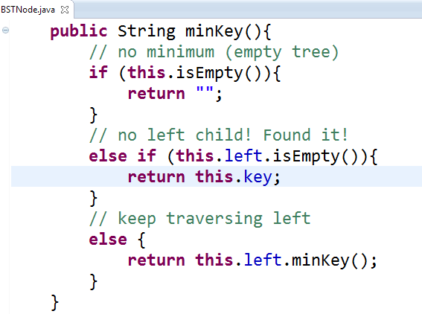
minKey Solution
(previous version had typo!)

Slide 16
Dynamic Programming Intro

Slide 17
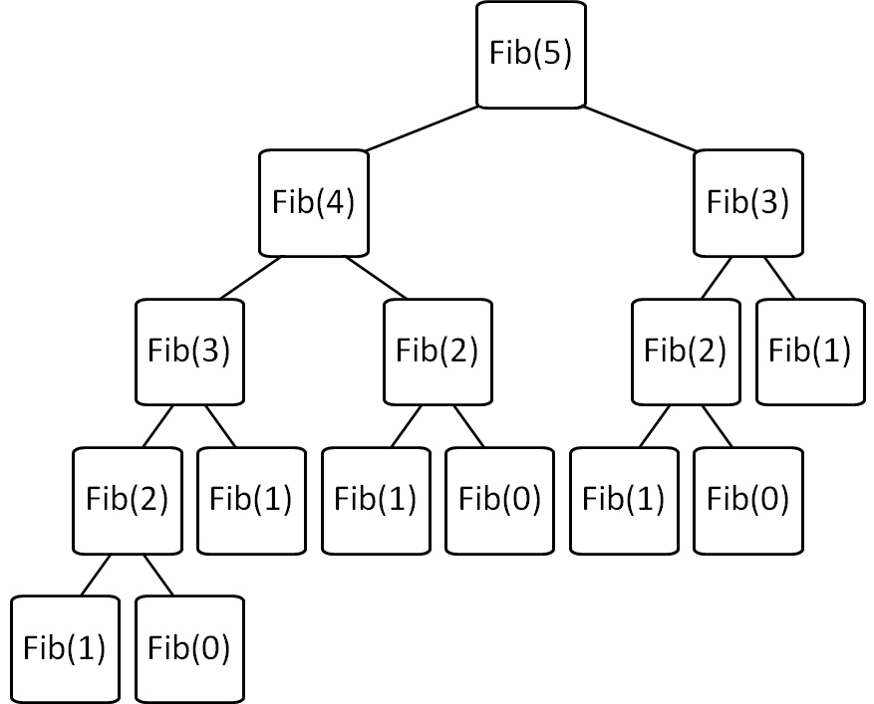
Consider: Fibonacci fib(X) = fib(X-1) + fib(X-2)
Brute force Fib(N)
is O(2^{N}) ☹
Can we improve this?

Slide 18
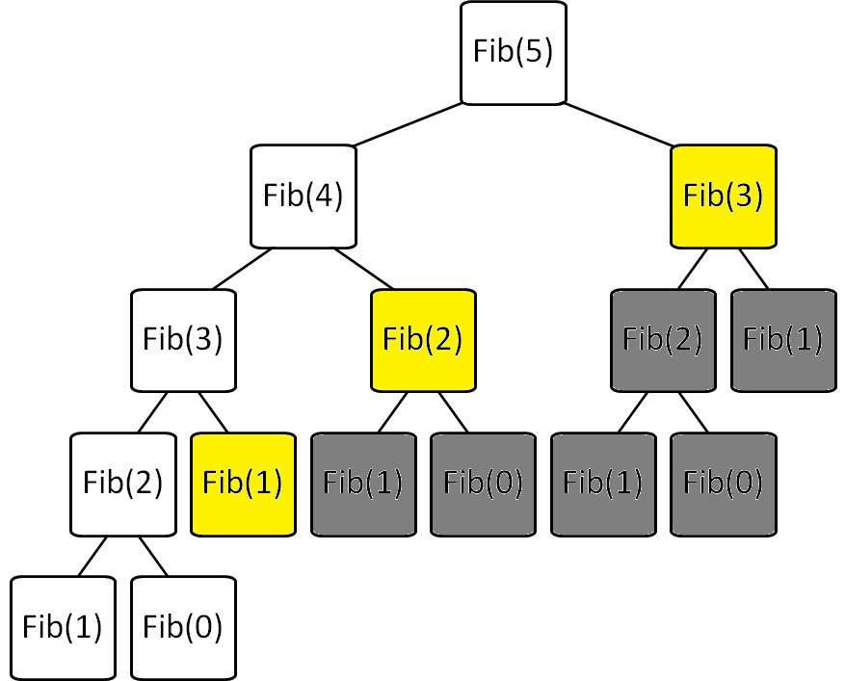
Fibonacci with Memoization
Keep track of recursive calls you’ve made and store the result!
Before you make a recursive call, check to see if you already know the answer.
Top-down (just like the regular recursive version)
Before I make the calls shown in yellow, I find that I already know the answer!

Slide 19
Fibonacci with Dynamic Programming
Work from the bottom-up!
Instead of doing the recursion, work from the bottom-up to create a table of answers of all recursive calls that might be made
We will NEVER make a recursive call, because we will always have already calculated the required components (e.g. fib(n-1) + fib(n-2))
Fib(0) | Fib(1) | Fib(2) | Fib(3) | Fib(4) | Fib(5)
0 | 1 | 1 | 2 | 3 | 5

Slide 20
Consider: Fibonacci
Brute force of Fib(N)
  is O(2^{N}) ☹
Memoization of Fib(N)
  is O(N) + overhead for keeping track of what recursive calls have been made
Dynamic Programming of Fib(N)
  is O(N) + overhead for making a table of size N

Slide 21

Differences between Memoization and Dynamic Programming
Brute Force Recursion
  Top-Down
Memoization
  Top-down
  Keep track of recursive calls you’ve made and store the result.
  Before you make a recursive call, check to see if you already know the answer.
Dynamic Programming
  Bottom-up
  Build up a table with answers to smaller problems
  Make sure you always have already calculated the required components (e.g. fib(n-1) + fib(n-2))
Fibonacci Solution Methods

Slide 22
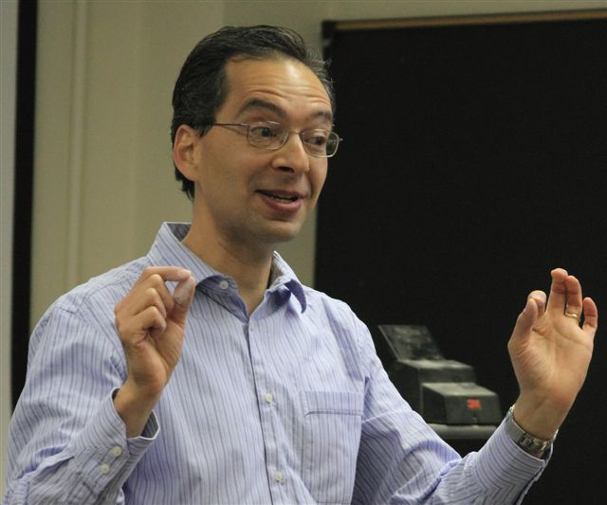
We learned:
To always start DP by writing recursion
That the DP table should include the possible inputs to the recursive call
In the DP table to look at:
  What do the cells mean?
  What cells are easy to fill in?
  What cells do we want?
  What rule fills in the cells?
What do you remember about Dynamic Programming (DP)
from CS60?

Slide 23
What do the cells mean?
What cells are easy to fill in?
What cells do we want?
What rule fills in the cells?
Fib(0) | Fib(1) | Fib(2) | Fib(3) | Fib(4) | Fib(5)
0 | 1 | 1 | 2 | 3 | 5

Slide 24
Write Recursive Pseudocode to find the min path cost based upon getEnergy
 | x = 0 | x = 1 | x = 2 | x = 3 | x = 4 | x = 5 | x = 6 | x = 7
y = 0 | 6 | 6 | 24 | 79 | 18 | 54 | 78 | 11
y = 1 | 7 | 9 | 12 | 46 | 95 | 106 | 118 | 93
y = 2 | 7 | 13 | 14 | 123 | 82 | 87 | 67 | 99
y = 3 | 3 | 6 | 33 | 153 | 142 | 187 | 62 | 56
y = 4 | 6 | 9 | 11 | 138 | 89 | 40 | 15 | 40
y = 5 | 10 | 3 | 3 | 79 | 137 | 60 | 42 | 77
y = 6 | 0 | 2 | 6 | 4 | 95 | 91 | 25 | 22
y = 7 | 1 | 4 | 10 | 9 | 38 | 162 | 12 | 9
That’s THREE recursive calls!
For each cell in the top row
  Return:
  energy at that cell +
  minimum path cost of 3 cells below
YUCK! There aren’t always 3 cells below!

Slide 25
Path from Hw 7:
What do the cells mean?
What cells are easy to fill in?
What cells do we want?
What rule fills in the cells?

Slide 26
Live coding
Factorial
(with recursion and DP)

Slide 27
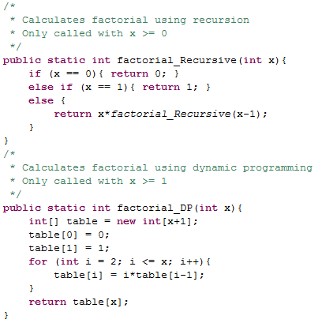
One cell in table for EACH possible recursive call.
Factorial using Dynamic Programming (DP)
(Note: it doesn’t provide any speed-up in this case)

Slide 28
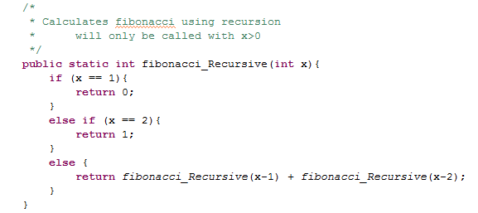
Fibonacci Using Recursion

Slide 29
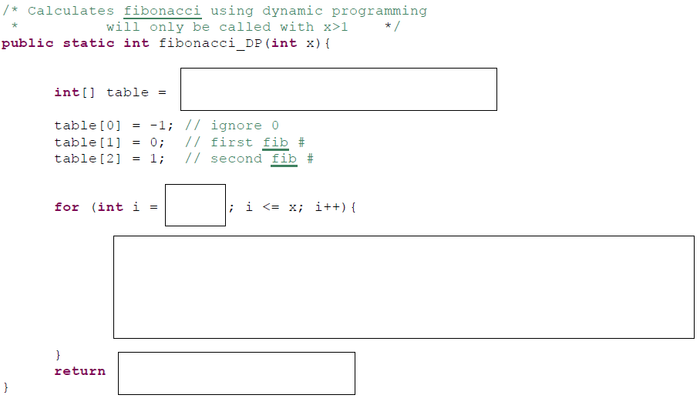
Fill In – Fibonacci DP
A) Stuck B) table[x] C)table[x-1] D)table[x+1]

Slide 30
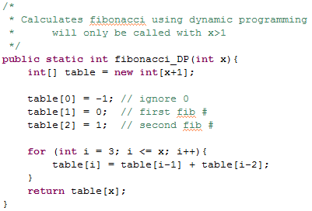
Fibonacci using Dynamic Programming (DP) SOLUTION

Slide 31
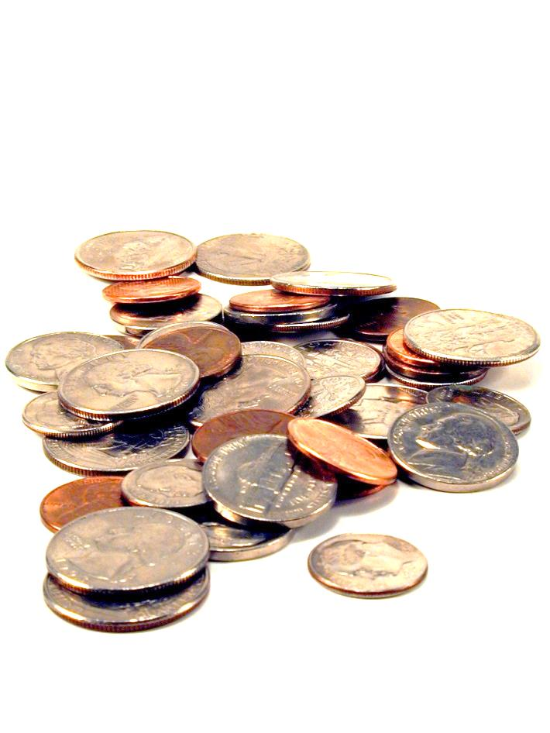
Making Change
Hw9
The homework doesn’t specify the algorithm directly. You have to figure it out.

Slide 32
we want the fewest coins that will produce this total
out of these denominations (we can use as many times as we want)
Does the algorithm of always using the largest coin possible get you the minimum number of coins?
A) Yes B) No C)??
change( 18, [1, 9, 10] )
Minimizing change...
in Racket + Prolog: recursive use-it-or…-or-lose-it

Slide 33
In CS (and life?)
Greed usually doesn’t work

Slide 34
we want the fewest coins that will produce this total
out of these denominations (we can use as many times as we want)
Minimizing change...
change( 18, [1, 9, 10] )
What is the fewest coins I can use to make this total?
You need to invent this DP algorithm in Hw9
0 | 1 | 2 | 3 | 4 | 5 | 6 | 7 | 8 | 9 | 10 | 11 | 12 | 13 | 14 | 15 | 16 | 17 | 18
0 | 1 | 2 | 3 | 4 | 5 | 6 | 7 | 8 | 1 | 1 | 2 | 3 | 4
in Java: dynamic programming!

Slide 35
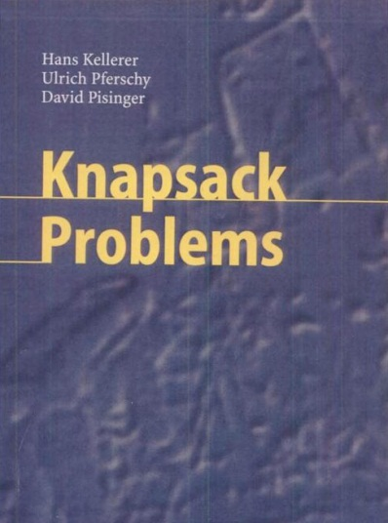
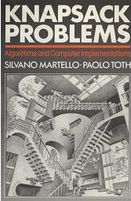
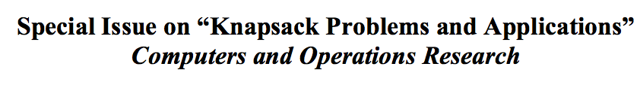
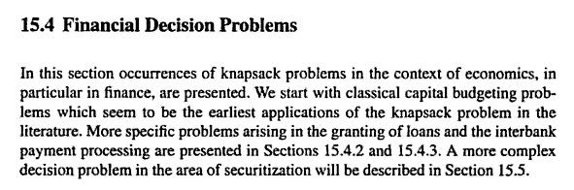
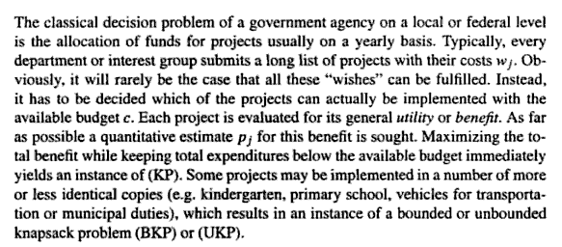
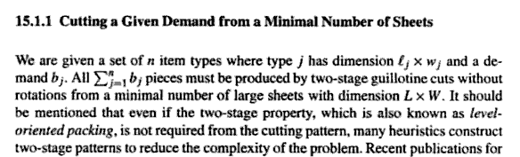
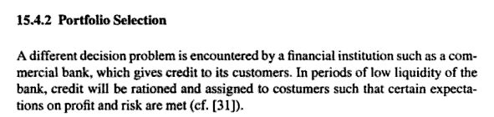
Knapsack!
2004 book
1990 book
Material use in manufacturing
Financial decision problems
Cryptosystems
Auction theory
~ Field of Operations Research

Slide 36
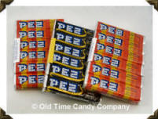
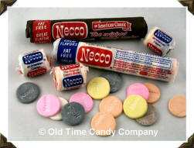

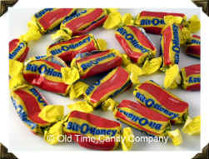
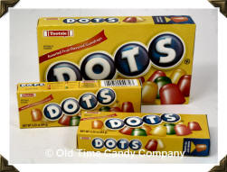
Recognize these?
1800's
1920's
1940's
1950's
1970's

Slide 37
Recognize these?
1800's
1920's
1940's
1950's
1970's
What should represent the 2000's?
Notes:
fun dip

Slide 38
Assume each of the candies has some value (v_{i})
v₁ = 100
w₁ = $2
v₁
w₁
i = 1
= 50
v₂ = 120
w₂ = $3
Assume each of the candies has some weight (w_{i})
v₂
w₂
= 40
i = 2
v₃ = 230
w₃ = $5
v₃
w₃
= 46
i = 3
We can calculate how good of a deal the candy is
v₄ = 560
w₄ = $7
v₄
w₄
i = 4
v_{i}
w_{i}
= 80
v₅ = 675
w₅ = $9
v₅
w₅
i = 5
= 75

Slide 39
Suppose "a friend" can consume a weight of 13 (i.e. $13). Assume that you won’t run out of candy
How can you maximize this
candy-value experience?
v₁ = 100
w₁ = $2
v₁
w₁
i = 1
= 50
v₂ = 120
w₂ = $3
v₂
w₂
= 40
i = 2
v₃ = 230
w₃ = $5
v₃
w₃
i = 3
= 46
v₄ = 560
w₄ = $7
v₄
w₄
i = 4
= 80
v₅ = 675
w₅ = $9
Does greed work?
v₅
w₅
i = 5
= 75

Slide 40
Suppose "a friend" can consume a weight of 13 (i.e. $13). Assume that you won’t run out of candy
How can you maximize this
candy-value experience?
v₁ = 100
w₁ = $2
v₁
w₁
i = 1
= 50
v₂ = 120
w₂ = $3
v₂
w₂
v₄ = 560
= 40
i = 2
1
w₄ = $7
v₄
w₄
v₃ = 230
= 80
w₃ = $5
v₃
w₃
i = 3
= 46
v₁ = 100
3
w₁ = $2
v₁
w₁
v₄ = 560
= 50
i = 1
w₄ = $7
v₄
w₄
i = 4
= 80
v_{Total} = 860
w_{Total} = $13
v₅ = 675
w₅ = $9
Does greed work?
v₅
w₅
i = 5
= 75

Slide 41
Suppose "a friend" can consume a weight of 13 (i.e. $13). Assume that you won’t run out of candy
How can you maximize this
candy-value experience?
v₁ = 100
w₁ = $2
v₁
w₁
i = 1
= 50
v₂ = 120
w₂ = $3
v₂
w₂
v₅ = 675
= 40
i = 2
1
w₅ = $9
v₅
w₅
v₃ = 230
= 75
i = 5
w₃ = $5
v₃
w₃
i = 3
= 46
v₁ = 100
2
w₁ = $2
v₁
w₁
v₄ = 560
= 50
i = 1
w₄ = $7
v₄
w₄
i = 4
= 80
v_{Total} = 875
w_{Total} = $13
v₅ = 675
w₅ = $9
Does greed work?
v₅
w₅
i = 5
= 75

Slide 42
In CS (and life?)
Greed usually doesn’t work

Slide 43
We learned:
To always start DP by writing recursion
That the DP table should include the possible inputs to the recursive call
In the DP table to look at:
  What do the cells mean?
  What cells are easy to fill in?
  What cells do we want?
  What rule fills in the cells?
What do you remember about Dynamic Programming (DP)
from CS60?

Slide 44
The Goal:
most value I can carry
(i.e. spend)
Knapsack problem
Use-it-or-lose-it
Option 1 (lose it):
How much value can I carry (i.e. buy) if I just assumed I had a capacity one smaller? (i.e. if I had $1 less)
bestValue( capacity ) =
bestValue( capacity-1 )
max
bestValue( capacity-w_{i} ) + v_{i}
over all possible i
Option 2 (use it):
How much value can I have if I use (i.e. buy) an item with
weight w_{i} and value v_{i}

Slide 45
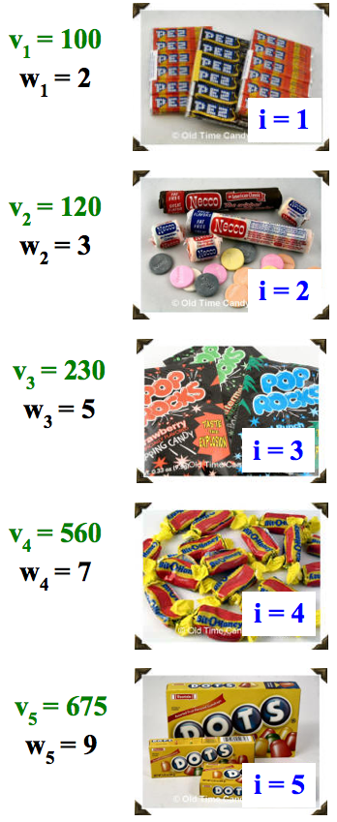
Dynamic programming
Create a table of possible recursive calls.
Compute the results of each one bottom-up.
T[ capacity ] = the maximum value obtainable for the given capacity
(i.e. that many dollars)
Which values are "easy" to fill in?
How do we fill in each cell?
CAPACITY
Fill in this table from 0 up to the actual capacity of interest…
$0 | $1 | $2 | $3 | $4 | $5 | $6 | $7 | $8 | $9 | $10 | $11 | $12 | $13

Slide 46
(1) Finish filling in this table of best-results for the knapsack problem:
CAPACITY
$0 | $1 | $2 | $3 | $4 | $5 | $6 | $7 | $8 | $9 | $10 | $11 | $12 | $13
0 | 0 | 100
Fill in this table from 0 up to the actual capacity of interest…
VALUE
Each cell is T[ capacity ] = the maximum value obtainable for the given capacity
(2) Estimate the big-O runtime of this table-filling algorithm, in terms of N, the number of items available and C, the capacity of the knapsack.
(3) How could you also keep track of the items to take using a 2nd table with one item per cell?
0 | 1 | 2 | 3 | 4 | 5 | 6 | 7 | 8 | 9 | 10 | 11 | 12 | 13

Slide 47
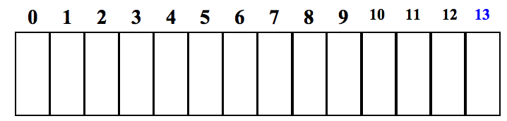
(1) Finish filling in this table of best-results for the knapsack problem:
CAPACITY
0
1
2
3
4
5
6
7
8
9
10
11
12
13
0
0
VALUE
100
120
200
230
300
560
560
675
680
775
795
875
Fill in this table from 0 up to the actual capacity of interest…
Each cell is T[ capacity ] = the maximum value obtainable for the given capacity
(2) Estimate the big-O runtime of this table-filling algorithm, in terms of C, the knapsack capacity.
What else does the big-O runtime depend on∞
O( N*C )
(3) How could you also keep track of the items to take using a 2nd table with one item per cell∞
CAPACITY
null
null
1
1
1
4
4
5
One Item
2
3
4
5
5
5

Slide 48
BONUS

Slide 49
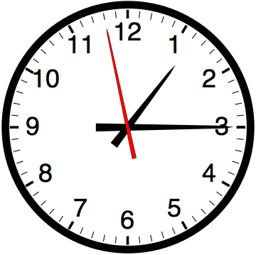

Slide 50


Computer
Science
&
= AWESOME

Slide 51
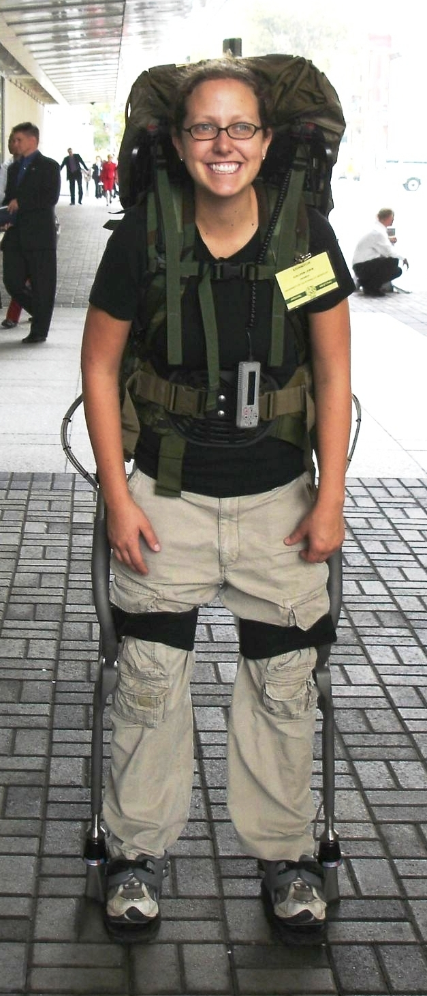
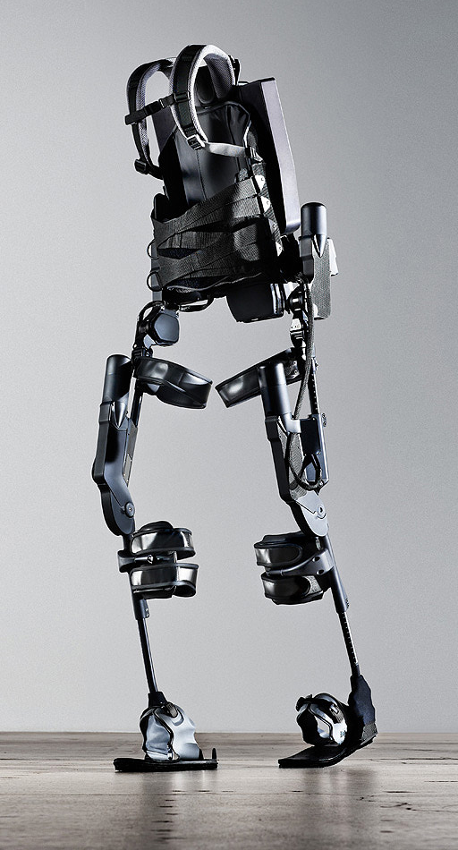
http://www.youtube.com/watch?v=pzRmNYA8LlY

Slide 52


ClickStart

Slide 53
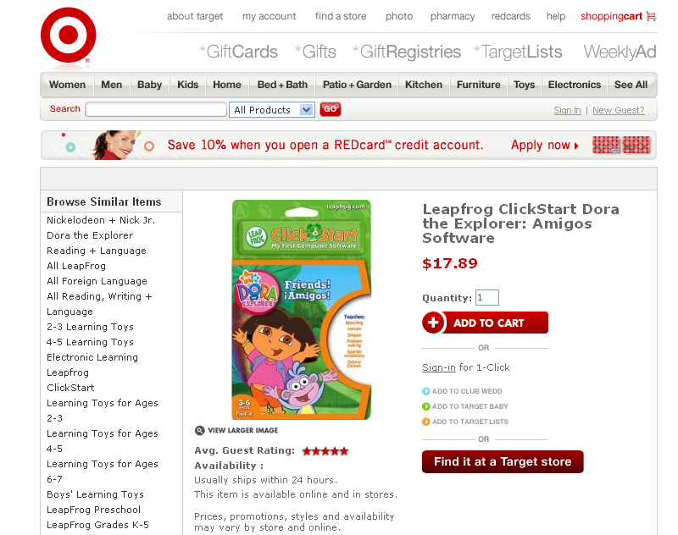

Slide 54
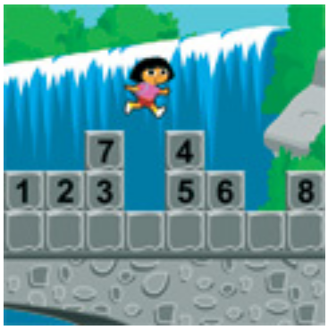
How should we represent the blocks in the computer?
Independent variables
2D Array
OpenList
I don’t know

Slide 55
The value in the array tells me what art asset to use
Each level is really a 3x10 vector!
0 | 0 | 7 | 0 | 4 | 0 | 0 | 0
1 | 2 | 3 | -4 | 5 | 6 | -7 | 8
B | B | B | B | B | B | B | B
Negative values tell me what block needs to go here to win!

Slide 56
0 | 0 | 7 | 0 | 4 | 0 | 0 | 0
1 | 2 | 3 | -4 | 5 | 6 | -7 | 8
0 | 0 | 0 | B | 0 | 0 | 0 | 0

Slide 57
BUGS!

Slide 58
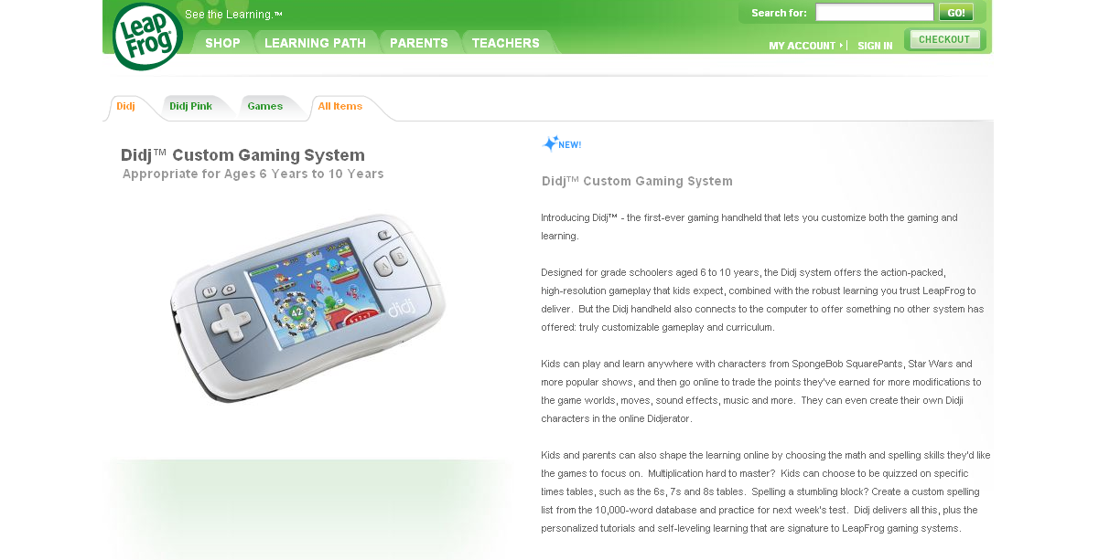

Slide 59
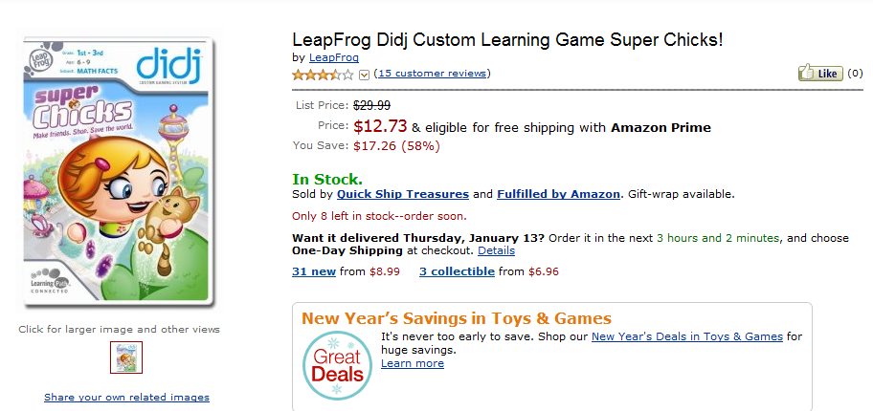
It is really sad when stuff you’ve made is on sale!

Slide 60
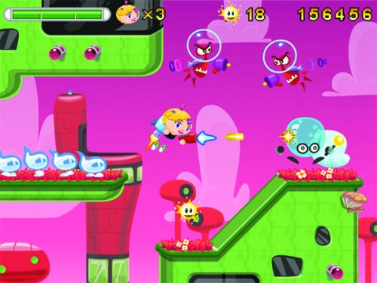
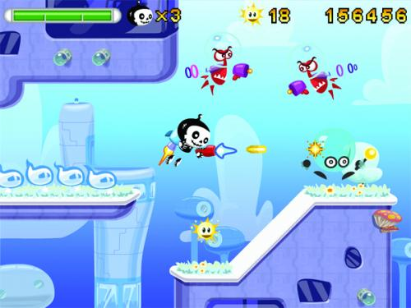

Which image is fake?
  A. Top Left
  B. Bottom Left
  C. Bottom Right

Slide 61
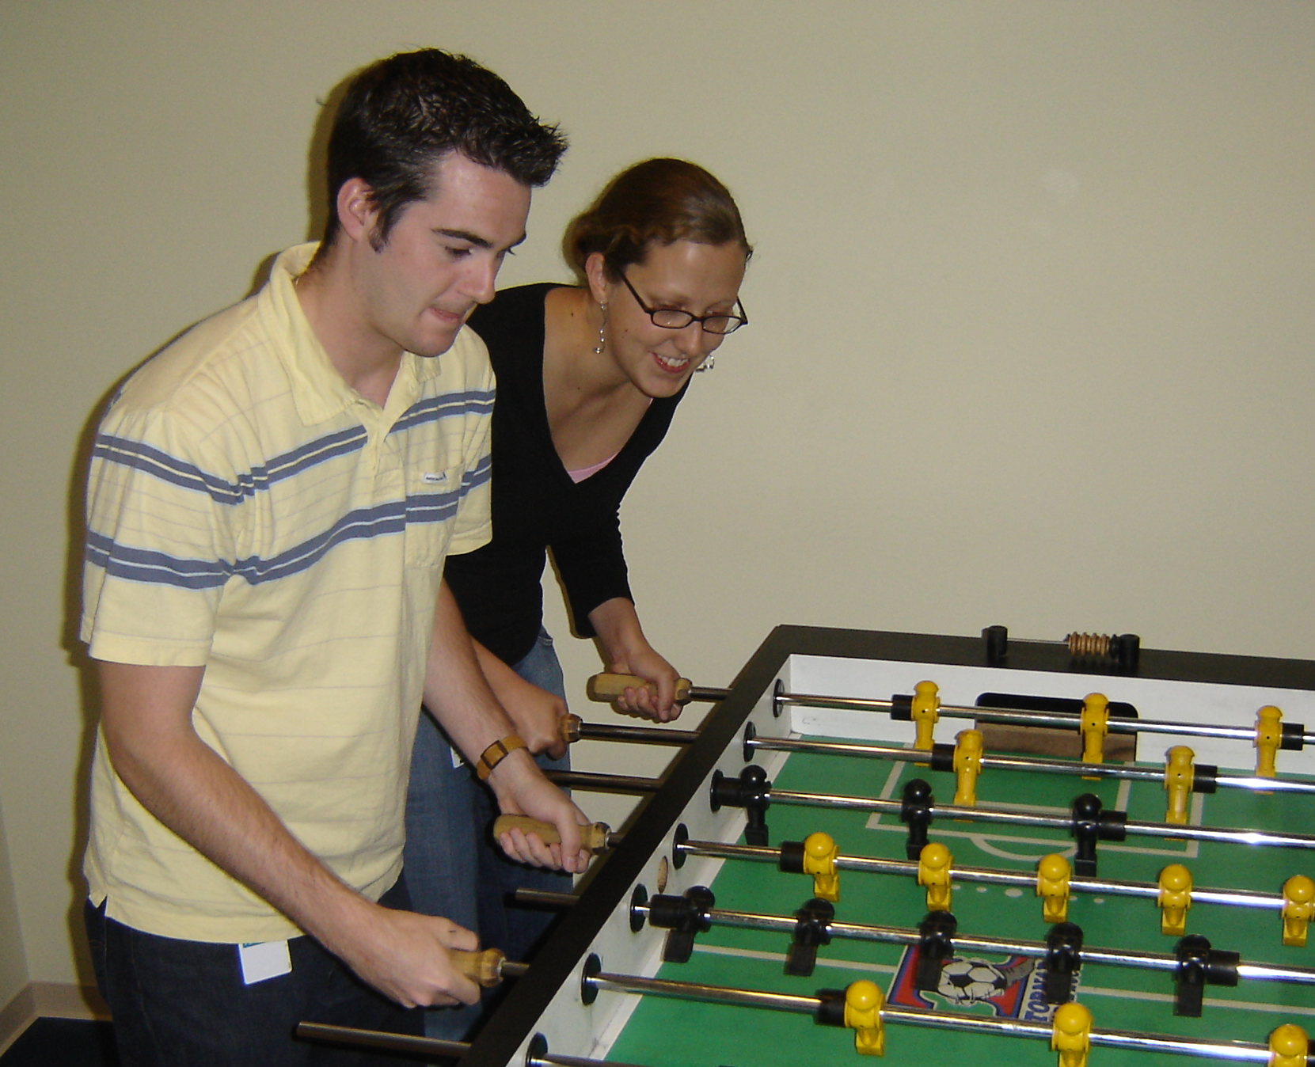

Slide 62
