Slide 1
CS 60
Knapsack and
Floyd-Warshall
2014-11-05
Wednesday – Week 9
Lecture 18

Slide 2
Lecture 18 – Learning Goals
Understand a knapsack problem
Be prepared to solve the countChange problem
Represent graphs using adjacency lists
Implement and justify Floyd-Warshall’s algorithm (which finds the shortest path between all pairs of nodes).

Slide 3
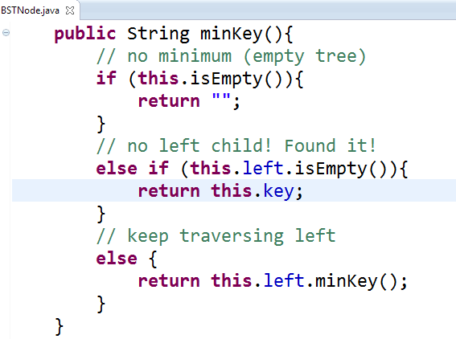
minKey Solution
(previous version had typo!)
WAS:
return this.left.key;
Which was WRONG

Slide 4
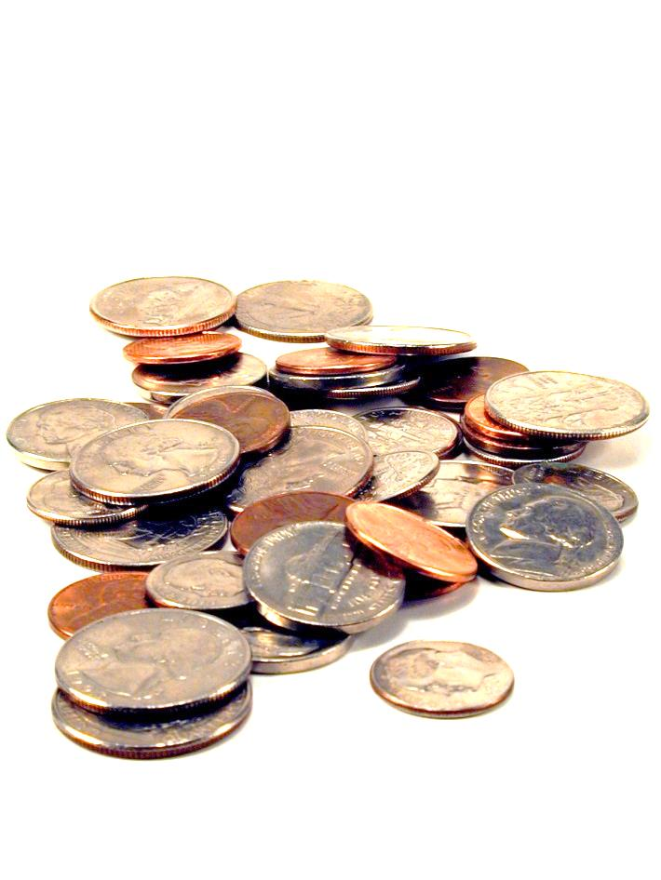
Making Change
Hw9
The homework doesn’t specify the algorithm directly. You have to figure it out.

Slide 5
we want the fewest coins that will produce this total
out of these denominations (we can use as many times as we want)
Does the algorithm of always using the largest coin possible get you the minimum number of coins?
A) Yes B) No C)??
change( 18, [1, 9, 10] )
Minimizing change...
in Racket + Prolog: recursive use-it-or…-or-lose-it

Slide 6
In CS (and life?)
Greed usually doesn’t work

Slide 7
we want the fewest coins that will produce this total
out of these denominations (we can use as many times as we want)
Minimizing change...
change( 18, [1, 9, 10] )
What is the fewest coins I can use to make this total?
You need to invent this DP algorithm in Hw9
0 | 1 | 2 | 3 | 4 | 5 | 6 | 7 | 8 | 9 | 10 | 11 | 12 | 13 | 14 | 15 | 16 | 17 | 18
0 | 1 | 2 | 3 | 4 | 5 | 6 | 7 | 8 | 1 | 1 | 2 | 3 | 4
in Java: dynamic programming!

Slide 8
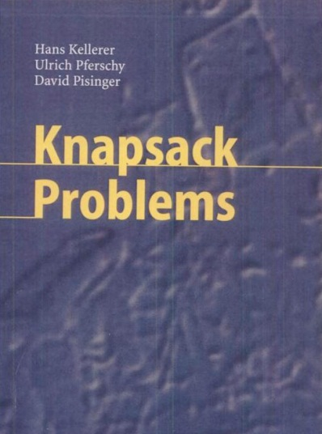
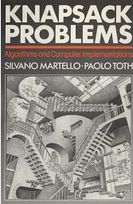
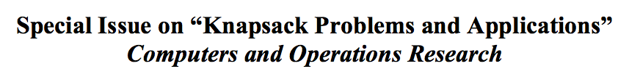
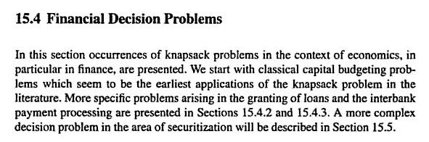
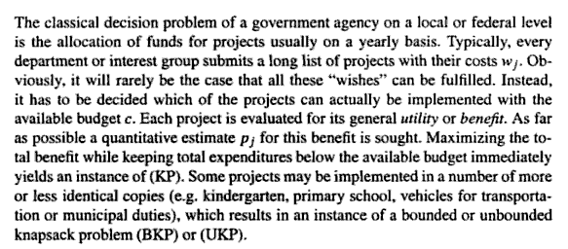
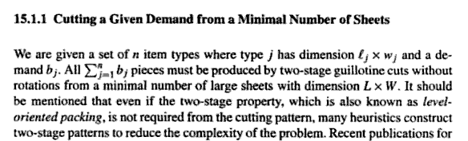
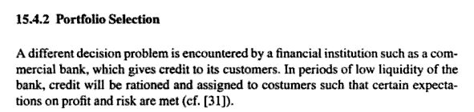
Knapsack!
2004 book
1990 book
Material use in manufacturing
Financial decision problems
Cryptosystems
Auction theory
~ Field of Operations Research

Slide 9
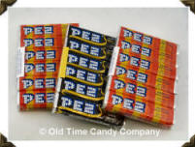
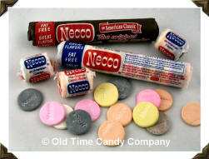

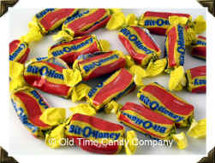
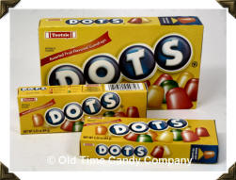
Assume each of the candies has some value (v_{i})
v₁ = 100
w₁ = $2
v₁
w₁
i = 1
= 50
v₂ = 120
w₂ = $3
Assume each of the candies has some weight (w_{i})
v₂
w₂
= 40
i = 2
v₃ = 230
w₃ = $5
v₃
w₃
= 46
i = 3
We can calculate how good of a deal the candy is
v₄ = 560
w₄ = $7
v₄
w₄
i = 4
v_{i}
w_{i}
= 80
v₅ = 675
w₅ = $9
v₅
w₅
i = 5
= 75

Slide 10
Suppose "a friend" can consume a weight of 13 (i.e. $13). Assume that you won’t run out of candy
How can you maximize this
candy-value experience?
v₁ = 100
w₁ = $2
v₁
w₁
i = 1
= 50
v₂ = 120
w₂ = $3
v₂
w₂
v₄ = 560
= 40
i = 2
1
w₄ = $7
v₄
w₄
v₃ = 230
= 80
w₃ = $5
v₃
w₃
i = 3
= 46
v₁ = 100
3
w₁ = $2
v₁
w₁
v₄ = 560
= 50
i = 1
w₄ = $7
v₄
w₄
i = 4
= 80
v_{Total} = 860
w_{Total} = $13
v₅ = 675
w₅ = $9
Does greed work?
v₅
w₅
i = 5
= 75

Slide 11
Suppose "a friend" can consume a weight of 13 (i.e. $13). Assume that you won’t run out of candy
How can you maximize this
candy-value experience?
v₁ = 100
w₁ = $2
v₁
w₁
i = 1
= 50
v₂ = 120
w₂ = $3
v₂
w₂
v₅ = 675
= 40
i = 2
1
w₅ = $9
v₅
w₅
v₃ = 230
= 75
i = 5
w₃ = $5
v₃
w₃
i = 3
= 46
v₁ = 100
2
w₁ = $2
v₁
w₁
v₄ = 560
= 50
i = 1
w₄ = $7
v₄
w₄
i = 4
= 80
v_{Total} = 875
w_{Total} = $13
v₅ = 675
w₅ = $9
Does greed work?
v₅
w₅
i = 5
= 75

Slide 12
In CS (and life?)
Greed usually doesn’t work

Slide 13
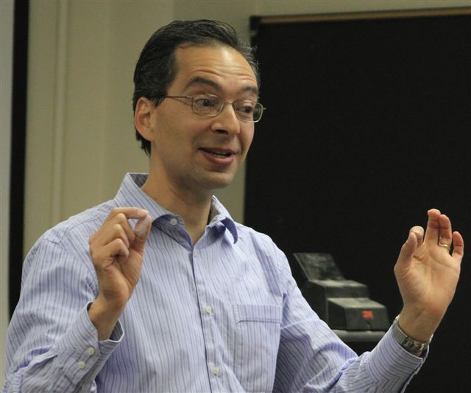
We learned:
To always start DP by writing recursion
That the DP table should include the possible inputs to the recursive call
In the DP table to look at:
  What do the cells mean?
  What cells are easy to fill in?
  What cells do we want?
  What rule fills in the cells?
What do you remember about Dynamic Programming (DP)
from CS60?

Slide 14
The Goal:
most value I can carry
(i.e. spend)
Knapsack problem
Use-it-or-lose-it
Option 1 (lose it):
How much value can I carry (i.e. buy) if I just assumed I had a capacity one smaller? (i.e. if I had $1 less)
bestValue( capacity ) =
bestValue( capacity-1 )
max
bestValue( capacity-w_{i} ) + v_{i}
over all possible i
Option 2 (use it):
How much value can I have if I use (i.e. buy) an item with
weight w_{i} and value v_{i}

Slide 15
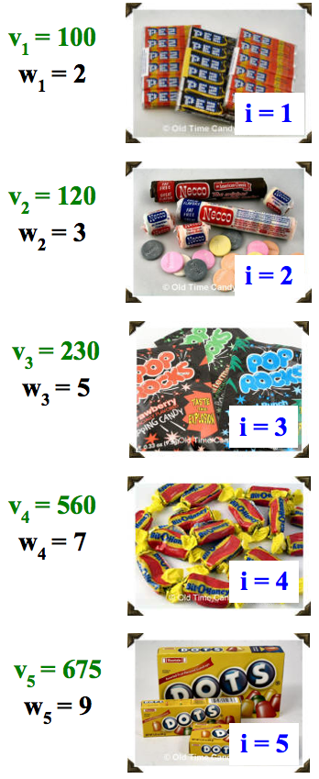
Dynamic programming
Create a table of possible recursive calls.
Compute the results of each one bottom-up.
T[ capacity ] = the maximum value obtainable for the given capacity
(i.e. that many dollars)
Which values are "easy" to fill in?
How do we fill in each cell?
CAPACITY
Fill in this table from 0 up to the actual capacity of interest…
$0 | $1 | $2 | $3 | $4 | $5 | $6 | $7 | $8 | $9 | $10 | $11 | $12 | $13

Slide 16
(1) Finish filling in this table of best-results for the knapsack problem:
CAPACITY
$0 | $1 | $2 | $3 | $4 | $5 | $6 | $7 | $8 | $9 | $10 | $11 | $12 | $13
0 | 0 | 100
Fill in this table from 0 up to the actual capacity of interest…
VALUE
Each cell is T[ capacity ] = the maximum value obtainable for the given capacity
(2) Estimate the big-O runtime of this table-filling algorithm, in terms of N, the number of items available and C, the capacity of the knapsack.
(3) How could you also keep track of the items to take using a 2nd table with one item per cell?
0 | 1 | 2 | 3 | 4 | 5 | 6 | 7 | 8 | 9 | 10 | 11 | 12 | 13

Slide 17
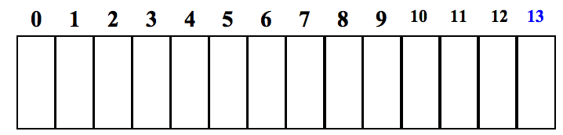
(1) Finish filling in this table of best-results for the knapsack problem:
CAPACITY
0
1
2
3
4
5
6
7
8
9
10
11
12
13
0
0
VALUE
100
120
200
230
300
560
560
675
680
775
795
875
Fill in this table from 0 up to the actual capacity of interest…
Each cell is T[ capacity ] = the maximum value obtainable for the given capacity
(2) Estimate the big-O runtime of this table-filling algorithm, in terms of C, the knapsack capacity.
What else does the big-O runtime depend on∞
O( N*C )
(3) How could you also keep track of the items to take using a 2nd table with one item per cell∞
CAPACITY
null
null
1
1
1
4
4
5
One Item
2
3
4
5
5
5

Slide 18
Floyd-Warshall
(all-pairs shortest path)

Slide 19
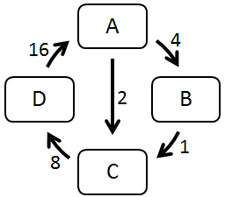
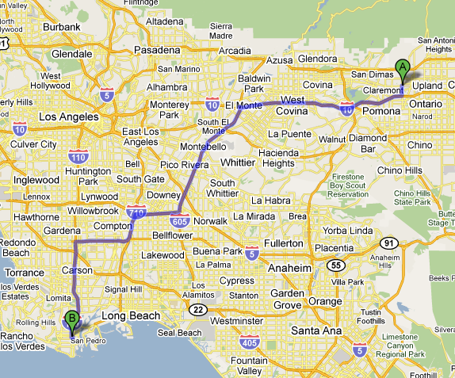

Finding all Paths
A directed graph:
Suppose we'd like the
shortest route from
any city to any other city.
How is this path different than the paths in the directed graph above?

Slide 20
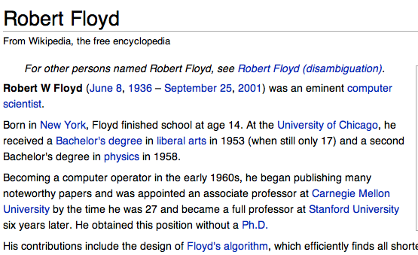
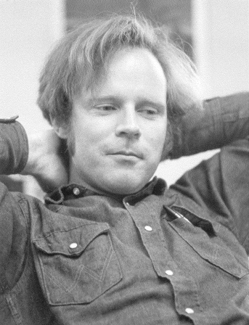
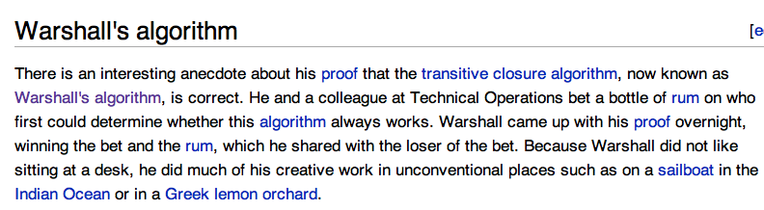
Floyd-Warshall algorithm
All-pairs shortest paths!
“Floyd may have been the first advocate of refactoring -- the rewriting of working programs from scratch, re-using only the essential ideas. Refactoring is now standard practice among computer programmers. By continuously looking for simpler ways to do the same thing, Floyd aimed to improve not only programs but also programmers' abilities and understanding...
He also was a passionate hiker and mountain climber who loved the wilderness country in the High Sierra…”
Stephen Warshall
What would a reasonable big-O running time be (N = # nodes)

Slide 21
Shortest Paths in CS60
O(N³)
O(2E)
min-dist
(Brute Force)
Floyd-Warshall
(Dynamic programming)
ALL PATHS
Hw2 part 1 Problem 9
ONE PATH

Slide 22
Graph Representations
(adjacency matrix)

Slide 23
Cost:
0 if self-edge
Edge | Cost
A → A | 0
A → B | 4
A → C | 2
A → D | ∞
B → A | ∞
B → B | 0
B → C | 1
B → D | ∞
C → A | ∞
C → B | ∞
C → C | 0
C → D | 8
D → A
D → B
D → C
D → D
Graph Representations
(cont.)
Cost:
∞ if no edge
Cost:
Otherwise just the edge weight
A
4
16
Fill these out
D
2
B
1
8
C
A) 0 B) 1 C) 2 D) ∞ E) ??

Slide 24
Graph Representation:
Adjacency Matrix
Edge | Cost
A → A | 0
A → B | 4
A → C | 2
A → D | ∞
B → A | ∞
B → B | 0
B → C | 1
B → D | ∞
C → A | ∞
C → B | ∞
C → C | 0
C → D | 8
D → A | 16
D → B | ∞
D → C | ∞
D → D | 0
A
4
16
A → A | A → B | A → C | A → D
0 | 4 | 2 | ∞
B → A | B → B | B → C | B → D
∞ | 0 | 1 | ∞
C → A | C → B | C → C | C → D
∞ | ∞ | 0 | 8
D → A | D → B | D → C | D → D
16 | ∞ | ∞ | 0
D
2
B
1
8
C
This is the source (src)
 | A | B | C | D
A | 0 | 4 | 2 | ∞
B | ∞ | 0 | 1 | ∞
C | ∞ | ∞ | 0
D | 16 | ∞ |  | 0
This is the destination (dest)
A) 2 B) 4 C) 8 D) ∞

Slide 25
Adjacency Matrix
Cost:
0 if self-edge
Cost:
Edge weight
Cost:
∞ if no edge
A (1) → A (1) 0 | A (1) → B (2) 4 | A (1) → C (3) 2 | A (1) → D (4) ∞
B (2) → A (1) ∞ | B (2) → B (2) 0 | B (2) → C (3) 1 | B (2) → D (4) ∞
C (3) → A (1) ∞ | C (3) → B (2) ∞ | C (3) → C (3) 0 | C (3) → D (4) 8
D (4) → A (1) 16 | D (4) → B (2) ∞ | D (4) → C (3) ∞ | D (4) → D (4) 0

Slide 26
Adjacency Matrix (Floyd-Warshall implementation detail):
Use a int[][] and number the nodes starting with 1
 | dest = 0 | dest = 1 | dest = 2 | dest = 3 | dest = 4
src = 0
src = 1 |  | A (1) → A (1) 0 | A (1) → B (2) 4 | A (1) → C (3) 2 | A (1) → D (4) ∞
src = 2 |  | B (2) → A (1) ∞ | B (2) → B (2) 0 | B (2) → C (3) 1 | B (2) → D (4) ∞
src = 3 |  | C (3) → A (1) ∞ | C (3) → B (2) ∞ | C (3) → C (3) 0 | C (3) → D (4) 8
src = 4 |  | D (4) → A (1) 16 | D (4) → B (2) ∞ | D (4) → C (3) ∞ | D (4) → D (4) 0
We’ll just ignore index 0 ☺

Slide 27
Tracing
Floyd-Warshall

Slide 28
Floyd-Warshall algorithm
For each node K:
For each pair of nodes (X →Y):
See if using an intermediate node K can reduce the cost of that path:
min[cost(X →Y),
cost(X →K) + cost(K →Y)]
{A, B, C, D}
{A→A, A→B, A→C, A→D,
B→A, B→B, B→C, B→D,
C→A, C→B, C→C, C→D,
D→A, D→B, D→C, D→D}
Don’t use the intermediate node
Use the intermediate node

Slide 29
Floyd-Warshall algorithm CS60
For each student K:
For each pair of students(X →Y):
See if using an intermediate student K can reduce the cost of that path:
min[cost(X →Y),
cost(X →K) + cost(K →Y)]
{1 … N}
{All pairs of students}
(Which is _____ pairs)
For K = 1, this for loop runs ___ times
For N students (nodes) we call min ____ times

Slide 30
CRAZY IDEA!
What if we kept a record of all path costs for each node K?

Slide 31
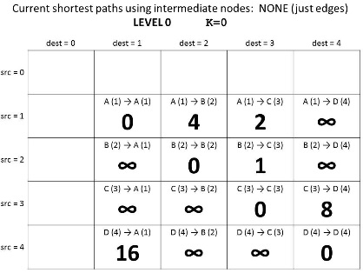
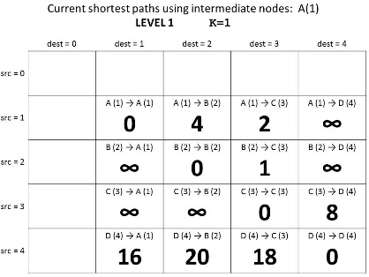
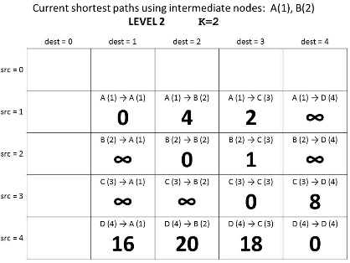
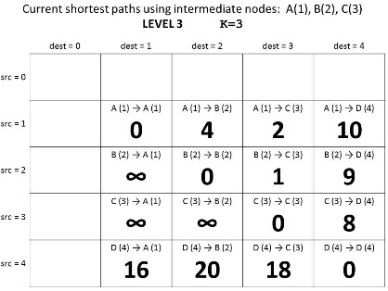
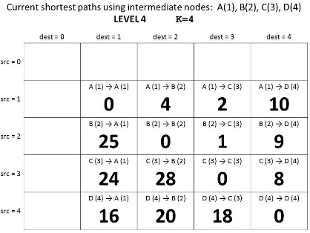
Guaranteed shortest path using NO intermediate nodes.
K = 0
Why does this give us the shortest path?
Guaranteed shortest path using only A as an intermediate node.
K = 1
Guaranteed shortest path using only A & B as intermediate nodes.
K = 2
Guaranteed shortest path using
only A, B, & C
as intermediate nodes.
K = 3
Guaranteed shortest path using
only A, B, C, & D
as intermediate nodes.
K = 4

Slide 32
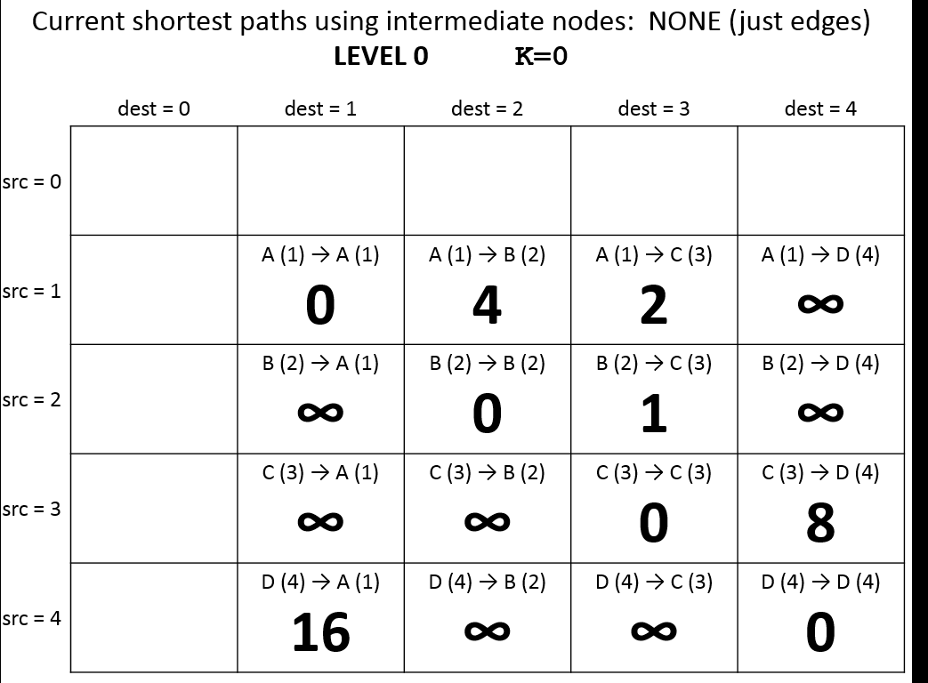
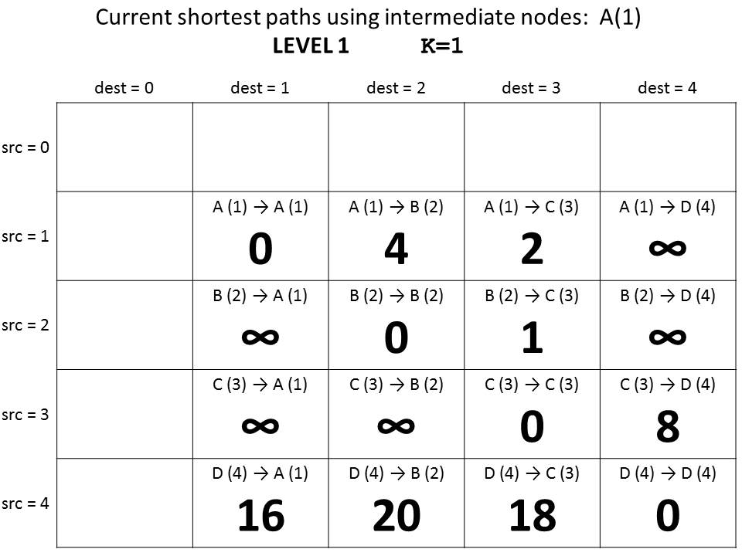
Costs if we get to use one intermediate Node: A (#1)
min[cost(X →Y),
cost(X →K) + cost(K →Y)]
min[cost(D →B),
cost(D →A) + cost(A→B)]

Slide 33
Guaranteed shortest path using NO intermediate nodes.
K = 0
Why does this give us the shortest path?
Guaranteed shortest path using only A as an intermediate node.
K = 1
Guaranteed shortest path using only A & B as intermediate nodes.
K = 2
Guaranteed shortest path using
only A, B, & C
as intermediate nodes.
K = 3
Guaranteed shortest path using
only A, B, C, & D
as intermediate nodes.
K = 4

Slide 34
Floyd-Warshall Pseudocode
We don’t use index 0, so we need N+1
int[][] cost = new int[N+1][N+1];
// set initial values = edge weights
for(int K=1; K<=N; K++){
for(int src=1; src<=N; src++){
for(int dest=1; dest<=N; dest++){
int prevCost = cost[src][dest];
int newCost = cost[src] [K] +
cost [K] [dest];
cost[src][dest] = min(prevCost, newCost);
}
}
}
min[cost(X →Y),
cost(X →K) +
cost(K →Y)]

Slide 35
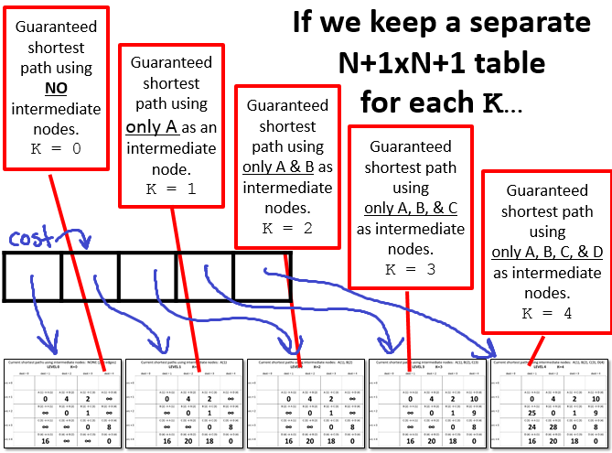

Slide 36
One N+1xN+1 array for each possible intermediate node
int[][][] cost = new int[N+1][N+1][N+1];
// set initial values = edge weights
for(int K=1; K<=N; K++){
for(int src=1; src<=N; src++){
for(int dest=1; dest<=N; dest++){
int prevCost = cost[K-1][src][dest];
int newCost = cost[K-1][src] [K] +
cost[K-1] [K] [dest];
cost[k][src][dest]=min(prevCost, newCost);
}
}
}
Look at the “current” shortest path
Floyd-Warshall Pseudocode (Layers)

Slide 37
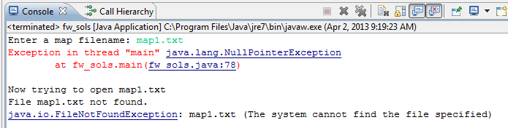
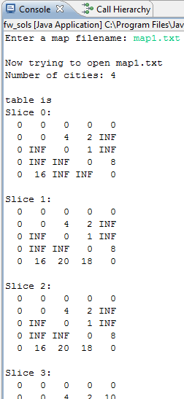
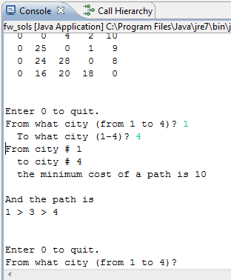
Shows each “layer” of the table cost
If you get this error (on this or Change) review the homework instructions
HOMEWORK 8
FILE INPUT!
You can query for ANY Path!

Slide 38
Discuss in your group
I’m thinking individually first
I’m talking to my neighbor
We think we’re set
We’re stuck
What is in cost?
  int[][][] cost = new int[N+1][N+1][N+1];
  What is in layer 0 (cost[0]) and layer N
    int[][] start = cost[0];
    int[][] done = cost[N];
Why will this give ALL shortest paths?

Slide 39
Current shortest paths using intermediate nodes: NONE (just edges)
LEVEL 0 K=0
 | dest = 0 | dest = 1 | dest = 2 | dest = 3 | dest = 4
src = 0
src = 1 |  | A (1) → A (1) 0 | A (1) → B (2) 4 | A (1) → C (3) 2 | A (1) → D (4) ∞
src = 2 |  | B (2) → A (1) ∞ | B (2) → B (2) 0 | B (2) → C (3) 1 | B (2) → D (4) ∞
src = 3 |  | C (3) → A (1) ∞ | C (3) → B (2) ∞ | C (3) → C (3) 0 | C (3) → D (4) 8
src = 4 |  | D (4) → A (1) 16 | D (4) → B (2) ∞ | D (4) → C (3) ∞ | D (4) → D (4) 0

Slide 40
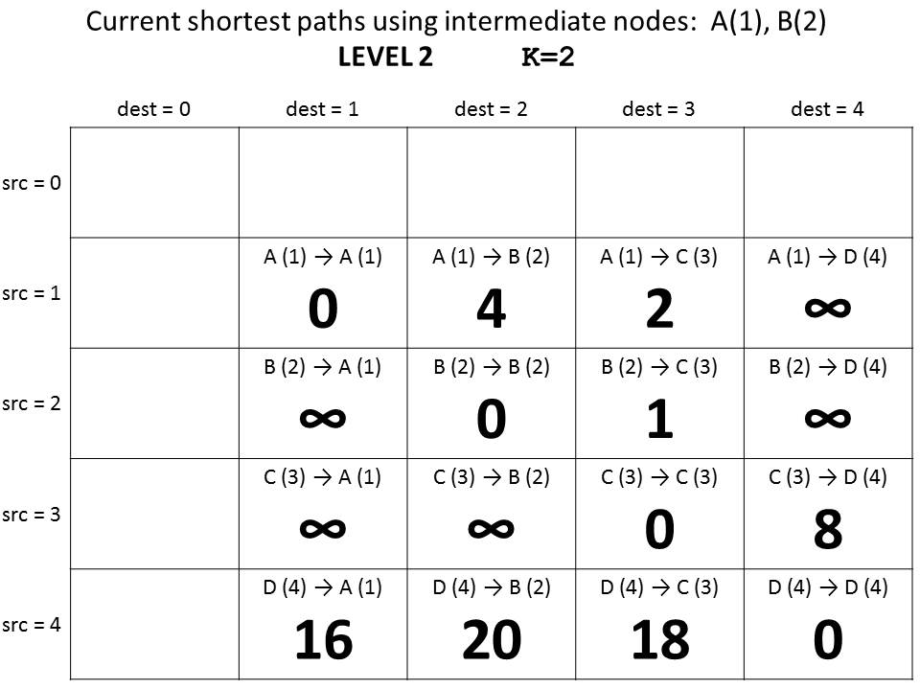
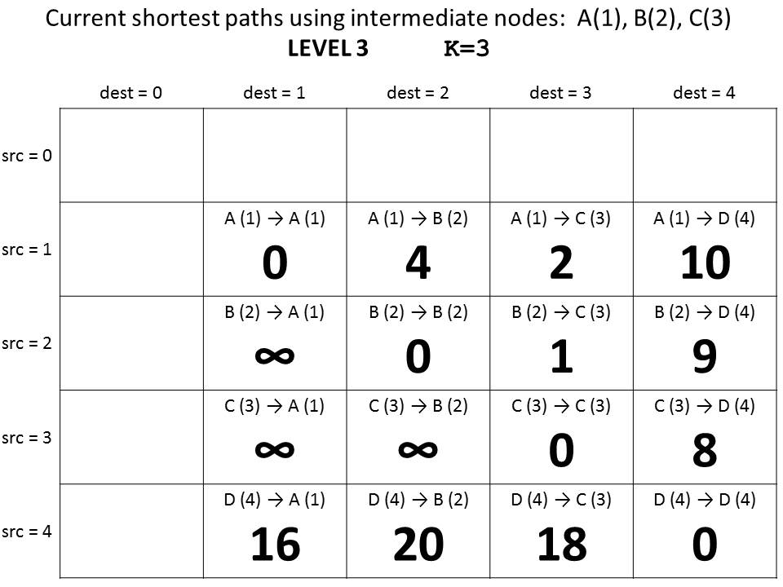
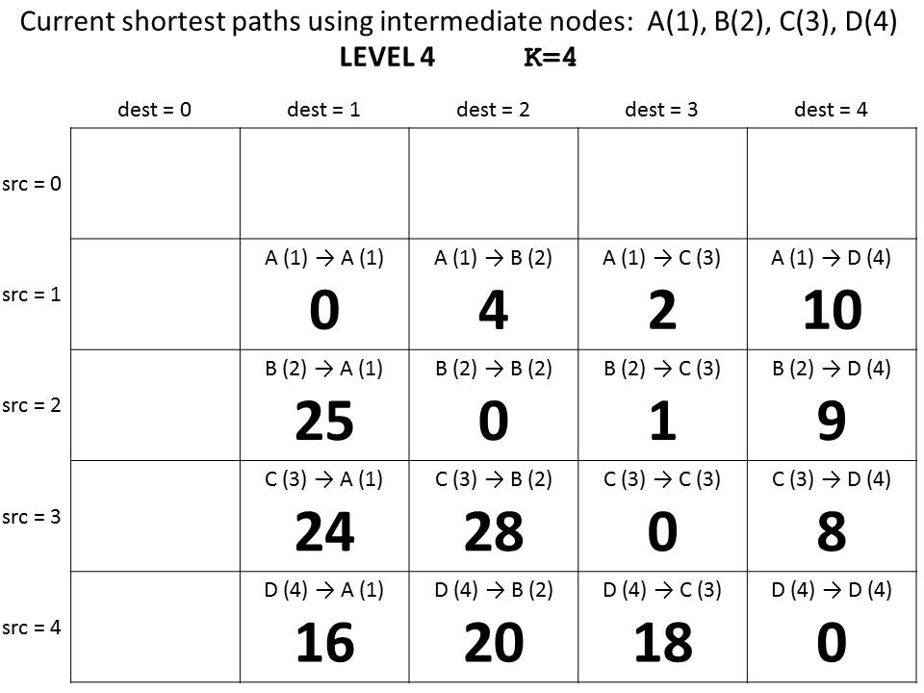

Slide 41
Current shortest paths using intermediate nodes: NONE (just edges)
LEVEL 0 K=0
 | dest = 0 | dest = 1 | dest = 2 | dest = 3 | dest = 4
src = 0
src = 1 |  | A (1) → A (1) 0 | A (1) → B (2) 4 | A (1) → C (3) 2 | A (1) → D (4) ∞
src = 2 |  | B (2) → A (1) ∞ | B (2) → B (2) 0 | B (2) → C (3) 1 | B (2) → D (4) ∞
src = 3 |  | C (3) → A (1) ∞ | C (3) → B (2) ∞ | C (3) → C (3) 0 | C (3) → D (4) 8
src = 4 |  | D (4) → A (1) 16 | D (4) → B (2) ∞ | D (4) → C (3) ∞ | D (4) → D (4) 0

Slide 42
Current shortest paths using intermediate nodes: A(1)
LEVEL 1 K=1
 | dest = 0 | dest = 1 | dest = 2 | dest = 3 | dest = 4
src = 0
src = 1 |  | A (1) → A (1) | A (1) → B (2) | A (1) → C (3) | A (1) → D (4)
src = 2 |  | B (2) → A (1) | B (2) → B (2) | B (2) → C (3) | B (2) → D (4)
src = 3 |  | C (3) → A (1) | C (3) → B (2) | C (3) → C (3) | C (3) → D (4)
src = 4 |  | D (4) → A (1) | D (4) → B (2) | D (4) → C (3) | D (4) → D (4)

Slide 43
Current shortest paths using intermediate nodes: A(1), B(2)
LEVEL 2 K=2
 | dest = 0 | dest = 1 | dest = 2 | dest = 3 | dest = 4
src = 0
src = 1 |  | A (1) → A (1) | A (1) → B (2) | A (1) → C (3) | A (1) → D (4)
src = 2 |  | B (2) → A (1) | B (2) → B (2) | B (2) → C (3) | B (2) → D (4)
src = 3 |  | C (3) → A (1) | C (3) → B (2) | C (3) → C (3) | C (3) → D (4)
src = 4 |  | D (4) → A (1) | D (4) → B (2) | D (4) → C (3) | D (4) → D (4)

Slide 44
Current shortest paths using intermediate nodes: A(1), B(2), C(3)
LEVEL 3 K=3
 | dest = 0 | dest = 1 | dest = 2 | dest = 3 | dest = 4
src = 0
src = 1 |  | A (1) → A (1) | A (1) → B (2) | A (1) → C (3) | A (1) → D (4)
src = 2 |  | B (2) → A (1) | B (2) → B (2) | B (2) → C (3) | B (2) → D (4)
src = 3 |  | C (3) → A (1) | C (3) → B (2) | C (3) → C (3) | C (3) → D (4)
src = 4 |  | D (4) → A (1) | D (4) → B (2) | D (4) → C (3) | D (4) → D (4)

Slide 45
Current shortest paths using intermediate nodes: A(1), B(2), C(3), D(4)
LEVEL 4 K=4
 | dest = 0 | dest = 1 | dest = 2 | dest = 3 | dest = 4
src = 0
src = 1 |  | A (1) → A (1) | A (1) → B (2) | A (1) → C (3) | A (1) → D (4)
src = 2 |  | B (2) → A (1) | B (2) → B (2) | B (2) → C (3) | B (2) → D (4)
src = 3 |  | C (3) → A (1) | C (3) → B (2) | C (3) → C (3) | C (3) → D (4)
src = 4 |  | D (4) → A (1) | D (4) → B (2) | D (4) → C (3) | D (4) → D (4)

Slide 46
JavaDocs
ARE AWESOME!

Slide 47
BONUS

Slide 48
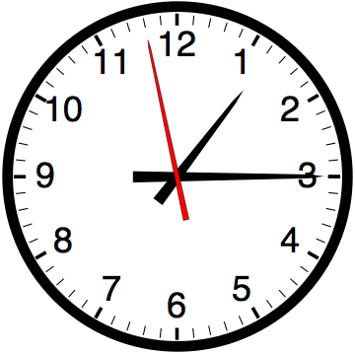

Slide 49


Computer
Science
&
= AWESOME

Slide 50
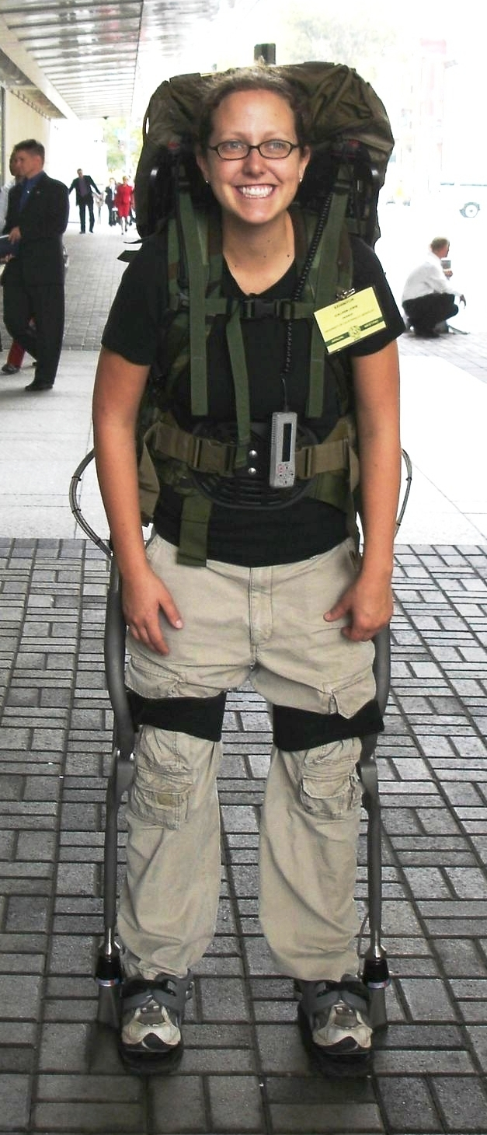
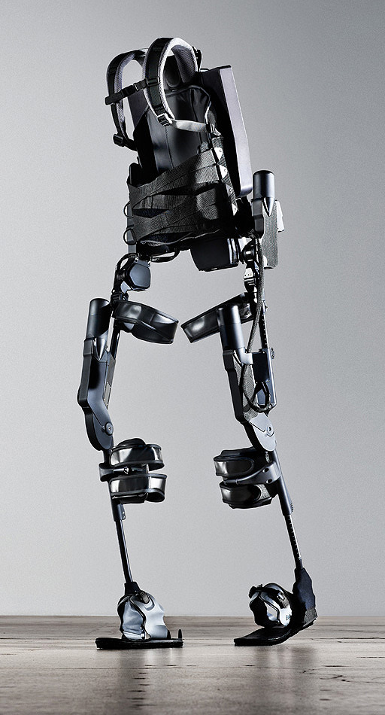
http://www.youtube.com/watch?v=pzRmNYA8LlY

Slide 51


ClickStart

Slide 52


Slide 53
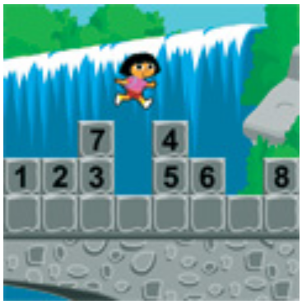
How should we represent the blocks in the computer?
Independent variables
2D Array
OpenList
I don’t know

Slide 54
The value in the array tells me what art asset to use
Each level is really a 3x10 vector!
0 | 0 | 7 | 0 | 4 | 0 | 0 | 0
1 | 2 | 3 | -4 | 5 | 6 | -7 | 8
B | B | B | B | B | B | B | B
Negative values tell me what block needs to go here to win!

Slide 55
0 | 0 | 7 | 0 | 4 | 0 | 0 | 0
1 | 2 | 3 | -4 | 5 | 6 | -7 | 8
0 | 0 | 0 | B | 0 | 0 | 0 | 0

Slide 56
BUGS!

Slide 57


Slide 58

It is really sad when stuff you’ve made is on sale!

Slide 59
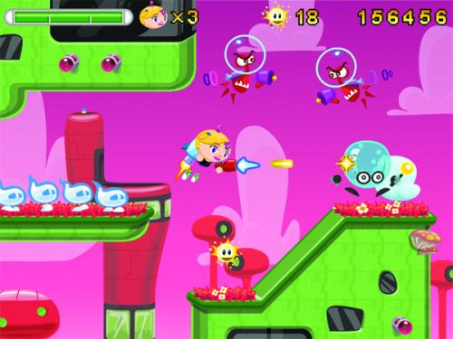
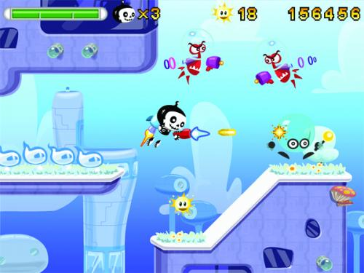

Which image is fake?
  A. Top Left
  B. Bottom Left
  C. Bottom Right

Slide 60
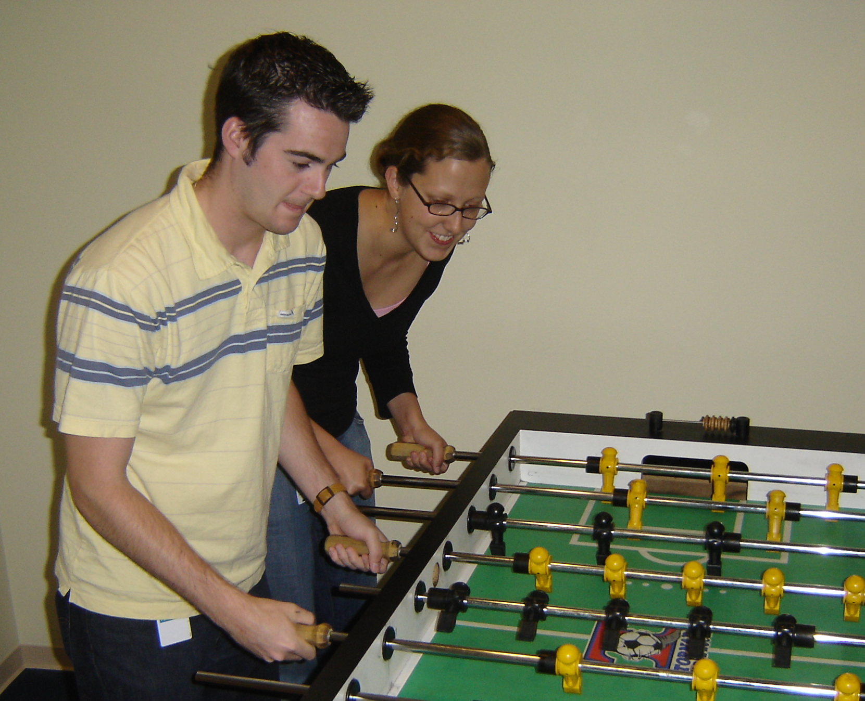

Slide 61
