Slide 1
CS 60
Big-O & Sorting
2014-11-10
Monday – Week 10
Lecture 19

Slide 2


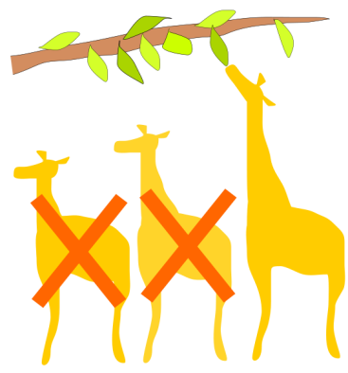
Lecture 19 – Learning Goals
Reason about big-O using:
For loops
Algorithms (not in code)
Recurrence relationships
Bubble Sort
Selection Sort

Slide 3
Runtimes (why we only care about the largest term)

Slide 4
Work on Part 1
If T(n) = 10*n² + 1000*n then T(n) ∈ O( )
If T(n) = 5*n² + 5*m³ then T(n) ∈ O( )
If T(n) = 10000000 + n then T(n) ∈ O( )
If T(n) = n*log(n) + n² then T(n) ∈ O( )
If T(n) = 2^{n} + n! then T(n) ∈ O( )
If T(n) = n^{n} + n! then T(n) ∈ O( )

Slide 5

How Fast Are Computers?
1 Hz = 1 operation /sec
2.9GHz = 2.9 x 10⁹ op / sec

Slide 6
Classes of Problems
Big-O Order
n
n
n!
Intractable Problems (Exponential)
n
2
3
n
2
n
Tractable Problems (Polynomial)
n log(n)
Instead of using measured time – reason about the complexity of the problem
n
√n
log(n)
No Problem!
1

Slide 7
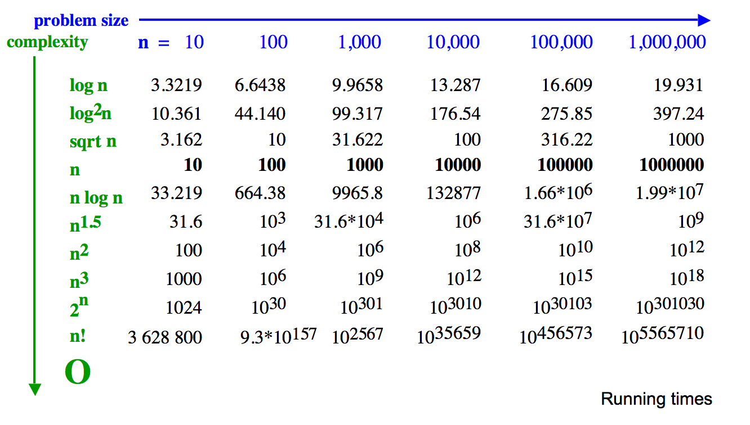
Why we only care about the largest term
How many operations are required?
Polynomial
Exp.
How big is n!
How long would these take if you have a 10 GHz Processor?

Slide 8
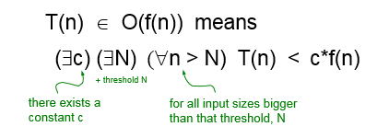
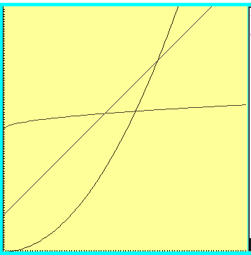
T(n) axis
N
n axis

Slide 9
Work on Part 1
If T(n) = 10*n² + 1000*n then T(n) ∈ O( )
If T(n) = 5*n² + 5*m³ then T(n) ∈ O( )
If T(n) = 10000000 + n then T(n) ∈ O( )
If T(n) = n*log(n) + n² then T(n) ∈ O( )
If T(n) = 2^{n} + n! then T(n) ∈ O( )
If T(n) = n^{n} + n! then T(n) ∈ O( )

Slide 10
Loop Counting

Slide 11
Work on Part 2
Write a for-loop in Java that requires c*n steps (where c is a constant and n is variable) – i.e. T(n) ∈ O(n)
Write a for-loop in Java that requires c*n*m steps (where c is a constant and n and m are variables) – i.e. T(n) ∈ O(n * m)
Write a for-loop in Java that requires c*n+ d*m steps (where c and d are constants and n and m are variables) – i.e. T(n) ∈ O(n + m)
Write a for-loop in Java that requires c*log(n) steps (where c is a constant and n is a variable) – i.e. T(n) ∈ O(log(n))

Slide 12
O(N+M)
for ( int i=0 ; i <= N ; i++){
// constant-time operation
}
for ( int z=0 ; z <= M ; z++){
// constant-time operation }
i=0
i=1
i=2
…
i=N-1
i=N
# ops per row
1
1
1
…
1
1
# ops per row
1
1
1
…
1
1
z=0
z=1
z=2
…
z=N-1
z=N
O(N+M)
Total of N
Total of M

Slide 13
O(N*M)
for ( int i=0 ; i <= N ; i++){
for ( int z=0 ; z <= M ; z++){
// constant-time operation
}
}
i=0
i=1
i=2
…
i=N-1
i=N
# ops per row
M
M
M
…
M
M
O(N*M)
Total of N*M

Slide 14
O(log₂(N))
for ( int i=N ; i > 0 ; i=i/2){
// constant-time operation
}
i=N
i=N/2
…
i=4
i=2
i=1
# ops per row
1
1
1
…
1
1
O(log₂(N))
Total
of log₂(N)

Slide 15
Work on Part 3
For a picture with height H and width W:
T(H,W) to get the color of one pixel ∈ O( )
T(H,W) to change every pixel to white ∈ O( )
T(H,W) to get the height of the picture ∈ O( )
T(H,W) to get the average of all pixels ∈ O( )
T(H,W) to blur each pixel based upon the average of the N pixels around each pixel ∈ O( )

Slide 16
Recurrence Relationships (This will involve a lot of algebra – but no magic!)

Slide 17
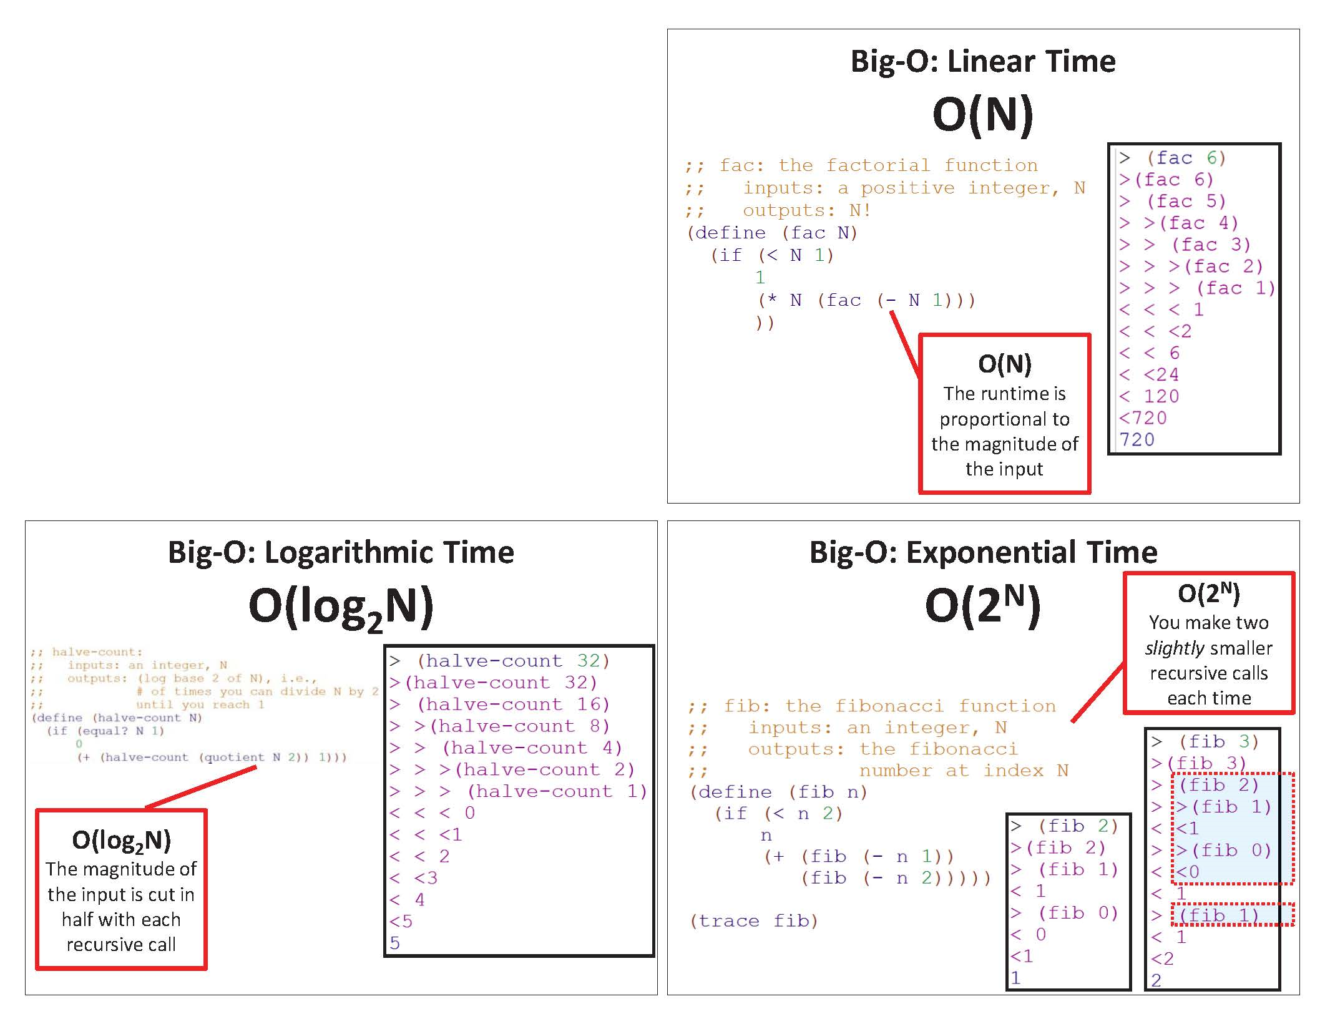
Imprecision ALERT!
Before, we looked at a specific example (e.g., N=6) and generalized!

Slide 18
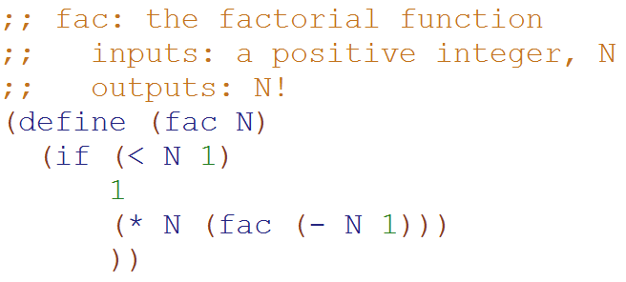
Big-O: Linear Time O(N)
How important was the assumption that this is exactly 1 constant-time operation?
Would using 6, 8, or 42 change the Big-O runtime?
A) Yes B) No C)??
How long does this take to run if N = 0?
Based upon this relationship
T(N) = 1 + T(N-1)
We can generalize that:
T(N-1) = 1 + T(N-2)
T(N-2) = 1 + T(N-3)
…
How long does this take to run for any N?
T(0) = 1
T(N) = 1 + T(N-1)
T(N) = 1 + 1 + T(N-2)
T(N) = 1 + 1 + 1 + T(N-3)
T(N) = 1 + 1 + 1 + … + 1 + 1 + 1
T(N) = N
Substitute this
Substitute this

Slide 19
Big-O: Linear Time O(N)
If N = 0,
only 3 constant-time operations
T(0) = 3
T(N) = 3 + T(N-1)
T(N) = 3 + 3 + T(N-2)
T(N) = 3 + 3 + 3 + T(N-3)
T(N) = 3 + 3 + 3 + … + 3 + 3 + 3
T(N) = 3N
BIG IDEA
The big-O answer is the same if we assume 3 constant-time operations or just 1
(on previous slide)
For N>0
3 constant-time operations
plus the recursive call

Slide 20
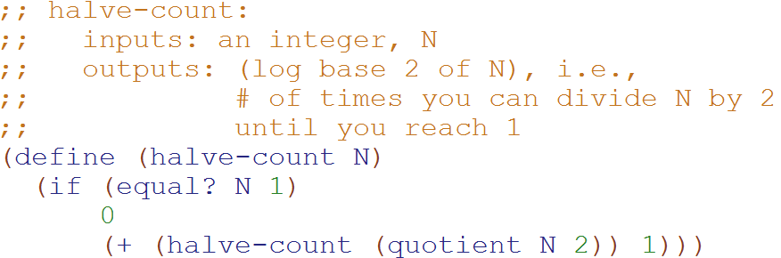
Big-O: Logarithmic Time O(log₂N)
Based upon this relationship
T(N) = 1 + T(N/2)
We can generalize that:
T(N/2) = 1 + T(N/4)
T(N/4) = 1 + T(N/8)
…
T(0) = 1
T(N) = 1 + T(N/2)
T(N) = 1 + 1 + T(N/4)
T(N) = 1 + 1 + 1 + T(N/8)
T(N) = 1 + 1 + 1 + … + 1 + 1 + 1
T(N) = logN
Substitute this
Substitute this

Slide 21
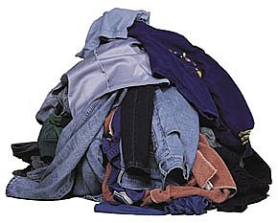
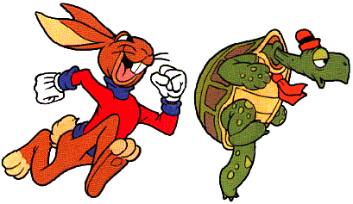

Bubble Sort
Selection Sort
Heap
Sort
Quick Sort
Merge
Sort

Slide 22

Bubble Sort

Slide 23
Bubble Sort Pseudocode http://www.youtube.com/watch?v=k4RRi_ntQc8
Step through the list to be sorted, compare adjacent elements, swap them if they are in the wrong order.
Repeat this process until no swaps are needed.
What is the Big-O runtime of Bubble Sort?
A) O(N) B) O(N log N) C) O(N²) D) O(2^{N}) E) ??
Is it sometimes faster than this? A) Yes B) No

Slide 24
Bubble Sort – Why it works!
Invariant: after the kth iteration, the k-largest elements are at the end of the list.

Slide 25
The Orange shows which elements are being compared.
15 | 3 | 1 | 9 | 4 | 7 | 5 | 4 | 0 | 12
3 | 15 | 1 | 9 | 4 | 7 | 5 | 4 | 0 | 12
3 | 1 | 15 | 9 | 4 | 7 | 5 | 4 | 0 | 12
3 | 1 | 9 | 15 | 4 | 7 | 5 | 4 | 0 | 12
3 | 1 | 9 | 4 | 15 | 7 | 5 | 4 | 0 | 12
3 | 1 | 9 | 4 | 7 | 15 | 5 | 4 | 0 | 12
3 | 1 | 9 | 4 | 7 | 5 | 15 | 4 | 0 | 12
3 | 1 | 9 | 4 | 7 | 5 | 4 | 15 | 0 | 12
3 | 1 | 9 | 4 | 7 | 5 | 4 | 0 | 15 | 12
3 | 1 | 9 | 4 | 7 | 5 | 4 | 0 | 12 | 15
The “biggest” element is in the right spot!

Slide 26
3 | 1 | 9 | 4 | 7 | 5 | 4 | 0 | 12 | 15
1 | 3 | 9 | 4 | 7 | 5 | 4 | 0 | 12 | 15
1 | 3 | 9 | 4 | 7 | 5 | 4 | 0 | 12 | 15
1 | 3 | 4 | 9 | 7 | 5 | 4 | 0 | 12 | 15
1 | 3 | 4 | 7 | 9 | 5 | 4 | 0 | 12 | 15
1 | 3 | 4 | 7 | 5 | 9 | 4 | 0 | 12 | 15
1 | 3 | 4 | 7 | 5 | 4 | 9 | 0 | 12 | 15
1 | 3 | 4 | 7 | 5 | 4 | 0 | 9 | 12 | 15
1 | 3 | 4 | 7 | 5 | 4 | 0 | 9 | 12 | 15
1 | 3 | 4 | 7 | 5 | 4 | 0 | 9 | 12 | 15
The two “biggest” elements are in the right spot!

Slide 27
1 | 3 | 4 | 7 | 5 | 4 | 0 | 9 | 12 | 15
1 | 3 | 4 | 7 | 5 | 4 | 0 | 9 | 12 | 15
1 | 3 | 4 | 7 | 5 | 4 | 0 | 9 | 12 | 15
1 | 3 | 4 | 7 | 5 | 4 | 0 | 9 | 12 | 15
1 | 3 | 4 | 5 | 7 | 4 | 0 | 9 | 12 | 15
1 | 3 | 4 | 5 | 4 | 7 | 0 | 9 | 12 | 15
1 | 3 | 4 | 5 | 4 | 0 | 7 | 9 | 12 | 15
1 | 3 | 4 | 5 | 4 | 0 | 7 | 9 | 12 | 15
1 | 3 | 4 | 5 | 4 | 0 | 7 | 9 | 12 | 15
1 | 3 | 4 | 5 | 4 | 0 | 7 | 9 | 12 | 15
The three “biggest” elements are in the right spot!

Slide 28
1 | 3 | 4 | 5 | 4 | 0 | 7 | 9 | 12 | 15
1 | 3 | 4 | 5 | 4 | 0 | 7 | 9 | 12 | 15
1 | 3 | 4 | 5 | 4 | 0 | 7 | 9 | 12 | 15
1 | 3 | 4 | 5 | 4 | 0 | 7 | 9 | 12 | 15
1 | 3 | 4 | 5 | 4 | 0 | 7 | 9 | 12 | 15
1 | 3 | 4 | 5 | 0 | 4 | 7 | 9 | 12 | 15
1 | 3 | 4 | 5 | 0 | 4 | 7 | 9 | 12 | 15
1 | 3 | 4 | 5 | 0 | 4 | 7 | 9 | 12 | 15
1 | 3 | 4 | 5 | 0 | 4 | 7 | 9 | 12 | 15
1 | 3 | 4 | 5 | 0 | 4 | 7 | 9 | 12 | 15
This entire set of n comparisons and we only swapped 2 elements!

Slide 29
; test cases for bubble
Started
Got base case
Got it
Stuck
(check-expect (bubble '(5))
'(5))
(check-expect (bubble '(5 1 2 3 4))
'(1 2 3 4 5))
(check-expect (bubble '(5 3 2 1 4))
'(3 2 1 4 5))
(check-expect (bubble '(3 5 2 1 4))
'(3 2 1 4 5))

Slide 30
; write bubble (in Racket)

Slide 31
; solution for bubble
(define (bubble L)
(if (or (null? L) (null? (rest L)))
L
(let ([element1 (first L)]
[element2 (second L)])
(if (> element1 element2)
(cons element2 (bubble (cons element1 (rest (rest L)))))
(cons element1 (bubble (cons element2 (rest (rest L))))) ))))

Slide 32

Sort

Slide 33
Insertion Sort Pseudocode
Starting with empty sequence of outputs S and the unsorted list of n input items I.
Add each item from input I, inserting into output sequence S at a position so the output is still in sorted order.
Invariant: at the kth iteration, the elements from 0 to k-1 in the output sequence S are sorted.
What is the Big-O runtime of Insertion Sort?
A) O(N) B) O(N log N) C) O(N²) D) O(2^{N}) E) ??
Is it sometimes faster than this? A) Yes B) No

Slide 34

Start with a “sorted” 1 element section
15 | 3 | 1 | 9 | 4 | 7 | 5 | 4 | 0 | 12
3 | 15 | 1 | 9 | 4 | 7 | 5 | 4 | 0 | 12
1 | 3 | 15 | 9 | 4 | 7 | 5 | 4 | 0 | 12
1 | 3 | 9 | 15 | 4 | 7 | 5 | 4 | 0 | 12
1 | 3 | 4 | 9 | 15 | 7 | 5 | 4 | 0 | 12
1 | 3 | 4 | 7 | 9 | 15 | 5 | 4 | 0 | 12
1 | 3 | 4 | 5 | 7 | 9 | 15 | 4 | 0 | 12
1 | 3 | 4 | 4 | 5 | 7 | 9 | 15 | 0 | 12
0 | 1 | 3 | 4 | 4 | 5 | 7 | 9 | 15 | 12
0 | 1 | 3 | 4 | 4 | 5 | 7 | 9 | 12 | 15

Slide 35
15 | 3 | 1 | 9 | 4 | 7 | 5 | 4 | 0 | 12
3 | 15 | 1 | 9 | 4 | 7 | 5 | 4 | 0 | 12
1 | 3 | 15 | 9 | 4 | 7 | 5 | 4 | 0 | 12
1 | 3 | 9 | 15 | 4 | 7 | 5 | 4 | 0 | 12
1 | 3 | 4 | 9 | 15 | 7 | 5 | 4 | 0 | 12
1 | 3 | 4 | 7 | 9 | 15 | 5 | 4 | 0 | 12
1 | 3 | 4 | 5 | 7 | 9 | 15 | 4 | 0 | 12
1 | 3 | 4 | 4 | 5 | 7 | 9 | 15 | 0 | 12
0 | 1 | 3 | 4 | 4 | 5 | 7 | 9 | 15 | 12
0 | 1 | 3 | 4 | 4 | 5 | 7 | 9 | 12 | 15
Let’s zoom into a single “insertion”

Slide 36
1 | 3 | 4 | 4 | 5 | 7 | 9 | 15 | 0 | 12
1 | 3 | 4 | 4 | 5 | 7 | 9 | 0 | 15
1 | 3 | 4 | 4 | 5 | 7 | 0 | 9 | 15
1 | 3 | 4 | 4 | 5 | 0 | 7 | 9 | 15
1 | 3 | 4 | 4 | 0 | 5 | 7 | 9 | 15
1 | 3 | 4 | 0 | 4 | 5 | 7 | 9 | 15
1 | 3 | 0 | 4 | 4 | 5 | 7 | 9 | 15
1 | 0 | 3 | 4 | 4 | 5 | 7 | 9 | 15
0 | 1 | 3 | 4 | 4 | 5 | 7 | 9 | 15 | 12
???
There are a lot of intermediate moves to get the 0 in the right spot.

Slide 37
% test cases for insert
:- begin_tests(insert).
test(insertT1) :- insert(1, [2, 3], [1, 2, 3]), !.
test(insertT2) :- insert(2, [1, 3], [1, 2, 3]), !.
test(insertT3) :- insert(3, [1, 2], [1, 2, 3]), !.
test(insertT4) :- insert(1, [1, 1], [1, 1, 1]), !.
test(insertT5) :- insert(1, [], [1]), !.
test(insertT6) :- \+insert(_, _, []).
:- end_tests(insert).
Started
Got base case
Got it
Stuck

Slide 38
% write insert in Prolog

Slide 39
% solution for insert
insert(X, [], [X]).
insert(X, [F|R], [X, F|R] ):- F >= X.
insert(X, [F|R], [F|R2]) :- X > F,
insert(X, R, R2).

Slide 40

Which is faster? A) Insertion Sort with an Array vs. B) Insertion Sort with a Linked List C) Tie! D) ??

Slide 41
Insertion Sort: O(n²)
Linked list
O(n) worst-case time to find the right position of S to insert each item (for n items).
O(1) time to insert the item (for n items).
Array
Find the right position in S in O(log n) time by binary search (for n items).
O(n) worst-case time to shift the larger items over to make room for the new item (for n items).

Slide 42

Selection Sort

Slide 43

Selection Sort Pseudocode
Starting an unsorted array (myArray) of n input items.
Walk through myArray and find the smallest item:
Swap the smallest item into the right place
(Also could: remove the item and put it at the end of an another array or linked list.)
Invariant: at the kth iteration, the k smallest elements of the input I are sorted.
What is the Big-O runtime of Selection Sort?
A) O(N) B) O(N log N) C) O(N²) D) O(2^{N}) E) ??

Slide 44
15 | 3 | 1 | 9 | 4 | 7 | 5 | 4 | 0 | 12
0 | 3 | 1 | 9 | 4 | 7 | 5 | 4 | 15 | 12
0 | 1 | 3 | 9 | 4 | 7 | 5 | 4 | 15 | 12
0 | 1 | 3 | 9 | 4 | 7 | 5 | 4 | 15 | 12
0 | 1 | 3 | 4 | 9 | 7 | 5 | 4 | 15 | 12
0 | 1 | 3 | 4 | 4 | 7 | 5 | 9 | 15 | 12
0 | 1 | 3 | 4 | 4 | 5 | 7 | 9 | 15 | 12
0 | 1 | 3 | 4 | 4 | 5 | 7 | 15 | 9 | 12
0 | 1 | 3 | 4 | 4 | 5 | 7 | 9 | 15 | 12
0 | 1 | 3 | 4 | 4 | 5 | 7 | 9 | 12 | 15
0 | 1 | 3 | 4 | 4 | 5 | 7 | 9 | 12 | 15
Swap the 15 with whatever is the smallest element
We swapped the 0 and the 15 (shown in gray)
Selection Sort
At this point the first 3 elements are sorted and in their final locations.

Slide 45
% test cases for min
:- begin_tests(min).
test(minT1) :- min([1, 2, 3], 1), !.
test(minT2) :- min([2, 1, 3], 1), !.
test(minT3) :- min([2, 3, 1], 1), !.
test(minT4) :- min([1, 1, 1], 1), !.
test(minT5) :- \+min([], _).
:- end_tests(min).
Started
Got base case
Got it
Stuck

Slide 46
% write min in Prolog

Slide 47
% solution for min
min([Min], Min).
min([F|R], Min):- min(R, Min), Min < F.
min([F|R], F) :- min(R, Min), Min > F.
min([F|R], F) :- min(R, Min), Min = F.

Slide 48
Runtime

Slide 49

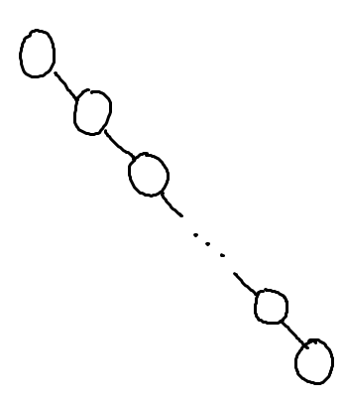
What is the worst case run-time for find in this Binary Search Tree?
O(1)
O(log n)
O(n log n)
O(n)
O(n²)

Slide 50
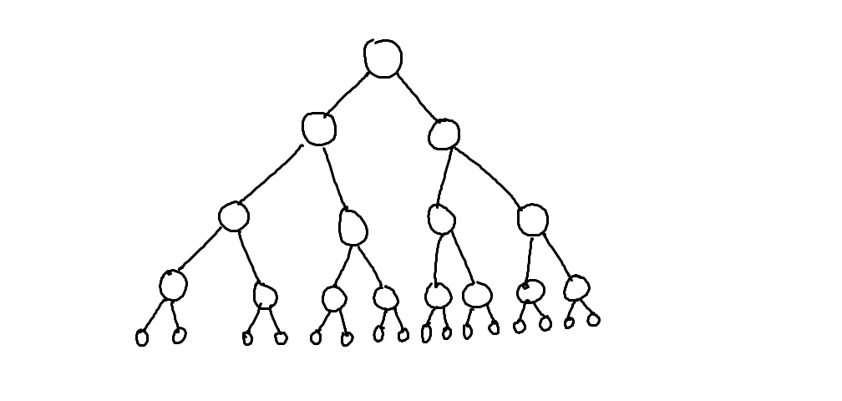
What is the worst case run-time for find in this Binary Search Tree?
O(1)
O(log n)
O(n log n)
O(n)
O(n²)
…

Slide 51
Assuming: all nodes have 0 or 1 children N nodes in the BST
BST Big-Oh (Completely Unbalanced Case)
Find |  | Insert |  | Delete
Best | Worst | Best | Worst | Best | Worst
O( ) | O( ) | O( ) | O( ) | O( ) | O( )

Slide 52
Assuming: all nodes have 0 or 2 children N nodes in the BST
BST Big-Oh (Balanced Case)
Find |  | Insert |  | Delete
Best | Worst | Best | Worst | Best | Worst
O( ) | O( ) | O( ) | O( ) | O( ) | O( )
O(1)
O(log n)
O(n log n)
O(n)
O(n²)

Slide 53
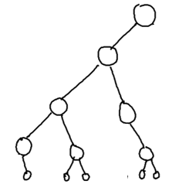
Assuming: most nodes have 0 or 2 children height is O(log n) N nodes in the BST
BST Big-Oh (Mostly Balanced Case)
Find |  | Insert |  | Delete
Best | Worst | Best | Worst | Best | Worst
O( ) | O( ) | O( ) | O( ) | O( ) | O( )

Slide 54
Big-Oh for Lists (a.k.a. linked lists)

Slide 55
Racket Lists Big-Oh
Insert (into front of list) | O( )
Insert (into end of list) | O( )
Find | O( )
Length | O( )
Delete (from the middle) | O( )
O(1)
O(log n)
O(n log n)
O(n)
O(n²)

Slide 56
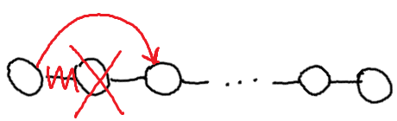
Assuming: the modifiable LinkedList using Hw5 List and ListNode
List/ListNode Big-Oh
Insert (into front of list) | O( )
Insert (into end of list) | O( )
Find (given a value) | O( )
Length | O( )
Delete (given a value) | O( )
Delete (given a ListNode ref) | O( )
O(1)
O(log n)
O(n log n)
O(n)
O(n²)

Slide 57
Big-Oh for Arrays

Slide 58
Unsorted Arrays Big-Oh
Insert (into first spot) | O( )
Insert (into last spot) | O( )
Find (given a value) | O( )
Delete (given a value) | O( )
5 | 3 | 8 | 2 | 1 | 7 | 0 | 0 | 0 | 0 | 0 | 0 | 0
Assuming:
unsorted array holding numbers within 1 to N
no duplicates
we keep track the last index we use (maxIndex)
all values at indices > maxIndex are 0 (unused).

Slide 59
Sorted Arrays Big-Oh
Insert (into first spot) | O( )
Insert (into last spot) | O( )
Find (given a value) | O( )
Delete (given a value) | O( )
Assuming:
sorted array holding numbers within 1 to N
no duplicates
we keep track the last index we use (maxIndex)
all values at indices > maxIndex are 0 (unused).
1 | 2 | 3 | 5 | 7 | 8 | 0 | 0 | 0 | 0 | 0 | 0 | 0

Slide 60
Boolean Arrays Big-Oh
Insert (into first spot) | O( )
Insert (into last spot) | O( )
Find (given a value) | O( )
Delete (given a value) | O( )
F₀ | T₁ | T₂ | T₃ | F₄ | T₅ | F₆ | T₇ | T₈
Assuming:
Boolean array representing numbers within 1 to X
X is a fixed number
no duplicates
Could I use this trick to store objects?

Slide 61
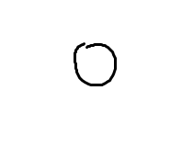
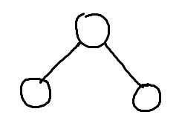
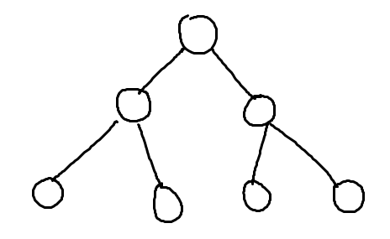
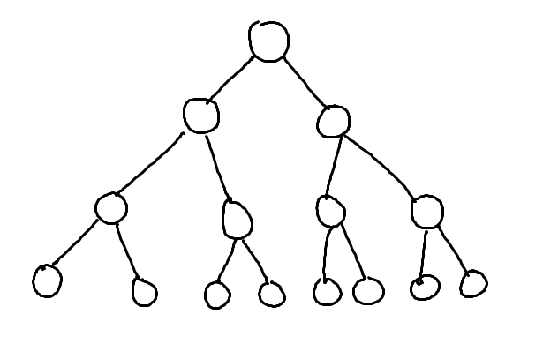
What’s the relationship between height and number of nodes?
3
7
1
15
31

Slide 62
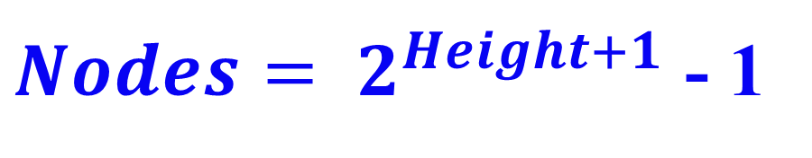
What’s the relationship between height and number of nodes?
1
3
7
Height | Nodes | 2^{Height+1}
0 | 1 | 2
1 | 3 | 4
2 | 7 | 8
3 | 15 | 16
4 | 31 | 32
5 | 63 | 64
15
31

Slide 63





// Take the log of both sides
Drop the 1
Who cares?
// Remember:

Slide 64
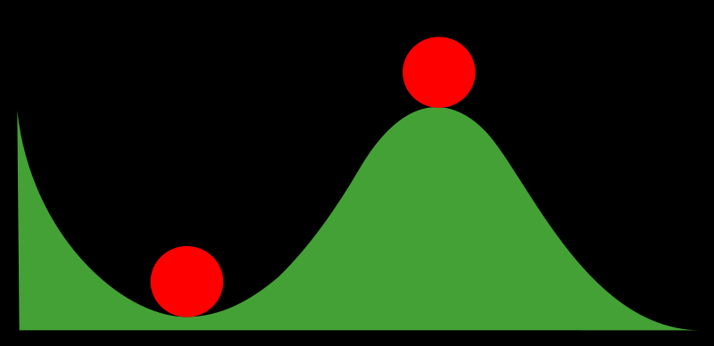
Stable and Non-Stable Sorting

Slide 65
Stable Sort
Sometimes there are equivalent keys in a data structure that is sorted.
Sometimes it matters if you change the order of those equivalent keys
E.g. Sorting music by song and then artist should keep each artists songs alphabetized
We call a sort “stable” if it doesn’t change the order of equivalent keys

Slide 66
Radix Sort (an example of a stable sort)

Slide 67
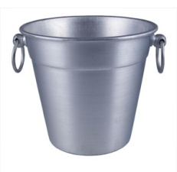
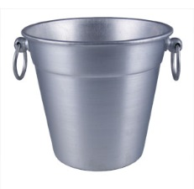
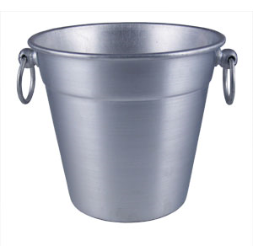

Easy Sorting Problems…
Sort N numbers in the range 0 to 9
0 | 1 | 2 | 3 | 4 | 5 | 6 | 7 | 8 | 9
How fast could you sort
N numbers
in the range 0 to B?
O(N)
O(B)
O(N+B)
O(N*B)
E) ??
In Big-O defining your variables is super important!

Slide 68
Harder Sorting Problems… Approach 1 – Two stages
Sort N numbers in the range 0 to 99
Make some buckets and calculate what bucket they need to go into.
Then sort each bucket
0 – 9 | 10-19 | 20-29 | 30-39 | 40-49 | 50-59 | 60-69 | 70-79 | 80-89 | 90-99

Slide 69
Harder Sorting Problems… Approach 2
Sort N numbers in the range 0 to 99
First sort by the one’s digit (this is counter intuitive)
95
25
98
29
20
32
93
85
97
38
39
0 | 1 | 2 | 3 | 4 | 5 | 6 | 7 | 8 | 9

Slide 70
Combine the buckets
Start from the first thing in the bucket
95
25
98
29
20
32
93
85
97
38
39
The 20’s are the correct relative order
0 | 1 | 2 | 3 | 4 | 5 | 6 | 7 | 8 | 9
20
20
32
93
85
25
25
95
97
38
98
39
29
29

Slide 71
Resort using the tens digit
20
32
93
85
25
95
97
38
98
39
29
Now Recombine!
98
29
39
97
25
38
95
20
32
85
93
0 | 1 | 2 | 3 | 4 | 5 | 6 | 7 | 8 | 9
20
25
29
32
38
39
85
93
95
97
98

Slide 72
Radix Sort the numbers 0-99
The running time for our example: (N + B)*2
We did two passes, each took N time.
We gathered up the buckets twice each took B time (where B is the number of buckets)

Slide 73








We can represent numbers with 1’s and 0’s
3 2 1 8
3*1000 + 2*100 + 1*10 + 8*1
1 0 0 1
1*8 + 0*4 + 0*2 + 1*1
We could use binary digits
0001 1
0010 2
0011 3
0100 4
0101 5
0110 6
0111 7
1000 8

Slide 74
Radix Sort with 32 bit numbers
We chose how many bits we want to sort at a time.
4 bits at a time (8 passes)
0000 0000 0000 0000 0000 0000 0000 0000
8 bits at a time (4 passes)
00000000 00000000 00000000 00000000
Running Time of Radix Sort in terms of
N: the number of items to sort
B: the number of buckets
P: the number of passes
Less than
Equal to
Greater than
??
O(N*B*P)

Slide 75
Quick Sort
This has to be the least helpful name ever…
But it is true. Quick Sort Rocks!

Slide 76
Quick Sort
Things we can do without too much trouble:
Divide up the list into two - based upon whether each element is bigger or smaller than a particular value (the “pivot”).
Delegating to another procedure to sort each of these halves
Sorting a 1 element list

Slide 77
QuickSort with Linked Lists
6 | 9 | 7 | 8 | 3 | 18 | 4 | 11 | 2 | 5 | 10
3 | 4 | 2 | 5
6
9 | 7 | 8 | 18 | 11 | 10
2
3
4 | 5
7 | 8
9
18 | 11 | 10
4
5
7
8
11 | 10
18
10
11
2 | 3 | 4 | 5 | 6 | 7 | 8 | 9 | 10 | 11 | 18

Slide 78
an array of zero or one elements is already sorted
function quicksort('array')
if length('array') = 1
return 'array'
select and remove a pivot value 'pivot' from 'array'
create empty lists 'less' and 'greater'
for each 'x' in 'array'
if 'x' <= 'pivot' then append 'x' to 'less'
else append 'x' to 'greater'
return concatenate(quicksort('less'), 'pivot', quicksort('greater'))
Divide
http://en.wikipedia.org/wiki/Quicksort

Slide 79
Quick Sort: The Algorithm (For your notes)
Given an unsorted list I of n items
Choose a pivot item v from I.
Partition I into two unsorted lists I1 and I2 I1 contains all items whose keys are smaller than v's key. I2 contains all items whose keys are larger than v's. Equal values can go either way.
After the partition v is in it’s final position.
Sort I1 recursively, yielding the sorted list S1.
Sort I2 recursively, yielding the sorted list S2.
Concatenate S1, v, and S2 together, yielding a sorted list S.

Slide 80
Can you make Quick Sort run in… (what is the worst you can do? Describe the input)
O(N)
O(N log N)
O(N²)
O(N³)
O(2^{N})

Slide 81
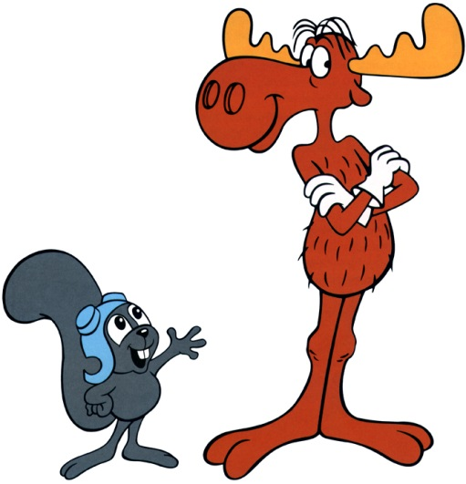
Can you make Quick Sort run in… (what is the best you can do? Describe the input)
O(N)
O(N log N)
O(N²)
O(N³)
O(2^{N})

Slide 82
Quick Sort – Choosing a Pivot
What if the pivot I chose was larger than all the other elements?
99 | 9 | 7 | 8 | 3 | 18 | 4 | 11 | 2 | 5 | 10
10 | 9 | 7 | 8 | 3 | 18 | 4 | 11 | 2 | 5 | 99
This gets sent to be recursively sorted
There is nothing to send in the other recursive call
Quick Sort is a “divide and conquer algorithm” but this didn’t divide!

Slide 83
Quick Sort
Worst case performance:
O(n²)
Best case performance:
O(n log n)
In practice the fastest known comparison-based sort for arrays
It matters how evenly the pivot divides the elements!!!

Slide 84
QuickSort with an Array
Pivot = first index you’re sorting
L = second index you’re sorting
G = last index you’re sorting
While L <= G
Increase L until it references something bigger than the pivot
Decrease G until it references something smaller than the pivot
Swap elements at L and G
Swap the pivot with the element at G

Slide 85
Quick Sort with an Array DEMO
L
L
L
L
G
L
G
G
G
G
G
G
6 | 5 | 2 | 8 | 3 | 18 | 4 | 11 | 7 | 9 | 10
6 | 5 | 2 | 4 | 3 | 18 | 8 | 11 | 7 | 9 | 10
3 | 5 | 2 | 4 | 6 | 18 | 8 | 11 | 7 | 9 | 10
6 | 9 | 7 | 8 | 3 | 18 | 4 | 11 | 2 | 5 | 10
6 | 9 | 7 | 8 | 3 | 18 | 4 | 11 | 2 | 5 | 10
6 | 9 | 7 | 8 | 3 | 18 | 4 | 11 | 2 | 5 | 10
6 | 9 | 7 | 8 | 3 | 18 | 4 | 11 | 2 | 5 | 10
6 | 9 | 7 | 8 | 3 | 18 | 4 | 11 | 2 | 5 | 10
6 | 5 | 7 | 8 | 3 | 18 | 4 | 11 | 2 | 9 | 10
6 | 5 | 7 | 8 | 3 | 18 | 4 | 11 | 2 | 9 | 10
6 | 5 | 7 | 8 | 3 | 18 | 4 | 11 | 2 | 9 | 10
6 | 5 | 2 | 8 | 3 | 18 | 4 | 11 | 7 | 9 | 10
6 | 5 | 2 | 8 | 3 | 18 | 4 | 11 | 7 | 9 | 10
6 | 5 | 2 | 8 | 3 | 18 | 4 | 11 | 7 | 9 | 10
6 | 5 | 2 | 4 | 3 | 18 | 8 | 11 | 7 | 9 | 10
6 | 5 | 2 | 4 | 3 | 18 | 8 | 11 | 7 | 9 | 10
6 | 5 | 2 | 4 | 3 | 18 | 8 | 11 | 7 | 9 | 10

Slide 86
Quick Sort Demo
6 | 9 | 7 | 8 | 3 | 18 | 4 | 11 | 2 | 5 | 10
6 | 9 | 7 | 8 | 3 | 18 | 4 | 11 | 2 | 5 | 10
6 | 9 | 7 | 8 | 3 | 18 | 4 | 11 | 2 | 5 | 10
6 | 9 | 7 | 8 | 3 | 18 | 4 | 11 | 2 | 5 | 10
6 | 9 | 7 | 8 | 3 | 18 | 4 | 11 | 2 | 5 | 10
6 | 5 | 7 | 8 | 3 | 18 | 4 | 11 | 2 | 9 | 10
6 | 5 | 7 | 8 | 3 | 18 | 4 | 11 | 2 | 9 | 10
6 | 5 | 7 | 8 | 3 | 18 | 4 | 11 | 2 | 9 | 10

Slide 87
Quick Sort Demo
6 | 5 | 7 | 8 | 3 | 18 | 4 | 11 | 2 | 9 | 10
6 | 5 | 2 | 8 | 3 | 18 | 4 | 11 | 7 | 9 | 10
6 | 5 | 2 | 8 | 3 | 18 | 4 | 11 | 7 | 9 | 10
6 | 5 | 2 | 8 | 3 | 18 | 4 | 11 | 7 | 9 | 10
6 | 5 | 2 | 8 | 3 | 18 | 4 | 11 | 7 | 9 | 10
6 | 5 | 2 | 4 | 3 | 18 | 8 | 11 | 7 | 9 | 10
6 | 5 | 2 | 4 | 3 | 18 | 8 | 11 | 7 | 9 | 10
6 | 5 | 2 | 4 | 3 | 18 | 8 | 11 | 7 | 9 | 10
6 | 5 | 2 | 4 | 3 | 18 | 8 | 11 | 7 | 9 | 10
3 | 5 | 2 | 4 | 6 | 18 | 8 | 11 | 7 | 9 | 10

Slide 88
Big-O Formal Definition

Slide 89
Big-O Overview
We want to express the speed of an algorithm independently of a specific implementation on a specific machine.
We examine the cost of the algorithms for large input sets i.e. the asymptotic cost.
In later classes you’ll do this in more detail

Slide 90



Which one is fastest?

Slide 91
“Woah! One of these is WAY better after this point. Let’s call that point N”

Slide 92



Which is fastest after some big value N?

Slide 93



Which is fastest after some value N?
WAIT – who cares? These are all proportional!
Sometimes we do care, but for simplicity we ignore constants

Slide 94
Formal definition
if and only if
for all n > N

Slide 95

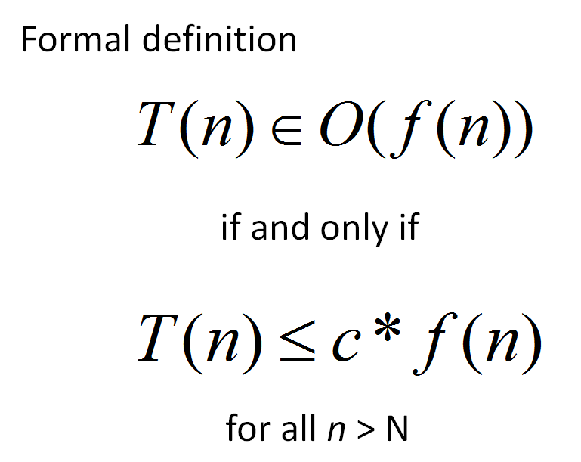
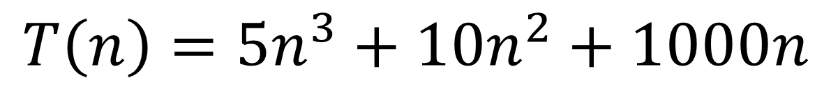
Applying the Formal Definition
$$T\left(n\right)=5n^{3}+10n^{2}+1000n$$
There is only one possible value for c and N
True
False
??
What values of c and N
make this true?

Slide 96

Big-O definition
(using different notation)
T(n) ∈ O(f(n)) means
(∃c) (∃N) (∀n > N) T(n) < c*f(n)
+ threshold N
there exists a constant c
for all input sizes bigger than that threshold, N
To claim that
42n² + 100n ∈ O(n²)
We need to find c and N such that for all n > N,
c =
N =
42n² + 100n < cn²
Notes:
n > 1001 = k, c = 1001
n > 1 = k, c = 42

Slide 97
Apply the formal definition
42n+999 ∈ O(n) ?
2
3
50n ∈ O(n ) ?
0.001*n! ∈ O(n ) ?
True or False?
True or False?
True or False?
c =
N =
c =
N =
c =
N =
Are these the “best” bounds?
Use simplest form with O notation

Slide 98
Recurrence Relationships (This will involve a lot of algebra – but no magic!)

Slide 99
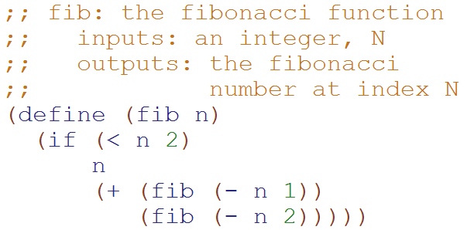
Big-O: Exponential Time O(2^{N})
T( __ ) = ______
T(N) = ___________________
How many terms?
1
2
3
4
??

Slide 100
Big-O: Exponential Time O(2^{N})
Define:
T₁(N) = 1 + 2*T₁(N-1)
T₂(N) = 1 + 2*T₂(N-2)
T₂(N) ≤ T(N) ≤ T₁(N)
T(1) = 1
T(N) = 1 + T(N-1) + T(N-2)
T₂(N) ≤ T(N)
1 + T₂(N-2) + T₂(N-2) ≤ 1 + T(N-1) + T(N-2)
1 + T₂(N-2) + T(N-2) ≤ 1 + T(N-1) + T(N-2)
?
?
This is complicated! Let’s look for an upper bound
T(N) ≤ T₁(N)
1 + T(N-1) + T(N-2) ≤ 1 + T₁(N-1) + T₁(N-1)
1 + T(N-1) + T(N-2) ≤ 1 + T₁(N-1) + T(N-2)

Slide 101
Big-O: Exponential Time O(2^{N})
Based upon this relationship
T₁(N) = 1 + 2*T₁(N-1)
We can generalize that:
T₁(N-1) = 1 + 2*T₁(N-2)
T₁(N-2) = 1 + 2*T₁(N-3)
…
T₁(1) = 1
T₁(N) = 1 + 2*T₁(N-1)
T₁(N) = 1 + 2*(1 + 2*T₁(N-2))
T₁(N) = 1 + 2 + 4*T₁(N-2)
T₁(N) = 1 + 2 + 4*(1 + 2T₁(N-3))
…
T₁(N) = 1 + 2 + 4 + … + 2^{N-1}
T₁(N) = 2^{N} -1
Substitute this
distribute
Substitute this

Slide 102
Big-O: Exponential Time O(2^{N})
Based upon this relationship
T₂(N) = 1 + 2*T₂(N-2)
We can generalize that:
T₂(N-2) = 1 + 2*T₂(N-4)
T₂(N-4) = 1 + 2*T₂(N-8)
…
T₂(0) = 1, T₂(1) = 1
T₂(N) = 1 + 2*T₂(N-2)
T₂(N) = 1 + 2*(1 + 2*T₂(N-4))
T₂(N) = 1 + 2 + 4*T₂(N-4)
T₂(N) = 1 + 2 + 4*(1 + 2T₂(N-8))
…
T₂(N) = 1 + 2 + 4 + … + 2^{N/2}
T₂(N) = 2*2^{N/2} -1 = 2^{N/2+1} -1
Substitute this
distribute
Substitute this
Simplification b/c we’re not worrying about odd values of N

Slide 103

Big-O: Exponential Time O(2^{N})
Define:
T₁(N) = 1 + 2*T₁(N-1)
T₂(N) = 1 + 2*T₂(N-2)
T₂(N) ≤ T(N) ≤ T₁(N)
T(1) = 1
T(N) = 1 + T(N-1) + T(N-2)
T₂(N) = 2^{N/2} -1 T₁(N) = 2^{N} -1
T₂(N) ≤ T(N) ≤ T₁(N)
2^{N/2} -1 ≤ T(N) ≤ 2^{N} -1(N-2)
We showed this
Calculated on previous slides.
Since Big-O is an upper bound,
T(N) O(2^{N})

Slide 104
Loop Counting (calculate runtime by counting each step)

Slide 105
Example 1: Count the total # of constant-time operations?
for ( int i=0 ; i < N ; i++){
// constant-time operation
}
i=0
i=1
i=2
…
i=N-1
i=N
# ops per row
1
1
1
…
1
1
O(N)
Total
of N
Technically 3 operations!

Slide 106
Example 2: Count the total # of constant-time operations?
for ( int i=1 ; i < N ; i=i*2){
// constant-time operation
}
i=1
i=2
i=4
…
i=N/2
i=N
# ops per row
1
1
1
…
1
1
O(log₂(N))
Total
of log₂(N)

Slide 107
Example 4: Count the total # of constant-time operations?
for ( int i=0 ; i < N ; i++){
for ( int z=0 ; z < N ; z++){
// constant-time operation
}
}
i=0
i=1
i=2
…
i=N-1
i=N
# ops per row
N
N
N
…
N
N
O(N²)
Total
of N²

Slide 108
Example 5: Count the total # of constant-time operations?
for ( int i=0 ; i < N ; i++){
for ( int z=0 ; z < M ; z++){
// constant-time operation
}
}
i=0
i=1
i=2
…
i=N-1
i=N
# ops per row
M
M
M
…
M
M
O(N*M)
Total of N*M

Slide 109
Example 6: Count the total # of constant-time operations?
for ( int i=0 ; i < N ; i++){
for ( int z=0 ; z < i ; z++){
// constant-time operation
}
}
i=0
i=1
i=2
…
i=N-1
i=N
# ops per row
0
1
2
…
N-1
N
O(N²)
Total of N(N+1)/2

Slide 110
Summations

Slide 111

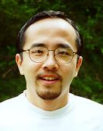
http://www.math.hmc.edu/funfacts/
REALLY COMMON SERIES (you should recognize these after today)
1 + 2 + 3 + … + (N-2) + (N-1) + N = N(N+1)/2 ∈ O(N²)
1 + 2 + 4 + … + N/4 + N/2 + N = 2N -1 ∈ O(N)
1 + 2 + 4 + … + 2^{N-2} + 2^{N-1} + 2^{N} = 2^{N+1} -1 ∈ O(2^{N})

Slide 112




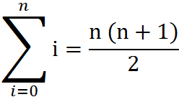
Some Algebra to calculate:
1 + 2 + 3 + … + (N-2) + (N-1) + N = N(N+1)/2 ∈ O(N²)
// Written backwards
OR

Slide 113
N + N/2 + N/4 + … + 4 + 2 + 1 = 2N -1 ∈ O(N)
N
2N
N | N/2
N | N/2 | N/4
N | N/2 | N/4 | N/8
N | N/2 | N/4 | N/8
N/16
The sum is less than 2N

Slide 114
2^{N} + 2^{N-1} + 2^{N-2} + … + 4 + 2 + 1 = 2^{N+1} -1 ∈ O(2^{N})
2^{N}
2 * 2^{N} = 2^{N+1}
2^{N} | 2^{N-1}
2^{N} | 2^{N-1} | 2^{N-2}
2^{N} | 2^{N-1} | 2^{N-2} | 2^{N-3}
2^{N} | 2^{N-1} | 2^{N-2} | 2^{N-3}
2^{N-4}
The sum is less than 2^{N+1}

Slide 115
BONUS

Slide 116
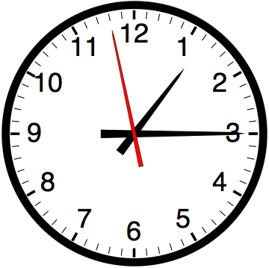

Slide 117


Computer
Science
&
= AWESOME

Slide 118

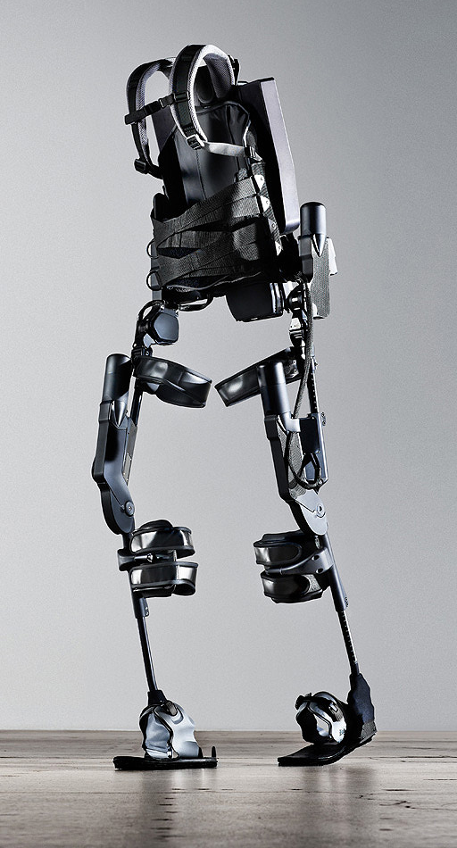
http://www.youtube.com/watch?v=pzRmNYA8LlY

Slide 119


ClickStart

Slide 120


Slide 121

How should we represent the blocks in the computer?
Independent variables
2D Array
OpenList
I don’t know

Slide 122
The value in the array tells me what art asset to use
Each level is really a 3x10 vector!
0 | 0 | 7 | 0 | 4 | 0 | 0 | 0
1 | 2 | 3 | -4 | 5 | 6 | -7 | 8
B | B | B | B | B | B | B | B
Negative values tell me what block needs to go here to win!

Slide 123
0 | 0 | 7 | 0 | 4 | 0 | 0 | 0
1 | 2 | 3 | -4 | 5 | 6 | -7 | 8
0 | 0 | 0 | B | 0 | 0 | 0 | 0

Slide 124
BUGS!

Slide 125


Slide 126

It is really sad when stuff you’ve made is on sale!

Slide 127



Which image is fake?
A. Top Left
B. Bottom Left
C. Bottom Right

Slide 128
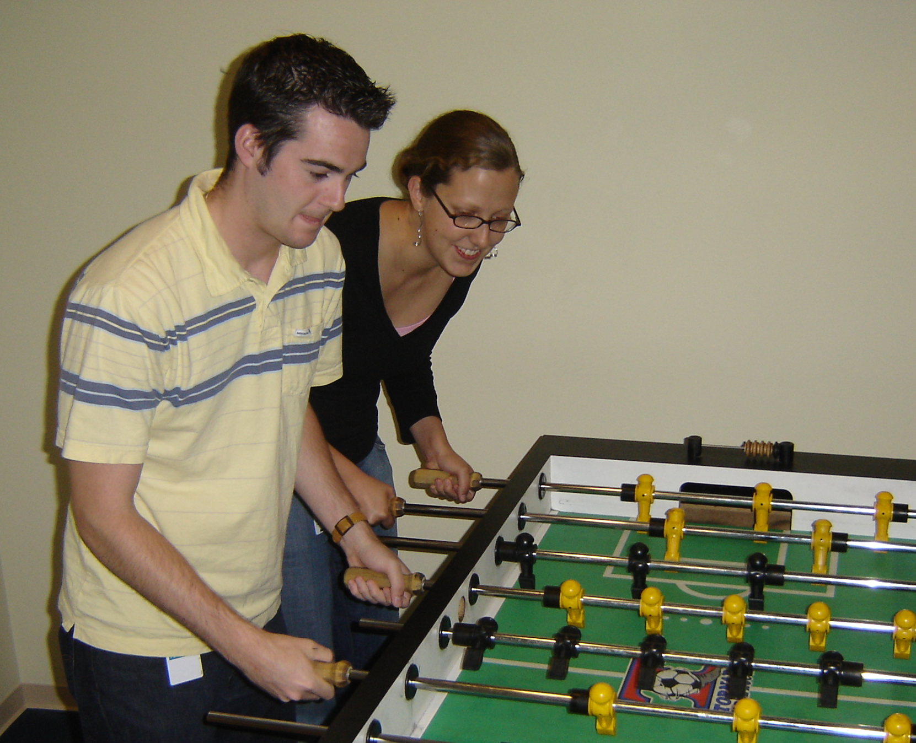

Slide 129
