Slide 1
CS 60
Big-O & Sorting
2014-11-12
Wednesday – Week 10
Lecture 20

Slide 2
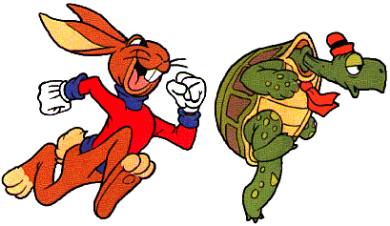
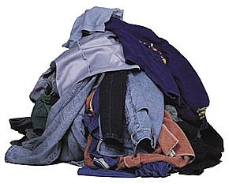

Lecture 20 – Learning Goals
Implement a Heap
Implement an arbitrary sorting algorithm
Describe sorting
algorithms including:
& Radix Sort
Quick Sort
Heap
Sort
Selection Sort

Slide 3

Helpful Math for HW 9
Remember:
You’ll likely need this for calculating:
$\log_{b}{xy}=\log_{b}{x}+\log_{b}{y}$
$$\log_{2}{1}+\log_{2}{2}+…+\log_{2}{N}$$

Slide 4



Bubble Sort
Selection Sort
Heap
Sort
Quick Sort
Merge
Sort

Slide 5
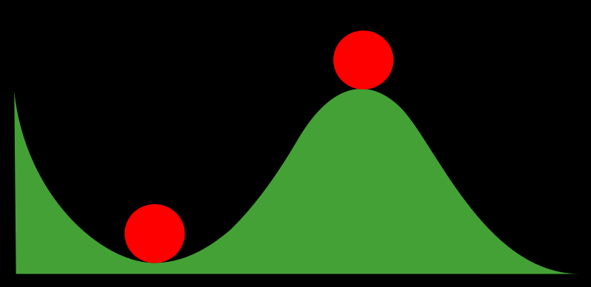
Stable and Non-Stable Sorting

Slide 6
Stable Sort
Sometimes there are equivalent keys in a data structure that is sorted.
Sometimes it matters if you change the order of those equivalent keys
E.g. Sorting music by song and then artist should keep each artists songs alphabetized
We call a sort “stable” if it doesn’t change the order of equivalent keys

Slide 7

Selection Sort

Slide 8

Selection Sort Pseudocode
Starting an unsorted array (myArray) of n input items.
Walk through myArray and find the smallest item:
Swap the smallest item into the right place
(Also could: remove the item and put it at the end of an another array or linked list.)
Invariant: at the kth iteration, the k smallest elements of the input I are sorted.
What is the Big-O runtime of Selection Sort?
A) O(N) B) O(N log N) C) O(N²) D) O(2^{N}) E) ??

Slide 9
15 | 3 | 1 | 9 | 4 | 7 | 5 | 4 | 0 | 12
0 | 3 | 1 | 9 | 4 | 7 | 5 | 4 | 15 | 12
0 | 1 | 3 | 9 | 4 | 7 | 5 | 4 | 15 | 12
0 | 1 | 3 | 9 | 4 | 7 | 5 | 4 | 15 | 12
0 | 1 | 3 | 4 | 9 | 7 | 5 | 4 | 15 | 12
0 | 1 | 3 | 4 | 4 | 7 | 5 | 9 | 15 | 12
0 | 1 | 3 | 4 | 4 | 5 | 7 | 9 | 15 | 12
0 | 1 | 3 | 4 | 4 | 5 | 7 | 15 | 9 | 12
0 | 1 | 3 | 4 | 4 | 5 | 7 | 9 | 15 | 12
0 | 1 | 3 | 4 | 4 | 5 | 7 | 9 | 12 | 15
0 | 1 | 3 | 4 | 4 | 5 | 7 | 9 | 12 | 15
Swap the 15 with whatever is the smallest element
We swapped the 0 and the 15 (shown in gray)
Selection Sort
At this point the first 3 elements are sorted and in their final locations.

Slide 10
% test cases for min
:- begin_tests(min).
test(minT1) :- min([1, 2, 3], 1), !.
test(minT2) :- min([2, 1, 3], 1), !.
test(minT3) :- min([2, 3, 1], 1), !.
test(minT4) :- min([1, 1, 1], 1), !.
test(minT5) :- \+min([], _).
:- end_tests(min).
Started
Got base case
Got it
Stuck

Slide 11
% write min in Prolog

Slide 12
% solution for min
min([Min], Min).
min([F|R], Min):- min(R, Min), Min < F.
min([F|R], F) :- min(R, Min), Min > F.
min([F|R], F) :- min(R, Min), Min = F.

Slide 13
Quick Sort
This has to be the least helpful name ever…
But it is true. Quick Sort Rocks!

Slide 14
Quick Sort
Things we can do without too much trouble:
Divide up the list into two - based upon whether each element is bigger or smaller than a particular value (the “pivot”).
Delegating to another procedure to sort each of these halves
Sorting a 1 element list

Slide 15
QuickSort with Linked Lists
6 | 9 | 7 | 8 | 3 | 18 | 4 | 11 | 2 | 5 | 10
3 | 4 | 2 | 5
6
9 | 7 | 8 | 18 | 11 | 10
2
3
4 | 5
7 | 8
9
18 | 11 | 10
4
5
7
8
11 | 10
18
10
11
2 | 3 | 4 | 5 | 6 | 7 | 8 | 9 | 10 | 11 | 18

Slide 16
an array of zero or one elements is already sorted
function quicksort('array')
if length('array') = 1
return 'array'
select and remove a pivot value 'pivot' from 'array'
create empty lists 'less' and 'greater'
for each 'x' in 'array'
if 'x' <= 'pivot' then append 'x' to 'less'
else append 'x' to 'greater'
return concatenate(quicksort('less'), 'pivot', quicksort('greater'))
Divide
http://en.wikipedia.org/wiki/Quicksort

Slide 17
Quick Sort: The Algorithm (For your notes)
Given an unsorted list I of n items
Choose a pivot item v from I.
Partition I into two unsorted lists I1 and I2 I1 contains all items whose keys are smaller than v's key. I2 contains all items whose keys are larger than v's. Equal values can go either way.
After the partition v is in it’s final position.
Sort I1 recursively, yielding the sorted list S1.
Sort I2 recursively, yielding the sorted list S2.
Concatenate S1, v, and S2 together, yielding a sorted list S.

Slide 18

Can you make Quick Sort run in… (what is the worst you can do? Describe the input)
O(N)
O(N log N)
O(N²)
O(N³)
O(2^{N})

Slide 19
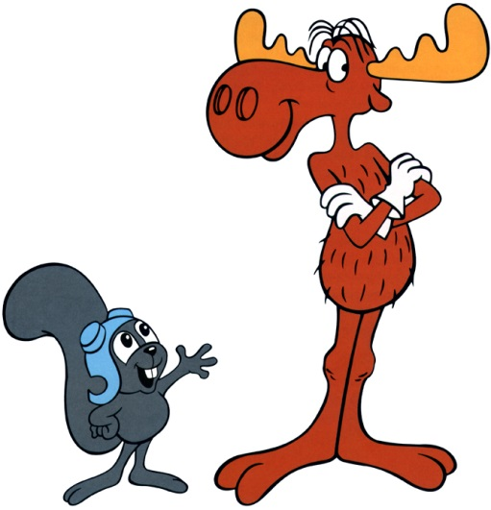
Can you make Quick Sort run in… (what is the best you can do? Describe the input)
O(N)
O(N log N)
O(N²)
O(N³)
O(2^{N})

Slide 20
Quick Sort – Choosing a Pivot
What if the pivot I chose was larger than all the other elements?
99 | 9 | 7 | 8 | 3 | 18 | 4 | 11 | 2 | 5 | 10
10 | 9 | 7 | 8 | 3 | 18 | 4 | 11 | 2 | 5 | 99
This gets sent to be recursively sorted
There is nothing to send in the other recursive call
Quick Sort is a “divide and conquer algorithm” but this didn’t divide!

Slide 21
Quick Sort
Worst case performance:
O(n²)
Best case performance:
O(n log n)
In practice the fastest known comparison-based sort for arrays
It matters how evenly the pivot divides the elements!!!

Slide 22
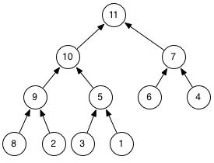
This is a Max Heap What would you guess are the invariants?

Slide 23
Binary Heaps (for your notes)
A Binary Heap is a binary tree, with two additional properties
Shape Property: It is a complete binary tree – a binary tree in which every row is full, except possibly the bottom row, which is filled from left to right
MAXIMALLY BALANCED!
Heap Property (or Heap Order Property): No child has a key greater than its parent's key. This property is applied recursively: any subtree of a binary heap is also a binary heap.
Nodes are bigger than their descendants
If we use the notion of smaller than in the Heap Property we get a min-heap. We’ll look at max-heap in this lecture.

Slide 24
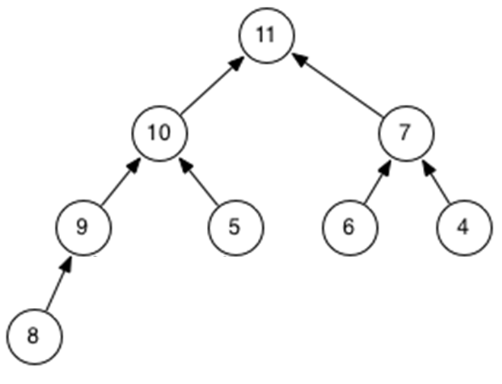
Initial Heap

Slide 25
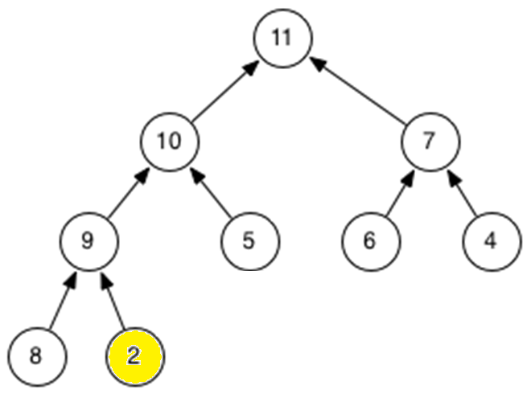
Add(2)

Slide 26
Add(2)

Slide 27
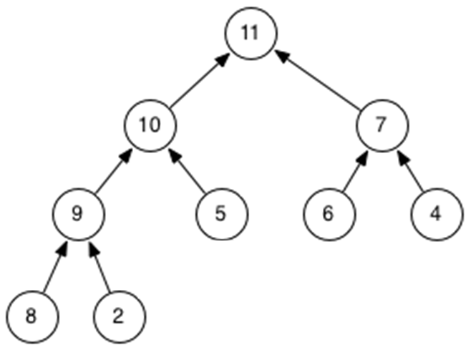
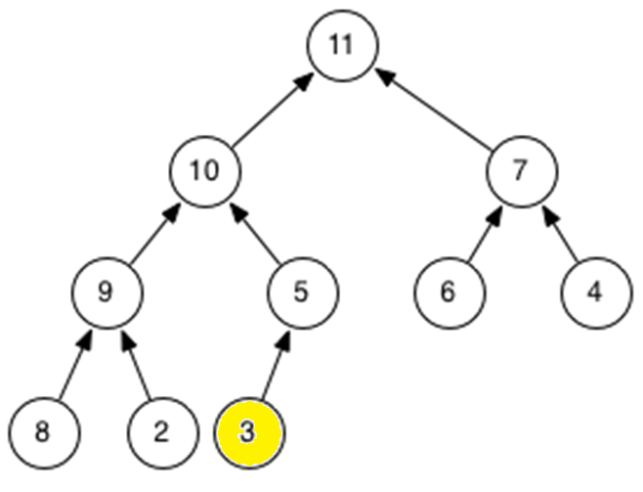
Add(3)

Slide 28
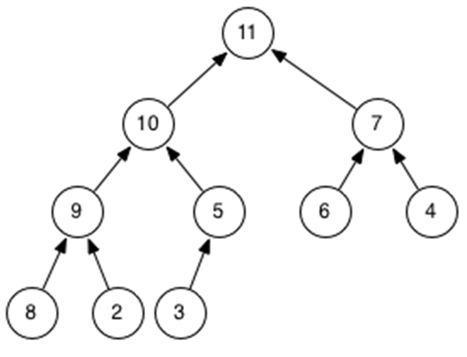
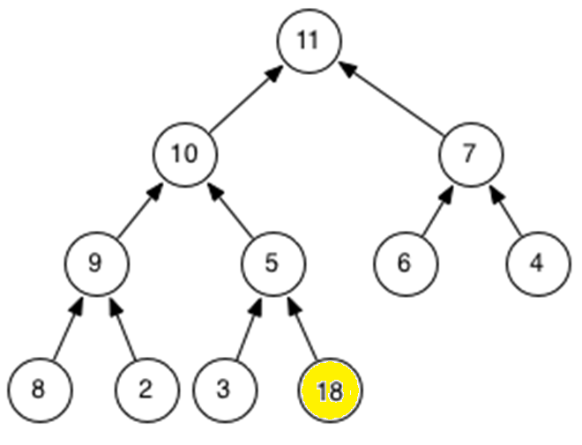
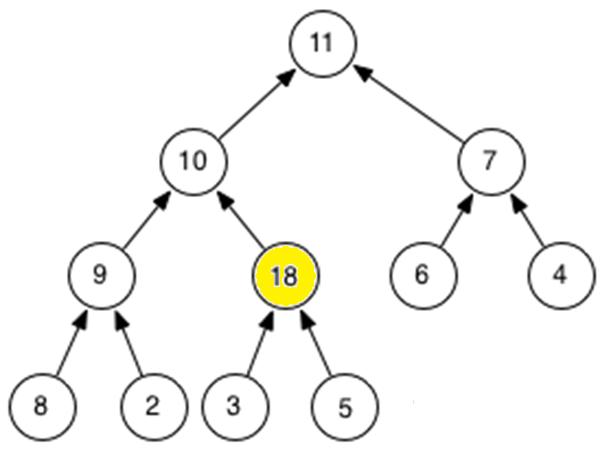
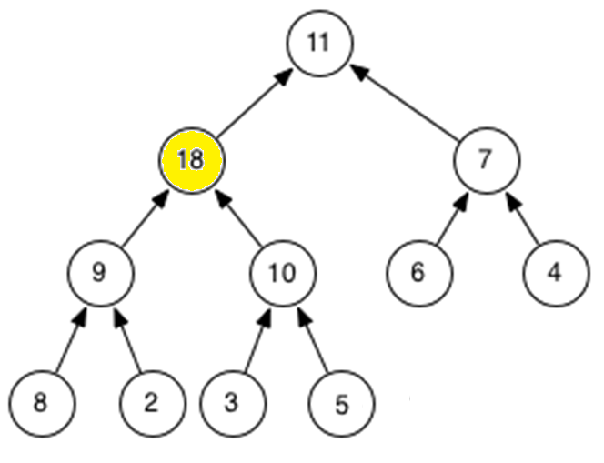
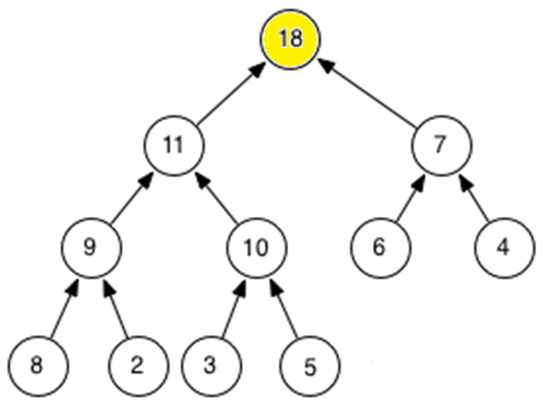
Add(18)

Slide 29
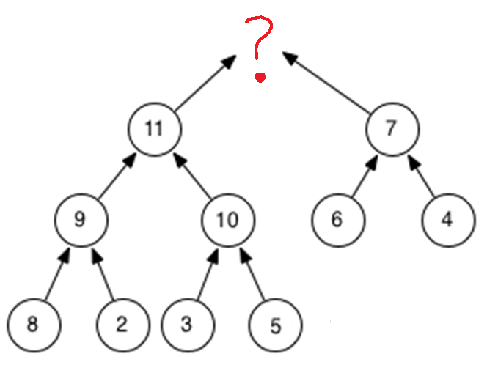
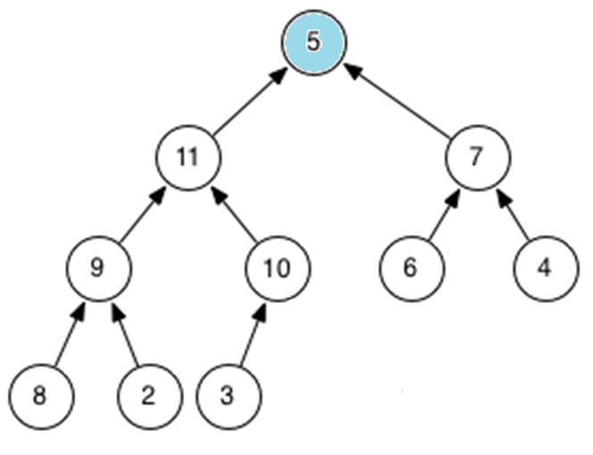
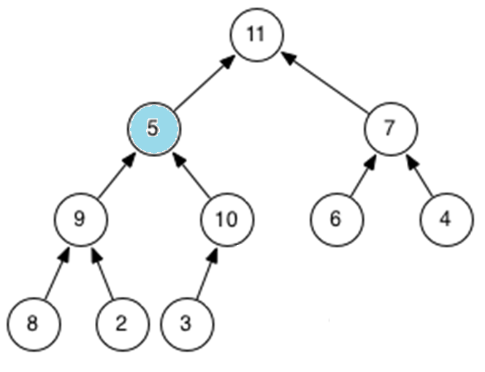
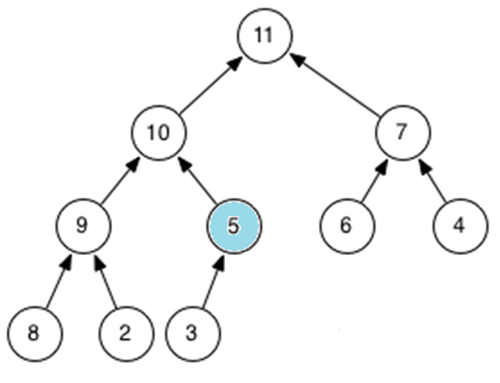
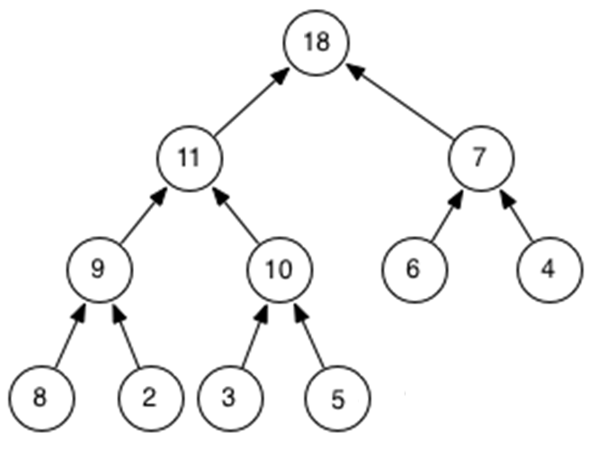
removeMax()

Slide 30
Heap Operations
Step 1: Ensure that it is maximally balanced
Step 2: Ensure that every node is bigger than its descendents
Add
Step 1: Put it in the next spot in the bottom row
Step 2: Potentially bubble it up
Remove
Step 1: Replace the max with the “last” bottom spot
Step 2: Potentially bubble it down

Slide 31
There are tons of Heap Animations
Heapify
http://students.ceid.upatras.gr/~perisian/data_structure/HeapSort/heap_applet.html

Slide 32
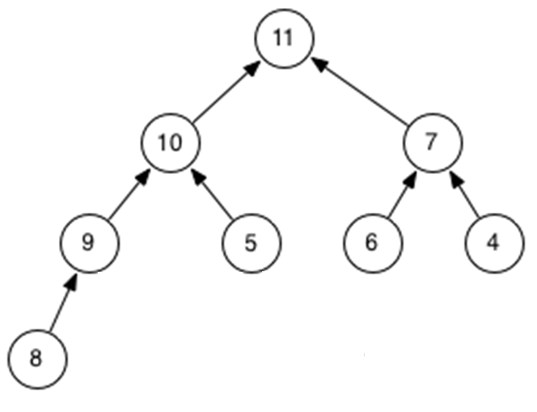
Representing Trees Array representations are common for Heaps
Left Child at 2n + 1
Right Child at 2n + 2
11 | 10 | 7 | 9 | 5 | 6 | 4 | 8
 | 0 | 1 | 2 | 3 | 4 | 5 | 6 | 7 | 8 | 9

Slide 33
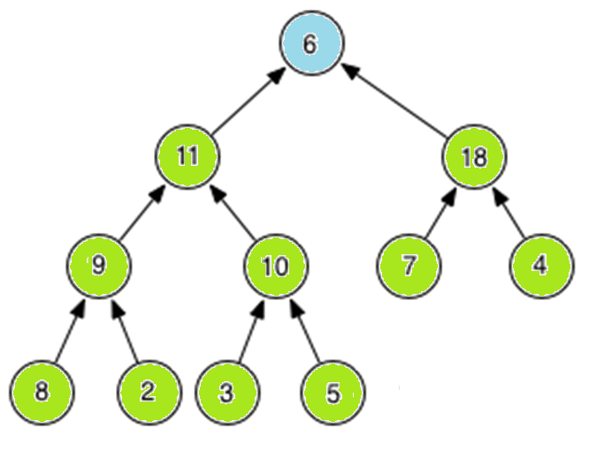
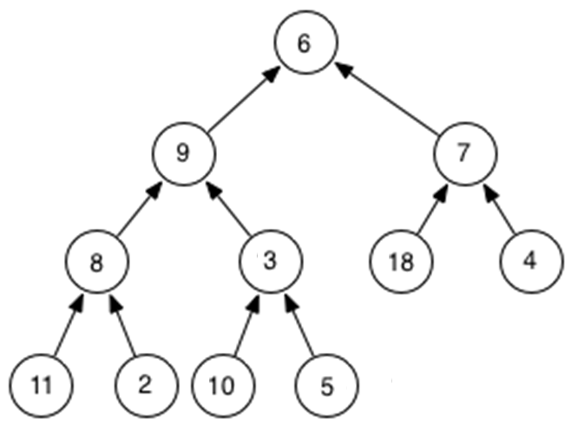
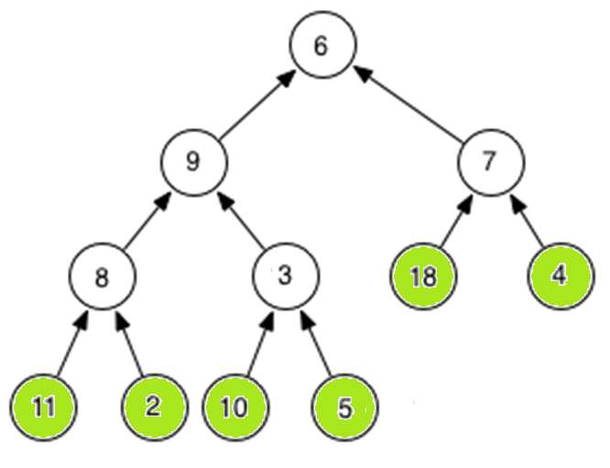
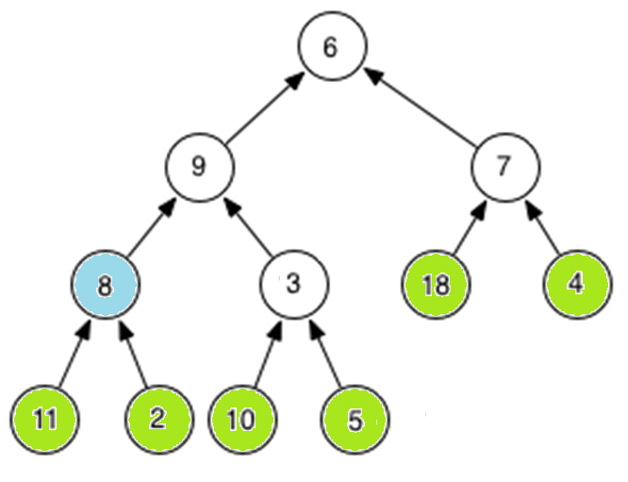
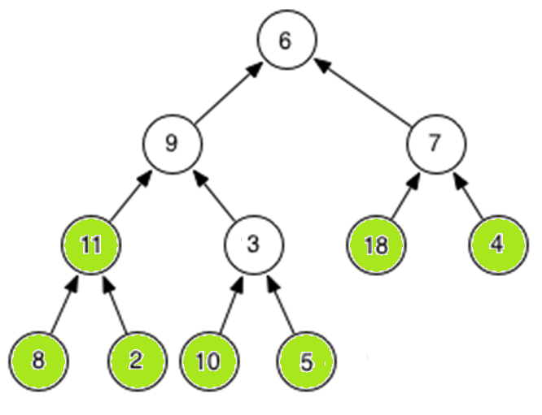
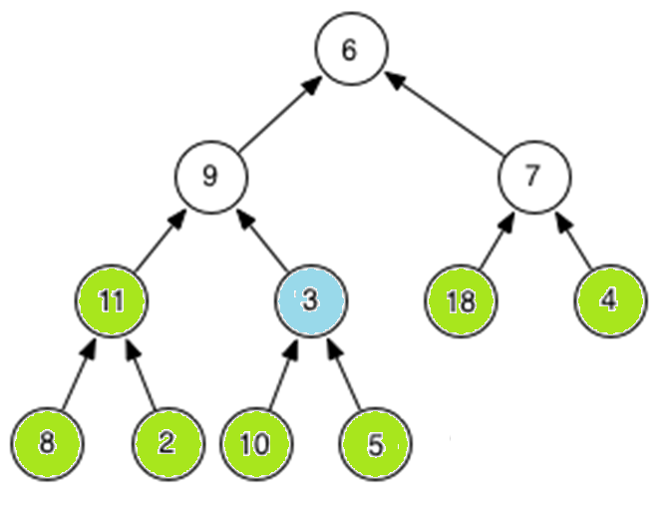
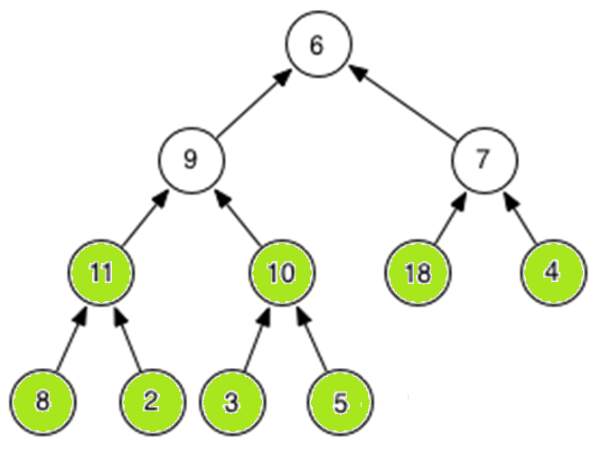
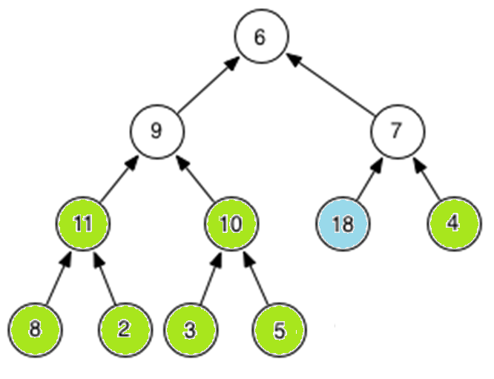
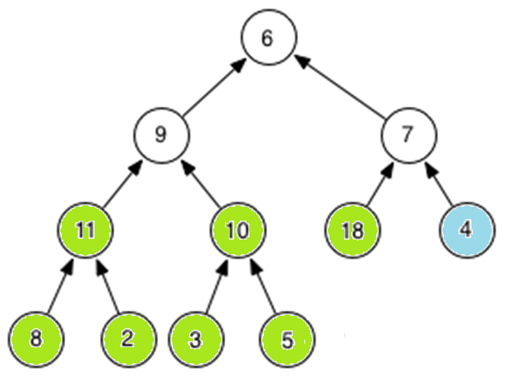
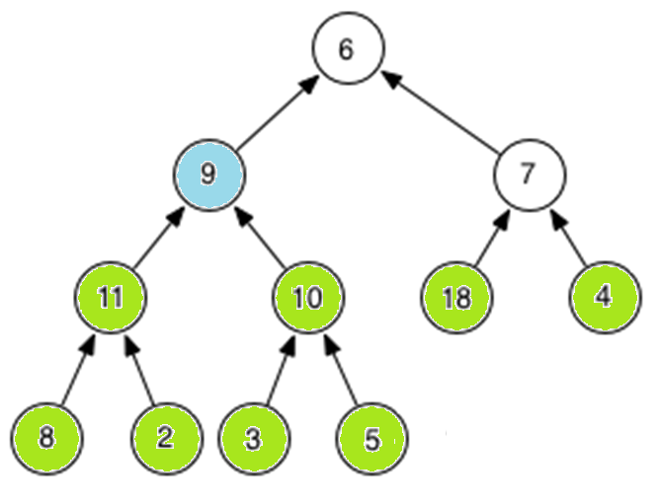
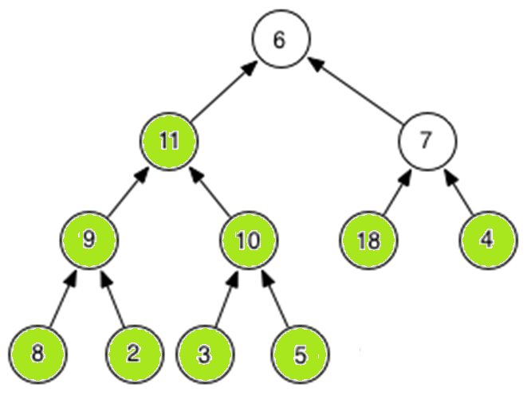
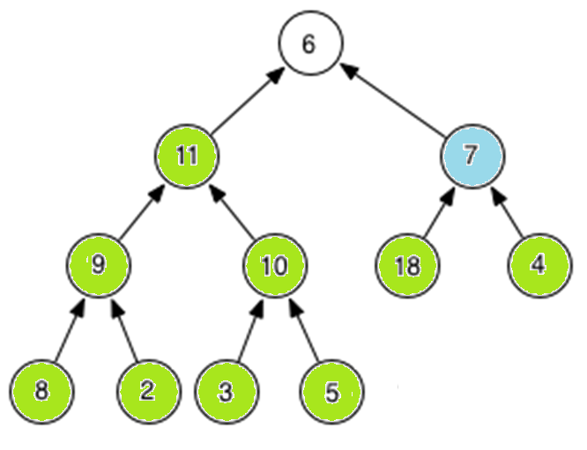
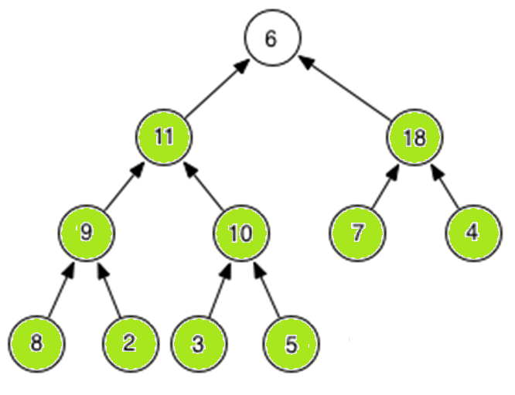
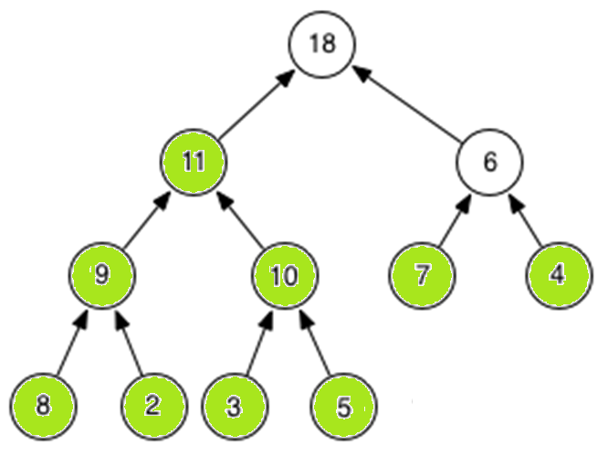
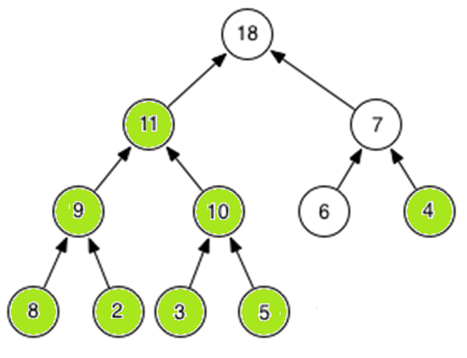
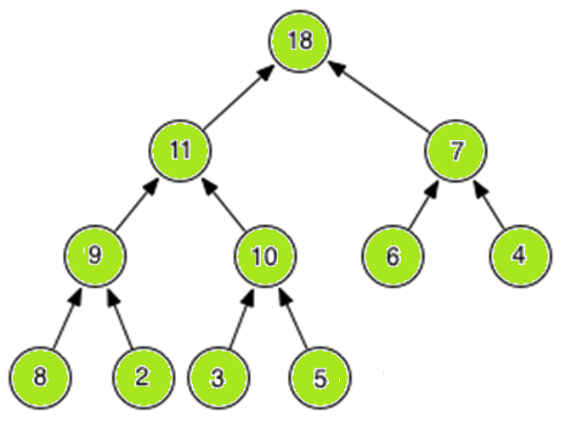
Heapify Demo

Slide 34
Heapify Demo Array Version
6 | 9 | 7 | 8 | 3 | 18 | 4 | 11 | 2 | 10 | 5
6 | 9 | 7 | 11 | 3 | 18 | 4 | 8 | 2 | 10 | 5
6 | 9 | 7 | 11 | 10 | 18 | 4 | 8 | 2 | 3 | 5
6 | 11 | 7 | 9 | 10 | 18 | 4 | 8 | 2 | 3 | 5
6 | 11 | 7 | 9 | 10 | 18 | 4 | 8 | 2 | 3 | 5
6 | 11 | 18 | 9 | 10 | 7 | 4 | 8 | 2 | 3 | 5
18 | 11 | 6 | 9 | 10 | 7 | 4 | 8 | 2 | 3 | 5
18 | 11 | 7 | 9 | 10 | 6 | 4 | 8 | 2 | 3 | 5

Slide 35
Bottom-Up Heap Construction
Suppose we are given a bunch of randomly ordered entries, and want to make a heap out of them.
What’s the obvious way
Apply insert to each item in O(n log n) time.
A better way: bottomUpHeap()
Make a complete tree out of the entries, in any random order.
Start from the last internal node (non-leaf node), in reverse order of the level order traversal, heapify down the heap as in removeMax().

Slide 36
Cost of Bottom Up Construction
If each internal node bubbles all the way down, then the running time is proportional to the sum of the heights of all the nodes in the tree.
Turns out this sum is less than n, where n is the number of entries being coalesced into a heap.
Hence, the running time is in O(n), which is better than inserting n entries into a heap individually.

Slide 37
Radix Sort (an example of a stable sort)

Slide 38
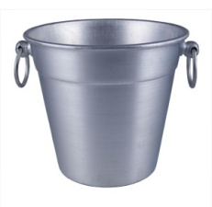
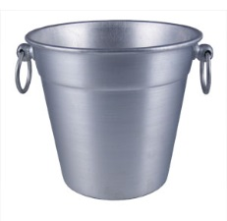
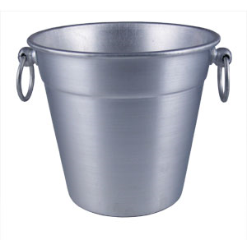

Easy Sorting Problems…
Sort N numbers in the range 0 to 9
0 | 1 | 2 | 3 | 4 | 5 | 6 | 7 | 8 | 9
How fast could you sort
N numbers
in the range 0 to B?
O(N)
O(B)
O(N+B)
O(N*B)
E) ??
In Big-O defining your variables is super important!

Slide 39
Harder Sorting Problems… Approach 1 – Two stages
Sort N numbers in the range 0 to 99
Make some buckets and calculate what bucket they need to go into.
Then sort each bucket
0 – 9 | 10-19 | 20-29 | 30-39 | 40-49 | 50-59 | 60-69 | 70-79 | 80-89 | 90-99

Slide 40
Harder Sorting Problems… Approach 2
Sort N numbers in the range 0 to 99
First sort by the one’s digit (this is counter intuitive)
95
25
98
29
20
32
93
85
97
38
39
0 | 1 | 2 | 3 | 4 | 5 | 6 | 7 | 8 | 9

Slide 41
Combine the buckets
Start from the first thing in the bucket
95
25
98
29
20
32
93
85
97
38
39
The 20’s are the correct relative order
0 | 1 | 2 | 3 | 4 | 5 | 6 | 7 | 8 | 9
20
20
32
93
85
25
25
95
97
38
98
39
29
29

Slide 42
Resort using the tens digit
20
32
93
85
25
95
97
38
98
39
29
Now Recombine!
98
29
39
97
25
38
95
20
32
85
93
0 | 1 | 2 | 3 | 4 | 5 | 6 | 7 | 8 | 9
20
25
29
32
38
39
85
93
95
97
98

Slide 43
Radix Sort the numbers 0-99
The running time for our example: (N + B)*2
We did two passes, each took N time.
We gathered up the buckets twice each took B time (where B is the number of buckets)

Slide 44








We can represent numbers with 1’s and 0’s
3 2 1 8
3*1000 + 2*100 + 1*10 + 8*1
1 0 0 1
1*8 + 0*4 + 0*2 + 1*1
We could use binary digits
0001 1
0010 2
0011 3
0100 4
0101 5
0110 6
0111 7
1000 8

Slide 45
Radix Sort with 32 bit numbers
We chose how many bits we want to sort at a time.
4 bits at a time (8 passes)
0000 0000 0000 0000 0000 0000 0000 0000
8 bits at a time (4 passes)
00000000 00000000 00000000 00000000
Running Time of Radix Sort in terms of
N: the number of items to sort
B: the number of buckets
P: the number of passes
Less than
Equal to
Greater than
??
O(N*B*P)

Slide 46
Recurrence Relationships (This will involve a lot of algebra – but no magic!)

Slide 47
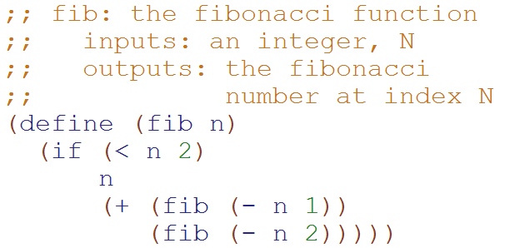
Big-O: Exponential Time O(2^{N})
T( __ ) = ______
T(N) = ___________________
How many terms?
1
2
3
4
??

Slide 48
Big-O: Exponential Time O(2^{N})
Define:
T₁(N) = 1 + 2*T₁(N-1)
T₂(N) = 1 + 2*T₂(N-2)
T₂(N) ≤ T(N) ≤ T₁(N)
T(1) = 1
T(N) = 1 + T(N-1) + T(N-2)
T₂(N) ≤ T(N)
1 + T₂(N-2) + T₂(N-2) ≤ 1 + T(N-1) + T(N-2)
1 + T₂(N-2) + T(N-2) ≤ 1 + T(N-1) + T(N-2)
?
?
This is complicated! Let’s look for an upper bound
T(N) ≤ T₁(N)
1 + T(N-1) + T(N-2) ≤ 1 + T₁(N-1) + T₁(N-1)
1 + T(N-1) + T(N-2) ≤ 1 + T₁(N-1) + T(N-2)

Slide 49
Big-O: Exponential Time O(2^{N})
Based upon this relationship
T₁(N) = 1 + 2*T₁(N-1)
We can generalize that:
T₁(N-1) = 1 + 2*T₁(N-2)
T₁(N-2) = 1 + 2*T₁(N-3)
…
T₁(1) = 1
T₁(N) = 1 + 2*T₁(N-1)
T₁(N) = 1 + 2*(1 + 2*T₁(N-2))
T₁(N) = 1 + 2 + 4*T₁(N-2)
T₁(N) = 1 + 2 + 4*(1 + 2T₁(N-3))
…
T₁(N) = 1 + 2 + 4 + … + 2^{N-1}
T₁(N) = 2^{N} -1
Substitute this
distribute
Substitute this

Slide 50
Big-O: Exponential Time O(2^{N})
Based upon this relationship
T₂(N) = 1 + 2*T₂(N-2)
We can generalize that:
T₂(N-2) = 1 + 2*T₂(N-4)
T₂(N-4) = 1 + 2*T₂(N-8)
…
T₂(0) = 1, T₂(1) = 1
T₂(N) = 1 + 2*T₂(N-2)
T₂(N) = 1 + 2*(1 + 2*T₂(N-4))
T₂(N) = 1 + 2 + 4*T₂(N-4)
T₂(N) = 1 + 2 + 4*(1 + 2T₂(N-8))
…
T₂(N) = 1 + 2 + 4 + … + 2^{N/2}
T₂(N) = 2*2^{N/2} -1 = 2^{N/2+1} -1
Substitute this
distribute
Substitute this
Simplification b/c we’re not worrying about odd values of N

Slide 51

Big-O: Exponential Time O(2^{N})
Define:
T₁(N) = 1 + 2*T₁(N-1)
T₂(N) = 1 + 2*T₂(N-2)
T₂(N) ≤ T(N) ≤ T₁(N)
T(1) = 1
T(N) = 1 + T(N-1) + T(N-2)
T₂(N) = 2^{N/2} -1 T₁(N) = 2^{N} -1
T₂(N) ≤ T(N) ≤ T₁(N)
2^{N/2} -1 ≤ T(N) ≤ 2^{N} -1(N-2)
We showed this
Calculated on previous slides.
Since Big-O is an upper bound,
T(N) O(2^{N})

Slide 52
Add(2)

Slide 53
Add(3)

Slide 54
Add(18)

Slide 55
removeMax()

Slide 56
Sorting with comparisons
A sorted list is just one of the possible _____ permutations of that list (assume list size n).
How long would it take to check through a list of all permutations to see which one is sorted (assume sorting a list of size n). _________
123
123
231
213
312
321

Slide 57
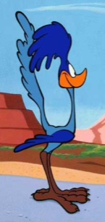

Sorting can't do better than O(NlogN) !
Start with all of the permutations of an n-element list.
The Algorithm -- asks questions comparing two elements
[e₁, e₂, e₃, ... , e_{n}]
[4,1,5,3,2]
[4,5,3,1,2]
[3,1,4,5,2]
[2,4,1,5,3]
[1,2,3,4,5]
[5,4,3,1,2]
Sorting is equivalent to determining which of the N! permutations we started with…
yes
?
no
e1 < e2
[1,2,3,4,5]
[4,1,5,3,2]
[4,5,3,1,2]
[5,4,3,1,2]
[2,4,1,5,3]
[3,1,4,5,2]
The Adversary -- gives yes or no answers to each question
Adversary Argument

Slide 58
Runtime

Slide 59
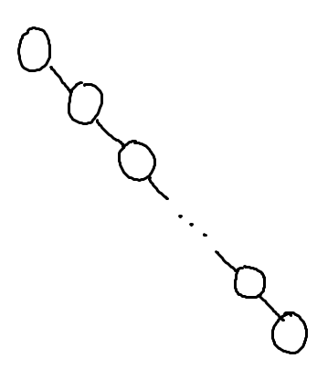
What is the worst case run-time for find in this Binary Search Tree?
O(1)
O(log n)
O(n log n)
O(n)
O(n²)

Slide 60
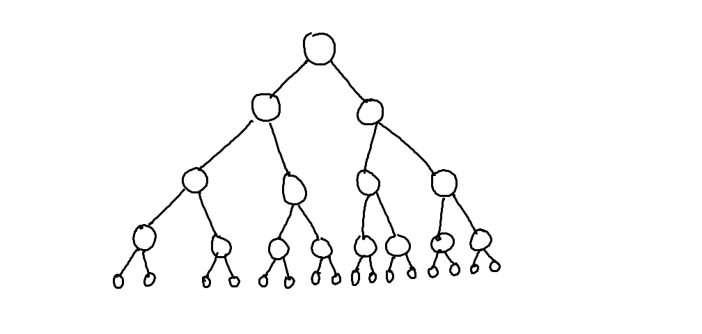
What is the worst case run-time for find in this Binary Search Tree?
O(1)
O(log n)
O(n log n)
O(n)
O(n²)
…

Slide 61
Assuming: all nodes have 0 or 1 children N nodes in the BST
BST Big-Oh (Completely Unbalanced Case)
Find |  | Insert |  | Delete
Best | Worst | Best | Worst | Best | Worst
O( ) | O( ) | O( ) | O( ) | O( ) | O( )

Slide 62
Assuming: all nodes have 0 or 2 children N nodes in the BST
BST Big-Oh (Balanced Case)
Find |  | Insert |  | Delete
Best | Worst | Best | Worst | Best | Worst
O( ) | O( ) | O( ) | O( ) | O( ) | O( )
O(1)
O(log n)
O(n log n)
O(n)
O(n²)

Slide 63
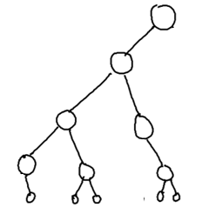
Assuming: most nodes have 0 or 2 children height is O(log n) N nodes in the BST
BST Big-Oh (Mostly Balanced Case)
Find |  | Insert |  | Delete
Best | Worst | Best | Worst | Best | Worst
O( ) | O( ) | O( ) | O( ) | O( ) | O( )

Slide 64
Big-Oh for Lists (a.k.a. linked lists)

Slide 65
Racket Lists Big-Oh
Insert (into front of list) | O( )
Insert (into end of list) | O( )
Find | O( )
Length | O( )
Delete (from the middle) | O( )
O(1)
O(log n)
O(n log n)
O(n)
O(n²)

Slide 66
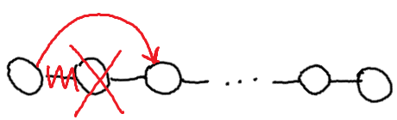
Assuming: the modifiable LinkedList using Hw5 List and ListNode
List/ListNode Big-Oh
Insert (into front of list) | O( )
Insert (into end of list) | O( )
Find (given a value) | O( )
Length | O( )
Delete (given a value) | O( )
Delete (given a ListNode ref) | O( )
O(1)
O(log n)
O(n log n)
O(n)
O(n²)

Slide 67
Big-Oh for Arrays

Slide 68
Unsorted Arrays Big-Oh
Insert (into first spot) | O( )
Insert (into last spot) | O( )
Find (given a value) | O( )
Delete (given a value) | O( )
5 | 3 | 8 | 2 | 1 | 7 | 0 | 0 | 0 | 0 | 0 | 0 | 0
Assuming:
unsorted array holding numbers within 1 to N
no duplicates
we keep track the last index we use (maxIndex)
all values at indices > maxIndex are 0 (unused).

Slide 69
Sorted Arrays Big-Oh
Insert (into first spot) | O( )
Insert (into last spot) | O( )
Find (given a value) | O( )
Delete (given a value) | O( )
Assuming:
sorted array holding numbers within 1 to N
no duplicates
we keep track the last index we use (maxIndex)
all values at indices > maxIndex are 0 (unused).
1 | 2 | 3 | 5 | 7 | 8 | 0 | 0 | 0 | 0 | 0 | 0 | 0

Slide 70
Boolean Arrays Big-Oh
Insert (into first spot) | O( )
Insert (into last spot) | O( )
Find (given a value) | O( )
Delete (given a value) | O( )
F₀ | T₁ | T₂ | T₃ | F₄ | T₅ | F₆ | T₇ | T₈
Assuming:
Boolean array representing numbers within 1 to X
X is a fixed number
no duplicates
Could I use this trick to store objects?

Slide 71
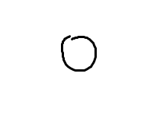
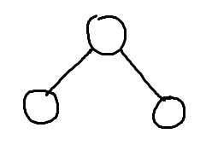
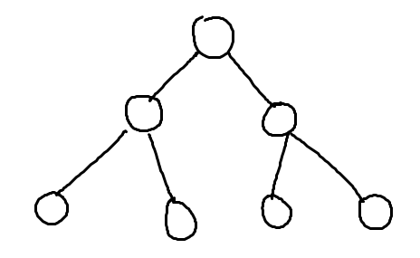
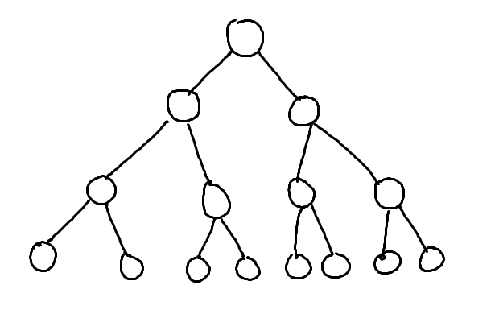
What’s the relationship between height and number of nodes?
3
7
1
15
31

Slide 72
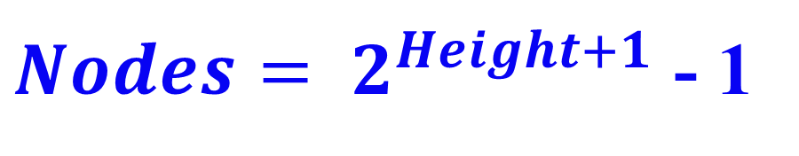
What’s the relationship between height and number of nodes?
1
3
7
Height | Nodes | 2^{Height+1}
0 | 1 | 2
1 | 3 | 4
2 | 7 | 8
3 | 15 | 16
4 | 31 | 32
5 | 63 | 64
15
31

Slide 73





// Take the log of both sides
Drop the 1
Who cares?
// Remember:

Slide 74
Stable and Non-Stable Sorting

Slide 75
Stable Sort
Sometimes there are equivalent keys in a data structure that is sorted.
Sometimes it matters if you change the order of those equivalent keys
E.g. Sorting music by song and then artist should keep each artists songs alphabetized
We call a sort “stable” if it doesn’t change the order of equivalent keys

Slide 76
BONUS

Slide 77


Slide 78


Computer
Science
&
= AWESOME

Slide 79


http://www.youtube.com/watch?v=pzRmNYA8LlY

Slide 80


ClickStart

Slide 81


Slide 82

How should we represent the blocks in the computer?
Independent variables
2D Array
OpenList
I don’t know

Slide 83
The value in the array tells me what art asset to use
Each level is really a 3x10 vector!
0 | 0 | 7 | 0 | 4 | 0 | 0 | 0
1 | 2 | 3 | -4 | 5 | 6 | -7 | 8
B | B | B | B | B | B | B | B
Negative values tell me what block needs to go here to win!

Slide 84
0 | 0 | 7 | 0 | 4 | 0 | 0 | 0
1 | 2 | 3 | -4 | 5 | 6 | -7 | 8
0 | 0 | 0 | B | 0 | 0 | 0 | 0

Slide 85
BUGS!

Slide 86


Slide 87

It is really sad when stuff you’ve made is on sale!

Slide 88



Which image is fake?
A. Top Left
B. Bottom Left
C. Bottom Right

Slide 89


Slide 90


