Slide 1
CS 60
Hw 10
Parsing Intro
2014-11-17
Monday – Week 11
Lecture 21

Slide 2
Lecture 21 – Learning Goals
Describe the steps in “parsing”:
  Tokenize
  Parse
  Evaluate
Be prepared for many files in hw10
Describe the process of parsing with production rules
Draw how production rules map to an expression
It is TERRIBLE that the whole process has the same name as one of the steps!

Slide 3
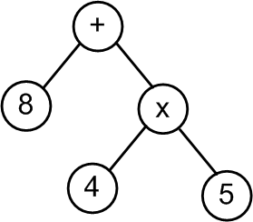
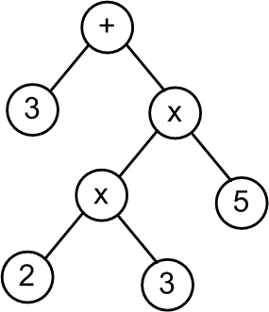
Warm-up: Evaluate these Trees
Does this remind you of a previous homework assignment???
We’ll call these Abstract Syntax Trees (or ASTs)

Slide 4
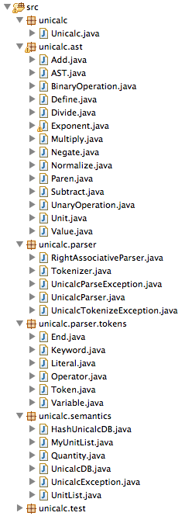
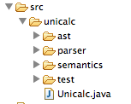
Introduction to Hw 10 Files
We’ll call these Abstract Syntax Trees (or ASTs)

Slide 5
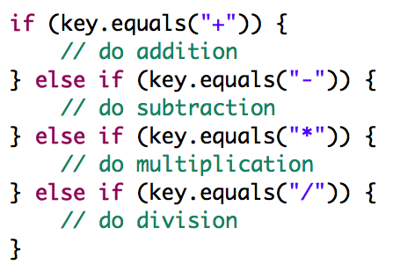
Design Motivation 1:
Imagine writing code to parse this tree

Slide 6
Design Motivation 2:
Java Design Decision
How should we visualize?
  (3+2)*5
  - 4
  def x 3
What should we do with non-binary operators?

Slide 7

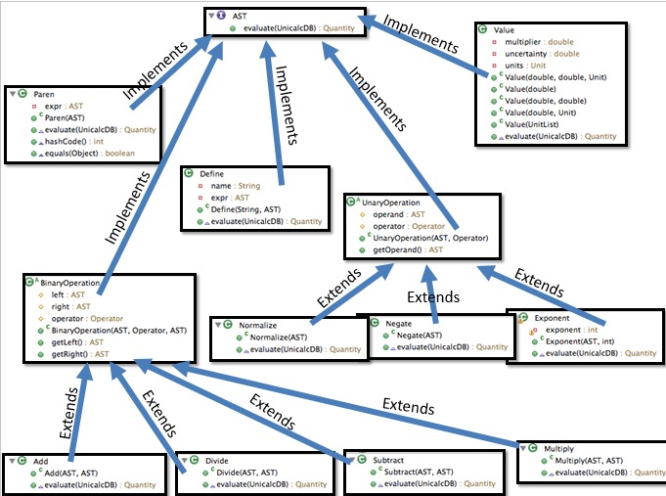

Design Strategy:
If we use inheritance, each type of tree, will know how to evaluate itself
This little I means it is an interface
You’ll implement evaluate(UnicalcDB) for each – (Part 3)

Slide 8
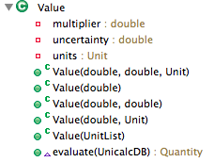
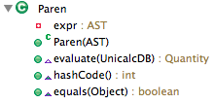


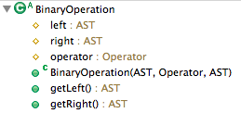






Implements
Implements
Implements
Implements
Implements
Extends
Extends
Extends
Extends
Extends
Extends
Extends

Slide 9
Visualizing AST Hierarchy
AST
Define
Paren
UnaryOperation
BinaryOperation
Value
Add
Divide
Subtract
Multiply
Normalize
Negate
Exponent

Slide 10
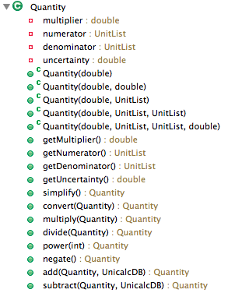
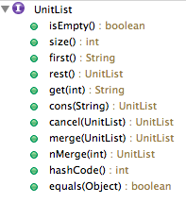
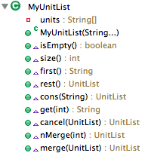
Remember Quantities?
(already implemented)
Has many
Implements
Write these methods (Part 0)

Slide 11
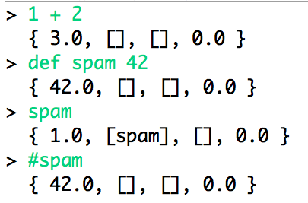
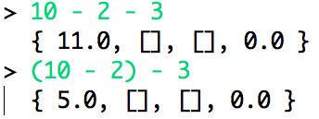
Unicalc Demo
The associativity is “wrong”

Slide 12

Unicalc in Java
> def hz 1 / 1[s]
{ 1.0, [], [s], 0.0 }
> def x 3 [m/s]
{ 3.0, [m], [s], 0.0 }
> def answer 7 * (x+x) / 2 [hz]
{ 21.0, [m], [hz, s], 0.0 }
> # answer
{ 21.0, [m], [], 0.0 }
Woah! I can define things and then use them in calculations!
An example
read-eval-print loop (REPL)

Slide 13
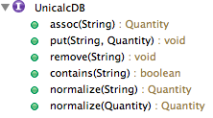
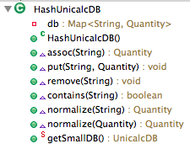
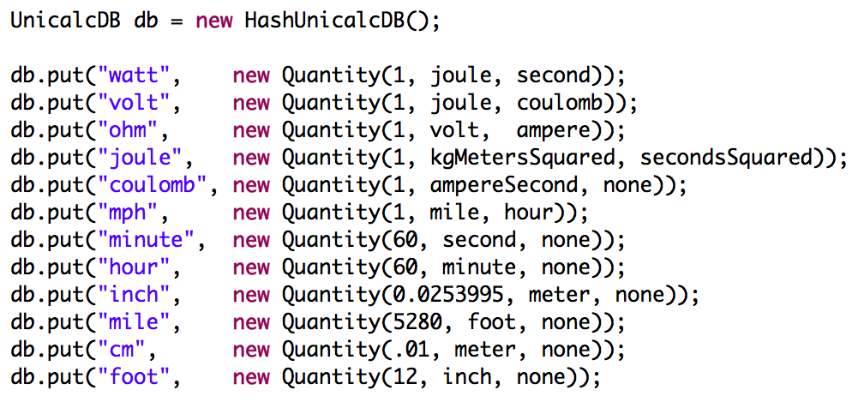
Unicalc DB
Implements

Slide 14
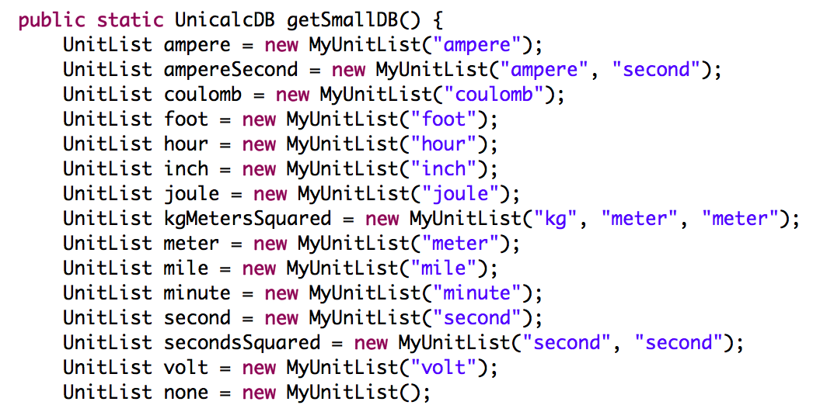
Note – Quantity objects have UnitLists

Slide 15
Big Picture for Unicalc in Java
String
"8 + 4 * 5"
Tokenizer
String[]
< “8” “+” “4” “*” “5” >
Parser
[+, [8], [*, [4], [5]]]
AST
Evaluator
Quantity
{28.0, [], [], 0.0}

Slide 16



Exceptions
Customized to our project!
RuntimeException
(Provided by Java)
Extends
Extends
Extends

Slide 17

Tokenizer
(Take in input and break it into pieces)
Java has a bunch of libraries, I bet I can use those to help me solve this problem!
It would save me time if Colleen just told me what libraries to use!

Slide 18
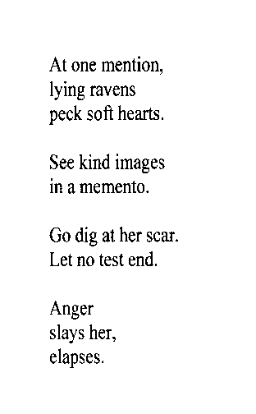
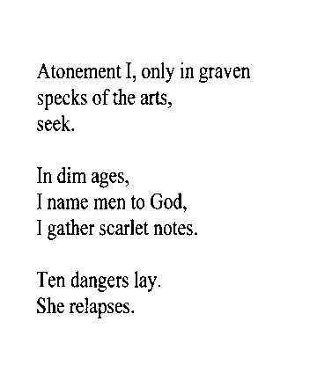
Tokenize – Figure out what are the tokens (words)
inumbrage
atonementionlyingravenspecksoftheartsseekindimagesinamementogodigatherscarletnotestendangerslaysherelapses
inumbrage
inumbrage
atonementionlyingravenspecksoftheartsseekindimagesinamementogodigatherscarletnotestendangerslaysherelapses
atonementionlyingravenspecksoftheartsseekindimagesinamementogodigatherscarletnotestendangerslaysherelapses
Re-parsable poetry?!
- Mike Maguire

Slide 19
Big idea of Hw10
(Unicalc)
Parsing

Slide 20
Starting with a SMALL grammar
(2 rules)
A sum, S, is either a value, V, or a value, V, plus a sum, S.
S → V | V + S
A value, V, is a number.
V → 0|1|2|3|…

Slide 21
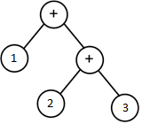





Parsing Sums
Find the V (I always start with a V)
If a + is next (I must be in the V+S case)
  skip the + and recurse (return ParseTree)
Else
  Return ParseTree with V in it
S → V | V + S V → 0|1|2|3|…
S
V
42 42 + 10 1 + 2 + 3

Slide 22
Grammar Vocab
Grammar: A set of rules that determines legal expressions in a language.
the starting rule or “production”
+
S V S
V
S = “I want to be a sum.”
V = “I want to be a value.”
"sum"
V
0
1
…
9
"value"
nonterminal or auxiliary symbol
This is how we write "or“ in grammars
each nonterminal symbol represents a “syntactic category”
terminal symbols -- things that appear in the expression to be parsed
alphabet = { +, 0, 1, …, 9 }

Slide 23
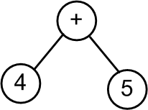
How grammars relate to ParseTrees
This shows how the production rules map to the tokens
A parser takes in tokens and outputs a parse tree,
according to some grammar!
Grammar:
S V S
V
+
"sum"
S
V
0
1
…
9
"value"
V
+
S
4
V
Parse tree: [+, [4], [5]]
5
Token list: <"4","+","5">
Input string: "4 + 5"

Slide 24
How grammars relate to ParseTrees
Show how the production rules map to the tokens
Grammar:
S
S V S
V
+
"sum"
V
0
1
…
9
"value"
Parse tree:
Token list: <"2","+","3","+","4" >
Draw the parse tree. How many nodes does it have? A) 3 B) 5 C) > 5 D) ??

Slide 25
We can handle + and – in the same rule
start here
S
V
+
S
V
-
S
V
S
V
0
1
…
9
8 - 4 + 5

Slide 26
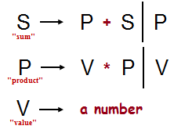
The Recursive Descent Parsing Algorithm
S
P
S
+
V
P
This shows how the production rules map to the tokens
V
*
P
8
V
4
5
Draw the resulting parse tree
< 8, +, 4, *, 5 >

Slide 27
Find the P (I always start with a P)
If a + or - is next (I must be in the P+S or P-S case)
  skip the + or - and recurse (return ParseTree)
Else
  Return ParseTree with P in it
Starting symbol
S
P
+
S
P
-
S
P
"sum"
P
V
*
P
V
/
P
V
"product"
Find the V (I always start with a V)
If a * or / is next (I must be in the V*P or V / P case)
  skip the * or / and recurse (return ParseTree)
Else
  Return ParseTree with V in it
V
0
1
…
9
"value"
Notes:
why it would be good -- because the expression comes out to 42!

Slide 28
Show how the production rules map to the tokens
S
Starting symbol
S
P
+
S
P
-
S
P
"sum"
P
V
*
P
V
/
P
V
"product"
V
0
1
…
9
"value"
7 * 3 + 9 / 2
expression to be parsed
Notes:
why it would be good -- because the expression comes out to 42!

Slide 29
Show how the production rules map to the tokens
Starting symbol
S
P
+
S
P
-
S
P
S
"sum"
P
V
*
P
V
/
P
V
S
+
"product"
V
0
1
…
9
"value"
P
P
V
P
/
V
*
P
V
V
7 * 3 + 9 / 2
expression to be parsed
Notes:
why it would be good -- because the expression comes out to 42!

Slide 30
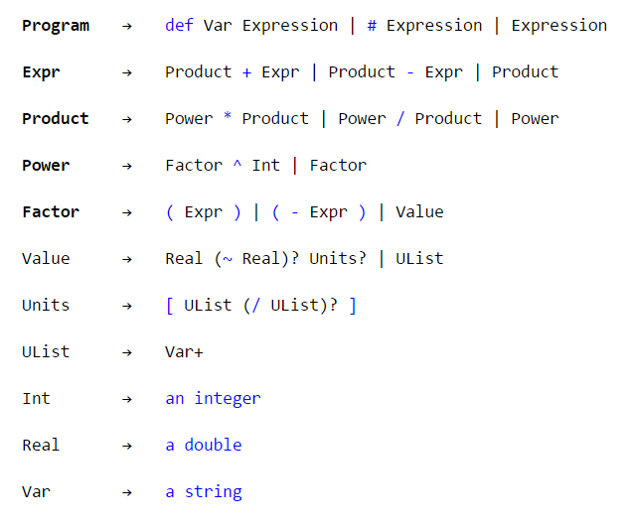
you'll need to add code for these rules
implemented in RightAssociativeParser.java for you already

Slide 31

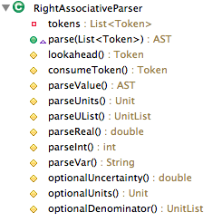
you'll need to add code for these rules
Each nonterminal corresponds to a method!
implemented in RightAssociativeParser.java for you already
Implements

Slide 32
UnicalcParser
List the methods you’ll add
Implements

Slide 33
Show how the production rules map to the tokens
S
Starting symbol
S
P
+
S
P
-
S
P
"sum"
P
V
*
P
V
/
P
V
"product"
V
0
1
…
9
"value"
1
Above, create the parse tree for the expression
What does parse tree evaluate to?
7 * 3 + 9 / 2
expression to be parsed
2
How could you change the grammar so that addition and subtraction had higher precedence than multiplication and division? And why might that be good?
What rule could you add that would enable the use of parentheses ( and ) for grouping terms?
3
Notes:
why it would be good -- because the expression comes out to 42!

Slide 34
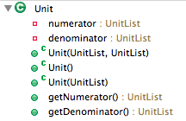

Slide 35
BONUS

Slide 36


Slide 37


Computer
Science
&
= AWESOME

Slide 38


http://www.youtube.com/watch?v=pzRmNYA8LlY

Slide 39


ClickStart

Slide 40
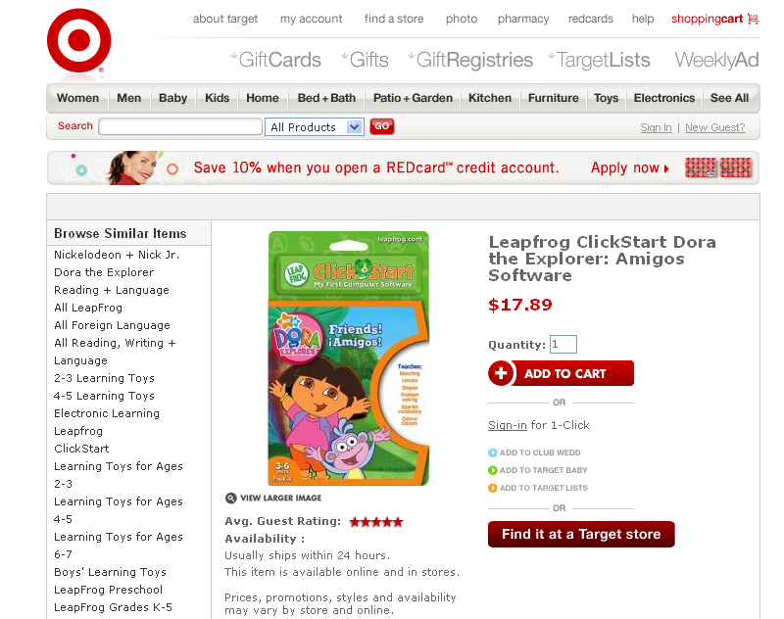

Slide 41

How should we represent the blocks in the computer?
Independent variables
2D Array
OpenList
I don’t know

Slide 42
The value in the array tells me what art asset to use
Each level is really a 3x10 vector!
0 | 0 | 7 | 0 | 4 | 0 | 0 | 0
1 | 2 | 3 | -4 | 5 | 6 | -7 | 8
B | B | B | B | B | B | B | B
Negative values tell me what block needs to go here to win!

Slide 43
0 | 0 | 7 | 0 | 4 | 0 | 0 | 0
1 | 2 | 3 | -4 | 5 | 6 | -7 | 8
0 | 0 | 0 | B | 0 | 0 | 0 | 0

Slide 44
BUGS!

Slide 45
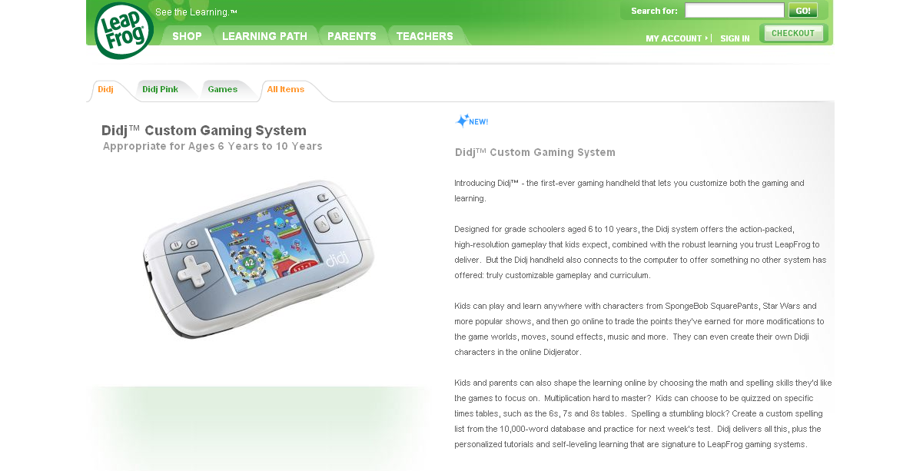

Slide 46

It is really sad when stuff you’ve made is on sale!

Slide 47



Which image is fake?
  A. Top Left
  B. Bottom Left
  C. Bottom Right

Slide 48


Slide 49
