Slide 1
CS 60
Parsing Wrap-up
+ Spampede
2014-11-19
Wednesday – Week 11
Lecture 22

Slide 2
Lecture 22 – Learning Goals
Draw how production rules map to an expression
Basics for writing RightAssociativeParser
Basics of Hw 11: Spampede
Understand the difference between
Queues & Stacks
Depth First Search & Breadth First Search

Slide 3
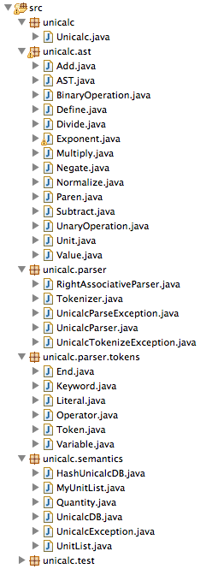
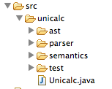
Introduction to Hw 10 Files
We’ll call these Abstract Syntax Trees (or ASTs)

Slide 4
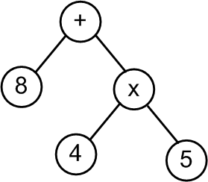
Big Picture for Unicalc in Java
String
"8 + 4 * 5"
Tokenizer
String[]
< “8” “+” “4” “*” “5” >
Parser
[+, [8], [*, [4], [5]]]
AST
Evaluator
Quantity
{28.0, [], [], 0.0}

Slide 5
Show how the production rules map to the tokens
S
Starting symbol
S
P
+
S
P
-
S
P
"sum"
P
V
*
P
V
/
P
V
"product"
V
0
1
…
9
"value"
2 + 3 * 4 + 5
Draw the resulting AST
expression to be parsed
Notes:
why it would be good -- because the expression comes out to 42!

Slide 6
Find the P (I always start with a P)
If a + or - is next (I must be in the P+S or P-S case)
skip the + or - and recurse (return ParseTree)
Else
Return ParseTree with P in it
Starting symbol
S
P
+
S
P
-
S
P
"sum"
P
V
*
P
V
/
P
V
"product"
Find the V (I always start with a V)
If a * or / is next (I must be in the V*P or V / P case)
skip the * or / and recurse (return ParseTree)
Else
Return ParseTree with V in it
V
0
1
…
9
"value"
Notes:
why it would be good -- because the expression comes out to 42!

Slide 7

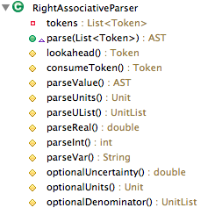
Updated!
(to improve clarity & fixing typo: “Expression” became “Expr”)
Program | → | def Var Expr | # Expr | Expr
Expr | → | Product + Expr | Product - Expr | Product
Product | → | Power * Product | Power / Product | Power
Power | → | Factor ^ Int | Factor
Factor | → | ( Expr ) | ( - Expr ) | Value
Value | → | Real | ~ Real | Real Units | ~ Real Units | UList
Units | → | UList | UList / Ulist
UList | → | Var | Var UList
Int | → | an integer
Real | → | a double
Var | → | a string
you'll need to add code for these rules
Each nonterminal corresponds to a method!
Implements
implemented in RightAssociativeParser.java for you already

Slide 8
UnicalcParser List the methods you’ll add
Implements

Slide 9
ArrayList & Generics
Actually stored as an array, so access time is O(1).
Like a list because it can grow and shrink – costs O(N)
What I want you to remember:
Arrays do not change size

Slide 10
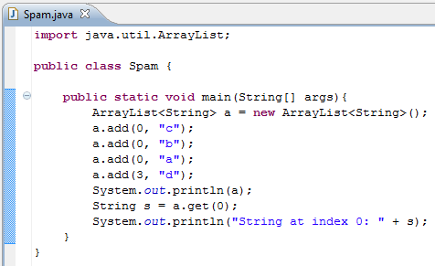

Use the <> to indicate what type of reference to use!
Add “b” at index 0
System.out.println calls toString() on input

Slide 11
Spampede Demo

Slide 12
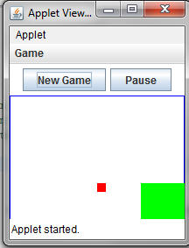
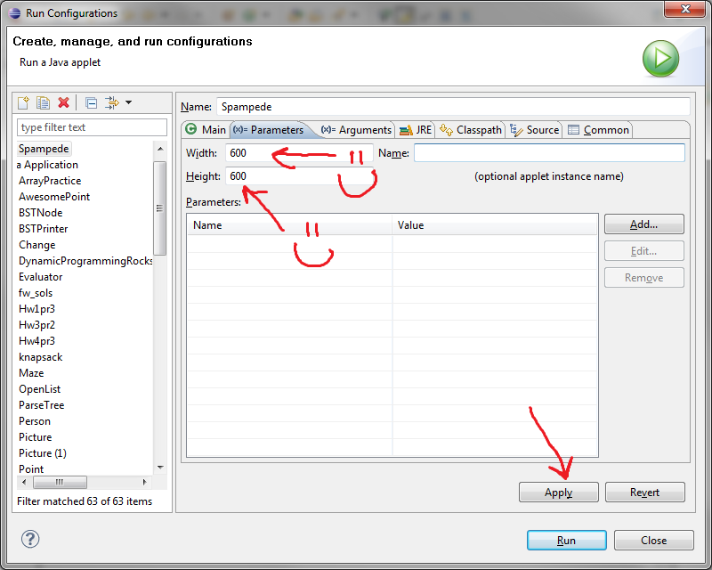
Run Spampede.java
If your window is funny shaped…

Slide 13
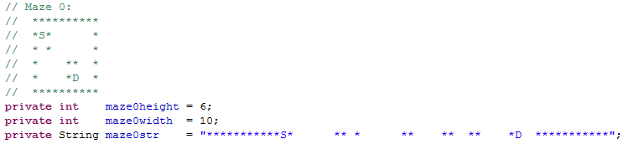
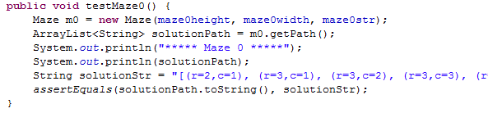
*: wall
S: Start
D: Destination
Input to make a Maze
getPath() returns an ArrayList<String>

Slide 14

Keep track of spam and your pede

Slide 15
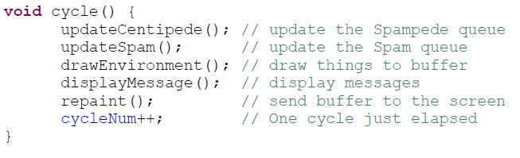
cycle()

Slide 16
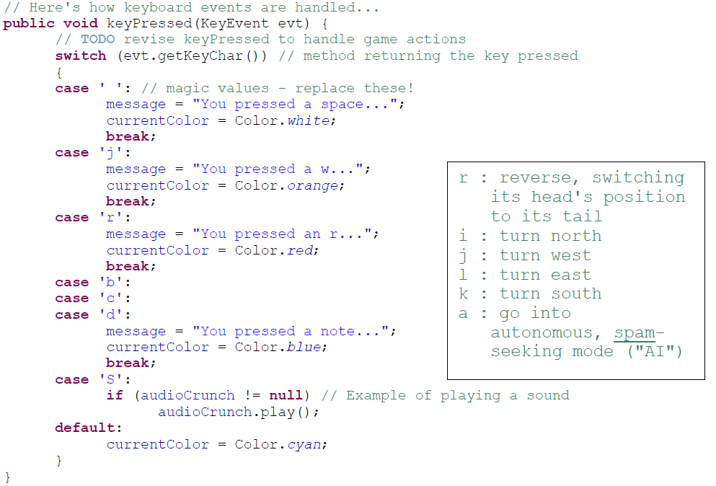
A separate thread will handle key presses

Slide 17
DFS/BFS

Slide 18
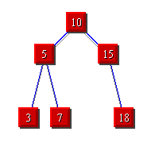


Breadth First Search (BFS)
3
Depth
First Search (DFS)
STACKS
QUEUES

Slide 19
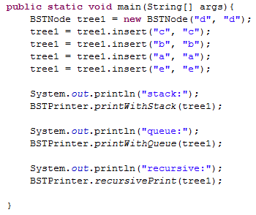
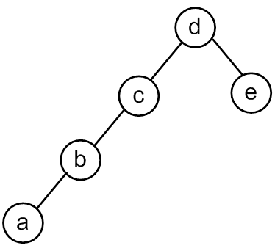
Remember the emptyBSTNode?

Slide 20
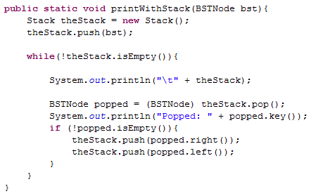
Print With a Stack

Slide 21
<TOP> d <BOTTOM>
Popped: d
<TOP> c e <BOTTOM>
Popped: c
<TOP> b empty e <BOTTOM>
Popped: b
<TOP> a empty empty e <BOTTOM>
Popped: a
<TOP> empty empty empty empty e <BOTTOM>
Popped: empty
<TOP> empty empty empty e <BOTTOM>
Popped: empty
<TOP> empty empty e <BOTTOM>
Popped: empty
<TOP> empty e <BOTTOM>
Popped: empty
<TOP> e <BOTTOM>
Popped: e
<TOP> empty empty <BOTTOM>
Popped: empty
<TOP> empty <BOTTOM>
Popped: empty
We put a bunch of empty stuff on the stack!
(a bunch of references to emptyBSTNode)

Slide 22
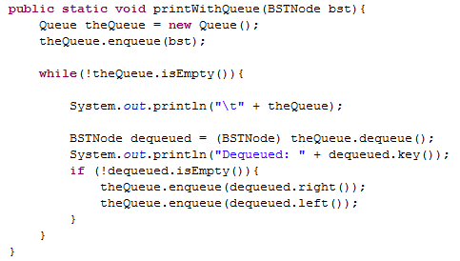
Print With a Queue

Slide 23
<FRONT> d <BACK>
Dequeued: d
<FRONT> e c <BACK>
Dequeued: e
<FRONT> c empty empty <BACK>
Dequeued: c
<FRONT> empty empty empty b <BACK>
Dequeued: empty
<FRONT> empty empty b <BACK>
Dequeued: empty
<FRONT> empty b <BACK>
Dequeued: empty
<FRONT> b <BACK>
Dequeued: b
<FRONT> empty a <BACK>
Dequeued: empty
<FRONT> a <BACK>
Dequeued: a
<FRONT> empty empty <BACK>
Dequeued: empty
<FRONT> empty <BACK>

Slide 24
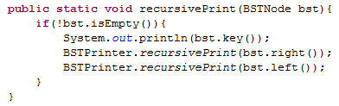
Will this print in the same order as:
Stack
Queue
?

Slide 25
Searching

Slide 26
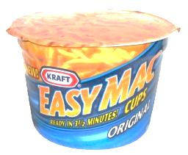


BFS Traversal Pseudocode (WRONG)
A
B
create an empty Queue
enequeue the starting node
while (the queue is not empty)
{
dequeue a node: “it”
for each neighbor of “it”
{
enqueue the neighbor
}
}
C
D
A. Looks good to me!
B. I see a problem! C. I see a solution!
it
it
it
it
it
A
B
D
D
C
C
A

Slide 27
BFS Traversal Pseudocode (Fixed)
Don’t look at your handout
create an empty Queue
enqueue the starting node
mark starting node as inTheQueue
while (the queue is not empty)
{
dequeue a node: “it”
for each neighbor of “it”
{
if (neighbor is not inTheQueue)
{
enqueue the neighbor
mark neighbor as inTheQueue
}
}
}
Mark node as “inTheQueue” or “visited” when we put it into the Queue
Would we have the same problem with a Stack?

Slide 28

Search for Spam!
Sample Input
class Maze
6 10
**********
*S* *
* * *
* ** *
* *D *
**********
class MazeCell
**********
*S* *
*o* oooo *
*oooo**o *
* *Do *
**********
class Maze
{
private MazeCell[][] maze;
Sample solution
Notes:
I don’t know if this really works...

Slide 29
Maze and MazeCell
col
col
col
col
col
col
0
1
2
3
4
5
class MazeCell
{
private int row;
private int col;
private char contents;
private boolean visited;
private MazeCell parent;
MazeCell(int row, int col, char c)
{
this.row = row;
this.col = col;
this.contents = c;
this.visited = false;
this.parent = null;
}
}
row
0
row
1
row
2
row
'D'
'S'
3
row
' '
4
row
'*'
'*'
5
Here are the available characters:
'S' = Start Spam Seeking
'*' = Wall!
'D' = Delectible Dinner Destination
' ' = Open Space
Notes:
I don’t know if this really works...

Slide 30
Demo Naming Conventions
 | D |  | S
 | K | A | B | C
 | D | I | S | E
 | J | H | G | F
 |  |  | L
Name all cells so we can refer to them in the demos!
'S' = Start Spam Seeking
'D' = Delectible Dinner Destination

Slide 31
 | K | A | B | C
 | D | I | S | E
 | J | H | G | F
 |  |  | L
create an empty Stack
push the starting node
mark starting node as visited
while (the stack is not empty)
{
pop a node: “it”
for each neighbor of “it”
{
if (neighbor is not visited)
{
push the neighbor
mark neighbor as visited
set parent of neighbor
if (neighbor is D){
DONE!!! } }
}
}
5
DEMO
&& not wall
A. Looks good to me!
B. I see a problem! C. I see a solution!
2nd
1st
3rd
4th
A | B | C | D | E | F | G | H | I | J | K | L | S

Slide 32
 | K | A | B | C
 | D | I | S | E
 | J | H | G | F
 |  |  | L

Slide 33
DFS Traversal (Stack) Solutions:
 | K | A | B | C
 | D | I | S | E
 | J | H | G | F
 |  |  | L
2nd
1st
3rd
4th
 |  |  |  |  |  |  |  |  |  | L
 |  |  |  |  |  |  |  |  | F | F | F
 |  |  |  |  |  | G |  | H | H | H | H | H |  | J
 |  |  |  |  | E | E | E | E | E | E | E | E | E | E | E
 |  |  |  | B | B | B | B | B | B | B | B | B | B | B | B
 | S |  | I | I | I | I | I | I | I | I | I | I | I | I | I
Stack begins here!
 | A | B | C | D | E | F | G | H | I | J | K | L | S
Visited? |  | T |  |  | T | T | T | T | T | T |  | T | T
Order visited |  |  |  |  |  | 3rd | 1st | 4th |  | 5th |  | 2nd | 0th
Parent |  |  |  | J |  | G | S | G |  | H |  | G

Slide 34
Stack Based (DFS) vs. Queue Based (BFS)
create an empty Stack
push the starting node
mark starting node as visited
while (the stack is not empty)
{
pop a node: “it”
for each neighbor of “it”
{
if (neighbor is not visited)
{
push the neighbor
mark neighbor as visited
set parent of neighbor
if (neighbor is D){
DONE!!! } }
}
}
create an empty Queue
enqueue the starting node
mark starting node as visited
while (the queue is not empty)
{
dequeue a node: “it”
for each neighbor of “it”
{
if (neighbor is not visited)
{
enqueue the neighbor
mark neighbor as visited
set parent of neighbor
if (neighbor is D){
DONE!!! } }
}
}

Slide 35
 | K | A | B | C
 | D | I | S | E
 | J | H | G | F
 |  |  | L
create an empty Queue
enqueue the starting node
mark starting node as visited
while (the queue is not empty)
{
dequeue a node: “it”
for each neighbor of “it”
{
if (neighbor is not visited)
{
enqueue the neighbor
mark neighbor as visited
set parent of neighbor
if (neighbor is D){
DONE!!! }}}}
DEMO
2nd
1st
3rd
4th
&& not wall
A | B | C | D | E | F | G | H | I | J | K | L | S

Slide 36
 | K | A | B | C
 | D | I | S | E
 | J | H | G | F
 |  |  | L

Slide 37
BFS Traversal (Queue) Solutions:
 | K | A | B | C
 | D | I | S | E
 | J | H | G | F
 |  |  | L
5
Queue begins here!
S
I
I | B
I | B | E
I | B | E | G
B | E | G
2nd
1st
3rd
4th
 | A | B | C | D | E | F | G | H | I | J | K | L | S
Visited? |  | T |  |  | T |  | T |  | T |  |  |  | T
Parent |  | S |  | I | S |  | S |  | S

Slide 38
BFS Traversal (Queue) Solutions (different order)
 | K | A | B | C
 | D | I | S | E
 | J | H | G | F
 |  |  | L
Queue begins here!
5
S
B
B | E
B | E | G
B | E | G | I
E | G | I
E | G | I | C
E | G | I | C | A
G | I | C | A
G | I | C | A | F
I | C | A | F
I | C | A | F | L
I | C | A | F | L | H
C | A | F | L | H
1st
4th
2nd
3rd
 | A | B | C | D | E | F | G | H | I | J | K | L | S
Visited | T | T | T |  | T | T | T | T | T |  |  | T | T
Parent | B | S | B | I | S | E | S | G | S |  |  | G

Slide 39
Stack Based (DFS) vs. Queue Based (BFS)
5
Which is better smaller (better)?
Speed of search?
1) DFS 2) BFS 3) Depends
Memory use?
1) DFS 2) BFS 3) Depends
Length of final path?
1) DFS 2) BFS 3) Depends

Slide 40
BONUS

Slide 41


Slide 42


Computer
Science
&
= AWESOME

Slide 43

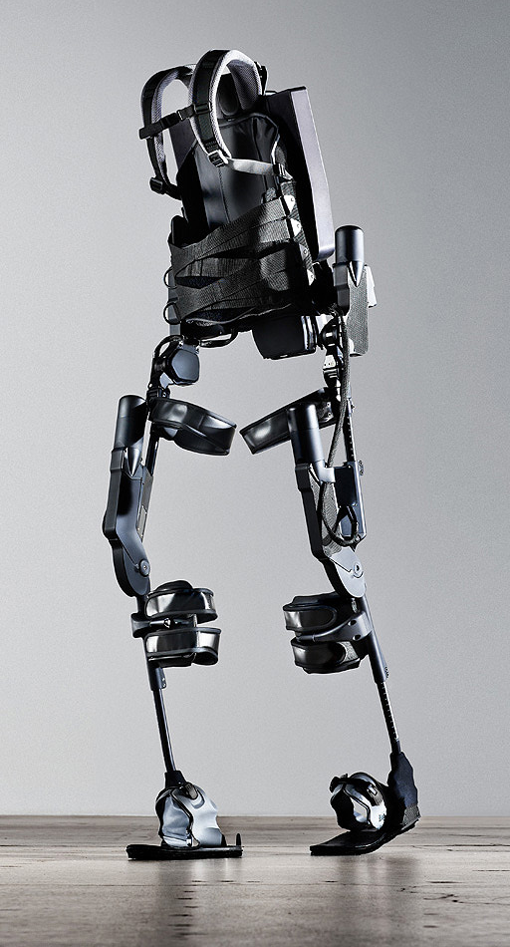
http://www.youtube.com/watch?v=pzRmNYA8LlY

Slide 44


ClickStart

Slide 45
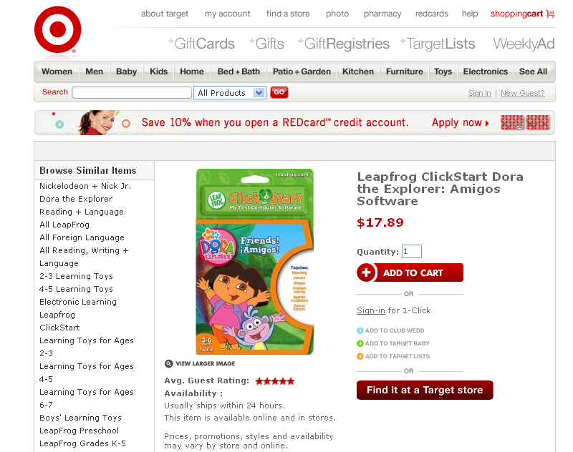

Slide 46
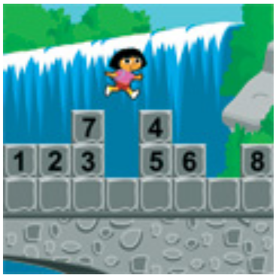
How should we represent the blocks in the computer?
Independent variables
2D Array
OpenList
I don’t know

Slide 47
The value in the array tells me what art asset to use
Each level is really a 3x10 vector!
0 | 0 | 7 | 0 | 4 | 0 | 0 | 0
1 | 2 | 3 | -4 | 5 | 6 | -7 | 8
B | B | B | B | B | B | B | B
Negative values tell me what block needs to go here to win!

Slide 48
0 | 0 | 7 | 0 | 4 | 0 | 0 | 0
1 | 2 | 3 | -4 | 5 | 6 | -7 | 8
0 | 0 | 0 | B | 0 | 0 | 0 | 0

Slide 49
BUGS!

Slide 50
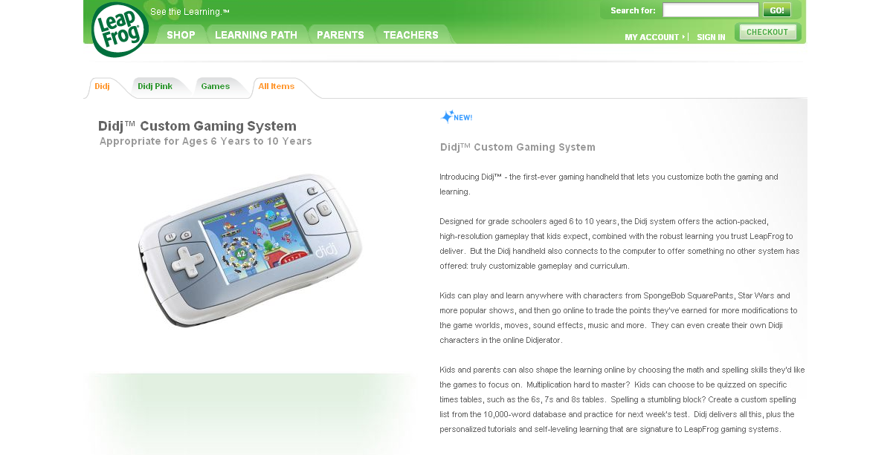

Slide 51

It is really sad when stuff you’ve made is on sale!

Slide 52
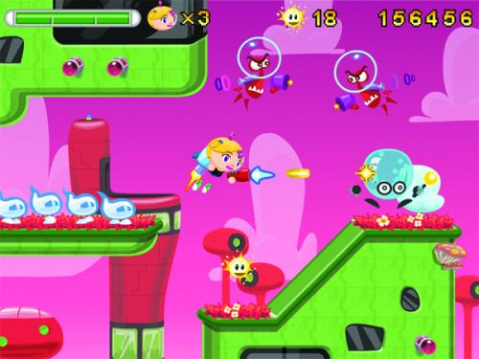
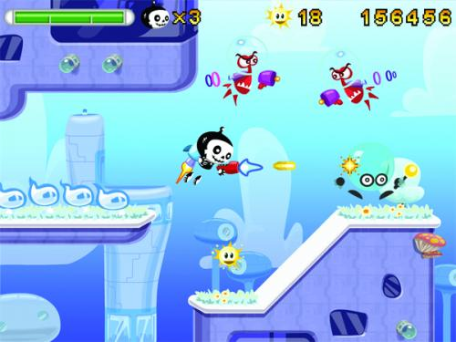

Which image is fake?
A. Top Left
B. Bottom Left
C. Bottom Right

Slide 53
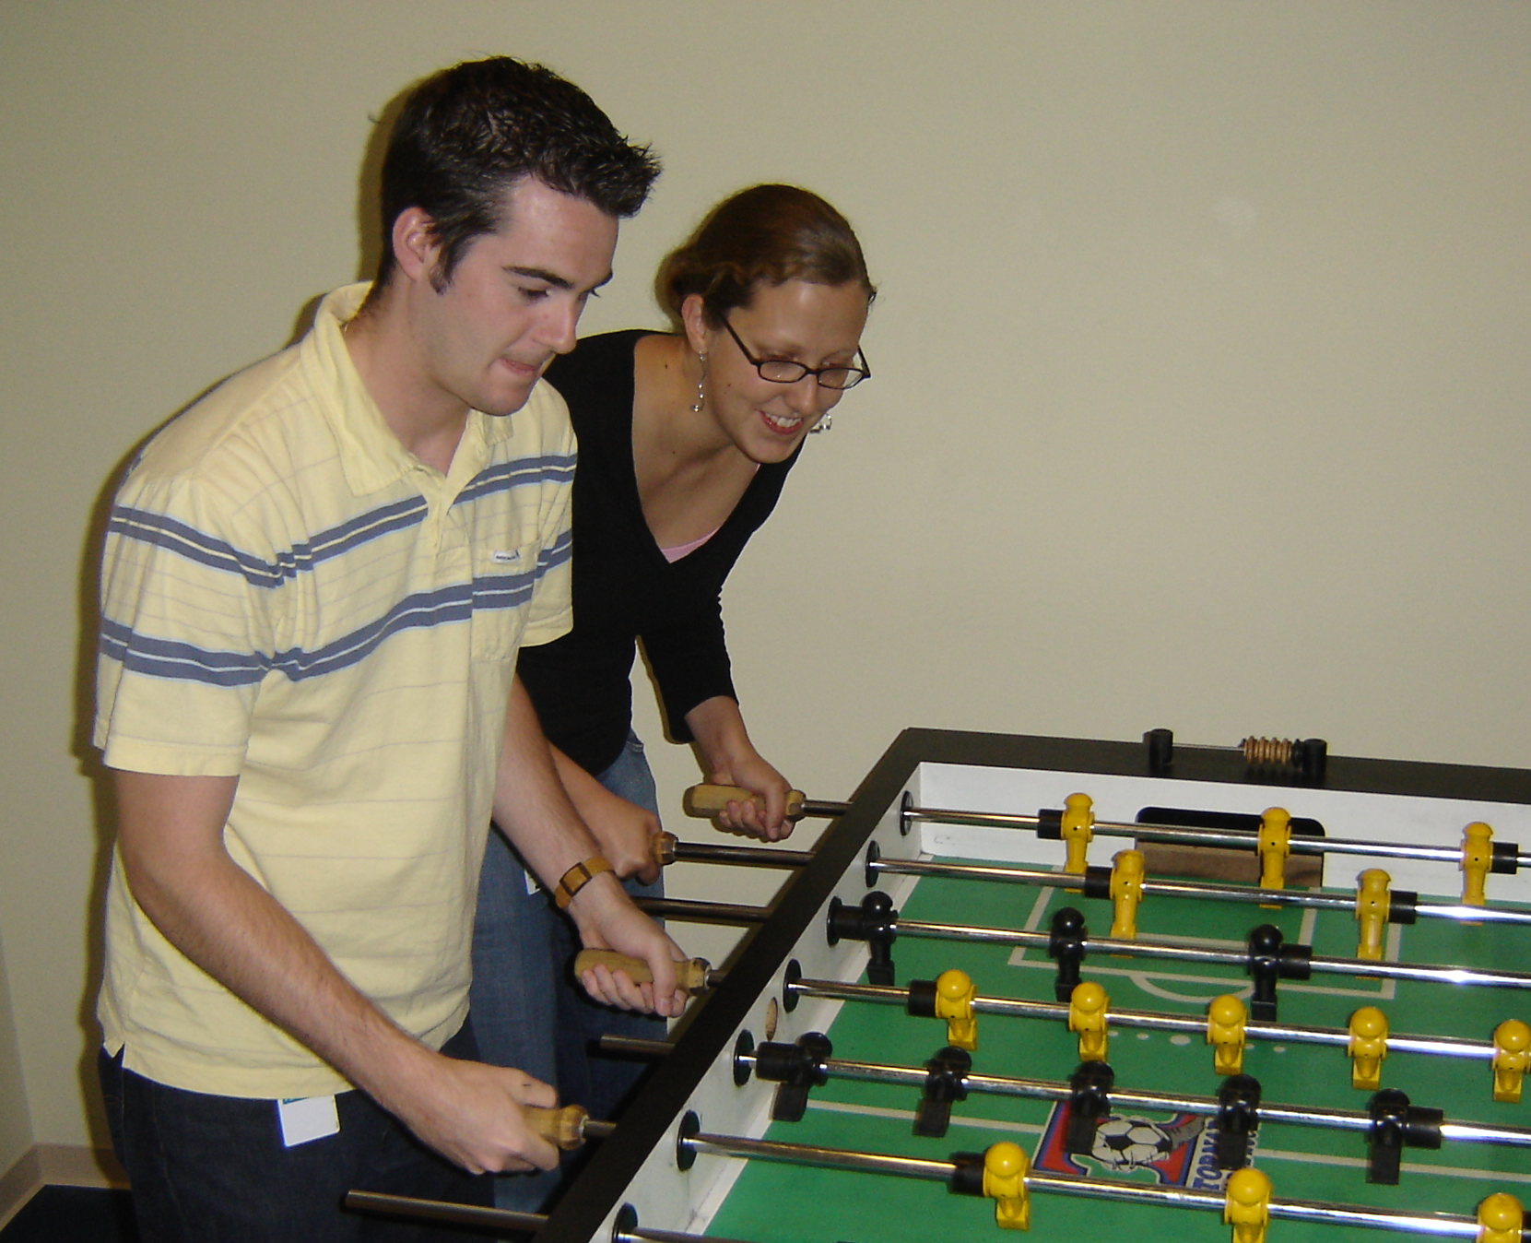

Slide 54
