Slide 1
CS 60
Parsing Wrap-up
+ Spampede
2014-11-24
Monday – Week 12
Lecture 23

Slide 2
Lecture 23 – Learning Goals
Be able to trace BFS and DFS in a graph.
Describe the inheritance (is-a) and composition (has-a) relationships used in Spampede.
Describe the benefits of avoiding “magic numbers” by using constants.

Slide 3
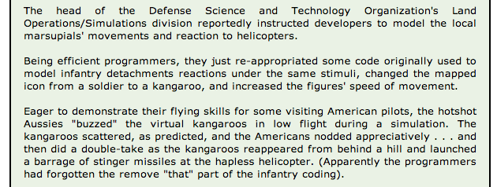
Dangers of Inheritance…
Goal: create a useful & representative data model
A derived class extends all of the capabilities of a base class… !

Slide 4
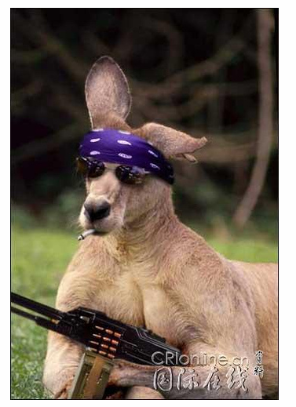

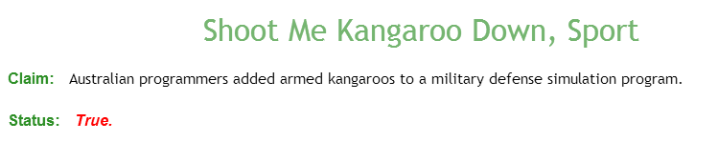
Dangers of Inheritance…
Goal: create a useful & representative data model
A derived class extends all of the capabilities of a base class… !

Slide 5
DFS/BFS

Slide 6
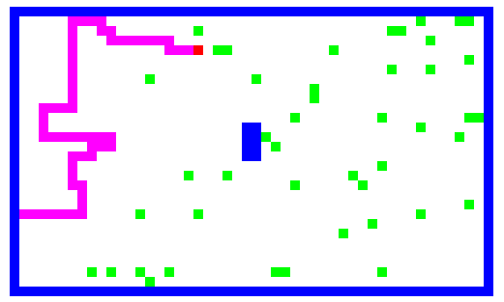
the Maze class stores the maze and can find paths within its model of the maze
Key Idea:
Notes:
other differences: the tail of the centipede the PEDE cells are like walls, too
what if: there is no solution!!

Slide 7
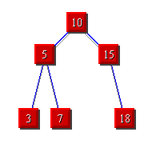
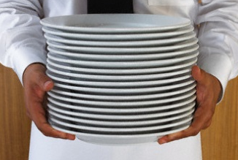

Breadth First Search (BFS)
3
Depth
First Search (DFS)
STACKS
QUEUES

Slide 8
Searching

Slide 9
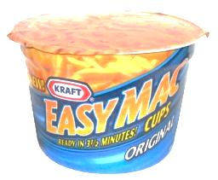


BFS Traversal Pseudocode (WRONG)
A
B
create an empty Queue
enequeue the starting node
while (the queue is not empty)
{
dequeue a node: “it”
for each neighbor of “it”
{
enqueue the neighbor
}
}
C
D
A. Looks good to me!
B. I see a problem! C. I see a solution!
it
it
it
it
it
A
B
D
D
C
C
A

Slide 10
BFS Traversal Pseudocode (Fixed)
Don’t look at your handout
create an empty Queue
enqueue the starting node
mark starting node as inTheQueue
while (the queue is not empty)
{
dequeue a node: “it”
for each neighbor of “it”
{
if (neighbor is not inTheQueue)
{
enqueue the neighbor
mark neighbor as inTheQueue
}
}
}
Mark node as “inTheQueue” or “visited” when we put it into the Queue
Would we have the same problem with a Stack?

Slide 11
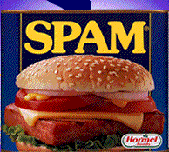
Search for Spam!
Sample Input
class Maze
6 10
**********
*S* *
* * *
* ** *
* *D *
**********
class MazeCell
**********
*S* *
*o* oooo *
*oooo**o *
* *Do *
**********
class Maze
{
private MazeCell[][] maze;
Sample solution
Notes:
I don’t know if this really works...

Slide 12
Maze and MazeCell
col
col
col
col
col
col
0
1
2
3
4
5
class MazeCell
{
private int row;
private int col;
private char contents;
private boolean visited;
private MazeCell parent;
MazeCell(int row, int col, char c)
{
this.row = row;
this.col = col;
this.contents = c;
this.visited = false;
this.parent = null;
}
}
row
0
row
1
row
2
row
'D'
'S'
3
row
' '
4
row
'*'
'*'
5
Here are the available characters:
'S' = Start Spam Seeking
'*' = Wall!
'D' = Delectible Dinner Destination
' ' = Open Space
Notes:
I don’t know if this really works...

Slide 13
Demo Naming Conventions
 | D |  | S
 | K | A | B | C
 | D | I | S | E
 | J | H | G | F
 |  |  | L
Name all cells so we can refer to them in the demos!
'S' = Start Spam Seeking
'D' = Delectible Dinner Destination

Slide 14
 | K | A | B | C
 | D | I | S | E
 | J | H | G | F
 |  |  | L
create an empty Stack
push the starting node
mark starting node as visited
while (the stack is not empty)
{
pop a node: “it”
for each neighbor of “it”
{
if (neighbor is not visited)
{
push the neighbor
mark neighbor as visited
set parent of neighbor
if (neighbor is D){
DONE!!! } }
}
}
5
Stack
&& not wall
A. Looks good to me!
B. I see a problem! C. I see a solution!
2nd
1st
3rd
4th
 | A | B | C | D | E | F | G | H | I | J | K | L | S
Visited?
Parent

Slide 15
DFS Traversal (Stack) Solutions:
 | K | A | B | C
 | D | I | S | E
 | J | H | G | F
 |  |  | L
2nd
1st
3rd
4th
 |  |  |  |  |  |  |  |  |  | L
 |  |  |  |  |  |  |  |  | F | F | F
 |  |  |  |  |  | G |  | H | H | H | H | H |  | J
 |  |  |  |  | E | E | E | E | E | E | E | E | E | E | E
 |  |  |  | B | B | B | B | B | B | B | B | B | B | B | B
 | S |  | I | I | I | I | I | I | I | I | I | I | I | I | I
Stack begins here!
 | A | B | C | D | E | F | G | H | I | J | K | L | S
Visited? |  | T |  |  | T | T | T | T | T | T |  | T | T
Order visited |  |  |  |  |  | 3rd | 1st | 4th |  | 5th |  | 2nd | 0th
Parent |  |  |  | J |  | G | S | G |  | H |  | G

Slide 16
Stack Based (DFS) vs. Queue Based (BFS)
create an empty Stack
push the starting node
mark starting node as visited
while (the stack is not empty)
{
pop a node: “it”
for each neighbor of “it”
{
if (neighbor is not visited)
{
push the neighbor
mark neighbor as visited
set parent of neighbor
if (neighbor is D){
DONE!!! } }
}
}
create an empty Queue
enqueue the starting node
mark starting node as visited
while (the queue is not empty)
{
dequeue a node: “it”
for each neighbor of “it”
{
if (neighbor is not visited)
{
enqueue the neighbor
mark neighbor as visited
set parent of neighbor
if (neighbor is D){
DONE!!! } }
}
}

Slide 17
 | K | A | B | C
 | D | I | S | E
 | J | H | G | F
 |  |  | L
create an empty Queue
enqueue the starting node
mark starting node as visited
while (the queue is not empty)
{
dequeue a node: “it”
for each neighbor of “it”
{
if (neighbor is not visited)
{
enqueue the neighbor
mark neighbor as visited
set parent of neighbor
if (neighbor is D){
DONE!!! }}}}
2nd
1st
3rd
4th
&& not wall
 | A | B | C | D | E | F | G | H | I | J | K | L | S
Visited?
Parent
Queue

Slide 18
BFS Traversal (Queue) Solutions:
 | K | A | B | C
 | D | I | S | E
 | J | H | G | F
 |  |  | L
5
Queue begins here!
S
I
I | B
I | B | E
I | B | E | G
B | E | G
2nd
1st
3rd
4th
 | A | B | C | D | E | F | G | H | I | J | K | L | S
Visited? |  | T |  |  | T |  | T |  | T |  |  |  | T
Parent |  | S |  | I | S |  | S |  | S

Slide 19
BFS Traversal (Queue) Solutions (different order)
 | K | A | B | C
 | D | I | S | E
 | J | H | G | F
 |  |  | L
Queue begins here!
5
S
B
B | E
B | E | G
B | E | G | I
E | G | I
E | G | I | C
E | G | I | C | A
G | I | C | A
G | I | C | A | F
I | C | A | F
I | C | A | F | L
I | C | A | F | L | H
C | A | F | L | H
1st
4th
2nd
3rd
 | A | B | C | D | E | F | G | H | I | J | K | L | S
Visited | T | T | T |  | T | T | T | T | T |  |  | T | T
Parent | B | S | B | I | S | E | S | G | S |  |  | G

Slide 20
Inheritance Review

Slide 21
Why these designs?
Reuse!
Containment
Inheritance
using existing classes as data members
extending classes that are already written
Part-of
Kind-of
Has-a
Is-a

Slide 22
Data design #1: part-of
Has-a
There are two basic relationship types that Java models:
(1) the part-of relationship
containment or embedding
a Pixel is part of a Picture
a MazeCell is part of a Maze
a char (the contents) is part of a MazeCell
class Picture
{
private Pixel[][] pix;
class Maze
{
MazeCell[][] maze;
class MazeCell
{
private int row;
private int col;
private char contents;
private boolean visited;
Notes:
last line is key … it's really extension!

Slide 23
Data design #2: kind-of
Is-a
There are two basic relationship types that Java models:
(1) the kind-of relationship
extensions
Kind-of
a String is a kind of an Object
"Inheritance"
a Maze is an Object
"is-a"!
a Spampede is a JApplet
class String
extends Object
{
private char[] data;
class Maze
extends Object
{
MazeCell[][] maze;
class Spampede
extends JApplet
{
Notes:
last line is key … it's really extension!

Slide 24
Containment
Inheritance
vs.
What is it?
Has-a
Is-a
part-of relationship
kind-of relationship
When to use it?
to contain ("wrap")
to extend capabilities
to constrain capabilities
to specialize capabilities
(tricky here…)
Why would I want to?
Code reuse
Lets new code call old code
Code reuse
Lets old code call new code
Notes:
this week's new Maze class will use your Queue class from last week
this week's new SpamMaze class will use a linked list that someone else wrote years ago…!
you – or someone – wrote a linked list class… now let's use it as a data member (or two or more)…

Slide 25
Visual overviews of inheritance
Capabilities (and memory)
Derived Class
Student
Person
Person
Base Class
or Sub-Class
or Super-Class
Base Class
or Super-Class
A Student is-a Person - and more!
Student
Identity
Derived Class
or Sub-Class
Base Class
or Super-Class
Derived Class
Person
or Sub-Class
Our hierarchy
Student
"Only some Persons are Students"

Slide 26
Spampede Overview

Slide 27
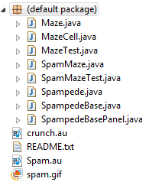
Spampede Files

Slide 28
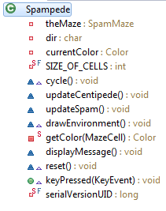
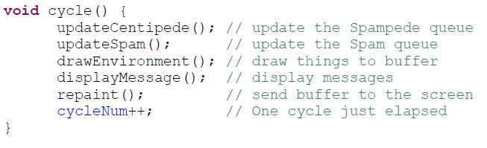
Spampede
Called every frame!
You write this stuff
Called when a key is pressed (update dir)

Slide 29


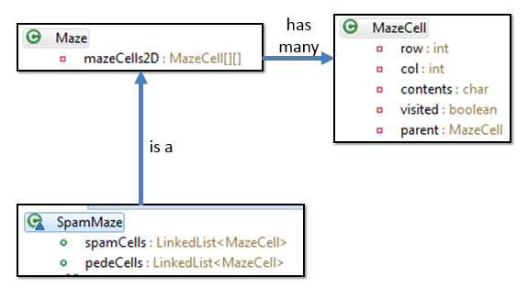
Full class structure
Ok to ignore!
Ok to ignore!
has one
is a
has one

Slide 30
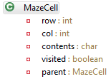
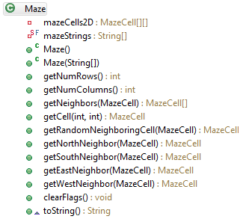
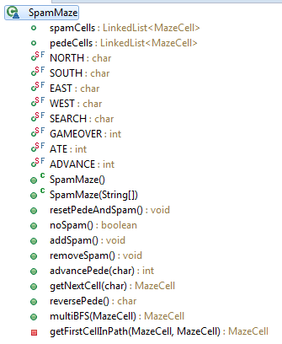
Data Model
has many
is a
class-design diagram
(UML)

Slide 31
Maze has a MazeCell[][]
Nothing too
crazy here…
clearFlags()
Clears visited and parent for all MazeCells after running BFS.

Slide 32
SpamMaze extends Maze
Instance variables
Modes for pede movement
Possible results of movement
Constructors & Initialization
Spam updating
Pede movement

Slide 33
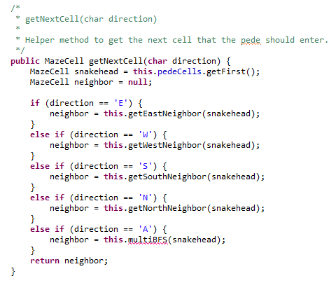
getNextCell
current direction
Should be updated to use constants
(see next slide)
leveraging the capabilities of the base class, Maze
this is the AI – its goal is to find the next cell to move!

Slide 34

Avoid magic !
magic numbers, magic strings, magic stuff in general…
Data constants make code easier to read and modify, e.g.,
even Prof. B. agrees...
public static final char SPAM = 'D';
public static final char START = 'S';
public static final char WALL = '*';
public static final char PEDE = 'P';
these are unchangeable values for use in functions, etc. Preface with class name, if needed…
This BFS looks different to me…
BFS( start, Maze.SPAM );

Slide 35
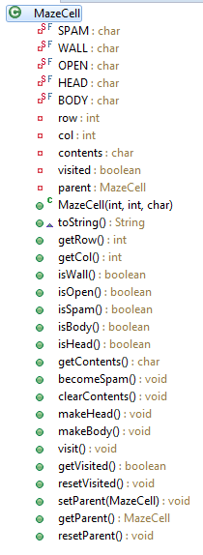
MazeCell
Types of contents
Instance variables
Constructor, toString, access row and column info
Methods to inspect contents
Methods for doing BFS:
visited:
avoid infinite loops parent:
retrace path
Methods to modify contents

Slide 36
Today's inheritance tree
Java's GUI classes
Component
Checkbox
Choice
TextComponent
Button
Container
List
TextArea
TextField
Window
Panel
Applet
Frame
Dialog
JApplet
This seemed like the right place for me…
SpampedeBase
Spampede

Slide 37
Object
wait()
Reuse via inheritance
notify()
get reused, too!
public void requestFocus()
Component
reusing base-classes' methods
public void addKeyListener()
public void repaint()
Container
public void paint()
public void add(Component c)
Panel
public void addNotify()
JApplet
public void init()
overriding of base-classes' methods
SpampedeBase
public void init()
Spampede

Slide 38
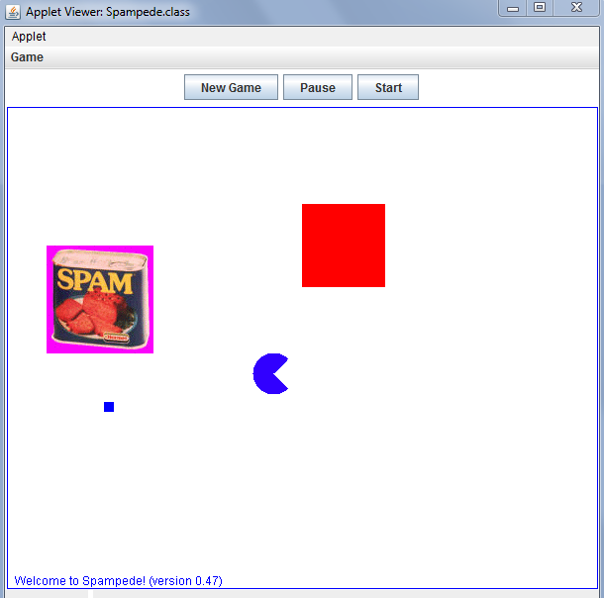
Spampede, as provided...
Menu
Buttons
(42,142)
(100,300)
Arc Man?
message
Panel/drawing canvas

Slide 39
Spampede Demo

Slide 40

Keep track of spam and your pede

Slide 41
cycle()

Slide 42
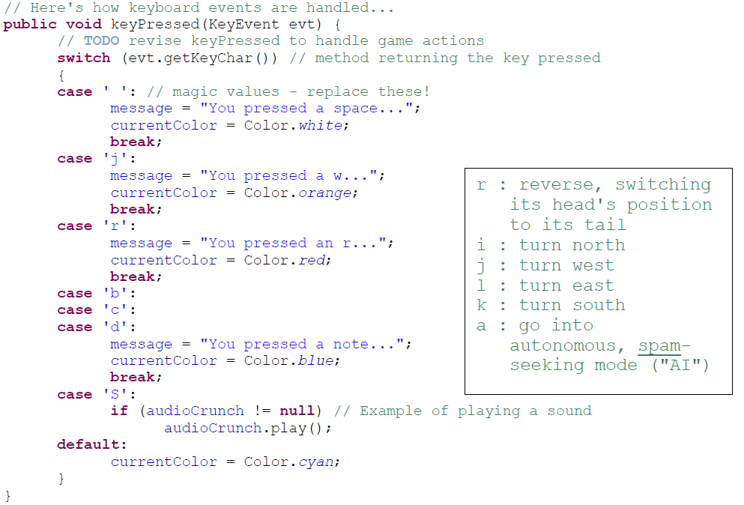
A separate thread will handle key presses

Slide 43

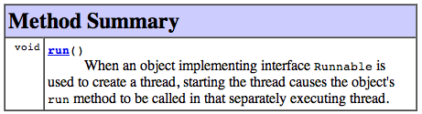
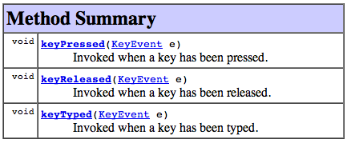
Interfaces enable event handling...
class SpampedeBase extends JApplet implements ActionListener, KeyListener, Runnable
"this object can handle button presses..."
"this object can run in a separate thread"
handles button presses...
"this object can handle key presses..."
A Java interface is a TYPE but not a class. By implementing it, you guarantee that you will include certain methods.
Then, other code - library code or other users' code - can rely on those methods being present!

Slide 44
Quiz
Code Treasure Hunt! try your luck; catch the adventure!
Name(s): ___________________
1) Start by looking over Spampede's data members...
1a) What is the NAME of the data member of type SpamMaze?
1b) What is the TYPE of this.dir? By the way, what is the type of this?
1c) Find where currentColor, and dir, get declared and then get assigned…
1d) Find where image, g, and cycleNum, get declared and then get assigned…
2) Find cycle and then find each method that cycle calls
3) Find the code that is drawing the small blue square ...
4) What do you think the four input arguments to fillRect(int,int,int,int) mean?
5) Trickier: do you think the arguments to fillArc(250,250,42,42,45,270) mean?
6) What keypress produces a hearty, spam-consuming crunch sound?
7) What keypress leads to drawing the large square blue? Are there others?
8) EXTRA! What's the longest time it could take for the large square to return to magenta color?
8b) EXTRA! How could you change the inputs to fillArc to create a PacMan-like animation?

Slide 45


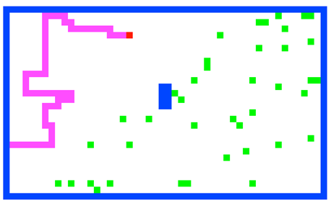

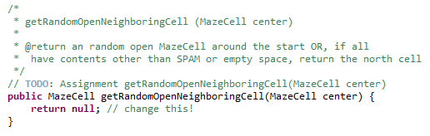
Maze and MazeCell classes
Model
to write…
The Maze is a 2d array of MazeCells.

Slide 46
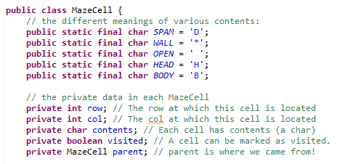


MazeCell
Different characters represent different cell contents
data for the AI…
many methods already written:

Slide 47
Java's LinkedList<E>
LinkedList<MazeCell> spamCells;
spamCells = new LinkedList<MazeCell>();
it's a crazy name, but it's a class just like all of Java's others…
It supports add/remove/peek on either side:
spamCells.addFirst(mc);
spamCells.removeFirst(mc);
spamCells.peekFirst()
spamCells.addLast(mc);
spamCells.removeLast(mc);
spamCells.peekLast()

Slide 48
Don't wait!
Incremental changes are key!
code
test
code
test
code
test
...
CODE
TEST
closing in on a solution
concentrated despair phase

Slide 49
Spampede: overview & AI
Notes:
Java's libraries are comprehensive and huge… [POSTER] – two versions ago
We don't teach them explicitly, actually, but it's always good to keep in mind that they're there…
story about balance (Lenovo's Mr. Challener)

Slide 50
Let's zoom in on the Game AI…
' '
'S'
'D'
We need to get from 'S' to 'D'
and then find our way back…
Notes:
Java's libraries are comprehensive and huge… [POSTER] – two versions ago
We don't teach them explicitly, actually, but it's always good to keep in mind that they're there…
story about balance (Lenovo's Mr. Challener)

Slide 51
Spampede's AI is maze-solving
class Maze
class MazeCell
This maze looks kinda easy to me…
How is this is the same as Spampede's AI?
Notes:
I don’t know if this really works...

Slide 52
Search!
(1) Place the start into a data structure of some sort
(2) While the data structure is not empty…
(2a) Remove the next cell
(2b) Check if it's the goal!
(2c) If so, we're done!
(2d) If not, keep going: add its neighbors to the data structure!
Notes:
Java's libraries are comprehensive and huge… [POSTER] – two versions ago
We don't teach them explicitly, actually, but it's always good to keep in mind that they're there…
story about balance (Lenovo's Mr. Challener)

Slide 53
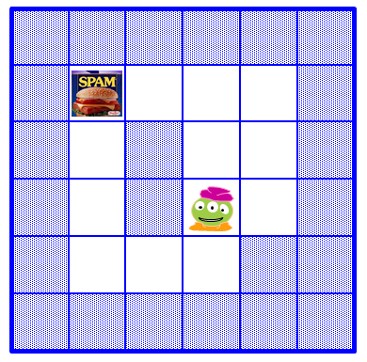
Search!
(1) Place the start into a data structure of some sort
(2) While the data structure is not empty…
(2a) Remove the next cell
(2b) Check if it's the goal!
(2c) If so, we're done!
(2d) If not, keep going: add its neighbors to the data structure!
Notes:
Java's libraries are comprehensive and huge… [POSTER] – two versions ago
We don't teach them explicitly, actually, but it's always good to keep in mind that they're there…
story about balance (Lenovo's Mr. Challener)

Slide 54
Parent and visited!
col
col
col
col
col
col
0
1
2
3
4
5
class MazeCell
{
private int row;
private int col;
private char contents;
private boolean visited;
private MazeCell parent;
MazeCell(int row, int col, char c)
{
this.row = row;
this.col = col;
this.contents = c;
this.visited = false;
this.parent = null;
}
public String toString()
{
return "[" + row + "," +
col + "," +
contents + "]";
}
}
row
0
row
'D'
1
row
2
row
'S'
3
row
' '
4
row
'*'
'*'
5
I was wondering why that was 'S' and 'D'!
'S' = Start Spam Seeking
'*' = Wall!
'D' = Delectible Dinner Destination
' ' = Open Space
Notes:
I don’t know if this really works...

Slide 55
The Stack:
top
Depth-First Search (DFS)…
1
3
2
4
uses a Stack to hold the fringe of cells still to be explored…
NEWS order
D
bottom
C
B
L
E
A
K
S
F
J
3
G
H
I
2
4
1
SWNE order?
Notes:
I don’t know if this really works...

Slide 56
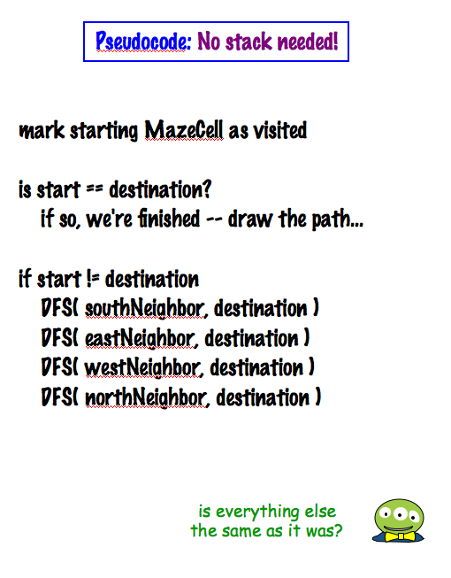
Recursive DFS!
other base cases…
D
S
Is everything the same as before?
‘S’ = Start
‘D’ = Destination
Is there really no stack here?
Notes:
I don’t know if this really works...

Slide 57
Try Breadth-First Search (BFS)…
Name(s) _____________________________
1
3
2
Draw the parents, the visited cells, and the Queue in each step of a breadth-first search from S to D…
4
uses a Queue to hold the fringe, instead of DFS's Stack.
NEWS order
The Queue:
back
front
time
D
C
B
L
E
A
K
S
F
J
G
H
I
Extra: Which is better? DFS or BFS ~ in terms of (a) the path found, (b) memory used, (c) time used
Notes:
I don’t know if this really works...

Slide 58
DFS vs. BFS ?
DFS is search using a Stack to hold the fringe.
BFS is search using a Queue to hold the fringe.
Which search approach is "better" in terms of
i.e., more efficient
(1) the path found
(2) memory use
(by the data structure)
(3) time required
Notes:
Java's libraries are comprehensive and huge… [POSTER] – two versions ago
We don't teach them explicitly, actually, but it's always good to keep in mind that they're there…
story about balance (Lenovo's Mr. Challener)

Slide 59
Search algorithm details…
(0) Be sure all MazeCells are marked unvisited! (clearFlags)
(1) Place the start MazeCell into a data structure of some sort
F
C
B
L
(2) While the data structure is not empty…
E
A
K
(2a) Remove the next MazeCell
D
S
(2b) Check if it's the goal!
J
(2c) If so, find the path back to the start & we're done!
G
H
I
(2d) If not, check all of the neighbors – for each not-yet-visited open neighbor, mark it as visited, set its parent, and add it!
another BFS path result…
Notes:
Java's libraries are comprehensive and huge… [POSTER] – two versions ago
We don't teach them explicitly, actually, but it's always good to keep in mind that they're there…
story about balance (Lenovo's Mr. Challener)

Slide 60
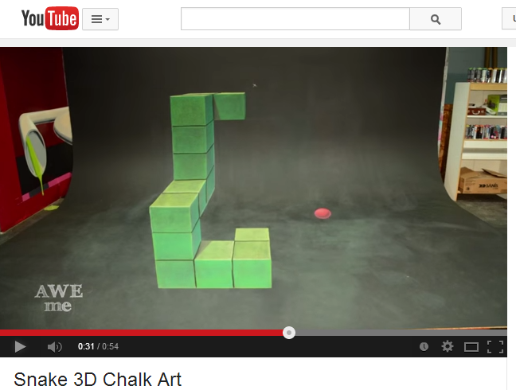
Is this BFS or DFS?!
I can't decide if it's 2d or 3d!
Perhaps it's CFS: chalk-first search?!

Slide 61
Implementation…
{
this.clearFlags();
Queue<MazeCell> cellsToVisit = (provided)
cellsToVisit.add( start );
while …
public MazeCell multiBFS( MazeCell start, char goal )
(0) Be sure all MazeCells are marked unvisited! (clearFlags)
(1) Place the start MazeCell into a data structure of some sort
(2) While the data structure is not empty…
(2a) Remove the next MazeCell
(2b) Check if it's the goal!
(2c) If so, find the path back to the start & we're done!
(2d) If not, check all of the neighbors – for each not-yet-visited open neighbor, mark it as visited, set its parent, and add it!
Notes:
Java's libraries are comprehensive and huge… [POSTER] – two versions ago
We don't teach them explicitly, actually, but it's always good to keep in mind that they're there…
story about balance (Lenovo's Mr. Challener)

Slide 62
 | K | A | B | C
 | D | I | S | E
 | J | H | G | F
 |  |  | L

Slide 63
BONUS

Slide 64
 | K | A | B | C
 | D | I | S | E
 | J | H | G | F
 |  |  | L

Slide 65
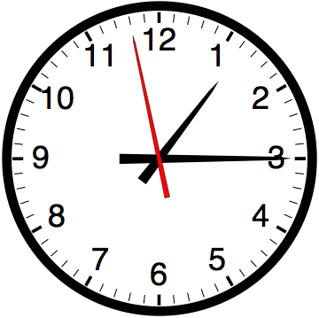

Slide 66


Computer
Science
&
= AWESOME

Slide 67
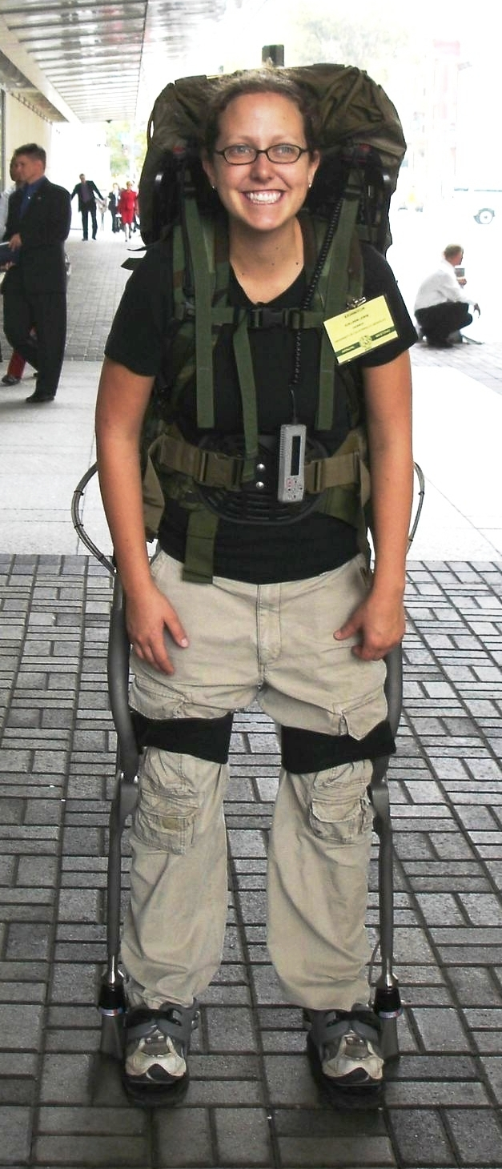
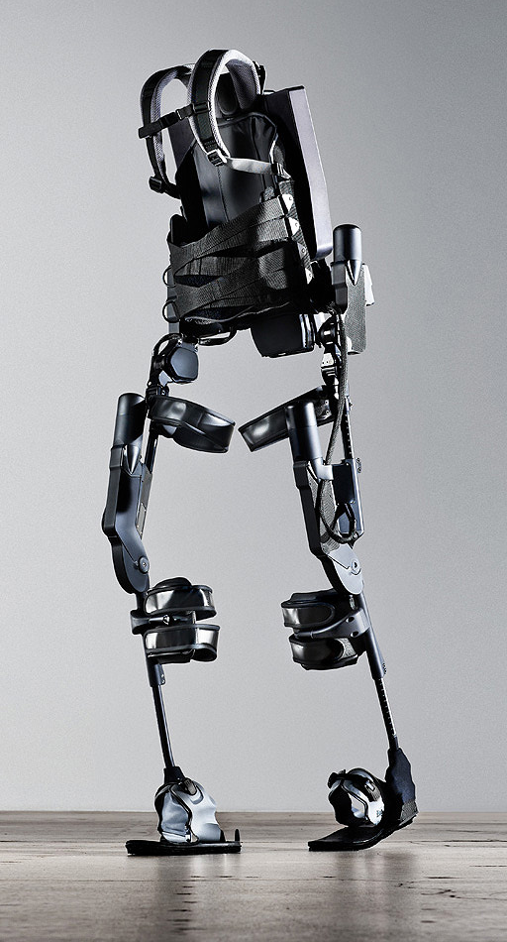
http://www.youtube.com/watch?v=pzRmNYA8LlY

Slide 68

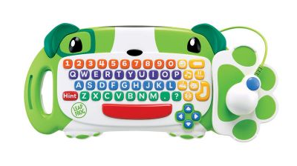
ClickStart

Slide 69
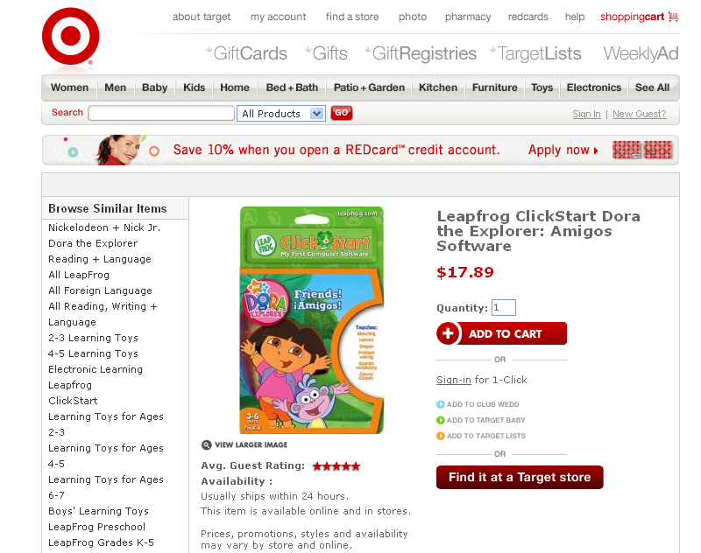

Slide 70
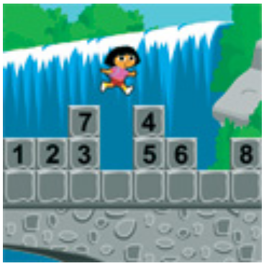
How should we represent the blocks in the computer?
Independent variables
2D Array
OpenList
I don’t know

Slide 71
The value in the array tells me what art asset to use
Each level is really a 3x10 vector!
0 | 0 | 7 | 0 | 4 | 0 | 0 | 0
1 | 2 | 3 | -4 | 5 | 6 | -7 | 8
B | B | B | B | B | B | B | B
Negative values tell me what block needs to go here to win!

Slide 72
0 | 0 | 7 | 0 | 4 | 0 | 0 | 0
1 | 2 | 3 | -4 | 5 | 6 | -7 | 8
0 | 0 | 0 | B | 0 | 0 | 0 | 0

Slide 73
BUGS!

Slide 74
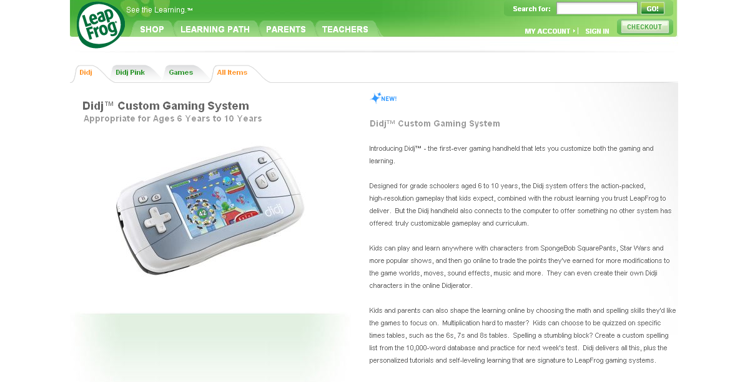

Slide 75
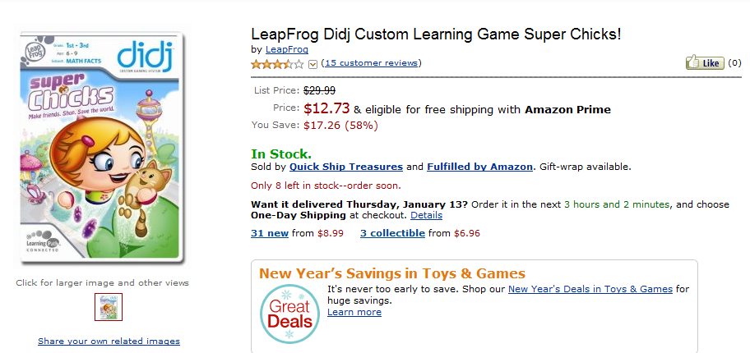
It is really sad when stuff you’ve made is on sale!

Slide 76
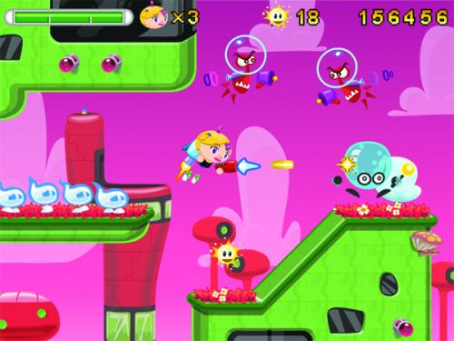
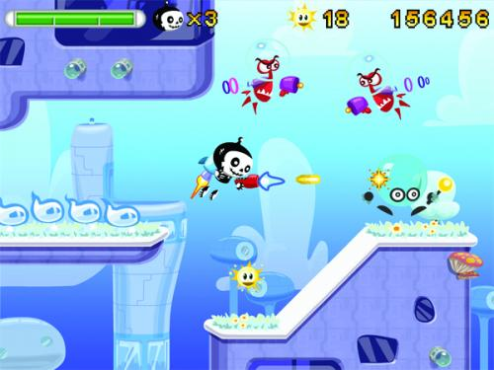
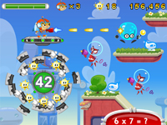
Which image is fake?
A. Top Left
B. Bottom Left
C. Bottom Right

Slide 77
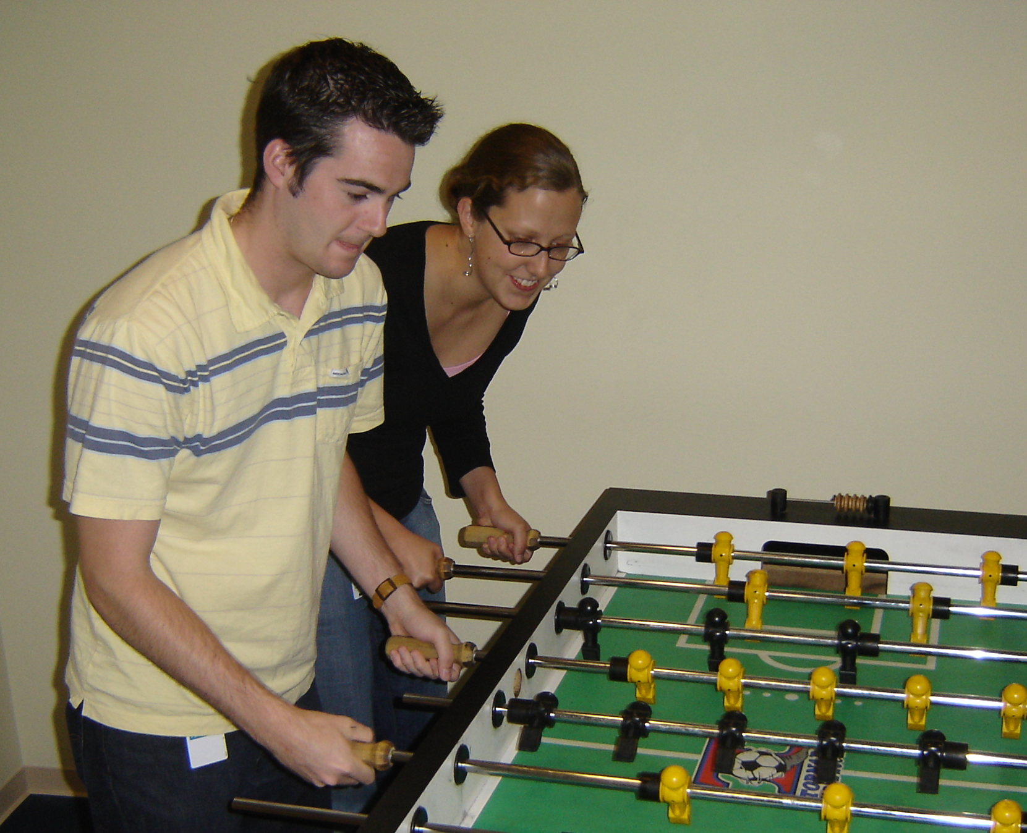

Slide 78
