Slide 1
Prolog's progress...
Dr. Prolog, P.I.T.'s newest faculty member
Prolog gets Professorship at P.I.T.
(Pasadena, AP): Prolog has been appointed a professor of computer science at the Pasadena Institute of Technology (P.I.T.). “Dr. Prolog appears to have an extraordinarily keen intellect,” said a dean at P.I.T. Although we didn't meet Dr. Prolog in person, we did conduct an interview through an unusual text-based dialog. Dr. Prolog's answers to our questions were extremely concise but always correct.
"During our online interview, we were a bit confused by Dr. Prolog's punctuation habits – and all the warnings about ‘singletons.’ We assumed that Dr. Prolog is simply very social and dislikes working in isolation – we're certain that Dr. Prolog will be a wonderful addition to our community." When asked if Dr. Prolog had any comments on this new position, the answer was simply “false.”
Notes:
Zachary Quinto -- Spock

Slide 2
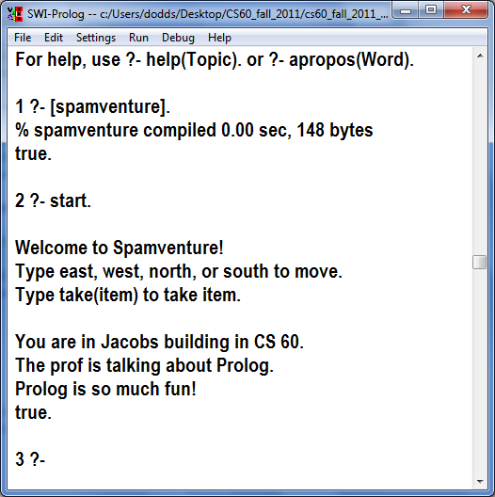
Welcome back to CS60!
spamventure.pl
Hw #5, due 3/3
logic.pl
Logic-based analysis
The adventures of Prolog!
Java!
Getting Java and Eclipse running
anticipating the next assignment…
Takehome midterm next week
Hw #6 will be due Fri. 3/14
Our path has been twisty…
path(A, A, _ [A]).
base case
lose it
path(A, B, [_|R], Path) :- path( A, B, R, Path).
use it
path(A, B, [[X,Y]|R], Path) :- path(A, X, R, PAX),
path(Y, B, R, PBY), append(PAX, PBY, Path).

Slide 3
CS 60 midterm: Racket and Prolog
study guide online and on Tuesday
Pick up from Olin B163 starting Wed. 3/5
Take in a single two-hour block by Sat. 3/8
Written or typed (may use editor … but don't run things)
Page of notes (best way to study: create notes; review hwks)
Individually done (worth one assignment)
No other CS60 deadlines until Friday, 3/14 (hw6)

Slide 4
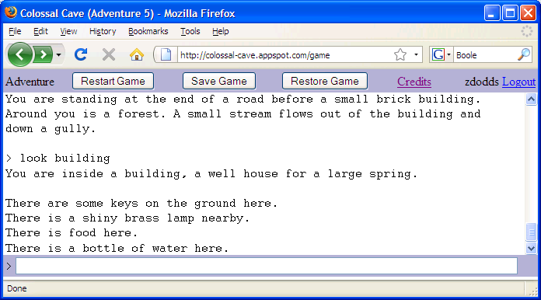
Adventure: the first interactive fiction game
You are in a twisting maze of little passages, all different.
You are in a maze of twisting little passages, all different.
You are in a little maze of twisting passages, all different.
Text Mazes!
You are in a maze of twisty little passages, all alike.
You are in a maze of twisty little passages, all alike.
You are in a maze of twisty little passages, all alike.

Slide 5
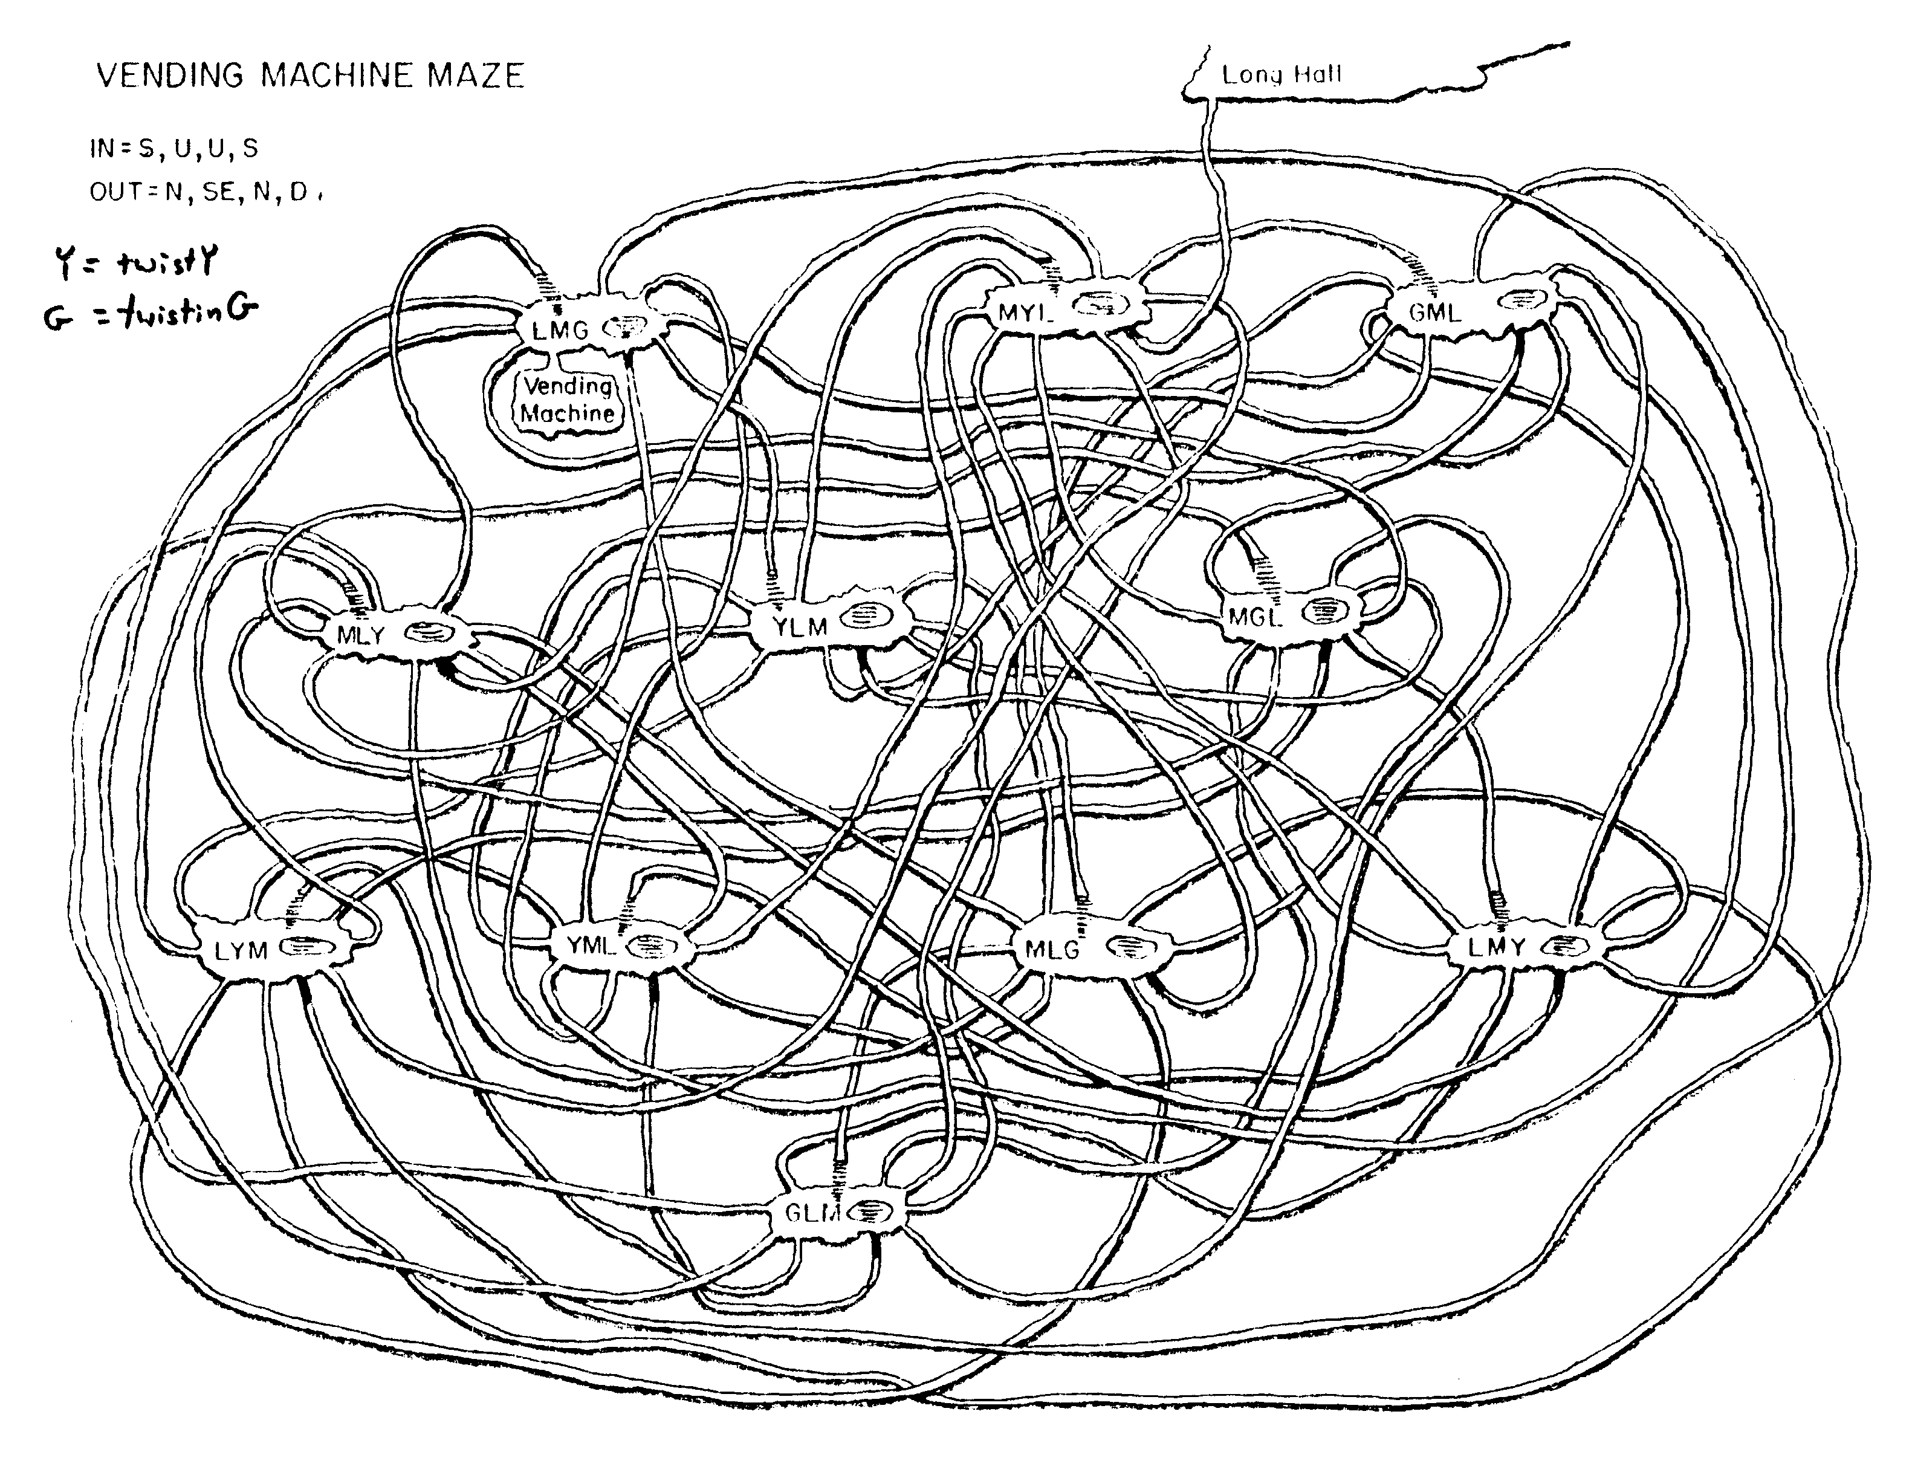
Try ESC-x dunnet within emacs…
At last!

Slide 6
Spamventure!
Example
To be added…
a goal + instructions
at least 6 locations
at least 4 items
needing to use an item
fix item descriptions
inventory.
drop (like take)
no more than 2 items in_hand
an additional feature
how to win! (so that we can...)
west
parsons
platt
east
south
north
south
north
key
spam
west
east
jacobs
west_dorm
items
locations

Slide 7
Dynamic predicates
:- dynamic player_at/1.
retract( player_at(pryne) ).
assert( player_at(parsons) ).
you must declare a predicate dynamic in order to add or remove Prolog facts
this will REMOVE player_at(pryne) from Prolog's knowledge base
this will ADD player_at(parsons) to Prolog's knowledge base

Slide 8
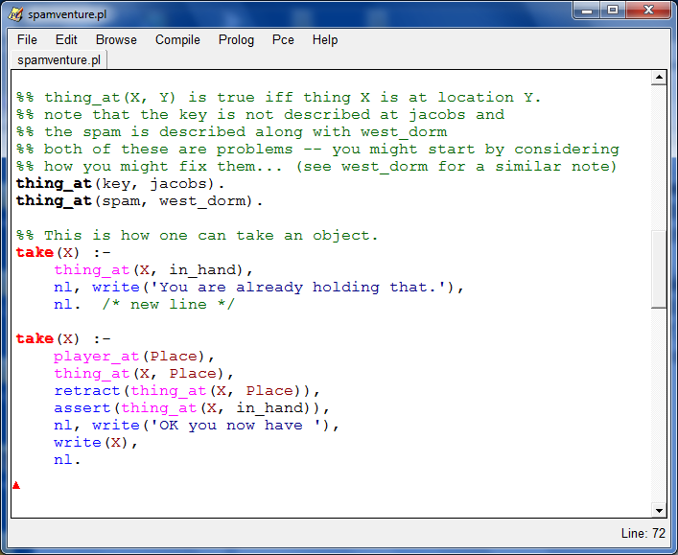
take a look…
How take(X). works...
How might inventory. work?

Slide 9
Quiz: succeeding with fail.
Name(s): ____________________________
Given the foo facts to the left, what will Prolog output to the two queries to the right?
Note that fail forces Prolog to consider that it has failed to meet the overall goal …
You should assume the user does NOT type a semicolon in order to get more values..
% Three foo facts!
foo(chris).
foo(taylor).
foo(dave).
% The 'good' and the 'bad':
bad :-
foo(X), write('foo: '),
write(X), nl.
good :-
foo(X), write('foo: '),
write(X), nl,
fail.
% Two foo queries:
?- bad.
?- good.
Is there anything we might do to make good better?

Slide 10
take a look…
inventory :-
this predicate will help!
How might inventory. work?

Slide 11

Eric warns!
write('Don't do this!').

Slide 12
Good luck with Spamventure!
write('Don\'t do this!').

Slide 13
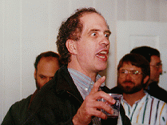
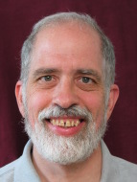
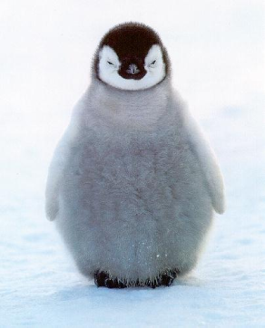
CS 5 black reunion
Tues., Mar. 4 and Tues. Mar. 11, we'll have a reunion of CS5 black: your CS60 will be in Shan B442 on Mar. 4.
Your host!
I'll be there!
We won't mention that this is also a CS5 gold reunion… But CS5-gold-appropriate snacks will be provided!

Slide 14

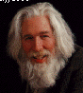
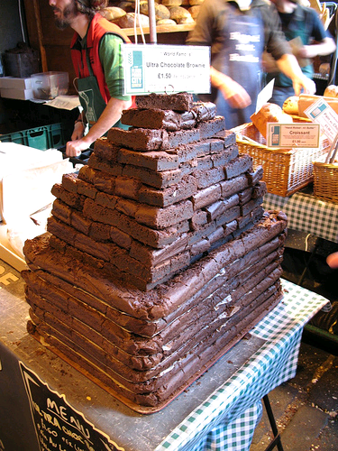
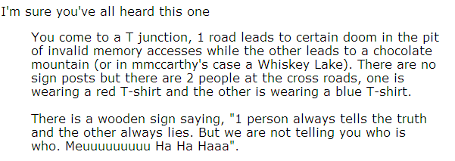
Truth-telling vs. Lying?
One is a knight – who always tells the truth.
One is a knave – who always lies (tells falsehoods).
Raymond Smullyan
Putting the logic into logic programming…

Slide 15
Truth-telling vs. Lying?
One is a knight – who always tells the truth.
One is a knave – who always lies (tells falsehoods).
Raymond Smullyan
Ask one of them, "Which path would the other one say leads to the chocolate?"
then, take the path NOT answered!

Slide 16
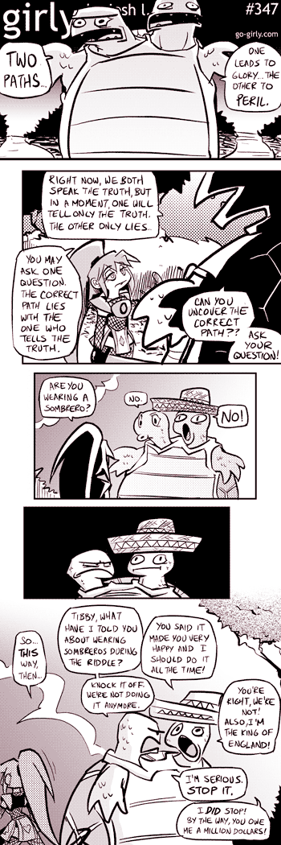
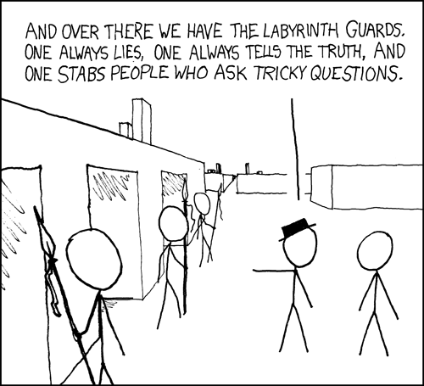
xkcd
Labyrinth, 1986
girly

Slide 17
Logical functions are all computation
Here are all logical functions from 2 bits of input to 1 bit of output
Inputs
this and #10 have the most names!
Outputs
Function number
x
y
0
1
2
3
4
5
6
7
8
9
10
11
12
13
14
15
0
0
0
0
0
0
0
0
0
0
1
1
1
1
1
1
1
1
0
1
0
0
0
0
1
1
1
1
0
0
0
0
1
1
1
1
1
0
0
0
1
1
0
0
1
1
0
0
1
1
0
0
1
1
1
1
0
1
0
1
0
1
0
1
0
1
0
1
0
1
0
1
6?
9?
13?
Which of these are familiar?
and what are their names?

Slide 18
Evaluating logical statements
Truth tables for familiar logical operators:
and
or
Inputs
Output
Inputs
Output
x
y
[and, x, y]
x
y
[or, x, y]
0
0
0
0
0
0
0
1
0
0
1
1
1
0
0
1
0
1
1
1
1
1
1
1
What about not?

Slide 19
Evaluating logical statements
Truth tables for less familiar logical operators:
iff
ifthen
Inputs
Output
Inputs
Output
x
y
[iff, x, y]
x
y
[ifthen, x, y]
0
0
1
0
0
1
0
1
0
0
1
1
1
0
0
1
0
0
1
1
1
1
1
1
This one seems crazy…
who we can blame?
Do we really need these?

Slide 20
ifthen
true
false
42 == 42
42 == 47
ifthen
Inputs
Output
x
y
[ifthen, x, y]
0
0
1
if
42 == 42
then
42 == 42
0
1
1
1
0
0
This blue statement is true.
1
1
1

Slide 21
ifthen
true
false
42 == 42
42 == 47
ifthen
Inputs
Output
x
y
[ifthen, x, y]
0
0
1
if
42 == 42
then
42 == 47
0
1
1
1
0
0
This blue statement is false.
1
1
1

Slide 22
ifthen
I blame the mathematicians !
true
false
42 == 42
42 == 47
ifthen
Inputs
Output
x
y
[ifthen, x, y]
0
0
1
if
42 == 47
then
anything
0
1
1
1
0
0
This blue statement is true!
1
1
1
(0) We need to show that, given 42==47, we can prove anything is true.
Proof:
(1) Presume we're given that 42==47.
(2) Assume that anything is false.
(by contradiction)
(3) Contradiction! namely, 42 == 47. Thus, anything is true.
(4) Done: If 42==47, then anything.

Slide 23
ifthen
true
false
42 == 42
42 == 47
ifthen
Inputs
Output
x
y
[ifthen, x, y]
0
0
1
if
42 == 47
then
42 == 47
0
1
1
1
0
0
This blue statement is true!
1
1
1
Not a general proof, but on one level it does seem obvious!

Slide 24

Surviving with logic!
at least on the Island of Knights and Knaves…
asks A, "What type are you?"
logical variable!
<mumble>
A
"A said that she is a knave"
B
"All three of us are knaves."
C
Each of A, B, and C is either a knight or a knave.

Slide 25
Evaluating logical expressions
All statements in predicate logic can be classified as
t/f expressions that may include variables
true, regardless of the values of any variables ("mumbles")
tautology
Knights speak only these...
if it can be made true (or it's already true)
satisfiable
Humans can say anything...
false, regardless of the values of any variables
unsatisfiable
Knaves speak only these...

Slide 26
Example logical expressions
Here are two examples of each kind of expression:
in prolog's form for Exprs!
t
tautology
[or, t, 1]
1
satisfiable
[or, 2, 1]
What's an unsatisfiable statement that includes a variable?
f
unsatisfiable
[ifthen, t, f]

Slide 27
Which are which?
tautology
true, regardless of the values of any variables
satisfiable
if it can be made true or is already true.
[iff, f, [not, f]]
unsatisfiable
false, regardless of the values of any variables
[or, 1, [not, 1]]
Which type is each of these five expressions?
[not 2]
here, in our Prolog representation…
[ifthen, f, [not, 1]]
[ifthen, 1, [ifthen, 2, 1]]
What is an algorithm for determining whether a logical expression is a tautology, satisfiable, or unsatisfiable?
- and what's its big-O run time?

Slide 28
Example tautology
true, regardless of the values of any variables ("mumbles")
tautology
Knights speak only these...
<mumble #1> OR (not <mumble #1>)
[or, 1, [not 1]]

Slide 29
Tougher talk !?
1 (2 1)
What islanders could make this statement?
implies
implies
If <mumble #1> then [if <mumble #2> then <mumble #1>]
[ifthen, 1, [ifthen, 2, 1]]
What algorithmic approach might we use to identify this statement?

Slide 30
Boole/Shannon expansion
1 (2 1)
What islanders could make this statement?
implies
implies
[ifthen, 1, [ifthen, 2, 1]]
[ifthen, t, [ifthen, 2, t]]
[ifthen, f, [ifthen, 2, f]]
(1) Choose a variable.
Algorithm:
(2) Replace it both ways!

Slide 31
Boole/Shannon expansion
1 (2 1)
What islanders could make this statement?
implies
implies
[ifthen, 1, [ifthen, 2, 1]]
[ifthen, t, [ifthen, 2, t]]
[ifthen, f, [ifthen, 2, f]]
[ifthen, t, [ifthen, t, t]]
[ifthen, f, [ifthen, t, f]]
[ifthen, t, [ifthen, f, t]]
[ifthen, f, [ifthen, f, f]]
recurse!
What's the base case?

Slide 32
Boole/Shannon expansion
1 (2 1)
What islanders could make this statement?
implies
implies
[ifthen, 1, [ifthen, 2, 1]]
[ifthen, t, [ifthen, 2, t]]
[ifthen, f, [ifthen, 2, f]]
[ifthen, t, [ifthen, t, t]]
[ifthen, f, [ifthen, t, f]]
[ifthen, t, [ifthen, f, t]]
[ifthen, f, [ifthen, f, f]]
t
t
t
t
Tautology!

Slide 33
hw 5, problem #2
id( Expr, Speaker ).
human
This could be
knight
This will be a fully-instantiated parse tree of logical operators, truth literals, and integers representing logical variables.
knave
Your id predicate should be able to both check and generate appropriate types…
id( 1, Who ).
Demo!
id( [ifthen, 1,[ifthen, 2, 1], Who ).
important pieces?
base cases?
id( [and, 2, [not, 2]], Who ).

Slide 34
Getting started…
f
1
[not,t]
[iff,1,2]
[and,1,[not,1]]
Here are five example Exprs
noVars( Expr )
noVars should be true when Expr has no (logical) variables. It does not need to generate Expr, only check it.
noVars( f ).
Base Cases
noVars( t ).
"SubExpression"
noVars( [ not, SE ] ) :-
noVars(
What will the 2nd recursive case look like?

Slide 35
Getting a variable…
I guess you'd call these prological expressions
f
1
[not,t]
[iff,1,2]
[and,1,[not,1]]
Here are five example Exprs
getVar( Expr, N )
getVar should be true when Expr does have a (logical) variable. It should bind N to an integer that represents one such (logical) variable.
Base Case
getVar( N, N ) :- number( N ).
if N is a number, then N is a variable (for our Prolog expressions, this is true!)
getVar( [ not, SE ], N ) :-
getVar(
Extra! How could we use noVars to make getVar faster?

Slide 36
Not only of theoretical interest…
Inputs
Outputs
Function number
x
y
0
1
2
3
4
5
6
7
8
9
10
11
12
13
14
15
0
0
0
0
0
0
0
0
0
0
1
1
1
1
1
1
1
1
0
1
0
0
0
0
1
1
1
1
0
0
0
0
1
1
1
1
1
0
0
0
1
1
0
0
1
1
0
0
1
1
0
0
1
1
1
1
0
1
0
1
0
1
0
1
0
1
0
1
0
1
0
1

Slide 37
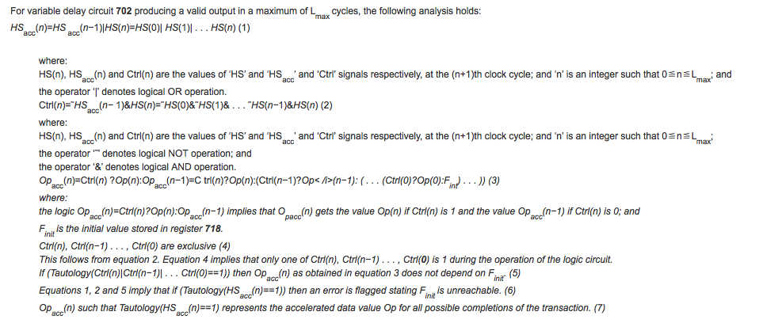
tautologies for... circuit simplification
a subroutine for minimizing circuit complexity…

Slide 38
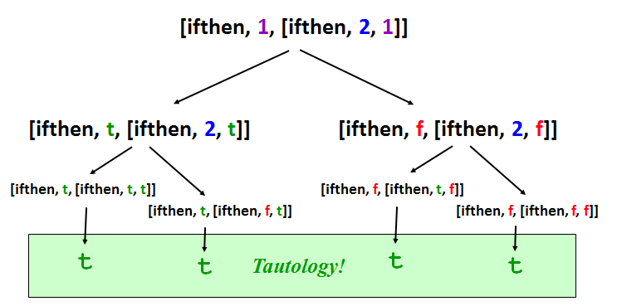
tautologies for... $1,000,000
Big-O for this week's tautology-checking algorithm?
O( )
There is a $1m bounty for EITHER
a polynomial algorithm
OR
a proof that none exists

Slide 39
Curry's Paradox
(a variation of it…)
If this sentence is true, then aliens rule the universe.
ifthen
Inputs
Output
x
y
[ifthen, x, y]
0
0
1
0
1
1
Just because it's a paradox, doesn't mean it's not true!
1
0
0
1
1
1

Slide 40
What's next?
:- dynamic cs60topic/1.
retract( cs60topic(prolog) ).
assert( cs60topic(java) ).
Have an adventurous and satisfiable weekend!

Slide 42
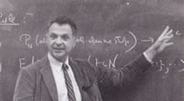
tautologies for... math truths (proofs)
x or y = y or x
Definition of a Boolean Algebra
(x or y) or z = x or (y or z)
!(!x or y) or !(!x or !y) = x
What’s this?
???
Definition of a Robbins Algebra
!(!(x or y) or !(x or !y)) = x
Herbert Robbins (1933)
Are these equivalent structures?
(This is actually Robbins in 1966.)

Slide 43

tautologies for... math truths (proofs)
x or y = y or x
Definition of a Boolean Algebra
(x or y) or z = x or (y or z)
!(!x or y) or !(!x or !y) = x
Yes!
Definition of a Robbins Algebra
!(!(x or y) or !(x or !y)) = x
Herbert Robbins (1933)
Proof: by EQP, 1996

Slide 44
Robbins algebras are Boolean
----- EQP 0.9, June 1996 -----
The job began on eyas09.mcs.anl.gov, Wed Oct 2 12:25:37 1996
UNIT CONFLICT from 17666 and 2 at 678232.20 seconds.
---------------- PROOF ----------------
2 (wt=7) [] -(n(x + y) = n(x)).
3 (wt=13) [] n(n(n(x) + y) + n(x + y)) = y.
5 (wt=18) [para(3,3)] n(n(n(x + y) + n(x) + y) + y) = n(x + y).
6 (wt=19) [para(3,3)] n(n(n(n(x) + y) + x + y) + y) = n(n(x) + y).
24 (wt=21) [para(6,3)] n(n(n(n(x) + y) + x + y + y) + n(n(x) + y)) = y.
47 (wt=29) [para(24,3)] n(n(n(n(n(x) + y) + x + y + y) + n(n(x) + y) + z) + n(y + z)) = z.
48 (wt=27) [para(24,3)] n(n(n(n(x) + y) + n(n(x) + y) + x + y + y) + y) = n(n(x) + y).
146 (wt=29) [para(48,3)] n(n(n(n(x) + y) + n(n(x) + y) + x + y + y + y) + n(n(x) + y)) = y.
250 (wt=34) [para(47,3)] n(n(n(n(n(x) + y) + x + y + y) + n(n(x) + y) + n(y + z) + z) + z) = n(y + z).
996 (wt=42) [para(250,3)] n(n(n(n(n(n(x) + y) + x + y + y) + n(n(x) + y) + n(y + z) + z) + z + u) + n(n(y + z) + u)) = u.
16379 (wt=21) [para(5,996),demod([3])] n(n(n(n(x) + x) + x + x + x) + x) = n(n(x) + x).
16387 (wt=29) [para(16379,3)] n(n(n(n(n(x) + x) + x + x + x) + x + y) + n(n(n(x) + x) + y)) = y.
16388 (wt=23) [para(16379,3)] n(n(n(n(x) + x) + x + x + x + x) + n(n(x) + x)) = x.
16393 (wt=29) [para(16388,3)] n(n(n(n(x) + x) + n(n(x) + x) + x + x + x + x) + x) = n(n(x) + x).
16426 (wt=37) [para(16393,3)] n(n(n(n(n(x) + x) + n(n(x) + x) + x + x + x + x) + x + y) + n(n(n(x) + x) + y)) = y.
17547 (wt=60) [para(146,16387)] n(n(n(n(n(x) + x) + n(n(x) + x) + x + x + x + x) + n(n(n(x) + x) + x + x + x) + x) + x)
= n(n(n(x) + x) + n(n(x) + x) + x + x + x + x).
17666 (wt=33) [para(24,16426),demod([17547])] n(n(n(x) + x) + n(n(x) + x) + x + x + x + x) = n(n(n(x) + x) + x + x + x).
------------ end of proof -------------
17,666 steps!
EQP’s output… has since been hand-checked!

Slide 45
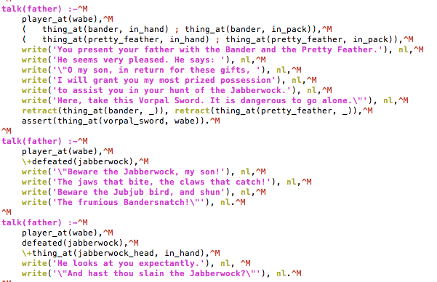
Going to Google Friday?
…from Aaron Gable's Spamventure

Slide 46
hw 5, problem #2
id( Expr, Speaker ).
human
This could be
knight
This will be a fully-instantiated parse tree of logical operators, truth literals, and integers representing logical variables.
knave
Your id predicate should be able to both check and generate appropriate types…
id( 1, Who ).
Demo!
id( [ifthen, 1,[ifthen, 2, 1], Who ).
important pieces?
base cases?
id( [and, 2, [not, 2]], Who ).

Slide 47
Helper predicates…
I guess you'd call these prological expressions
f
1
[not,t]
[iff,1,2]
[and,1,[not,1]]
Here are five example Expr trees
noVars( Expr )
noVars should be true when Expr has no (logical) variables. It does not need to generate Expr, only check it.
noVars( f ).
Base Cases
noVars( t ).
noVars( [ not, SubExpr ] ) :-
noVars(
What will the 2nd recursive case look like?

Slide 48
Helper predicates…
f
1
[not,t]
[iff,1,2]
[and,1,[not,1]]
Here are five example Expr trees
getVar( Expr, N )
getVar should be true when Expr does have a (logical) variable. It should bind N to an integer that represents one such (logical) variable.
Base Case
getVar( N, N ) :- number( N ).
true if N is a number
getVar( [ not, SubExpr ], N ) :-
getVar(
Extra! How could we use noVars to make getVar only return a single result, even when there are more variables present ?

Slide 49
If this sentence is true, then penguins rule the universe.
I don't see a paradox here!
ifthen
Inputs
Output
x
y
[ifthen, x, y]
0
0
1
0
1
1
1
0
0
1
1
1
See Curry's Paradox...
Even logicians are bothered by this – as are aliens, who really rule the universe.

Slide 50
An adventure with prolog…
Spamventure!
To be added
a goal + instructions
at least 6 locations
at least 4 items
needing to use an item
fix item descriptions
inventory.
drop (like take)
no more than 2 items in_hand
an additional feature
how to win! (so that we can...)
west
parsons
platt
east
south
north
south
north
key
spam
west
jacobs
east
west_dorm
items
locations

Slide 51
Fail!
How to succeed with fail.
Name(s): _______________
Given the foo facts to the left, what will Prolog output to the two queries to the right? Note that fail will tell Prolog that it has failed to meet the overall goal!
% Three foo facts!
foo(chris).
foo(taylor).
foo(dave).
% The 'good' and the 'bad':
bad :-
foo(X), write('foo: '),
write(X), nl.
good :-
foo(X), write('foo: '),
write(X), nl,
fail.
% Two foo queries:
?- bad.
?- good.
1
2
Is there anything we can do to make good better?

Slide 52
Hw5, problem 1
Spamventure!

Slide 53
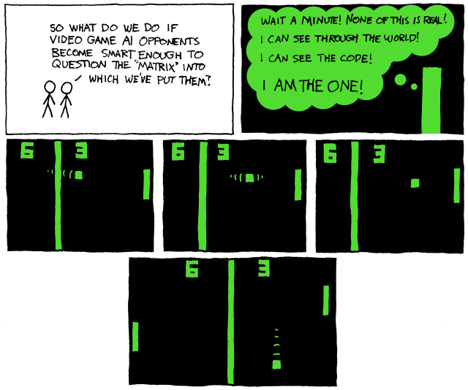
Early computer games?
Pong!

Slide 54
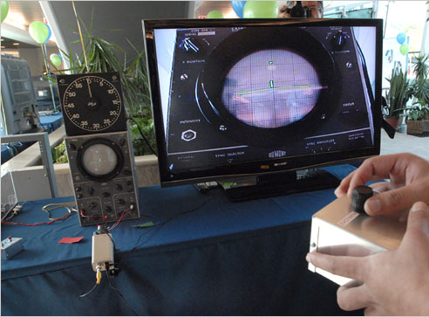
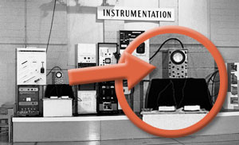
The first video game!
created to liven up lab tours in 1958
the console: an oscilloscope
only known picture of the original game
similar to pong - but with invisible paddles…
It took 4 people 3 working months to recreate the game for its 50th anniversary in 2008
tennis for two @ Brookhaven national labs
http://www.nytimes.com/2008/11/09/nyregion/long-island/09videoli.html
http://www.bnl.gov/bnlweb/history/higinbotham.asp

Slide 55
Adventure: the first interactive fiction game
You are in a twisting maze of little passages, all different.
You are in a maze of twisting little passages, all different.
You are in a little maze of twisting passages, all different.
Aargh! Mazes!
You are in a maze of twisty little passages, all alike.
Lost? Try Emacs's ESC-x dunnet
You are in a maze of twisty little passages, all alike.

Slide 56
Try ESC-x dunnet within emacs…
At last!

Slide 57
An adventure with prolog…
Spamventure!
To be added
a goal + instructions
at least 6 locations
at least 4 items
needing to use an item
fix item descriptions
inventory.
drop (like take)
no more than 2 items in_hand
an additional feature
how to win! (so that we can...)
west
parsons
platt
east
south
north
south
north
key
spam
west
jacobs
east
west_dorm
items
locations

Slide 58
Dynamic predicates
:- dynamic player_at/1.
retract( player_at(pryne) ).
assert( player_at(parsons) ).

Slide 59
What's planned for Wed.?
:- dynamic cs60topic/1.
retract( cs60topic(prolog) ).
assert( cs60topic(java) ).
Good luck prologging with hw #4!

Slide 60
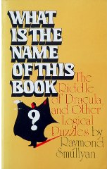
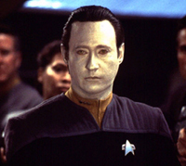

CS 60 today
Pair Spamventuring…
and submitting!
"I am not a sane knight."
knight vs. knave
sane vs. insane
this is, perhaps, obvious
(believes the truth + disbelieves falsehoods)
(vice versa)
Hw 5: Prolog finale (due Mon. 10/15/12)
id( Expression, Who ).
Office/tutoring hours as usual (Fri. 2-4)
Spamventure!
Next
(c)up:
Java!
All data structures are equal,
but some are more equal than others.
- George big-O(rwell)
Java loves me!

Slide 61
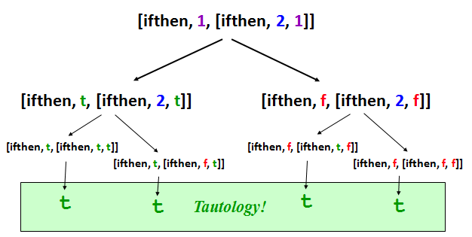
hw10pr2: The lie detector!
No - I've been framed! I'm really a knave!
Hmmm, I'm still unsatisfied.
id( Expr, Speaker ).
Key subroutines
Key strategy
getVar
taut
Use recursion!
subst
noVars
unsat
If not working, go to

Slide 62
Big-O for lie detecting?
Suppose that Expr has N distinct logical variables.
What is the big-O run time of the tautology checker?
Is it any faster to check satisfiability or unsatisfiability?
Can we do better?
O(N^{k}) ~ polynomial?

Slide 63
tautologies for... math truths (proofs)
x or y = y or x
Definition of a Boolean Algebra
(x or y) or z = x or (y or z)
!(!x or y) or !(!x or !y) = x
What’s this?
???
Definition of a Robbins Algebra
!(!(x or y) or !(x or !y)) = x
Herbert Robbins (1933)
Are these equivalent structures?
(This is actually Robbins in 1966.)

Slide 64
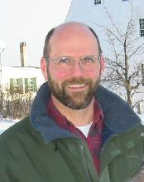
tautologies for... math truths (proofs)
x or y = y or x
Definition of a Boolean Algebra
(x or y) or z = x or (y or z)
!(!x or y) or !(!x or !y) = x
Yes!
Definition of a Robbins Algebra
!(!(x or y) or !(x or !y)) = x
Herbert Robbins (1933)
William McCune, Argonne National Lab
theorem prover, EQP
6/96

Slide 65
Java: keeping types in mind
Code is not allowed to run until the types match!
class Welcome
{
public static void main(String[] args)
{
int x = 41;
x += 1;
System.out.println("x is now " + x)
x = "Nah.";
String x = "Meh.";
x = 3.14;
double d = x;
int x = 42;
}
}
I'd say this is a plus!
Which lines will Java be upset about? Why?

Slide 66
Java: the strong and not-so-silent type
Python or Racket
Java
Statically Typed
Dynamically Typed
every variable must have its type declared, known, and CORRECT, when you compile before you run the program
each variable has its type checked during execution or run-time
There’s SAFETY in checking units!
Faster to prototype !
speed, too
Faster to run...
you're too static - and just not my type

Slide 68
“Quiz”
How to succeed with fail.
Given the foo facts to the left, what will Prolog output to the two queries to the right? Note that fail will force Prolog to consider that it has failed to meet the overall goal …
% Three foo facts!
foo(chris).
foo(taylor).
foo(dave).
% The 'good' and the 'bad':
bad :-
foo(X), write('foo: '),
write(X), nl.
good :-
foo(X), write('foo: '),
write(X), nl,
fail.
% Two foo queries:
?- bad.
?- good.
1
2
Is there anything we can do to make good better?

Slide 69
Consider logical parse trees that use the operators: or, and, iff, ifthen, and not.
I guess you'd call these prological expressions
Quiz
Name(s)____________
f
1
[not,t]
[iff,1,2]
[and,1,[not,1]]
Here are five example trees
noVars( Tree )
noVars should be true when Tree has no (logical) variables. It does not need to generate Tree, only check it.
noVars( f ).
Base Cases
noVars( t ).
noVars( [ _, T ] ) :-
noVars(
What will the 2nd recursive case look like?

Slide 70
Consider logical parse trees that use the operators: or, and, iff, ifthen, and not.
I guess you'd call these prological expressions
Quiz
Name(s)____________
f
1
[not,t]
[iff,1,2]
[and,1,[not,1]]
Here are five example trees
getVar( Tree, N )
getVar should be true when Tree does have a (logical) variable. It should bind N to an integer that represents one such (logical) variable.
getVar( N, N ) :- number( N ).
Base Case
true if N is a number
getVar(
getVar(
Extra! Try using noVars to make getVar only return a single result, even when there are more than 1 present...

Slide 71
Consider logical parse trees that use the operators: or, and, iff, ifthen, and not.
I guess you'd call these prological expressions
Quiz
noVars( Tree )
Write these two predicates
getVar( Tree, N )
Examples
noVars( [not, f] ).
true.
noVars( [or, t, 1] ).
false.
getVar( [not, 2], N ).
N = 2
getVar( [or, 1, 2], N ).
N = 1
noVars should be true when Tree has no (logical) variables. It does not need to generate Tree, only check it.
getVar should be true when Tree does have a (logical) variable. It should bind N to an integer that represents one such (logical) variable.
noVars( f ).
getVar( N, N ) :- number( N ).
Base Case
Base Cases
true if N is a number
noVars( t ).
getVar(
noVars(
getVar(
noVars(
Write a recursive case to handle each of the lengths of the possible logical expressions!
You can also use noVars to speed up getVar!

Slide 72
CS 60 this week
Human?
Knight?
Knave?
http://mysite.verizon.net/vzeeaya7/raymondsmullyan/
Finding the truth! (tautologies)
Logical Programming
CS as data-structuring
functional programming
the logical rapids of CS 60
They're an adventure!
Java!
Racket…
Hw 4: Puzzling prolog (due tonight!)
debugging riverpuzzle?!?
Hw 5: Prolog finale (due 10/15/12)
2 large-ish problems…
Extra! How fail. will help you succeed with prolog!
Why is this not surprising?

Slide 73
?- num42s( [42,3,42,42,3], N ).
N = 5
num42s( L, 0 ) :- L = [].
num42s( [42|R], N ) :- M is N-1, num42s( R, M ).
num42s( [F|R], N ) :- F \== 42, num42s(R,N).
?- nnodes( [42, [5,[],[]], []], N ).
N = 2
nnodes( [], 0 ).
nnodes( [Root|Rest], N ) :-
LN is N – RN – 1,
Rest = [L,R],
nnodes( L, LN ),
nnodes( R, RN ).
Prolog problems…
counts 42s in a list
counts nodes in a BST
Note! Use this code only as example(s) of incorrect or troublesome Prolog predicates!

Slide 74
Prolog strategies…
?- num42s( [42,3,42,42,3], N ).
N = 5
num42s( [], 0 ).
num42s( [42|R], N ) :- num42s( R, M ), N is M+1.
num42s( [F|R], N ) :- num42s(R,N), F \== 42.
?- nnodes( [42, [5,[],[]], []], N ).
N = 2
nnodes( [], 0 ).
nnodes( [Root, L, R], N ) :-
nnodes( L, LN ),
nnodes( R, RN ),
N is LN+RN+1.
use structural pattern-matching for base cases and recursive cases
is binds only right-to-left
recurse early
negative predicates as late as possible
bindings after recursion when possible

Slide 75
The Mystery of the Spamwarts Express
Five "people" are traveling home in adjacent train seats for break…
Seat 1
Seat 2
Seat 3
Seat 4
Seat 5
Names = [algird, bruno, collette, dino, edwina].
Each has a different name.
Schools = [pomona, pitzer, hmc, cmc, scripps].
Each is from a different Claremont College.
Snacks = [jots, chocolate, donuts, pez, spam].
Each has brought a different snack.
1) Dino and Bruno sat in the end seats.
2) Algird sat next to the student from HMC.
3) Collette sat next to friends with chocolate and donuts.
4) The HMC student brought spam as a snack and sat in the middle seat.
5) Chocolate was immediately to the left of pez.
6) Bruno, Dino, and Algird do not go to Scripps.
7) The Pomona student sat between the one with jots and the one with spam.
8) Dino did not sit next to the person with donuts.
9) The CMC student did not sit next to Edwina.
9 hints are available

Slide 76
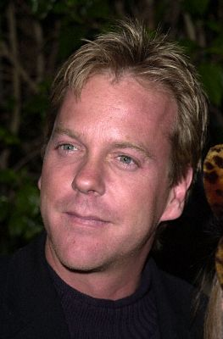
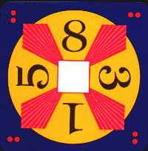
24
Can you combine these numbers into 24 with the operations + - * ÷ ?
Each operation may be used any number of times.
A two-dot card from the "official" 24 game: 24game.com
solve( [‘+’,‘-’,‘*’,‘/’], [1,3,8,5], 24, Tree ).
operators available: (use any number of times)
values:
(use each exactly once)
final answer
arithmetic tree
Tree = [+,[+,1,8],[*,3,5]]

Slide 77
24
Can you combine these numbers into 24 with the operations + - * ÷ ?
Each operation may be used any number of times.
A two-dot card from the "official" 24 game: 24game.com
solve( [‘+’,‘-’,‘*’,‘/’], [4,4,4,4], 24, Tree ).
operators available: (use any number of times)
values:
(use each exactly once)
final answer
arithmetic tree
Tree = [+,4,[+,[*,4,4],4]]

Slide 78
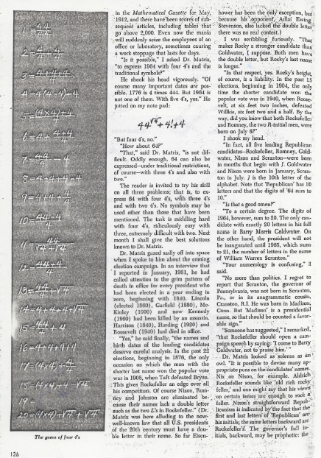
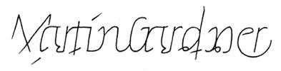
For four 4's
0 = 4 + 4 - 4 - 4
1 = 44 / 44
2 = 4
...
8 = sqrt( .4 ) * (4+4+4)
...
19 = ???
20 = 4! + 4 - 4 - 4
4/(4+4)
Ask around the math department…

Slide 79
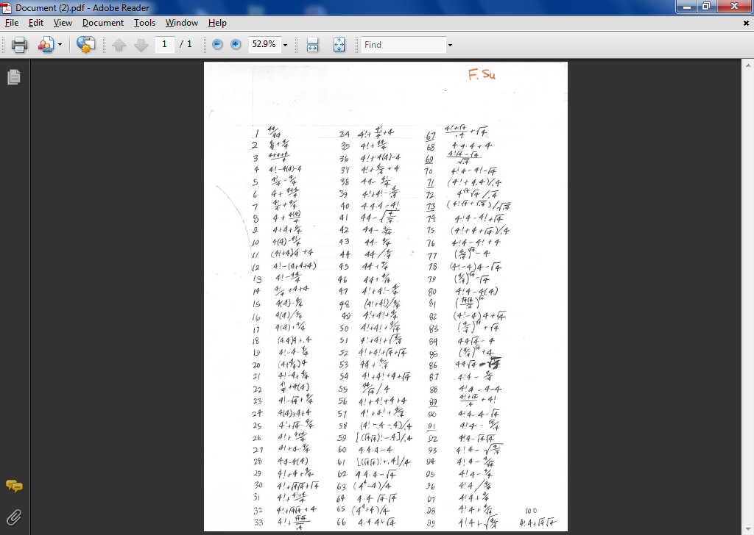

Slide 81
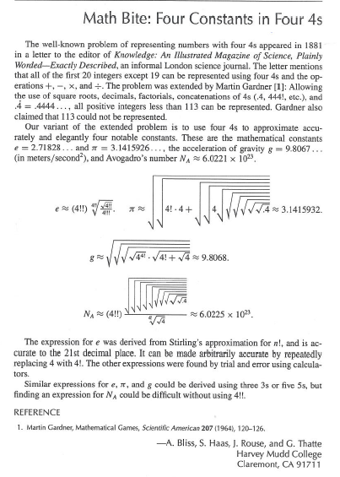
From lots of four-fours work in Prolog... !

Slide 82
eval
Notice the base case!
eval(R, R) :- number(R).
eval(['+', A, B], R) :- eval(A, AR), eval(B, BR), R is AR + BR.
eval(['*', A, B], R) :- eval(A, AR), eval(B, BR), R is AR * BR.
eval(['-', A, B], R) :- eval(A, AR), eval(B, BR), R is AR - BR.
eval(['/', A, B], R) :- eval(A, AR), eval(B, BR), BR\==0, R is AR // BR.
the tree
also checks nonvar(A) and nonvar(B)
nonvar?
resulting value
This eval can both test and generate resulting values, R.

Slide 83
dynamic predicates
:- dynamic marked/1.
declares marked to be a dynamic rule ~ it can be changed an the fly…
add
assert( marked(42) ).
places marked(42) into the program's current database of facts.
marked( X )
will now produce at least one binding: X = 42
retract( marked(42) ).
removes marked(42) from the program's current database of facts.
remove
removes all of marked's rules from the program's current facts.
retractall( marked(_) ).

Slide 84
dynamic action!
:- dynamic foo/1.
foo(X).
false
assert( foo(42) ).
true
foo(X).
x = 42;
false.
assert( foo(spam) ).
true
foo(X).
x = 42;
x = spam;
false.
retract( foo(42) ).
foo(X).
x = spam;
false.
retractall( foo(_) ).
foo(X).
false.

Slide 85
Avoiding repeated configurations...
Prolog's working general-purpose puzzle-solver:
final( [[],[],P3] ) :- sorted(P3). %% the final config.
solve(C, []) :- final(C). %% Done! No moves needed.
dynamic marked/1.
solve(C, [Mv|RoM]) :-
validmove(C, Mv, NewC),
solve(NewC, RoM).
How do we use marked inside solve?
On your mark ... get set ... Prolog!

Slide 86
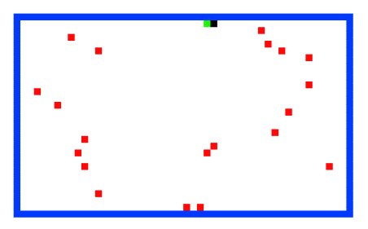
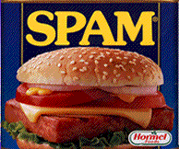

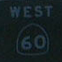
The alien, the spampede, and the spam!
Goal: Get back to the dorms with the spam, the spampede, and the three-eyed alien.
Constraints: Can’t carry more than one thing and can’t leave two things alone if one would eat the other…
Mudder
West
East

Slide 87
The alien, the spampede, and the spam…
Configuration ~ a list of two lists
[ [ mudder, alien, spampede, spam ], [ ] ]
West
East
one possible configuration
Thoughts on how this problem is (a bit) different?

Slide 88
CS 60 midterm take home on Wed. 11/2; due Fri. 11/4
90 minute exam ~ about 5 questions
~2 Racket problems
key advantage: NO COMPUTER!
~2 Java problems
more advantage: NO COMPUTER!
~1 problem with a very short-answer questions
You may bring 1 page of notes with whatever you'd like on it…
Review sheet available @ website and as handout….
Strategy?
Create a page of notes!
Take a look
Look over hw assignments…

Slide 89
Review
(1) For up to two points! of extra credit on the midterm… Pair up with s/o you don't know (or don't know well) and find something unusual you have in common…
Names:
Thing in common:
Java and object-oriented programming
What is a constructor and when is it invoked?
What does this refer to in a java class?
What do private, protected, and public mean and where is it appropriate to use each of them?
What are accessor methods and why are they important?
What is static and where and why would it be used?
What is inheritance, why is it useful, and how does it work?◦Within an inheritance hierarchy, how does Java decide which out of several overridden methods to actually invoke for an Object?
What is polymorphism and why is it useful?
How are the terms extends, super, and implements used in Java?
You should be comfortable with box-and-arrow diagrams to illustrate how Java organizes references and data in computer memory. What is the difference between the stack and the heap?
How do reference counting and mark-and-sweep garbage-collection algorithms work in Java. What are the advantages/disadvantages?
What is the merge technique and under what conditions can it be used?
How many points per minute is one furlong per fortnight?
Data Structures
A note on terminology: an information structure is a datatype adhering to a specific interface, such as a StackInterface or a QueueInterface; a data structure is a specific implementation of an information structure.
How do Java interfaces work - and how do they facilitate the connection between information structures and data structures?
What operations do the information structures named Open Lists, Queues, Stacks, and Deques support?
You should be comfortable with the data-structure implementation of the above structures using linked lists of cells, as we showed for Stack and you wrote for OpenList and Queue.
What are the differences between open lists and closed lists?
How do breadth-first search and depth-first search work? How are queues and stacks used in each of these algorithms? What are the potential advantages/disadvantages of each?
How can recursion be used to implement depth-first search without explicitly using a stack?
Then, read over these & circle those you find least familiar…
On the structure of (computer) languages
What do tokenizing, parsing, and evaluation each contribute to the execution of a computer program?
How do grammars and production rules work? How does a grammar of production rules specify the meaning of a legal expression?
You should be familiar with how to use recursive descent in order to parse a list of tokens and how to use recursion to evaluate the resulting parse tree.
How does an environment contribute to the evaluation of an expression? What are free and bound variables within an expression?
Functional Programming in Racket/Scheme
Make sure that you understand and feel comfortable with Scheme's syntax and basic functions like first, rest, etc.
You should be comfortable about the differences in the assumptions that append, list, and cons make about their inputs.
What does assoc do and what is an association list?
Make sure that you can write basic Scheme functions like those developed in lecture and in the assignments. Nothing so large as Unicalc, to be sure, but a small function that might use one helper function would make a reasonable exam question. In particular, recursion is the secret to all happiness in functional programming -- you may want to review decomposing problems recursively.
What are anonymous functions and where are they useful? How is lambda used in Scheme?
What is tail recursion and how can it improve performance?
You should be familiar with the Scheme higher-order functions such as map, foldr, filter, and sort. You certainly don't need to memorize them, but you should feel like you could implement them and other higher-order functions from a definition using recursion. You should also feel comfortable using them in order to implement higher-level tasks.
How can objects such as graphs and tree (for example, parse trees and binary search trees) be encoded as lists? Make sure that you feel comfortable writing Scheme functions to manipulate these information structures.
You should feel comfortable with the use-it-or-lose-it approach to problem decomposition and solving.

Slide 90
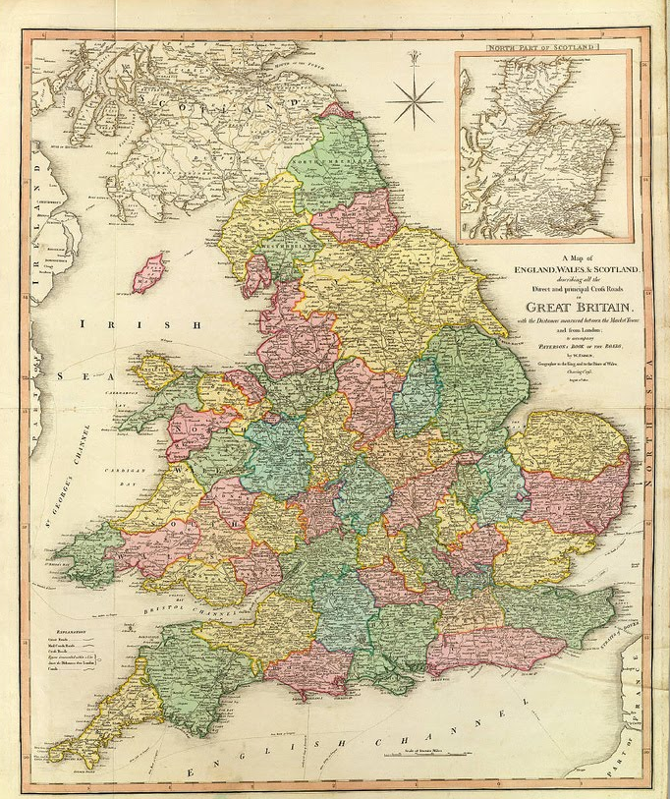
Just in case you're as pro-prolog as I am!
Other puzzles?
For example, the map-coloring puzzle...
Extra credit #2: prologify another puzzle of your own choosing...
Sudoku variants...
Four fours puzzle...
(1852; F. Guthrie) Assigning colors to the counties of England so that no two neighboring counties had the same color...

Slide 91
Map Coloring: 1852-1976
colorMap([A,B,C,D,E,F,G],Colors) :-
adj(A,B,Colors),
adj(A,C,Colors),
adj(A,D,Colors),
adj(A,E,Colors),
adj(B,C,Colors),
adj(B,D,Colors),
adj(B,E,Colors),
adj(B,F,Colors),
adj(B,G,Colors),
adj(C,E,Colors),
adj(D,E,Colors),
adj(D,F,Colors),
adj(E,G,Colors),
adj(F,G,Colors).
adj(X,Y,Clrs) :- member(X,Clrs), member(Y,Clrs), X\==Y.
?- colorMap(Solution, [ocher , puce , taupe , zaffer]).
The Map
F
B
G
D
A
C
E
This is your brain on prolog... any questions?

Slide 92
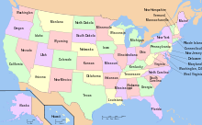
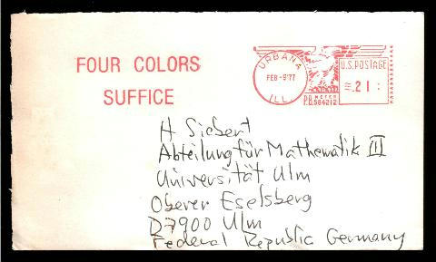
Map Coloring: 1852-1976
1852: Francis Guthrie conjectures that all maps can be 4-colored.
4-color US? See Wikipedia...
1879: A. B. Kempe’s proof lasted eleven years...
1890: Heawood’s Discovery and proof for all maps with 5 colors
1922: Franklin: proof that all maps are 4-colorable with =< 25 regions
1925: Errera: 4-colors-proof for all maps with =< 26 regions
1940: Winn: 4-colors-proof for all maps with =< 36 regions
1970: Ore & Stemple: 4-colors-proof for all maps with =< 40 regions
1976: Appel & Haken & machine: proof that all maps are 4-colorable!

Slide 93
Good luck with the midterm exam...
...and Hw #9!

Slide 94
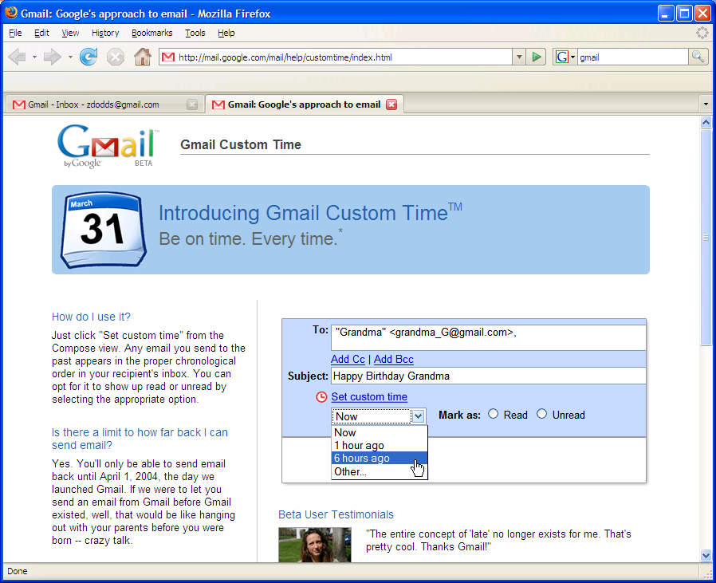
More prolog adventure next week...
in honor of Apr. 1, I'll be disguised as Jack Ma on Friday…

Slide 95
Write 2 validmoves and solve for ToH...
Quiz
Name(s): _______________
We will need six of these validmove rules overall.
OldC
validmove( [[F1|R1],P2,P3],
peg1toPeg2,
) :-
Move
NewC
What constraints do we need to enforce?
validmove( ,
peg3toPeg1,
) :-
Base Case ~ no moves needed!
solve( [[],[],L], [] ) :-
What must be true about L?
solve( StartC, [Mv|RestOfMoves] ) :-
Recursive Case...
Use validmove in solve...
Any concerns?

Slide 96
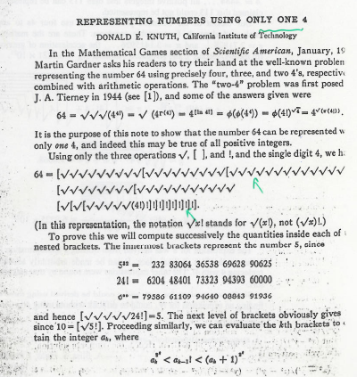
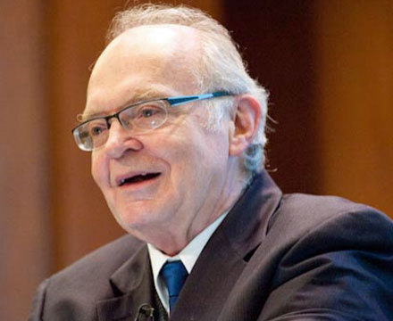
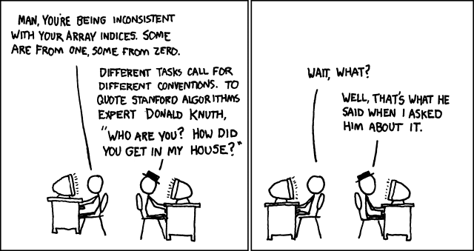
Why use four fours when you only need one!

Slide 97
Spampede... !

Slide 98
Problem #3: Towers of Hanoi
is similar to
Goal: Get all of the disks from Peg 1 to Peg 3.
Constraints: You may not place a smaller disk onto a larger one.
Peg 1
Peg 2
Peg 3
solve( [[1,2,3,4],[],[]], LoM ).
hanoi.pl is provided

Slide 99
solve( [‘+’,‘-’,‘*’,‘/’], [1,3,8,5], 24, Tree ).
Each operation may be used any number of times.
operators available: (use any number of times)
values:
(use each exactly once)
arithmetic tree
final answer
Tree = [+,[+,1,8],[*,3,5]]
solve
What is the base case?
solve(
What is the recursive case?
solve( Ops, Values, Ans, Tree ) :-
Set up: Ops and Values will have values; Tree may not (5pts); or Ans (6pts); …
How to create Left and Right here?
What about Op ?
What helper predicates will be needed?
Tree = [ Op, Left, Right ].
Let's split!
Leave until the end.

Slide 100
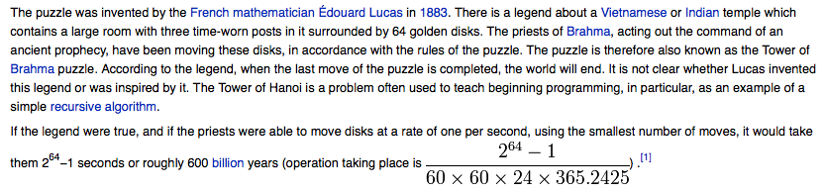
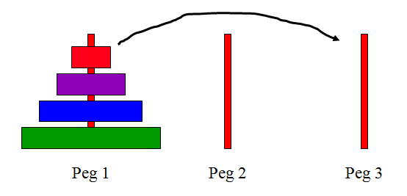
Towers of Hanoi: background
History:
This could get Hanoi’ing!
Recursive running time?
for a starting stack of N disks...
http://www.mazeworks.com/hanoi/

Slide 101
ToH: Configurations
Configuration ~ a list of three sorted lists
[ [ 1, 2, 3, 4 ], [ ], [ ] ]
Left
Center
Right
one possible configuration
Why sorted?
What is the config. after the next move?
[ ]
[ ]
... and at the very end?

Slide 102
Towers of Hanoi: validmove + solve
Configuration ~ a list of three sorted lists
[ [ 4 ], [ 3 ], [ 1, 2 ] ]
OldC
a move
How many moves will there be?
validmove( OldC, peg3toPeg2, NewC ).
NewC =
validmove( OldC, peg1toPeg2, NewC ).
NewC =

Slide 103
Towers of Hanoi: validmove + solve
Configuration ~ a list of three sorted lists
[ [ 1, 2 ], [ ], [ 3, 4 ] ]
StartC
the moves...
list of moves
peg1toPeg2
peg2toPeg3
peg1toPeg3
peg3toPeg1
peg2toPeg1
peg3toPeg2
solve( StartC, LoM ).
LoM =
[
]
will there be other LoMs?

Slide 104
Write 2 validmoves and 2 solves for ToH...
Quiz
Don't hand this in…
We will need six of these validmove rules overall.
OldC
validmove( [[F1|R1],P2,P3],
peg1toPeg2,
) :-
Move
NewC
What constraints do we need to enforce?
validmove( ,
peg3toPeg1,
) :-
Base Case ~ no moves needed!
solve( [[],[],L], [] ) :-
What must be true about L?
solve( StartC, [Mv|RestOfMoves] ) :-
Recursive Case...
Use validmove in solve...
Any concerns?

Slide 105
Towers of Hanoi: validmove + solve
OldC
validmove( [[F1|R1],P2,P3],
peg1toPeg2,
) :-
Move
[R1,[F1|P2],P3].
inorder( [F1|P2] ).
NewC
What constraints do we need to enforce?
[P1,P2,[F3|R3]],
validmove(
peg3toPeg1,
) :-
[[F3|P1],P2,R3].
inorder( [F3|P1] ).
it's possible to instead use recursion – for some of the rules!
can P2 be a "don't care"?

Slide 106
Towers of Hanoi: validmove + solve
Base Case - no moves needed!
solve( [[],[],L], [] ) :-
inorder(L).
Recursive Case...
solve( StartC, [Mv|RestOfMoves] ) :-
validmove(StartC,Mv,NewC),
solve(NewC,RestOfMoves).
Use validmove in solve...
Will this work elsewhere?
Any concerns?

Slide 107
Configuration-space search!
Prolog's general puzzle-solving:
final( [[],[],P3] ) :- sorted(P3). %% the final config.
%% what it means for a list of moves to solve the puzzle...
%% C is a configuration.
solve(C, []) :- final(C). %% Done! (no moves needed)
solve(C, [Mv|RoM]) :- %% Mv ~ next move to make
validmove(C, Mv, NewC), %% selects a valid move...
solve(NewC, RoM). %% solves the rest of the puzzle!
Doesn't this solve ALL problems !?!
How well does it do?

Slide 108
Configuration-space search!
Aargh! It doesn't work!!
Prolog's puzzle-solving:
final( [[],[],P3] ) :- sorted(P3). %% the final config.
%% what it means for a list of moves to solve the puzzle...
%% C is a configuration.
solve(C, []) :- final(C). %% Done! (base case)
solve(C, [Mv|RoM]) :- %% Mv ~ next move to make
validmove(C, Mv, NewC), %% selects a valid move...
solve(NewC, RoM). %% solves the rest of the puzzle!
Doesn't this solve ALL problems !?!
How well does it do?

Slide 109
Parsing reminders...
s, v
0, 1, +
A grammar…
(with variable s designated as the start variable)
s -> v + s | v
v -> 0 | 1
variables
terminals
A derivation tree…
s
(Left) Sentential Forms
(also called a parse tree)
partial parse trees, expressed as "sentences"
s
v + s
1 + s
v
+
s
1 + v + s
1
+
v
s
1 + 0 + s
0
v
1 + 0 + v
This isn't really a reminder...
1
1 + 0 + 1

Slide 110
Parsing in Prolog
s, v
0, 1, +
A grammar…
(with variable s designated as the start variable)
s -> v + s | v
v -> 0 | 1
variables
terminals
%% file: g0.pl
%% A grammar must specify variables, terminals, and rules.
variable(s). %% grammar variables, NOT prolog variables!
variable(v).
terminal(0). %% grammar terminals, NOT prolog constants…
terminal(1).
terminal(+). %% actually, all of these are prolog constants
%% Here are the rules for this grammar: [LHS, RHS]
%% s -> v + s | v
%% v -> 0 | 1
rule(s, [v, +, s]).
rule(s, [v]).
rule(v, [0]).
rule(v, [1]).
A grammar expressed in prolog.
this is the file g0.pl

Slide 111
Parsing in Prolog
you’ll write parser.pl
parse([s], [1,+,0,+,1]).
true
Your parse predicate should work for any reasonable grammar! (We provide 5 of them.)
parse([s], [1,0,+,1]).
false
We will ONLY test with fully-instantiated lists…
%% file: g0.pl
%% A grammar must specify variables, terminals, and rules.
variable(s). %% grammar variables, NOT prolog variables!
variable(v).
terminal(0). %% grammar terminals, NOT prolog constants…
terminal(1).
terminal(+). %% actually, all of these are prolog constants
%% Here are the rules for this grammar: [LHS, RHS]
%% s -> v + s | v
%% v -> 0 | 1
rule(s, [v, +, s]).
rule(s, [v]).
rule(v, [0]).
rule(v, [1]).
Extra credit #1: generate token lists, in addition to checking them...
A grammar expressed in prolog.
this is the file g0.pl

Slide 112
Is someone who parses called a parson ?
Parsing in Prolog
An example of how prolog might think about this…
parse([s], [1,+,0,+,1]).
parse([v,+,s], [1,+,0,+,1]).
parse([1,+,s], [1,+,0,+,1]).
parse([+,s], [+,0,+,1]).
parse([s], [0,+,1]).
parse([v,+,s], [0,+,1]).
parse([0,+,s], [0,+,1]).
parse([+,s], [+,1]).
parse([s], [1]).
parse([v], [1]).
parse([1], [1]).
parse([], []).
yes
What are the key decisions being made here?

Slide 113
Towers of Hanoi, briefly
The Towers of Hanoi puzzle was first published in 1883 by French mathematician Edouard Lucas.
class hanoi
{
public static void main(String[] args)
{
int n = Integer.parseInt(args[0]); // # of disks
int x = 0; // move number
int to = 0; // peg to move to
int from = 0; // peg to move from
for (x=1 ; x < (1<<n) ; ++x)
System.out.println("Move " + x +
": from peg " + ((x&x-1)%3) +
" to peg " + (((x|x-1)+1)%3));
}
}
Can be done recursively AND without recursion.

Slide 114
Math in Prolog
Rex: there are no side effects (assignments) new data is created and returned.
Java: you have a choice to use side effects, or return new data as needed
Prolog: everything is done via side effects, there are no return values!
Math without return values ?
factorial rules!
fac(X,N)
! does rule!

Slide 115
Sorting in Prolog? mysort
%% sort is built-in, so we’ll write mysort:
mysort(L,S) :- perm(L,S), sorted(S).
%% sorted checks if a list is sorted...
sorted([]).
sorted([_]).
sorted([F,S|R]) :-
%% perm can generate all permutations of L
%% it does not work in right-to-left, however
This is mysort of programming!
what do we need here?

Slide 116
Sorting in Prolog? mysort
%% sort is built-in, so we’ll write mysort:
mysort(L,S) :- perm(L,S), sorted(S).
%% sorted checks if a list is sorted...
sorted([]).
sorted([_]).
sorted([F,S|R]) :-
%% perm can generate all permutations of L
%% it does not work in right-to-left, however
perm([],[]).
perm(L, [F|R]) :-
app(BeforeF, [F|AfterF], L), %% split L around F
app(BeforeF, AfterF, PermR), %% recombine all except F
perm(PermR, R). %% PermR is bound, so we're OK
This is mysort of programming!
what do we need here?

Slide 117
Listing with Prolog
%% member is not built in to prolog...
member(X, [X|R]).
member(X, [F|R]) :- member(X, R).
%% length is built-in, so we will write len
%% just to illuistrate how it might be written
len([], 0).
len([_|R], L) :- len(R, L2), L is L2+1.
%% append is built-in, so we will write app
%% again just to see how it might be done
app([], L, L).
app([F|R], L, [F|A]) :- app(R, L, A).
Why might Prolog complain here?
Does order matter here?
I should underscore the importance of this!
See! Prolog is friendly!

Slide 118
Good luck ~ midterm (Th) and Hw #8 (Sun.)

Slide 119
“Quiz” #2
Mathematics with Prolog
Write a predicate fac that finds factorials…
How many arguments will fac need?
Write a predicate sum that finds the sum of two values…
How many arguments will sum need?
Will your predicates always work?

Slide 120
Unhappy Prolog
len([], 0).
len([_|R], L) :- len(R,L2), L2 is L-1.
When will Prolog not like these definitions?
sum(X, Y, Z) :- Z is X + Y.
any ideas?

Slide 121
More flexible sums…
digits([0,1,2,3,4,5,6,7,8,9]).
sum(X,Y,Z) :-
digits(D),
member(X,D),
member(Y,D),
Z is X+Y.
sum(X,Y,Z) :-
D = [0,1,2,3,4,5,6,7,8,9],
member(X,D),
member(Y,D),
Z is X+Y.
better?

Slide 122
Searching to the end…
be sure there is an end!
setof( Tree, solve( [‘+’,‘-’,‘*’,‘/’], [1,2,4,7], 24, Tree ) , S).
variable whose values you want to collect into a set
the set
predicate that you would like to satisfy…
setof( Tree, solve( [‘+’,‘-’,‘*’,‘/’], [5,1,155,11], 24, Tree ) , S).
a much smaller example…
notice the splitting!
[2,8,22,424] ~ 42
[4,4,4,4] ~ 42
setof( N, T^solve( [‘+’,‘-’,‘*’,‘/’], [4,4,4,4], N, T ) , S).
a surprisingly well-studied problem!
T^ ~ there exists a T

Slide 123
More flexible sums…
sum(X,Y,Z) :-
D = [0,1,2,3,4,5,6,7,8,9],
member(X,D),
member(Y,D),
Z is X+Y.
digits([0,1,2,3,4,5,6,7,8,9]).
sum(X,Y,Z) :-
digits(D),
member(X,D),
member(Y,D),
Z is X+Y.
better solution? Use var, nonvar
sum(X,Y,Z) :- nonvar(Y), nonvar(Z), X is Z-Y.
sum(X,Y,Z) :- nonvar(X), nonvar(Z), Y is Z-X.
sum(X,Y,Z) :- nonvar(X), nonvar(Y), Z is X+Y.
It’s possible to make sum generate ALL integer solutions even when X, Y, and Z are all variables…
How many of these rules will sum(2,2,4) and sum(2,2,5) finish?

Slide 124
Introducing…
Java
… a data-structuring language
compiled
statically typed
object-oriented
Notes:
I don’t know if this really works...

Slide 125
Objects
"Oh yeah!"
42
42
Data reigns
x
y
a String object…
a Point object…
Java ~ an object-oriented programming language
Classes
input
Methods
Functions
output
Types

Slide 126
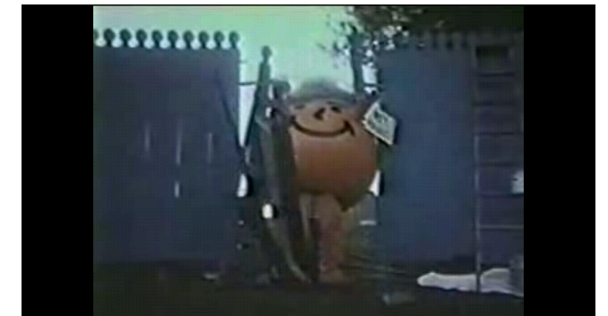
Oh Yeah!
http://www.youtube.com/watch?v=nBeUGqeYsQg

Slide 127
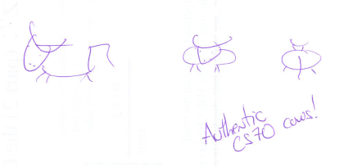
C++ objects just aren't Kool...
Prof O'Neill's handiwork...
Hah! And do they come in 7 delicious flavors?
In C++, data objects are cows, not Kool aid.
4
2
x
y

Slide 128
Objects
"Oh yeah!"
42
42
Data reigns
x
y
a String object…
a Point object…
In Java, the fundamental activity is designing and creating DATATYPES and DATA (rather than functions)
Classes
input
Methods
Functions
output
Types

Slide 129
Objects
"Oh yeah!"
42
42
Data reigns
x
y
a String object…
a Point object…
In Java, the fundamental activity is designing and creating DATATYPES and DATA (rather than functions)
data are objects
This seems a bit disorganized to be about data organization!
datatypes are classes
Classes
input
Methods
Functions
output
Types

Slide 130
Programming language space
JFLAP
computation
Prolog
Racket
JFLAP
Prolog
Python
Matlab
abstraction axis
Java
C
Java
Hmmm
HWare
task-independent
specificity axis
task-specific
Racket
You'll use at least four programming languages...
the language formerly known as Scheme

Slide 131
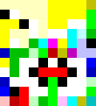
All corners of computational space?
Say hello.
Cow
MoO moO MoO mOo MOO OOM MMM moO moO MMM mOo mOo moO MMM mOo MMM moO moO MOO MOo mOo MoO moO moo mOo mOo moo
Fibonacci
Whitespace
Hello world
0 lI'moH A cher
1 lI'moH B cher
A cha' B cha'
18 {
A B boq
latlh
cha'
B "A" cher
"B" cher
} vangqa'
Piet
Var’aq
Fibonacci
Fibonacci
Malbolge
(=<`$9]7<5YXz7wT.3,+O/o'K%$H"'~D|#z@b=`{^Lx8%$Xmrkpohm_Ni;gsedcba`_^]\[ZYXWVUTSRQPONMLKJIHGFEDCBA@?>=<;:9876543s+O<oLm
Hello world
Who are you calling fringe?
Fortunately, CS 60 does NOT goto the fringe of the programming-language universe !

Slide 132
A+ - Dialect of APL used at Morgan-Stanley.
A0 or A-0 - Grace Hopper's team at Remington Rand, 1952, for the UNIVAC I
AACC - Language for building finite state automata.
AADL - Axiomatic Architecture Description Language.
ABC ALGOL - An extension of ALGOL 60 with arbitrary data structures
ACOS – Bulletin-board language for PRODOS 8 on Apple ][.
ACP - Algebra of Communicating Processes.
ACT++ - Concurrent extension of C++ based on actors.
Act1 - An actor language, descendant of Plasma.
Act2 - An actor language. "Issues in the Design of Act2", by D. Theriault
Act3 - High-level actor language, descendant of Act2.
Ada - named for Ada Lovelace (1811-52), arguably the world's first programmer
... skipping 2,279 languages ...
yacc - Yet Another Compiler Compiler. Language used to build parsers.
YALLL - Yet Another Low Level Language. Patterson et al, UC Berkeley,
Yay - Yet Another Yacc - An extension of Yacc with LALR(2) parsing.
Yerk - named for Yerkes Observatory, where it was used/developed
ZAP - Language for expressing transformational developments.
Zed - 1978. Software Portability Group, U Waterloo. Eh, with types added.
ZENO - U Rochester 1978. Euclid with asynchronous message-passing.
ZIL - Zork Implementation Language. Language used by Infocom's Interactive
zsh - Sh with list processing and database enhancements.
Zuse - named for Konrad Zuse, the designer of the first binary digital computer
Programming Languages!
CS 60’s goal: to think computationally ~ i.e., pick up any of these languages easily…

Slide 133
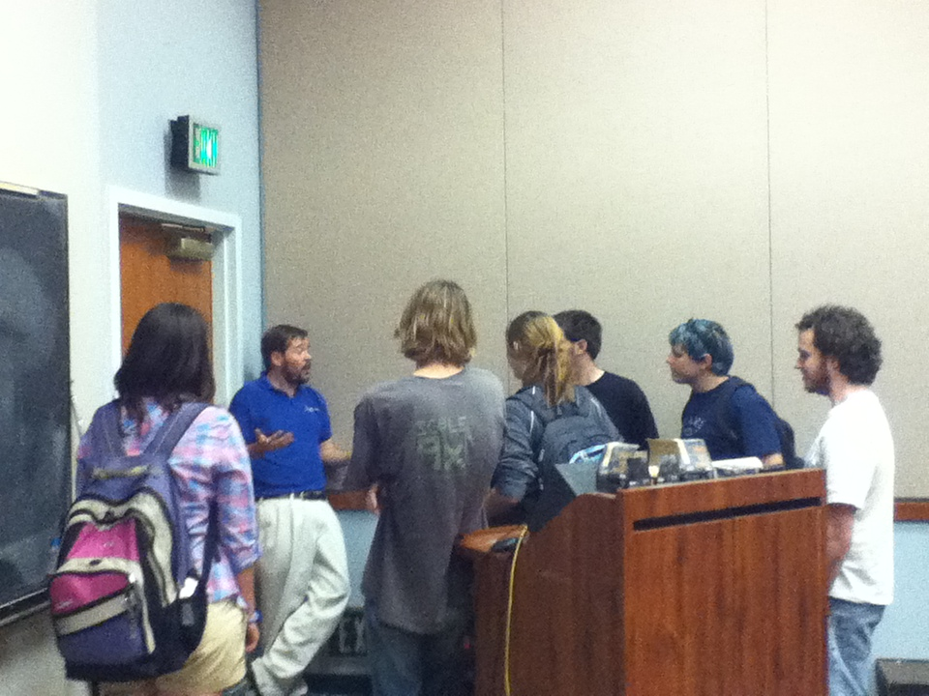
Google agrees!
Scott Ellsworth, Google Irvine and HMC '89 visiting yesterday... returning Thursday … other HMC Googlers @ the career fair Friday

Slide 134
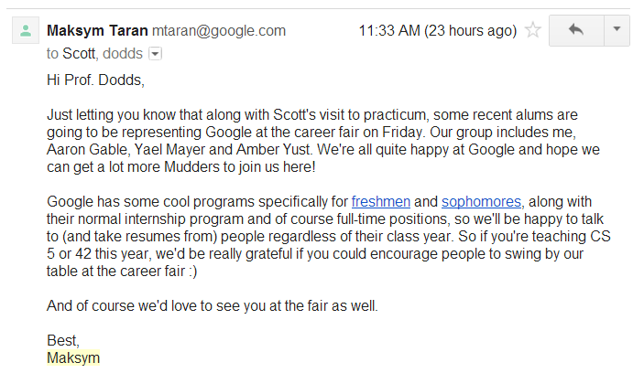
Google agrees!
Scott Ellsworth, Google Irvine and HMC '89 visiting yesterday... returning Thursday … with other HMC Google representatives Friday

Slide 135
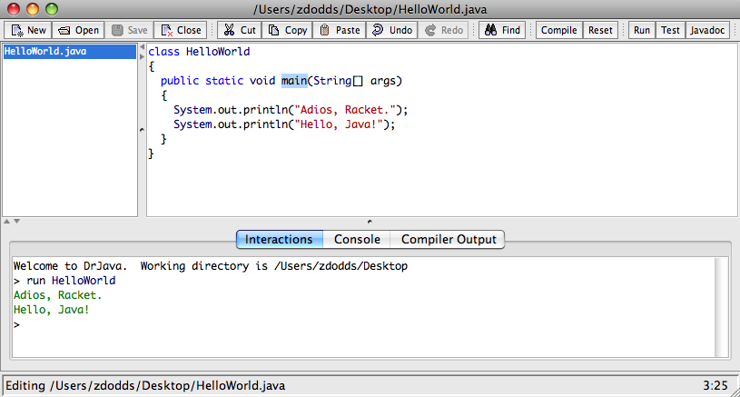
Switching doctors!
I'DE like to know what an IDE is!
We'll be using Dr. Java, but feel free to use any IDE.
Integrated Development Environment
Eclipse lives up to its name…

Slide 136
Java is a compiled language
writing your program
HelloWorld.java
source code
compiling your program
javac HelloWorld.java
HelloWorld.class
byte code
running your program
java HelloWorld
Run!
I knew this HelloWorld program had ".class" !

Slide 137
Code observations… ?
in a file named HelloWorld.java
class HelloWorld
{
public static void main(String[] args)
{
System.out.println("Adios, Racket.");
System.out.println("Hello, java!");
}
}
This looks alien !

Slide 138
Overhead ~ baggage
args? Arg!
The one and only class of this program
class HelloWorld
{
public static void main(String[] args)
{
System.out.println("Adios, Racket.");
System.out.println("Hello, Java!");
}
}
Makes this method accessible from any class.
Result type of this method (none).
called on start-up
input type and name
The print-with-end-of-line method for object System.out.
The standard output stream object, pre-defined in the System class.
The “System” class.

Slide 139
class ItsAFac
{
public static double fac(int N)
{
if (N < 2)
{
return 1.0;
}
else
{
return N*fac(N-1);
}
}
public static void main(String[] args)
{
int x = 5;
double solution = fac(x)/2.0;
System.out.println("solution: " + solution);
}
}
Types almost everywhere!
Where are the types in this Java program?
Recursion or loops are welcome!
You don't need to tell a function the type you're sending .
How does Java know ?
This seems odd for a language so concerned with types!

Slide 140
$ javap -c ItsAFac
Compiled from "ItsAFac.java"
class ItsAFac extends java.lang.Object{
ItsAFac();
Code:
0: aload_0
1: invokespecial #1; //Method "<init>"
4: return
Compiles to byte code
class ItsAFac
{
public static double fac(int N)
{
if (N<2)
{
return 1.0;
}
else
{
return N*fac(N-1);
}
}
public static void main(String[] args)
{
int x = 4;
x = x+1;
double solution = fac(x)/2.0;
System.out.println("solution: " + solution);
}
}
public static double fac(int);
Code:
0: iload_0
1: iconst_2
2: if_icmpge 7
5: dconst_1
6: dreturn
7: iload_0
8: i2d
9: iload_0
10: iconst_1
11: isub
12: invokestatic #2; //Method fac;
15: dmul
16: dreturn
Hmmm… this looks familiar!
Where did the types go?
public static void main(java.lang.String[]);
Code:
0: iconst_4
1: istore_1
2: iload_1
3: iconst_1
4: iadd
5: istore_1
6: iload_1
7: invokestatic #2; //Method fac:(I)D
< more -- too much to fit here! >

Slide 141
Data in Java
Primitive types
Objects
int, double, boolean, char, float, short, byte, long
int x;
Point p;
0
x
p
x = 41;
p = new Point(4,2);
the same memory location as above – but now holding a different memory location – one pointing to a newly-born (or poured) object!
a Java reference
this is the same memory location as above!
41
really holds a memory address
4
2
x
p
x
y
boxes holding data
boxes holding references to data

Slide 142
Java's built-in (primitive) types
int x = 5;
holds from -2,147,483,648 to 2,147,483,647
These eight are the only primitive types.
byte b = 3;
holds from -128 to 127
short s = 4;
holds from -32768 to 32767
long l = 6;
holds from -9,223,372,036,854,775,808 to 9,223,372,036,854,775,807
double d = 42.0;
holds up to 1.0 * 10**307 (pos. or neg.)
float f = 42.0;
about 7 places of precision (vs. double's 15)
boolean b = true;
holds either true or false
char c = 't';
used to hold single characters
String s = "this is a string of text";
Note the single vs. double quotes !
Strings are Objects, not primitive types.
sketch these two…

Slide 143
Java family pictures
Primitive types
bits (with a type to interpret them)
int, double, boolean, char, byte, short, long, float
a container holding data
42
101010
int x
Objects
named collections of named data
String s
101010
a container holding a memory reference to structured data "on the heap"
"Oh Yeah!"
Point p
101111
4
2
a String object…
x
y
a Point object…

Slide 144
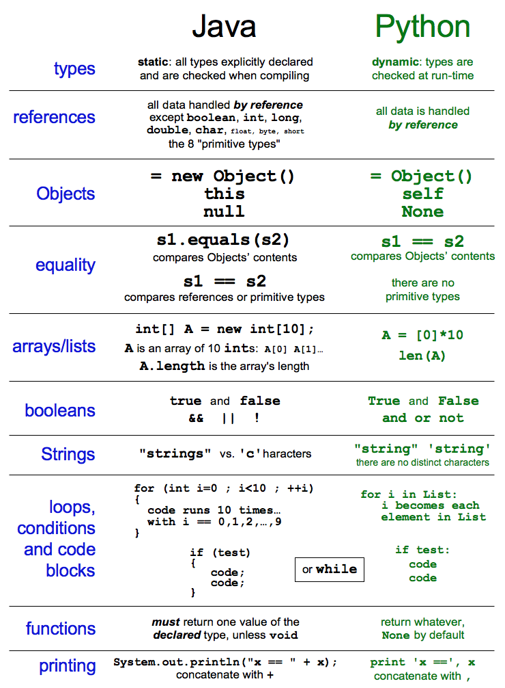
Syntax
How Java "thinks"
vs.
stack
Any more stack and I'll be in a heap of trouble!
CodingBat !
heap
Your memory in Java
full?
Notes:
memory may well be full!

Slide 145
class Point
{
private double x;
private double y;
public Point(double x_in, double y_in)
{
this.x = x_in;
this.y = y_in;
}
public static void main(String[] args)
{
Point p1 = new Point(7, 8);
Point p2 = new Point(p1.x, p1.y);
p2.x = 42.0;
System.out.println("p1.x is " + p1.x);
}
STACK
HEAP

Slide 146
class Point
{
private double x;
private double y;
public Point(double x_in, double y_in)
{
this.x = x_in;
this.y = y_in;
}
public static void main(String[] args)
{
Point p1 = new Point(7, 8);
Point p2 = new Point(p1.x, p1.y);
p2.x = 42.0;
System.out.println("p1.x is " + p1.x);
}
the Constructor builds an Object from scratch (all of its data!)
p1
STACK
all Objects are created on the HEAP by calling new and a Constructor
p2
inputs via =
7
8
local variables are stored on the STACK
x
y
it's still 7
7
8
HEAP
42
local variables "die" (go out of scope) when their closing curly brace is reached
x
y

Slide 147
The assignment operator, =, always does the same thing…
... it copies the CONTENTS on the right to the LOCATION on the left.
y is treated as a LOCATION
y = x
x is treated as a VALUE
that value might be a reference!
41
y
x
p2 = p1
p2
p1
7
8
x
y

Slide 148
class Point
{
private double x;
private double y;
public Point(double x_in, double y_in)
{
this.x = x_in;
this.y = y_in;
}
public static void main(String[] args)
{
Point p1 = new Point(7, 8);
Point p2 = p1;
p2.x = 42;
System.out.println("p1.x is " + p1.x);
}
p1
STACK
p2
HEAP
Draw what happens in memory here…
creative interpretations of "Kool Aid thing" are welcome!

Slide 149
class Point
{
private double x;
private double y;
public Point(double x_in, double y_in)
{
this.x = x_in;
this.y = y_in;
}
public static void main(String[] args)
{
Point p1 = new Point(7, 8);
Point p2 = p1;
p2.x = 42;
System.out.println("p1.x is " + p1.x);
}
p1
STACK
p2
multiple names are possible for the same data ~ aliasing
7
42
8
HEAP
x
y

Slide 150
class Point
{
private double x;
private double y;
public Point(double x_in, double y_in)
{
this.x = x_in;
this.y = y_in;
}
public static void main(String[] args)
{
Point p1 = new Point(7, 8);
Point p2 = new Point(7, 8);
if (p1 == p2)
System.out.println("p1 and p2 are equal");
else
System.out.println("p1 and p2 are NOT equal");
System.out.println("p1 is " + p1);
System.out.println("p2 is " + p2);
}
p1
STACK
p2
7
8
x
y
7
8
HEAP
What will print here?
x
y
No curlies?

Slide 151
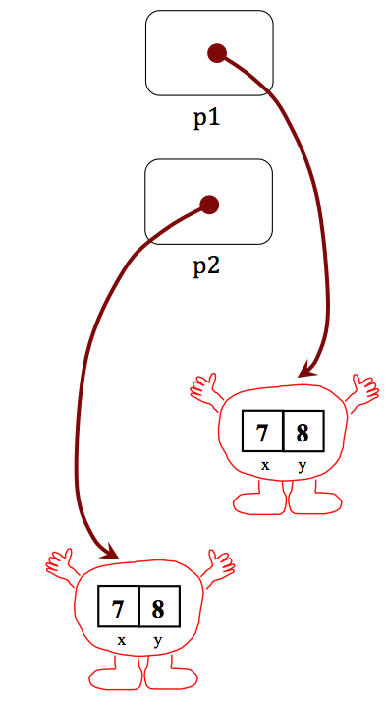
class Point
{
private double x;
private double y;
public Point(double x_in, double y_in)
{
this.x = x_in;
this.y = y_in;
}
public boolean equals( Point p )
{
return (this.x == p.x && this.y == p.y);
}
public String toString()
{
return "(" + x + "," + y + ")";
}
public static void main(String[] args)
{
Point p1 = new Point(7, 8);
Point p2 = new Point(7, 8);
if (p1.equals(p2))
System.out.println("p1 and p2 are equal");
else
System.out.println("p1 and p2 are NOT equal");
System.out.println("p1 is " + p1);
System.out.println("p2 is " + p2);
}
equals
"deep" comparison instead of shallow (reference) comparison
(1) What's this saying?
(2) Which Point is p?
(3) Anything seem missing here?
here
toString
is called

Slide 152
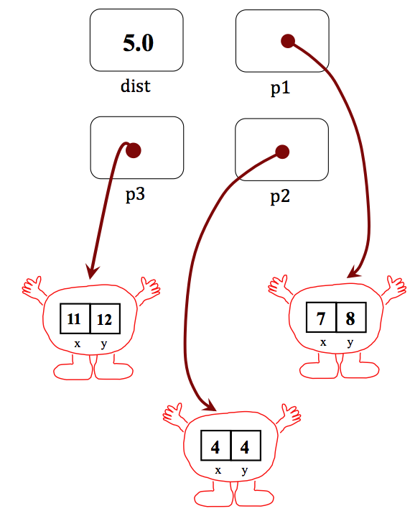
import static java.lang.Math.*;
class Point
{
private double x;
private double y;
public Point(double x_in, double y_in)
public double dist( Point p )
{
}
public Point add( Point p )
{
}
public static void main(String[] args)
{
Point p1 = new Point(7, 8);
Point p2 = new Point(4, 4);
Point p3 = p1.add(p2); // p3 is the sum
double dist = p1.dist(p2); // Euclidean dist.
// then we might print...
}
}
Try it!
Write add and dist. See main for examples.
multiple lines are OK, though both can be only 1 line!
Hint: Power is pow(b,p); sqrt(x) is also available.
Hint: Use the Point constructor!
The desired final data picture

Slide 153
import static java.lang.Math.*;
class Point
{
private double x;
private double y;
public Point(double x_in, double y_in)
public double dist( Point p )
{
}
public Point add( Point p )
{
}
public static void main(String[] args)
{
Point p1 = new Point(7, 8);
Point p2 = new Point(4, 4);
Point p3 = p1.add(p2); // p3 is the sum
double dist = p1.dist(p2); // Euclidean dist.
// then we might print...
}
}
Quiz
Name(s) __________________
Write add and dist. See main for examples.
multiple lines are OK, though both can be only 1 line!
Hint: Power is pow(b,p); sqrt(x) is now available.
Hint: Use the Point constructor!
The desired final data picture

Slide 154
Java: the strong and not-so-silent type
Java C++ C
Python Prolog Racket
every variable must have its type declared, known, and CORRECT, when you compile before you run the program
each variable has its type checked during execution or run-time
Statically Typed
Dynamically Typed
Tradeoffs?
you're too static - and just not my type

Slide 155


Welcome back to CS 60!
CS 60 Then and Now:
Weeks 1-4: Java
Weeks 5-8: Rex
Weeks 10-15:
Prolog, ISCAL, JFLAP, and more!
Guest-appearing this week …
Keeping the CS 60 ecosystem balanced…
This makes me appreciate my own family reunions…

Slide 156
The idea:
Provide data/relationships that describe the world. Then ask questions.
Questions:
child(lisa,marge).
parent(marge,X).
Is Lisa a child of Marge?
Who has Marge as a parent?
Is Ug a parent of Bart?
Who are the ancestors of Lisa?
Who are uggette's descendants?
Who is who's parent?
Who are John's grandchildren?

Slide 157
Prolog lists…
unifies L with [1, 2, 3]
Prolog has a more Python-like list syntax than Scheme:
L = [ 1, 2, 3 ].
== comparison (structural -- no arithmetic!)
\==
=:= arithmetic comparison with both-sided evaluation
=\=
2 not-equals
3 == 3. <-- yes
1+2 == 1+2. <-- yes
1+2 == 2+1. <-- no
1+2 =:= 2+1. <-- yes
[1,X] == [1,X]. <-- yes
[1,2] == [1,X]. <-- no
[1,2] = [1,X]. <-- yes, X is bound to 2

Slide 158
Math in Prolog
General operators/rules
Example
Notes
comparing for equality: == X == Y
arithmetic assignment: is X is Y+42
pattern matching (lists): = [F|R] = L
inequalities: < > =< >= \==
does not bind X or Y --
they must be bound
binds X ; Y must be bound
binds F and R
L must already be bound
read(X)
write(X)
nl
reads keyboard input into X
writes X to the screen
writes a newline “\n” to the screen
Input / Output

Slide 159
Towers of Hanoi
Goal: Get all of the disks from Peg 1 to Peg 3.
Constraints: You may not place a smaller disk onto a larger one.
Peg 1
Peg 2
Peg 3

Slide 160
Einstein's Zebra puzzle…
length( L, N )
append( L, M, Both )
Short. Sweet!

Slide 161
And I thought parse was just a good jotto word!
Parse ~ Jotto?

